Slide 1
RD_MUCOL activities @ INFN-MI
in synergy with IFAST EU-project
The Group: Alberto Bacci (LC)
Illya Drebot
Luca Serafini (new)
Camilla Curatolo (new)
Activities list
Done in 2021 and in progress:
Lemma schema for Muon production [e⁺ (e⁻ i.e. target) (45 GeV) → u⁺ u⁻ (@γ_{relativistic}=200)]:
Very low emittance but also low cross section. To increase the flux (two embedded source)
1) 5GeV spent e+ on target to regenerate 5MeV e⁺ new beam
2) γ-ray (Muon production) impinging on target → 100 MeV e⁺ new beam
For both 1 & 2 needs a positron trap.
Foreseen for 2022:
A new Muon Source that promises a very low emittance with a sustainable plug power balance. Serafini/Curatolo scheme [e⁻ x(150keV) → u⁺ u⁻]; NAME: e X M p
Activities on others muon production schemes
Notes:
E x 150 kev to mp exmp

Slide 2
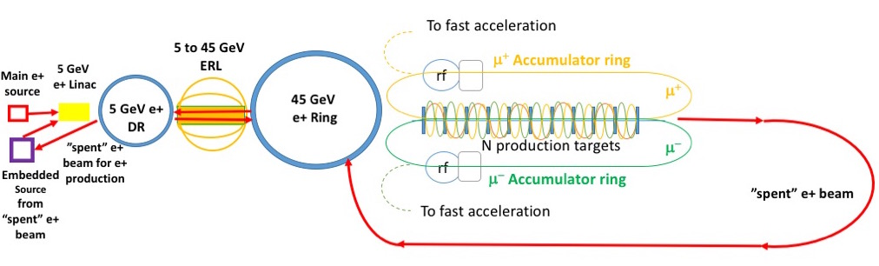
LEMMA layout + embedded sources:
5 GeV spent e+ on target
→ 5 MeV e+ new beam
gamma on target
→ 100 MeV e+ new beam
A High efficiency
Positron trap is needed

Slide 3
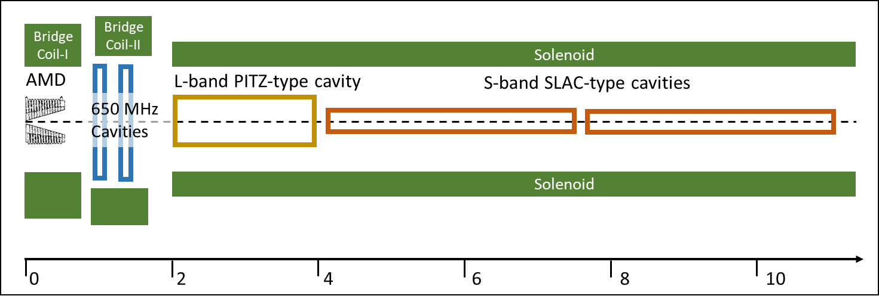
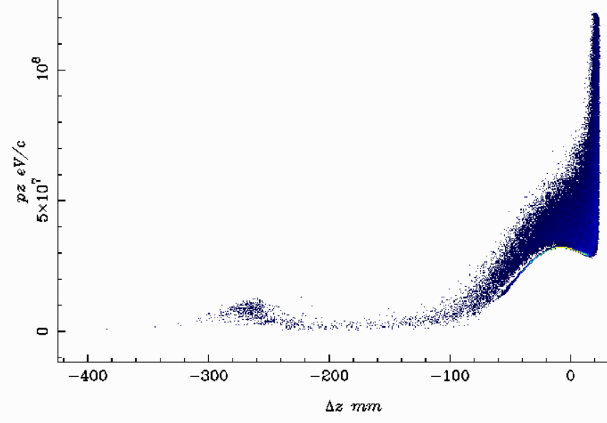
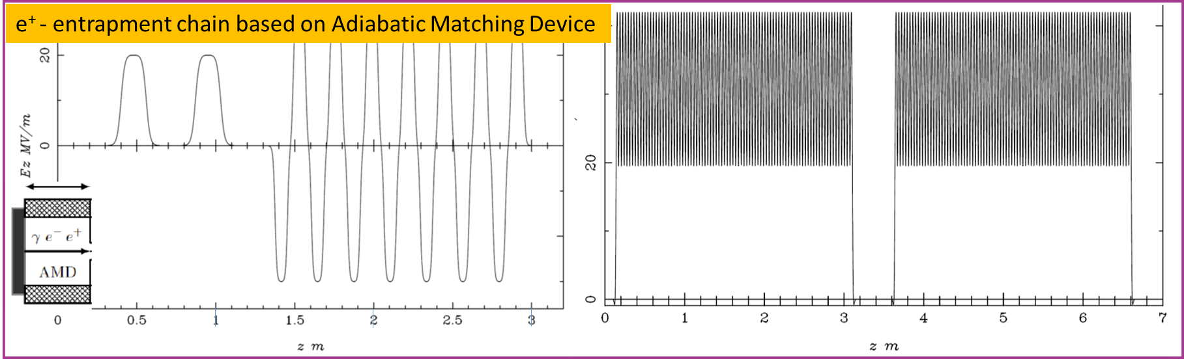
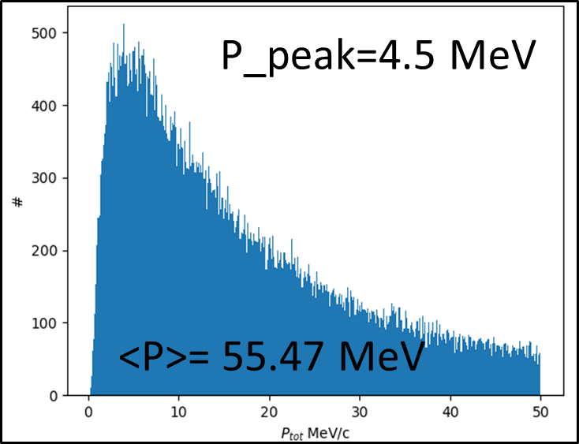
Simulation schema & results
Trapped positrons in
acc. bucket. Afther the L-banc cavity
whole trapping chain
optimized with
GIOTTO
a genetic code develop in MIlano
The Simulation flow:
Bunch generated by Astra Code → Geant4 e+ target interaction and rigeneration → Astra to capture and accelerate

Slide 4
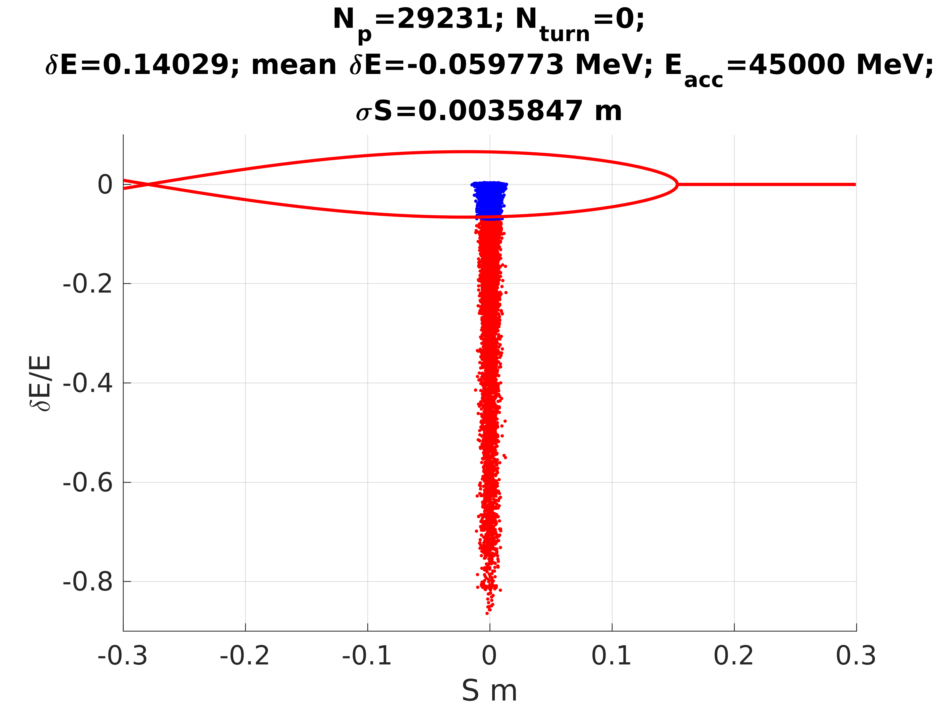
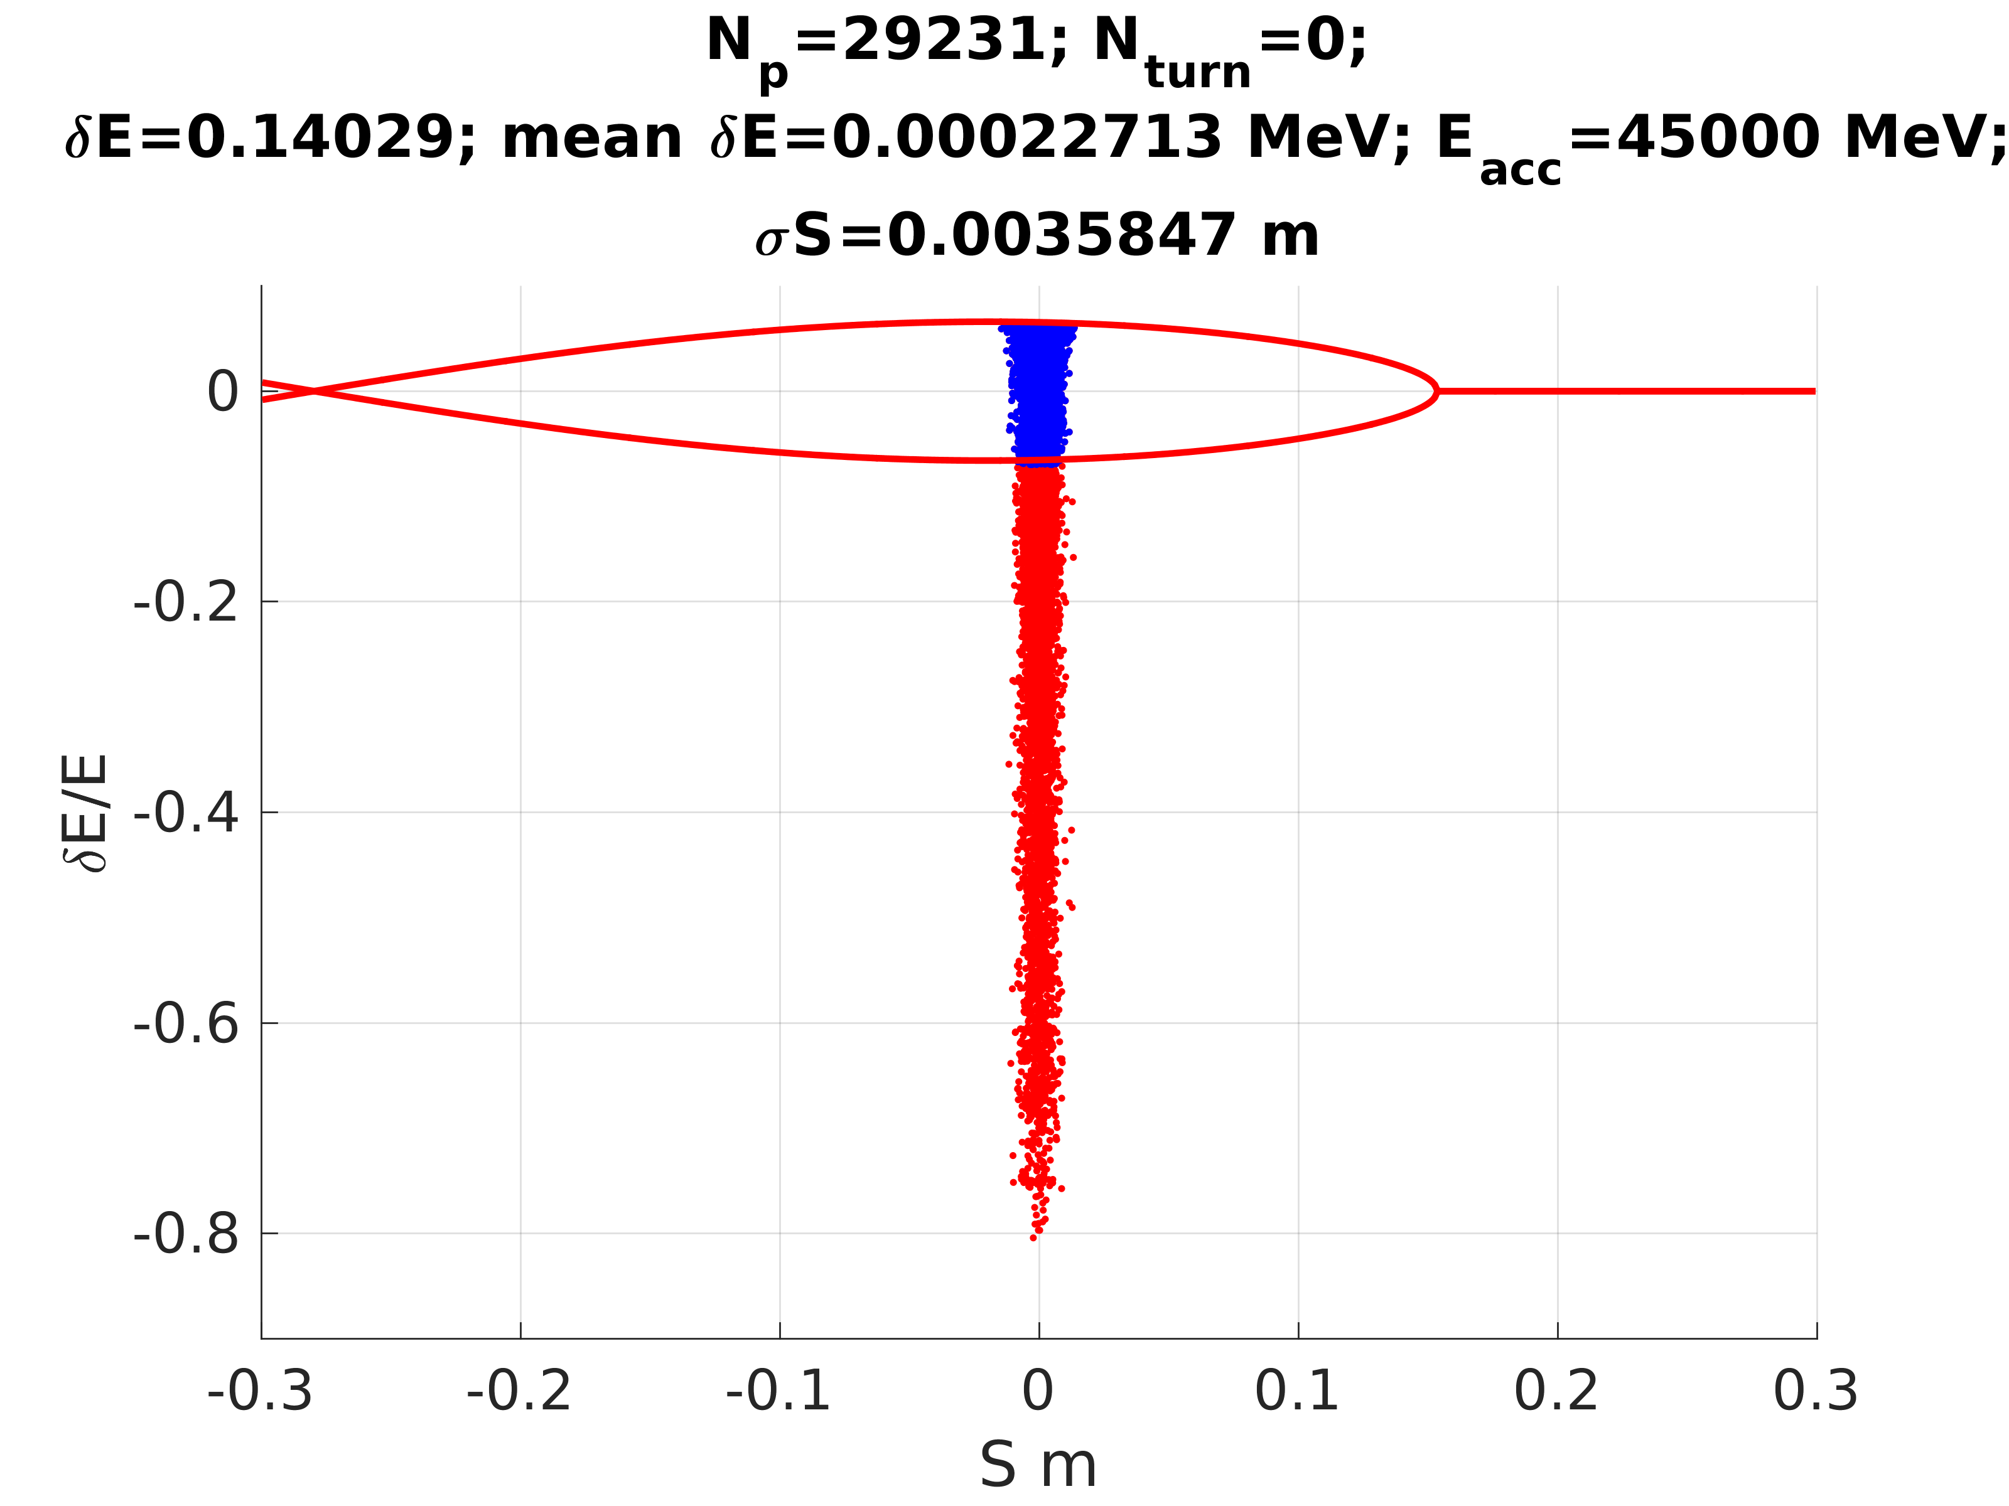
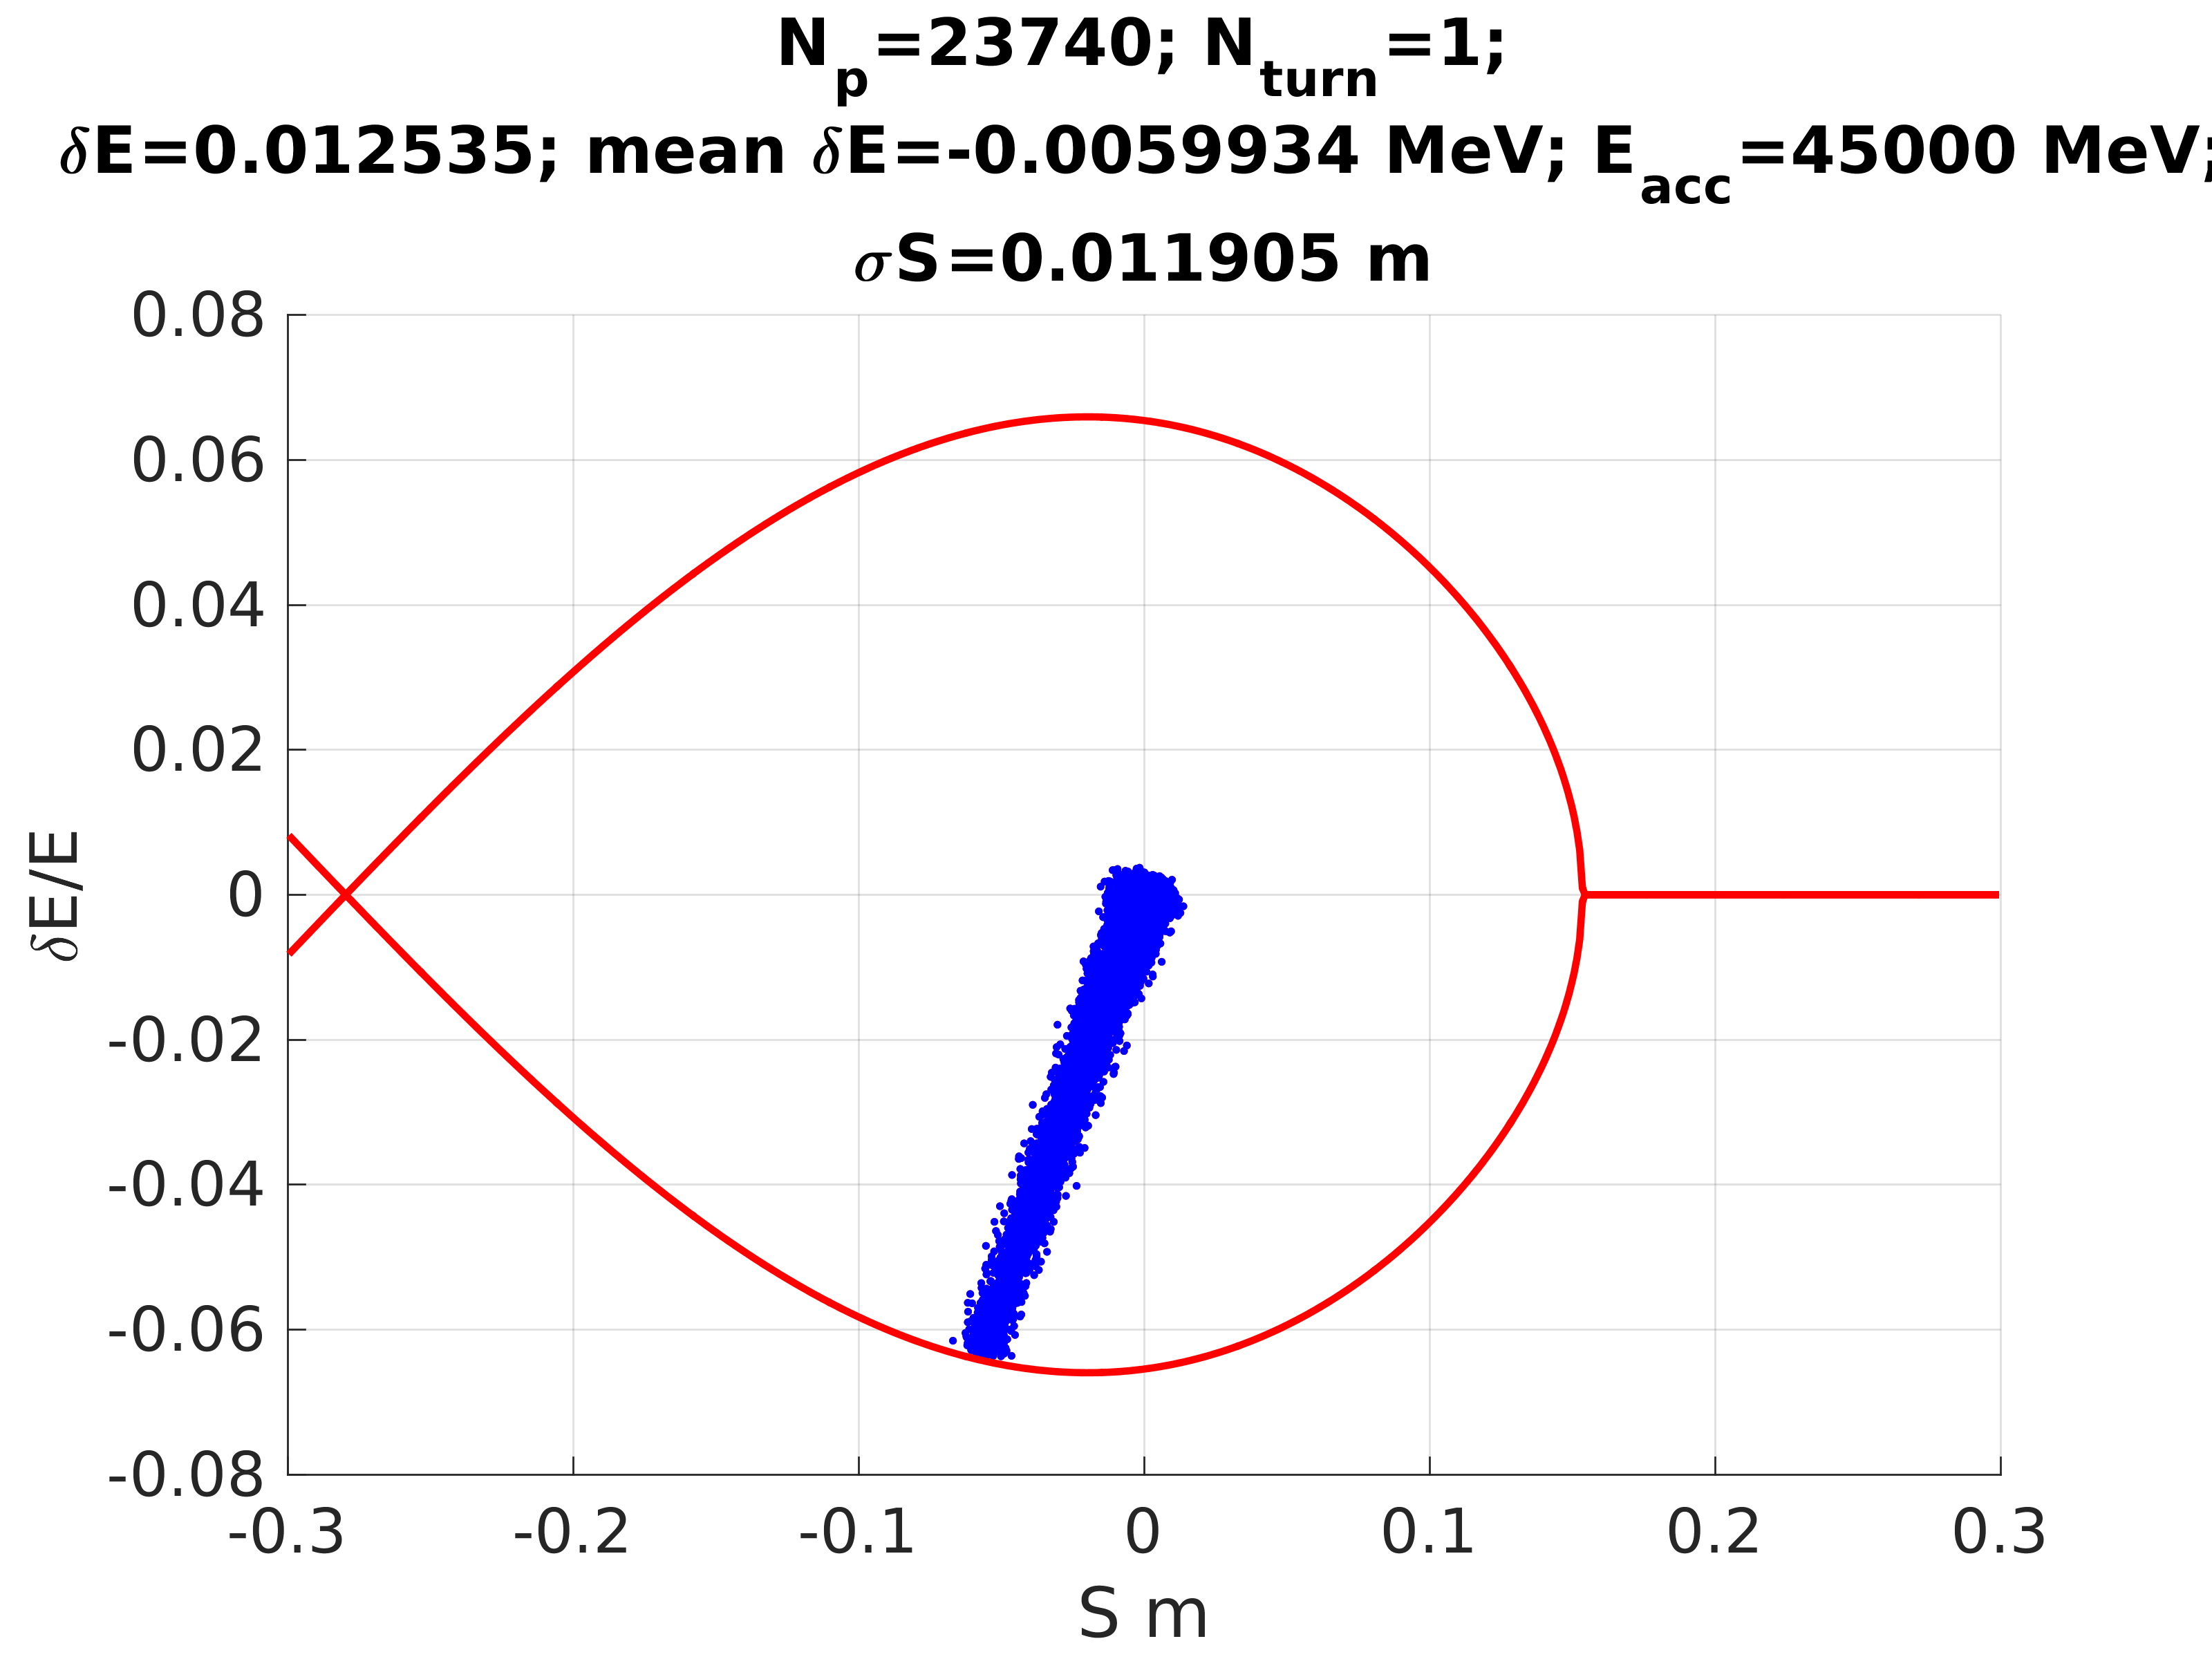
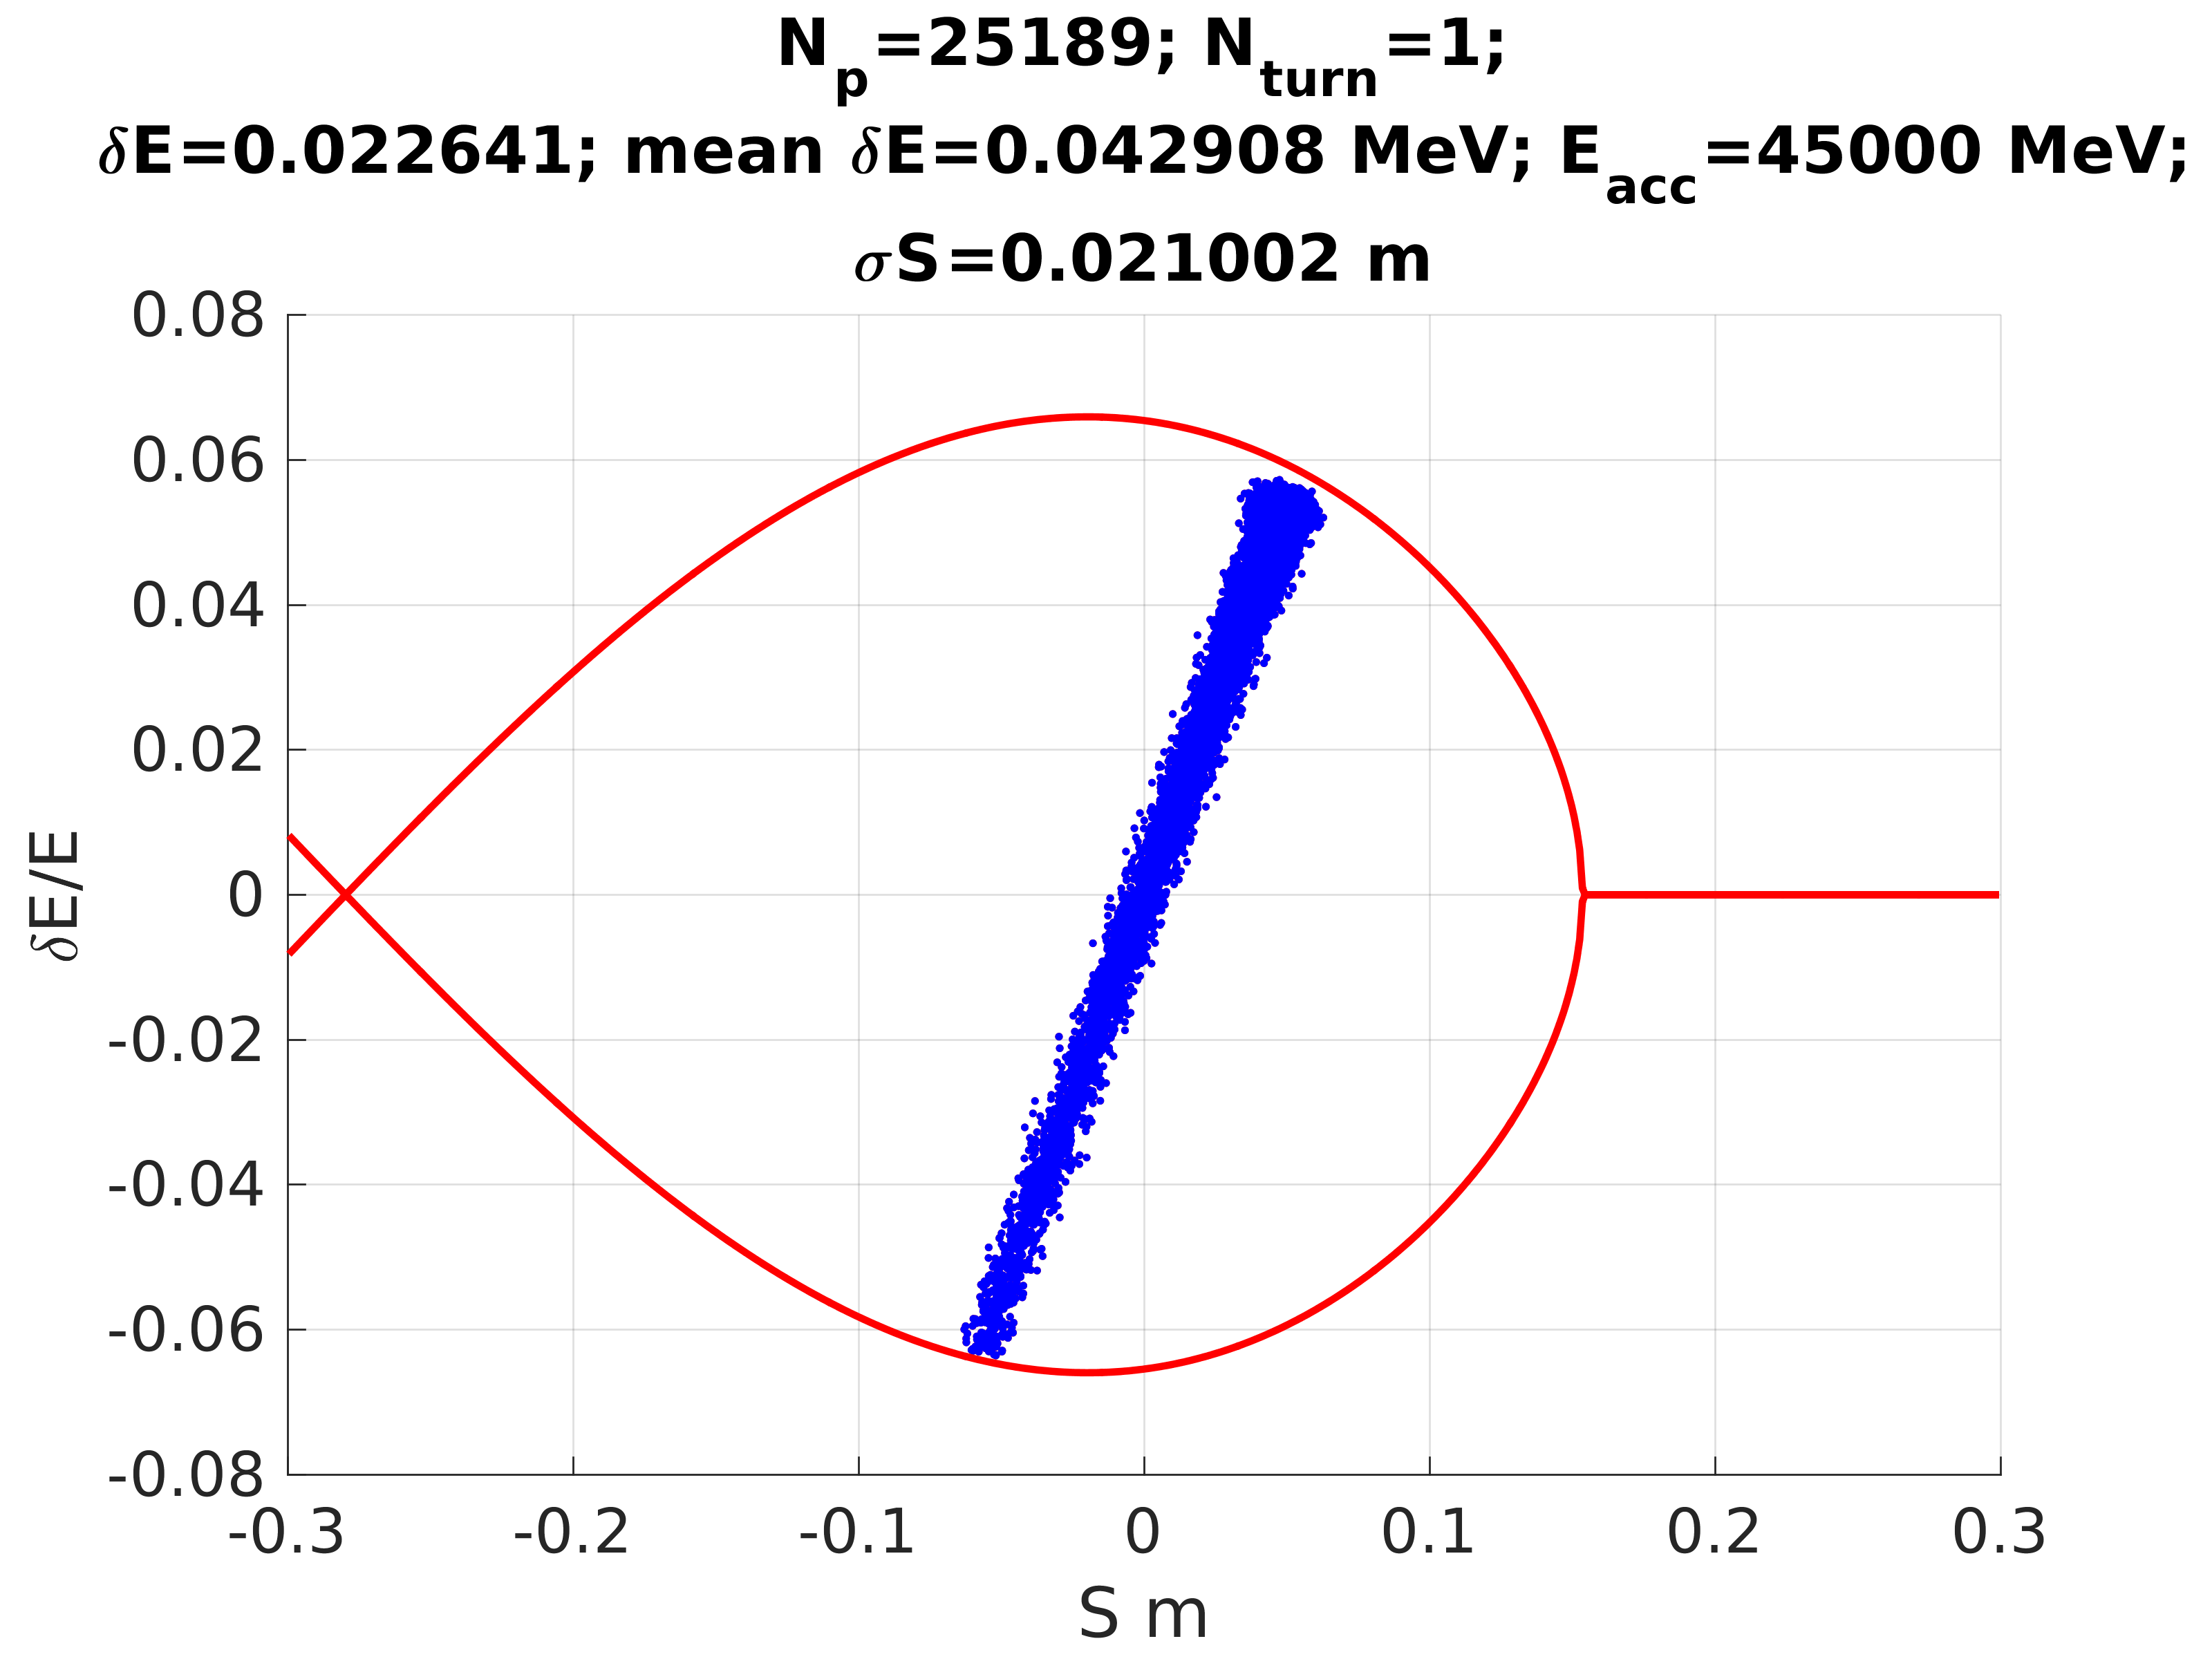
INJECTION INTO POSITRON RING
Example of (linear) tracking injection
Without energy offset
With energy offset 6%
Beam at injection
Injecting beam directly after the target
with energy spread ~15% into the ring with energy acceptance ~8% means lost around ~20% of particle
Instead, injecting beam with energy offset give possibility push into bucket more particle to increase efficiency injection.
Efficiency 81%
Efficiency 86%
Beam after 1 turn
Injection with energy offset require 6D tracking simulation until beam converge to the equilibrium

Slide 5
A new Muon Source. Serafini/Curatolo scheme [e⁻ x-ray (150keV) → u⁺ u⁻]
Notes:
Schemi come Map: proton on target → Pioni → decay in muon …. Hanno emittanze molto più alte degli schemi basati su leptoni, ma hanno sezio
Fcc 500 MW, CERN (120 lhc) + (80 lab) --- SIAMO COMPARABILI
Collisioni in vuoto quindi le energie si recuperano tutte ---- non si termalizza nulla
La luminosità è cos’ì alta perchè elettroni e fotoni NON SI VEDONO!
NO beamstrahlung effect… .NON fasci piatti …. Non limite fisico alla focalizzazione solo tecnologico.
ILC e+ e- SI beamstrahlung

