Slide 1

HL-LHC High Order Correctors
Marco Statera
on behalf of the LASA magnet team
INFN Milano - LASA
MIlano– 9 Luglio 2021

Slide 2
Outline
Scope: HL-KLHC and the High Order correctors magnets
Design
Series production status
Conclusion

Slide 3
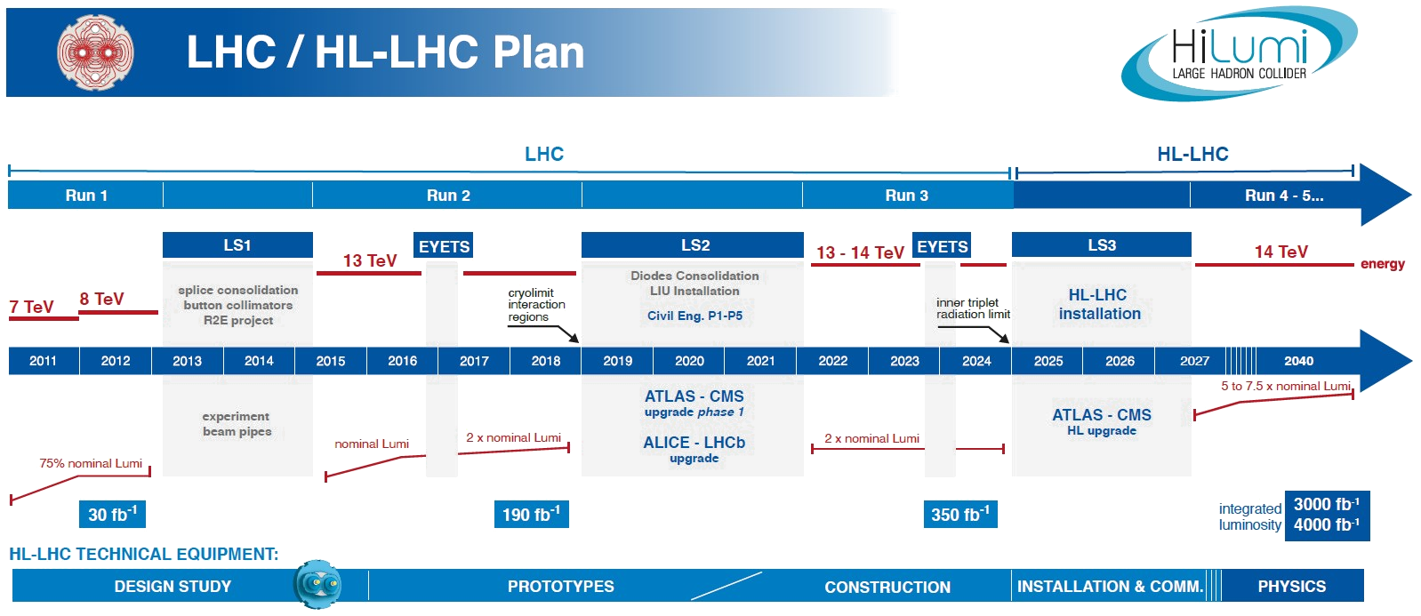
HiLumi LHC
The main objective of HiLumi LHC Design Study is to determine a hardware configuration and a set of beam parameters that will allow the LHC to reach the following targets: A peak luminosity of L_{peak} = 5×10³⁴ cm⁻²s⁻¹ with levelling, allowing: An integrated luminosity of 250 fb⁻¹ per year, enabling the goal of L_{int} = 3000 fb⁻¹ twelve years after the upgrade. This luminosity is more than ten times the luminosity reach of the first 10 years of the LHC lifetime.
Courtesy of L. Rossi

Slide 4
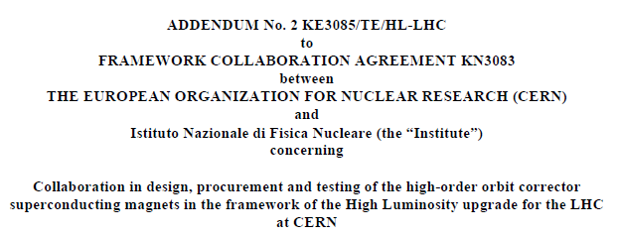
Scope - High Order Correctors
The INFN-LASA follows the design, construction and test of the 5 prototypes of the High Order (HO) corrector magnets for the HL interaction regions of HL-LHC. KE2291
The INFN-LASA will follow the series production of the HO corrector magnets for the interaction regions of HL-LHC. KE3085
Deliverables are the magnets, i.e. active part (coils) with iron yoke and support structure, plus the vertical tests
Integration in the cold mass corrector package is done at CERN
30th Nov 2017
54 S.C. High Order Corrector magnets

Slide 5
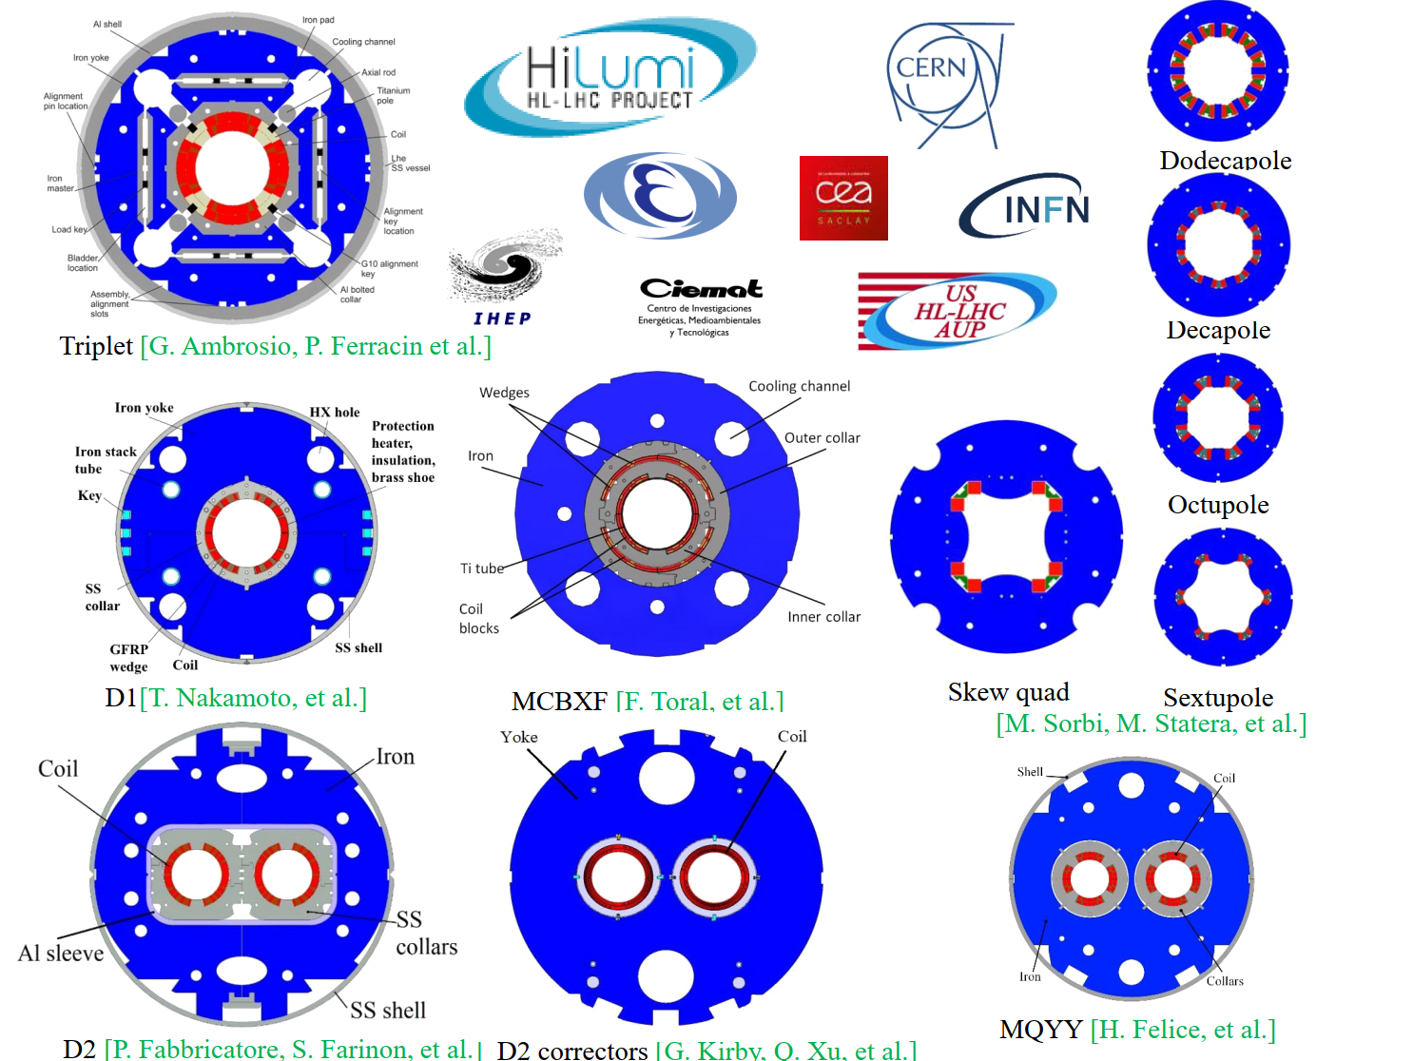
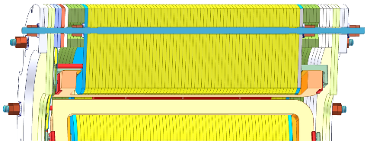
HO Corrector Magnets Zoo
Design
Construction & Test
5 prototypes
54 series magnets
Cu be rod
Iron pole
coil
NbTi SuperFerric design
Geometrical lengths:
200 mm - 265 mm
12P, S4P: 540 mm – 580 mm
Outer diam. 320 mm – 460 mm
Inner bore φ 150 mm

Slide 6
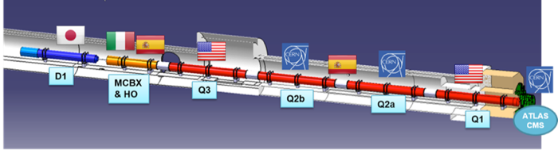
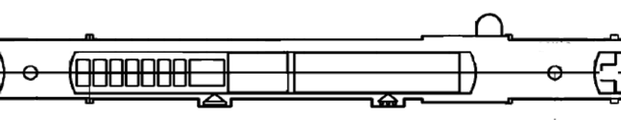
THE LOW BETA SECTION and the High Order Correctors
73.6 m
IP
by P. Fessia
b3
b4
b5
b6
a2
a3
a4
a5
a6

Slide 7
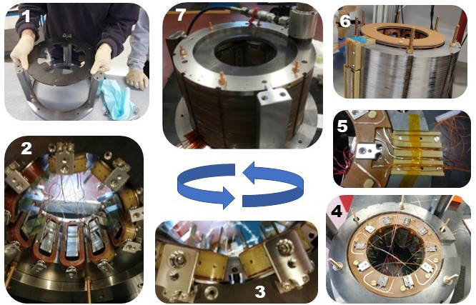
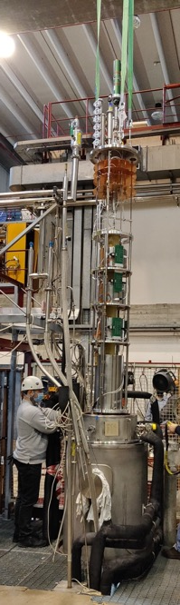
Assembly
Prototypes assembled at LASA/industry
Series magnet assembled in industry SAES Rial Vacuum (Parma)
PCB BOX
Lamination
Power and voltage tap
Printed Circuit Board
SC coil
pole

Slide 8
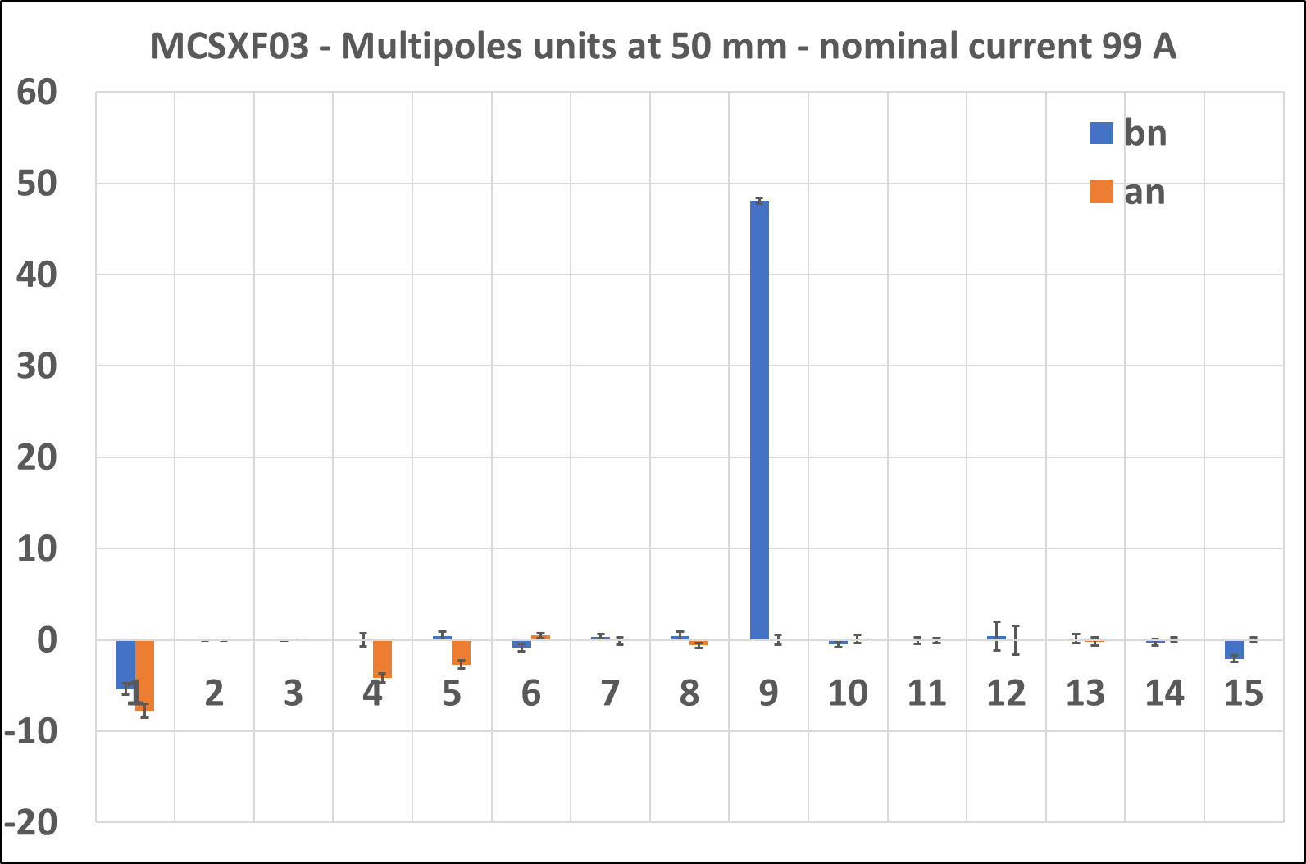
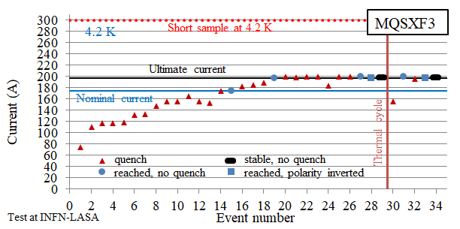
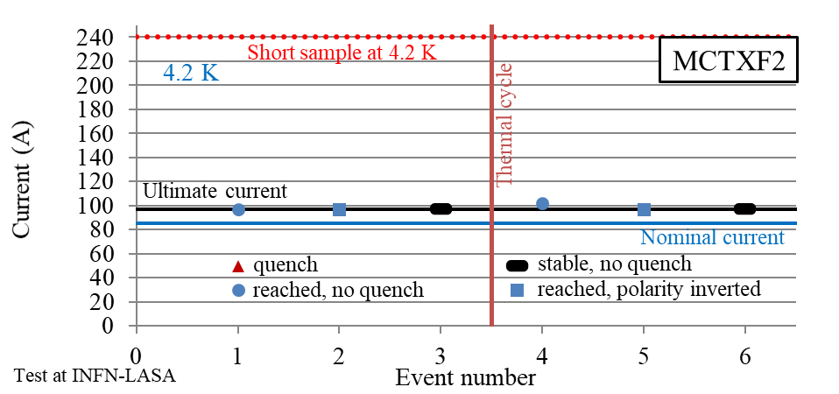
Selected Results
Training
Quench memory after thermal cycle
Field quality
Transfer function integrated field/current
MCDXF03

Slide 9
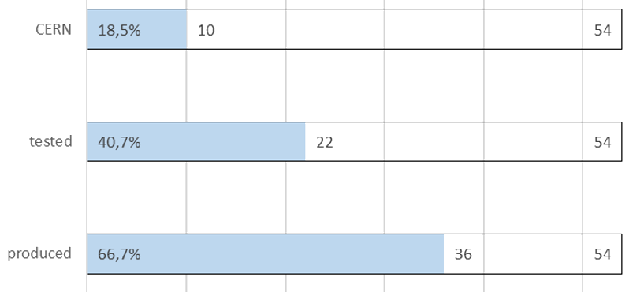
Series Production and Test
MM@LASA 13 magneti (24%)
End of production 10/2021
End of test @LASA 7/2022
Shipping to CERN 9/2022

Slide 10
HL_SHOC
HL-LHC High Order Correctors
Personale ricerca 1.7 FTE
Personale tecnico 2.4 FTE
respnaz
Richieste servizi 2022
Progettazione meccanica 3 mu
Officina meccanica 1 mu

Slide 11
Conclusion
The INFN-LASA follows the design, construction and test of the High Order (HO) corrector magnets: prototypes and series production
All prototypes were successfully tested
Knowledge transfer to industry for the series production
Series production and testing ongoing
Delivery to CERN within Sept 2022

Slide 12

THANK YOU
LASA team
F. Broggi, E. De Matteis, S. Mariotto, A. Paccalini, A. Palmisano, A. Pasini, D. Pedrini, A. Leone, M. Quadrio, M. Prioli, M. Sorbi, M. Statera, M. Todero, C. Uva

