Slide 1
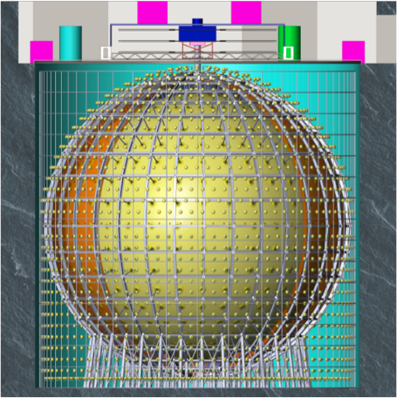
A large LS spherical detector
JUNO has been approved in China in Feb. 2013 and by INFN in 2014
Approved funding from several other countries:
Belgium
Czech Republic
Finland
France
Germany
Russia
Taiwan
Chile
Brazil
Thailand
Pakistan
USA
LS large volume: ➔ for statistics
High Light(PE) ➔ for energy resolution 1200 pe/MeV
Steel Truss
Holding pmts
~20000 x 20”
~25000 x 3”
Acrylic Sphere
filled with 20 kton
of liquid scintillator
Main INFN contributions:
Scintillator purification and optics measurements (Milano)
Electronics&trigger (central detector and top tracker)
Low background techniques
Software&Computing (Milano)
PMT testing
Geo-neutrino investigations
Under discussion: TAO near det.
Excavation of the site completed in south of China – started in January 2015 and completed at the end of 2020

Slide 2
Global status of the project
Final preparation of the site ongoing
All components and subsystems ready for detector and plants assembly
Imminent start up of on-site installations
Detector fill in the first months of 2023

Slide 3
Activities in Milano
Purification plants: distillation and stripping units
Laboratory measurements of scintillator properties: lifetime and Cherenkov component
MC&analysis: sensitivity to solar neutrinos in JUNO
Phenomenology: JUNO sensitivity to Non standard interactions in ν sector and to LIV
Computing: interactions with CNAF for resources usage and collaboration software SNIPER

Slide 4
Distillation & Stripping Plants Status
Distillation & Stripping plants have been completed and already delivered to Shekou port into shipping containers. Now temporary stored in a repository 20 km far from JUNO site.
Distillation Plant:
Shipped on: 10 November 2020
Delivered on: 24 December 2020
Stripping Plant :
Shipped on: 29 July 2020
Delivered on: 01 October 2020
Operation | Status
Equipment and piping construction | ✓
Cleaning | ✓
Equipment installation inside skids | ✓
Instrument and piping connections | ✓
Insulation | ✓
Helium leak test | ✓
DCS tests | ✓
FAT | ✓
Preparation for transport & shipping | ✓

Slide 5
keuro
145
Missioni
consumo
24.5
trasporti
5
inventario
11
licenze
4.5

Slide 6
Anagrafica
Vito Antonelli 70% Ricercatori
Davide Basilico 100%
Barbara Caccianiga 40%
Federico Ferraro 100%
Emanuela Meroni 0%
Lino Miramonti 20%
Alessandra Re 80%
Marco Torri 100% 5.1 FTE
Cecilia Landini 100% Tecnologi
Paolo Lombardi 80%
Gioacchino Ranucci 80% 2.6 FTE
Augusto Brigatti 80% Tecnici
Sergio Parmeggiano 80%
Paolo Saggese 50% 2.1 FTE

