Slide 1
HASPIDE
(HAmorphous Silicon Pixel Detector for ionizing radiation)
Giuseppe Maruccio
Department of Mathematics and Physics, University of Salento,
INFN-Lecce, CNR NANOTEC, Lecce (Italy)
Proposal presented at the Commission V of the INFN (CSN5)
Scientific Responsabile: Leonello Servoli
Area of activity: Rivelatori
INFN Units Involved: INFN Perugia, INFN Firenze, INFN LNS, INFN Milano, INFN Torino

Slide 2
Objectives
The HASPIDE project wants to explore the possibility to use a:Si-H as a detection material for ionizing radiation of different types (photons, electrons, protons, ions, neutrons).
The project's foundation is the capability already demonstrated by several research groups and by some of the proponents to use this material to build several devices
Two detection regimes should be tackled:
the continuous or pulsed intense radiation flux;
the pulse-by-pulse mode, typical of space applications or neutron detection.
The material in itself is very radiation-resistant, could be deposited as a thin layer of few micrometres over many substrates, including flexible ones like Kapton, that potentially opens up the way toward many important applications, among which we choose to explore:
beam monitoring of clinical and non-clinical accelerators;
detection of cosmic radiation in space;
neutron detection.

Slide 3
methodology
Fabrication and optimization of detectors.
During the prototyping phase, basic detector configurations will be built to assess the performances of the various prototypes. These configurations will include:
Single diodes of various areas and active thicknesses;
Small arrays of diodes (2 x 2 and 3 x 3) with different areas, thicknesses and diode spacings. The purpose of this phase is to evaluate the basic performance of multiple diode structures that will be used in the application Work Packages (WP4, WP5 and WP6).
These diodes will be fabricated using two different deposition technologies:
1. Plasma enhanced chemical vapor deposition (PECVD) (by EPFL on substrate produced by INFN-Lecce).
2. Pulsed Laser Deposition (PLD) INFN-Lecce.

Slide 4
methodology
2) Front-end electronic and DAQ for:
• ionizing radiation flux measurement and for clinical dosimetry
• very small fluxes, that could be considered a sequence of single particles, and for neutron detection, a single charge pulse read-out solution will be adopted.
3) Simulation of the a:Si-H material and of the devices and of their properties.
To drive the R&D on sensor dimensions and performances simulation activities aiming at the a-Si:H sensor/detector analysis and optimization to target the different applications are needed. Approches: Monte-Carlo approach (GEANT4) and Technology CAD (TCAD) approach.
4) Customization and optimization for ionizing radiation flux measurement and dosimeter for ionizing radiation beam, including the exploration of flexible matrices to be used in transmission mode.
5) Study of the performance of this a:Si-H for use in spatial environment for specific ionizing radiation measurements.
6) Study of the capability to detect the conversion of an incoming thermal neutron on a 10B thin layer deposited over the a:Si-H material. Aim: improvement of neutron detection efficiency and gamma-ray rejection.
The prototypes will be tested against one or more of the following applications:
• Dose monitoring in radiotherapy.
• Dose monitoring in BNCT (Boron Neutron Capture Therapy).
• Space applications, particularly secondary neutrons generated by the nuclear reaction of high
energy charged particles (protons and heavier ions) with spacecraft materials.

Slide 5
Objectives & Partners
6 INFN italian research groups (PG, FI, LE, LNS, MI, TO)
and 2 foreign institutions (EPFL, UOW).

Slide 6
WP1 - Tasks Description
WP1: Deposition process and device fabrication
• Responsible Menichelli Mauro
• Working Group (PG, LE, EPFL)
• Tasks
T1.1: Single Diode PECVD Prototype production and testing
T1.2: Single Diode PLD Prototype production and testing
T1.3: Small arrays PECVD Prototype production and testing
T1.4: Small arrays PLD Prototype production and testing
T1.5: Irradiation tests of prototypes
T1.6: Production of WP4 detector
T1.7: Production of WP5 detector
T1.8: Production of WP6 detector
• Milestones
M1.1: End of single diode with PECVD qualification tests
M1.2: End of single diode with PLD qualification tests
M1.3: End of small array with PECVD qualification tests
M1.4: End of small array with PLD qualification tests.
M1.5: End of irradiation tests.
• Deliverables
D1.1: Single array with PECVD delivered
D1.2: Single array with PLD delivered
D1.3: Small array with PECVD delivered
D1.4: Small array with PLD delivered
D1.5: WP4 detector delivered
D1.6: WP5 detector delivered
D1.7: WP6 detector delivered

Slide 7
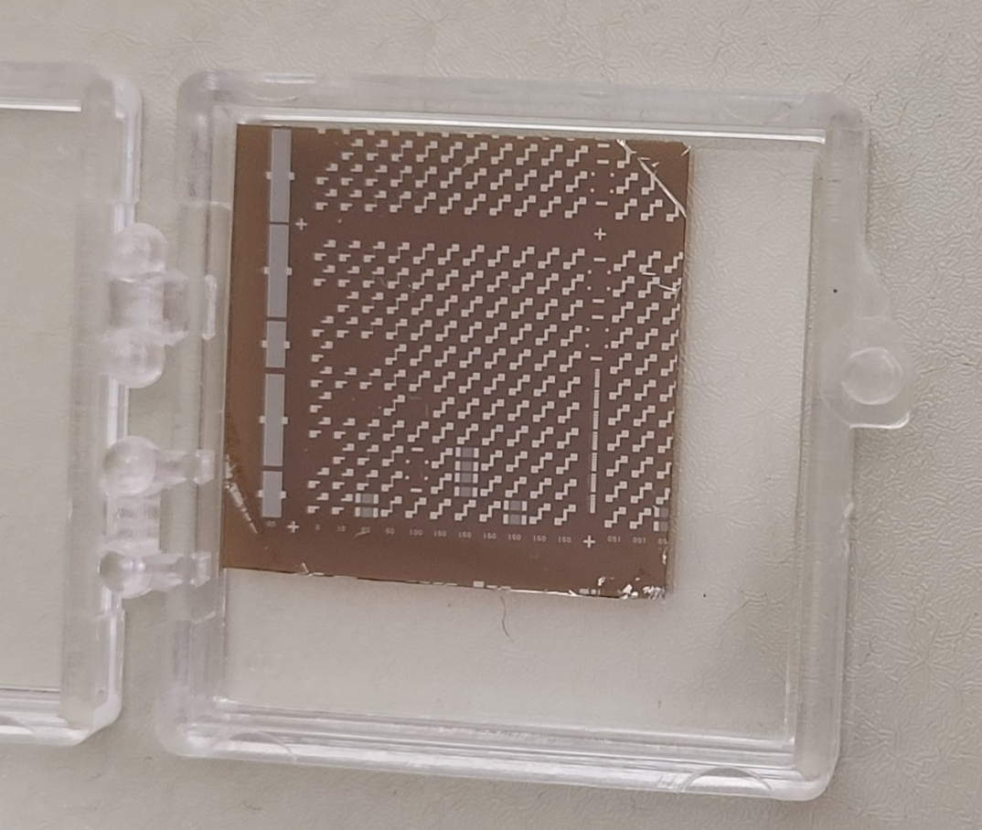
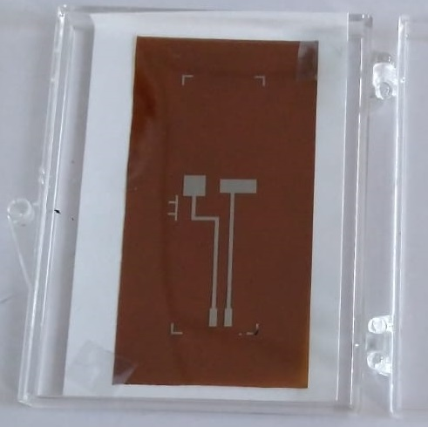
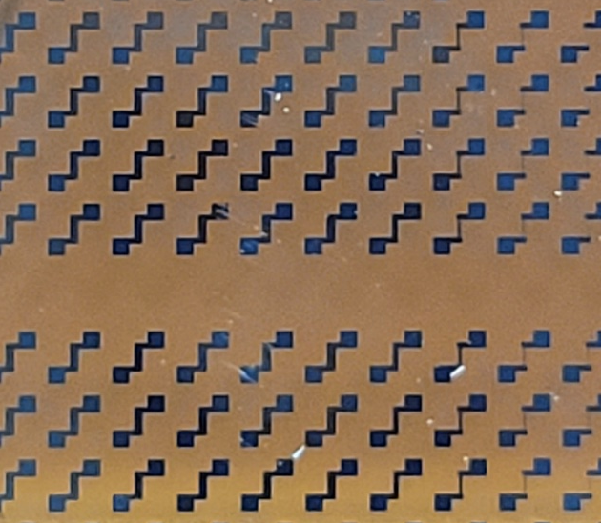
Lithography on Kapton substrate

Slide 8
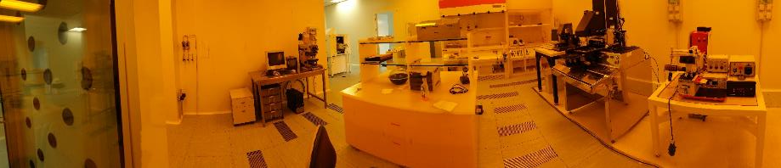
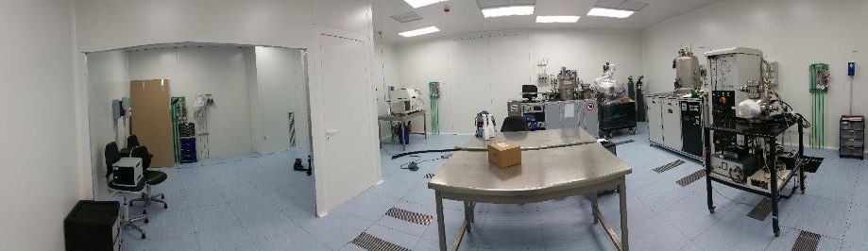
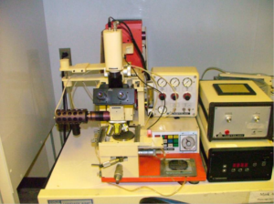
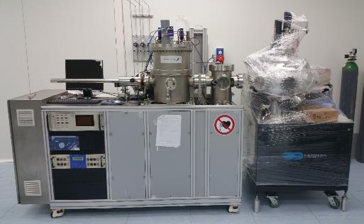
Clean room

Slide 9



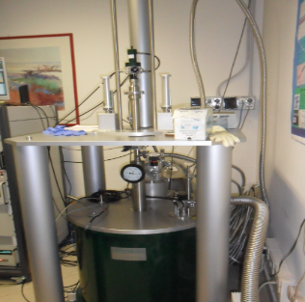
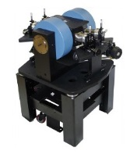
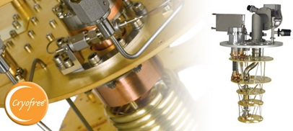

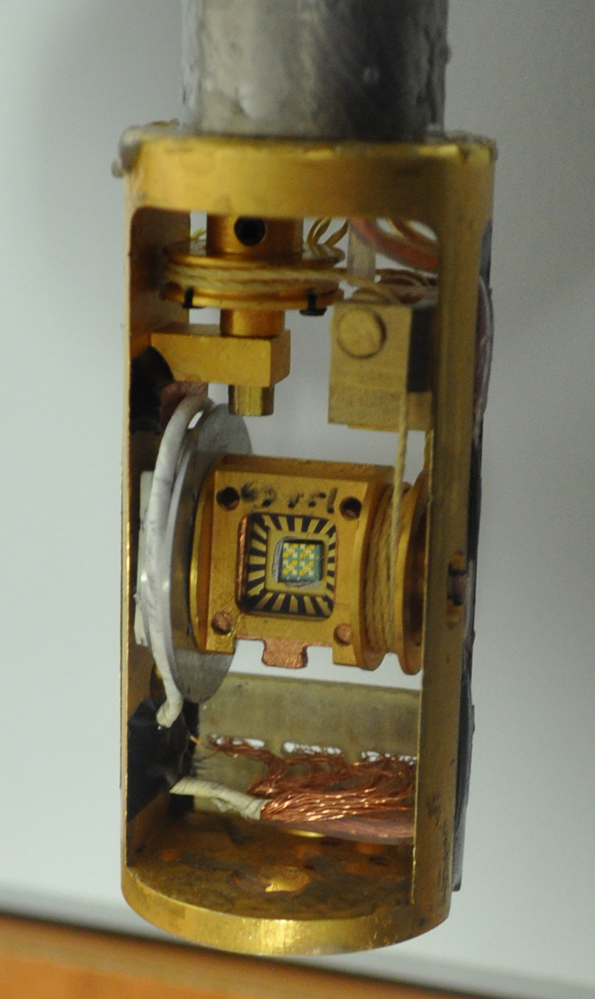
Spintronics Lab
Cryogenic superconducting magnet (10.5 T, 0.3-300 K)
Oxford dilution refrigerator (down to 10 mK, vector magnet 6T/1T/1T)
Cryogenic RF probe station (down to 8 K and up to 0.5 T and 70 GHz).

Slide 10
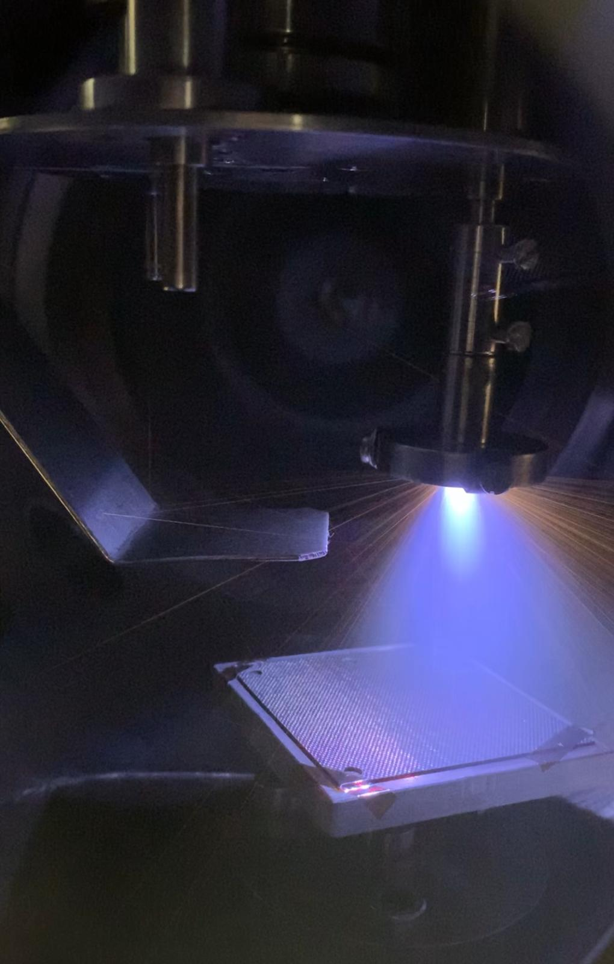
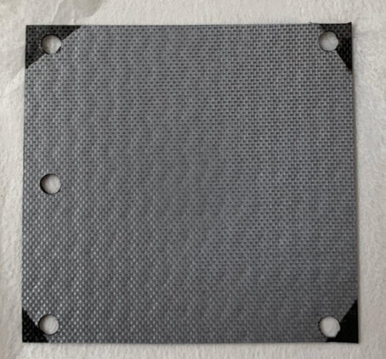
WP6:PLD Deposition of ¹⁰B conversion layers
WP6: Neutron detection
• Responsible: Gianluca Quarta
• Working group: (LE)
In the frame of WP6 the PLD (Pulsed Laser Deposition) technique will be used to deposit ¹⁰B thin films to be used as conversion material for thermal neutron detection in combination with a-Si:H to be used for the detection of charged particles released by the ¹⁰B(n,α)⁷Li reaction

Slide 11
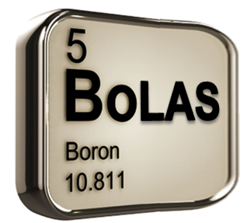
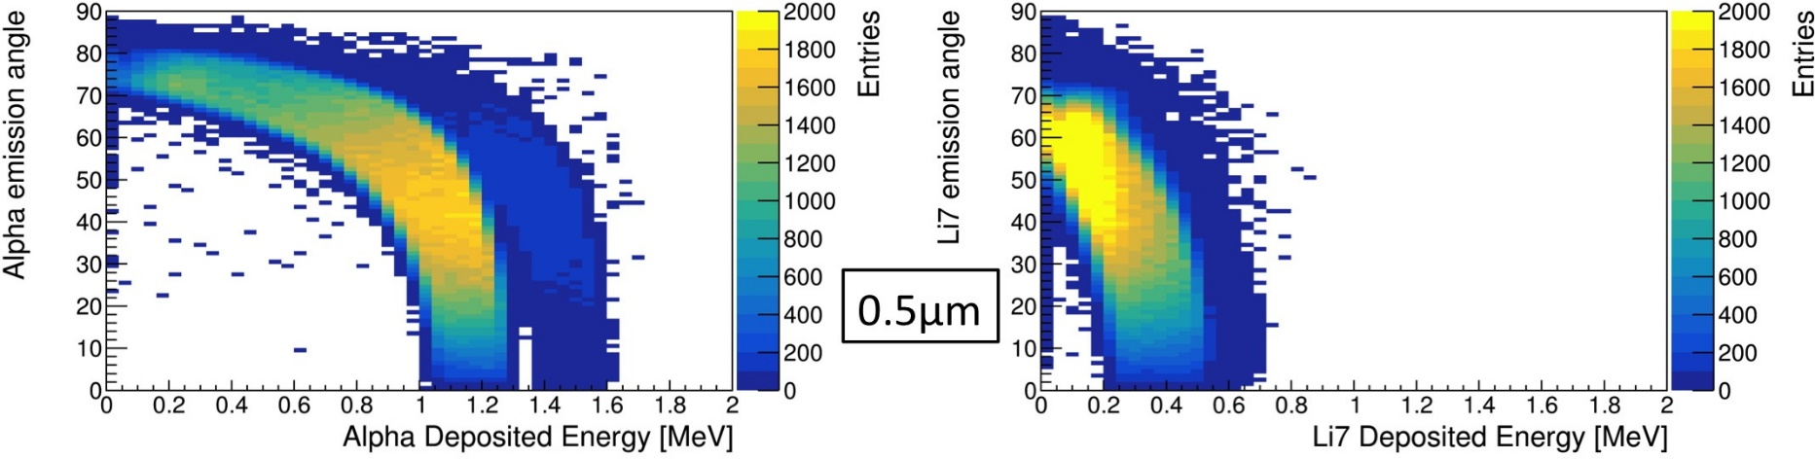
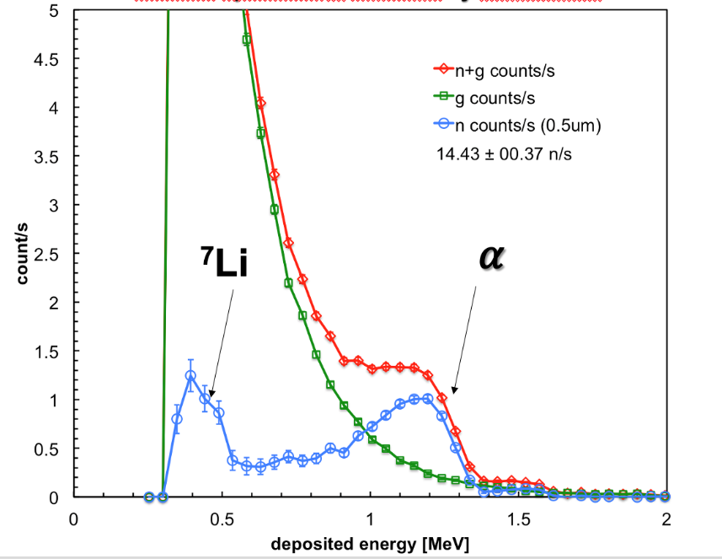
WP6:PLD Deposition of ¹⁰B conversion layers
The INFN section in Lecce has now a consolidated experience in the PLD deposition, characterisation and tests of ¹⁰B film for thermal neutron detection acquired through the
BoLAS and BoLAS-Next CSN5 experiments

Slide 12
WP6 - Tasks Description
• Tasks
T6.1 Determinations of optimal conditions of the PLD system for 10B deposition (Month 1-12). The optimal
experimental set-up of the PLD will be determined in terms of laser wavelength, fluence and deposition
geometries on different test-substrates. Deposited films will be characterized by SEM, TEM, AFM and IBA
techniques. Optimal film thickness will be determined.
T6.2 Deposition of 10B films on substrates and a-Si:H-based detectors (Month 12-24). 10B films will be
deposited on both flexible substrates and a-Si:H diodes.
T6.3 Tests of the devices (Month 18-36) 10B covered diodes or films coupled to a-Si:H detectors will be exposed
to thermal neutron fields in order to assess their detection capabilities. Detector performances will be evaluated
in terms, for instance of efficiency and gamma rejection. The effect of exposure to energetic charged particles
will be also evaluated.
• Milestones / Deliverables
M6.1-Month 12. Deposition of pure and thick 10B film on flexible substrates and on sample miming
the devices
M6.2-Month 24. Deposition of 10B converters on a-Si:H devices and substrates
M6.3-Month 36. Test of the devices for thermal neutron detection.

Slide 13
Lecce Group
INFN-LE
Name | Surname | Position | FTE
Anna Grazia | Monteduro | Ricercatore RTD-A (UniSalento) [RL] | 0.3
Giuseppe | Maruccio | Professore Ordinario (UniSalento) | 0.2
Silvia | Rizzato | Ricercatore RTD-A (UniSalento) | 0.2
Gianluca | Quarta | Professore associato (UniSalento) | 0.2
Anna Paola | Caricato | Professore Associato (UniSalento) | 0.1
Maurizio | Martino | Professore Associato (UniSalento) | 0.2
Lucio | Calcagnile | Professore Ordinario (UniSalento) | 0.2
Alfio | Torrisi | Ricercatore RTD-A (UniSalento) | 0.2
 |  | 24 months AdR from first year (WP1) | 1
 |  | 24 months AdR from second year (WP6) | 1
INFN-LE Total |  |  | 3.6

Slide 14
Budget Lecce
INFN-LE
Expenditure | Description | 1st Y [k€] | 2nd Y[k€] | 3rd Y [k€] | Total [k€]
Instruments | Parameter analyzer+DC probes | 50 | 0 | 0 | 50
Instruments | Upgrade PLD chamber | 30 | 0 | 0 | 30
Consumables | Materials for a:Si-H device fabrication | 5 | 3 | 2 | 10
Consumables | Material ¹⁰B deposition | 6 | 12 | 1 | 19
Travels | Collaboration meetings and experiment runs | 3 | 5 | 6 | 14
Personnel | INFN AdR | 24 | 24 |  | 48
Total |  | 94 | 20 | 9 | 171
Richieste | Descrizione | Totale euro/FTE
Officina meccanica | / | /
Laboratorio di elettronica | / | /
Servizio calcolo | / | /

