Slide 1
DART WARS
Detector Array Readout with Traveling Wave AmplifieRS
Giuseppe Maruccio
Department of Mathematics and Physics, University of Salento,
INFN-Lecce, CNR NANOTEC, Lecce (Italy)
Proposal presented at the Commission V of the INFN (CSN5)
Scientific Responsabile: Andrea Giachero (MIB)
Area of activity: Detectors and Electronics
INFN Units Involved: LNF, LE, MIB, SA, TIFPA
Call tematica: “Sviluppo di tecnologie quantistiche per i settori di fisica di interesse INFN”

Slide 2
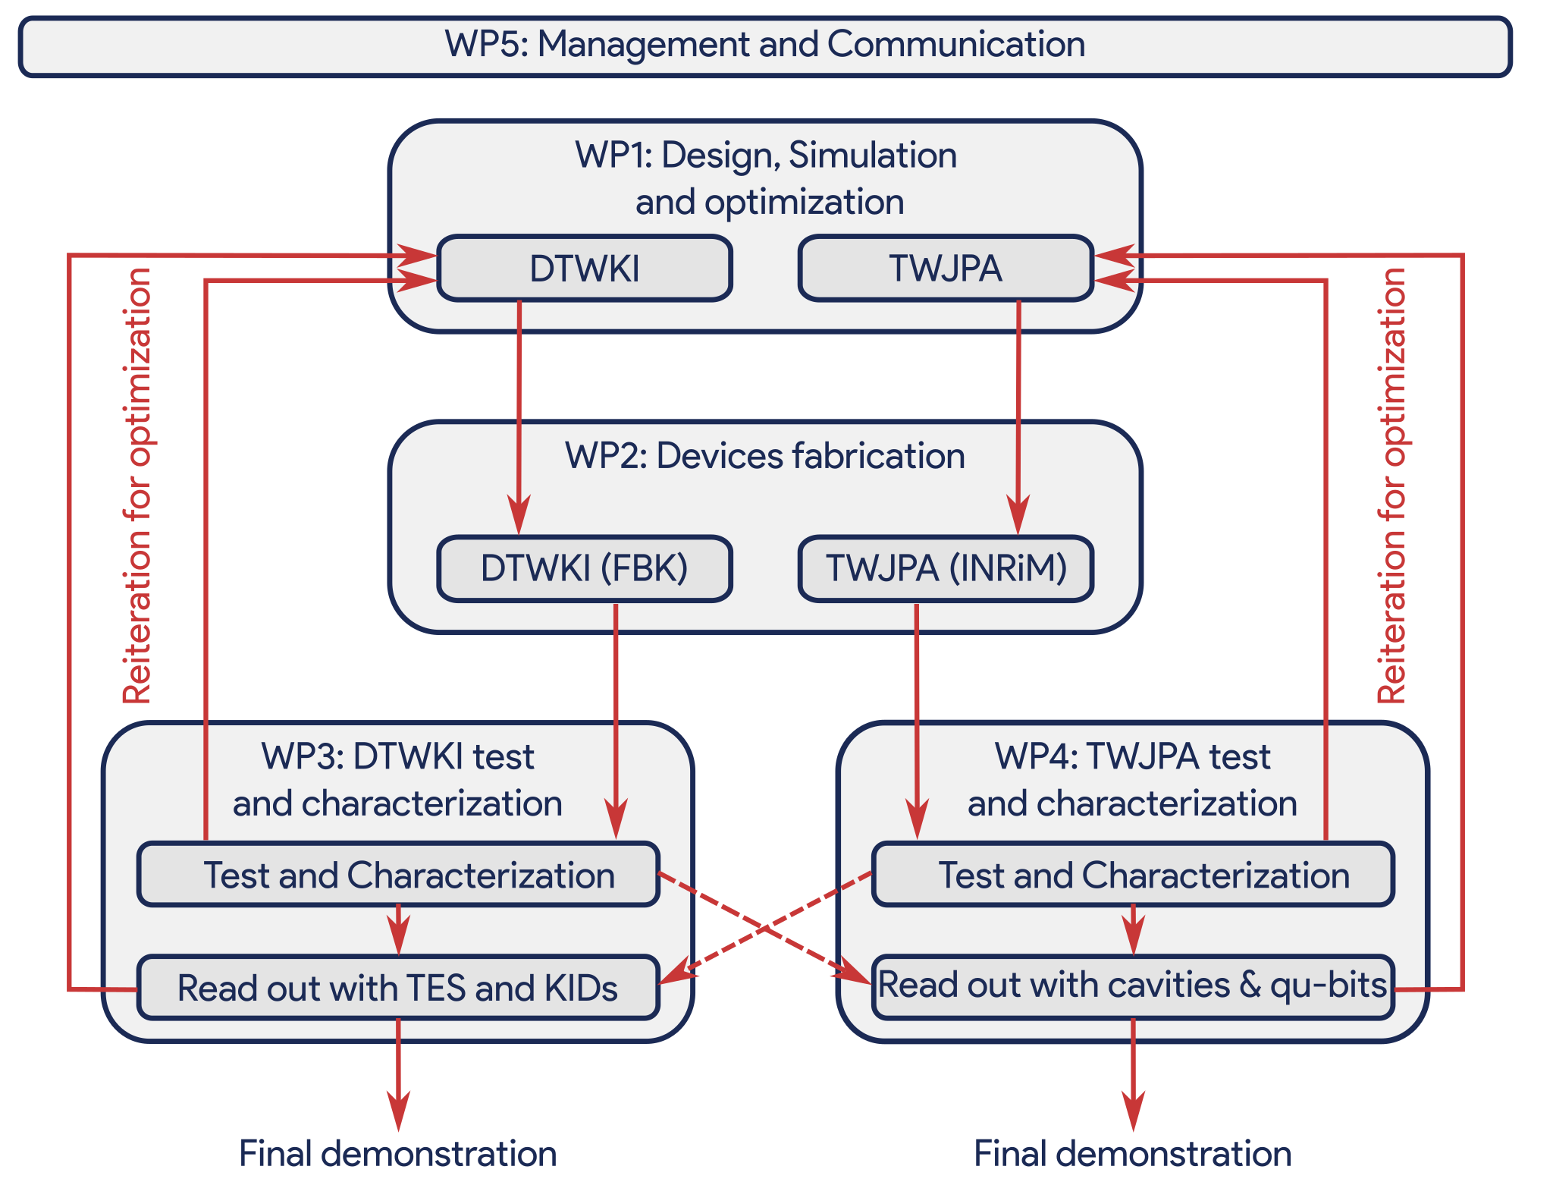
Objectives
development of high performing wideband superconducting parametric amplifiers (transmission line with embedded Josephson junctions (TWJPA) and Dispersion-engineered Traveling Wave Kinetic Inductance (DTWKI));
read out demonstration of various detectors/components (TESs, MKIDs, microwave cavities and qubits) with improved performances due to a parametric amplification with a noise at the quantum level;
Technical goal: 20 dB gain, comparable to HEMT, a high saturation power (around -50 dBm), and a quantum limited or nearly quantum limited noise (noise temperature < 600 mK).
opening future prospective toward next generation of particle, astroparticle and astrophysics experiments
Quantum limited microwave amplifier with large bandwidth operating at mK temperatures useful for
resonant axion-detectors, such as haloscopes
many quantum technology applications, for example the rapid high-fidelity multiplexed readout of superconducting qubits.

Slide 3
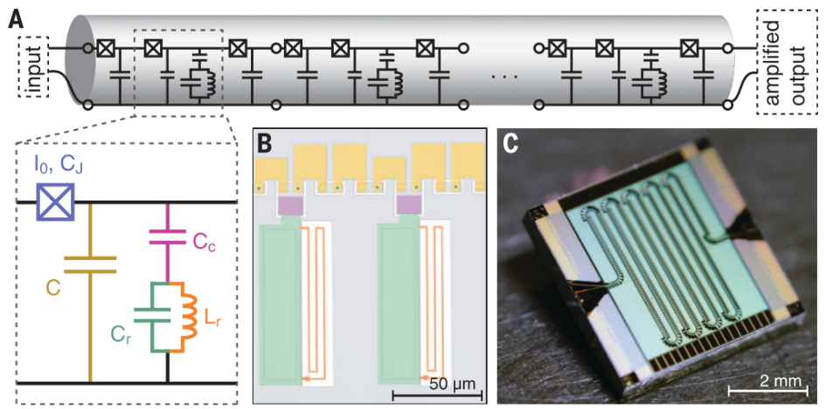
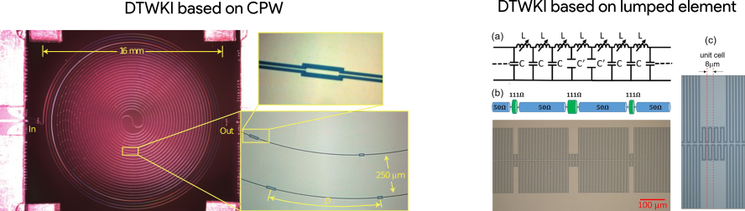
Amplifiers
Figure1: Josephson traveling-wave parametric amplifier. (A) Circuit of a transmission line with embedded Josephson junctions (TWJPA) implemented as a nonlinear lumped-element transmission line; one unit cell consists of a Josephson junction and a capacitive shunt to ground. (B) Optical micrograph: the coloring corresponds to the inset in (A). (C) Photograph of a 2037 junction JTWPA. The line is meandered several times on the 5 mm by 5 mm chip to achieve the desired amplifier gain.
Figure 2: (Left) picture of Dispersion-engineered Traveling Wave Kinetic Inductance (DTWKI) amplifier implemented with a 0.8 m length of NbTiN CPW line arranged in a double spiral to reduce resonances due to coupling between adjacent lines [Nat. Phys. 8, 623–627 (2012)]. (Right) Micrograph of the periodically loaded artificial transmission line for a lumped-based DTWKI amplifier showing one period of the loading section (bottom) and a cartoon showing its transmission line model (top)

Slide 4
Impact 1
gamma-ray and x-ray spectroscopy²² applications, in beam science²³ and in neutrino physics²⁴.
large low temperature calorimeters for the studies of Dark Matter²⁵, neutrinoless double beta decay (DBD)²⁶, coherent elastic neutrino-nucleus scattering²⁷ (CEνNS) and relic neutrino measurements²⁸.
DBD²⁹ and Dark Matter³⁰ searches and neutrino mass measurements³¹.
search for galactic axions. Haloscope experiments, including INFN-QUAX and IBS-CAPP, employ JPAs as quantum limited amplifiers → Replacing these narrow-band amplifiers in haloscopes with a single TWJPA will allow to scan large frequency regions with a single device.
A TWJPA with high gain and noise at the quantum limit operating in a frequency band from 1 to 15 GHz is an urgent need of the whole axion community. Readout of a cavity array will improve the sensitivity and the scan rate of axion experiments opening the way to “broadband axion-experiments” able to perform a fast scan over a wide frequency-region.
QUAX Collaboration (Legnaro, Padova, Roma, Salerno)
searches for DM axions through their coupling with the electron spin
Crescini et al. PRL 124, 171801 (2020)
Exclusion plot at 95% C.L. on the axion-electron coupling

Slide 5
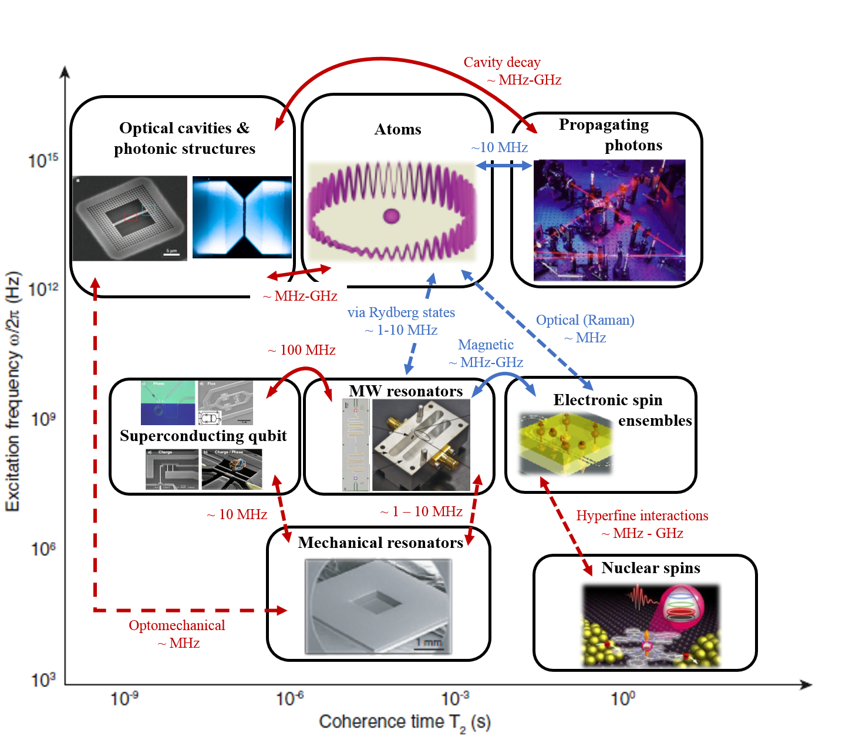
Impact 2
revolutionary performances in computation, communications as well as high-precision sensing. Amplifiers with noise at the quantum limit can be generally exploited as the first-stage amplification in the output chain when interrogating fragile quantum systems. In quantum technologies, encoding information in different physical systems can provide advantages in overcoming the strict requirements in terms of decoherence timescales and capacity to process the information. Magnons exhibit strong stability in coupling with photons, when they are excited in YIG single crystals embedded in microwave cavities. Cavity magnonics read out by a TWJPA emerged as an attractive field for applications in quantum technologies demonstrating the ability for integrating different systems and excitations together and the possibility to store information in the magnetic subsystem and transfer it to strongly coupled cavity modes as well as phonons, optical photons and transmon qubits.
Kurizki, G., et al., Quantum technologies with hybrid systems. Proceedings of the National Academy of Sciences, 2015. 112(13): p. 3866-3873.
Arrows indicate possible coupling mechanisms and the corresponding coupling strength that can be realistically achieved.

Slide 6
Objectives & Partners
INFN-MIB , INFN-LNF COLD , INFN-LE , INFN-SA , INFN-TIFPA , Fondazione Bruno Kessler (FBK), Istituto Nazionale di Ricerca Metrologica (INRiM), Institute for Basic Science Center for Axion and Precision Physics Research (IBS-CAPP)
Design, Optimization and Simulation
LNF | LE | MIB | SA
6 | 6 | 10 | 32
Devices fabrication
LNF | LE | TIFPA | INRiM
4 | 6 | 32 | 13
DTWKI Test and Characterization, and read out demonstration with microcalorimeters
LE | MIB | TIFPA
10 | 18 | 41
TWJPA test and Characterization, and read out demonstration with microwave cavities and qubits
LE | LNF | SA | CAPP
34 | 39 | 26 | 32

Slide 7
WP4 - Tasks Description
Tasks Description
Task 4.1: Set up of the experimental instrumentations (M1-M6)
Task 4.2: Experimental characterization of the performances of produced TWJPAs (M12-30);
Task 4.3: Test of produced TWJPAs and read out demonstration with detectors (M24-36);
Role of participants
INFN-SA test for fast feedback in He3 refrigerator during fabrication
INFN-SA Bonding and housing of chips in custom designed microwave chip-holder
INFN-LNF, INFN-LE and INFN-SA will test and characterize the produced TWJPA amplifiers;
INFN-LNF, INFN-LE noise characterization of devices
INFN-LNF will perform the read out demonstration with microwave cavities arrays (8-12 GHz device);
IBS-CAPP cavity readout (1-4 GHz device)
INFN-LE will perform the read out demonstration with YIG spheres coupled to arrays of microwave cavities (8-12 GHz device)
Deliverables
D4.1: Setup of the experimental instrumentations (M6)
D4.2: Report on the TWJPA characterization (M18/M30)
D4.3: Report on the on the read out demonstration with TWJPA (M36)

Slide 8
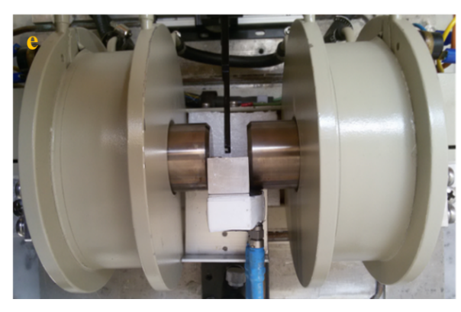
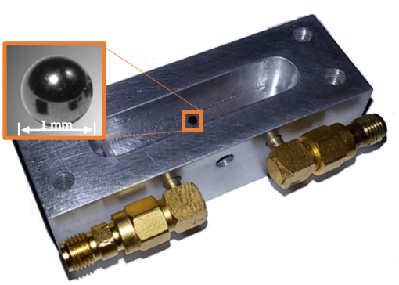
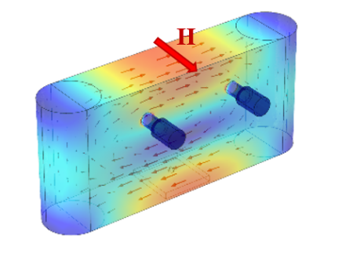
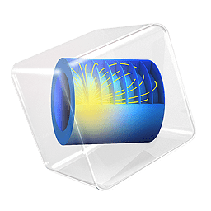
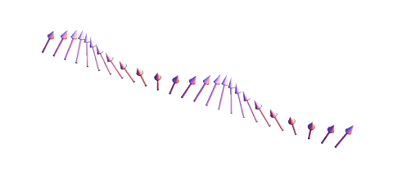
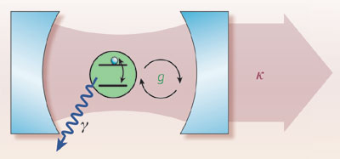
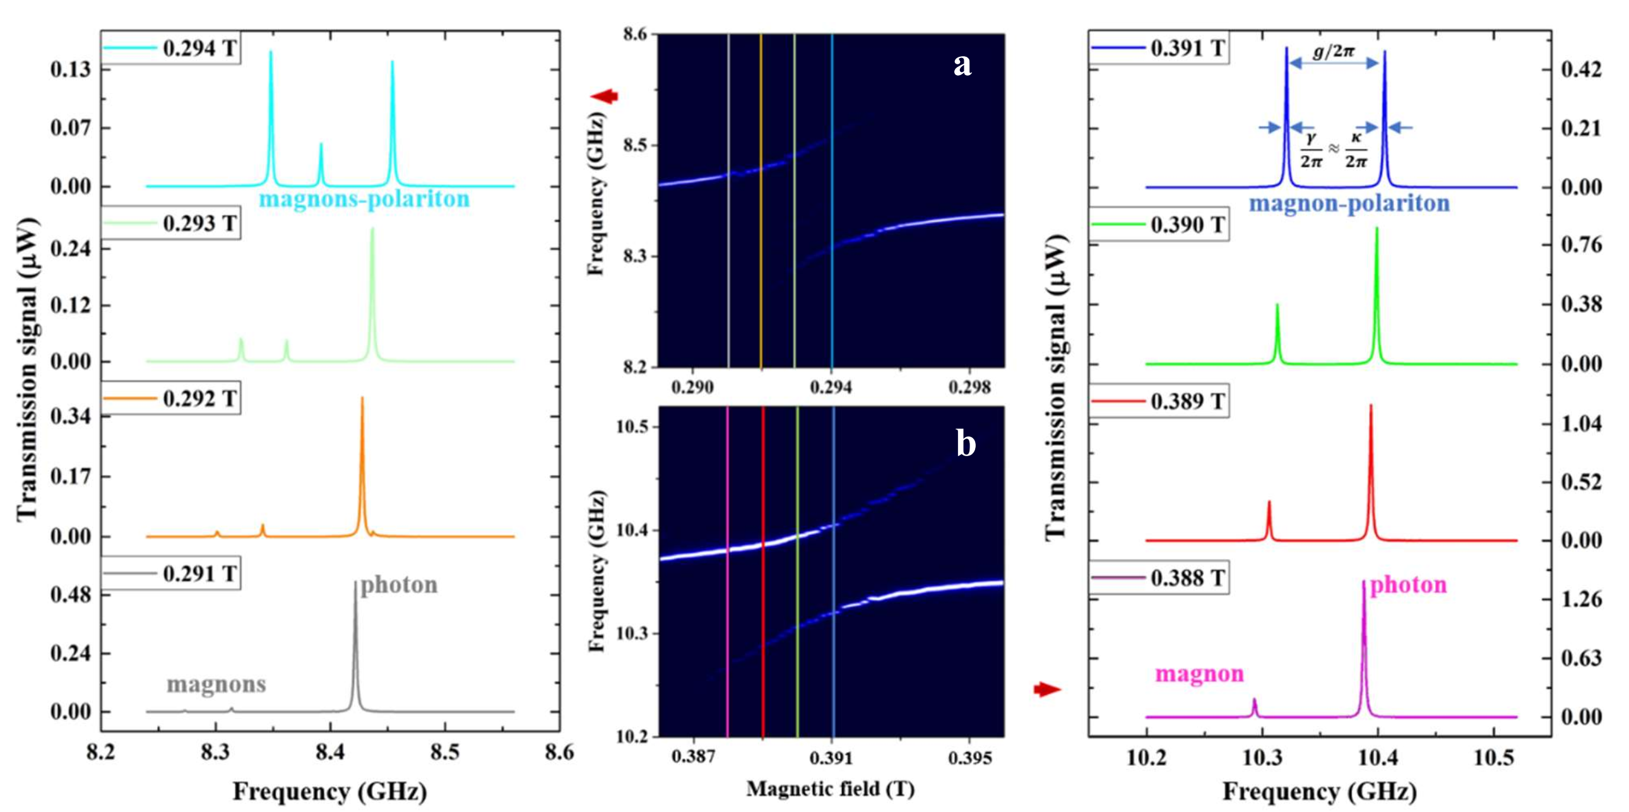
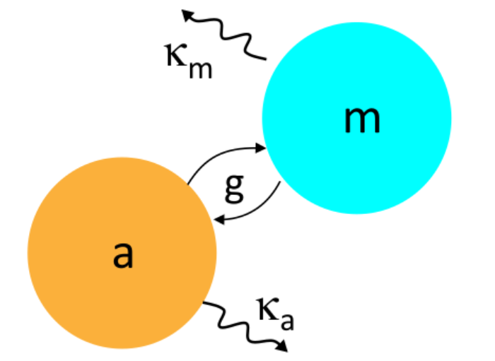



Strong coupling
A. Leo, A. G. Monteduro, S. Rizzato, L. Martina and G. Maruccio, Identification and time-resolved study of ferrimagnetic spin-wave modes in a microwave cavity in the strong-coupling regime, Phys. Rev. B 2020, Vol. 101, p., issn. 2469-9950, http://dx.doi.org/10.1103/PhysRevB.101.014439.
Anticrossing and magnon-polaritons
near TE₁₀₁
near TE₁₀₂
Magnon mode damping rate: $κ_{m}$ ($m$ = FMR, MSMs)
Magnon mode at $ω_{m}$ ($m$ = FMR, MSMs)
FMR
MW
Cavity mode at:
$ω_{c}$
Total cavity decay rate:
$κ_{c}$= $\frac{1}{2}\left(2κ_{i,o}+κ_{int}\right)$
Coupling strength
$g_{m}$ ($m$ = FMR, MSMs)
Strong coupling between fundamental mode in the YIG sphere and the TE₁₀₁ and TE₁₀₂ cavity modes.
Leo et al. ArXiv (2019)
Sub: Phys Rev B

Slide 9
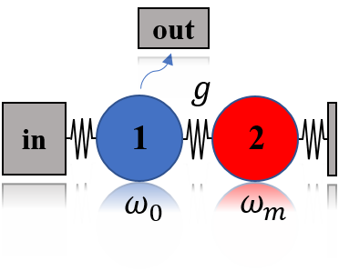
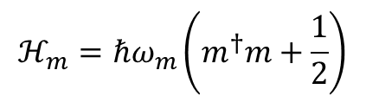
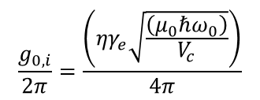
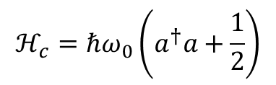
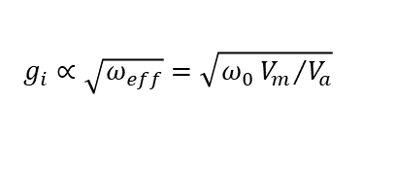
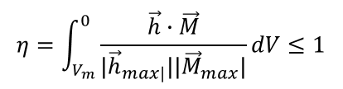
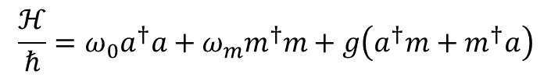


Magnon-Photon coupling
$$ℋ_{c}=ℏω_{0}\left(a^{†}a+\frac{1}{2}\right)$$
Confined EM field
$$ℋ_{m}=ℏω_{m}\left(m^{†}m+\frac{1}{2}\right)$$
Magnons
only with resonant interactions:
$$\frac{ℋ}{ℏ}=ω_{0}a^{†}a+ω_{m}m^{†}m+g\left(a^{†}m+m^{†}a\right)$$
$$ℋ=ℋ_{c}+ℋ_{m}+ℋ_{int}$$
Coupling strength of each spin:
As a spin ensemble:
$$\frac{g_{0,i}}{2π}=\frac{\left({ηγ}_{e}\sqrt{\frac{\left(μ_{0}ℏω_{0}\right)}{V_{c}}}\right)}{4π}$$
$$g_{i}=g_{0,i}\sqrt{Ns}$$
$$g_{i}∝\sqrt{ω_{eff}}=\sqrt{ω_{0}{V_{m}}/{V_{a}}}$$
$$η=\int_{V_{m}}^{0}{\frac{\vec{h}∙\vec{M}}{{|\vec{h}}_{max|}||{\vec{M}}_{max}|}}dV≤1$$
Overlap among subsystems:
Notes:
Description of spin waves – MWs hybridization can be done by considering their bosonic nature; therefore the em field can be quantized following the analogy to an harmonic oscillator. Then the hamiltonian of photonic subsystem presents photon number operator and frequency of em signal, in a similar way to magnonic excitation. In particular conditions, the two subsystems can interact, then energy levels of the whole system are determined by hamiltonian of two coupled oscillators, acting on states due by combination of states of the single subsystems. Here a term proportional to g refers to interaction among subsystems; the g is called coupling strenght, and depends from spatial overlap among confined field and magnetic material, from net spin density.
Interaction among them led to define various types of regimes, as a function of magnetic and photonic damping in relation to coupling strength: so, if magnetic damping is less than coupling and photonic relaxation, purcell effect occurs; while if MW broadening is greater than the other two parameters, one has MIT.

Slide 10



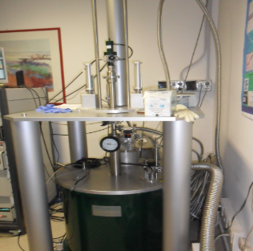
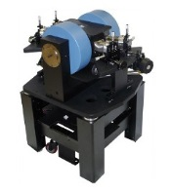
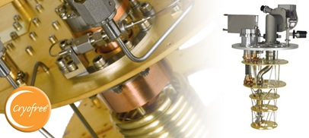

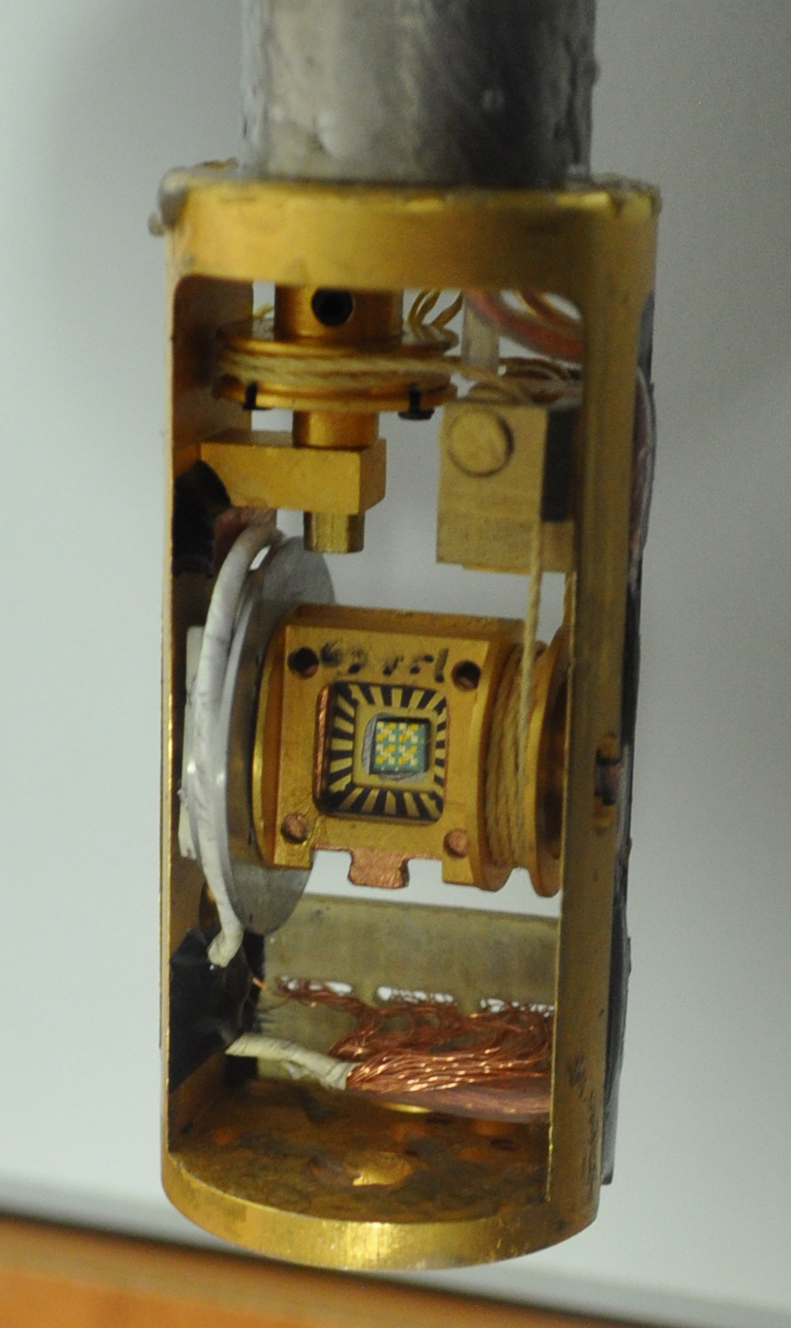
Spintronics Lab
Cryogenic superconducting magnet (10.5 T, 0.3-300 K)
Oxford dilution refrigerator (down to 10 mK, vector magnet 6T/1T/1T)
Cryogenic RF probe station (down to 8 K and up to 0.5 T and 70 GHz).

Slide 11
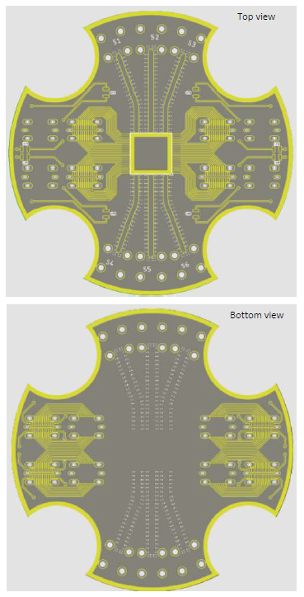
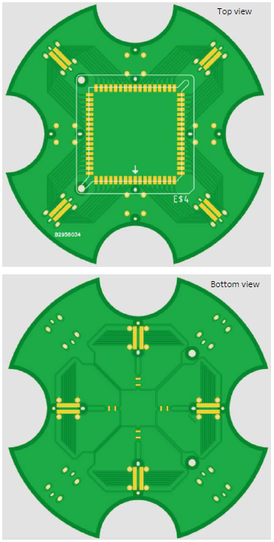
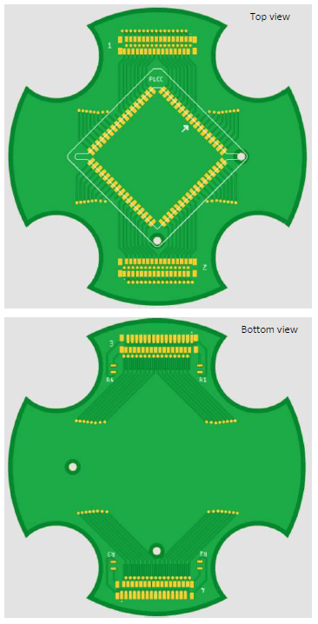
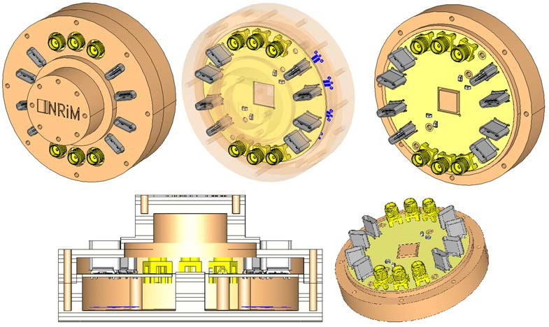
PCB and Sample holder
DC measurements (Layout 1)
Components: 4 USB-C (top), 1 68-pins PLCC, 4 USB-C (bottom), 4 resistances (bottom)
DC measurements (Layout 2)
Components: 2 32-contacts easy-on FCC FPC connectors (top), 1 68-pins PLCC, 2 32-contacts easy-on FCC
FPC connectors (bottom), 4 resistances (bottom)
DC + RF measurements
Components: 6 SMP (top), 4 USB-C (top), 4 resistances (top), 4 TPs (top), 4 USB-C (bottom)

Slide 12
WP/Task |  | Year 1 |  |  |  | Year 2 |  |  |  | Year 3
 | Description | Q1 | Q2 | Q3 | Q4 | Q1 | Q2 | Q3 | Q4 | Q1 | Q2 | Q3 | Q4
WP1 | Design and Simulation
T1.1 | Development of the TWPA theoretical model |  |  | D1.1
T1.2 | Simulation and design of the TWPA |  |  |  | D2.1 M1.1 |  |  |  | D2.2 M1.2 |  |  | D2.2 M1.3
T1.3 | Analysis of simulation/experimental results |  |  |  | D2.3 |  |  |  | D2.3 |  |  |  | D234
WP2 | Devices fabrication
T2.1 | Study and definition of the fabrication procedure |  |  | D2.1
T2.2 | Fabrication of the DTWKI amplifiers at FKB |  |  |  |  | D2.1M2.1 |  |  |  | D2.1M2.3 |  |  | D2.1
T.2.3 | Fabrication of the TWJPA amplifiers at INRiM |  |  |  |  | D2.2M2.2 |  |  |  | D2.1M2.4 |  |  | D2.2
WP3 | DTWKI Test and Characterization
T3.1 | Set up of the experimental instrumentations |  | D3.1
T3.2 | Characterization of the produced DTWKIs |  |  |  |  |  |  | D3.2 |  |  |  | D3.2
T3.3 | Read out TESs and MKIDs with DTWKIs |  |  |  |  |  |  |  |  |  |  |  | D3.3
WP4 | TWJPA Test and Characterization
T4.1 | Set up of the experimental instrumentations |  | D4.1
T4.2 | Characterization of the produced TWJPAs |  |  |  |  |  |  | D4.2 |  |  |  | D4.2
T4.3 | Read out with microwave cavities and qubit with TWJPAs |  |  |  |  |  |  |  |  |  |  |  | D4.3
WP5 | Management
T5.1 | Active management |  | M5.2
T5.2 | Collaboration meetings | M5.1
T5.3 | Reporting activities |  |  |  | D5.1 |  |  |  | D5.1 |  |  | 54.1 | D5.2

Slide 13
Description of the research group
The INFN-MIB will coordinate the whole project and will work specifically on the design and on characterization of the developed devices. The INFN-MIB Cryogenic Laboratory hosts several dilution refrigerators and it is fully equipped for low temperature detectors testing with RF instrumentation. The people directly involved in these activities have more than 20 year of experience in cryogenics techniques (within the the project CUORE/CUPID, HOLMES, KIDS_RD) and they can exploit a long-lasting scientific collaboration with external institutions (FBK, INRiM, NIST, Caltech, MIT).
The INFN-LNF COLD (CryOgenic Laboratory for Detectors) group activities range from the characterization of cryogenic devices such as normal and superconducting resonant cavities, to the development of single photon detectors, in particular Josephson Junctions. The group has experience in multi-harmonic magnetic susceptibility measurement as well. COLD group is currently working on the QUAX, SIMP and SUPERGALAX projects, and proposed the KLASH experiment. The INFN-LNF unit will supervise the device's fabrication and will participate in its characterization.
The INFN-LE Cryo-Spintronics group has expertise in cavity magnonics, spintronics and material science and will focus on investigating magnon-cavity polaritons for quantum computation and quantum sensing applications. The group is the Italian node of the European Infrastructure on Magnetism (funded within the ISABEL project) and coordinated/participated in various EU, PRIN and FIRB projects. The group laboratory is equipped with a cryogenic RF probe station, superconducting magnets, also combined to a dilution fridge (down to 10 mK), and several instrumentation for RF analysis available for the project.
The INFN-SA group will coordinate the design and simulation of the TWPAs following the two approaches: DTWKI, TWJPA, and will perform mounting and initial testing of TWJPA devices. The group has a multi-decennial experience in modelling and simulation of Josephson based systems, as well as in the experimental characterization of Josephson based devices. It is currently working on FEEL, SIMP and VIRGO projects. Simulation activities will exploit a dual processor workstation equipped with TITAN GPU, for parallel computing, to local clusters (UNISA and INFN at UNINA). For the experimental characterization, the cryogenic laboratory hosts a low temperature cryostats (down to 0.3 K), and microwave instrumentations suitable for characterization of superconducting devices.
The INFN-TIFPA group will supervise the device's production at FBK and will participate in its characterization. The group has a long-standing experience in preparation and run of experimental activities down to mK temperatures, high Q mechanical resonators, electromechanical systems (feedback cooling, parametric squeezing), and cryoelectronics (SQUID, KIDs). The local cryogenics laboratory hosts a dilution refrigerator, helium liquefier and dewars, electronics and data acquisition. The group was and is involved in many national (mainly INFN) and international activities.
1.4 Other INFN National Commissions (CSNs) involved
Fondazione Bruno Kessler (FBK)
Fondazione Bruno Kessler (FBK) is a non-profit research organization founded in 2006 by Autonoma Provincia di Trento. The Micro System Technology group (MST) of Centre for Materials and Microsystems (CMM) has a long lasting experience in fabricating KID detectors for which it has developed Ti/TiN multilayer films. FBK is equipped with a 6” CMOS pilot microfabrication line including optical lithography with submicron resolution and e-beam lithography as well as additional equipment for micromachining. The MST group will be in charge of the fabrication of the DTWKI prototypes.
Istituto Nazionale di Ricerca Metrologica (INRiM)
Istituto Nazionale di Ricerca Metrologica (INRiM) is the National Metrology Institute of Italy with the task of carrying out and promoting scientific research in metrology, new technologies and materials. INRiM with his Quantum Metrology and Nanotechnology (QN) Division has a long experience in advanced nano- and microfabrication with various deposition techniques. In this project, the role of INRIM is devoted to the design and fabrication of TWJPA prototypes in Al technology fabricated by means of shadow mask lithography.
Institute for Basic Science Center for Axion and Precision Physics Research (IBS-CAPP)
CAPP, the Center for Axion and Precision Physics established in October 2013, is part of the Institute for Basic Science of the Republic of Korea; it aims to launch a state of the art axion dark matter experiment using high quality microwave resonators, high-field and high-aperture magnets as well as the state of the art microwave amplifiers. The Center hosts a Low Vibration Research Facility (LVRF) in which several low temperature refrigerators are installed to perform axion search experiments, test cavities and characterise sensors and detecting modules. The experimental setups are installed in a dedicated test facility with two dilution refrigerators in which multiple devices can be tested. IBS-CAPP will co-finance the parametric amplifier production.

Slide 14
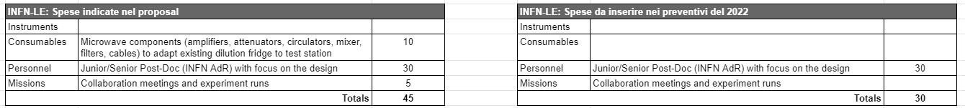
Budget Lecce
INFN-LE
Expenditure | Description | 2021 [k€] | 2nd Y[k€] | 3rd Y [k€] | Total [k€]
Instruments | Signal Generator, 250 kHz to 20 GHz Rohde & Schwarz SMA100B | 25→29.3 |  | 0 | 15
Consumables | YIG spheres; Al and Cu for cavities; printed circuit boards; Microwave components to adapt existing dilution fridge to test station | 15→10.7 |  | 10 | 3
Personnel | Junior/Senior Post-Doc (INFN AdR) with focus on the characterization | 0 | 30 | 30 | 60
Missions | Collaboration meetings and experiment runs | 1 |  | 5 | 14
Total |  | 41 | 30 | 45 | 132
Anno→ stanziato
Totals | 354 | 379 | 179 | 912
Richieste | Descrizione | Totale euro/FTE
Officina meccanica | / | 0.1 FTE
Laboratorio di elettronica | / | /
Servizio calcolo | / | /
INFN-LE
Name | Surname | Position | FTE
Giuseppe | Maruccio | Professore Ordinario (UniSalento) [RL] | 0.3
Angelo | Leo | Assegnista (UniSalento) | 0.3
Anna Grazia | Monteduro | Ricercatore RTD-A (UniSalento) | 0.3
Silvia | Rizzato | Ricercatore RTD-A (UniSalento) | 0.3
Anna Paola | Caricato | Professore Associato (UniSalento) | 0.1
 |  | 24 months AdR from the second year | 1
INFN-LE Total |  |  | 2.3
L.Martina e D.Montanino

