Slide 1
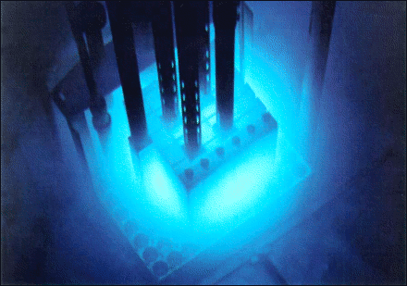
NUCLEAR DATA NEEDS for Accelerator-Driven Sub-Critical Systems
Pasquale Boccaccio, Workshop on ADS and INFN, Turin, July 8, 2010

Slide 2
IV GENERATION REACTORS
Significant combustion cycle improvement would result by burning not only U and Pu but even most of waste material (including long-lifetime actinides)
Thanks to waste material reduced volume and lifetime, stocking problems are minimized
Increased fuel burning efficiency allows about 2 orders of magnitude increase in output power per unit mass of U

Slide 3
NEW GENERATION REACTORS
DESIGN OF INNOVATIVE NEW REACTOR TYPES IS DONE ESSENTIALLY BY USING:
-PERFORMANT, STATE OF THE ART CODES FOR MONTE CARLO SIMULATION and
-RELIABLE CROSS SECTION LIBRARIES WITH KNOWN DATA PRECISION
-BENCHMARKING

Slide 4
WASTE PROCESSING
Radiotoxicity of Nuclear Waste:
production of Pu and Actinides (Np, Am,...) by "breeding" (combination of neutron capture and beta decay)
production of long-lived radioactive fission products
Transmutation:
"burn" minor actinides (by neutron-induced fission),
"transform" long-lived fission products into short-lived or stable isotopes (by neutron capture)
requires fast neutrons

Slide 5
DATABASE PROBLEMS : IMPRECISE DATA EXTRAPOLATION (example)

Slide 6
DATABASE PROBLEMS : INACCURACY IN DATA FILES (example)
120
Paul (1953)
⁶¹Ni(n,p)⁶¹Co
Cross (1963)
Preiss (1960)
Qaim (1977)
Bahal (1984)
Model prediction
Qaim (1984)
Viennot
80
Ribansky (1985)
Viennot (1991)
Molla (1991)
cross section (mb)
Osman (1996)
Val'ter (1962)
Levkovskiy (1969)
IRMM
40
61
Co: N=24/2.499 MeV; 6.48/-.89: D
=1.50 keV
0
N=11/1.682 MeV; 6.85/-.87: 0.95
N=24/2.499 MeV ; 6.85/-.75: 1.04
0
TALYS_0.49
2
4
6
8
10
12
14
16
18
20
neutron energy (MeV)

Slide 7
Fast Reactor Physics
FISSION BARRIER ~ 1 MeV

Slide 8
Neutron Data Needs (i)
Worldwide TOF facilities (GELINA, n_TOF, in Europe, LANSCE, Los Alamos, etc…) have been conducting several measurement programs aiming at neutron cross-section measurements (capture, fission, scattering processes), in order to reduce cross-section uncertainties.
Future experimental facilities (e.g. NFS at SPIRAL2, Ganil) are planned to that purpose.

Slide 9
Neutron Data Needs (ii)
For short-lived isotopes like e.g. ²³⁸Pu, ²⁴¹Pu, ^{242m}Am, ^{243,244}Cm, etc… existing facilities cannot provide sufficiently intense neutron beams.
In such cases, a valuable alternative experimental technique is represented by integral measurements, by fairly wide spectrum neutrons (as in the European Project Myrrha).
Integral measurements exploit relatively intense neutron fluxes with suitable energy distributions. In the case of IV-generation, ADS-type reactors, important data are collected in the energy ranges suitable to nuclear waste transmutation apparata.
FARETRA (FAst REactor simulator for TRAnsmutation studies) is a Laboratori Nazionali di Legnaro (Padova, Italy) project aiming at transforming accelerator-produced monoenergetic neutron beams to a IV-generation reactor spectrum.

Slide 10
FARETRA
The LNL SPES project cyclotron driver is designed to deliver 70 MeV 0.5 mA proton beams. Secondary neutron beams can be generated by 40-70 MeV protons on heavy targets like e.g. Ta or W.
Neutron spectrum can be suitably shaped by a moderator structure, in order to reproduce a fast reactor spectrum (keV to MeV range).
The moderated neutron beam can be conveniently used to achieve energy-integrated cross sections of interest in IV-generation reactors and nuclear waste processing techniques (e.g. fission, capture cross sections in actinides and short-lived fission fragments; activation measurements of reactor constituents).
Collaboration : N. Colonna (Univ. And INFN, Bari), J. Esposito, INFN Legnaro, P. Boccaccio, INFN Legnaro

Slide 11
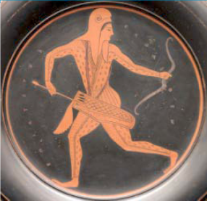
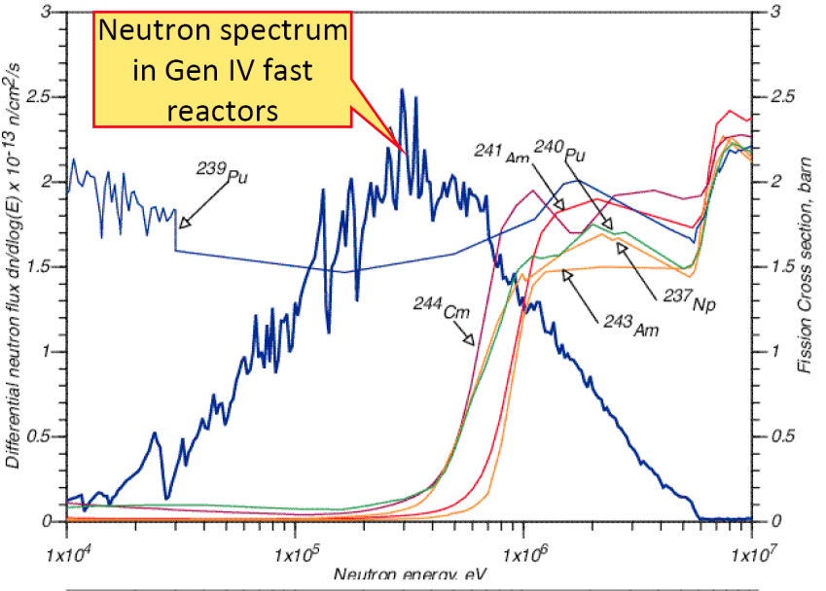
Nuclear Cross-Section Measurements for IV-Generation Reactors
FARETRA
FAst REactor simulator for TRAnsmutation studies
Purpose: generate a IV-Generation-like neutron spectrum for integral cross-section measurements
Tools: 40-70 MeV proton beam on neutron production target (Be, W, Pb) + neutron moderator
Design: neutron source intensity: Sn ~2∙10¹⁴ s⁻¹
moderation efficiency: 10⁻³ ÷ 10⁻⁴
Integral Neutron Flux: Φ_{n}= ~ 10¹⁰ cm⁻²s⁻¹
Expected Transmutation Rate : ~ 20 /s for 1 μgr ²³⁸Pu (87 y, 0.6 MBq) , σ=1 b

Slide 12
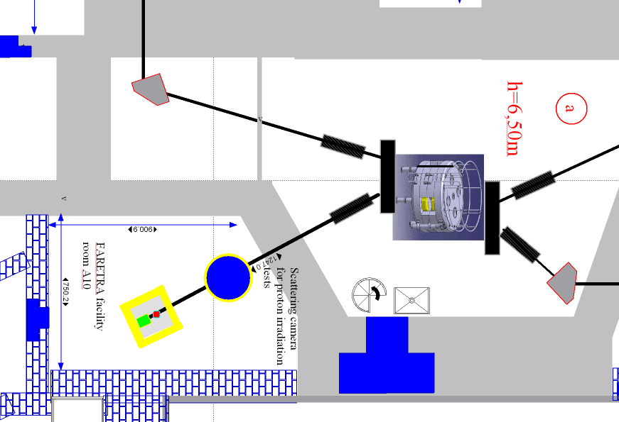
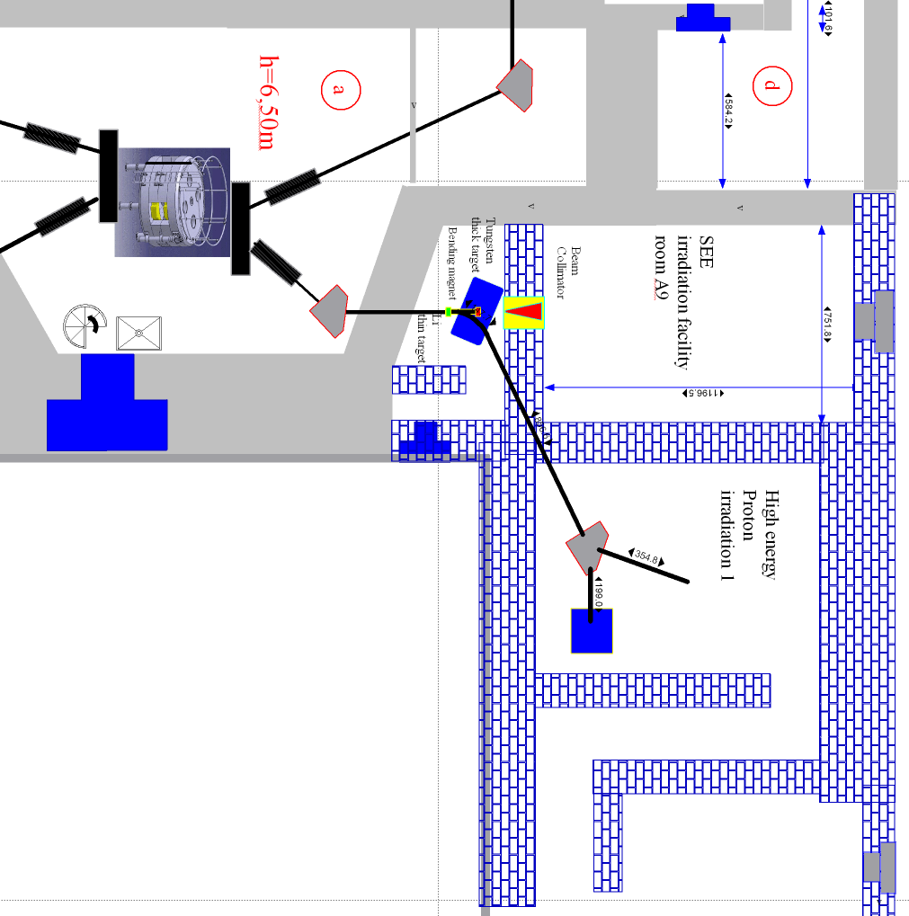
FARETRA location in SPES building at the Laboratori Nazionali di Legnaro (Padova, Italy)
SPES cyclotron driver

Slide 13
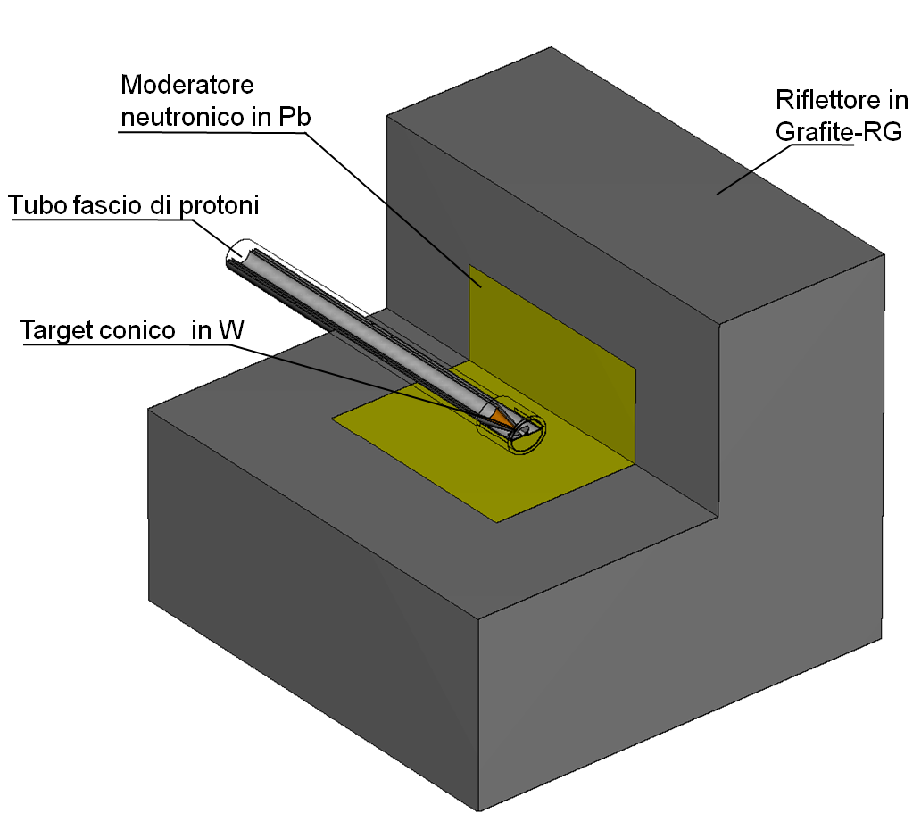
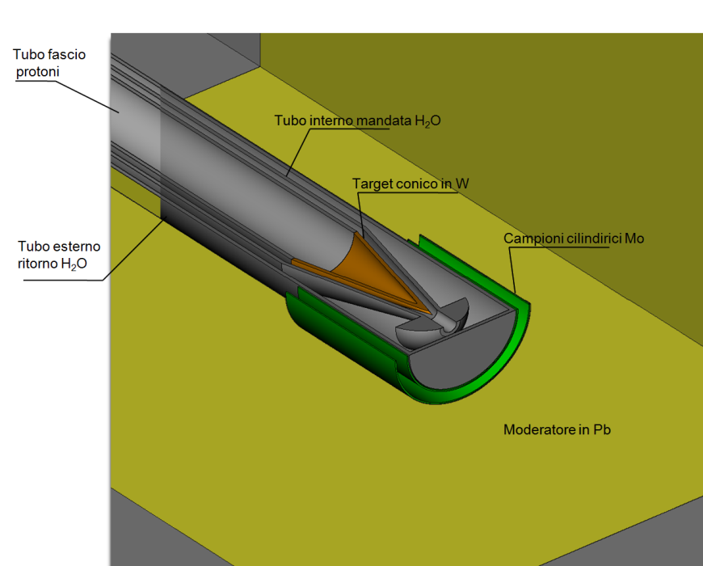
FARETRA Preliminary Design
Fe Spectrum Converter
Fe Spectrum Translator
Graphite Reflector
p beam line
Con. W Target
Irradiation Chambers
Camere di irraggiamento

Slide 14

MCNPX Monte Carlo Simulation (preliminary)
Fe converter
Conversion Efficiency (10 keV -10 MeV) : ~ 8∙10⁻⁴
Integral neutron flux: Φ_{n}= ~ 1.5∙10¹¹ cm⁻²s⁻¹
Red curve : +1 cm borated PE around irradiation chambers

Slide 15
Fiber Neutron Detectors (collaboration)
Istituto Nazionale di FisicaNucleare, Laboratori Nazionali di Legnaro : P. Boccaccio, J. Esposito
Universita’ e Istituto Nazionale di Fisica Nucleare, Bologna : A. Zoccoli, R. Dona’

Slide 16
Fiber Neutron Detectors
Coated non-scintillating plastic fibers are a possible neutron detection technique.
Radiation Hardness
Excellent neutron/gamma rejection ratio
Fast Response
Clear fiber coated with neutron absorber and scintillator powder mixture
neutrons
Can be conveniently employed in ADS/Reactor environment
photomultiplier
Pasquale Boccaccio, Workshop on ADS and INFN, Turin, July 8, 2010

Slide 17
Nuclear Reactions for Neutron Detectors
n + ³He → ³H + ¹H + 0.764 MeV
n + ⁶Li → ⁴He + ³H + 4.79 MeV
n + ¹⁰B → ⁷Li* + ⁴He→⁷Li + ⁴He +2.31 MeV+ gamma (0.48 MeV) (93%)
→ ⁷Li + ⁴He +2.79 MeV ( 7%)
n + ¹⁴N → ¹⁴C + ¹H + 0.626 MeV
n + ¹⁵⁵Gd → Gd* → gamma-ray spectrum + conversion electron spectrum (~70 keV)
n + ¹⁵⁷Gd → Gd* → gamma-ray spectrum + conversion electron spectrum (~70 keV)
n + ²³⁵U → xn + fission fragments + ~160 MeV (<x> ~ 2.5)
n + ²³⁹Pu → xn + fission fragments + ~160 MeV (<x> ~ 2.5)
¹⁹⁷Au(4.906 eV), 115In( 1.46 eV), ¹⁸¹Ta(4.28 eV), ²³⁸U(6.67, 10.25 eV); energy-selective detectors, narrow resonances, prompt capture gamma rays

Slide 18
Scintillators for Neutron Detectors
Intrinsic scintillators contain small concentrations of ions (“wave shifters”) that shift the wavelength of the originally emitted light to the longer wavelength region easily sensed by photomultipliers.
ZnS(Ag) is the brightest scintillator known, an intrinsic scintillator that is mixed heterogeneously with converter material, usually Li⁶F in the “Stedman” recipe, to form scintillating composites, which are only semitransparent.

Slide 19
Some Common Scintillators for Neutron Detectors
Material
Density of
⁶Li atoms
(cm⁻³⁾
Scintillation
efficiency
Photon
wavelength (nm)
Photons per neutron
Li glass (Ce)
1.75x10²²
0.45 %
395 nm
~7,000
LiI (Eu)
1.83x10²²
2.8 %
470
~51,000
ZnS (Ag) - LiF
1.18x10²²
9.2 %
450
~160,000
Li₆Gd(BO₃)₃ (Ce),
3.3x10²²
~ 400
~40,000
YAP
NA
350
~18,000
per MeV gamma

Slide 20
Position-Sensitive Neutron Imaging Detector Basics
Clear Fiber
2-D tube
Coincidence tube
Neutron Beam
Wavelength-shifting fiber
Aluminum wire
Scintillator Screen

Slide 21
⁶Li-ZnS neutron detector
The scintillator screen for this detector consists of a mixture
of ⁶LiF and silver-activated ZnS powder in an epoxy binder, deposited as a thin film around an optical fiber. Neutrons incident on the screen react with ⁶Li to produce a triton and an alpha particle. Interaction of these charged particles in ZnS(Ag) induce scintillation at a wavelength of approximately 450 nm. The 450 nm photons are absorbed in the wavelength-shifting fibers where they are converted to 520 nm photons emitted in modes that propagate out the ends of the fibers.
n + ⁶Li → ⁴He + ³H + 4.79 MeV
Optical fiber

Slide 22
SCHEMATIC LAYOUT OF PROPOSED fiber NEUTRON DETECTOR
n
QUARTZ FIBER
to PMT
Epoxy binder
ZnS (grain)
n-capture material (grain)

Slide 23
Neutron Fiber Detector R&D
Quartz Fibers tests in intense neutron flux environments, as in fission reactors, exhibited good radiation resistance, up to a fast neutron fluence of 1×10²³ n/m² (Fusion Eng. Des. 51 (2000) 179)
Besides ⁶Li (thermal neutron detection) and fissionable isotopes (fast neutron detection) other isotopes are under investigation, exploiting charged-particle decay of composite nuclei following neutron capture to deduce (through suitable calibration) incident neutron energy.
En (MeV)

