Slide 1
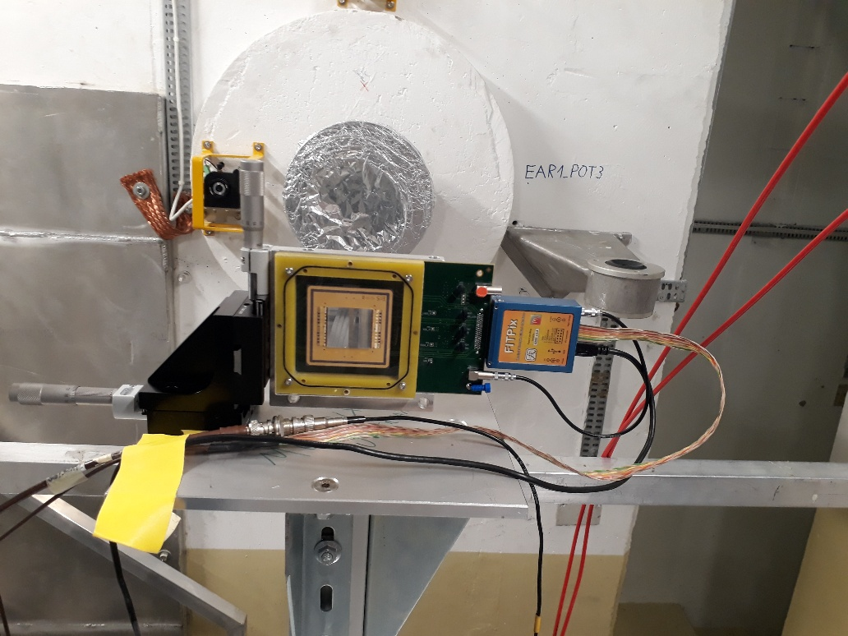
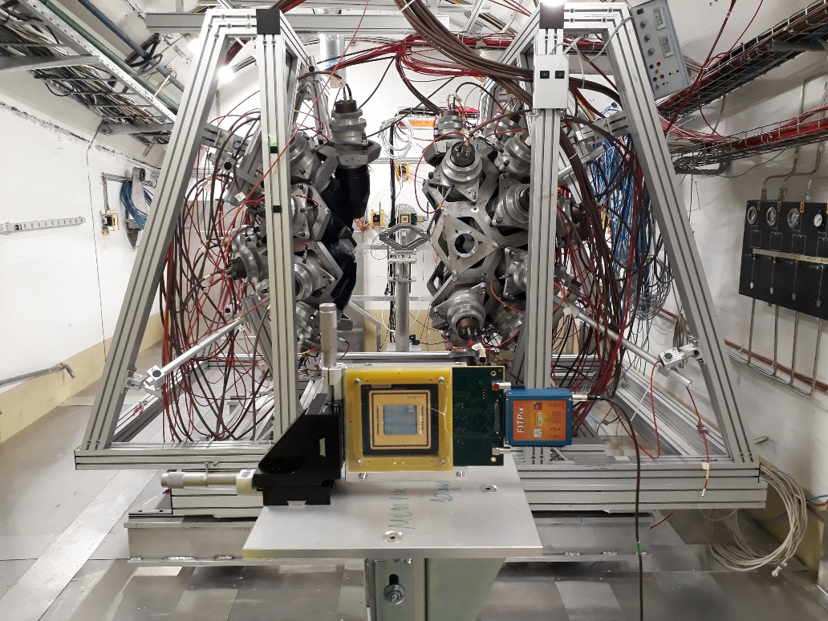
Timepix Installation in EAR1 for the beam/laser alignement
Installation in EAR2 ongoing with the two Timpixquad bought in 2020

Slide 2
Laser alignment in EAR1

Slide 3
Laser alignment in EAR2

