Slide 1
Misura ⁶⁴Ni(n,γ)
G. Tagliente, P. M. Milazzo, C. Massimi

Slide 2
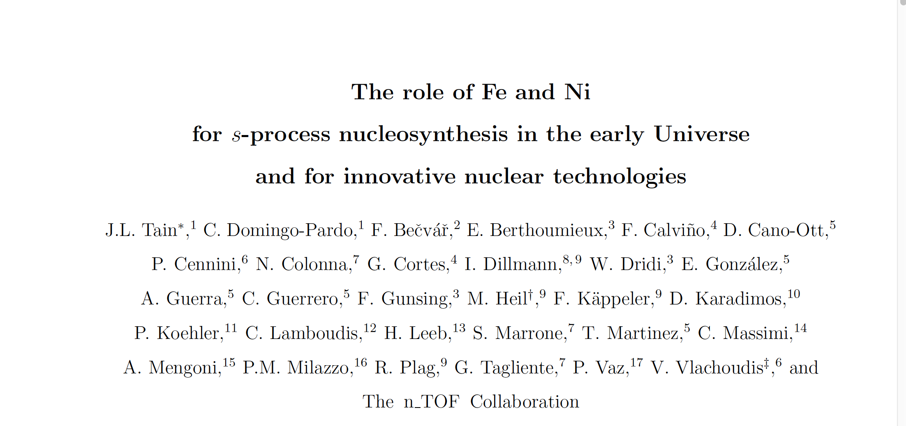

Slide 3
Abundances beyond Fe–ashes of stellar burning
α-nuclei
¹²C,¹⁶O,²⁰Ne,²⁴Mg, …. ⁴⁰Ca
Gap
B,Be,Li
Elements heavier than Fe are the result of neutron capture processes
NEUTRONS
H 30 000
C 10
Fe 1
Au 2 10⁻⁷
r-process peaks (nuclear shell closures)
s-process peaks (nuclear shell closures)
Fe peak
Th, U
Au
Pb

Slide 4
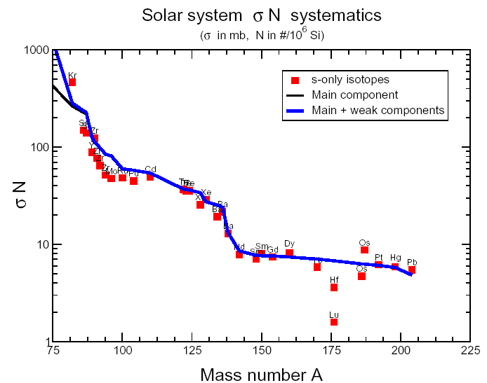
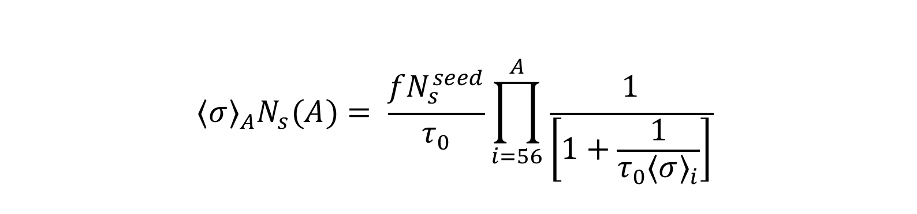
Stellar models: s-process components
f ≈ 0,06% τ₀≈ 0,3 mb⁻¹ → n_{c} = 10
Main component: A ≥ 90
f ≈ 1,6% τ₀≈ 0,07 mb⁻¹ → n_{c} = 3
Weak component: A < 90

Slide 5
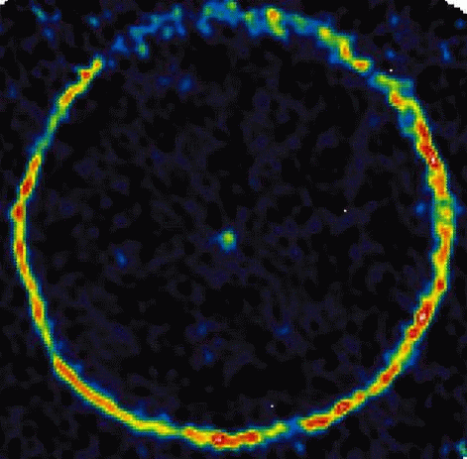
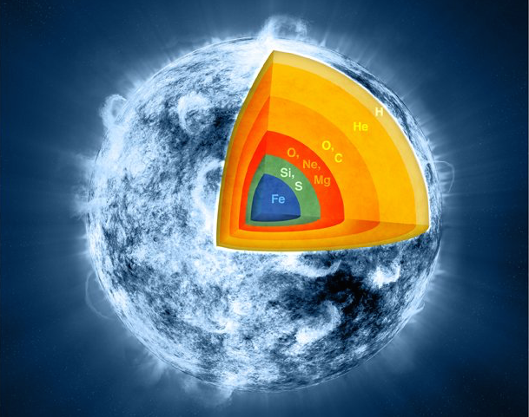
s-process stellar sites
Main component
Low mass Asympotic Giant Branch (AGB) M≈1.5 - 3 M
¹³C(α,n)¹⁶O T ~ 8 keV N_{n} < 10⁷ n/cm³
²²Ne(α,n)²⁵Mg T ~ 23 keV N_{n}~10¹⁰-10¹² n/cm³
Weak component
Massive stars M≈15 - 25 M
²²Ne(α,n)²⁵Mg
In core He-burning T ~ 26 keV N_{n} ~ 10⁶ n/cm³
In shell C-burnig T ~ 90 keV N_{n}~ 10¹¹ n/cm³

Slide 6
Stellar Models: local equilibrium approximation
A>90
Local equilibrium approximation

Slide 7
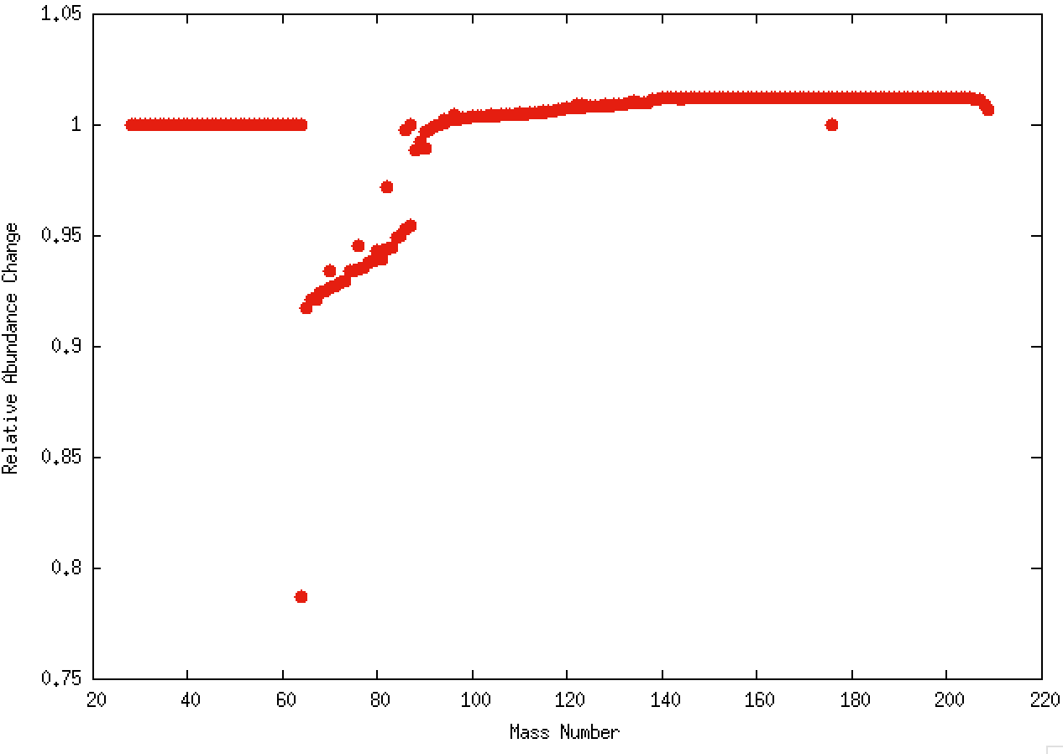
s-process abundance sensitivity: ⁶⁴Ni
Effect of cross section uncertainty on the s-process efficiency in weak component- massive stars
Results obtained with the reaction network NETZ
http://exp-astro.physik.uni-frankfurt.de/netz

Slide 8
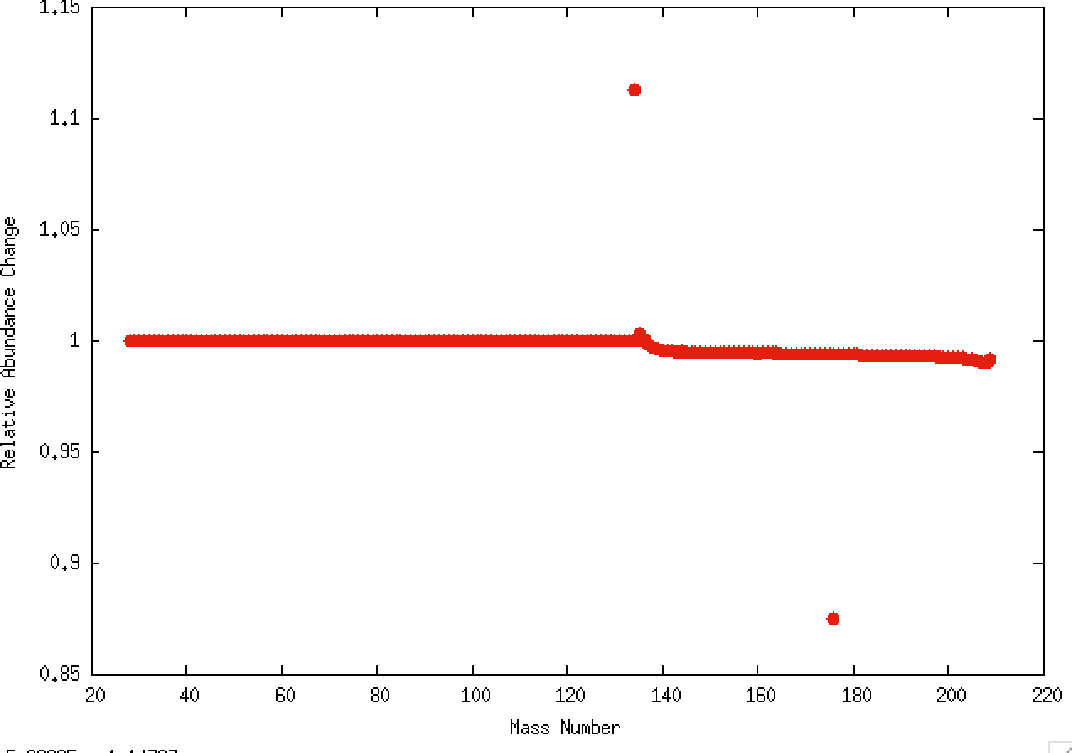
s-process abundance sensitivity: ^{134Ba}
Effect of cross section uncertainty on the s-process efficiency in main component - AGB star

Slide 9
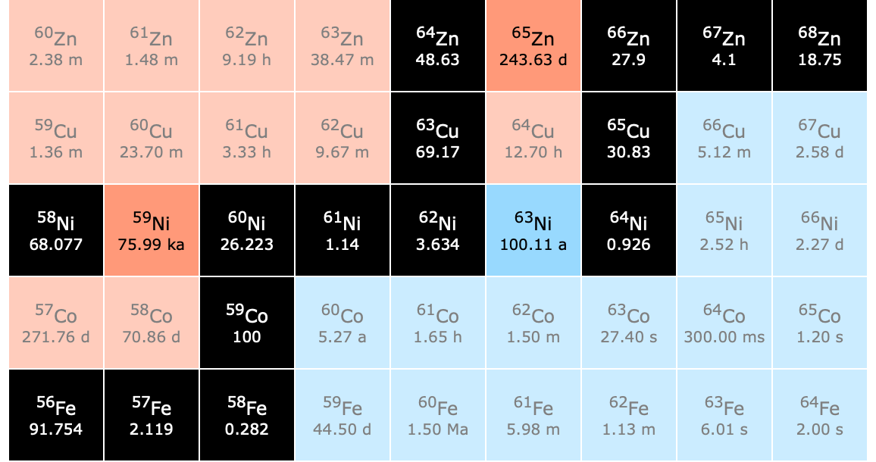
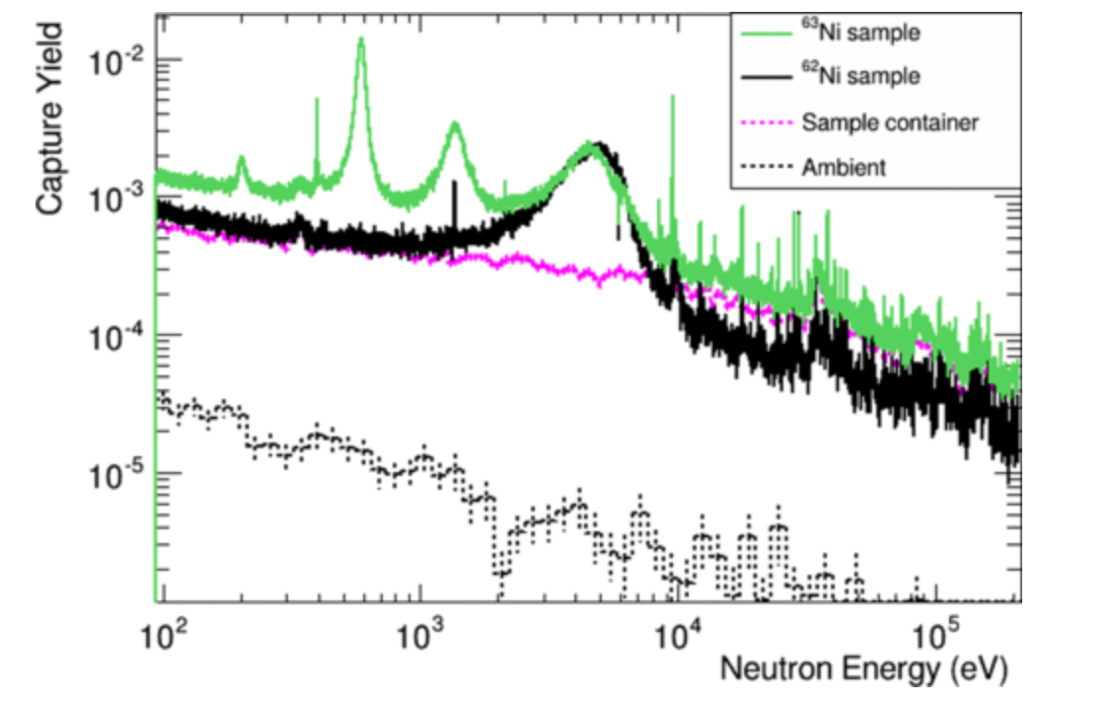
Misurato @ n_TOF
⁶⁴Ni₃₆(n,γ)
2 g
98 %
RRR ~ 200 keV
^{62,63}Ni Misurato @ n_TOF
MACS @ 30 keV → 22 mb

Slide 10
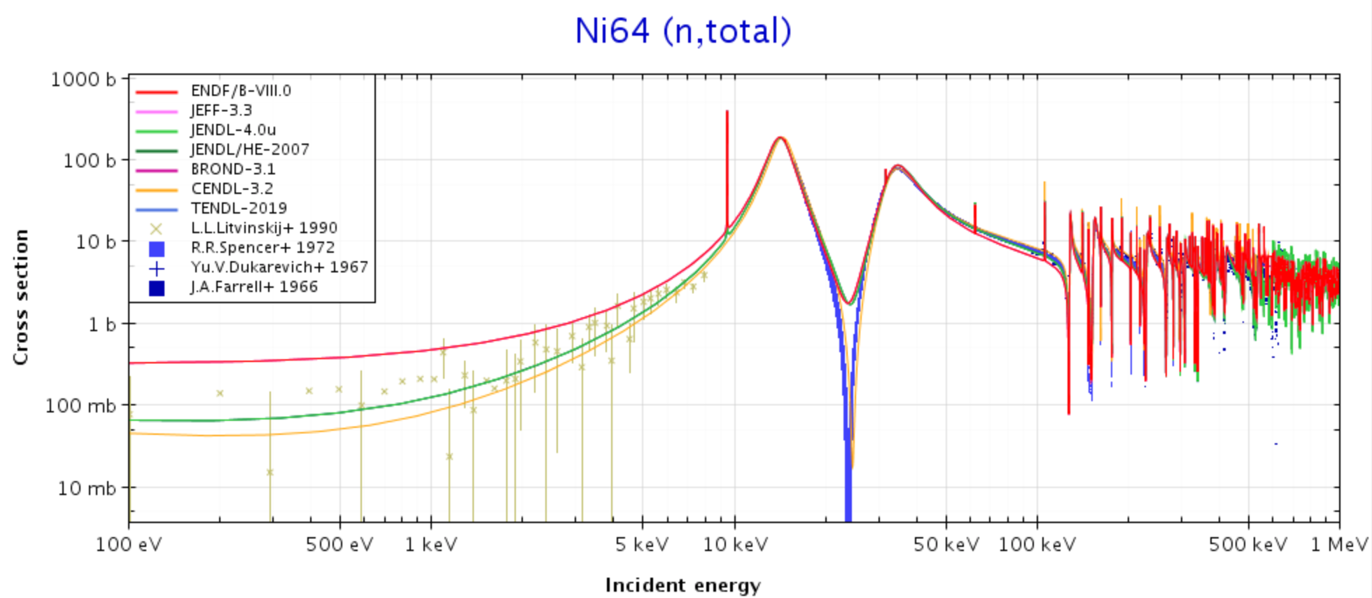
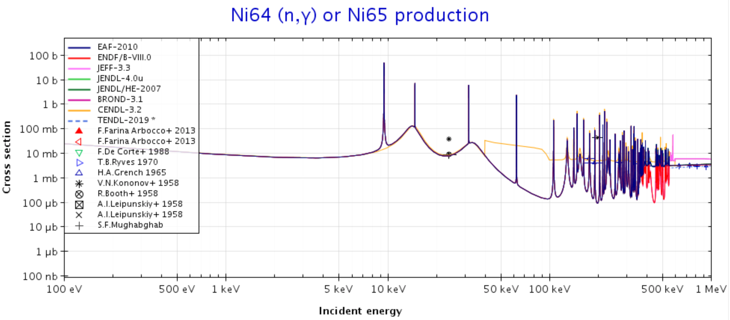
RRR 500 keV
Γ_{n} >> Γ_{γ.} ∼1000
⁶⁴Ni₃₆(n,γ)
Wisshak 20 - 40 keV
Beer 5 - 70 keV

Slide 11
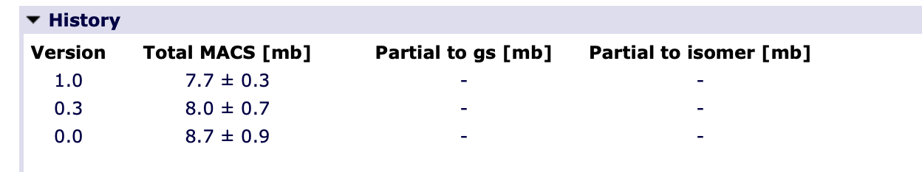
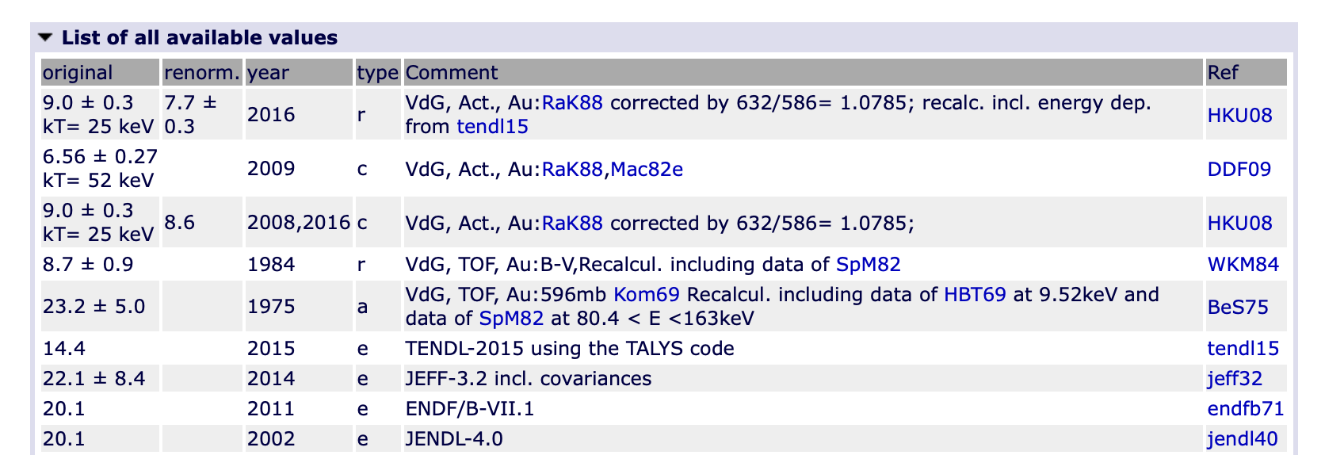
⁶⁴Ni₃₆(n,γ)
Version | MACS @ 10 keV
1.0 | 24.8 ( 1.6 )
0.3 | 13.6
Wisshak 20 - 40 keV
Beer 5 - 70 keV
Wisshak 20 - 40 keV
Beer 5 - 70 keV

Slide 12
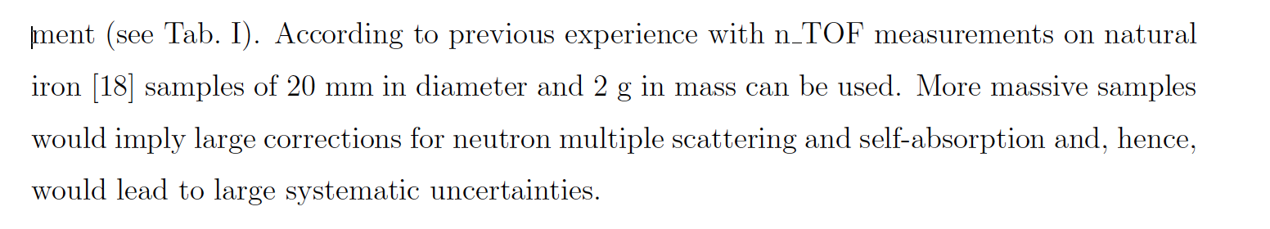
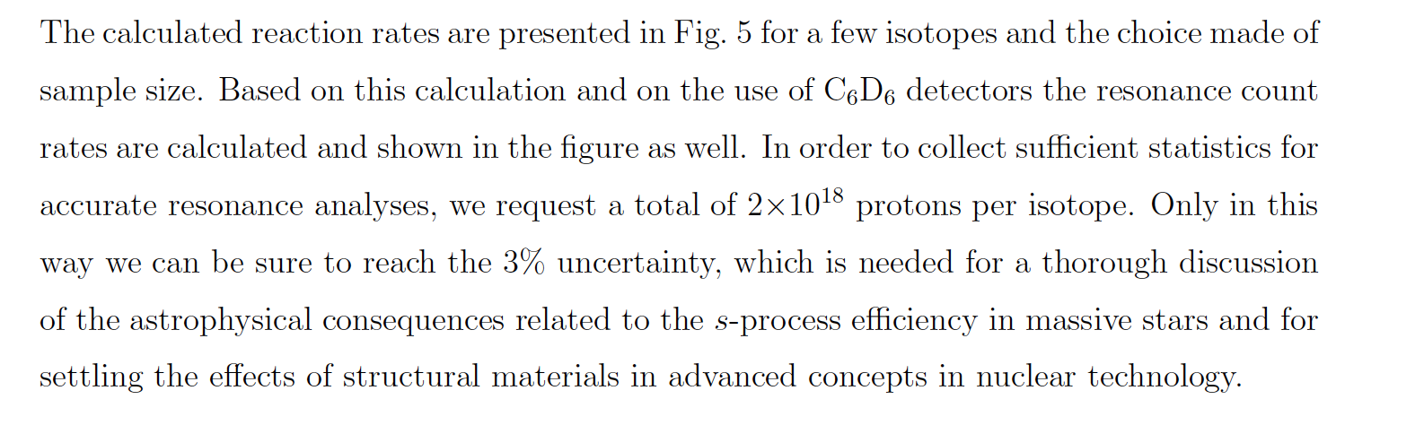
Campione & Protoni

Slide 13
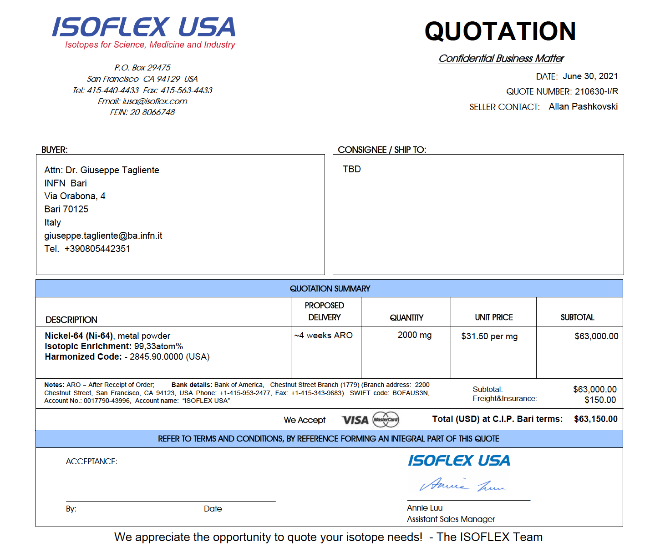

Slide 14
Conclusioni
Misura interessante
Costo campione molto elevato
Necessario contributo della collaborazione

