Slide 1
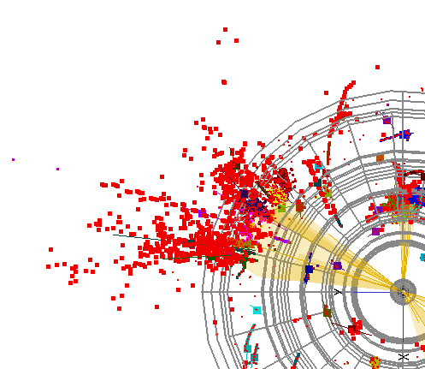



Physics at Muon Collider

Slide 2
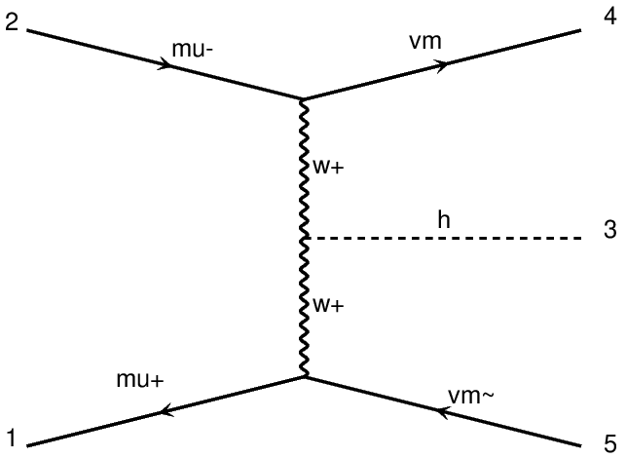
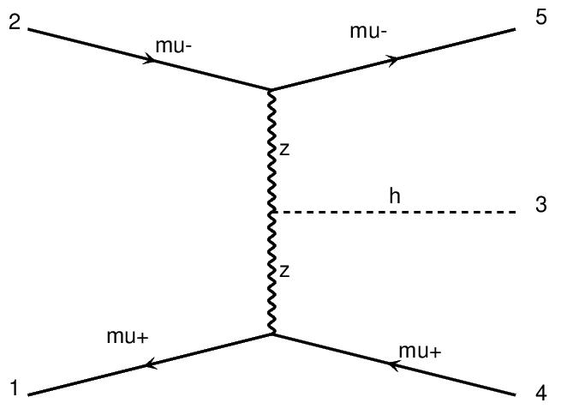















Higgs Physics at a Muon Collider
Dominant Higgs boson production mechanism: vector boson fusion
Main contribution from WW fusion.
$$\sqrt{s} [TeV]$$ | $𝓛$ (4 year)$[ab^{−1}]$
1.5 | 0.5
3.0 | 1.3
10 | 8.0
$$μ^{−}$$
$$μ^{−}$$
$$ν_{μ}$$
$$μ^{−}$$
W
H
Z
H
$$μ^{+}$$
W
Z
$${\overline{ν}}_{μ}$$
$$μ^{+}$$
$$μ^{+}$$
$σ$ = 2.1$∙{10}^{2} fb (\sqrt{s} \text{ =1}\text{TeV})$
$σ$ = 1.5$∙{10}^{1} fb$
$$(\sqrt{s}\text{ =1}\text{TeV})$$
$σ$ = 5$∙{10}^{2} fb (\sqrt{s} \text{ =3}\text{TeV})$
$σ$ = 3.8$∙{10}^{1} fb$
$$(\sqrt{s}\text{ =}\text{3}\text{TeV})$$
O(1M) Higgs produced in the low energy (<10 TeV scenario)
Clean events as in e+e- colliders with high collision energy as in hadron colliders
The muon collider is the dream machine for Higgs physics measurements

Slide 3
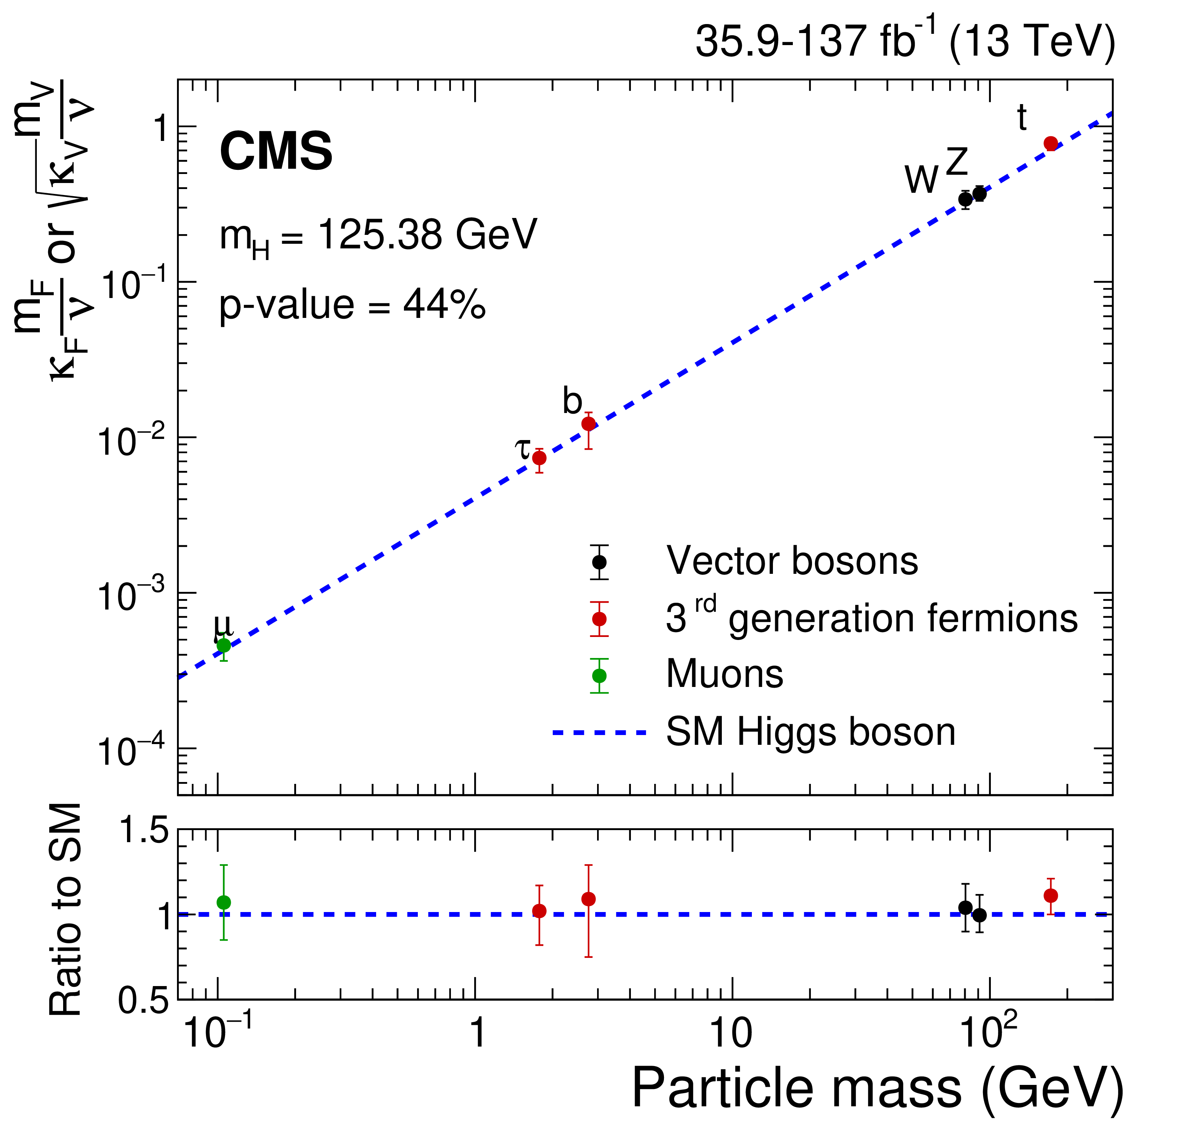
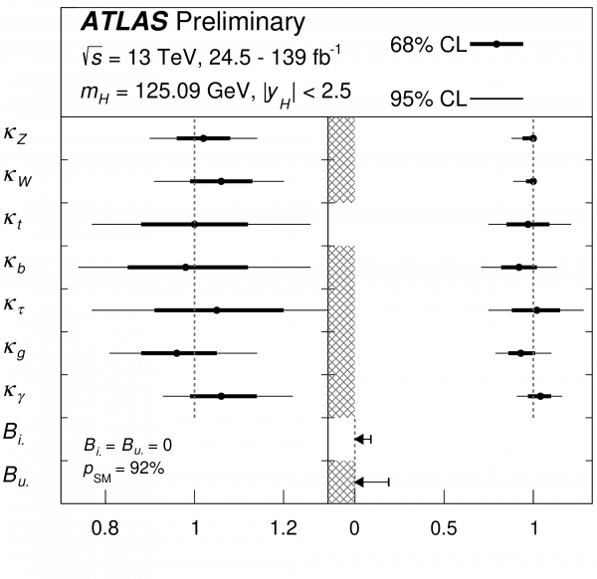
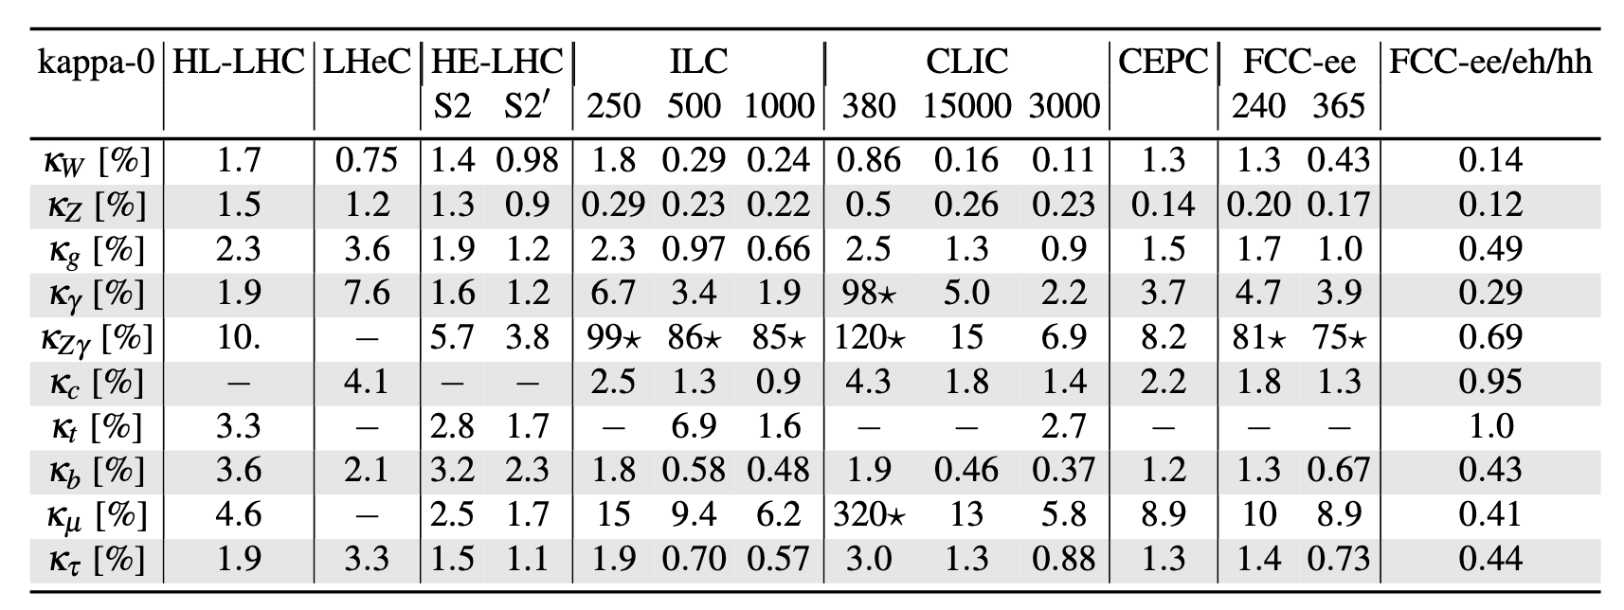
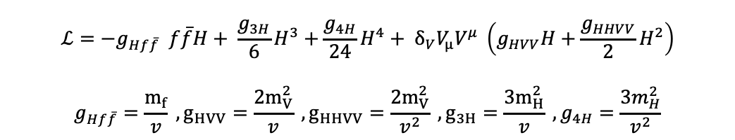
Higgs boson couplings: from present to future
One of the goals of future colliders: precise measurement of Higgs couplings with SM particles
push the knowledge of the couplings below the 1% precision
→ access un-explored couplings
→ use the Higgs boson as a tool to probe beyond standard model scenarios!
$$ℒ=−g_{Hf\overline{f}} f\overline{f}H+ \frac{g_{3H}}{6}H^{3}+\frac{g_{4H}}{24}H^{4}+ δ_{V}V_{μ}V^{μ} \left(g_{HVV}H+\frac{g_{HHVV}}{2}H^{2}\right)$$
$$g_{Hf\overline{f}}=\frac{m_{f}}{v} , g_{HVV}=\frac{2m_{V}^{2}}{v} , g_{HHVV}=\frac{2m_{V}^{2}}{v^{2}} , g_{3H}=\frac{3m_{H}^{2}}{v} , g_{4H}=\frac{3m_{H}^{2}}{v^{2}}$$
The present
The future

Slide 4
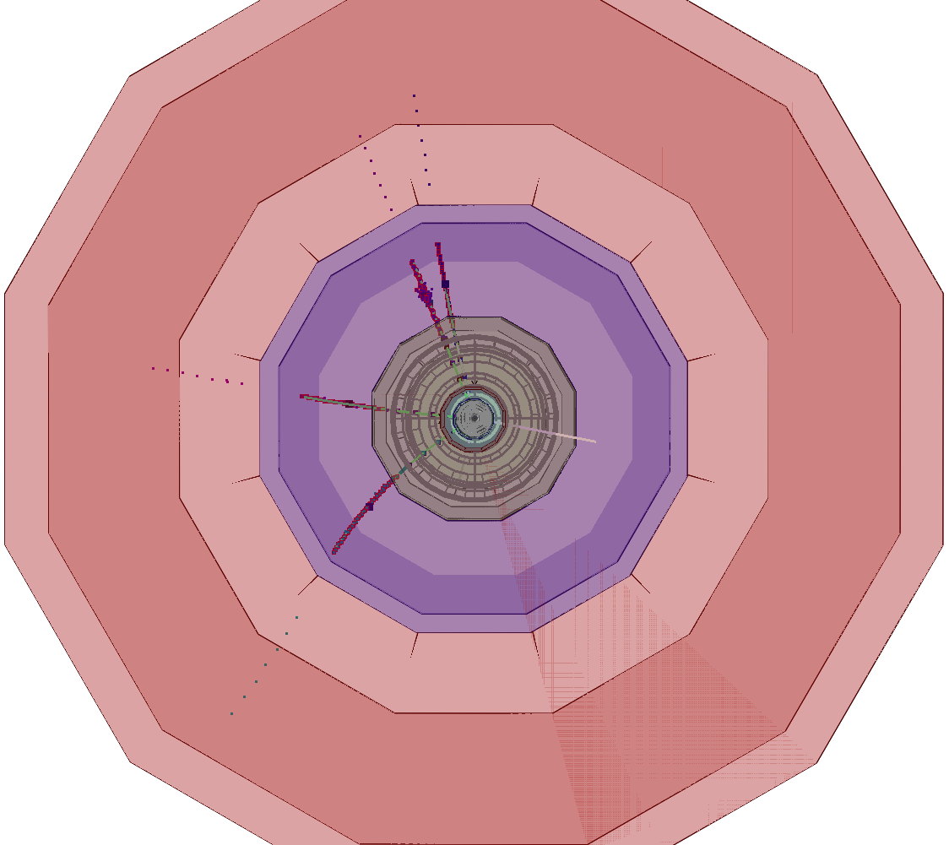
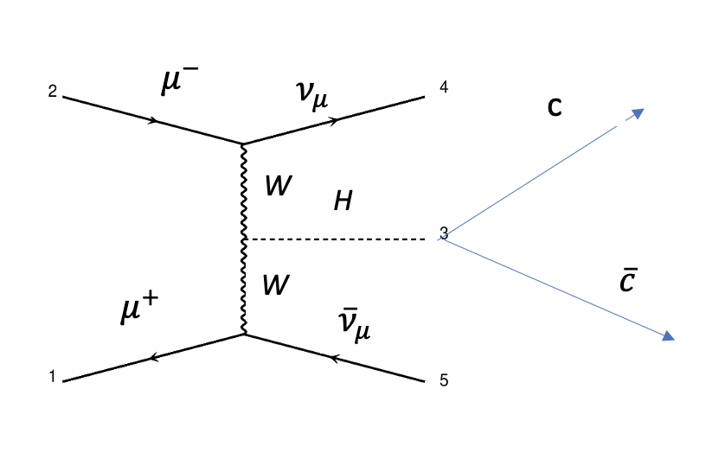
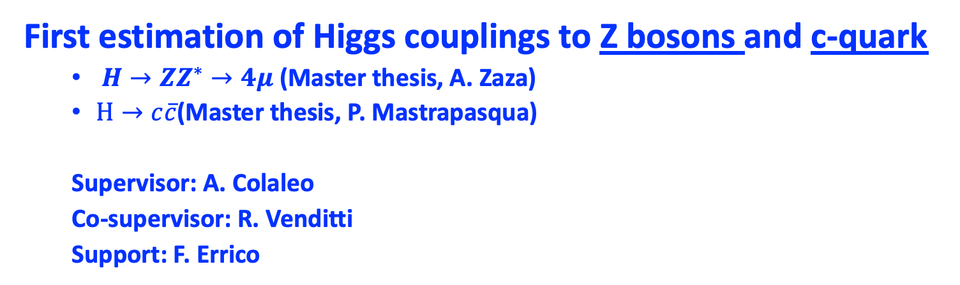


What has been explored this year in Bari
First estimation of Higgs couplings to Z bosons and c-quark
  $H→ZZ^{∗}→4μ$ (Master thesis, A. Zaza)
  $H→c\overline{c}$(Master thesis, P. Mastrapasqua)
  Supervisor: A. Colaleo
  Co-supervisor: R. Venditti
  Support: F. Errico
$$H→ZZ^{∗}→4μ$$
$H→c\overline{c}$

Slide 5
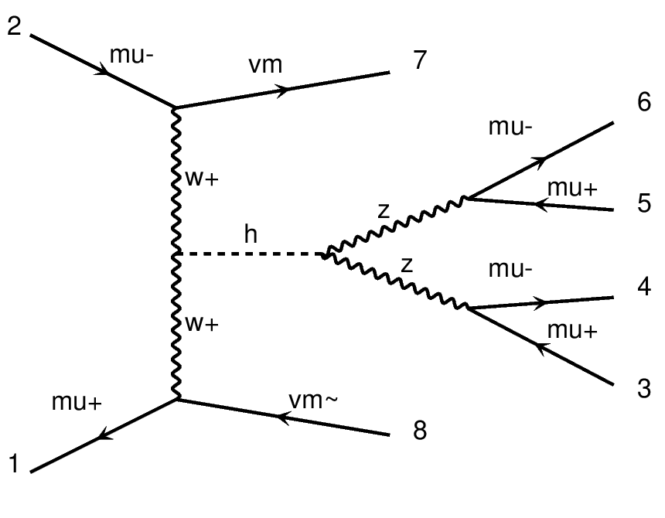
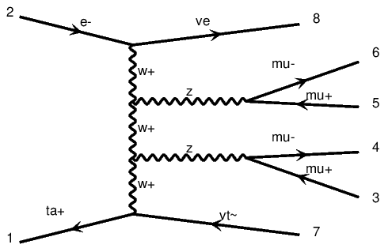
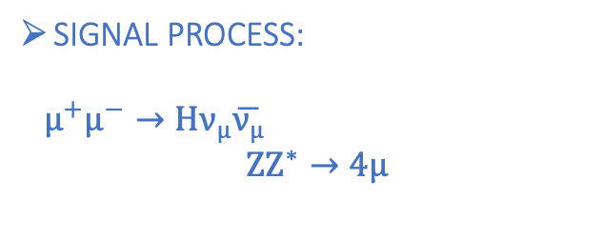
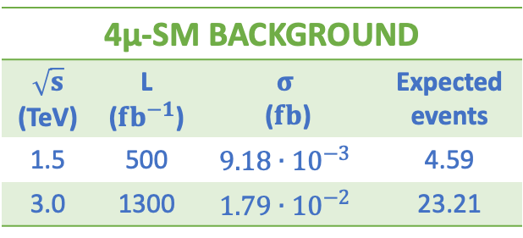
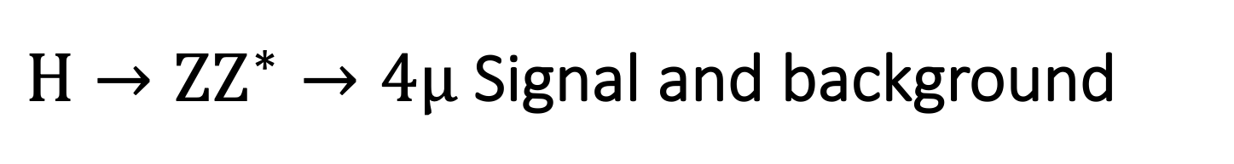
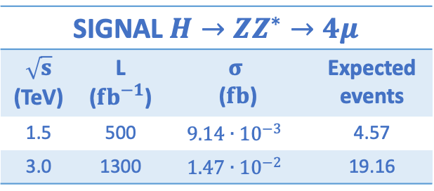

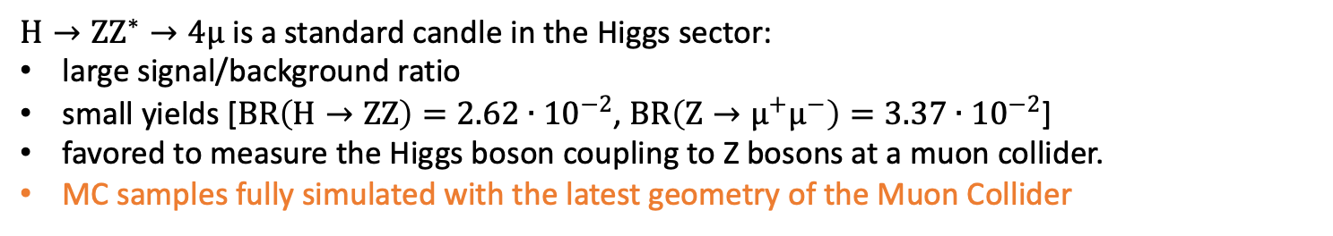
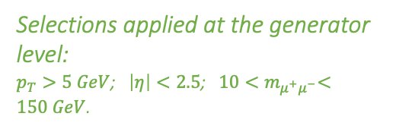
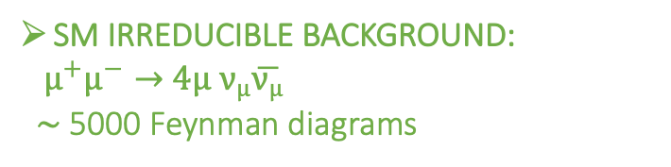
$H→ZZ^{∗}→4μ$ Signal and background
$$H→ZZ^{∗}→4μ$$
$H→ZZ^{∗}→4μ$ is a standard candle in the Higgs sector:
large signal/background ratio
small yields [$BR\left(H→ZZ\right)=2.62∙{10}^{−2}$, $BR\left(Z→μ^{+}μ^{−}\right)=3.37∙{10}^{−2}$]
favored to measure the Higgs boson coupling to Z bosons at a muon collider.
MC samples fully simulated with the latest geometry of the Muon Collider
SIGNAL PROCESS:
$${ μ}^{+}μ^{−}→Hν_{μ}\overline{ν_{μ}}$$
$ZZ^{∗}→4μ$
SIGNAL $H→ZZ^{∗}→4μ$
$\sqrt{s}$ (TeV) | L (${fb}^{−1}$) | $$σ$$ ($fb$) | Expected events
1.5 | 500 | $$9.14∙{10}^{−3}$$ | 4.57
3.0 | 1300 | $$1.47∙{10}^{−2}$$ | 19.16
SM IRREDUCIBLE BACKGROUND:
${ μ}^{+}μ^{−}→$ $4μ$ $ν_{μ}\overline{ν_{μ}}$
$\sim$ 5000 Feynman diagrams
4µ-SM BACKGROUND
$\sqrt{s}$ (TeV) | L (${fb}^{−1}$) | $$σ$$ ($fb$) | Expected events
1.5 | 500 | $$9.18∙{10}^{−3}$$ | 4.59
3.0 | 1300 | $$1.79∙{10}^{−2}$$ | 23.21
Selections applied at the generator level:
$p_{T}>5 GeV$; $\left|η\right|<2.5$; ${ 10<m}_{μ^{+}μ^{−}}<150 GeV$.
5

Slide 6
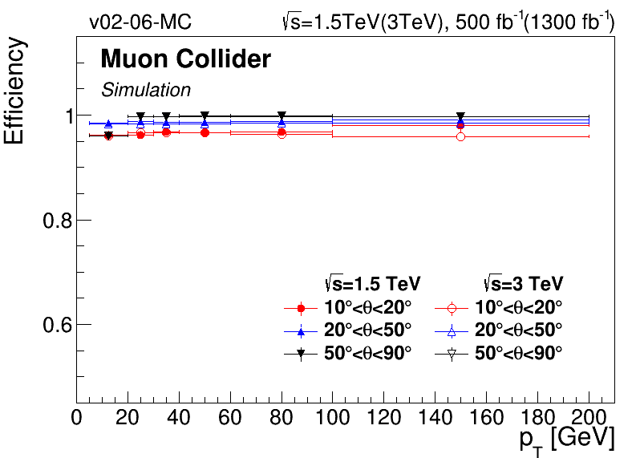
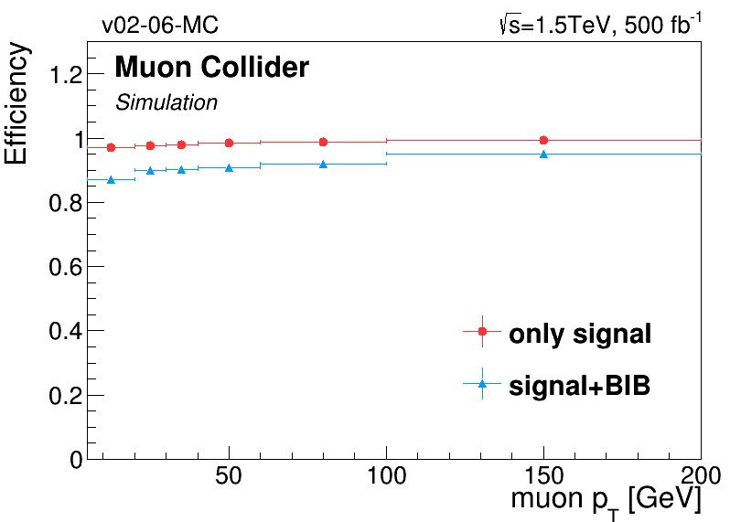
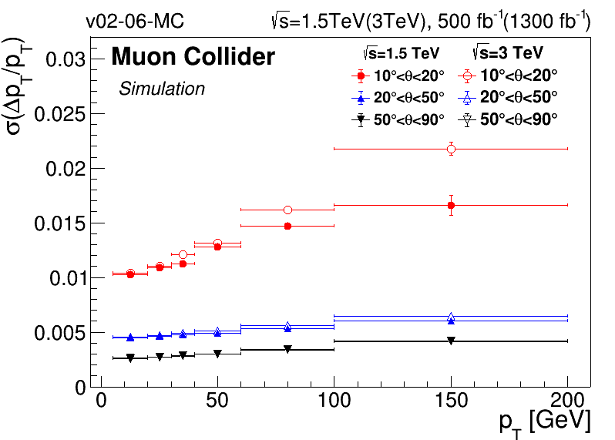
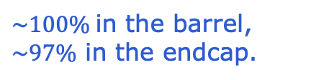
Muon reconstruction performance
$$H→ZZ^{∗}→4μ$$
Track reconstruction based on conformal tracking
Muons are reconstructed with a particle flow approach combining tracker tracks with hits in calorimeters and muon system
Estimation of the impact of the BIB: cone-filter for tracker hits to reduce the processing time.
$\sim 100\%$in the barrel,
$\sim 97\%$ in the endcap.
Tracking efficiency slightly reduced when including BIB O(10%)→ mitigation strategy under development
Results used for parametric evaluation of the BIB impact on the final results

Slide 7
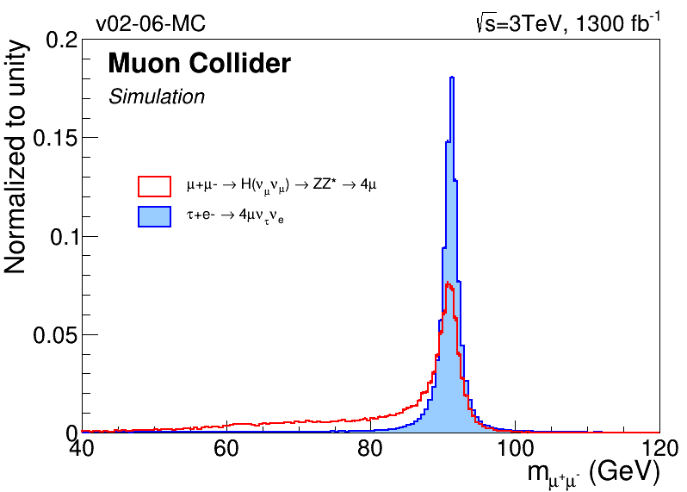
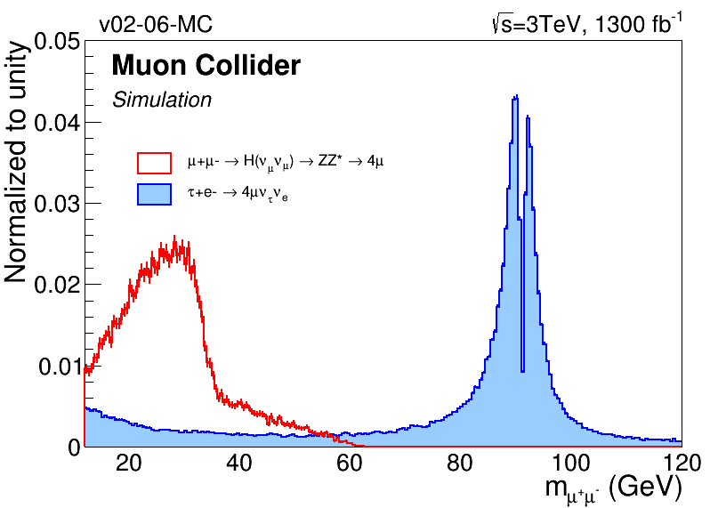
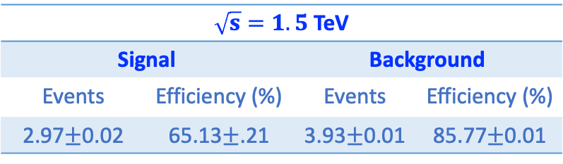
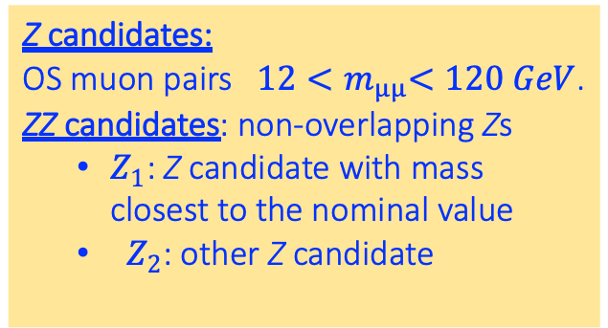
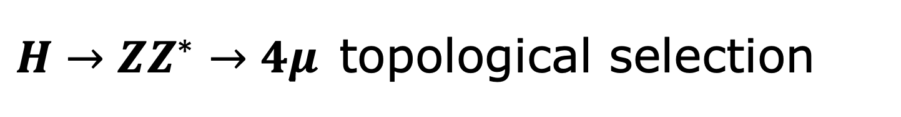

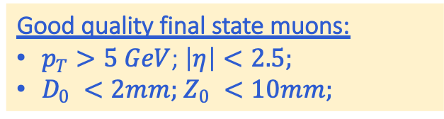

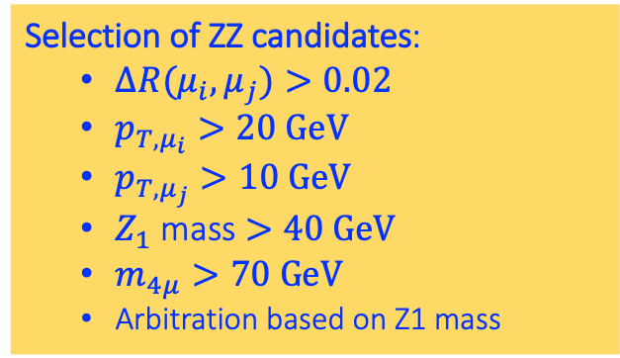
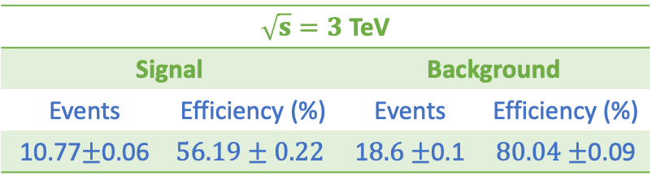
$H→ZZ^{∗}→4μ$ topological selection
$$H→ZZ^{∗}→4μ$$
Good quality final state muons:
$p_{T}>5 GeV$; $\left|η\right|<2.5;$
$D_{0} <2mm;$ $Z_{0} <10mm;$
$Z_{1}$ reconstructed mass
$Z_{2}$ reconstructed mass
Z candidates:
OS muon pairs ${ 12<m}_{µµ}<120 GeV$.
ZZ candidates: non-overlapping Zs
  $Z_{1}$: Z candidate with mass closest to the nominal value
  $Z_{2}$: other Z candidate
$\sqrt{s}=1.5$ TeV
Signal |  | Background
Events | Efficiency (%) | Events | Efficiency (%)
2.97$±$0.02 | 65.13$±$.21 | 3.93$±$0.01 | 85.77$±$0.01
Selection of ZZ candidates:
  $∆R(μ_{i}, μ_{j})>0.02$
  $p_{T,μ_{i}}>20 GeV$
  $p_{T,μ_{j}}>10 GeV$
  $Z_{1}$ mass $>40 GeV$
  $m_{4μ}>70 GeV$
  Arbitration based on Z1 mass
$\sqrt{s}=3$ TeV
Signal |  | Background
Events | Efficiency (%) | Events | Efficiency (%)
10.77$±$0.06 | $$56.19±0.22$$ | 1$8.6±$0.1 | $80.04±$0.09

Slide 8
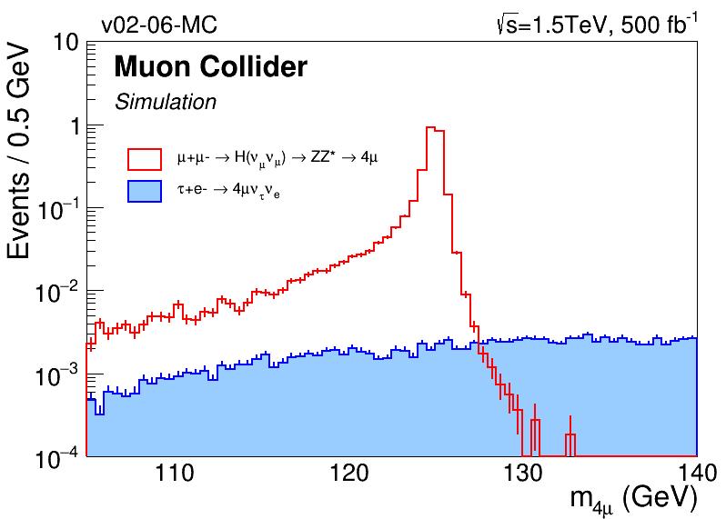
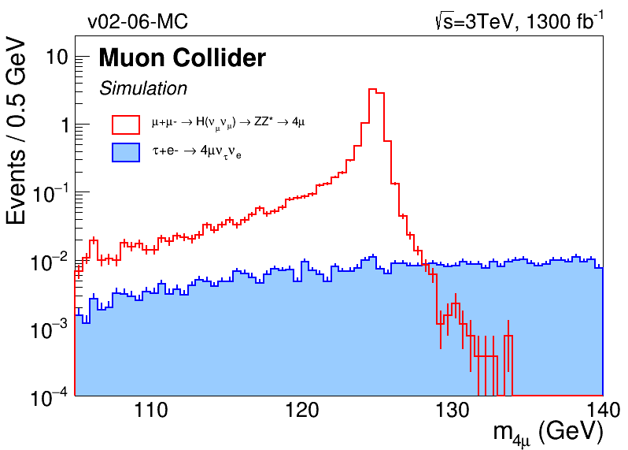
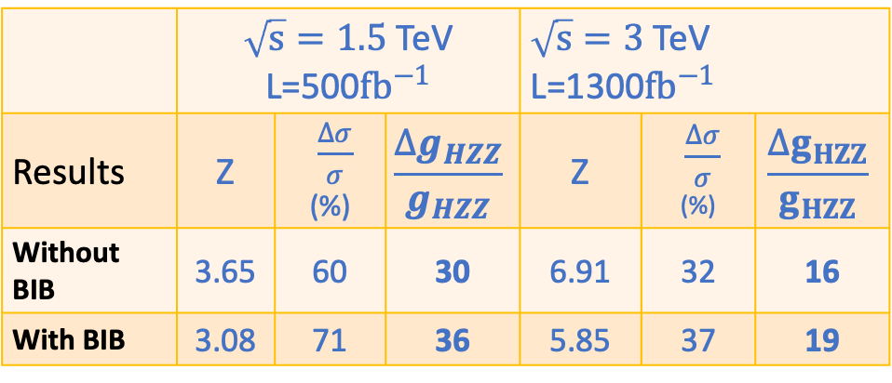
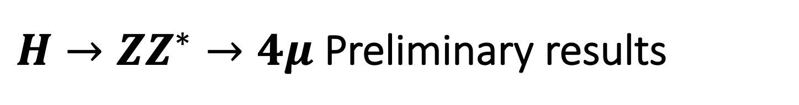
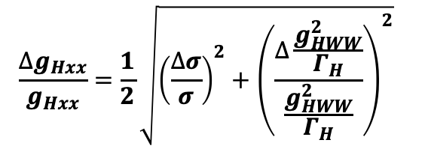
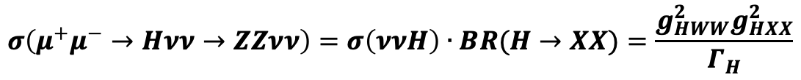


$H→ZZ^{∗}→4μ$ Preliminary results
$$H→ZZ^{∗}→4μ$$
$$σ\left(μ^{+}μ^{−}→Hνν→ZZνν\right)=σ\left(ννH\right)∙BR(H→XX)=\frac{g_{HWW}^{2}g_{HXX}^{2}}{Γ_{H}}$$
$$\frac{∆g_{Hxx}}{g_{Hxx}}=\frac{1}{2}\sqrt{{\left(\frac{∆σ}{σ}\right)}^{2}+{\left(\frac{∆\frac{g_{HWW}^{2}}{Γ_{H}}}{\frac{g_{HWW}^{2}}{Γ_{H}}}\right)}^{2}}$$
Relative uncertainty on the HXX coupling
(X any SM particle)
$\sqrt{s}=1.5$ TeV
 | $\sqrt{s}=1.5$ TeV L=500${fb}^{−1}$ |  |  | $\sqrt{s}=3$ TeV L=1300${fb}^{−1}$
Results | Z | $\frac{∆σ}{σ}$ (%) | $$\frac{∆g_{HZZ}}{g_{HZZ}}$$ | Z | $\frac{∆σ}{σ}$ (%) | $$\frac{∆g_{HZZ}}{g_{HZZ}}$$
Without BIB | 3.65 | 60 | 30 | 6.91 | 32 | 16
With BIB | 3.08 | 71 | 36 | 5.85 | 37 | 19
$\sqrt{s}=3$ TeV
Results can be improved by a factor 2 including all the leptonic channels (assuming same efficiencies)
Further improvement: inclusions of the fully hadronic final states

Slide 9
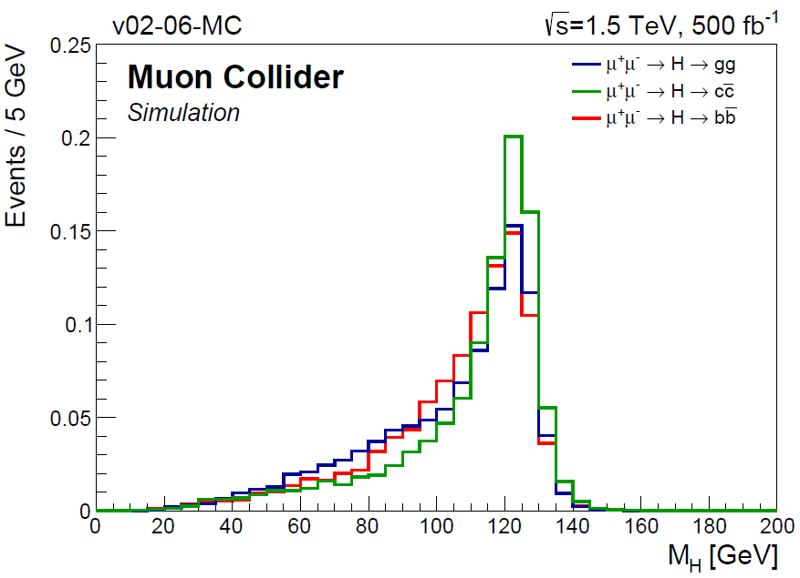
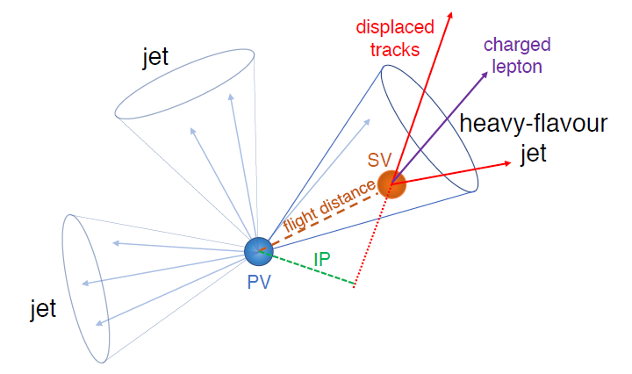

H-to-c-quark coupling at Muon Collider
H→cc
$$H→gg , H→c\overline{c}, H→b\overline{b}$$
are kinematically indistinguishable.
Dedicated tagger to discriminate c jets from b and light-flavour ones.
Heavy-flavour hadron characteristics:
Secondary vertices (SV)
Displaced tracks
Low-energy non isolated leptons

Slide 10
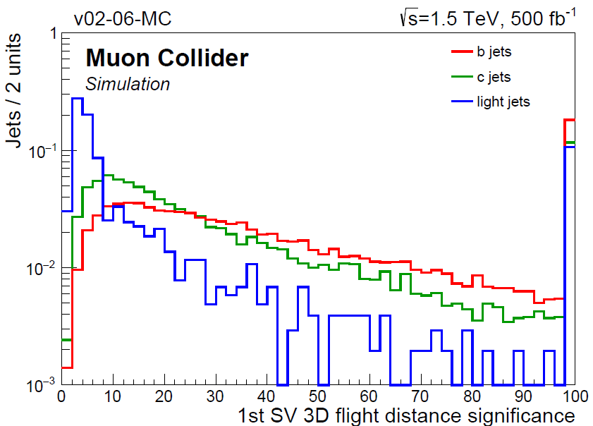
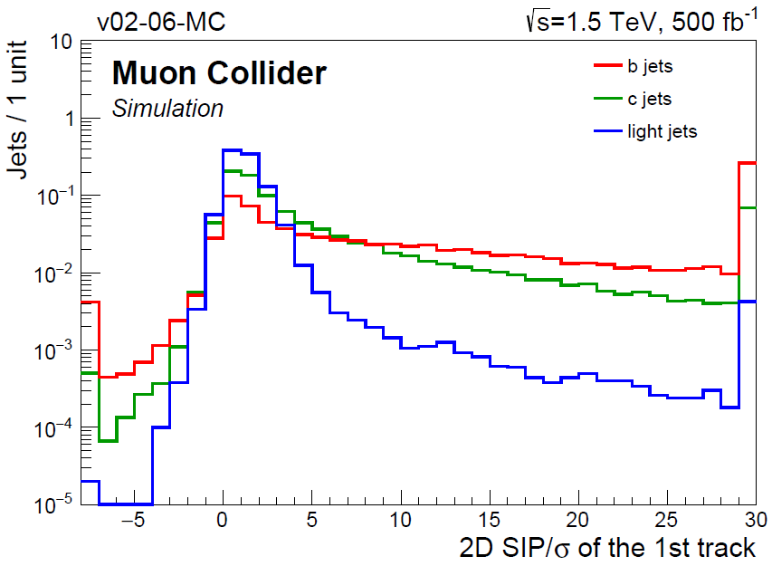
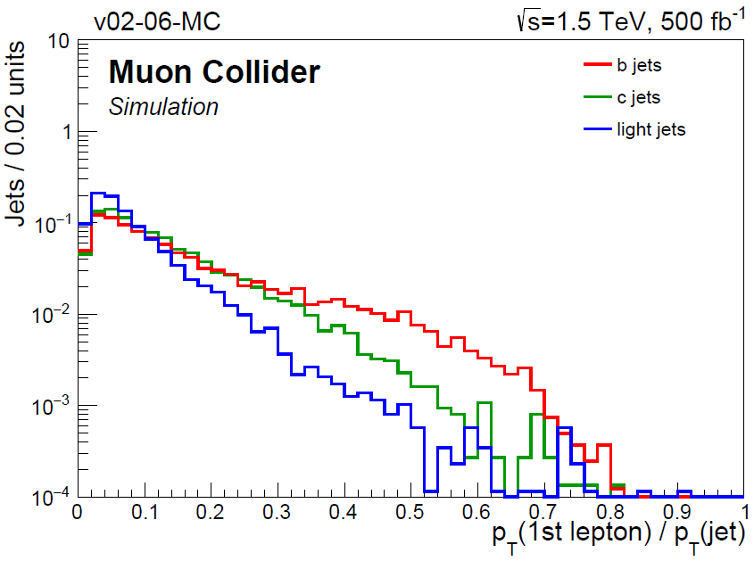
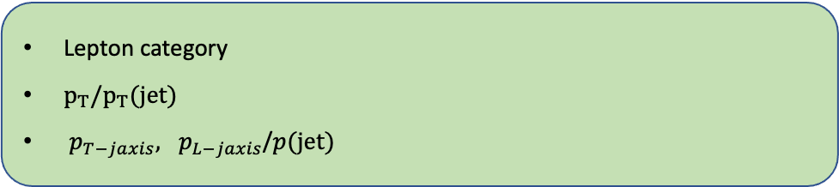
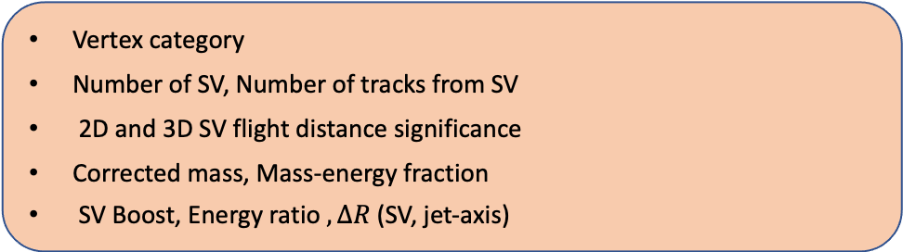
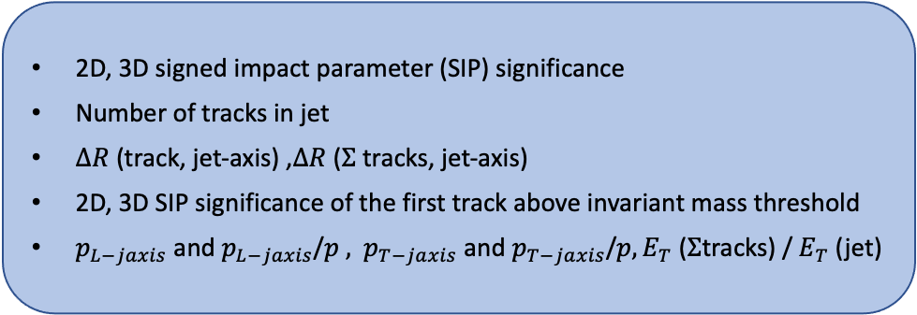
C-jet tagging algorithm: the variables
H→cc
Vertex category
Number of SV, Number of tracks from SV
2D and 3D SV flight distance significance
Corrected mass, Mass-energy fraction
SV Boost, Energy ratio$, ∆R$ (SV, jet-axis)
Vertex variables
2D, 3D signed impact parameter (SIP) significance
Number of tracks in jet
$∆R$ (track, jet-axis) ,$∆R$ ($Σ$ tracks, jet-axis)
2D, 3D SIP significance of the first track above invariant mass threshold
$p_{L−jaxis}$ and $p_{L−jaxis}$/$p ,$ $p_{T−jaxis}$ and $p_{T−jaxis}$/$p, E_{T}$ ($Σ$tracks) / $E_{T}$ (jet)
Track variables
Lepton category
$p_{T}/p_{T}(jet)$
$p_{T−jaxis}, p_{L−jaxis}$/$p(jet)$
Lepton variables

Slide 11
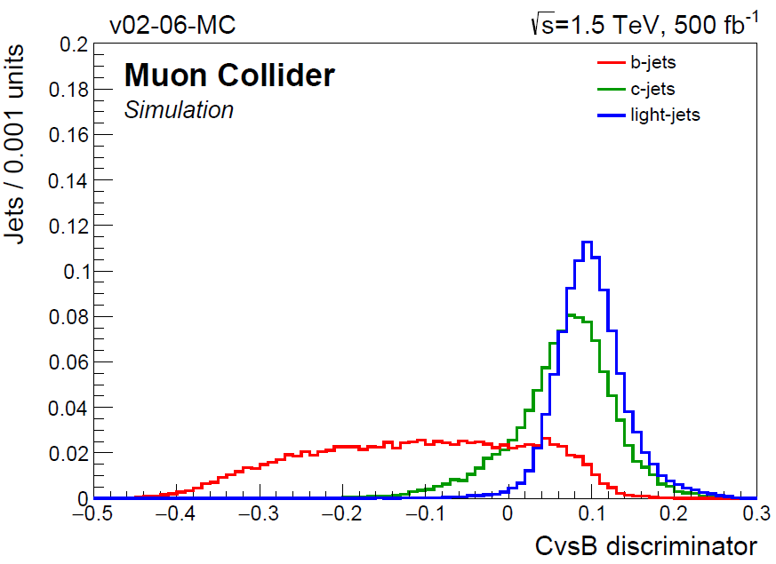
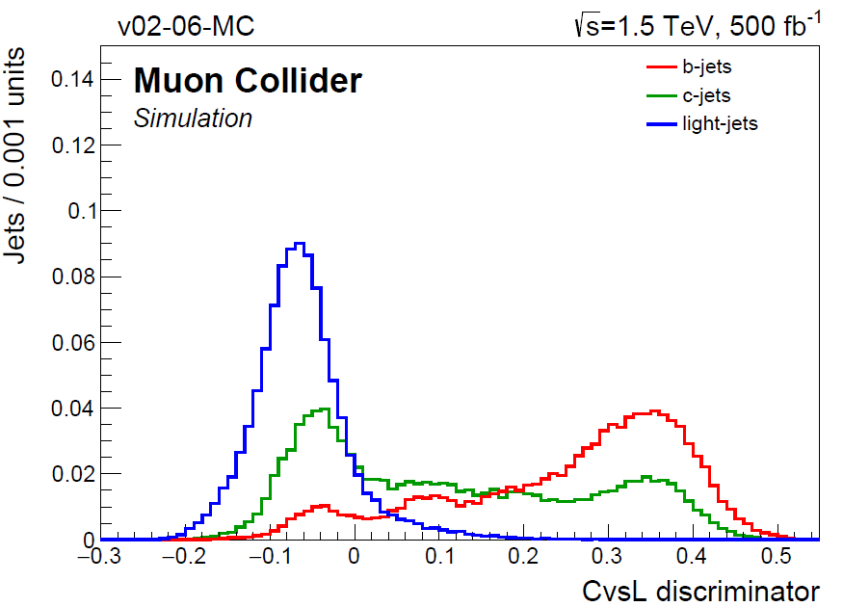
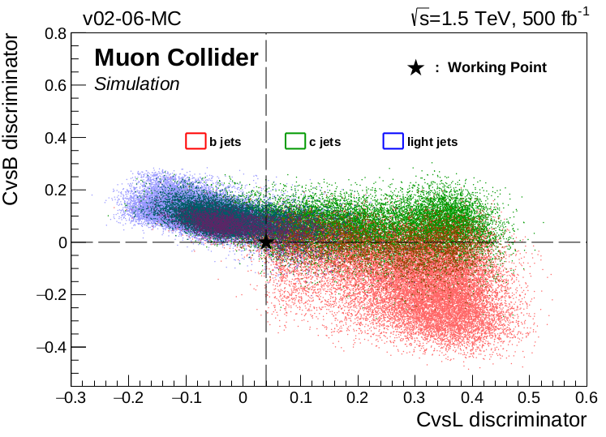
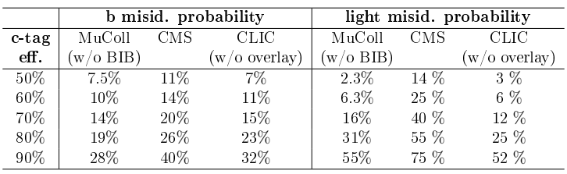

C-jet tagging algorithm
H→cc
The variables are combined in a single Boosted Decision Tree.
Two independent taggers :
CvsB : separate c-jets from b-jets
CvsL : separate c-jets from light flavor
Signal: c jets
Bkg : b jets
Signal: c jets
Bkg : light jets
($CvsL, CvsB$) | $$c$$ efficiency | $b$ contamination | $light−flav.$ contamination
(0.04, 0.00) | 40 % | 13 % | 5 %

Slide 12







$H→c\overline{c}$ preliminary results
H→cc
Before topological selections
After flavor tagging, Higgs candidates are built using the two highest pT jets and further topological selections are applied
$E_{H}$ > 130 GeV, $pT_{H}$> 30 GeV
$∆R\left(j_{1},j_{2}\right)$ < 3, $m_{H}∈[110,130]$ GeV
$\sqrt{s}$= 1.5 TeV, 500 $fb^{−1}$ (no BIB overlay)
$$S/\sqrt{S+B}$$ | $$Δσ/σ$$ | $$Δg_{Hcc}/g_{Hcc}$$
9.5 | 10.5 % | 5.5 %
After topological selections
Projection at $\sqrt{s}$= 3 TeV, 1300 $fb^{−1}$ (assuming same selection efficiencies)
$$S/\sqrt{S+B}$$ | $$Δσ/σ$$ | $$Δg_{Hcc}/g_{Hcc}$$
20.4 | 4.9 % | 2.6 %
S = 378
B = 1205
CLIC: 350 GeV, 500 $fb^{−1}:\text{6.2 }\text{\%}$ precision
CLIC: 1.4 TeV, 1500 $fb^{−1}:\text{2}\text{.}\text{3} \text{\%}$ precision

Slide 13
Summary
Summary
The Muon Collider is the dream machine for Higgs Physics and beyond
So far measured Higgs couplings with full simulation/extrapolations (√s=3 TeV):
  Hbb: 1% (published result)
  Hcc: 2.3%
  HZZ: 8% (only electron and muon final states)
Precision improves with increasing energy → Muon Collider has the potential to reach higher energy wrt electron-based colliders.
Goal for next year:
  Inclusion of the BIB and impact on the final results
  Re-optimize analysis strategy for both Hcc and HZZ
  Optimize muon and jet reconstruction (next slide)

Slide 14

Perspectives and future challenges
Perspectives
The reconstruction of final states leptons and jets play a crucial role.
Efficient vertexing and tracking rely on high granular tracker
Reliable jet reconstruction limited by the calorimeters
Muon tagging is crucial and muon stations are not yet fully exploited
Physics channel will drive the detector design
Presently, just the Higgs sector has been considered
Near future: keep going in the Higgs sector and exploring BSM multi-TeV signature
BSM signatures/Going up with COM energies poses new challenges → e.g. merging final state jet in a single fat jet
  Jet substructure and flavor tagging relies on information created at one spatial location during the decay of the original particle.
  Detector design should be optimized accordingly
W
q/g

Slide 15
Backup

Slide 16



The Muon Collider experiment and challenges
Main challenges:
Muon production
Beam-Induced Background (BIB): Decays of circulating beam muons into electrons, positrons and neutrinos→interactions with the machine → production of secondary particles
hadronic calorimeter
electromagnetic calorimeter
tracking system
shielding nozzles ($θ=10°$)
superconducting solenoid (3.57 T)
muon chambers

Slide 17






Jet reconstruction
Complex task: tracker info + energy deposits in calorimeters
Particle reconstruction is performed through Pandora Particle Flow (PF) algorithm → improve the jet energy resolution.
Output of PF is used for jet clustering: $k_{T}$ algorithm with radius parameter R = 1.0.
Eff. $≈$ 100% for $p_{T}$> 80 GeV
$σ$ $≤$ 10% for $p_{T}$> 10 GeV
Higher $p_{T} →σ≈$ 4%

