Slide 1


Design and Optimization of Radio-Frequency Pulse Compressor Systems for High Brightness Linacs
LEVAN KANKADZE
Sapienza University (Rome, Italy)
INFN-LNF (Frascati, Italy)
Advisor Co-Advisor
Massimo Ferrario (INFN-LNF) David Alesini (INFN-LNF)

Slide 2
OUTLINE
Rf pulse compressors for LINACs:
  Pulse compressors based on SLED
  Pulse compressors based on Barrel Open Cavity (BOC)
  BOC working principle details
  Comparison between the SLED and the BOC schemes
Realization of accelerator components without brazing: the LNF-INFN technology
EuPRAXIA@SPARC_LAB project: short introduction
  Overview of the EuPRAXIA@SPARC_LAB LINAC
BOC design workflow
  Electromagnetic design of the BOC cavity, feeding waveguide and the bend
  Sensitivity studies
  Simulations results: Summary
  Thermo-mechanical simulations
  Mechanical design
BOC pulse compressor design for standing wave RF structures
  RF-guns
  The c band gun
  Feeding schemes for the c band gun
  Optimization of the BOC for C band gun and electromagnetic design of the BOC for C band gun feeding
Conclusions and Outlook

Slide 3
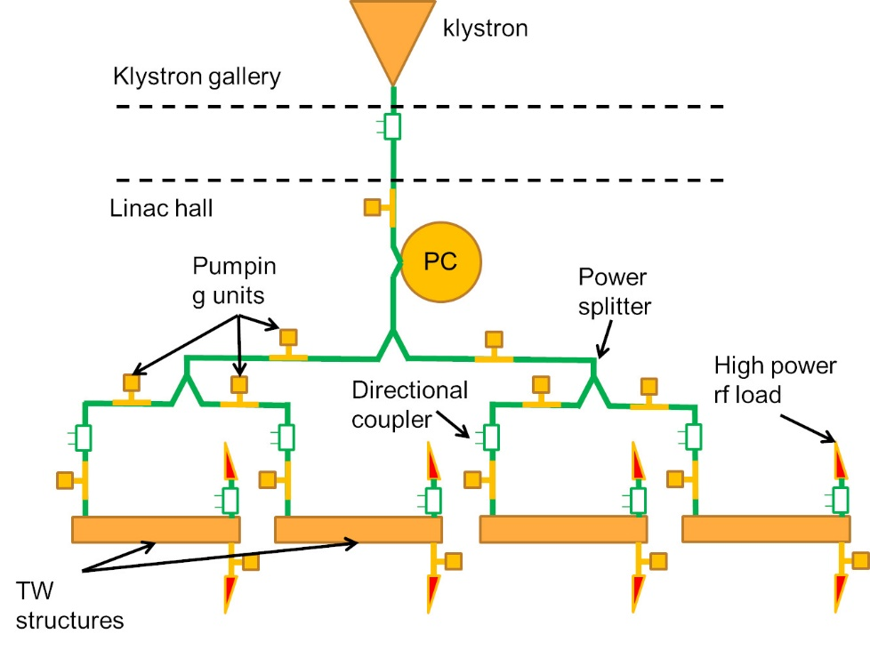
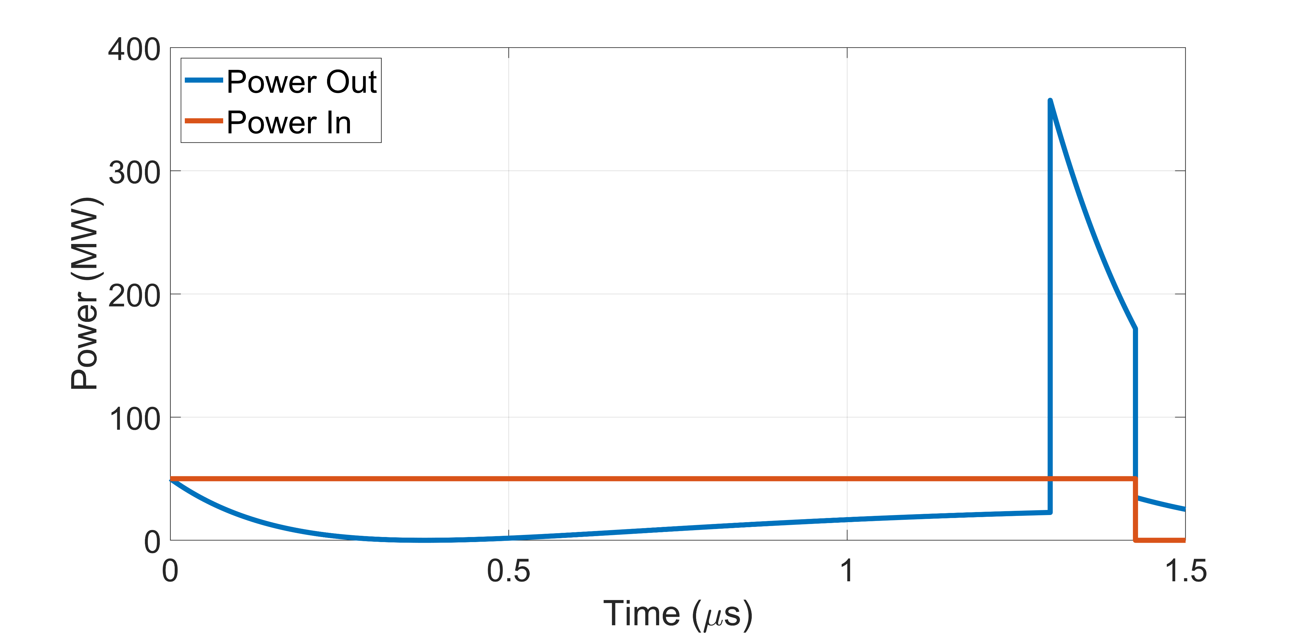
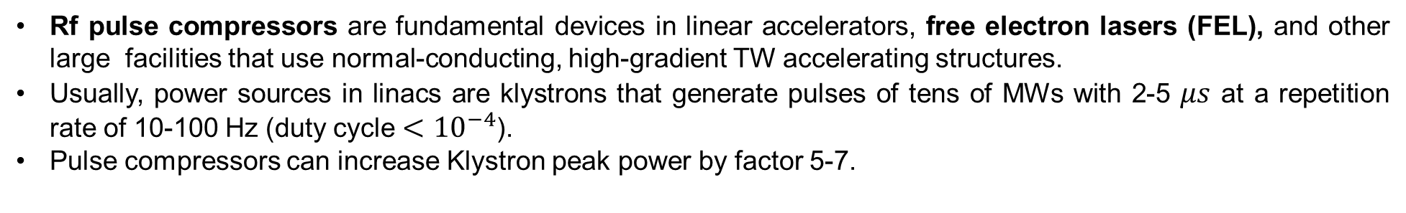

RF PULSE COMPRESSORS FOR LINACS
Rf pulse compressors are fundamental devices in linear accelerators, free electron lasers (FEL), and other large facilities that use normal-conducting, high-gradient TW accelerating structures.
Usually, power sources in linacs are klystrons that generate pulses of tens of MWs with 2-5 $μs$ at a repetition rate of 10-100 Hz (duty cycle $<{10}^{−4}$).
Pulse compressors can increase Klystron peak power by factor 5-7.
First rf pulse compressor named SLED
was invented at SLAC in 1973. [1]
Input port
Output port
3dB hybrid
Reversing the phase of the input pulse
High $Q_{0}$ cavities

Slide 4
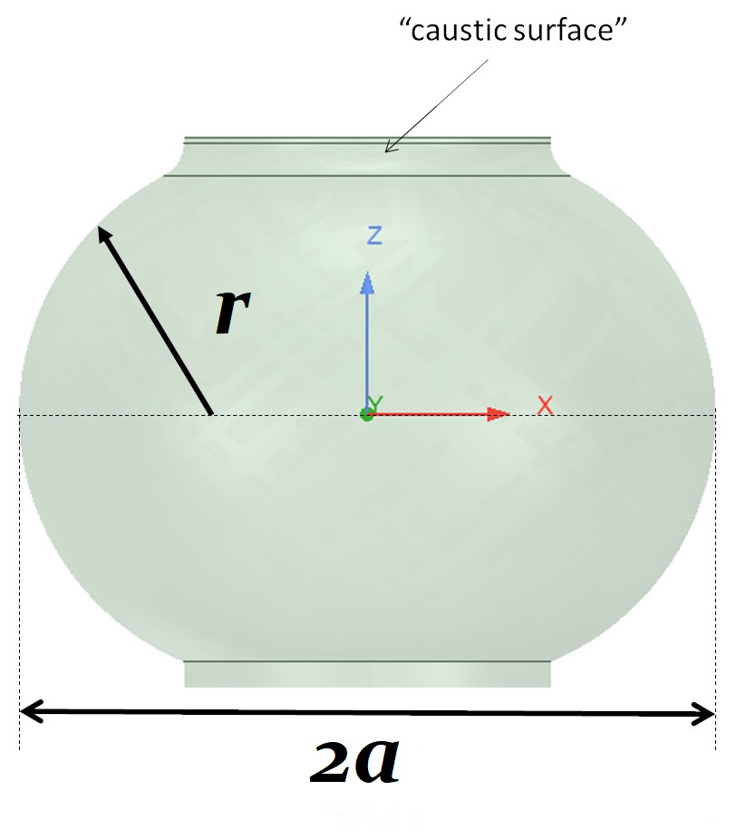
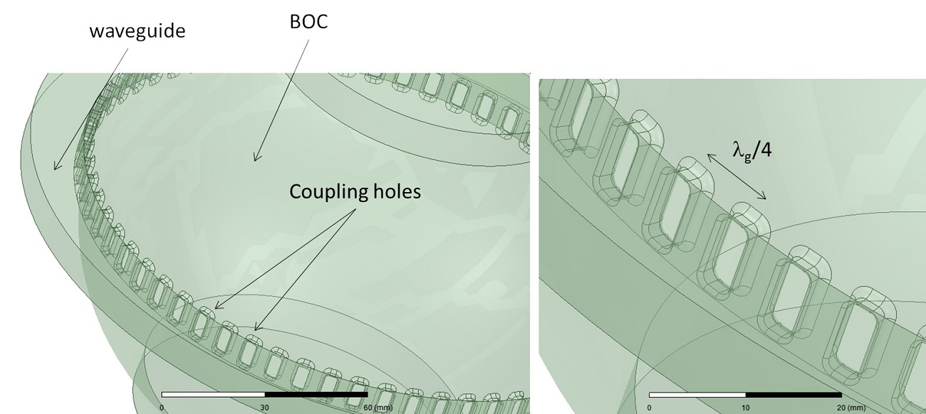
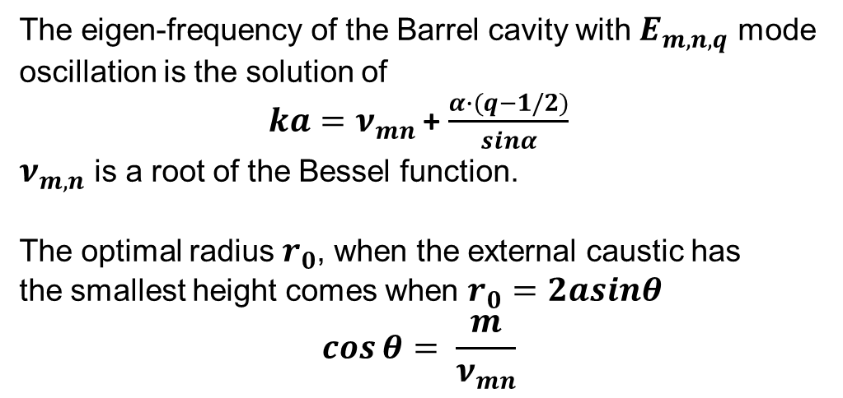
PULSE COMPRESSORS BASED ON Barrel Open Cavity (BOC)
The working principle of the BOC is similar to the SLED. In the BOC two resonating modes are excited in quadrature in the same cavity through a particular configuration of the waveguide system and coupling holes, with this particular coupling system, their reflections back to the source are combined and canceled, while they add on the propagating direction.
BOC Cavity
The eigen-frequency of the Barrel cavity with $E_{m,n,q}$ mode oscillation is the solution of
$ka=ν_{mn}$ + $\frac{α∙(q−1/2)}{sinα}$
$ν_{m,n}$ is a root of the Bessel function.
The optimal radius $r_{0}$, when the external caustic has
the smallest height comes when $r_{0}=2asinθ$
$$\cos{θ}= \frac{m}{ν_{mn}}$$
BOC Cavity and Coupler Waveguide

Slide 5
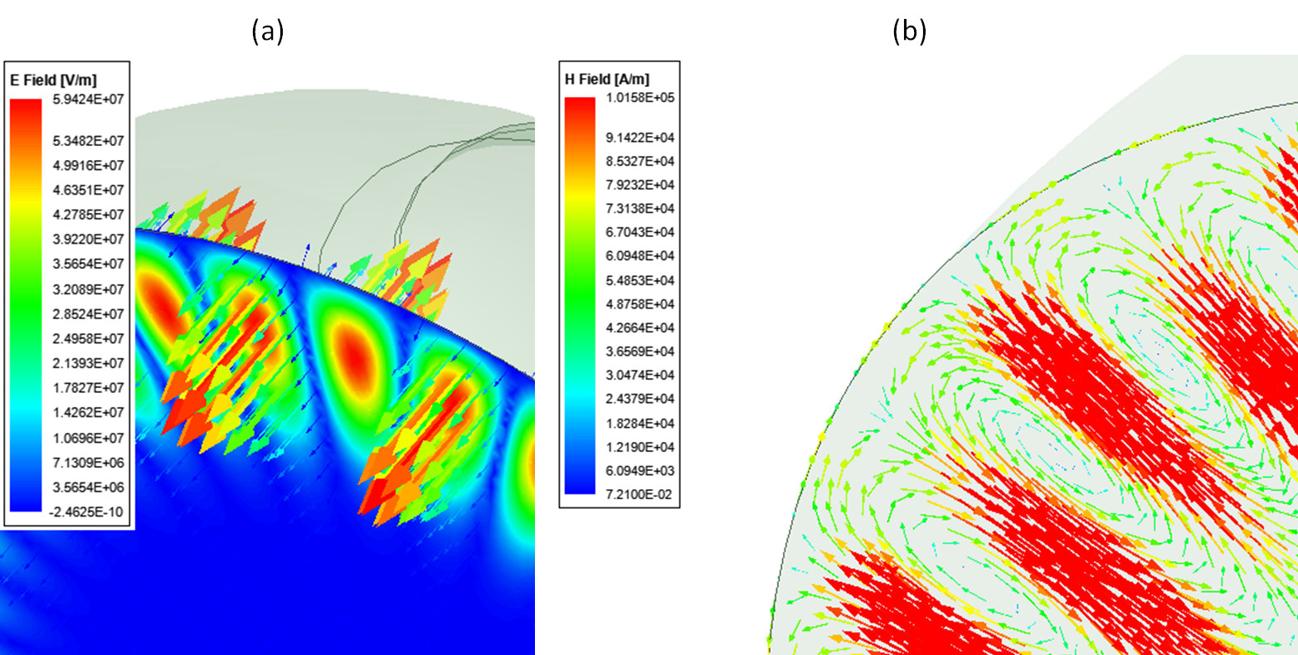
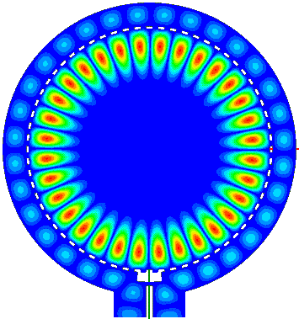
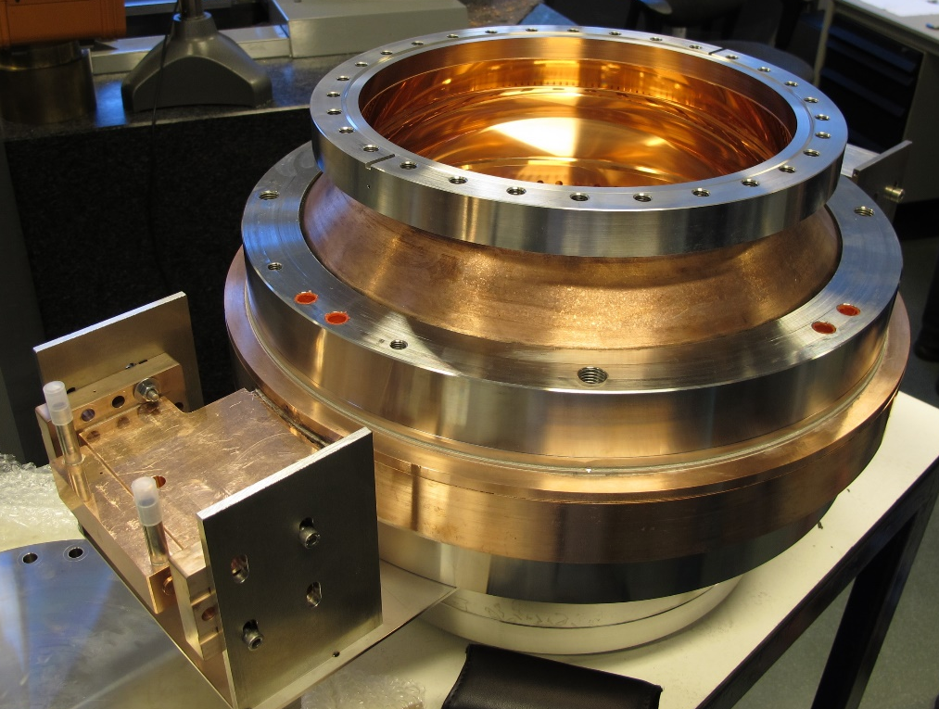
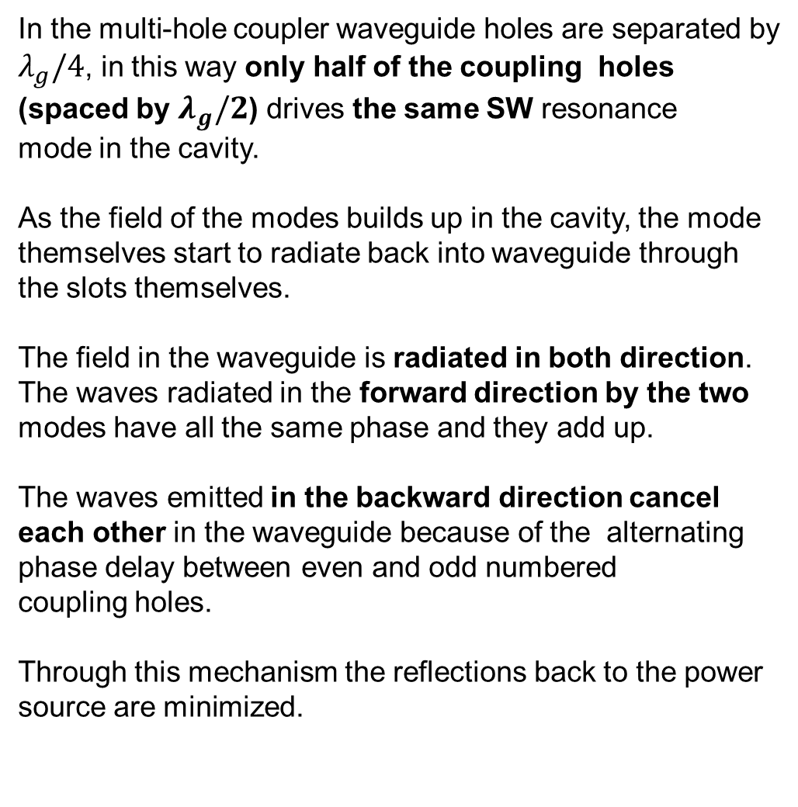

BOC WORKING PRINCIPLE DETAILS
In the multi-hole coupler waveguide holes are separated by $λ_{g}/4$, in this way only half of the coupling holes (spaced by $λ_{g}/2$) drives the same SW resonance
mode in the cavity.
As the field of the modes builds up in the cavity, the mode themselves start to radiate back into waveguide through the slots themselves.
The field in the waveguide is radiated in both direction. The waves radiated in the forward direction by the two modes have all the same phase and they add up.
The waves emitted in the backward direction cancel
each other in the waveguide because of the alternating phase delay between even and odd numbered
coupling holes.
Through this mechanism the reflections back to the power
source are minimized.
Excited SW mode
Electric Field
Magnetic Field
Wave Propagation
2016 – PSI (5.712 GHz) ${TM}_{18,1,1}$
Kankadze L, thesis, chapter 4.2.1 Working Principle
Zennaro R., WEPFI059, IPAC (2015).

Slide 6
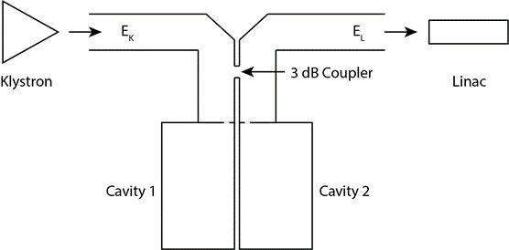
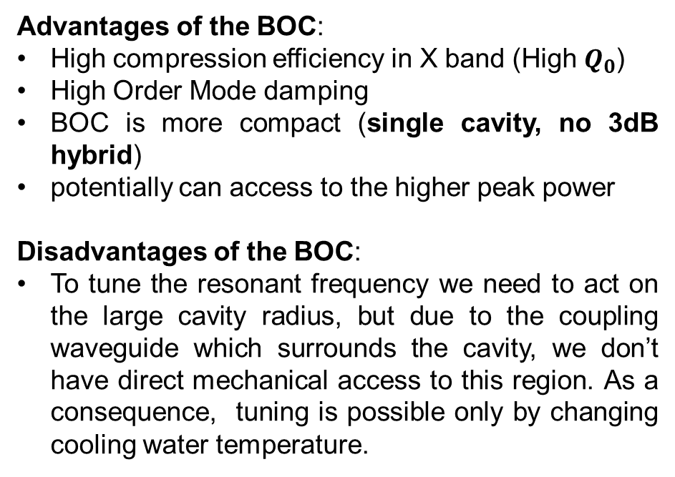
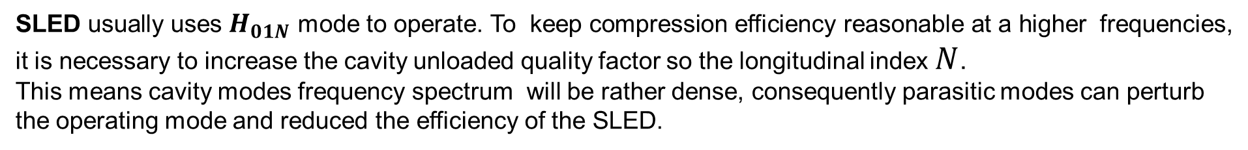
ADVANTAGES AND DISADVANTAGES OF
THE BOC WITH RESPECT TO SLED
SLED usually uses $H_{01N}$ mode to operate. To keep compression efficiency reasonable at a higher frequencies, it is necessary to increase the cavity unloaded quality factor so the longitudinal index $N$.
This means cavity modes frequency spectrum will be rather dense, consequently parasitic modes can perturb the operating mode and reduced the efficiency of the SLED.
SLED
Advantages of the BOC:
High compression efficiency in X band (High $Q_{0}$)
High Order Mode damping
BOC is more compact (single cavity, no 3dB hybrid)
potentially can access to the higher peak power
Disadvantages of the BOC:
To tune the resonant frequency we need to act on the large cavity radius, but due to the coupling waveguide which surrounds the cavity, we don’t have direct mechanical access to this region. As a consequence, tuning is possible only by changing cooling water temperature.
BOC
Zennaro R., WEPFI059, IPAC (2015).

Slide 7
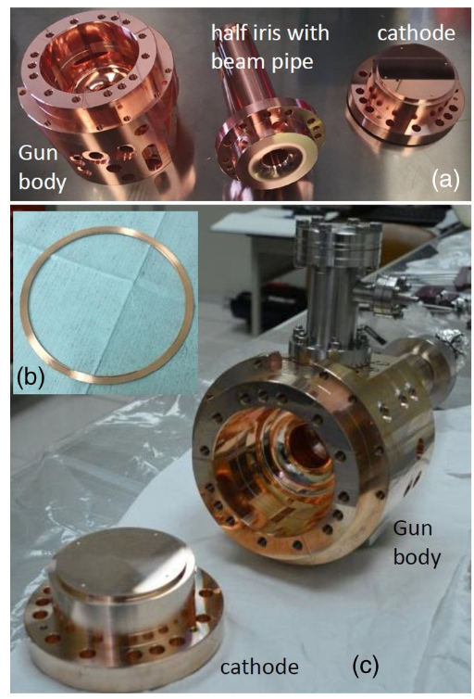
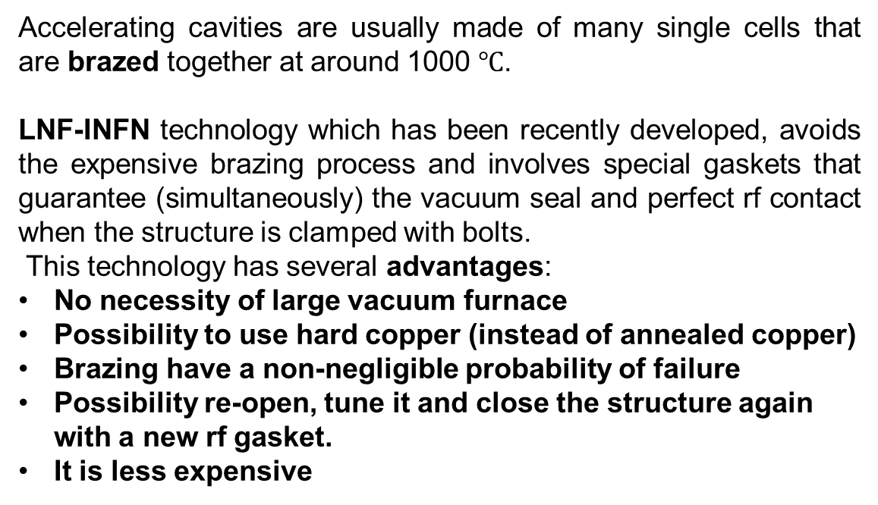
REALIZATION OF ACCELERATOR COMPONENTS WITHOUT BRAZING: THE LNF-INFN TECHNOLOGY
Accelerating cavities are usually made of many single cells that are brazed together at around 1000 $℃$.
LNF-INFN technology which has been recently developed, avoids the expensive brazing process and involves special gaskets that guarantee (simultaneously) the vacuum seal and perfect rf contact when the structure is clamped with bolts.
This technology has several advantages:
No necessity of large vacuum furnace
Possibility to use hard copper (instead of annealed copper)
Brazing have a non-negligible probability of failure
Possibility re-open, tune it and close the structure again with a new rf gasket.
It is less expensive
So far two rf-guns for SPARC_LAB and ELI-NP projects in S-band have been successfully designed and tested on high power and two more RF guns for the CLEAR and SPARC_LAB projects have been constructed and are ready for testing.
[1] Alesini D. et al , PhysRevAccelBeams.21.112001 – 2018
[2] Alesini D. et al , PhysRevAccelBeams.18.092001 – 2015
[1]

Slide 8

EuPRAXIA@SPARC_LAB project: short introduction
The project EuPRAXIA@SPARC_LAB aims at constructing a FEL radiation source (λ_{FEL}=3 nm) based on RF linear accelerator combined with a plasma module;
The CDR of the overall machine has been already published few years ago and now the effort is directed towards the preparation of the TDR (expected for 2024);
The project is one of the pillar of the European Project EUPRAXIA (coord. R. Assmann, http://www.eupraxia-project.eu/) now waiting for the outcome of the ESFRI application. In any case EuPRAXIA@SPARC_LAB will be funded by INFN (independently from the EUPRAXIA-Eu developments).
A new building, now under executive design phase will host the new Facility at LNF
TDR

Slide 9
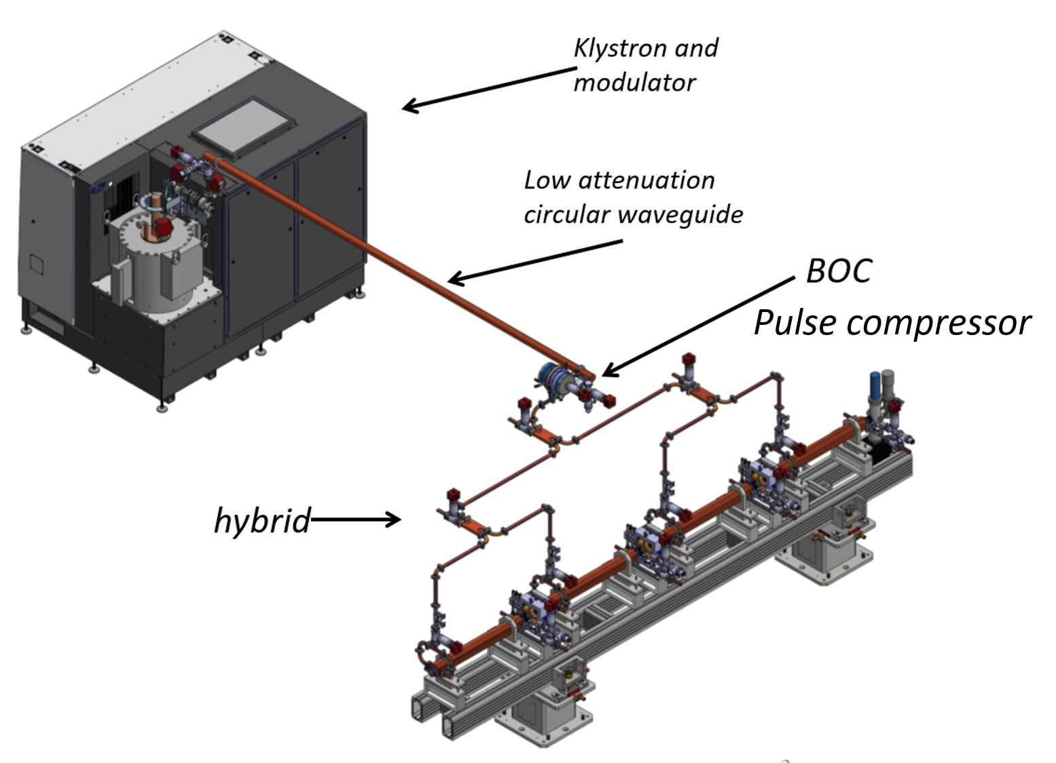
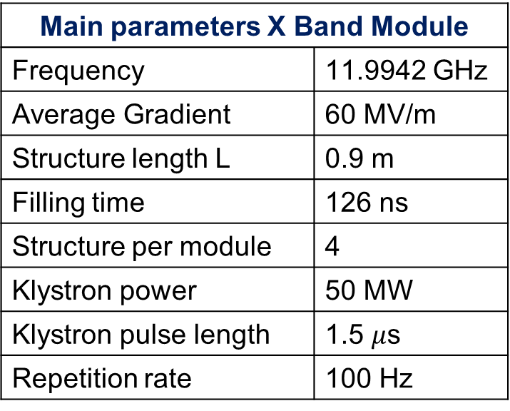
Overview of the LINAC
Undulators
The RF baseline of the linac is the X-band technology (with an S band injector), and it will be used to produce high brightness electron beams up to an energy of 1 GeV;
The beam will be either injected in the FEL undulators, or used to drive a plasma cell to boost the energy further before injection in the undulators;
We will need 5-6 X band 50 MW klystron to run this facility.
X-Band power stations
S-Band power stations
Plasma module
Chicane
X band modules
Main parameters X Band Module
Frequency | 11.9942 GHz
Average Gradient | 60 MV/m
Structure length L | 0.9 m
Filling time | 126 ns
Structure per module | 4
Klystron power | 50 MW
Klystron pulse length | 1.5 $μ$s
Repetition rate | 100 Hz
S-Band 3 m TW structures
S-Band RF gun and injector
X-Band Klystron and modulator
BOC pulse compressor
Low attenuation waveguide
Hybrid

Slide 10
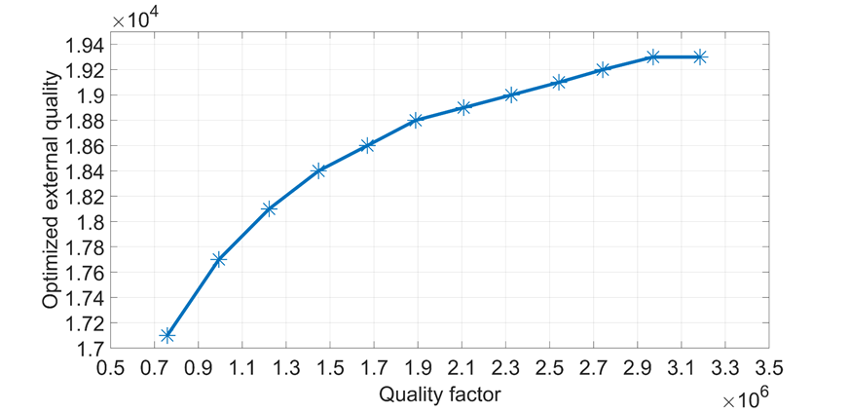
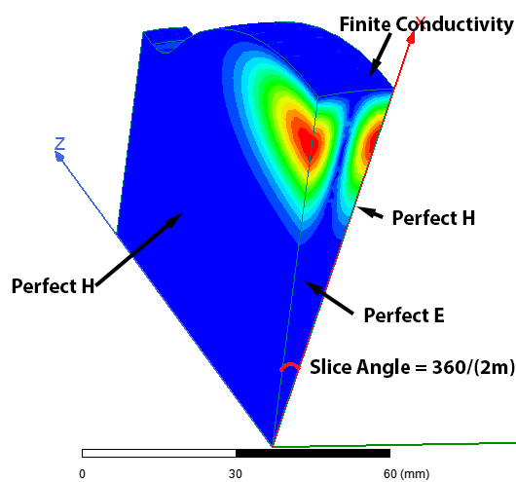
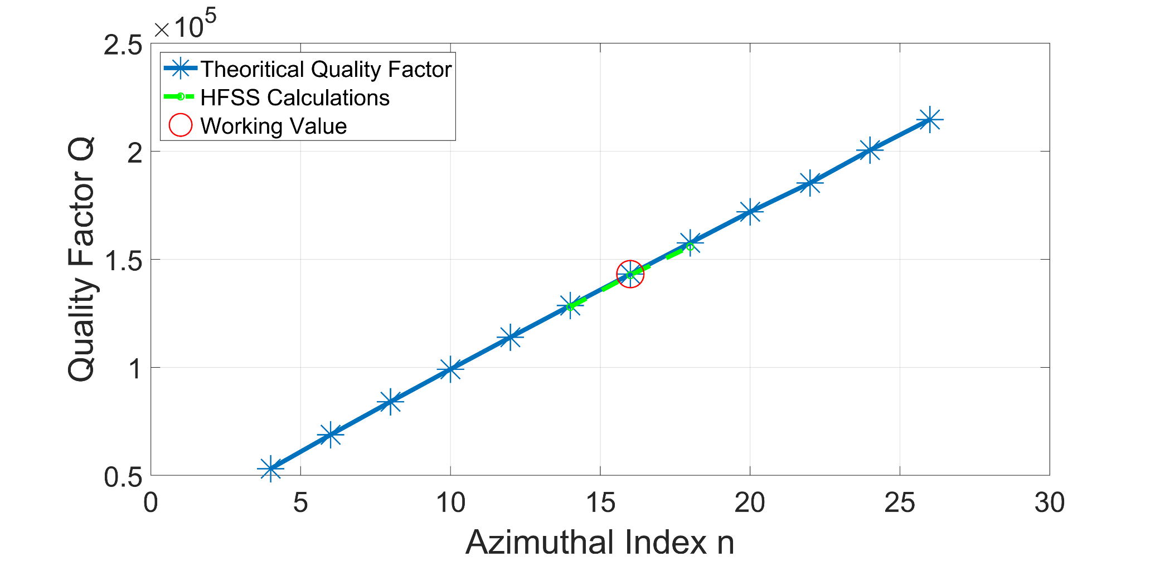
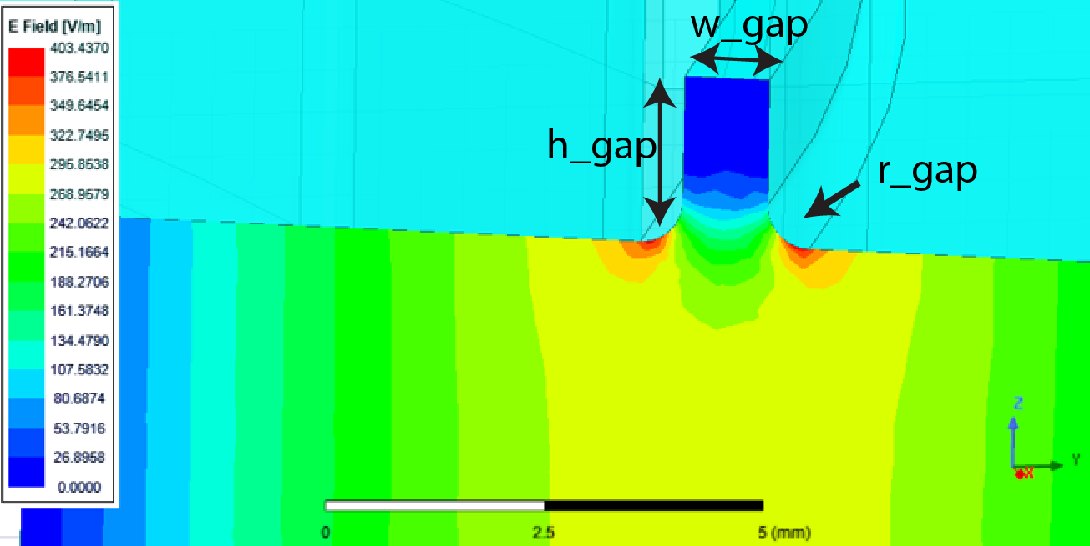
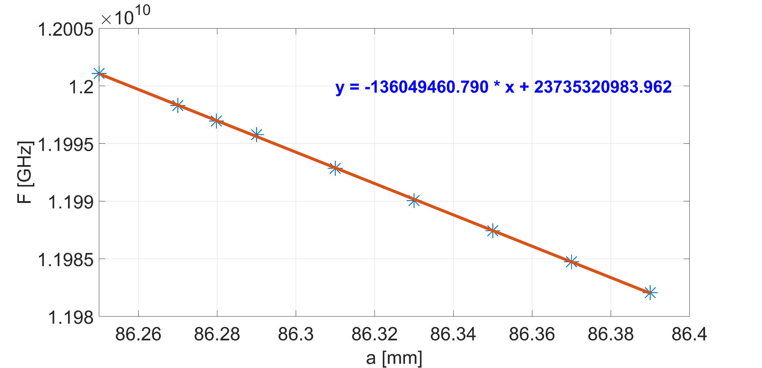
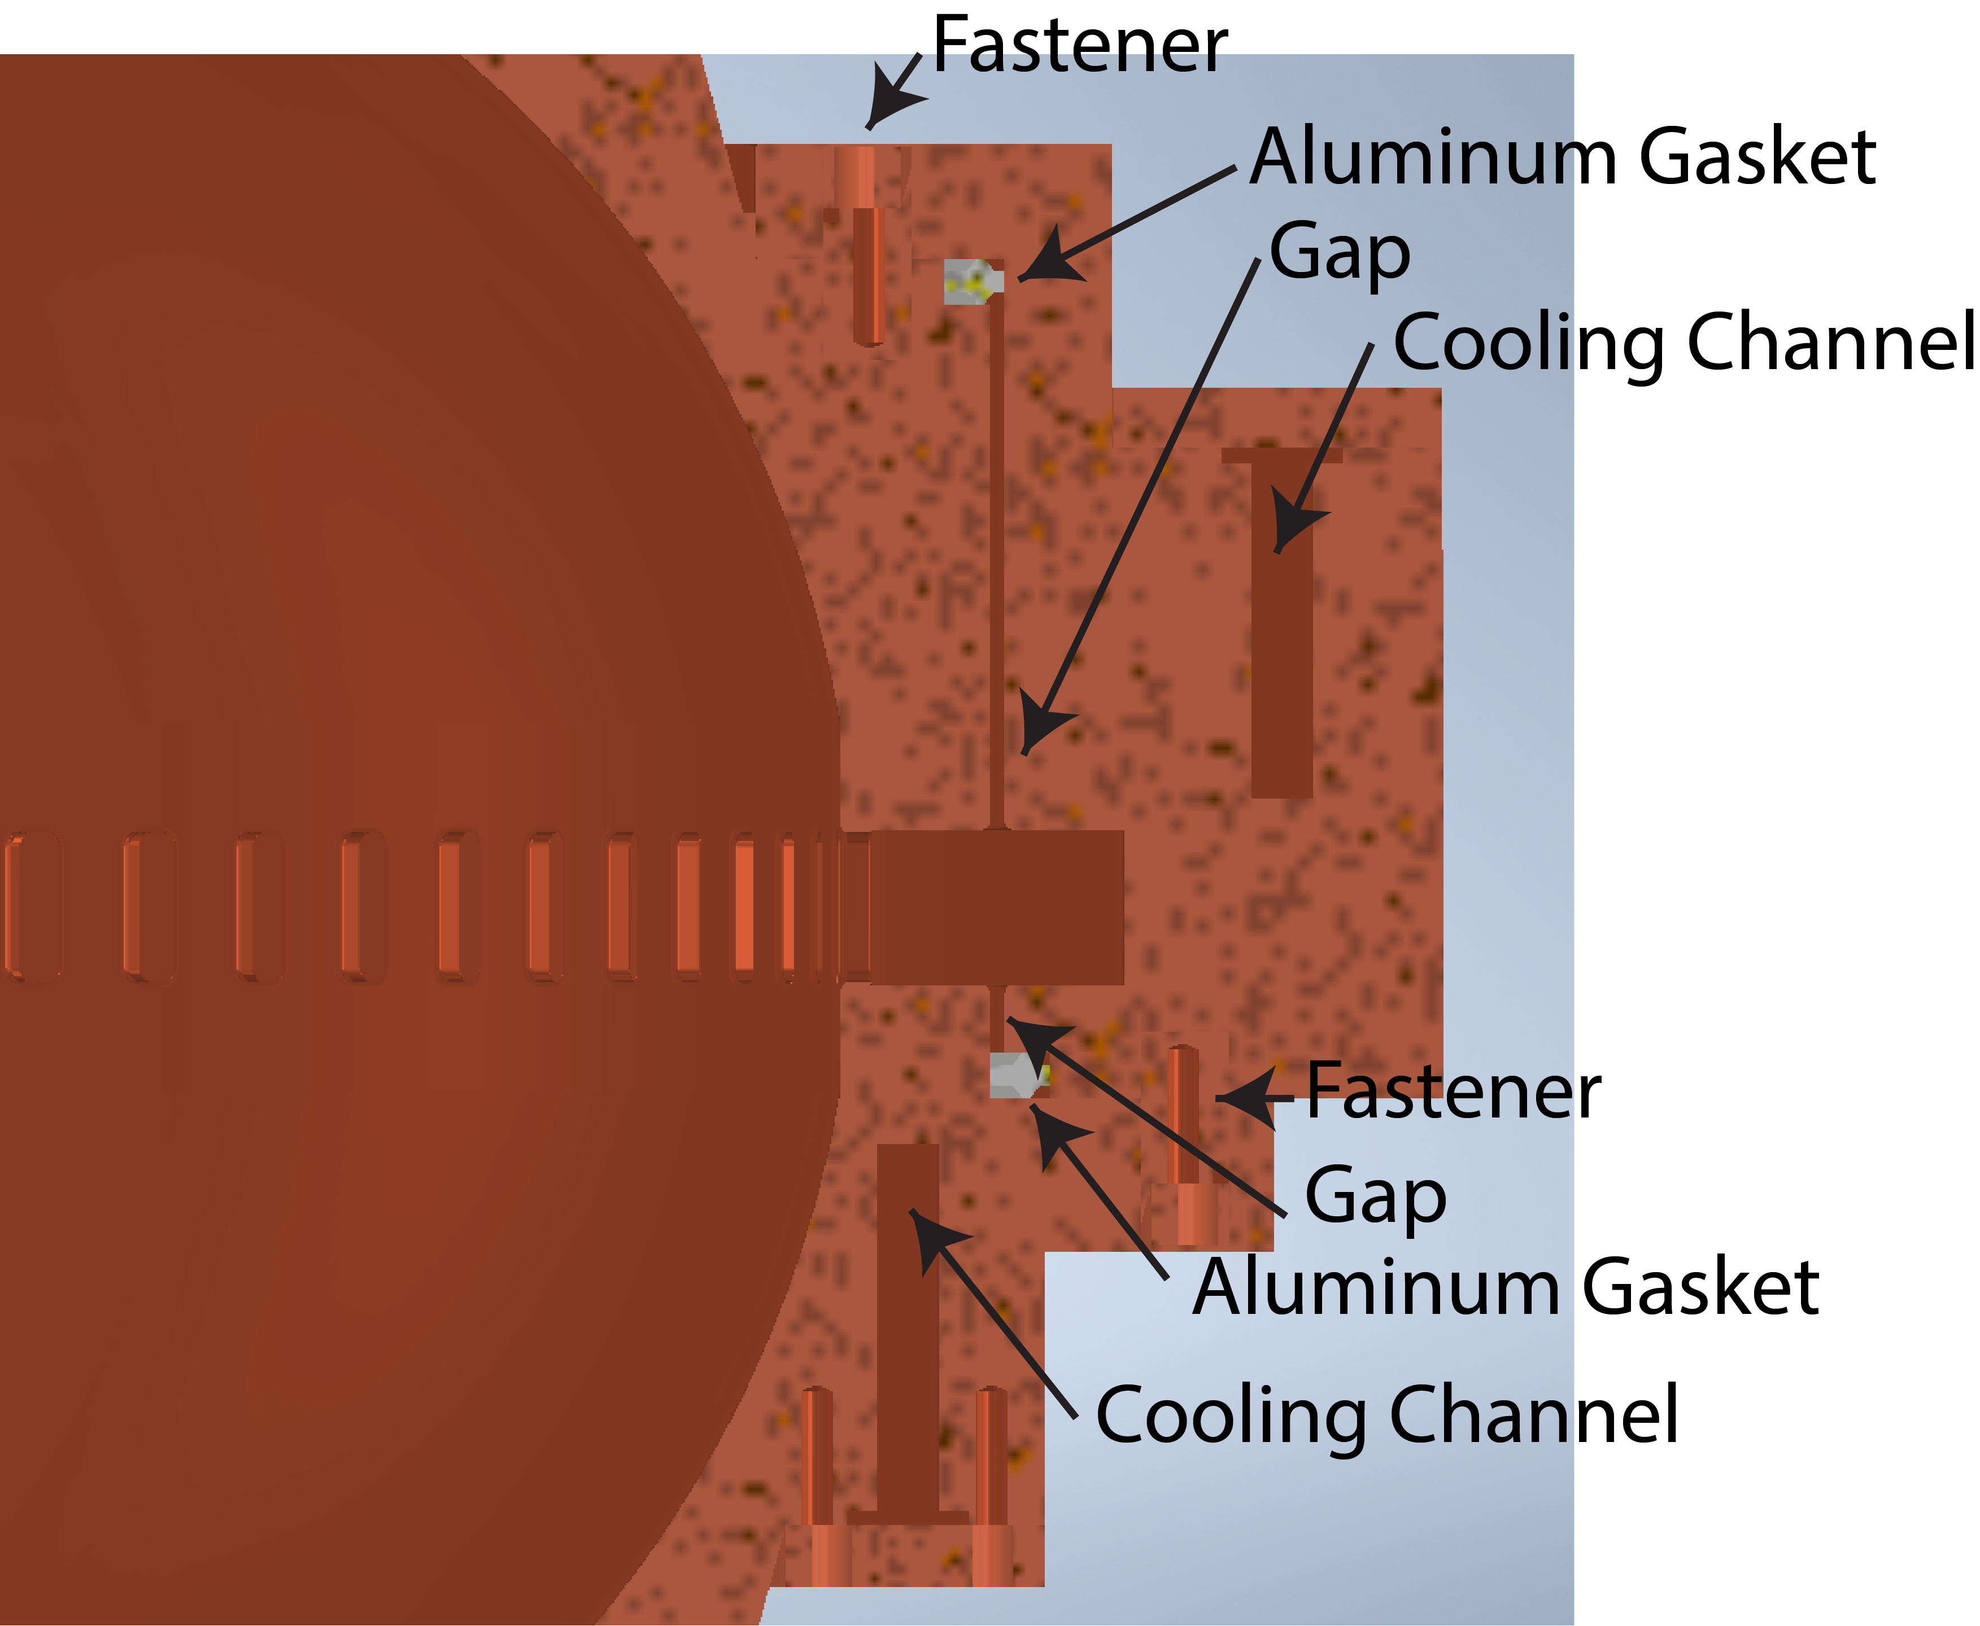
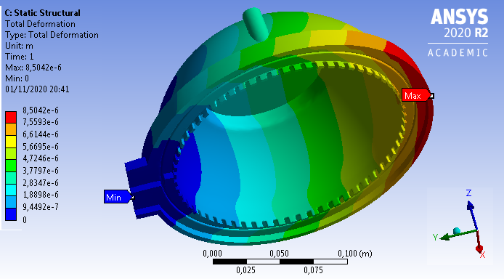
BOC DESIGN WORKFLOW
Theoretical optimization of the BOC parameters (maximizing the efficiency of TW structures )
Eigen mode simulations, for tuning resonant frequency and calculating unloaded quality factor
EM design of the coupler and bend to implement brazing free technology,
Sensitivity calculation has been performed for mechanical tolerances definition
Design of the cooling system and thermo- mechanical simulations
Mechanical design to allow fabrication of the structure

Slide 11

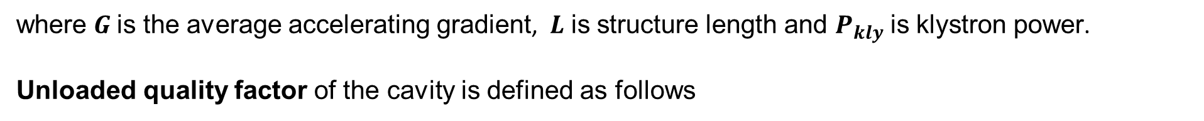
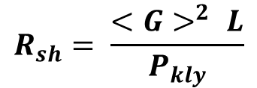
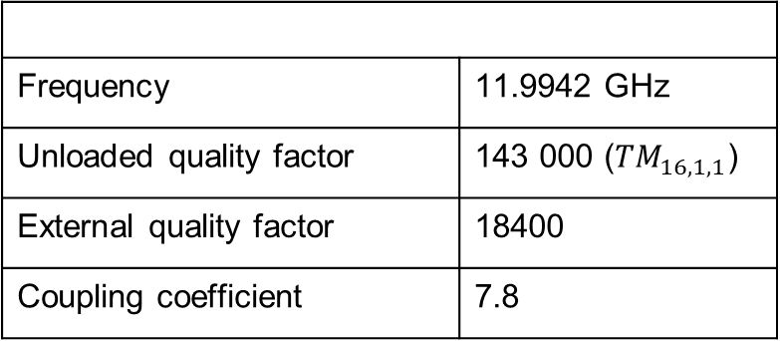

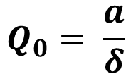
BOC DESIGN PARAMETERS
The TW accelerating structures have been optimized assuming a BOC unloaded quality factor equal to 150 000.
Optimal external quality factors for a different BOC unloaded quality factors has been calculated, for which effective shunt impedance of a TW accelerating structure is optimized.
$$R_{sh}= \frac{{<G>}^{2} L}{P_{kly}}$$
where $G$ is the average accelerating gradient, $L$ is structure length and $P_{kly}$ is klystron power.
Unloaded quality factor of the cavity is defined as follows
$$Q_{0}= \frac{a}{δ}$$
$a$is the large cavity radius $δ$ is the skin depth
Design Goal
Frequency | 11.9942 GHz
Unloaded quality factor | 143 000 (${TM}_{16,1,1}$)
External quality factor | 18400
Coupling coefficient | 7.8

Slide 12
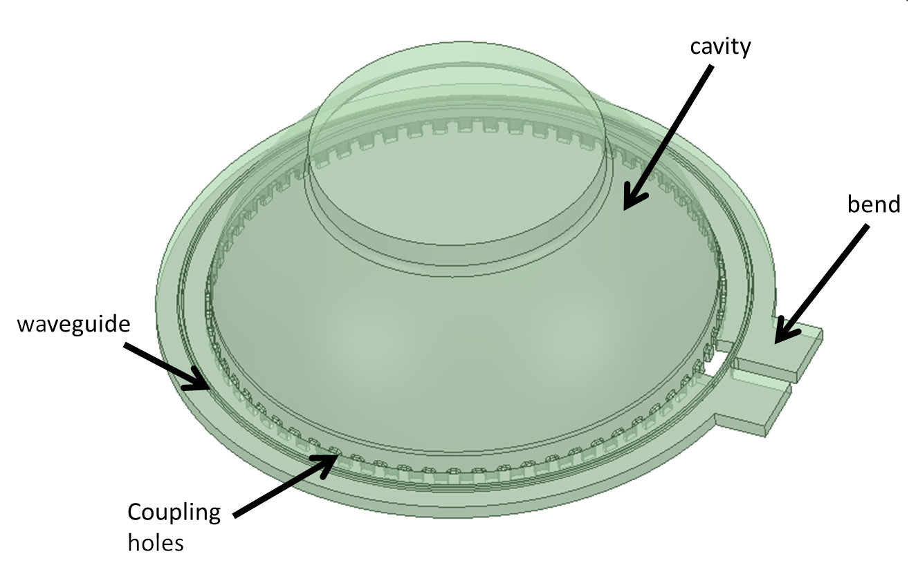
ELECTROMAGNETIC DESIGN OF THE BOC CAVITY
Slice for eigen mode simulations
The design of the cavity has been performed in ANSYS-HFSS
In Eigen mode simulations we can tune the resonant frequency and check unloaded quality factor
The Driven modal simulations tune the different design parameter’s dimensions (slots, waveguide, gap, bend and so on). also the scattering parameters to evaluate overall performance of the system
Geometry for driven modal simulations

Slide 13
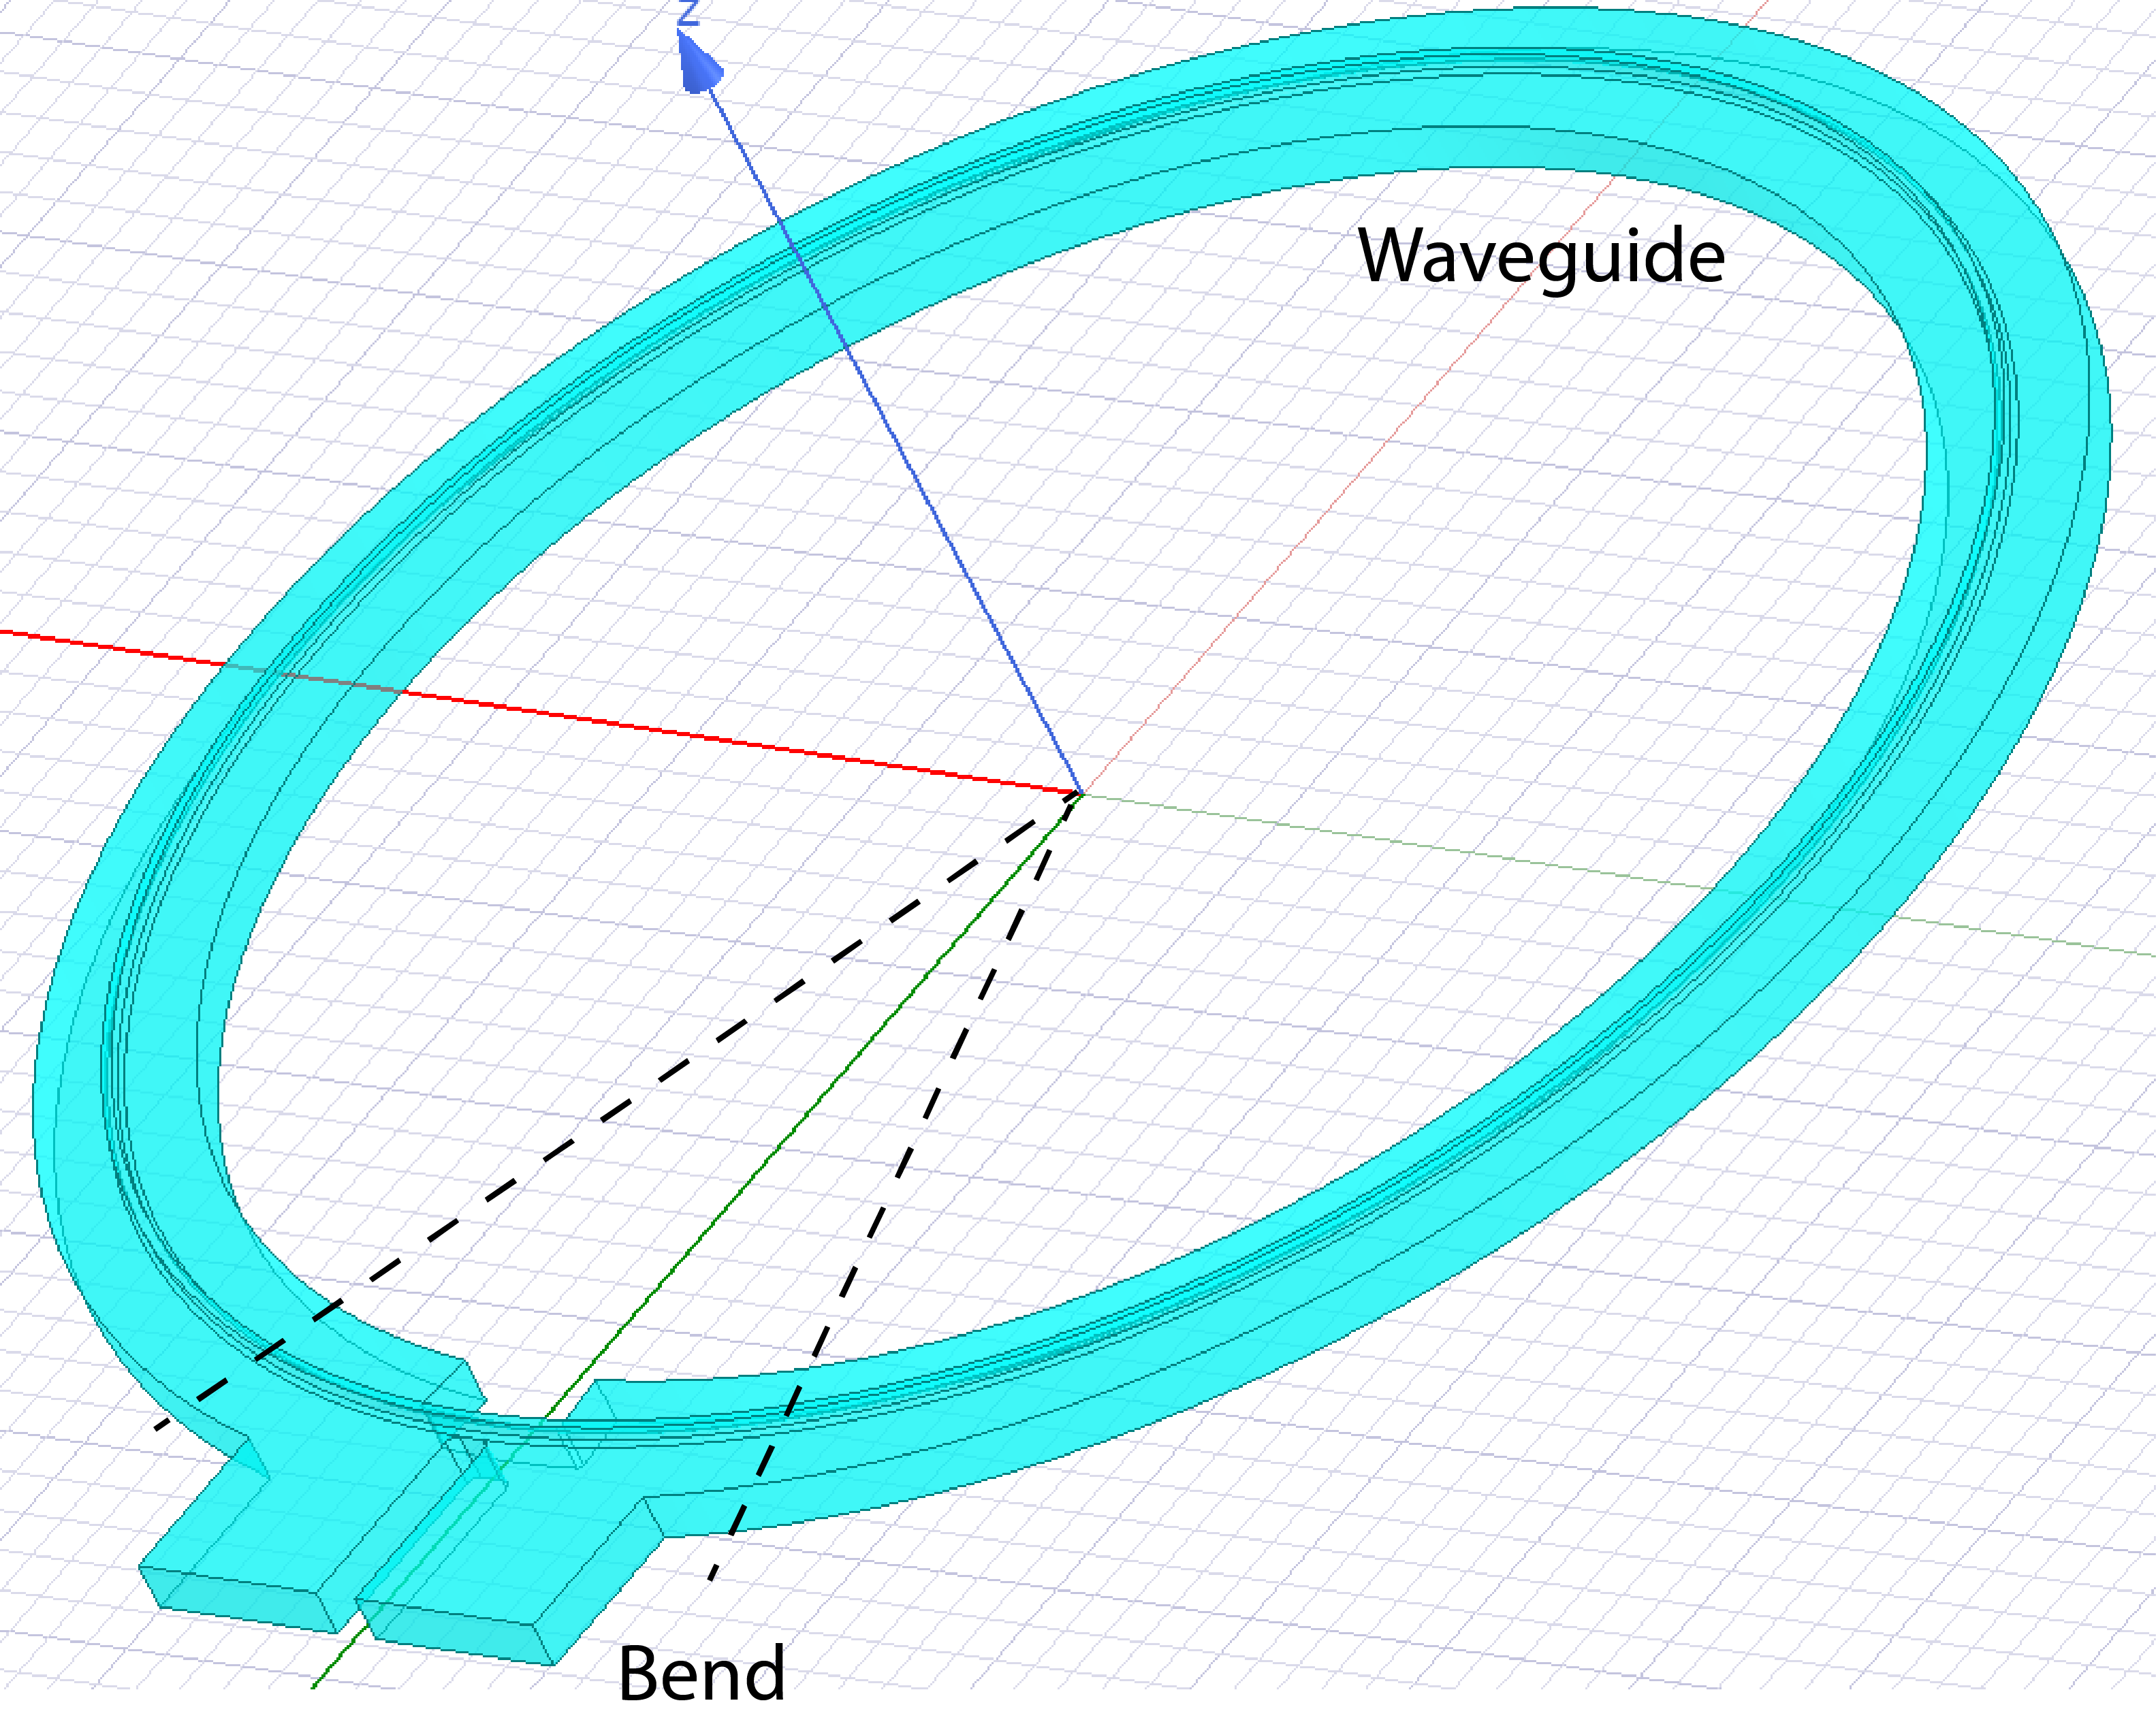
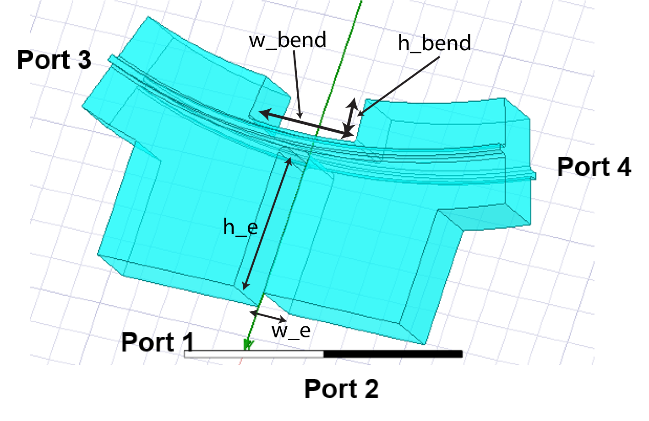
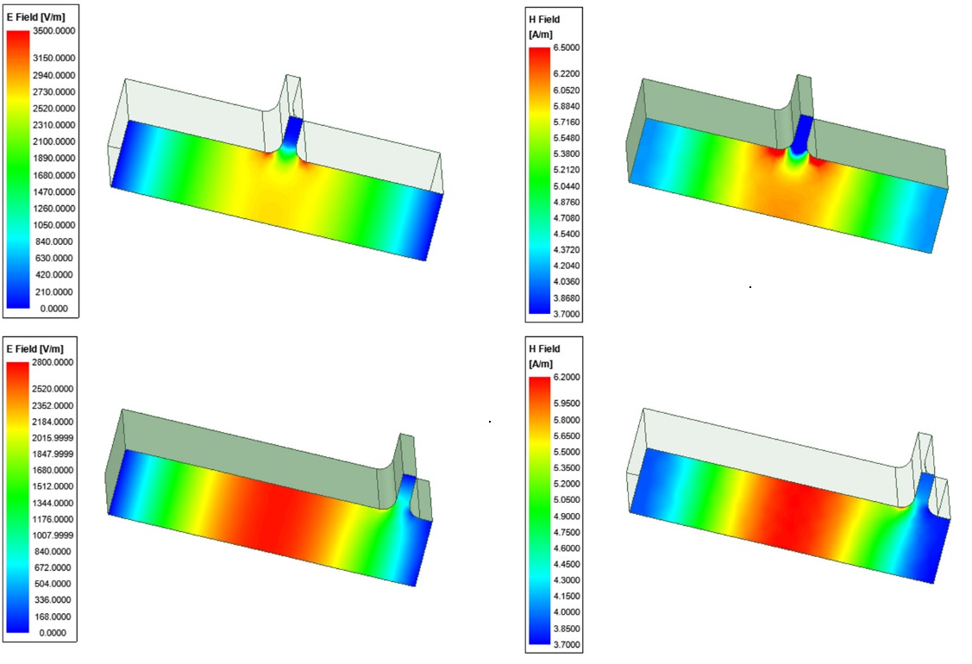
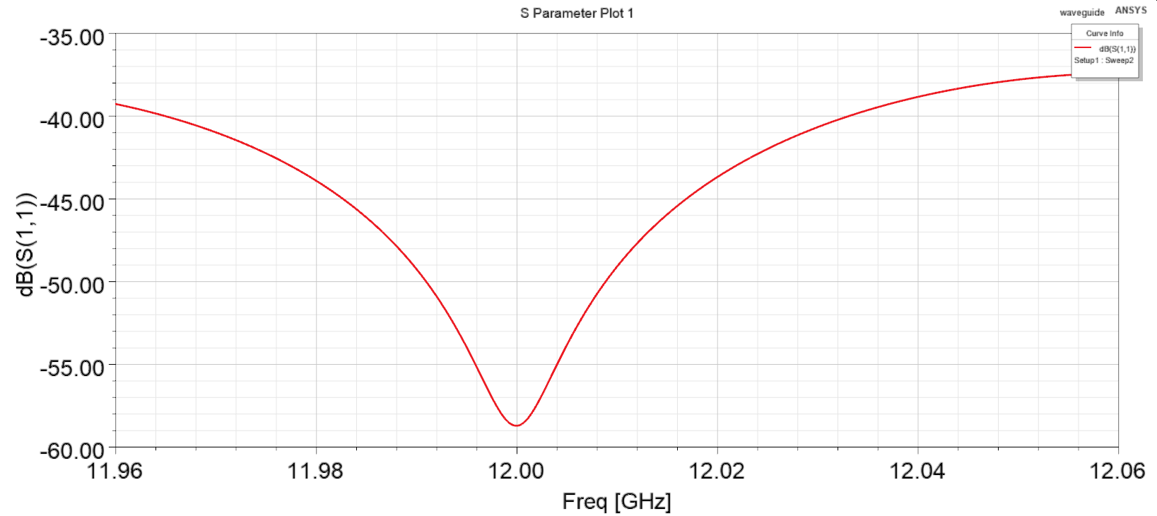
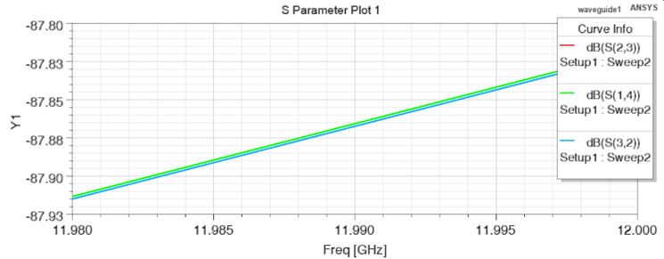


DESIGN OF THE FEEDING WAVEGUIDE AND THE BEND
For implementation brazeless assembly, gap has been introduced in the waveguide and in the bend.
Waveguide and bend
Bend
Gap has been optimized in such way
to reduce field penetration
Also different gap positions has been studied
$$S_{11}< \sim −40dB$$
No crosstalk between ports $< \sim −87dB$

Slide 14
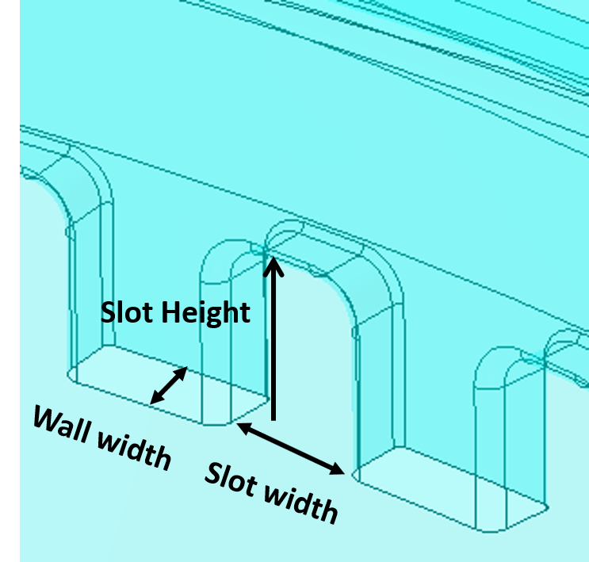
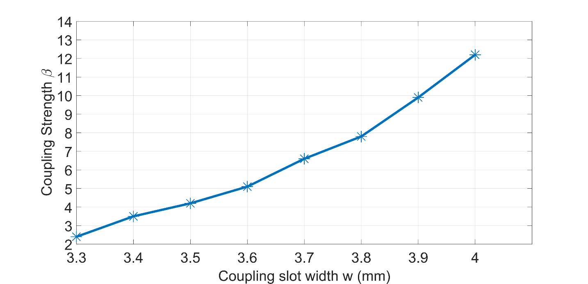
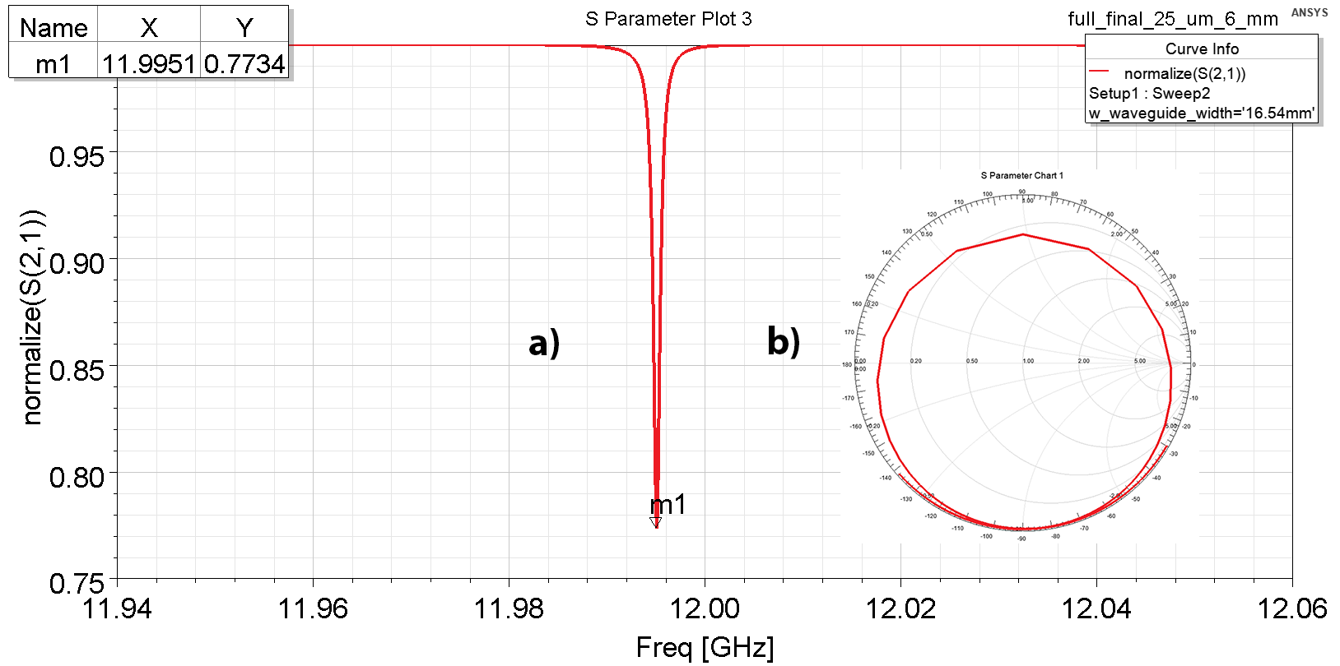
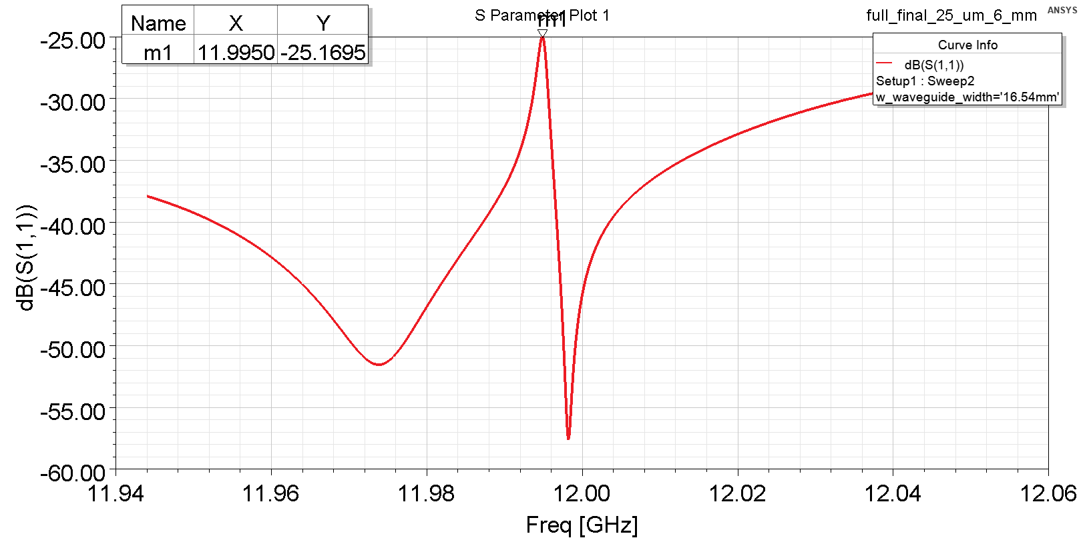

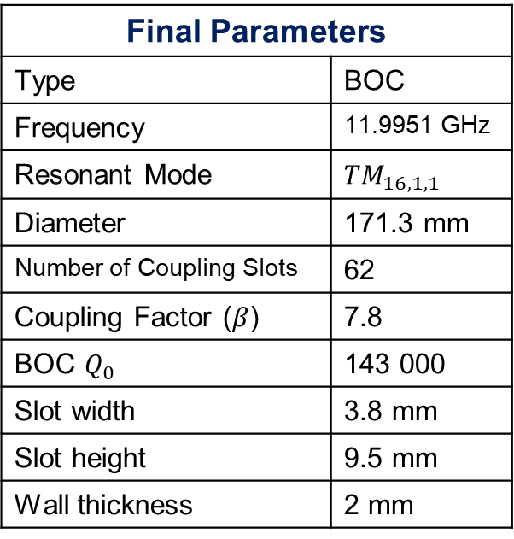


EM SIMULATION FOR COUPLING DESIGN
Coupling coefficient for different coupling slot width has been studied, for each change of waveguide width has
been reoptimized. Final results are shown below: $S_{21 }=0.7734 ⇒ β=7.8$
Parametrized coupling slot
$β$ versus slot width
Final Parameters
Type | BOC
Frequency | 11.9951 GHz
Resonant Mode | $${TM}_{16,1,1}$$
Diameter | 171.3 mm
Number of Coupling Slots | 62
Coupling Factor ($β$) | 7.8
BOC $Q_{0}$ | 143 000
Slot width | 3.8 mm
Slot height | 9.5 mm
Wall thickness | 2 mm
Transmission Coefficient $S_{21}=0.77$
Reflection Coefficient $S_{11}<−25 dB$

Slide 15
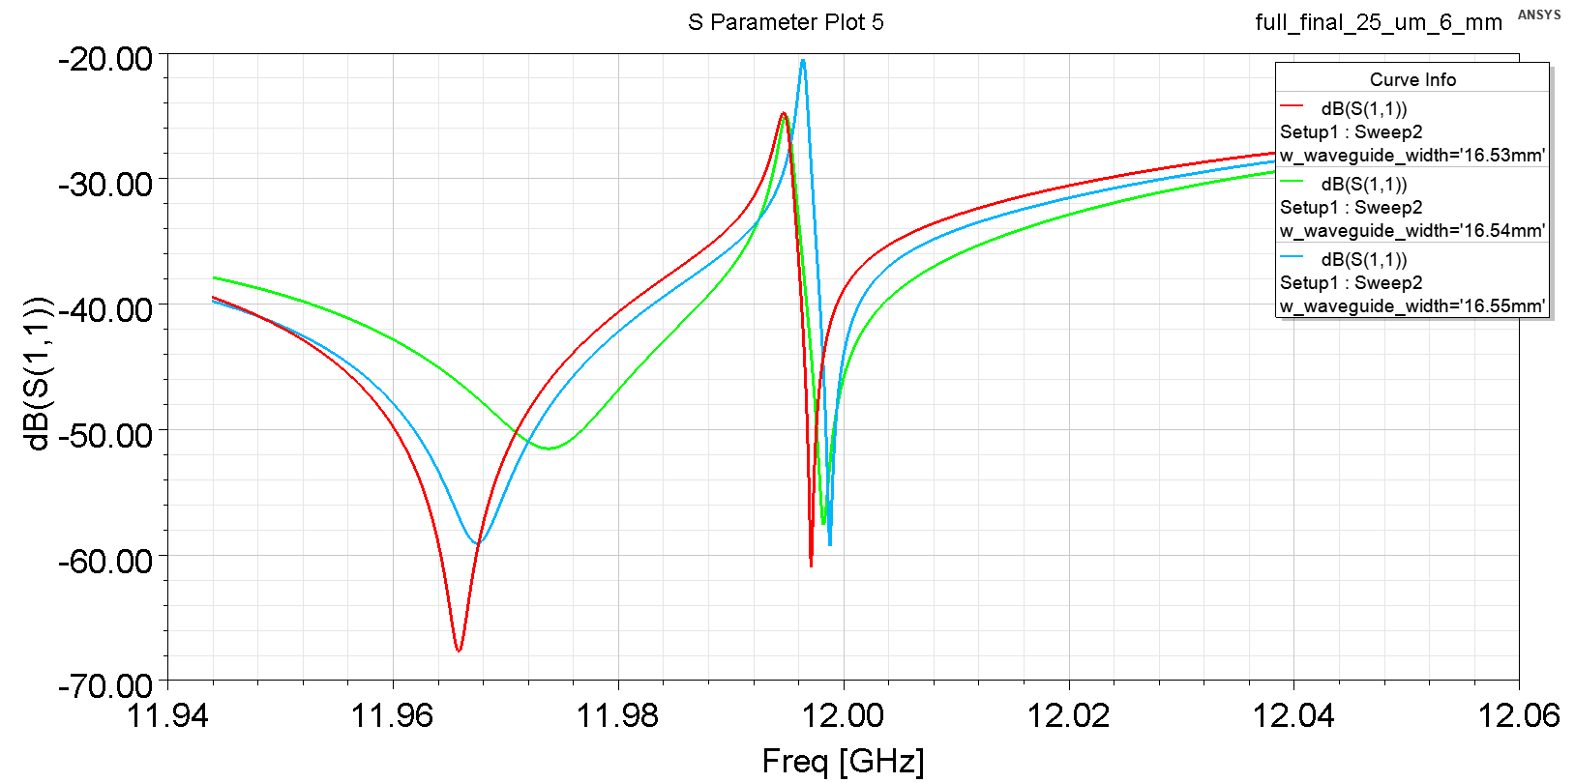

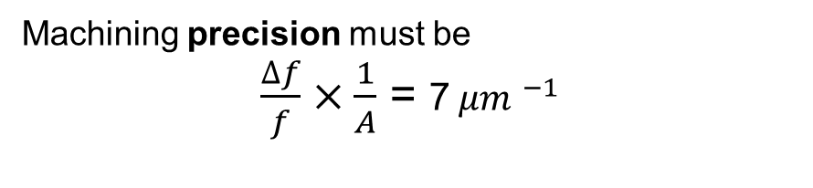
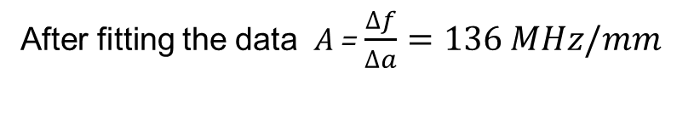
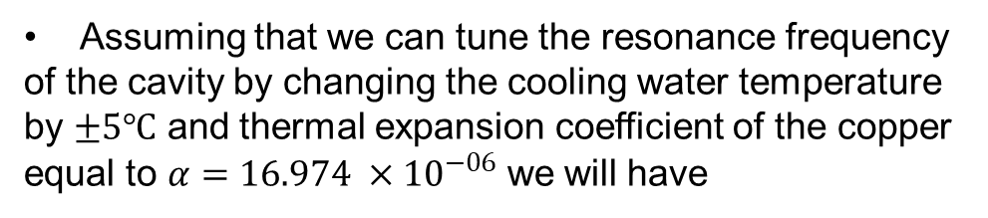
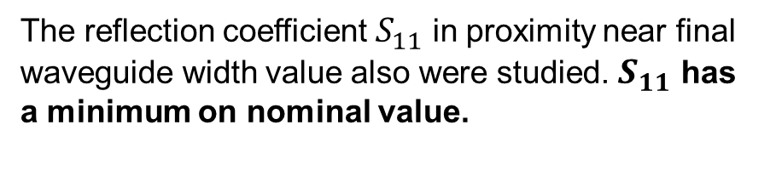
SENSITIVITY STUDIES
Assuming that we can tune the resonance frequency
of the cavity by changing the cooling water temperature
by $±5℃$ and thermal expansion coefficient of the copper equal to $α=16.974 ×{10}^{−06}$ we will have
Machining precision must be
$\frac{∆f}{f}×\frac{1}{A}$ = ${\text{7} μm }^{−1}$
$\frac{∆f}{f}$ = $α ×T= ±1 MHz$
The reflection coefficient $S_{11}$ in proximity near final
waveguide width value also were studied. $S_{11}$ has
a minimum on nominal value.
The most critical geometrical parameters in the sensitivity calculation is the cavity large radius a.
After fitting the data A = $\frac{∆f}{∆a}=136 MHz/mm$

Slide 16
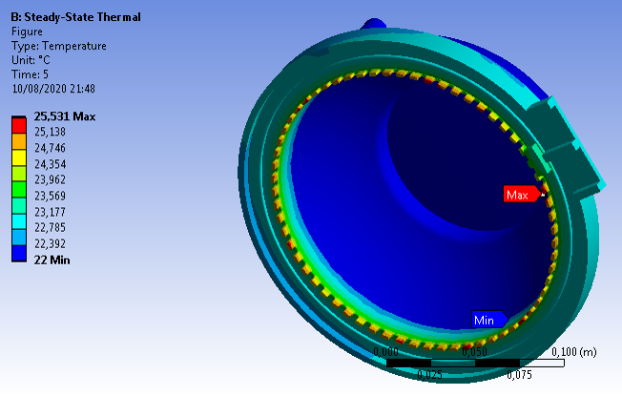
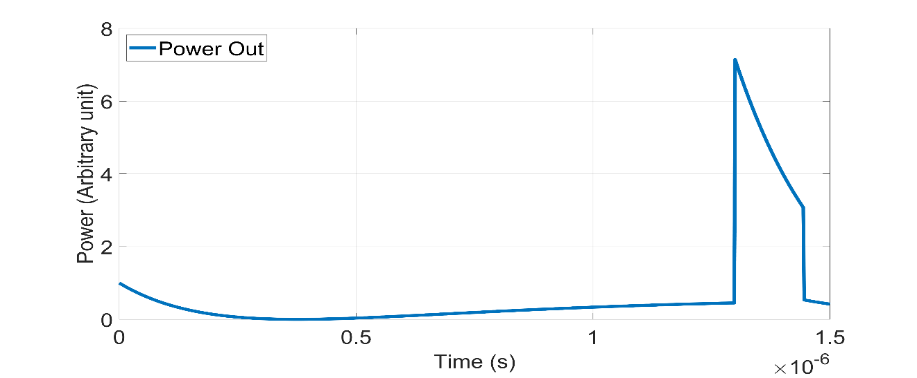
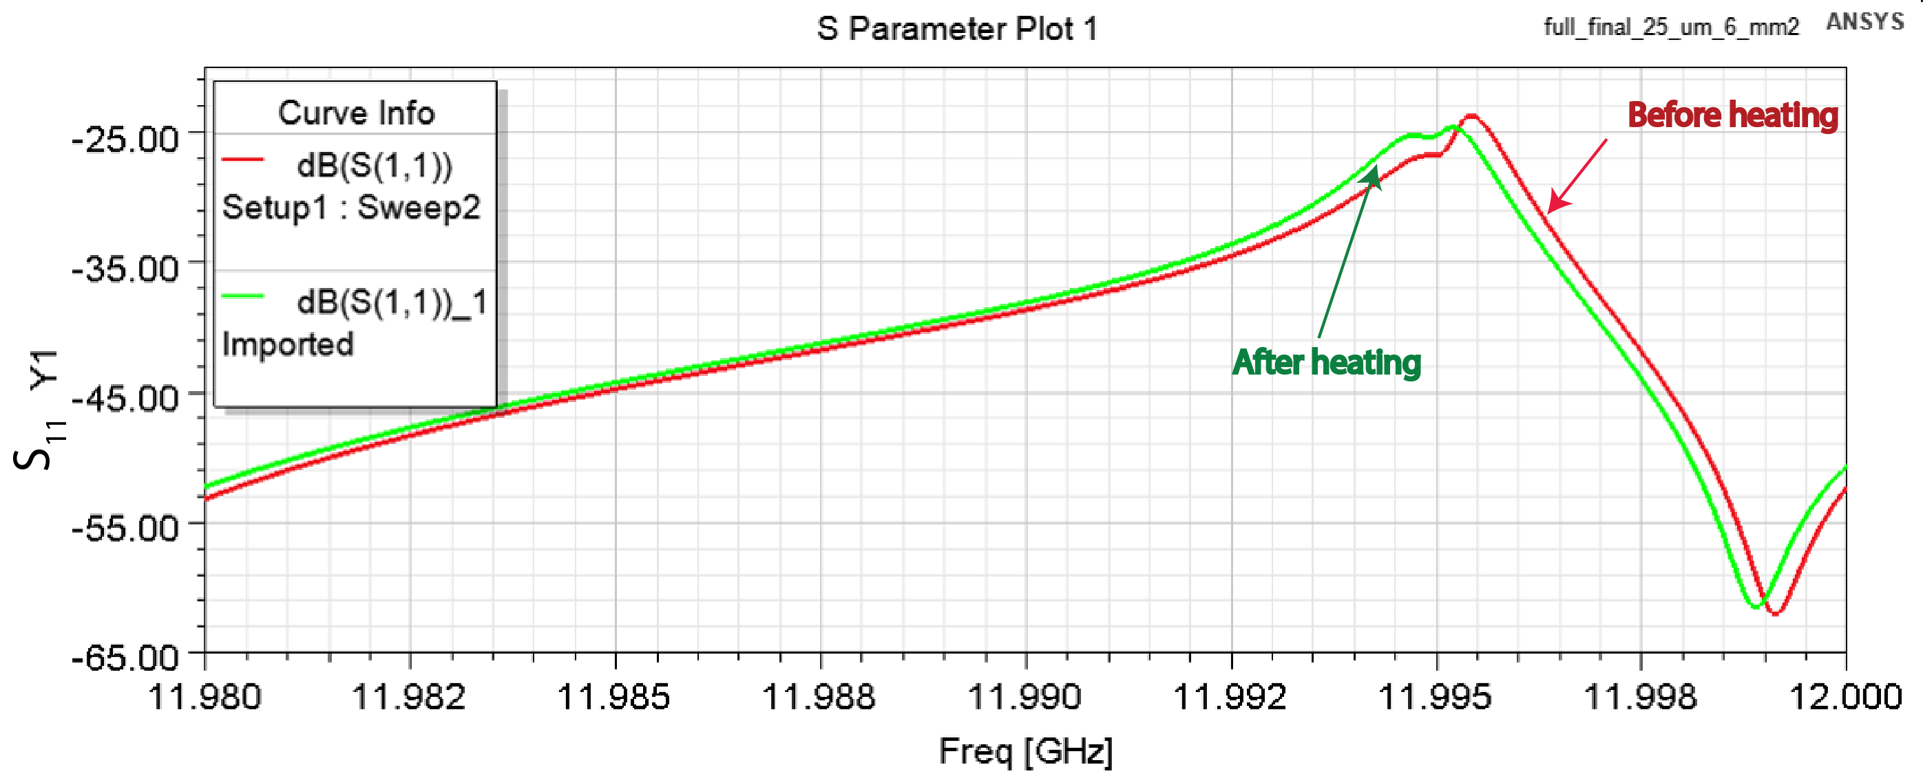
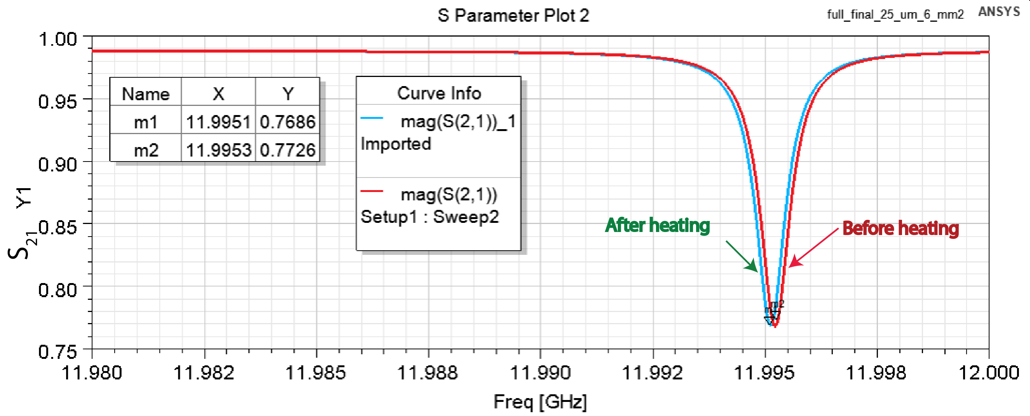
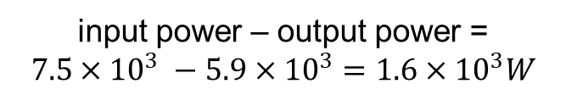
THERMO-MECHANICAL SIMULATIONS
Dissipated power
Heating the structure
Deformation due to heat
input power – output power =
$$7.5×{10}^{3} −5.9×{10}^{3}=1.6×{10}^{3}W$$
The change of scattering parameters
The cooling water temperature was set to 22 $℃$

Slide 17
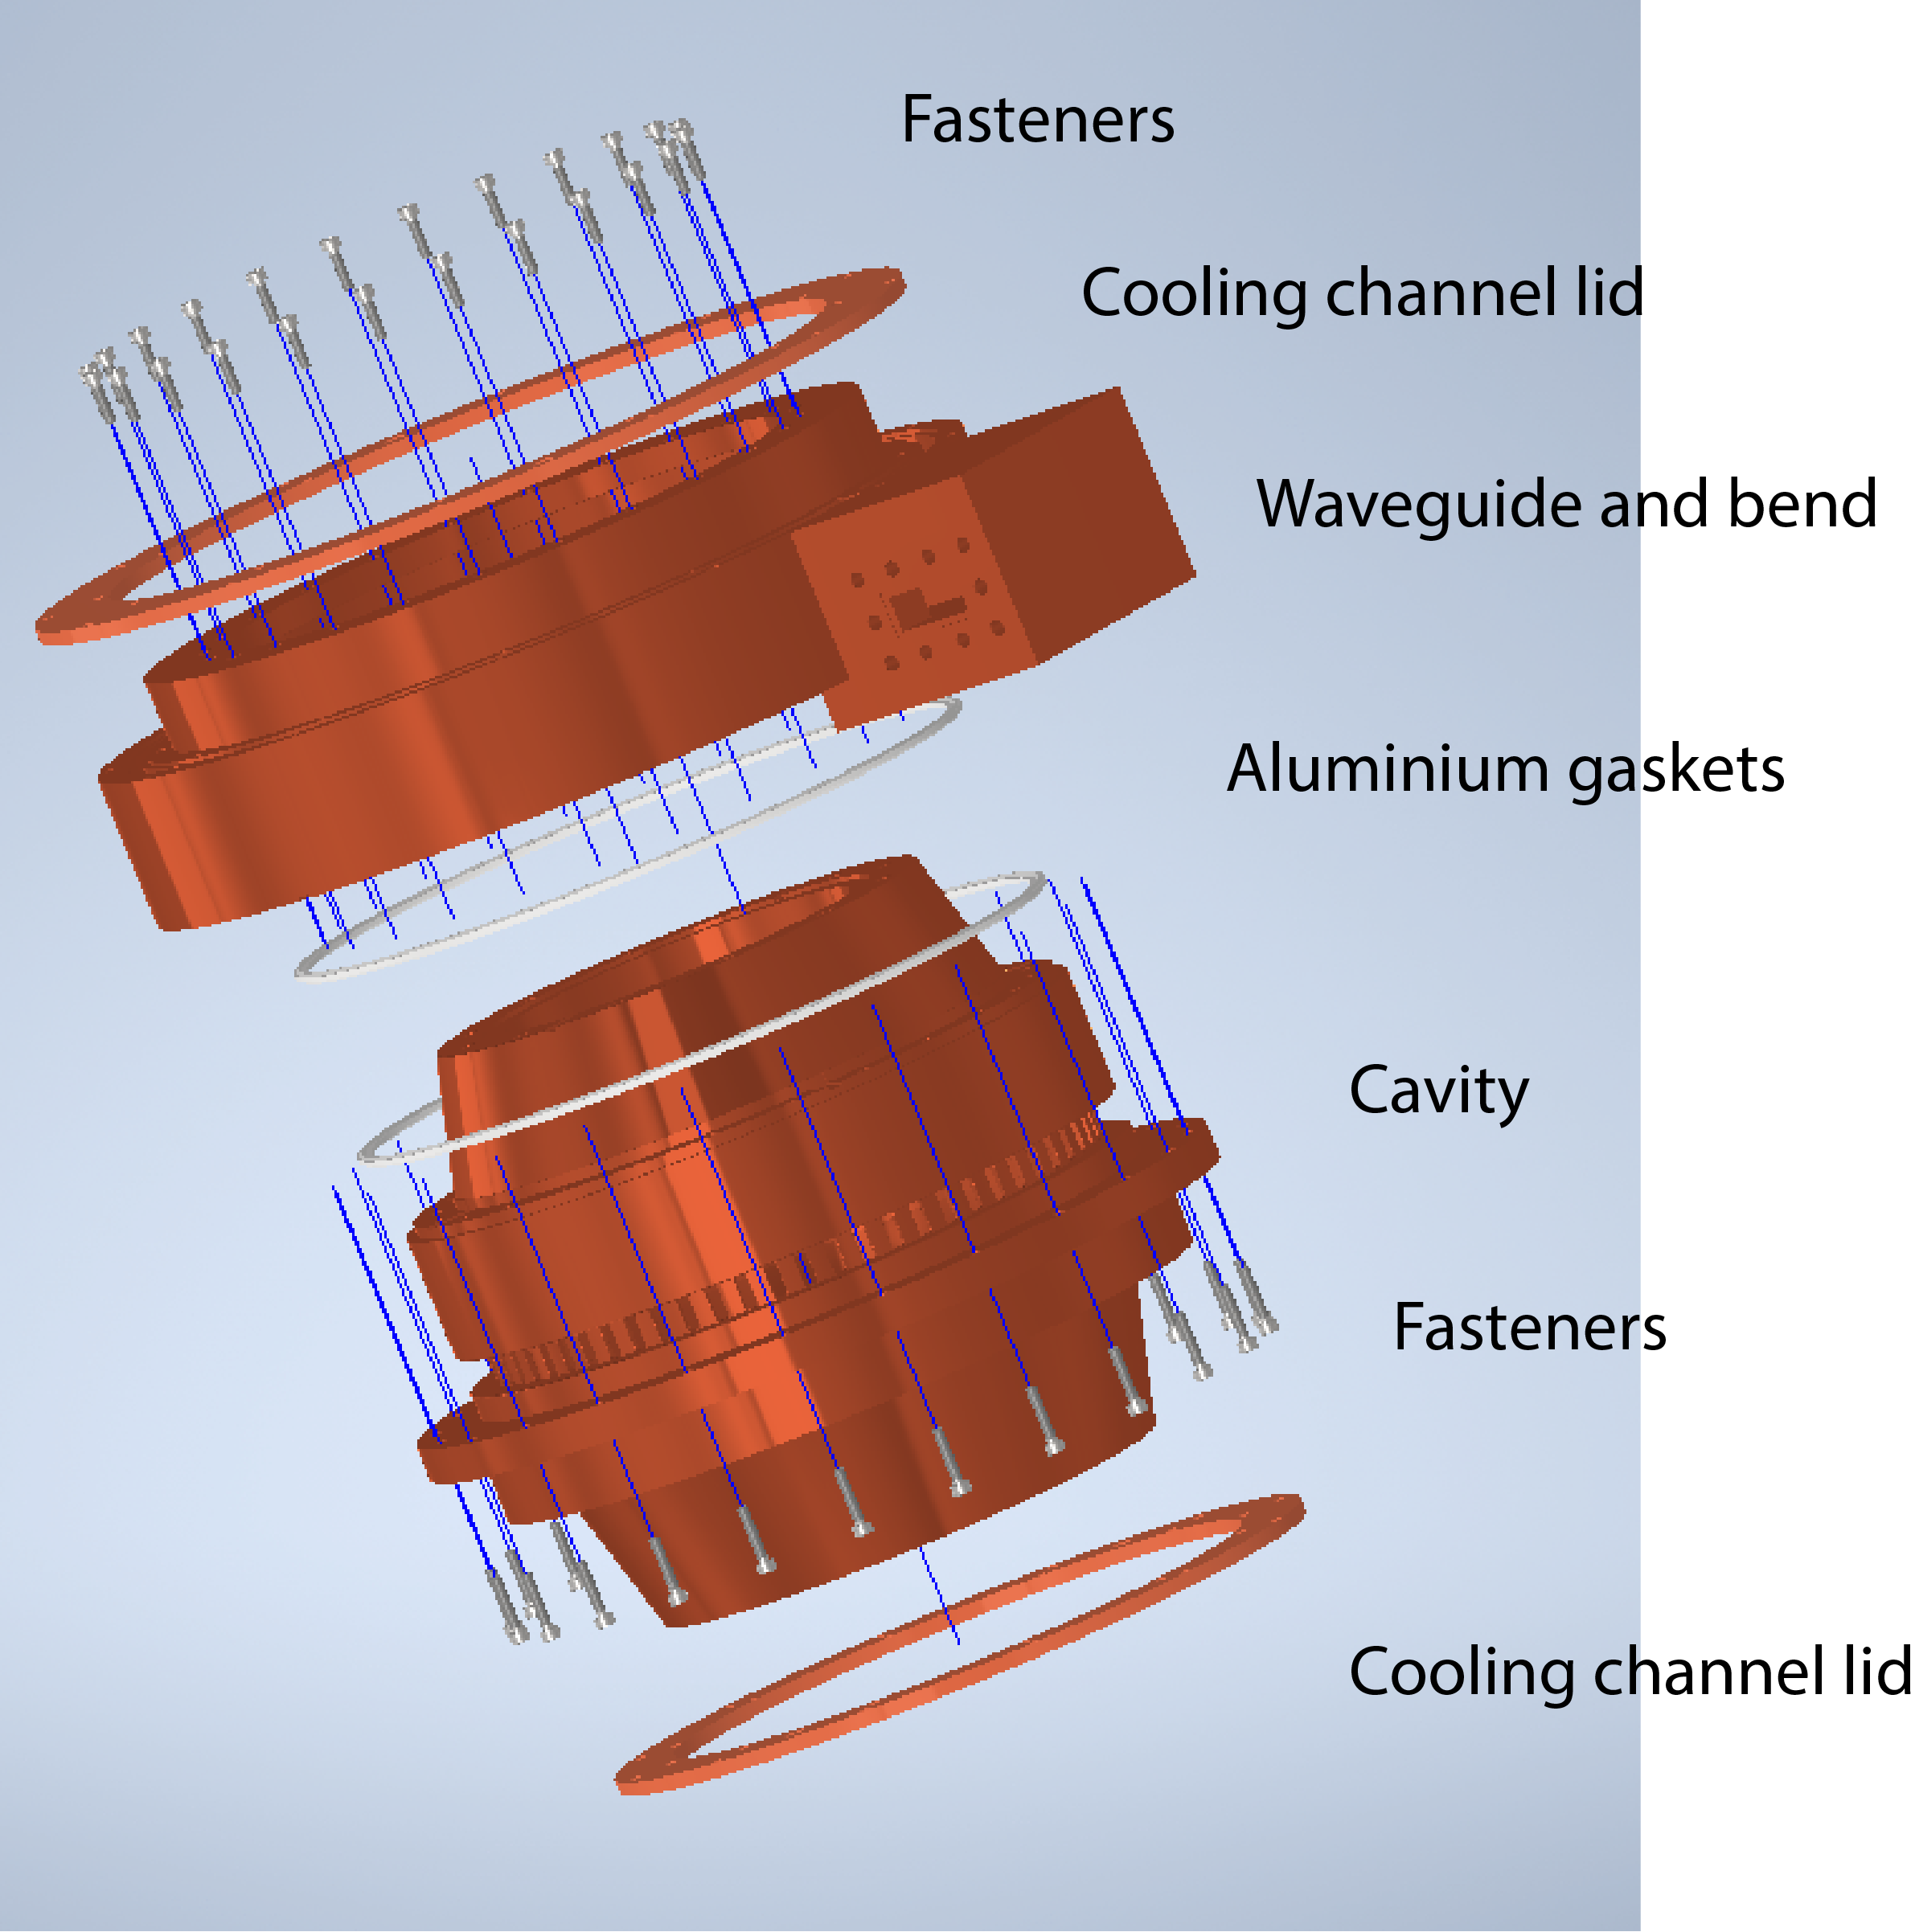
MECHANICAL DESIGN
In the overall design a continuous feedback between the electromagnetic design and the mechanical model has been necessary to match electromagnetic and mechanical constraints.
The structure is composed by a main cavity and coupler waveguide with bend. They are connected with 24 screw holes disposed at 15° to one another to provide homogeneous force on the gasket when the cells are clamped together.
Each parts will be fabricated from cylinders of Oxygen Free High Conductivity (OFHC) copper using high precision lathe and milling machines.

Slide 18


BOC PULSE COMPRESSOR DESIGN FOR
STANDING WAVE RF STRUCTURES
SW cavities are typically feed through circulators (or isolators) in order to protect the klystron from the reflected power during RF transients.
Commercially, circulators are available at different frequencies, as example in L or S band,
Circulators are not available at higher frequencies as in the case of C or X band,
Alternative feeding scheme, which avoids circulator or isolator, can be realized with pulse compressor and power splitter.
If rf pulse compressor amplifies the klystron power by a factor $F$ and the power is then splitted by a power splitter by a factor $S$. The reflections from the SW structure back to the klystron are then reduced by a factor $F/S^{2}$ because of the presence of the power splitter itself.
The residual power from the splitter $F×(1 − 1/S)$ can be either dissipated into a rf load or, more conveniently, used to feed another TW cavity (that hasn’t reflections).

Slide 19


RF-GUNS
RF Photo-guns are electron sources widely used in modern facilities and finds applications as injectors for FELs, THz and Compton sources allowing reaching very high beam brightness.
A laser pulse of a suitable wavelength extracts the electrons from a cathode embedded in an RF cavity called RF Gun
An external RF power source excites the cavity accelerating mode so that the photo-electrons are immediately accelerated by the RF electric field on the cathode and all along the gun beam axis
Presently, the RF technology mostly used for RF Guns is the L or S-band (f=1.3 or 3 GHz).
According to beam dynamics studies, the higher the peak electric field on the cathode, the better is the quality of the beam emerging from the Gun. In this respect the S-band represents the state-of-the-art, providing typical peak fields of ≈120 MV/m on the cathode.

Slide 20


THE C BAND GUN
Main Parameters
C band gun
Recently the idea to implement rf guns operating in C-band RF ($F= 5.712 GHz$) has been developed.
C band is a more recent technology whose reliability and effectiveness have been already fully demonstrated.
Frequency step-up from S-band to C-band can provide an improvement of the photo-injector beam quality.
This is mainly related to the filling time reduction in case of SW cavities, corresponding to an RF pulse duration shortening, which scales as $f^{−3/2}$, and to the increase of the RF structure efficiency (the shunt impedance per unit length) which scales as $f^{1/2}$ and allows saving RF power to reach the design peak field.
In the framework of the XLS-Compact Light design study and of the EuPRAXIA@SPARC_LAB proposal a new SW C band gun has been proposed.
Working frequency [GHz] | 5.712
$E_{cath}$/${P_{diss}}^{1/2}$ $[MV/(mMW^{1/2})]$ | 52
RF input power [MW] | 18
Cathode peak field [MV/m] | 160
Cathode type | Copper
Rep. rate [Hz] | 100
Quality factor | 11800
Filling time [ns] | 164
Coupling coefficient | 3
RF pulse length [ns] | 300
$E_{surf}$/$E_{cath}$ | 0.9
Modified Poynting vector [W/μm2] | 2.5
Pulsed heating [C] <20 | 20
Average diss. Power [W] | 230

Slide 21






OPTIMIZATION OF THE BOC FOR C BAND GUN
Field reflected from the cavity
Cathode peak fields for different coupling coefficient and phase jump time have been calculated
$$T_{c}\frac{dE_{e}}{dt}+E_{e}=−αE_{i}$$
$E_{i}$ is BOC output, which feeds the SW structure.
Dissipated power in the cavity
$$P_{diss. }= {E_{e}^{2}/Q}_{0}$$
Cathode peak field of the rf-gun is
$$E_{cathode}=52 × {P_{diss. }}^{1/2}$$
C band klystron with $50 MW$output power, 2.5 $μs$ rf pulse length.
If the BOC coupling coefficient is equal to 12 and a phase jump time ($t_{f}$) is 2.2 $μs,$ $E_{cath.}/\sqrt{P_{in}}$is equal to $80 MV/(m{MW}^{1/2})$.
If splitter has a splitting factor $S = 12.5,$cathode peak field will be equal $160 MV/m$ and a peak reflected power to the klystron equal to$\sim 340MW/S^{2} \sim 2 MW$. It is a reasonable value of the reflected power also because of the very short pulse duration.

Slide 22






ELECTROMAGNETIC DESIGN OF BOC FOR C BAND GUN FEEDING
Fully Parameterized Geometry
The design of the BOC has been performed in ANSYS-HFSS
Electric field inside the simulated half geometry
Final Parameters
Type | BOC
Frequency | 5.712 GHz
Resonant Mode | $${TM}_{18,1,1}$$
$a$ radius | 199.70 mm
Number of Coupling Slots | 70
Coupling Factor ($β$) | 13.3
BOC $Q_{0}$ | 210 500
Slot width | 7 mm
Slot height | 19 mm
Wall thickness | 3 mm
$S_{21 }$=$0.86 dB ⇒ β=\text{13.3}$
$$S_{11 }<−25dB$$

Slide 23
CONCLUSION AND PERSPECTIVES
This work has been done in the framework of the EuPRAXIA@SPARC_LAB
Concerning X band BOC I have:
optimized X band pulse compressor for X band TW structures
completely designed BOC from EM point of view, allowing the implementation brazing free LNF-INFN technology
performed Thermo-mechanical and sensitivity studies
designed a BOC mechanical point view
The BOC pulse compressor is now ready for construction with the new technology
Concerning C band BOC I have:
Optimized pulse compressor parameters by writing dedicated MATLAB code, to feed the SW structures (RF guns) and avoid the use of circulators
Designed C band BOC from EM point of view
Next steps foreseen:
Realization of first prototype of the X band BOC to be tested at low and high power.
Scale X band mechanical design I have done for C band BOC implementation.

Slide 24
Thank you for your attention !

