Slide 1



Single shot diagnostics for plasma accelerated beams
Advisors:
Prof. Massimo Ferrario
Prof. Alessandro Cianchi
Candidate:
Matteo Cesarini
Ph.D. in accelerator physics, thesis discussion, Sapienza, 30/06/2021

Slide 2
Introduction
  The plasma acceleration
OTR based diagnostics
  OTR: theory and diagnostic applications
  Angular distributions measurement
  Emittance measurement
A new innovative scheme: concept and simulation
  The micro-lenses array for the correlation term
  Theorical single-shot measurement setup
  The need of a polarizer
The measurement
  Experimental setup at SPARC_LAB
  Case of study: simulation
  Data analysis
  Results
Conclusions

Slide 3
Introduction
  The plasma acceleration
OTR based diagnostics
  OTR: theory and diagnostic applications
  Angular distributions measurement
  Emittance measurement
A new innovative scheme: concept and simulation
  The micro-lenses array for the correlation term
  Theorical single-shot measurement setup
  The need of a polarizer
The measurement
  Experimental setup at SPARC_LAB
  Case of study: simulation
  Data analysis
  Results
Conclusions

Slide 4
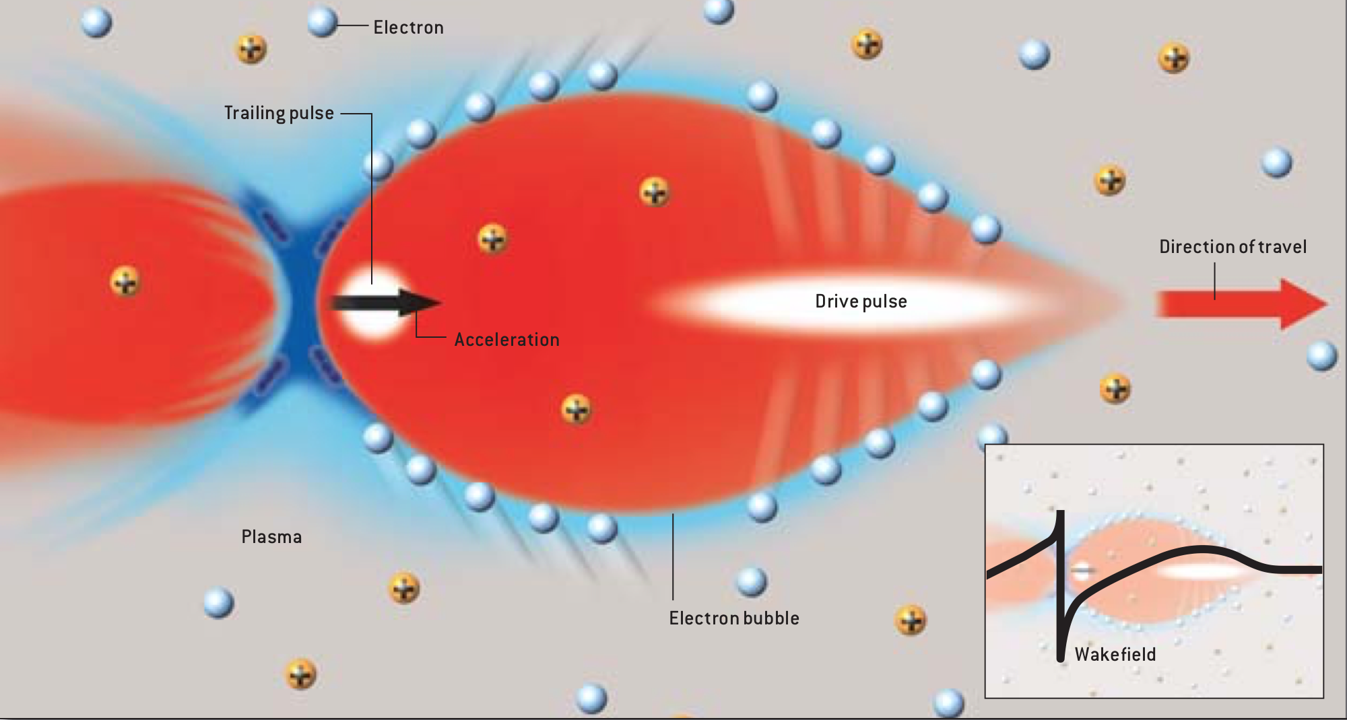
The plasma acceleration

Slide 5
The plasma acceleration
The plasma acceleration leads to a reduction of the machine dimensions.
The first plasma based accelerators suffer from instability.
The diagnostics are required to be as compact as possible.
There is the need to use diagnostics that allow a single shot characterization of the beam.

Slide 6
Introduction
  The plasma acceleration
OTR based diagnostics
  OTR: theory and diagnostic applications
  Angular distributions measurement
  Emittance measurement
A new innovative scheme: concept and simulation
  The micro-lenses array for the correlation term
  Theorical single-shot measurement setup
  The need of a polarizer
The measurement
  Experimental setup at SPARC_LAB
  Case of study: simulation
  Data analysis
  Results
Conclusions

Slide 7
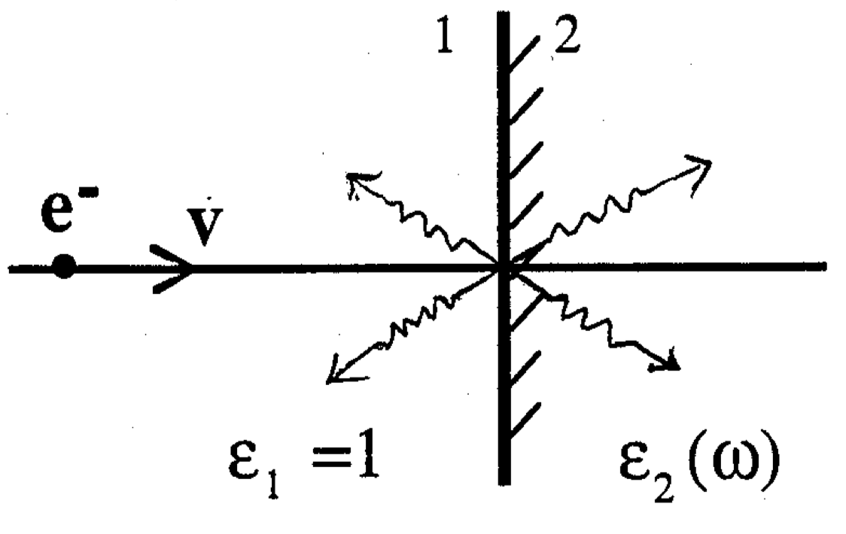
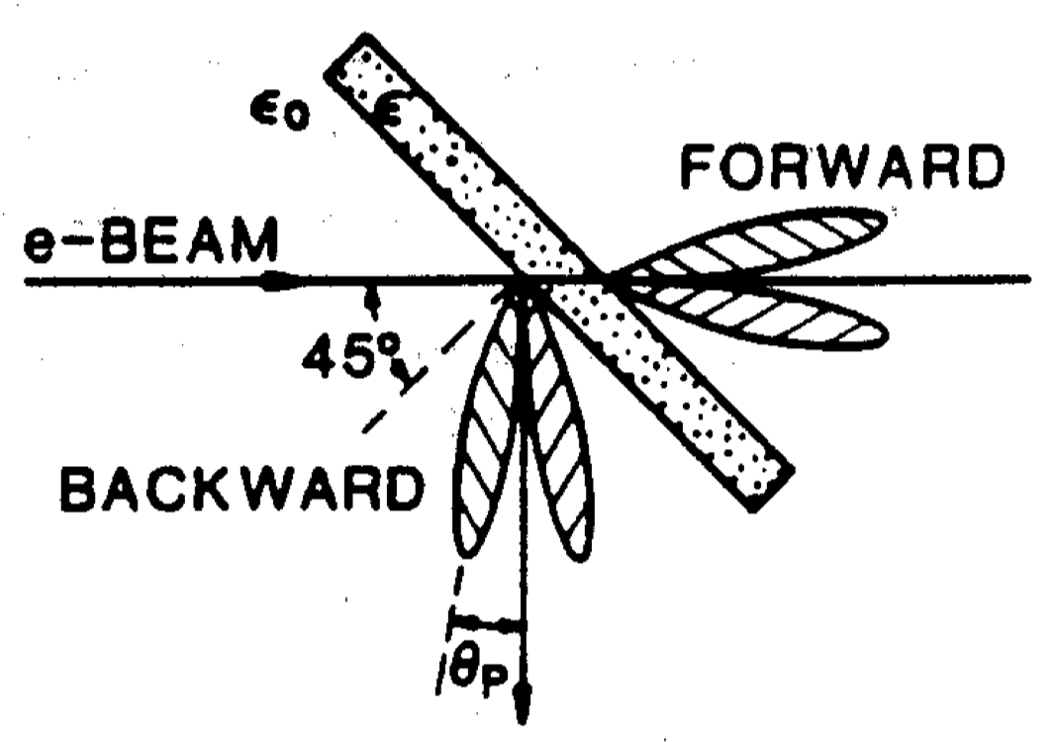
OTR: theory and diagnostic applications
A charged particle passing through the boundary between two media with different optical properties generates transition radiation. For beam diagnostics purposes, only the visible part of the radiation is used.
The backward radiation, produced by a thin metallic foil is normally used to measure the beam spot, by means of an imaging system.
The main advantage of OTR is the instantaneous emission process which makes it suitable for single shot diagnostic measurements.
The main drawback is the low radiation intensity, with respect for example to the scintillator screens, widely used for the beam spot measurement.

Slide 8
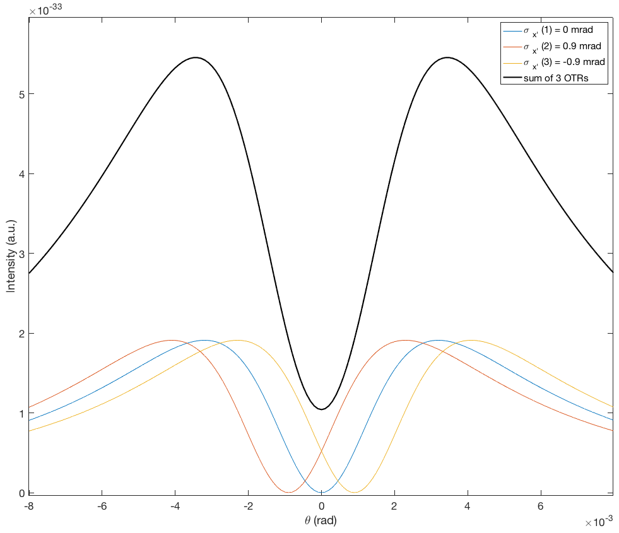
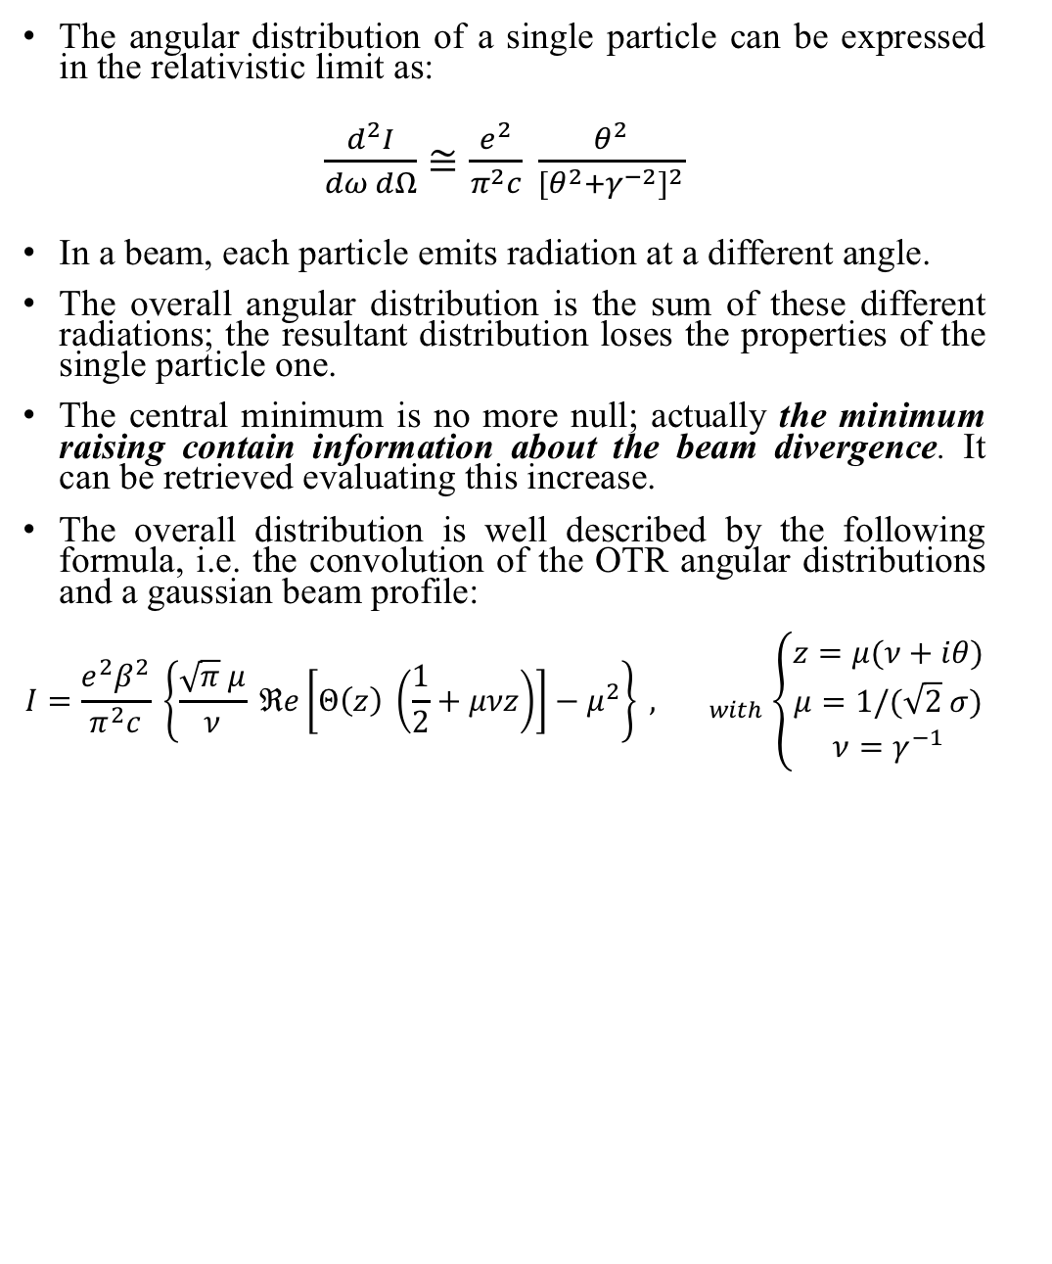
Angular distributions measurement
The angular distribution of a single particle can be expressed in the relativistic limit as:
$\frac{d^{2}I}{dω dΩ}≅\frac{e^{2}}{π^{2}c} \frac{θ^{2}}{{{[θ}^{2}+γ^{−2}]}^{2}}$
In a beam, each particle emits radiation at a different angle.
The overall angular distribution is the sum of these different radiations; the resultant distribution loses the properties of the single particle one.
The central minimum is no more null; actually the minimum raising contain information about the beam divergence. It can be retrieved evaluating this increase.
The overall distribution is well described by the following formula, i.e. the convolution of the OTR angular distributions and a gaussian beam profile:
$$I=\frac{e^{2}β^{2}}{π^{2}c} \left\{\frac{\sqrt{π} μ}{ν} ℜe\left[Θ\left(z\right) \left(\frac{1}{2}+μνz\right)\right]−μ^{2}\right\} ,{ }_{with }\left\{\begin{aligned}z=μ(ν+iθ) \\ μ=1/(\sqrt{2} σ) \\ ν=γ^{−1}\end{aligned}\right.$$

Slide 9
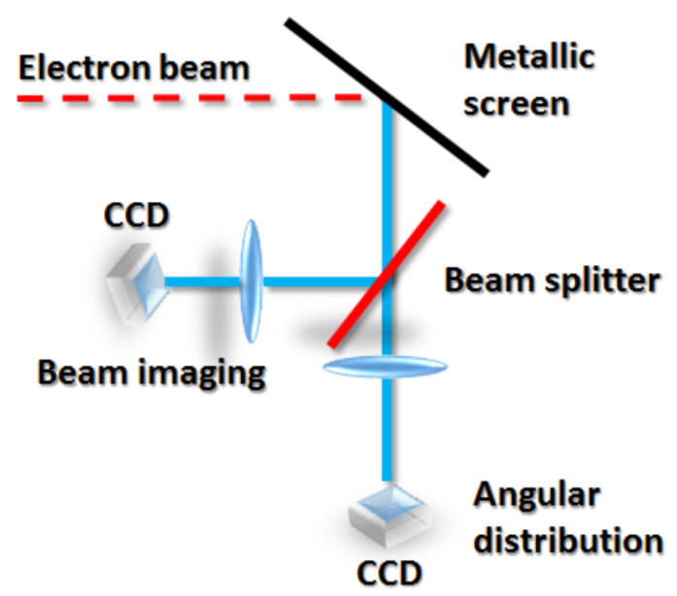
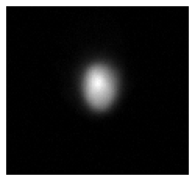
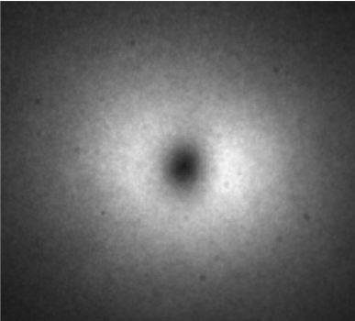
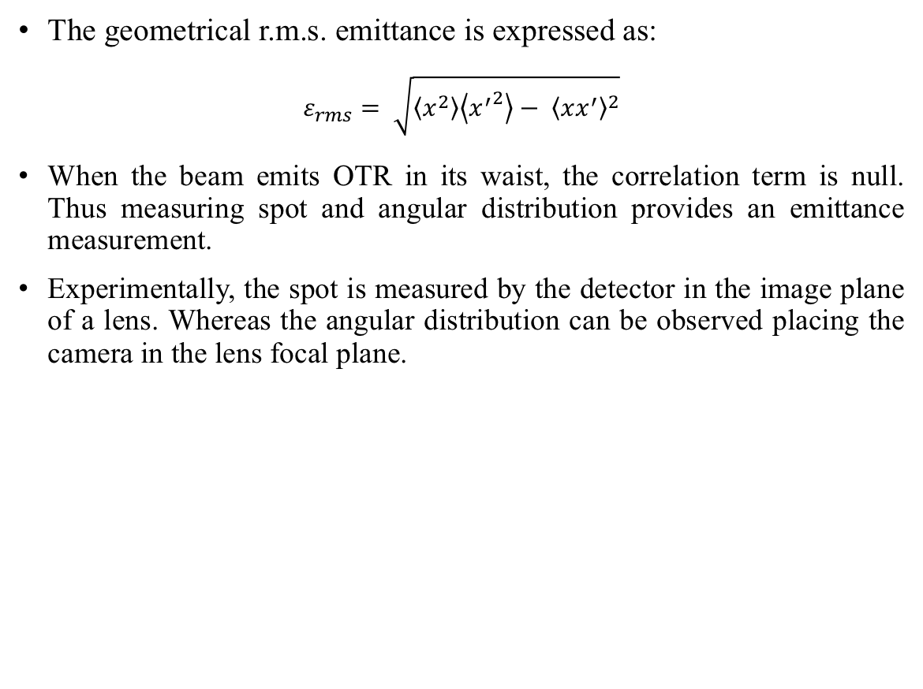
Emittance measurement
The geometrical r.m.s. emittance is expressed as:
$$ε_{rms}= \sqrt{\left\langle x^{2}\right\rangle \left\langle {x^{′}}^{2}\right\rangle − {\left\langle xx^{′}\right\rangle }^{2}}$$
When the beam emits OTR in its waist, the correlation term is null. Thus measuring spot and angular distribution provides an emittance measurement.
Experimentally, the spot is measured by the detector in the image plane of a lens. Whereas the angular distribution can be observed placing the camera in the lens focal plane.
Beam spot
OTR angular distribution

Slide 10
Introduction
  The plasma acceleration
OTR based diagnostics
  OTR: theory and diagnostic applications
  Angular distributions measurement
  Emittance measurement
A new innovative scheme: concept and simulation
  The micro-lenses array for the correlation term
  Theorical single-shot measurement setup
  The need of a polarizer
The measurement
  Experimental setup at SPARC_LAB
  Case of study: simulation
  Data analysis
  Results
Conclusions

Slide 11
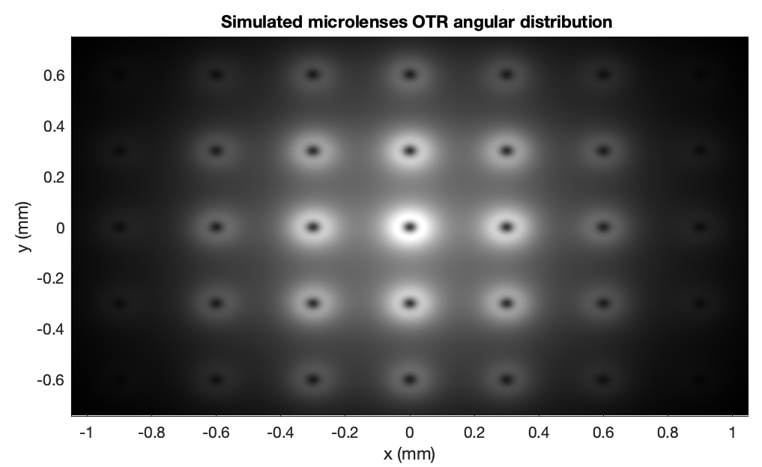
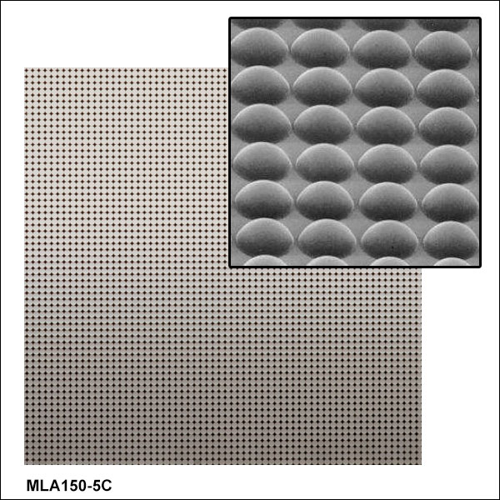
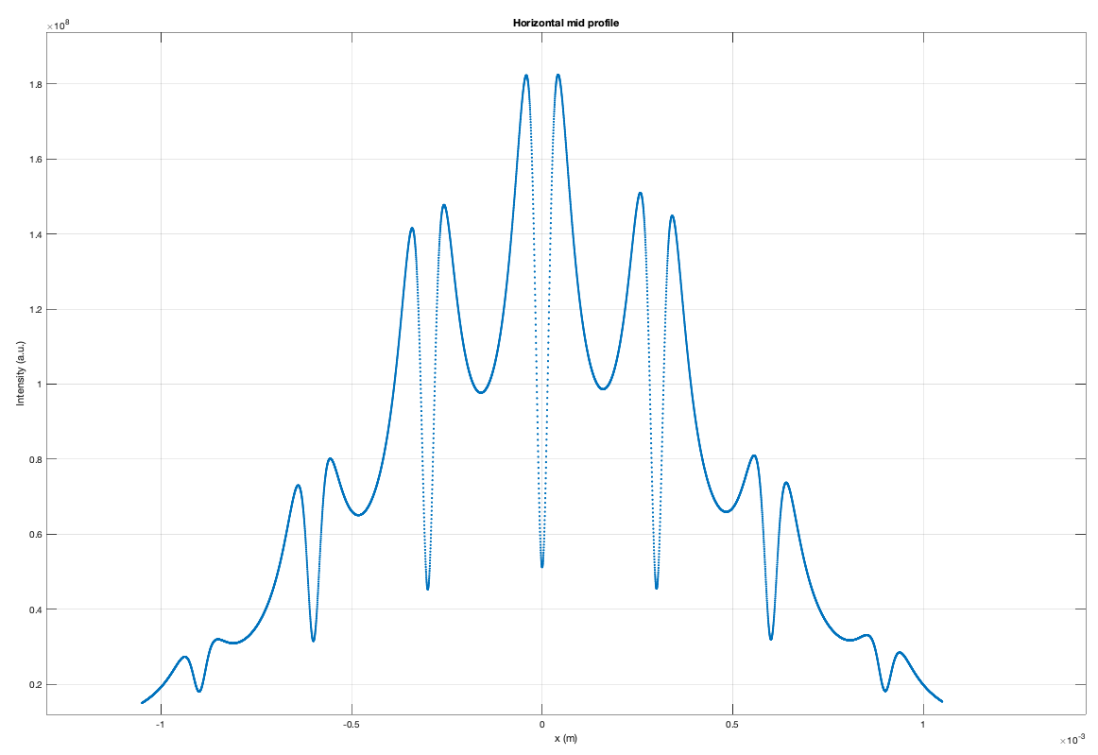
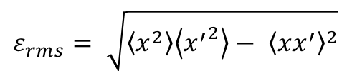
The micro-lenses array for the correlation term
For the correlation term of the r.m.s. emittance, the measurement of the divergence in different transverse positions of the beam is needed.
A micro-lenses array accomplishes this feature: each lens provides an angular distribution of the light from different transverse parts is directed on it.
In order to compute the divergence in the proper transversal position, an image of the beam OTR on the micro-lenses array is created by using a lens.
The overall profile obtained is analyzed to retrieve the term.
$$ε_{rms}= \sqrt{\left\langle x^{2}\right\rangle \left\langle {x^{′}}^{2}\right\rangle − {\left\langle xx^{′}\right\rangle }^{2}}$$

Slide 12
Theorical single-shot measurement setup
Beam splitter
Beam splitter
Metallic screen
Microlenses array
CCD
Imaging lens
Imaging lens for the microlenses focal plane
Lens for
angular distribution
Lens for
beam imaging
Correlation
Electron beam
CCD
CCD
Spot
Divergence

Slide 13
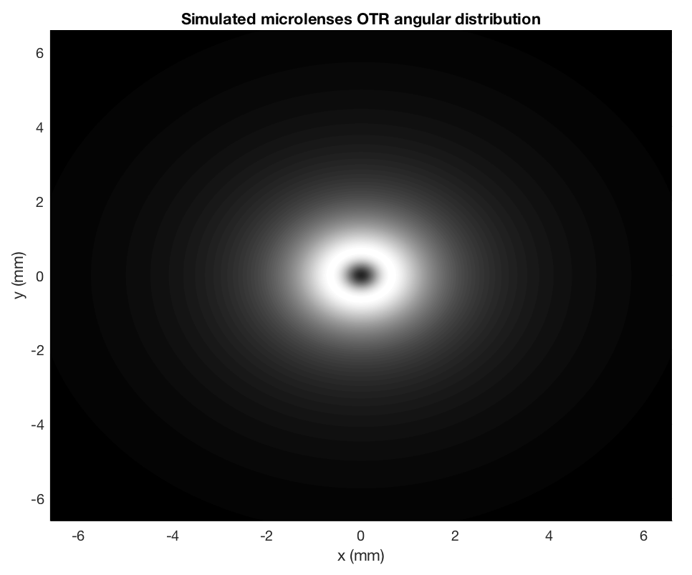
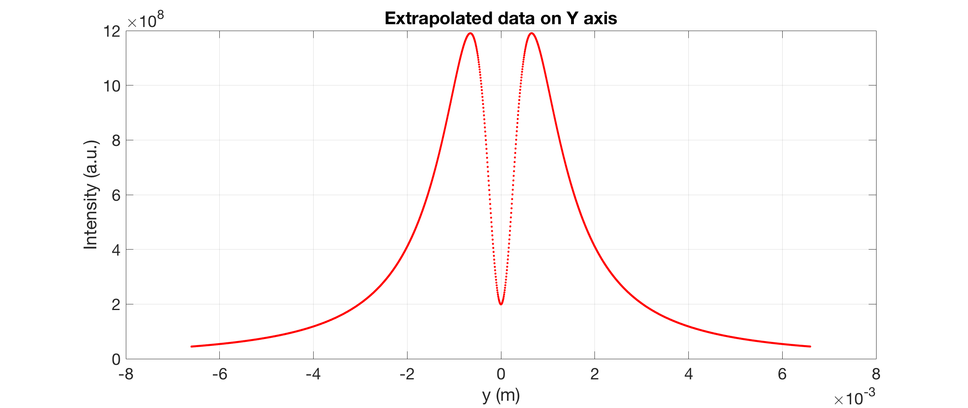
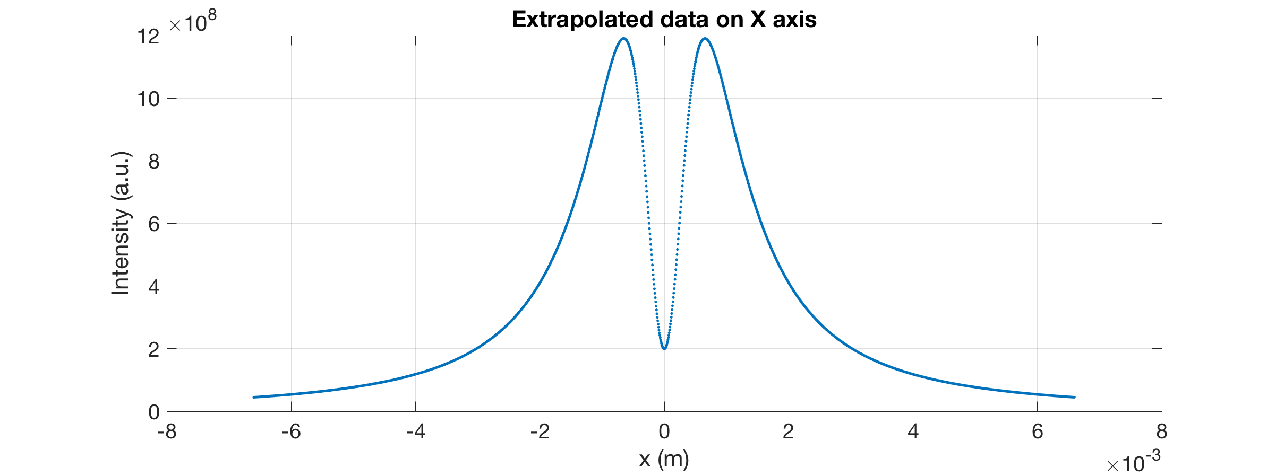
The need of a polarizer
The OTR angular distribution has in the inner hole the contribution of the both transverse planes.

Slide 14
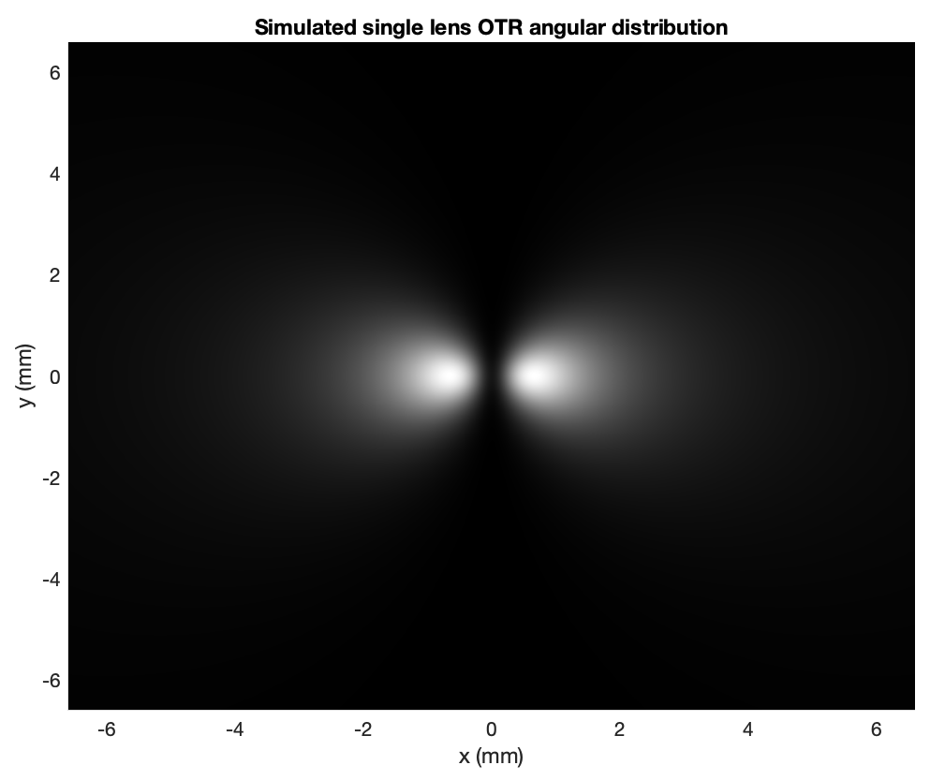
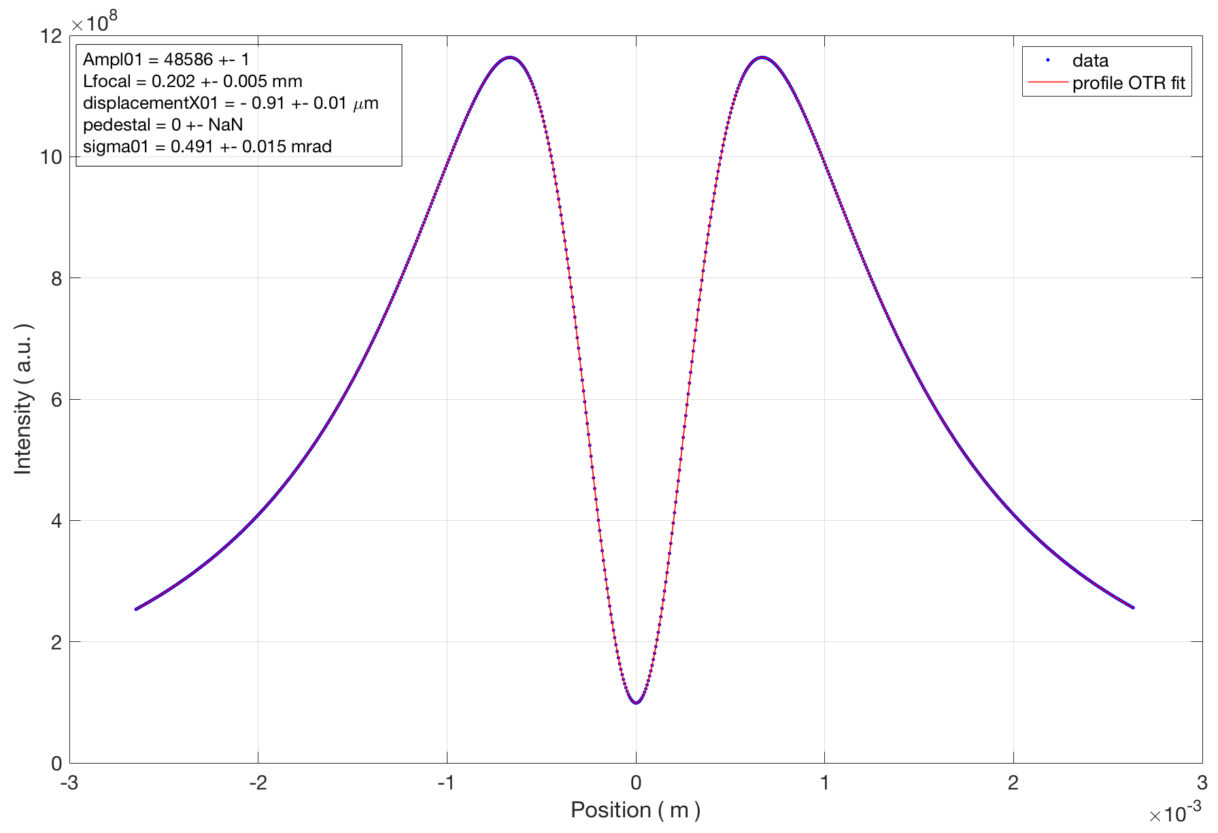
The need of a polarizer
The OTR angular distribution has in the inner hole the contribution of the both transverse planes.
The use of a polarizer let us to retrieve the divergence related to one of the two planes.

Slide 15
Introduction
  The plasma acceleration
OTR based diagnostics
  OTR: theory and diagnostic applications
  Angular distributions measurement
  Emittance measurement
A new innovative scheme: concept and simulation
  The micro-lenses array for the correlation term
  Theorical single-shot measurement setup
  The need of a polarizer
The measurement
  Experimental setup at SPARC_LAB
  Case of study: simulation
  Data analysis
  Results
Conclusions

Slide 16
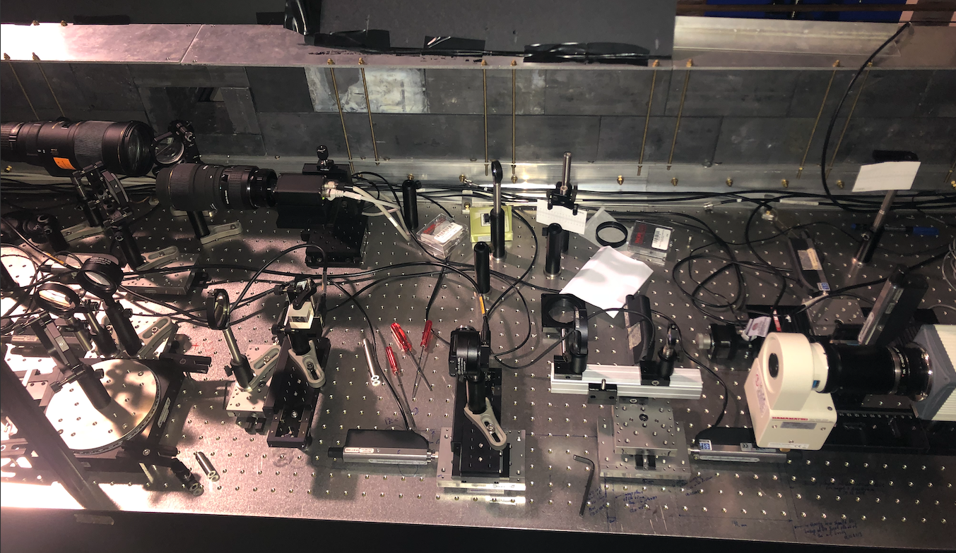
Experimental setup at SPARC_LAB
Motorized stages allow to switch optical transfer line to chose which one acquire and to take control of the optical line itself.
A polarizer beam splitter let us have the separation between the two transverse plane; moreover an interferential filter reduce the blurring of the distribution.
A Micro-Channel Plate is used to amplify the signal collected by a CMOS based fast camera.
The acquisition of OTR angular distribution with the single lens and with the microlenses array is not simultaneous.
Imaging lens
f=400 (m.l.)
Beam splitter
Microlenses array (m.l.)
OTR single lens
f=200 (s.l.)
PBS (hor.)
MCP + camera
Filter
500+-40 nm
mirror
Imaging lens
f=200 (s.l.)
Imaging lens
f=50 (m.l.)

Slide 17
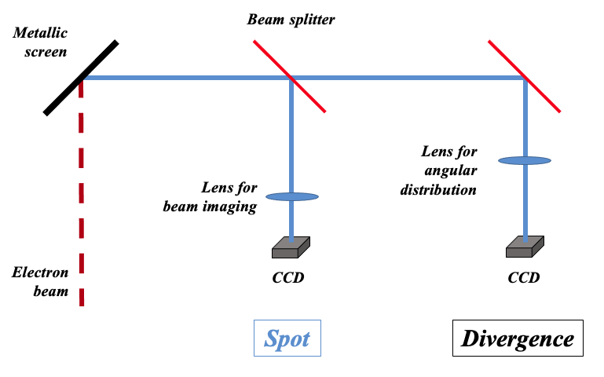
Experimental setup at SPARC_LAB
The acquisition of OTR angular distribution with the single lens and with the microlenses array is not simultaneous.
This is the optical line for the
divergence measure.
Imaging lens
f=400 (m.l.)
Beam splitter
Microlenses array (m.l.)
OTR single lens
f=200 (s.l.)
PBS (hor.)
MCP + camera
Filter
500+-40 nm
mirror
Imaging lens
f=200 (s.l.)
Imaging lens
f=50 (m.l.)

Slide 18
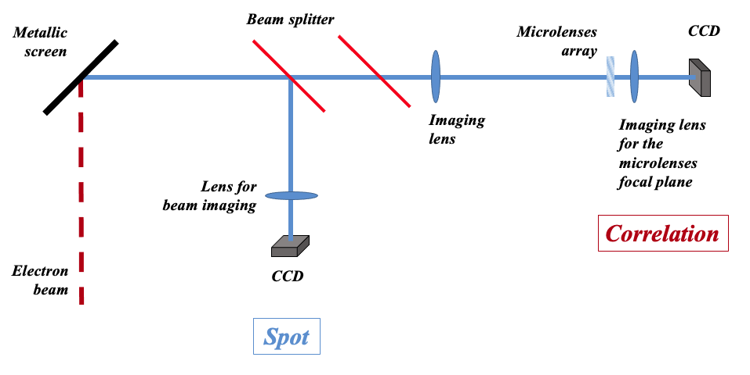
Experimental setup at SPARC_LAB
The acquisition of OTR angular distribution with the single lens and with the microlenses array is not simultaneous.
This is the optical line for the
correlation measure.
Imaging lens
f=400 (m.l.)
Beam splitter
Microlenses array (m.l.)
OTR single lens
f=200 (s.l.)
PBS (hor.)
MCP + camera
Filter
500+-40 nm
mirror
Imaging lens
f=200 (s.l.)
Imaging lens
f=50 (m.l.)

Slide 19
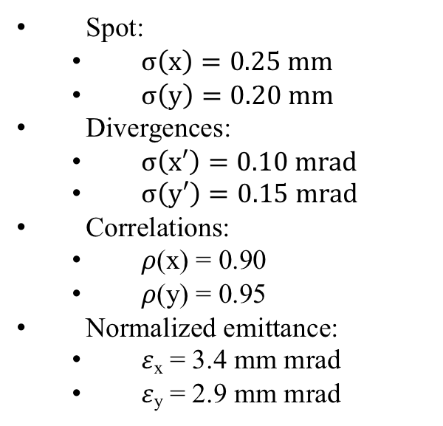
Case of study: simulation
Spot:
  $σ\left(x\right)=0.25 mm$
  $σ\left(y\right)=0.20 mm$
Divergences:
  $σ\left(x′\right)=0.10 mrad$
  $σ\left(y′\right)=0.15 mrad$
Correlations:
  𝜌(x) = 0.90
  𝜌(y) = 0.95
Normalized emittance:
  𝜀_{x} = 3.4 mm mrad
  𝜀_{y} = 2.9 mm mrad

Slide 20
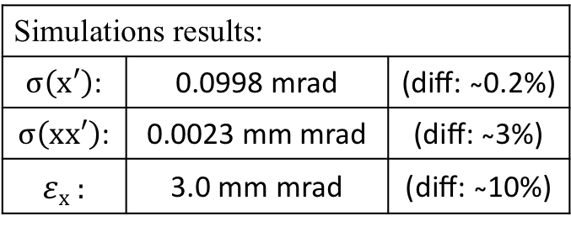
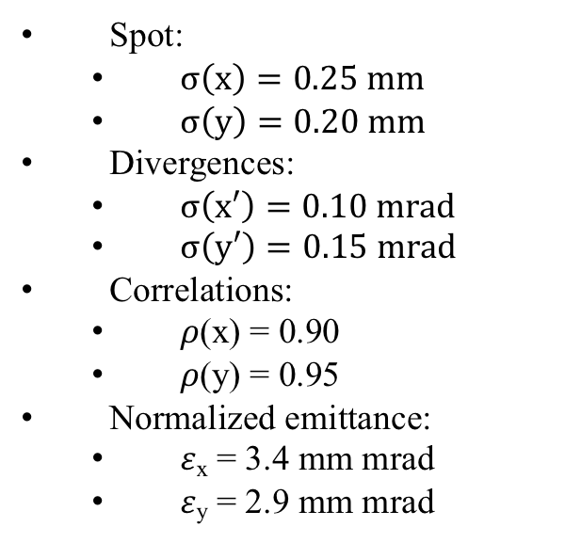
Case of study: simulation
Spot:
  $σ\left(x\right)=0.25 mm$
  $σ\left(y\right)=0.20 mm$
Divergences:
  $σ\left(x′\right)=0.10 mrad$
  $σ\left(y′\right)=0.15 mrad$
Correlations:
  𝜌(x) = 0.90
  𝜌(y) = 0.95
Normalized emittance:
  𝜀_{x} = 3.4 mm mrad
  𝜀_{y} = 2.9 mm mrad
Simulations results:
$σ\left(x′\right)$: | 0.0998 mrad | (diff: ̴0.2%)
$σ\left(xx′\right)$: | 0.0023 mm mrad | (diff: ̴3%)
𝜀_{x} : | 3.0 mm mrad | (diff: ̴10%)

Slide 21
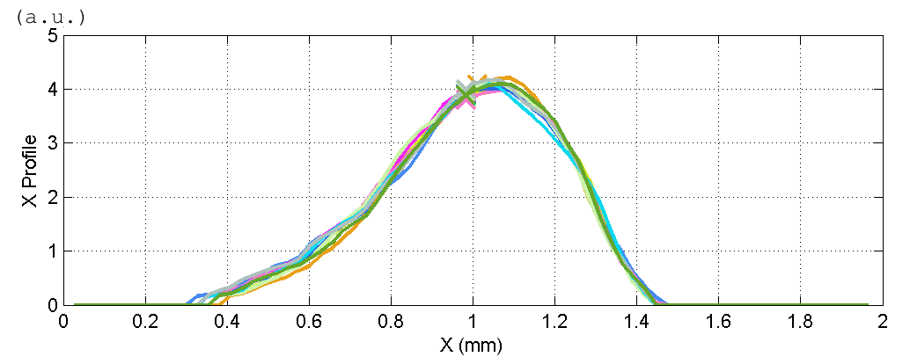

Data analysis
Spot and angular distribution of both single lens and micro-lenses have been acquired.
For each one, 20 images of signal and background have been acquired, filtered, subtracted each other and then analyzed.
In order to improve the results, mean and std. deviation are computed.
$$σ\left(x\right)=214 ±7 μm$$

Slide 22
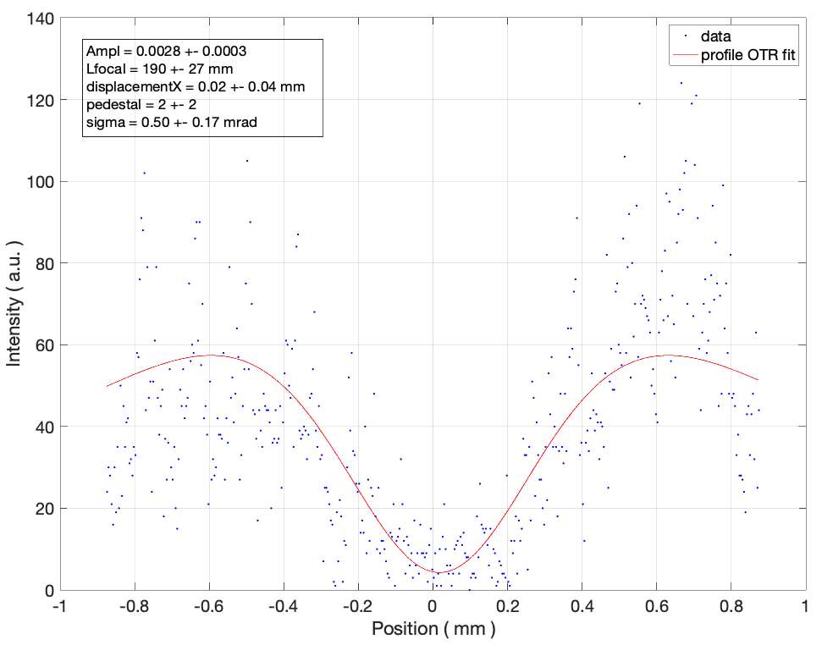
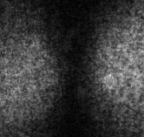
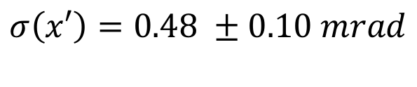
Data analysis
Spot and angular distribution of both single lens and micro-lenses have been acquired.
For each one, 20 images of signal and background have been acquired, filtered, subtracted each other and then analyzed.
In order to improve the results, mean and std. deviation are computed.
$$σ\left(x′\right)=0.48 ±0.10 mrad$$

Slide 23
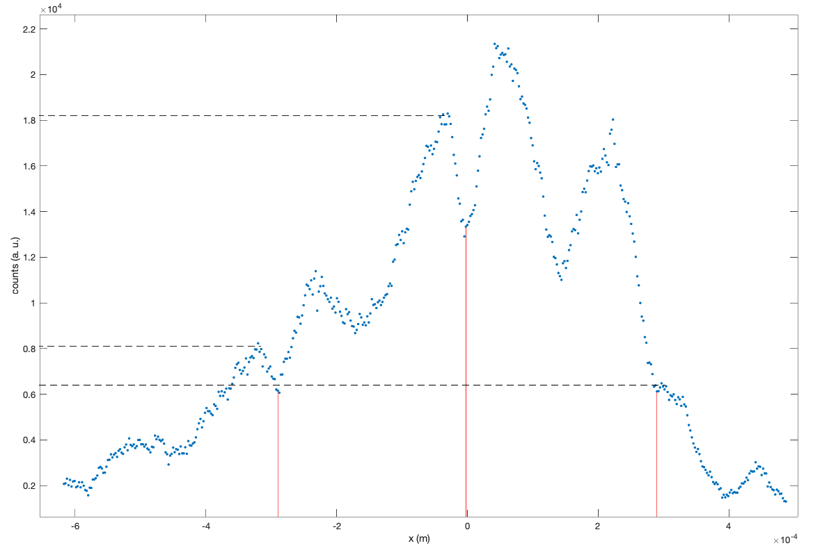
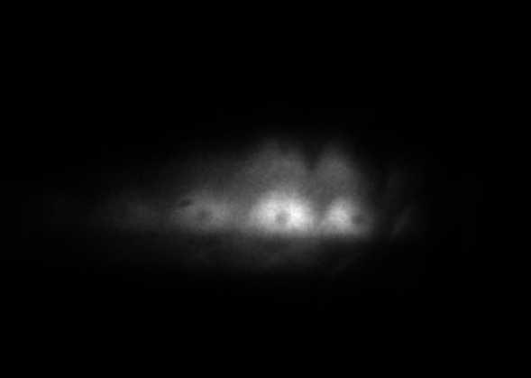
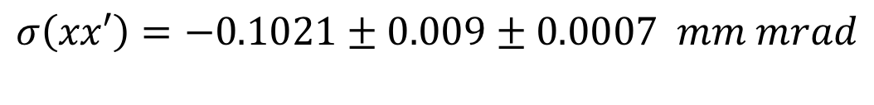
Data analysis
Spot and angular distribution of both single lens and micro-lenses have been acquired.
For each one, 20 images of signal and background have been acquired, filtered, subtracted each other and then analyzed.
In order to improve the results, mean and std. deviation are computed.
$$σ\left(xx′\right)=\text{−0.1021 ± 0.009 ± 0.0007 } mm mrad$$

Slide 24
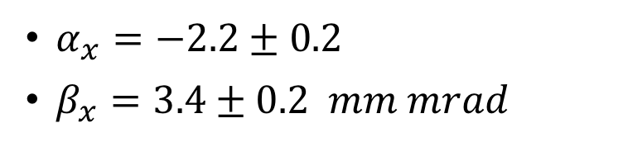
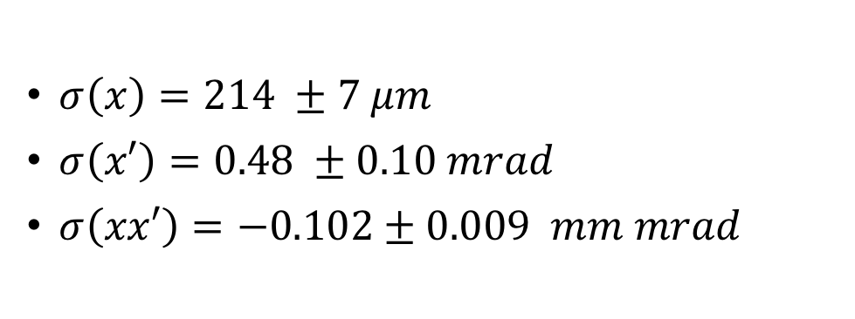
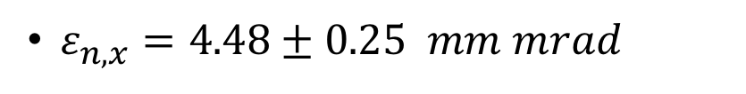
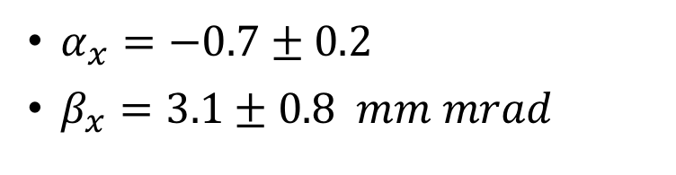
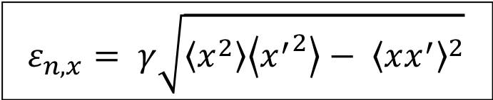
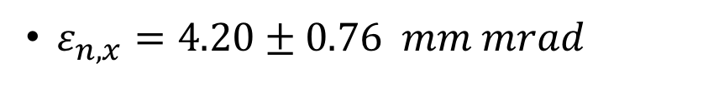
Results
$σ\left(x\right)=214 ±7 μm$
$σ\left(x′\right)=0.48 ±0.10 mrad$
$σ\left(xx′\right)=\text{−0.102 ± 0.009 } mm mrad$
$$ε_{n,x}= γ\sqrt{\left\langle x^{2}\right\rangle \left\langle {x^{′}}^{2}\right\rangle − {\left\langle xx^{′}\right\rangle }^{2}}$$
Quadrupole scan results:
$ε_{n,x}=\text{4}\text{.2}\text{0}\text{ ± 0.}\text{76} mm mrad$
$ε_{n,x}=\text{4.48 }\text{± 0.}\text{25} mm mrad$
$α_{x}=\text{−}\text{0}\text{.}\text{7}\text{ ± 0.}\text{2}$
$β_{x}=\text{3}\text{.}\text{1}\text{ ± 0.}\text{8} mm mrad$
$α_{x}=\text{−}\text{2}\text{.2 ± 0.}\text{2}$
$β_{x}=\text{3}\text{.}\text{4}\text{ ± 0.2 } mm mrad$

Slide 25
Introduction
  The plasma acceleration
OTR based diagnostics
  OTR: theory and diagnostic applications
  Angular distributions measurement
  Emittance measurement
A new innovative scheme: concept and simulation
  The micro-lenses array for the correlation term
  Theorical single-shot measurement setup
  The need of a polarizer
The measurement
  Experimental setup at SPARC_LAB
  Case of study: simulation
  Data analysis
  Results
Conclusions

Slide 26
Conclusions
The Ph.D. thesis work has been aimed at the study and the characterization of this innovative OTR based diagnostics.
The simulations has highlighted some crucial aspects, such as the need of a polarizer to select one polarization.
The experimental results have shown the compatibility between the emittance value measured with this technique and the one obtained with the classical reliable quadrupole scan method.

Slide 27
Backup Slides

Slide 28
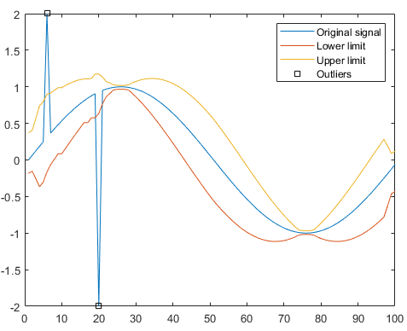
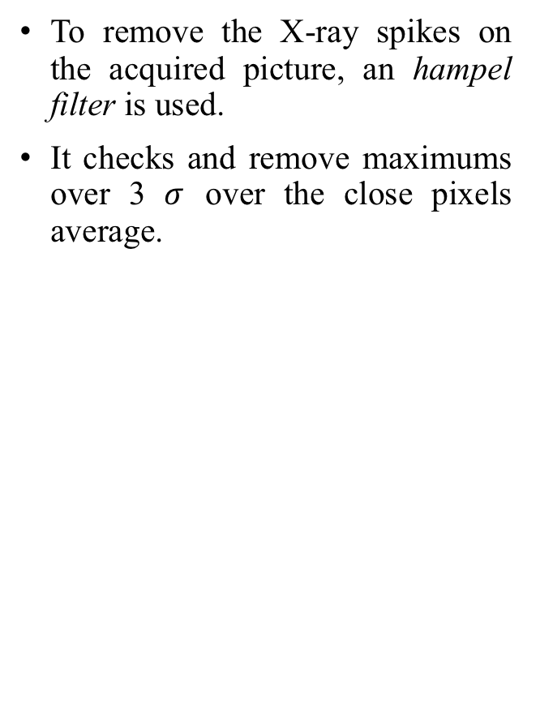
Data analysis algorithm
To remove the X-ray spikes on the acquired picture, an hampel filter is used.
It checks and remove maximums over 3 $σ$ over the close pixels average.
Before hampel filter
After hampel filter

Slide 29
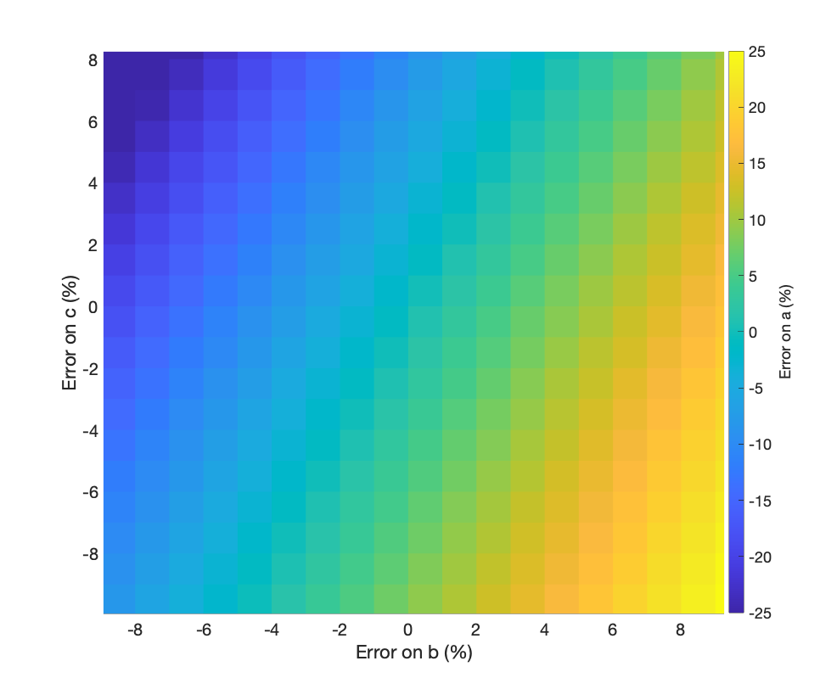
Errors compensation in emittance-like formula
In the general formula:
a² = b² – c²
a compensation of errors made on b and c leads to a better estimation of a when they are correlated.
This happens with emittance.

Slide 30
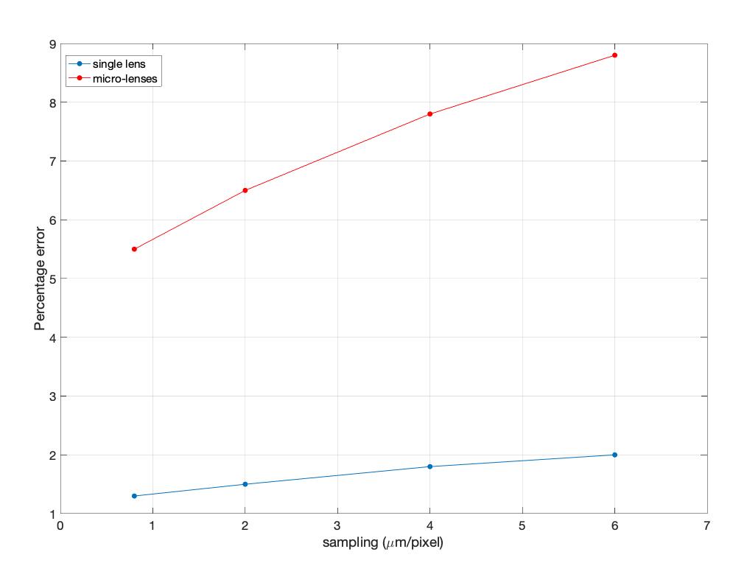
Simulations errors
The main errors on the parameters estimation done with the simulations are due to the discretization.

Slide 31
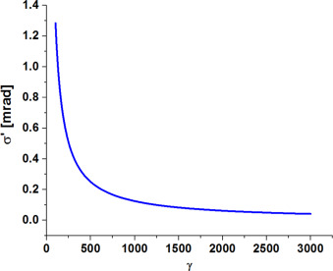
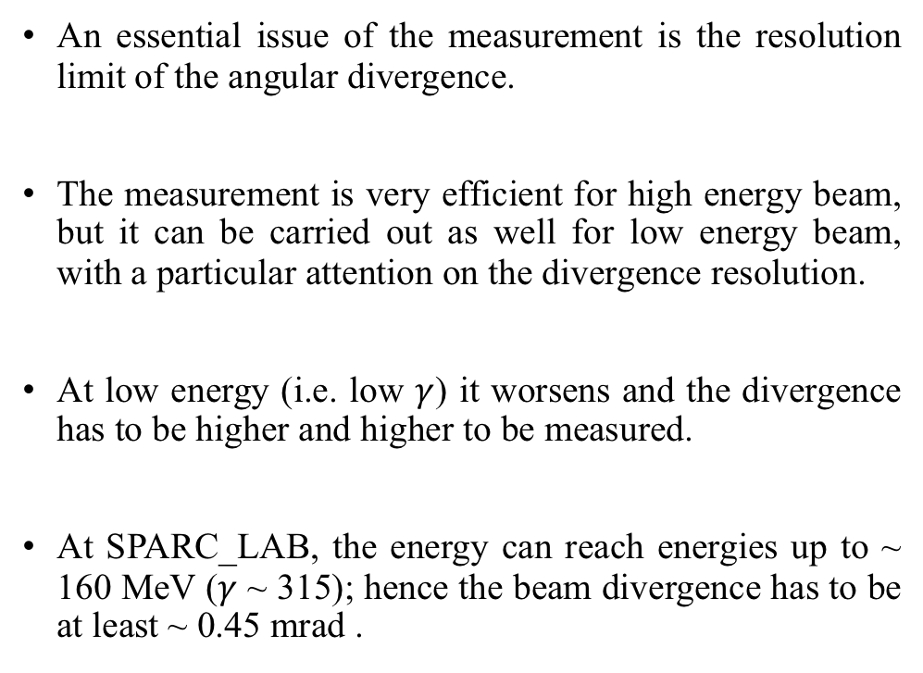
Divergence resolution
SPARC_LAB limit
An essential issue of the measurement is the resolution limit of the angular divergence.
The measurement is very efficient for high energy beam, but it can be carried out as well for low energy beam, with a particular attention on the divergence resolution.
At low energy (i.e. low $γ$) it worsens and the divergence has to be higher and higher to be measured.
At SPARC_LAB, the energy can reach energies up to ~ 160 MeV ($γ$ ~ 315); hence the beam divergence has to be at least ~ 0.45 mrad .
Angular divergence resolution as function of the relativistic $γ$

Slide 32
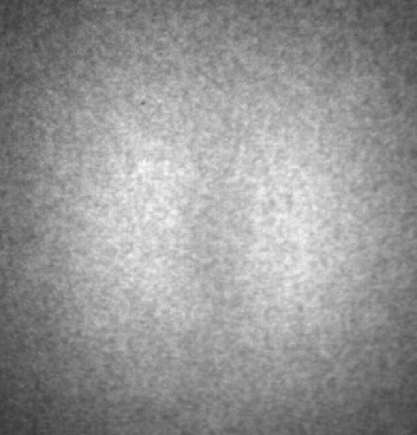
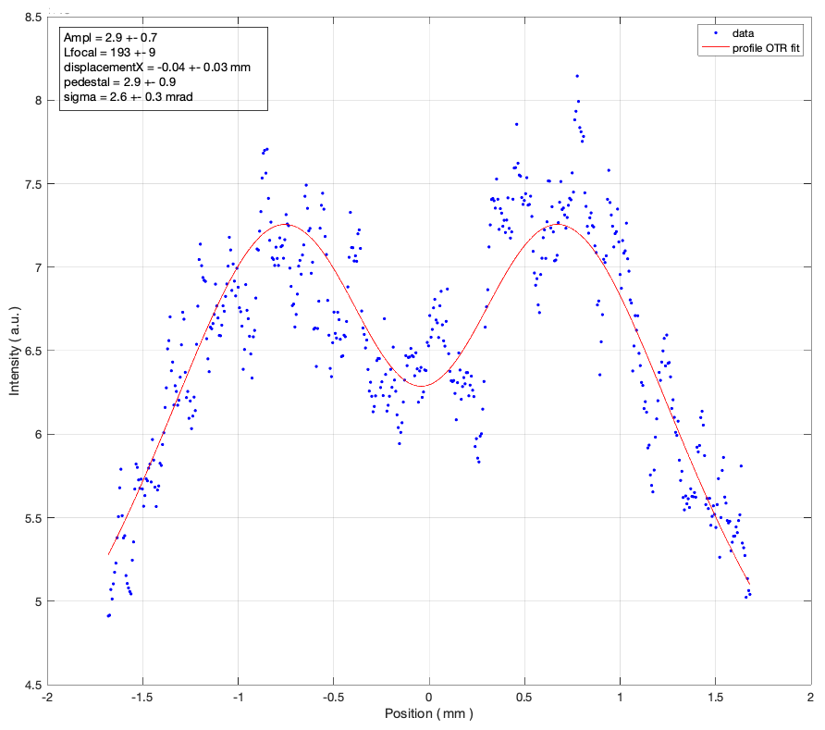
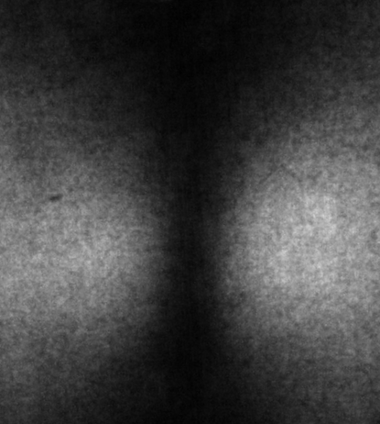
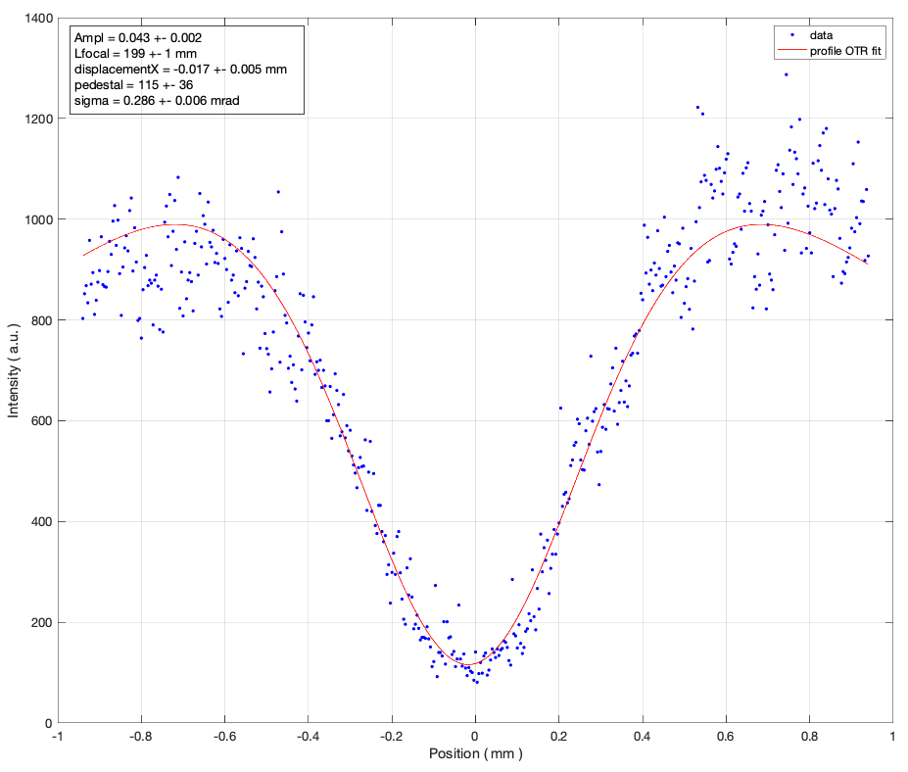
Experimental evidence of the polarizer need
Integrated shots of two configurations both with an expected divergence value of σ_{x’} = 0.283 mrad.
The first configuration, with the polarizer.
Fit result: σ_{x′} = 2.6 ± 0.3 mrad.
The second configuration, without the polarizer.
Fit result: σ_{x′} = 0.286 ± 0.006 mrad.

Slide 33
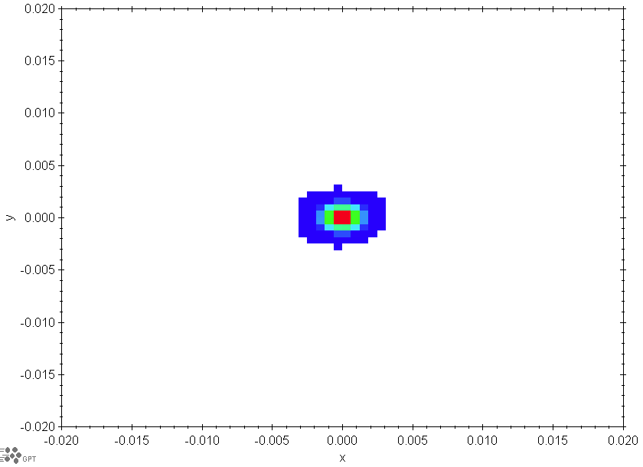
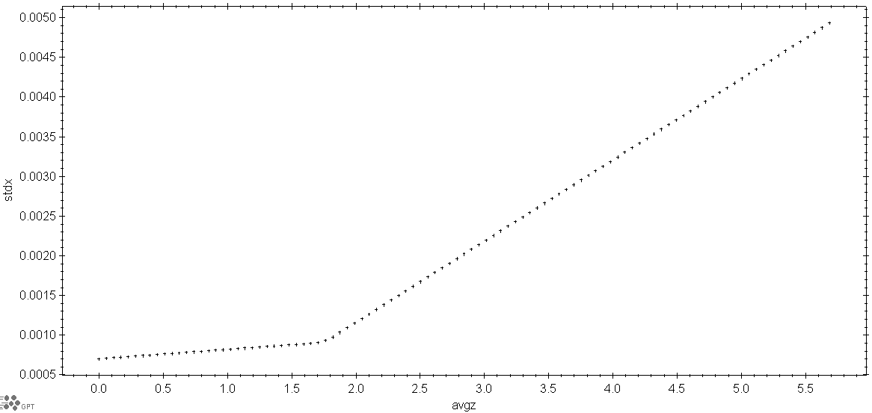
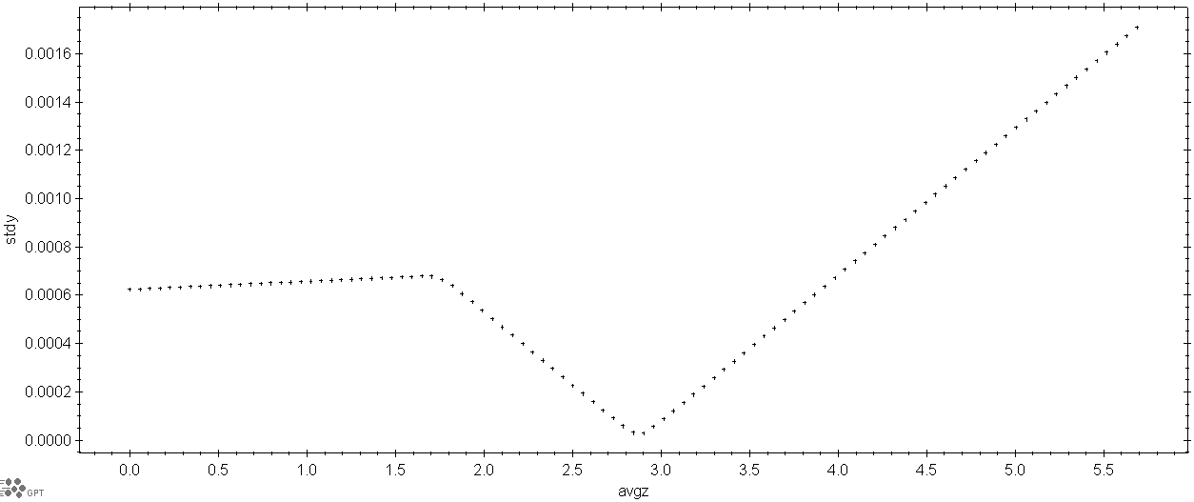

Backtracking
To estimate the expected emittance in the OSE apparatus position, the beam transport along the machine optics is carried out thanks to GPT, that reconstruct the beam dynamics from the Q scan position, up to the OSE setup.

Slide 34



Parameters of the neglected transversal plane
The angular distribution intensity with the polarizations contributions in Cartesian coordinates is expressed as:
$\frac{d^{2}I}{dω dΩ}≅\frac{e^{2}β^{2}}{π^{2}c} \frac{{(x−x0)}^{2} +{ (y−y0)}^{2}}{{[{ \left(x−x0\right)}^{2 }+{ \left(y−y0\right)}^{2} + {\left( f / γ \right)}^{2} ]}^{2}}$
Neglecting the vertical polarization the term ${ \left(y−y0\right)}^{2}$ disappears only in the numerator.
A simulations scan has been done to test its effect on the measurement.
The term in denominator affects the measurement of the horizontal divergence and hence the emittance.
A clue on an aspect ratio of 5 on the transversal divergences appears from the simulations.

