Slide 1
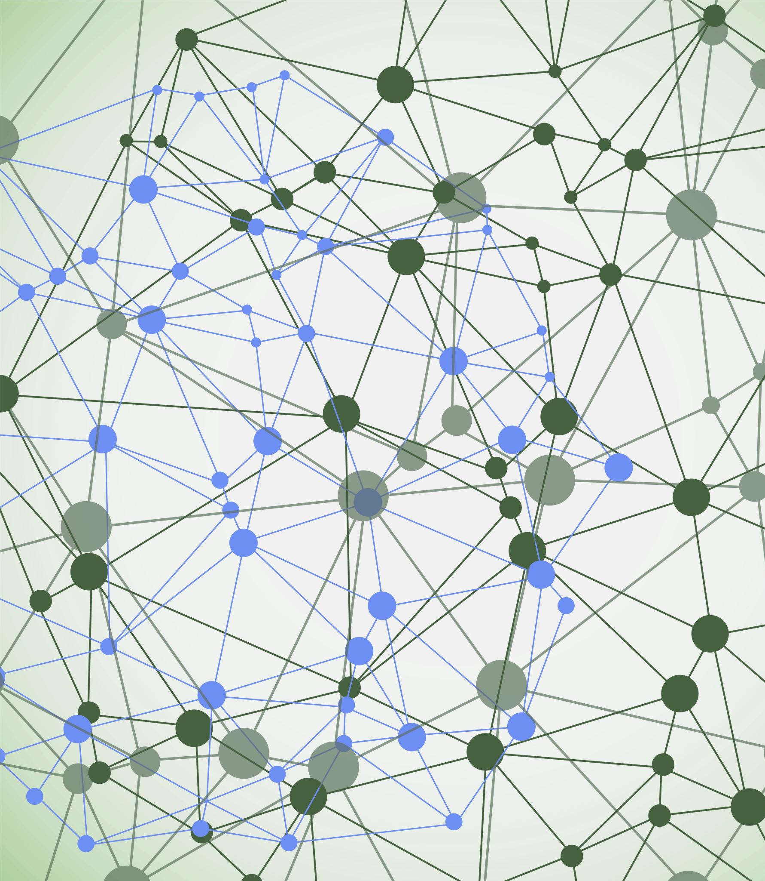
Argomenti per la riunione
Cosa deve fare ogni sede ?
Come iniziamo ad ottobre ?
Calendario Mostre
Regolamento opere
Valutazione opere
Questionari II e III edizione
Progetto MIUR PANN 2020
Progetto ERASMUS+

Slide 2
Di cosa deve occuparsi ogni sede
Deadline progetto scritto
Approvazione del progetto sul portale
Deadline per le opere
Verifica ed eventuale preselezione delle opere
Scelta sede per la mostra locale
Definizione della giuria
Premiazione, certificati, premi e gadget (per chi e cosa)
Trasporto opere vincitrici A/R
Gestire i costi-extra (non finanziati da INFN)
Cercare partner e sponsor

Slide 3
Calendario Mostre
Propongo di esplorare la possibilità da inserire alcune delle mostre nel periodo gennaio-febbraio
In modo da non avere una sovrapposizione completa.
Tecnici/art@CMS/giurie/premiazioni/....etc etc
Ogni sede è responsabile per:
Scelta della sede e dell’allestimento
Giuria
Premiazione (certificati, gadget e premi)
Trasporto opere verso Mostra Nazionale ?
Gennaio | Gennaio | Febbraio | Febbraio | Marzo | Marzo | Aprile | Aprile
 | Potenza | Padova | Milano |  | Bari
 |  |  |  | Roma | Roma
 |  |  | Cagliari | Cagliari | Pisa
 |  |  |  |  | LNF
 |  |  |  |  | Torino | Torino

Slide 4
 | Sede mostra | data inizio | data fine | deadline progetto | deadline opera
Bari | Castello Svevo (da confermare) o Ateneo | 19/03/2022 | 04/03/2022 | da definire | 15 febbraio | da definire
Cagliari | Nuoro
Milano | Acquario Civico oppure Triennale (da definire mediante l'aiuto della Rettrice di Bicocca) | 12/02/2022 | 27/02/2022 | Prima metà di Novembre | Fine Gennaio | L'Aquario costa 8000 (482 Euro/giorno) + spese accessorie (il luogo a più buon Mercto a Milano). L'allestimento costa circa 5000 Euro. Se invece riusciamo ad avere (come promesso dalla Rettrice) la Triennale ci saranno solo i costi di allestimento. Chiostri San Barnaba (economico)
Lecce
LNF | Scuderie Aldobrandini Frascati | 12/03/2022 | 27/03/2022
Napoli | MANN |  |  |  | da definire
Potenza | Museo Archeologico
Pisa | Museo della Grafica | 14/3/2022 | 27/3/2022 | fine ottobre | meta' febbraio
Genova | Struttura Universitaria
Padova | Loggia della Gran Guardia
Venezia | Museo Università
Roma | Palaexpo | marzo 2022
Torino | CCR o Mausoleo Bela Rosin | (marzo/aprile) |  | da definire | da definire
Nazionale | MANN | Maggio 2022

Slide 5
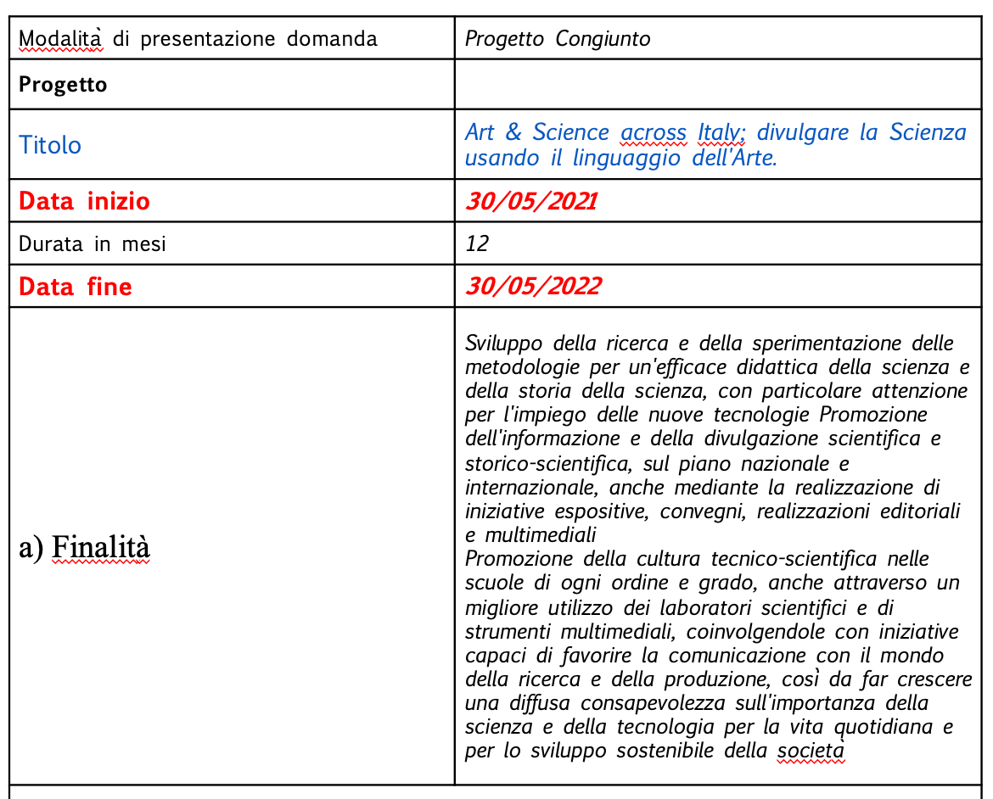
Progetto MIUR PANN2020

Slide 6
Progetto MIUR – termina maggio 2022
In questi 12 mesi le attività principali sono:
1) Formazione: divulgazione scientifica
2) Progettazione e realizzazione delle composizioni artistiche (gruppi di 3 studenti)
3) Esposizione presso le mostre locali (durata di 3 settimane)
4) Mostra Nazionale alla quale parteciperanno i primi 5 classificati di ogni mostra locale (durata 1 mese nel maggio 2022 presso il Museo MANN di Napoli)
5) Evento spettacolo per la premiazione dei vincitori (maggio 2022 a Napoli)
I costi preventivati sono suddivisi nel seguente modo:
Personale = 26.591 euro (3 ricercatori dipendenti + 1 borsista non dipendente)
Strumentazione = 24.250 euro (noleggio sistemi informatici e di installazioni museali per le 13 Mostre e gli eventi programmati)
Consumi = 18.050 euro (materiale necessario alle attività di laboratorio scientifico e alla realizzazione delle composizioni artistiche e alle installazioni museali)
Missioni = 10.000 euro (per le giurie delle mostre locali e nazionali)
Generali = 2.500 (attrezzi, toner, carta...)
Altro = 18.200 euro (trasporto materiale informatico e composizione artistiche dalla 12 città alla mostra nazionale)

Slide 7
Progetto ERASMUS+: Playing with Protons goes online
 | INFN | Università | Sede
 | Paolucci | Organtini | La Sapienza
 | Menasce | Cavallo | Basilicata
 | Scianitti | Conventi | Partenophe
 | Bagliesi | Di Crescenzo | Partenophe
 |  | Merola | Federico II
 |  | Rossi | Federico II

Slide 8
Playing with Protons Goes Digital
playingwithprotonserasmus@lists.infn.it

Slide 9
13 people participating?

Slide 10
Playing with Protons Goes Digital
ERASMUS+
Start on 01-06-2021
End on 31-05-2023
Duration 24 months
Partner: INFN, Ellinogermaniky Agogi Scholi (Greece), University of Birmingham (UK), Città della Scianza (IT) and Creativitic Innova (Spain)
Total Grant: 298.615 euro

Slide 11
Partners
Ellinogermaniki Agogi (EA) is an educational organization of private law, officially recognized by the state. Established in 1995, the Research and Development Department of EA provides the test bed for research applications for the design, development and implementation of the research activities in education. EA is an institutional member of EDEN (European Distance Education Network), of STEDE (Science Teacher Education Development in Europe) and of ECSITE (European Network of Science Centres and Museums) network, as well as a partner school of the German Schools-Excellence Network.
CreativiTIC is a SME founded in 2011 and located in Basque Country and La Rioja (Spain). CreativiTIC has Augmented Reality R&D experience in FP7 (Learning and Skills) and Horizon 2020 (Education, Content and Creativity) European Commission programs and it’s specialized in empowering the human development through Interactive Technologies such as Augmented, Mixed and Virtual Reality combined with Deep Learning and Artificial Intelligence. Our company researches the latest technologies to offer innovative solutions for Industry40, eHealth & Education.

Slide 12
Partners
INFN (Italy) The National Institute for Nuclear Physics (INFN) is the Italian research agency dedicated to the study of the fundamental constituents of matter and the laws that govern them, under the supervision of the Ministry of Education, Universities and Research (MIUR). INFN has a staff of around 2000 employees, but other 3600 researchers afferent to other national and international institutions work in INFN facilities, as associated members. INFN has direct collaborations and agreements with research institutions in five continents and more than 30 countries.
Fondazione Idis-Città della Scienza is a non-profit organisation that has among its founding members the Nobel Prize Laureates Rita Levi Montalcini and Carlo Rubbia. It boasts a number of scientific collaborations with major museums and scientific Institutions in Europe and worldwide. Città della Scienza started its activities in 1987 and was completed in 2001, in the western part of Naples, with a structure dedicated to the dissemination of scientific and technological culture, as well as to the innovation of the educational and business systems. One of the main values of Città della Scienza is to set up a new form of scientific citizenship, bridging the gap between science and society, in order to bring the science outside of the realm of laboratories through an open dialogue with citizens and stakeholders. Hence, Città della Scienza aims at creating an efficient relationship between science, innovation and society for the economic and social development of the region and fostering social inclusion through social innovation.

Slide 13
Project Summary
The rapid shift to online teaching and learning due to COVID-19 offers a unique opportunity to grasp the transformative potential of new digital technologies in facilitating an inspiring and engaging science classroom.
The project places strong emphasis on building teacher digital competences by providing teachers and educators with an integrated toolkit that would allow them to co-design online STEAM resources that speak to the digital habits, needs and interests of the generation Z of school learners.
The project will work with 50 schools (10 in rural/remote settings), 100 teachers and 500 students. The project aims to reach 2000 teachers through its various activities
Here, we are looking into offering remote schools the ability to:
work with exciting STEAM activities;
collaborate with organizations such as INFN and Città della Scienza with the use of open digital tools;
access exciting open content that can be delivered by teachers remotely during closures or outside teaching hours.

Slide 14
Main goals
Be acquainted with and fully understand the context of creative science teaching methodologies adapted and reworked into a unique and easily digested approach from selected STEAM initiatives
Put to practice various teaching components, by taking into account the needs and skills of students and the various contexts addressed
Be able to deploy new arts/creativity methodologies such as simple but engaging augmented reality activities and games
Bring into their science teaching a unique collection of tools and interdisciplinary resources and learning scenarios
Learn how to create science learning scenarios that suit their own needs for using e-Learning tools
Establish a collaboration framework with colleagues and peers, allowing them to synchronize and coordinate delivery, as well as performing joined activities with their students
Join a European a community network of peers and stakeholders (teachers, adult trainers, teacher trainers, facilitators, education policy makers, scientists)
Expand learning beyond the school
Expand their continuous professional development opportunities
Learn how to build an opening up strategy for their school based on “Playing with Protons Goes Digital” concrete recommendations.

Slide 15
Playing with Protons Goes Digital
Late primary and early secondary school (10-15 years)
50 schools (10 in rural/remote settings)
100 teachers
500 students.
Inquiry-based metodologies;
Creativity and problem solving
Art based activity
Play-based physics demonstration
Online environment to facilitate collaboration and learning
Open school approach with STEAM activities.
INFN will organise a Training Activity in the form of a Summer School for the consortium in the second year

Slide 16
How the project is structured
5 Intellectual Outputs
8 multiplier events
5 transnational meetings

Slide 17
Budget allocation

Slide 18
Budget Items

Slide 19
IO budget and responsibility

