Slide 1
TOTEM Status
TOTEM completerà la sua campagna di presa dati con l’ultimo run special a l’energia più alta possibile nel Run3.
Le attività saranno quindi legate al:
  Completamento del nuovo rivelatore T2;
  Commissioning del detector per la preparazione al run speciale, i.e. rivelatori, DAQ, DCS etc. etc.
  Partecipazione al run special.
Malgrado le attività di presa dati ancora previste, è stato stabilito di chiudere la sigla in CSN1 e completare l’iter dell’MOU con CMS del 2018, integrando anche le attività di TOTEM in CMS.
Le risorse per completare la presa dati verranno richieste via CMS, per chi ha percentuali in PPS, o su DOT1, per chi non ha le percentuali.

Slide 2
Cross-section measurements
Eur. Phys. J. C (2019) 79: 103

Slide 3

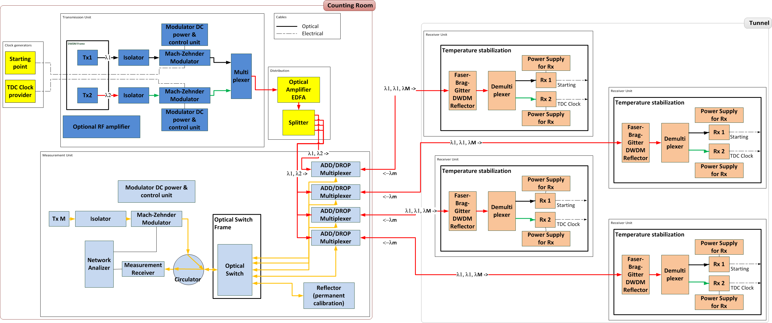
Il sistema di distribuzione del clock di precisione
In use in PPS since September 2017, it is now the baseline.

Slide 4
Run III upgrade: new T2
The new beam pipeline layout for Run II , forced us to completely review the design of the T2 telescope.
We have now reduced room with difficult access, so the new detector should be easy to move and with limited services.
A scintillator based telescope, with slabs readout by SiPM has been designed tested and under construction.
Different light collection configurations have been studied and tested using cosmic rays and test beams (Desy).

Slide 5
Backups

Slide 6
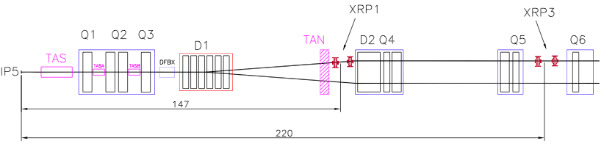
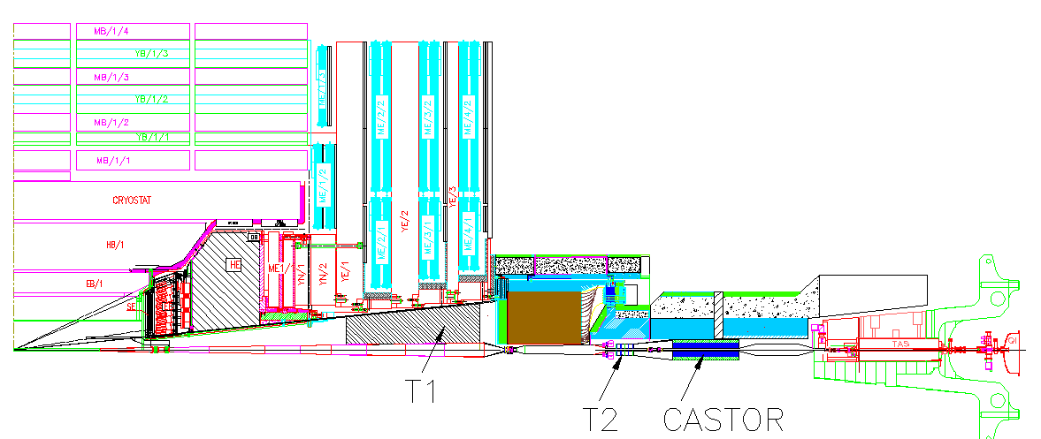
Experimental Setup @ IP5 LHC Run I
Inelastic telescopes: charged particle
& vertex reconstruction in inelastic events
T1: 3.1 < η < 4.7
T2: 5.3 < η < 6.5
T1: 18 – 90 mrad
T2: 3 – 10 mrad
HF (CMS)
IP5
~ 10 m
T1
~ 14 m
CASTOR (CMS)
T2
LHC RunI layout
Roman Pots: measure elastic & diffractive protons close to outgoing beam
IP5
RP147
RP220
Notes:
6

Slide 7
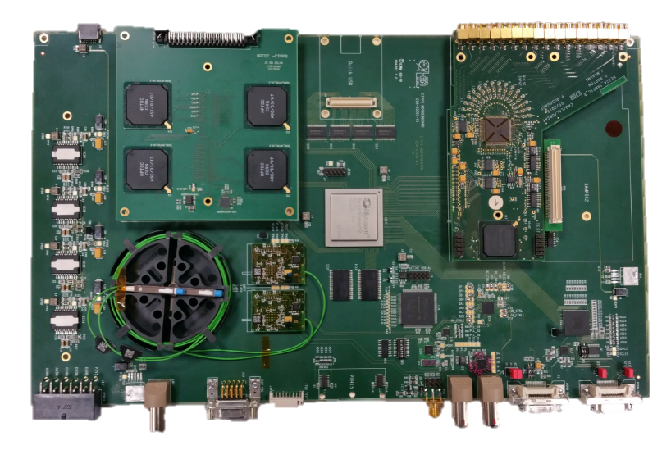
Read out: Digitizer Board
To handle all different kind of front end electronics of timing detectors, a common read out board has been developed that can be specialized to a given detector using dedicated mezzanines.
For the diamond detectors and UFSD, two different mezzanines have been developed, with different read-out electronics: SAMPIC and HPTDC.
Manage the packets formation and broadcast it to the TOTEM DAQ.
Scheme of the readout chain for a RunII diamond detector.

Slide 8
PPS timing detectors for Run III
Detector consolidation with new hybrid boards, to increase the amplification stability and HV isolation.
New discriminator board (still based on NINO chip), to reduce timing degradation in digitization phase.
The amplifier low voltages will be remotely controlled.
Sensor readout with SAMPIC chip (fast sampler @ 7.8 Gsa/s) will be available for commissioning phase and sensor monitoring (cannot sustain hit rate at nominal luminosity). Successfully used as CMS-TOTEM timing sensor readout for a special run in 2018 (lower hit rate, Ultra Fast Silicon Detectors as sensor)[PoSTWEPP2018 (2019) 137].
A new timing station for each arm will be built and installed. Each station will be equipped with 4 double diamond planes.
𝜎_{𝑡}~50 𝑝𝑠 at test beam
with oscilloscope
readout.

Slide 9

Cross-section measurements
13 TeV
β* 90m : lumi independent
β* 2500m: ρ measurement
Different beam conditions
7TeV, several methods
Same beam conditions
8TeV, several methods
Different beam conditions

Slide 10
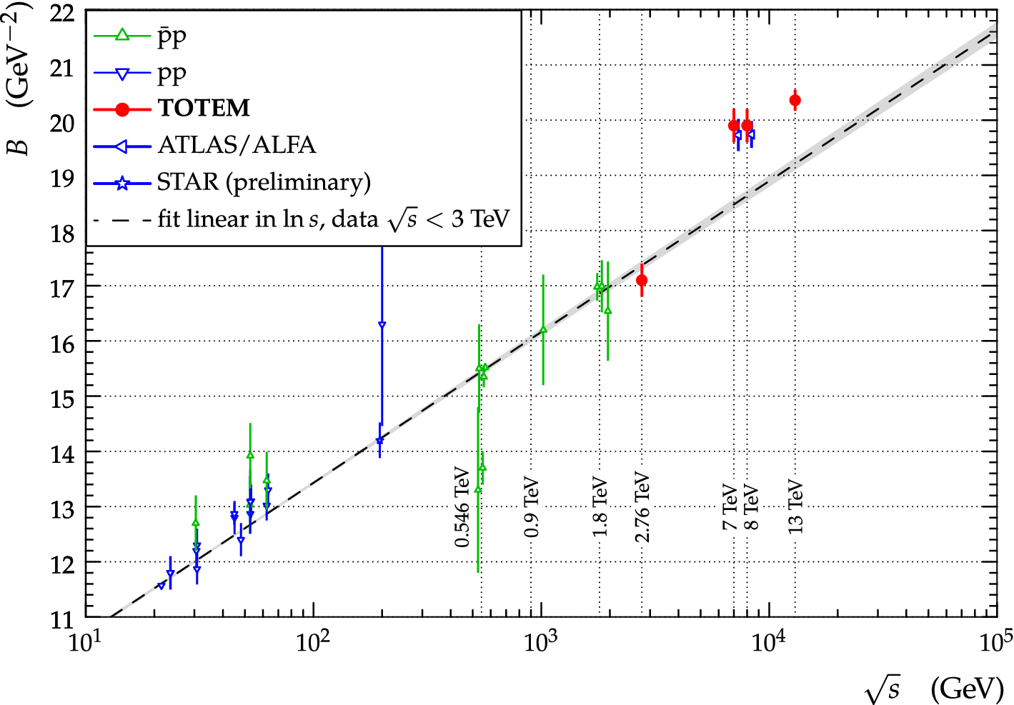
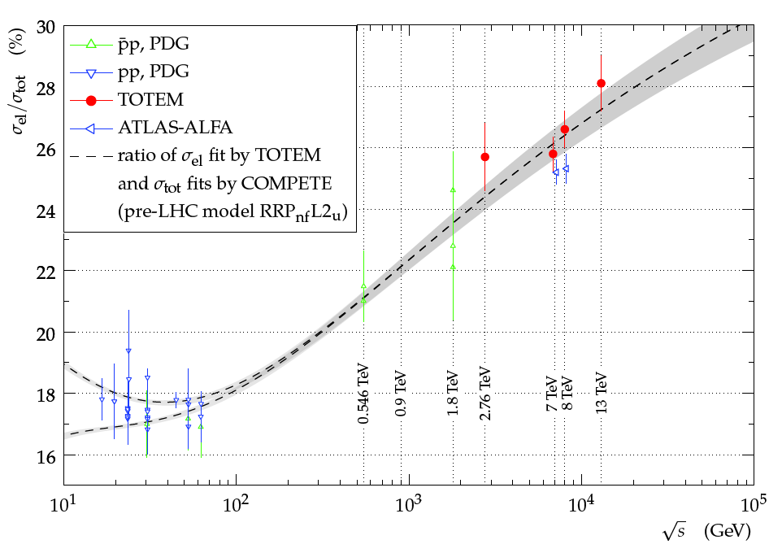
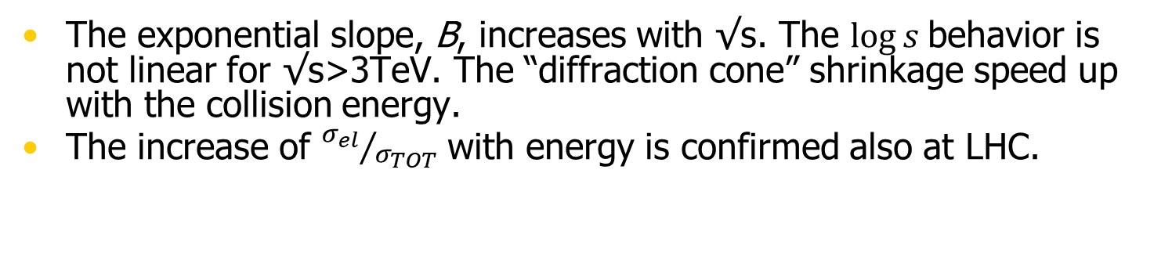
Cross-section measurements
Eur. Phys. J. C (2019) 79: 103
The exponential slope, B, increases with √s. The $\log{s}$behavior is not linear for √s>3TeV. The “diffraction cone” shrinkage speed up with the collision energy.
The increase of ${σ_{el}}/{σ_{TOT}}$ with energy is confirmed also at LHC.

Slide 11

Elastic measurements: dip @13TeV
No dip in p$\overline{\text{p}}$
dip position in |t| decreases with increasing √s

Slide 12
Elastic measurements: dip & high t
Dip is present at high energy and moves.
No structure found at high t.

Slide 13
Cross section: 13TeV analysis
To verify the results of the luminosity independent method 𝜎_{𝑡𝑜𝑡} and 𝜌, from 𝛽∗= 2.5km, has been computed using QED normalization method.
Three approaches (all using Coulomb-nuclear interference):
  normalization fixed using 𝛽∗= 90m data from lumi-independent method.
  partial QED normalization with a 𝜒² term corresponding to the lumi-independent result.
  full QED normalization.
All 𝜎_{𝑡𝑜𝑡} and 𝜌 results consistent within uncertainties: 𝜎_{𝑡𝑜𝑡} results 110.3 ± 3.5 mb and 109.3 ± 3.5 mb, obtained with fully independent methods and disjoint data sets: should be averaged and should lead to smaller uncertainty: ~ 110.5 ± 2.4 mb.
CERN-EP-2017-335-v3, accepted in EPJ C

Slide 14
Coulomb Nuclear interference: ρ
CERN-EP-2017-335
First LHC determination from Coulomb-hadronic interference at √s=8TeV: ρ = 0.12±0.03. Uncertainty still too high due to the low statistics.
At 13 TeV : sample with very high statistics
allows an unprecedented precision. The new
points are too low respect to the prediction.

Slide 15
σ_{tot} & ρ: model comparisons
CERN-EP-2017-335
None of the COMPETE models is able to describe σ_{tot} and ρ at the same time.

Slide 16
σ_{tot} & ρ: odderon hints?
CERN-EP-2017-335
t-channel exchange of a colourless 3-gluon bound state (JPC = 1--) could decrease ρ in pp collisions at large energy.

Slide 17
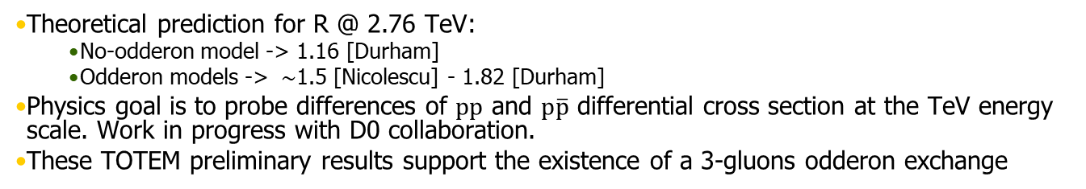

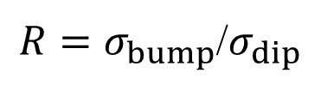
σ_{tot} & ρ: odderon hints?
$R=σ_{bump}$/$σ_{dip}$
$$R ∈[1.5 :1.9]$$
TOTEM preliminary
Theoretical prediction for R @ 2.76 TeV:
  No-odderon model -> 1.16 [Durham]
  Odderon models -> $\sim$1.5 [Nicolescu] - 1.82 [Durham]
Physics goal is to probe differences of $pp$ and $p\overline{p}$ differential cross section at the TeV energy scale. Work in progress with D0 collaboration.
These TOTEM preliminary results support the existence of a 3-gluons odderon exchange

