Slide 1
RD_MUCOL
Piu’ informazioni sono reperibili qui: https://agenda.infn.it/event/27514/

Slide 2
Summary of Bari interests
Physics studies.
Detector optimization
detector performances studies under background condition expected at the different CoM energies.
Detector hardware (Muon system, hadronic calorimeter)
Software (reconstruction/ID) and computing development
Test beam @ CERN :
Measurement of the emittance and cross-section e+e- → mu+ mu-
Neutrino and target studies

Slide 3
Attivita’ Bari 2022 e sinergie
Physics studies→ Anna, Rosma, Federica, Caterina, Filippo…
Detector optimization → AnnaS, Anna, Rosma, Federica, Piet, Marcello, Antonello
detector performances studies under background condition expected at the different CoM energies.
→ Sinergia con AIDAINNOVA (WP7, WP11, WP12, MODE_INFN)
- Muon chambers
- Hadronic calorimeter (PFA) with fast timing MPGD (technology to be studied).
Software (reconstruction/ID) and computing development ( Lucia,Rosma, Anna, Marcello)
→ Sinergia con LHC experiment (CMS/ALICE/LHCb new tracking algo/GPU)
→ Sinergia con AIDAINNOVA WP12.2 (R&D software framework)
Sinergia con IBISCO (GPU/CPU and storage)
Test beam @ CERN → AnnaS, Anna, Lucia, Rosma, Federica, Piet, Marcello, Antonello, Filippo
Measurement of the emittance and cross-section e+e- → mu+ mu-
➔ Sinergia CMS Phase2 (pixel, GEM, DT , RPC, ECAL e DAQ/Trigger)
Bersagli and neutrinos studies (Gabriella, Emilio)

Slide 4
Several studies done inside CALICE Collaboration (ILC), mainly with RPC. We would like to focus on calorimeters with MPGD for Muon Collider and other future colliders
Nuova attivita’: calorimetrica adronica
Activities:
1st y:
Measure energy, time and spatial resolution
Include those parameters in simulation algo and check if they are suitable for PFHGCAL4MuCol
Validate the fast-simulation ML algorithm
Optimize the new design parameters with fast-simulation ML algorithm
Radiation length
Estimate the improvement that can be bring from MM/µrwell
2nd y:
Repeat studies with MM
Build a 4 layers prototype
Absorber-active layer
Absorber
Material: Steel
Total radiation length (to be studied)
Active layer (1st year)
Start with 4 triple-GEMs (the ones with high spatial res. LEMMA-TB)
Active layer (Roma3/LNF or 2nd year)
2 Micromegas
2 r-well (2023)
Readout (same for both) ?
Sinergia con MODE_INFN (SIGLA CSN5)

Slide 5
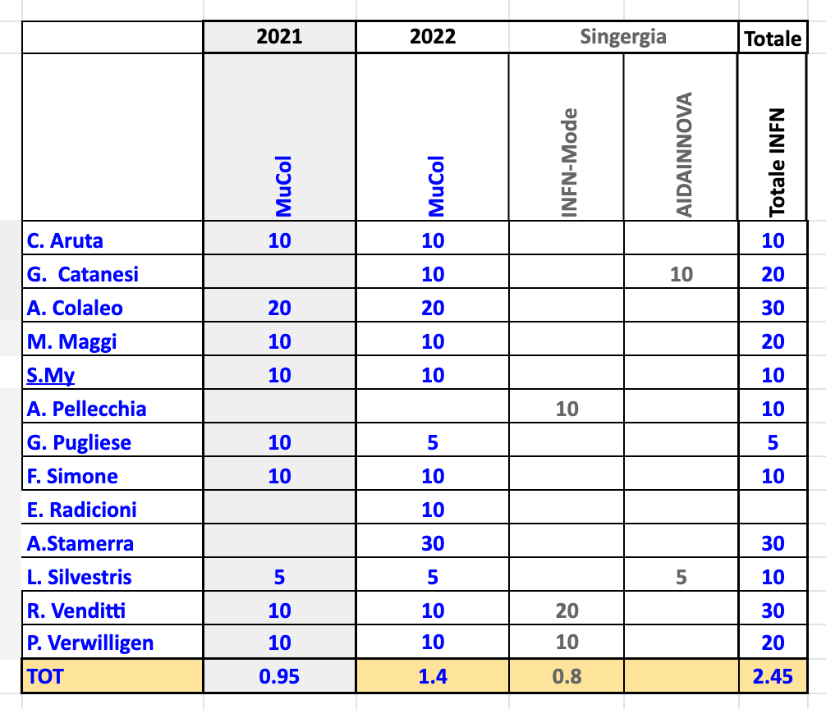
FTE e attivita’ (preliminari)
https://docs.google.com/spreadsheets/d/1U0cXCs7WxqneDok2XEK4htRP8s4rFxLOflUS9FZ_1x4/edit?usp=sharing

Slide 6
Servizi
1 m.u.- Per officina meccanica per Test beam

