Slide 1
A mechanical design proposal for the CMD-3 drift chamber

Slide 2
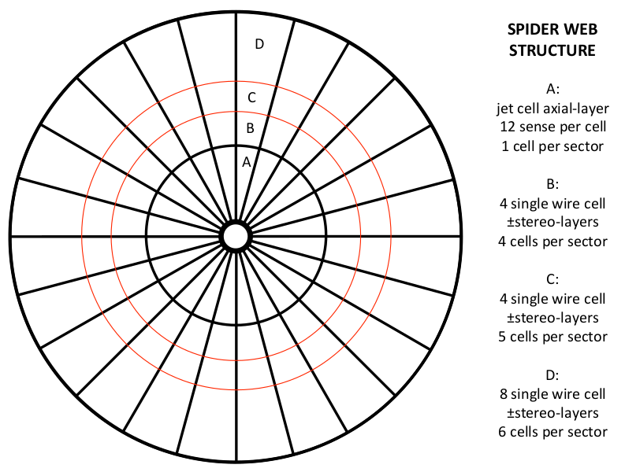
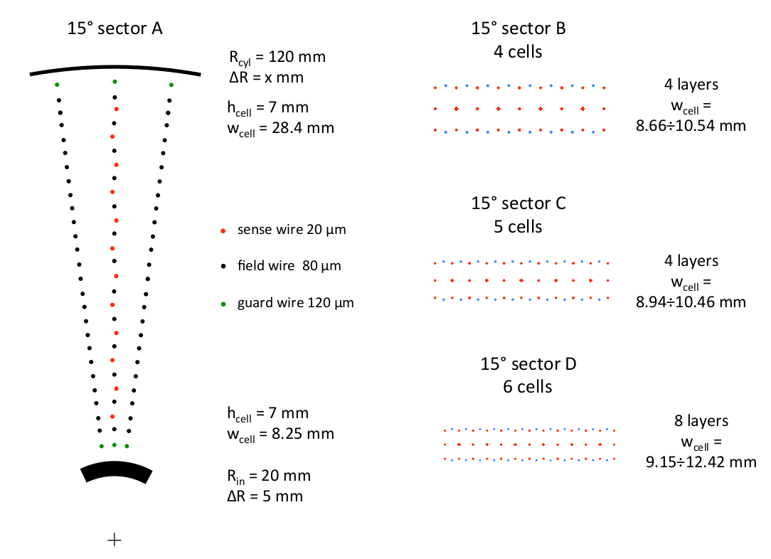
The mechanical design development of the CMD3 drift chamber.
Cell structure
From inside to outside, marked with black circle:
inner cylinder
middle cylinder
outer cylinder
Red circles show the different sectors in which the chamber is conceptually divided.
Sector A: jet-cells with wires arranged axially.
Sector B, C, D: single-wire cells with the wires arranged in stereo angle configuration.

Slide 3
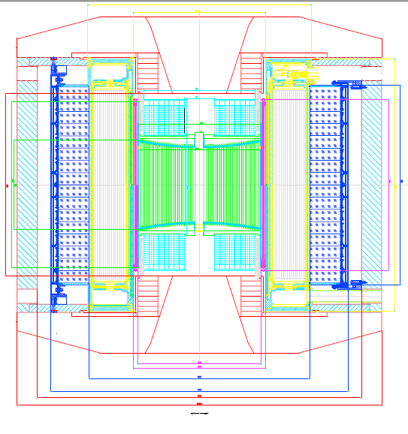
DIMENSIONS
Along beam axis ( distance between end-cap calorimeter) = 484 mm
Transverse direction (diameter) = 609 mm
Inner shell= 41 mm
The size along beam will be change not more than 5-15 mm, due to the optimization of BGO electronics.
Superconducting solenoid
Z-CHAMBER
CsI barrel calorimeter
BGO
Iron yoke
1092
1469
655
1600
550
1800.5
150
609
41
602
Liquid Xe calorimeter
Vacuum chamber
DC
Dimensions in mm

Slide 4
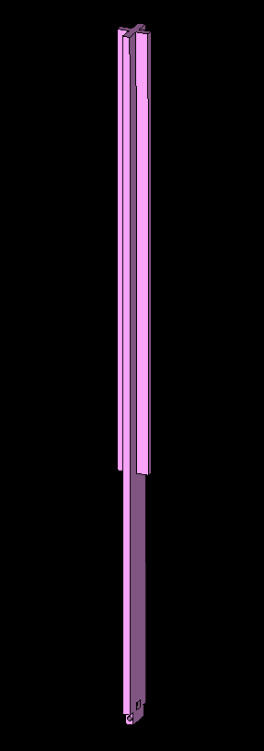
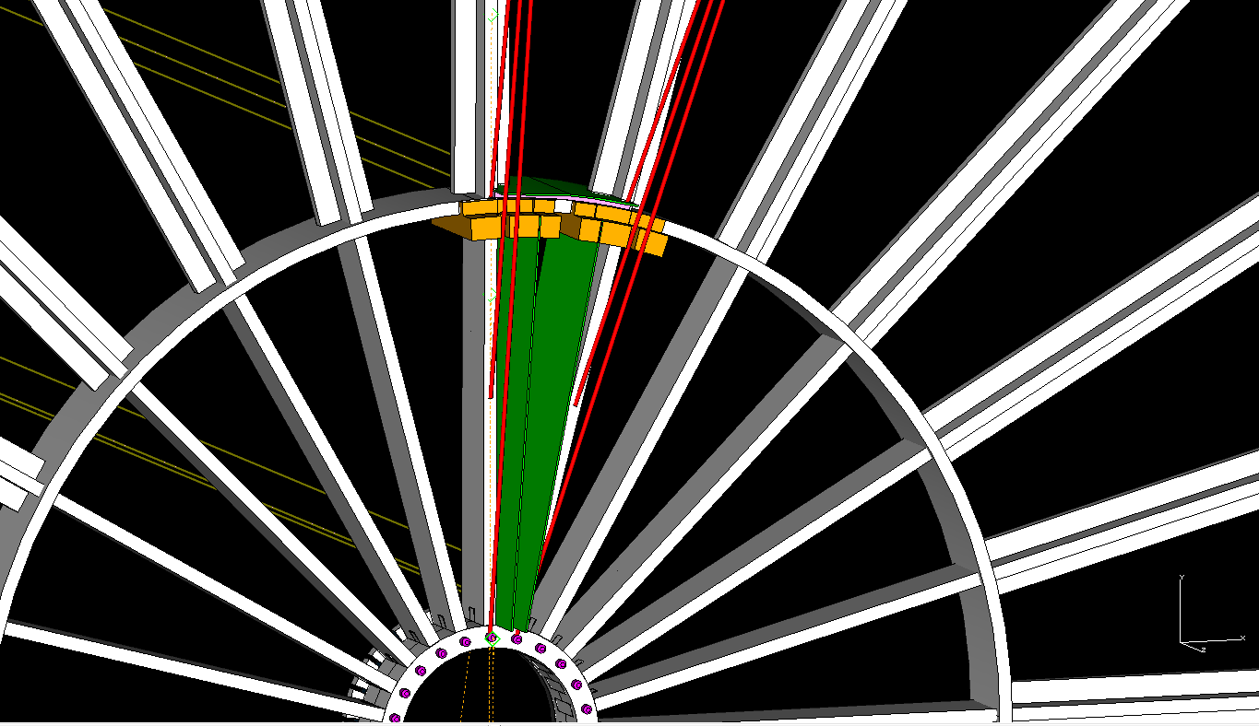
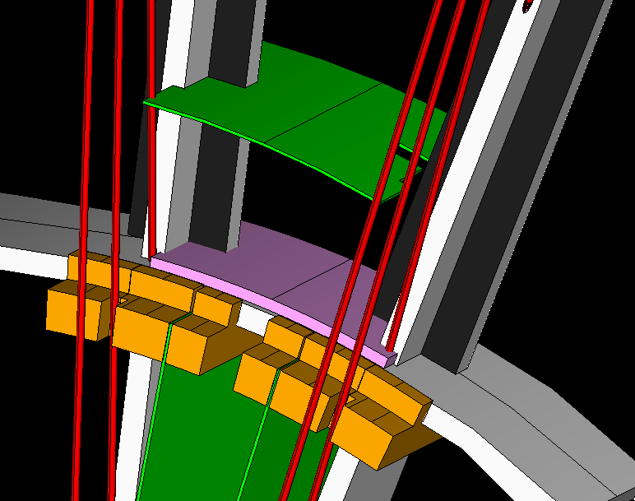
Sector A: 24 spokes-48 PCBs
The construction of the chamber is driven by two main purposes:
The high transparency
The mechanical stability of the whole structure
Each spoke will be inserted inside the inner cylinder
The spider web structure will be built in carbon fiber.
Support for PCB
Wire PCB for sector B
PCB for sector A
Tie-rod
The spoke will be fixed with a tiny pin

Slide 5
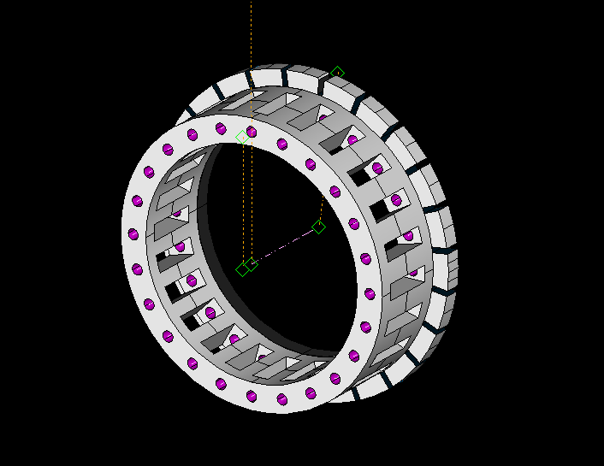
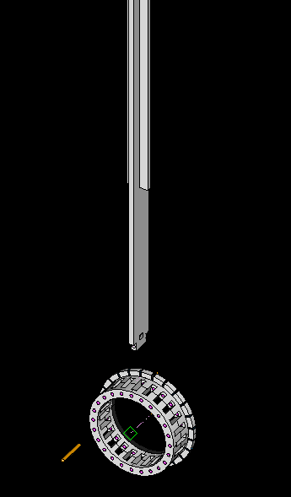
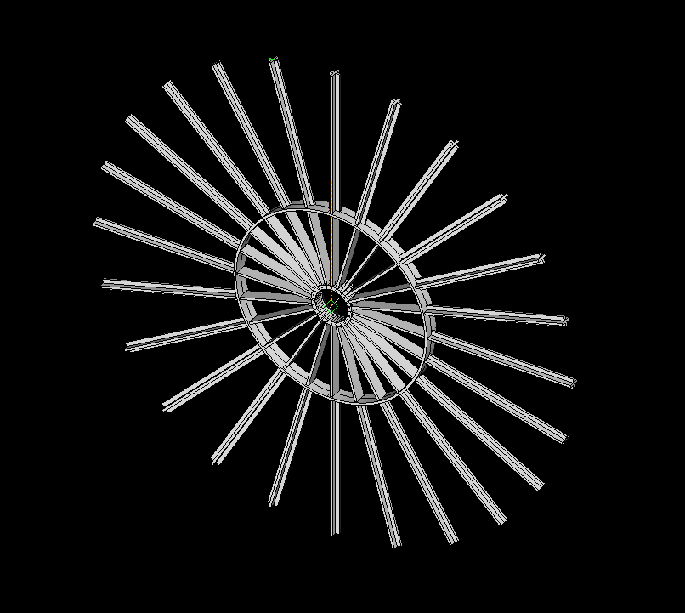
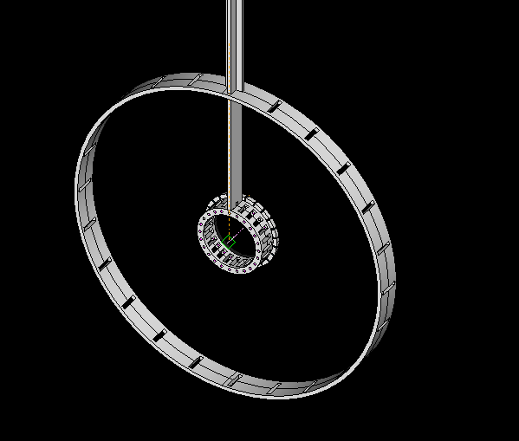
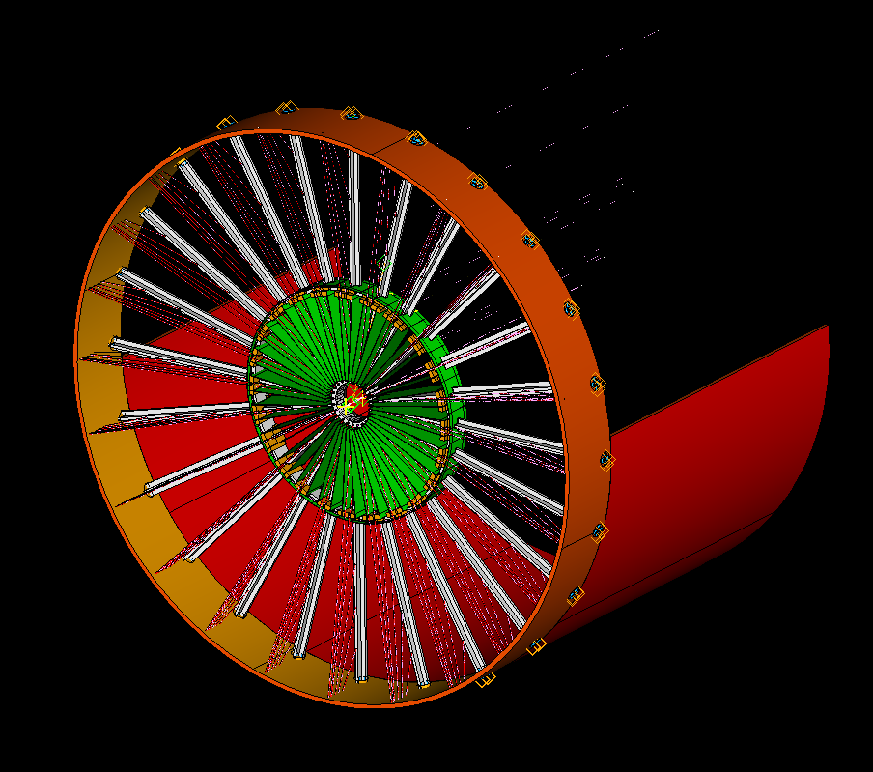

Slide 6
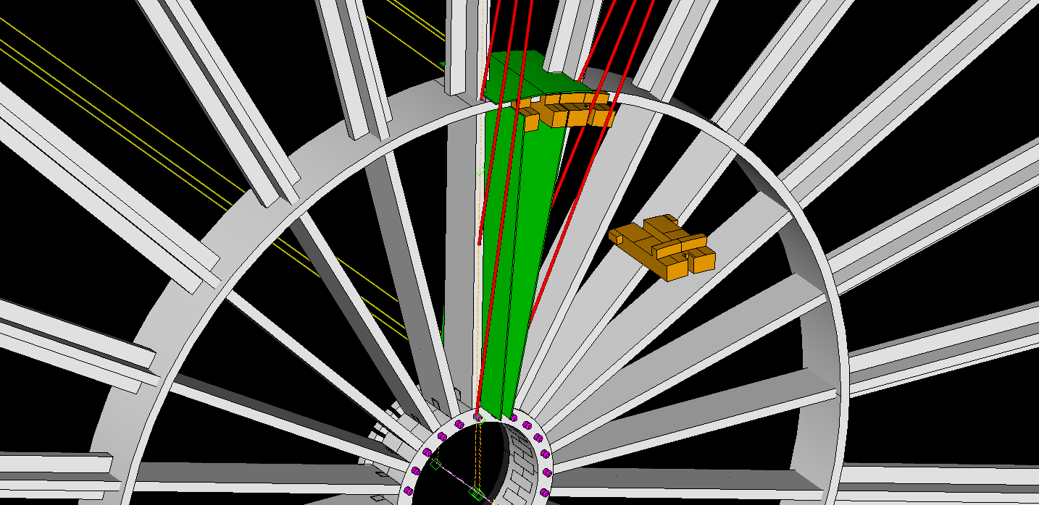
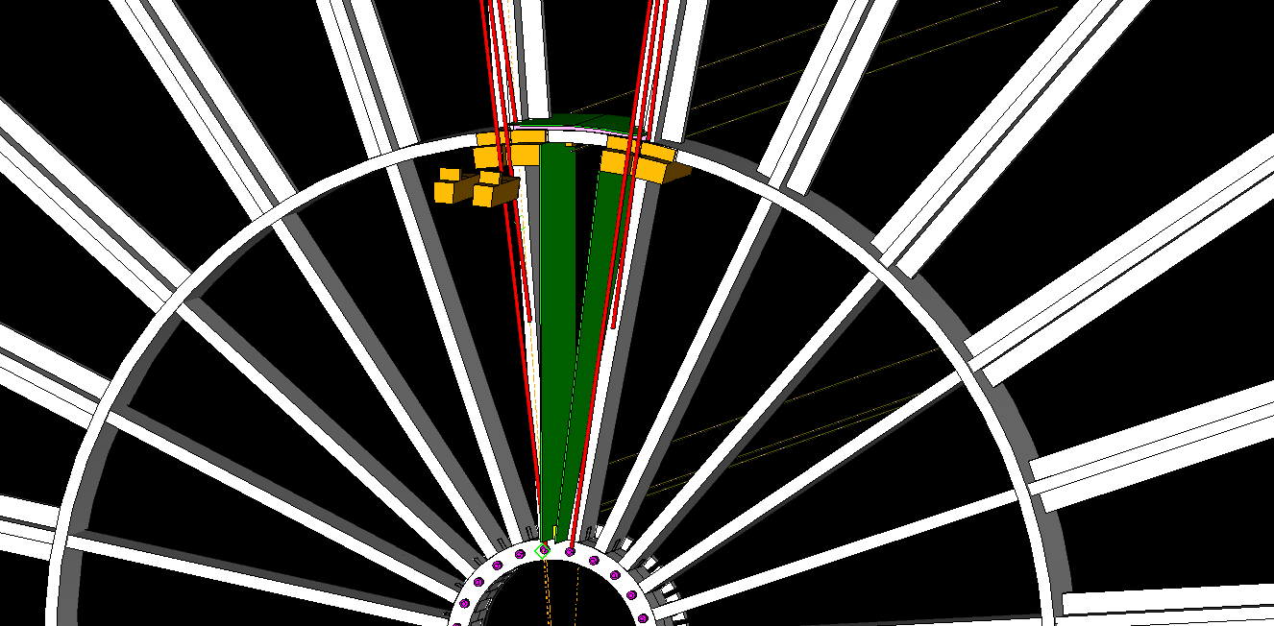
Details about the positioning of PCBs in sector A
At the intermediate ring, supports will be built with a suitable shape to host the PCBs.
At the inner ring, we will insert a wedge-shaped locking plate.

Slide 7
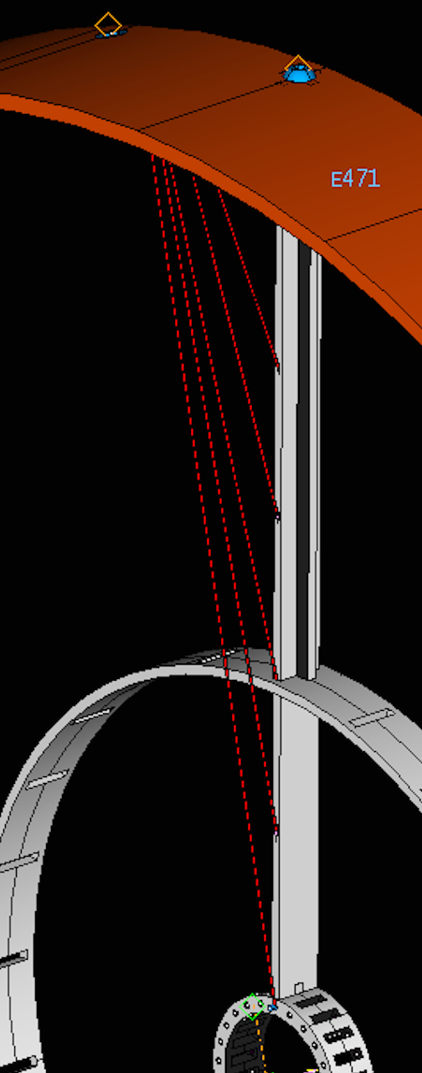
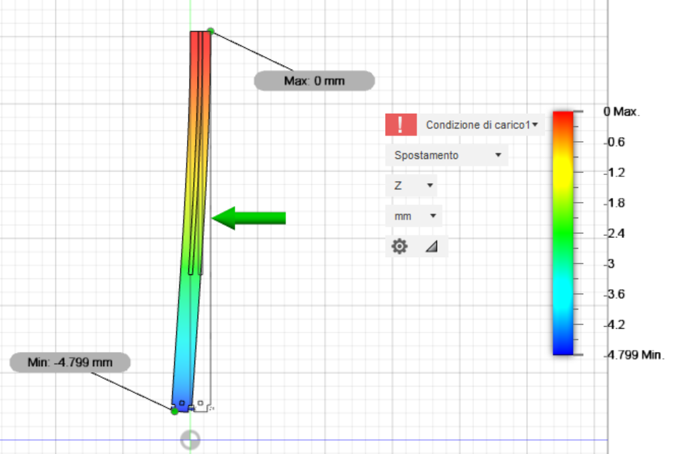
Tie rod to prevent deformations
Due to the wire loads, (≈20 kg per spokes), the end-plates are affected by deformations.
We intend to install an appropriate number of tie rods per spoke to minimize the deformations due to the wire load.
C-fiber (low modulus, 133 GPa) 4.8 mm deflection
Al 9.4 mm deflection
Ss 3.3 mm deflection

Slide 8
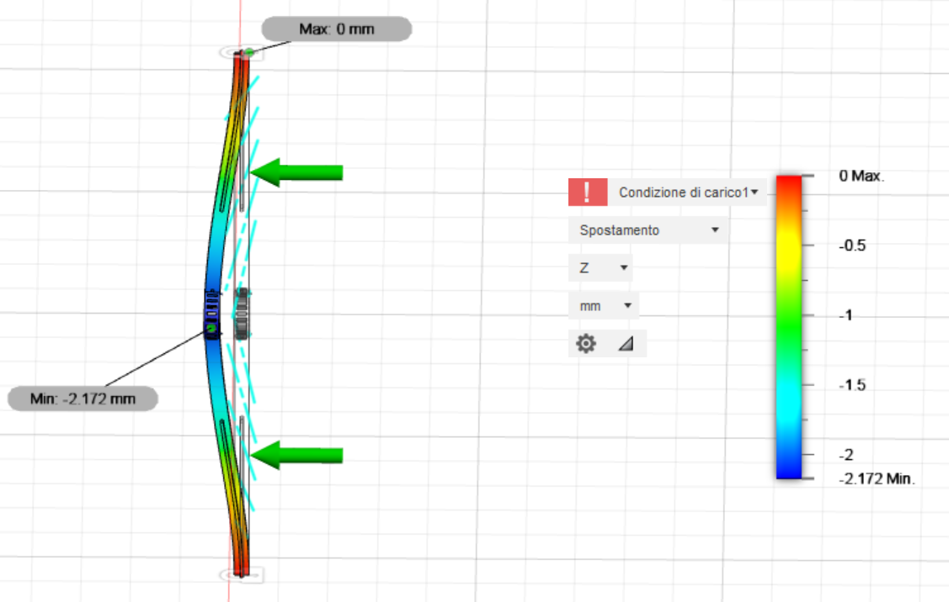
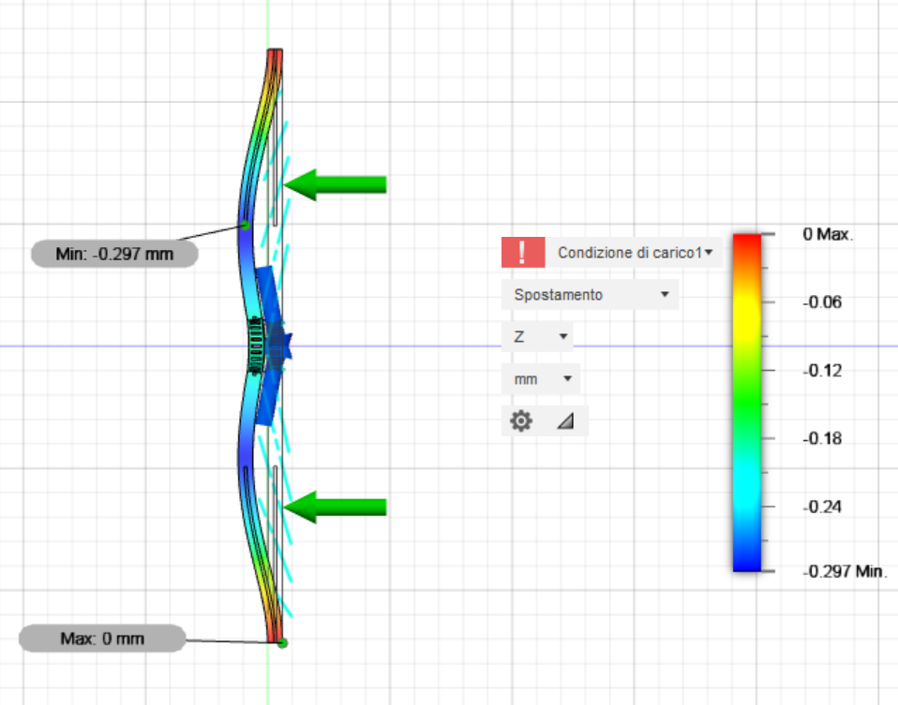
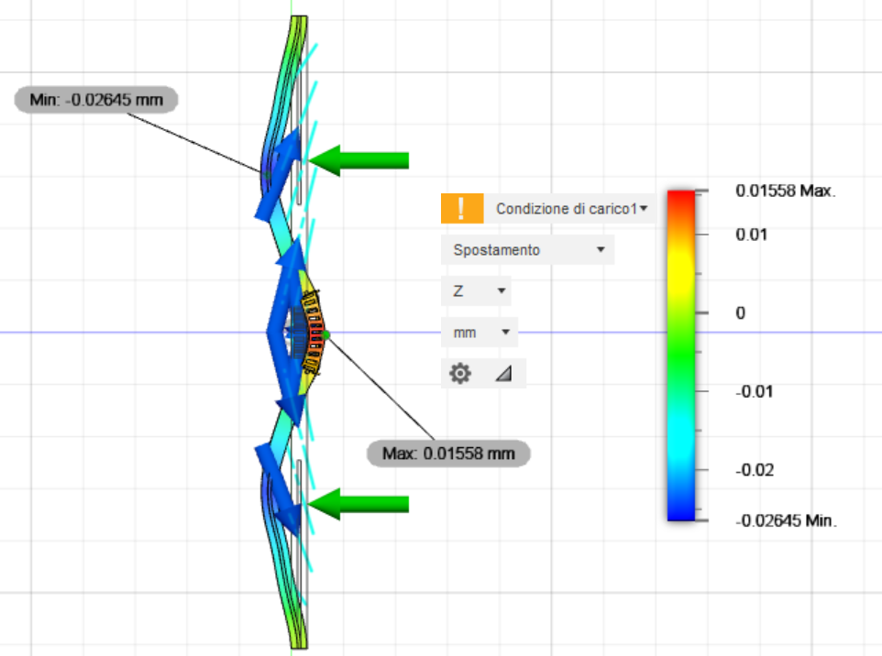
back to back spokes
Single tie rod per spokes
Three tie rod per spokes
Just by adding symmetry reduces to 2.2 mm deflection
Single tie-rod at inner radius loaded with 450 N at 10°: max deflection < 300 μm
Three tie rods loaded with : 140 N at 10°, 240 N at 14°, 200 N at 21°: max defection <±25 μm

Slide 9
Possible ways to attach the tie rods on the spokes
First proposal:
create buttonholes, insert an eyelet and hook the tie rod.
Second proposal: create two buttonholes, insert an eyelet and hook the tie rod.
Third proposal:
use a “cart”, like the mast of a sailboat

Slide 10
Conclusion
We started a collaboration with the technicians from University and Polytechnic of Bari, planning the following steps:
Finite elements simulation of the inner cylinder and spokes
Analysis and choice of suitable materials
Building of a prototype
We accept any suggestion, criticism and doubt!

