Slide 1
NU_AT_FNAL
Carla Distefano
Riunione Gruppo 2 LNS, 30 Giugno 2021

Slide 2
Programma di ricerca NU_AT_FNAL
Programma di ricerca finanziato dalla CSN2 che include due diversi esperimenti inerenti alla fisica del neutrino al Fermi National Accelerator Laboratory (FNAL):
SBN (Short Baseline Neutrino) Experiment → neutrini sterili (eV-scale)
DUNE (Deep Underground Neutrino) Experiment → violazione di CP

Slide 3
SBN: motivazioni scientifiche
Da più di 20 anni si osservano anomalie nei dati sperimentali che suggeriscono l’esistenza di neutrini sterili (ipotizzati da Bruno Pontecorvo nel 1967):
Anomalie sperimentali più significative: eccesso in (anti-) ν_{e} appearance agli acceleratori in LSND e MiniBooNE (short-baseline anomaly).
Altre anomalie osservate: deficit in (anti-) ν_{e} disappearance in sorgenti radioattive (gallium anomaly) e ai reattori (quest’ultime mitigate da nuovi calcoli del flusso nel 2011) (reactor anomaly).
Mancata osservazione di una corrispondente disappearence di ν_{μ} negli esperimenti MINOS e IceCube.
Le osservazioni cosmologiche non sono compatibili con un numero di neutrini > 4. Il quadro delle indicazioni sperimentali a favore dell’esistenza di un 4° neutrino sterile sulla scala dell’eV è molto complesso e controverso e necessita di un chiarimento definitivo.
Fondamentale misurare entrambi i canali di appearance ν_{μ} → ν_{e} e di disappearance ν_{μ} → ν_{μ} nello lo stesso esperimento:
  fascio di neutrini da acceleratore
  L / E ~ 1 km / GeV al far detector

Slide 4
SBN: sensibilità attese
SBN soddisfa queste richieste ed è ottimizzato per la ricerca di neutrini sterili sulla scala dell’eV.
3+1 scenario
arXiv:1503.01520
The LSND 99% C.L. region will be covered at ∼ 5 σ – level in 3 years of data taking with positive focusing of the BNB (∼ 6.6 x 10²⁰ pot).
Sensitivity to ν_{μ} disappearance will cover the current best limits in 3 years of data taking with positive focusing of the BNB (∼ 6.6 x 10²⁰ pot).

Slide 5
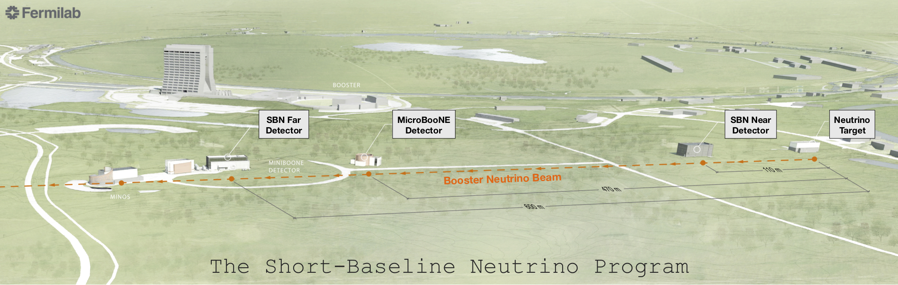
SBN: lay-out
Three liquid argon time projection chamber (LArTPC) detectors in the
Booster Neutrino Beam (BNB) at Fermilab.
  ○ using the same target/technology for near, medium and far detector reduces systematic uncertainties
  ○ make a high precision measurement on ν-Ar cross sections (1 yr: 1.5 million ν_{μ} and 12,000 ν_{e})
  ○ develop LArTPC technology for future large neutrino experiments like DUNE

Slide 6
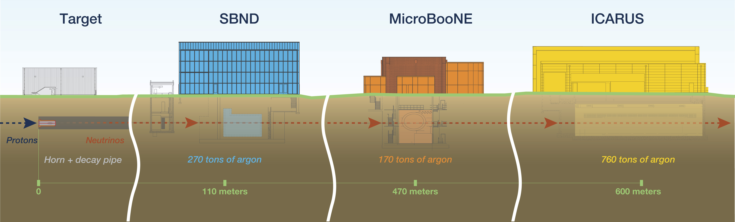
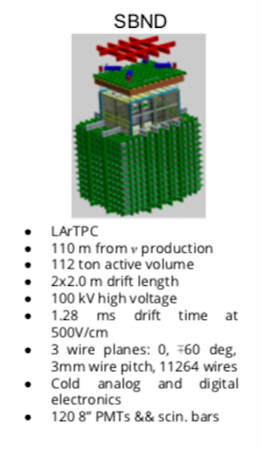
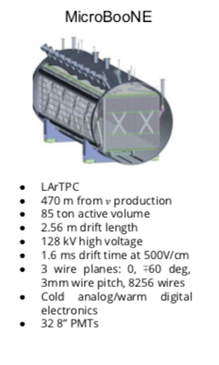
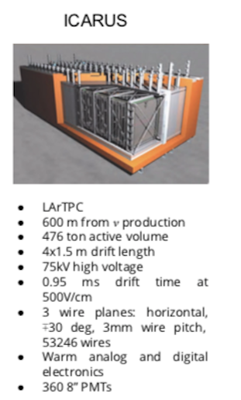
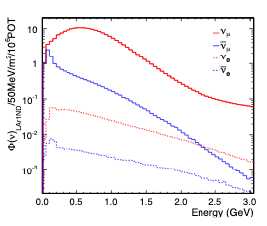
8 GeV protons from the Booster accelerator impinging a beryllium target
arXiv:1503.01520

Slide 7
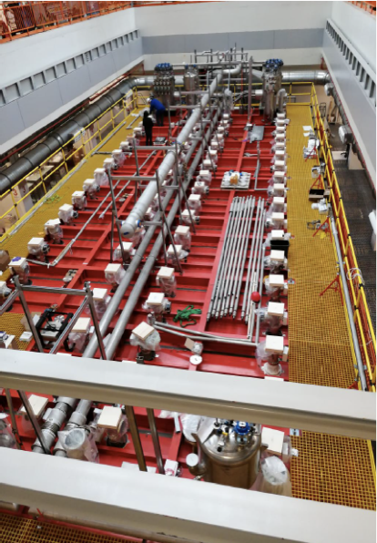
ICARUS
LNS group in ICARUS Collaboration
Commissioning is going on
  started in mid 2020 with cosmic rays
  first runs with neutrino beam earlier this year
LNS group in shift since July 2020
CRT installation and commissioning to be completed

Slide 8
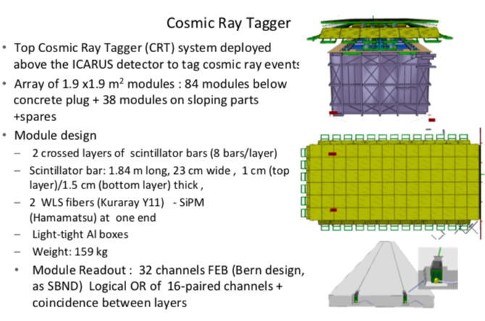
ICARUS Cosmic Ray Tagger
At the nominal BNB intensity of 5 × 10¹² pot/spill:
1 neutrino CC interaction every 240 spills
expected cosmic rays rate of 1 every 55 spills
LArTPC (slow technology): drift times in the msec range, detectors at the surface record significant cosmic activity with each readout (5-15 muons per readout in SBN detectors)
Cosmic Ray Tagger (CRT)
LNS participated at construction and test of the ICARUS CRT (2019-2020)
CRT modules are at FNAL ready for installation (delay to Covid-19)
Start of installation and testing this month (completed by the end of the year) → participation of the LNS group

Slide 9
DUNE: science program
• Neutrino Oscillation Physics → Universe is made of matter
- Search for leptonic (neutrino) CP Violation (matter-antimatter asymmetry)
- Resolve the mass ordering (m₃>m_{1,2} or m_{1,2} > m₃)
- Precision oscillation physics
        Parameter measurements, θ₂₃ octant
        Testing the current 3-neutrino model, non-standard interactions, ...
• Nucleon Decay → force unification
• Supernova burst physics (3000 ν_{e} events in 10 sec from SN at 10 kpc)
→ birth of a neutron star or a black hole
+ many other topics (ν interaction physics with near detector, atmospheric neutrinos, sterile neutrinos, WIMP searches, Lorentz invariance tests, etc.)

Slide 10
Mass Hierarchy and CP Violation

Slide 11
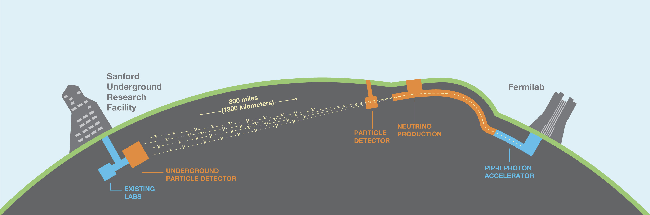
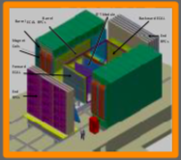

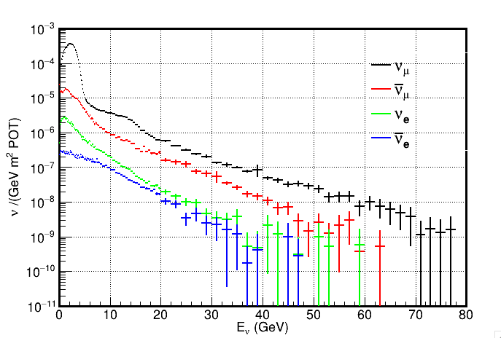
DUNE: overview
• Neutrinos from high-power proton beam: 1.2 MW from day one; upgradeable to 2.4 MW
• Massive underground Liquid Argon Time Projection Chambers: 4 x 17 kton fiducial mass of > 40 kton
• Near detector to characterize the beam (100s of millions of neutrino interactions)
South
Dakota
Chicago
575 m from the target
62 m underground
FHC, ND
1.5 km underground
7.5 × 10¹³ protons every 1.2 seconds at 120 GeV
On-axis detectors: broad neutrino energy range

Slide 12
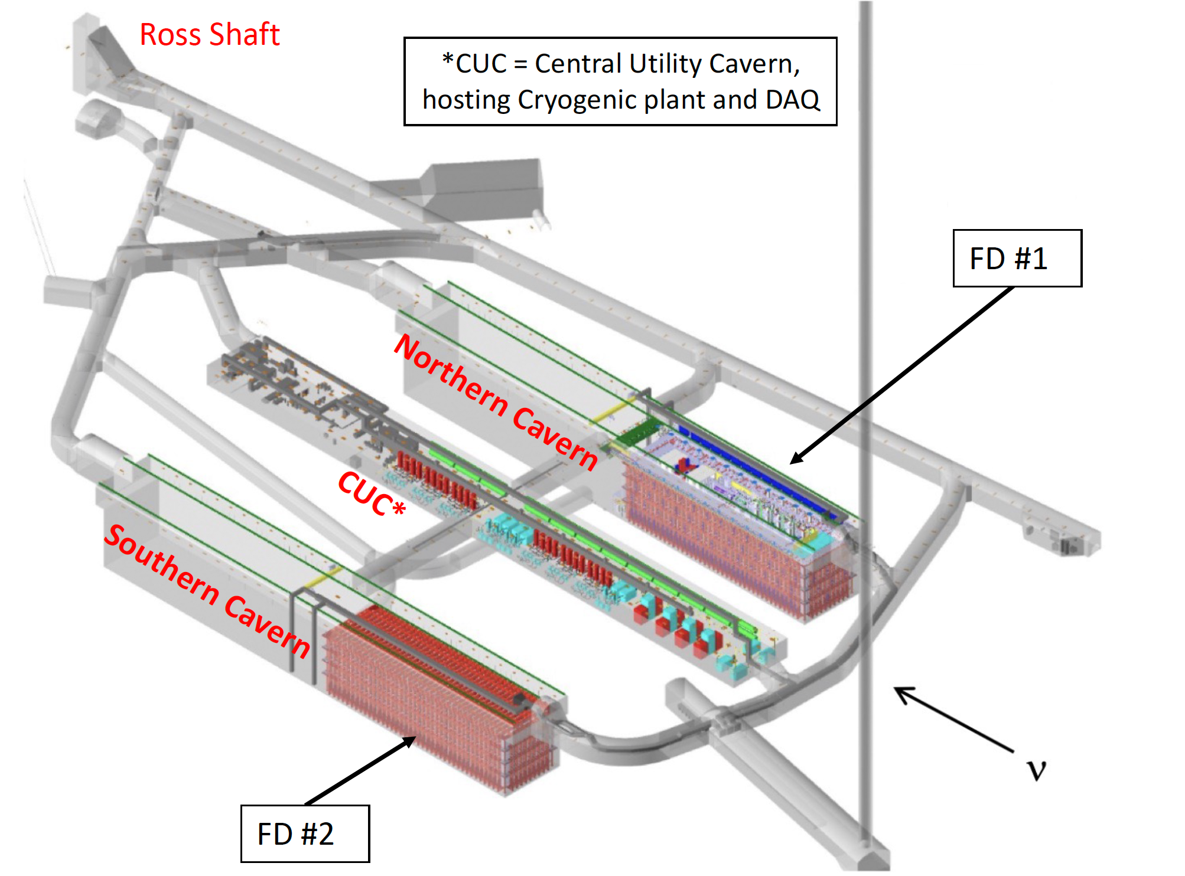
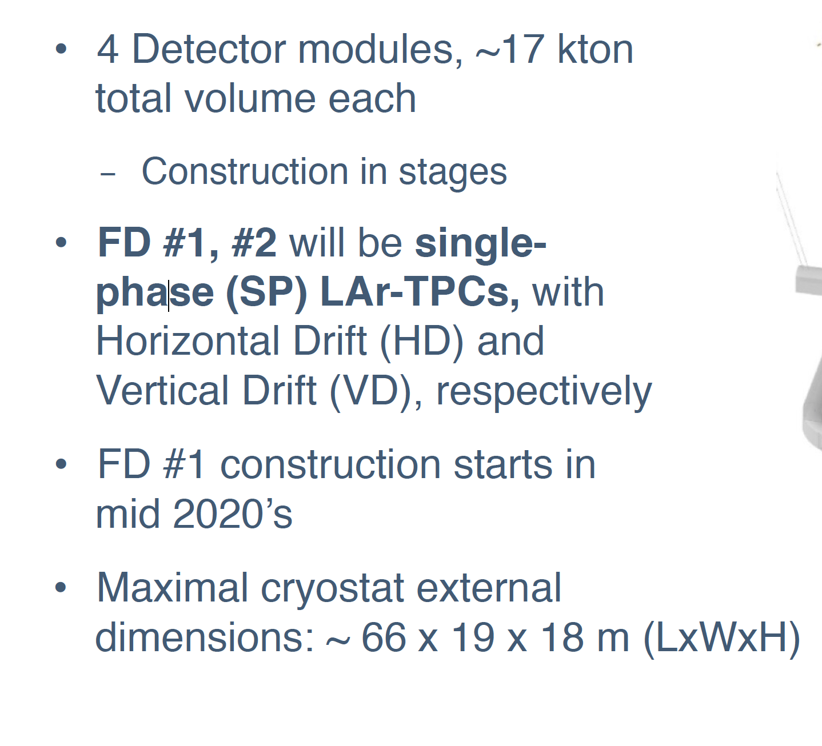
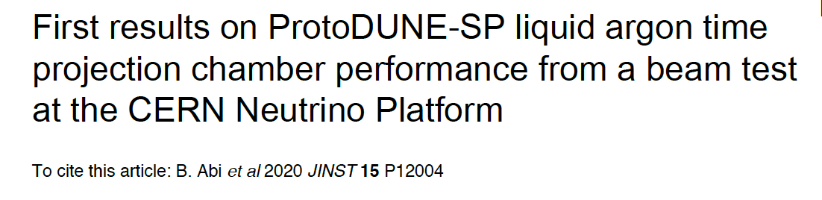
The Far Detector
Proposed FD Technology tested in ProtoDune
Run 1: 2018 – 2020
Run 2: next year

Slide 13
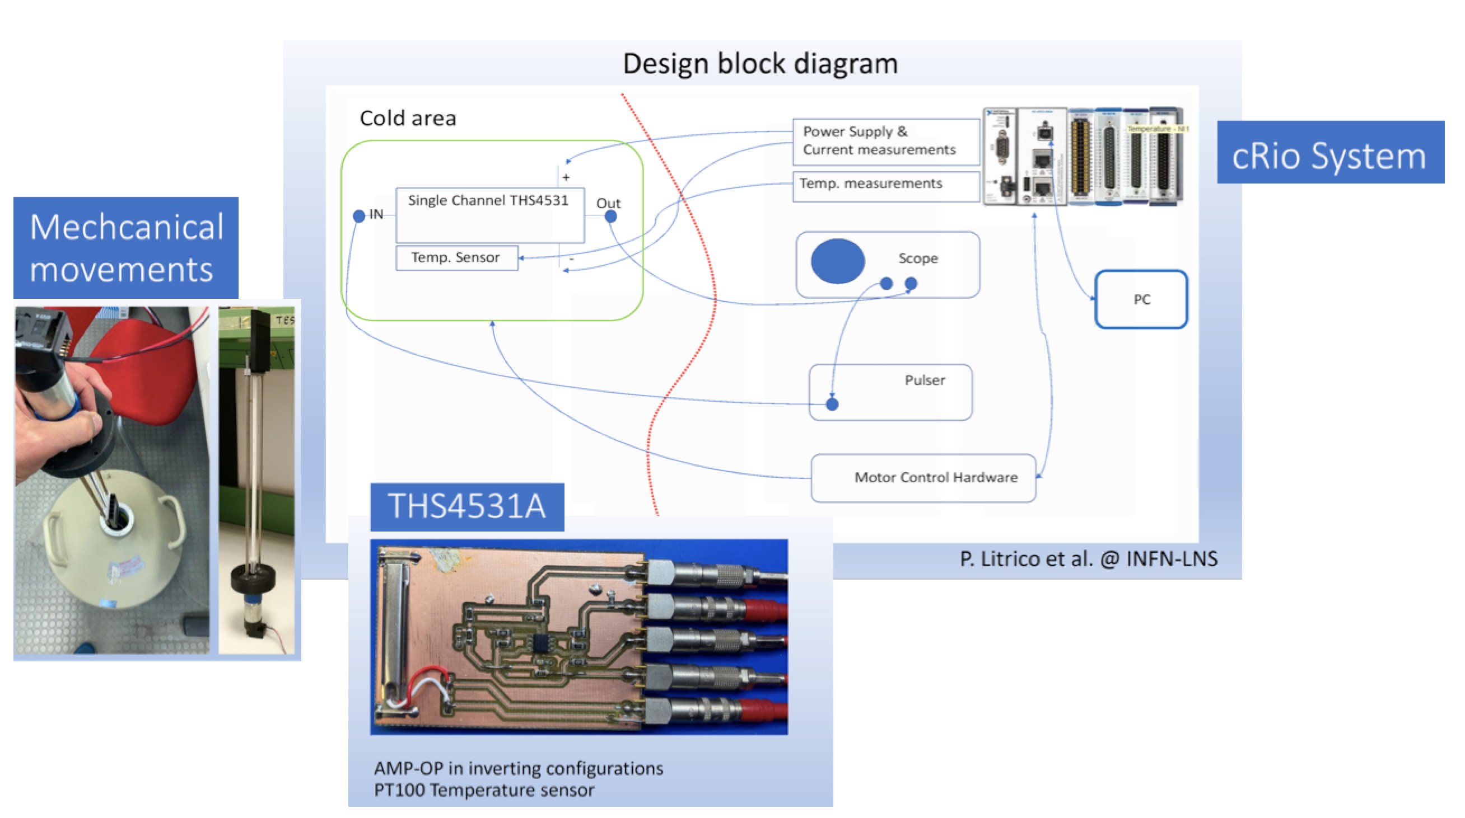
Photon Detection System
LNS responsible for Qualification of electronic components at cryogenic temperatures
Prototype complete and working

Slide 14
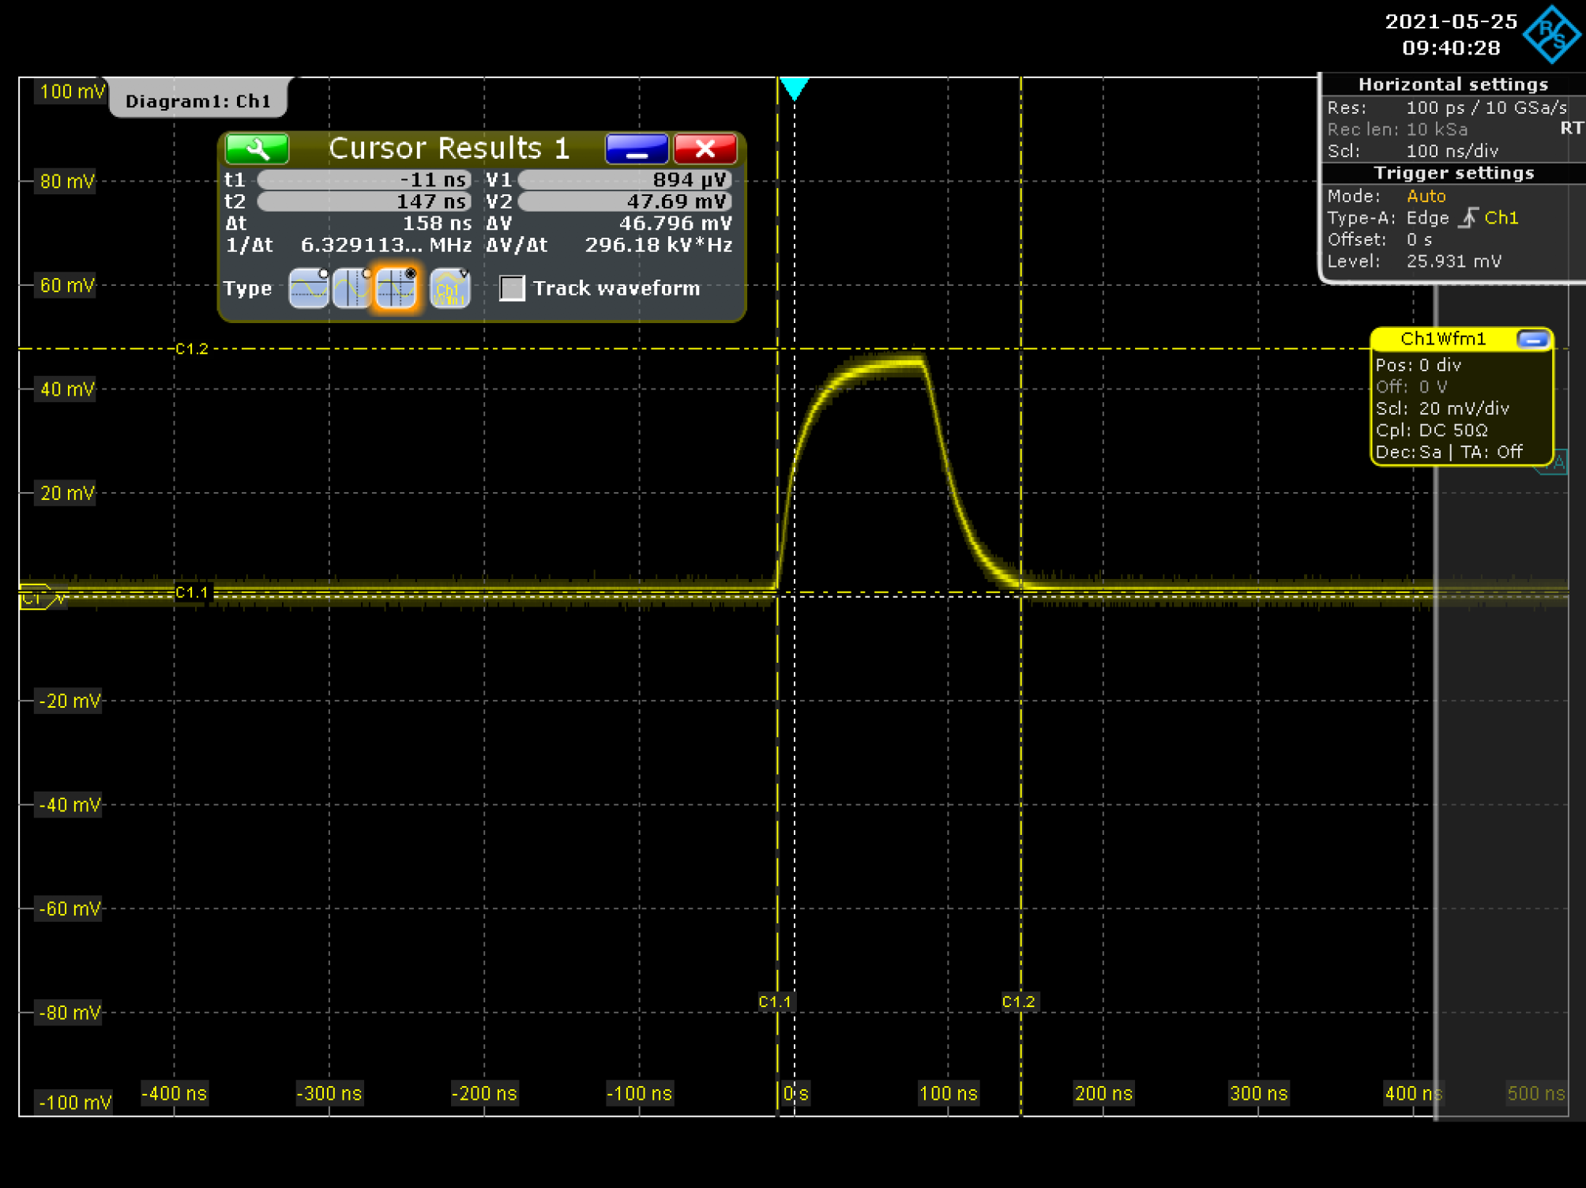
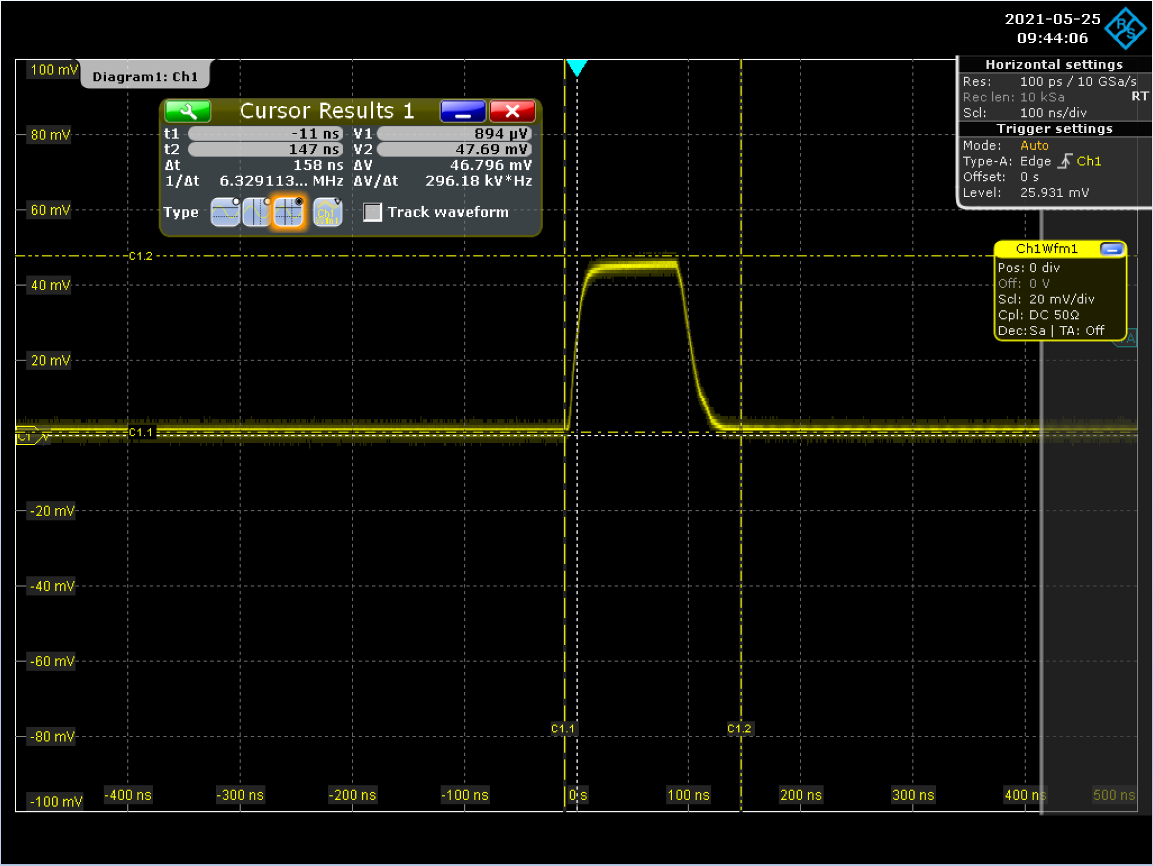
First results
THS4531 output @ ambient temperature
THS4531 output @ 77K
Prossimo passo: realizzazione del sistema finale per la mass production

Slide 15
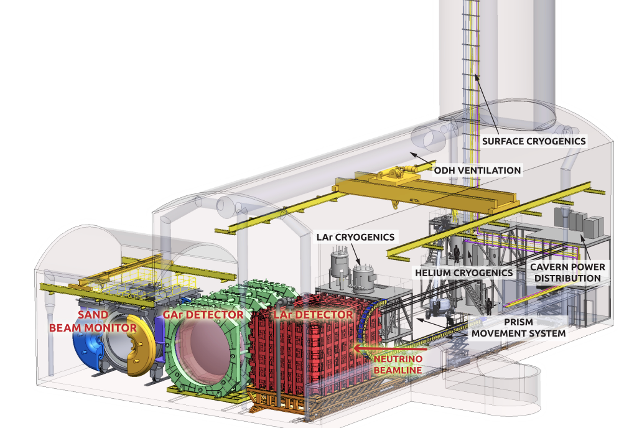
The Near Detector complex
Multi-technology Near Detector, focused on:
Precise characterization of neutrino beam
Limitation of cross sections uncertainties
Italian group mainly involved in SAND
SAND will continuously monitor the rate, spectrum and profile of the neutrino beam → real time variations of the beam operating conditions
SAND is the only component that will be permanently located
on-axis along the neutrino beam (the other systems will move off-axis for about 50% of the time).

Slide 16
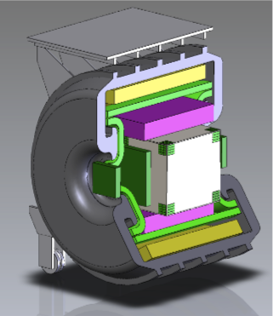
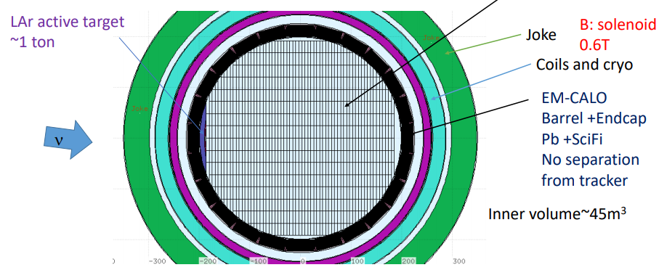
SAND concept
ECAL
TPC
Solenoidal superconducting magnet 0.6 T (KLOE magnet)
4π electromagnetic calorimeter (KLOE ECAL)
Inner tracker
GRAIN: thin LAr meniscus target (～ 1 ton)
Different options for the inner tracker are under investigation:
  • 3DST (3D scintillator tracker) + TPC (as in T2K- Near Detector)
• 3DST + STT (Straw Tube Tracker)
• STT (+ TPC)
3DST
magnet coil
yoke
SAND can provide unique constraints on the systematic uncertainties related to nuclear effects by performing various measurements with targets different from argon, most notably carbon and hydrogen

Slide 17
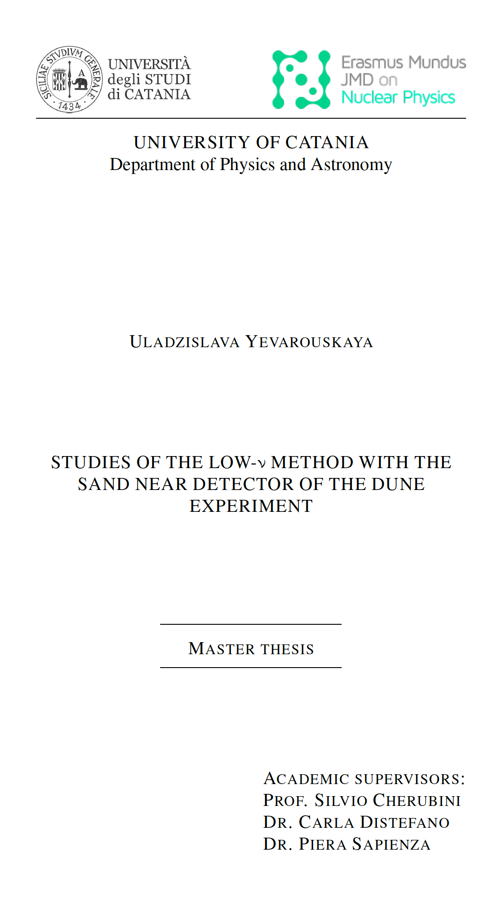
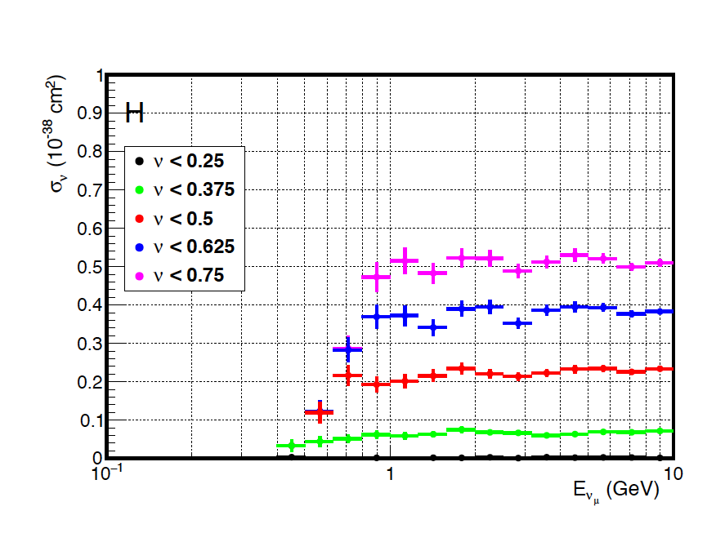
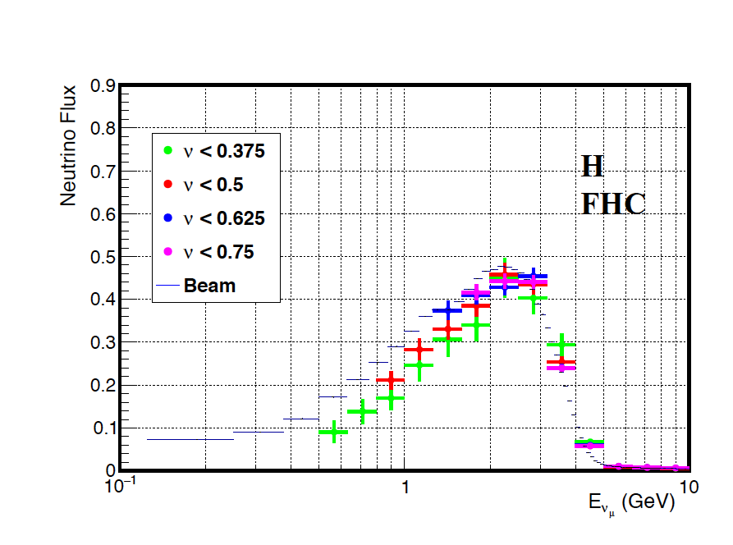
LNS activities in SAND
Monte Carlo simulations: generation of neutrino events with GENIE, mass production
Possible application of low-nu method:
Inclusive CC neutrino cross section does not depend on the neutrino initial energy in the limit of low neutrino energy transfer to the hadronic system (ν → 0)

Slide 18
Attività LNS in NU_AT_FNAL
DUNE:
Simulazioni del ND (SAND): generazione di neutrini con GENIE, mass production
Possibile applicazione del metodo Low-Nu per la misura dello spettro di neutrino al ND
(Uladzislava Yevarouskaya’s master thesis)
Caratterizzazione e qualifica dei SiPM per il Far Detector (light collection consortium)
SBN:
Costruzione e test del CRT di ICARUS ai LNF
Turni in locale e in remoto
Installazione e commissioning del CRT di ICARUS
Simulazione Monte Carlo e analisi dati di ICARUS

Slide 19
Anagrafica 2022
Nome | Ricercatori | Tecnologi | FTE
Cherubini Silvio | X |  | 20
Biagi Simone | X |  | 20
Distefano Carla | X |  | 30
Greco Vincenzo | X |  | 10
Noto Francesco |  | X | 20
Papaleo Riccardo |  | X | 20
Riccobene Giorgio | X |  | 20
Sapienza Piera | X |  | 30
 |  |  | 1.7
Divisone ricerca (reparto di elettronica)
Divisione tecnica

Slide 20
Richieste 2022
Inventario e consumo per il sistema di qualifica a freddo dell’elettronica del FD (circa 3keuro):
Richieste per schede National Instrument
Dewar
Meccanica
Materiale di consumo
Missioni (circa 30keuro):
Turni
Disponibilità per refurbishment e smontaggio KLOE
Meeting
…

