Slide 1
Laboratori Nazionali del Sud Università degli Studi di Sassari

Slide 2
INFN UNISS Role
VIRGO: Data analysis. Search for Burst Multi-messenger event candidates
ET: Sos Enattos Characterization and Candidature

Slide 3
VIRGO: Activity
Detector upgrades on going (Ad Virgo+, Phase I)
Quantum noise reduction: implementation of a frequency-dependent squeezing system
Newtonian noise cancellation system installed
installation of the instrumented baffles around Input Mode Cleaner mirror, in order to reduce the diffused light
testing the new suspensions for heavier mirrors

Slide 4
First observation of GW associated to the merge of a Neutron Star and a Black Hole:
GW200105 (8.9 and 1.9 solar masses)
GW200115 (5.7 and 1.5 solar masses)

Slide 6
VIRGO: UniSS/LNS Contribution
Burst Multi-messenger events: Search for transient GWs signals associated with GRB and FRB during LIGO-Virgo third observational run
Use of machine learning techniques to search for GW events

Slide 7
VIRGO: Burst Multi-messenger events
250 GRBs reported by Fermi and Swift, ~30 analyzed by LNS group

Slide 8
VIRGO: Machine Learning Analysis
Implementation of pre-filter trigger to distinguish event candidates by means of machine learning techniques
Hierarchical approach
Test on Monte Carlo data with very promising results.

Slide 9
VIRGO: Anagrafica/Richieste 2021
Personel | Virgo FTE
Massimo Carpinelli | 0.50
Domenico D’Urso | 0.50
Daniele Dell’Aquila | 0.50
Davide Rozza | 0.50
Valeria Sipala | 0.40
Iara Tosta e Melo | 0.50
Tot | 2.7
 |  |  |  | (kEuro)
Missioni | N. 6 Meeting Nazionali 1 fisico x 3 gg |  |  | 4.5
 | N. 3 Meeting Internazionali 1 fisico x 3 gg |  |  | 5.5
Tot |  |  |  | 10.0

Slide 10
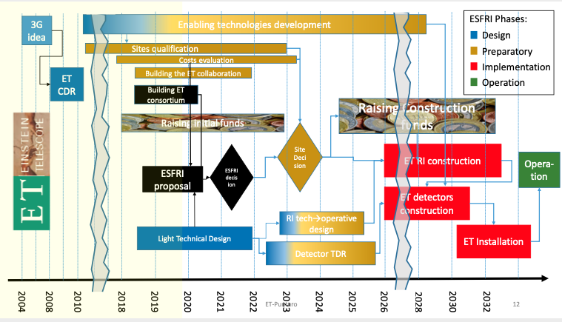
ET Roadmap

Slide 11
ET: ESFRI Proposal approved
On 30 June, the European Strategy Forum on Research Infrastructures (ESFRI) decided to include ET in the update of its roadmap for 2021.

Slide 12
ET: Sos Enattos Characterization
Sensors on site
4 broadband triaxial seismometers (1 surface vault installation + 3 underground);
3 short-period triaxial seismometers (first seed of a new array);
2 magnetometers (1 buried at surface, 1 underground).
High precision tiltmeter (Archimedes prototype)
Weather station
Data acquired at the SarGrav control room, transmitted via UMTS link to remote server (INGV-PI server → ET repository) and through an INFN access point
Underground station equipped with GPS signals for DAQ

Slide 13
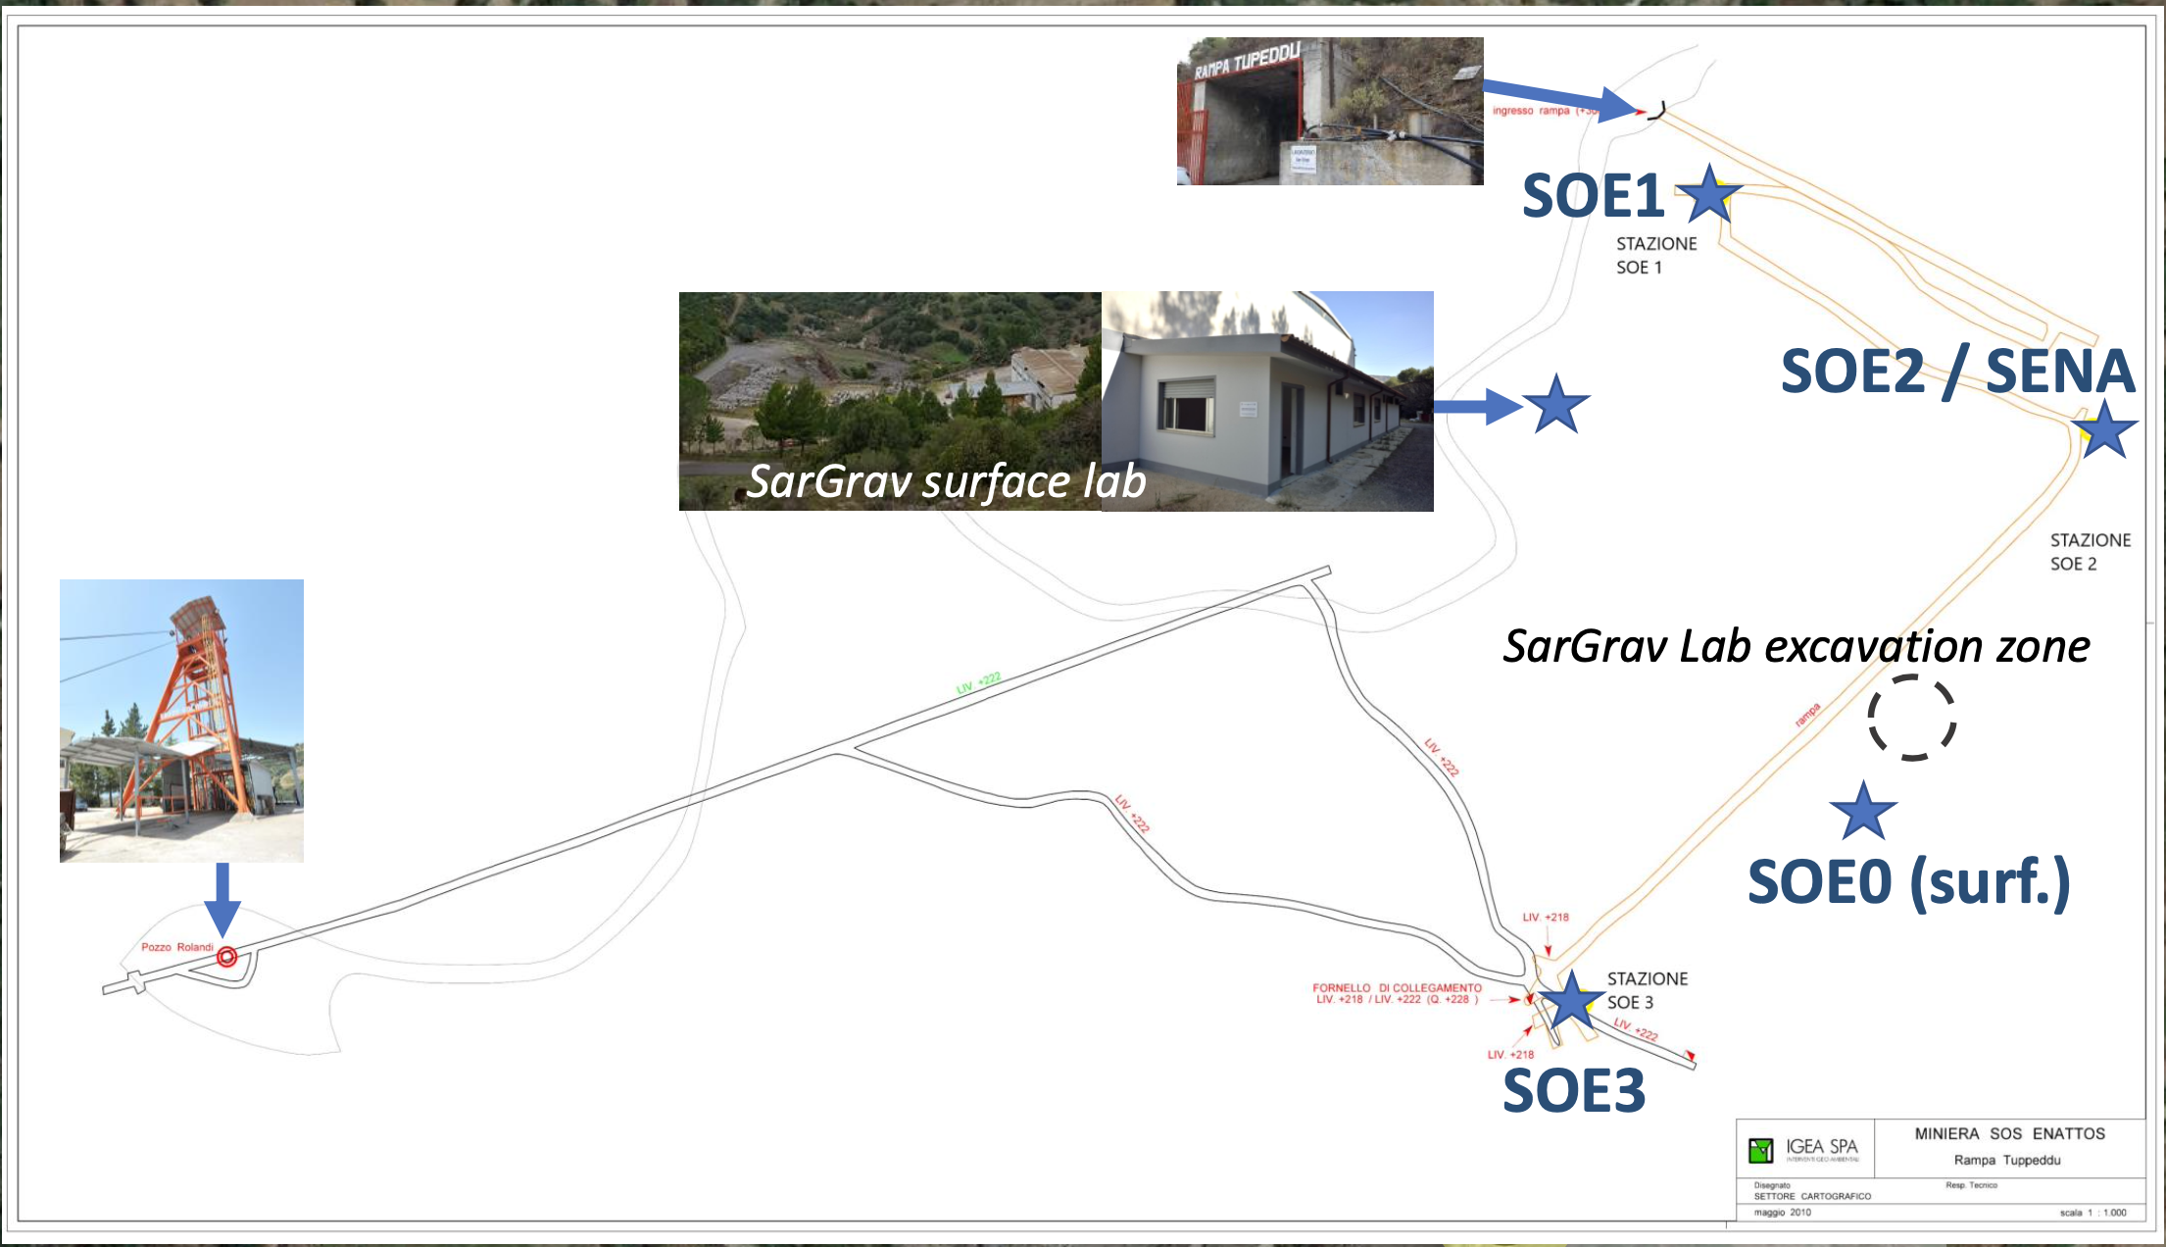
Sos Enattos Measurement Stations

Slide 14
ET: Sos Enattos Candidature Next Steps
Infrasound microphone arrays to be deployed in surface and underground;
Geological survey along the ET “triangle” with georesistivimeter probe.

Slide 15
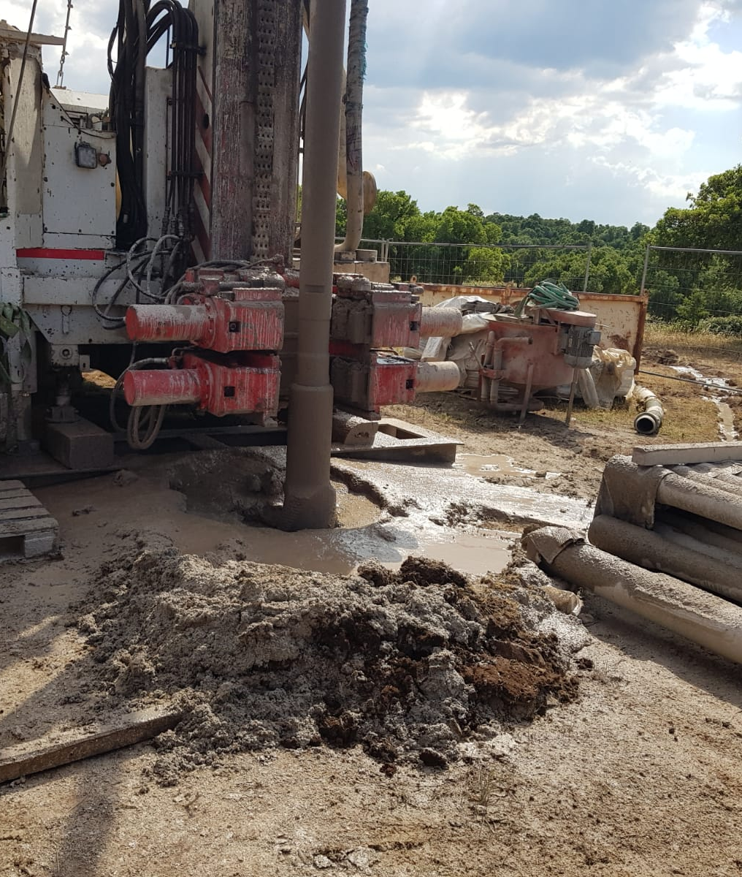
ET: Sos Enattos Candidature Next Steps
Borehole excavation at the corner P2 and P3 completed
Long-period borehole micro-seismic measurements at depth 250-300m with broadband borehole seismometers (Nanometrics Trillium120 BH Slim);
Surface seismic measurements at the corners close to the boreholes with broadband seismometers (Nanometrics Trillium120H).

Slide 16
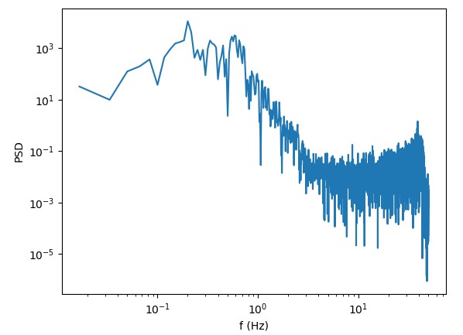
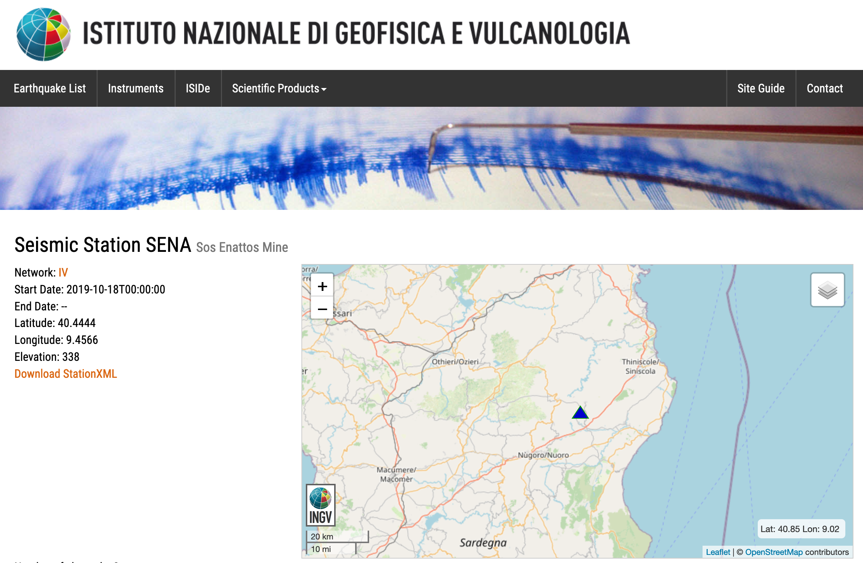
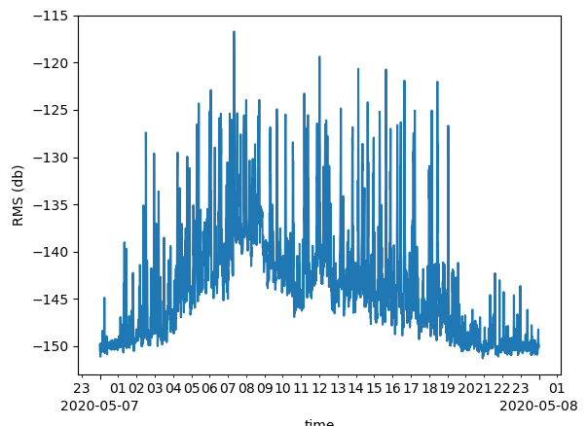
ET: LNS-UNISS Role
First analysis of seismic sensor data published
Waveform => PSD
PSD => RMS
time

Slide 17
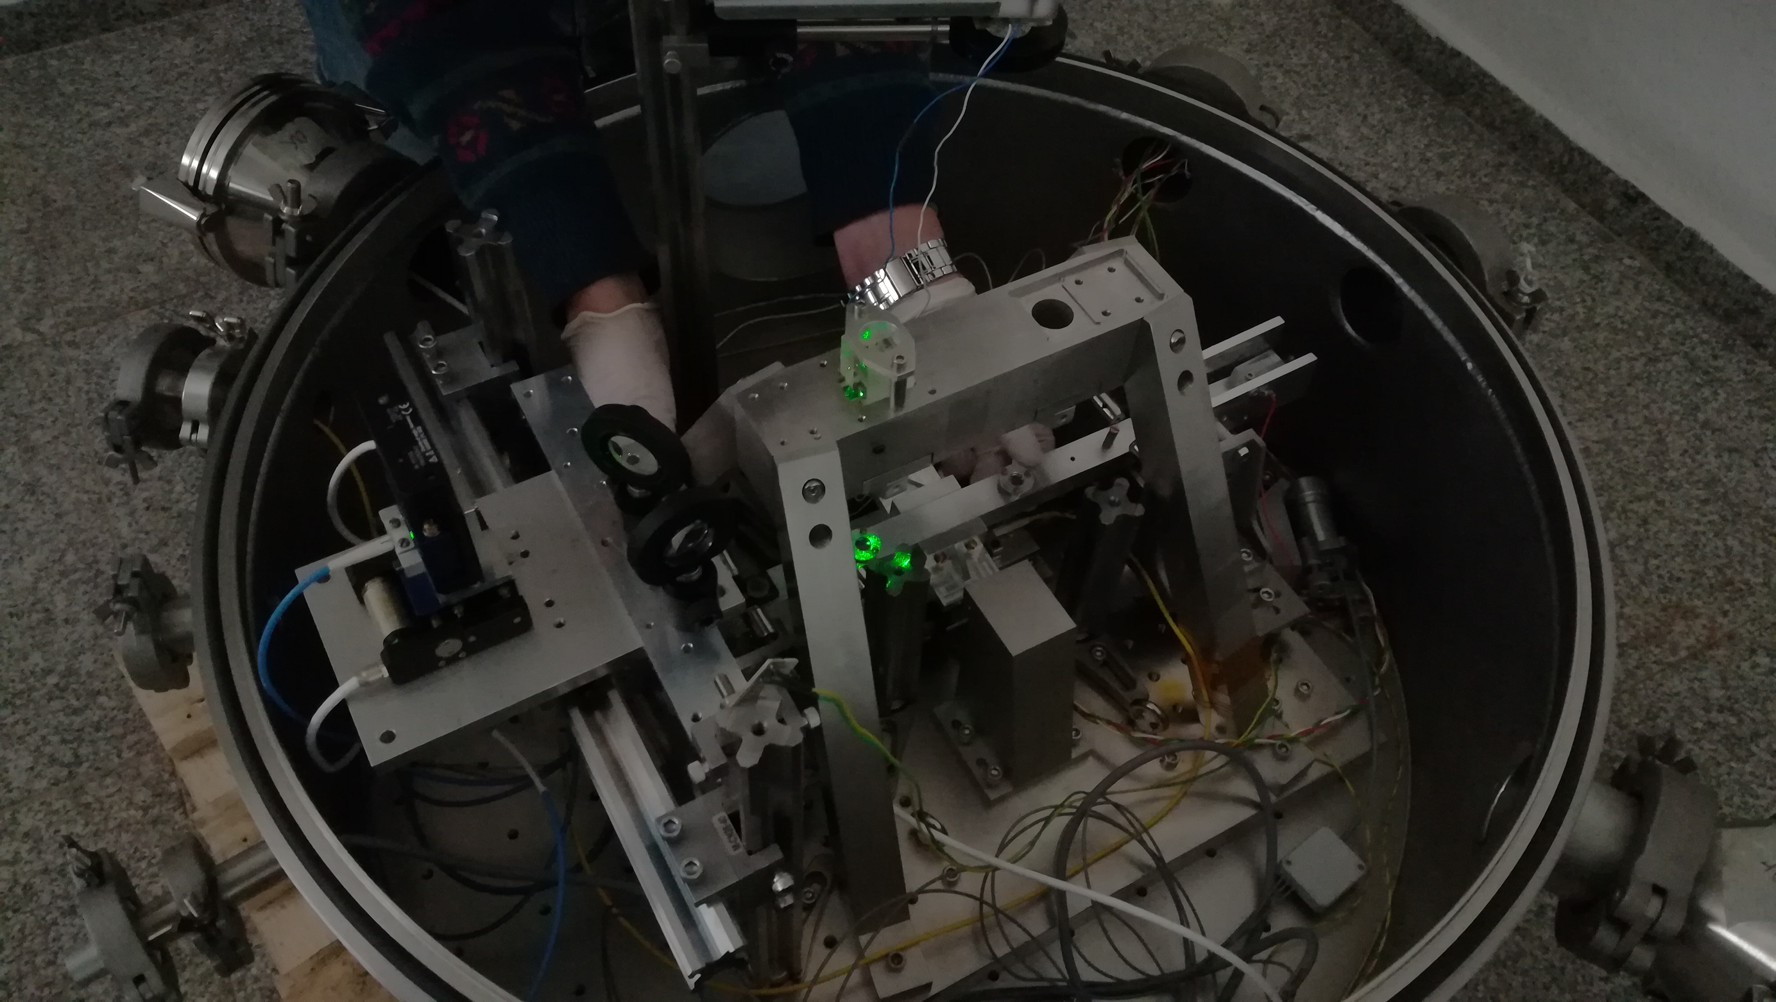
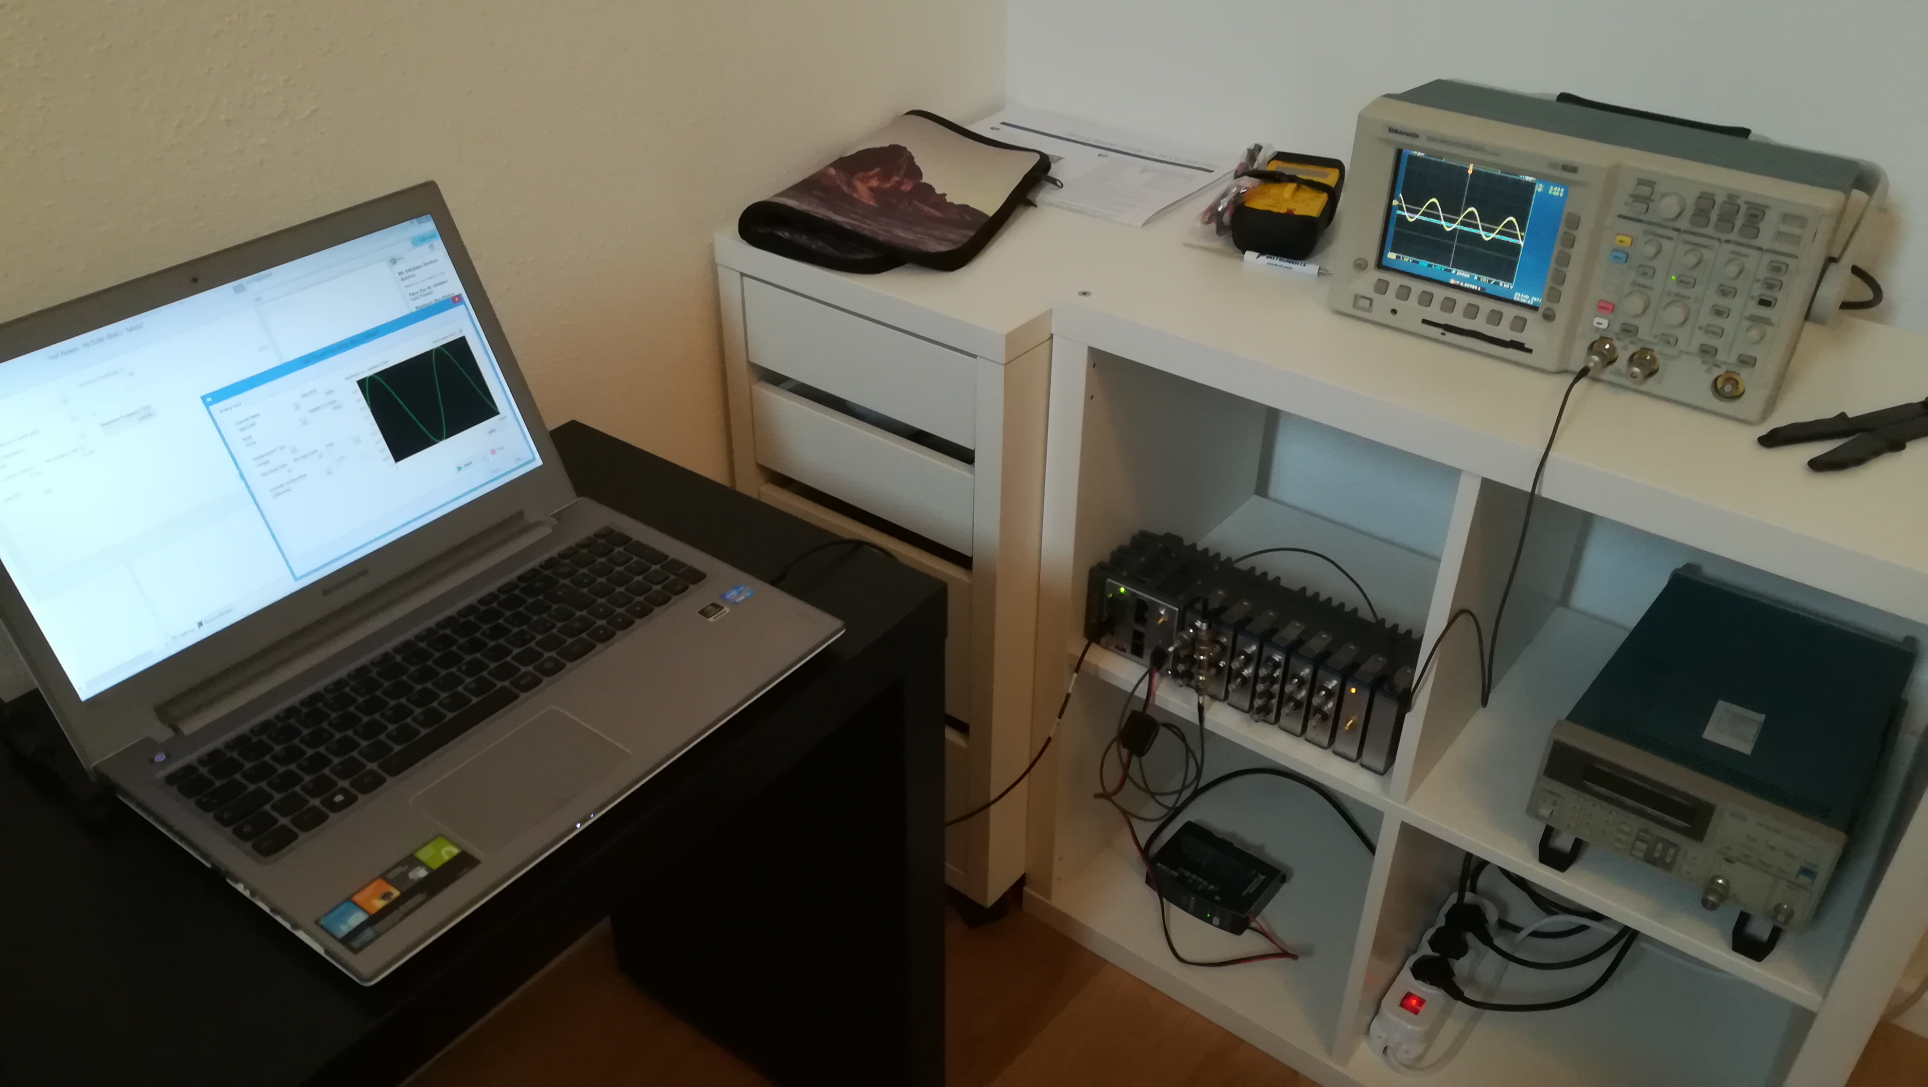
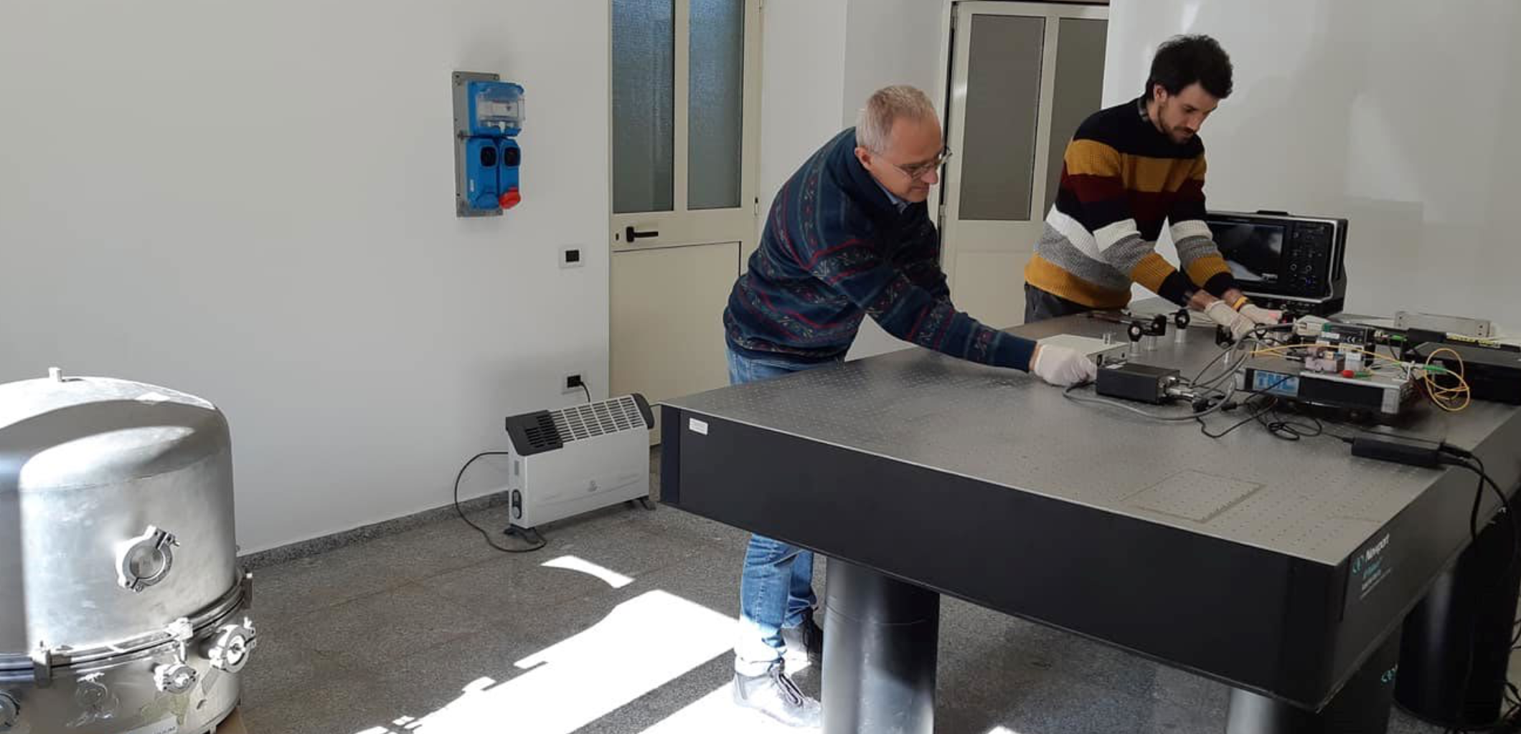
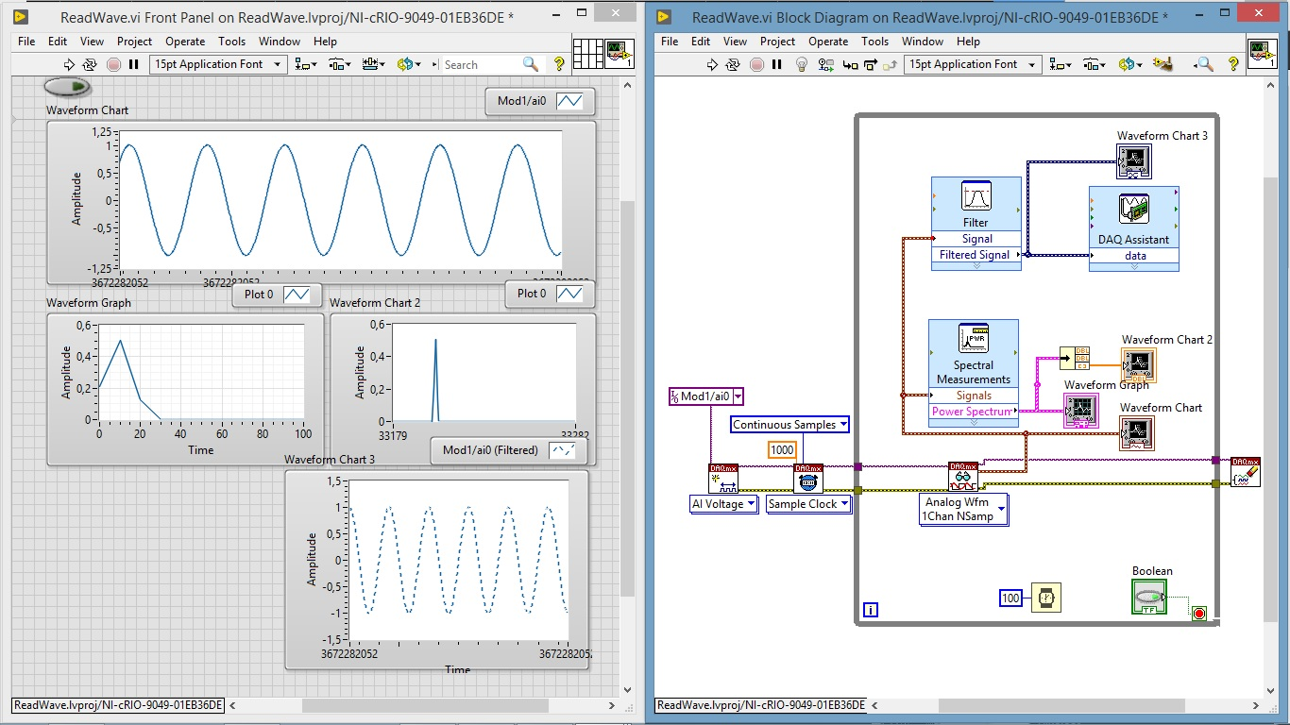
ET: LNS-UNISS Role
@UNISS
Configuration of NI-cRIO-9049 electronic system for Archimedes balance (founded by SarGrav project)
Control room preparation
Optical components assembly for the Archimedes balance prototype

Slide 18
ET: Attività 2022
Candidatura Sos Enattos
campagne di campionatura del suolo, operazioni di carotaggio, studi geo-fisici e geo-elettrici sulla natura dei terreni
campagne di misura del rumore sismico e ambientale
stima degli impatti socio-economici dell'Osservatorio.
“sponsorizzazione” sito

Slide 19
ET: Attività 2022
Misure long-term del segnale sismico in prossimità della localizzazione dei vertici dell’interferometro
stima noise ambientale (naturale e/o antropico) alla profondità e nella sede prevista per l’infrastruttura
correlazione con misure analoghe eseguite a diverse profondità all’interno della miniera di Sos Enattos

Slide 20
ET Anagrafica/Richieste 2022
Personel | ET FTE
Massimo Carpinelli | 0.10
Domenico D’Urso | 0.20
Davide Rozza | 0.20
Giovanni Luca Cardello | 1.00
Iara Tosta e Melo | 0.50
Luca Deidda | 0.50
Giacomo Oggiano | 0 (over 65)
Gaetano Schillaci | 0.5
Daniele Cittadino | 0.5
Tot | 3.2

Slide 21
Richieste
 |  |  |  | (kEuro)
Missioni | Missioni sul sito per installazioni manutenzione sensori e misure in loco |  |  | 10
 | Missioni sul sito per la definizione e la valutazione della localizzazione delle infrastrutture |  |  | 10
Apparati | Stazione sismometrica |  |  | 18
Consumi | Materiale di consume per I sismometri di superficie |  |  | 20
Servizi | Servizio di sorveglianza |  |  | 20
 | Carotaggi per indagini geologiche |  |  | 15
Tot |  |  |  | 93.0

