Slide 1
Proposta di apertura sigla locale Gr. II

Slide 2
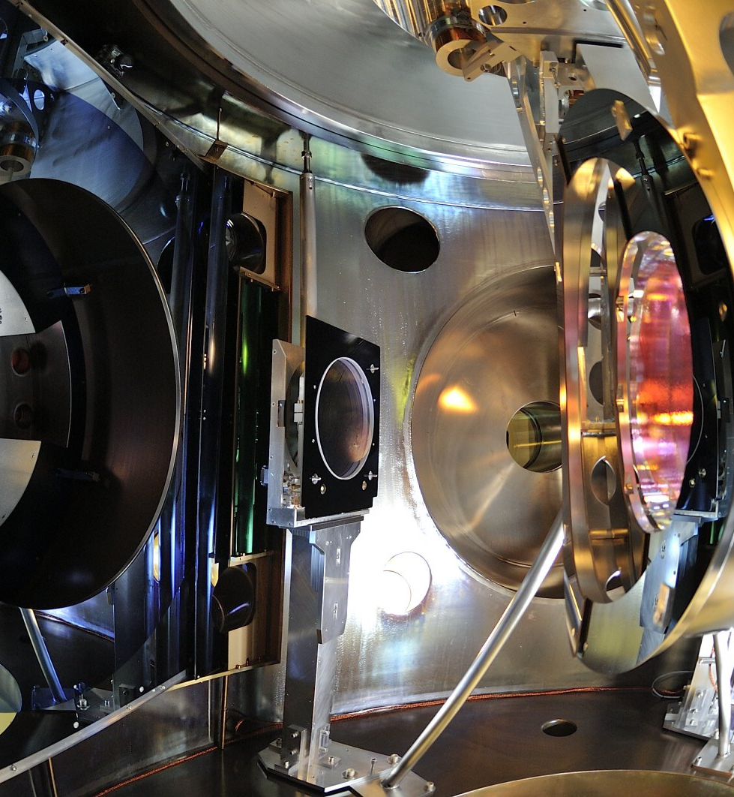
LNF is proposing to contribute and participate to the ET-Italia project, aiming to develop the required R&D to produce a technical design study for the construction of a third generation Gravitational Waves detectors.
The possibility that Italy may host this infrastructure in Sardinia, makes our contribution strategic to enter from the beginning to this exiting enterprise.
The new design will be based on longer arms (10 km each) and cryogenically cooled mirrors
R&D on Vacuum and Cryogenics for Einstein Telescope
@
LNF

Slide 6
LNF tasks: Vacuum
Outgassing surface treatment studies; inner surface treatments.
Bake-out Needs of In situ bake-out system
Procurement of certified materials and corrosion tests anti-corrosion (external wall of the tube)
Pipe VAC projections Overall feasibility projections
LNF tasks: cryogenics
Materials and outgas Cryostat VAC-CRYO studies: Multi layer cryo super-insulation VS degassing rate. Water presence adsorption/desorption
LowT VAC Cryotraps and Cryostat long pipes.
Cold Surfaces and coating Thermal radiation shields, emissivity studies, radiative cooling.
Thermal duct Cryostat mechanics (includes thermal duct)

Slide 7
Part of this research activity is part of a call, just presented
to gr. V (National responsible: Ettore Maiorana – Rome 1)
Independently from the outcome of this call, ET- Italia needs some of the foreseen activities to be started anyway, being crucial for the R&D of the project.
We wish to enter in ET-Italia starting with the following activities:
Emissivity study & test of cryostat thermal shields and UHV vacuum pipes (G. Delle Monache)
Outgassing/absorption study & test of SS inner surfaces (A. Liedl)
Cryogenic Vacuum issues: detrimental frost formation on the optics (L. Spallino & M. Angelucci)
Electrostatic charging mtigation (L. Spallino & M. Angelucci)
Will grant visibility to LNF

Slide 8
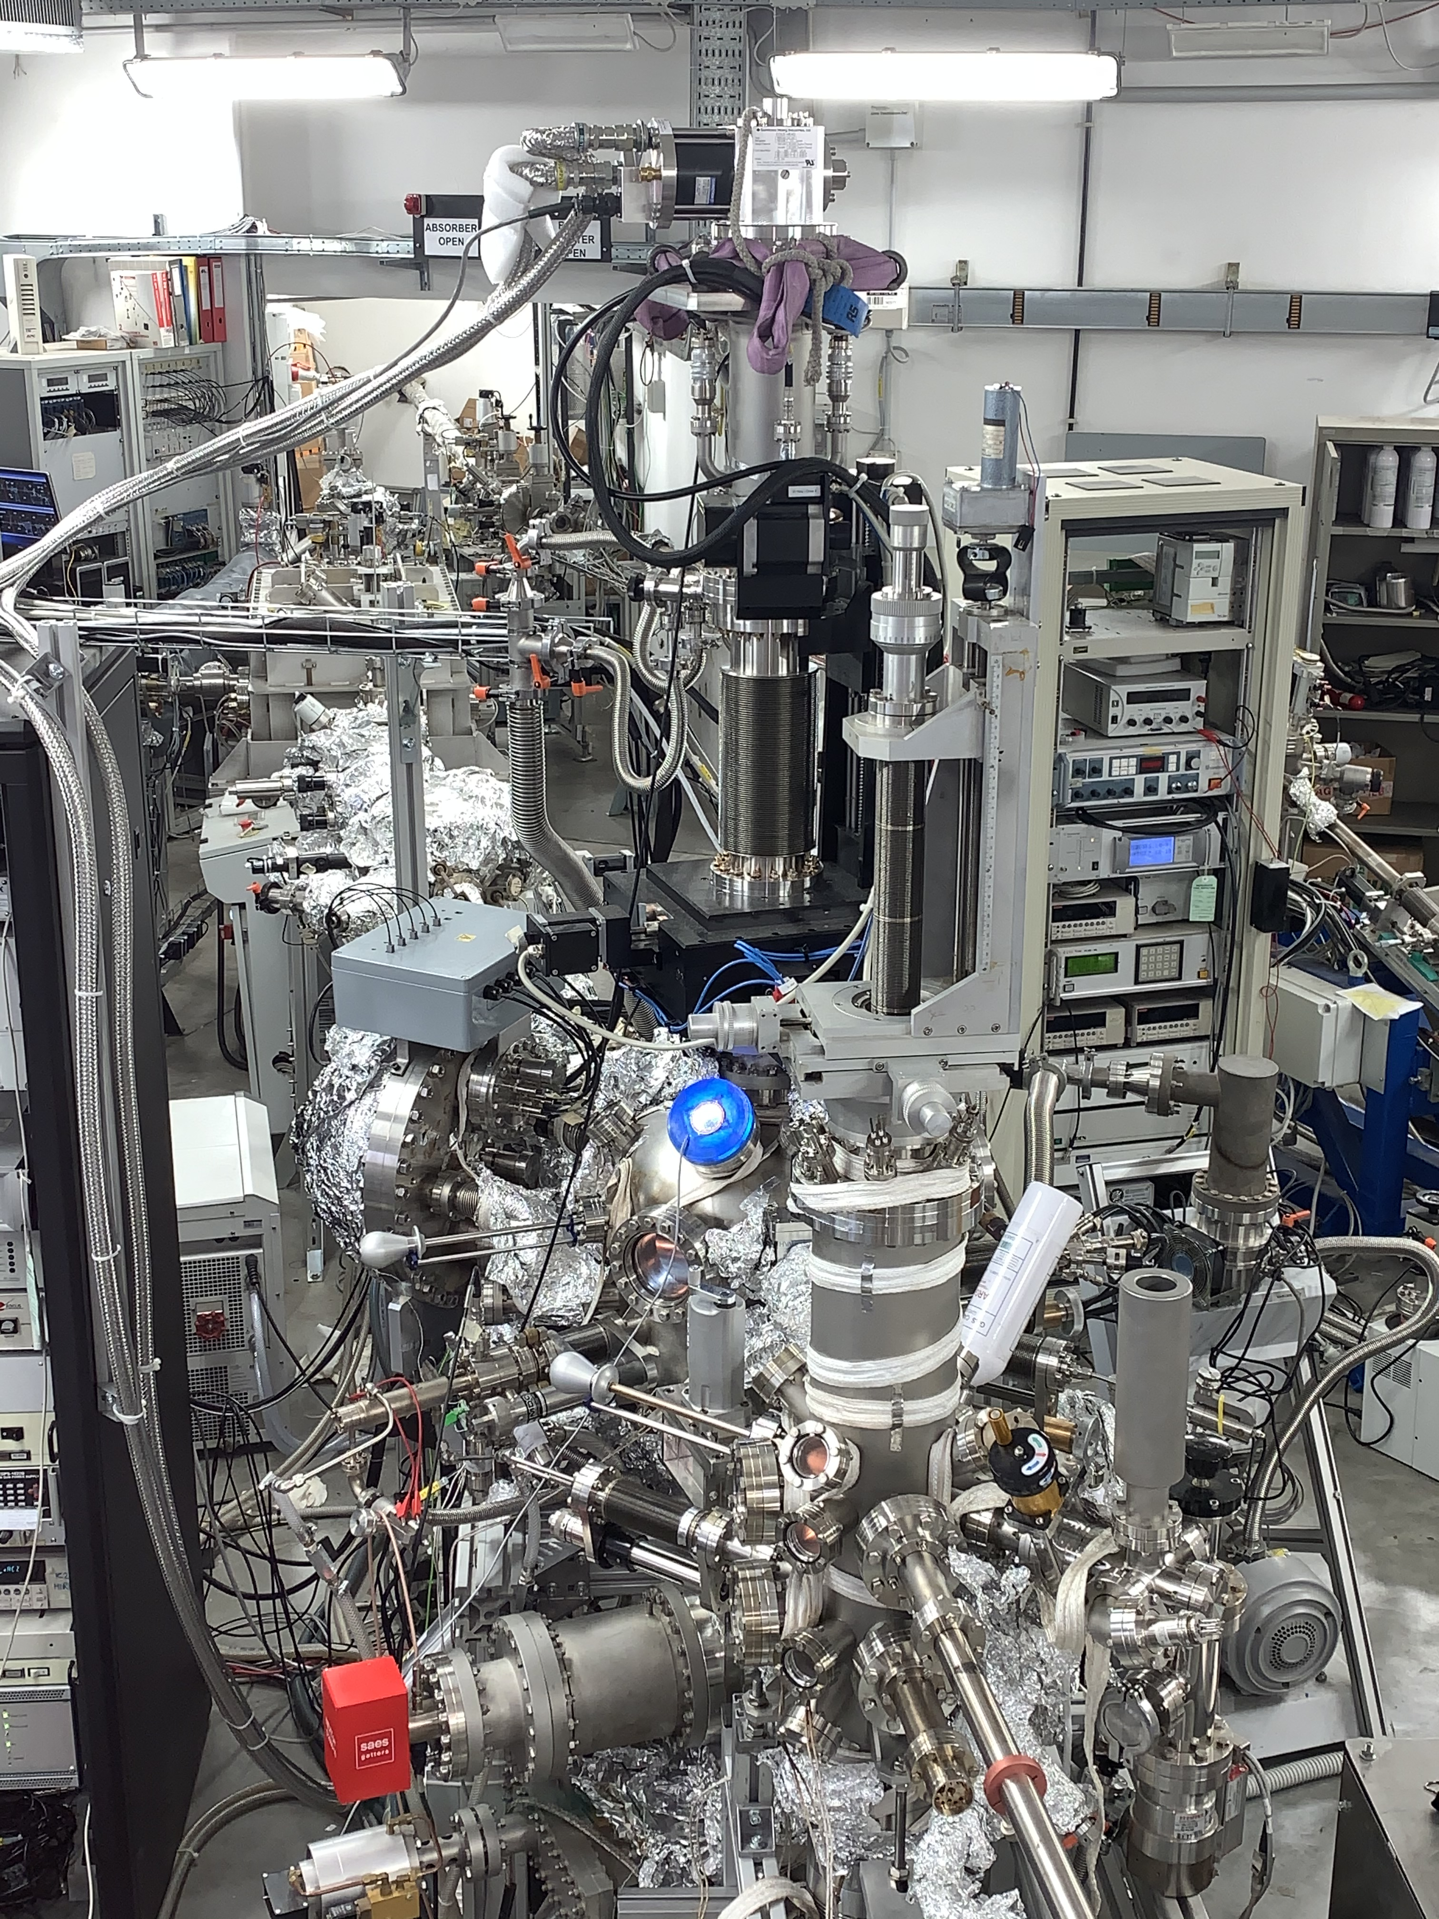
Cryogenic Vacuum Issues
Electrostatic charging
Mirror Temperature will define tower operating pressure since, at cryogenic temperature, residual gas will cryosorb on the mirror surface inducing detrimental effects on the optical properties
An active mitigation method is mandatory to remove the unavoidable frost formation on the optics
Both VIRGO and LIGO optics undergo to inhomogeneous electrostatic charging that may induce unwanted noise
The existing mitigation method cannot be applicable at cryogenic temperature since microns of N₂ will cryosorb on the surface
MassLab
At MassLab there two “state of the art” UHV set-ups equipped with cryogenic manipulators for hosting small samples (10x10mm²) at <20 K, electron guns, XPS, SEY, QMS and other spectroscopies to perform:
Surface studies of mirrors materials at RT and LT before and after cryosorption of gases and electrostatic charging.

Slide 9
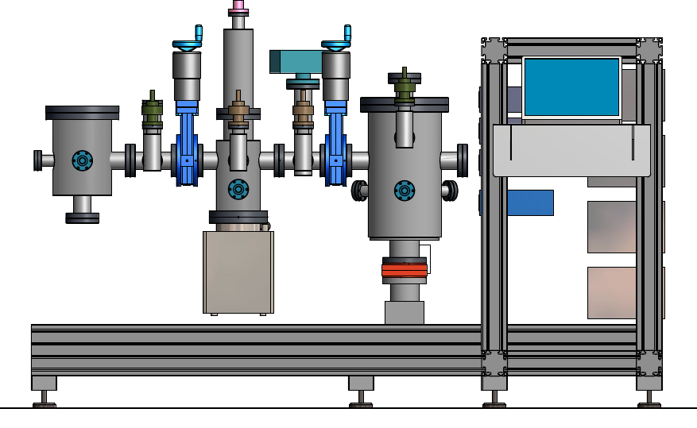
Outgassing rate Measurement
Characterization of the Outgassing rate is a step mandatory part for the R&D of the vacuum chamber’s inner surfaces. A system able to measure outgassing, in terms of rate and emitted gases, is needed.
The R&D studies include not only the material choice but also the effects of heat treatments and thin film coatings.
LATINo «Outgassing rate System» at LNF-INFN
Separation Valves
Residual Gas Analyzer
Mass Range: 200 amu
resolution: 2x10⁻¹⁴ mbar
Max P_{oper.}=10⁻⁴ mbar
«High Outgassing Chamber»
L= 300 mm
φ= 200 mm
Control System
Measure Chamber
«Low Outgassing Chamber»
h= 500 mm
φ= 250 mm
Size: ∼2x1.5 m²
LATINO (Laboratory in Advanced Technologies for INnOvation) is a cofunded project (INFN-Regione Lazio) - Call “Open Research Infrastructure”

Slide 10
Marco Angelucci | 30
Simone Bini | 10
Roberto Cimino | 40
Fara Cioeta | 10
Giovanni Delle Monache * | 40
Andrea Liedl | 30
Lucia Sabbatini | 10
Luisa Spallino | 40
Total FTE ~ 2
down to 1 on GR. V call approved (dotazioni)
Financial request
  6 k€ missions Collaboration meetings
  40 k€ consumable Instrumentation for vacuum and cryogenic tests

