Slide 1


uRANIA a μRwell Advanced Neutron Identification Apparatus
G. Cibinetto (INFN Ferrara)
on behalf of the uRANIA collaboration
International Conference
on Technology and Instrumentation in Particle Physics
May 24-28, 2021

Slide 2
Outline
Neutron Detection
micro-RWELL Technology
The uRANIA Project
Development of a Simulation Toolkit
Proof of Concept
Ongoing and Future Studies
Technology Transfer to Industries

Slide 3
Reasons to go for Neutrons
ESS Technical Design Report S. Peggs (ESS, Lund)(ed.), 2013
PROBING STRUCTURE AND MOTION
HIGH PENETRATION
A PRECISE TOOL
HIGH SENSITIVITY AND SELECTIVITY
A UNIQUE PROBE FOR MAGNETISM
A PROBE OF FUNDAMENTAL PROPERTIES

Slide 4
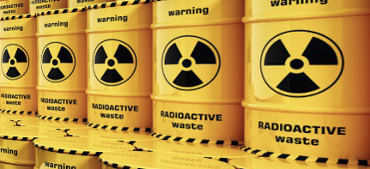
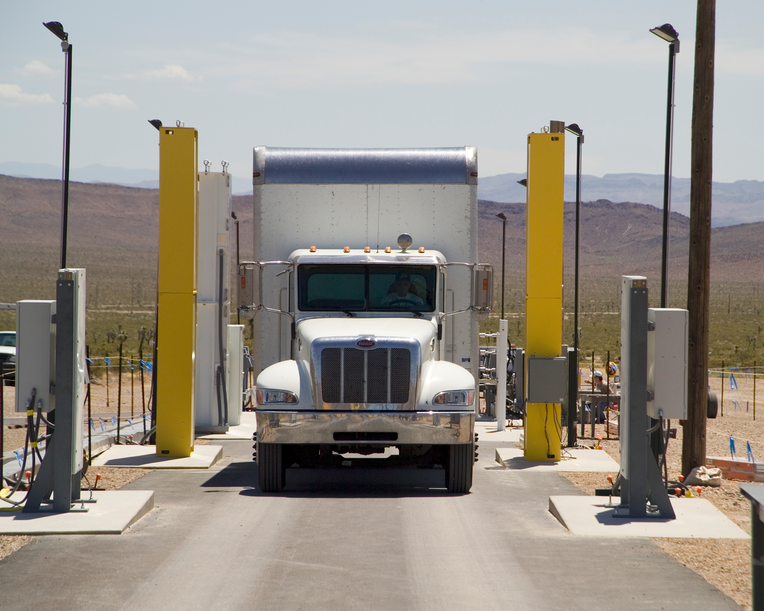
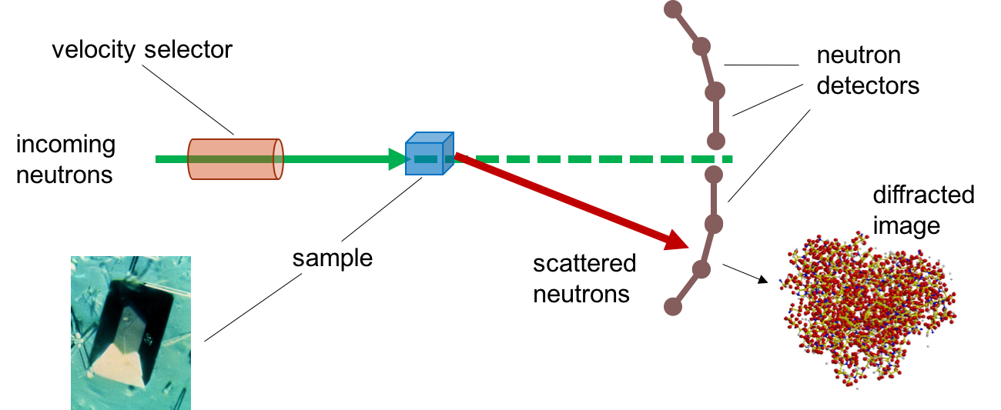
Few Applications relevant to our project
Radioactive waste monitoring (PuO₂ or PuF₄)
Radiation Portal Monitor (RPM) for homeland security
Neutron diffraction imaging
diffracted image
Complementary to X-ray imaging

Slide 5
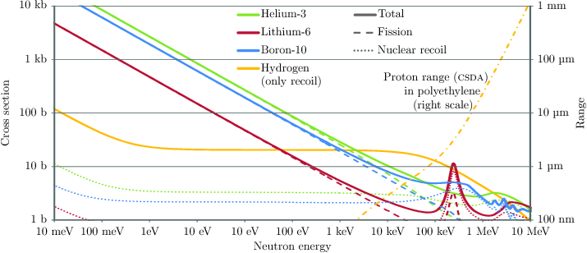
Neutron Detection in a Nutshell
High energy: Hadron Calorimeter
  measure energy deposited in form of hadronic shower
Moderate energy: np-Scattering
  scattering with protons from material containing appreciable amounts of hydrogen
Low energy: Exoergic Nuclear Processes
  Use converter medium with large capture cross-section
Mod. Phys. Lett. A 28 (2013) 1340025
Dana A. Shea, D. Morgan (2010)
Helium-3 shortage calls for alternatives
Notes:
X section increase with the time the neutron is close to the absorbing nucleus
high energy little effect of the neutrality of the particle
low energy: for slow neutrons; capture process results in unstable nuclei ... Subsequent decay products give a detectable signal ...

Slide 6

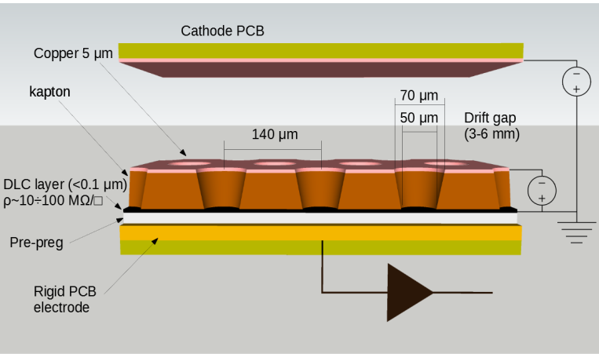
u-RWELL Advanced Neutron
Imaging Apparatus (uRANIA)
https://phase1.attract-eu.com/showroom/project/u-rwell-advanced-neutron-imaging-apparatus-urania/
funded by
Development of an innovative neutron detector based on micro-Resistive WELL technology: a compact, spark-protected, single-amplification stage MPGD
Boron-coated cathode PCB
  Applications in grain mapping of structural and functional materials, characterization of protein crystals at spallation sources
  Applications to homeland security → RPM portals
JINST_10_P02008 (2015)

Slide 7
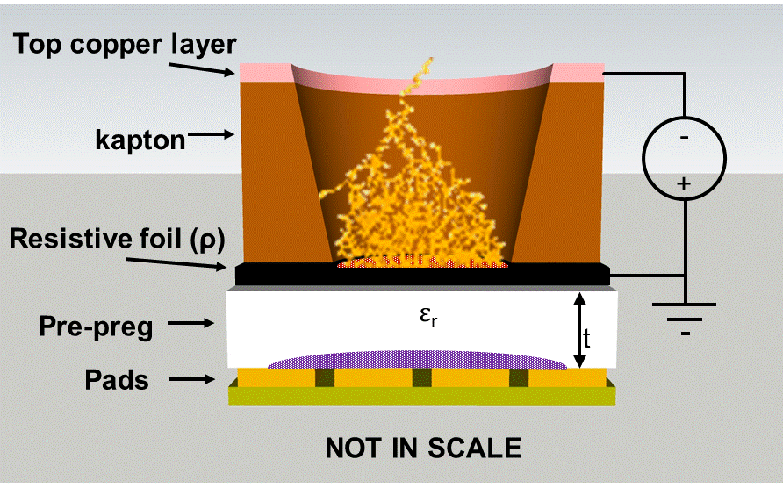
μ-Resistive Well Detector
easy assembly
and HV supply
The “WELL”, suitably polarized applying HV between top and DLC, acts as a multiplication channel for the ionization produced in the gas
JINST 14 P05014 (2019)
Single amplification stage resistive MPGD composed of
  μ-RWELL_PCB
  drift/cathode PCB defining the gas gap
μ-RWELL_PCB
  ampl.-stage
  res.-layer
  r/out PCB (with suitable segmentation)
Large area & flexible geometry
Comes in two flavors: low rate and high rate

Slide 8
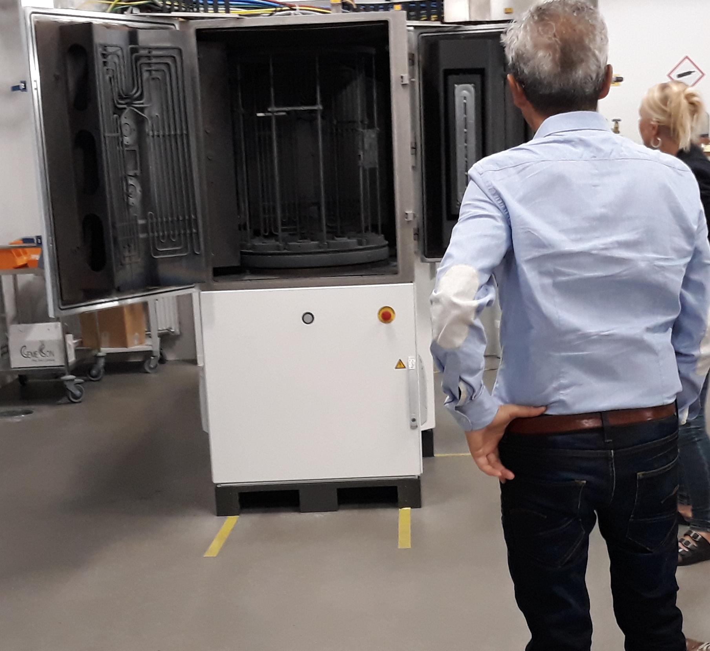
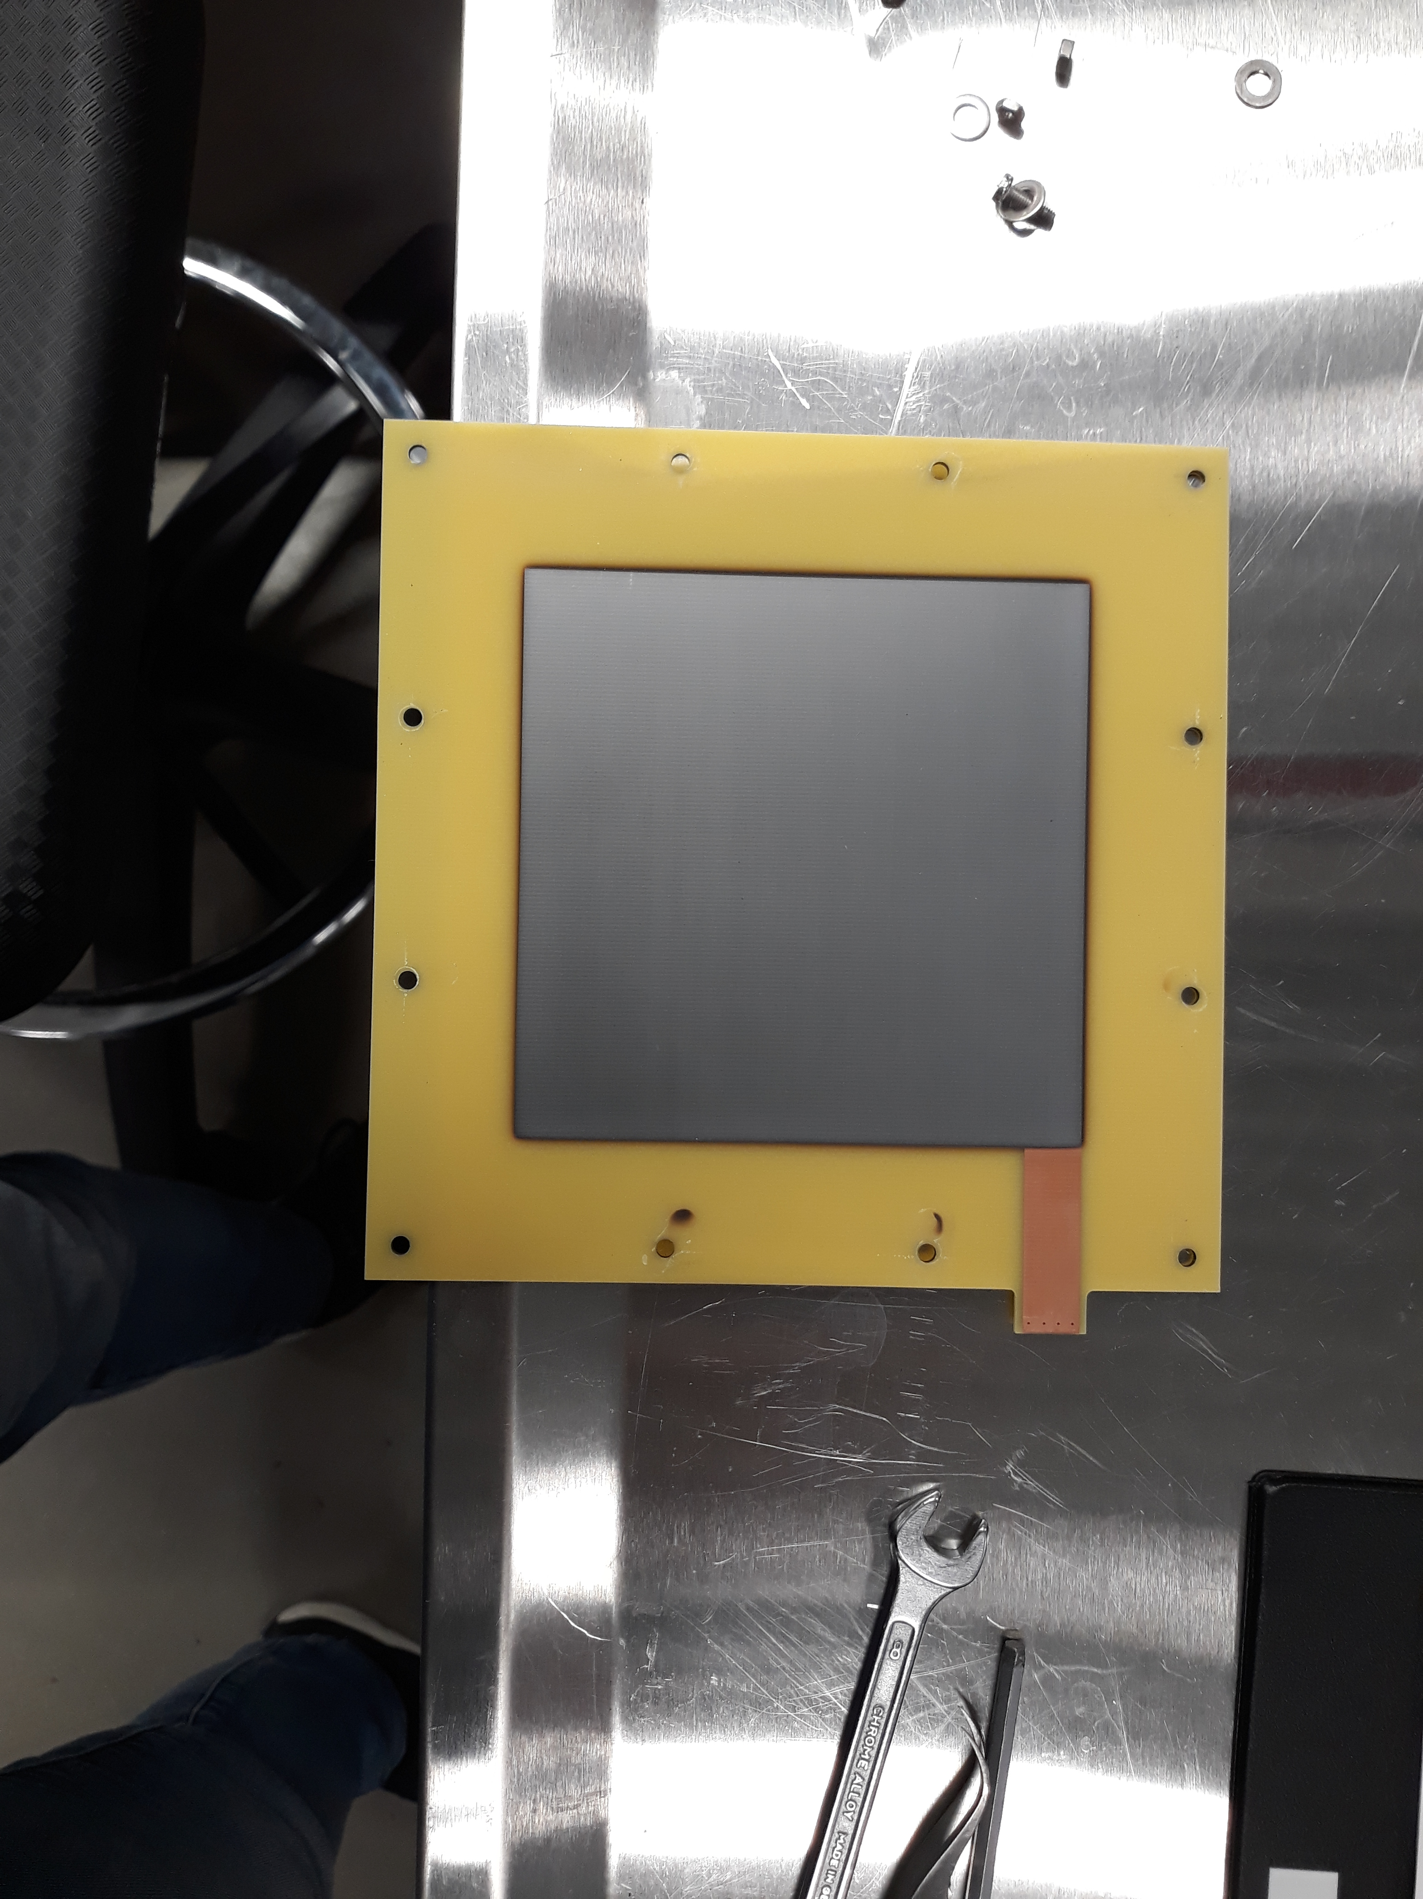
Neutron capture through Boron coating
chemically stable
not too expensive
adherence to substrate
low impurity level
uniform sputtering thickness on large surface
B₄C enriched with 97% of ¹⁰B sputtered on a copper surface at the ESS Coating Workshop in Linköping (Sweden) with direct current magnetron sputtering technology
About 94% of the time the recoiling ⁷Li ion is produced in an excited state and de-excites in flight, emitting a 477 keV γ ray
α particle and a ⁷Li ion are produced back-to-back, only one enters the gas volume and produces detectable signal

Slide 9
Neutron Converter Simulation
Energy release for different Boron thickness
⁷Li ions
1 μm of B
2 μm of B
3 μm of B
4.7 μm of B
Simulation is used to optimize the detector and to extract the detection efficiency from the current measurement
Gas mixture ionizing energy ~ 31.5 eV
Particles range < 6 mm of gas
  all the energy released in the gas
  ~10⁴ number of primaries
Neutron source energy distribution and divergence considered in the simulation
α particles
1 μm of B
2 μm of B
3 μm of B
4.7 μm of B

Slide 10
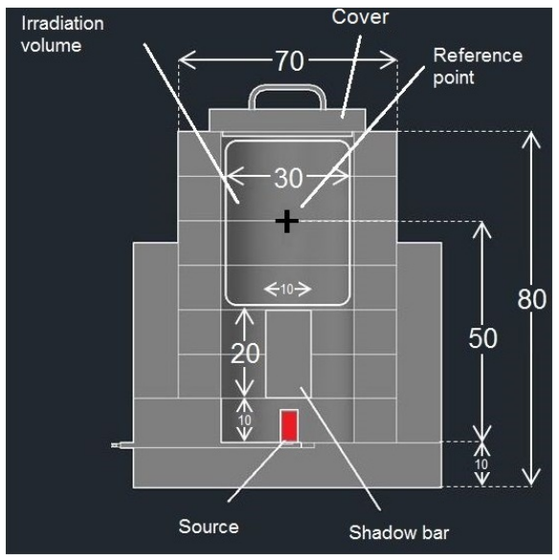
Source test facility:
Hotnes (ENEA)
NIMA 843 (2017) 18–21
Detector characterization done @ ENEA (Frascati, Italy)
HOmogeneous Thermal NEutron Source (HOTNES) – ²⁴¹Am-B source
Thermal fluence rate about 750 cm⁻² s⁻¹
Shadow bar to stop photons
Energy spectrum peaks at 100 meV (FWHM ~290 meV)

Slide 11
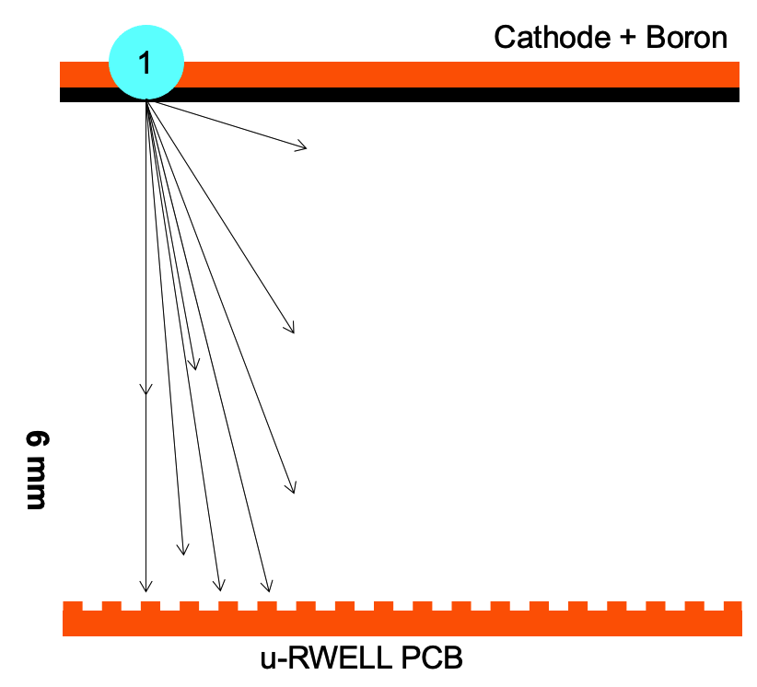
Proof of concept with planar cathode
NOT IN SCALE
1
with Hotnes n source
Efficiency for thermal neutrons (25 meV)
about twice the values of the Hotnes setup
due to the source energy distribution

Slide 12
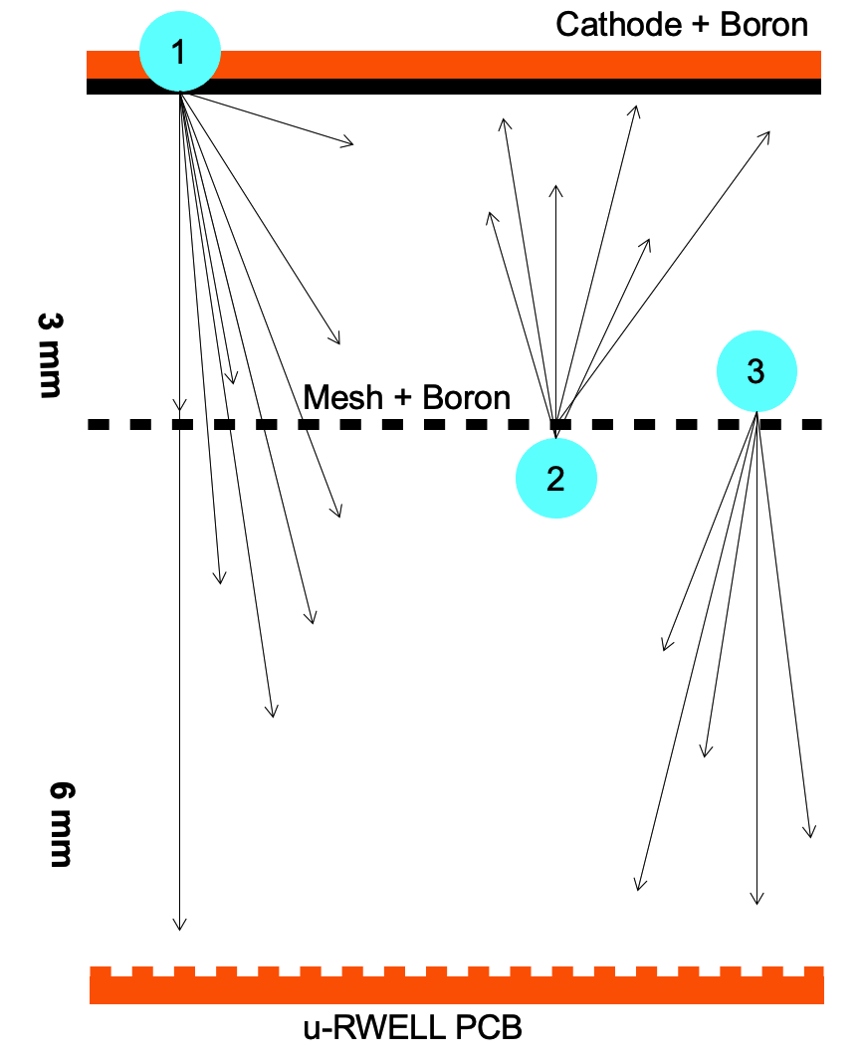
Boron-coated mesh
Adding a boron-coated mesh to increase the efficiency
Different contributions studied independently with simulation and source test
material | wire diameter [um] | pitch [um] | opt. transparency
Copper | 56 | 190 | 60%
Aluminum | 53 | 74 | 33%
NOT IN SCALE
1
3
1
4
2
2
3
4
Preliminary results show
about a factor 2 efficiency increase
negligible dependance on the Boron thickness
importance of optical transparency tuning

Slide 13
Grooved cathode
Grooved cathode can also increase the efficiency
NOT IN SCALE
Different geometries under study
For each layout, the energy deposit has been considered on the spacings, slopes and peaks
1
A factor ~2 of increase in the efficiency can be achieved
with respect to planar cathode

Slide 14
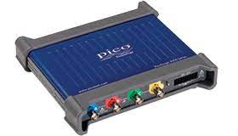
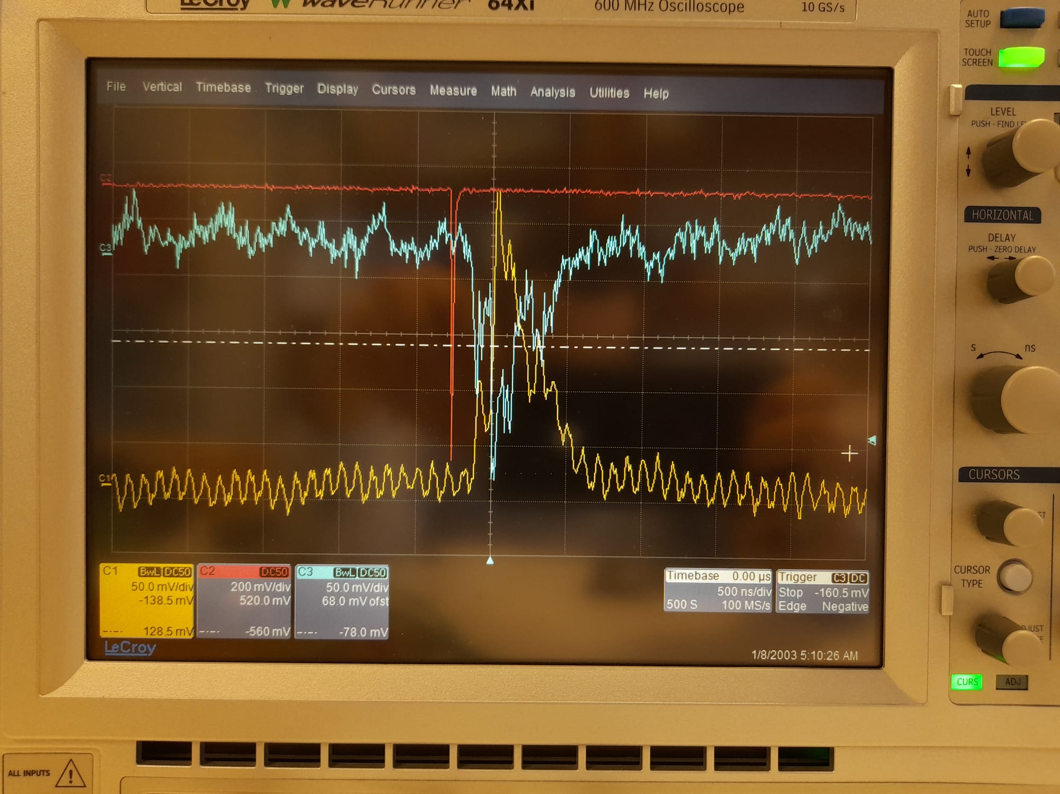
Counting mode electronics
Detector
Input
Readout large fraction of the chamber with one channel
Developed for large area application where position information is less relevant (RPM, RWM)
Two readout under testing
  CAEN A1422-based
  - gain ~0.2 mV/fC
  - noise ~20 mV
  - signal duration ~5 um
  CREMAT CR110-based
  - gain ~0.5 mV/fC
  - noise ~20 mV
  - signal duration ~5 um
test with m.i.p.
signal waveform acquired with a Picoscope for amplitude analysis
Anode signal
TOP signal
reference PMT

Slide 15
Counting mode electronics
Signal amplitude spectrum from data
(CREMAT CR-110 readout)
First validation done with Hontes source
Signal amplitude from neutron conversion (top) is compared with simulation (bottom)
Simulation reproduces the same features of the data down to the noise level
E_{dep} from simulation (α+⁷Li)
⁷Li ions step
α particles step

Slide 16
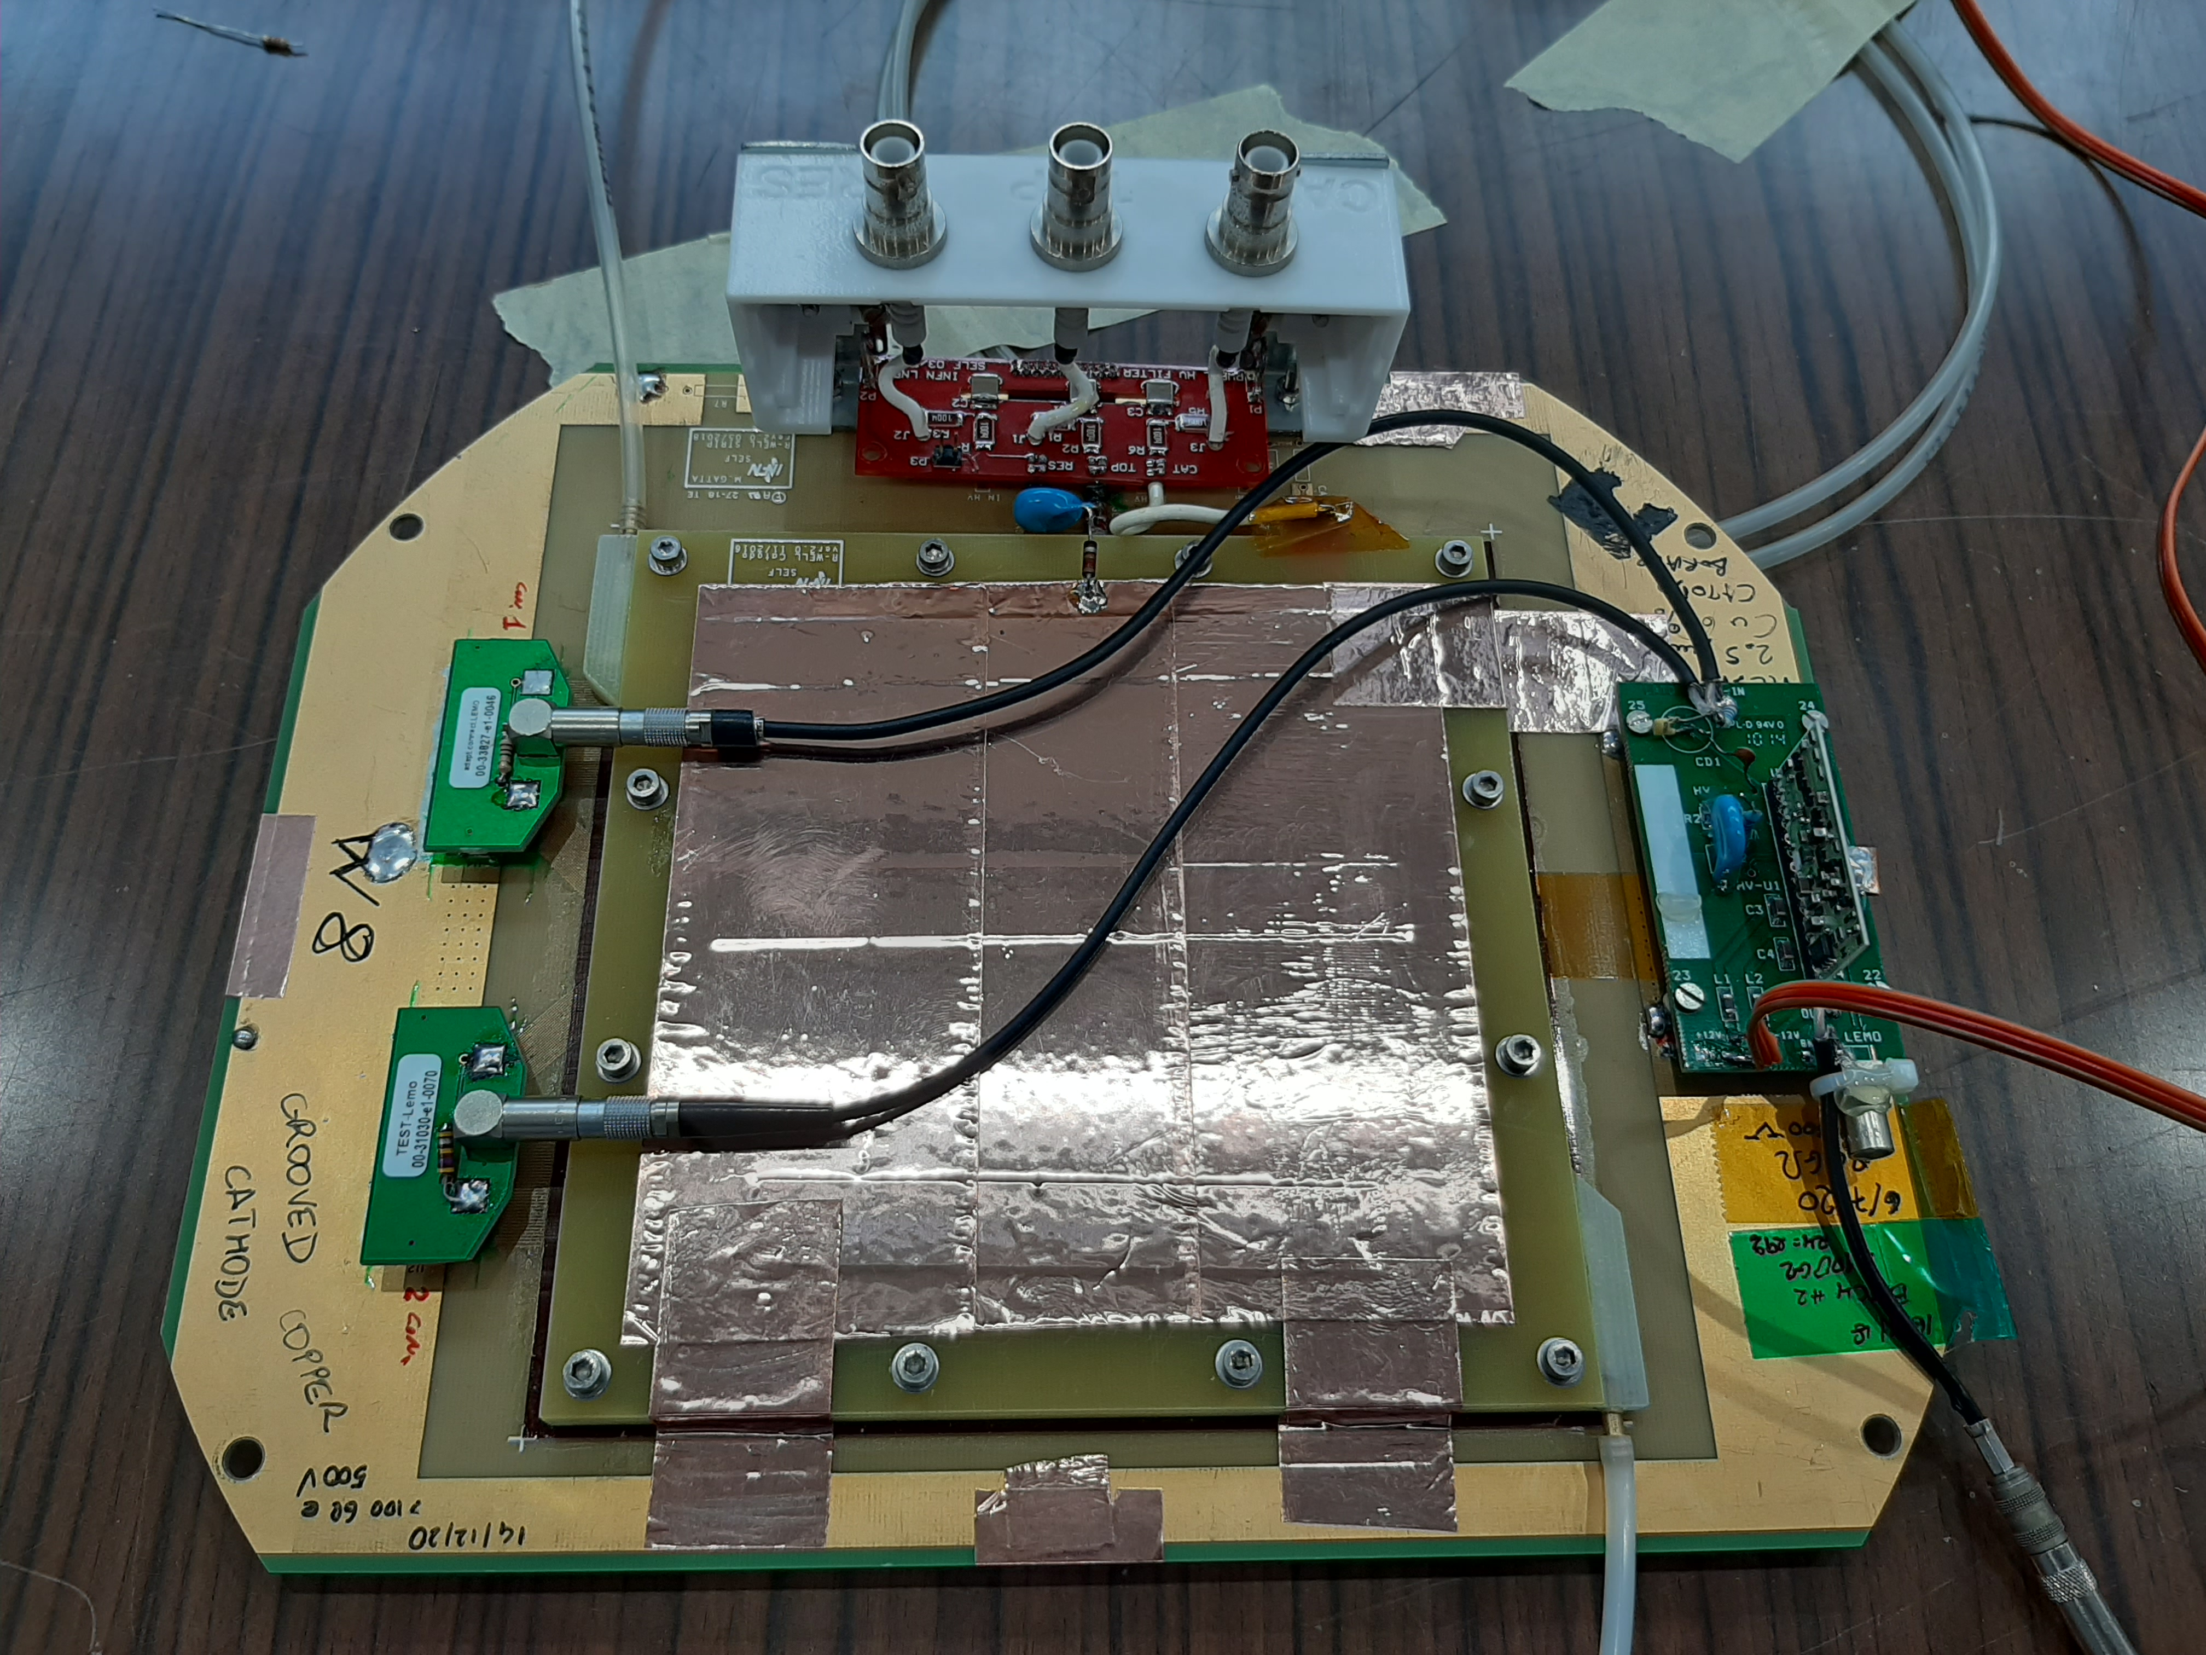
All in all
2
μRWELL_PCB
HV and filtering
Anode readout connectors
Counting mode electronics
External shielding
4
3
5
1

Slide 17

Technology transfer: μ-RWELL_PCB @ELTOS
The ELTOS company (Arezzo, Italy) performs the coupling of the DLC-foil with the readout PCB (only for low-rate layout)
The max size of the μ-RWELL-PCB that can be produced by ELTOS is about 600x700 mm². Up to 8 PCBs of such a size can be manufactured at the same time
The PI etching to be done @ CERN
33x33 cm² active area LR - RWELL
INFN and ELTOS participate to the
AIDAinnova project for further TT
https://cordis.europa.eu/project/id/101004761

Slide 18
Summary and Conclusions
The μ-RWELL technology, robust, easy to assemble and relatively cheap MPGD, can be a valuable alternative for neutron detection
μ-RWELLs have been successfully tested for thermal neutron detection with a ¹⁰B layer as converter
  Source test data confirms simulation studies with good accuracy
Efficiency improvement by means of grooved cathode, converting mesh and other detector layout
  10-20% efficiency can be achievable with a single detector for 25 meV neutrons
  higher efficiency with multiblade or multi-stack configurations
For neutron imaging applications standard MPGD electronics can exploit the high spatial resolution of the μ-RWELL detector
For Radiation Portal Monitors counting electronics under development will reduce the costs
Technology Transfer is ongoing
  large area μ-RWELL_PCB can be produced by industries (except for the Kapton etching)

