Slide 1
SiPM radiation effect in GECAM mission
GECAM Team
liuyaqing@ihep.ac.cn
2021-06-11

Slide 2
Outline
Introduction of GECAM : GRD and CPD
GECAM-SiPM In-flight performance

Slide 3
GECAM Payload
CPD
GRD
Detectors of each GECAM satellite:
25 Gamma-ray Detectors (GRD)
8 Charged Particle Dectors(CPD)

Slide 4
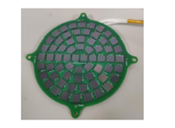
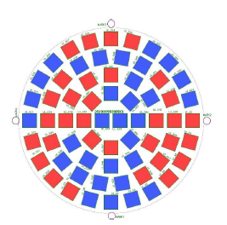
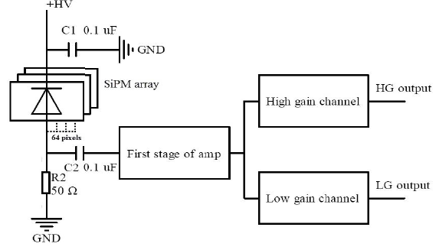
divided in two groups
Each GRD: 64 SensL SiPM MicroFJ-60035-TSV
Independent power supply of two groups of SiPMs increases reliability
Readout using high and low gain dual channels
High gain(4 keV–200 keV) Low gain(40 keV–4 MeV)
Gain stabilization by SiPM temp-voltage bias feedback(look-up table)

Slide 5
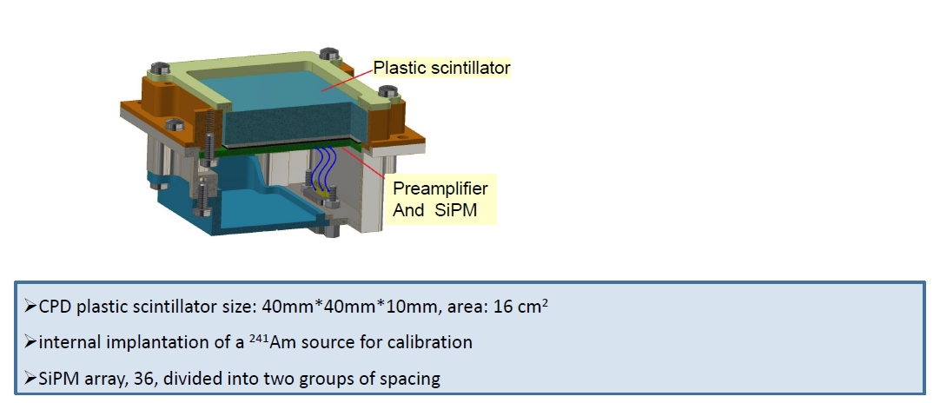
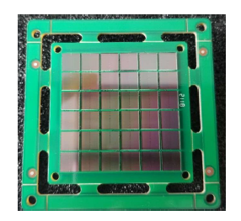
GECAM-CPD
CPD SiPM Array
(Only one group is powered inflight)

Slide 6
Orbit space environments
Annual proton fluence expected for the SiPMs
Orbit* | Altitude | Inclination | Proton fluence | 1MeV neutron equivalent fluence
ISS | 405 km | 51.6° | 2.6×10⁸ p/cm² | 4.3×10⁸ n_{eq}/cm²
LEO | 550 km | 40° | 1.3×10⁹ p/cm² | 2.1×10⁹ n_{eq}/cm²
GECAM | 600 km | 29° | 2.2×10⁹ p/cm² | 3.4×10⁹ n_{eq}/cm²
SSO | 750 km | 98.5° | 2.0×10⁹ p/cm² | 3.1×10⁹ n_{eq}/cm²
The SiPM equivalent shielding (GRD): 10 mm (Al), a cumulative dose each year is about 229 rad(Si).
The SiPM equivalent shielding (CPD): 5 mm (Al), a cumulative dose each year is about 331 rad(Si).
*EIRSAT-1 satellite and GECAM orbits

Slide 7
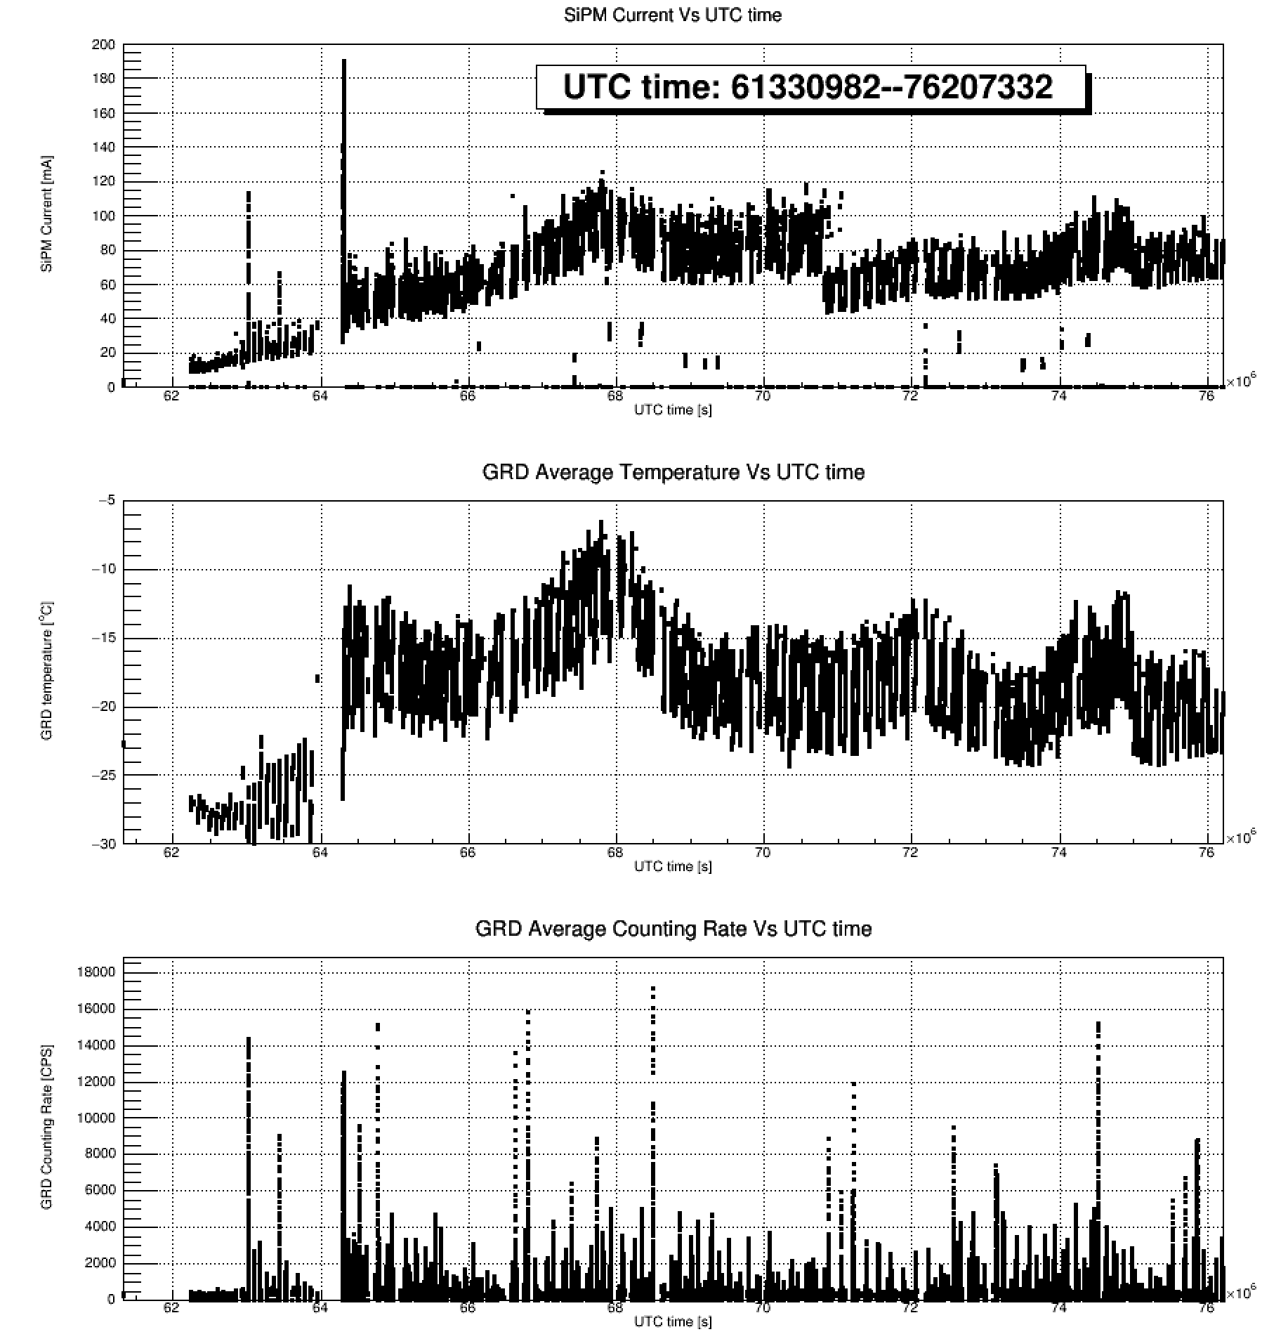
In-flight
SiPM bias is adjusted for the first time(28-27.8V)
SiPM bias is adjusted for the second time(27.8-27.5V)
There are 1744 SiPMs powered by GECAM satellite, and the SiPM current telemetry is the total current of all SiPMs.
The onboard current of SiPM continues to increase.
To test the current change with bias of SiPM, twice bias adjustments were made.
2020/12/10
2021/06/01
Notes:
Groundtesting < 20mA (+19℃)

Slide 8
Notes:
Large current results in increase of the p–n junction temperature and high power consumption.
The current reaching the multiplication region increases DCR.

Slide 9
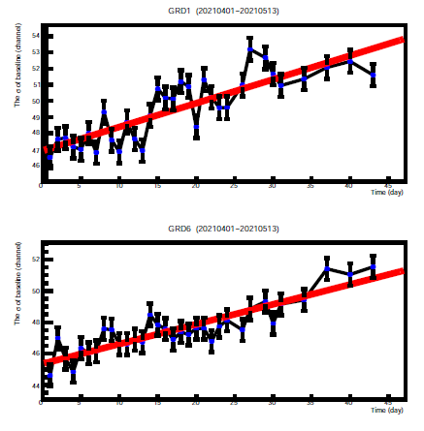
Noise Threshold
The energy threshold would adjust by judging the sigma of the baseline.
The threshold is increasing as the sigma of baseline is continually grow.
The daily growth rate of sigma is 13% for GRD01 at present.
Noise Threshold after a year later might increase by 10keV.
Sigma of baseline

Slide 10
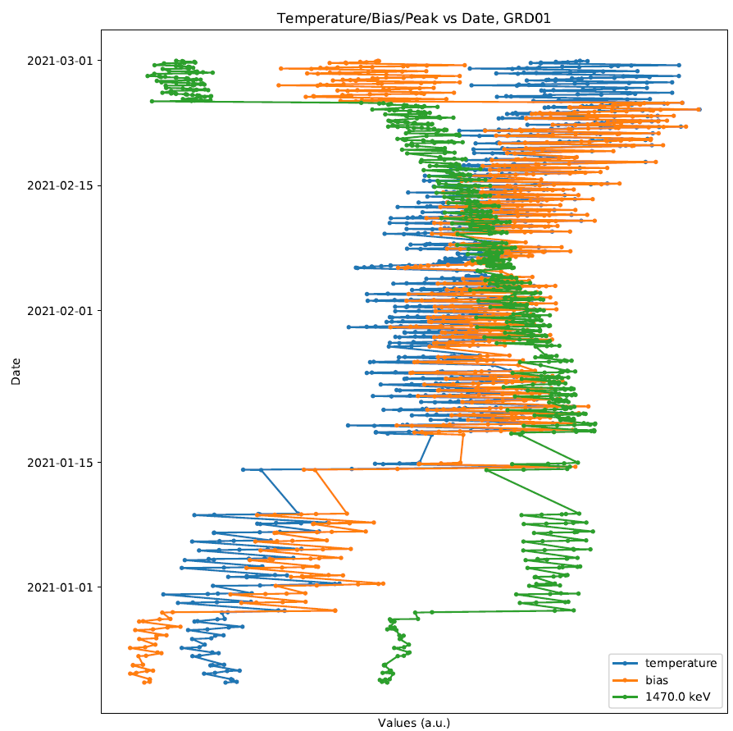
GRD Peak
The peak drops slowly

Slide 11
THANK YOU!

