Slide 1
NA62 Pisa
( Approvato Sett. 2009)
Due impegni principali di Pisa:
- TDAQ Progetto e realizzazione
(M. Sozzi responsabile per la Collab. NA62)
- LAV 12 Contatori di veto per fotoni a grande angolo
(insieme a LNF, RM1, NA)
Progettazione meccanica F. Raffaelli, S. Bianucci
in collaboraz. con Dulach, Capoccia, Cecchetti (LNF)

Slide 2
NA62 Pisa TDAQ
Il gruppo ha subito un pesante ridimensionamento: – 2 FTE dedicati di grande esperienza
+ 1 borsista Cambio tecnologi (a tempo parziale) << richieste Prossimo bando per assegno di ricerca dedicato (fisici/ingegneri)
(Praticamente nessun supporto da altri gruppi di NA62)
Attivita’ significative per la collaborazione:
Sistema integrato di trigger e readout basato su TDC (per 80% dei rivelatori INFN e non)
Upgrade schede comuni “TELL1” (per quanto sopra e altro)
Processore centrale di livello 0 (cuore del trigger HW)
Costruzione, installazione, test: entro 2012

Slide 3
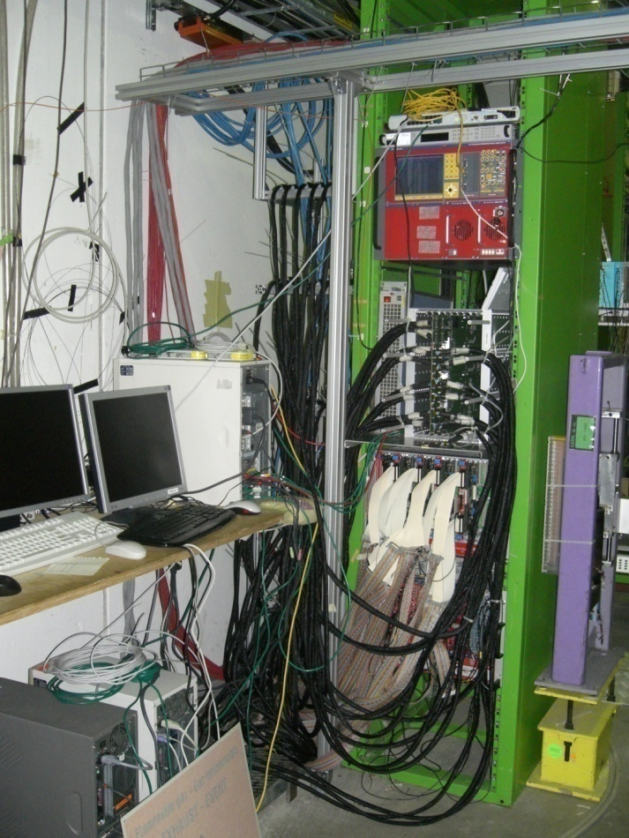
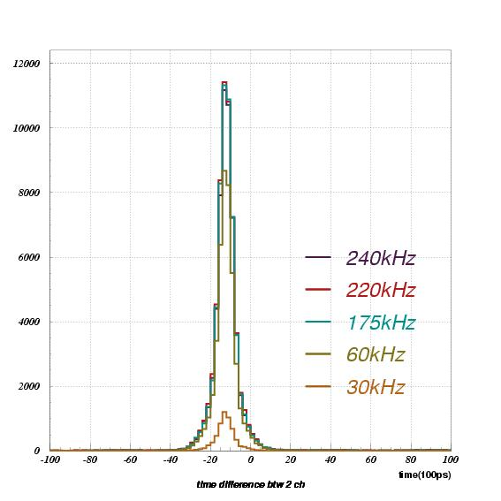
RICH-400 readout test con TELL1/TDC
Test beam al CERN (estate 2009)
Dati del test del RICH raccolti con il sistema prototipale 2009 TELL1/TDC.
Ottimo funzionamento del sistema: 1 Crate, 1 TELL1, 4 TDCB, 32 cavi, 3 PC, 1 Clock generator…
O(10) canali mascherati su 512
Firmware naive (Versione prelim. 2008, non riproducibile e con trigger esterno)
>500 ore di presa dati (17000 bursts) .
Rate di acquisizione media: 30-50 kHz (cfr. 10 kHz max in NA48), picco raggiunto 300 kHz

Slide 4
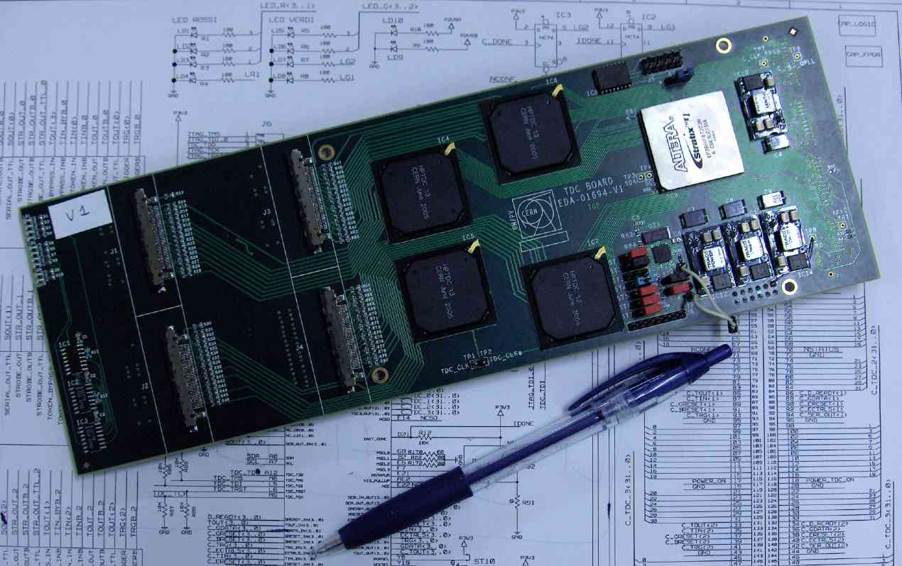
NA62 Pisa TDAQ – Stato/progressi (1)
Scheda TDC: progetto firmware non portato a termine dal progettista - 1 prototipo V3 completo (hardware OK, errori di montaggio)
- sistema prototipale (2009)TELL1/TDC verra' usato quest'anno per i 2 test beam delle STRAW e del LAV Firmware: ancora in sviluppo (A. Burato, ass. ric.) Cavi: le soluzioni proposte commercialmente si sono rivelate impraticabili rendendo necessaria - V4: layout completato (CERN), pronti per 10-20 prototipi

Slide 5
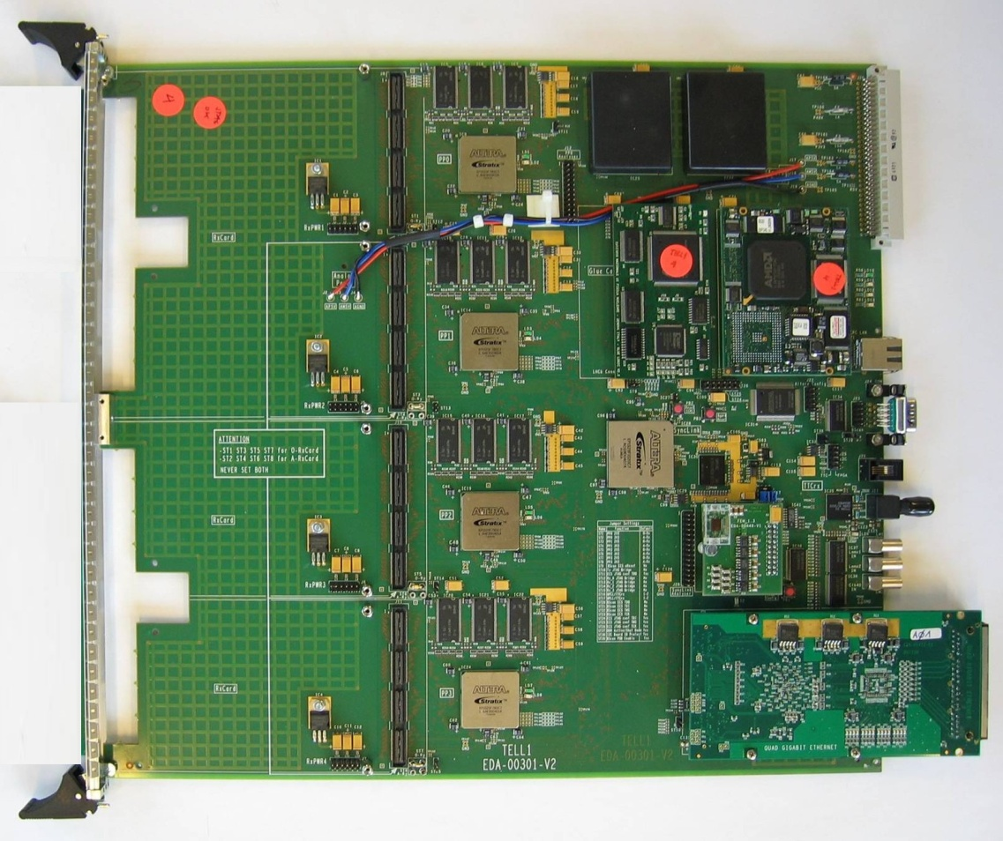
NA62 Pisa TDAQ – Stato/progressi (2)
TELL1 upgrade: scheda complessa (F. Spinella). - disegno (Pisa) quasi completato - inizio layout (CERN) a breve, poi prototipi, test - Obiettivo: fine R&D 2010 - Test con aiuto da Roma T.V. - Produzione: Roma T.V. Firmware: fermi alla versione primitiva di test beam 2009, versione finale da iniziare (impegnativo, aiuto da collaborazione)

Slide 6
NA62 Pisa TDAQ – Stato/progressi (3)
Processore L0: poco progresso - “subappaltata” una parte HW (Birmingham/Bratislava) - inizio studio su soluzione “PC” - stabiliti contatti con:
+ gruppo ingegneria S. Anna (proposta consulenza a spin-off),
+ gruppo Tripiccione/Schifano (Ferrara),…
Simulazione: ripreso lavoro Monte Carlo a Pisa
R&D: studio implementazione trigger HW con GPU

Slide 7
Pisa TDAQ – 2011
Pisa rimane il gruppo di riferimento per il TDAQ.
Il problema di manpower condizionera’ il mantenimento degli impegni INFN (es. processore L0)
In qualche momento del 2011 si dovrebbe essere pronti per produzione TDCB e TELL1++: questa verra’ presumibilmente posticipata, mentre si acquisteranno i componenti critici: O(210KE) finanziamento CORE
E’ necessario un maggiore supporto elettronico qualificato, per il completamento dell’ hardware e lo sviluppo del firmware

Slide 8
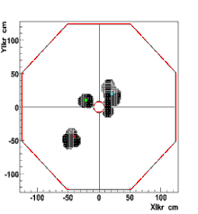
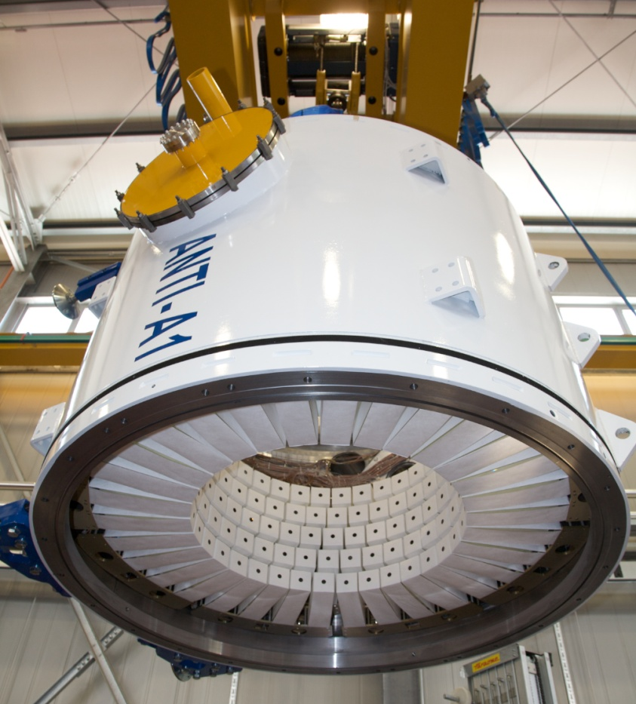
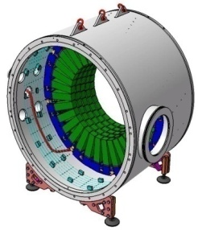
LAV postcard
12 rings along >120 m decay region
>20 X₀ to ensure shower containment staggered LG crystals
Very low detection inefficiency for γ: O(10⁻⁴) down to 100-200 MeV
Time resolution better than 1 ns,energy resolution 10% at 1 GeV
Operation in high vacuum region: O(10⁻⁶) mbar
Detector based on Lead glass blocks dismounted form OPAL calorimeter

Slide 9
LAV STATUS
2009 LAV1 Test beam
(80 ch. instrumented for R/O: 16 per layer, summing up to 5 half-rings)
Validate time-over-threshold as R/O method
Equalization procedure with muon runs
Study response to 2-4-6 GeV electrons, compare with μ
Evaluate energy resolution, linearity of response
2010 LAV2 Test beam August 2010
(All 160 ch. instrumented for R/O)
Test of new HPTDC on TELL1
Final version of ToT circuit, LED monitoring system
New voltage dividers PM’s
Validation of whole R/O chain.

Slide 10
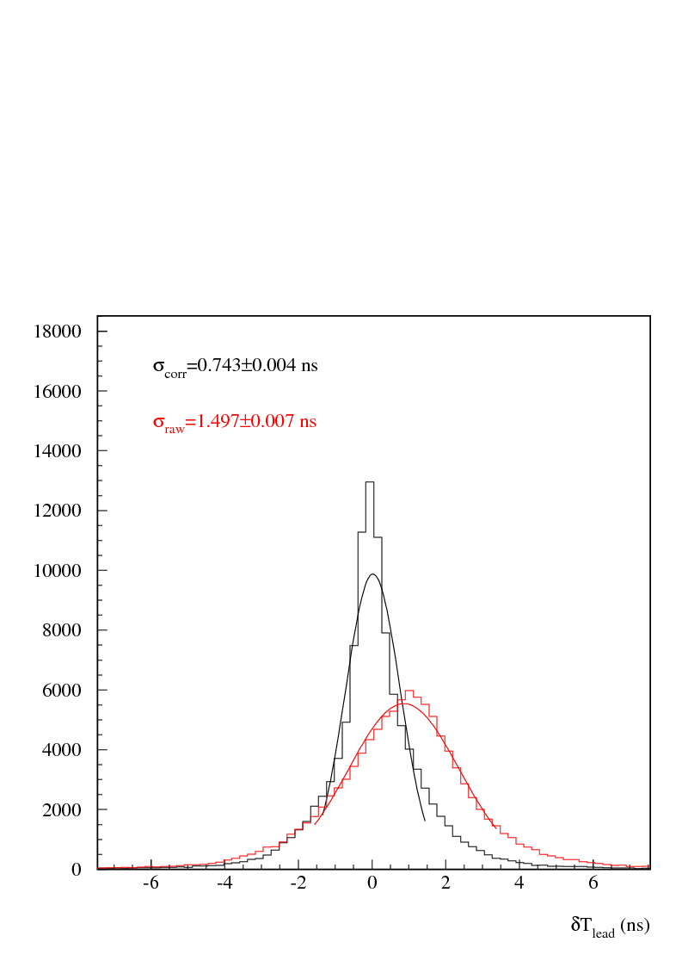
Time resolution
After slewing correction
2 GeV electrons run
Time differences btw 2
subsequent blocks
Slewing correction
Q obtained from time
over threshold
Very preliminary
σ_{t} singleblock=0.743/sqrt(2)=0.5 ns

Slide 11
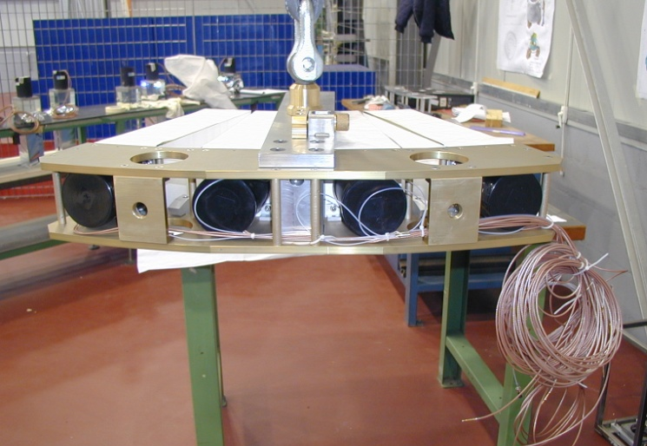
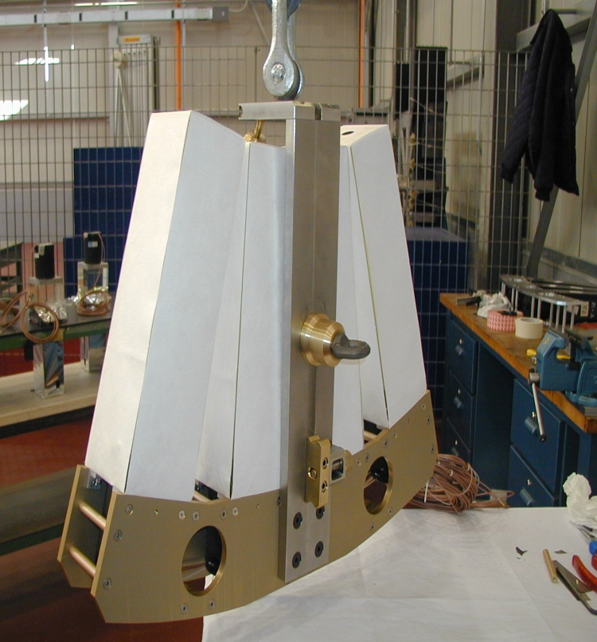
‘Bananas’ assembly (LNF)
Time required:
1h: 2 workers (1 crane driver)
2h: 1 workers (1 crane driver)
Assembly rate during construction:
0.9 bananas/day
Limited by gluing speed
Time lost for rotating and storing bananas can be reduced (directly mount bananas inside the vessel.)

Slide 12
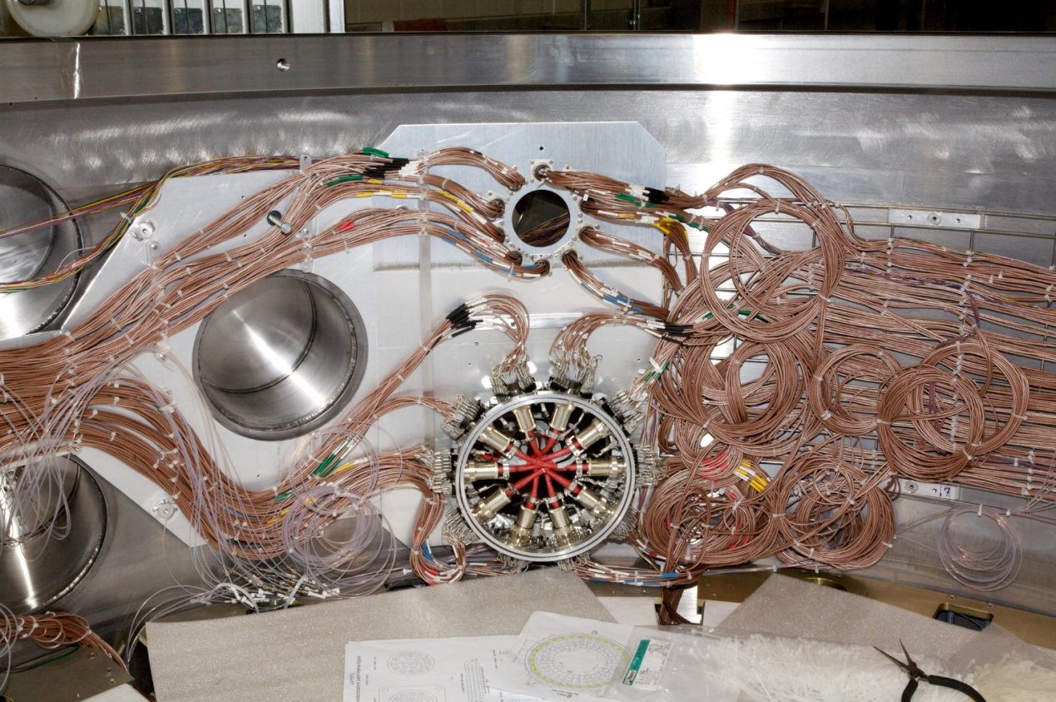
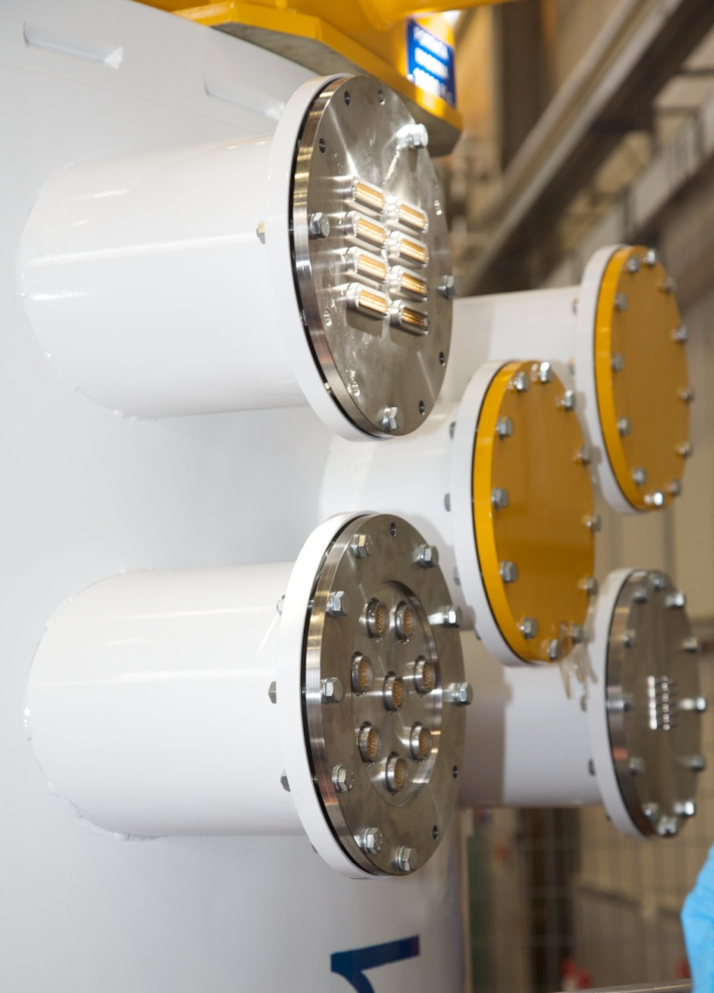
Module assembly: cabling
Signal
High voltage
LED light
Cabling took a bit long time due to tuning of the procedure on the go.
All the blocks of the layer have been tested after the cabling to check signal and HV in dark.
Second signal and cabling test has been performed during vacuum test (only a couple of inversion 1 failure found, all fixed)
Cabling connection could be simplified in future
All the flanges have been installed and vacuum tested
All fiber have been pulsed
1 missing fiber/plane investigating

Slide 13
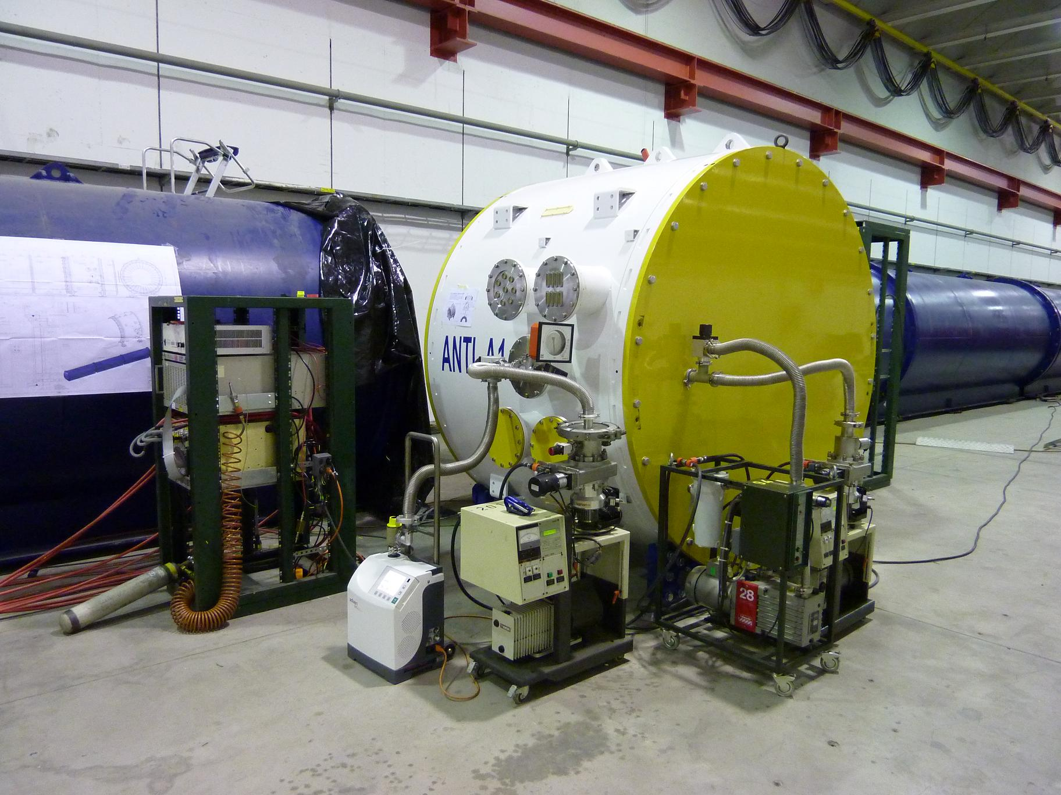
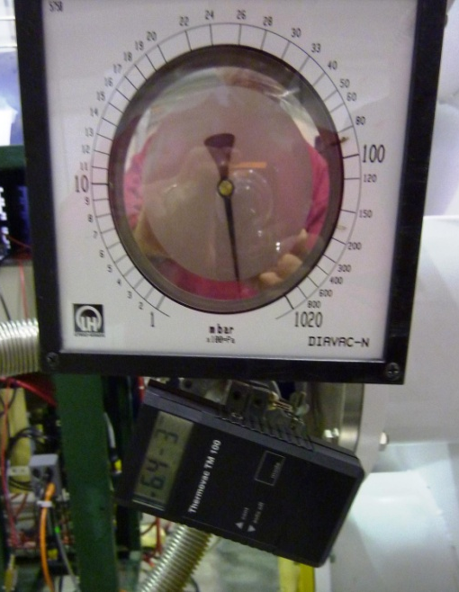
HELIUM LEAK TEST - SETUP
VACUUM GAUGES
VACUUM GAUGE
The Anti-1 is now on the side of blue tube line, closed with endcups and equipped with pumps, valves and gauge to make and measure vacuum.
There’s also a helium detector and helium bottle to perform the leak test.
Note: After 12 hours of turbomolecular pumping the vacuum was 6.4x10-3
Now 6x10⁻⁴ mbar
HELIUM BOTTLE
HELIUM DETECTOR
TURBOMOLECULAR PUMP
PRELIMINARY PUMP
C.Capoccia 04.12.2009

Slide 14
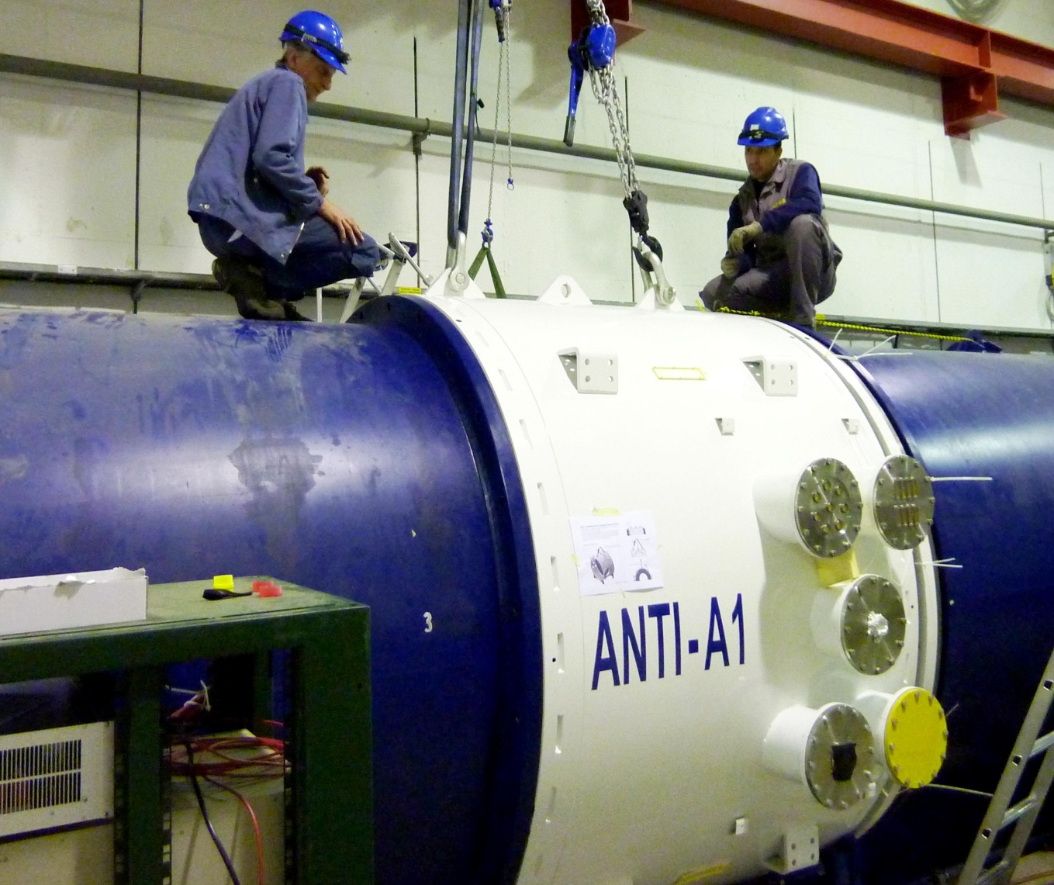
NA62 LAV Anti1 REMOVAL & TESTS
New procedure for work organization: very detailed work package and meeting, we were guinea pig for this new procedure…everything went smoothly
During the Lav Module zero removal we made some test to verify procedure, tools, and make experiences with Lav detector.
Removal & Installation with blue
tube in place
Handling by Crane with Winches
Flanges protection
O-Ring and its groove
Support review
Helium Leak test for long term
degassing measurement
From 24 to 27 November 2009 @ Cern
C.Capoccia 04.12.2009

Slide 15
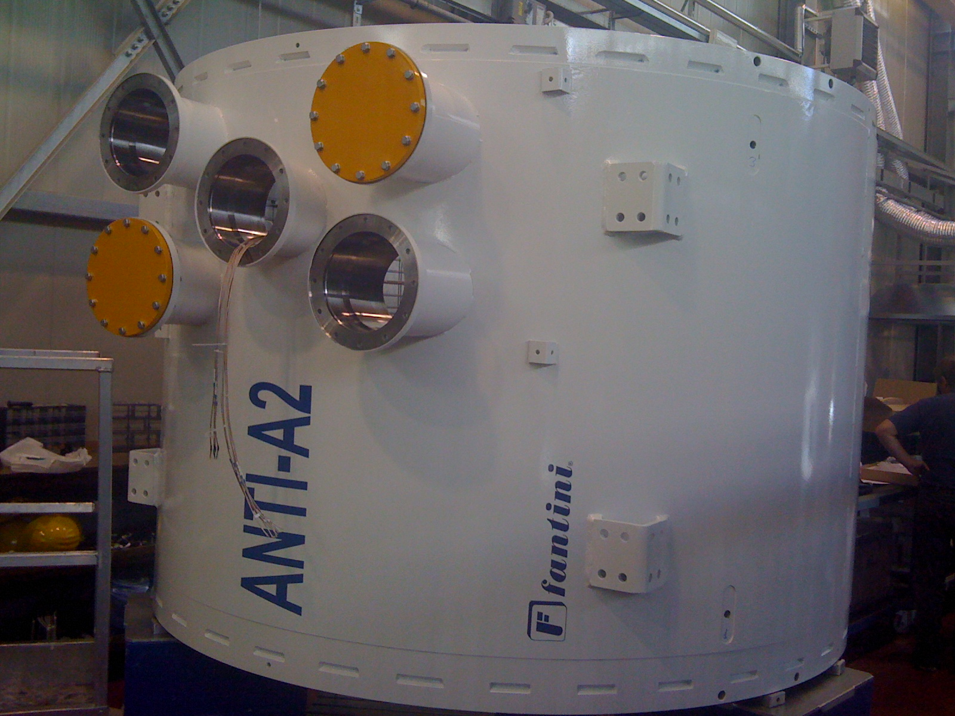
Montaggio LG in corso presso LNF (Giugno 2010)

Slide 16
Schedule NA62 ( F.H. May 2010)
 | 2010 |  |  |  |  |  |  |  |  |  |  |  | 2011 |  |  |  |  |  |  |  |  |  |  |  | 2012
 | J | F | M | A | M | J | J | A | S | O | N | D | J | F | M | A | M | J | J | A | S | O | N | D | J | F | M | A | M | J | J | A | S | O | N | D
Beam
Cedar
GTK
CHANTI
LAV
IRC/SAC
RICH
Installation
Vessel
Gas
Nose
Demonstrator
ASIC Design
Prod.
Bond. + Ass.
Install.
Read-Out Board
Cooling Studies
Cooling Design
Cool. Constr. + Test
Install.
LAV 1-5
LAV 6-8
LAV 9-11
L 12
Install.
Install.
Install.
Install.
Install.
Vessel
Gas
PMT’s.
Mirrors, Beam P.

Slide 17
SPARES

Slide 18
Status of Supporting mechanics for Anti 2-3-4-5
Parts of supporting mechanics
Plates
Spacers
C type 1
Some modifications were made wrt the first sets, improving the assembly procedures and adding additional features to restrain cables.
Plates to assemble the second Anti are ready. Spacers and C to assemble all the fours Anti and Material to make all plates have been delivered.
Plates
C type 2
Material delivered to Frascati:
Spacers N. 2070
C type 1 N. 180
C type 2 N. 180
Plates N. 80

Slide 19
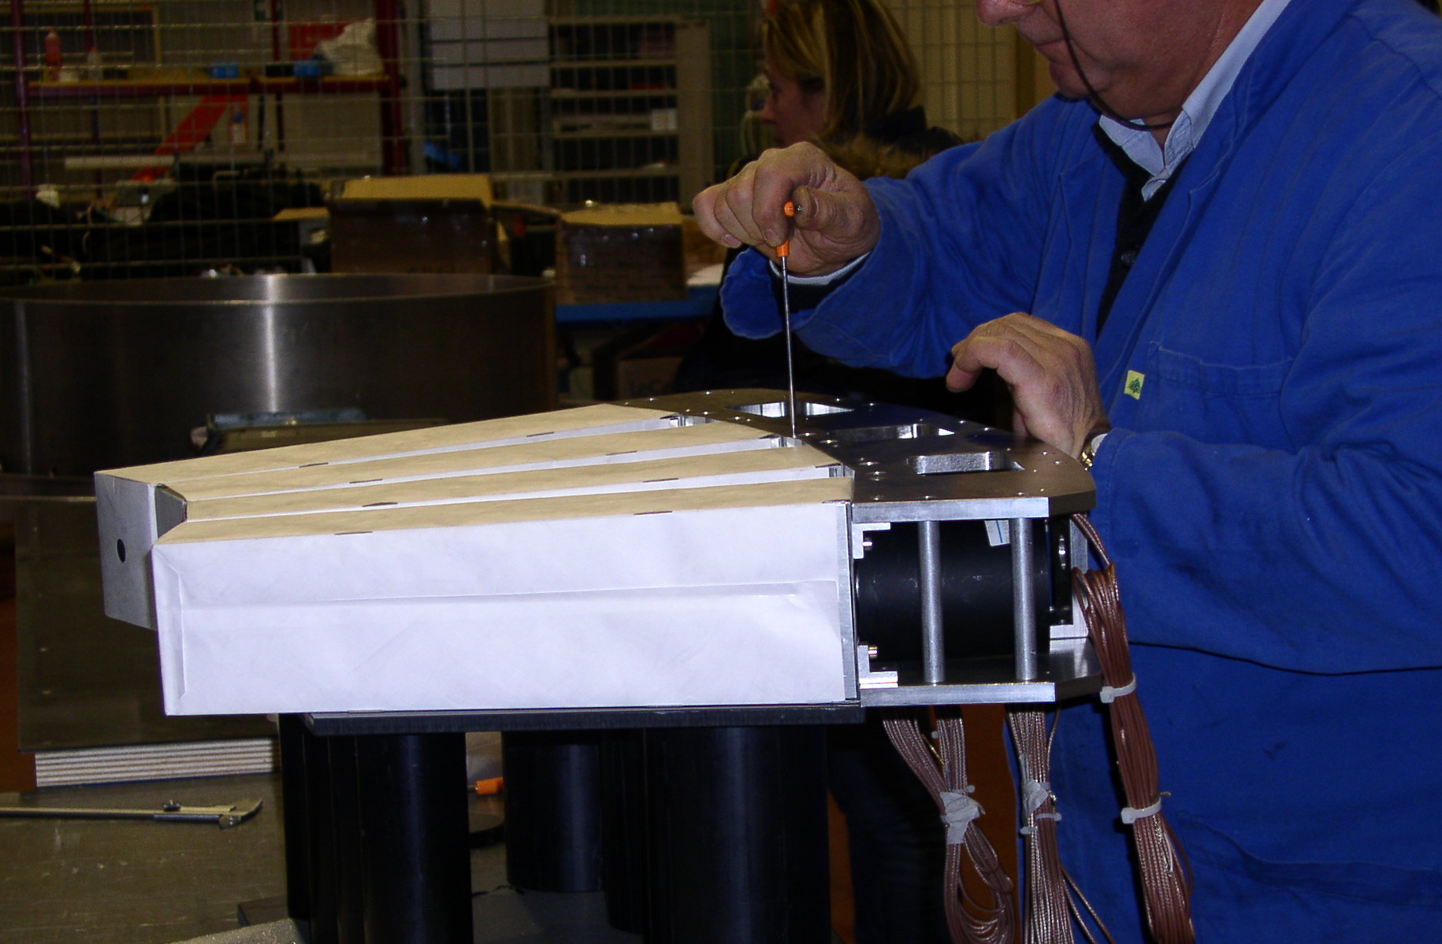
Test of Supporting mechanics for Anti 2-3-4-5
Plates
Parts of supporting mechanics

Slide 20
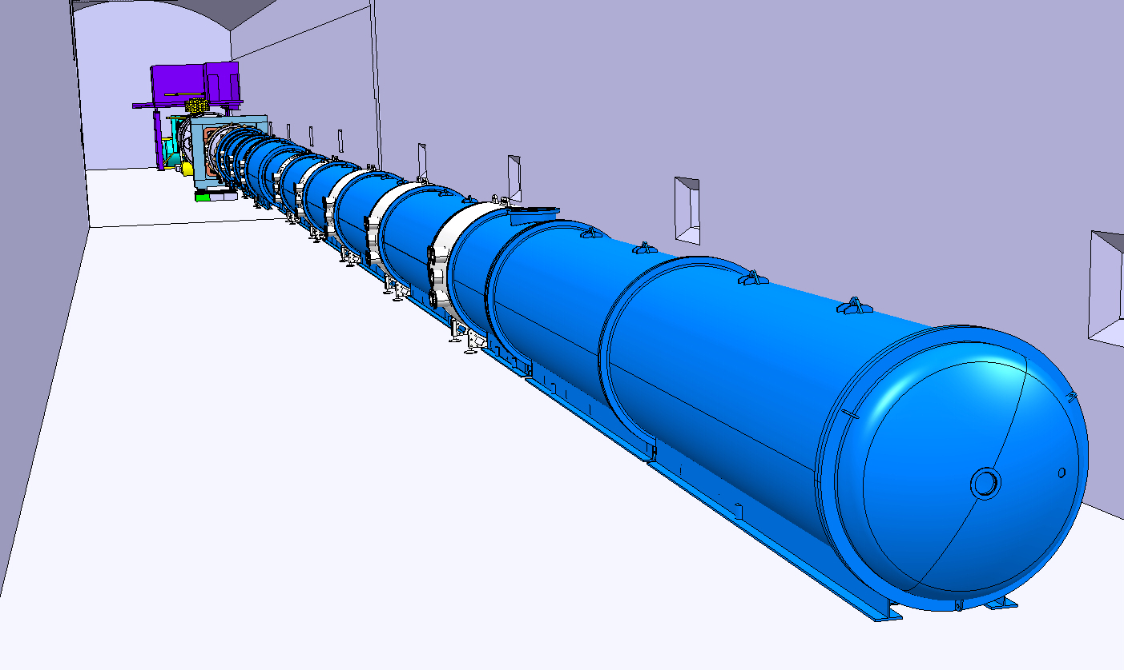
NA62 CATIA STATUS
Olivier Jamet
Layout EXPERIMENT
INTEGRATION:
Magnet MNP33
STRAWS interface
RICH
Blue tube
SUMMARY

Slide 21
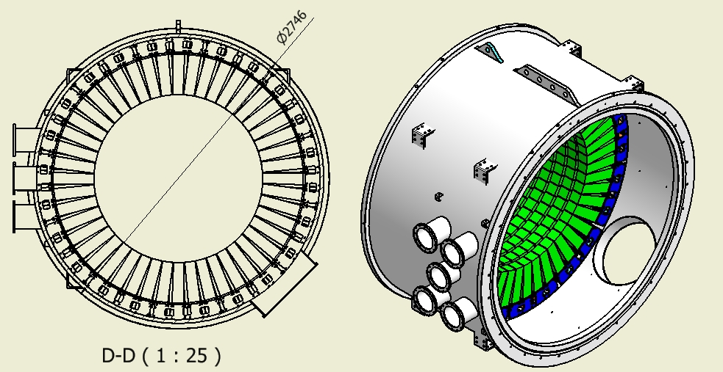
Status of production of production drawing of anti 6-7-8.
F. Raffaelli - 19/04/2010

Slide 22
Schedule (2)
 | 2010 |  |  |  |  |  |  |  |  |  |  |  | 2011 |  |  |  |  |  |  |  |  |  |  |  | 2012
 | J | F | M | A | M | J | J | A | S | O | N | D | J | F | M | A | M | J | J | A | S | O | N | D | J | F | M | A | M | J | J | A | S | O | N | D
LKR
Straw Tracker
CHOD
MUV
Vacuum Tank
CARE Installation
Design
Constr. Mod. 1
Constr. Mod. 2, 3 + 4
Mod. 5+6
Mod. 7+8
Install 1
Install 2
Install 3
Installation
Installation
Ass. 1
Ass. 2
Ass. 3
Pump 1
Pump 2
Pump
Pump

Slide 23
Drawing also to show:
Manufacturing & assembly
tolerances
Connection details
Positioning and adjustment
tolerances

Slide 24
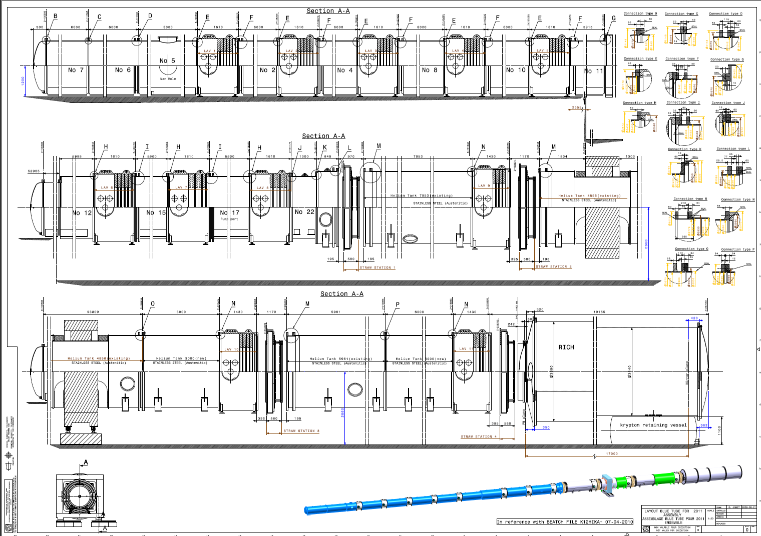
NA62 CATIA STATUS
Olivier Jamet

