Slide 1
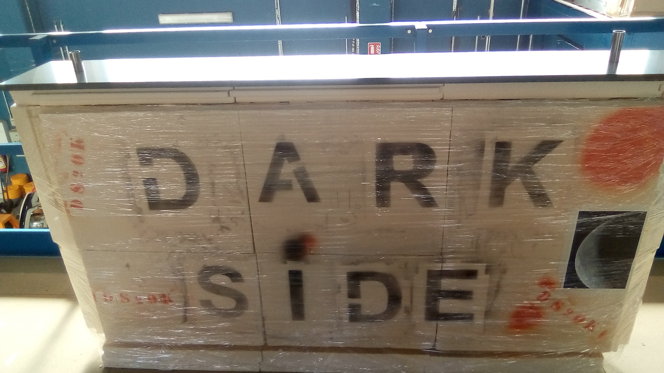
Mock-up status
Calibration system meeting – 3rd June 2021 – Pierre B. on behalf of CPPM group

Slide 2
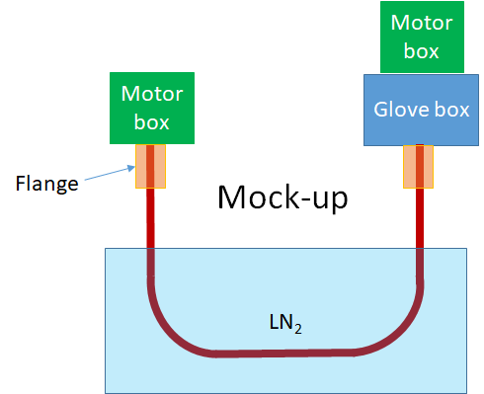
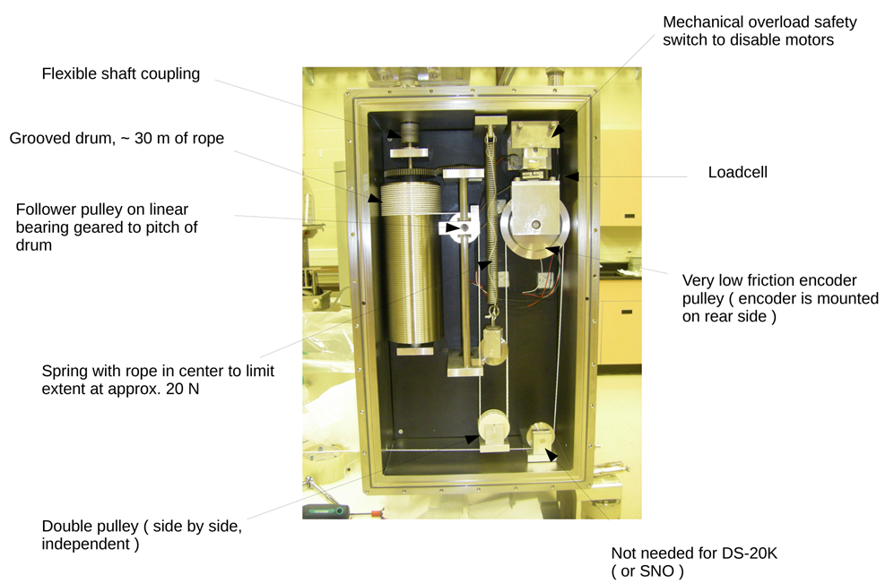
Reminder: Mock-up
Testing the principle of the calibration system is mandatory
The idea is to test most of the aspects of the calibration system with a U-pipe of shorter length (~ 3m) but baseline dimensions (30 mm diameter, 1.5 mm thickness) and curvature (40 cm radius) immersed in liquid nitrogen.
The mock-up should include the final motor box and glove box (could be included later) + the pipe-box fixation system.
The mock-up will be the ideal set-up to develop and test the control-command system.
It seems imperative to perform long duration tests to assess the robustness of the system.
Cold tests must be carried out to check the impact of cold environment on the system.

Slide 3
Elements
Cold cuve
Oxygen detector
Liquid nitrogen
Dry air
U-tube
Strain gauges (deformation measurement)
PT100 temperature measurements
cDAQ-9174 rack
NI-9217 module (temperature)
NI-9237 module (strain gage)
NI-9949 (RJ50 to screws)
RJ50 cable
Rope/cable
Humidity sensor
Glue for strain gages/PT100
Cables for strain gages, PT100, humidity sensor
Soldering wire for strain gages and PT100
Arduino UNO (humidity measurement - tbc)
Motors
Motor box mechanical pieces
Motor boxes
Glove boxes
Encoders
Loadcells
Evaluation board (XCore407I)
Daughter boards
Monitoring laptop
Software

Slide 4
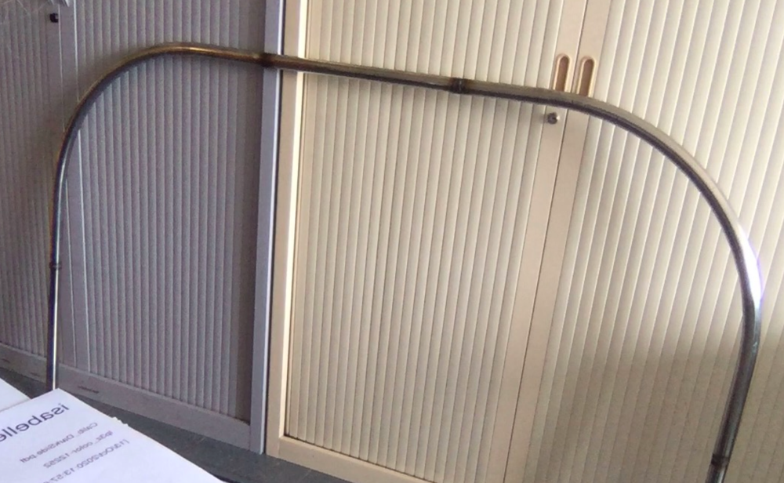
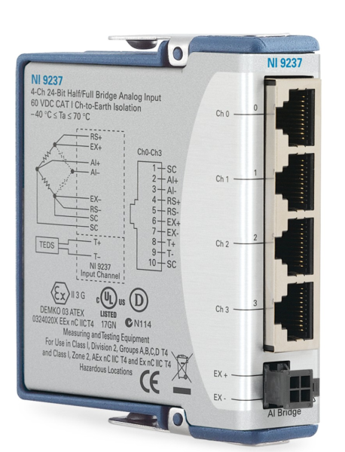
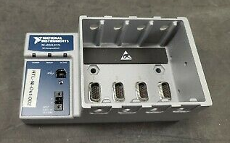
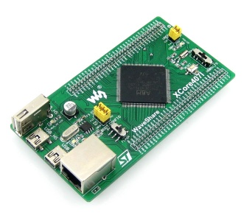
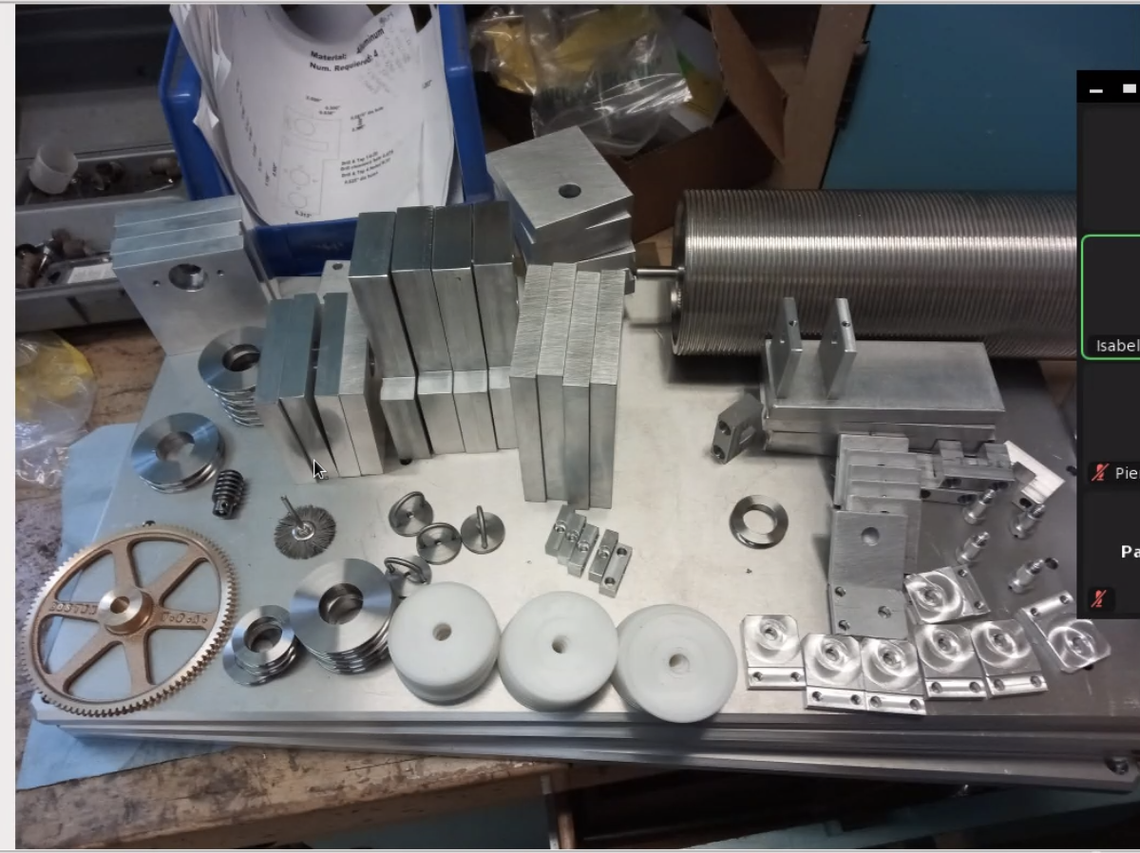
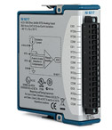

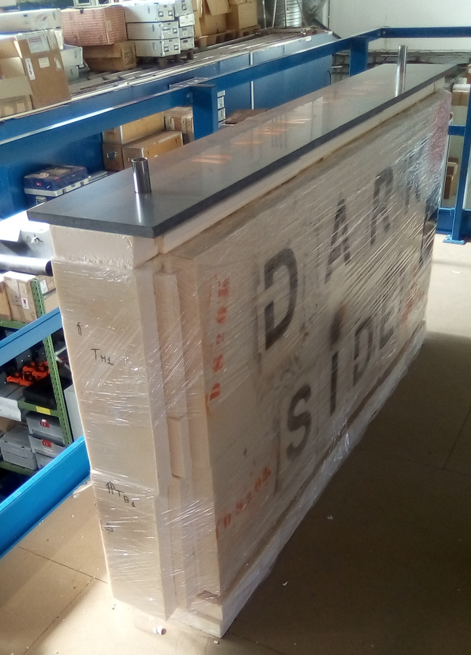
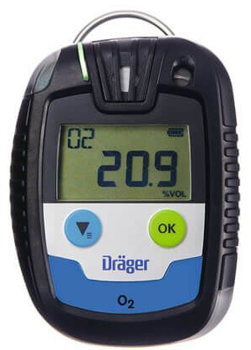
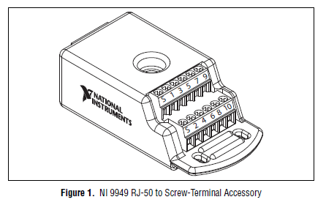

Slide 5
Mock-up tests
Cold cuve leak tests (end 2020)
Strain gauge measurements with 10 cm segment of tube in climate chamber and liquid nitrogen (April-May 2021)
Cold tests involving (week of 5th of July):
  Cold cuve
  U-tube
  Liquid nitrogen
  Strain gauges + NI9237
  PT100 + NI9217
  Humidity sensor + arduino uno
  Dry air
Cold tests (fall 2021) with everything above + motor system and control-command system

Slide 6
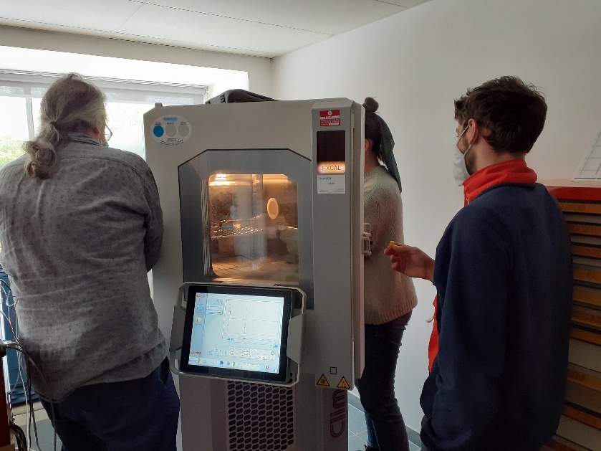
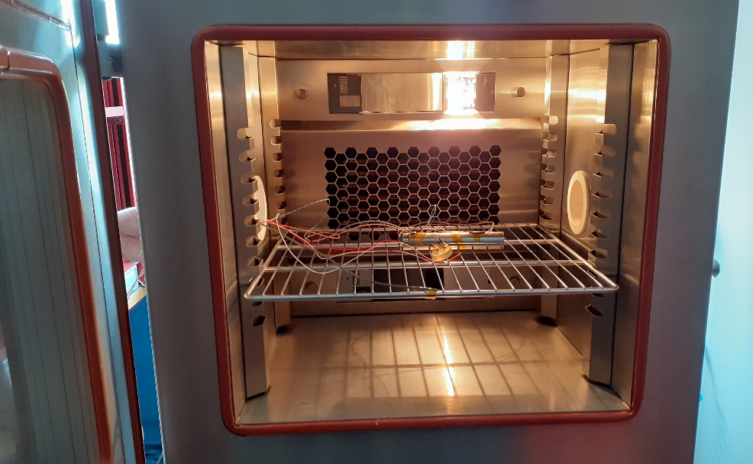
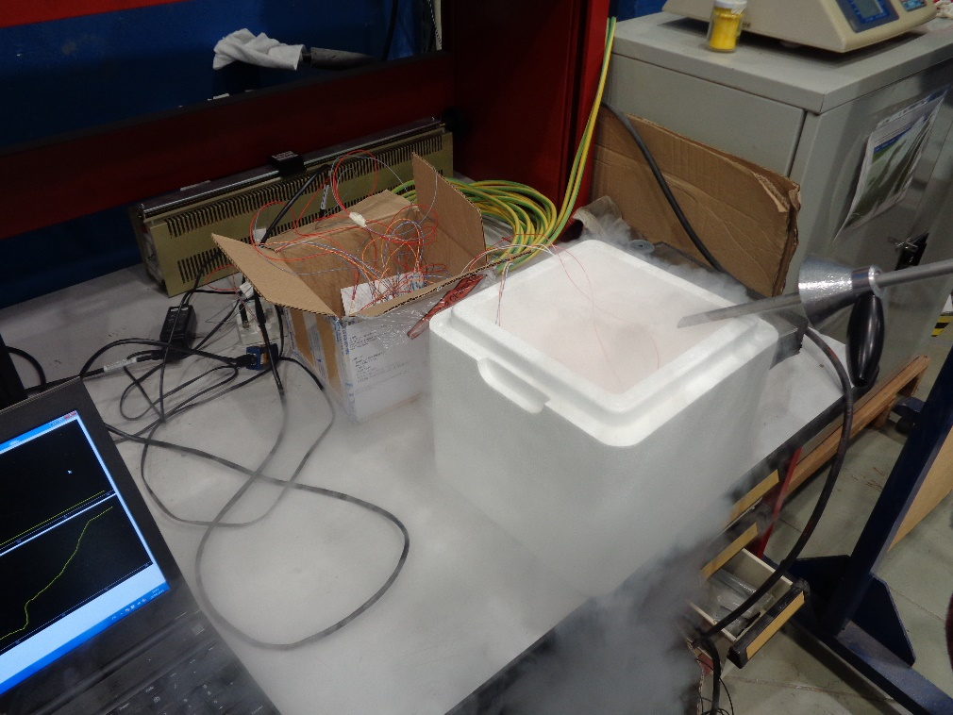
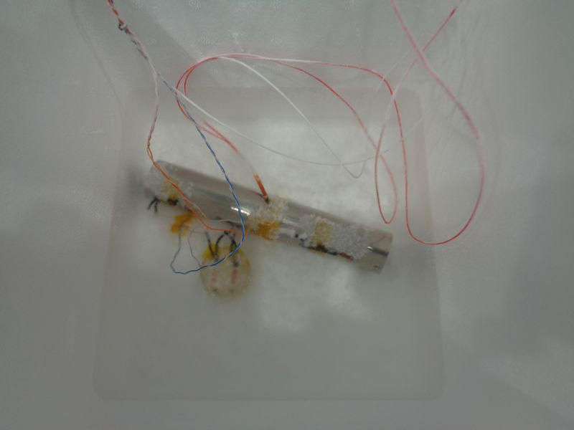
Initial strain gauge measurements
Analysis by Marie Van Uffelen
(Master/future phd student)

Slide 7
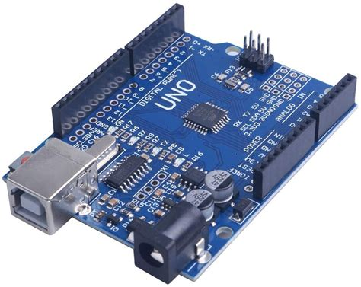

Mock-up set-up for first cold test
Dry air
LN2
Humidity sensor
Python/Labview
U-tube
USB
Arduino
PT100
USB
NI rack
NI9217
Strain gauges
NI9237
Cold cuve

Slide 8
Back-up slides

Slide 9
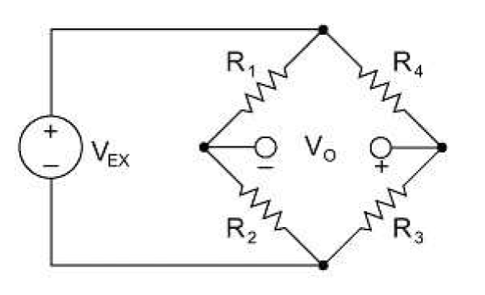
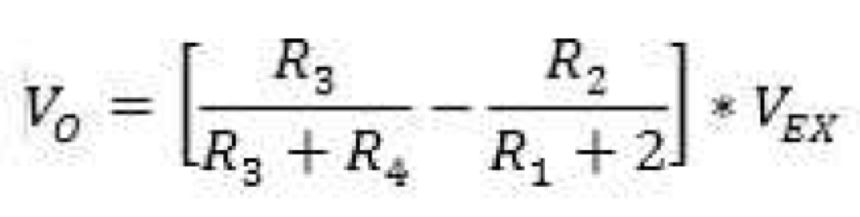
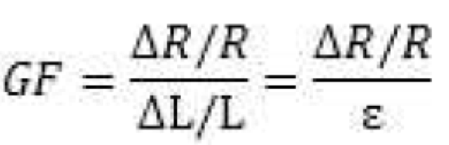
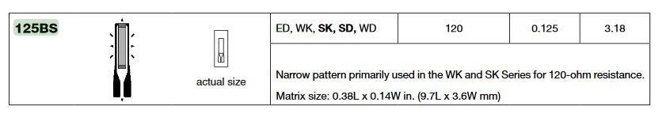
Tube to be tested
(axial deformation)
R₃
R₁
Wheastone bridge
With R₁ = R₂ = R₃ = R₄
V₀ = 0
R₂
R₂
R₄
Reference material
All resistors can be replaced by strain gages
Gage factor (dependent of the strain gage model and t°)
WK-06-125BS-120: provided by Eric V (GF = 2.03% @24°C)

Slide 10
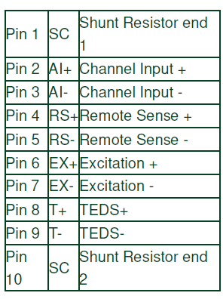
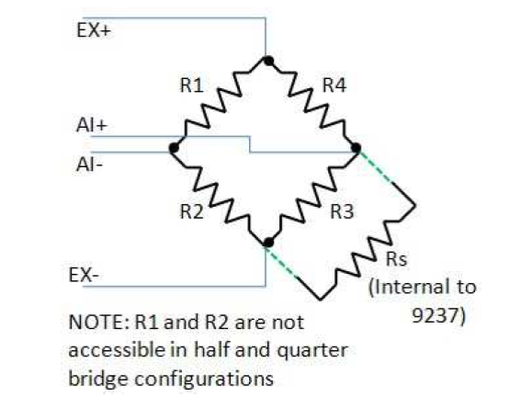
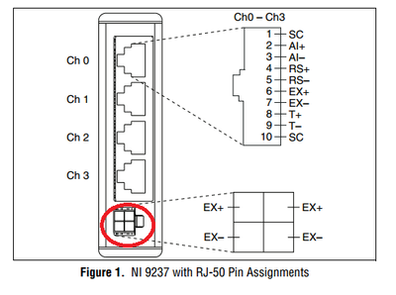
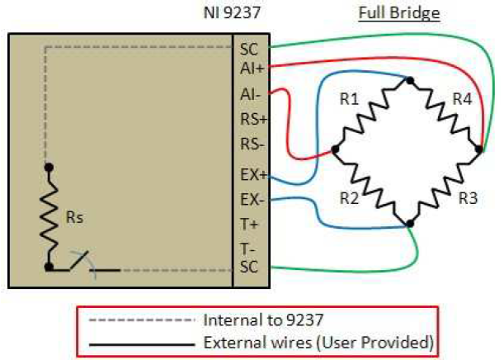
Using NI9237
NI 9949 could be of use
RJ50 connector pinout
NI 9237
R1 is defined between EX + & AI -
R2 is defined between EX - & AI -
R3 is defined between EX - & AI +
R4 is defined between EX + & AI +

