Slide 1
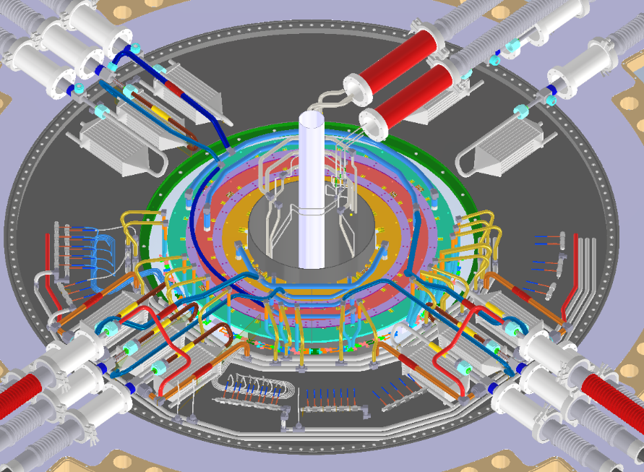
PP1 Cooling
Inner System
In attesa degli input esterni: nuove flange EC, nuovi tools per saldature in loco;
Nuovi capillary manifold;
Procedure di assemblaggio OB, EC, IS;
Mockup;
Outer Endcap
Outer Barrel
Warm Nose

Slide 2
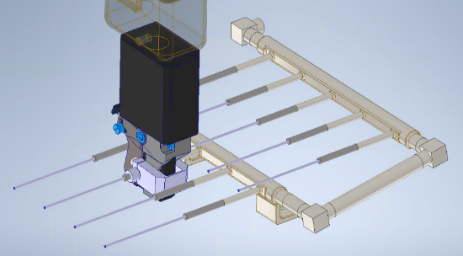
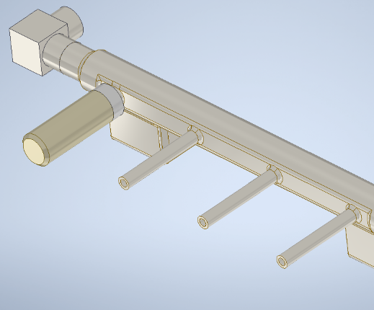
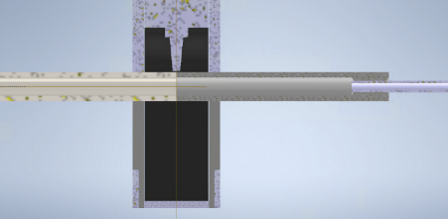
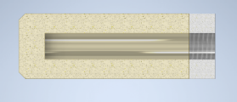
New Manifold for the capillaries under study
More rooming for brazing and repairing capillaries
Special cap for testing, avoiding the pipe cutting
Alignment tool
Male thread (not in the pic)
orbital welding head
Very preliminary
“manifold side”
“capillary side”
Female thread
Emiliano Dané – AUW- April 28th 2021

Slide 3
If we don’t to cut, we need to use «special» caps

Slide 4
Endcap piping procedure
Alex/Fred have to confirm the exhaust and inlets pipe diameters
We are waiting for the new positions of the Exhaust and Inlets

Slide 5
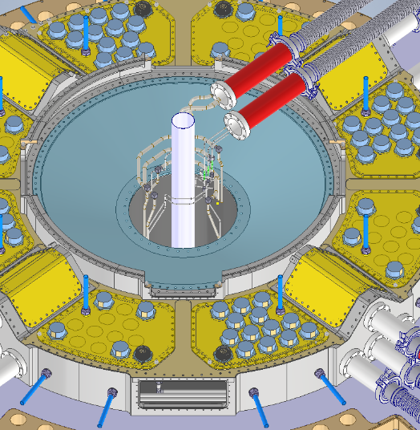
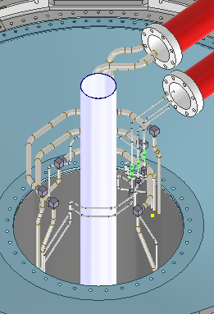
Inner System: some open issues in SR1
How to do the tests for Inner System?
It will be tested before the insertion in the IST ?
When do the cables will be tested?
Are necessary the “temporary flex lines”?
Emiliano Dané – AUW- April 28th 2021

Slide 6
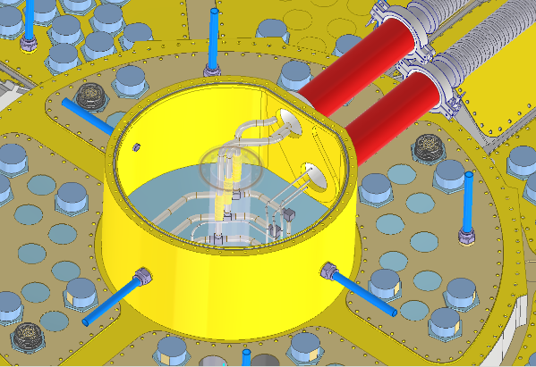
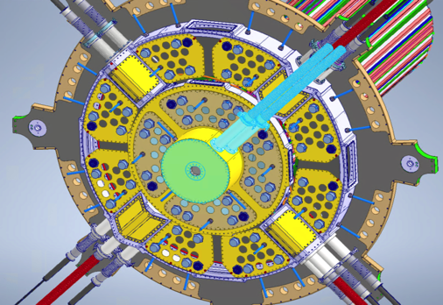
Inner System Cooling pipe connection at PIT
Flex Insertion
Remove the TOP
CFT-IS-A1-2-1/2
Emiliano Dané – AUW- April 28th 2021

Slide 7
Camera Pulita
Apertura busta in questa settimana
Inizio lavori: Settembre
Questioni aperte: Lucasz, basamenti;
Impianto Lucasz
Camera Climatica
Basamenti

Slide 8
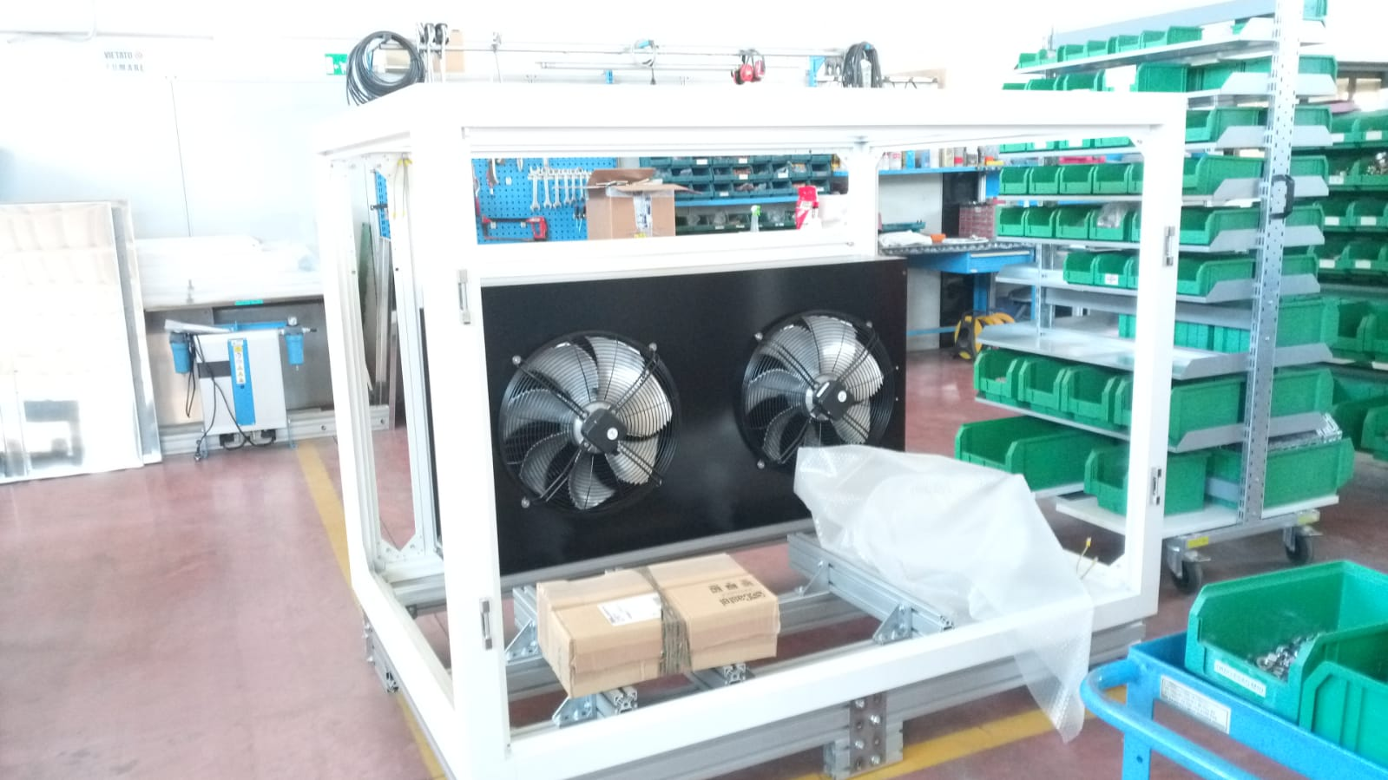
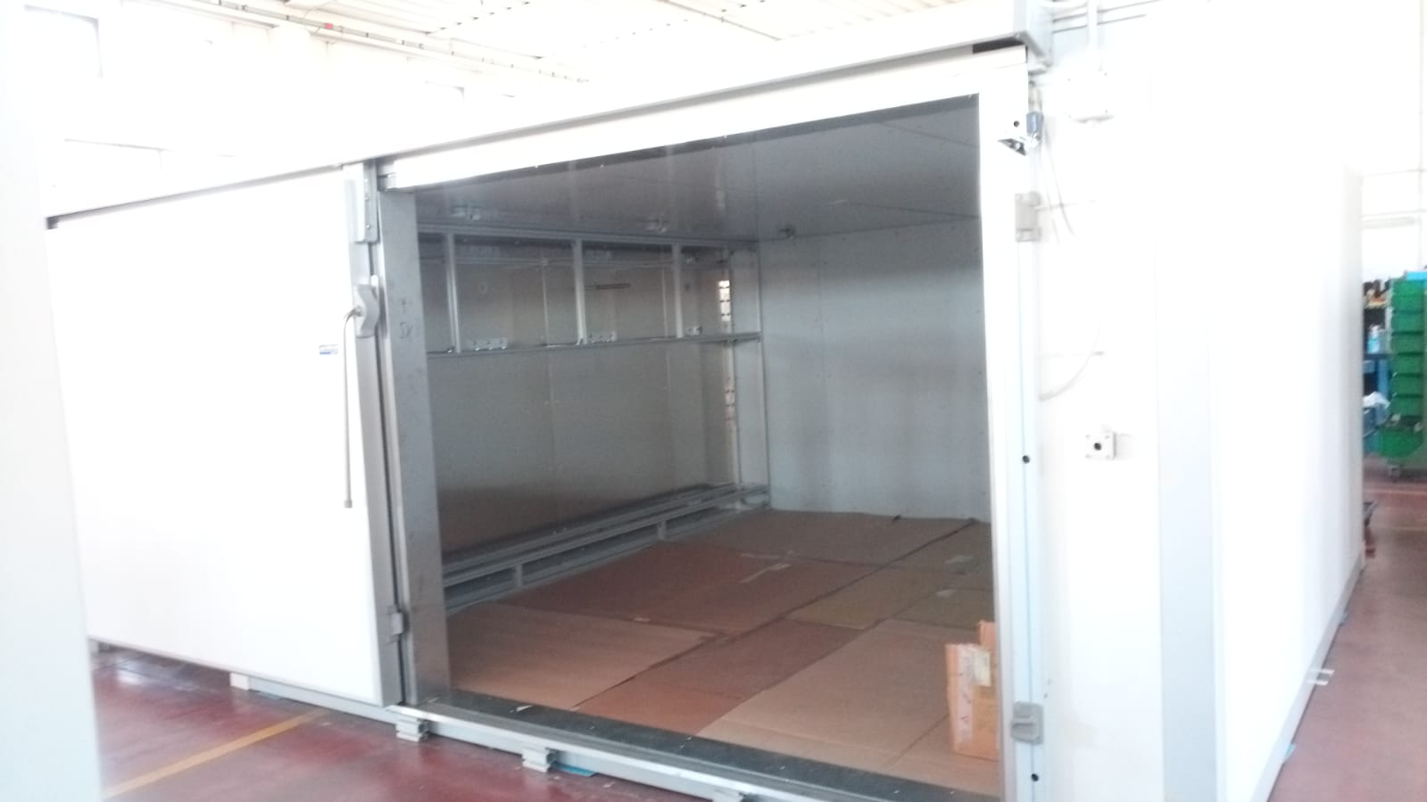
Camera Climatica
Venerdì prossimo visita presso ditta;
Fine costruzione prevista per fine Luglio;
Inizio test presso la ditta a Settembre;
Consegna a metà Ottobre (dipende dai tempi della CC);

