Slide 1
SEM Meeting
INFN-LNF
F. Rosatelli
09/06/2021

Slide 2
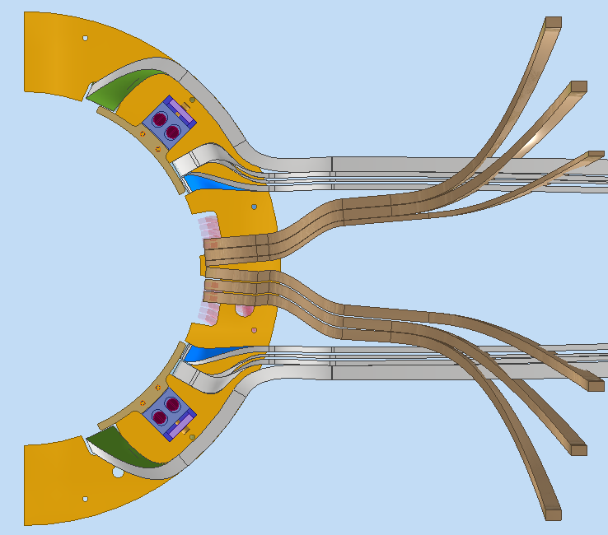
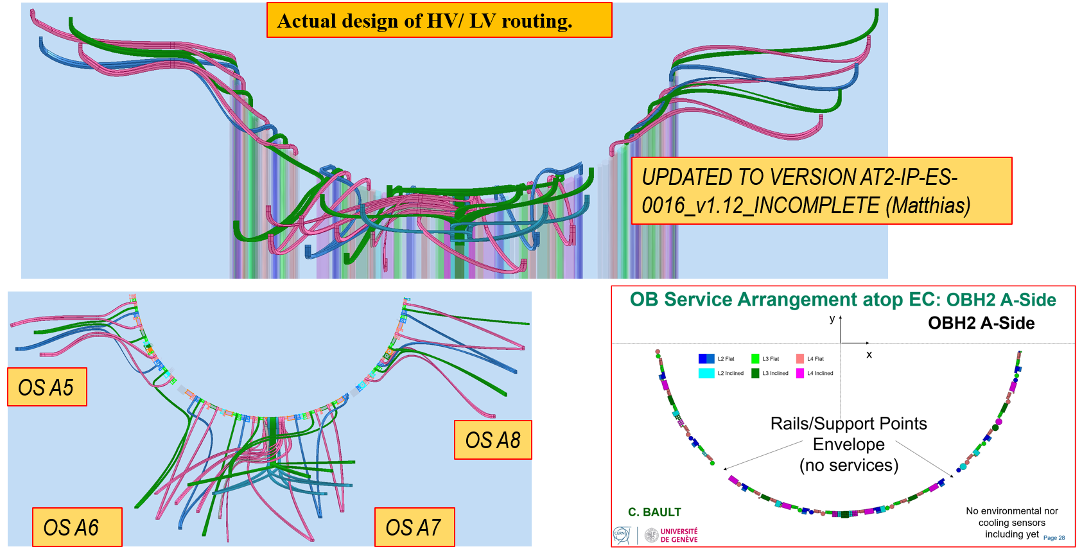
ATLAS ITk – Cabling
EC L2 NOW
DATA
HV/LV
Activities:
Update the Layer 2 routing in End caps (WIP). Waiting news from ATLAS collaboration to update Layer 3 and Layer 4.
Align Outer Barrel routing with the last services mapping. There will be small changes.
Preliminary disposition in data Feedthroughs to check the routing outside the PP1.

Slide 3
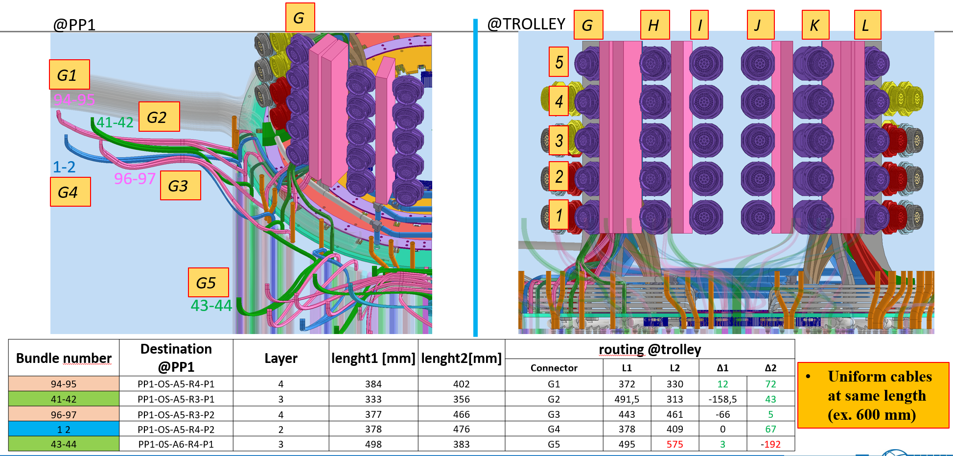
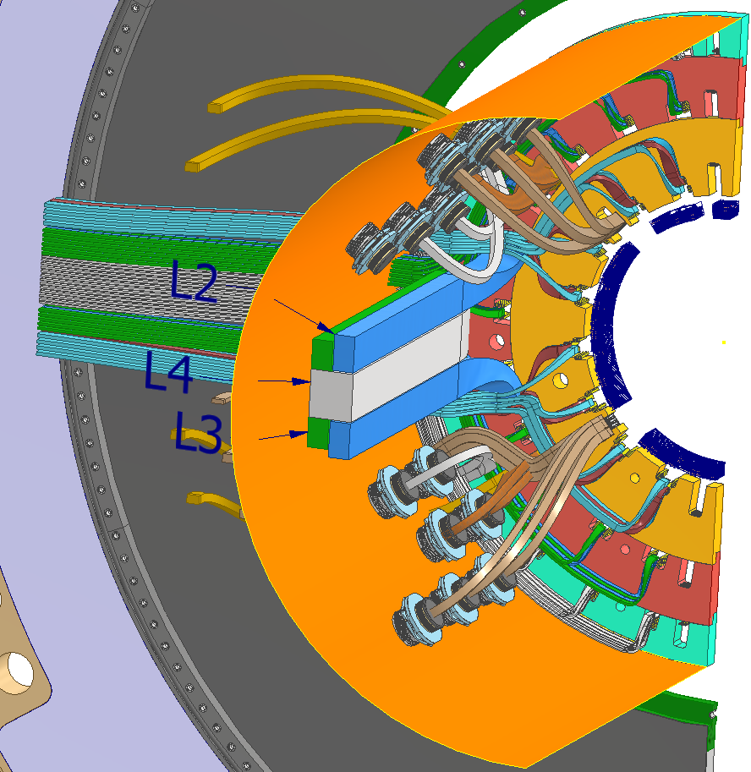
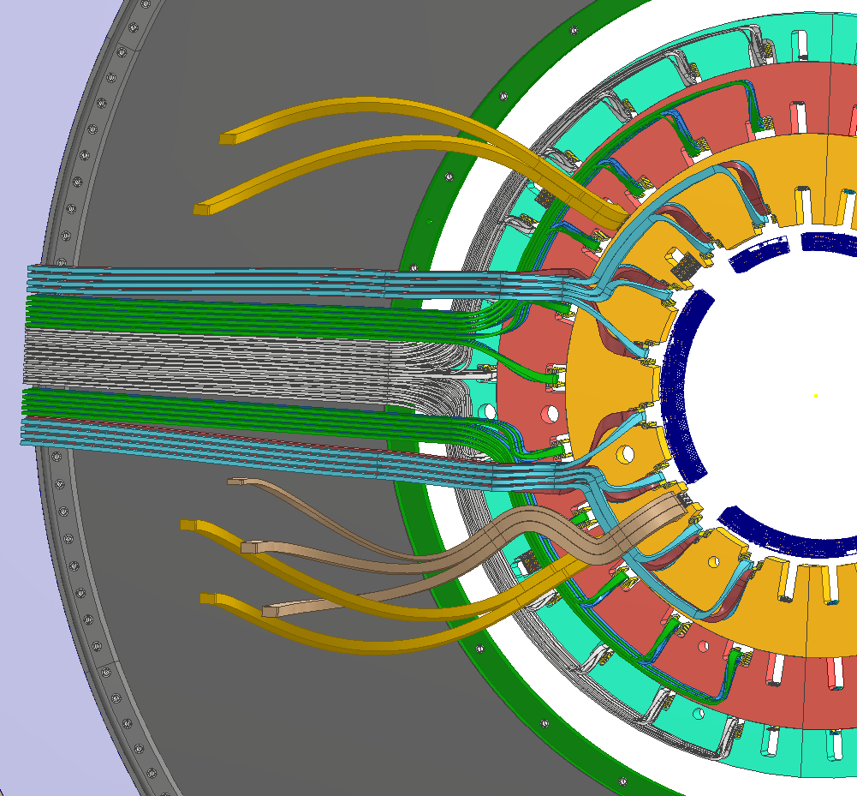
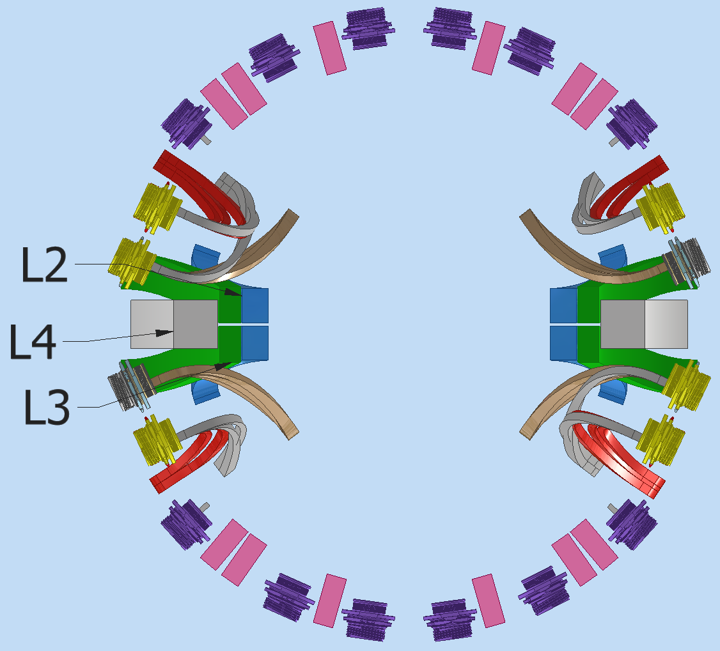
ATLAS ITk – Cabling
Before integration
After integration
Z
AFTER
EC envelope
OB
Activities:
Preliminary study of data link and power cables disposition on trolley. This respecting the integration sequence and envelope assigned.
Verify if the layout on trolley it’s compatible with the length of the cables in the detector (WIP).
EC
EC
OB

Slide 4
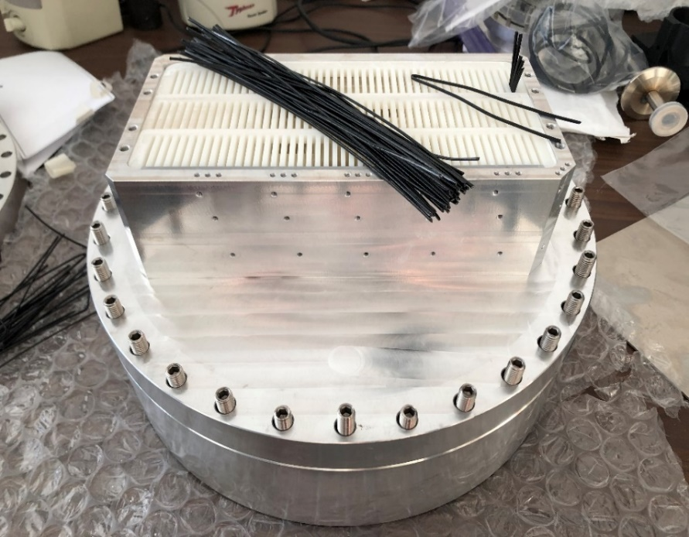
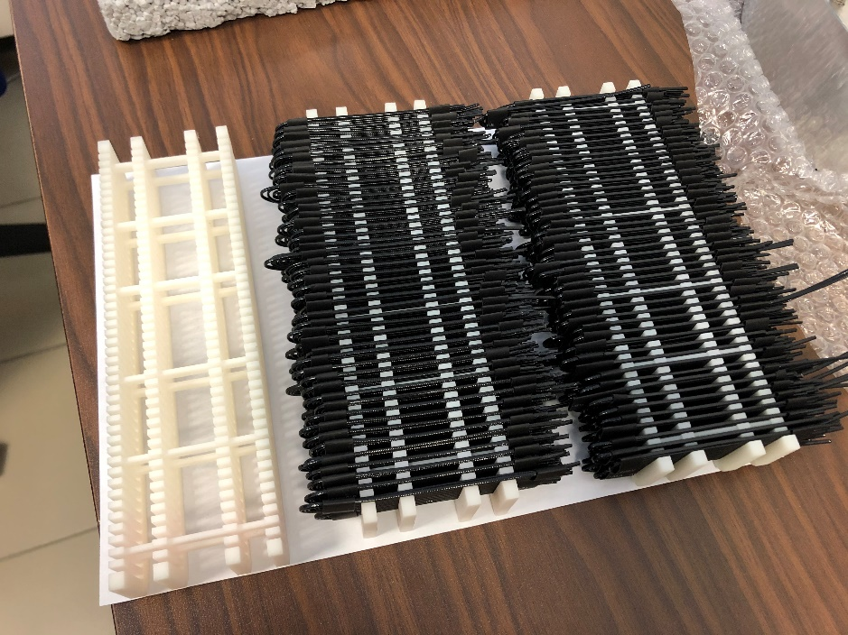
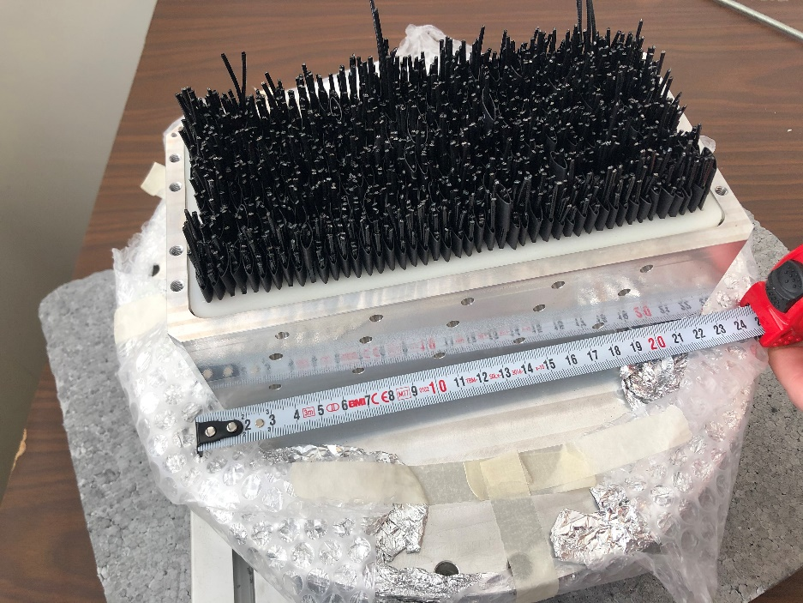
ATLAS ITk –Leak test
1:1 SCALE FEEDTHROUGHT OS
PREPARATION OF COMBS
FEEDTHROUGHT WITH DATA LINK
VESSEL
FLANGE
U-BENDED CABLES (INSIDE)
Activities:
Full scale Outer system feedthrough ready for filling process. Data link 2484.
Test the behaviour of different compounds for filling.

Slide 5
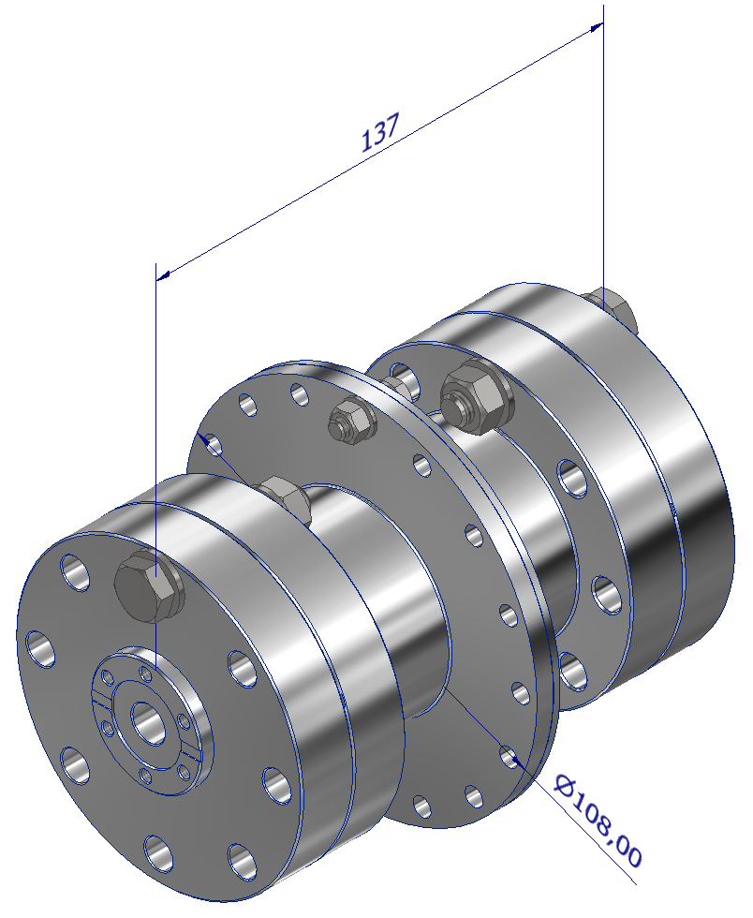
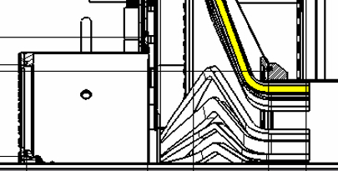
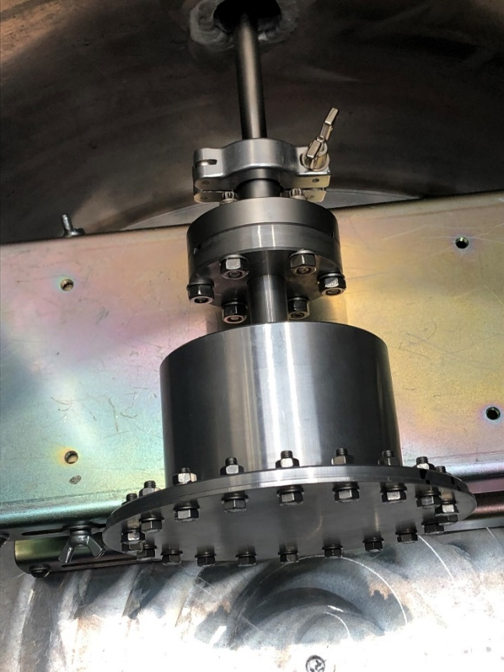
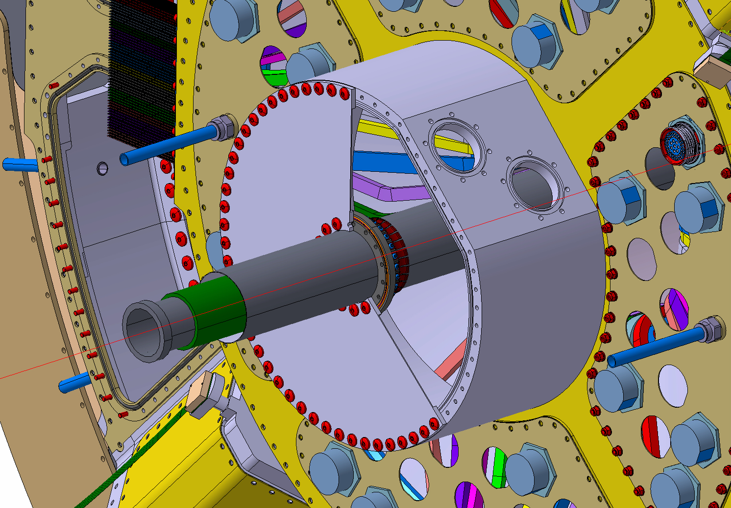
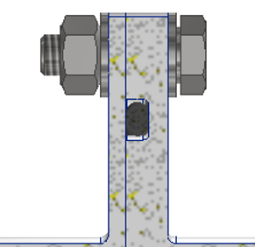
ATLAS ITk –Leak test
Prototype tested
New prototype
4MGy
6MGy
4MGy
6MGy
Activities:
O-ring Leak check test performed. Radiation dose 3,5 MGy.
Design a new prototype to test a new batch of compressed O-ring (Shieldseal® 663), up to 6 MGy.

Slide 6
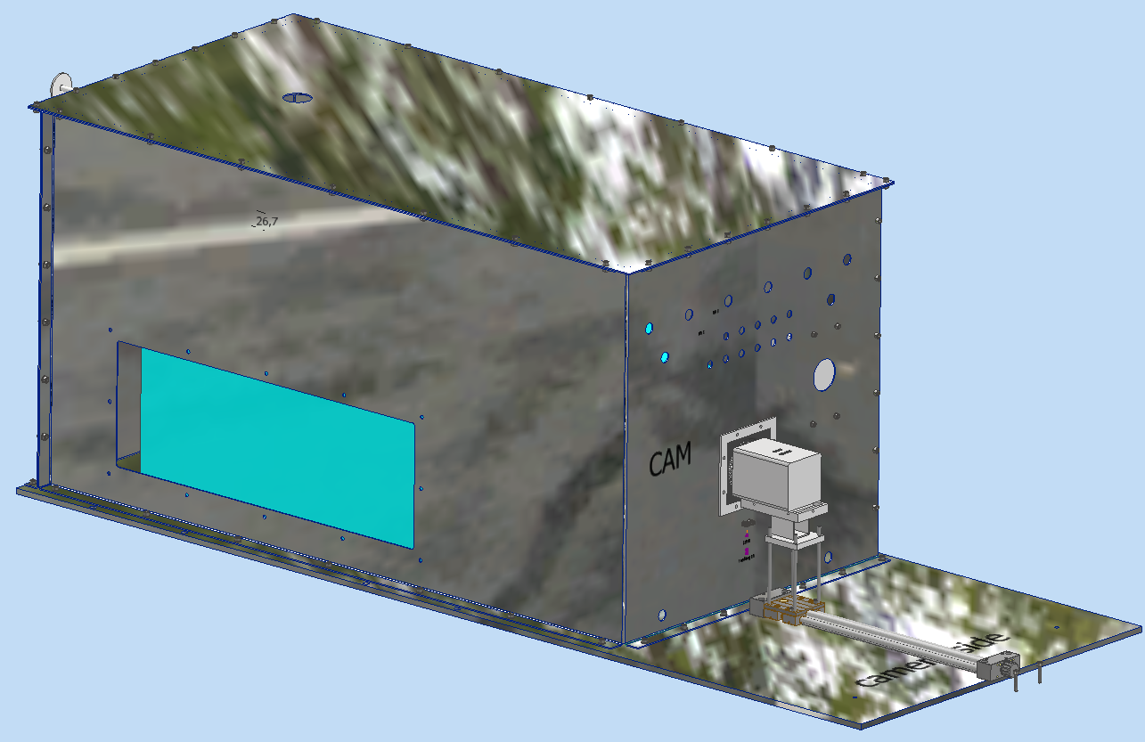
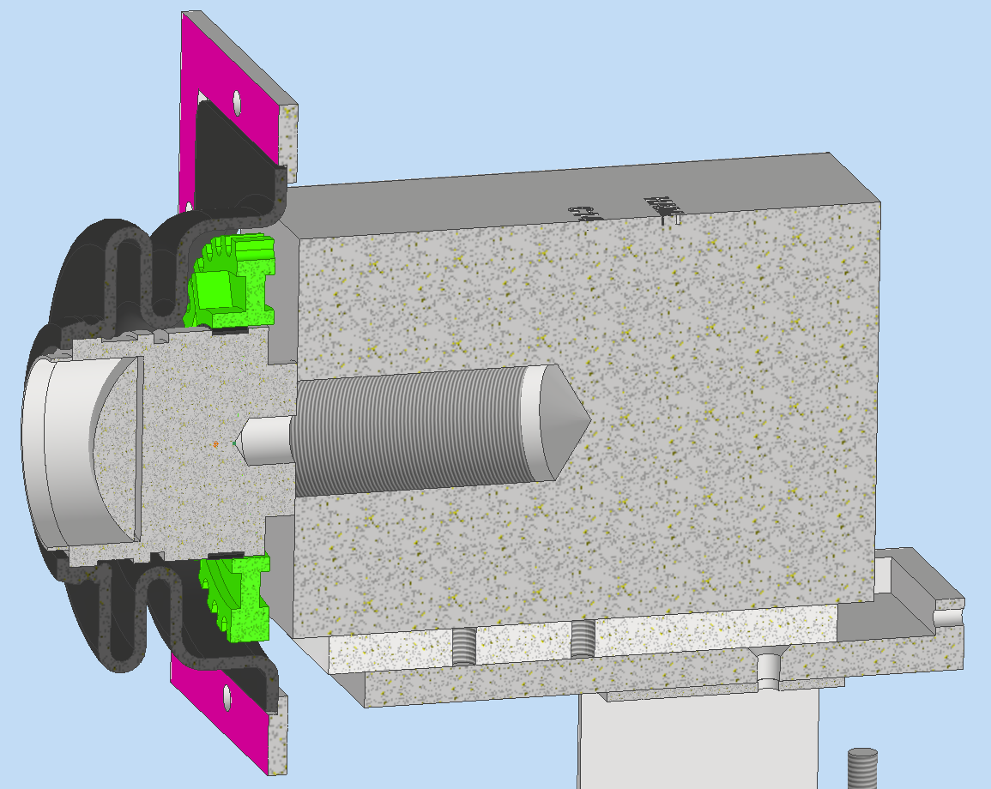
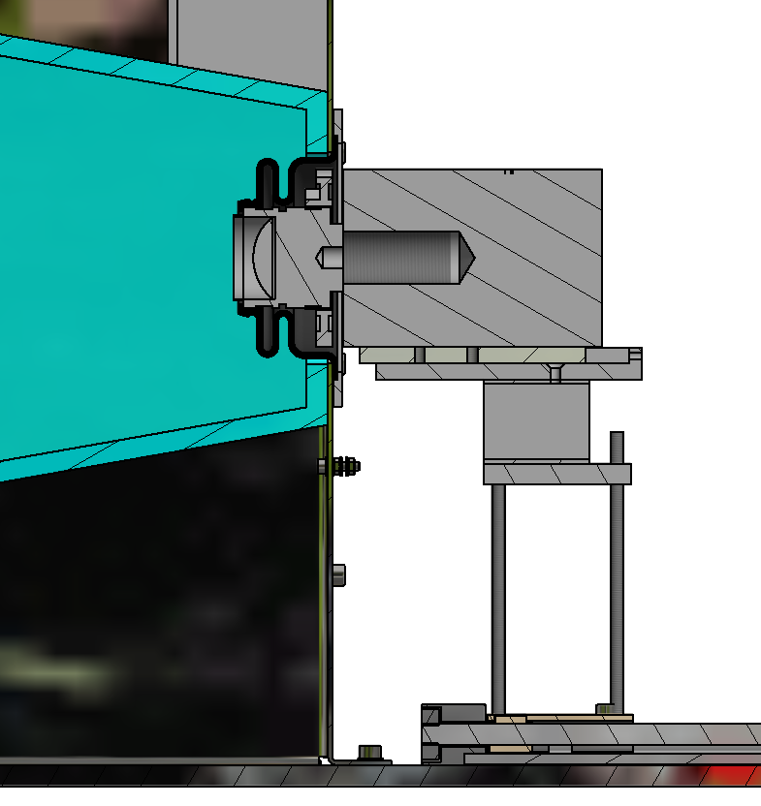
CYGNO - LIME
Activities:
New bellow for camera.
Regulation system for camera lens (WIP).
Support to the experiment.

