Slide 1
All Silicon Tracker in fun4all

Slide 2
Geometry
Ver 1 : old version of the beampipe (way too small in radius, without crossing angle, ...) and it also included an aluminum support structure to simulate the effects from support and services. We exported the entire geometry (barrel, disks, support, beampipe) into a TGeo file which was then loaded into Fun4All

Slide 3
Hits in silicon detectors

Slide 4
Detector Version 1

Slide 5
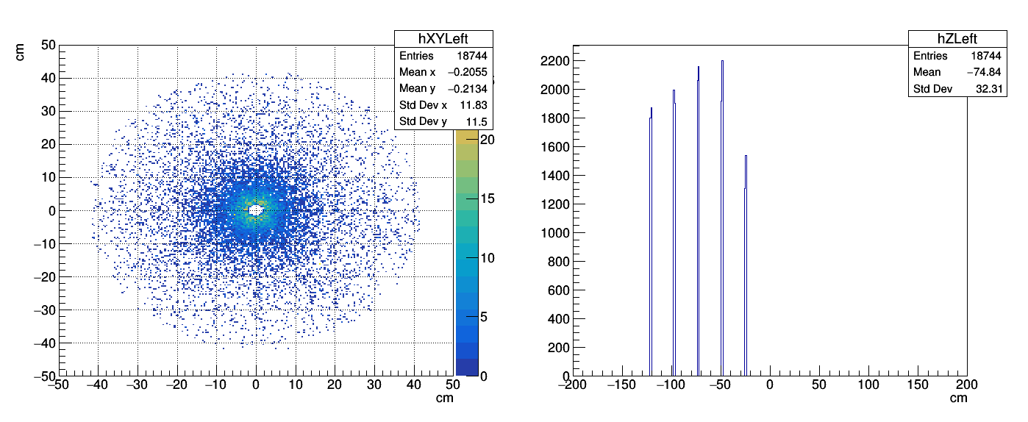
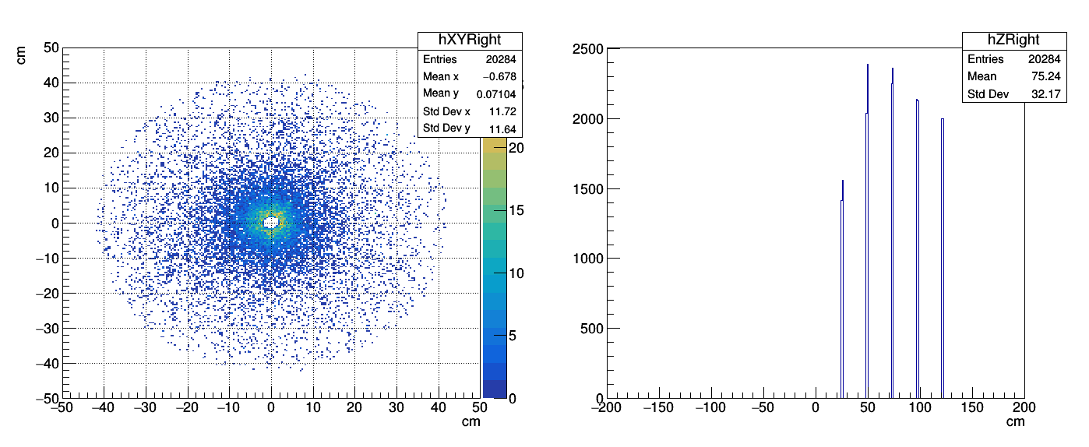
Hits in forward silicon detectors Detector Version 1

Slide 6
Tracks Detector Version 1
π- box : flat pt [0-30] and flat η ( |η|<4)

Slide 7
Geometry
DetVer = 2 (Default & YR)
Ver 2 : beampipe that Håkan referenced, the disk apertures and inner barrel radii larger to fit the beampip. Older projection for the material budget which corresponds to staves of average X = 0.3% X0 (the hybrid uses 0.05 for vertexing, 0.55 for barrel, and 0.24 for disks, which is a more recent projection from Leo Greiner) [-→moved to studies with the new material budget since the YR]

Slide 8
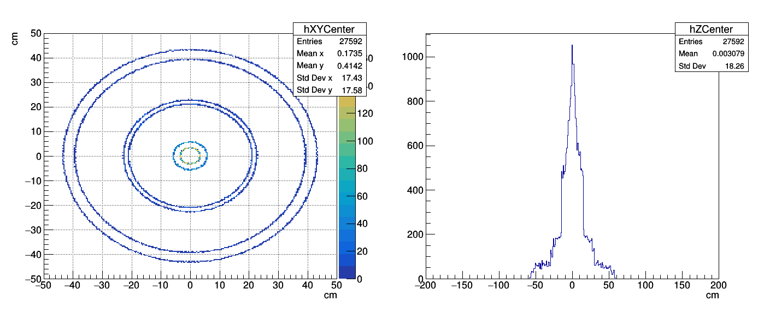
Hits in central silicon detectors (DEFAULT)

Slide 9
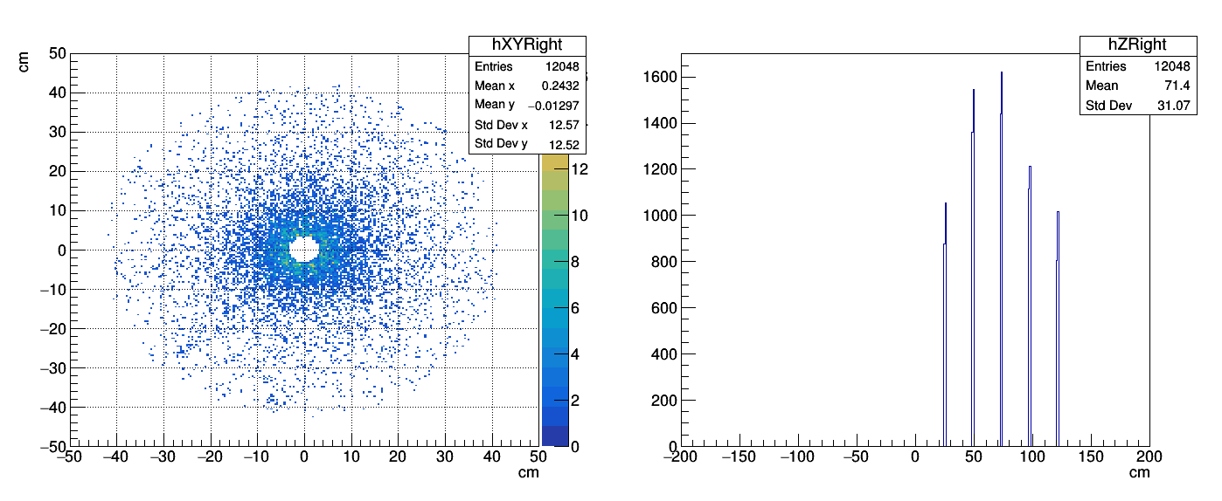
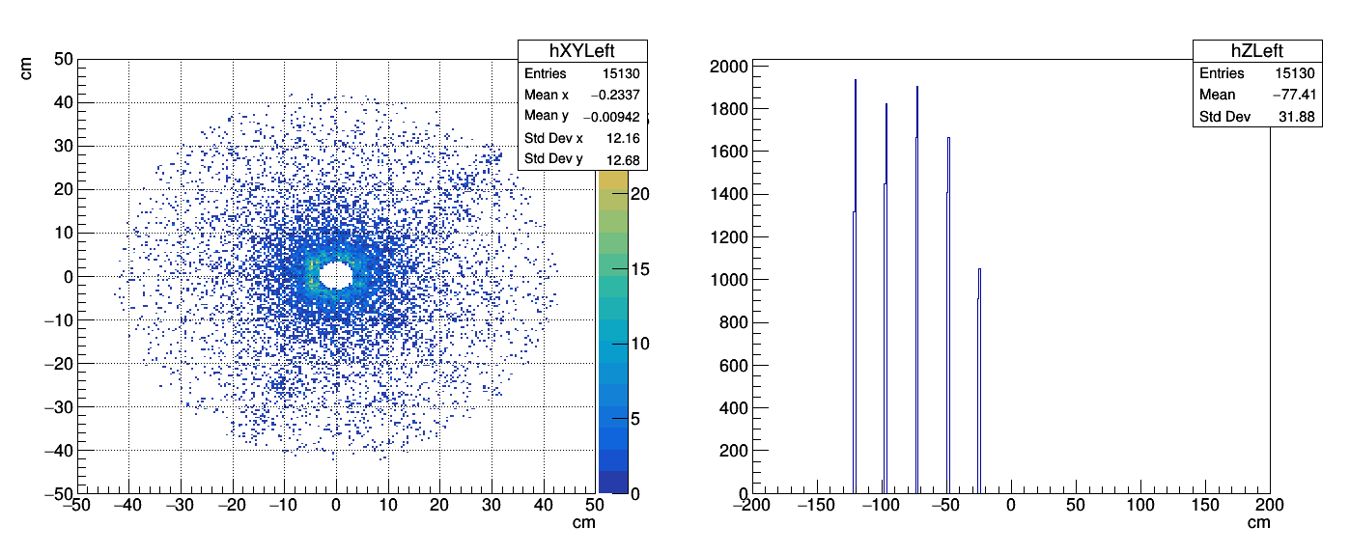
Hits in forward silicon detectors (DEFAULT)

Slide 10
Tracks (DEFAULT)
π- box : flat pt [0-30] and flat η ( |η|<4)

