Slide 1
Inclusion of dRICH in Geant4 and hit maps with IP6 Field
Chandradoy Chatterjee
Roberto Preghanella

Slide 2
The dRICH has been implemented into the Geant4 simulation. This ensures realistic gas and geometry.
The hit positions are obtained for w/ and w/o the presence of the field. For 30 GeV pions and kaons.
To obtain a quantitative assessment, we are currently working on a simple geometry to do inverse ray tracing, independently. Work in progress.

Slide 3
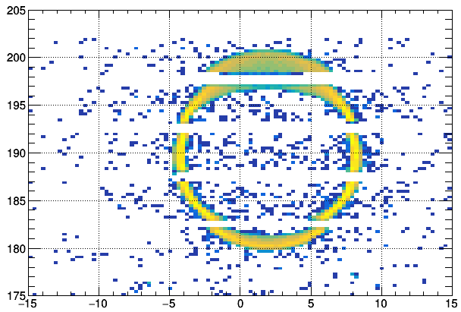
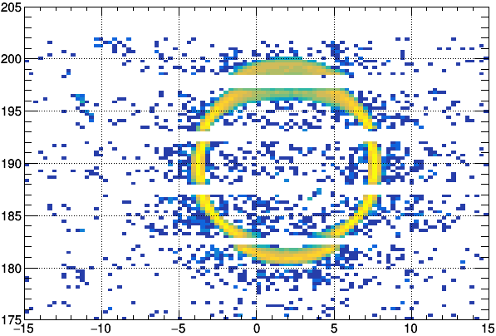
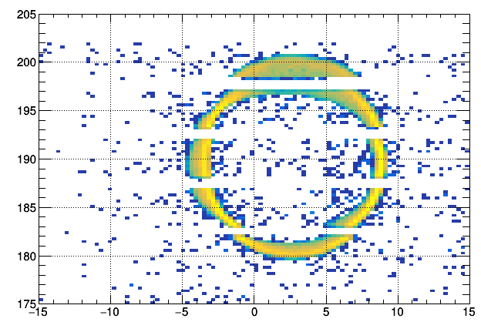
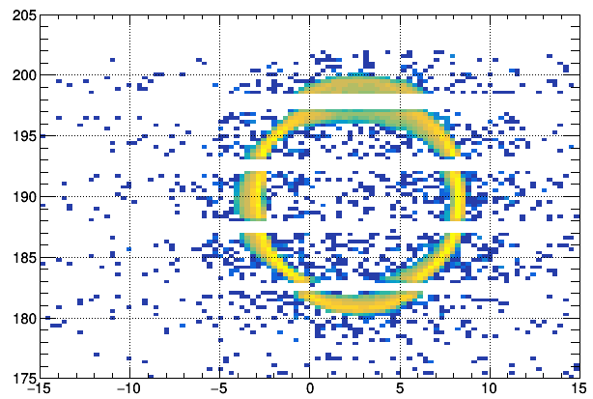
30 GeV pi (left)
30 GeV k (right)
w/o B filed
30 GeV pi (left)
30 GeV k (right)
w/ B filed
Positive tracks are bending towards +ve x values
X [cm]
X [cm]

