Slide 1
DIRCs for PANDA
M. Hoek for the PANDA Cherenkov Group
Notes:
20 minutes total
Comments:

Slide 2
Physics at PANDA
Non-perturbative QCD
Hypernuclei
Precision Hadron Spectroscopy
Exotic States
(Glueballs, Hybrids)
In-Medium Modifications
Nucleon Structure
Notes:
Some physics book results
General PANDA physics goals (Map?)
Final states for some key channels

Slide 3
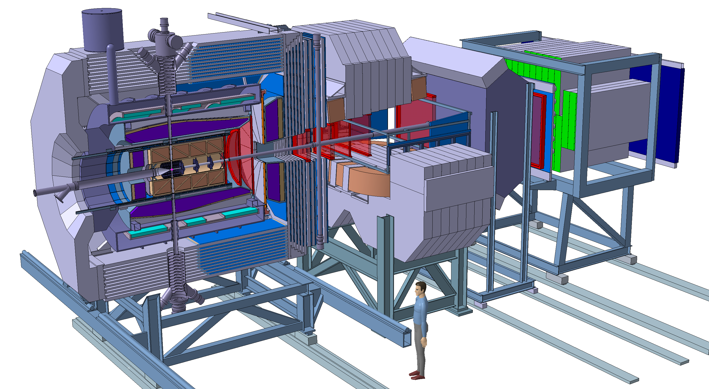
Introduction – PANDA Detector
Forward Spectrometer
Laminated Yoke
Central Tracker
Target
Forward Tracker
Endcap EMC
Beam
Barrel EMC
Magnet Coils
Target Spectrometer
Notes:
Introduction needs to be short

Slide 4
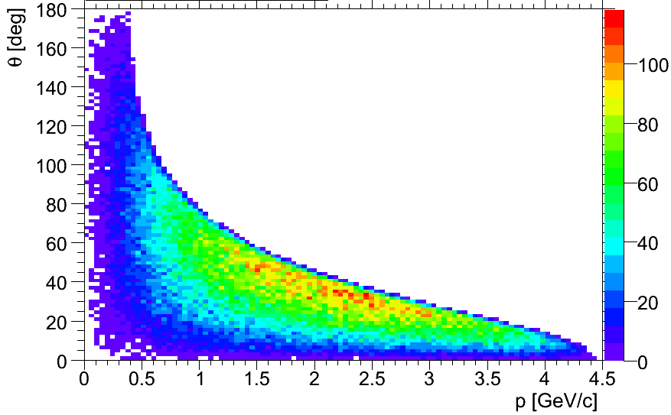
PANDA Target Spectrometer
Barrel DIRC acceptance
140° - 22°
Endcap DIRC
J/Ψ → K⁺K⁻ γ
–
Barrel DIRC
Beam
Endcap DIRC acceptance
5° - 22°
Notes:
Boundary Conditions for DIRCs
Point out
EMC
solenoid yoke
self triggering

Slide 5
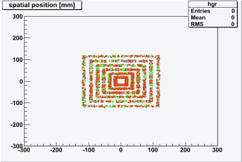
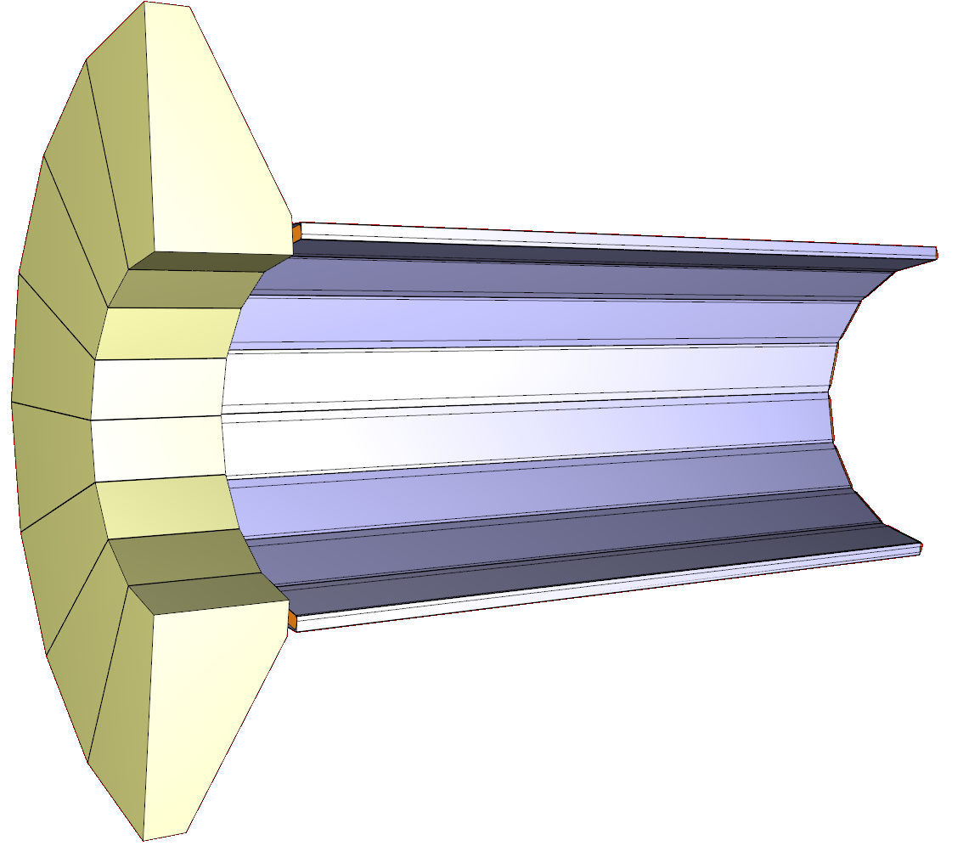
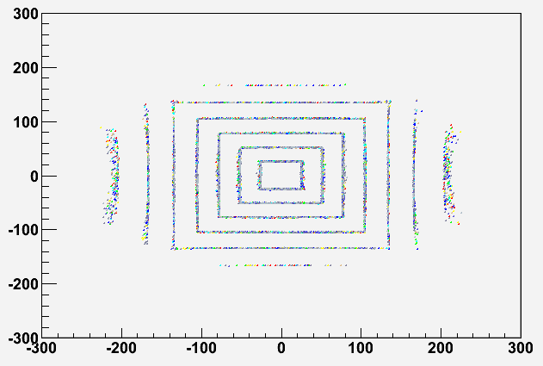
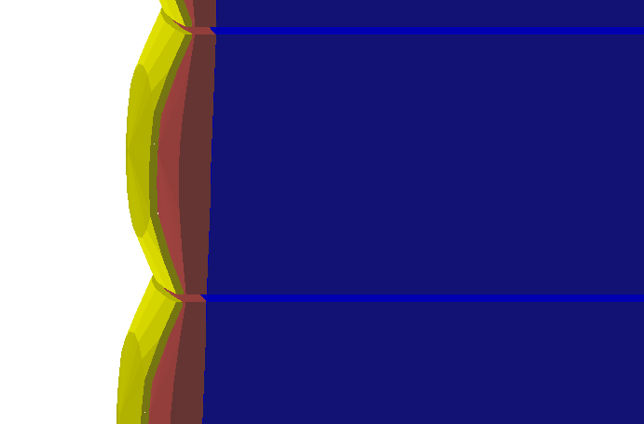
PANDA Barrel DIRC Design
Photon Detectors & Electronics
No Lens
Radiator Bars
First Lens
2.3m
0.4m
Radiator Bar
Focussing Optics
Second Lens
Notes:
Barrel DIRC:
Imaging with lens to reduce stand-off box
Lens system reduces blurring, therefore smaller stand-off box possible

Slide 6
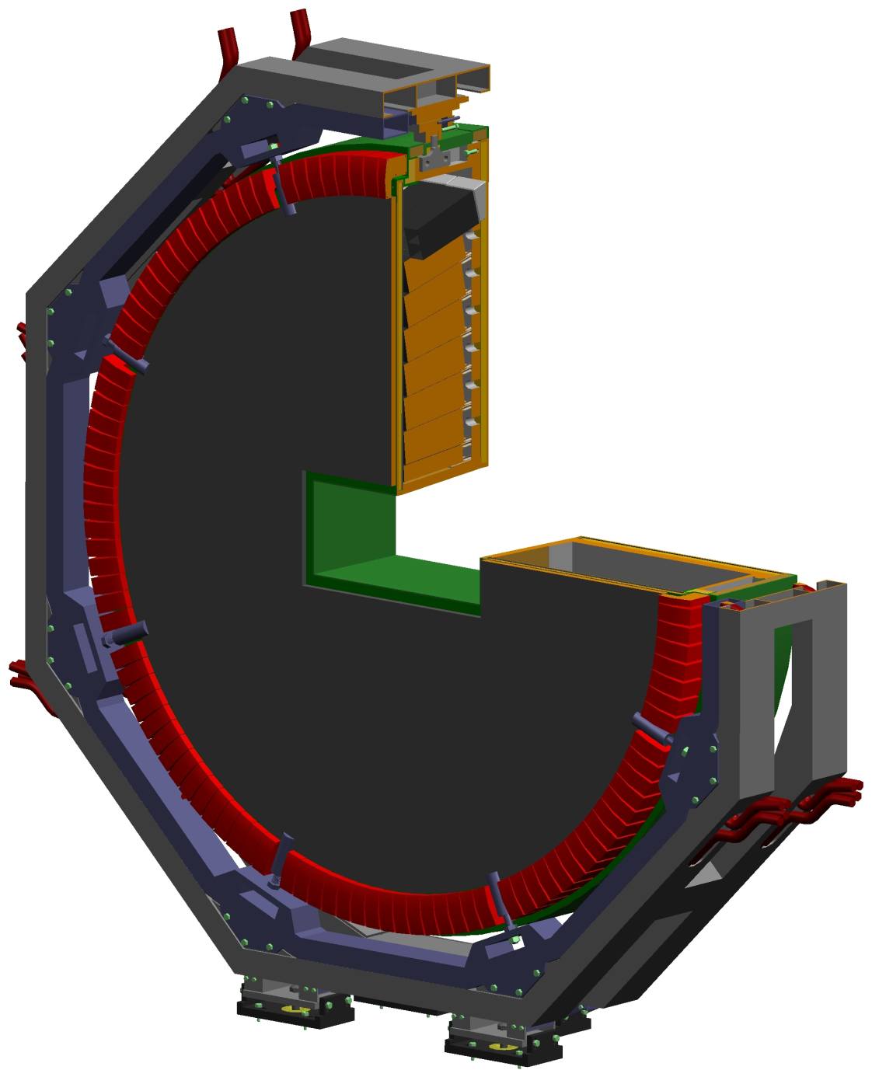
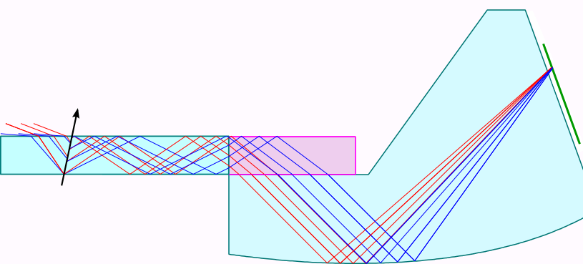
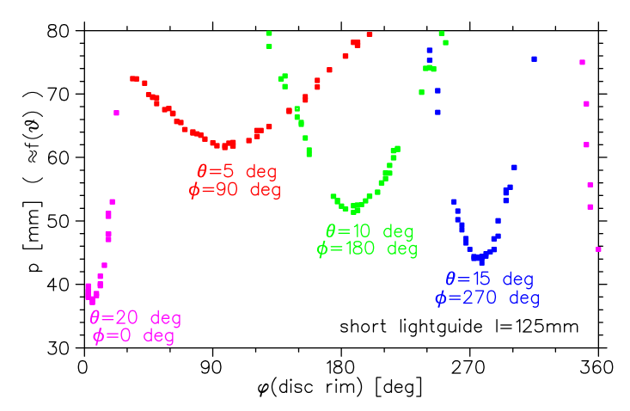
Endcap DIRC – Focussing Lightguide Design
Fused Silica
Radiator Disc
Lithium Fluoride
Endcap EMC
φ
Position-sensitive Photon Detector
~2.5m
Imaging Units
Notes:
120 imaging units

Slide 7
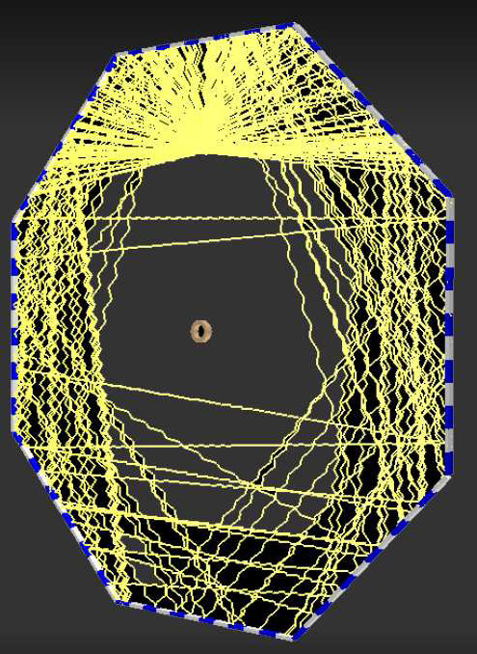
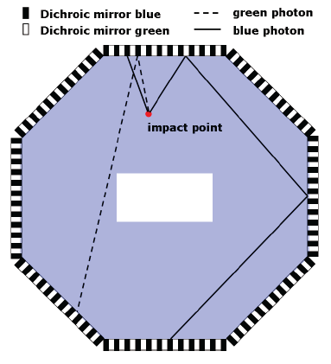
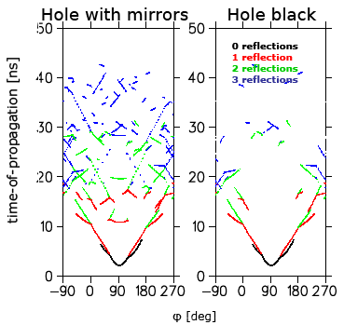
Endcap DIRC – Time-of-Propagation Design
Notes:
Two designs on equal footing
ToP
FDIRC:
- CAD drawing with E-EMC

Slide 8
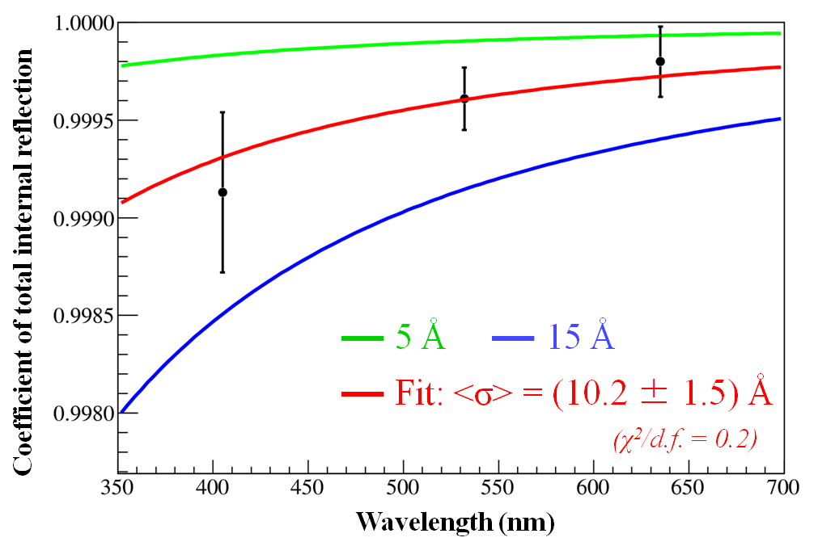
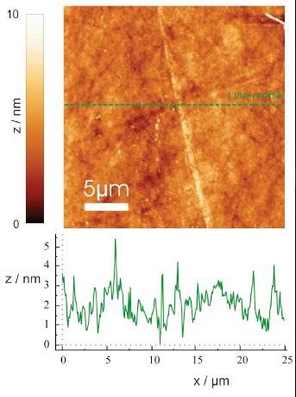
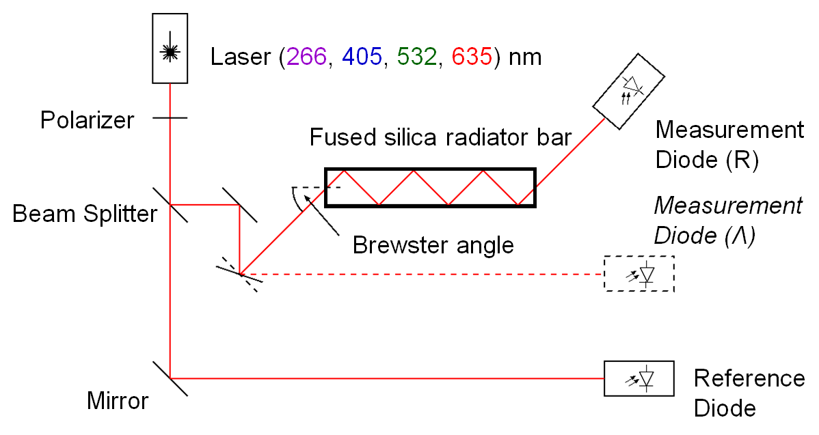
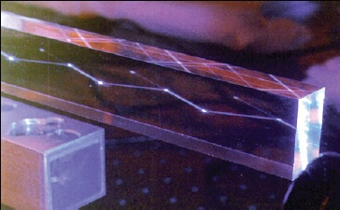
Challenges – Radiator Surface Quality
Standard Polish
Advanced Polish
Notes:
Comments:
AFM plot does not fit to laser measurements
drop AFM plot and increase setup plot

Slide 9
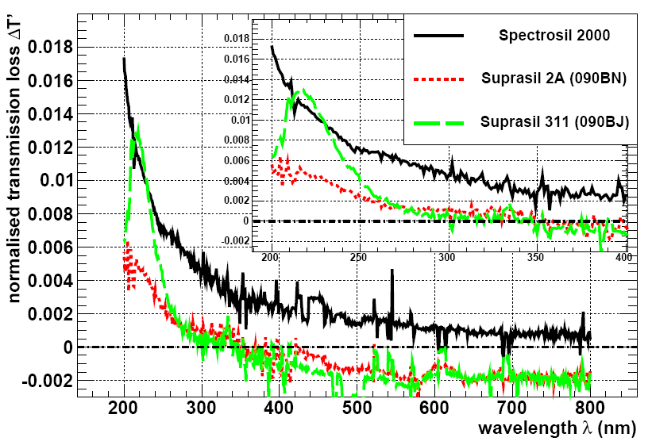
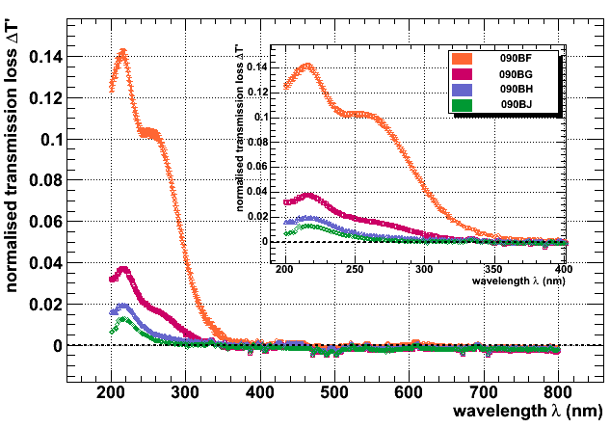
Challenges – Radiator Radiation Hardness
10 Mrad
1 Mrad
10 Mrad
1 Mrad
100 krad
(estimated PANDA lifetime )
100 krad
(estimated PANDA lifetime )
Suprasil 1
Fused Silica
Schott LF5 Glass

Slide 10
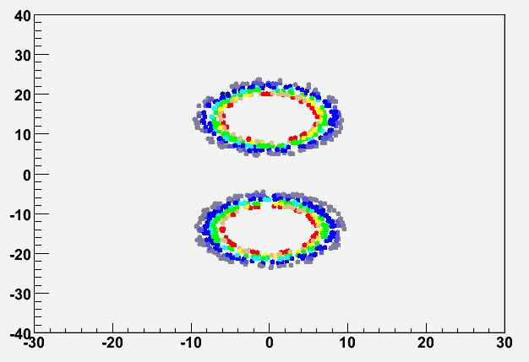
Challenges – Chromatic Dispersion
Blurring of Cherenkov Ring Image
Photon Time-of-Propagation
2 GeV/c Kaon
0.5 GeV/c Kaon
100ps - 200ps resolution
Notes:
Comments:
doesn’t like 0.5GeVc plot
Add cos(theta(lambda)) formula
Dipersion only at threshold so prominent, disappears; used only for illustration

Slide 11
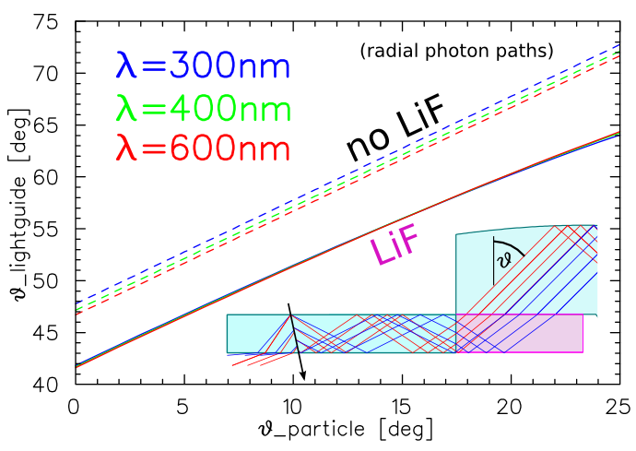
Challenges – Chromatic Dispersion
Angular Distribution
Distribution after LiF Element
Absolute Shift
Fused Silica
SiO₂
Lithium Fluoride
Fused Silica
SiO₂

Slide 12
Challenges – Photon Detector
1.5Tesla
1Tesla
0.7Tesla
Barrel DIRC
Photon Detector
Barrel DIRC
Notes:
Magnetic field strength
Photon flux
Single photon detection
Time resolution
Life time

Slide 13
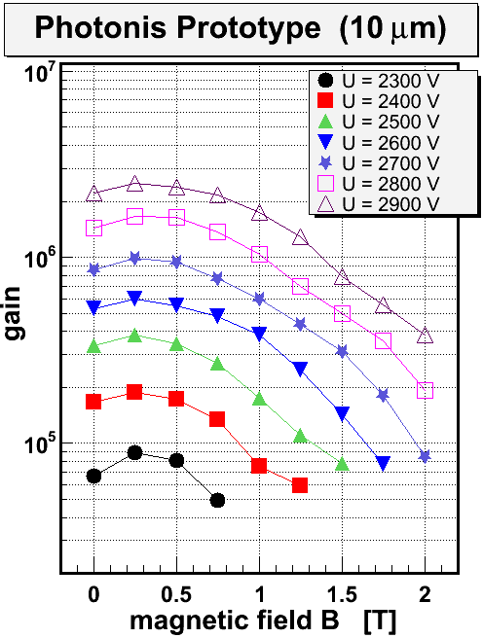
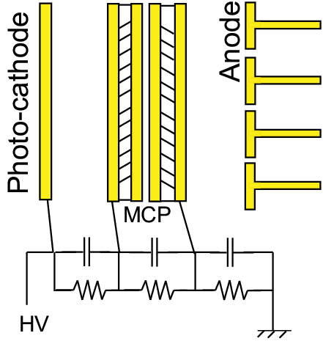
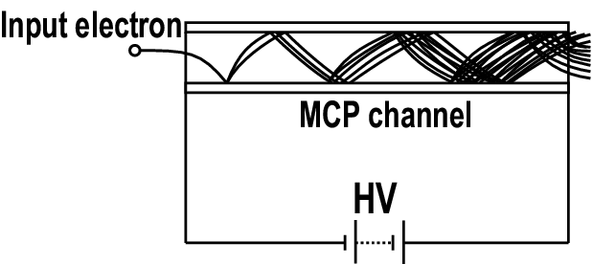
Challenges – Photon Detector (MCP-PMT)
Notes:
Min gain 5x10^5

Slide 14
MCP-PMT Single Photo-Electron Timing

Slide 15
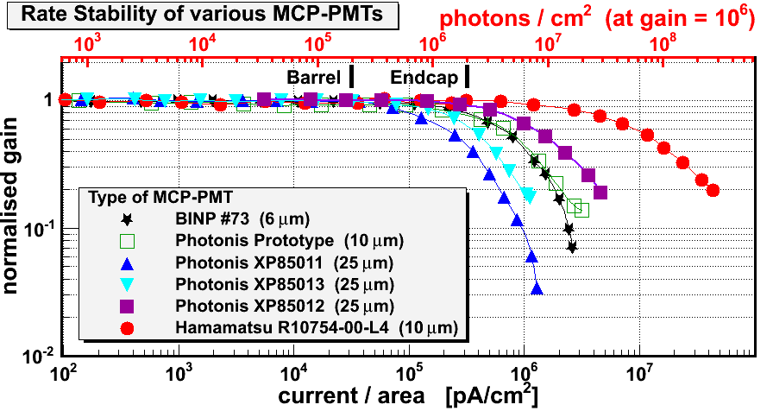
MCP-PMT Rate Stability

Slide 16
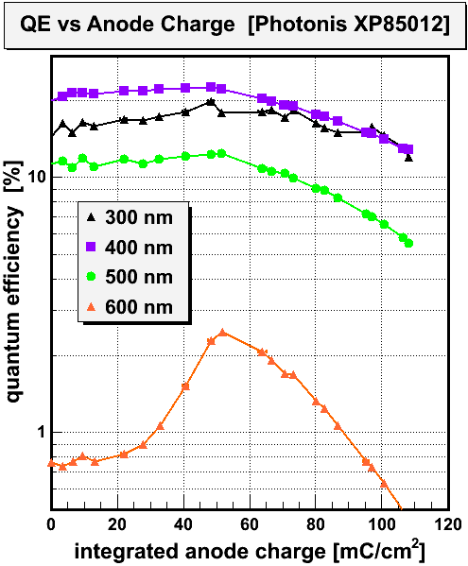
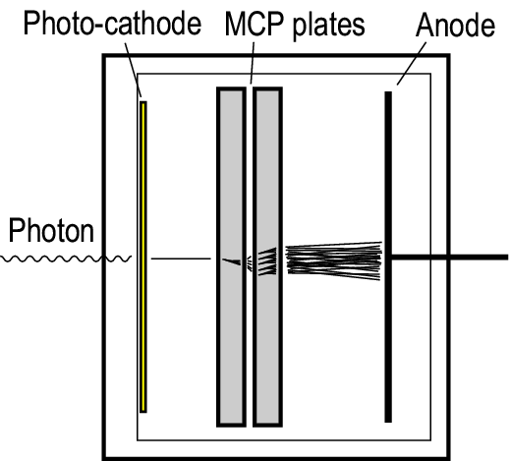
MCP-PMT Lifetime
~ 50% loss
(at 500nm)
0.11 C/cm²
Ion Backflow
Barrel DIRC
~ 0.8 C/cm²/year
Endcap DIRC
~ 4 C/cm²/year (Focussing Design)
~ 10 C/cm²/year (ToP Design)
Notes:
Get numbers from Albert’s talk at RICH2010

Slide 17
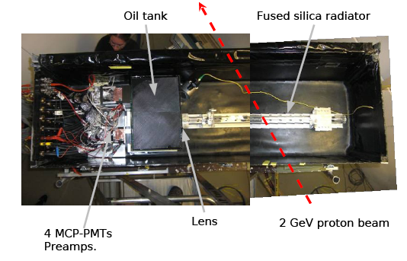
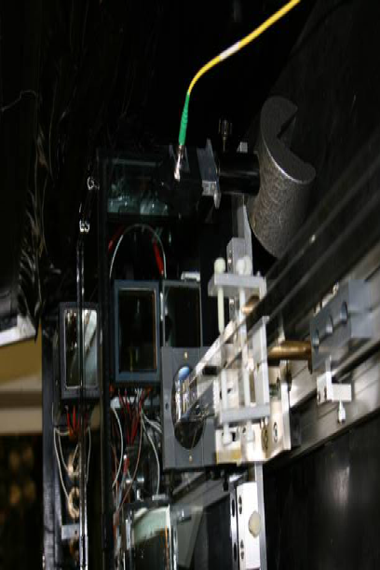
First Results – Barrel DIRC
MCP-PMTs
Lens
Radiator Bar
Notes:
2GeV protons -> beta = 0.948

Slide 18
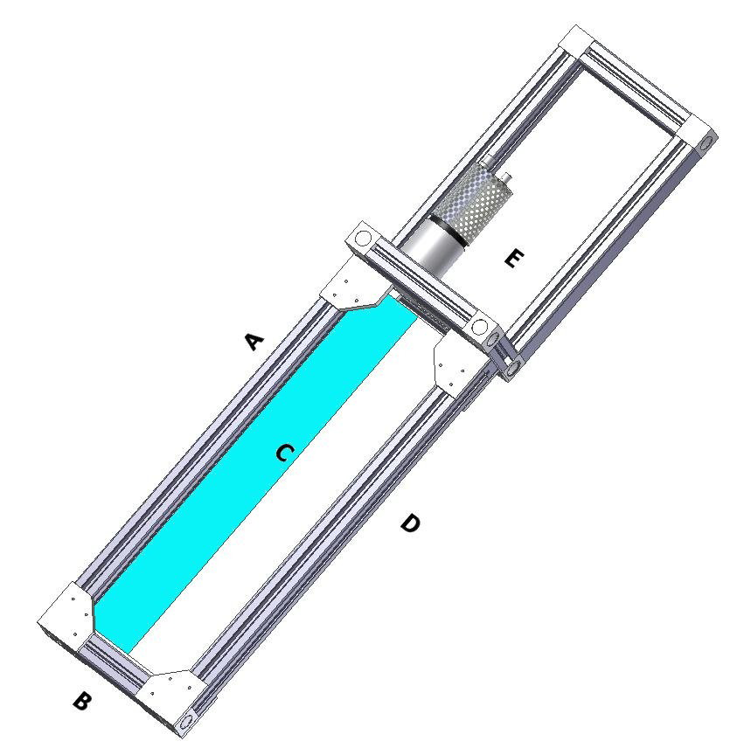
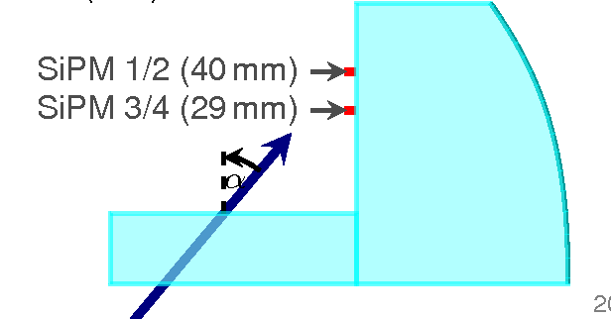
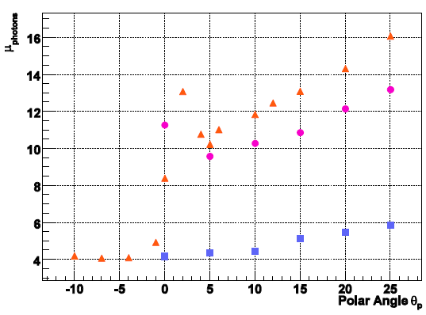
First Results – Endcap DIRC
2 GeV Proton Beam
Polar Angle θ
Data
Simulation

Slide 19
Thank You

Slide 21
Backup Slides

Slide 22
Barrel DIRC Performance
Notes:
Comments
Drop this slide as design is unknown

Slide 23
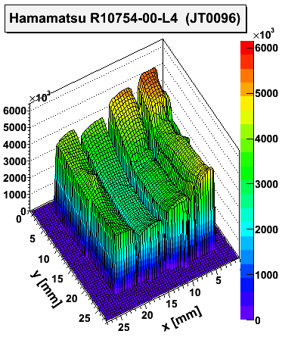
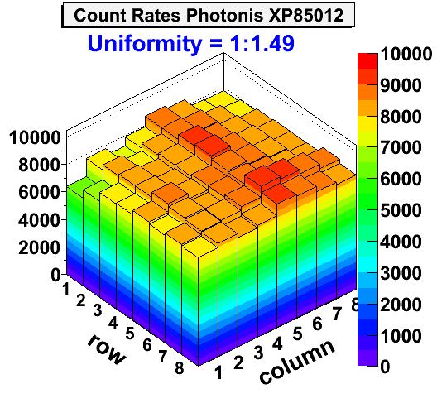
MCP Uniformity

