Slide 1
Studies of partonic distributions using semi-inclusive production of kaons with CLAS12
Probing strangeness in hard processes
Laboratori Nazionali di Frascati
Tuesday 19 October 2010
Kawtar Hafidi

Slide 2
Outline
Flavor decomposition using polarized and unpolarized Semi-Inclusive hadron production from polarized and unpolarized hydrogen and deuterium targets using CLAS12 detector enhanced with a RICH counter
  E-09-007 (H. Avakian, F. Benmokhtar, A. EL Alaoui, M. Mirazita & K.H)
Studies of spin-orbit correlations in kaon electroproduction with longitudinally polarized hydrogen and deuterium targets using CLAS12 detector enhanced with a RICH counter
  E-09-009 (H. Avakian, E. Cisbani, K. Griffioen, P. Rossi & K.H)

Slide 3
Flavor decomposition
Unpolarized Measurements
Polarized Measurements
Proton
Deuteron
Deuteron
Proton
Measure Multiplicities
(π⁺, π⁻, π⁰, K⁺, K⁻, K_{s}⁰)
Measure Multiplicities
(π⁺ + π⁻, K⁺ + K⁻, K_{s}⁰)
Measure Asymmetries
(e⁻, π⁺ + π⁻, K⁺ + K⁻, K_{s}⁰)
Measure Asymmetries
(e⁻, π⁺, π⁻, π⁰, K⁺, K⁻, K_{s}⁰)
Isoscalar Method
Extract shape of
Extract
Flavor Decomposition
Extract

Slide 4
Quark helicities contribution to the nucleon spin
Inclusive DIS
Semi-Inclusive DIS
ΔΣ = 0.2 – 0.25 at Q²= 1 GeV² MS-Bar scheme
Δu is large and positive
Δd is negative and smaller
ΔS ≈ -0.06 ± 0.01
Δu is large and positive
Δd is negative and smaller
ΔS ≈ 0 and slightly positive
Assumptions:
SU(3) flavor symmetry in hyperon decay
Flavor symmetric sea
Quark and anti-quarks of the same flavor can
not be distinguished
The strange sea can only be separated in terms
of first x-moments
Need a good knowledge of fragmentation
functions
The exploitation of the method suffers
from “u-quark dominance”

Slide 5
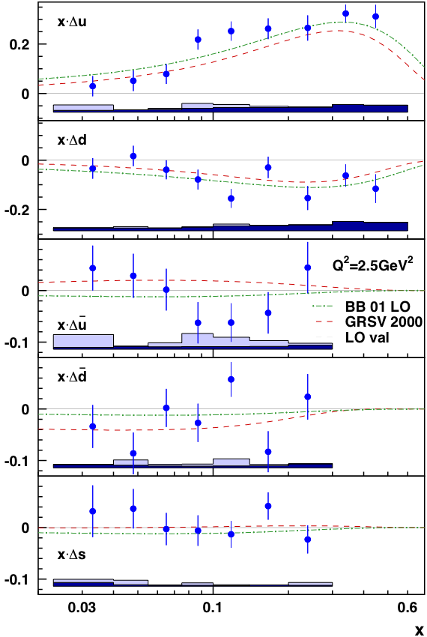
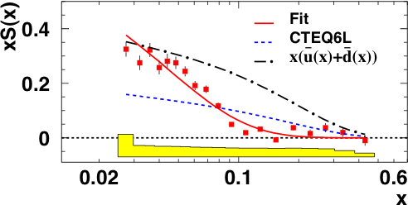
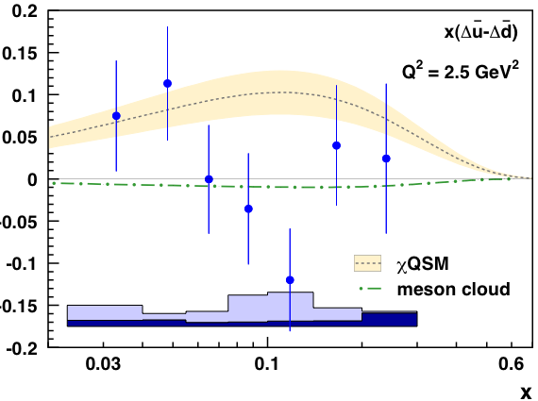
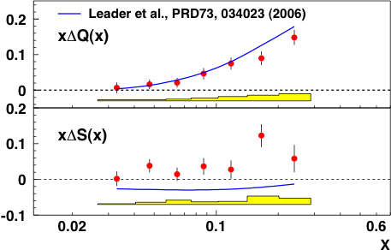
Measure Asymmetries on proton & deuteron
(e⁻, π⁺, π⁻, π⁰, K⁺, K⁻, K_{s}⁰)
Measure Asymmetries & multiplicities on deuteron
(e⁻, π⁺ + π⁻, K⁺ + K⁻, K_{s}⁰)
Notes:
Chiral quark soliton model is based on on an effective theory where baryon appear as soliton solution of the chiral lagrangian.

Slide 6
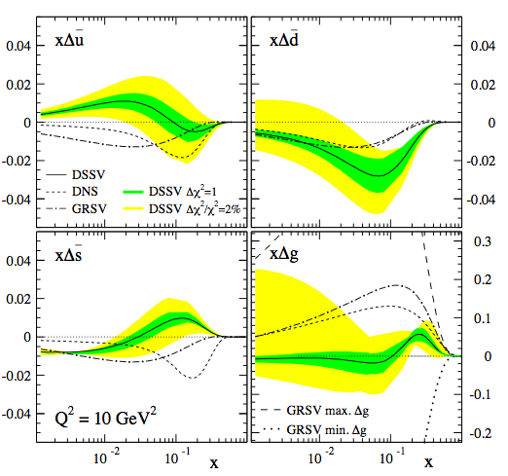
Motivations
The combination of high luminosity and the large acceptance of CLAS12 will allow a dramatic improvement of the statistical precision in the extraction of individual quark contributions to the nucleon spin
The systematics related to our knowledge of fragmentation functions can further be reduced with high precision multiplicity measurements
Test whether or not the light sea is symmetrically polarized
Improve NLO global analysis of Helicity Parton densities and their uncertainties

Slide 7
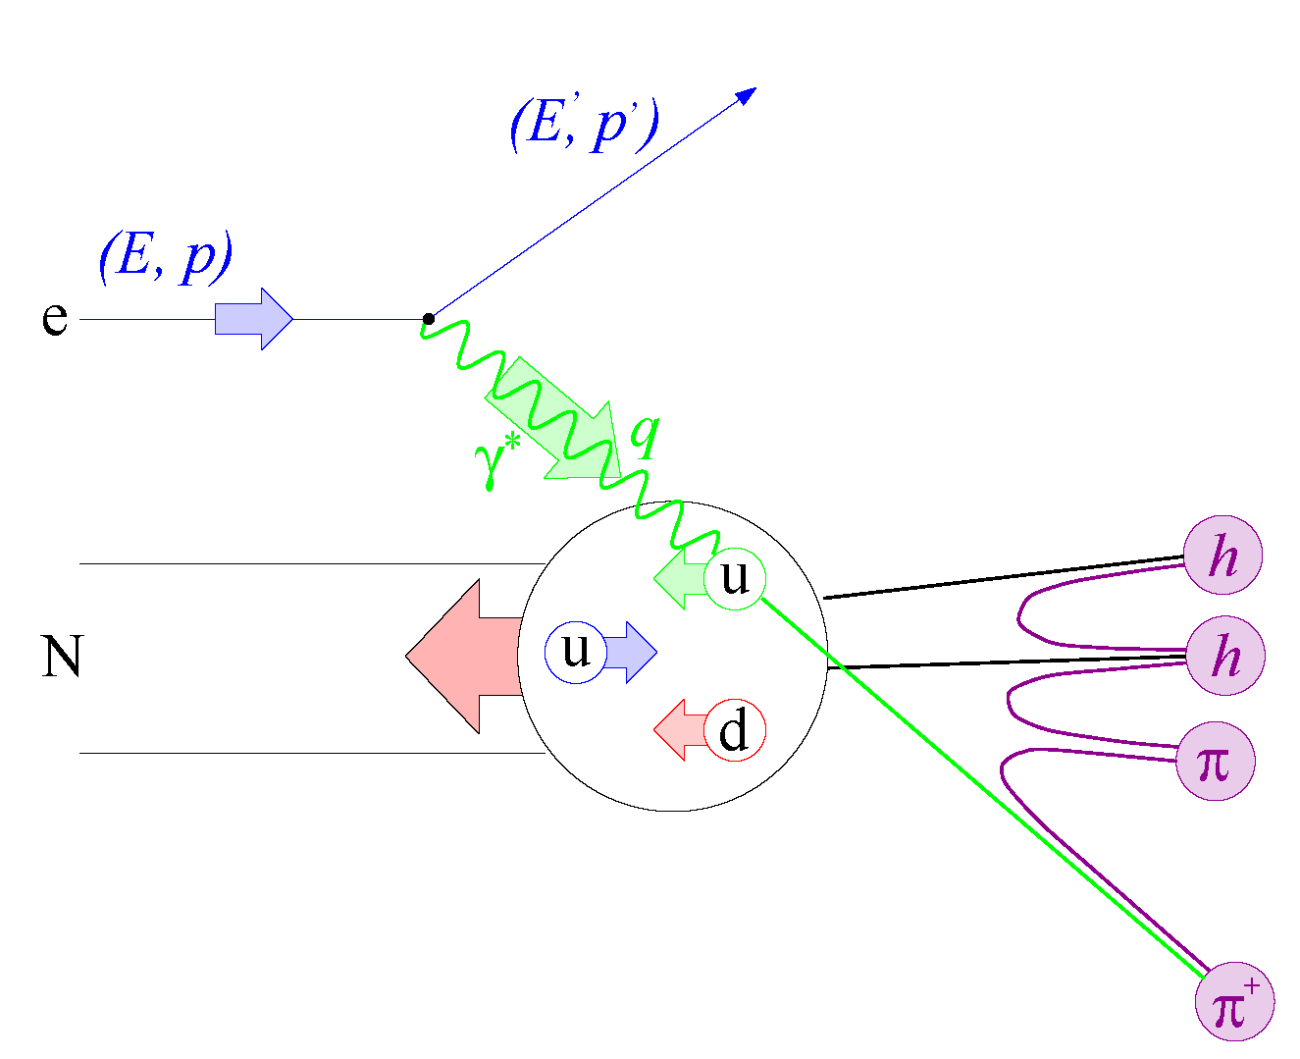
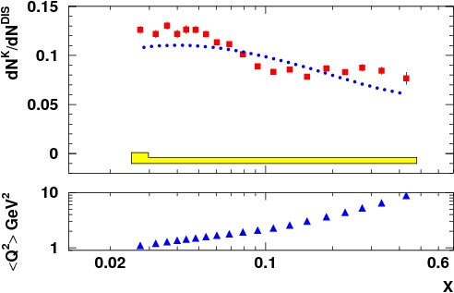
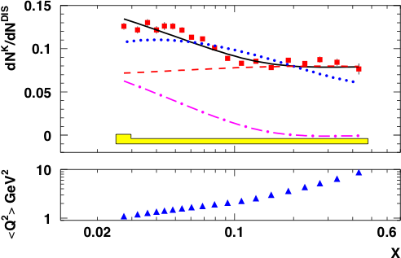
Formalism – Unpolarized measurements on deuterium
At the leading order QCD
Assuming factorization
For an isoscalar target
Assuming isospin symmetry
& charge conjugation invariance
H = K⁺ + K⁻
H = K_{s}⁰
H = π⁺ + π⁻
Extract the Q² dependence of the non strange FF
h
HERMES
K⁺
Deduce
➔ The x-dependence of the sum of the strange PDFs

Slide 8
Formalism – Polarized Measurements
Leading order
Double spin asymmetry
Integrating the purities
over the variable z
For an isoscalar target
Assuming isospin symmetry
& charge conjugation invariance

Slide 9
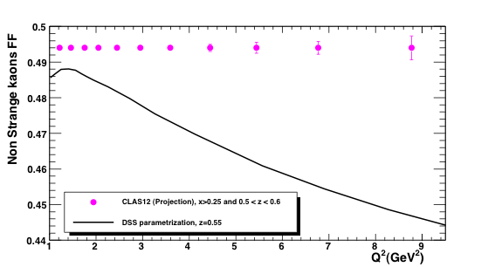
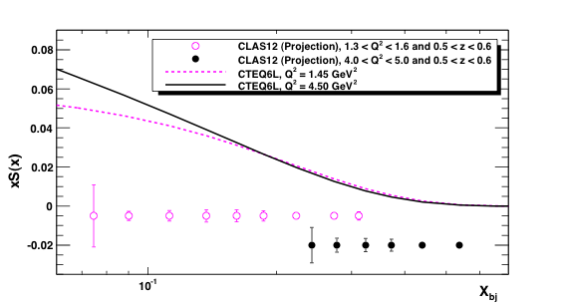
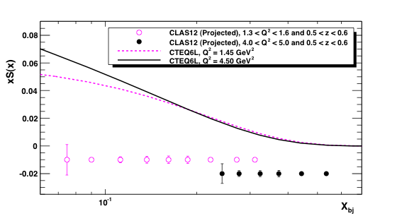
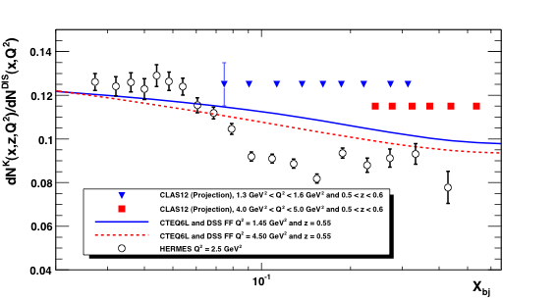
Projections – Deuteron unpolarized data
K⁺ + K⁻
HERMES:
0.2 < z < 0.8 & integrated over Q²
CLAS12:
1.3 < Q² < 1.6 GeV² & 0.5 < z <0.6
4. < Q² < 5. GeV² & 0.5 < z <0.6
K_{s}⁰

Slide 10
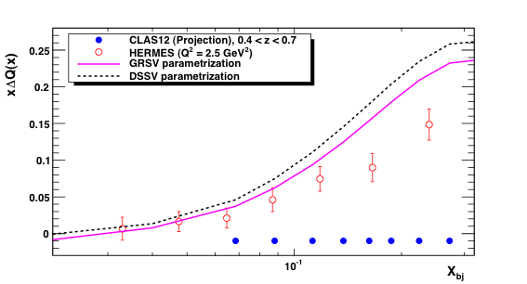
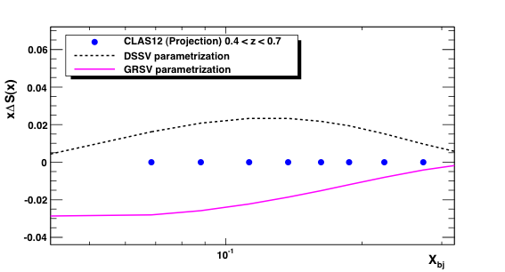
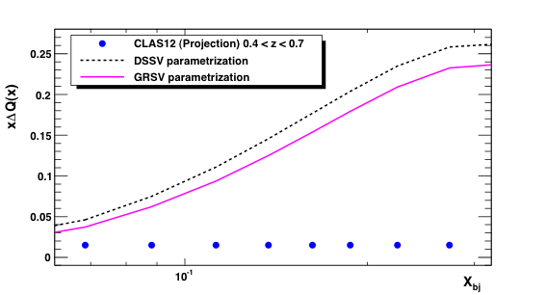
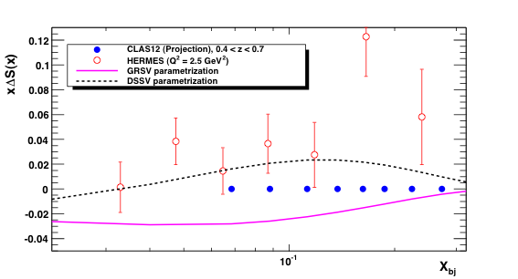
Projections – Isoscalar Method
K⁺ + K⁻
K_{s}⁰
Notes:
Statistical error both in asymmetries and multiplicities is included.

Slide 11
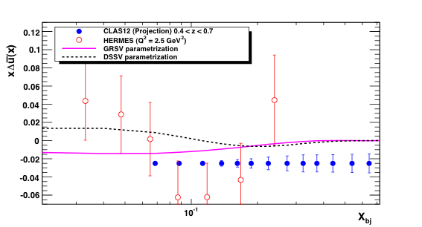
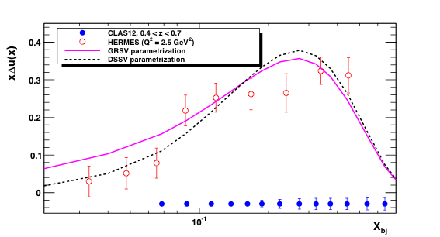
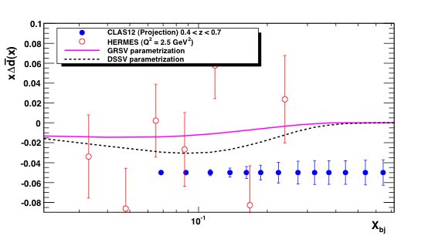
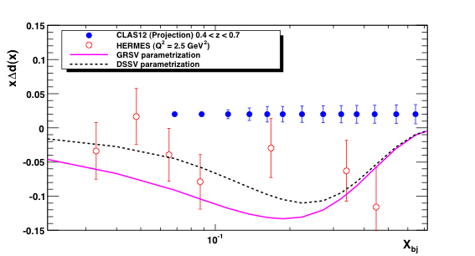
Projections – Flavor decomposition (1) - 10% systematics on asymmetries
Notes:
10% uncertainty on the asymmetries

Slide 12
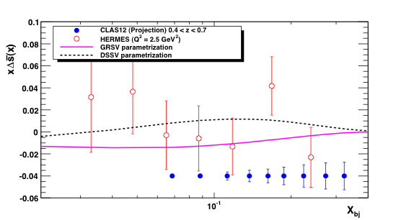
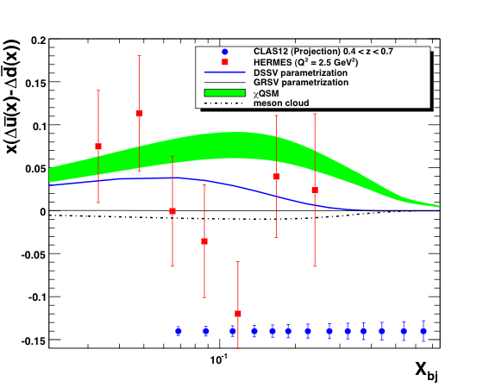
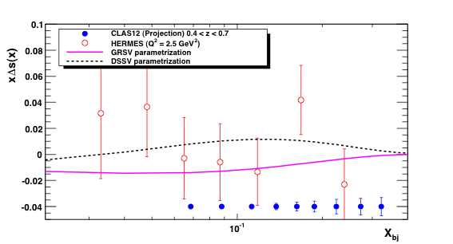
Projections – Flavor decomposition (2) - 10% systematics on asymmetries

Slide 13

Beyond the collinear picture of the nucleon: new degrees of freedom in QCD
TMDs
Parton density
GPDs
Parton longitudinal momentum
distributions is a function of
the parton Longitudinal
momentum fraction x
Transverse Momentum Dependent
distribution functions (TMDs)
Impact parameter dependent PDFs.
They are Fourier transform of the
t-dependence of GPDs
Notes:
IPD for ksi=0 because Heisenberg uncertainty principle forbids a simultaneous exact measurements of x and the longitudinal position of quarks. IPDs provide information of the position space of quarks carrying a certain momentum fraction x.

Slide 14
TMDs: The nucleon @Twist-2
Boer-Mulders
Helicity
Kotzinian-Mulders
(Worm-gear)
Pretzelosity
Sivers
Worm-gear
Transversity
All transverse-momentum dependences even for f₁ are interesting and largely unknown
Uncolored TMDs survive integration over transverse momentum
All colored TMDs vanish if there is no OAM
There is a strong indirect connection with OAM. So far any statement about OAM is model dependent

Slide 15
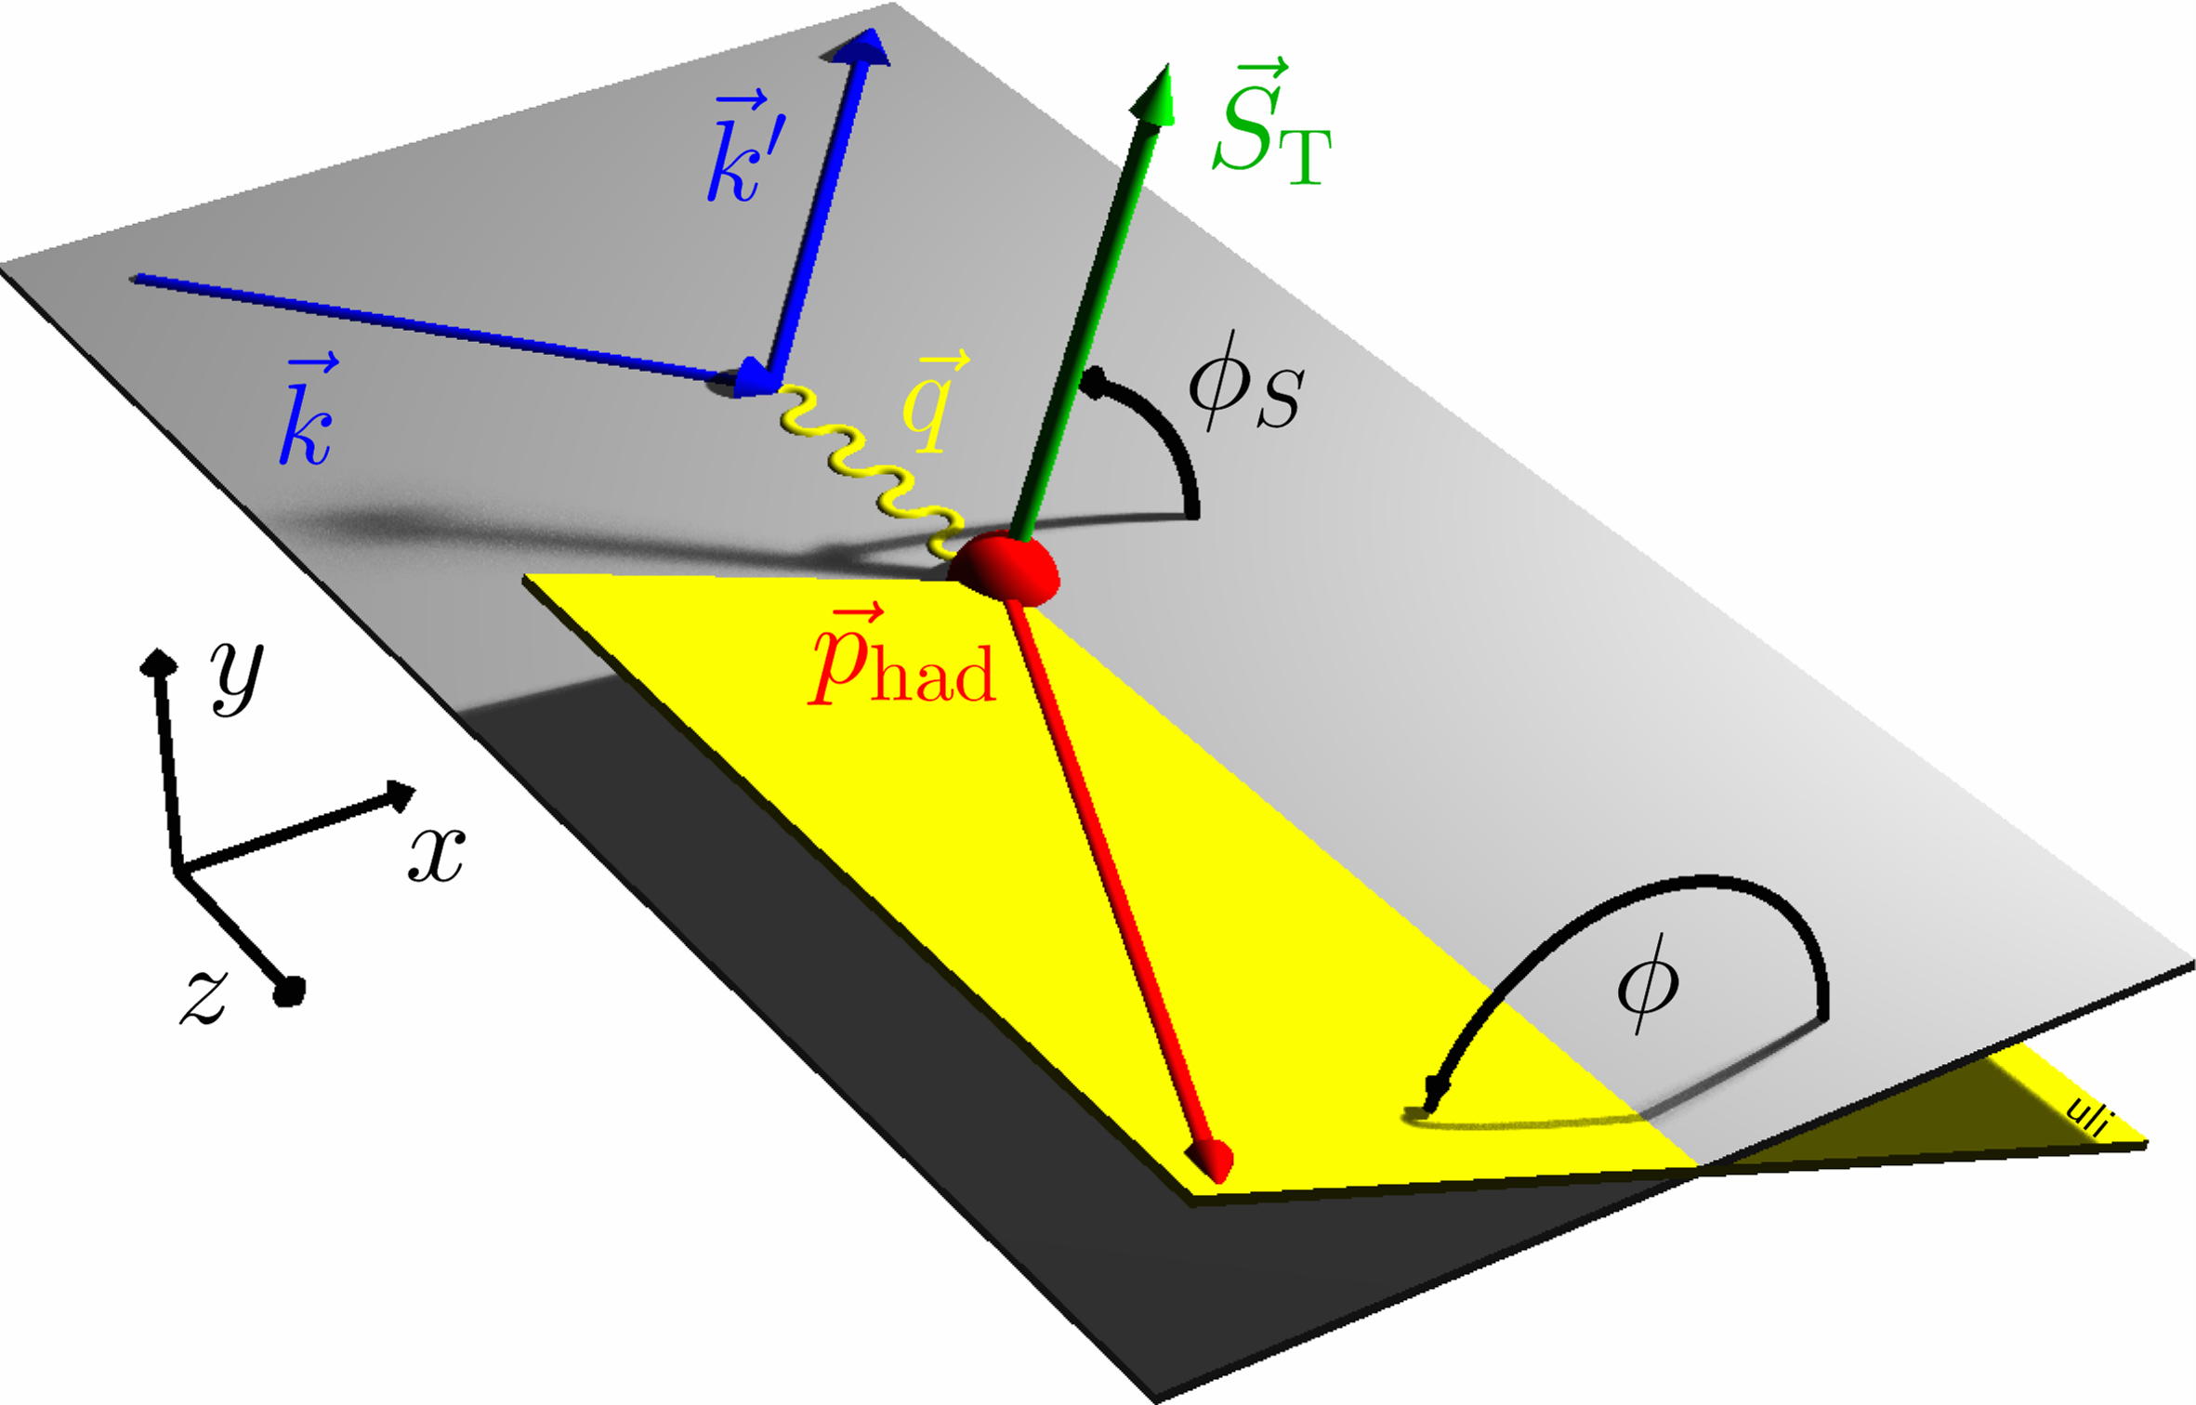

SIDIS Land
Kotzinian-Mulders

Slide 16
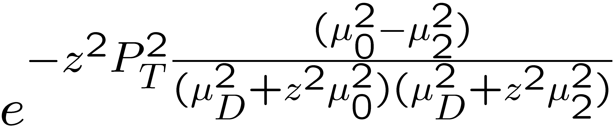
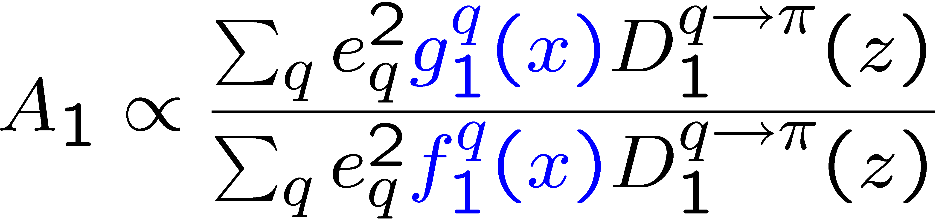
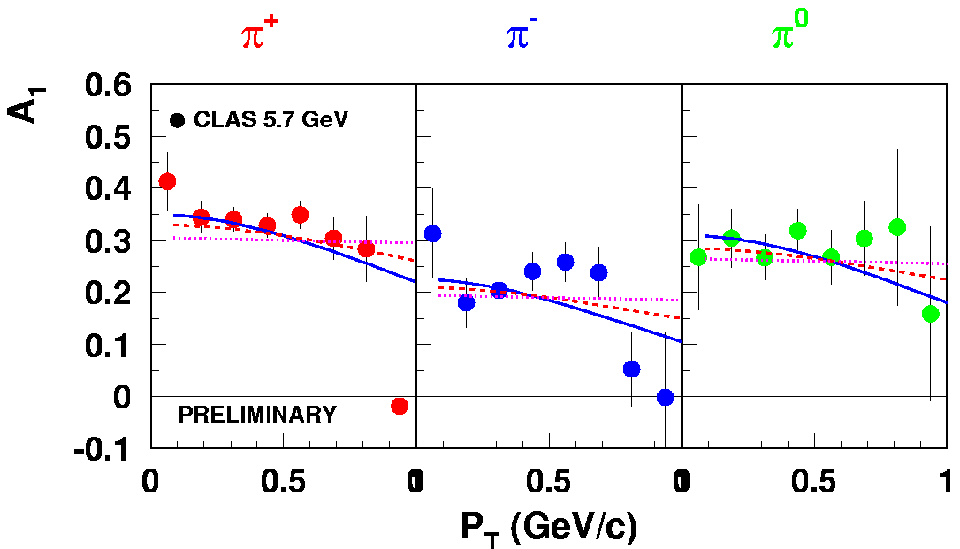
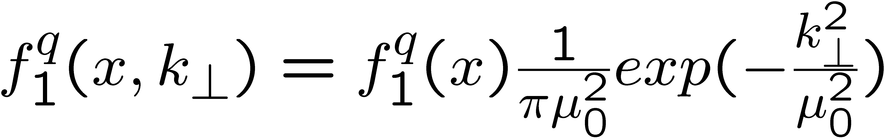
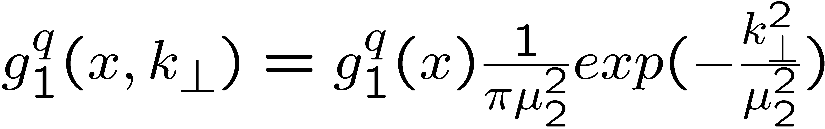
A₁ P_{T}-dependence in SIDIS
M.Anselmino et al hep-ph/0608048
0.4<z<0.7
μ₀² = 0.25GeV²
μ_{D}² = 0.2GeV²
π⁺ A₁ suggests broader k_{T} distributions for f₁ compared to g₁
π⁻ A₁ may require non-Gaussian k_{T}-dependence for different helicities and/or flavors

Slide 17
Double spin asymmetry- longitudinally polarized target – A₁ P_{T} dependence
CLAS results
Projected results
For Exp. E05-113
Collected data with much more statistics will allow the study of the P_{T} dependence for
different quark helicities and flavors and for several x bins

Slide 18
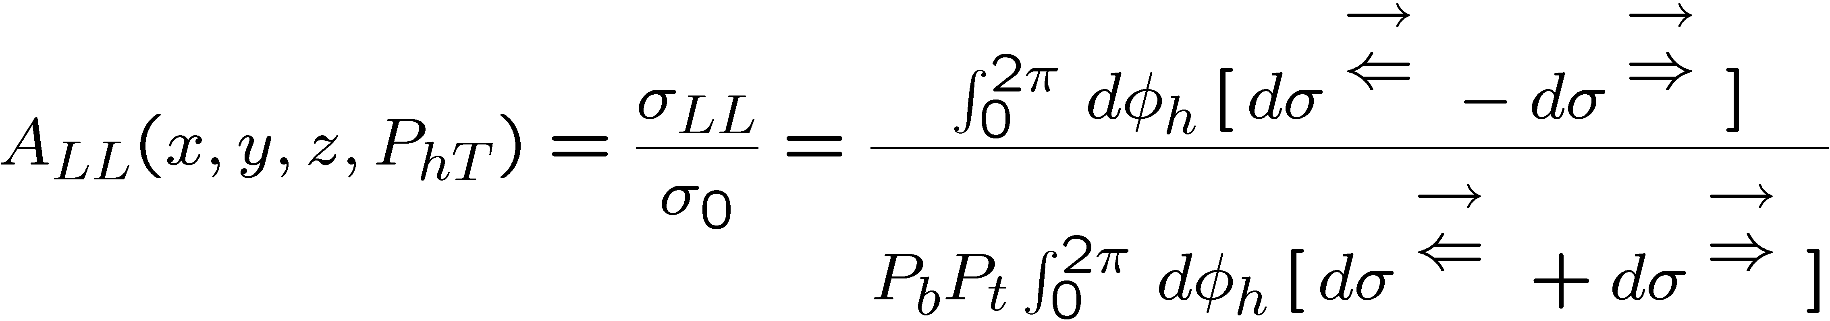
A_{LL} P_{T}-dependence for kaons
Anselmino et al, Phys.Rev.D74:074015,2006.
proton
deuteron
GRSV-2000+Kretzer
Azimuthal asymmetry sensitive to the difference of widths in PDFs
Proton and deuteron data provide a complete set required for the flavor decomposition

Slide 19
Longitudinal Target SSA measurements at CLAS
Kotzinian-Mulders asymmetry
(Worm gear)
CLAS-2009 (E05-113)
HERMES
No indication of Collins effect for π⁰
Non-zero negative asymmetry for charged pions
19
19

Slide 20
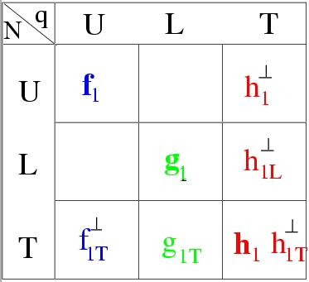
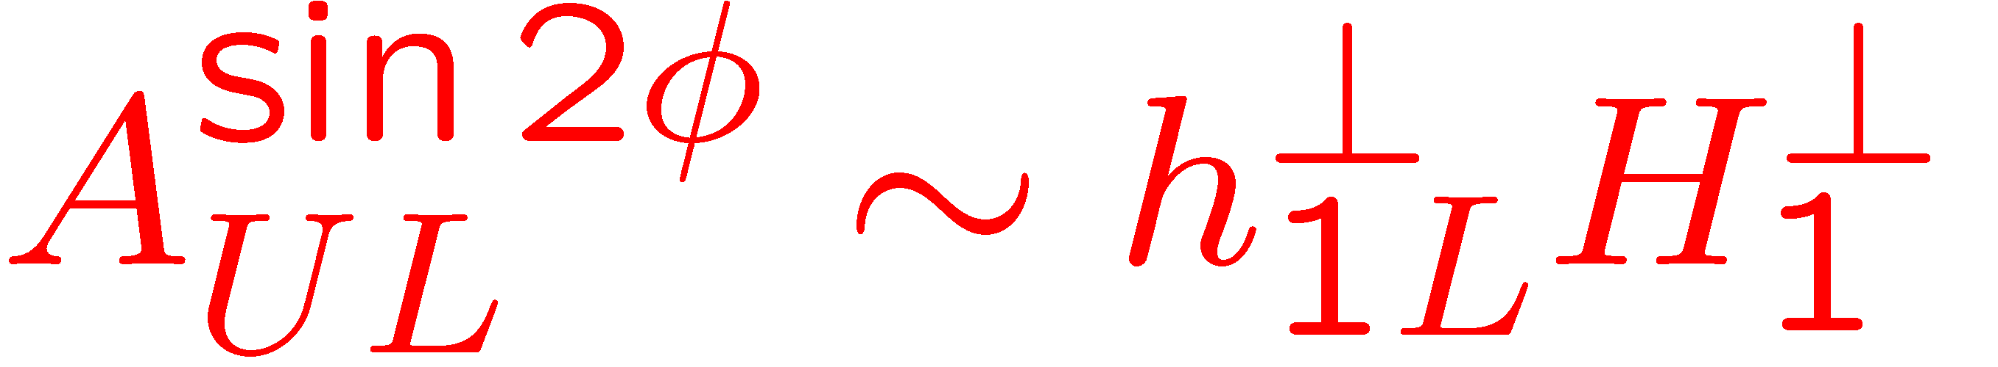

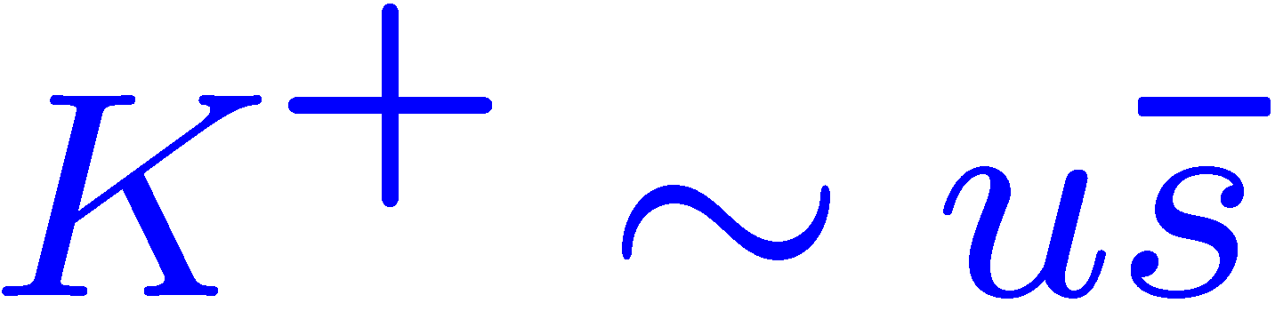
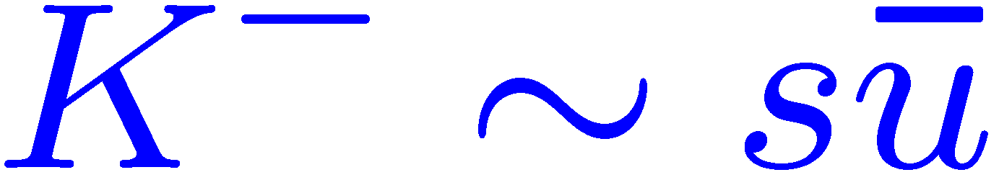
Collins fragmentation: Longitudinally polarized target
Kotzinian-Mulders (worm gear) Asymmetry
proton
deuteron
Pasquini et al.
Study the Collins function of kaons
Provides independent information on the Kotzinian-Mulders TMD

Slide 21
Summary
The combination of high luminosity offered by JLab 12 GeV upgrade and the large
acceptance of CLAS12 spectrometer enhanced with a RICH detector are important ingredients of success in studying individual quark contribution to the nucleon spin and azimuthal asymmetries in kaon electroproduction
  Several hadron multiplicities will be measured to constrain fragmentation functions and improve the existing parameterizations
  Individual light flavor polarization will be extracted and the effect of kinematical dependencies will be exploited for 0.05 < x < 0.7, 1 < Q² < 9 GeV² and 0.4 < z <0.7
  The strange sea polarization will be extracted using different methods that have different sensitivities and systematics
  The delicate quantity will be measured with unprecedented precision to test whether or not the light sea is symmetrically polarized
  Measure the shape of the unpolarized strange PDF for several (x,Q²) bins
  Probe the Collins polarized fragmentation function of kaons
  Provide complementary to pions info on the flavor and helicity dependence of quark transverse momentum distributions
  Study the transverse polarization of quarks in the longitudinally polarized nucleon through measurements of the leading twist chiral-odd worm gear distribution function.
  Study higher twist effects and probe T-odd distributions in a wide range of Q²
Notes:
Kinematical dependencies means x,z and Pt

Slide 22
THE END

Slide 23
Corrections and Systematics
Measured quantities: Multiplicities and Asymmetries
Corrections:
Charge symmetric background
Radiative and detector smearing effects
Acceptance correction
Particle identification inefficiencies
Background subtraction (π⁰, K_{s}⁰)
Diffractive vector meson contributions
Systematics:
Beam polarization
Target polarization
Dilution factor
Depolarization and R
Transverse spin effect
Extracted quantities: Δq
Systematics:
Purities: acceptance, uncertainties in unpolarized PDFs, NLO effects, use FFs from
fragmentation function parameterizations
Notes:
R = longitudinal to transverse photo-absorption cross sections in the depolarization factor.
A1 = virtual photon asym compared to longitudinal asymmetry. There is an additional term g2/F1 that we neglect in A1= A||/D(1+eta) -…g2/F1

Slide 24
Beam Time needed
Unpolarized Measurements
can run in parallel with E12-07-104
Polarized Measurements
can run in parallel with E12-06-109 & E12-07-107
11 GeV polarized beam
80% polarization
Polarized NH₃ target 85%
Polarized ND₃ target 35%
10³⁵ cm⁻² s⁻¹ luminosity
RICH: 2 sectors coverage
80% RICH detection efficiency
50% of the time with reversed field
11 GeV beam energy
LH₂ and LD₂ simultaneously
10³⁵ cm⁻² s⁻¹ luminosity
RICH: 2 sectors coverage
80% RICH detection efficiency
50% of the time with reversed field
54 days
+ 2 days diagnostic tests
30 days proton
+ 50 days deuteron

Slide 25
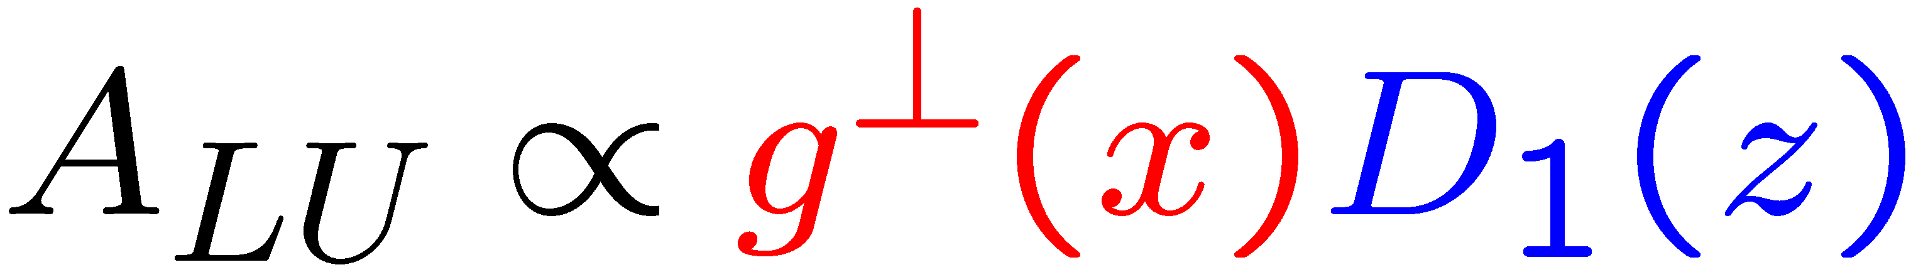
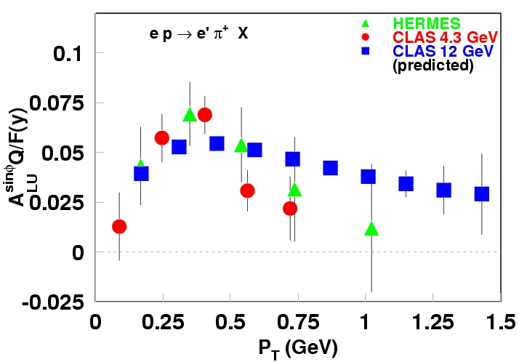
P_{T}-dependence of beam SSA
σ^{sinφ}_{LU(UL)} ~F_{LU(UL)}~ 1/Q (Twist-3)
1/P_{T}
1/Q
Nonperturbative TMD
Perturbative region
Check of the higher twist nature of observed SSA
Critical SSA test transition from non-perturbative to perturbative region

Slide 26
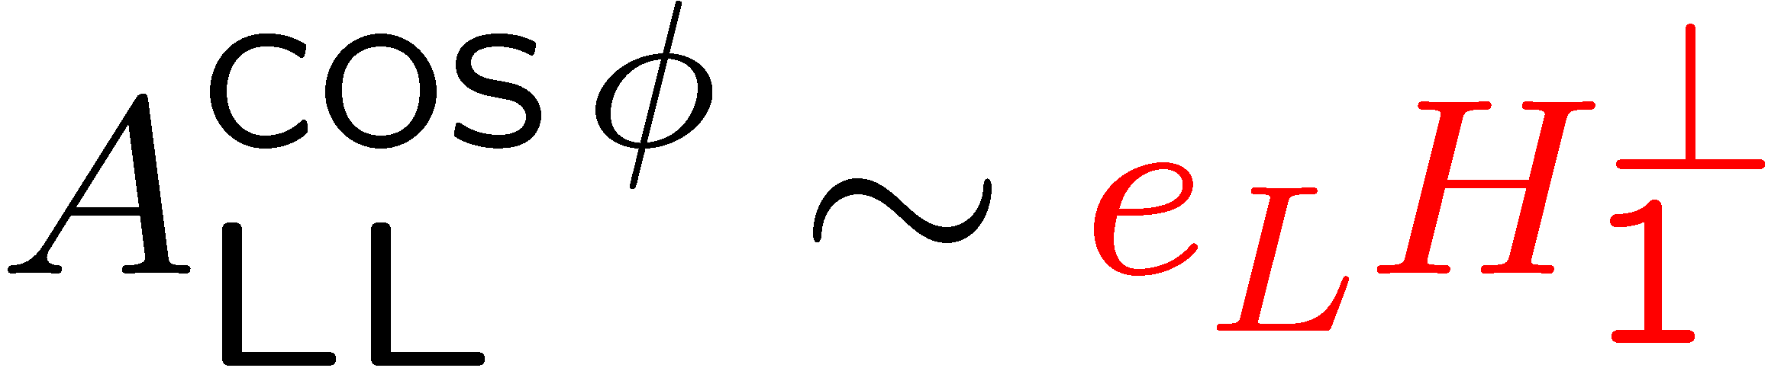
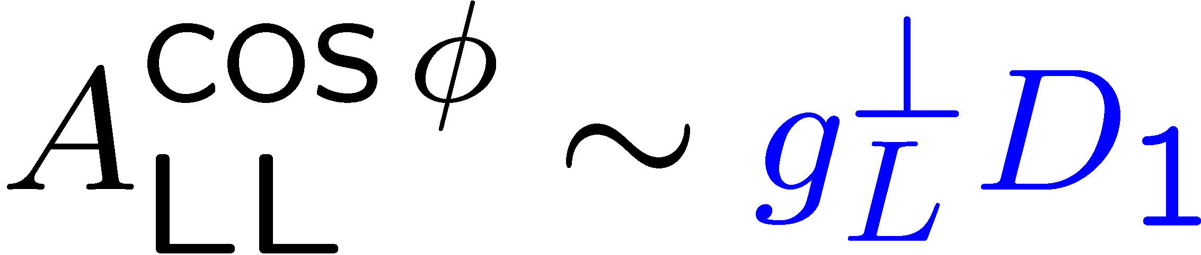
cosφ moment in A_{LL}-P_{T}-dependence
Projected results
For Exp. E05-113
hep-ph/0608048
μ₀²=0.25GeV²
μ_{D}²=0.2GeV²
CLAS PRELIMINARY
P_{T}-dependence of cosφ moment of double spin asymmetry is most sensitive to k_{T}-distributions of quarks with spin orientations along and opposite to the proton spin
26

