Slide 1
The LNF-INFN today

Slide 2
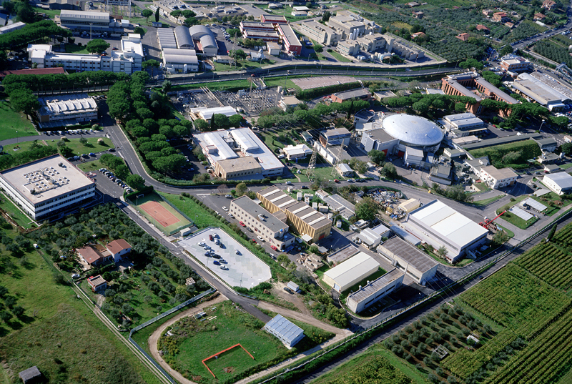
LNF
RD
Adm-
DAFNE
LINAC
AD
TD
Staff = 450 LNF+AC
Associates = 181
Visitors = 463
TOTAL 1100
LIFE-Lab
M.Calvetti
INFN-LNF
Università di Firenze

Slide 3
LNF-INFN
Detector
R&D
ILC
Medical
Applications
Hadron
therapy
CNAO
ATLAS
CMS
LHC-b
ALICE
CDF
BABAR
NA62
JFLAB
PANDA
Synchrotron
light
LdS
DAFNE
HIGH
PRECISION
PHYSICS
KLOE-FINUDA-SIDDHARTA
Linear
Accelerators
CTF3
CLIC
FEL
SPARC
SPARC-X
Cryogenic
Antenna
NAUTILUS
High
intensity
lasers
FLAME
Dosimentry
Physics
In
Space

Slide 4
DAFNE
DAFNE- LIGHT
Laboratory
Two new soft X-ray lines
and
UV beam line in a clean area
Synchrotron light from DAFNE
SPARC
SPARX
Conventional sources
LNF are part of the European Infrastructure
for synchrotron light

Slide 5
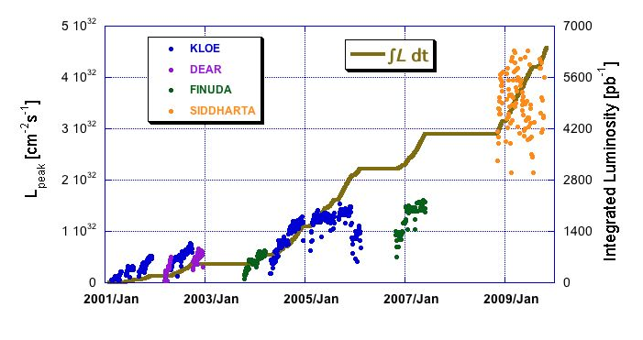
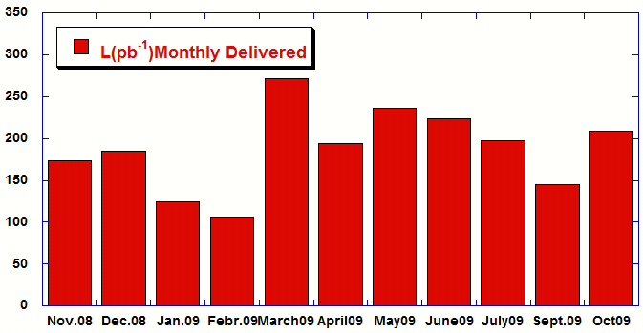
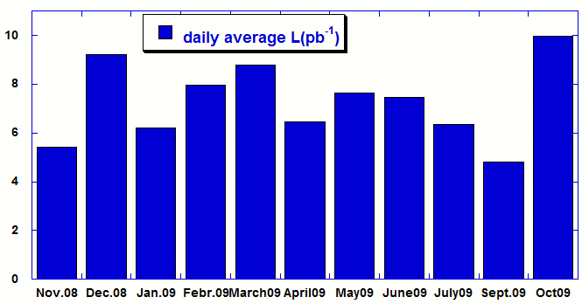
STATUS OF DAFNE
Peak (dots) and integrated (line) luminosity acquired on DAΦNE by the experiments
Monthly performances (Nov. 1st 2008 – Oct. 23th 2009)
(Days of run)
(20)
(24)
(23)
~ 2.4 fb⁻¹ delivered in 18 months (Mar 2008 ÷ Nov 2009)

Slide 6
Summary about DAΦNE achievements
 | DAΦNE upgrade SIDDHARTA | DAΦNE KLOE | DAΦNE FINUDA
L_{peak} [cm⁻²s⁻¹] | 4.53•10³² (5.0•10³²) | 1.5•10³² | 1.6 •10³²
L_{∫day} [pb⁻¹] | 14.98 | 9.8 | 9.4
L_{∫1 hour} [pb⁻¹] | 1.033 | 0.44 | 0.5
I⁻_{MAX} in collision [A] | 1.52 | 1.4 | 1.5
I⁺_{MAX} in collision [A] | 1.0 | 1.2 | 1.1
N_{bunches} | 105 | 111 | 106
ξ_{y} | 0.0443 (0.074) | 0.025 | 0.029

Slide 7
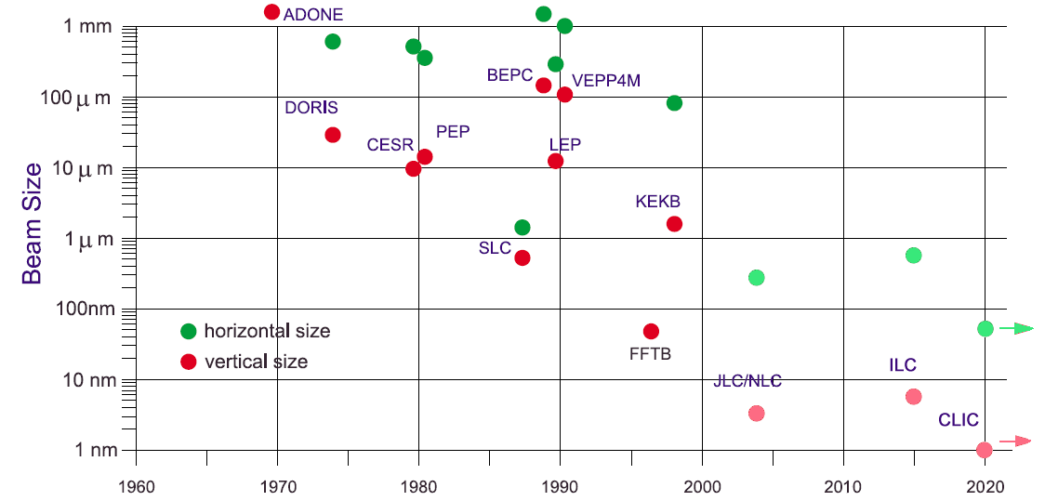
To have luminosity …smaller beam sizes
Beta function and emittance
ADA
The small beam size challenge
DAFNE
SB
Adapded from S. Chattopadhyay, K. Yokoya, Proc. Nanobeam `02

Slide 8
KLOE is starting a new run
KLOE-2

Slide 11
Fabio Bossi- Spokesperson of the KLOE2 experiment
There are also revived ideas for a DAFNE upgrade in energy up to 2.5 GeV in the CM with high luminosity (several 10^32)
The KLOE collaboration and the Accelerator Division are working very hard to run KLOE now and to prepare for the future.
We shall know the DAFNE luminosity toward the end of the year
(now we have the solenoid)

Slide 12
Accelerator physics
FEL
CNAO
CLIC-CTF3
ILC
PLASMA Acceleration
X-RAY

Slide 13
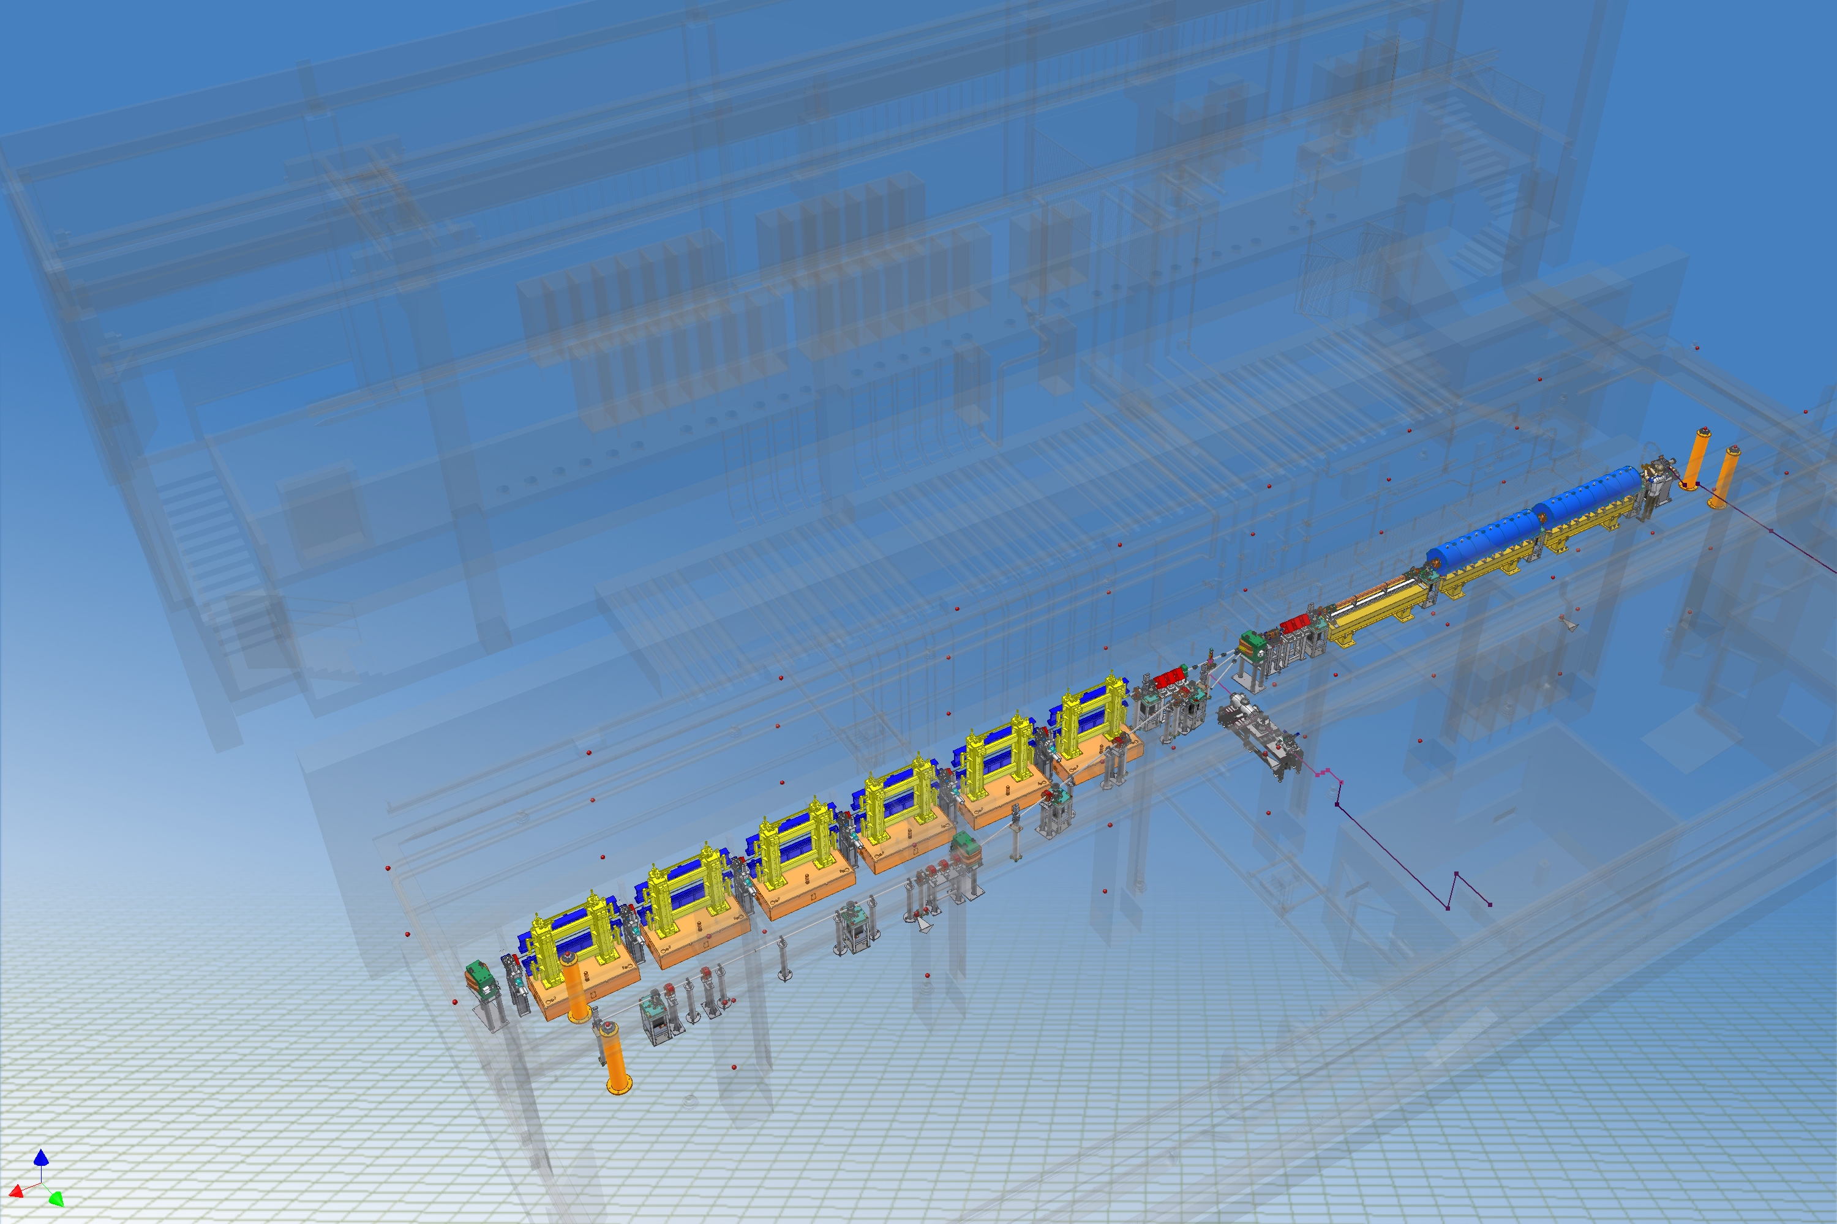


FEL
150 MeV S-band linac
Velocity Bunching
Diagnostic and Matching
Undulators
λ_{u} = 2.8 cm
K_{max} = 2.2
λ_{r} = 500 nm
12 m
Long Solenoids
S-band Gun
15 m
Seeding
THz Source

Slide 14
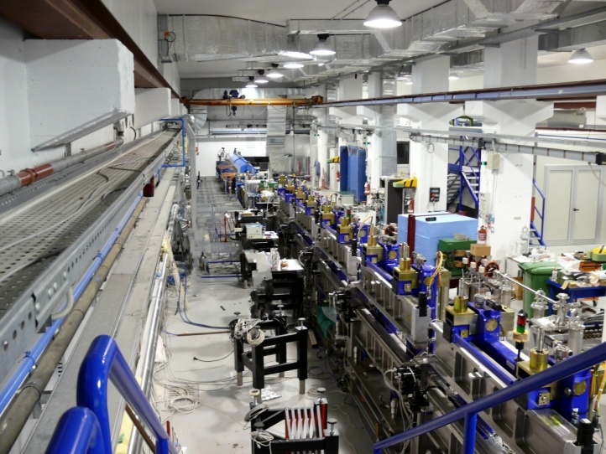
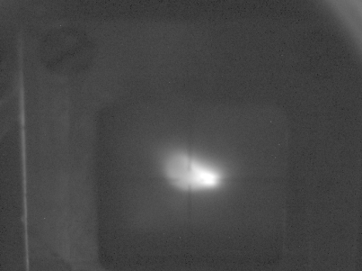
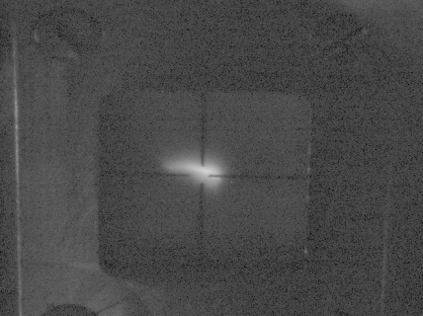
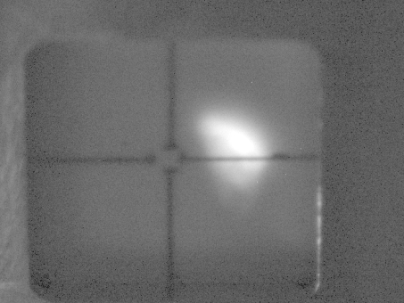
SPARC - FEL
Notes:
14

Slide 15
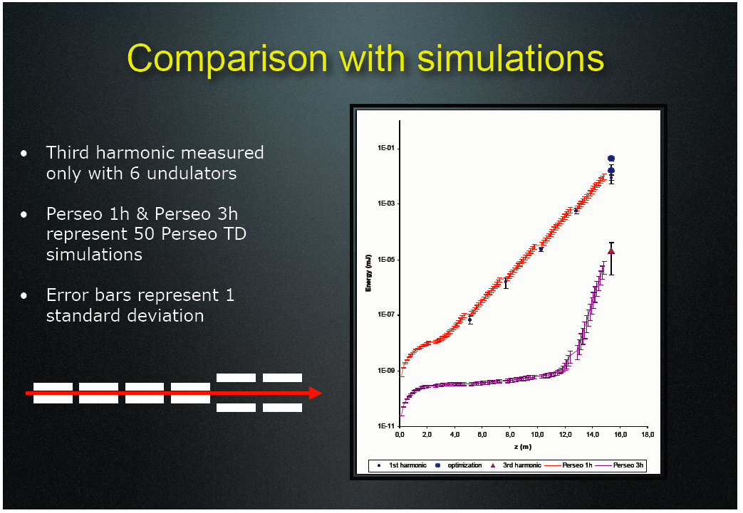

Slide 16
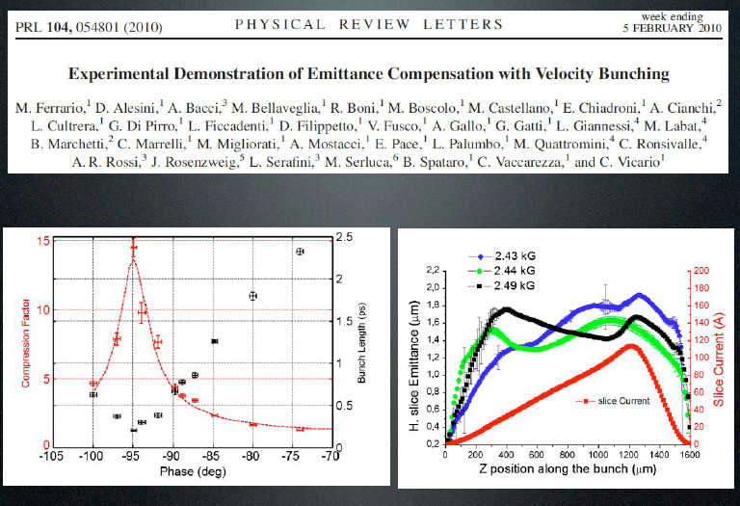

Slide 18
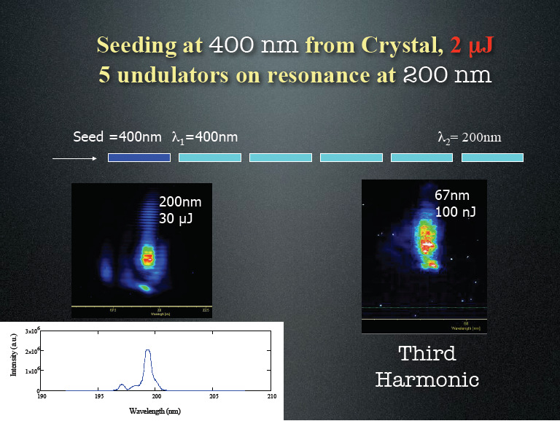

Slide 20
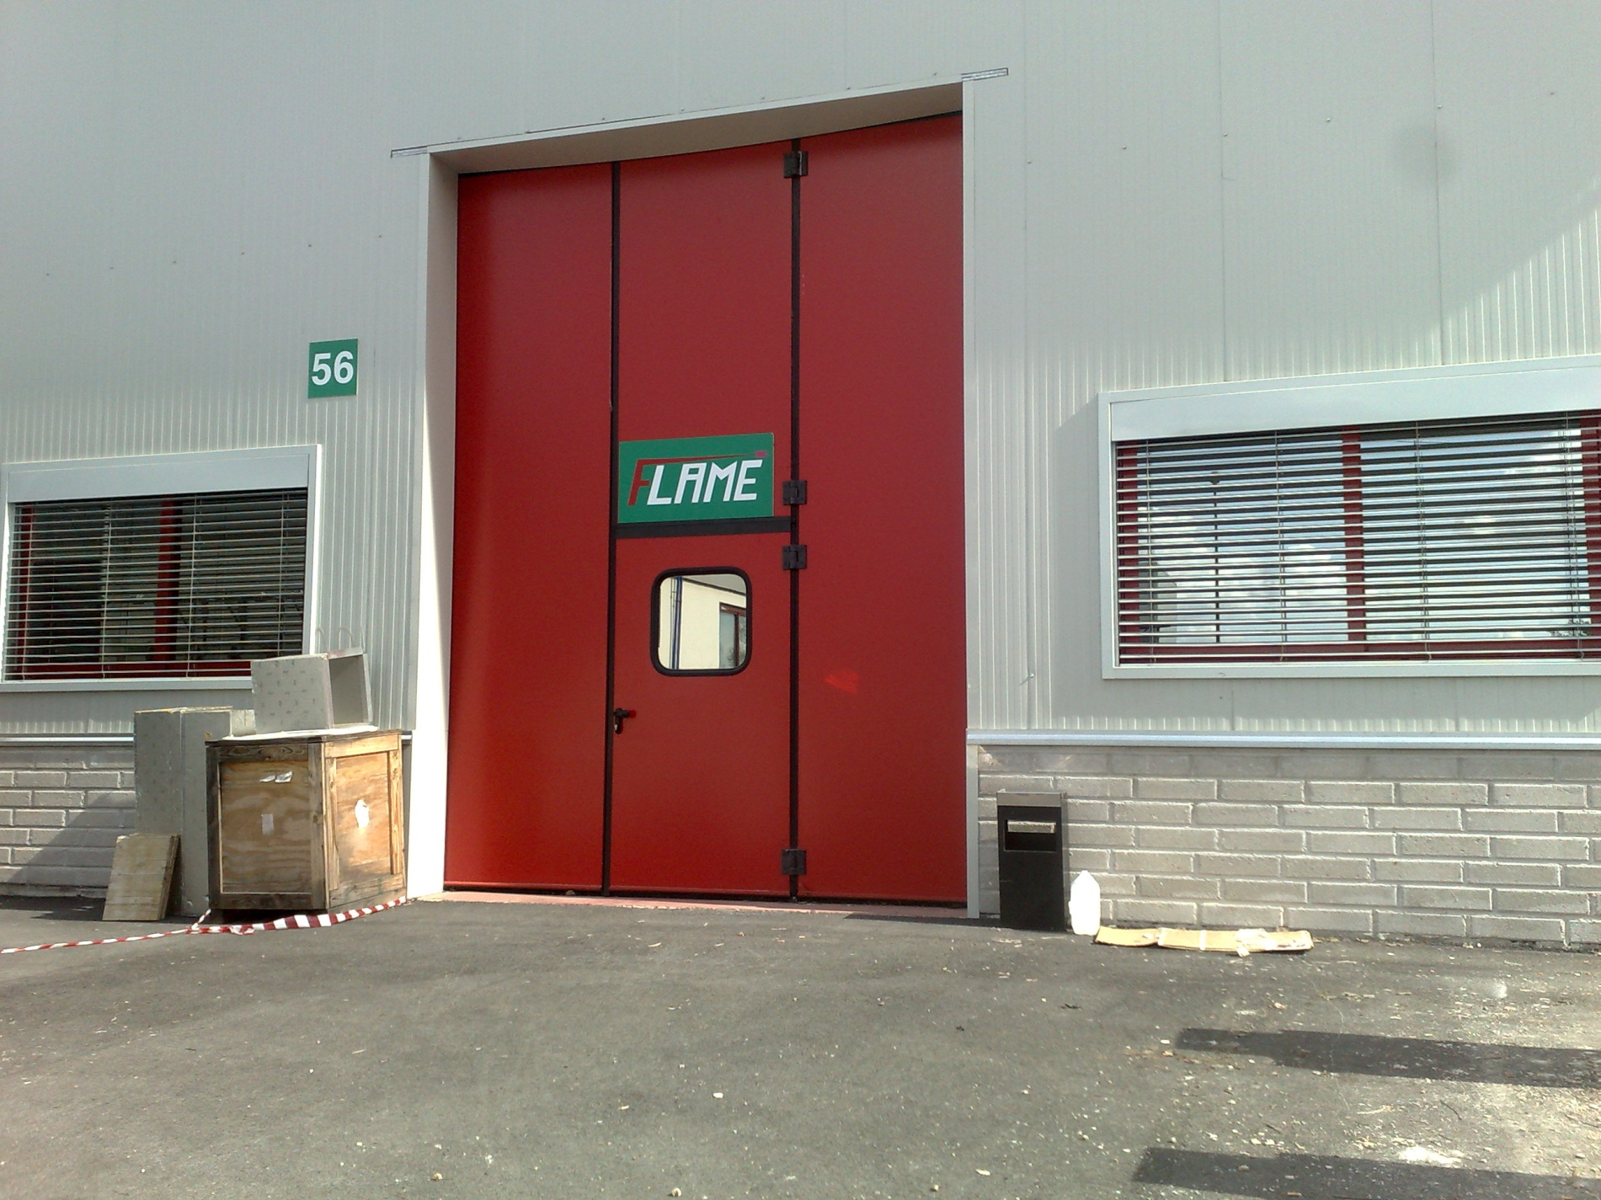
LABORATORIO FLAME

Slide 21
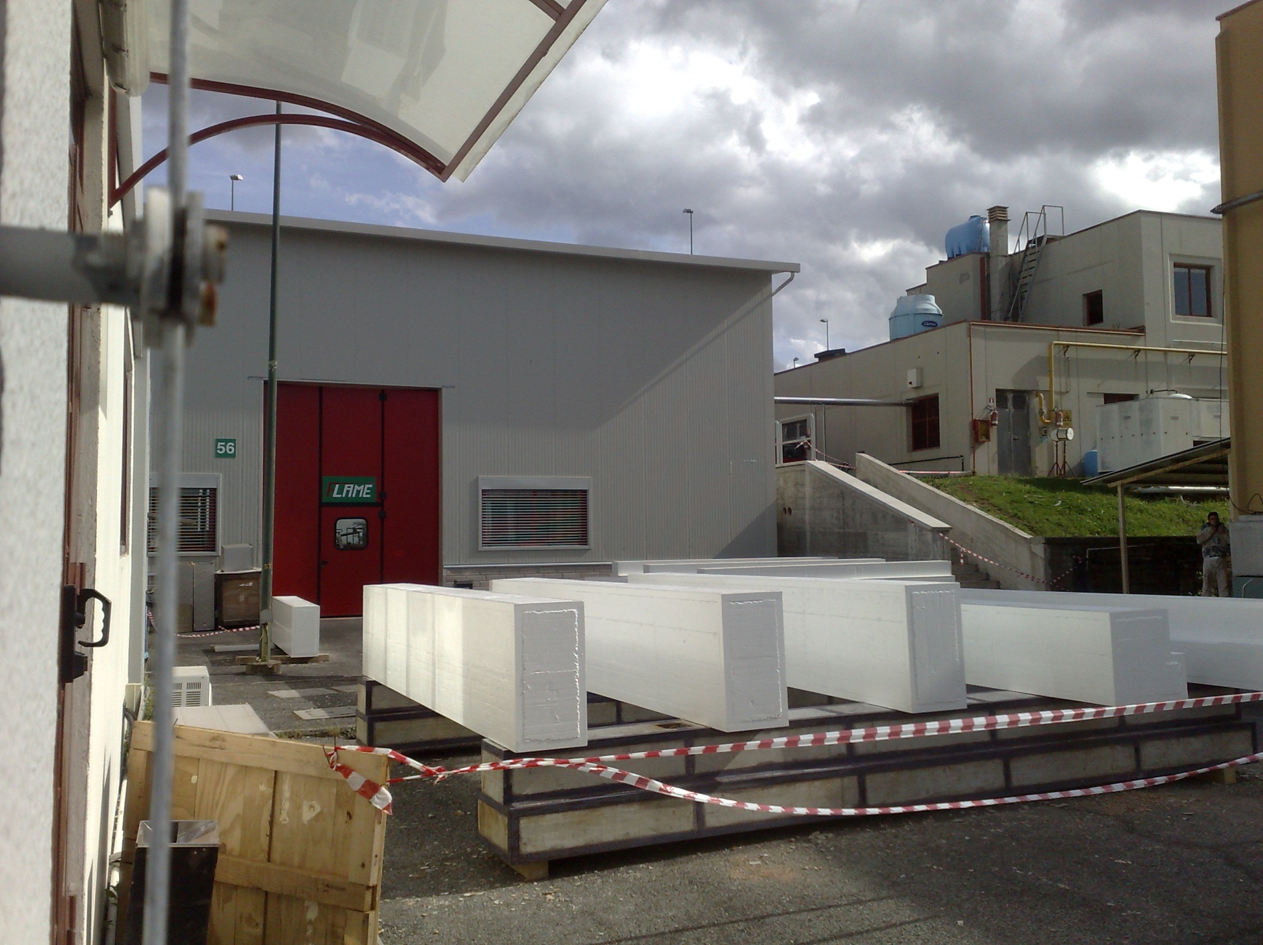
FLAME-LAB

Slide 22
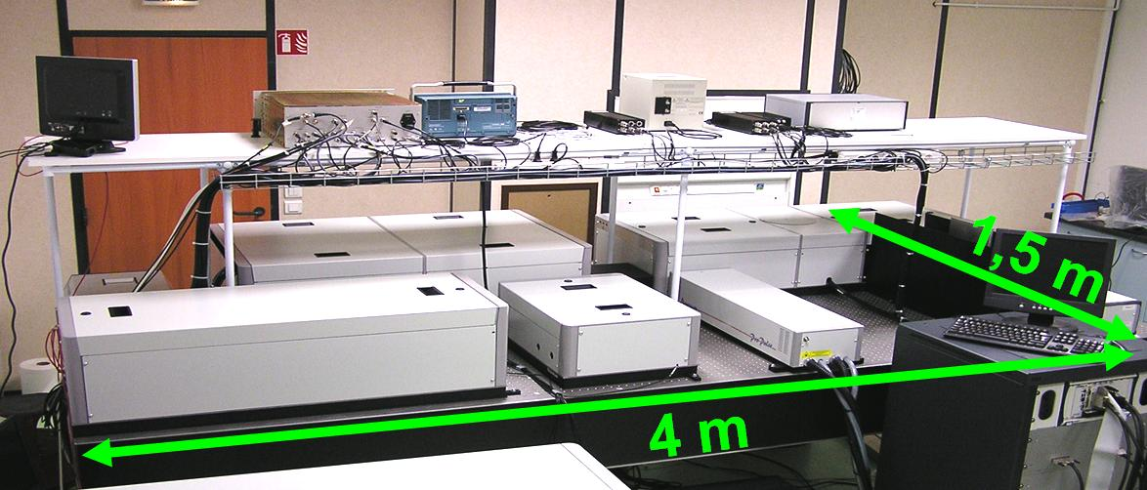

FLAME laser: specifications
Repetition Rate 10 Hz
Energy (after compression) up to 6 J (typ. exp. 5.6J)
Wavelength 800 nm
Pulse duration down to 20 fs (typ. 23 fs)
Peak power up to 300 TW
ASE contrast > 10¹⁰
Pre-pulse contrast > 10⁸
Front end @

Slide 23
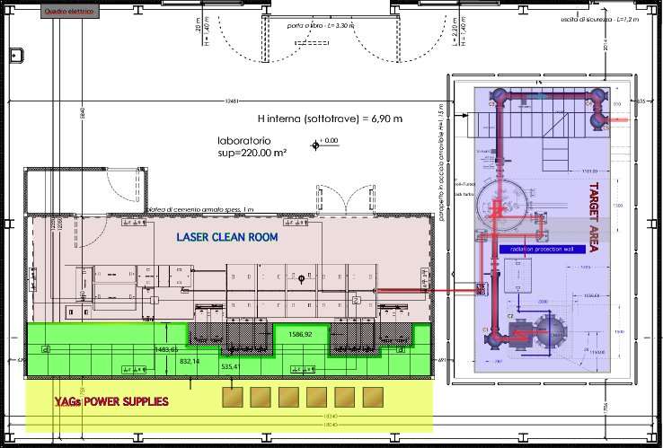
The FLAME laboratory – general layout
laser pulses: 50 fs, 800 nm >100 TW @10 Hz

Slide 24
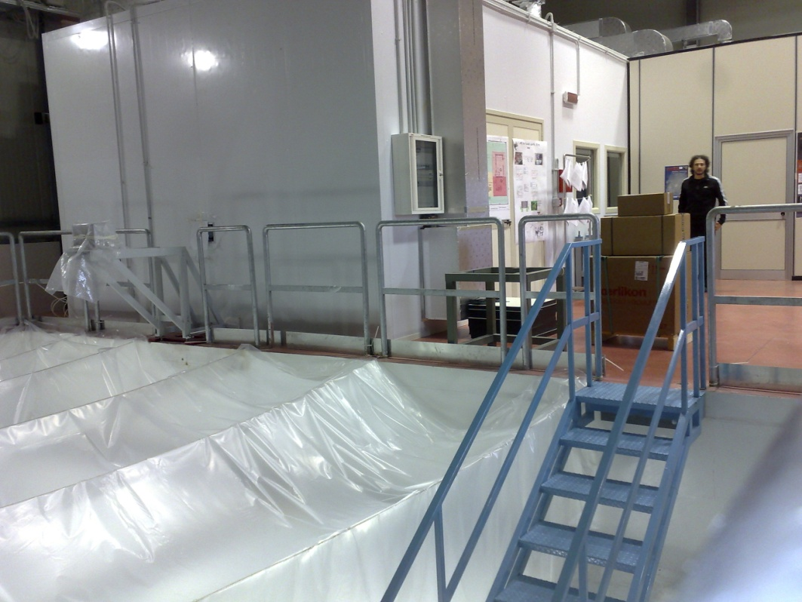
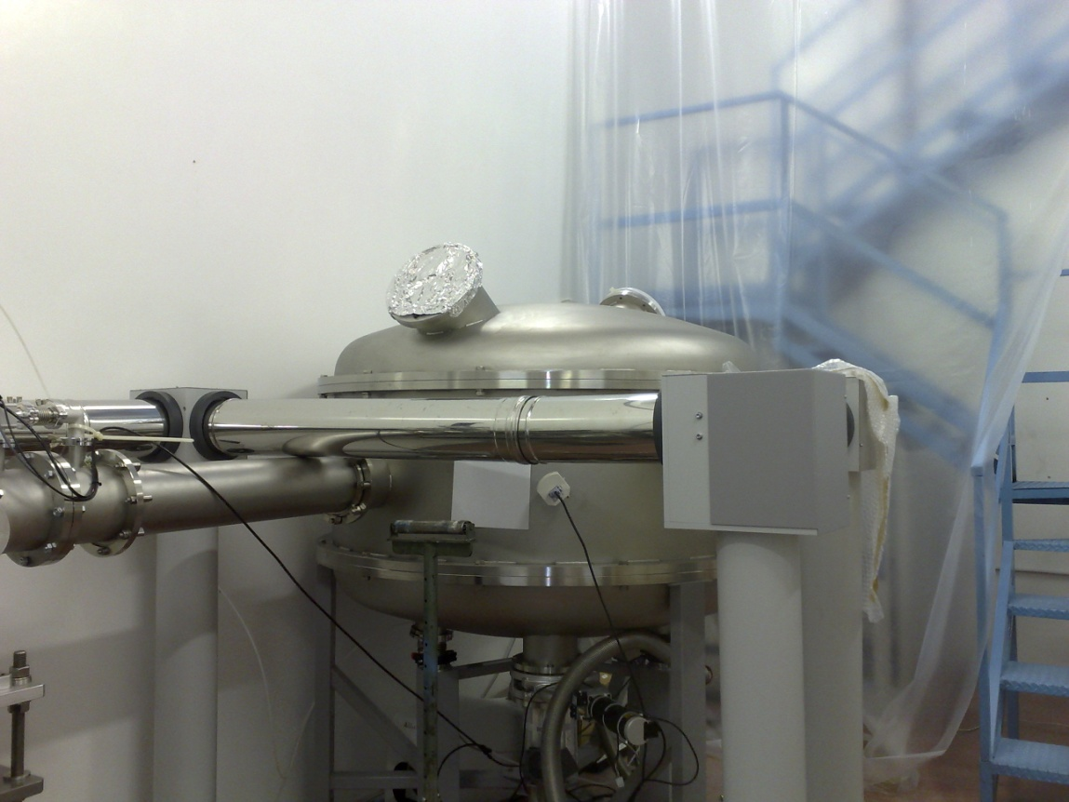
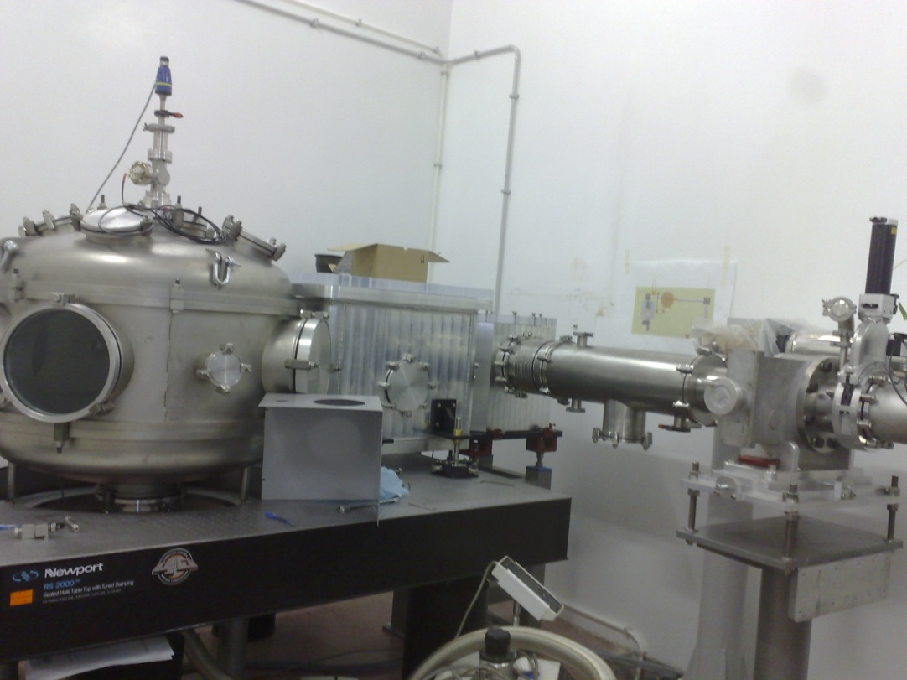
FLAME
EXPERIMENTAL HALL

Slide 25
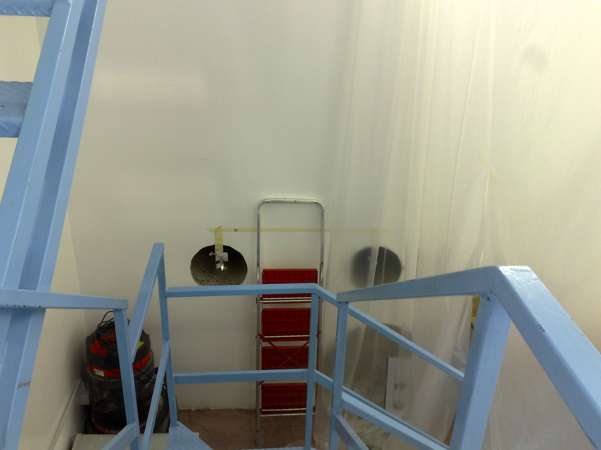
LUCE LASER VERSO IL LABORATORIO SPARC

Slide 26


Tuneable X-ray radiation source based on Thomson Scattering
X ray pulses : 10⁹ photons/s, 3 ps, 20 keV - 1 MeV
SCHEDULED IN 2011

Slide 27

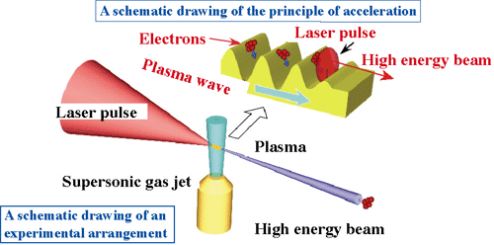
LASER PLASMA ACCELERATION
http://cnmt.kist.re.kr
1μ 300TW 20 fs 10 Hz Laser pulses
150 MeV low emittance high current electron bunches
Laboratorio Interdisciplinare Fotoni Elettroni
A new LAB to study High Intensity Laser Interactions with matter and charged particles

Slide 28
LWFA acceleration of externally injected electrons in a gas-jet plasma
ESPERIMENTO PREVISTO PER IL 2012

Slide 29
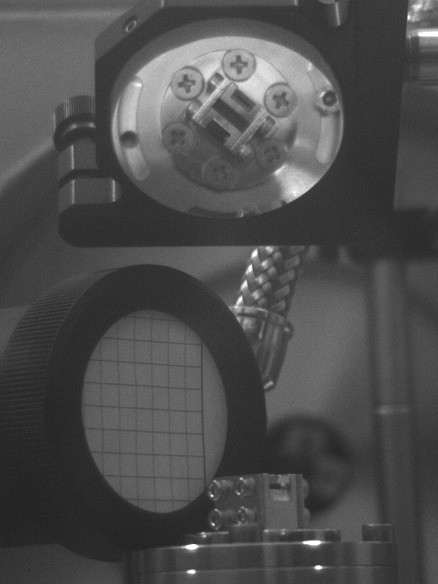

Slide 30
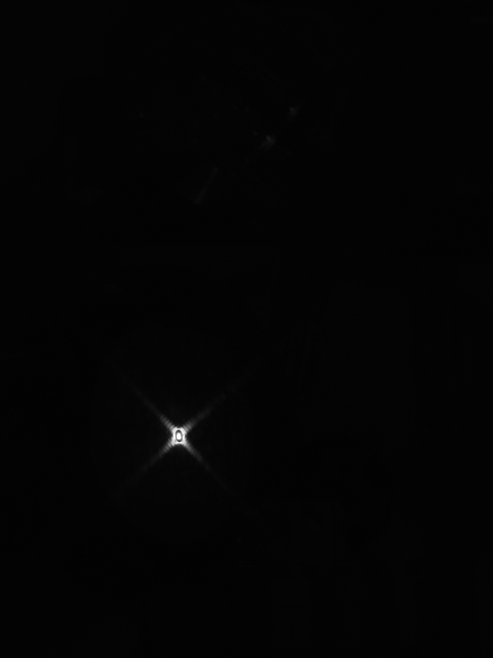

Slide 31
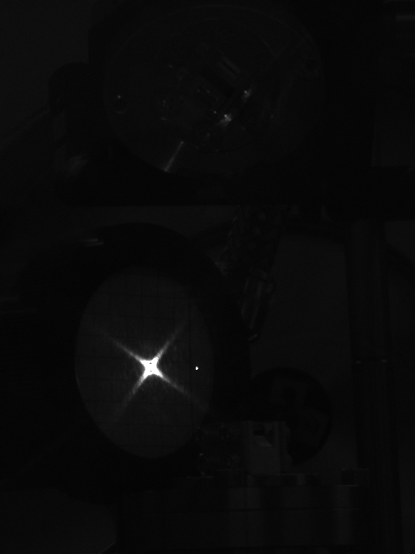

Slide 32
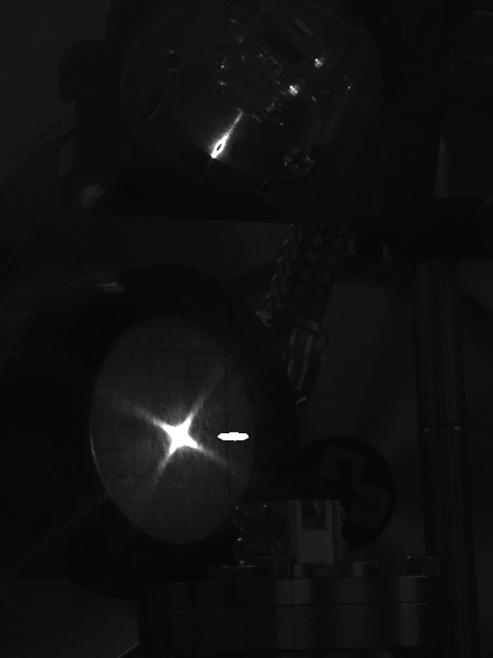

Slide 34
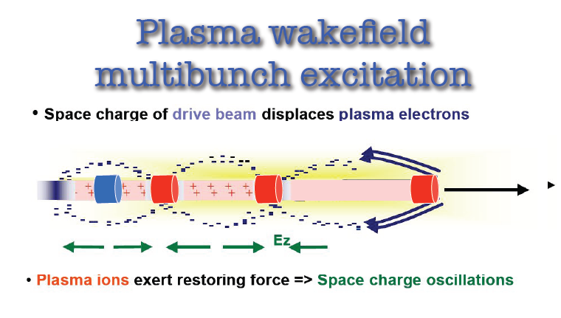

Slide 36
Other projects

Slide 37
The CNAO High technology
Protons and Ions
GSI Linac
LINAC
0.4 - 7 MeV/u H³⁺
0.4 - 7 MeV/u C⁴⁺
RFQ
0.008 - 0.4 MeV/u H³⁺
0.008 - 0.4 MeV/u C⁴⁺
Ion Sources
0.008 MeV/u H³⁺
0.008 MeV/u C⁴⁺
I ~ 0.7 mA H³⁺
I ~ 0.2 mA C⁴⁺
Synchrotron
7-250 MeV p
7-400 MeV/u C
I ~ 0.1-6 mA (p)
I ~ 0.03-1.5 mA (C)
High Energy
Transfer Lines
60-250 MeV p
120-400 MeV/u C
< 10¹⁰ p/spill (~2nA)
< 4 10⁸ C/spill (~0.4nA)
Treatment Rooms
Notes:
37

Slide 38
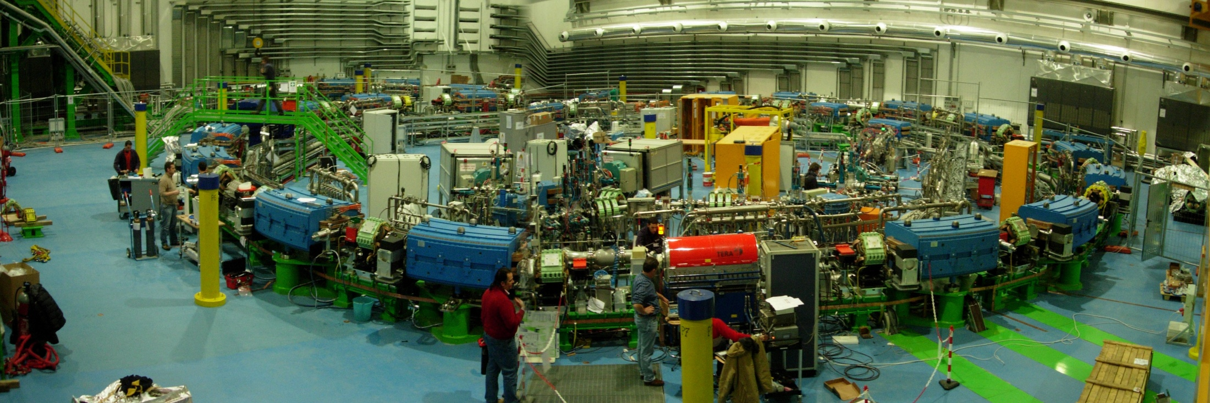
Synchrotron hall today
ACCELERATORE PER LA TERAPIA ONCOLOGICA CON FASCI DI PARTICELLE
A PAVIA

Slide 39

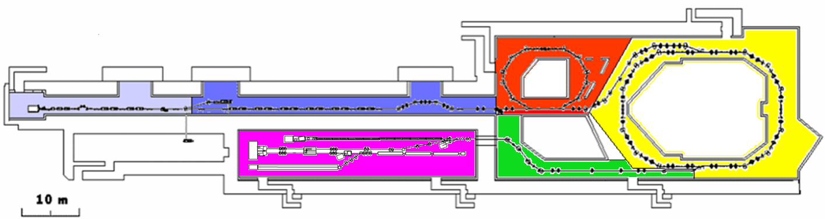
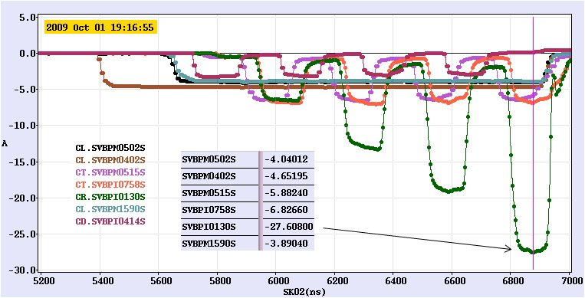
Measured currents in CTF3:
[28A in CR]
CRM
TL1
DL
CR
TL2
CLEX
CLIC

Slide 40
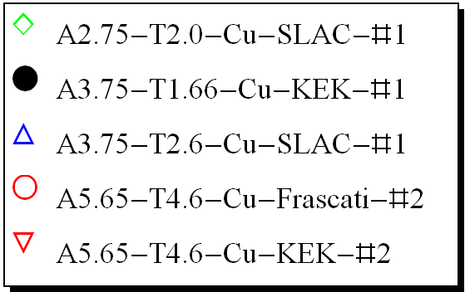
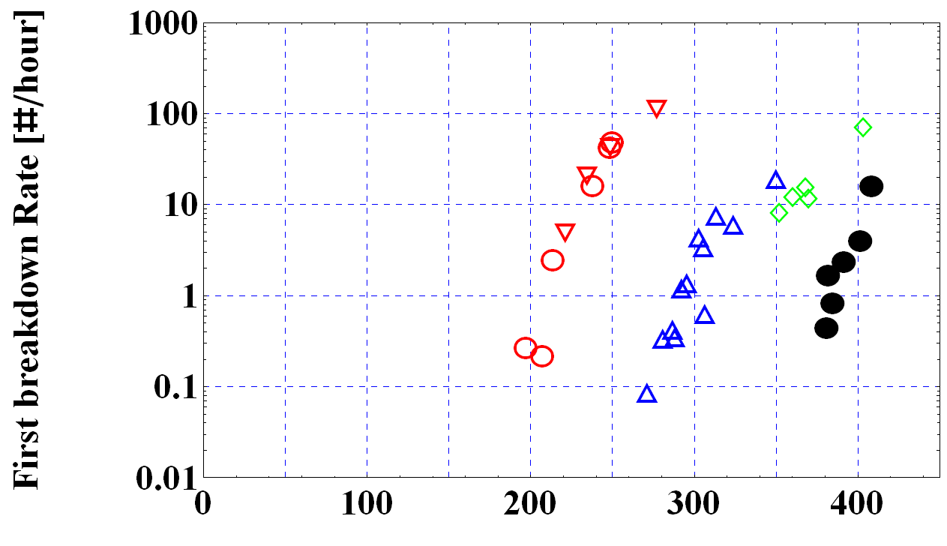
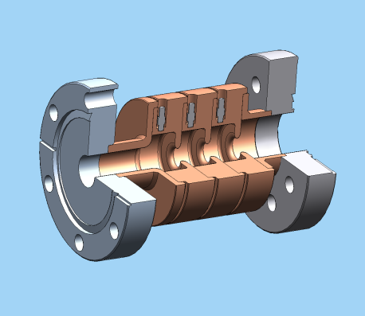
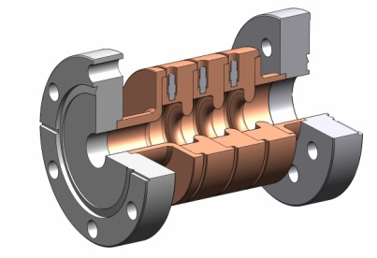
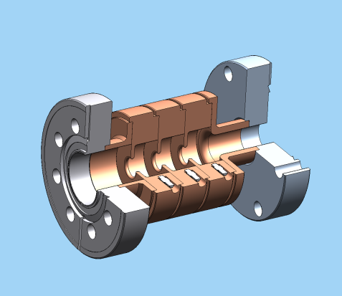
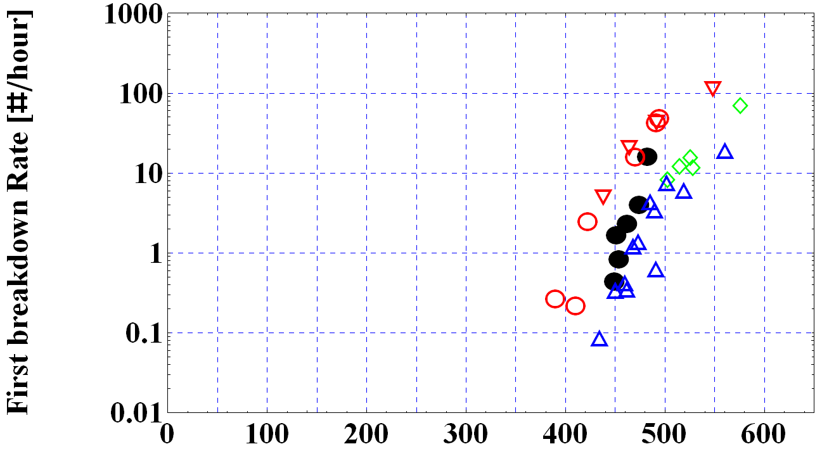
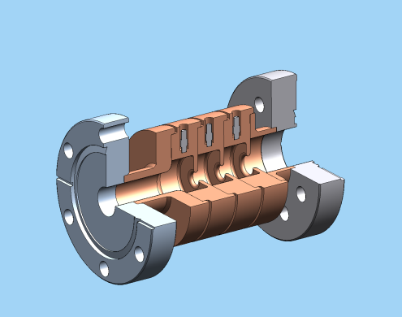
Surface fields for 5 different single cell structures, shaped pulse
(flat part: A5.65-T4.6-KEK-#1- 150 ns, A5.65-T4.6-Frascati-#2- 150 ns, A3.75-T2.6-Cu-SLAC-#1: 150 ns, A3.75-T1.66-Cu-KEK-#1 200 ns, A2.75-T2.0-Cu-SLAC-#1 200 ns)
Maximum surface electric fields [MV/m]
LABORATORIO
TECNOLOGIE
RADIOFREQUENZA
Maximum surface magnetic fields [kA/m]
Notes:
40

Slide 41
DAFNE
LUCE DI SINCROTRONE A
Nuovo Laboratorio per Ottiche di Raggi X
DAFNE- LIGHT
Laboratory
Two new soft X-ray lines
under construction
Syncrotron ligth from DAFNE
SPARC
SPARX
Conventional sources
LNF are part of the European Infrastructure
for syncrotron light

Slide 42
CONCLUSION
Storage rings physics and technology
FEL physics and technology
Flavour physics with the KLOE experiment
Physics in Space
High density nuclear matter. Finuda-Amadeus
Detector technology
High Intensity LASER applications (LIFE-Lab)
LHC Experiments
FNAL and JLAB experiments
Strong Collaboration among the National Labs-
SLAC-PSI-ELETTRA

Slide 43
THE FUTURE
Difficult to predict
Boundary conditions changing
DAFNE
SPARCX-project ready, waiting
LHC-running
SPACE
RARE PHYSICS
DETECTORS
APPLICATIONS
COMPUTING
ELECTRONICS
LASERS

Slide 44
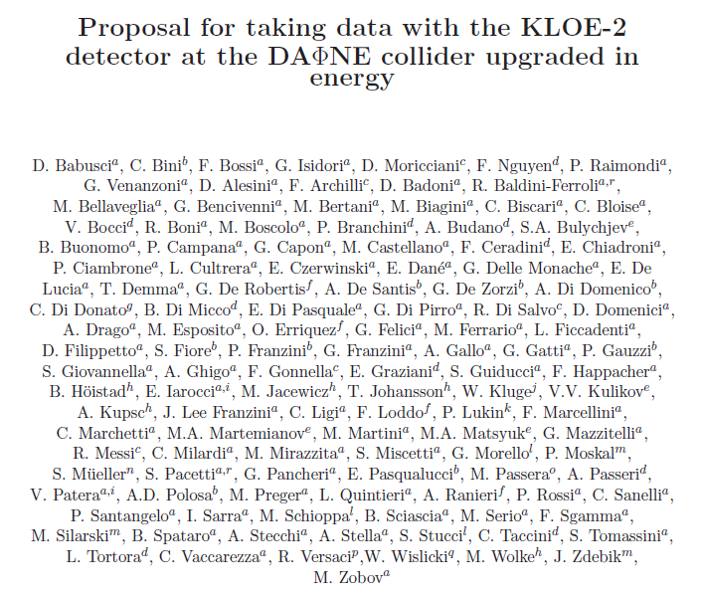
Rivolgersi a Fabio Bossi dei LNF

Slide 45
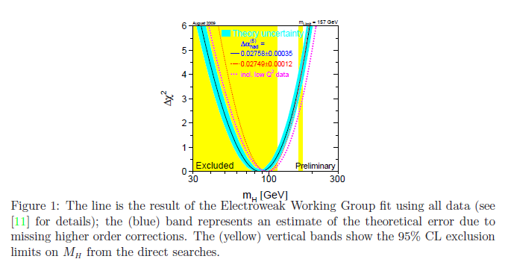
Si riduce di un fattore 4 l’errore su Δα had
Misurando R all’1% fini alla Y

Slide 46
FISICA DI PRECISIONE
FISICA DEI K
FISICA NUCLEARE
KLOE2
SIDDHARTA
AMADEUS
IKON
Preparare per il dopo KLOE2
DAFNE UPGRADE
SPARCX

