Slide 1
Semi-Inclusive Kaon Electroproduction with CLAS
M. Osipenko
PSHP 2010,
October 19, 2010,
Frascati, Italy

Slide 2
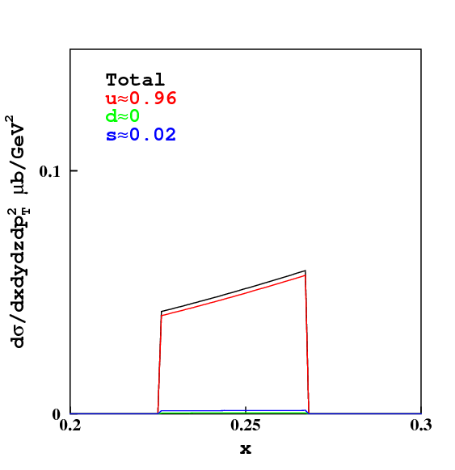
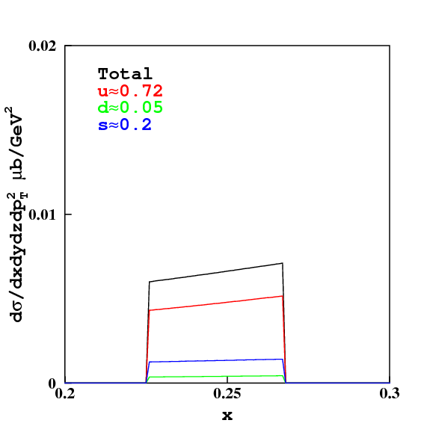
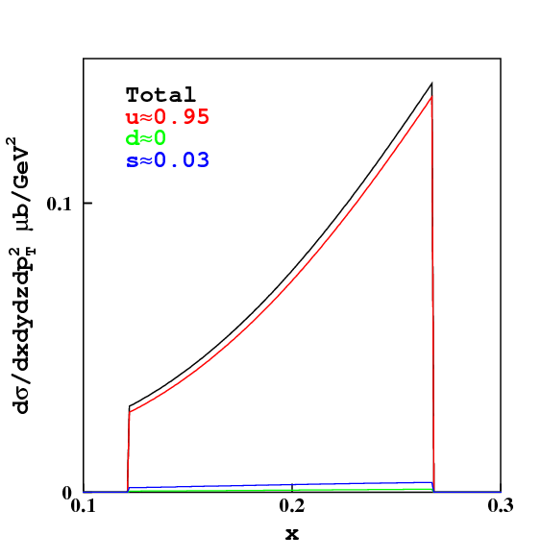
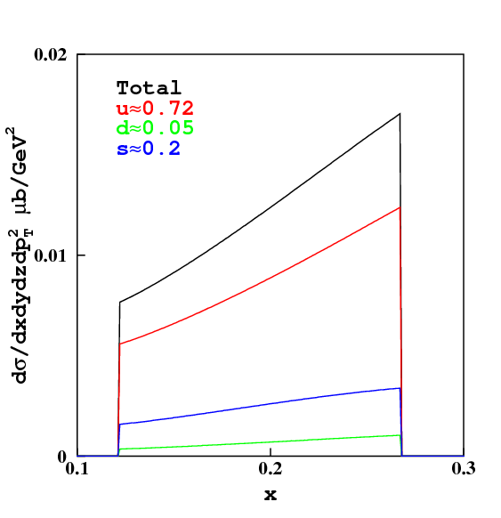
Contribution of s-quarks
K⁺
K⁻
Typical kinematics:
Q²=2.5 GeV²
z=0.5
CLAS 6 GeV
CLAS 6 GeV
Acceptance cuts.
LO param.:
GRV 94 LO
DSS 07 LO
K⁺
K⁻
CLAS 11 GeV
K⁻ production allows to study of s-quark contribution.
CLAS 11 GeV

Slide 3
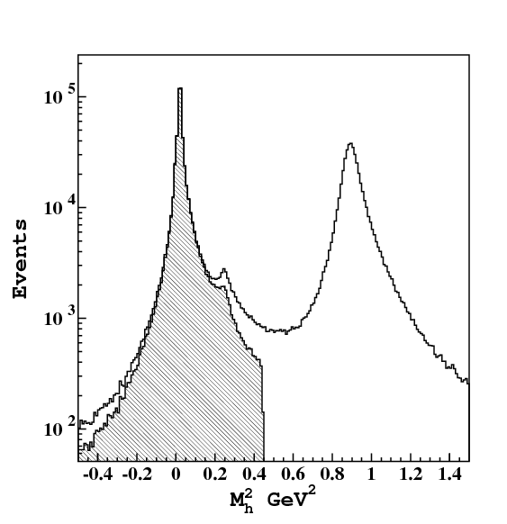
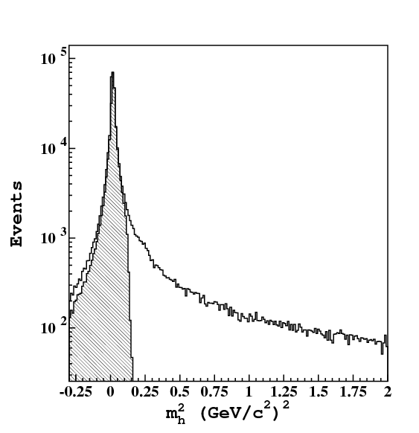
CLAS data
Hadron identification – Time Of Flight system (Scintillation Counter)
Time of flight
Resolution:
Flight Distance:
Maximum momentum of 1σ K-π separation
h⁺
Convoluted with CLAS acceptance.
π⁻
h⁻
π⁺
p
K⁺

Slide 4
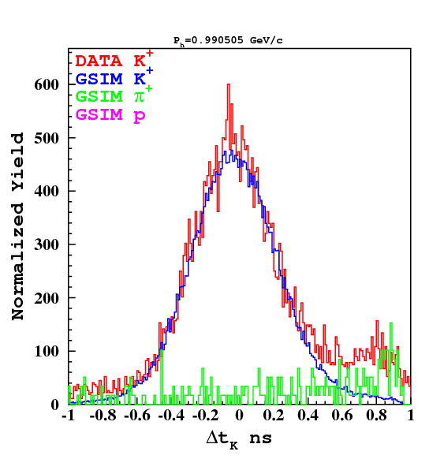
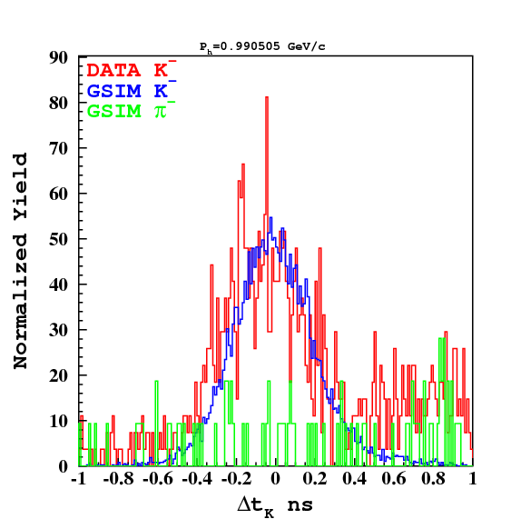
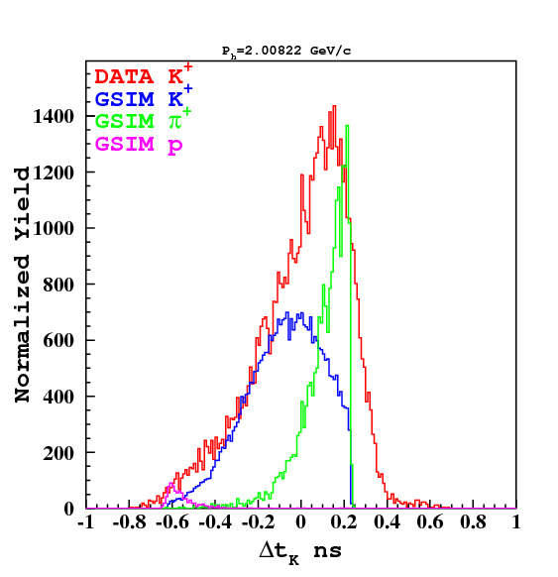
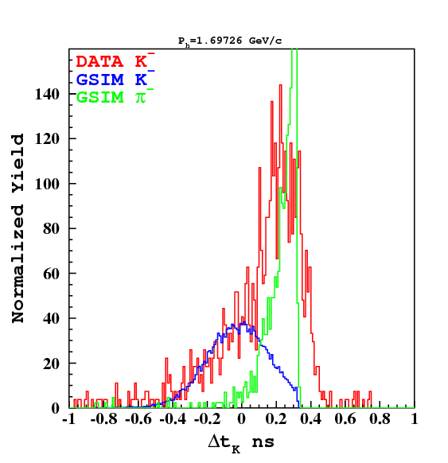
TOF PID
P=1 GeV
P=1 GeV
Monte Carlo GSIM describes well TOF resolution.
cut
cut
Momentum dependent cuts is applied to suppress pion and proton contaminations.
P=2 GeV
P=1.7 GeV

Slide 5
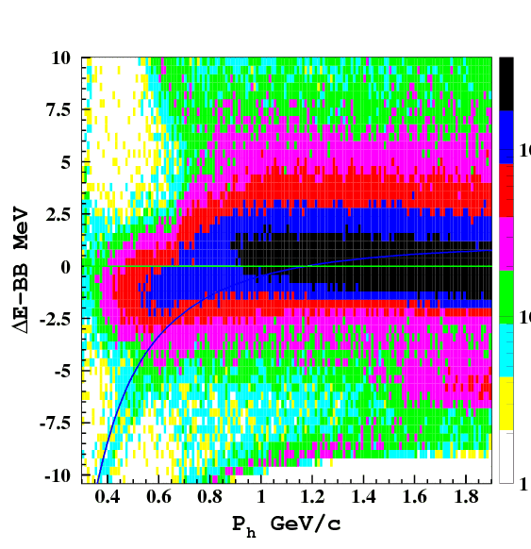
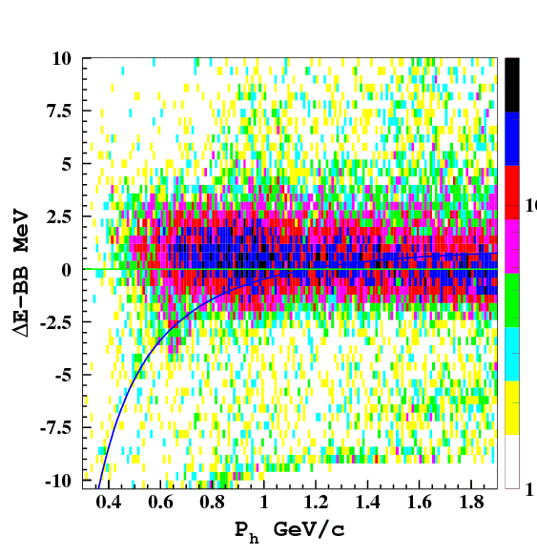
Energy loss in scintillator
Energy loss allows to clean pion contamination at momenta P_{h}<0.8 GeV/c,
Obtained after TOF cuts distributions do not exhibit large contamination,
Distributions are slightly different from Bethe-Bloch formula + Birks quenching effect.
K⁺
K⁻
π⁺
π⁻

Slide 6
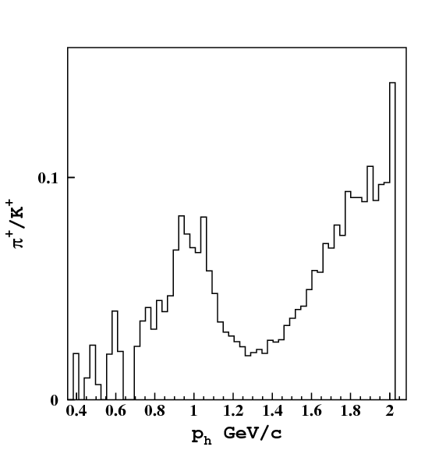
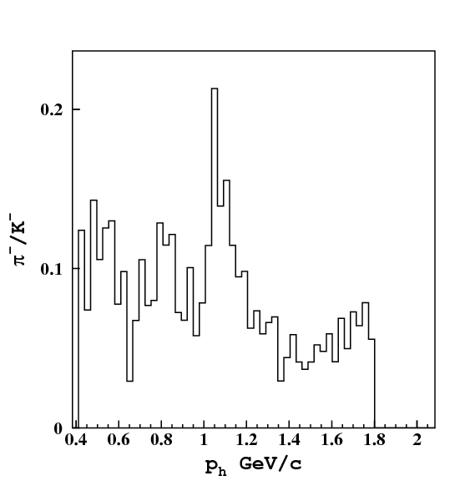
Pion Contamination
Contamination remaining after all cuts (TOF,Energy loss) ranges from 10% to 20%,
From previous measurements we know pion rate with systematic precision of 10-15%,
The main systematic uncertainty is due to ability of Monte Carlo simulations to describe TOF resolution.
K⁺
K⁻

Slide 7
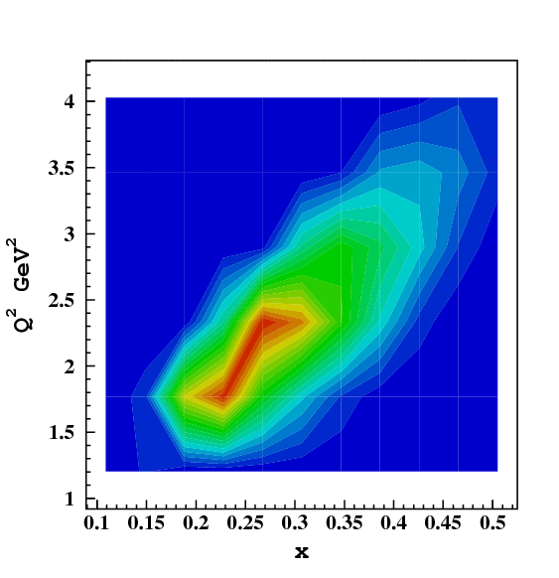
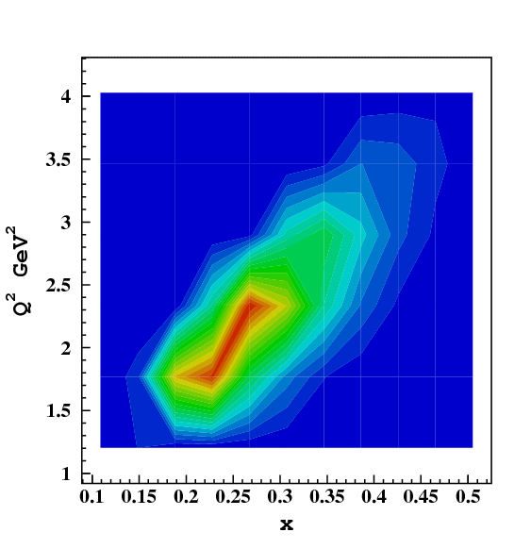
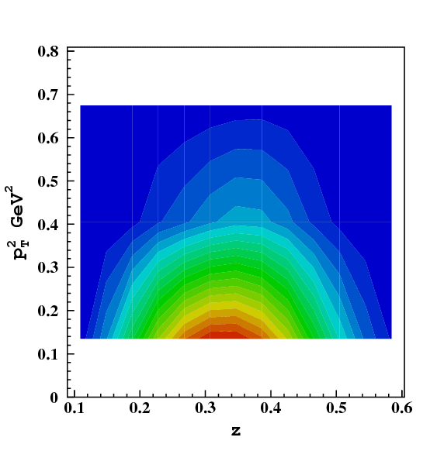
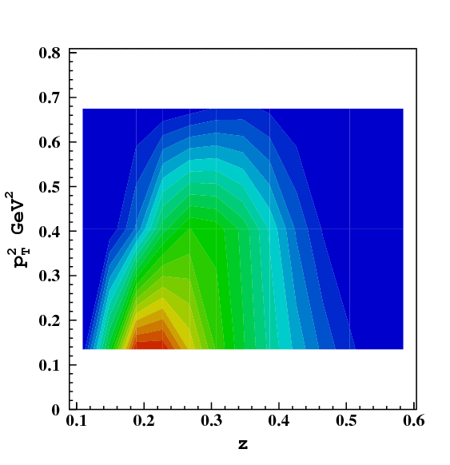
Kinematical Coverage of E1-6a run
Negative kaons:
Lower mean z-values,
20 times smaller statistics
K⁺
4x10⁵ events
K⁻
2x10⁴ events

Slide 8
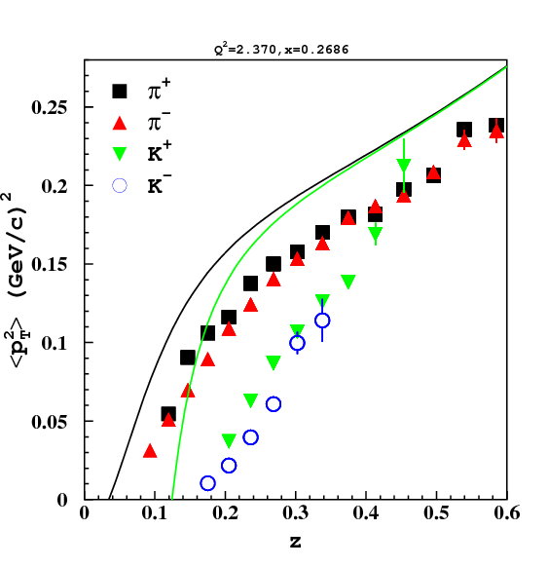
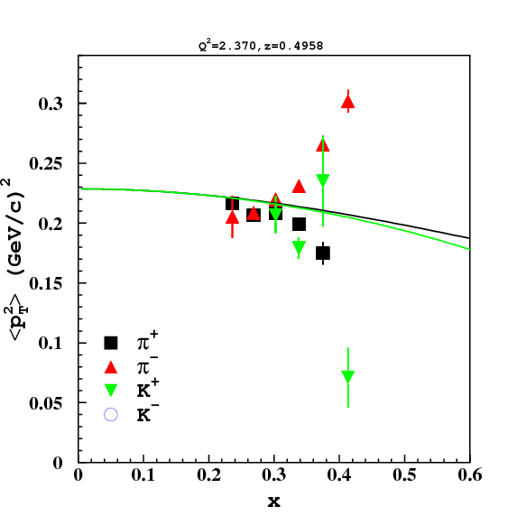
Transverse momentum
Parton model predicts simple dependence of the mean transverse momentum:
Upper limit on transverse momentum:
preliminary
DIS
current fragm.
curve - M.Anselmino et al., PRD71

Slide 9
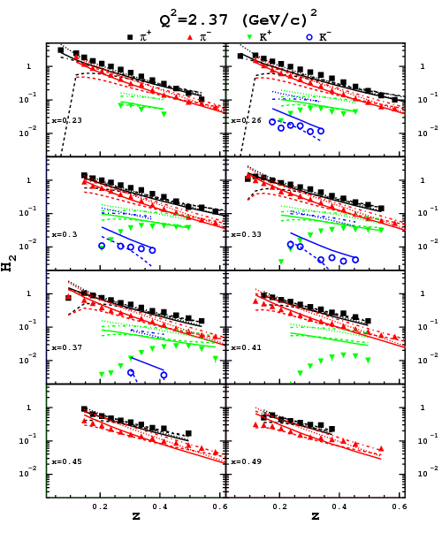
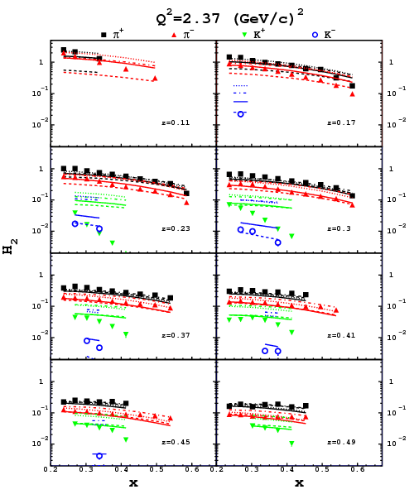
Data vs. pQCD
Solid – LO DSS
Dashed – NLO DSS
Dotted – LO Kretzer
Dot-dashed – NLO Kretzer
Sys.err. 15%
preliminary

Slide 10
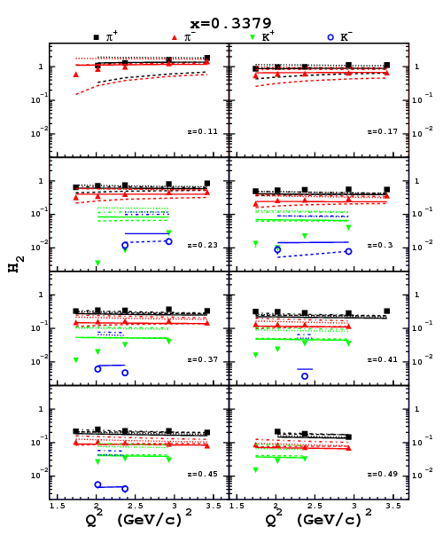
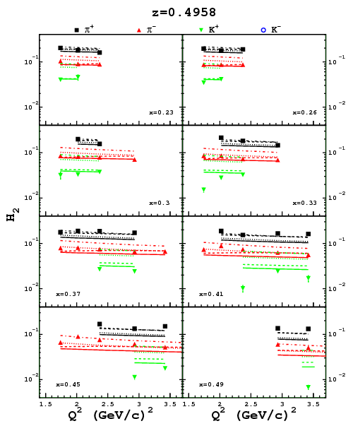
Q²-evolution
Solid – LO DSS
Dashed – NLO DSS
Dotted – LO Kretzer
Dot-dashed – NLO Kretzer
Sys.err. 15%
preliminary

Slide 11
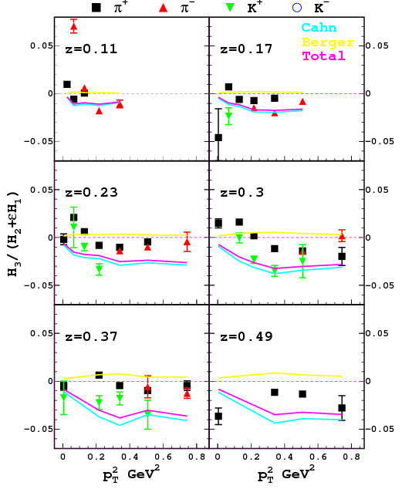
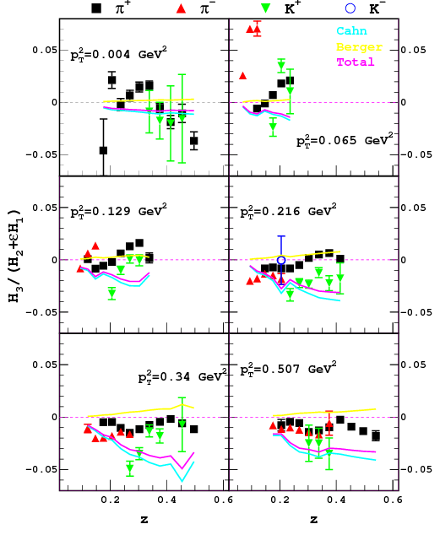
<cosφ>
Cahn - M.Anselmino et al., PRD71,
Berger – A.Brandenburg et al., PLB347
<Q²>=2.2 GeV²
Sys.err. 2%

Slide 12
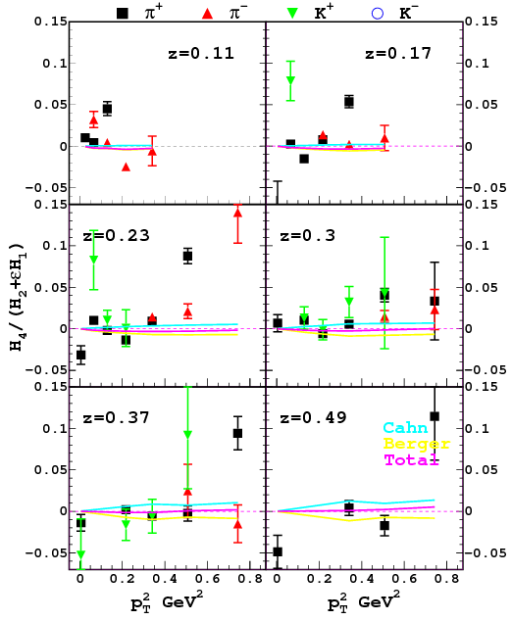
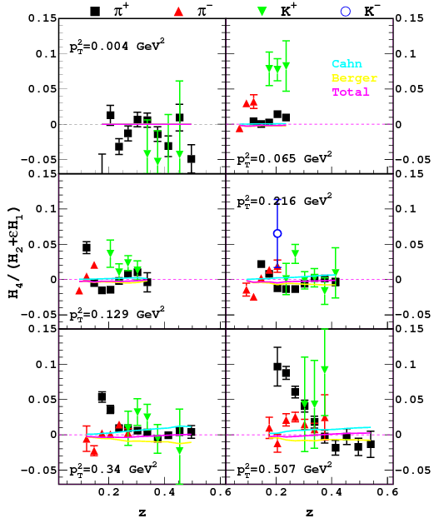
<cos2φ>
Cahn - M.Anselmino et al., PRD71,
Berger – A.Brandenburg et al., PLB347
<Q²>=2.2 GeV²
Sys.err. 2%

Slide 13
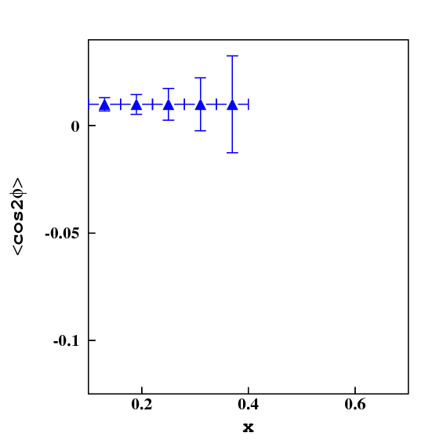
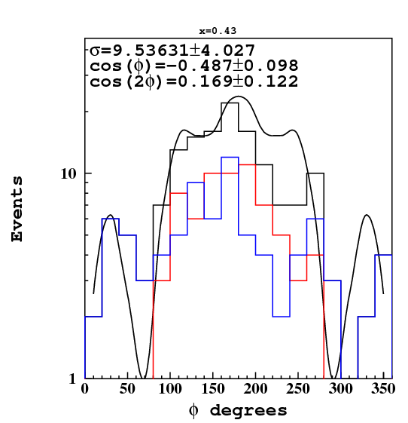
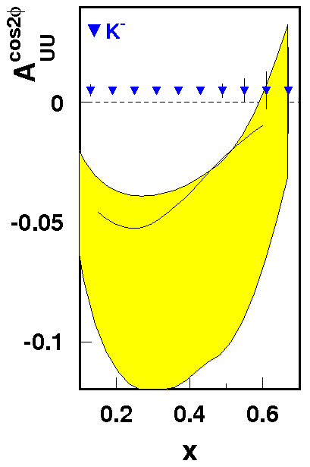
CLAS12 projection
Proposal “Studies of Boer-Mulders Asymmetry in Kaon Electroproduction with Hydrogen and Deuterium Targets” by H.Avakian et al.
With 2 RICH sectors statistical uncertainties are of the order of 0.5% for data integrated in SIDIS,
For large-x kinematics, the accessible φ-interval is incomplete, undermining azimuthal asymmetry extraction, proposed run with inbending torus field should solve this problem.
3x10⁶ SIDIS K⁻
H. Avakian et al.
inbending
outbending

Slide 14
Summary
We measured 5-fold differential semi-inclusive electro-production cross sections for π⁺, π⁻, K⁺ and K⁻ in a wide kinematical range in all 5 independent variables;
In current fragmentation region all the data are in reasonable agreement with naïve current fragmentation pQCD calculations;
The measured <cosφ> moments are incompatible with Cahn and Berger effects, while <cos2φ> is compatible with zero in agreement with theory;
Projections for 12 GeV Upgrade show significant improvement in statistics and kinematic coverage.

Slide 15
BACKUP SLIDES

Slide 16
Status of Un.Semi-Inclusive in CLAS
We measured semi-inclusive electro-production cross sections for π⁺, π⁻, K⁺, K⁻ and protons:
π⁺ was published in PRD80 (2009),
π⁻ in Deep Processes Working Group review (Kaftar, Harut, Marco Contalbrigo),
Parallel analysis of Wes Gohn is on-going, intends to extract isospin asymmetry of pions, a cross check of the two analyses is expected, we have an agreement that π⁻ paper is published first and will not include any discussion of Boer-Mulders functions,
Proton is in progress: analysis note is almost ready, draft of the paper to be written,
K⁺/K⁻ first results are obtained, analysis note and draft to be written, depends on velocity of π⁻ review,
Neutron analysis is foreseen, depending on status of proton analysis.

Slide 17
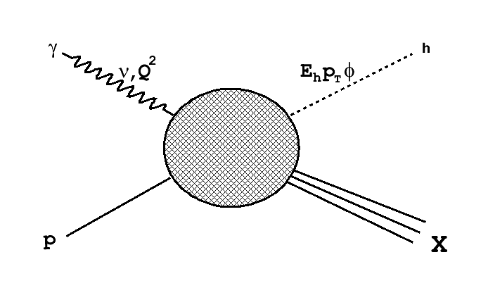
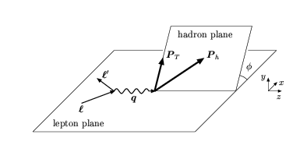
Semi-inclusive Kinematics
Detect the scattered electron in coincidence with hadron h: e+p→e'+h+X
In OPE approximation:
Four-momenta in Lab:
5 independent variables
Initial state:
Final state:

Slide 18
Observables
Cross section is described by 4 functions of 4 variables:
where
J.Levelt & P.Mulders, PRD49
Azimuthal asymmetries (moments):

Slide 19
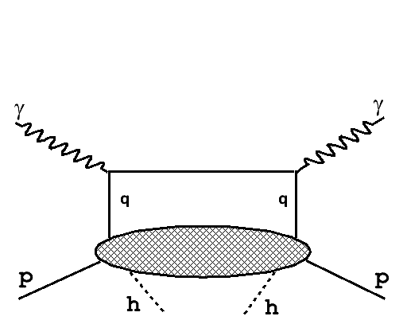
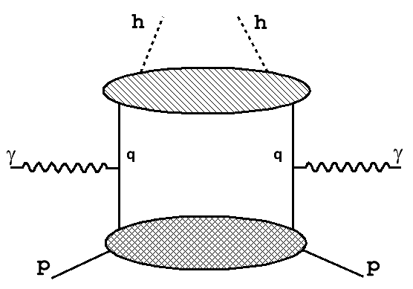
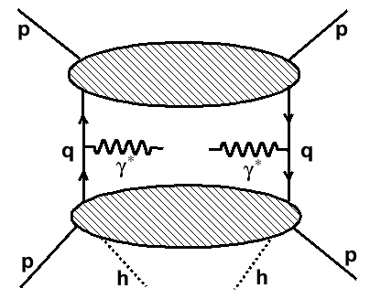
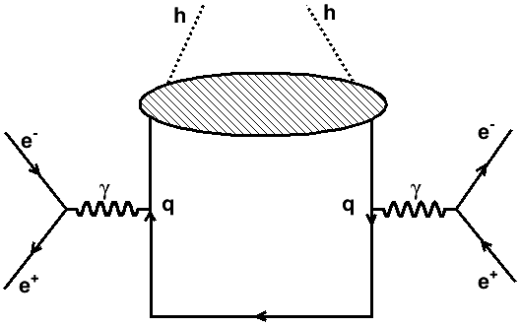
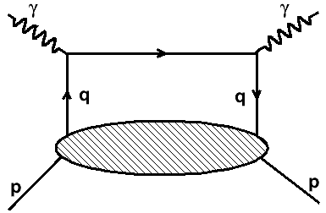
SIDIS: constant in φ
Current fragmentation
L.Trentadue & G.Veneziano, PLB323
Target fragmentation
Factorization proved
X.Ji et al., PRD71
J.C.Collins, PRD57

Slide 20
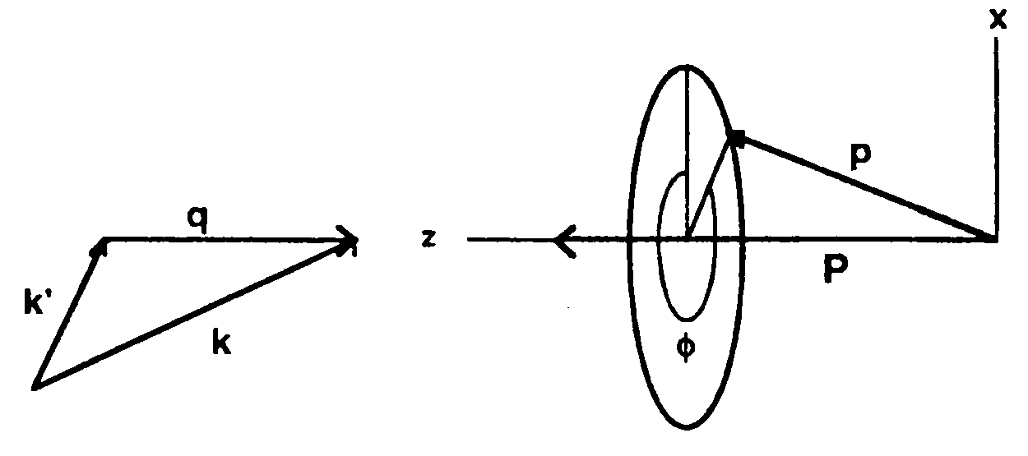
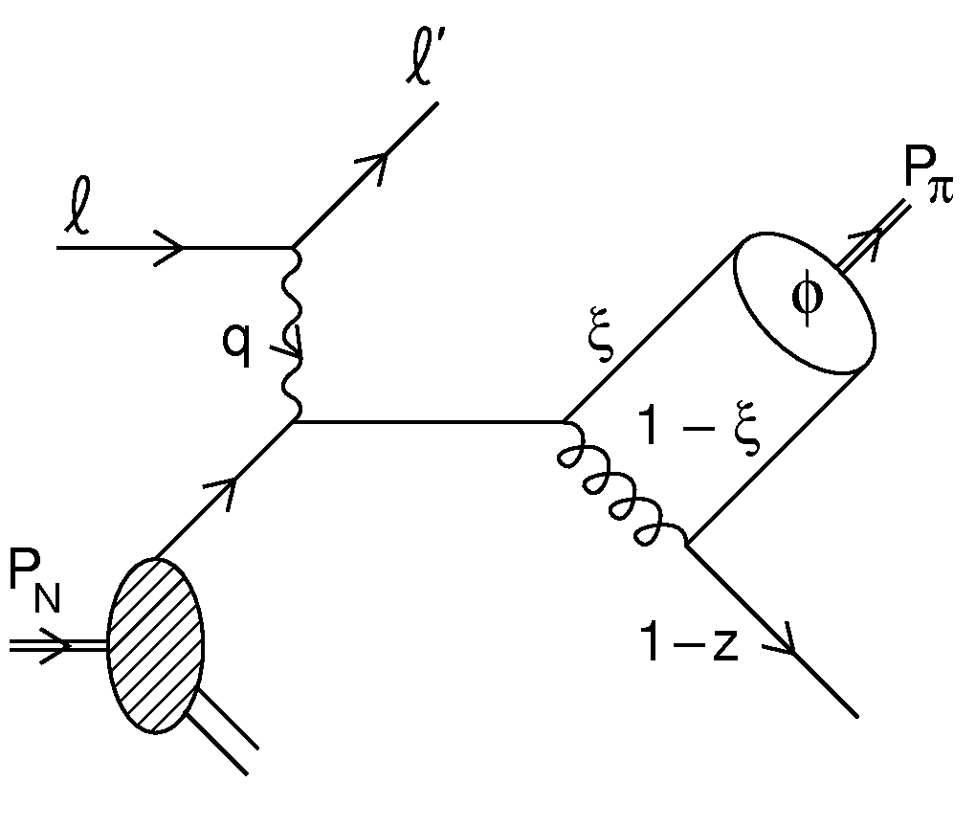
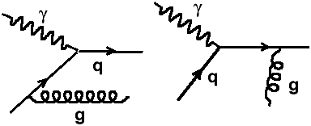
SIDIS: φ-dependence
R.N.Cahn, PRD40
1.Cahn effect:
E.Berger, ZPC4
2.Berger effect:
hadron wave function
3.Boer-Mulders function h₁┴ (TMD) contribution:
D.Boer&P.Mulders, PRD57
H₁┴ from e⁺e⁻ collisions
4.Higher Order pQCD corrections:
H.Georgi&H.Politzer, PRL40

Slide 21
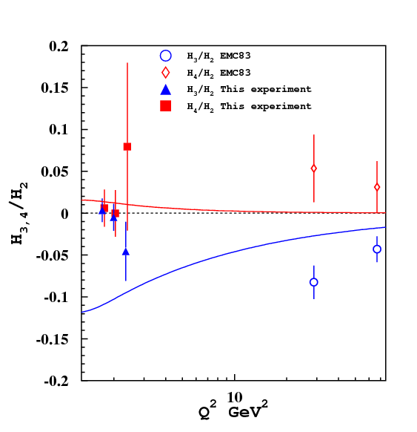
Q²-dependence for π⁺
We compared our data on φ-dependent terms with EMC measurement (J.Aubert et al., PLB130) performed at significantly higher Q²:
curves show Cahn effect prediction corrected for threshold effect:
CLAS
EMC(83)
<cos2φ>
x=0.24
z>0.2
p_{T}>0.2 GeV
<cosφ>
and n=1,2
Larger threshold effect predicted in: A.Konig and P.Kroll, ZPC16

Slide 22
Normalization
Hadron multiplicity:
In e⁺e⁻ collisions
In SIDIS, neglecting target fragmentation contribution
=>
=>
Cut on x_{F} removes part of the p_{T} region breaking normalization of transverse momentum distribution.

Slide 23
Azimuthal angle definition
k – initial electron 3-momentum,
p_{h} – hadron 3-momentum,
q – virtual photon 3-momentum
Trento
convention

Slide 24
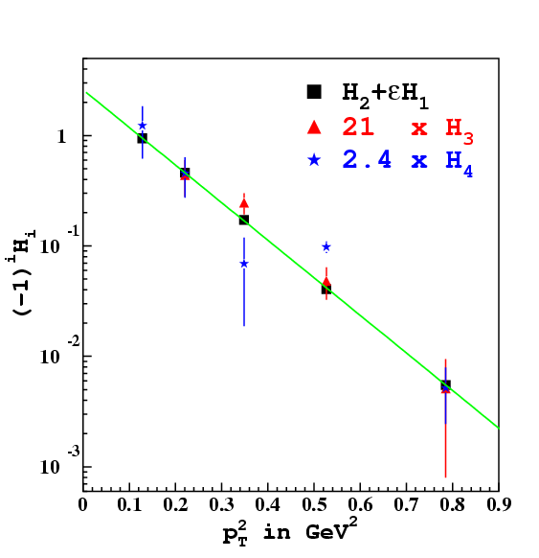
p_{T}-dependence
Structure functions were separated by fitting φ dependences in each separate kinematical bin.
Only bins with complete φ-coverage were considered.
CLAS
The same p_{T} behavior for all structure functions => trivial kinematical factors for azimuthal asymmetries <cosφ> and <cos2φ>
H₃ contribution is negative
H₄ is mostly positive
Suggest only internal transverse motion of quarks (Cahn)?
Preliminary
Q²=2.4 GeV², x=0.26, z=0.23
up to p_{T}~1 GeV

Slide 25
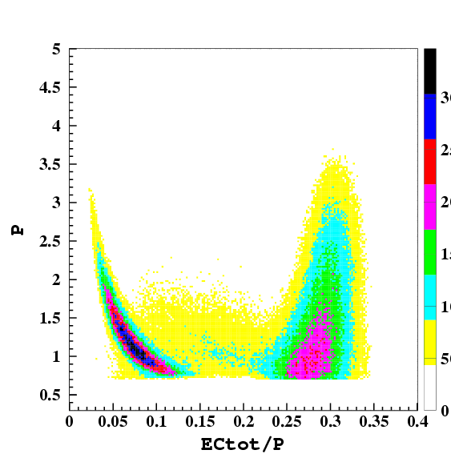
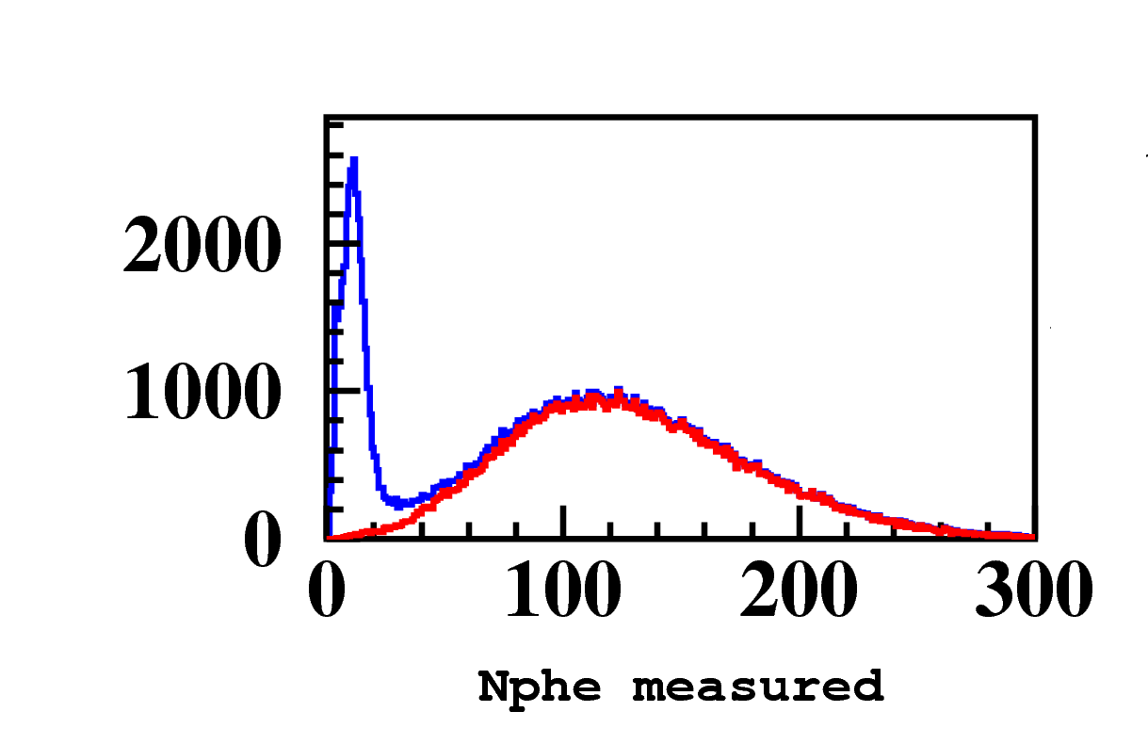
e⁻ measurement
Cherenkov Counter (CC) uniquely identify electrons up to P~3 GeV
Electromagnetic Calorimeter (EC) separates high energy electrons
e⁻
π⁻+CC noise
π⁻
e⁻

Slide 26
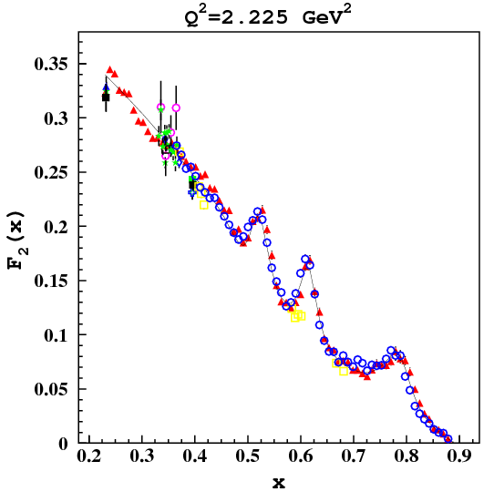
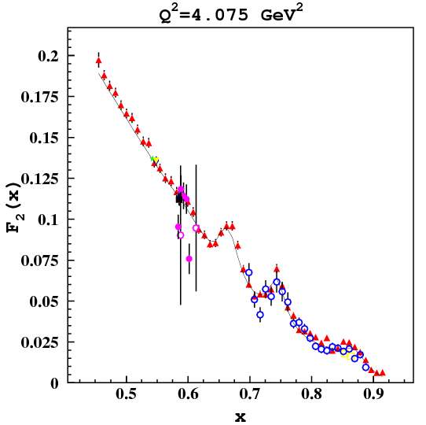
e⁻ inclusive
Inclusive cross sections obtained with the same data are in good agreement with world data.
Little effort needed to complete the inclusive data analysis at 6 GeV
CLAS E1-6
CLAS E1-6
Bodek fit
Bodek fit
World
World

Slide 27
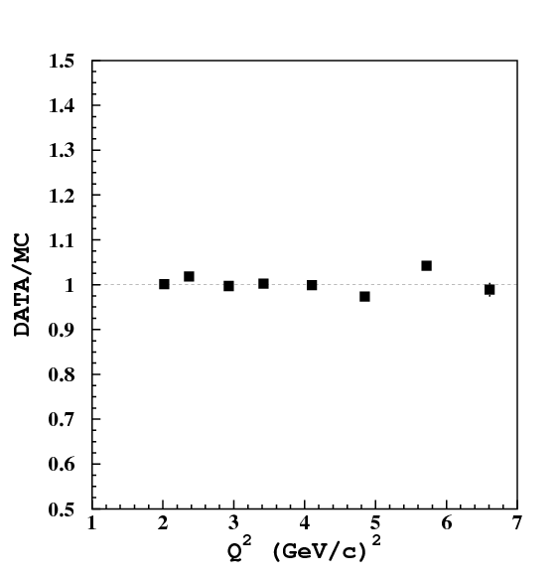
Ep-elastic

Slide 28
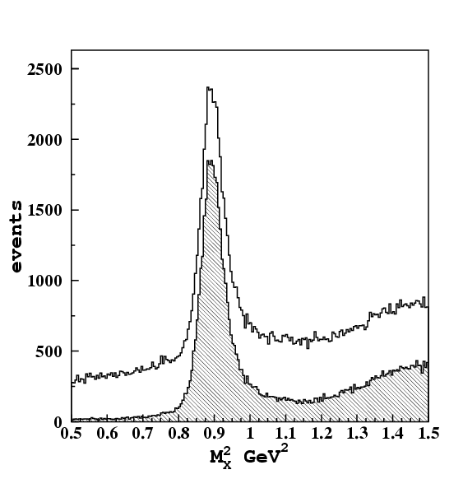
π⁺ measurement
Pions are well identified by Time Of Flight (TOF) measurement in all accessible kinematical range
Loss of events in data and Monte Carlo (MC) simulations due to PID cuts was checked in π⁺n peak
all positive hadrons
π⁺n peak
background
selected events

Slide 29
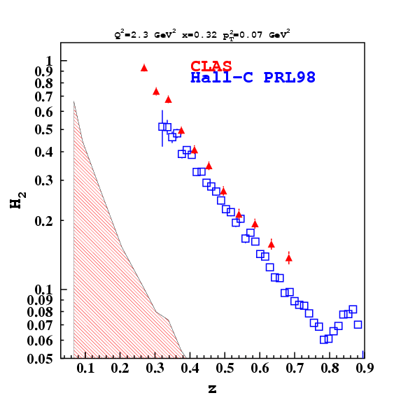
π⁺ semi-inclusive
New CLAS data are in agreement with previously published measurements within given uncertainties
Comparison also shows non-trivial p_{T}-behavior
p_{T}=0.07 GeV/c
p_{T}=0 or 0.1

Slide 30
π⁺ semi-inclusive
Kinematics does not match perfectly, some extrapolations have been performed in CLAS data.

Slide 31
EMC data
Much larger <p_{T}²> values measured by EMC, but seen to increase rapidly with W.
EMC, PLB95

Slide 32
Parameterization dependence
Very small uncertainty due to parton distribution function
Larger uncertainty due to fragmentation function
CTEQ 5 LO
GRV 98 LO
MRST cg LO
CTEQ 5 NLO
GRV 98 NLO
MRST cg NLO

Slide 33
ZEUS data
The same limitations as for EMC and E665
More detailed data sample in hep-ex/0608053 represented in different variables (pseudorapidity and minimum hadronic energy in HCM) and integrated also over neutral hadrons appears hard to compare
ZEUS, PLB481
ZEUS, PLB481
0.01<x<0.1
180<Q²<7220 GeV²
0.2<z<1

Slide 34
EMC and E665 data
The same limitations also in E665 data
Minimum transverse momentum of hadrons is commonly used p_{T}^{C} which can mask possible sign change at low p_{T}
Strong x_{F} variation is seen by EMC
E665, PRD48
Q²>3 GeV²
100<W²< 900 GeV²
Q²>4 GeV²
40<W²< 450 GeV²
EMC, Z.Phys.C34

Slide 35
EMC data in p_{T}
Summed over all charged hadrons positive and negative, no PID
Integrated over all other variables: x, Q², z
Radiative corrections with Monte Carlo
Q²>4 GeV²
40<W²< 450 GeV²
EMC, PLB130
EMC, Z.Phys.C34

Slide 36
CLAS Acceptance 0
Zero-order approximation:
φ-constant term
Acceptance mixes Fourier coefficients with different n.

Slide 37
Fourier analysis of acceptance
100 harmonic expansion: CLAS acceptance is cosine-like. Even number of sectors generate mostly even functions in azimuthal distributions.
even (cos nφ)
odd (sin nφ)
DATA
Fourier series
DATA
Fourier series

Slide 38
CLAS Acceptance

Slide 39
CLAS Acceptance
Only first 10 harmonics are significant, but 20 harmonics are kept in the analysis.

Slide 40
Three methods
Comparison of the three methods for structure function separation:
Fit of φ-distribution
Moments method in zero-order approximation
Moments method accounting for N=20 harmonics of CLAS acceptance
Higher harmonics are important in the extraction of φ–even observables from CLAS data

Slide 41
Pseudo-data Cross Check
Pseudo-data generated in a limited kinematical area from a known model (different from that used in the reconstruction) were used to check that the two extraction procedures are able to extract correct φ-moments.
model
model

Slide 42
Results of Integration
Different assumptions yield slightly different results in low-z region.
Correct expression for low energy:
Exponential p_{T}
Exponential t
Numerical p_{T} integ.
Numerical t integ.
exact formula
no E_{h}/p|| correction
unphysical high p_{T} tail
LO pQCD

Slide 43
Data vs. Monte Carlo

Slide 44
Semi-Inclusive Kinematical Domains
n
ep→e’π⁺X
Exclusive production
Inclusive production:
M_{X}<1÷2 GeV ∗ - Resonance region
M_{X}>1÷2 GeV ∗ - Deep Inelastic Scattering (DIS)
Q²<1 GeV^{2 †} - Non-perturbative
Q²>1 GeV^{2 †} - Perturbative
Current fragmentation
Target fragmentation
Δ⁰
resonances
inelastic
π⁰
ep→e’p’X
J.P.Albanese et al.,PLB144
η
ω,ρ
elastic peak
ep→e’p’
Y CMS rapidity

Slide 45
Structure Function Separation
Two methods of separation:
fit of φ-dependence
event-by-event moments

Slide 46
p_{T} dependences
p_{T} dependence cannot be calculated by ordinary pQCD, only TMD-based approach will permit for a complete description of the measurement. One has to integrate the data in p_{T}²:

