Slide 1

(Anti)Lambda polarization in SIDIS
Aram Kotzinian
Uni&INFN, Torino & YerPhI, Armenia
  Unpolarized target
    Strangeness distribution in nucleon
Polarized target
    Polarized strangeness in polarized nucleon

Slide 2
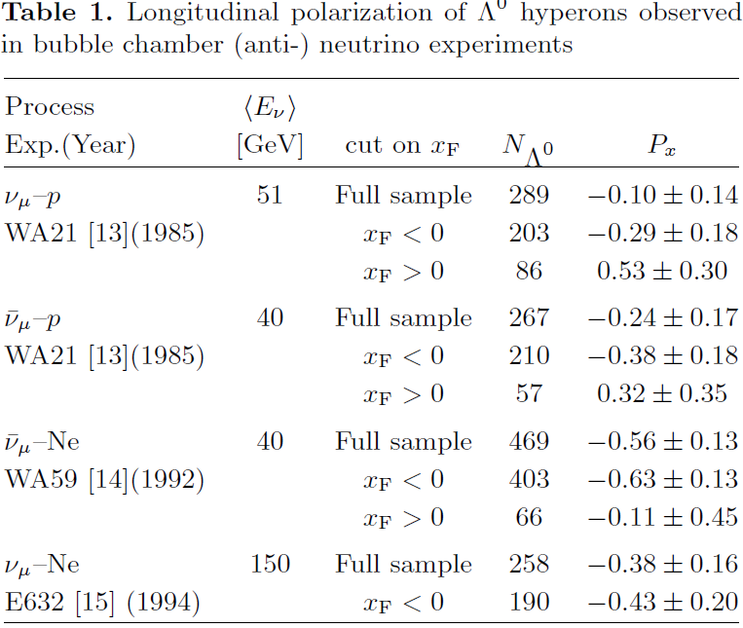
Longitudinal Λ polarization (old)

Slide 3
Longitudinal Λ polarization (new)

Slide 4
Meson cloud model for TFR
Melnitchouk & Thomas (1995)
l'
correlated
quarks
l
K⁺
Λ
N
Zero polarization for unpolarized target

Slide 5
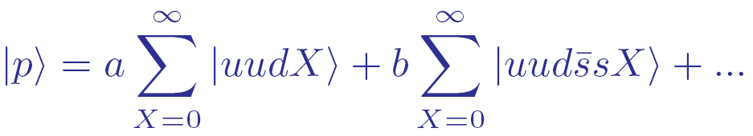
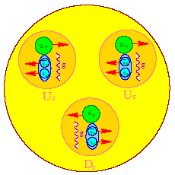
Intrinsic Strangeness Model
Ellis, Karliner, Kharzeev , Sapozhnikov, Alberg
  nucleon wave function contains an admixture with component:
  π,K masses are small at the typical hadronic mass scale ⇒ a strong attraction in the − channel.
  pairs from vacuum in state
“Spin crisis”:
Polarized proton:

Slide 6
Spin flow
J.Ellis, D.Kharzeev, A.K., 1996
J. Ellis, A. K. & D. Naumov, 2002
TFR
z
N
Λ
Λ
CFR
z
N

Slide 7
LEPTO MC Generator
Parton DF, hard X-section & Hadronization are factorized
l'
q
l
N
TR
q
h
TR
For hadrons in TFR can be considered as a model for FracFun

Slide 8
LUND String Fragmentation
5
1
4
2
3
3
Soft Strong Interaction
Rank from diquark
Rank from quark
2
4
1
5
No polarization effects

Slide 9
Intrinsic Strangeness Model for Λ polarization
CFR
μ′
μ′
Λ
-
u
μ
s
u
s
μ
TFR
P
(ud)₀
P
Λ
(ud)₀
R_{qq}<R_{q}: spin transfer from intrinsic
strangeness and polarized diquark
via heavier hyperons
R_{q}<R_{qq}: spin transfer only
from final quark

Slide 10
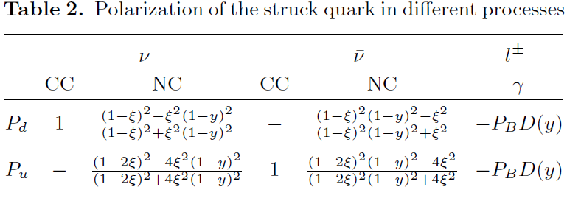
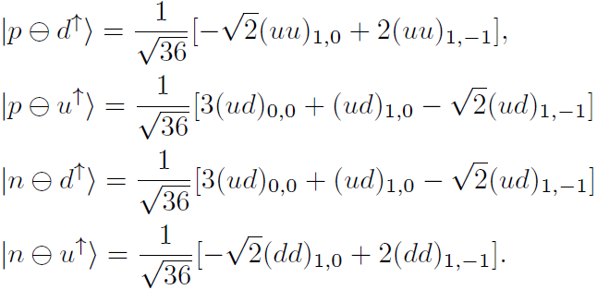
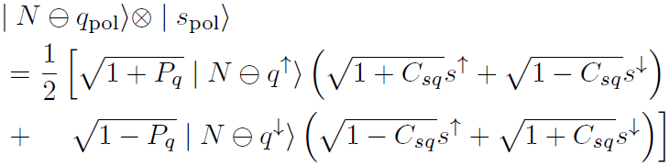
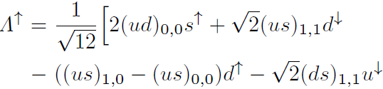
Spin transfer in TFR
J.Ellis, D.Naumov&AK (2002)

Slide 11
Spin transfer in SIDIS
Spin transfer
from qq side
Spin transfer
from q side

Slide 12


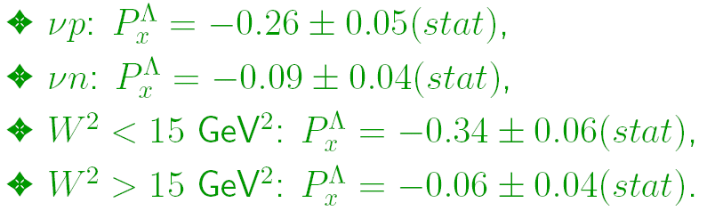
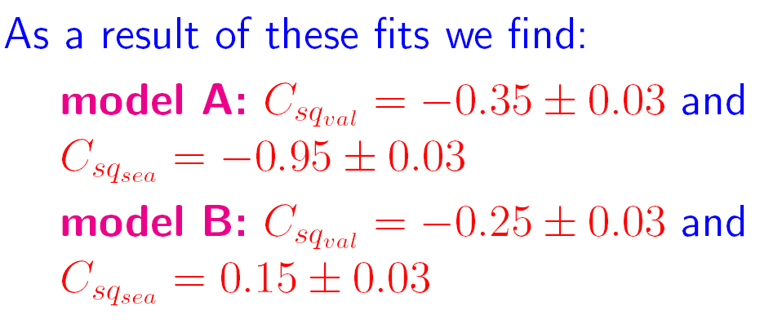
Fixing free parameters
We vary two correlation coefficients ( and ) in order to fit our models A and B to the NOMAD Λ polarization data.
We fit to the following 4 NOMAD points to find our free parameters:

Slide 13
NOMAD data

Slide 14
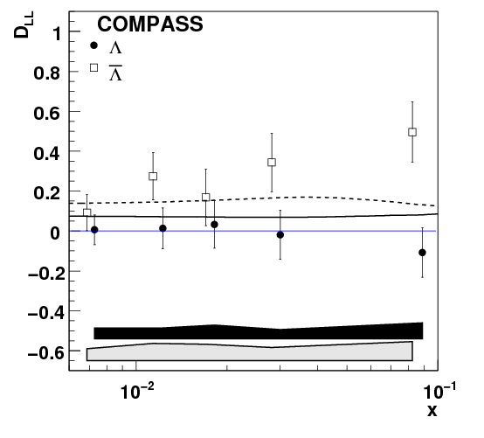
Theory predictions for Λ and‾Λ
J.Ellis, A.K., D.Naumov
and M.Sapozhnikov
EPJ.C52:283-294,2007
‾Λ
Λ

Slide 15
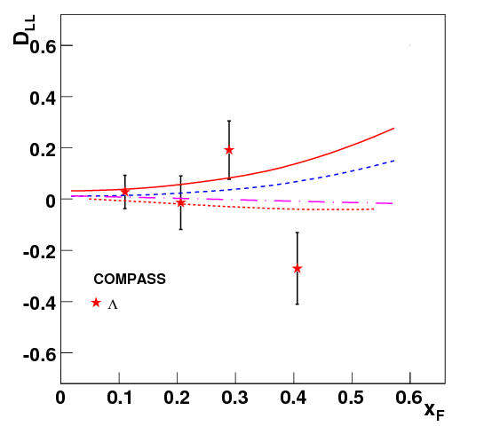
Sensitivity to the strange distribution s(x)
CTEQ5L
GRV98
D_{LL}(s)=0, BJ model
D_{LL}(s)=0, SU(6) model

Slide 16
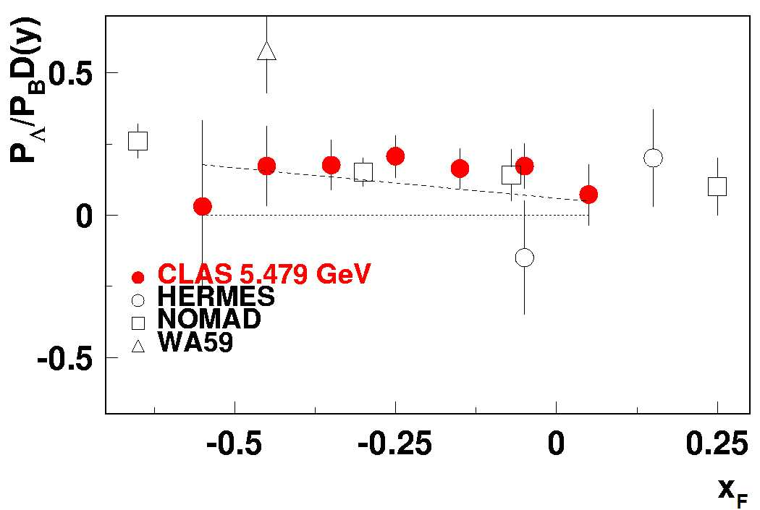
CLASS preliminary (from H. Avakian)
PRELIMINARY
6
Lambda polarization for 5.75 GeV with proton target (predictions for 5.75 GeV from Ellis, Kotzinian and Naumov)

Slide 17
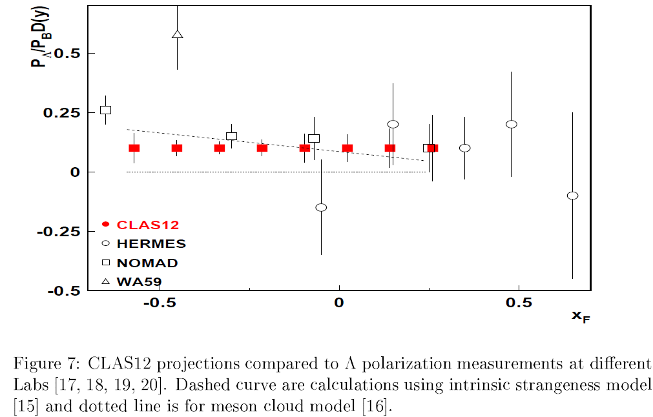
CLAS12 projections

Slide 18
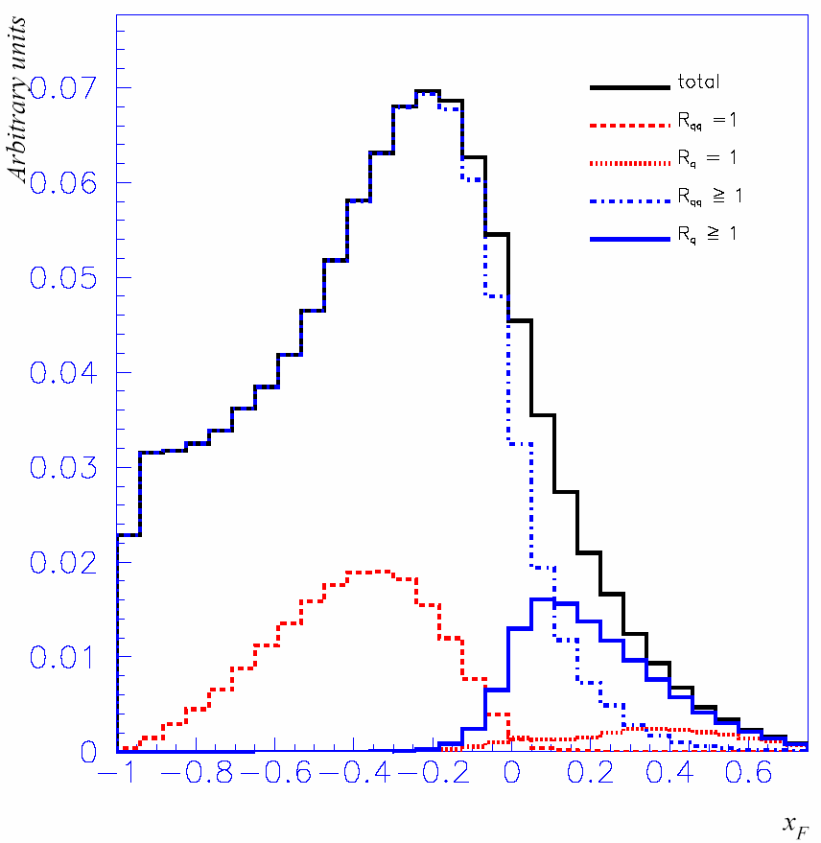
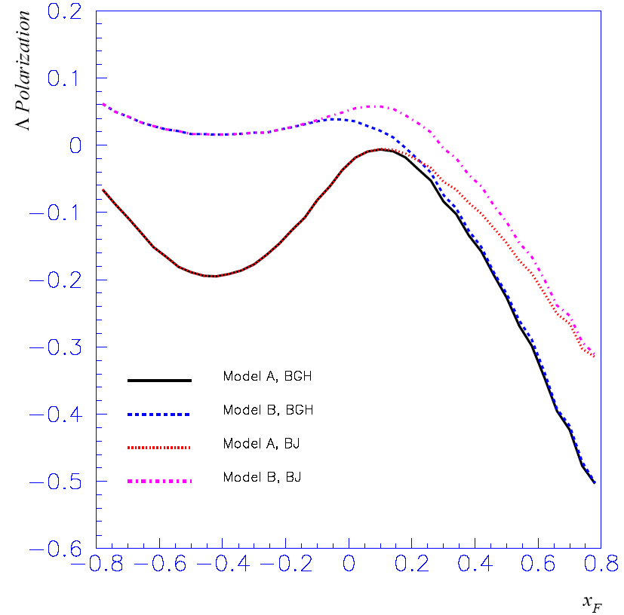
Predictions for EIC
5 GeV/c electron + 50 GeV/c proton,
Good separation of the quark and diquark fragmentation allows to distinguish between
different spin transfer mechanisms in the quark fragmentation

Slide 19
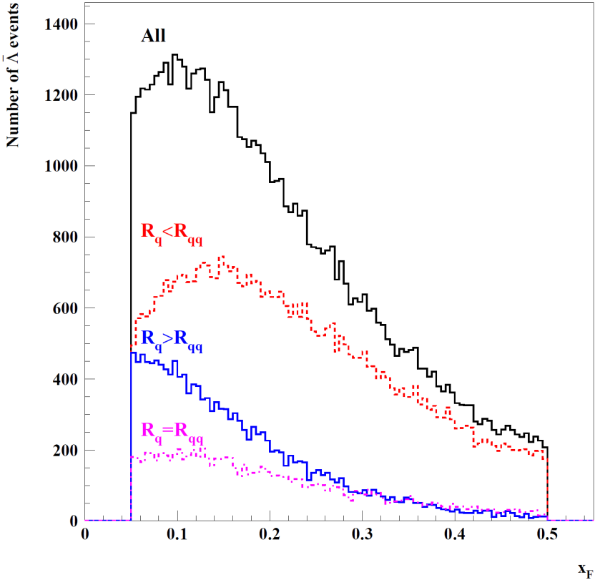
Λ polarization
No spin transfer
from remnant
diquark
μ′
μ′
Λ
u
μ
u
μ
-
s
P
P
Λ
s
(ud)₀
R_{qq}<R_{q}: spin transfer only
from intrinsic strangeness
R_{q}<R_{qq}: spin transfer only
from final quark

Slide 20
CFR: simple model: LO, independent fragmentation
Fraction of events with
hard scattering off s-bar
(s-bar purity)

Slide 21
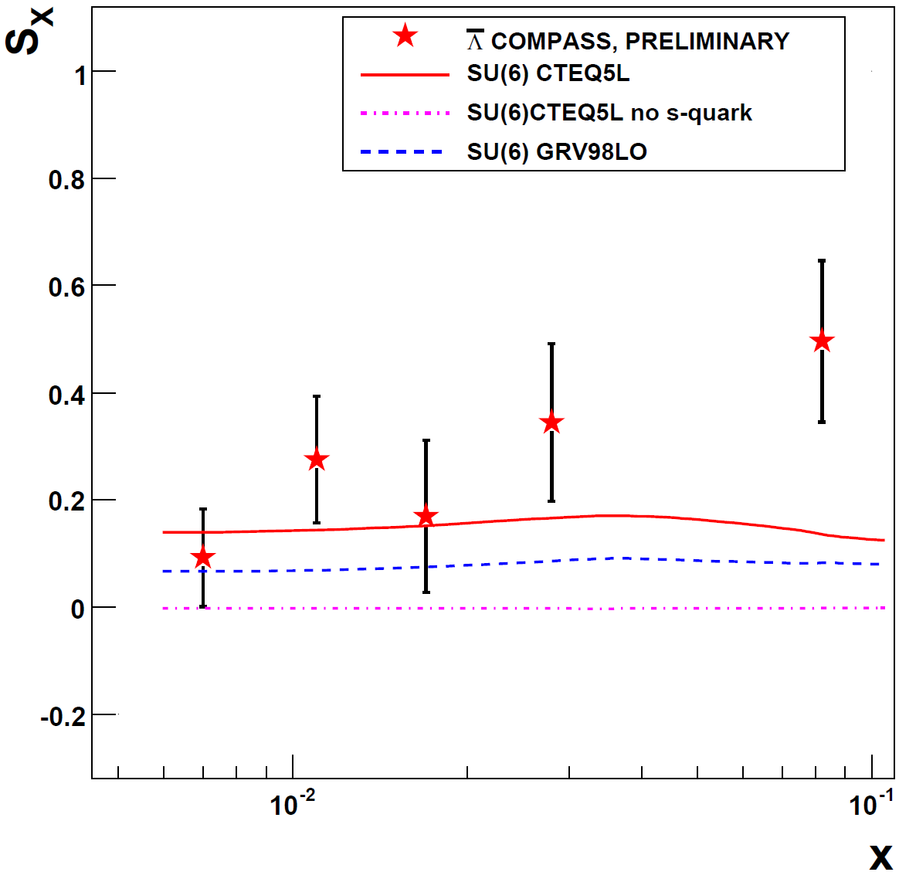
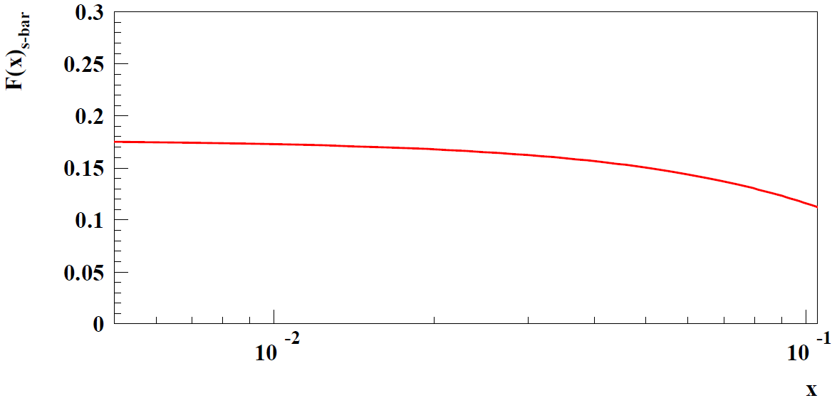
Unpolarized target
SU(6), CTEQ5L
NOMAD tuning used
Best description with SU(6)
model for spin transfer.
LEPTO MC: s-bar fractional
contribution

Slide 22
Quark type fraction in anti-Lambda production
LEPTO MC
with CTEQ5L
and COMPASS cuts
u
s
u
d
s
d
In contrast to K
production asymmetry,
mainly s-bar
contributes to
u
d
u
s
d
s
s
u
d
d
u
s
polarization in CFR
is a good s-PDF filter

Slide 23
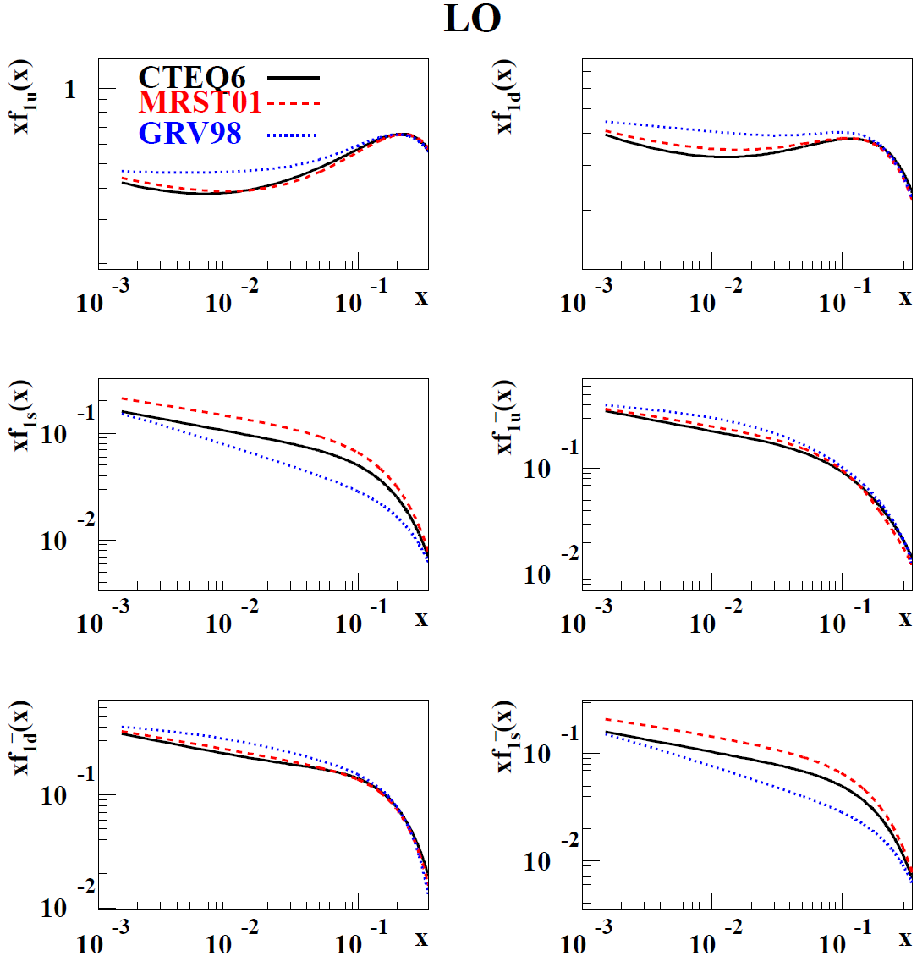
PDFs

Slide 24
Hyperon production cross-section and polarization for polarized beam and target (CFR)
From general considerations for double and triple
longitudinal polarization observables:
Triple-spin effect
Target polarization sign is written explicitly
Beam polarization contains sign

Slide 25
Polarization Asymmetry
Polarization asymmetry

Slide 26
Factorized LO QCD parton model
We can neglect
pol.dep. part in denom.
ISM expression is more complicated, but results are almost unchanged

Slide 27
in LO QCD parton SU(6) model

Slide 28
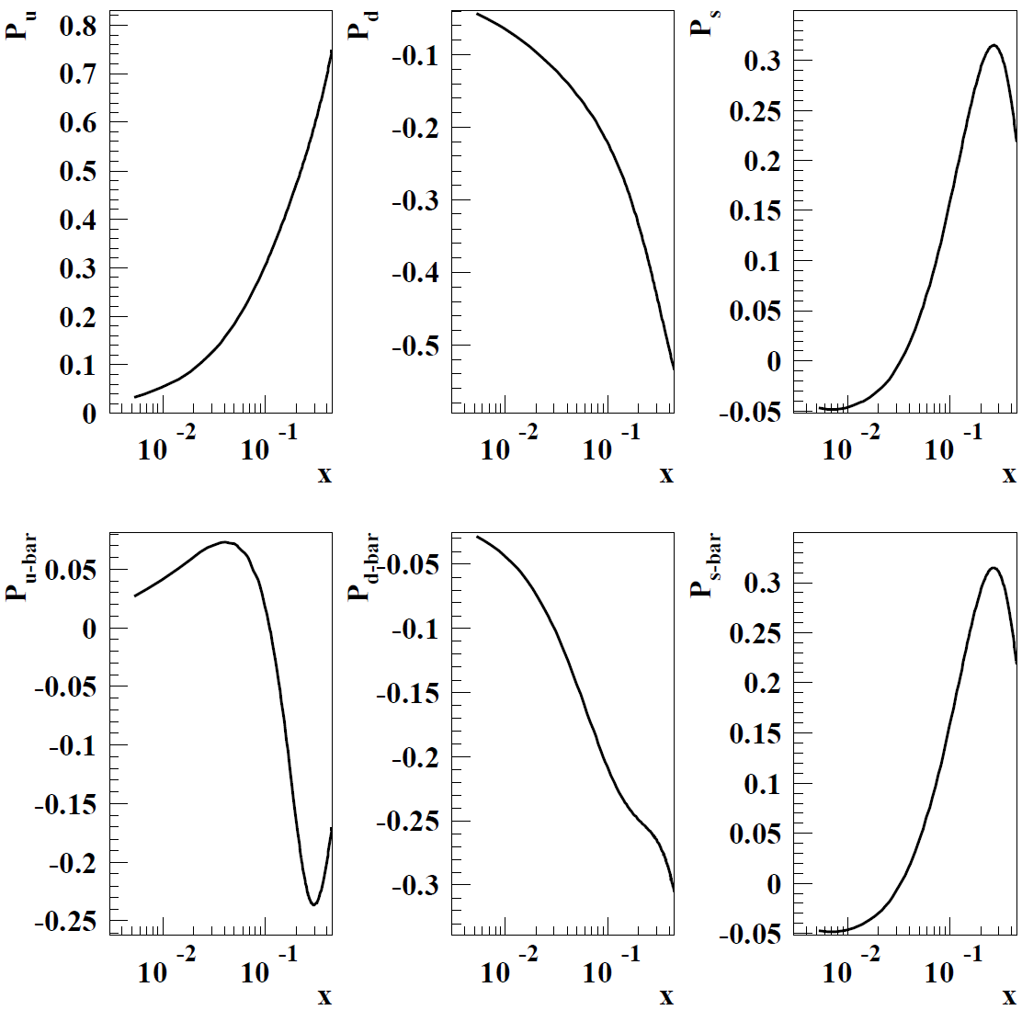
Two inputs for P_{q}=Δq/q
GRSV2000+GRV
DSSV 2008+MRST02

Slide 29
ISM calculations using LEPTO
Nomad settings and
Symbolic notations: Lund Model is realization of Fracture Functions.
Spin transfer via heavy hyperons is taken into account.
Separately calculate numerator and denominator by
reweighting each generated event

Slide 30
COMPASS cuts
Q² > 1 (GeV/c)²; 0.2 < y <0.9
Primary vertex: -100 < z < 100 or -30 < z < 30 (cm)
Decay vertex: 35 < z_{dec} < 140 (cm)
Vertexes colinearity cut: θ_{col} = 0.01
Decay particles momentum: p > 1 GeV/c
Feynman variable: 0.05 < x_{F} < 0.5
Λ rest frame decay angle cut: cos(θ*) < 0.6

Slide 31
Dependence on pol. PDFs
To verify sign change of Δs measure in two bins of x:
x < 0.03 and x > 0.03

Slide 32
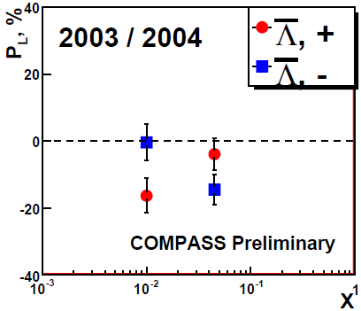
COMPASS preliminary
Sing change of ΔP corresponds to DSSV PDFs

Slide 33
Conclusions
(Anti)Lambda polarization measurements in SIDIS of polarized leptons off unpolarized and polarized targets can shed light on unpolarized and polarized strangeness distributions in nucleon
  (Anti)Lambda polarization on unpolarized target strongly depends on strangeness PDF
  Polarization asymmetry strongly depends on strangeness polarization
(Anti)Lambda polarization in SIDIS is well suited filter for nucleon strangeness study
We need more precise data and theory development

Slide 34
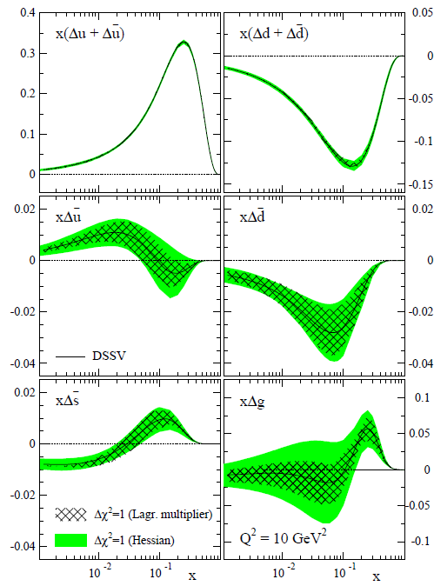
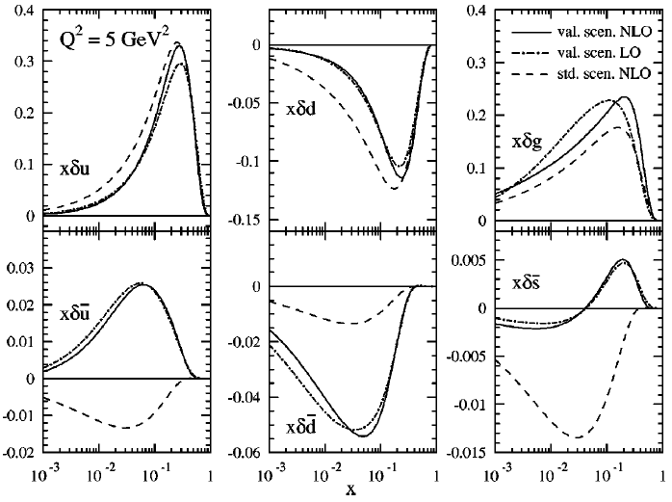
GRSV
DSSV

