Slide 1
ET Vacuum System
3 x (low frequency cryo-interferometer
+ high frequency warm-interferometer)
Baseline solution
Build one detector, the other two will follow later
HF at ground floor
LF cryo at upper floor

Slide 2
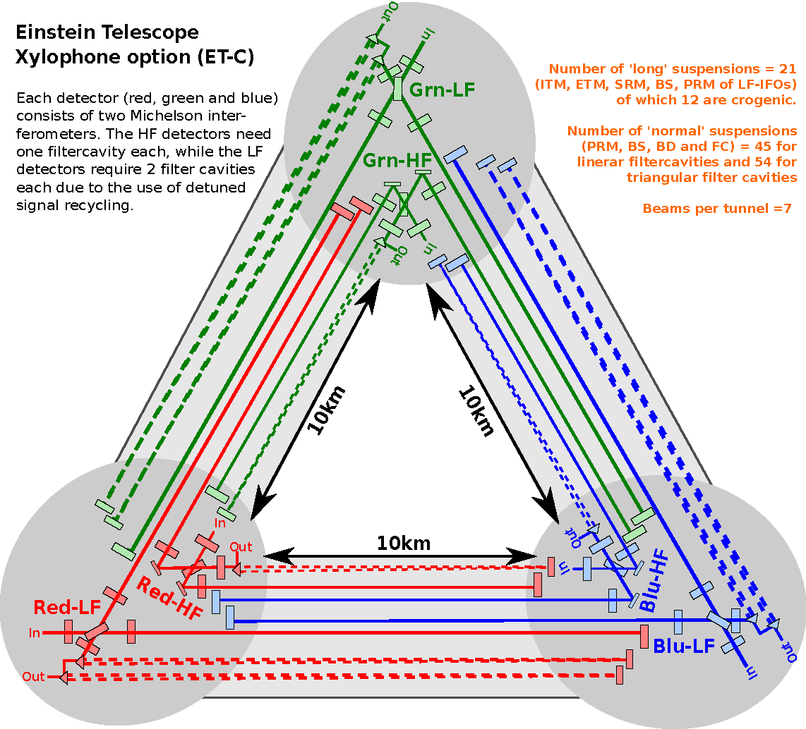

Slide 3
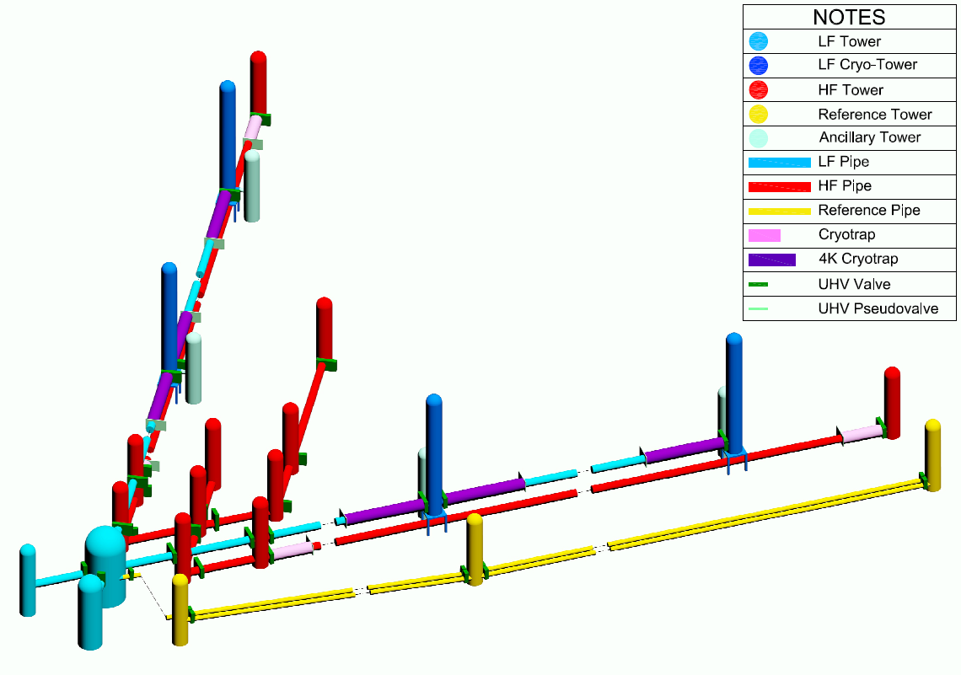
ET Vacuum System Lay-out
φ 750 mm 2 x 10 km
φ 900 mm 2 x 10 km + 700 m
φ 670 mm 2 x 10 km

Slide 4
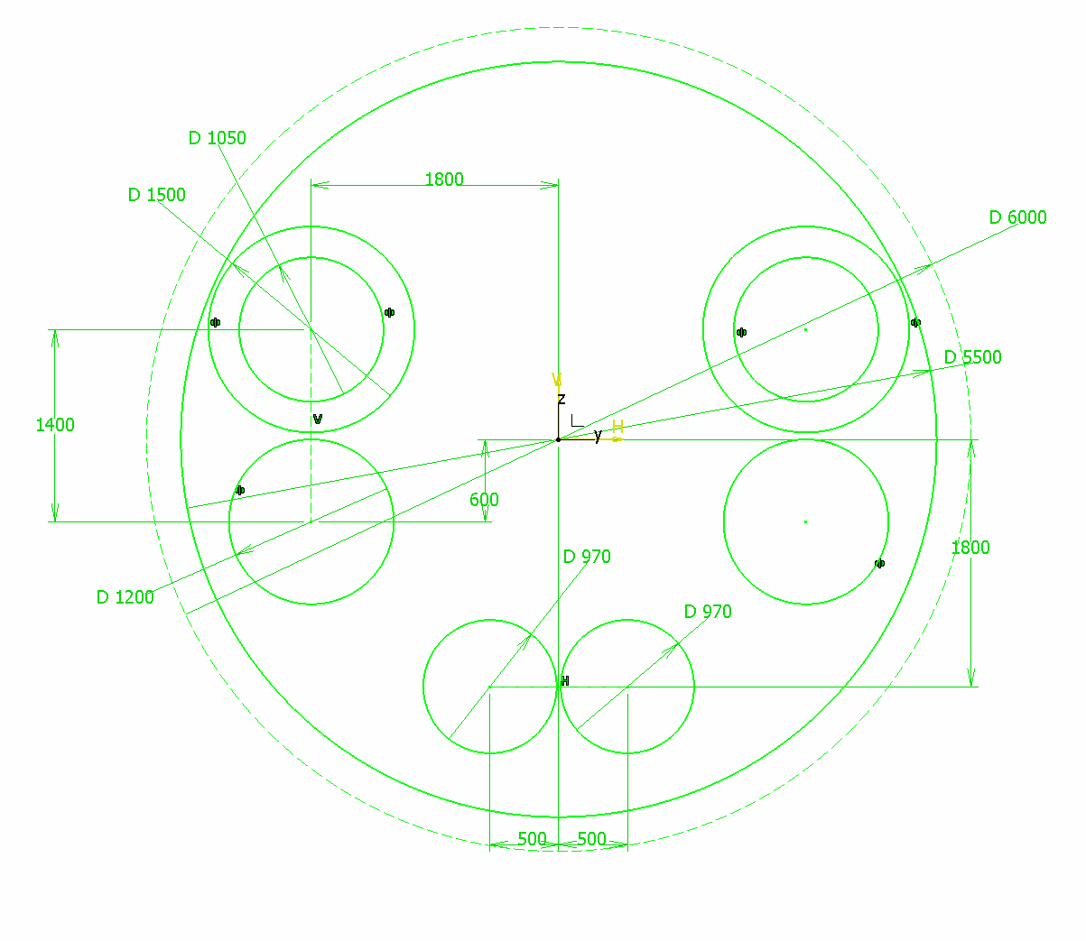

Slide 5
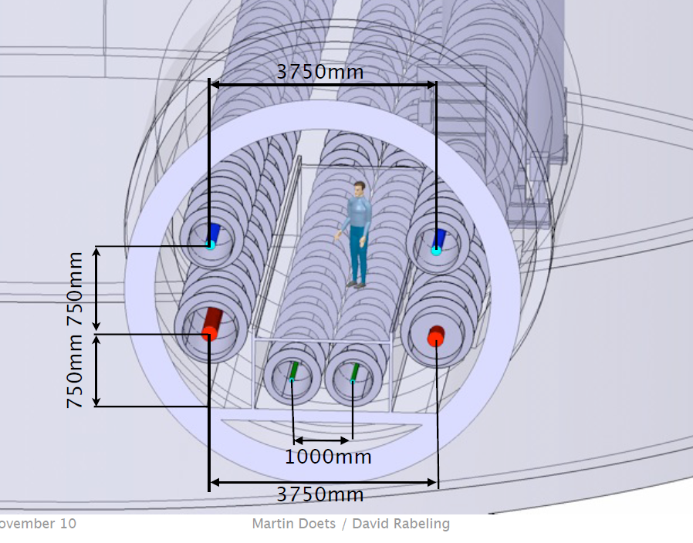

Slide 6
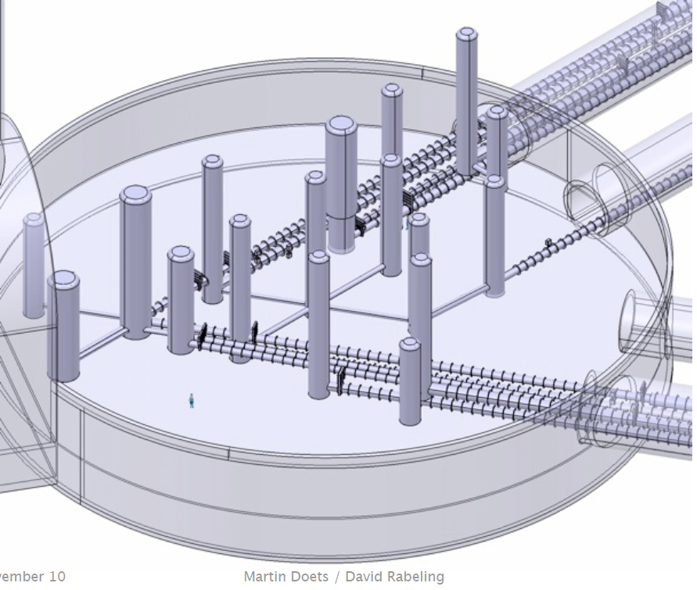

Slide 7
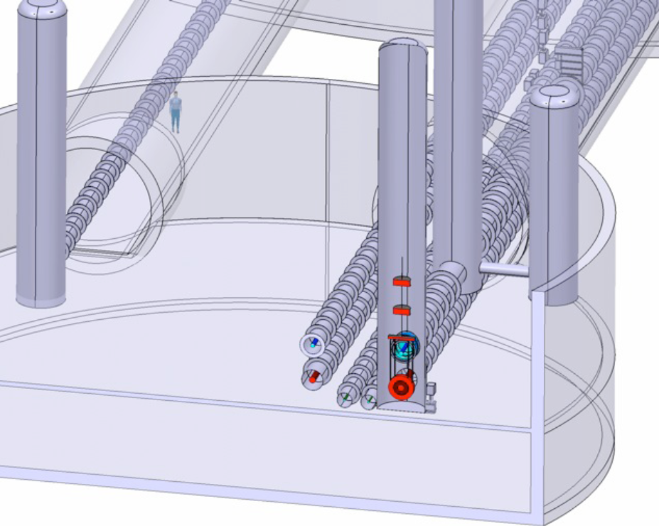

Slide 8
Vacuum pipes
304L, 3-4 mm spiral welded on site, with outer stiffening rings
20 m elements including bellows and lips for on site assembly
  HF 0.9 m diameter, free aperture 0.7 m (baffles), outer diameter 1.2 m (thermal insulation)
  LF 0.75 m diameter, free aperture 0.45 m (baffles), outer diameter 1.05 m (thermal insulation), cryotrap diameter 1.5 m
  filter cavities 0.7 m diameter, free aperture 0.4 m (baffles), outer diameter 1.0 m (thermal insulation)

Slide 9
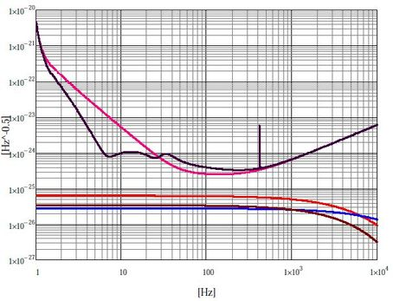
10⁻²¹ Hz^{-1/2}
10⁻²⁴ Hz^{-1/2}
H₂ 10⁻¹⁰ mbar
H₂O 5.10⁻¹¹ mbar
N₂ 10⁻¹¹ mbar
“Vacuum Noise” - after firing @ 400 ºC and baking @ 150 ºC

Slide 10
10⁻⁶ mbar
10⁻¹⁰ mbar
10⁻⁸ mbar

Slide 11
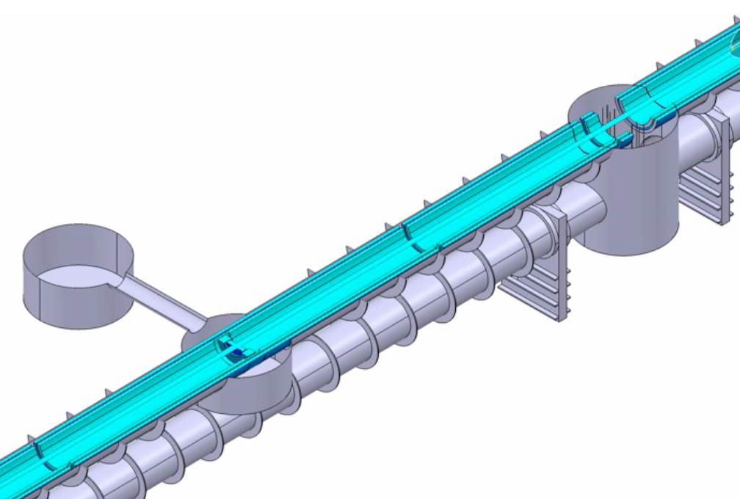

Slide 12
PUMPING SYSTEM
Pipes 120 x (60 km / 500 m)
Evacuation 2000 l/s turbo + scroll
Permanent 5000 l/s Ti sublimation + 300 l/s Ion
Cryotraps (4 x 8 m liquid N₂, 6 x 50 m liquid He)
Evacuation 2000 l/s turbo + scroll
Towers (21 x)
upper chamber evac. 2000 l/s turbo + scroll
perm. 2500 l/s cryo + Ion (TBC)
mirror chamber evac. 2000 l/s turbo + scroll
perm. 2500 l/s cryo + Ion
Cryo Towers (4 x)
upper chamber evac. 2000 l/s turbo + scroll
perm. 2500 l/s cryo + Ion (TBC)
mirror chamber evac. 2000 l/s turbo + scroll
perm. 2500 l/s cryo + Ion

Slide 13
Vacuum System Challenges
Cleanliness
Thermal treatments
Quiet pumping
COST

