Slide 1
Outline
Exercising the Reader for the 2L channel
  nominal (latest publication) selection
    a first look at trees
Jet variables modeling for three jet collection variants
  check data / MC in the Reader output before applying W/Z tagging cuts
  Ongoing … no updates today
(p)DNN code adapted to the current Reader version
  first functionality tests
Next steps

Slide 2
Running the reader for the 2L channel
Current master version run on SM background processes, signal and data (2015-2016) for all jet collections, TCC_EMTopo, LCTopo_EMTopo, and UFO_PFlow (v33-08)
For TCC_EMTopo, distributions of mllJ or mlljj for signal and Z control regions obtained from the trees:
  ZZ signal regions and Z+jets control regions:
    3 in VBF (MergHP, MergLP, Res)
    6 in ggF/DY: (MergHP, MergLP, Res) x (Tag, Untag)
  ZW signal and Z+jets control regions
    3 in VBF: (MergHP, MergLP, Res)
    3 in ggF/DY: (MergHP, MergLP, Res)
easytreeplotter (tree to histograms with root data-frames manipulation):
  Following instructions in https://gitlab.cern.ch/CxAODFramework/CxAODReader_VVSemileptonic/-/wikis/Plotting%20Tools - thanks to Rob. L.
plotting macros of CxAODReader_VVSemileptonic

Slide 3
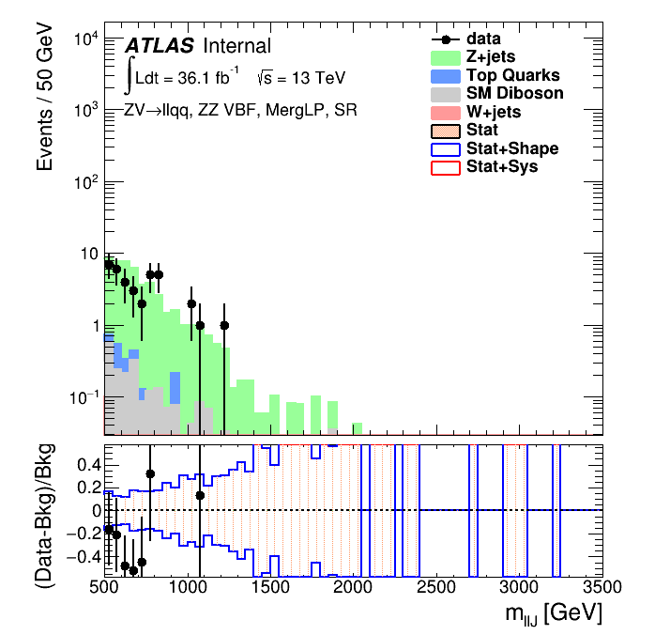
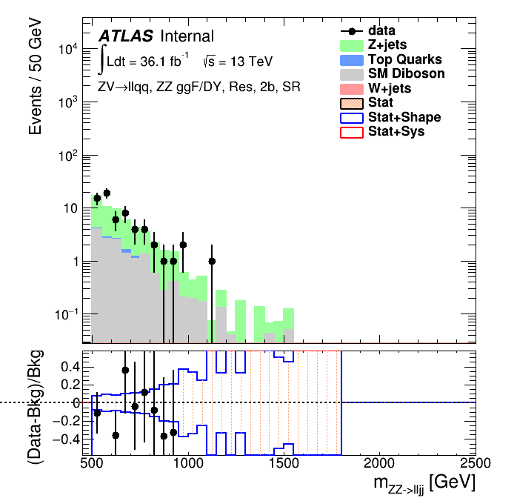
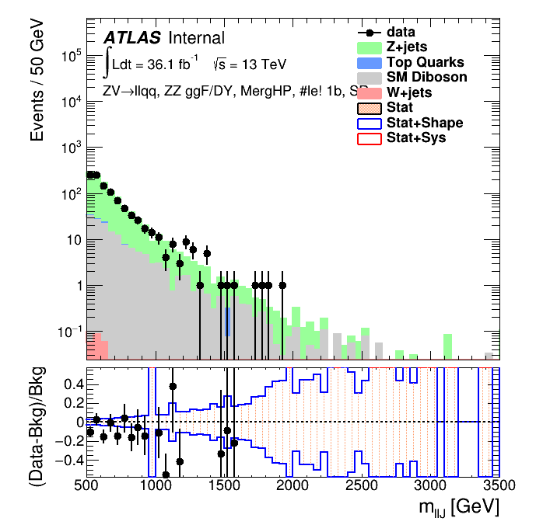
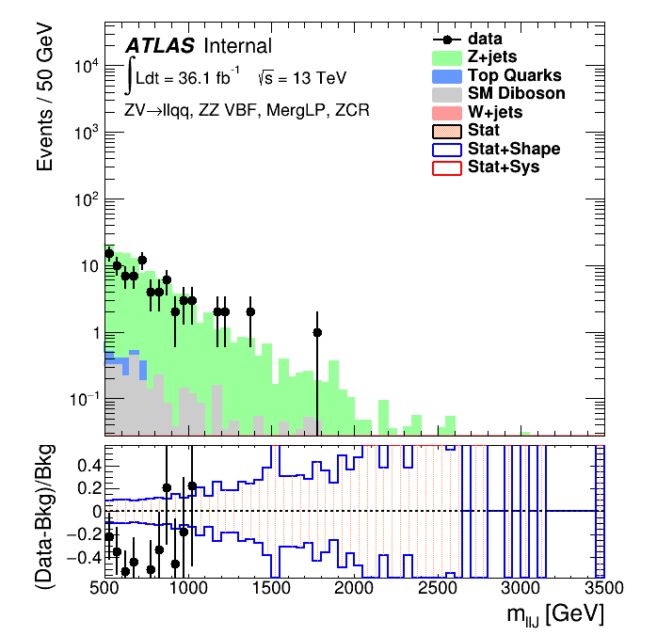
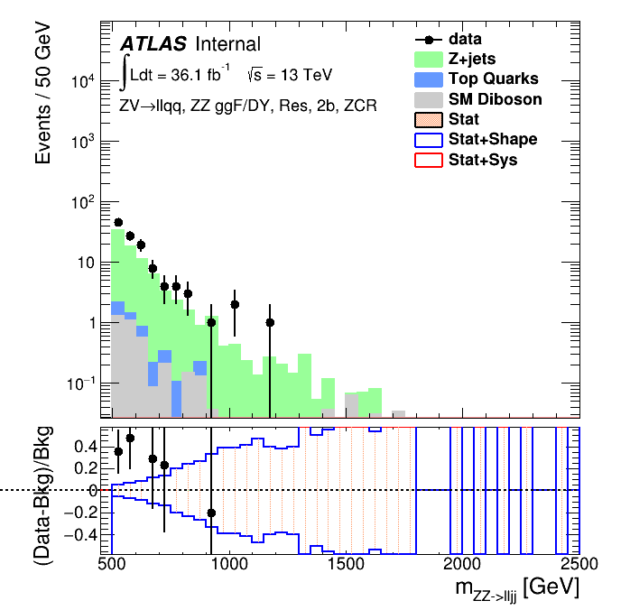
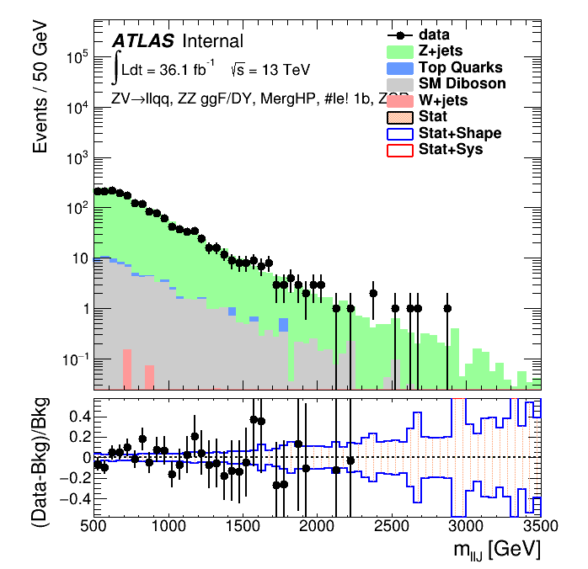
Running the reader for the 2L channel
a sample of plots
MergLP_VBF_ZZ_SR_X_boosted_m
Res_GGF_ZZ_Tag_SR_X_resolved_WZ_m
MergHP_GGF_ZZ_Untag_SR_X_boosted_m
MergLP_VBF_ZZ_ZCR_X_boosted_m
Res_GGF_ZZ_Tag_SR_X_resolved_WZ_m
MergHP_GGF_ZZ_Untag_ZCR_X_boosted_m

Slide 4
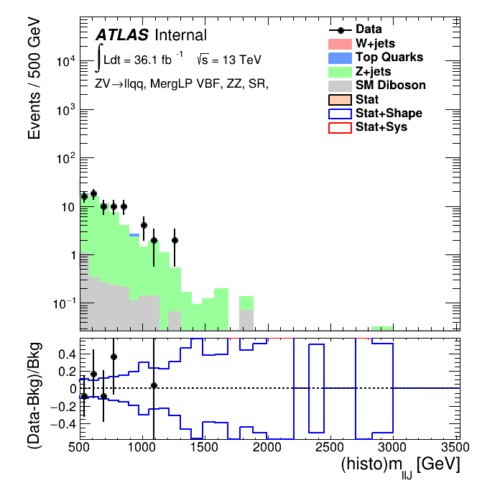
Running the reader for the 2L channel
comparing plots obtained from the trees with Reader output histograms
Tree
Histograms
MergLP_VBF_ZZ_SR_X_boosted_m
MergLP_VBF_ZZ_SR_X_boosted_m
yield in the output histograms is ~twice the yield from trees
  bug in histogram filling code identified and fix provided, being delivered to the repository

Slide 5
Running the reader for the 2L channel
several checks still to be done but toolset successfully exercised
bug in histogram filling code identified and fix provided, being delivered to the repository

Slide 6
℗ DNN
Alessandra’s slides

Slide 7
Next steps
Reader
  Gain confidence in cut-flows and histograms + tree output
  Scrutinize reader 2L analysis configuration
DNN/pDNN
  Proceed with validation and optimization
  Understand in detail the performance
  Consider a wider set of variables
Interface DNN & Reader
  Started looking at the lwtnn
  We are available/willing to work on updating the pDNNUpdates branch
    Shall we ?
    Anyone else interested in / undertaking this task ?

