Slide 1
Future RPC development R.Cardarelli
RCC kick off meeting
12/05/2021

Slide 2
Cylindrical geometry
The cylindrical geometry is very interesting in the case the external pressure is different respect to the internal gas gap pressure, two important cases:
The external pressure is very low, application in space
The internal pressure of the gas gap is very high for instance 2-10 bar, this high pressure is useful to increase the performance of the detector in the range of ps time resolution , high efficiency per single gas gap and spatial resolution (30-50 um), for this approach the experience of MDT ATLAS group for large gas distribution at 3 bar, is very important.

Slide 3
Detector with uniform field but different geometry
Mono-gap planar geometry
Cylindrical mono-gap geometry
Cylindrical multi-gap geometry
Multi-gap planar geometry
Gas gap

Slide 4
RCC structure
Graphite
Bakelite
Foam
Copper

Slide 5
Electric field in cylindrical geometry
In fig (1) the Emax trend is graphically represented as a function of the ratio R1 / R2
From (1) it is clear that the electric field E reaches its greatest value on the surface of the inner cylinder, that is for r = R1, while as r increases it decreases until it reaches its smallest value at r = R2; ie on the surface of the outer cylinder
There are two cases:
for R2 / R1 <(1 / e) we have the gas discharge rate at Townsend
for R2 / R1> (1 / e) we have the spark rate
E_{max}
R₁
r
R₂
R₁/R₂
1
fig1
fig2
(1)
E=(V/r)/log(R₂/R₁)
(2)
E_{max}=(V/R₁)/log(R₂/R₁)

Slide 6
Working mode for different polarization
Gradient electric field increase in the direction of electronic avalanche, over exponential multiplication
Gradient electric field decrease in the direction of electronic avalanche, under exponential multiplication,

Slide 7
MDT+RCC
Resistance 30 ohm
Out RCC
HV RPC
Wire MDT
Resistance 1Mohm
Graphite
Resistance 1Mohm
Aluminum tube
Gas gap RCC
HV MDT
Bakelite tube
Resistance 1Mohm
Out MDT
Gas gap MDT
Copper tube
insulating tube

Slide 8
RCC preliminary tests and results Alessandro Rocchi
RCC kick off meeting
12/05/2021

Slide 9
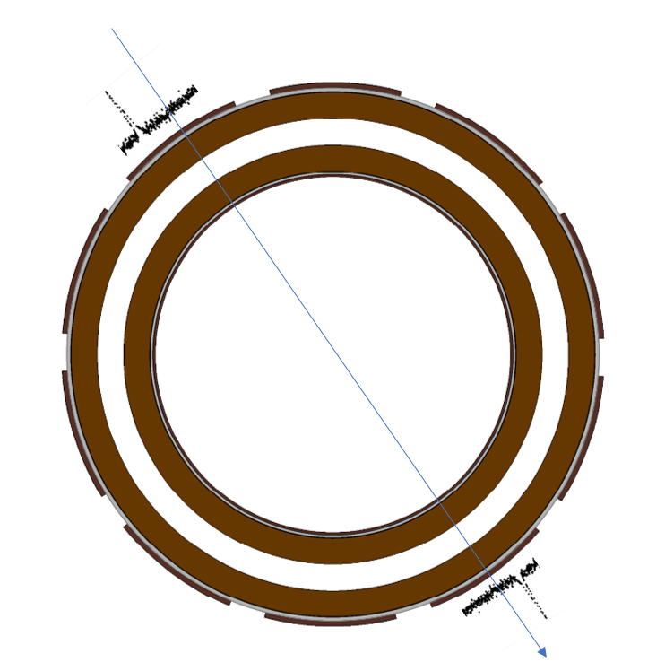
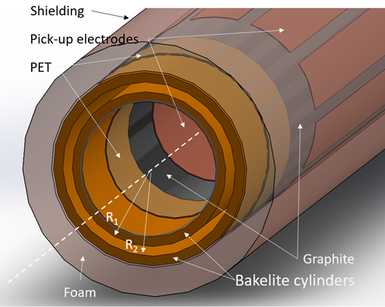
Prototypes
RPC Cylindrical chamber with 1 mm gas gap:
Feasibility study of Resistive Chylindrical chambers
Effcet of the electric field gradient on the detector performance
RPC Cylindrical chamber with 0.2 mm gas gap :
Effcet of the gas pressure on the detector performance
RPC Cylindrical chamber with 1 mm gas gap, metallic ground electrode, integrated with MDT detector:
Feasibility study of Resistive Chylindrical chambers integrated with MDT detector (same gas mixture, same readout pick-up)

Slide 10
Cylindrical bakelite electrode resistivity
$ρ=4,3 ×{10}^{12}$ Ω cm

Slide 11
RCC 1 mm (prototype design)
Electric field inside the gas gap with ∆V=+5600 V
$$E\left(r\right)=−\frac{V}{r log\frac{R_{1}}{R_{2}}}$$
Grafite
HV
Z_{L}
~ 5 cm
D₁ = 16 mm
D₂ = 18 mm
Gap = 1mm

Slide 12
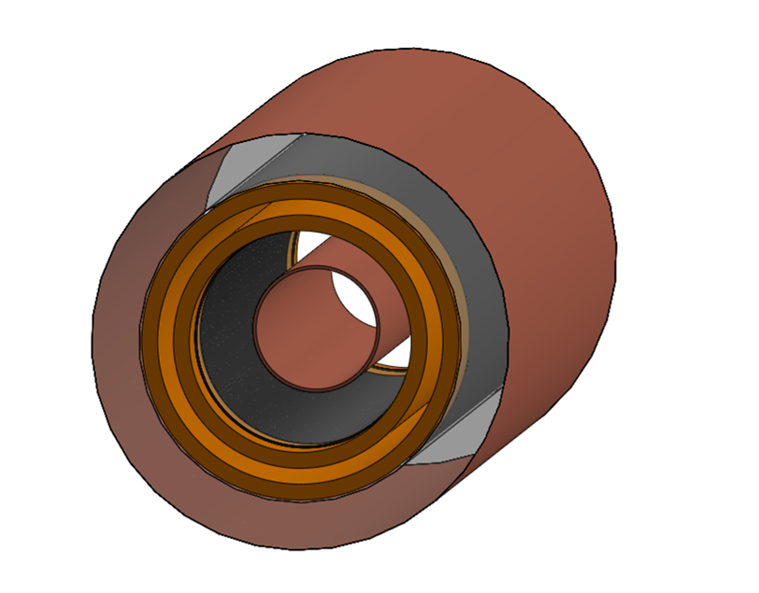
RCC 1 mm (experimental setup)
Bakelite
Shielding
Read – out RPC 200 um
Signals
Foam
Trigger: Scint 1 And Scint 2 And Scint 3
Graphite
Scintillator 1
Pick-up
Scintillator 2
Scintillator 3
RPC 0,2 mm

Slide 13
RCC 1 mm efficiency

Slide 14
RCC 1 mm (time of flight as respect to RPC 0,2 mm)
HV -
HV +

Slide 15
RCC 0.2 mm (prototype design)
Electric field inside the gas gap with ∆V=+3000 V
$$E\left(r\right)=−\frac{V}{r log\frac{R_{1}}{R_{2}}}$$
Grafite
HV
Z_{L}
~ 5 cm
D₁ = 17,6 mm
D₂ = 18 mm
Gap = 0,2 mm

Slide 16
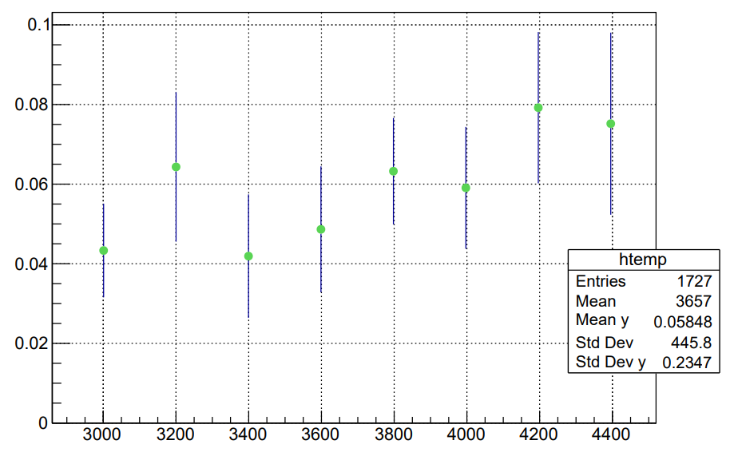
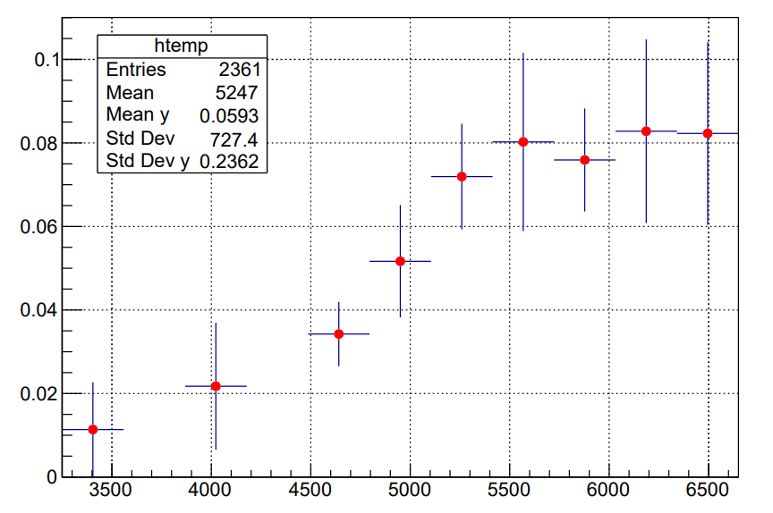
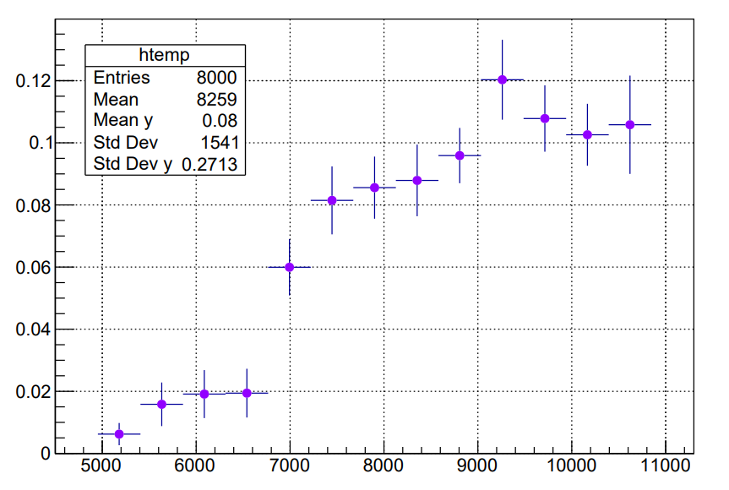
Efficiency x acceptance RCC 200 µm negative HV - CO2 100%
+0 bar
+1 bar
+2 bar
HV (V)
HV (V)
HV (V)

Slide 17
Efficiency x acceptance RCC 200 µm negative HV - CO2 100%
Efficiency plateau as function of the gas pressure
Efficiency knee as function of the gas pressure

Slide 18
RCC 0.2 mm (signals average)
Average profile of normalized signals

Slide 19
RPC Cylindrical chamber with 1 mm gas gap, metallic ground electrode, integrated with MDT detector
Metallic wire
Graphite
MDT signals Ar-CO2 (86%-14%)
HV1
Metal
Z_{L}
HV2
~ 5 cm
D₁ = 16 mm
D₂ = 18 mm
Gap = 0,1 mm

Slide 20
MDT Efficiency Ar-CO2 (86%-14%)
Pick-up on the wire
External pick-up

Slide 21
RCC + MDT
RCC time resolution
RCC Signals std_mixture

Slide 22
RCC Efficiency TFE-iC4H10-Sf6 (94,5%-5%-0,5%)

Slide 23
TOF with respect to the trigger signal MDT Ar-CO2 (86%-14%) vs RCC mix std

