Slide 1

HE and VHE gamma-ray observations in the multi-wavelength and multi-messenger context
Congresso della Sezione INFN e del Dipartimento di Fisica di Bari
21-22 giugno 2021
Serena Loporchio – serena.loporchio@ba.infn.it

Slide 2
Agn: Active galactic nuclei
Galaxies with HE emission from the nucleus which cannot be explained as thermal radiation
SMBH accreting + disk of hot plasma rotating
Can be radio-loud or radio-quiet

Slide 3
Agn: Active galactic nuclei
Galaxies with HE emission from the nucleus which cannot be explained as thermal radiation
SMBH accreting + disk of hot plasma rotating
Can be radio-loud or radio-quiet
  Loudness in radio band → production of collimated jets (several kpc)
  Jets are the only components of AGN able to produce VHE emission
  Blazars: close alignment between jets and line of sight

Slide 4
Spectral Energy Distribution
Markarian 421
HBL
z=0.031
Discovered in 1992
We learn something different from each component!
Synergy between instruments and community is crucial!
A. A. Abdo et al 2011 ApJ 736 131

Slide 5
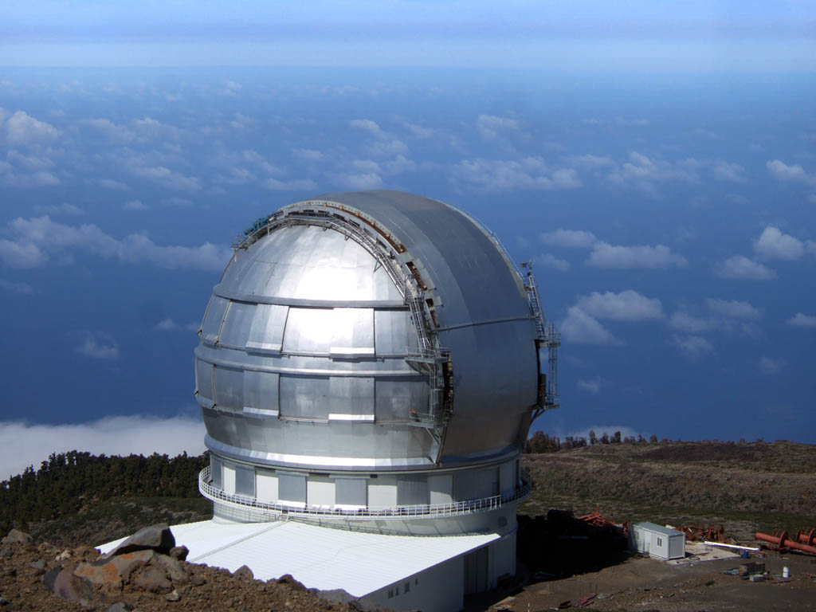
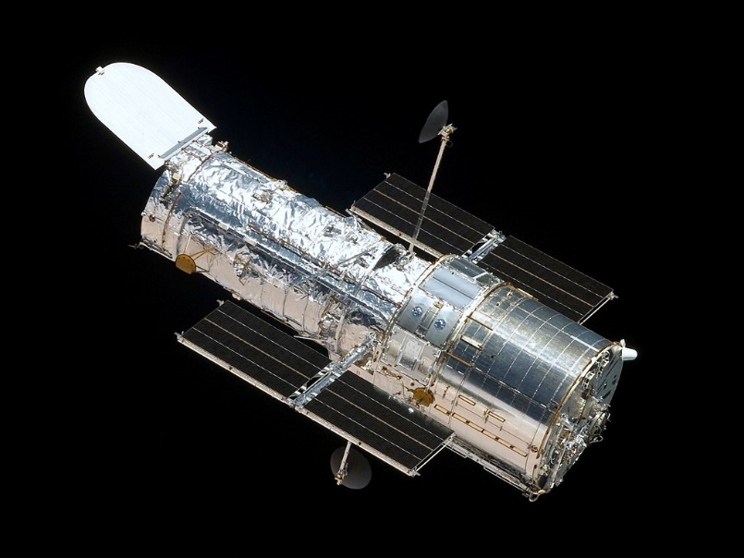
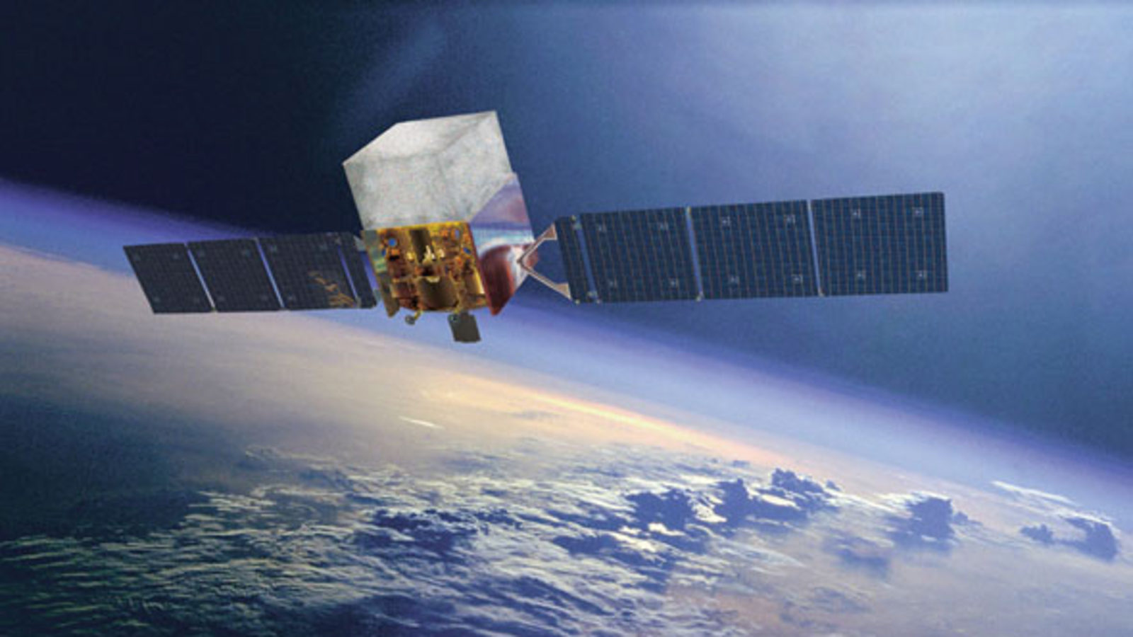
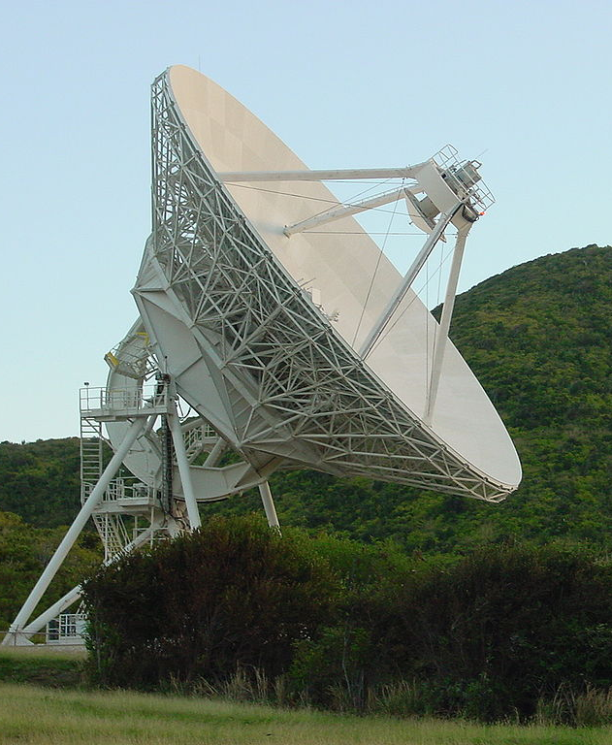
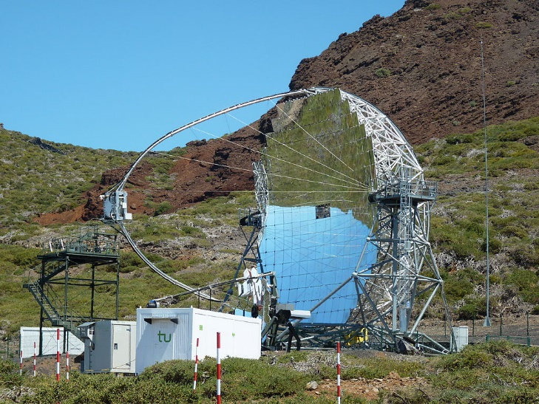
Spectral Energy Distribution
Optical telescopes
and
satellites
VHE gamma-ray:
Cherenkov telescopes
X-ray telescopes
HE gamma-ray:
Fermi satellite
Radio telescopes
A. A. Abdo et al 2011 ApJ 736 131

Slide 6
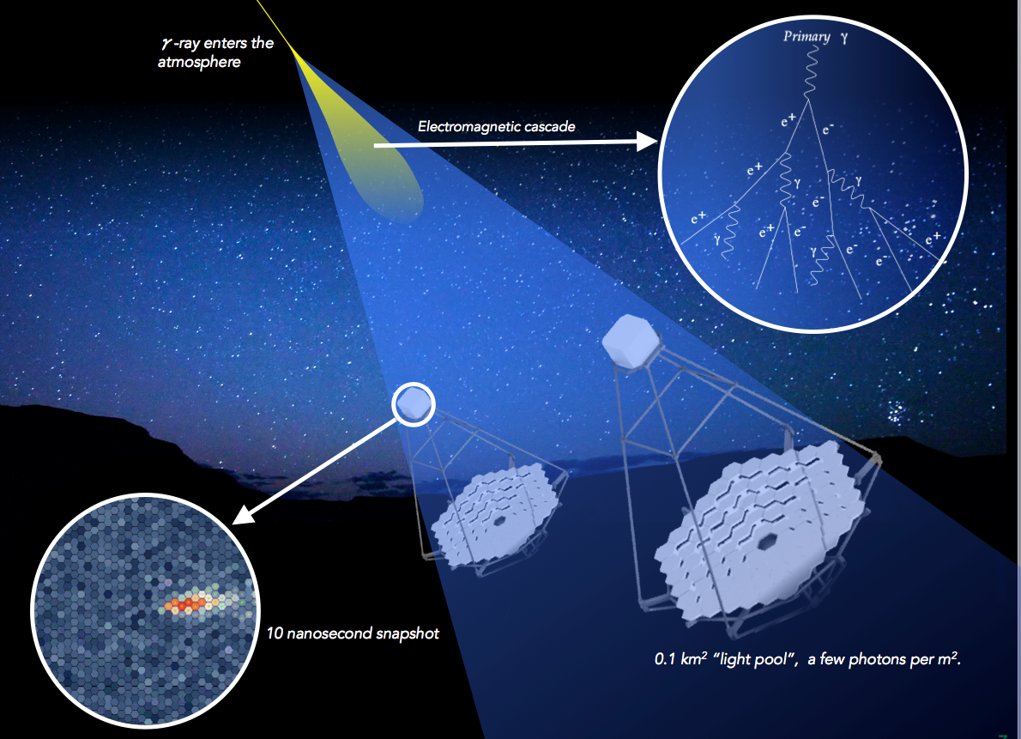
VHE GAMMA-RAY Detection:
Cherenkov telescopes
System of stereo telescopes to detect VHE gamma rays thanks to their interaction with the atmosphere
Image reconstruction → nature of primary, energy and direction
From tens of GeV to tens of TeV
3 instruments (at the moment):
  MAGIC, H.E.S.S. and VERITAS
Future: CTA

Slide 7
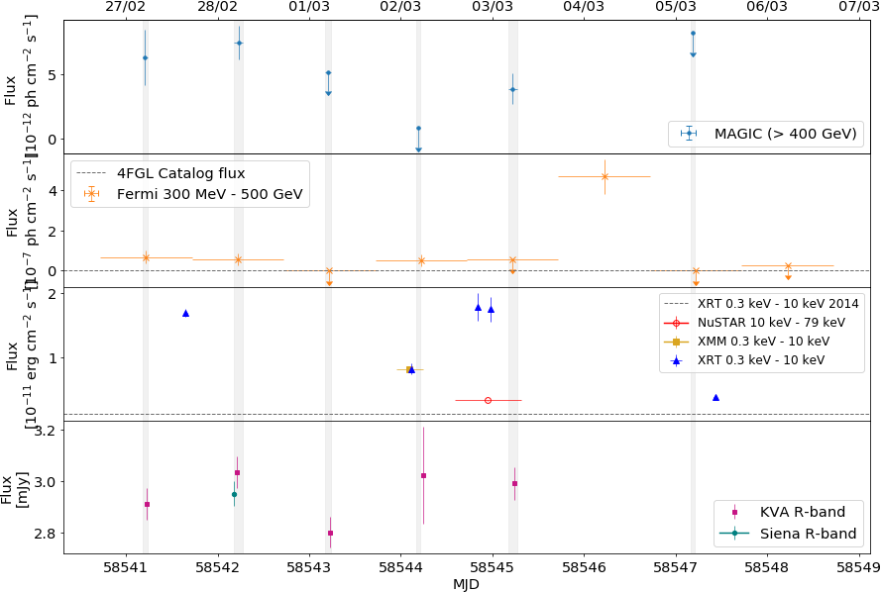
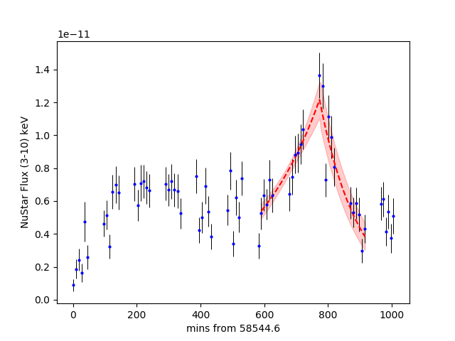
TXS 1515-273 X-ray variability
TXS 1515-273
HBL
z=0.1281
Discovered in 2019
MWL light curve of BL Lac object TXS 1515-273 during observational campaign in 2019
Rapid variability in the X-rays
VHE γ
HE γ
X-rays
Optical
Notes:
Qui vediamo la curva di luce a diverse

Slide 8
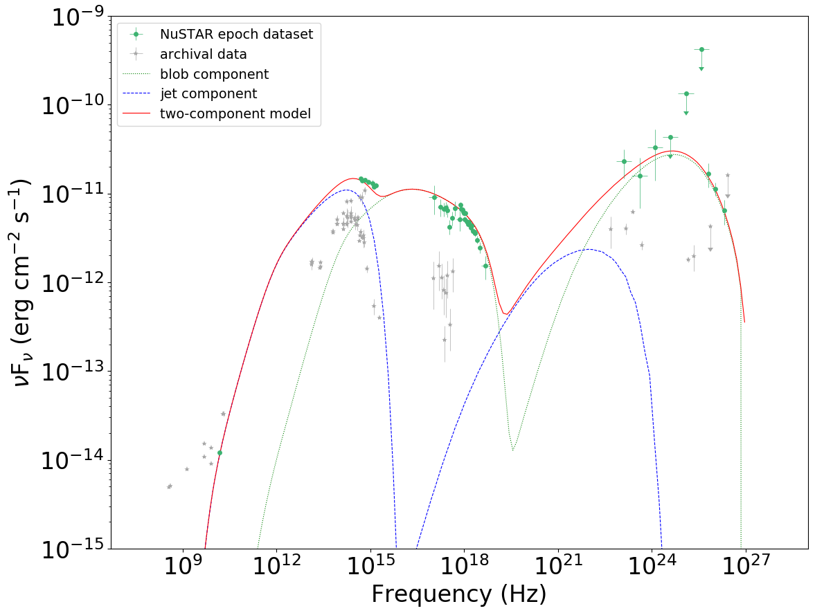
TXS 1515-273 SED modeling
SED modelling with leptonic models
Parameters constrained from different observations
Synchrotron emission + IC on same electron population → Synchrotron Self Compton
Hadronic models?
Blazars are proposed as UHECR accelerators

Slide 9
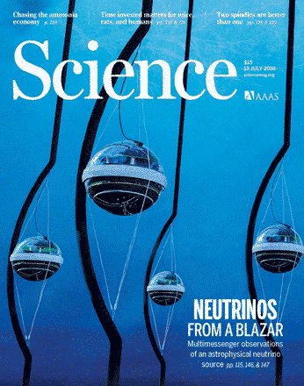
A Multi-messenger case:
TXS 0506+056
TXS 0506 is a bright gamma-ray emitting blazar
Special interest for the hadronic scenario
September 22, 2017: neutrino with E = 290 TeV detected by IC in
  AMON_ICECUBE_EHE alert 50579430 distributed via AMON & GCN after 43s
  Multiple observatories pointed at its location after the IC trigger
  Spatial and temporal coincidence with enhanced gamma emission
Evidence of hadronic emission in blazars
A. Keivani et al., ApJ 864:84 (2018).

Slide 10
Neutrinos from TXS 0506+056 (IceCube)
IceCube Collaboration et al., Science 361 (2018).
Electromagnetic follow-up campaign of the event IceCube-170922A → the event came from the direction of a known AGN blazar, TXS 0506+056.
Found to be flaring at multiple wavelengths.
IceCube conclusion: evidence of a HE ν from a blazar
z=0.3365

Slide 11
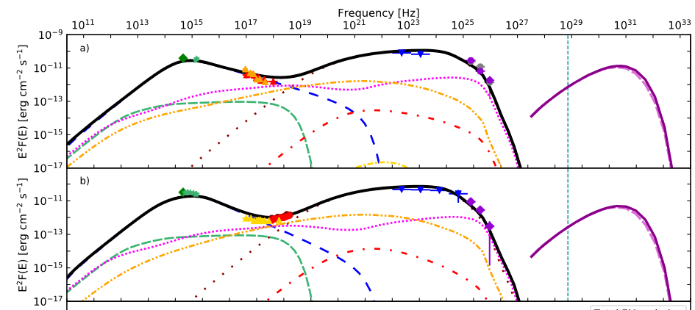
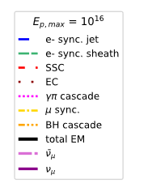
Hadronic models and neutrino production in agns
ν
π±
p
γ
radiation fields and matter
π⁰
γ
e±
Leptonic & hadronic components
High state
Low state
S. Ansoldi et al 2018 ApJL 863 L10

Slide 12
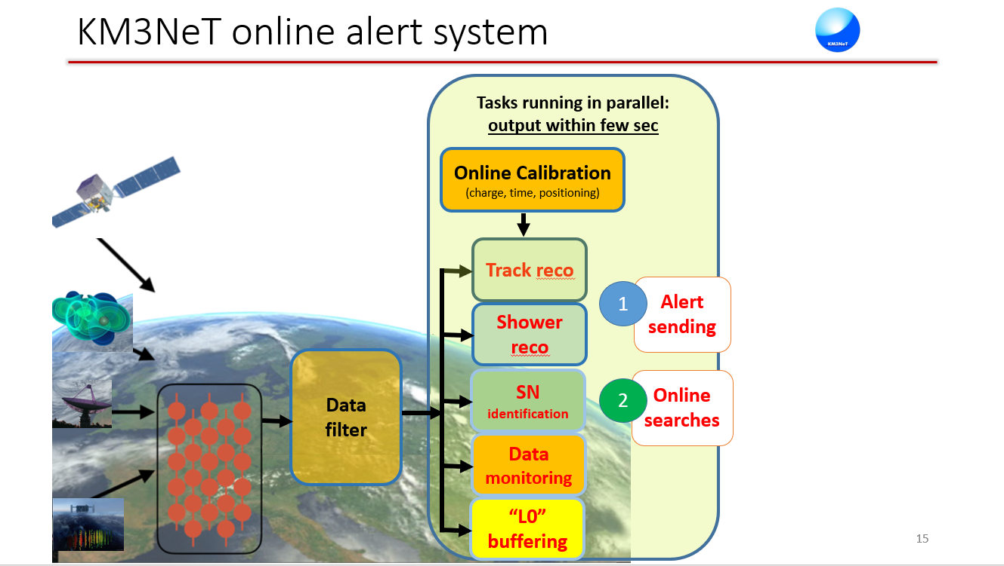
M. Spurio: Neutrino telescopes,
@ THESEUS CONFERENCE 2021
Notes:
In casi come quello che vi ho appena descritto è fondamentale, da parte della comunità astrofisica, una reazione immediate. È quindi necessario che I dati vengano analizzati velocemente e che le allerte siano mandate, a tutta la comunità che parte di questo network, nel minor tempo possible.

Slide 13


Multi-messenger doesn’t go on holiday!
B. P. Abbott et al 2017 ApJL 848 L12
17 August 2017: Fermi-GBM detects GRB170817A at
12:41:06 UTC
GCN is issued at 12:41:20 UTC
6 minutes later a GW is detected, consistent with a
BNS merger at 12:41:04 UTC,
less than 2s BEFORE the GRB.
70 observatories → extensive observing campaign
in all e.m. spectrum
Bright optical transient detected less than 11h after
the merger
X-ray and radio counterpart
Breakthrough of the Year by Science!

Slide 14
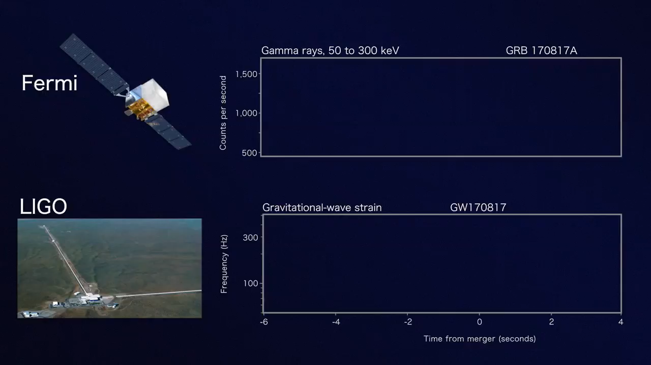
Gamma-ray and GW:
Multi-messenger from GRBs

Slide 15

Gamma-ray and GW:
Multi-messenger from GRBs
NS-NS merging
Host galaxy NGC 4993
~ 40 Mpc
Transient GW signal from a binary neutron star merger: GW170817 + GRB170817A
Huge regions of the sky
The first multi-messenger paper

Slide 16
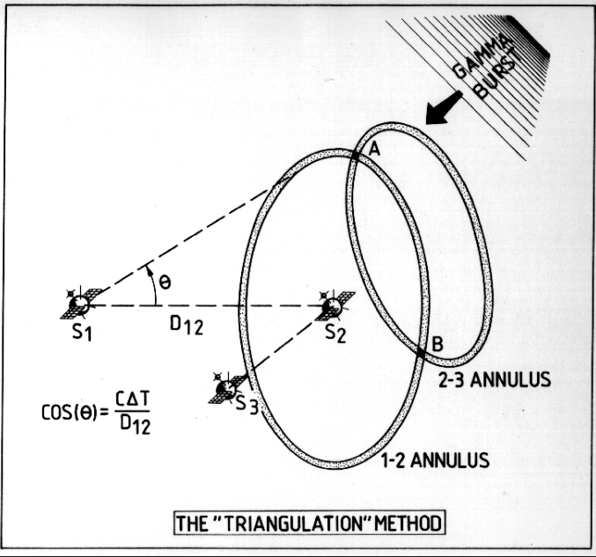
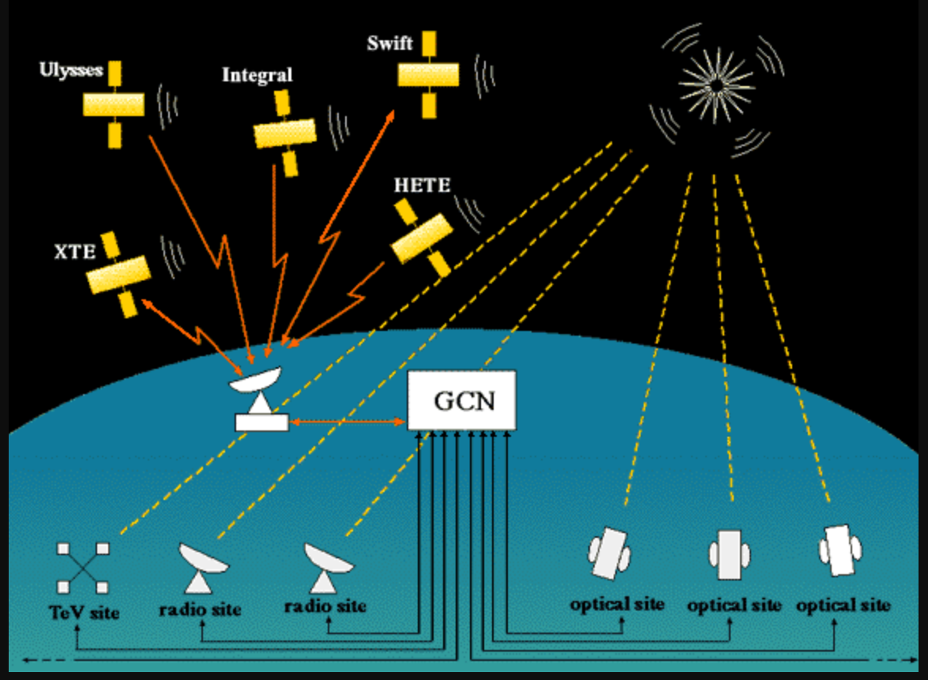
Synergy is the key!
The 3rd Interplanetary Network (IPN3)
The Gamma-ray Coordinates Network (GCN)
Astrophysical Multimessenger Observatory Network (AMON)
transient
Notes:
Riprendo anche IC: network che comprande tutti I messaggeri e tutti gli strumenti
AMON
GCN
Collaborazioni di tutto il mondo
Data Open access
Pop up: software tools, open data, far parlare tutto con tutto expertise di persone che fanno cose diverse
Sponsorizzare nuove missioni: APT, AMEGO, CTA?
Quando ricomincia ligo?
Timeline ligo/virgo

Slide 17
Optical telescopes
and
satellites
VHE gamma-ray:
Cherenkov telescopes
X-ray telescopes
HE gamma-ray:
Fermi satellite
Radio telescopes
A. A. Abdo et al 2011 ApJ 736 131

Slide 18
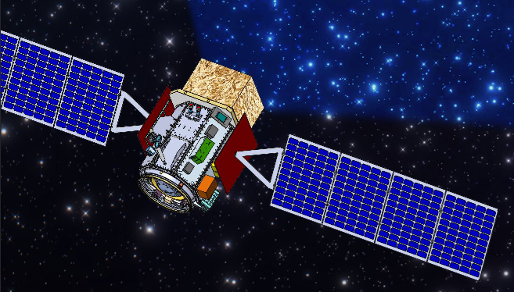
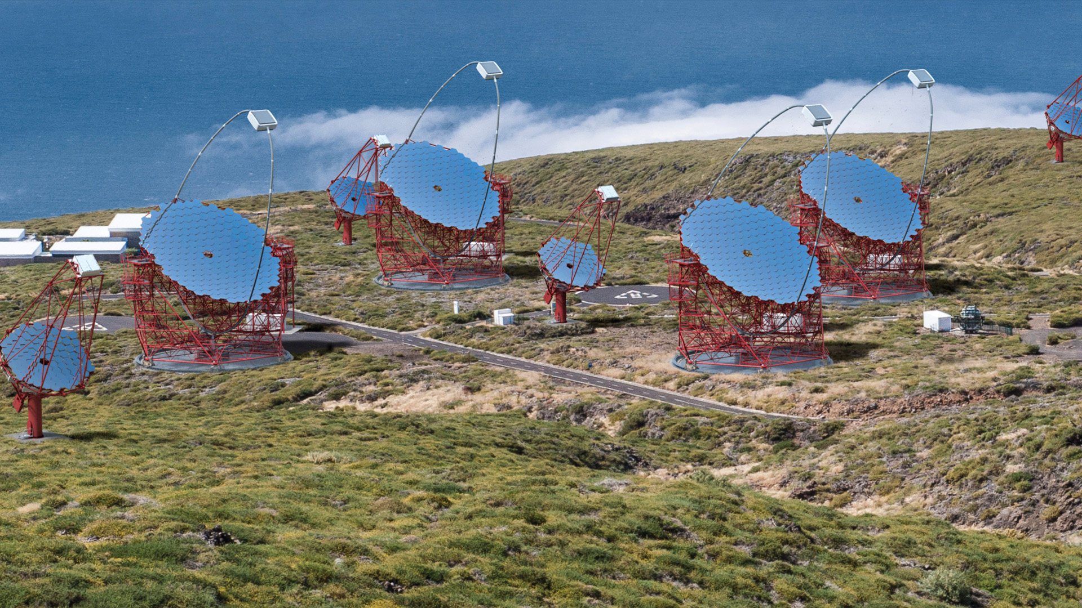
New satellites for MeV energy range: APT, AMEGO
Optical telescopes
and
satellites
Future of Cherenkov: CTA
VHE gamma-ray:
Cherenkov telescopes
X-ray telescopes
HE gamma-ray:
Fermi satellite
Radio telescopes
A. A. Abdo et al 2011 ApJ 736 131
Notes:
Aggiungere bolle di CTA e MeV → future?
+ interferometri Ligo india e kagra
+ neutrini

Slide 19
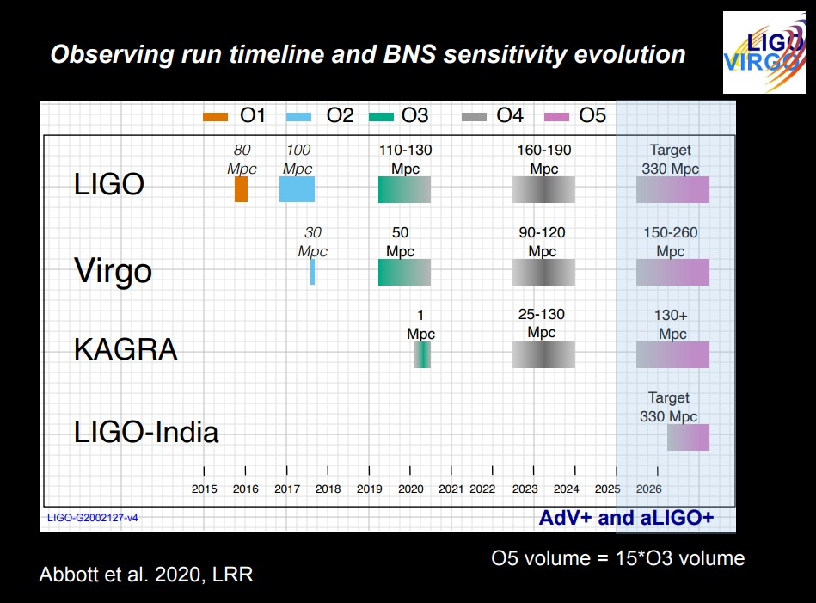
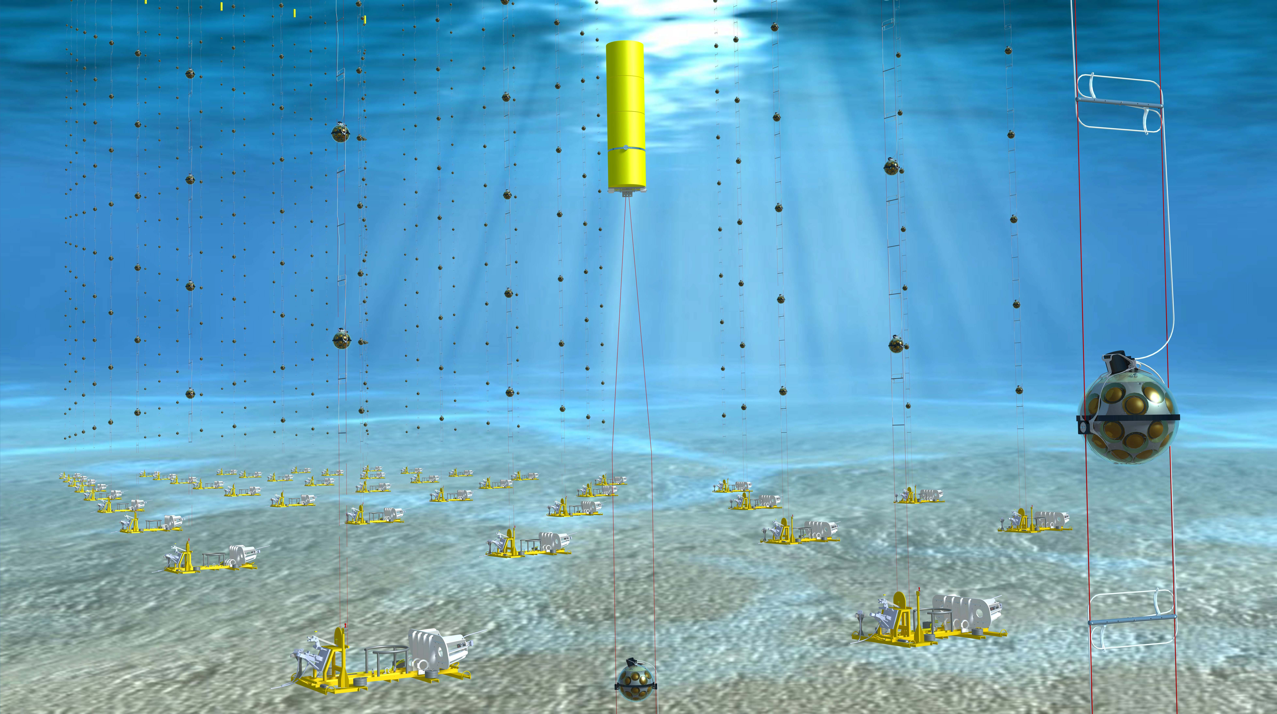
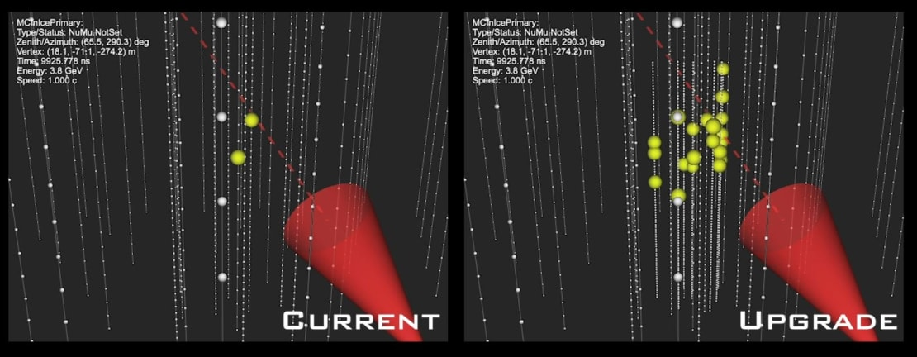
New satellites for MeV energy range: APT, AMEGO
Optical telescopes
and
satellites
Future of Cherenkov: CTA
VHE gamma-ray:
Cherenkov telescopes
X-ray telescopes
HE gamma-ray:
Fermi satellite
Radio telescopes
A. A. Abdo et al 2011 ApJ 736 131
Notes:
IceCubeplans to extend to 10 km3of glacial ice at the South Pole, improving IceCube’ssensitive volume by an order of magnitude. Expected thousands events per year over several years. •On the other side of the world in the Mediterranean sea. ANTARES is currently the only deep sea high energy neutrino telescope that is operating in the Northern hemisphere. •ANTARES is planned to be followed by a multi-cubic-kilometer detector in the Mediterranean sea called KM3NeT in the next few years. (Capo Passero, Sicily). •The realization of next generation high energy detectors like CTA for TeVphotons, KM3Net and IceCube-Gen2 for higher energy neutrinos and the improving sensitivity of Gravitational Waves detectors will open a new era in multimessengerastrophysics

Slide 20
Thank you for your attention!

Slide 21
Neutrinos from the blazar TXS 0506+056 (IceCube)
IceCube Collaboration et al., Science 361 (2018).
A further analysis of archival IceCube data revealed that this blazar was emitting neutrinos before
Excess of 13±5 events found in 2014-2015 data
During this period, there was no significant EM flaring activity
IceCube conclusion: Compelling evidence of a HE ν from a blazar
P. Padovani et al., MNRAS, 480 (2018) 192

Slide 22
The Multi Messenger Network
M. Spurio: Neutrino telescopes,
@ THESEUS CONFERENCE 2021
M. Spurio: Neutrino telescopes, @ THESEUS CONFERENCE 2021

Slide 23
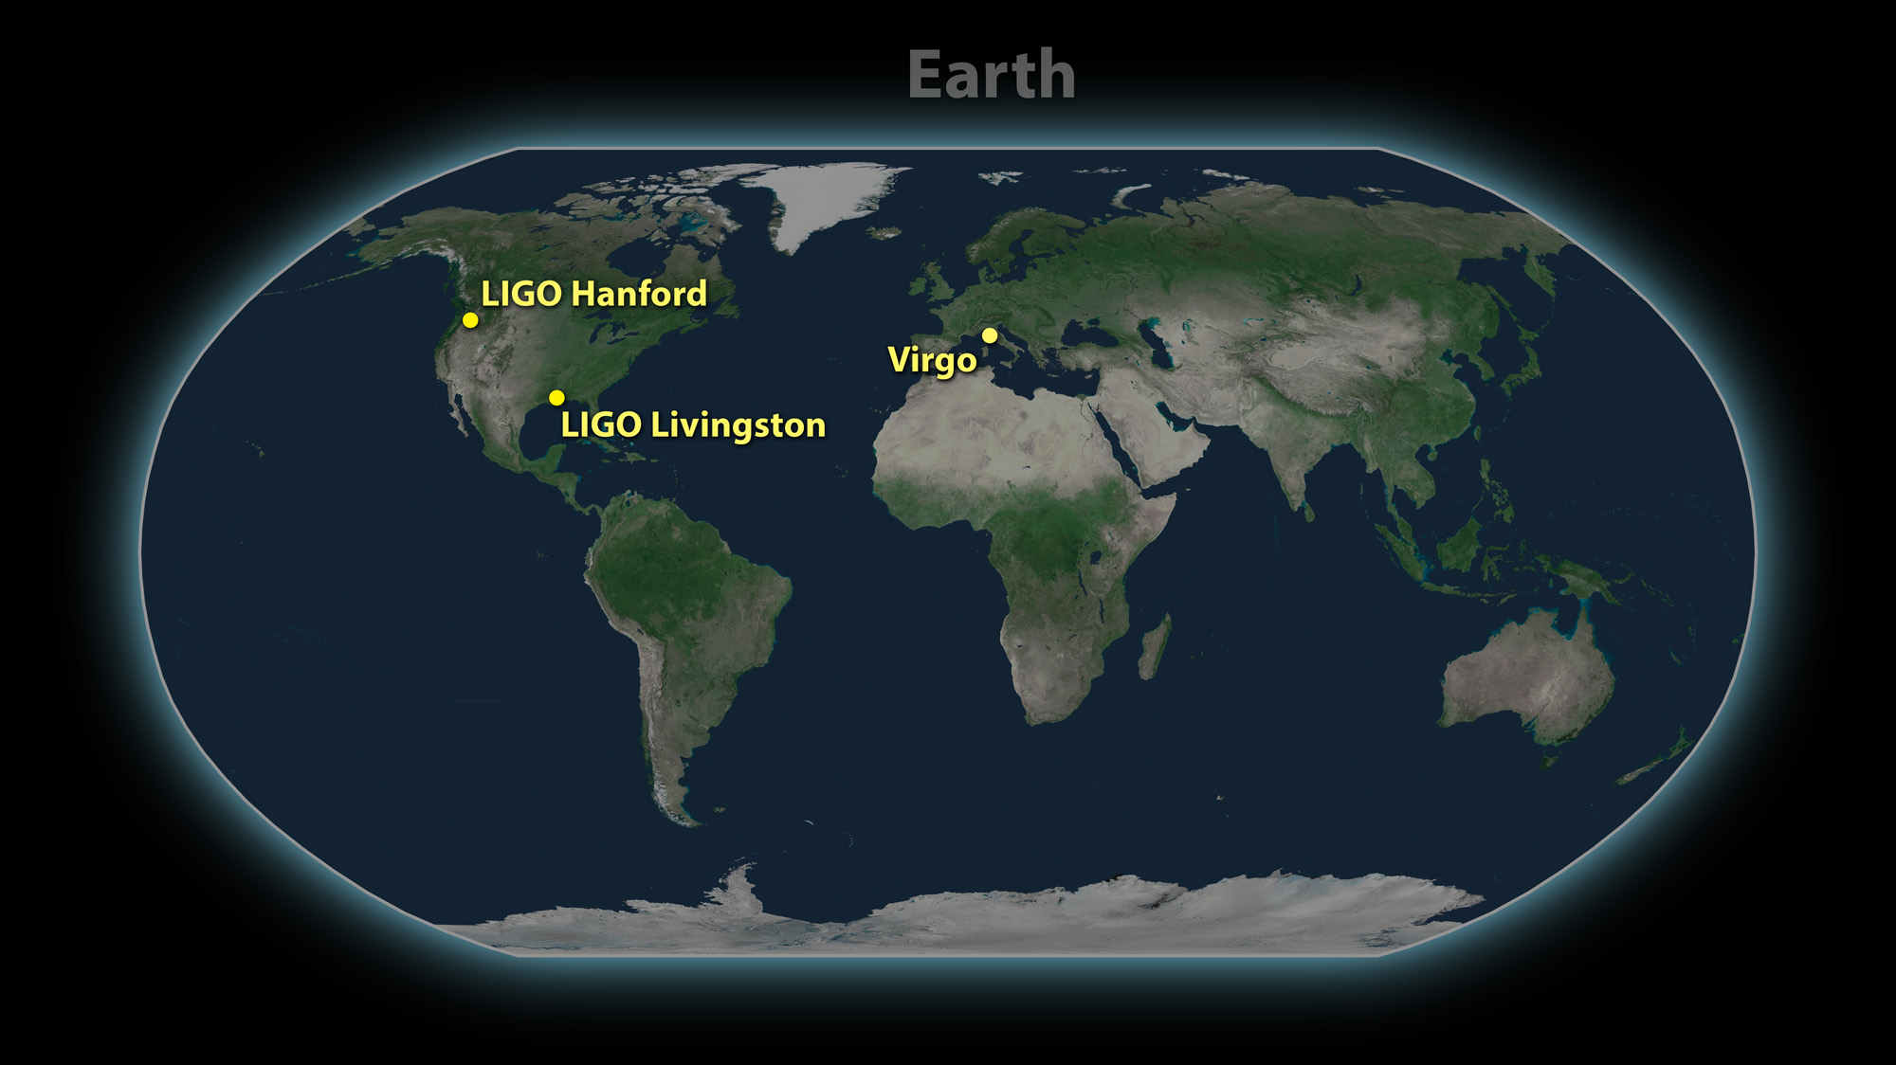
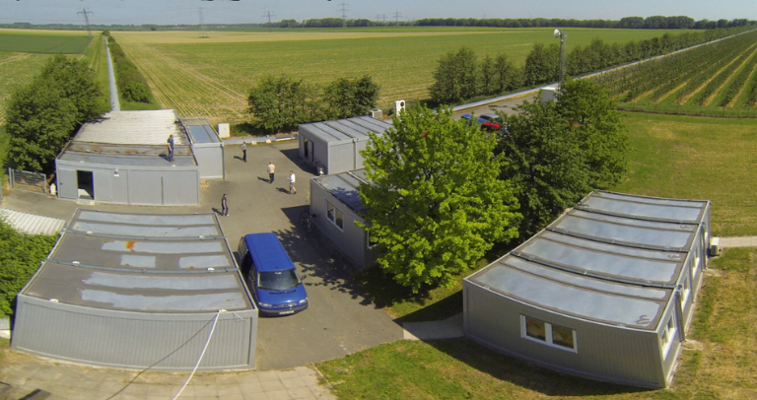
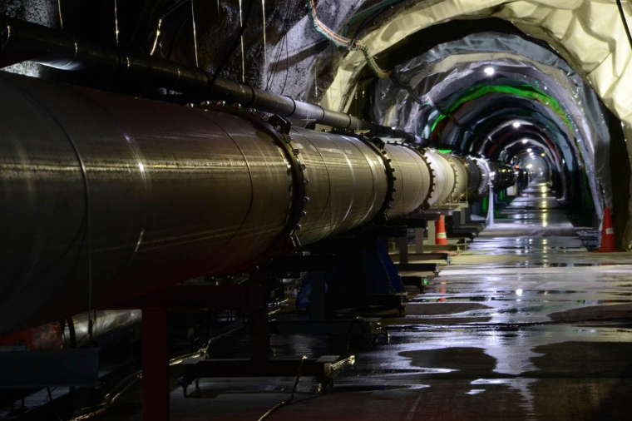
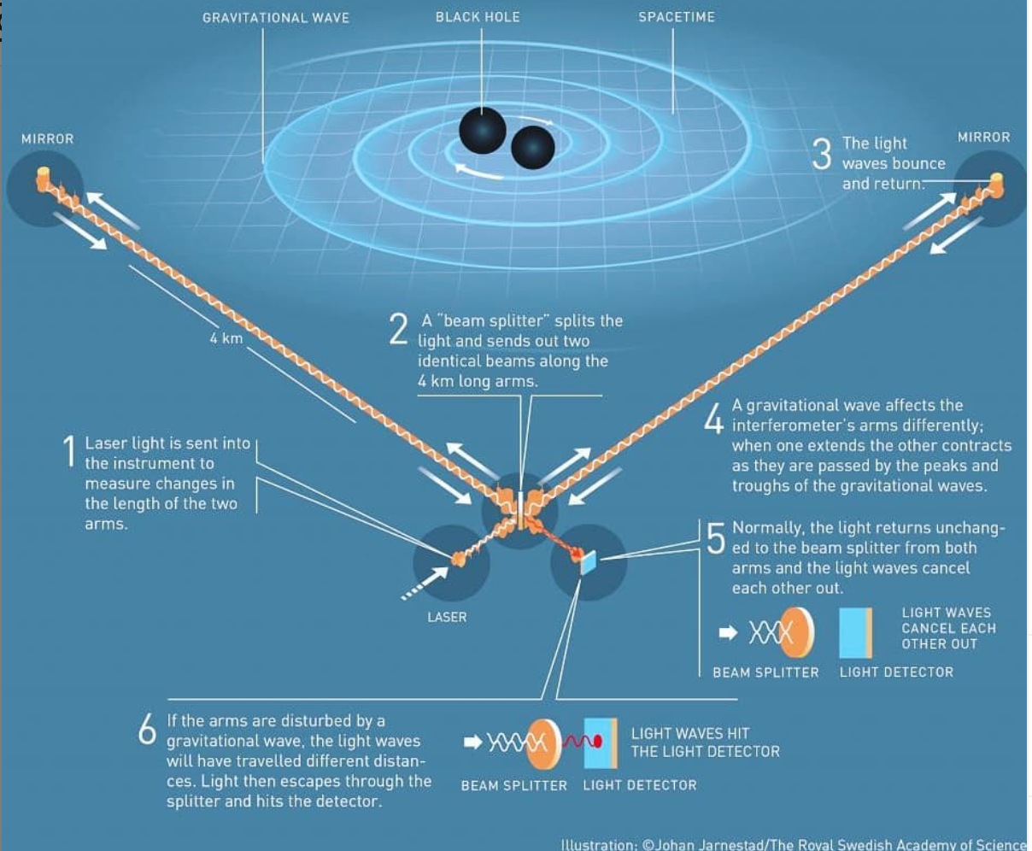
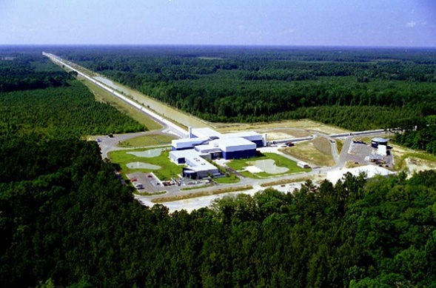
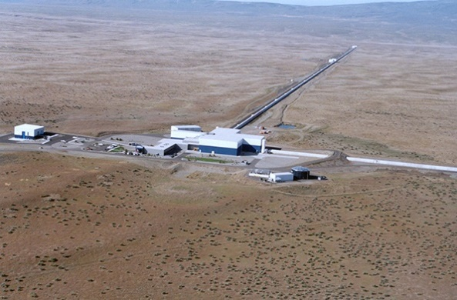
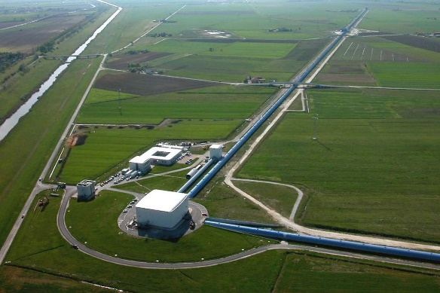
A new window into the Universe
1970s: Early work on GW detection by laser interferometers
GEO600
Kagra
Operational
Under construction
Planned
LIGO India
2000s: First Science Runs
Since 2015:
Advanced Detectors
4 km
3 km
Credit: LIGO–Virgo
LIGO, Livingston, LA
LIGO, Hanford, WA
Virgo, Cascina, Italy
Notes:
LIGO Livingston Observatory in Louisiana
LIGO Hanford in State of Washington
Virgo Cascina, near Pisa, Italy
GEO600 near Hamburg in Germany

Slide 24
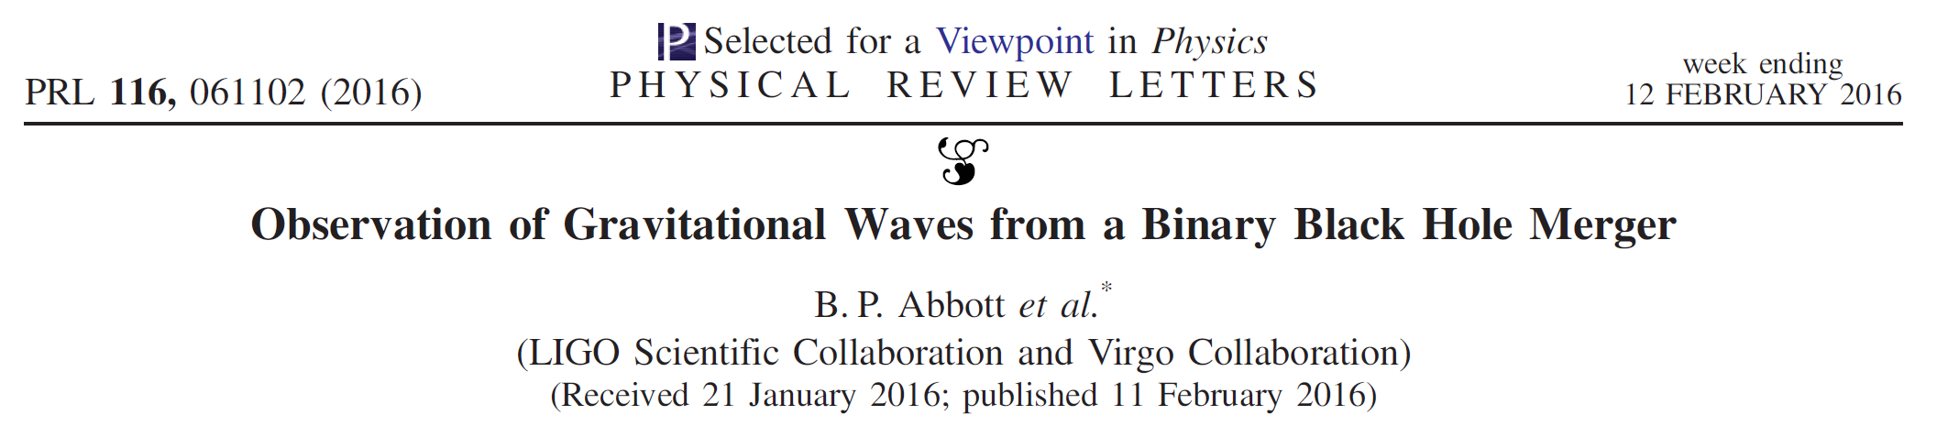
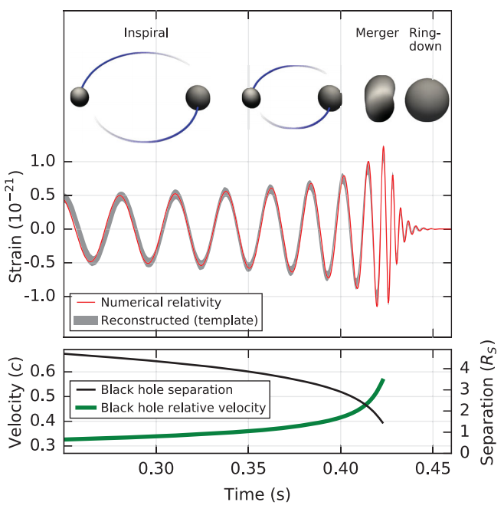
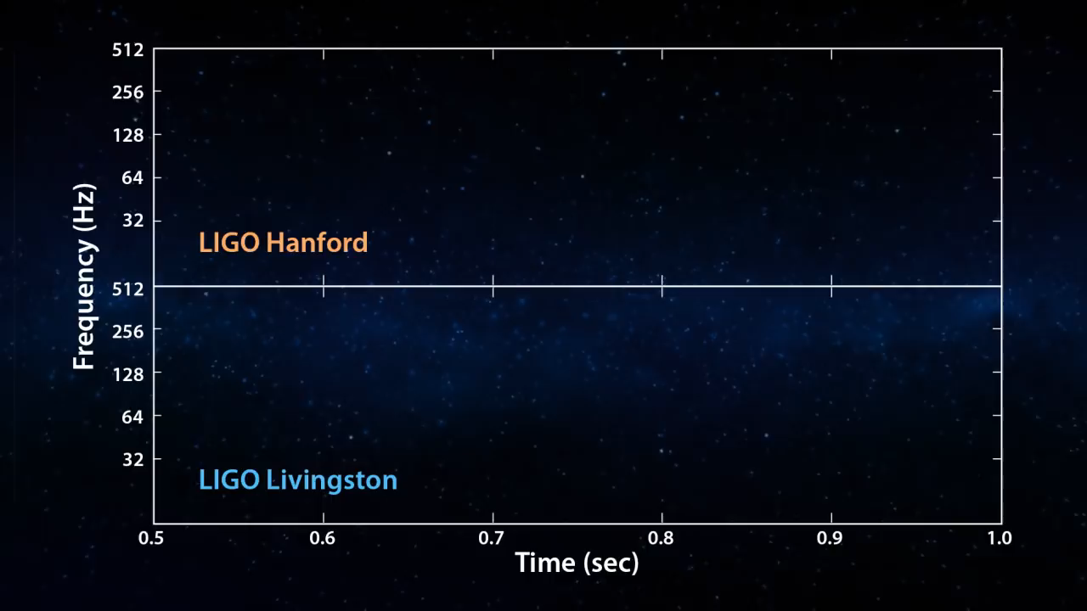
The beginning of the GW Era!
GW150914
B.P. Abbott et al (2016) Phys. Rev. Lett. 116, 061102
Credit Caltech/MIT/LIGO Lab

Slide 25
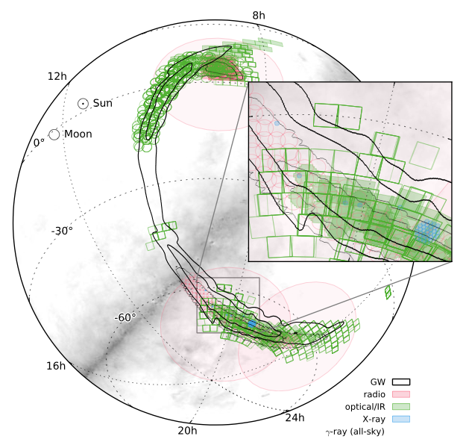
The EM follow-up of GW150914
No coincident triggers from space-based observatories → Offline searches
Follow-up observations reported by 25 teams
via private GCN circulars: NO counterpart detected!
  Event nature (BBH merger) → Little expectation of a detectable
  EM signature
➔ But: Milestone achieved! First broadband EM
counterpart search campaign!
    Proving broad capabilities of the transient
    astronomy community and their observing strategies
Skymap of observations
Abbott+2016
B.P. Abbott et al (2016) Phys. Rev. Lett. 116, 061102
Notes:
Sky localizations: 230 deg2

Slide 26
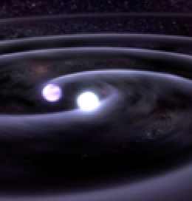
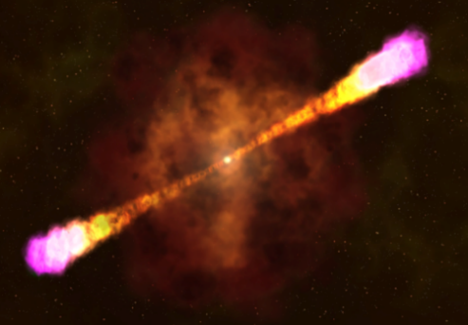

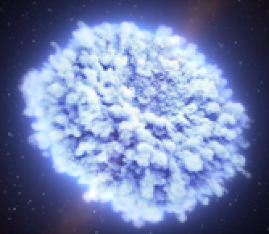
///////////////////////////////////
TITLE: GCN/FERMI NOTICE
NOTICE_DATE: Thu 17 Aug 17 12:41:20 UT
NOTICE_TYPE: Fermi-GBM Alert
RECORD_NUM: 1
TRIGGER_NUM: 524666471
GRB_DATE: 17982 TJD; 229 DOY; 17/08/17
GRB_TIME: 45666.47 SOD {12:41:06.47} UT
TRIGGER_SIGNIF: 4.8 [sigma]
TRIGGER_DUR: 0.256 [sec]
E_RANGE: 3-4 [chan] 47-291 [keV]
ALGORITHM: 8
NS merger
Short GRB
GBM GCN Notice
X-ray afterglow Radio
T₀ +1.7s +16s +45min +6hrs +11 hrs +9 days +16 days
LVC GCN Circular
LHV sky localization
UV/Optical/NIR Kilonova
///////////////////////////////////
TITLE: GCN CIRCULAR
NUMBER: 21505
SUBJECT: LIGO/Virgo G298048: Fermi GBM trigger 524666471/170817529: LIGO/Virgo Identification of a possible gravitational-wave counterpart
DATE: 17/08/17 13:21:42 GMT
FROM: Reed Clasey Essick at MIT <ressick@mit.edu>
The LIGO Scientific Collaboration and the Virgo Collaboration report:
The online CBC pipeline (gstlal) has made a preliminary identifi-cation of a GW candidate associated with the time of Fermi GBM trigger 524666471/170817529 at gps time 1187008884.47 (Thu Aug 17 12:41:06 GMT 2017) with RA=186.62deg Dec=-48.84deg and an error radius of 17.45deg.
The candidate is consistent with a neutron star binary coalescence with False Alarm Rate of ~1/10,000 years.
40 Mpc
away!

Slide 27
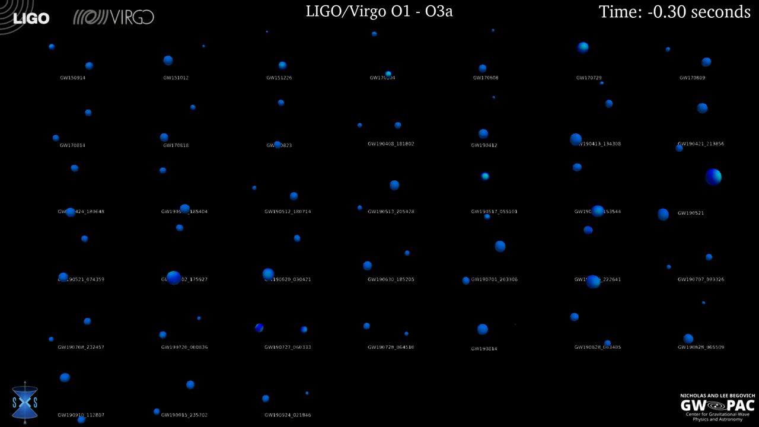
23 November 2020

Slide 28
The Advanced Particle-astrophysics Telescope (APT) – ASTRO2020
The APT detector design (3m x 3m x 2.5m):
  mission concept for a space-based gamma-ray and cosmic-ray explorer
    Combine a pair and Compton telescope in one design (like AMEGO, ASTROGAM).
  20 layers of 5mm thick CsI(Na) with crossed wavelength shifting fiber (WLS fiber) readout
  20 x - y scintillating optical fiber tracker (SOFT) layers using interleaved 1.5mm round scintillating fibers
  With the addition of foam radiators, the CsI detectors could detect the transition radiation X-rays from very-high-energy light cosmic rays
  Top-bottom symmetry doubles FoV (in L2 orbit)
  Read out on the sides with SiPM photodetectors and analog-pipeline waveform digitizers

Slide 29
MeV-GeV satellite
ASTROGAM:
  nearly 56 m² of double-sided Si strip detectors (DSSDs)
  4 towers, 56 layers of 5×5 DSSDs
    5600 DSSDs
  Each DSSD wafer has a cross section of 9.5×9.5 cm², a thickness of 500 µm and a pitch of 240 µm (384 strips per side)
  Strips of the DSSDs are wire-bonded to form 5×5 2-D ladders
AMEGO
  4 towers, 60 layers of 4×4 DSSDs
    4800 DSSDs
  DSSD wafers 9.5 cm wide, 500 µm thick and pitch of 500 µm (190 strips per side)
  Strips of the DSSDs are wire-bonded to form 4×4 2-D ladders

Slide 30
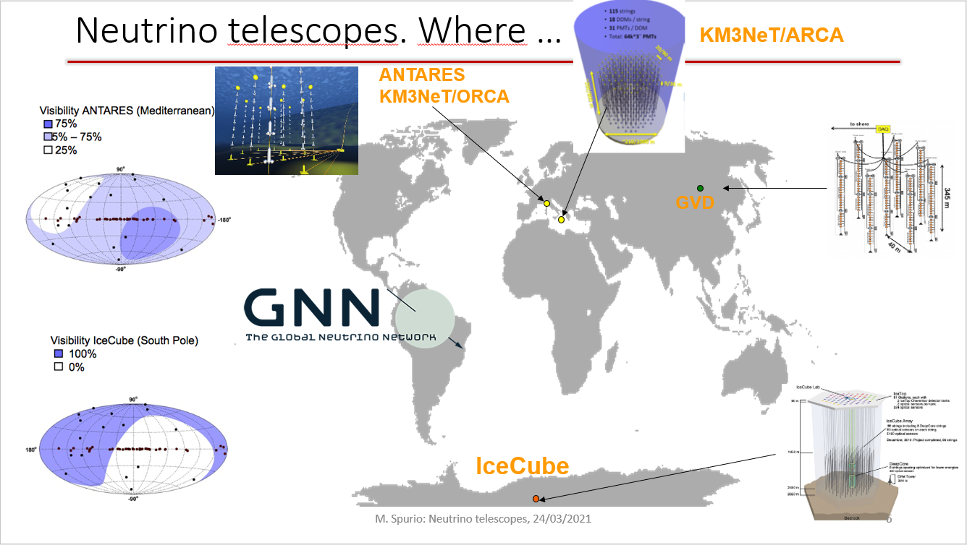
M. Spurio: Neutrino telescopes,
@ THESEUS CONFERENCE 2021
MeV-GeV satellite
ASTROGAM:
  nearly 56 m² of double-sided Si strip detectors (DSSDs)
  4 towers, 56 layers of 5×5 DSSDs
    5600 DSSDs
  Each DSSD wafer has a cross section of 9.5×9.5 cm², a thickness of 500 µm and a pitch of 240 µm (384 strips per side)
  Strips of the DSSDs are wire-bonded to form 5×5 2-D ladders
AMEGO
  4 towers, 60 layers of 4×4 DSSDs
    4800 DSSDs
  DSSD wafers 9.5 cm wide, 500 µm thick and pitch of 500 µm (190 strips per side)
  Strips of the DSSDs are wire-bonded to form 4×4 2-D ladders

Slide 31


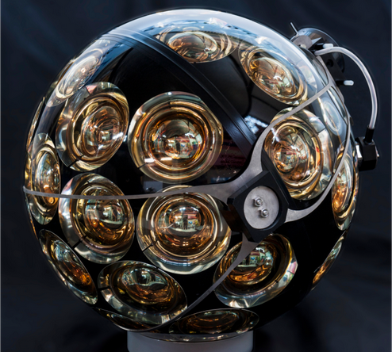
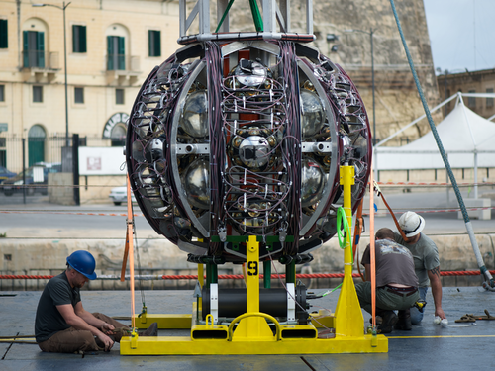

New telescopes in water: KM3NeT
M. Spurio: Neutrino telescopes,
@ THESEUS CONFERENCE 2021
~ 700 or 200 m
Digital Optical Module (DOM)
Multi-PMT : 31 x 3” PMTs
Gbit/s on optical fiber
Positioning & timing
Detection Unit (DU)
18 DOMs
Low-drag design
Rapid deployment
Multiple strings/sea campaign
Autonomous/ROV unfurling
Reusable

Slide 32

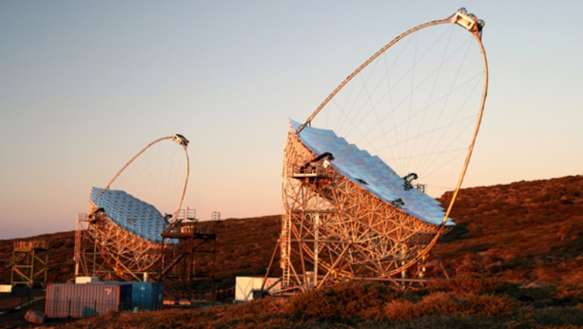
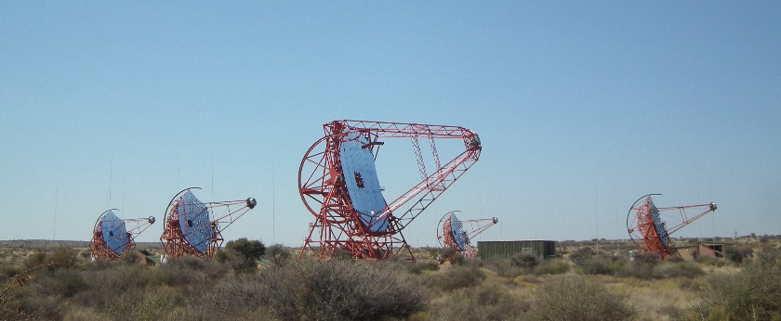
Current IACT facilities
Energy range: from tens of GeV to tens of TeV, overlapping with satellites
MAGIC
La Palma – 2200 m asl
2 x 17 m Ø
Since 2003 (1), 2009 (2)
VERITAS
Arizona – 1270 m asl
4 x 12 m Ø
Since 2007
H.E.S.S.
Namibia – 1800 m asl
4 x 12 m Ø + 1 x 28 m Ø
Since 2003 (4), 2012 (5)

Slide 33

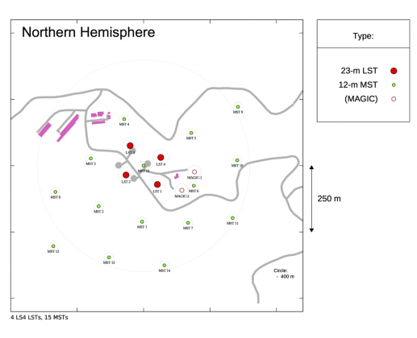
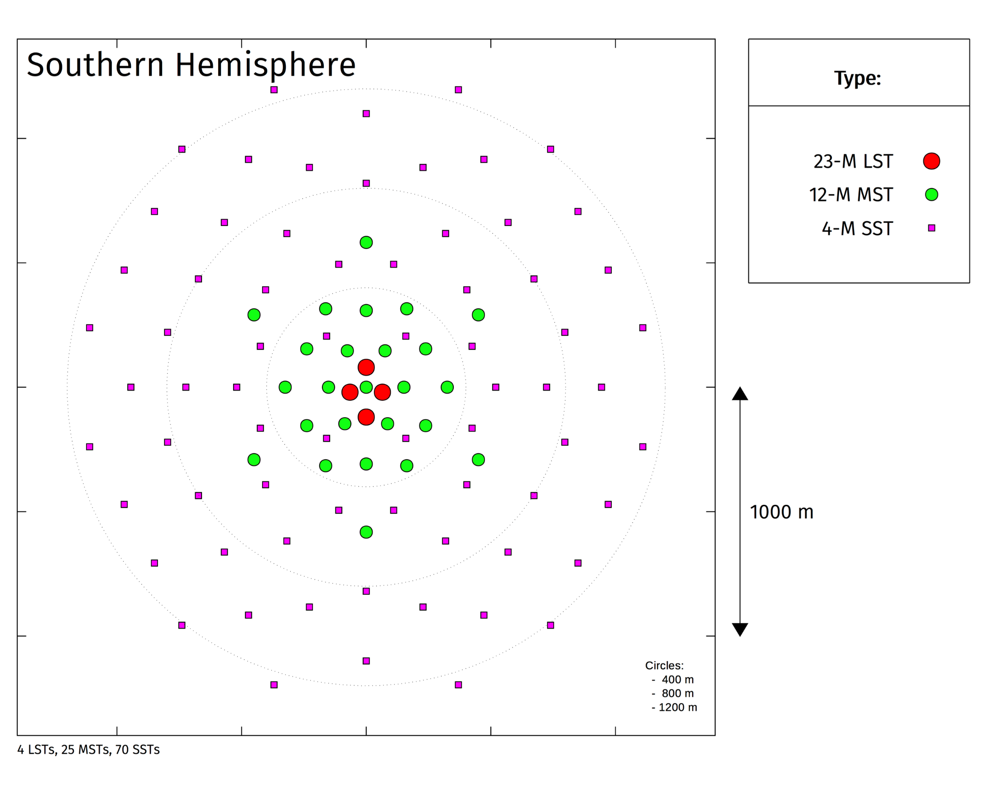
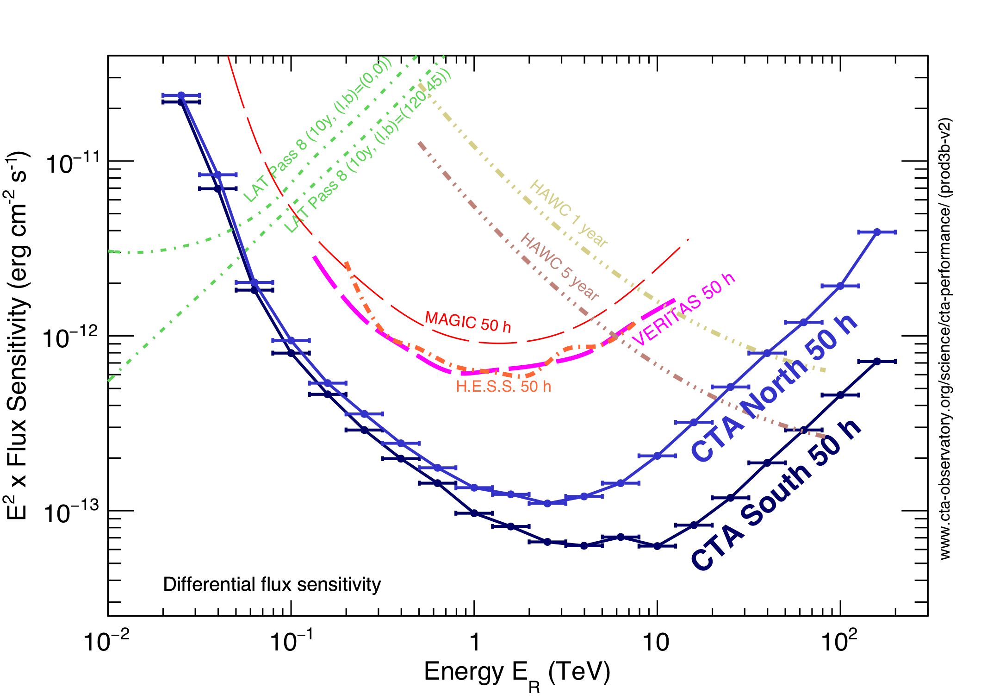
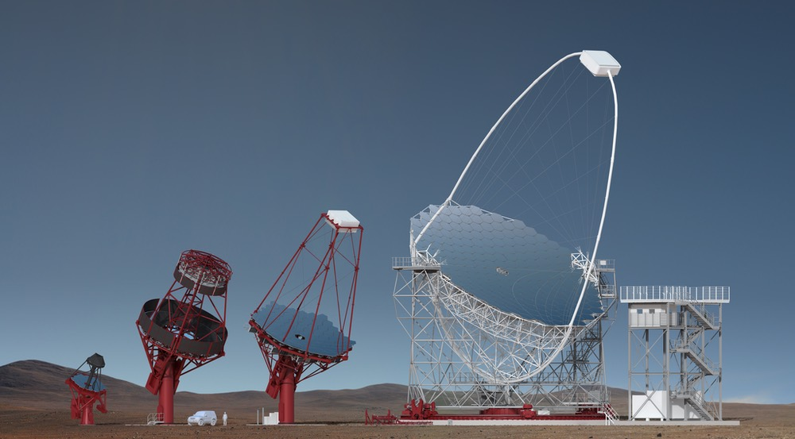
Cherenkov Telescope Array
about100 telescopes
increased detection area
improved sensitivity
3 telescope sizes.
North Site: La Palma
South Site: Chile
Energy range: from tens of GeV to hundreds of TeV

Slide 34
Hadronic models
Proton blazar model
Low energy emission from synchrotron radiation from electrons
High energy emission from interaction between energetic protons in the jet (production of e+/e-, pions)
Production of gamma rays at higher energies w.r.t. leptonic processes, but more extreme conditions (strong B)
These processes are slower → difficult to explain fast variability
Also it is difficult to explain the correlation between X-rays and gamma rays
→ lepto/hadronic models: hadronic emission responsible for luminosity, leptonic for variabilty

Slide 35
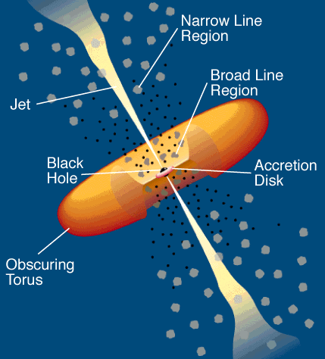
Radio-loud AGN classification
Radio galaxies: AGN seen from large angles. Central BH, accretion disk and BLR are hidden by the torus
Blazars: closely aligned AGN, the jets emission hides the thermal emission from the rest of the galaxy
  FSRQ: two bump continuum in the spectrum and strong evidence of BLR and NLR in addition to thermal component
  BL Lacs: two bump continuum but no evidence for emission or absorption line
  Classified in LSP, ISP and HSP according to the location of the synchrotron peak (<10¹⁴ Hz, 10¹⁴ Hz – 10¹⁵ Hz, >10¹⁵ Hz)
Rapidly variable luminosity in all energy bands, strong optical polarization and emission up to gamma-ray energies

Slide 36
The Fermi-LAT
  Tens of MeV – few hundreds of GeV
  Pair-conversion telescope
  Converter-tracker
    16 layers of high Z material (W) → conversion of gamma rays into e⁻/e⁺ pair
    Conversion layers interleaved with planes of Si strip detectors to track the trajectories
    Two layers of Si strip → 2D reconstruction
  Calorimeter
    Reconstruction of the energy
    8 layers of CsI(Tl) + photo-diodes to readout the signal
  Segmented ACD
    Plastic scintillator to act as veto for charged particles

