Slide 1
Tales from Flatland How 2D semiconductors react to light excitation

Slide 2
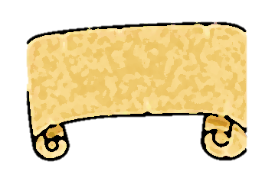
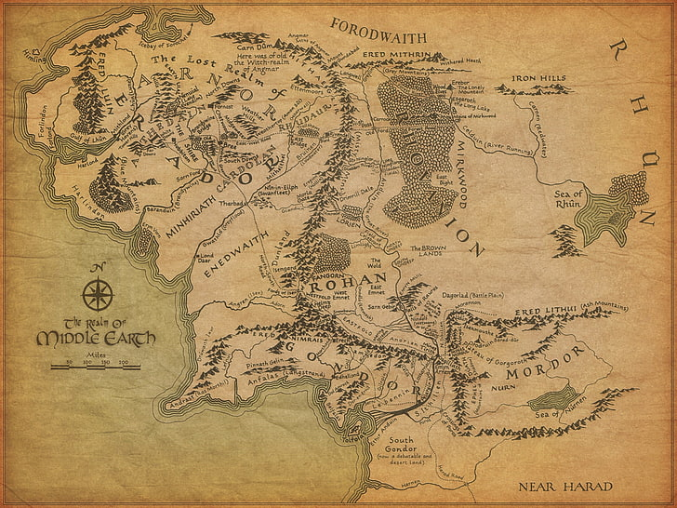
Table of contents
01. Something about Semiconductors
02. Photoluminescence
04. Valley-Hall Effect
03. 2D TMDs

Slide 3
01
Something about Semiconductors
and their main features

Slide 4
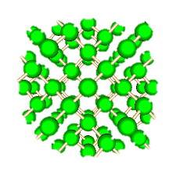
Electrons’ energy levels in solids
In crystals, electrons feel the periodic potential
of surrounding ions
$$H(\vec{r})=H_{0}+U(\vec{r})$$
This leads continous energy levels that we call «band»

Slide 5
Band Structures
Depending on the band structure, solids react as:
Metal
Semiconductor
Insulator
E
Conduction
Band
E
E
Energy
Gap
≳$5$
eV
$$\sim$$
eV
Valence
Band
k
k
k
Metal
Semiconductor
Insulator

Slide 6
02
Photoluminescence
That is, how do we investigate semiconductors

Slide 7
Excitons in semiconductors
Excitons are quasi-particles made by an electron in the conduction band and a «hole» in the valence band
Having opposite charge, they form a bound state due to the Coulomb interaction
E
e-
$$e^{−}$$
$$h^{+}$$
h+
k

Slide 8
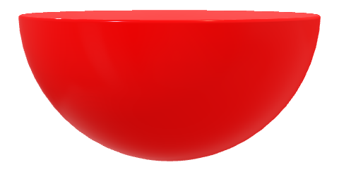
Photoluminescence
Thermalization
$τ\sim 10 fs$
Emission
Excitation
BANDA DI
CONDUZIONE
$τ\sim 1 ns$
ħω
BANDA DI
VALENZA

Slide 9
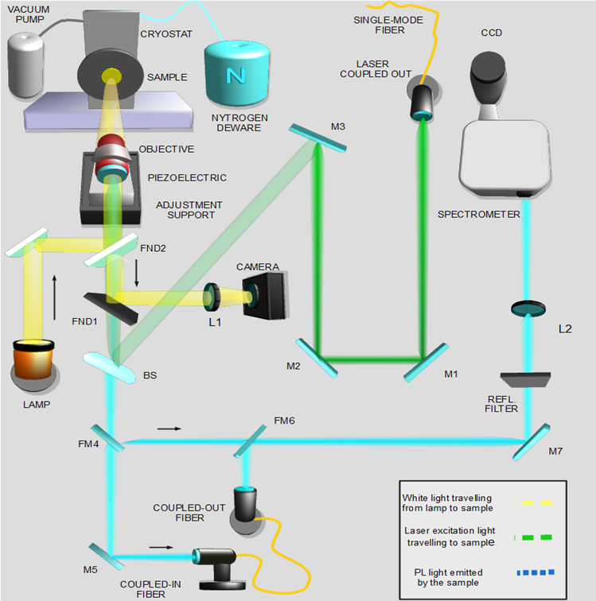
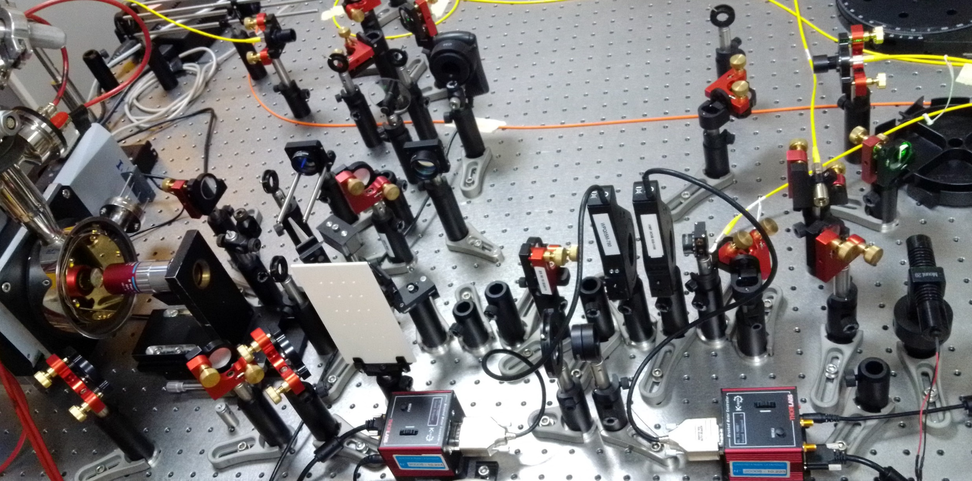
The gate to
Flatland
The Nanophotonics gate to Flatland is a µ-PL experimental setup
We excite our samples with laser, and collect the emitted signal with CCD cameras

Slide 10
03
2D TMDs
and why they are so intreresting

Slide 11
WHY 2D TMDs?
Semiconductors are the basic brick of our technology
Silicon is the most used for practical purposes, like microprocessor
In order to improve the processors’ efficiency, we need to increase the transistors’ density
But Silicon presents scaling problem, being not possible to realize devices smaller than 5 nm
We need to look for semiconductors useful on lower length scale

Slide 12
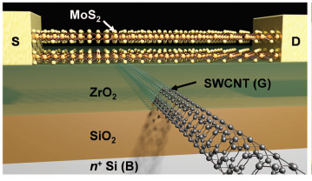
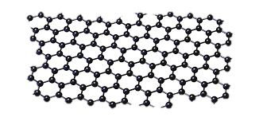
A bit of history
1965
2004
2010
2016
Moore’s Law
Discovery of Graphene [1]
First PL observation from ML MoS2 [2]
MoS2 based transistor with 1 nm length gate [3]
[1] Novoselov, Geim et al. «Electric field effects in atomically thin carbon films», Science, 306 (5696), 666-669 (2004)
[2] A. Splendiani, et al. «Emerging photoluminescence in Monolayer MoS2» Nano Lett. 10, 1271 (2010).
[3] Desai, et al. «MoS2 transistor with 1-nanometer gate length » Science, 354-6308 (2016)

Slide 13
Let’s meet
TMDs
2D TMDs are made of
1 Transition Metal M (Mo, W)
2 Chalcogens X (Se, S, Te)
X
X
Hexagonal structure
Monolayer made of three atomic sheets
Direct semiconductors in the monolayer limit [4]
M
[4] Kuc et al. «How does quantum confinement influence the electronic structure of transition metal sulphide» , Phys. Revi. B, (2011)
Pagina 13

Slide 14
Indirect to direct transition
BULK
MONOLAYER
While bulk TMDs are indirect semiconductors, ML TMDs have a direct transition due to different orbitals contributions[5],[6]
This promotes them as efficient semiconductors, suitable for practical purposes
[5] T. Li and G. Galli. “Electronic Properties of MoS2 Nanoparticles” .J.Phys. Chem. 111, 16192 (2007).
[6] A. Cappelluti et al. “Tight-binding model […] and multilayer MoS2” Phys. Rev. B. 88, 075409 (2013).
Pagina 14

Slide 15
04
Valley-Hall Effect
yes, the fanciest part

Slide 16
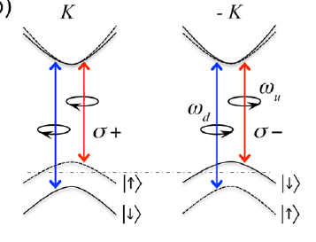
Valley degree
of freedom
180°
$$∆_{SO}^{WS2}=0.4 eV$$
The band structure presents two «valleys» K, -K with the same energy
The breaking of rotational symmetry couples each valley with left/right circular polarization
The strong spin orbit coupling protects the valley degree of freedom (VDF) against relaxation processes
We can use the VDF as a qubit!
[7] D. Xiao, et al. “Coupled Spin and Valley Physics in Monolayers of MoS2 and Other.” PRL. 108, 196802 (2012).
[8] W. Yao, et al. “Valley-dependent optoelectronics from inversion symmetry breaking.” Phys. Rev. B 77, 235406 (2008).

Slide 17
Valley Hall
Effect
$$ρ$$
CLASSICAL HALL EFFECT
VALLEY-HALL EFFECT
 | CLASSICAL HALL EFFECT | VALLEY-HALL EFFECT
CARRIER | CHARGE | VALLEY INDEX
BOOSTER | MAGNETIC FIELD | PSEUDO-MAGNETIC FIELD (STRAIN)
EFFECT | HALL CURRENT | ANOMALOUS VELOCITY [9]
OBSERVABLE | HALL VOLTAGE | CIRCULAR DICHROISM
CONDUCTIVITY | $$R_{H}=\frac{1}{ne}$$ | $σ^{H}=\frac{e^{2}}{ħ}\int_{BZ}{\frac{d^{2}k}{{\left(2π\right)}^{2}}f_{0}(k)Ω(k)}$ [10]
[9] M-C. Chang et al. “Berry phase, hyperorbits, and the Hofstadter spectrum:Semiclassical dynamics in magnetic Bloch bands.” Phys. Rev. B 53, 11 (1996).
[10] D. Xiao et al., «Valley-Contrasting Physics in Graphene: Magnetic Moment and Topological Transport” PRL, 99, 236809 (2007)

Slide 18
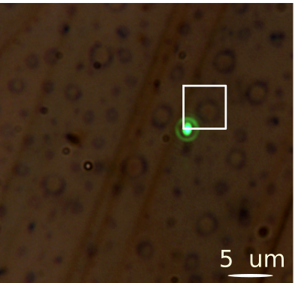
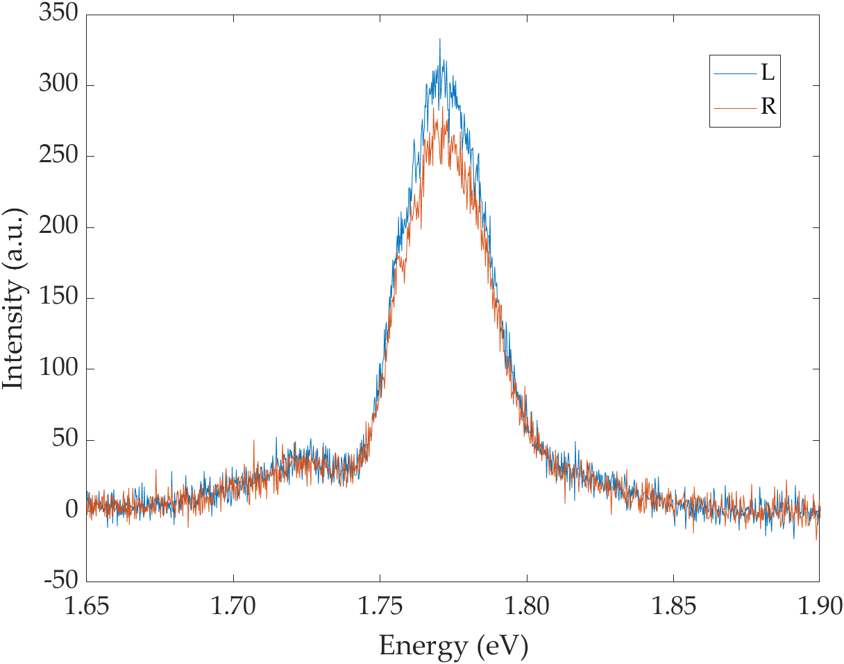
Experimental candies
The top-left panel is an optical image of a WS2 dome-patterned region
The right panel provides a PL map from the white squared dome
The bottom figure is a typical PL spectrum that exhibits circular dichroism
We create monolayer hydrogenating
bulk crystals
This provides monolayered «domes» with high strain fields
In the figure it’s reported the PL intensity arising from the ML region [11]
[11] D. Tedeschi et al. «Proton-driven patterning of bulk transition metal dichalcogenides.” arXiv:1803.09825v1 (2018).

Slide 19
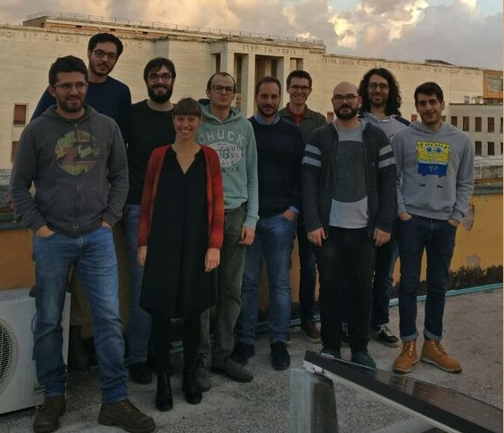
Thanks…
…you all for your attention, and the whole
Nanophotonics group of Prof. Rinaldo Trotta
for the funny adventures that we have in
Flatland (…and zero-land)

Slide 20
The End

