Slide 1
Status of the
W→τν Analysis:
new event selection
&
comparison data/MC
Lidia

Slide 2
Introduction
Last time (8th March) I talked about:
the aim of the W→τν analysis, signal and background characteristics
the status of the (to become) INT Note @ 10 TeV
the D3PDs production and validation (D3PDs are now used to do most of the analysis)
the initial steps in the optimization of the cut flow for the analysis on 7 TeV data
In the meantime:
we have finalized the cut flow at 7 TeV
the tau ID community has swithched from Cone4H1TopoJets to AntiKt4H1TopoJets for the jet algorithm used to seed a tau: I have compared the samples with the two different algorithms.
Today I will show you:
some brand new results on the optimization of the cut flow, using the significance of missing transverse energy
the possibility of having a W→τν candidate already with 10 nb⁻¹
a comparison between data and MonteCarlo
our ideas about joining th effort for a CONF Note on tau reconstruction
the outilne of what comes next

Slide 3
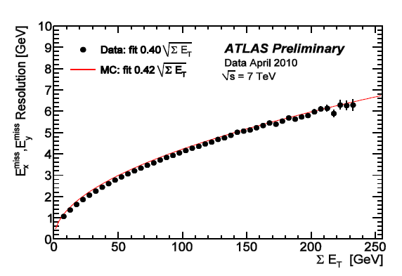
MET Significance
To start the comparison between data and MC we are loosening our selection cuts, in particular lowering MET cut from 35 GeV to 20 GeV.
In this situation we are overwhelmed by QCD di-jets background events.
My main goal was to find a good tool to reject QCD di-jets and being able to see W→τν asap.
The idea is to exploit the fact that for QCD di-jet events the missing transverse energy is fake.
We can use missing transverse energy significance.
If we can get rid of QCD by cutting on MET significance, we can relax other cuts, such as MET cut.
MET rsolution studies are ongoing.
Still some discrepancies, but hope to get a clear picture soon, as we are getting enough data.
http://indico.cern.ch/getFile.py/access?contribId=3&resId=1&materialId=slides&confId=93399

Slide 4
MET Significance Cut
This is the new proposed cut:
The optimization of the value of MET significance to cut on has been optimized on the “standard” cut flow.
Now, in our relaxed cuts with first data, we are cutting in this way:

Slide 5
QCD di-jets – events before any cut

Slide 6
Signal & EW backgrounds
NB This new cut doesn’t intend to cut EW background! These plots are shown just for reference.
All EW backgrounds in backup slides

Slide 7
CutFlow – which value?
W→τν Event Selection
Trigger: EF_tau12_loose_xe20 (10,15,20)
Missing E_{T}: MET_Final > 35 GeV
Missing E_{T} significance > XX
Tau identification:
only one tau reco by both the reconstruction algorithms (calorimeter and tracking based) and which passes safe tight cuts
20 GeV < E_{T} < 60 GeV
not in 1.3<|η|<1.7
ElectronVetoTight and MuonVeto
Veto leptons in the event:
Electron: loose and author!=8 ant pT>5GeV
Muon: STACO and isCombinedMuon and pT>5GeV
Veto jets with pT > 20 GeV and 1.3<|η|<1.7.
Topological cut: Δφ(τ, MET) > 2.5
Cut optimization done on “base cut flow” on 100 pb⁻¹
Cutting at 6, we start loosing some QCD
To be safer, a cut at 7 would help. But we start loosing much signal.
A cut at 8 would be the safest to reject QCD.
More tables in backup slides.
→ I will use 6 in the following

Slide 8
CutFlow comparison
100 pb⁻¹
No Cut
MET significance > 6

Slide 9
Cuf flow for first data
W→τν Event Selection
GRL selection
Collision candidate cleaning
Trigger: L1_J5
Jet cleaning
Missing E_{T}: MET_Topo > 20 GeV
Missing E_{T} significance > 6
Tau identification:
only one tau reco by both the reconstruction algorithms (calorimeter and tracking based) and which passes safe tight cuts
20 GeV < E_{T} < 60 GeV
not in 1.3<|η|<1.7
ElectronVetoTight and MuonVeto
Veto leptons in the event:
Electron: loose and author!=8 ant pT>5GeV
Muon: STACO and isCombinedMuon and pT>5GeV
Veto jets with pT > 20 GeV and 1.3<|η|<1.7.
Topological cut: Δφ(τ, MET) > 2.5
Data (April reprocessing): D3PDs from L1Calo Stream (DESD_MET).
Total lumi: 3.21 nb⁻¹
MC (April reprocessing): D3PDs without DESD_MET skimming.
see backup slides for all the details
NOTE:
Applied cuts overcome the DESD_MET skimming (both trigger and MET/tau selection).
Collision candidate and jet cleaning applied also to MC.

Slide 10
MC: events expected in 3.21 nb⁻¹
Signal expected in 3.21 nb⁻¹
Background expected in 3.21 nb⁻¹
S/B = 8

Slide 11
Data-MC comparison
Due to DESD skimming, it is not posible to compare data-MC at this stage of the cut flow!
See following slides!
Very good agreement on the number of expected events data-MC!

Slide 12
Data-MC comparison: MET

Slide 13
Data-MC comparison: MET signif.

Slide 14
Data-MC comparison: ΣE_{T}

Slide 15
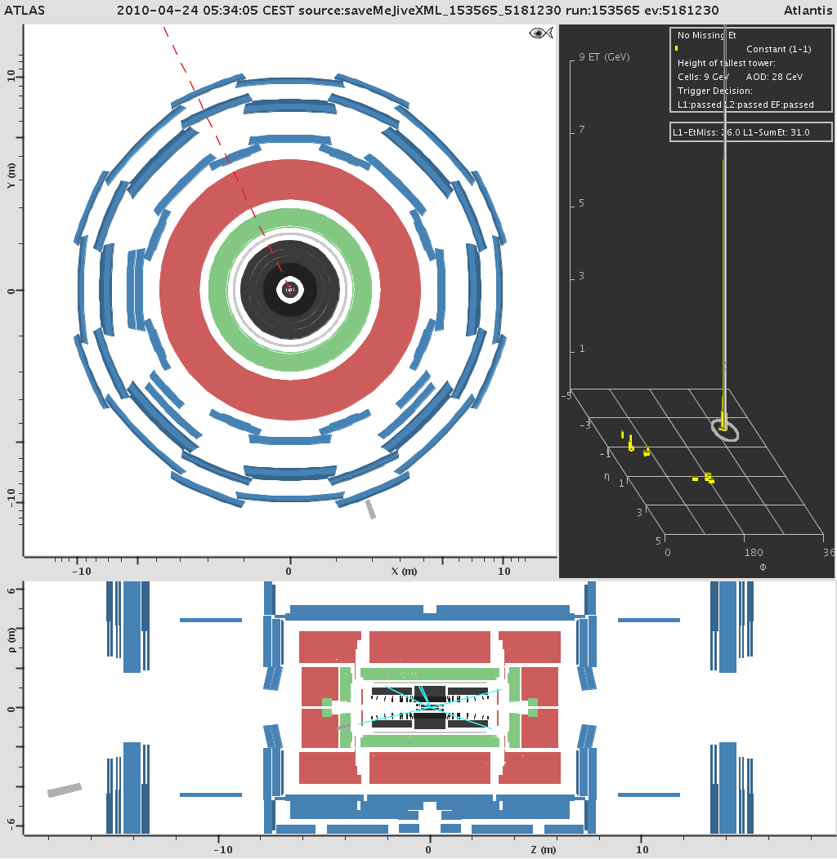
The first candidate
RunNumber: 153565
EventNumber: 5181230
LB: 318
Triggers:
L1_TAU5 1
L1_TAU6 1
L1_TAU6_XE10 1
L2_tau12_loose 1
L2_tau12_loose_xe20 1
L2_tau16_loose 1
L2_tau16_loose_xe20 1
EF_tau12_loose 1
EF_tau12_loose_xe20 1
EF_tau16_loose 1
EF_tau16_loose_xe20 1
MET_Topo: 31098.7 MeV
Taus in the event: 1 SafeTight
η: -2.13043
φ: -1.23067
E_{T}: 37542.8 MeV
Missing E_{T}
Jet

Slide 16
The first candidate
Nothing in the hadronic calorimeter…
Track
Cluster (id: 1 index: 0)
storegate key: egClusterCollection
ET = 28.353 GeV
E = 120.325 GeV
η = -2.124
Φ = 290.248° (5.066 rad)
InDetTrack (id: 0 index: 0)
storegate key: TrackParticleCandidate
d0 = -0.011 ± 0.002 cm
z0 = 0.786 ± 0.018 cm
|z0-zVtx| = 0.339 cm
phi0 = 289.510 ± 0.019° (5.053 ± 0.000 rad)
η = -2.130 ± 0.001
tL = -4.148 ± 0.002
pT = -20.06 GeV ± 0.781 GeV
p = -85.60 GeV
chi2/numDoF = 2.7686727
Sounds like a W→eν event…

Slide 17
TauReconstruction CONF Note
For this CONF Note, a set of standard plot on ID variables will be shown.
Our idea is to produce the very same plots with their same selection + the selection of missing transverse energy, to show which are the performance for our analysis.
We will also produce some other plots of variables which are strictly connetcted to our analysis: lepton vetos, MET distribution, MET significance, MT…
We (me&Guilherme) have now agreed on the samples, on the cut flow (the official will be sent out today).
(Our) Event Selection
GRL selection
( Trigger: L1_J5 )
Jet cleaning
Missing E_{T}: MET_Topo > 20 GeV
Tau selection (without ID!!):
leading of the taus reco by both the reconstruction algorithms (calorimeter and tracking based)
20 GeV < E_{T} < 60 GeV
not in 1.3<|η|<1.7

Slide 18
ToDoList
I will rerun the analysis on the full statistics available:
use May reprocessing
have to wait for D3PDs production
will have to run on the grid as bringing all the datasets to Milano is getting painful
We should also keep an eye to pileup, as it will become important soon. (Small) datasets for pileup studies are available.
Also the trigger is crucial. Soon our full trigger will be in the menu, so we should keep on checking that it is selecting our candidates.
I will try to find another smart cut to suppress the W→eν background, which is now the most problematic one
see what people from the W→eν are doing
try to understand if it is possible to cut on “no electron candidate in the event” (overlap removal?)
I will also contribute the the tau Reco CONF note, which is also useful for my thesis.
I have to start writing first the index and then also the thesis!!

Slide 19
Back up

Slide 20
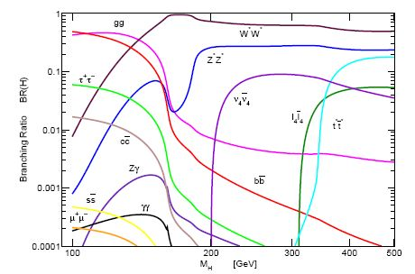
Motivation to W→τν analysis
Taus are interesting objects because:
the τ leptons in the final state are important signature for Higgs boson and SUSY searches – as the heaviest lepton, they have the largest coupling to the Higgs boson both in the Standard Model and in the MSSM.
BUT hadronically decaying taus are difficult to identify in hadron collision, due to the overwhelming QCD background.
understand τ _{had} reconstruction and
identification
is essential and challenging
Main processes with τ _{had} final states:
ttbar σ = 3.74 x 10² pb (@10TeV)
Z →ττ σ = 1.13 x 10³ pb (@10TeV)
W→τν is an interesting channel to study taus:
it is the most abundant source of τ leptons with σ = 7.69 x 10³ pb @10TeV
it will be possible to study this channel only with the very first data at low luminosity (10³¹ - 10³² cm⁻²s⁻¹), due to the QCD background rate
There are some interesting measurements that can be done with 100 pb⁻¹ of data:
cross section
BR(W→τν)/BR(W→eν) ratio

Slide 21
Status of the analysis in ATLAS
14 TeV analysis – documented in a note (ATL-PHYS-INT-2009-011) by Y.Coadou, P.Malecki and E.Richter-Was
10 TeV analysis – documented in a note (ATL-COM-PHYS-2010-067) G.Nunes-Hanninger, L.Dell’Asta, A.Andreazza, D.Casadei, Y.Coadou, J.Dingfelder, O.Igonkina, J.Kroseberg, P.Malecki, M.Neubauer, E.Richter-Was and A.Sfyrla.
For the moment it is just a communication. We have been assigned a rewier (S.Demers, Yale) and answered to all the comments. It still has to become an INT note.
7 TeV analysis – documented on a dedicated twiki page.
Cut flow has been optimized and the standard cut flow foresees 50 events/pb-1
Cut flow has also been adapted for very first data analysis, loosening both the trigger and the missing transverse energy selection

Slide 22
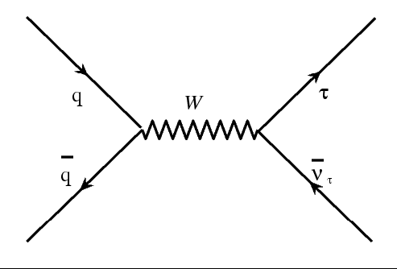
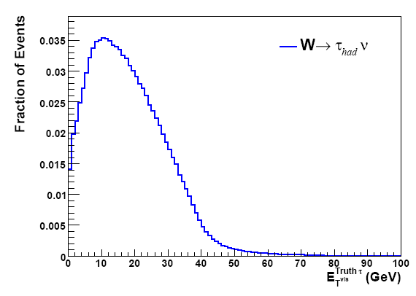
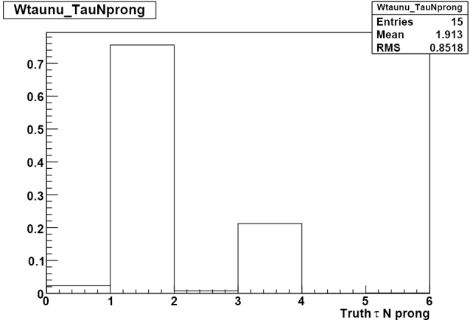
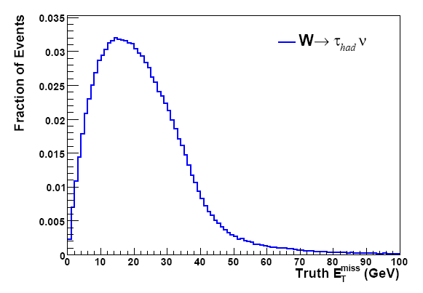
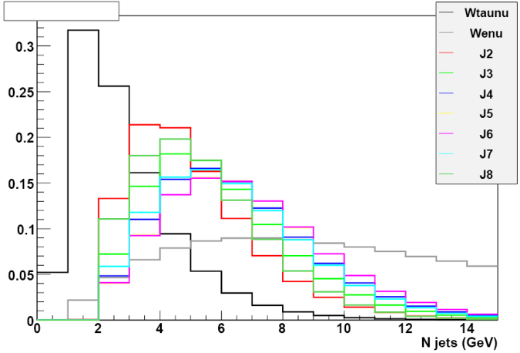
W→τν – signal
Soft τ lepton with 20<p^{τ}_{T} <40 GeV
Signature:
τ lepton
missing transverse energy
@10TeV
Relative low missing transverse energy, tipically in the range from 10 GeV to 40 GeV (+ a long tail)
When the τ lepton decays hadronically, we have an hadronic jet which is well collimated and has few charged particles.
@10TeV

Slide 23
W→τν – backgrounds
W→eν / W→μν
the electron (muon) from the W decay is identified as a single-prong hadronic τ decay
the electron (muon) is lost and a fake τ is reconstructed from the initial state QCD radiation
signal | cross section
W→τν (τ→had) | 7.69 x 10³ pb
background | cross section
W→τν (τ→lep) | 4.18 x 10³ pb
W→eν | 1.176 x 10⁴ pb
W→μν | 1.176 x 10⁴ pb
Z→ττ | 1.128 x 10³ pb
Z→ee | 1.144 x 10³ pb
Z→μμ | 1.144 x 10³ pb
ttbar | 3.7 x 10² pb
QCD di-jets | 10¹⁰ pb
Z→ee / Z→μμ
one electon (muon) is wrongly identifed as hadronic τ and the other is lost or ouside the geometrical acceptance
Z→ττ
one τ is identified as an hadronic τ decay and the other one is lost, i.e. neither reconstructed as second hadronic τ nor as electron or muon
ttbar
one of the W decays into a τ lepton and the other decays into a pair of quarks, or electron or muon which are not reconstructed
QCD di-jet
cross section ~6 order of magnitude higher
one jet is wrongly identifed as a τ
The background can be taken under control and the signal extracted:
using the proper trigger
applying some specific cuts on cinematic variables:
missing E_{T}
tau p_{T}
using some algorithms that help in the particle identification, such as the electron/muon veto
applying topological cuts.
The cut flow must be tuned to maximize the S/B ratio.

Slide 24
W→τν Event Selection
Trigger: combined trigger which asks for a certain amount of missinig E_{T} and for an isolated τ with a minimum p_{T} of 16 GeV → EF_tau16i_loose_xe(15,15,25)
Missinig E_{T}: the offline reconstructed missing E_{T} must be higher than 40 GeV (now using MET_RefFinal, has to move to MET_Final for first data)
Tau identification: there must be only one τ which passes certain selection cuts, both on identification and on momentum. The τ has to have been reconstructed by both the reconstruction algorithms (calorimeter and tracking based), the identification must satisfy the safe tight cuts, the energy must be 20 GeV < E_{T} < 60 GeV, |η|<2.4 and not 1.3<|η|<1.4. Finally the τ candidate must not be flagged as an electron or a muon.
Veto leptons in the event. If in the event there is an electron identified as a loose electron or a muon (STACO muon) the event is rejected.
Veto jets in the crack region.
Topological cut: Δφ(τ, MET) > 2.5
Cut flow @10TeV

Slide 25
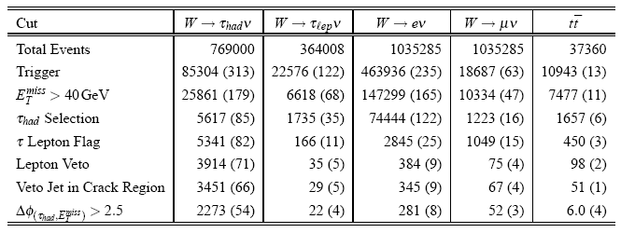
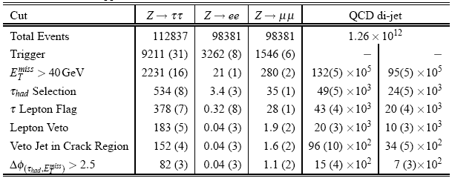
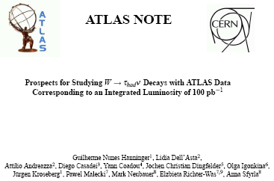
W→τν Event Selection (100 pb⁻¹)
Cut flow @10TeV

Slide 26
CutFlow: cut optimization
100 pb⁻¹
MET significance > 5
MET significance > 6

Slide 27
CutFlow: cut optimization
100 pb⁻¹
MET significance > 7
MET significance > 8

Slide 28
MC D3PD – April reprocessing
r125X MC D3PD – TauD3PDMaker-00-05-00
Release details:
release 15.6.9.3,AtlasProduction
packages: see TauD3PDMaker twiki (https://twiki.cern.ch/twiki/bin/view/AtlasProtected/TauD3PDMaker)
Datasets:
group10.perf-tau.mc09_7TeV.105009.J0_pythia_jetjet.recon.ESD.e468_s766_s767_r1251.v.00-05-00.tauPerfD3PD
group10.perf-tau.mc09_7TeV.105010.J1_pythia_jetjet.recon.ESD.e468_s766_s767_r1251.v.00-05-00.tauPerfD3PD
group10.perf-tau.mc09_7TeV.105011.J2_pythia_jetjet.recon.ESD.e468_s766_s767_r1251.v.00-05-00.tauPerfD3PD
group10.perf-tau.mc09_7TeV.105012.J3_pythia_jetjet.recon.ESD.e468_s766_s767_r1251.v.00-05-00.tauPerfD3PD
group10.perf-tau.mc09_7TeV.105013.J4_pythia_jetjet.recon.ESD.e468_s766_s767_r1251.v.00-05-00.tauPerfD3PD
group10.perf-tau.mc09_7TeV.105014.J5_pythia_jetjet.recon.ESD.e468_s766_s767_r1251.v.00-05-00.tauPerfD3PD
group10.perf-tau.mc09_7TeV.105015.J6_pythia_jetjet.recon.ESD.e468_s766_s767_r1251.v.00-05-00.tauPerfD3PD
group10.perf-tau.mc09_7TeV.106020.PythiaWenu_1Lepton.recon.ESD.e468_s765_s767_r1250.v.00-05-00.tauPerfD3PD
group10.perf-tau.mc09_7TeV.106021.PythiaWmunu_1Lepton.recon.ESD.e468_s765_s767_r1250.v.00-05-00.tauPerfD3PD
group10.perf-tau.mc09_7TeV.106022.PythiaWtaunu_1Lepton.recon.ESD.e468_s765_s767_r1250.v.00-05-00.tauPerfD3PD
group10.perf-tau.mc09_7TeV.106023.PythiaWhadtaunu.recon.ESD.e468_s765_s767_r1250.v.00-05-00.tauPerfD3PD
group10.perf-tau.mc09_7TeV.106050.PythiaZee_1Lepton.recon.ESD.e468_s765_s767_r1250.v.00-05-00.tauPerfD3PD
group10.perf-tau.mc09_7TeV.106051.PythiaZmumu_1Lepton.recon.ESD.e468_s765_s767_r1250.v.00-05-00.tauPerfD3PD
group10.perf-tau.mc09_7TeV.106052.PythiaZtautau.recon.ESD.e468_s765_s767_r1250.v.00-05-00.tauPerfD3PD
all datasets in container: group10.perf-tau.mc09_7TeV_r1250_fromESD.00-05-00.tauPerfD3PD/

Slide 29
Data D3PD – April reprocessing
Used the latest runs from April reprocessing
Total lumi: 3.21 nb⁻¹
D3PDs from L1Calo Stream and DESD_MET samples
Good run list selection
Collision candidate cleaning
Jets cleaning

Slide 30
W backgrounds

Slide 31
Z backgrounds

Slide 32
Other tests&results
These results have been posted on the W→τν sharepoint and some useful discussion are onging.
Tomorrow we will discuss these results in the W→τν informal meeting.
On Wednesday I will present these results and the outcome of the discussion in the SM WZ Signatures meeting.
Yann&Guilherme proposed:
check if it possible to exploit better the cut on significance, using a different line
check the analysis using also medium and loose taus, to see if the agreement in the cut flow is still fine

