Slide 1
EIC_NET MC
Status of vertex simulation
Central tracking baseline concepts in the YR
Vertex simulation in the hybrid tracker
All-silicon tracker simulation
How to proceed
Domenico Elia

Slide 2
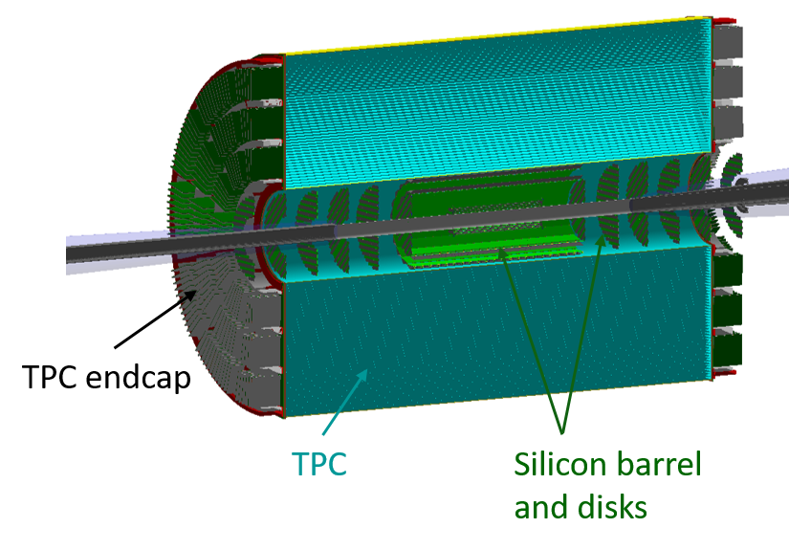
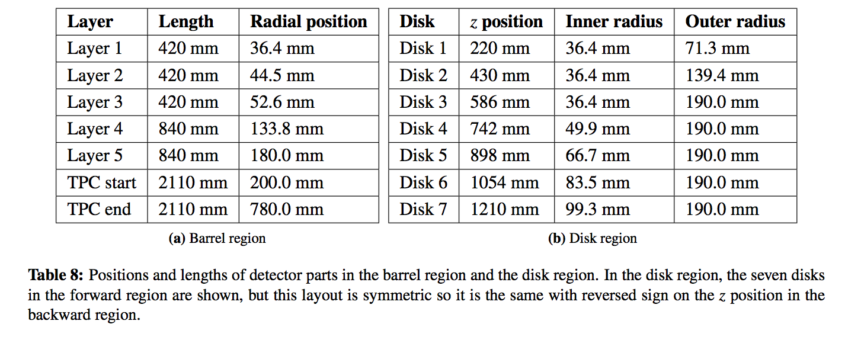
Central tracking baseline concepts
HYBRID tracking system:
silicon vertex + TPC (barrel), 7 silicon disks for back/forward regions
Silicon detectors based on ALICE ITS3 (10x10 μm²)
  3 innermost vertexing layers X/X₀ = 0.05%
  2 tracking layers X/X₀ = 0.55%
  disks X/X₀ = 0.24%
+ MPGDs disks in the endcaps (not yet in the simulation)

Slide 3
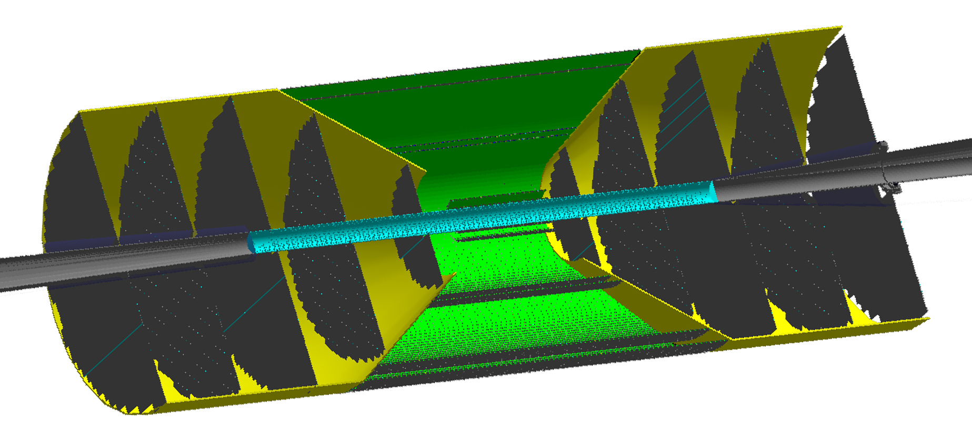
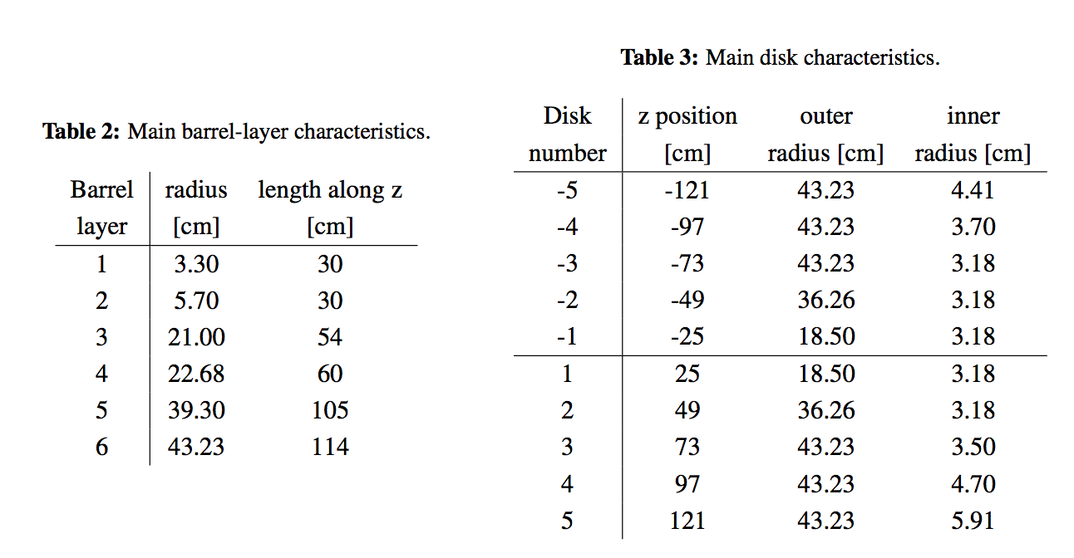
Central tracking baseline concepts
ALL-SILICON tracking system:
6-layer barrel, 5+5 disks for back/forward regions
Silicon detectors based on ALICE ITS3
(10x10 μm², all staves X/X₀ = 0.3%)

Slide 4
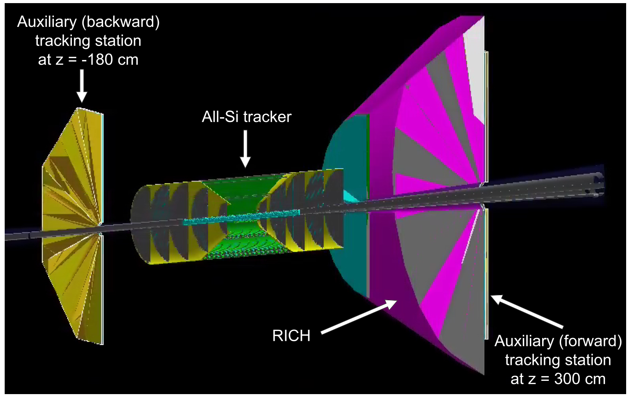
Central tracking baseline concepts
ALL-SILICON tracking system:
to improve momentum resolution at large rapidities (|η| > 2):
  complement all-silicon tracker with auxiliary tracking stations
  different space available in the backward and forward directions:
Alternative forward/backward tracking:
GEM detectors with 50-μm resolution
additional 10-μm silicon disks
station positioning:
backward: z ~ -180 cm
forward: z ~ 300 cm (behind RICH)

Slide 5
Existing software
HYBRID tracking system:
EICROOT:
  vertexing implementation started by Birmingham in 2018
  most of it by H. Wennlof, main contributor to YR studies (also in Fun4All)
  refined early 2020 (starting YR activities):
    barrel layer and disk construction from individual detector staves
    staves are detailed, containing cooling, cables, some support structures
    disks could be made more accurately without gaps
  TPC used was the BeAST TPC implementation of EICROOT
  most relevant details: http://go.web.cern.ch/go/xKk6

Slide 6
Existing software
HYBRID tracking system:
EICROOT:
  used also by Bari (A. Mastroserio): https://github.com/eic/EicRoot
  available in docker container and with different trackers:
    config.1 - a simplistic forward detector (silicon disks in magnetic field)
    config.2 - a more advanced silicon vertex + TPC tracker
    config.3 - a complete BeAST tracker simulation
    config.4 - simplified ePHENIX forward tracker setup
  same configuration with 5 layers + TPC as Birmingham:
    cross-check of the initial results obtained with fast simulation (ALICE ITS2)
    very good agreement found

Slide 7
Existing software
HYBRID tracking system:
Fun4All (Birmingham):
  vertex geometry imported from EICROOT via GDML:
    used GDML export functionality of EICROOT to generate geometry files
    GDML importer in Fun4All to read in all silicon parts from generated files
    stave details and geometry building implemented in EICROOT preserved
    GDML importer: https://gitlab.com/hwennlof/fun4allgdmlimport
    and how to use it: https://gitlab.com/hwennlof/eicrootlayoutfiles
  final files for the hybrid baseline, with ITS3-like detector layers:
    https://gitlab.com/hwennlof/fun4allgdmlimport/-/tree/master/macros/hybridBaseline
  TPC: Fun4All EIC version used + sPHENIX TPC endcaps

Slide 8
Existing software
ALL-SILICON tracking system:
EICROOT:
  all-silicon tracker implementation by LBNL
  original implementation by E. Sichtermann, then Rey Cruz Torres
  stave model similar to that from Birmingham but:
    old version of the beampipe (way too small in radius, without crossing angle)
    aluminum support structure to simulate the effects from support and services
  TPC used: BeAST TPC implementation of EICROOT

Slide 9
Existing software
ALL-SILICON tracking system:
Fun4All (mostly LBNL):
  implementation used for YR studies: https://github.com/eic/g4lblvtx
  vertex geometry imported from EICROOT via TGeo:
    produce TGeo file to be imported in Fun4All (help from Chris Pinkenburg)
  available geometries can be retrieved with:
  https://github.com/eic/g4lblvtx/blob/master/macros/Fun4All_G4_FastMom.C
    det_ver == 1 → EICROOT geometry
    det_ver == 2 → final geometry used in Fun4All for the YR studies
  differences wrt hybrid tracker:
    older projection for the material budget: corresponds to staves of average X = 0.3%X0 (the hybrid uses 0.05% for vertexing, 0.55% for barrel, and 0.24% for disks)

Slide 10
Existing software
ALL-SILICON tracking system:
Fun4All (mostly LBNL): (cont’d)
  idea to complement the all-silicon tracker with GEMs far away from the IP:
    GEMs were taken directly from the Fun4All implementation
    implemented a mock-up forward RICH, in coordination with PID WG:
      approximate geometry but includes all the material expected to be there

Slide 11
Existing software
WHAT NEXT:
Start from Fun4All implementations:
  not ideal: changes in the geometry imply starting from EICROOT ...
  option: implement directly in Fun4All via Alexander's EicToyModel:
    implement important EICROOT parts as a Fun4All module
    example here:https://github.com/eic/EicToyModel/blob/master/fun4all_with_eicroot/macro/Fun4All_G4_Tracking.C
    basic element “detector stave”, modifications to have the projected material
    looks very similar to “EICROOT-based” from first checks
  possible effort from H. Wennlof in May/June
  aim to stop using EICROOT as a standalone tool and move to Fun4All:
    would make simulations more centralised in one system

Slide 12
Existing software
WHAT NEXT:
Move on with Fun4All:
  implementation of more accurate services:
    would benefit from discussions with adjacent detector systems
    maybe easier in the context of the detector proposal preparation
  would also be good to use the latest magnetic field maps available
  include the latest beam-pipe implementation
  on the gaseous detector side:
    eRD6 are working on implementing more accurate gaseous detectors
    updates of TPC parameters and GEM planes useful to integrate once ready
  H. Wennlof moving to DESY in July, new post-doc starting at Birmingham

Slide 13
Existing software
WHAT NEXT:
Move on with Fun4All: (cont’d)
  some work already started by LBNL after YR:
    implement realistic geometry directly into Fun4All, bypassing EICROOT
    try to simplify the implementation:
      super realistic staves look overkill (many other details are at the moment at the level of fast simulations, and we know that the final staves will be anyway different)
      a simplistic all-silicon tracker geometry directly in Fun4All with just cylindrical layers of silicon already implemented → results in agreement with YR geometry
    to be discussed in the context of the tracking WG studies
  Rey available to continue (and help us to start contributing)
  Annalisa (and Giacomo) in contact with Rey and Hakan

