Slide 1
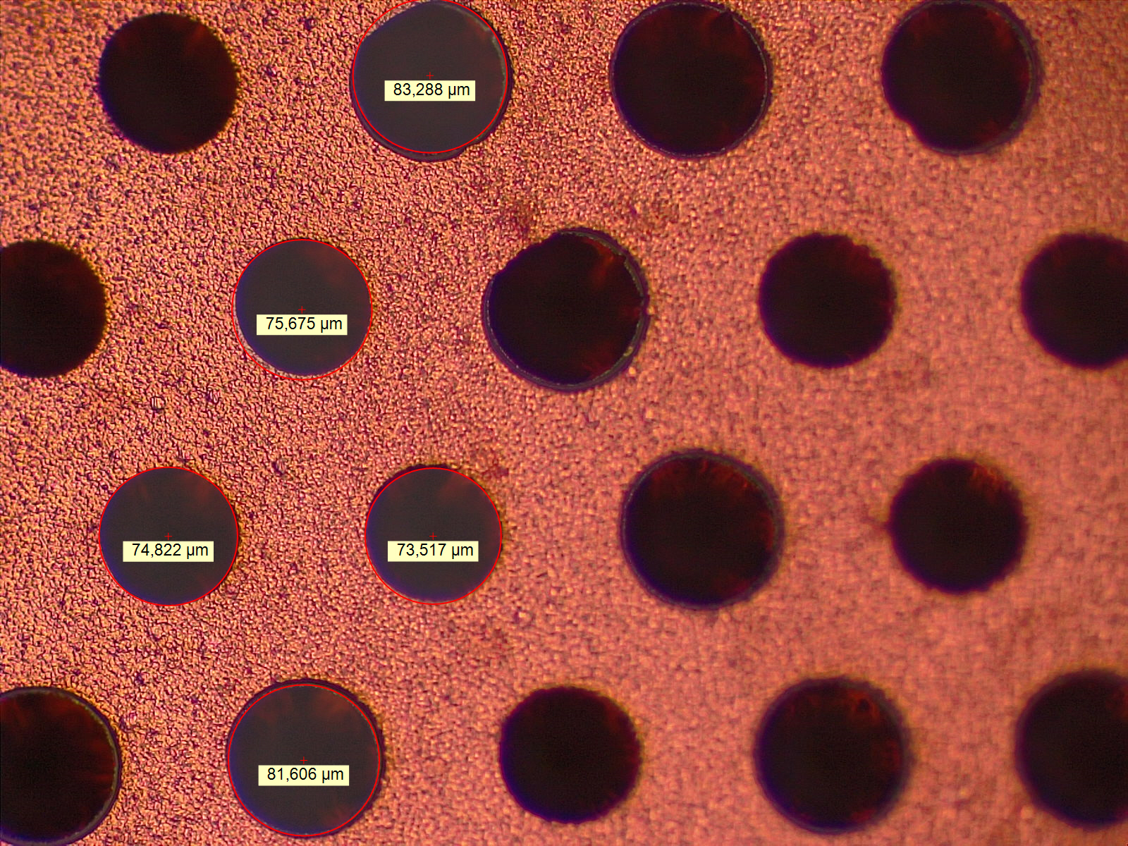
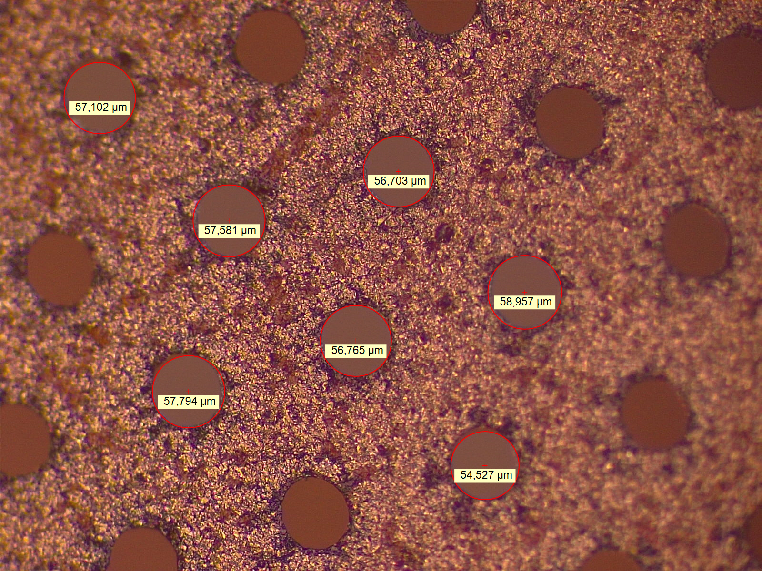
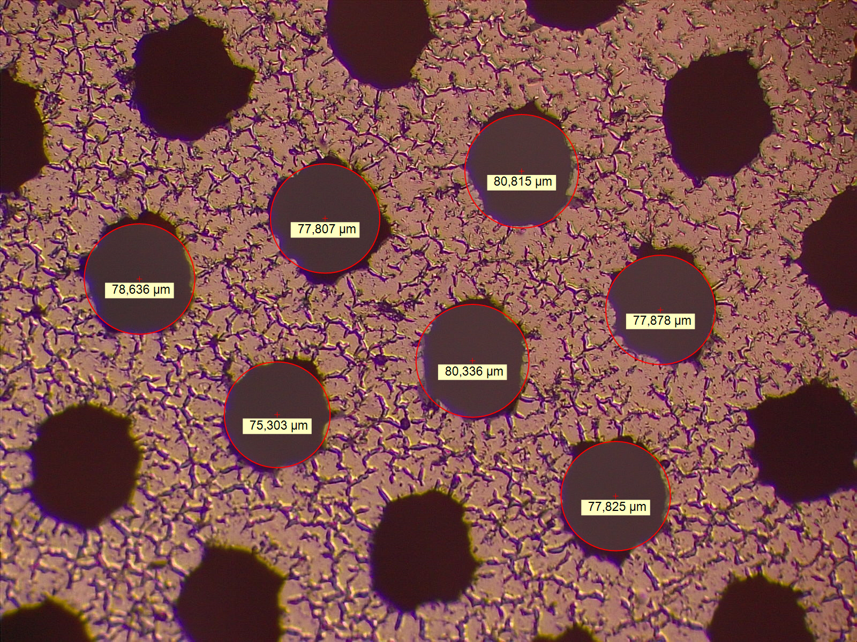
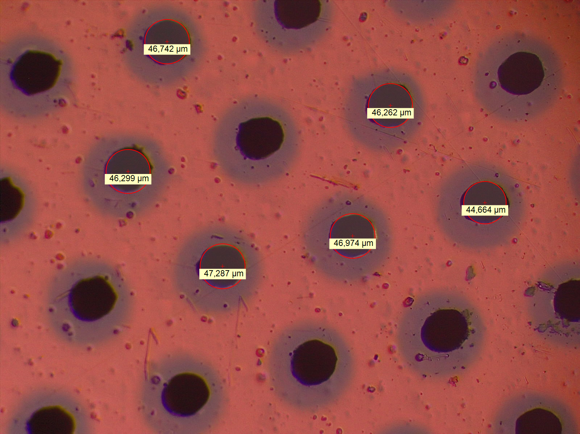
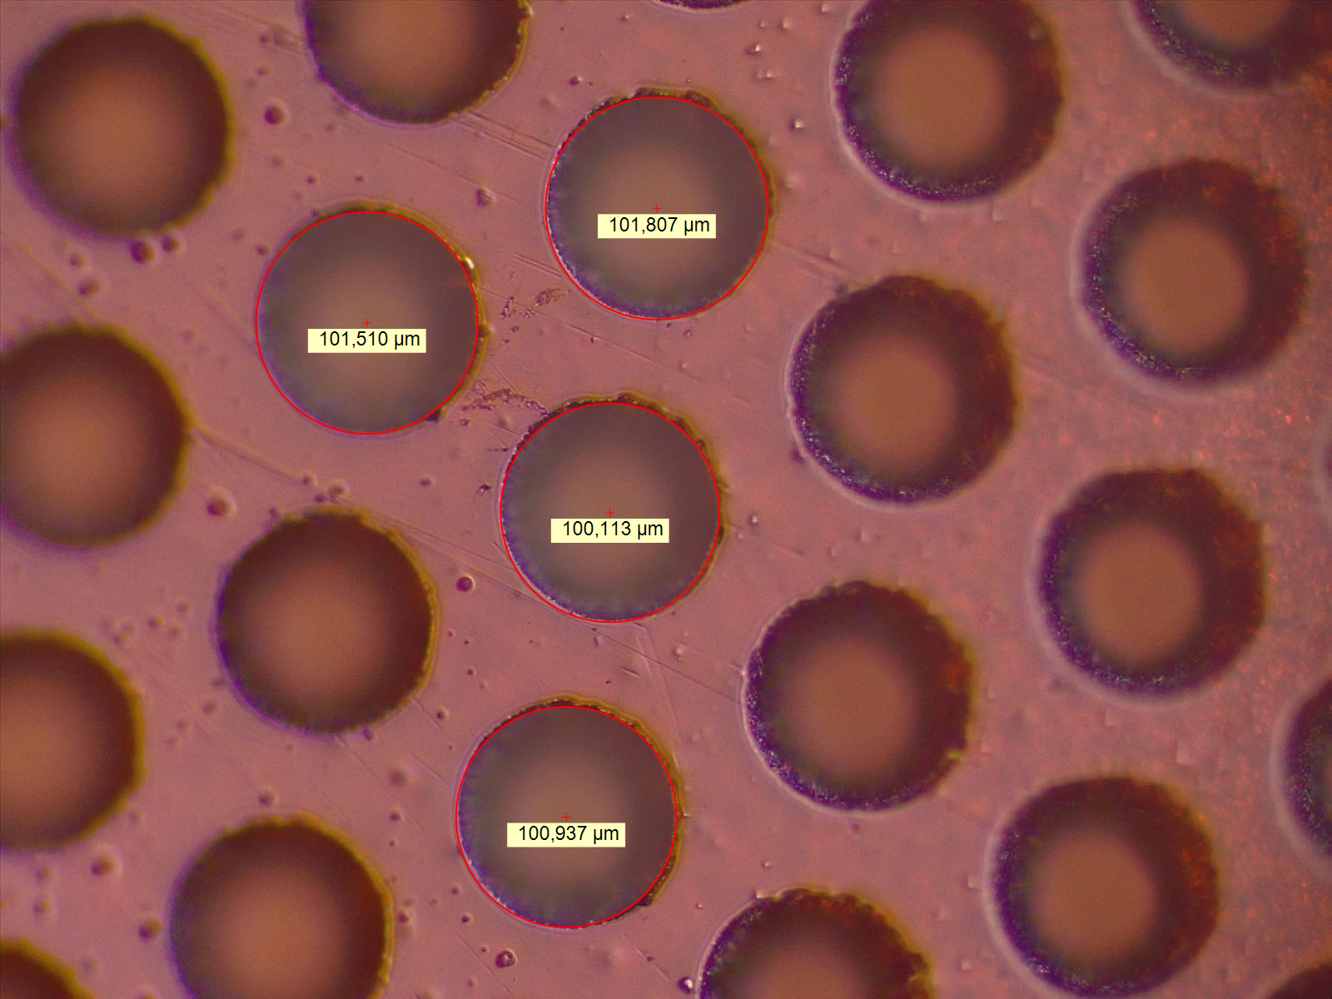
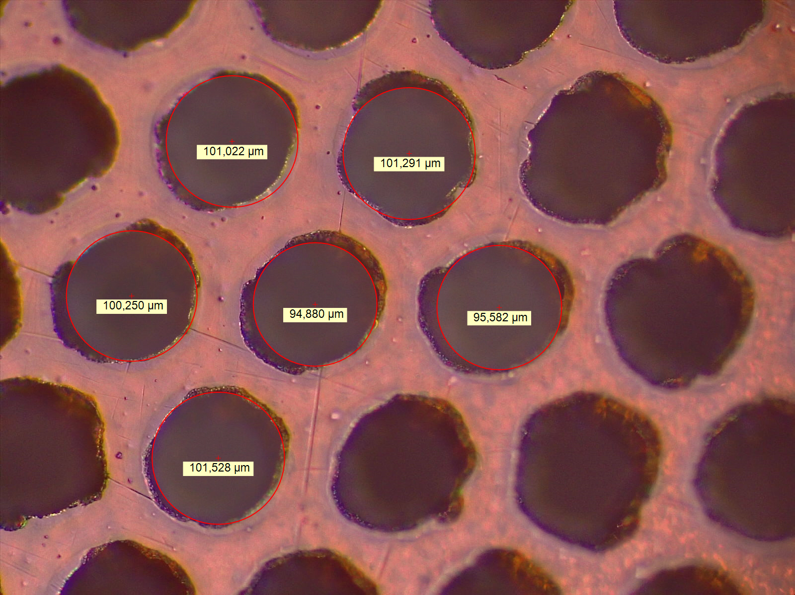
Quality of Amplification Foils (Cond’ive & Res’ive)
Conductive Foil
Resistive Foil (1st prod)
Resistive Foil (2nd prod)
2020
2019
2020
Top (Cu/DLC)
$∅$75-80um
$∅57$um
$∅$78um
Bottom (PI)
$∅45$um
$∅100$um
$∅100$um

Slide 2
Observations / Concerns
Cu electrode (July 2020)
Smooth surface, hole quality is great, grain-size < 1um
First production DLC foil (July 2019)
Smooth surface, hole quality is great, grain-size < 10um
Very circular bottom holes
2nd production DLC foil (July 2020)
Canyon-like surface, no grains visible, distored holes
Distored bottom holes
Check USTC details of 2019 and 2020 FTM foil production
DLC Foil Production Procedure: Breaking of DLC in last step is clean / high quality ?

Slide 3
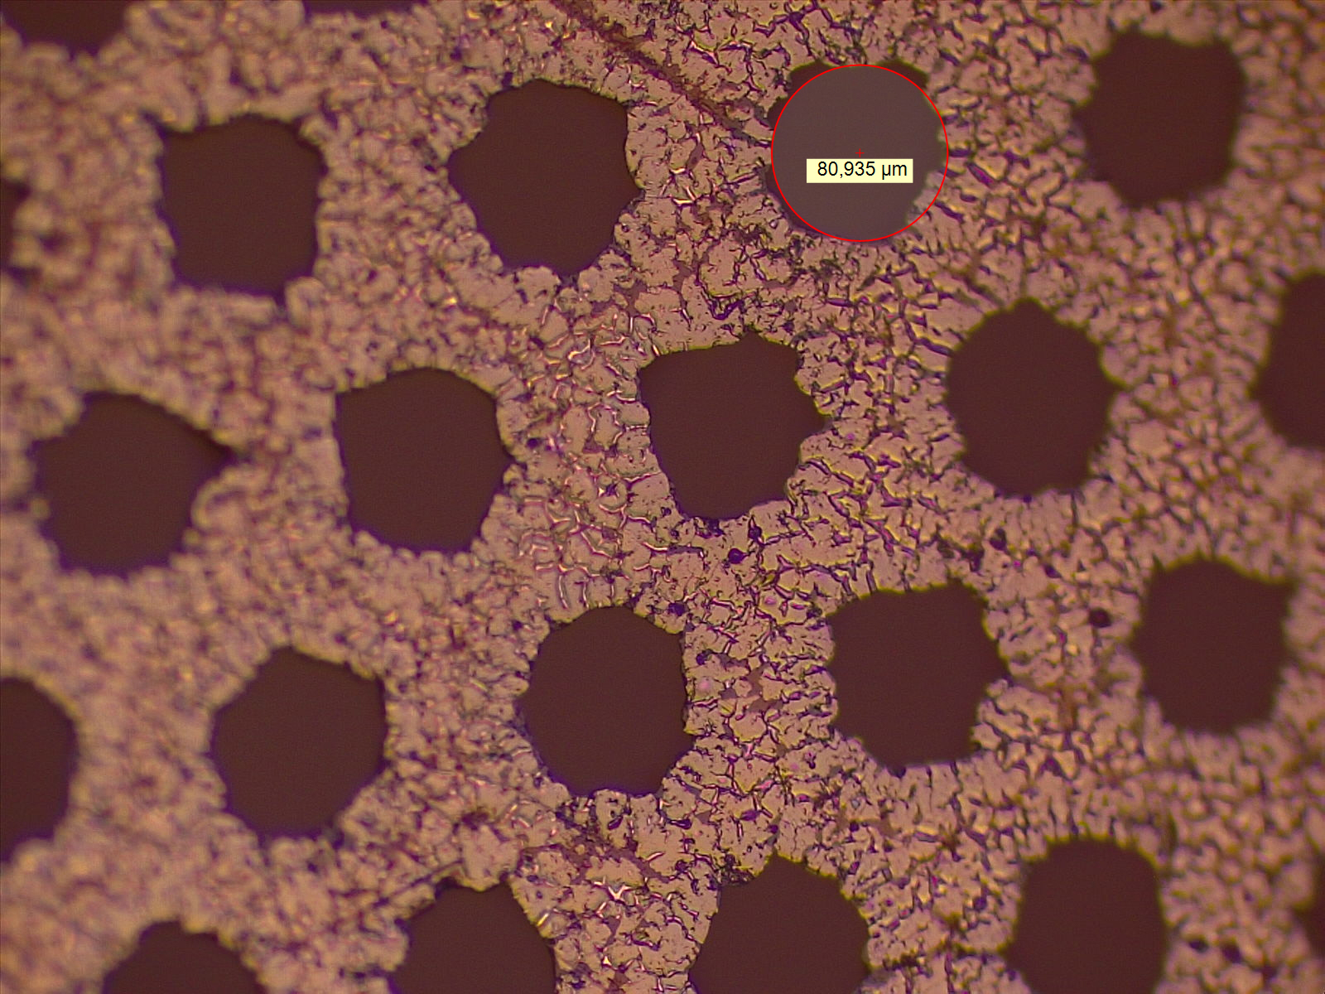
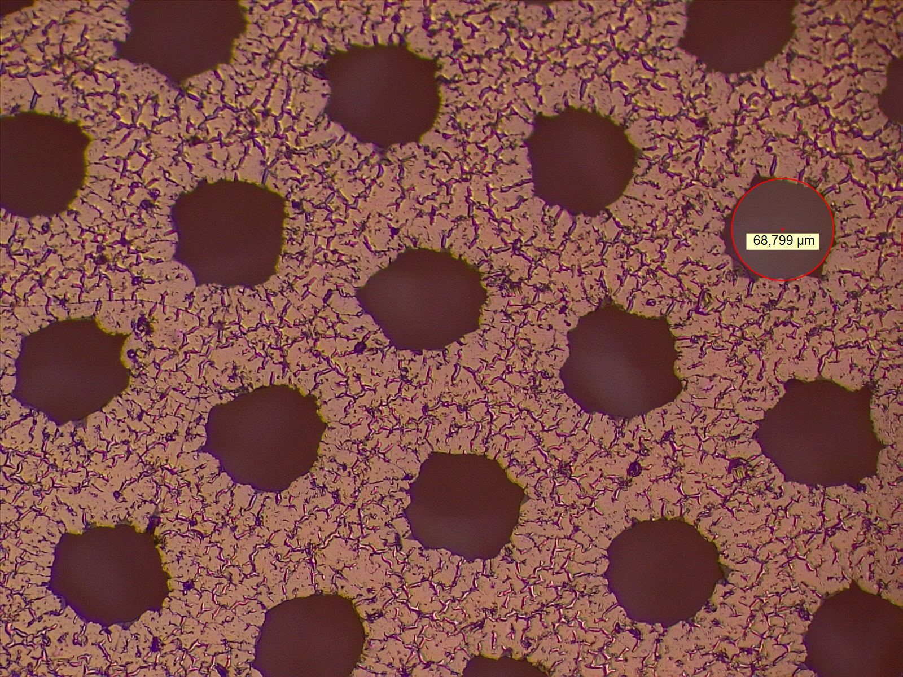
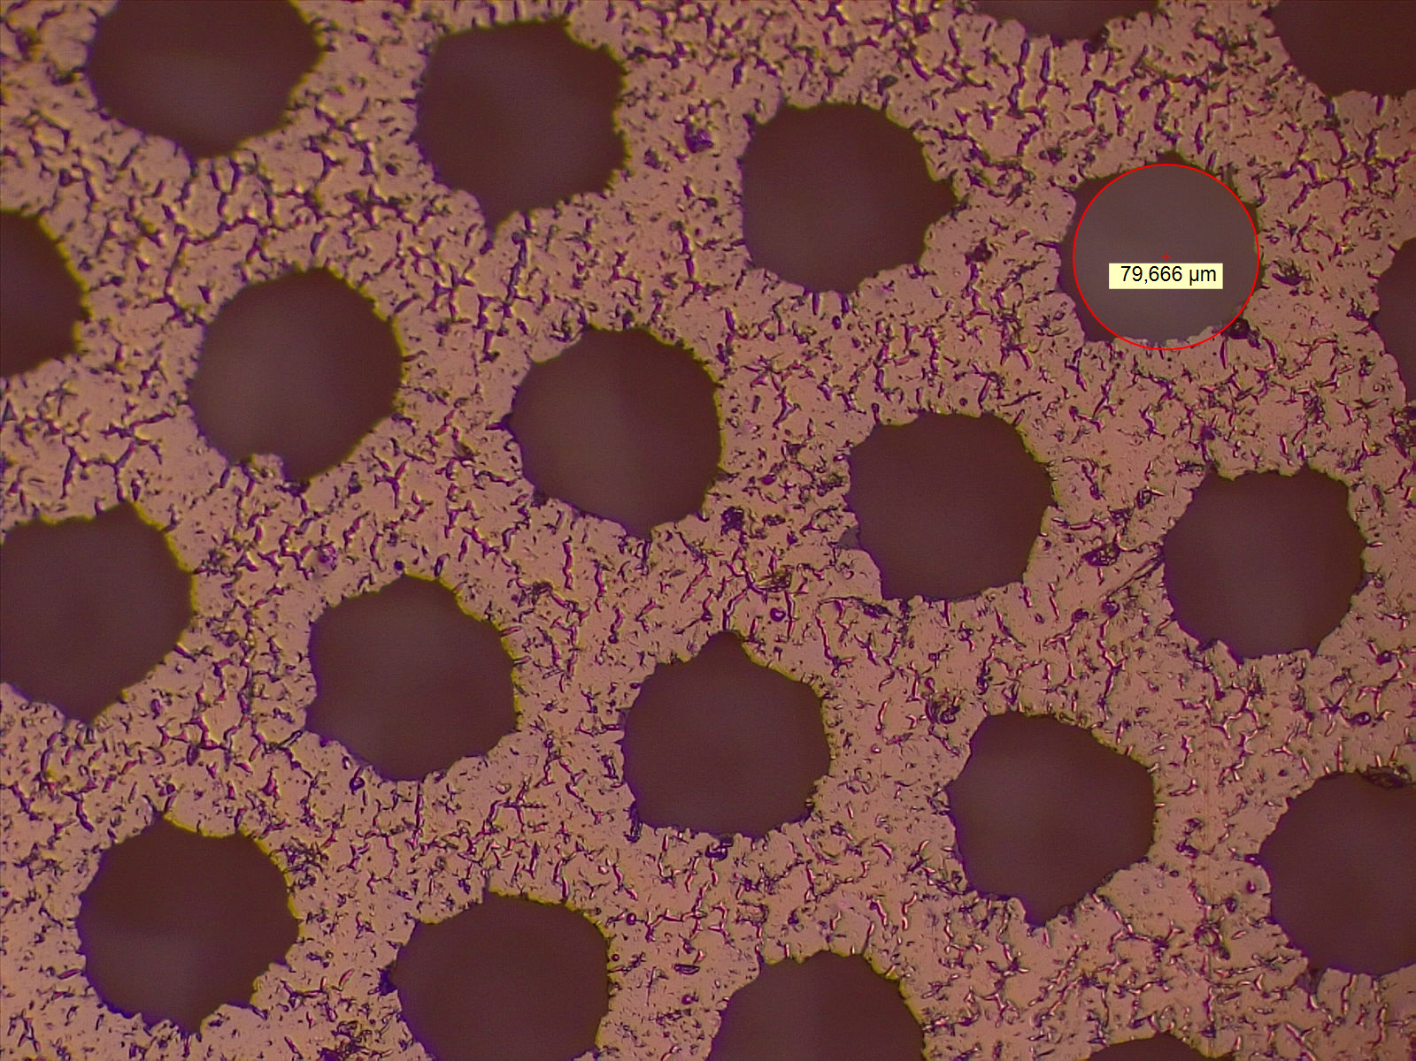
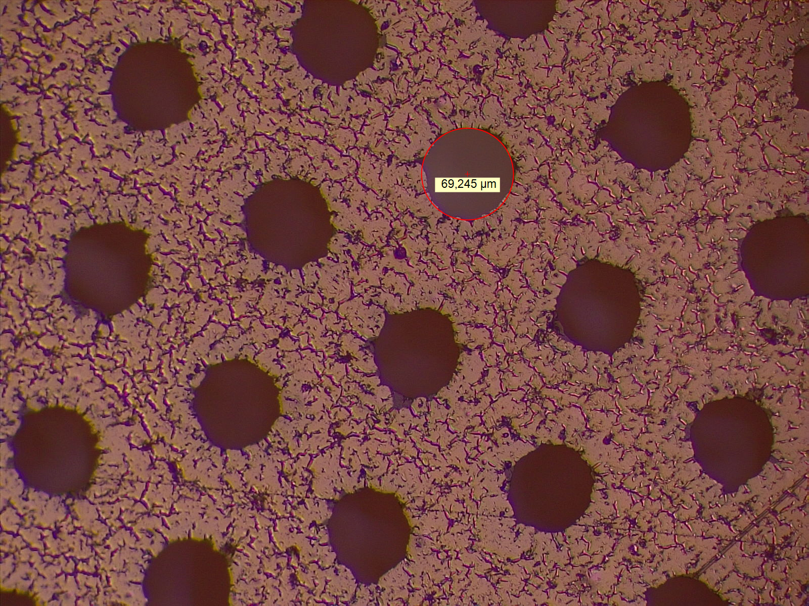
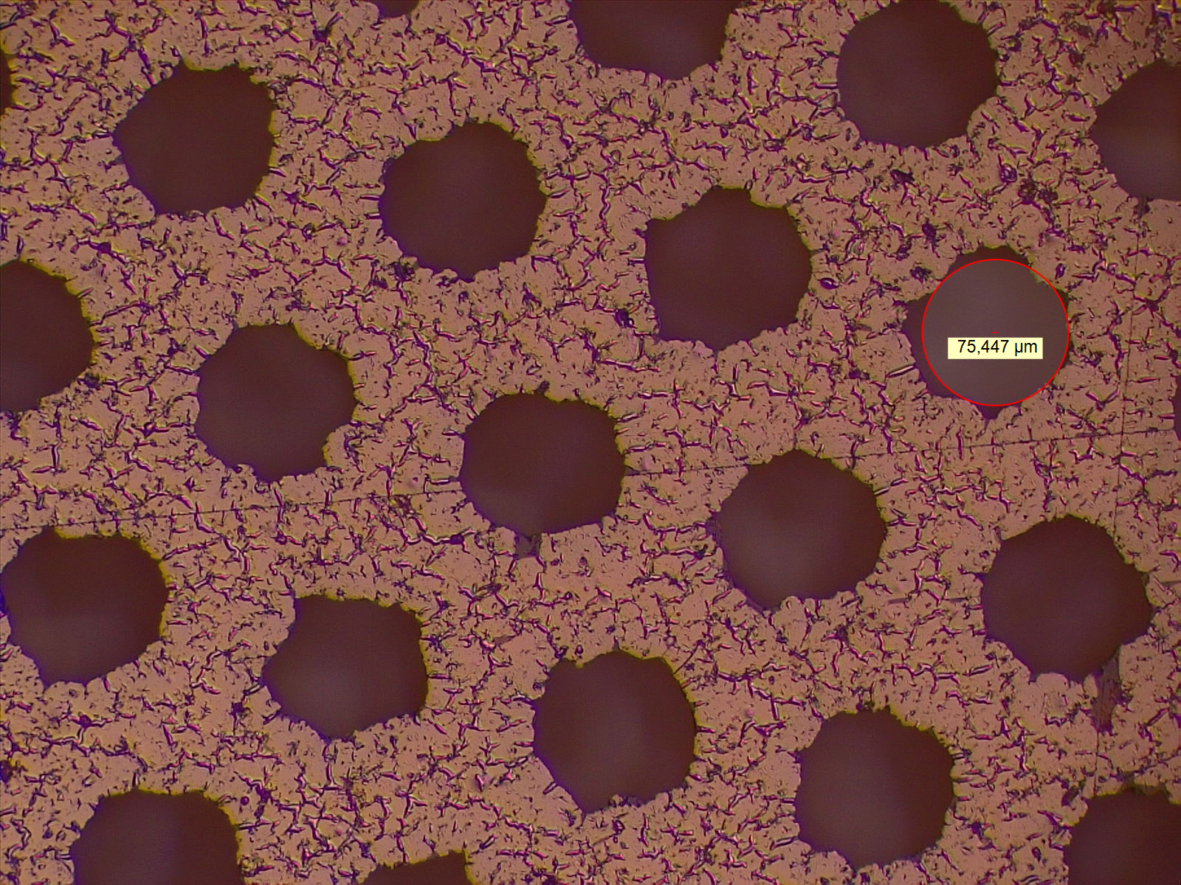
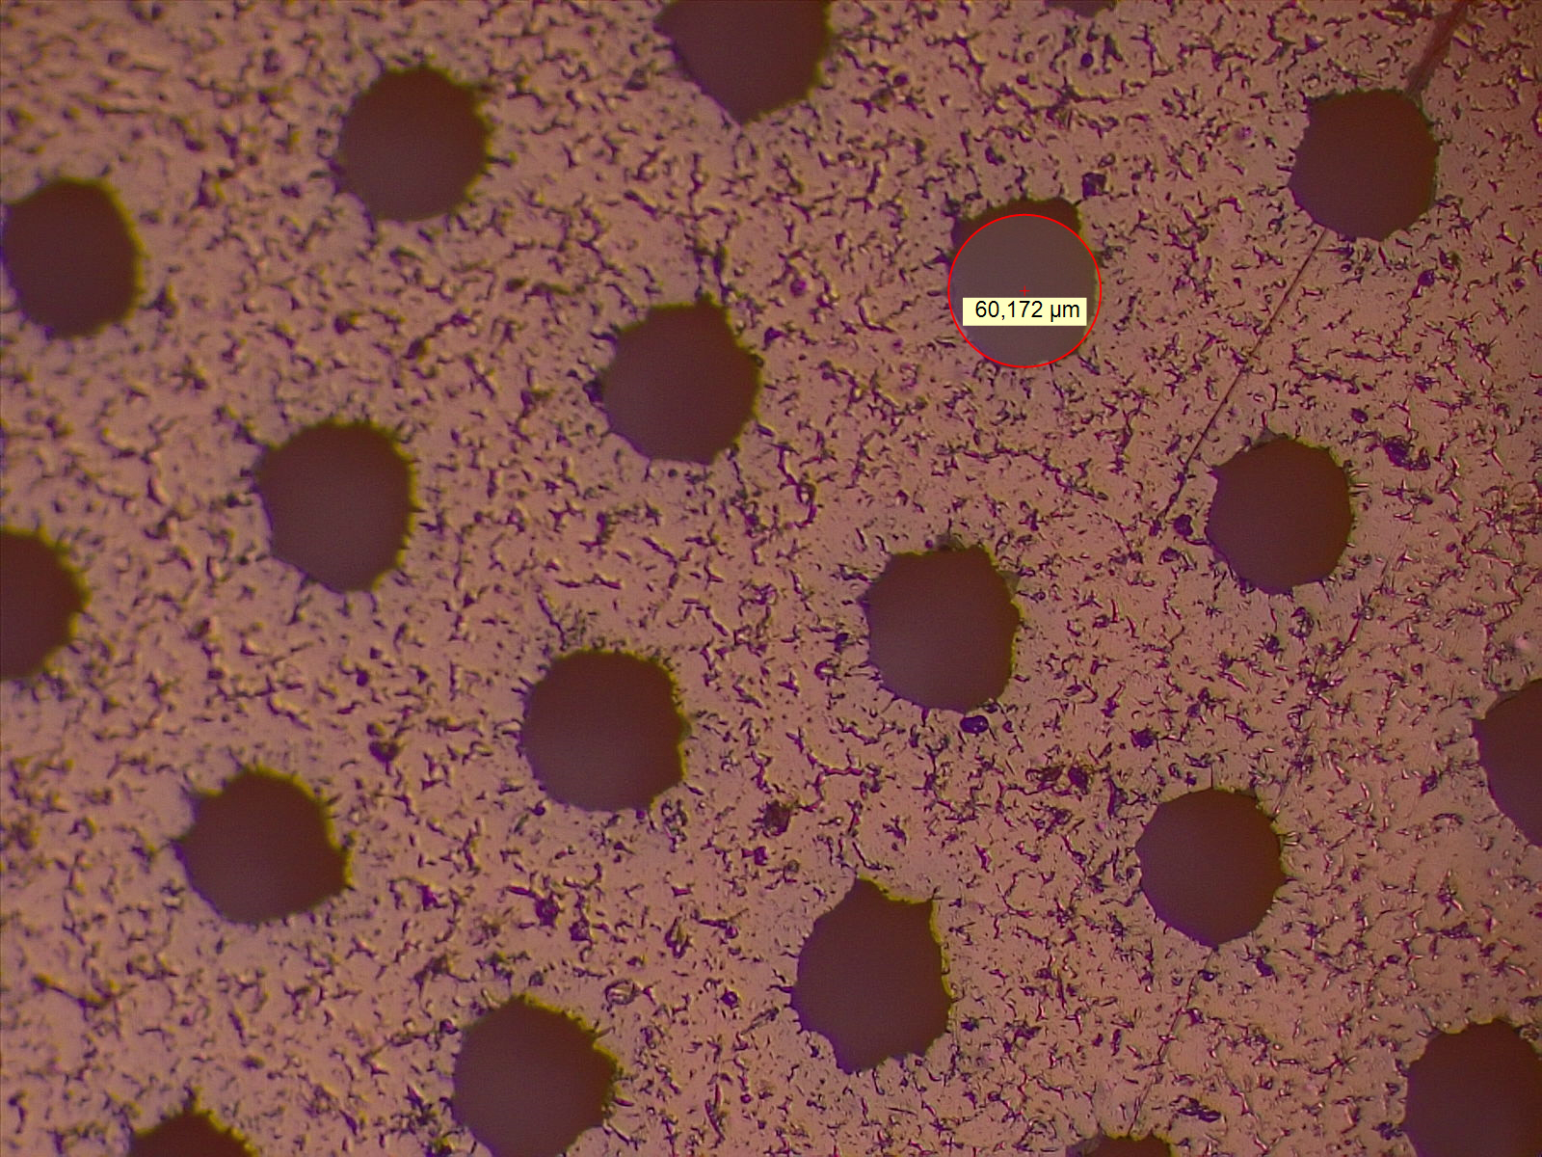
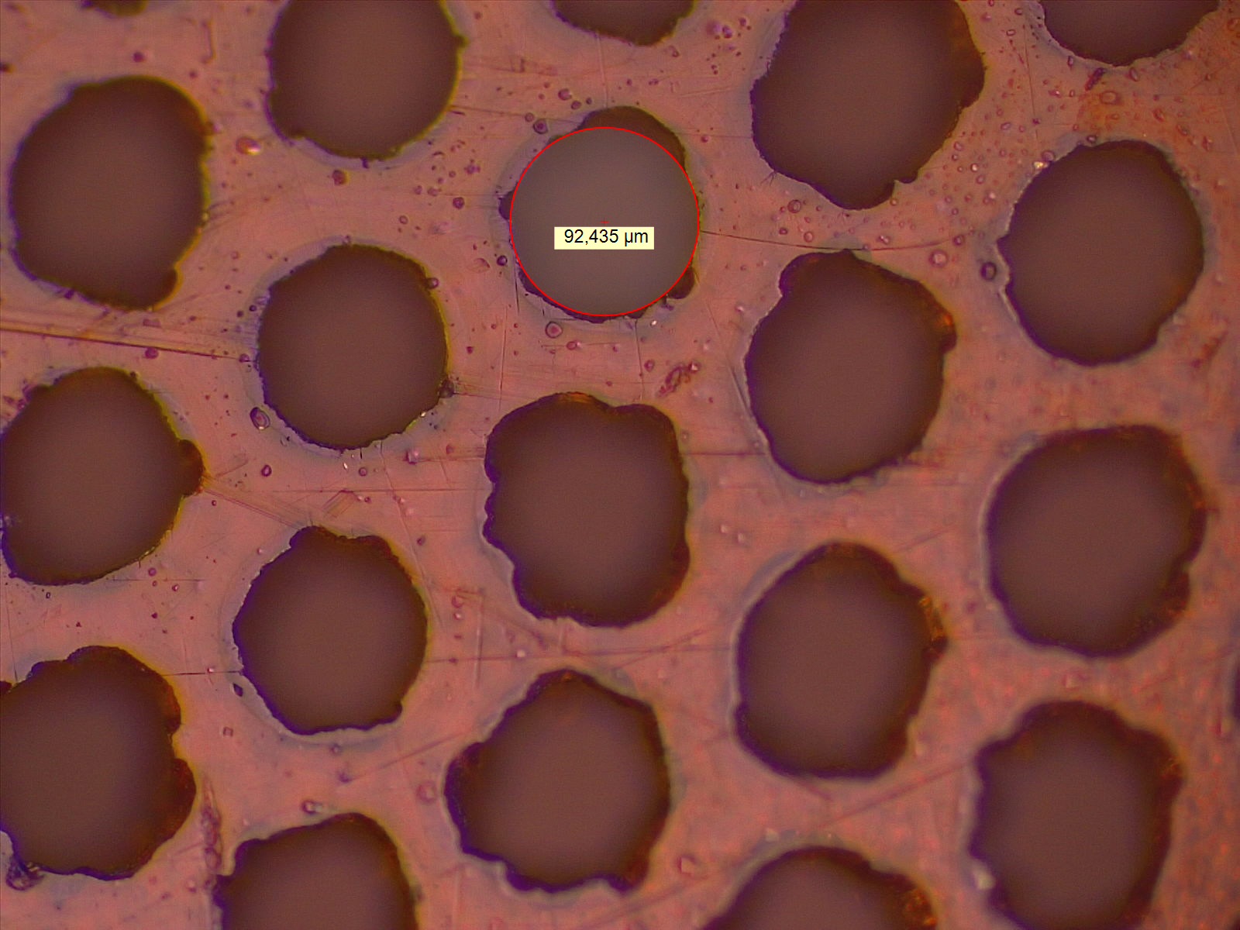
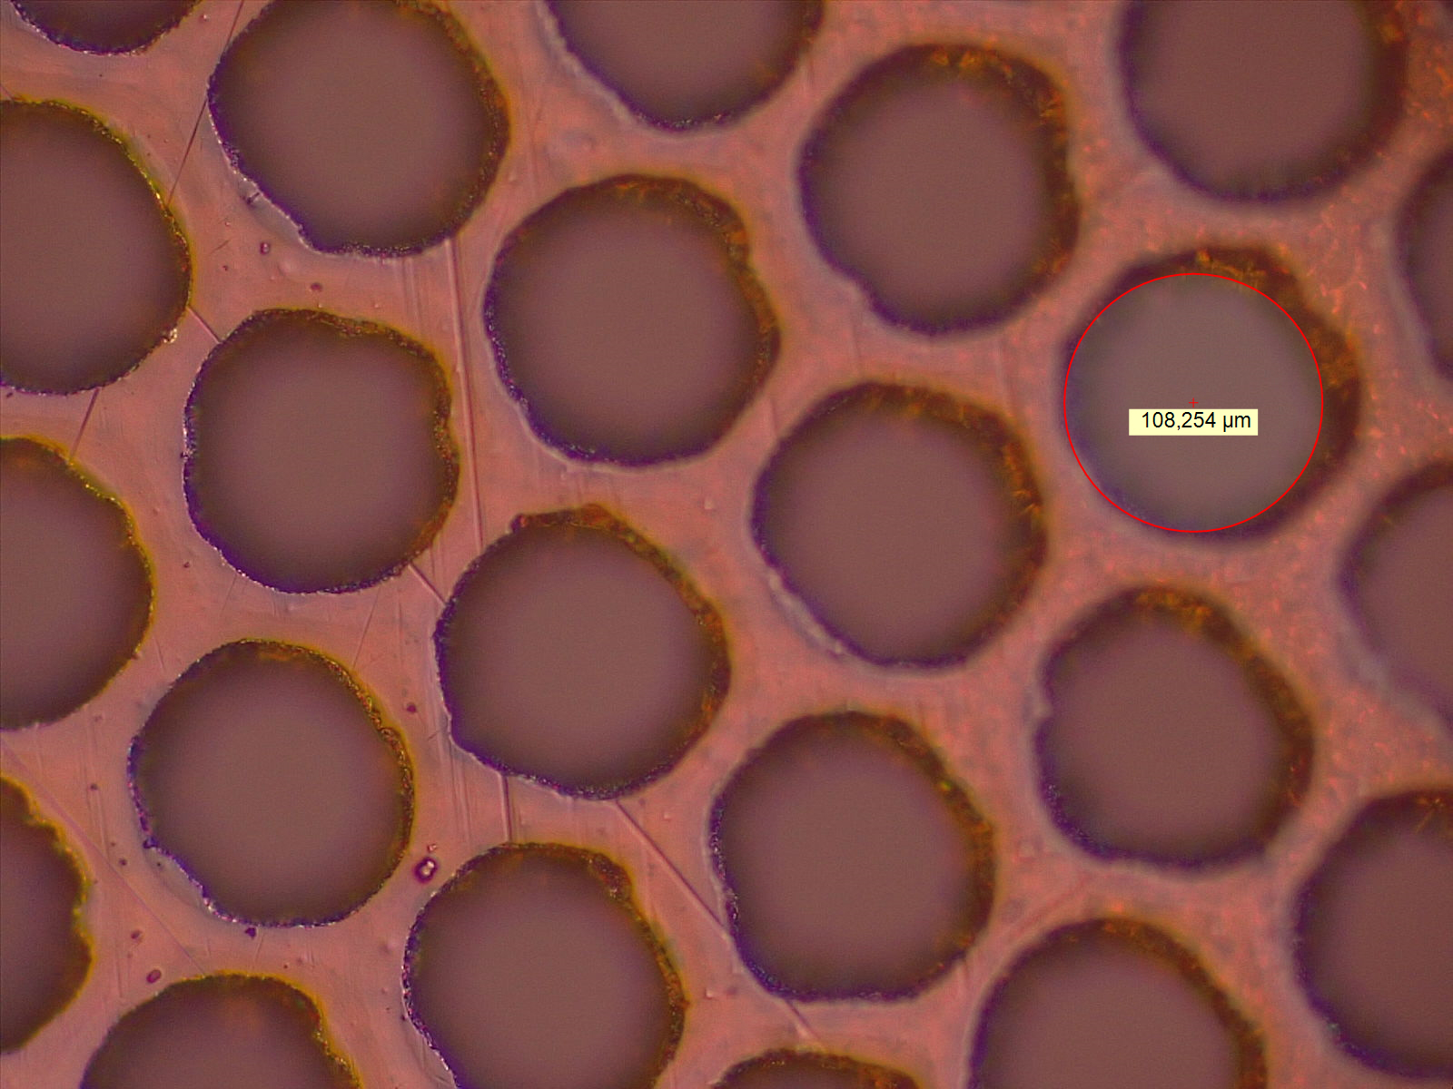
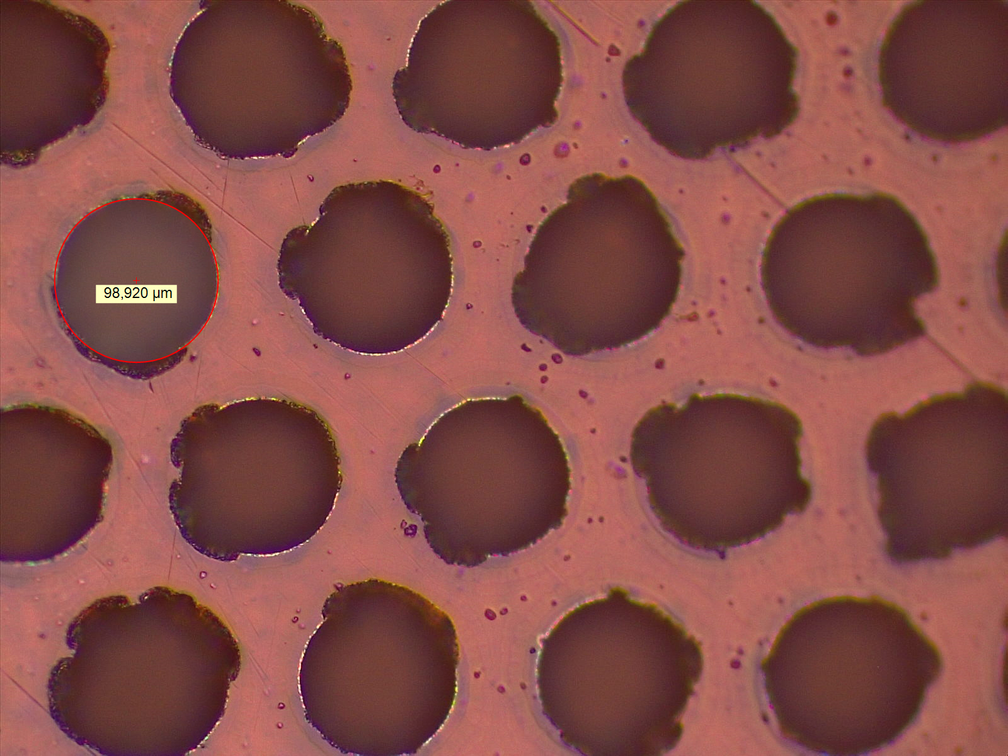
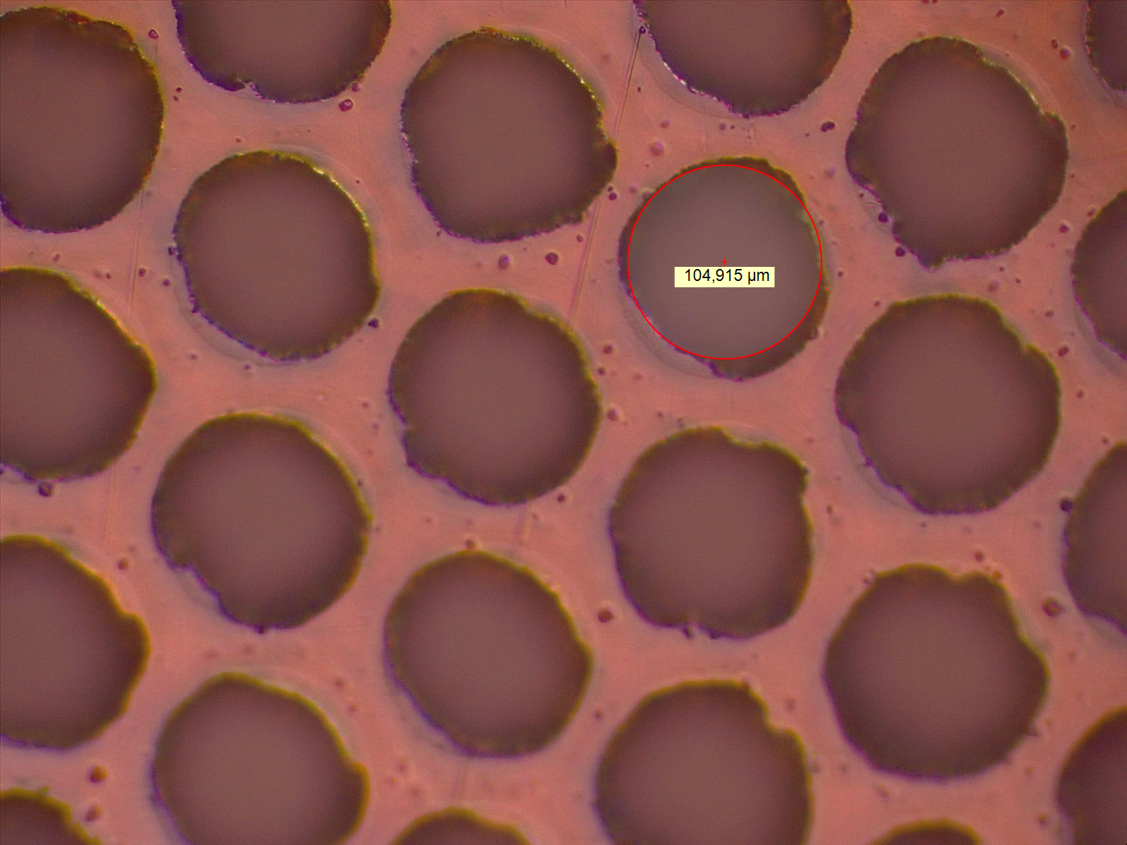
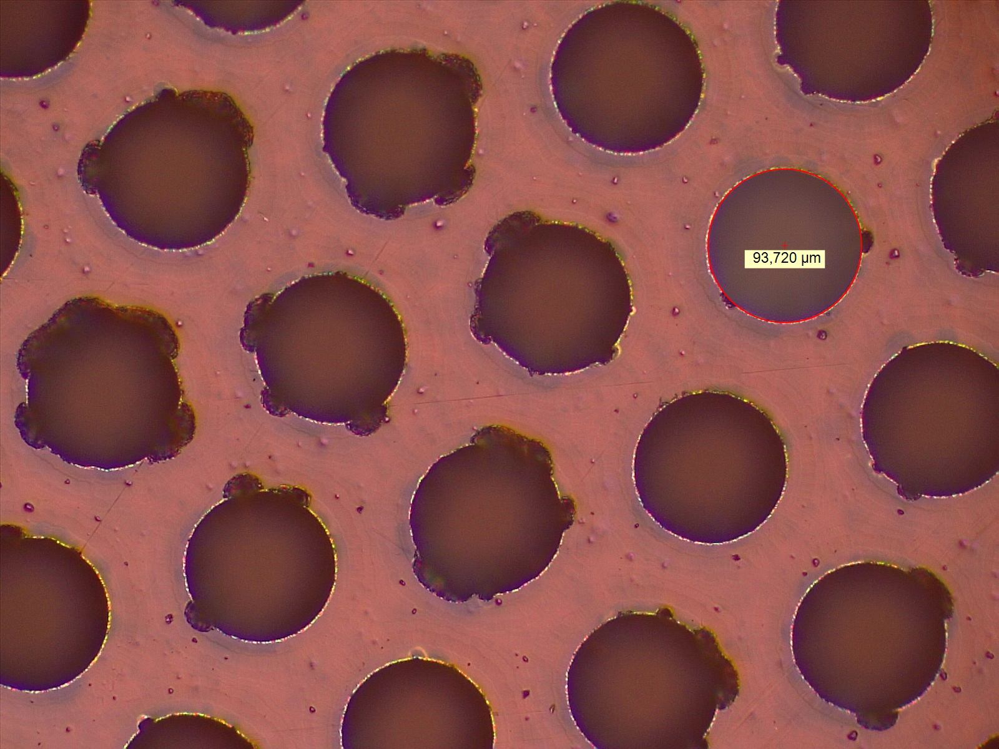
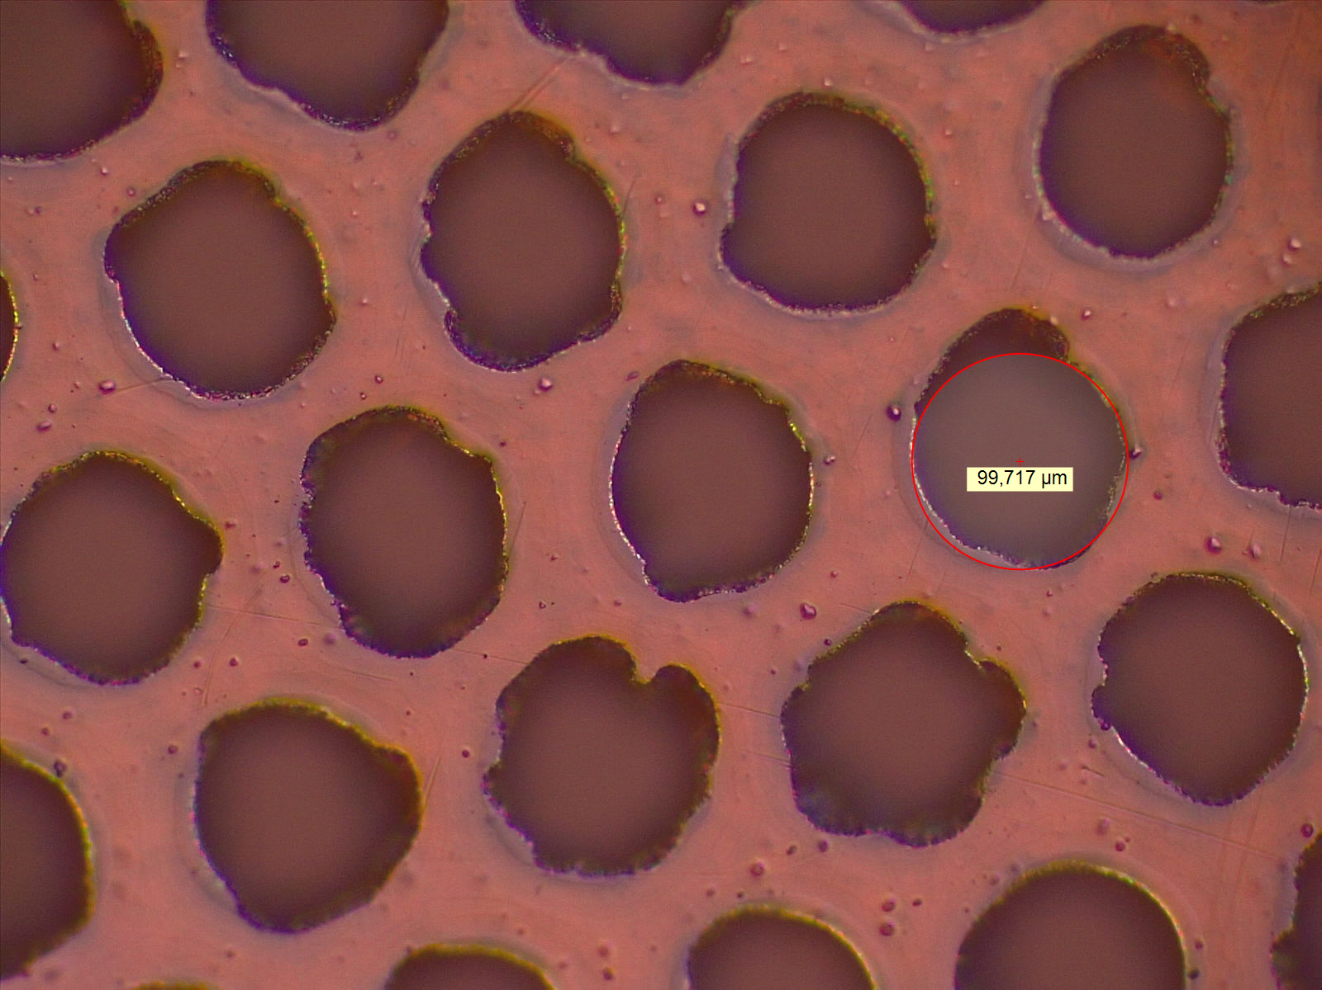
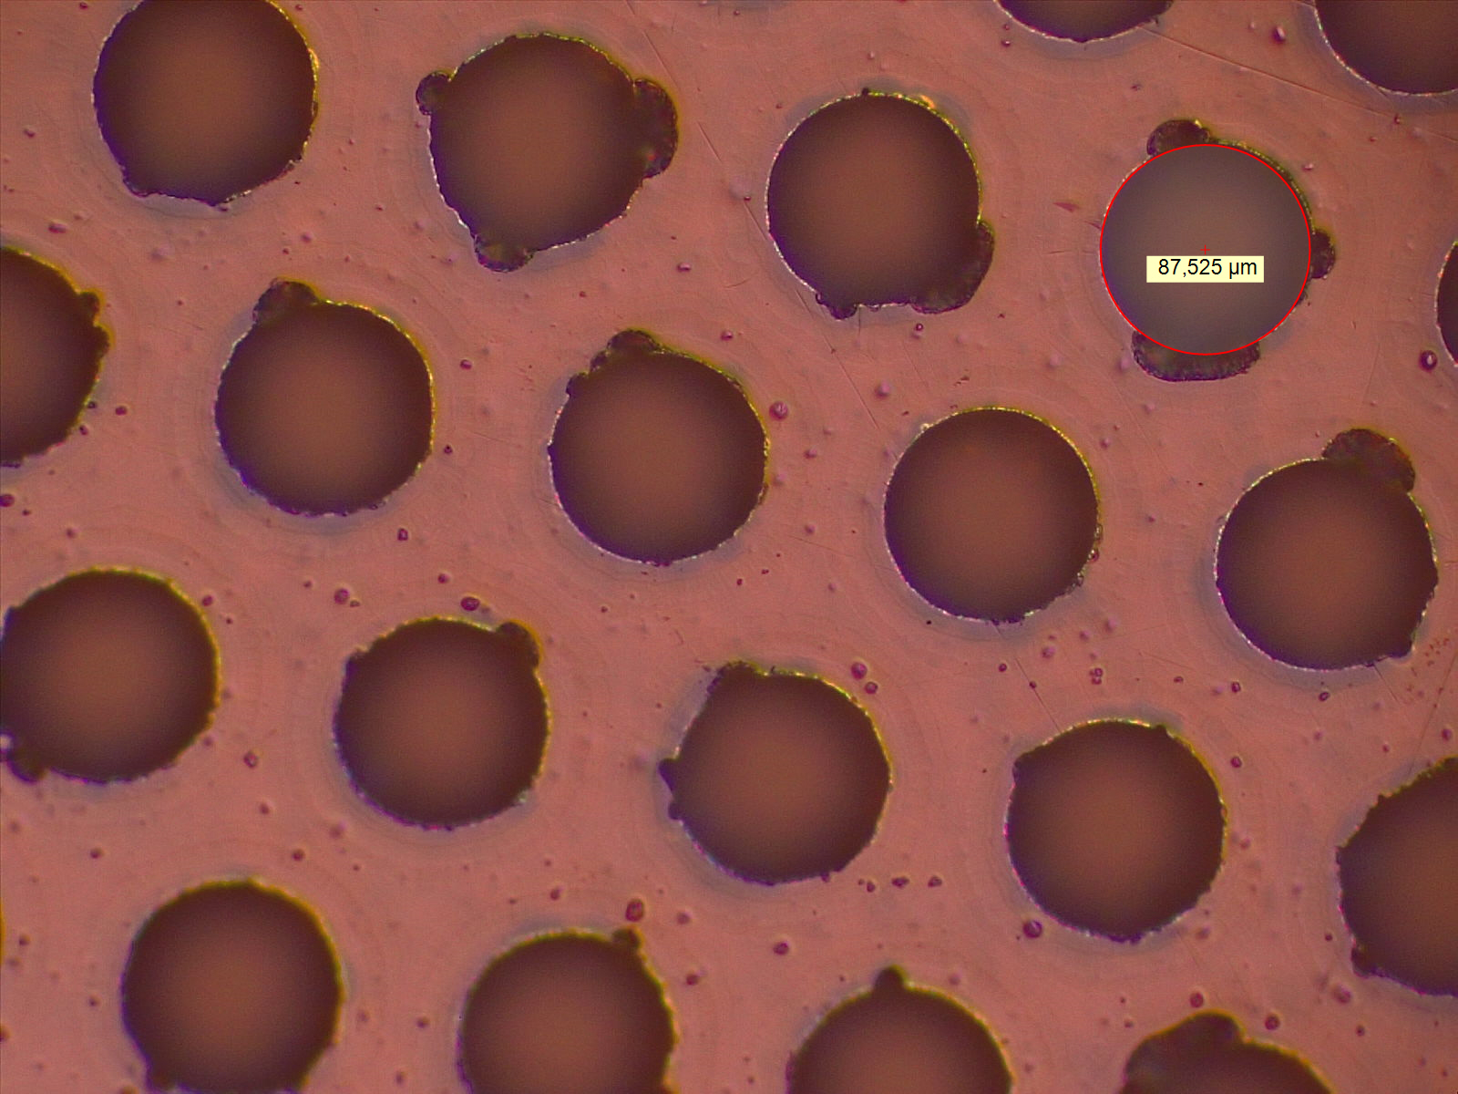
Top (DLC)
2nd Foil prod (2020)
inside detector
$∅$81um
1
$∅$87um
3
$∅$69um
5
$∅$80um
7
also inside detector
$∅$78um
2
$∅$69um
4
$∅$75um
6
$∅$60um
8
inside detector
$∅$92um
1
$∅$108um
3
$∅$99um
5
$∅$105um
7
Bottom (PI)
also inside detector
$∅$100um
2
$∅$93um
4
$∅$100um
6
$∅$88um
8

Slide 4
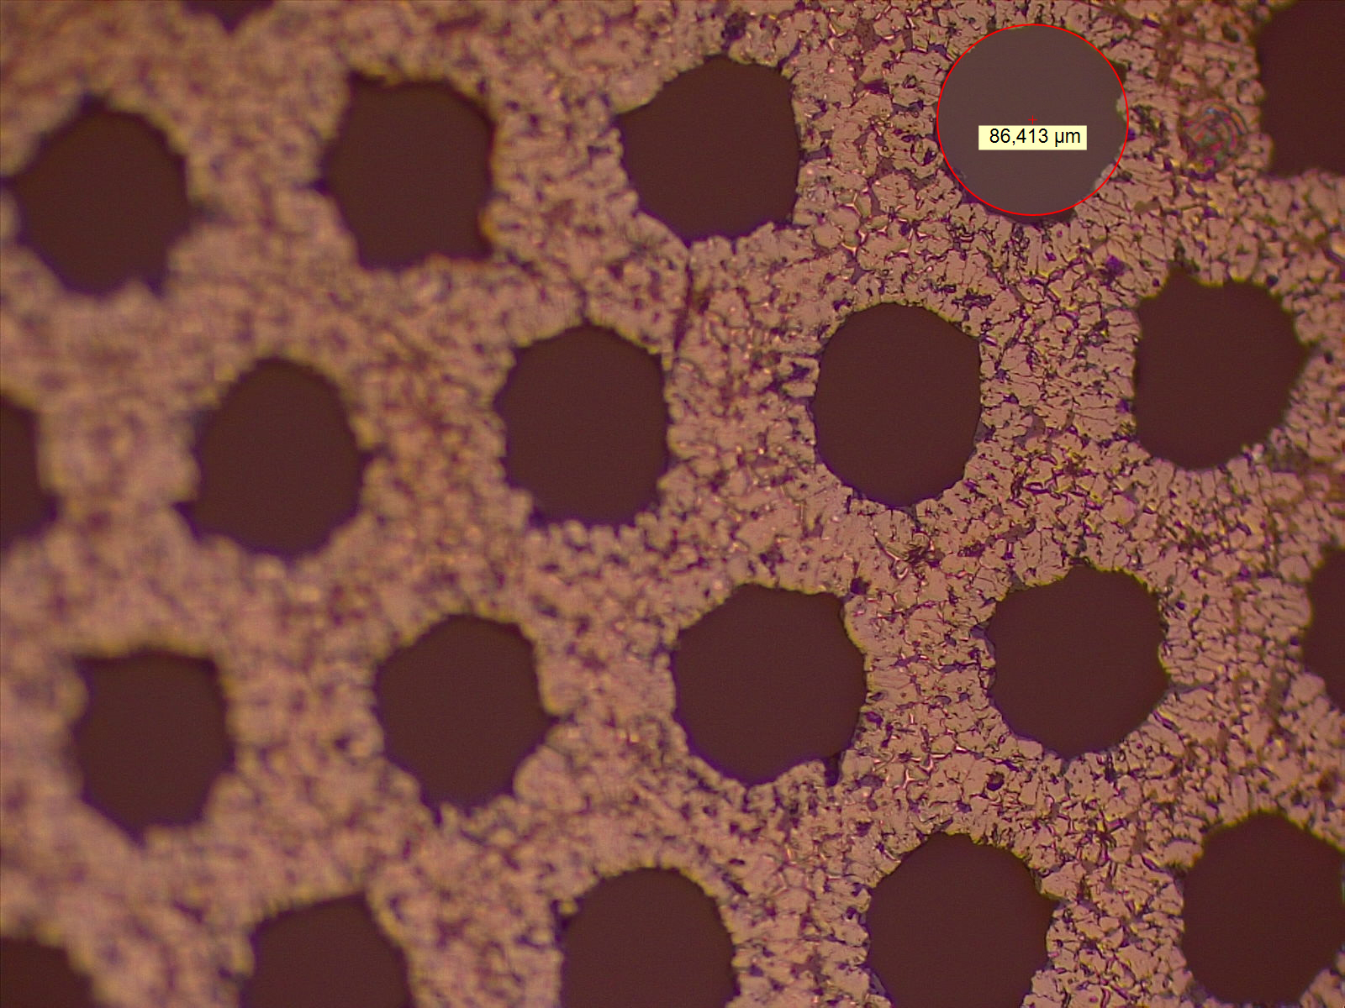
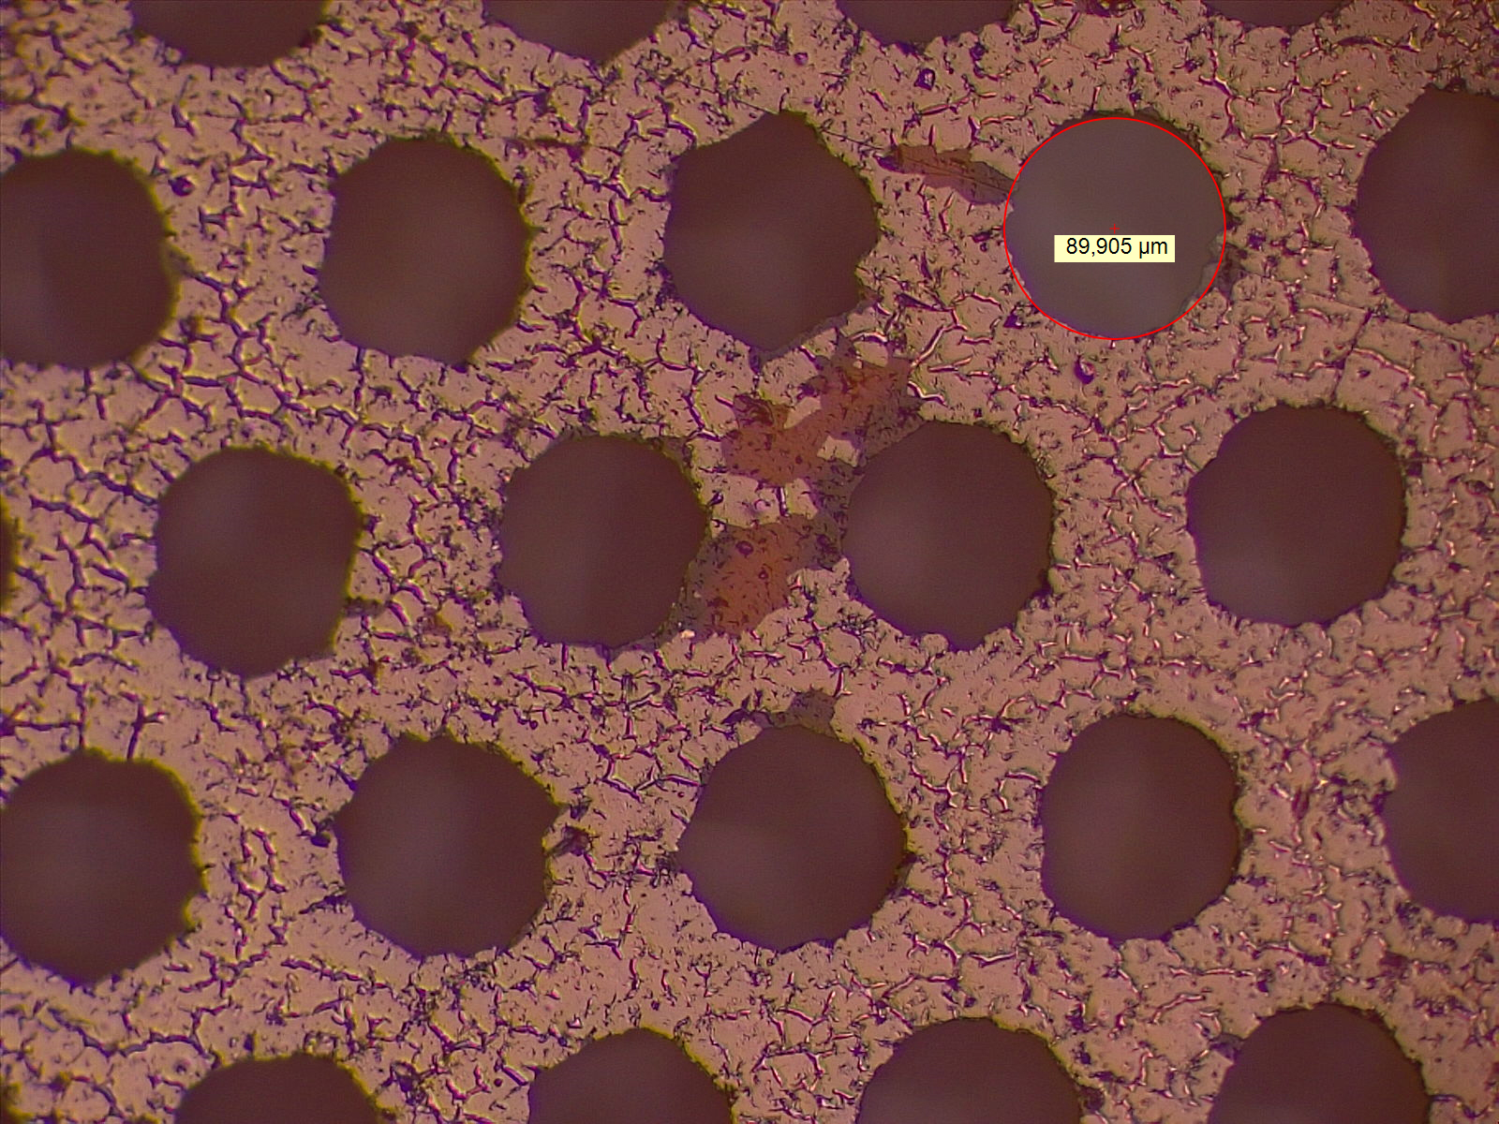
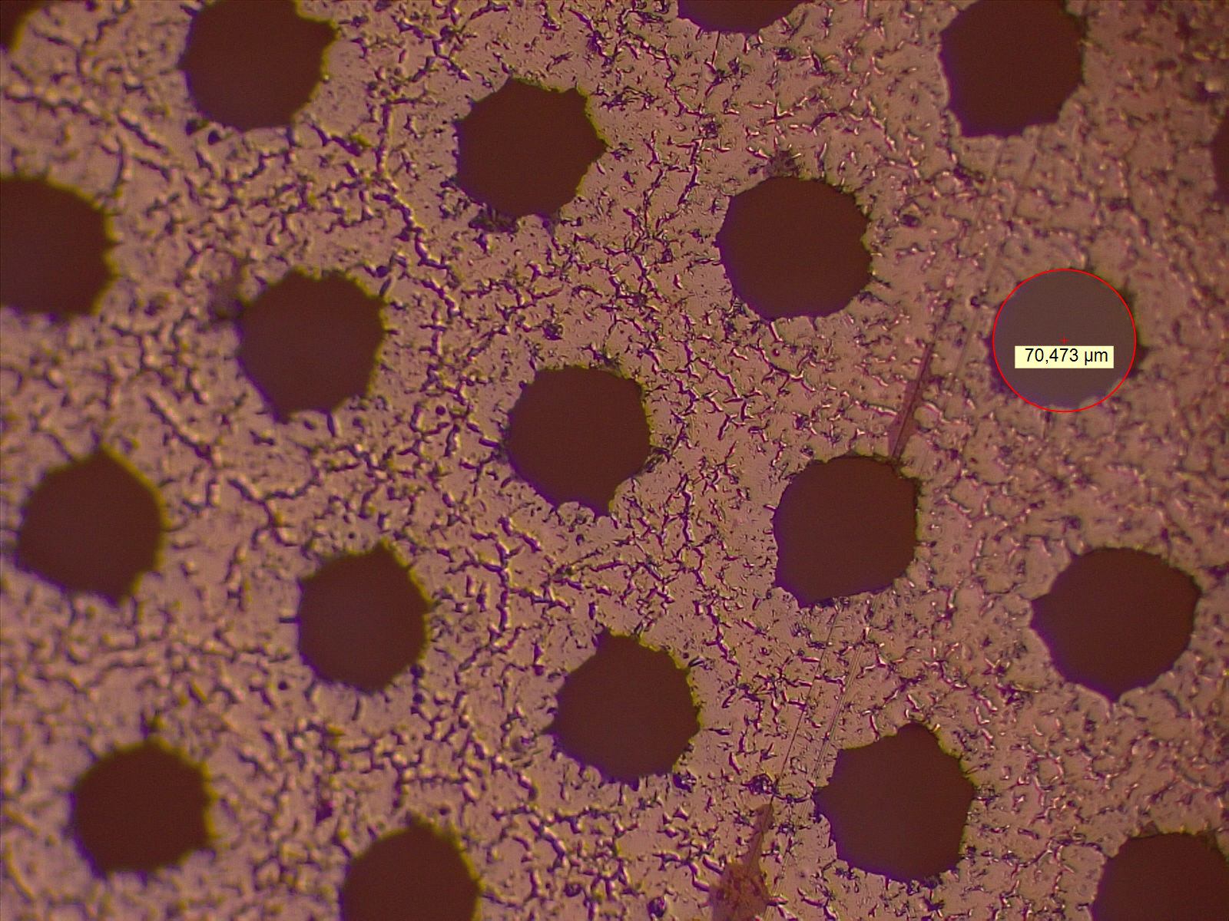
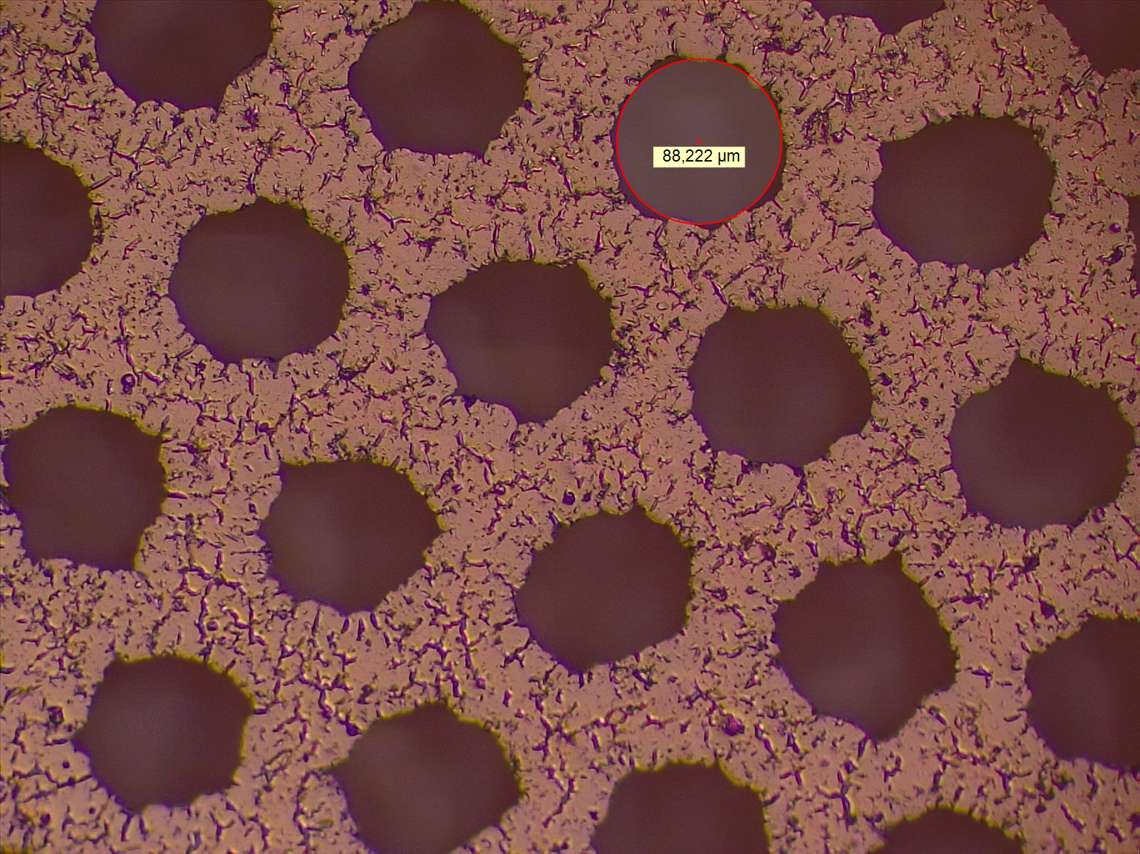
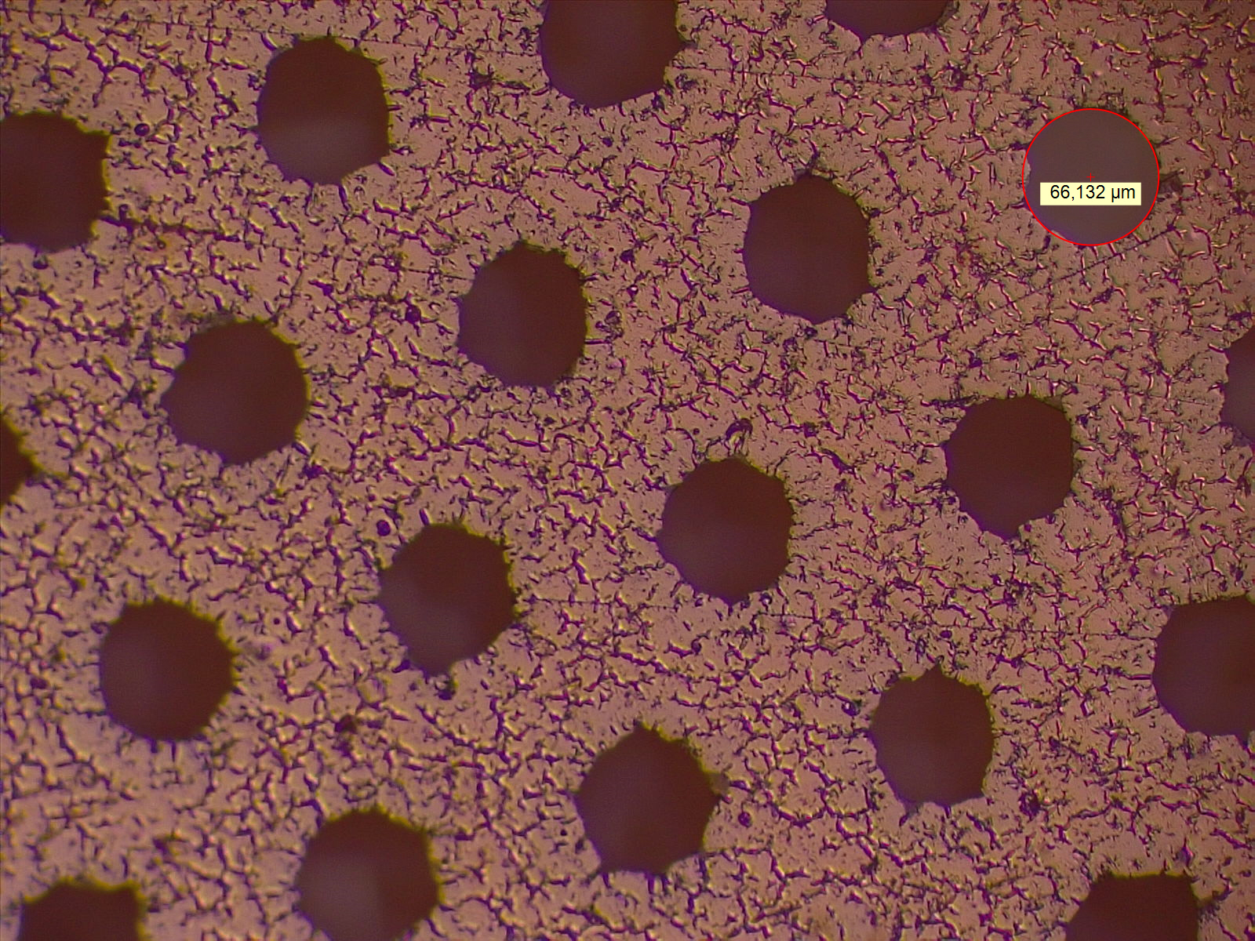
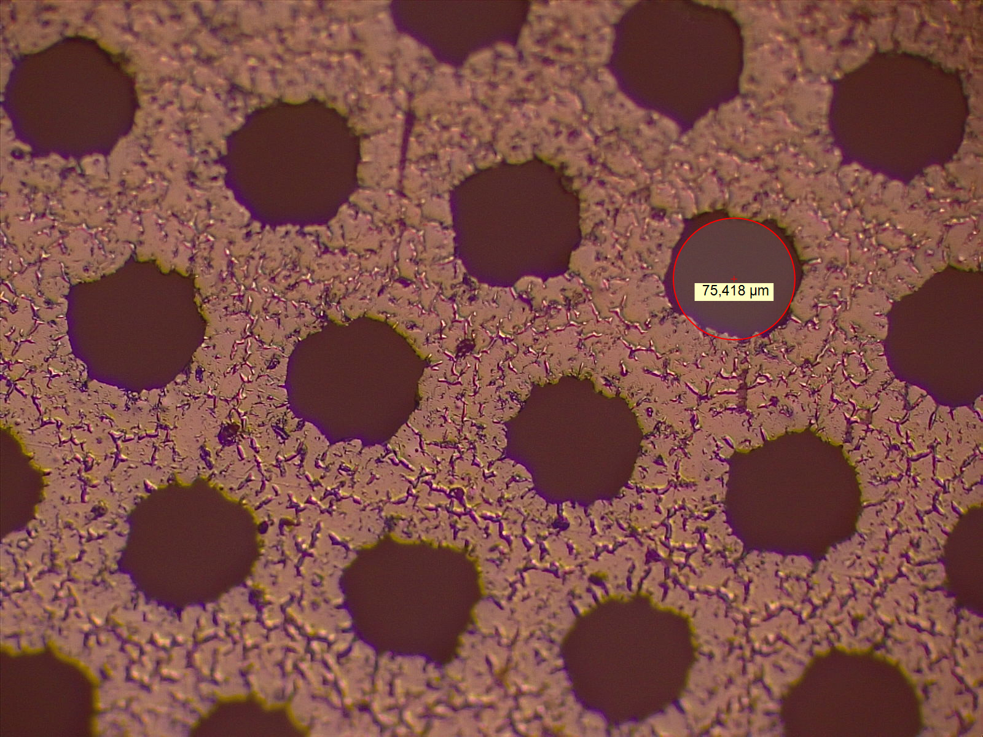
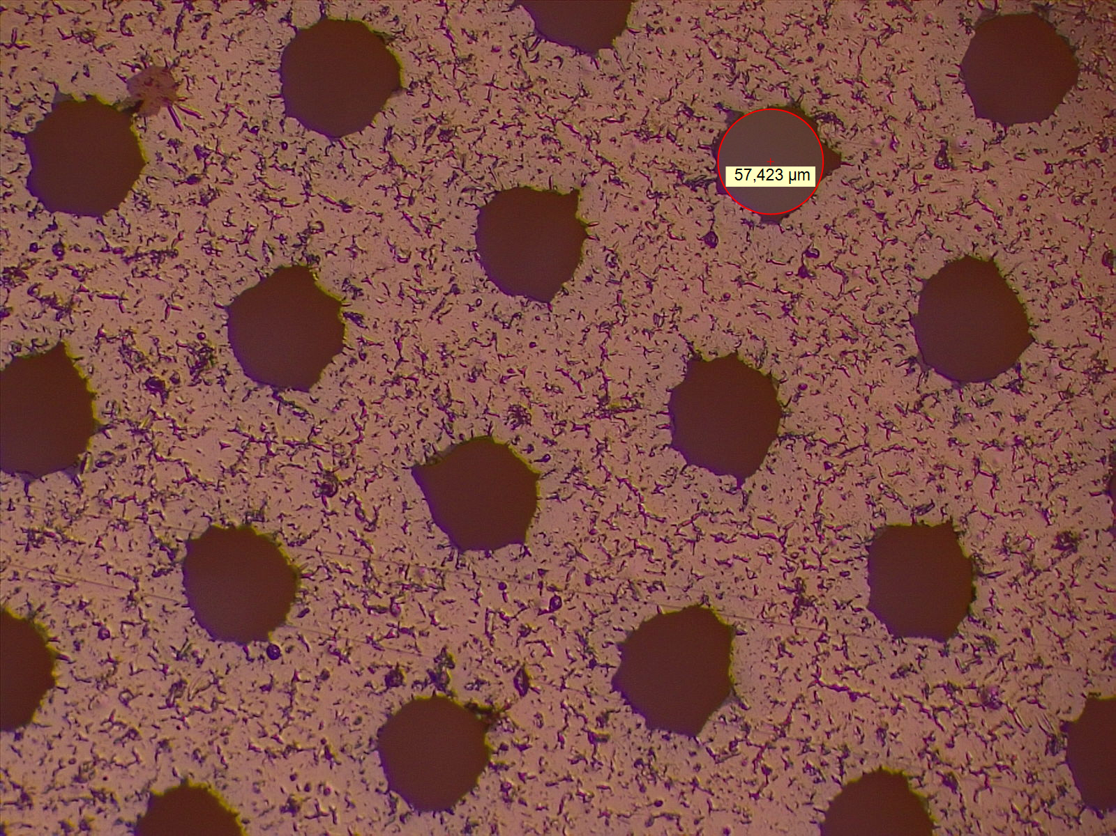
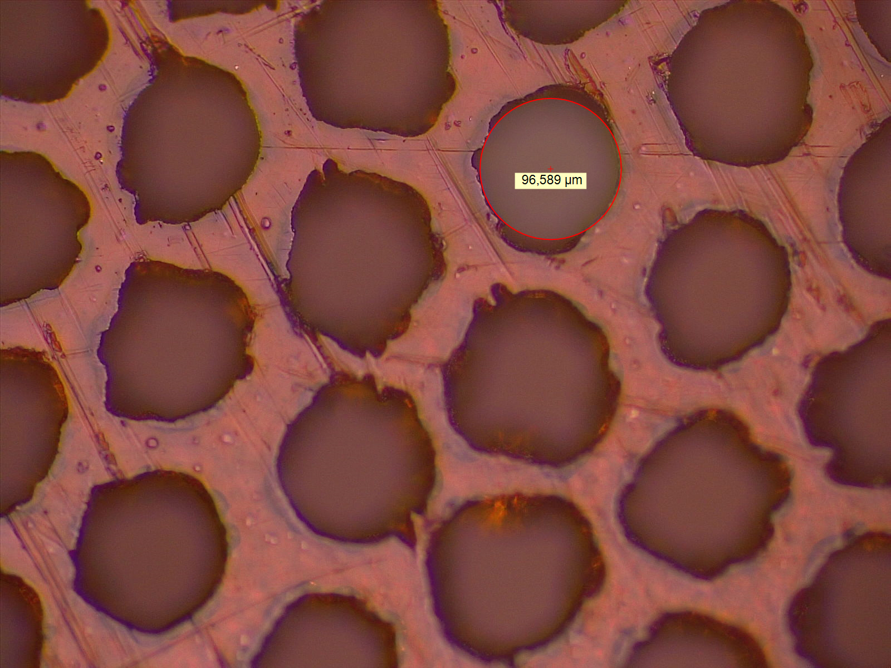
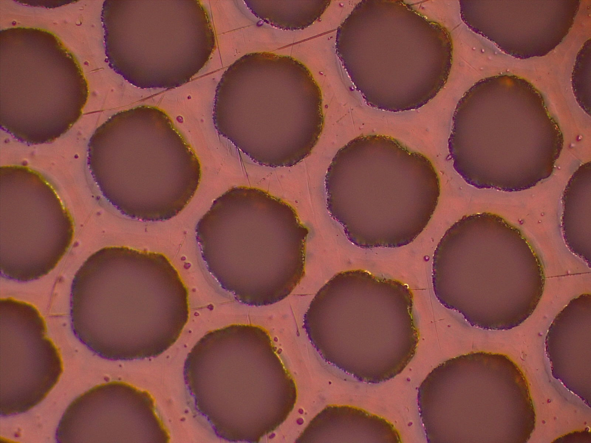
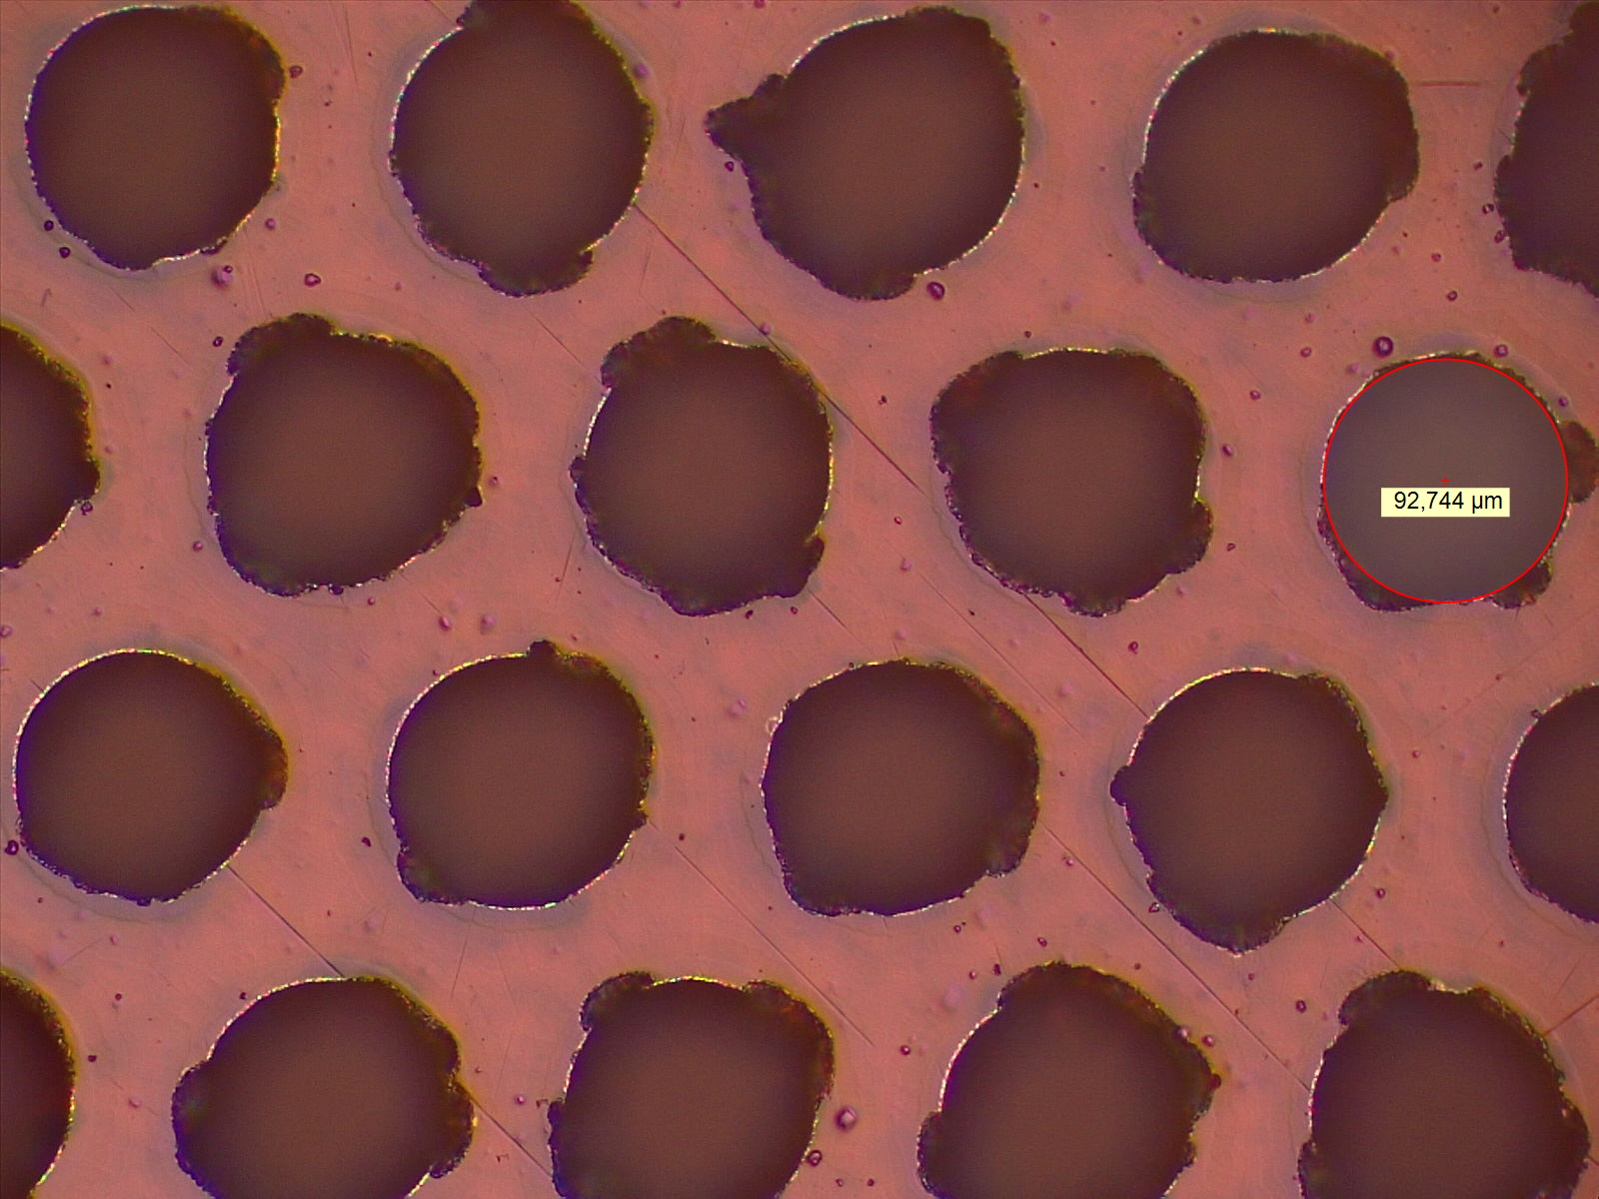
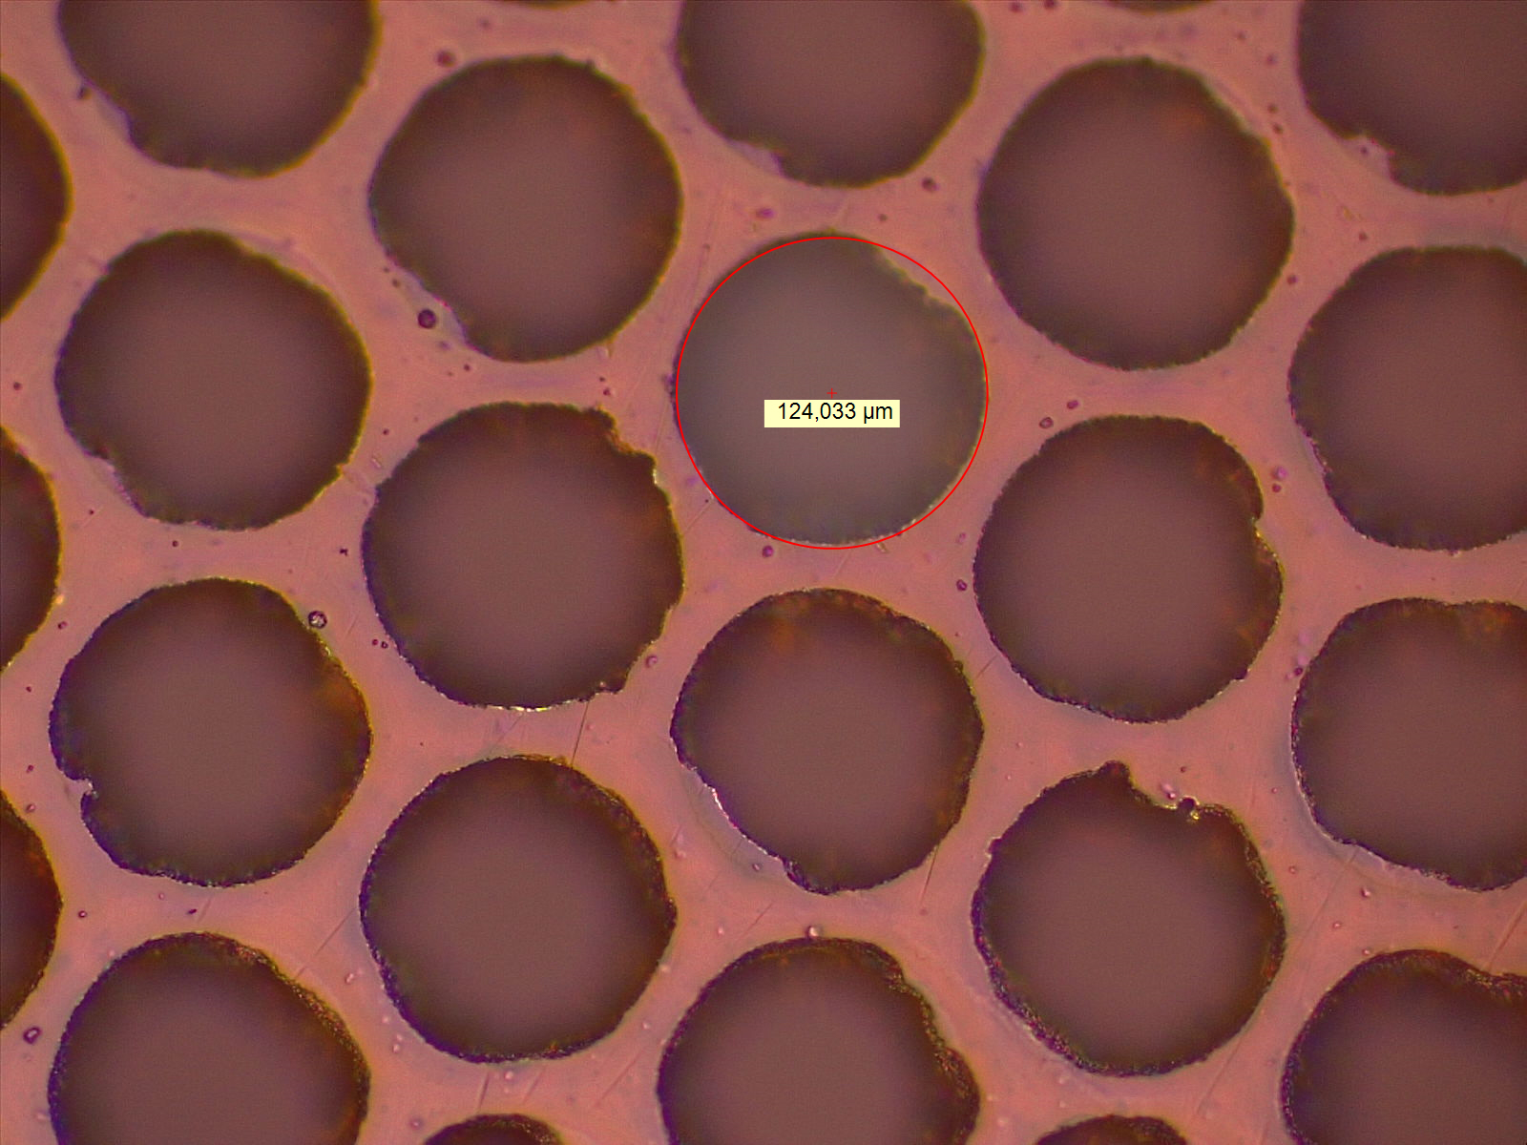
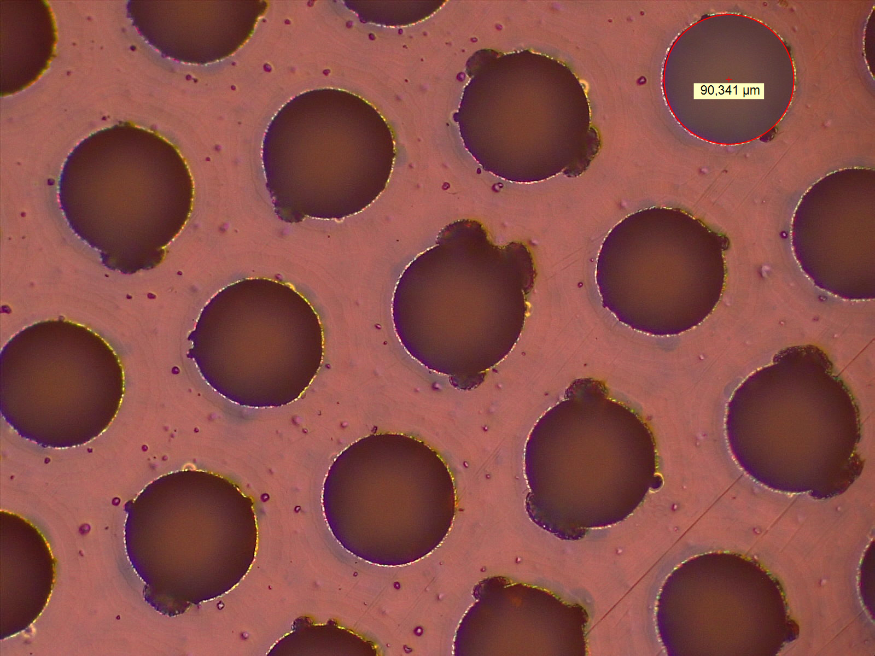
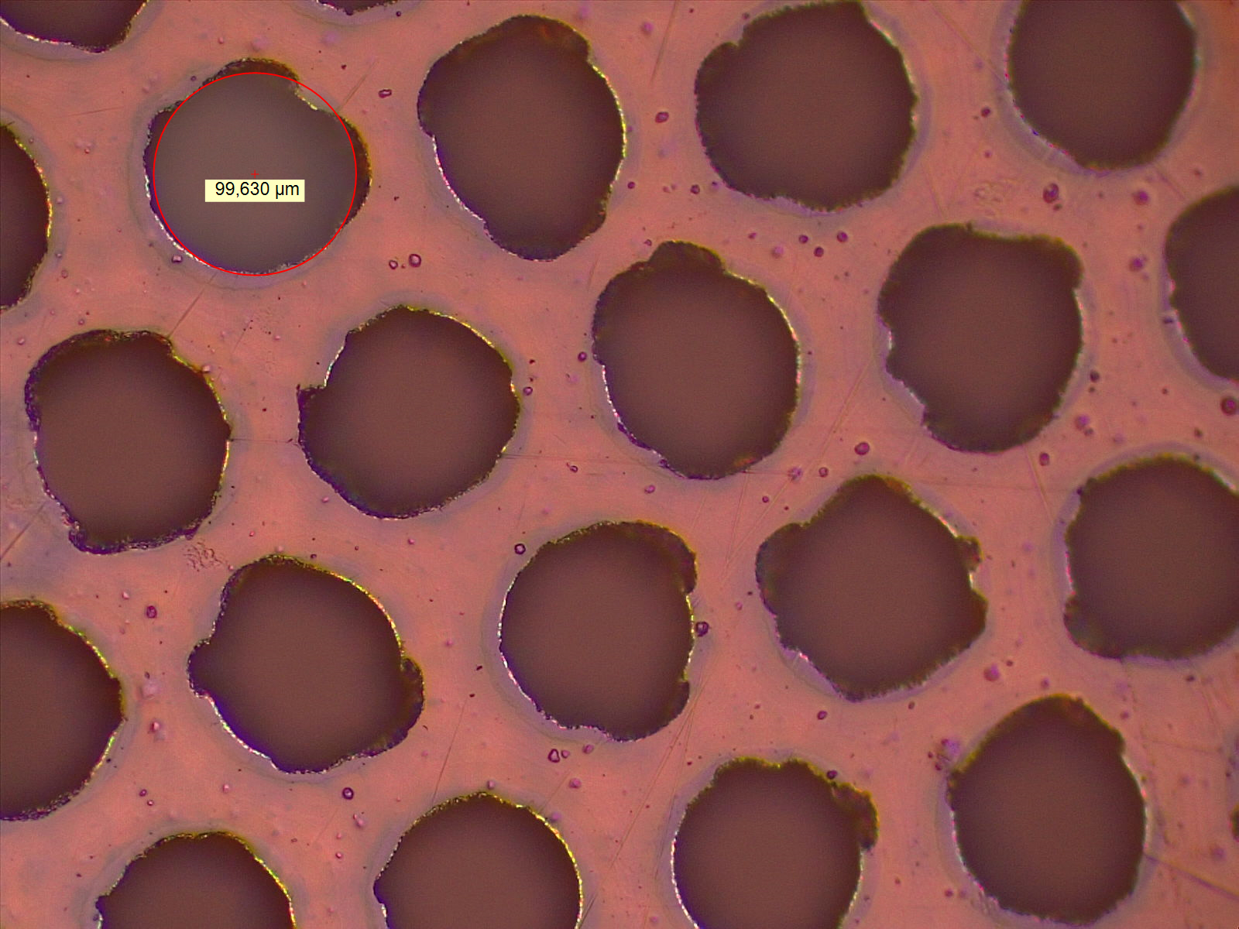
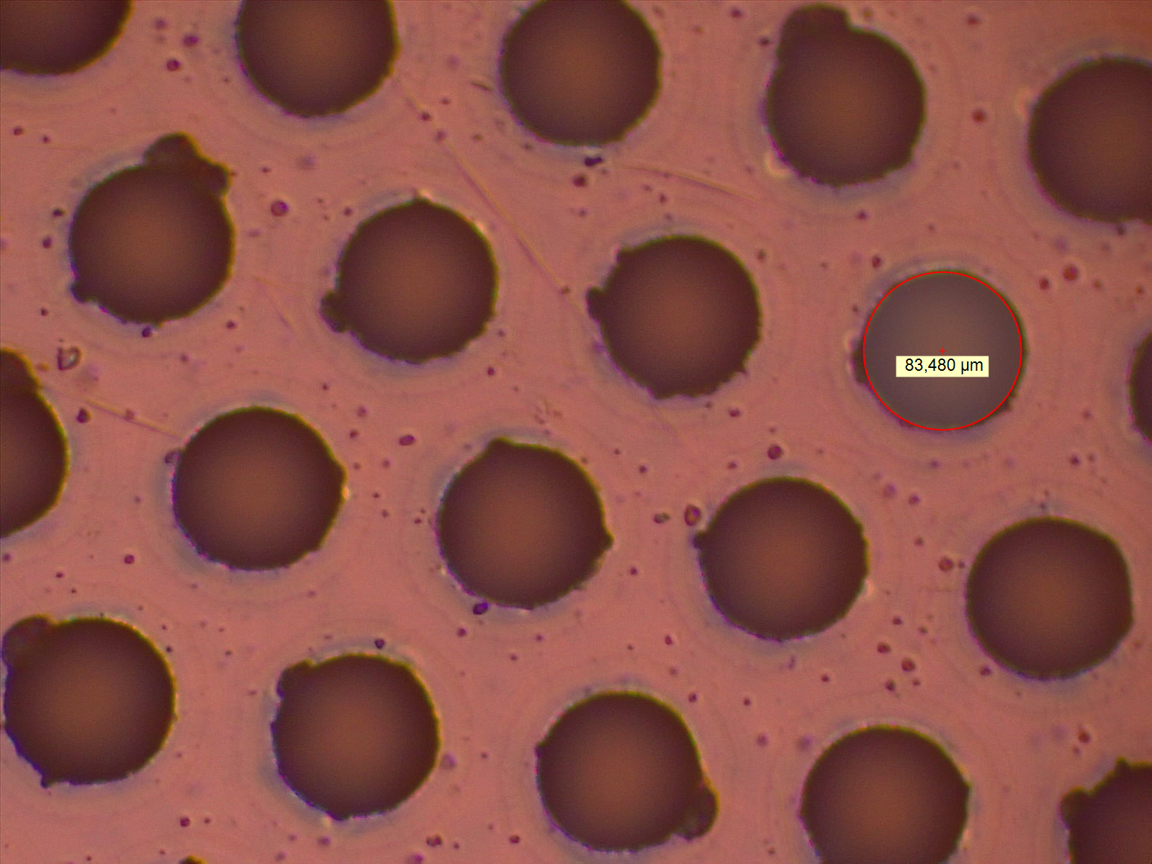
Top (DLC)
2nd Foil prod (2020)
inside detector
$∅$86um
1
$∅$90um
3
$∅$70um
5
$∅$88um
7
also inside detector
Second Foil inside detector
2
$∅$75um
2
$∅$66um
4
6
$∅$57um
8
Second Measurement
inside detector
$∅$97um
1
no meas
3
$∅$93um
5
$∅$124um
7
Bottom (PI)
also inside detector
Second Foil inside detector
2
$∅$90um
4
$∅$100um
6
$∅$83um
8

Slide 5
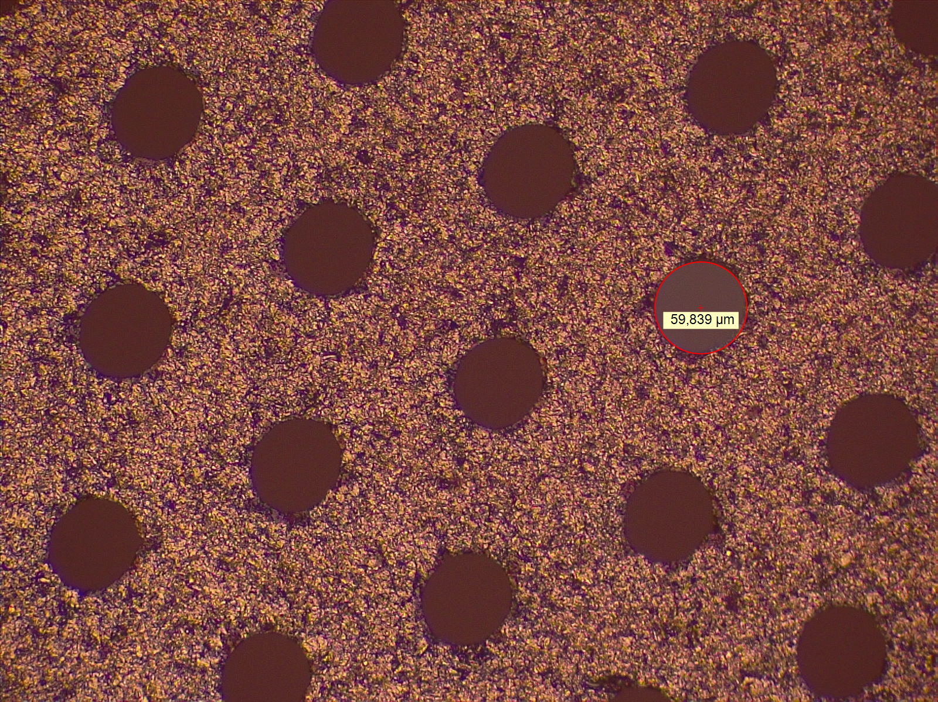
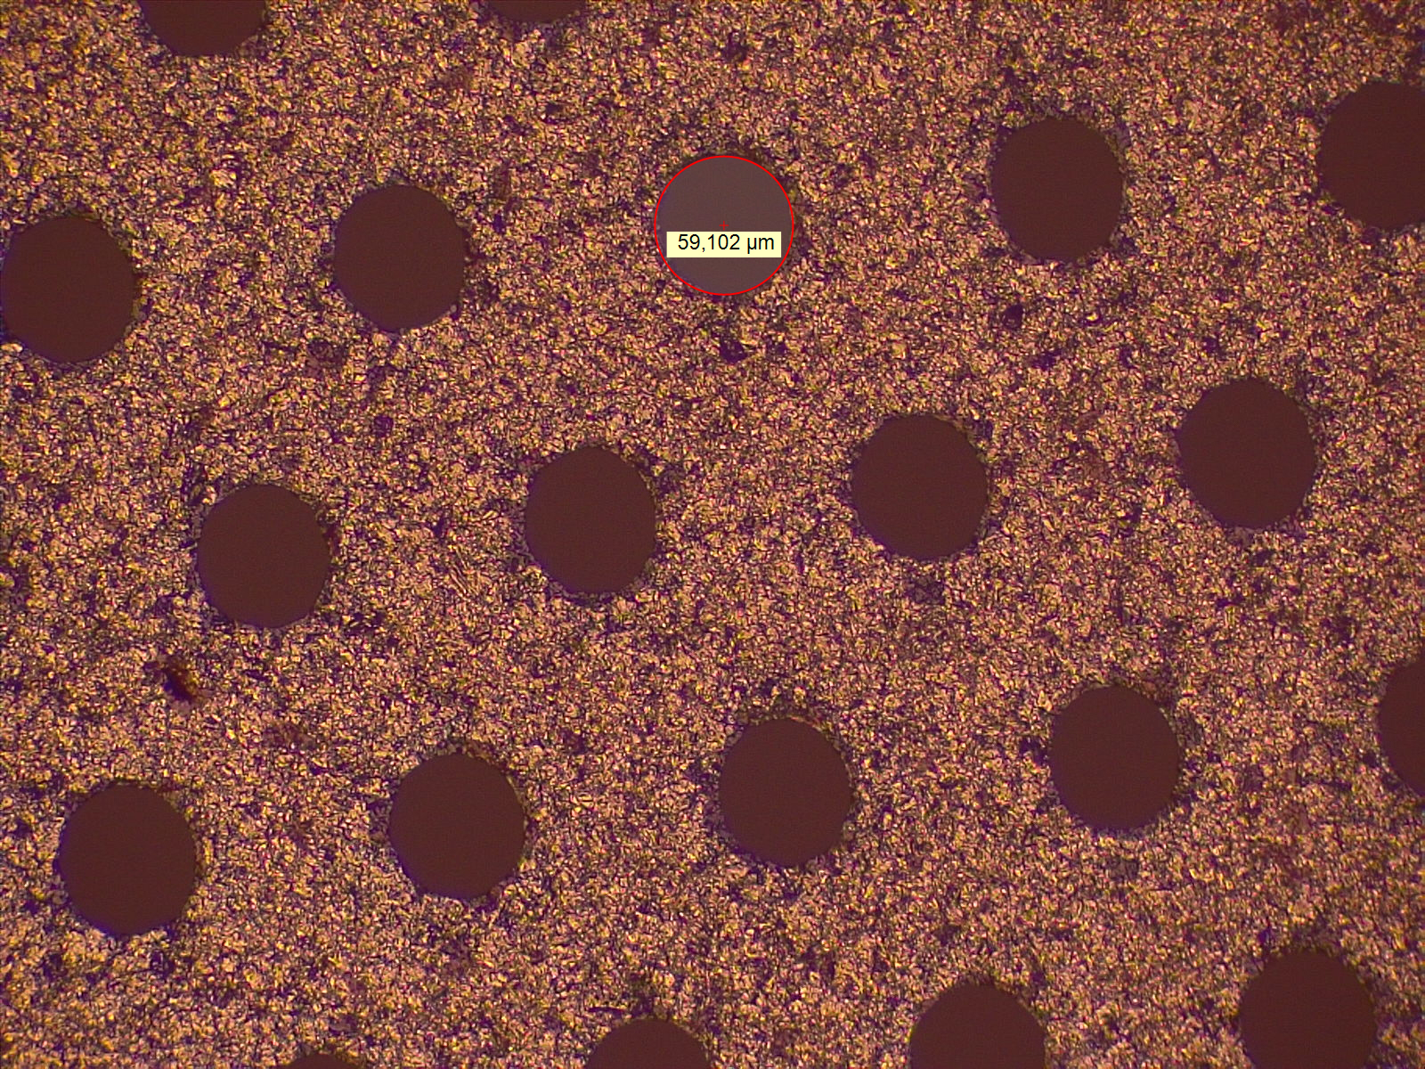
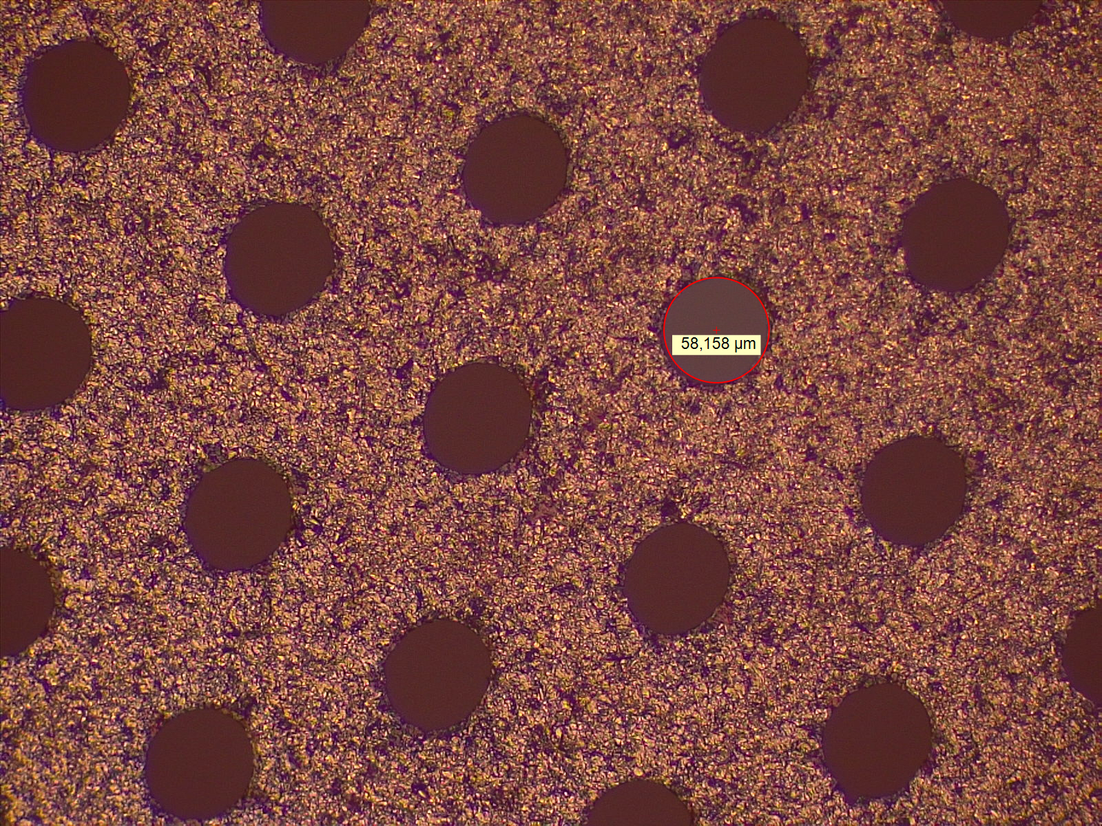
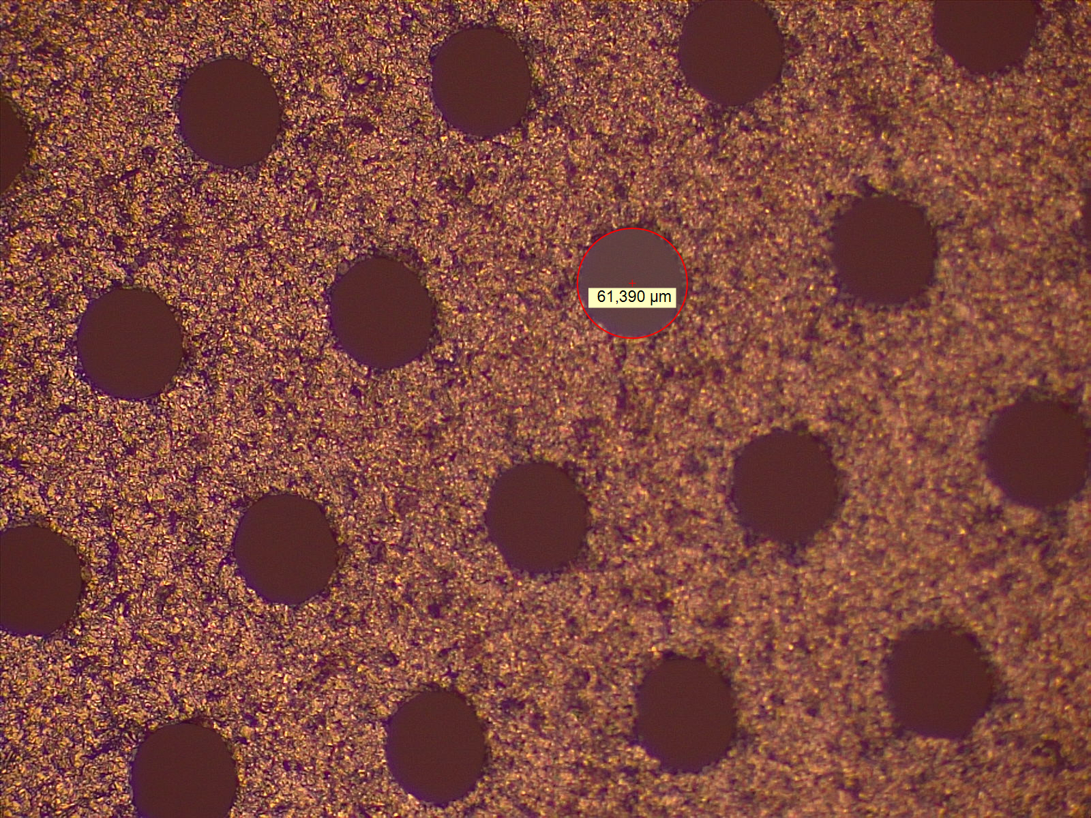
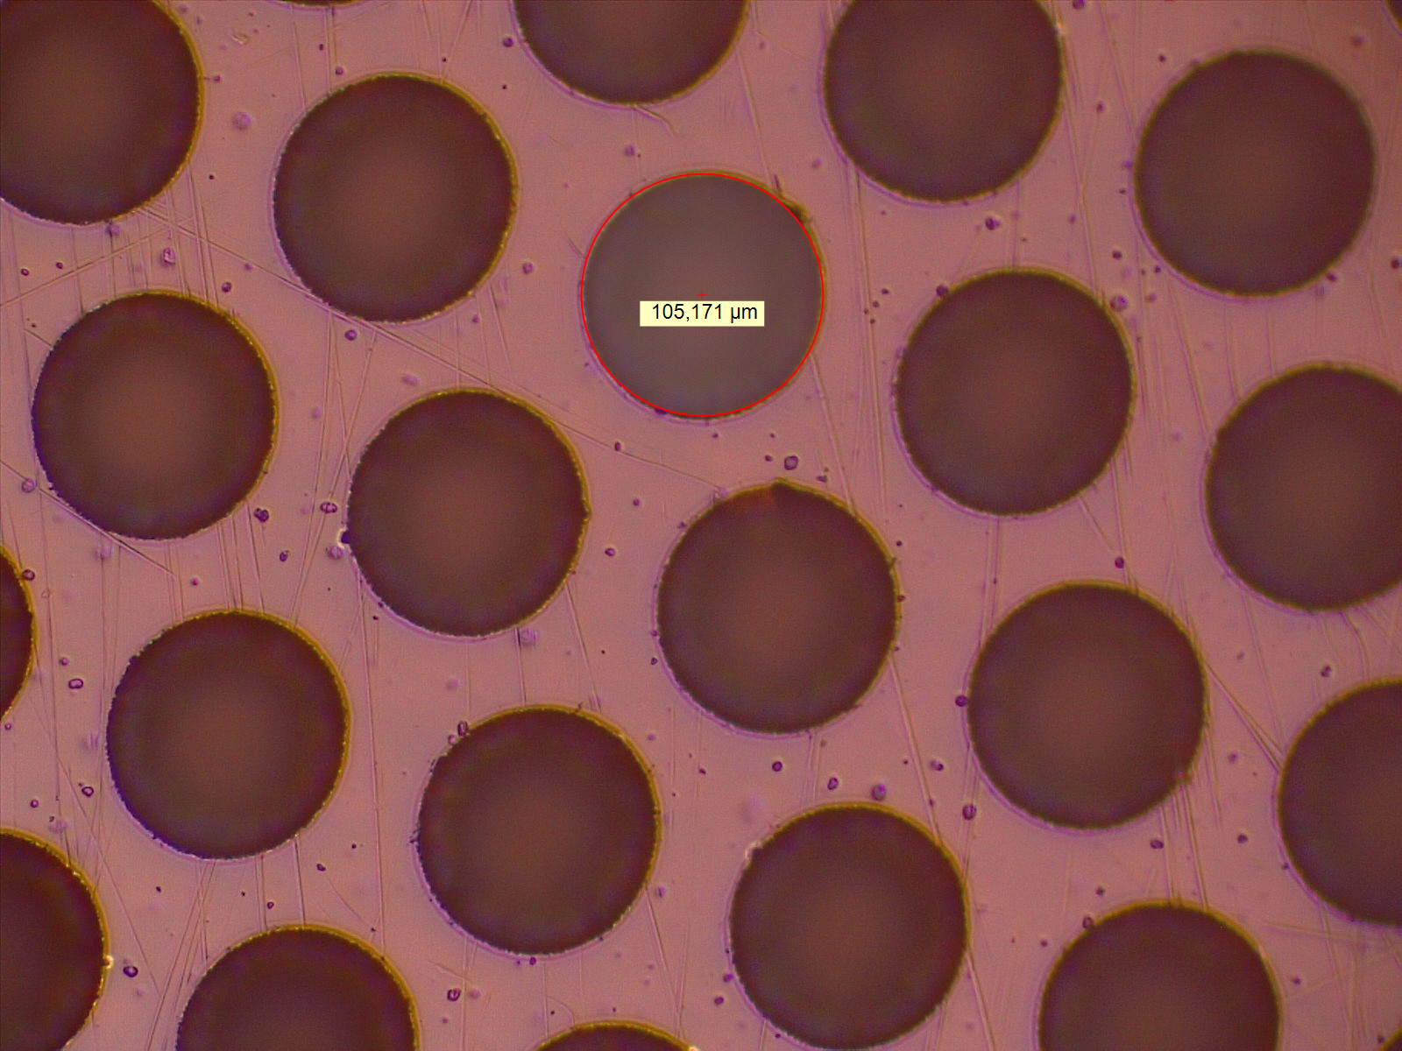
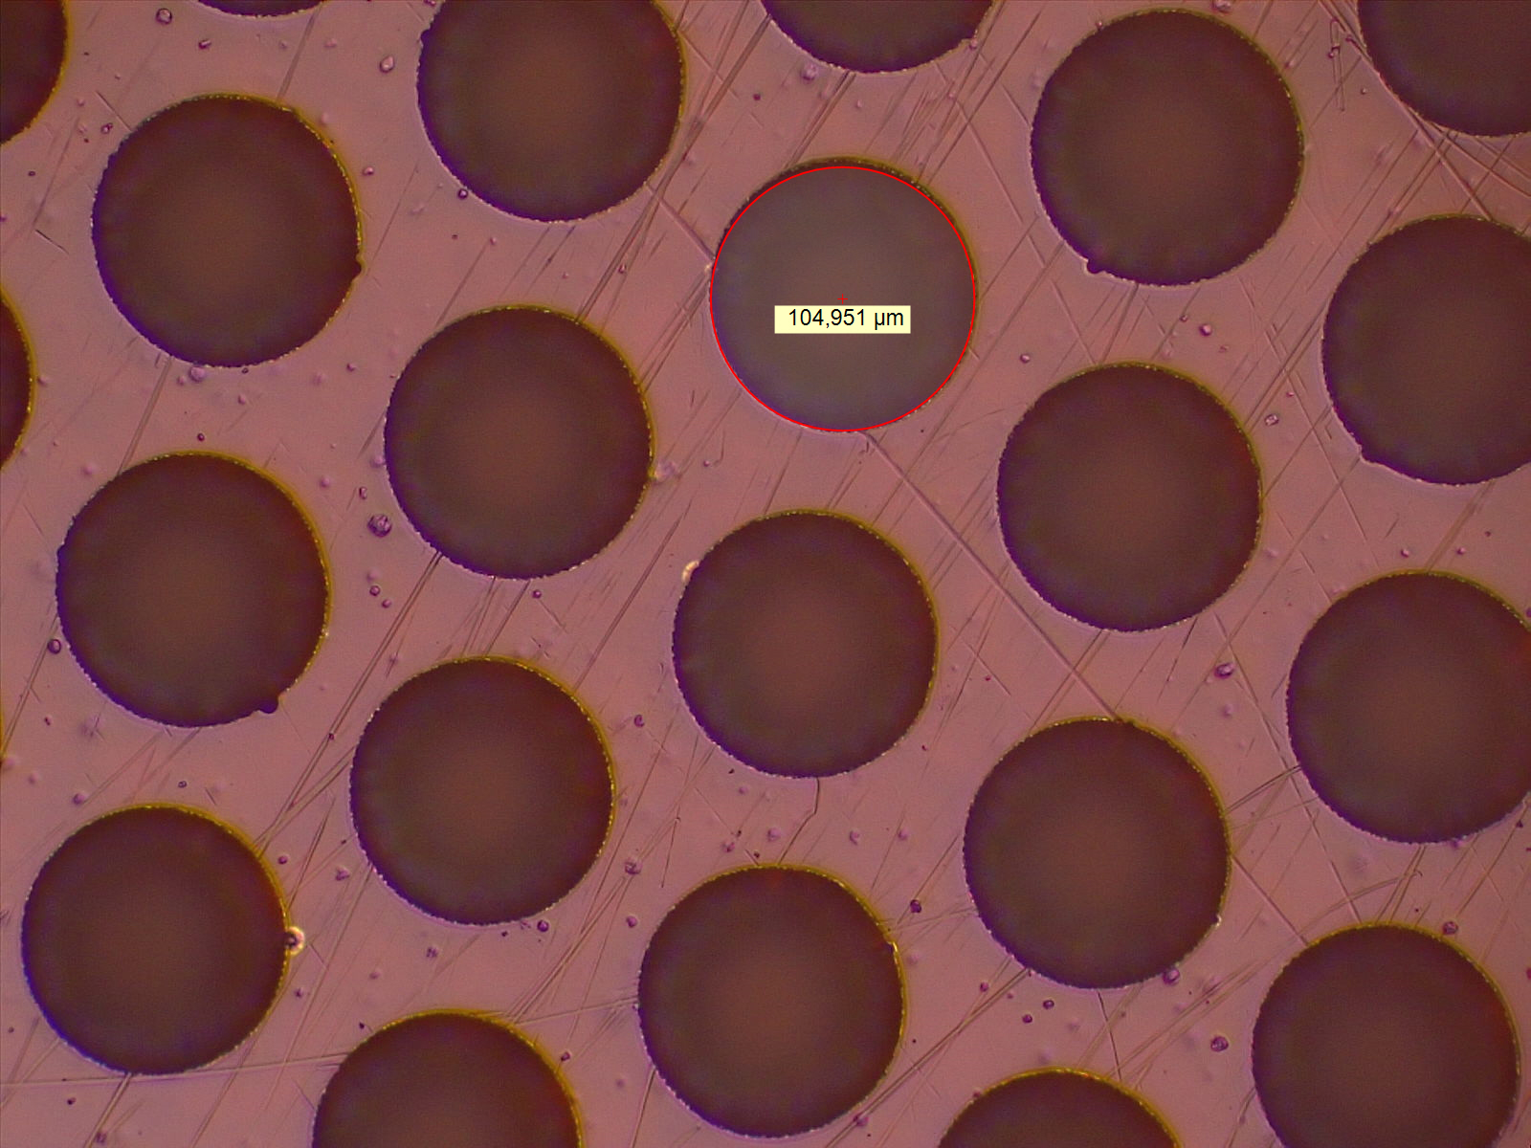
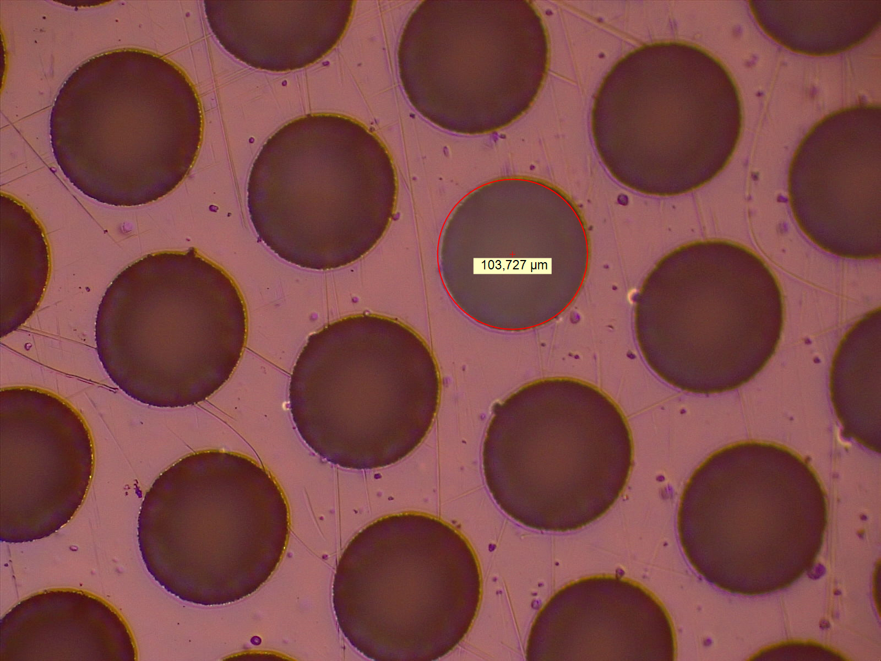
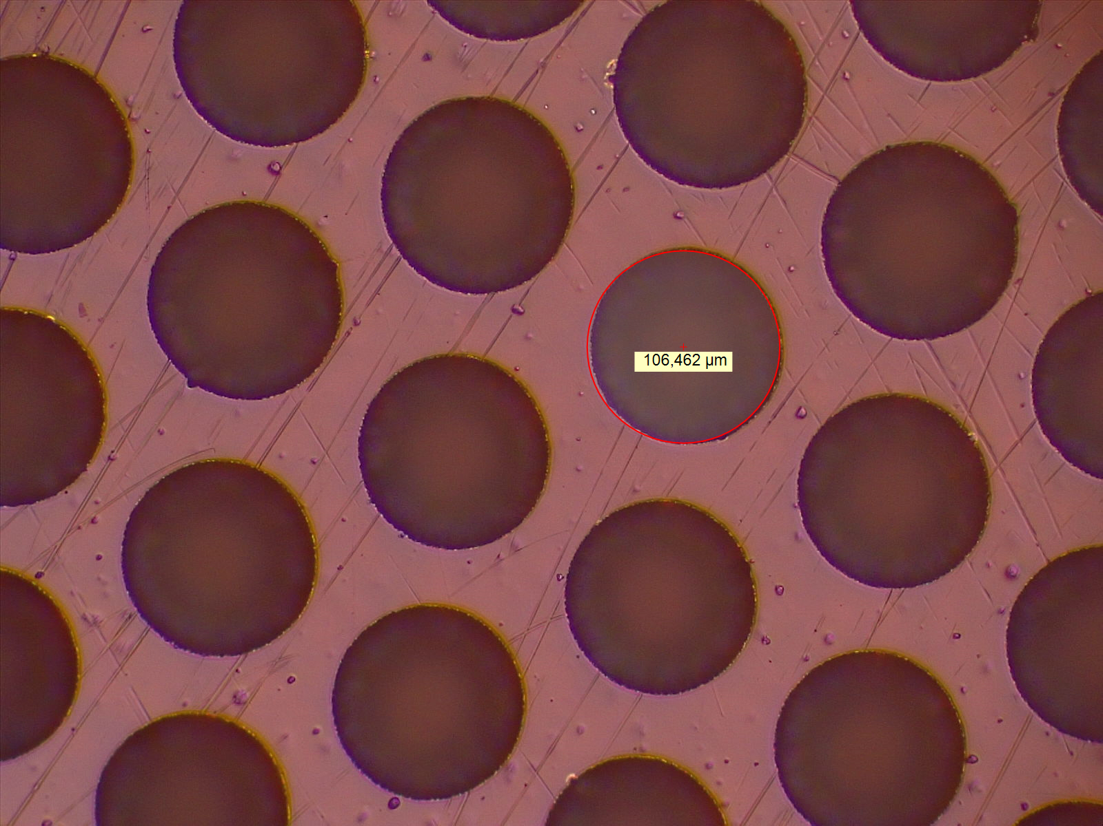
Top (DLC)
1st Foil prod (2019)
inside detector
inside detector
Second Foil inside detector
$∅$86um
1
2
$∅$60um
$∅$59um
$∅57$um
1
$∅$90um
3
3
4
2
$∅$66um
4
$∅$58um
3
$∅$61um
4
inside detector
also inside detector
inside detector
Second Foil inside detector
$∅100$um
1
2
$∅$97um
1
no meas
$∅$105um
3
$∅$105um
4
Bottom (PI)
also inside detector
4
$∅$104um
3
$∅$106um
8

Slide 6
Selection of Best Foil
 | Foil 1 | Foil 2 | Foil 3 | Foil 4 | Foil 5 | Foil 6 | Foil 7 | Foil 8
Top (1) | 81 | 78 | 87 | 69 | 69 | 75 | 80 | 60
Top (2) | 92 | - | 90 | 66 | 70 | 75 | 88 | 57
Bot (1) | 86 | 100 | 108 | 93 | 99 | 100 | 105 | 88
Bot (2) | 97 | - | - | 90 | 93 | 100 | 124 | 83
Rank | ? | 5 | 7 | 2 | 3 | 4 | 6 | 1
 | Foil 1 | Foil 2 | Foil 3 | Foil 4 | Foil 5 | Foil 6 | Foil 7 | Foil 8
B/T (1) | 1,14 | 1,28 | 1,24 | 1,35 | 1,43 | 1,33 | 1,31 | 1,47
B/T (2) | 1,13 | - | - | 1,36 | 1,33 | 1,33 | 1,41 | 1,45
Rank

Slide 7
Gain Depends on Top & Bot diam
Simulation
Measurement
Cu Foil: top: $∅$70um, bottom: $∅$50um
DLC Foil: top: $∅$50um, bottom: $∅$70um
Gain factor 2 higher for small top diameter
Cu Foil: top: $∅$75-80um, bottom: $∅$45um
DLC Foil: top: $∅$78um, bottom: $∅$100um Gain factor 2 higher for DLC foil

Slide 8
Gain: Old vs New DLC Foil
Foil prod 2020 – Test 2021
$∅$78um
Foil prod 2019 – Test 2020
$∅57$um

Slide 11
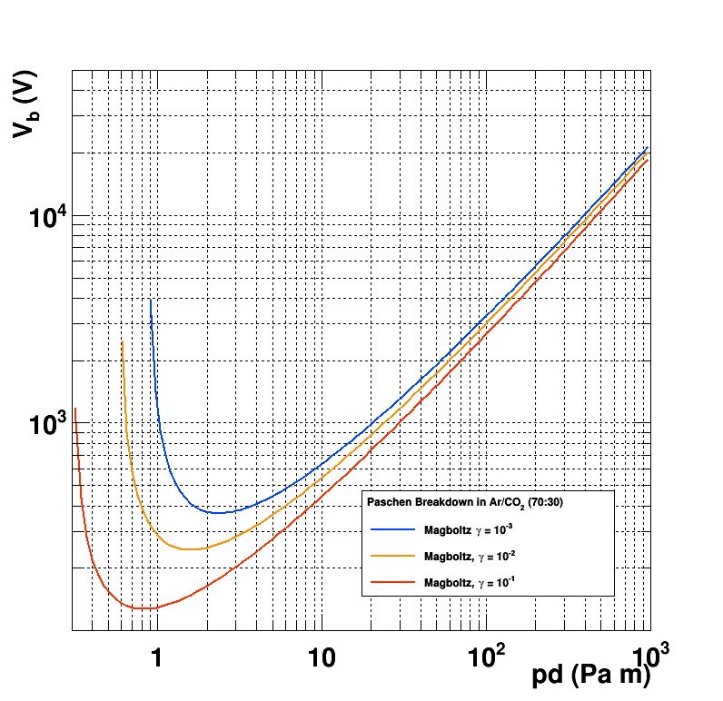
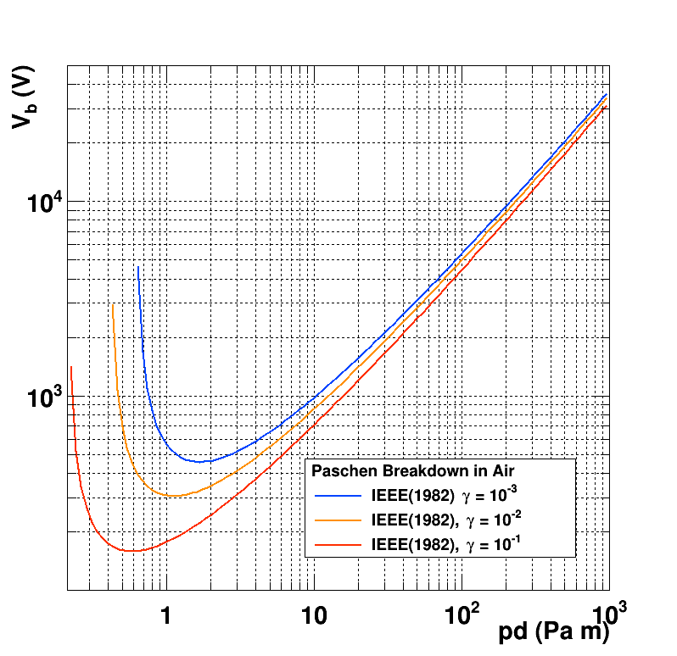
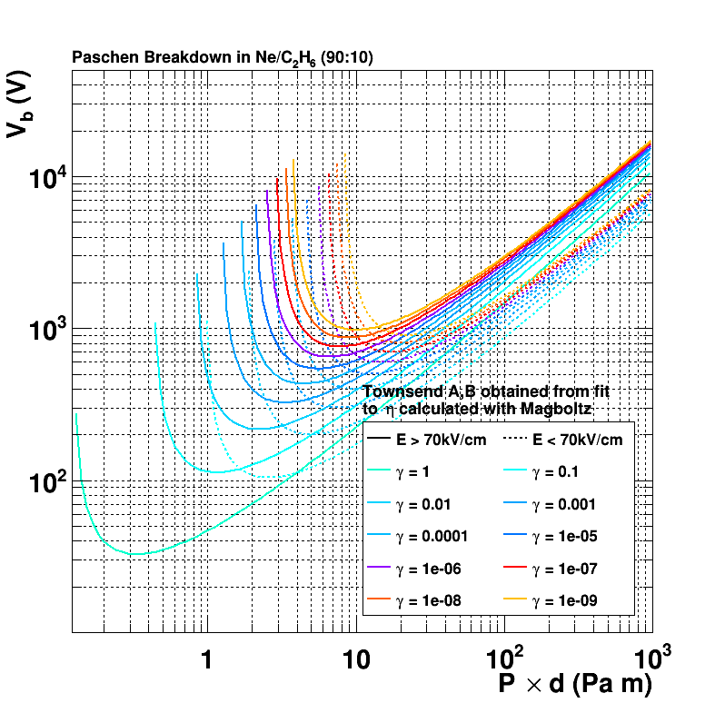
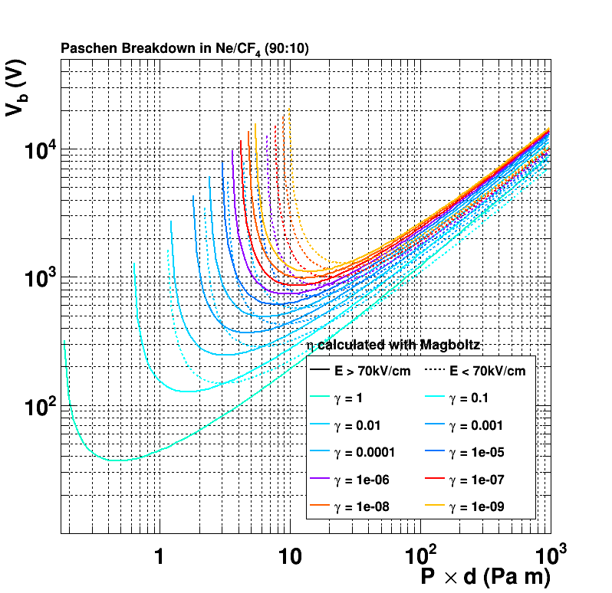
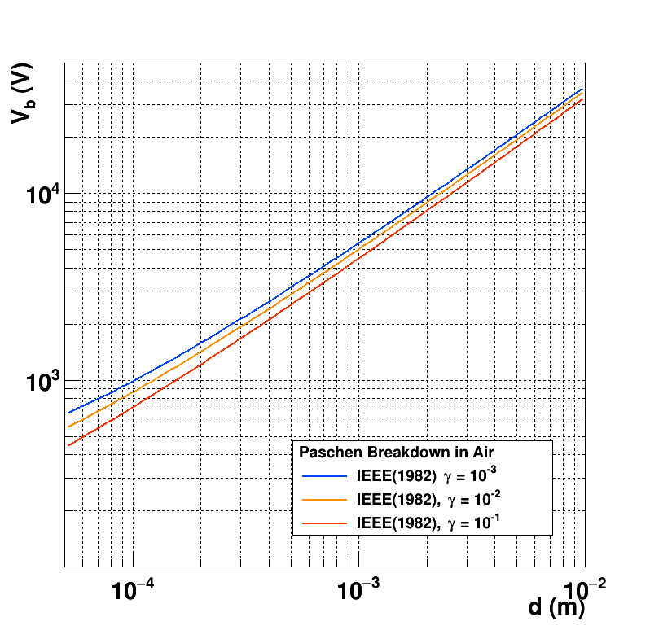
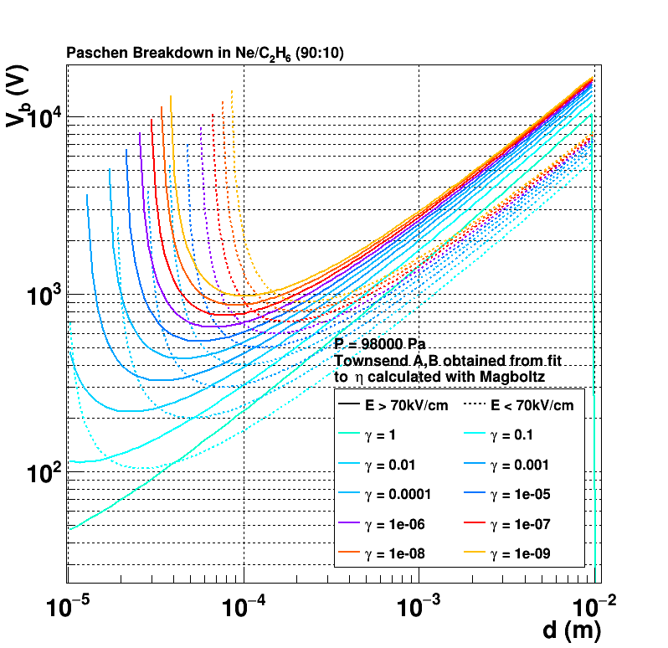
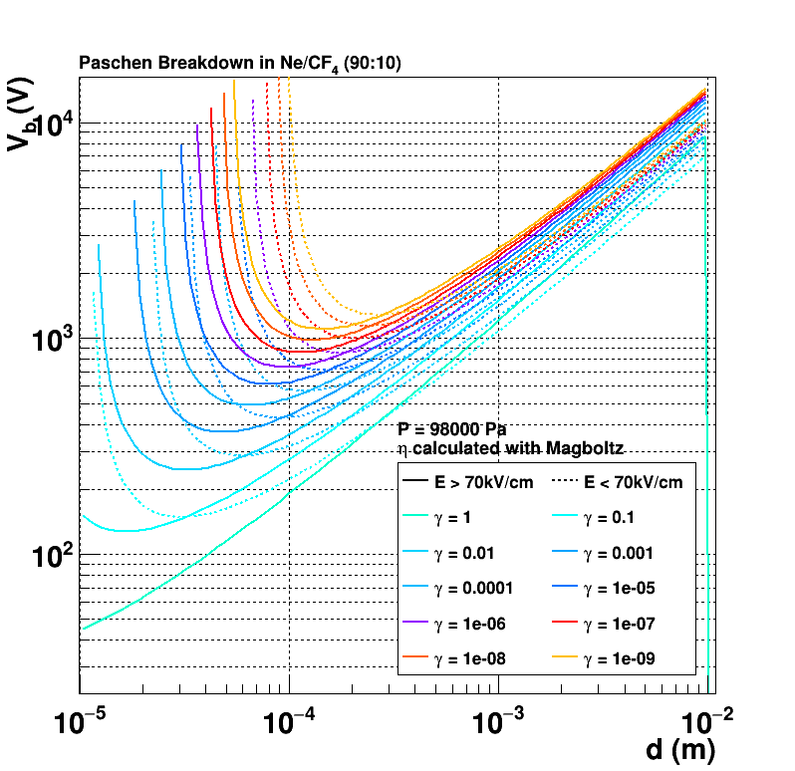
Paschen Curve
Ar:CO2 70:30
Air
Ne:C2H6 90:10
Ne:CF4 90:10

Slide 12
FTM Foil production procedure 1 – The actual procedure
Layer | Thickness | Color code
Cu | 7um
Cr | 10nm
DLC | 100nm
Polyimide | 50um
Cu | 5um
1
2
3
Starting FCCL: single DLC layer
Photo-Lithography & Cu Etching
Kapton Etching
Cu Etching & Cr removal (and DLC partially goes away)
Clean DLC with water jet & pummice → suggestion: try with plasma etching
4
5

Slide 13
FTM Foil production procedure 2 – With Delaminating DLC
1
Layer | Thickness | Color code
Cu | 7um
Cr | 10nm
DLC | 100nm
Polyimide | 50um
Cu | 5um
2a
2b
Photo-Lithography & Cu Etching
(a) Kapton Etching: etching (b) Delamination => more etching (c) Kapton Etching: remove PI
Cu Etching & Cr removal
Remove DLC with water jet → try with plasma etching
Delamination allows the etching liquid to attack more Polyimide than foreseen by the mask, in an irregular pattern, resulting in irregular hole shape both in top (DLC) as bottom (PI).
2c
3
4

Slide 14
FTM Foil production procedure 3 – Suggestion & Future: Create Rim
Layer | Thickness | Color code
Cu | 7um
Cr | 10nm
DLC | 100nm
Polyimide | 50um
Cu | 5um
1
2
3
Starting FCCL: single DLC layer
Photo-Lithography & Cu Etching
Kapton Etching
Cu Patterning on top (larger), leave Cu as protection on the bottom
Etch / Remove DLC (scrubbing: water jet with small pummice) or with Plasma Etching
Cu & Cr removal
Procedure can be scaled up to 125um polyimide, inserting a 2nd kapton etching step, starting from the top
4
5

Slide 15
Res GEM Foil production procedure
Layer | Thickness | Color code
Cu | 5um
Cr | 10nm
DLC | 100nm
Polyimide | 50um
DLC | 100nm
Cr | 10nm
Cu | 5um
1
2
3
4
Starting FCCL: double DLC layer
Photo-Lithography & Cu-Cr Etching
DLC “breaking” (sand blasting - pummice)
Kapton Etching
DLC “breaking” (sand blasting)
Cu Etching & Cr removal
5
6

Slide 16
FTM Foil production procedure 4 - Future
1
Layer | Thickness | Color code
Cu | 7um
Cr | 10nm
DLC | 100nm
Polyimide | 50um
Cu | 5um
2
3
Starting FCCL: single DLC layer
Photo-Lithography & Cu-Cr Etching
DLC “breaking” (sand blasting?)
Kapton Etching
DLC “breaking” (sand blasting?)
Cu Etching & Cr removal
4
5
6

Slide 17
Alternative Detection Structures to be considered?
Picosec micromegas (with pre-amp) arrive at few 10⁵ – 10⁶ with pre-amplification. Assume pre-amp of factor 10, then MM in Compass gas (Ne:CF4:C2H6 80:10:10) still has G = few 10⁴ – 10⁵
RETGEM shows gain 10⁵ (Peskov) 10⁴ (Confirmed Chinese Colleagues)
REGEM (Japan) however not successful
Possibility to make Micromegas with Resistive Mesh? E.g. Glass Fiber mesh coated with DLC?
Polyester mesh to be coated with DLC is a possibility …
Possibility to make RETGEM without Cu layer on top of PCB. PCB of 0.2 – 0.4 – 1mm ?
Increased thickness of amplification stage will result in reduced Capacitance (C=eA/d), and hence reduced transparency / signal induction

Slide 18
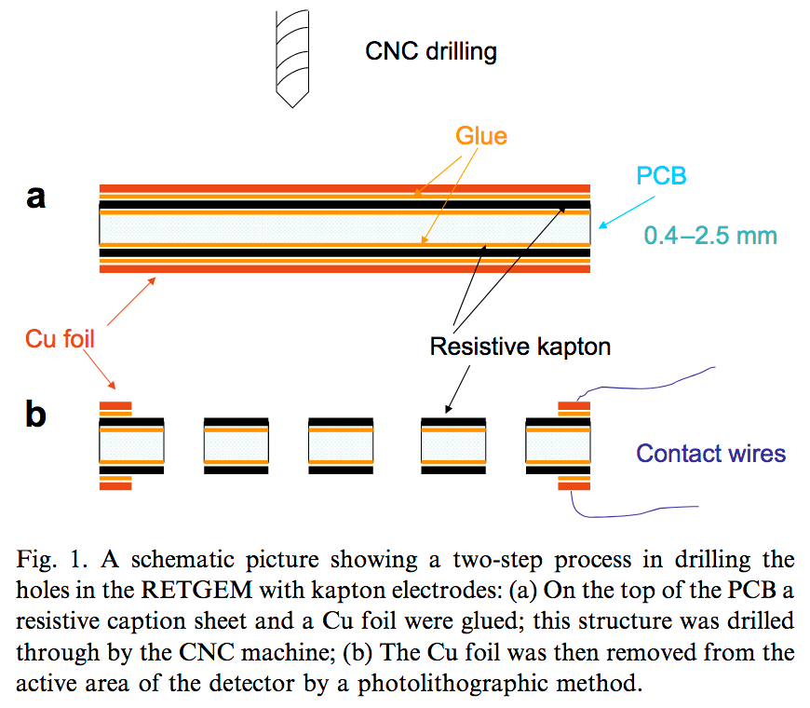

Slide 19
For the Graphene Collaboration

