Slide 1
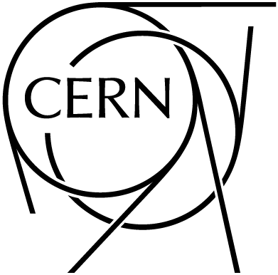
¹⁵⁴Eu
⁸⁸Sr
¹⁷⁶Lu
¹⁶⁰Tb
¹³⁴Cs
23 April 2021

Slide 2
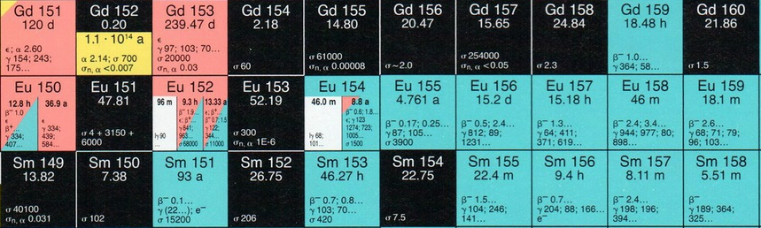
¹⁵⁴Eu
probably impossible by TOF
could be done at the NEAR station, by activation
sample @ILL?
transmission measurement already done (see Mughabghab’s table)
𝜎(n,𝛾) ~ 𝜎(n,tot) at low energies
only theoretical MACS in KADONIS

Slide 3
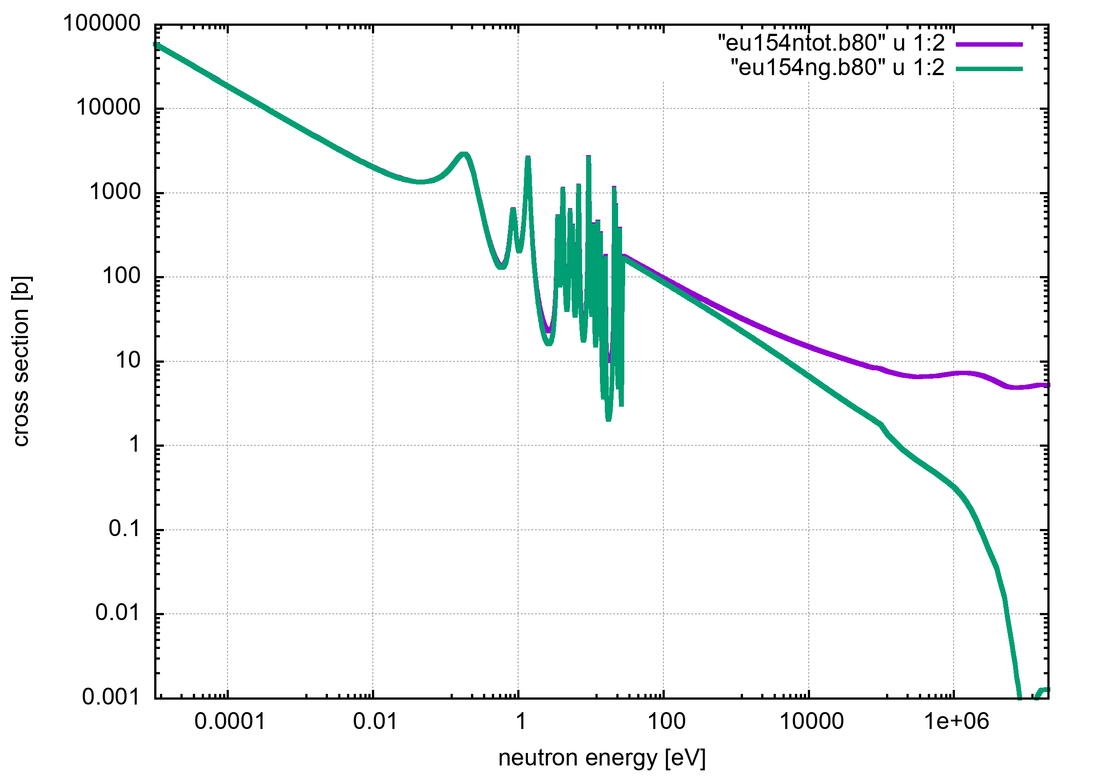
¹⁵⁴Eu

Slide 4
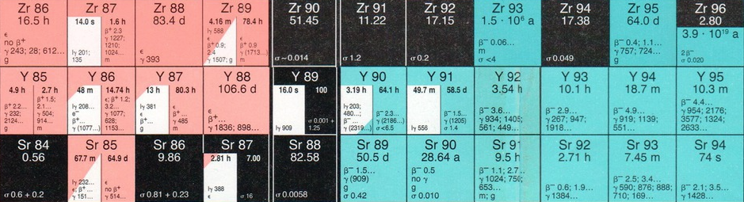
⁸⁸Sr
TOF already proposed (INTC-P-453)
small cross section
activation at NEAR possible (?): 909 keV 𝛾 with 0.0095 % probability, but… already done by several authors

Slide 5
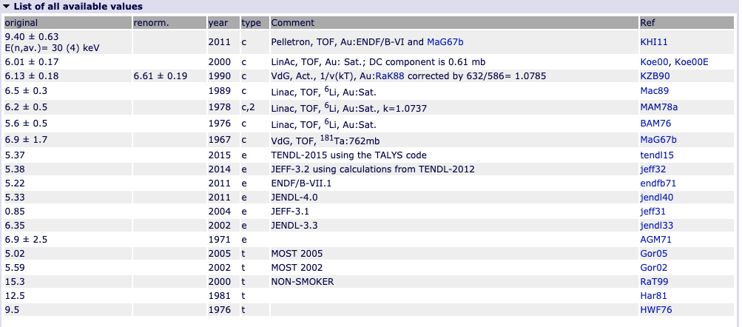
⁸⁸Sr
TOF already proposed (INTC-P-453)
small cross section
activation at NEAR possible (?): 909 keV 𝛾 with 0.0095 % probability, but… already done by several authors

Slide 6
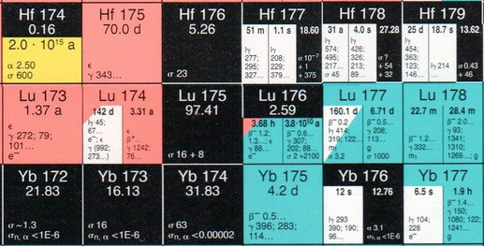
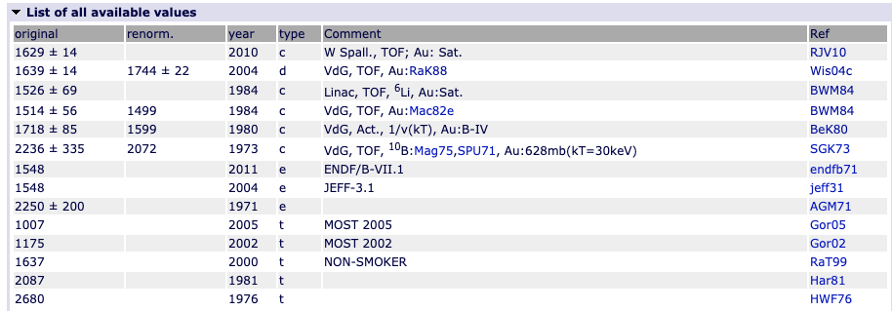
¹⁷⁶Lu
many measurements available
why is on this list?

Slide 7
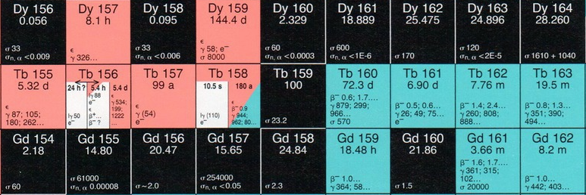
¹⁶⁰Tb
no measurement available
activation is possible
TOF?

Slide 8
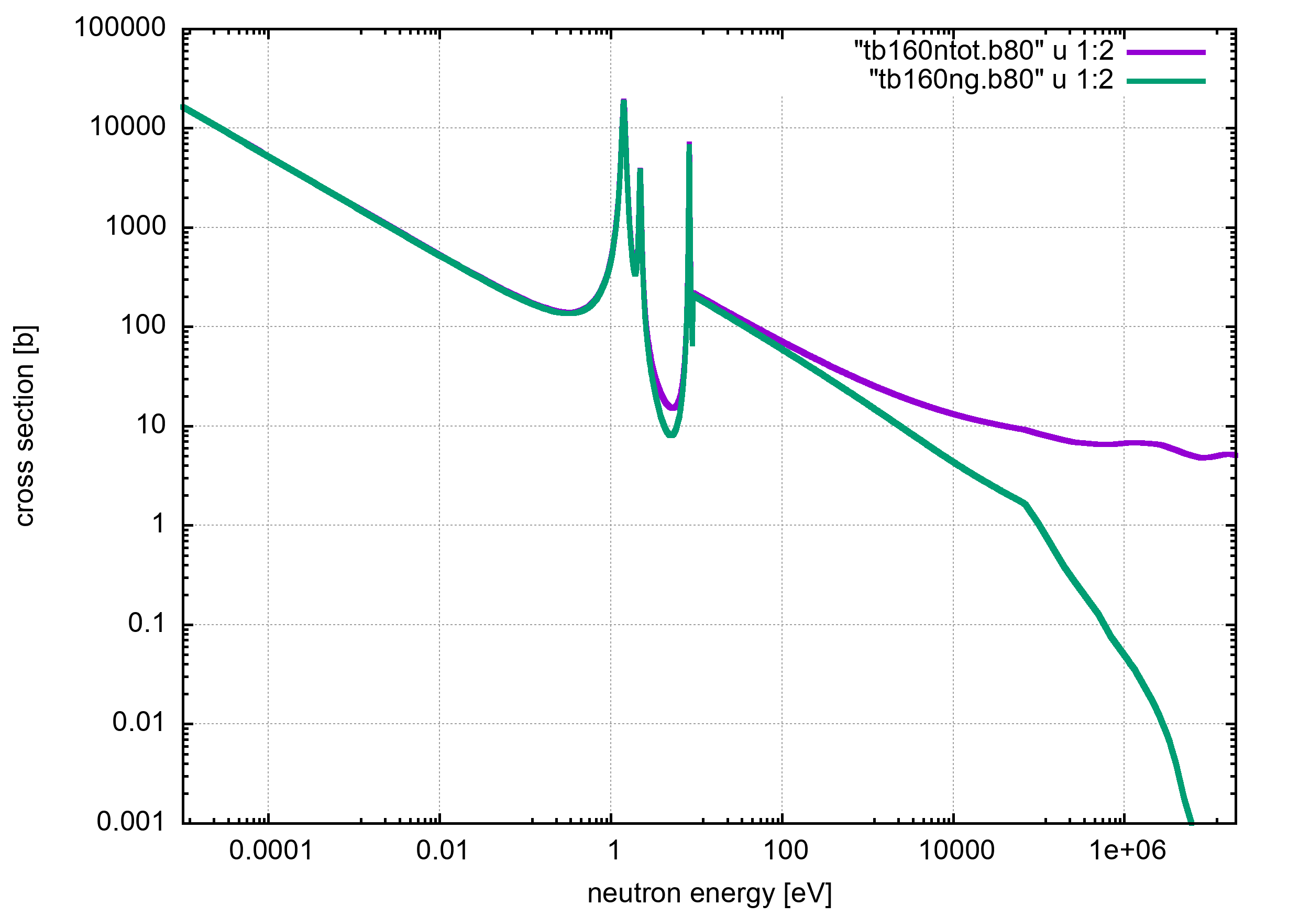
¹⁶⁰Tb
no measurement available
activation is possible
TOF?

Slide 9
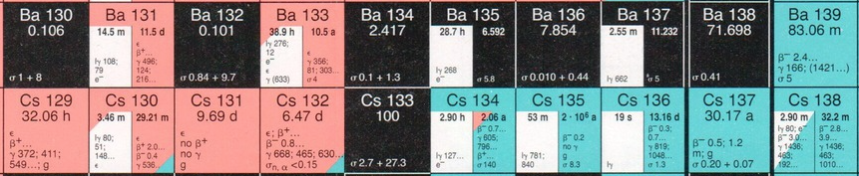
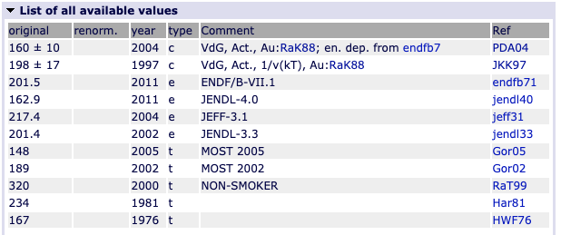
¹³⁵Cs
activation measurement(s) available
activation at NEAR possible, but why?

