Slide 1
JLab12 Roma1(dotazioni)
Ricercatori:
G. M. Urciuoli 30%
F. Meddi 20%
Laureando:
F. De Persio 100%

Slide 2
Impulse Approximation limitations to the (e,e'p)
reaction on ²⁰⁸Pb, ²⁰⁹Bi and ¹²C
Jefferson Lab, Newport News, VA
and the Hall A Collaboration
E06-007
Spokepersons: K. Aniol, A. Saha, J.M. Udías, G. Urciuoli
Students: Juan Carlos Cornejo¹, Joaquin Lopez Herraiz²
Hall A: Alexandre Camsonne
(a) Search for long range correlations at x = 1 for states near the Fermi surface.
(b) Search for possible Q² dependence on spectroscopic factors.
(c) Using A_{TL}, search for additional evidence for relativistic effects in nuclear structure.
(1) Now at William and Mary in PhD program
(2) PhD thesis accepted, Universidad Complutense de Madrid

Slide 3
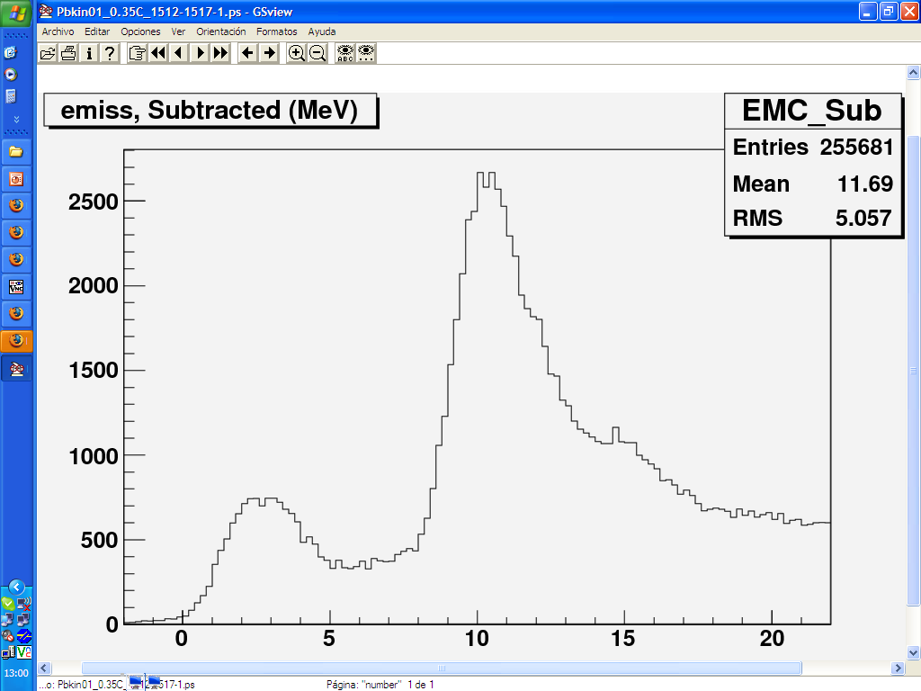
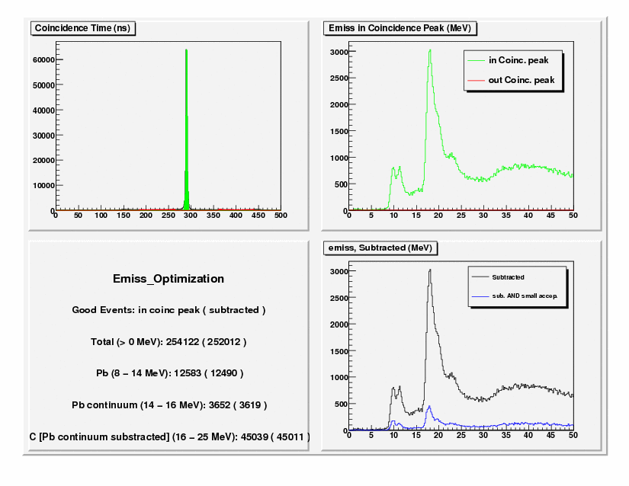
Spectrometer Calibration
Optics Optimization: Energy
1 ) QUASIELASTIC (e,e’p) REACTION
2 ) SIMULATIONS
3 ) DESCRIPTION OF THE EXPERIMENTS
5 ) RESULTS
6 ) SUMMARY AND CONCLUSIONS
OPTIMIZED
SPECTRUM
ONLINE SPECTRUM
Ex (MeV) | Shell
0 | 3s_{1/2}
0.351 | 2d_{3/2}
1.348 | 1h_{11/2}
1.683 | 2d_{5/2}
3.470 | 1g_{7/2}
¹²C
¹²C
²⁰⁸Pb
²⁰⁸Pb
With the optimized database and with the appropriate raster correction, good resolution has been achieved.
Two peaks can be separated in this ²⁰⁸Pb E_{miss} spectrum (p_{miss}=0).
E_{miss} (MeV)
E_{miss} (MeV)
Low lying states in ²⁰⁷Tl
3
Notes:
3
3
The strength of the 1g7/2 shell can be neglected at this low pmiss.

Slide 4
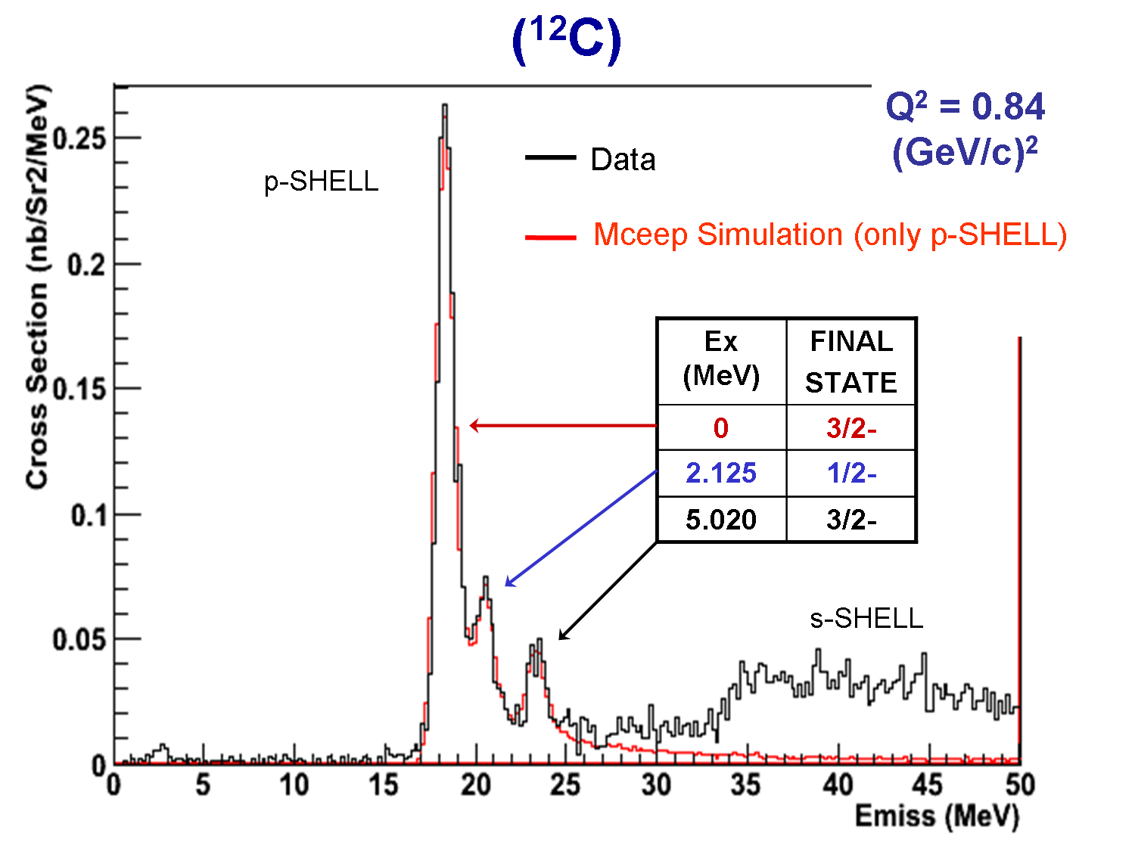
¹²C(e,e’p) E_{miss}
1 ) QUASIELASTIC (e,e’p) REACTION
2 ) SIMULATIONS
3 ) DESCRIPTION OF THE EXPERIMENTS
4 ) DATA ANALISIS
5 ) RESULTS
6 ) SUMMARY AND CONCLUSIONS
Pmiss = 0-100MeV/c
4

Slide 5
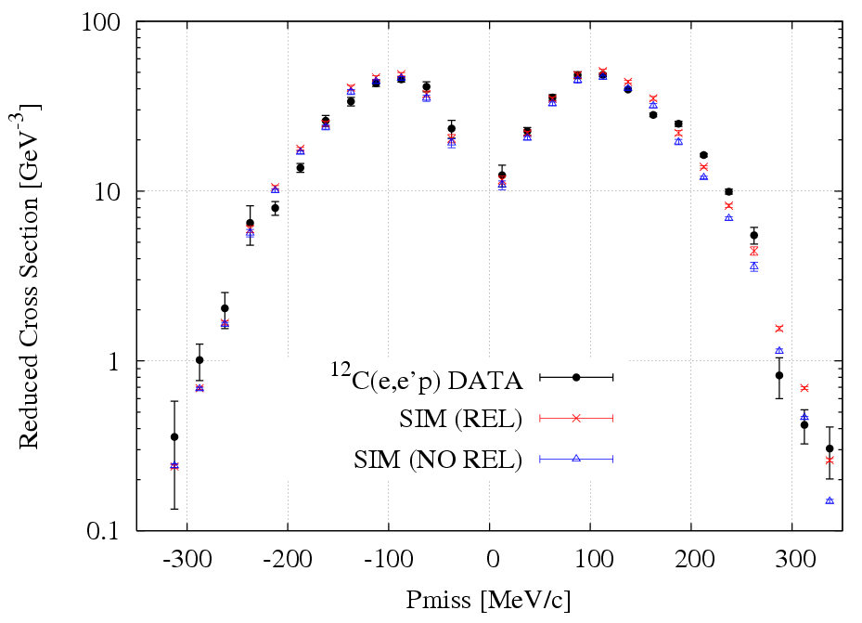
¹²C(e,e’p) – 1p_{3/2} shell
Reduced Cross Section
1 ) QUASIELASTIC (e,e’p) REACTION
2 ) SIMULATIONS
3 ) DESCRIPTION OF THE EXPERIMENTS
6 ) SUMMARY AND CONCLUSIONS
Spec. factor = 0.85 ± 0.05
5

Slide 6
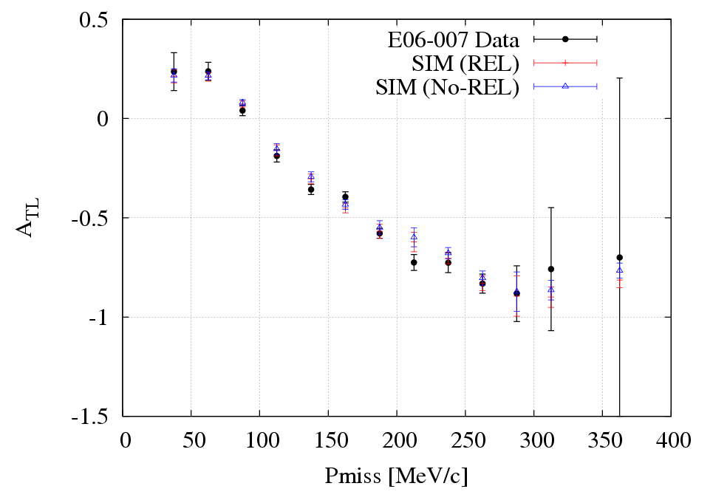
¹²C(e,e’p) - 1p_{3/2} shell
A_{TL}
1 ) QUASIELASTIC (e,e’p) REACTION
2 ) SIMULATIONS
3 ) DESCRIPTION OF THE EXPERIMENTS
4 ) DATA AN
chi²_{DOF} =1.59 (Rel.)
chi²_{DOF} =2.09 (No Rel.)
6

Slide 7
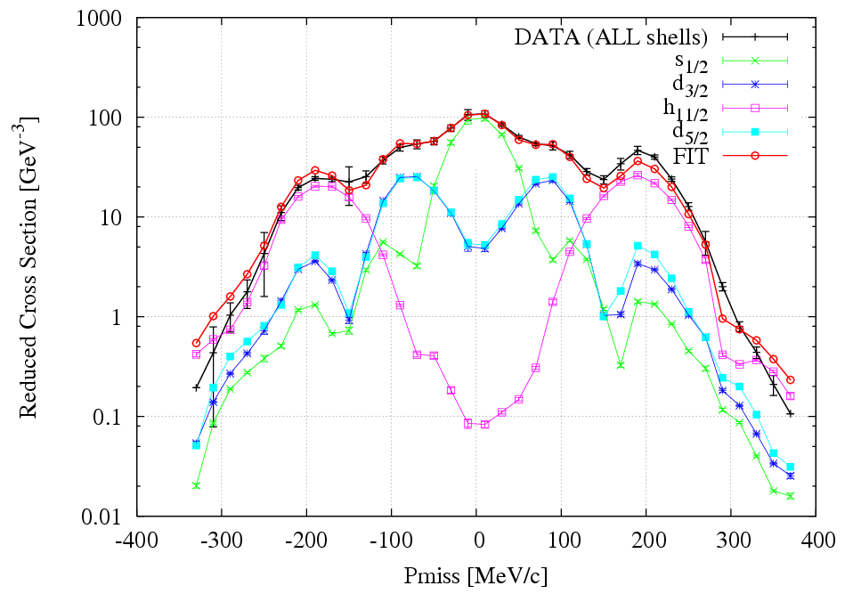
²⁰⁸Pb(e,e’p) – Valence States
Reduced Cross Section
1 ) QUASIELASTIC (e,e’p) REACTION
2 ) SIMULATIONS
3 ) DESCRIPTION OF THE EXPERIMENTS
4 ) DATA ANAL
6 ) SUMMARY AND CONCLUSIONS
3s1/2, 0.52(6)
2d3/2, 0.59(6)
1h11/2, 0.65(6)
2d5/2, 0.52(6)
Experimental ²⁰⁸Pb(e,e'p) reduced cross section (for the aggregate of valence states) together with the results from relativistic DWIA for the contributions from individual shells.
Relativistic DWIA mean field calculations
7

Slide 8
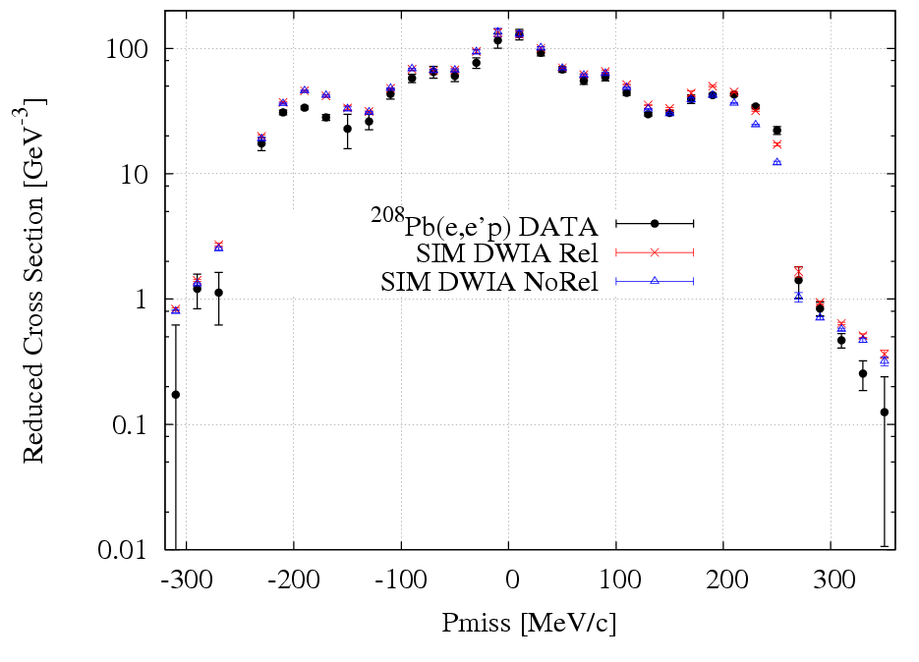
²⁰⁸Pb(e,e’p) – Valence States
Reduced Cross Section
1 ) QUASIELASTIC (e,e’p) REACTION
2 ) SIMULATIONS
3 ) DESCRIPTION OF THE EXPERIMENTS
4 ) DATA ANAL
6 ) SUMMARY AND CONCLUSIONS
8

Slide 9
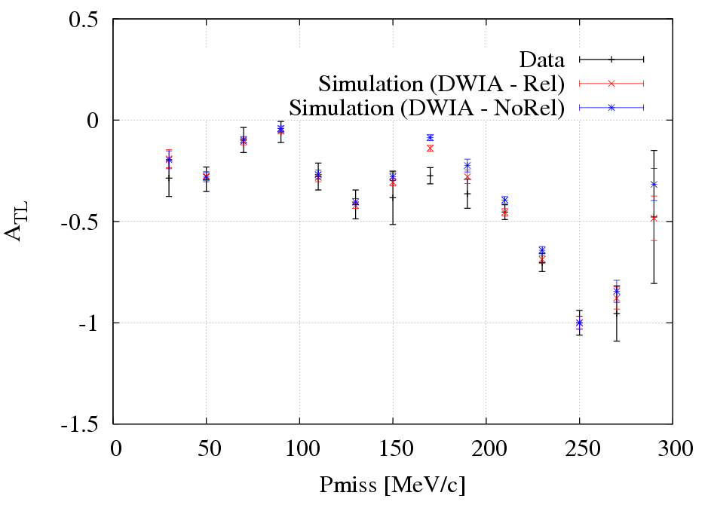
²⁰⁸Pb(e,e’p) - Valence States
A_{TL}
1 ) QUASIELASTIC (e,e’p) REACTION
2 ) SIMULATIONS
3 ) DESCRIPTION OF THE EXPERIMENTS
4 ) DATA ANALIS6 ) SUMMARY AND CONCLUSIONS
chi²_{DOF} = 1.13 (Rel.)
chi²_{DOF} = 2.65 (No Rel.)
9

Slide 10
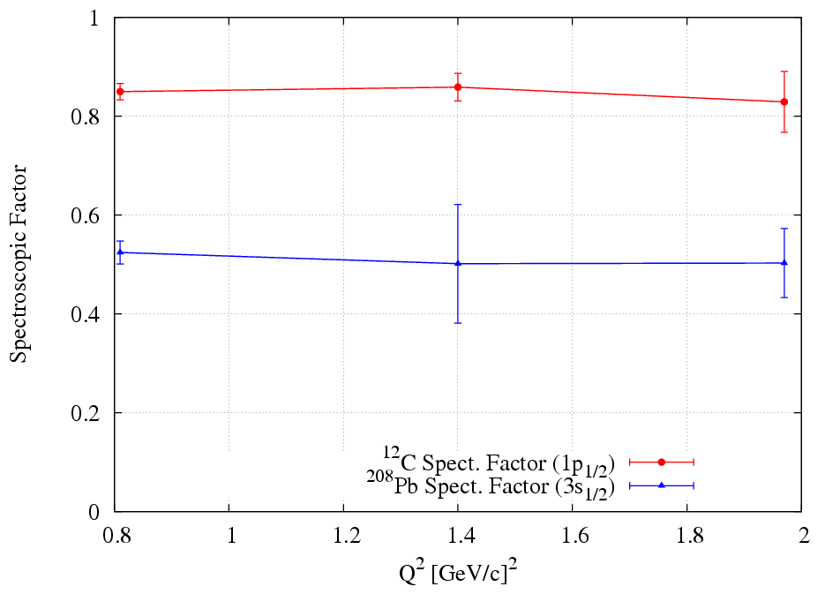
Spectroscopic factors vs Q²
nucleus | shell | spec.fact
12C | 1p1/2 | 0.85(5)
208Pb | 3s1/2 | 0.52(6)
 | 2d3/2 | 0.59(6)
 | 1h11/2 | 0.65(6)
 | 2d5/2 | 0.52(6)
Spectroscopic factors at Q² = 0.8 GeV²
-100MeV/c<Pmiss<100MeV/c

Slide 11
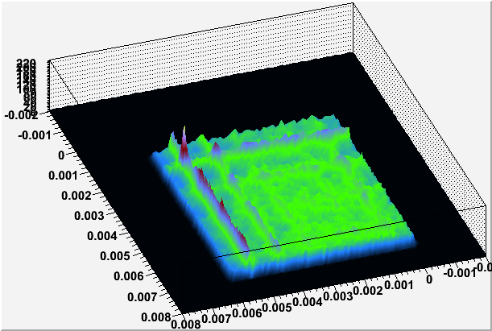
Run 1 (March 2007) – First exposure to data taking with heavy metal targets at high currents.
We want to look at the LHRS momentum spectrum as a luminosity monitor. We have carbon data which we can subtract from the diamond/lead/diamond spectra.
Raster pattern for carbon
The morphology of the heavy metal targets changes during the exposures.
A stable total trigger rate is not a reliable measure of a stable target.
Raster pattern selected avoids the frame.

Slide 12
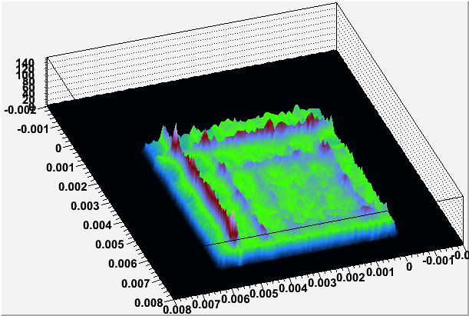
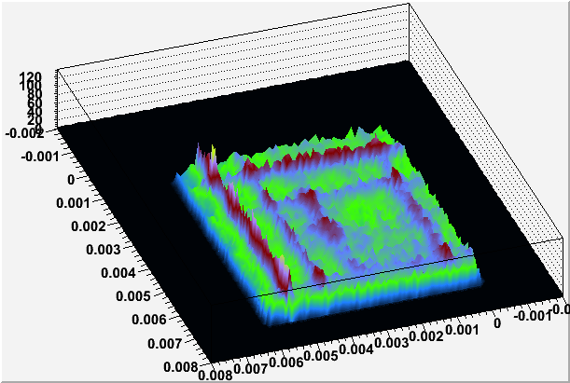
R1207, Pb/Q =259.6
After several hours at 50uA.
Target is 0.17mm thick.
R1208, Pb/Q = 255.8

Slide 13
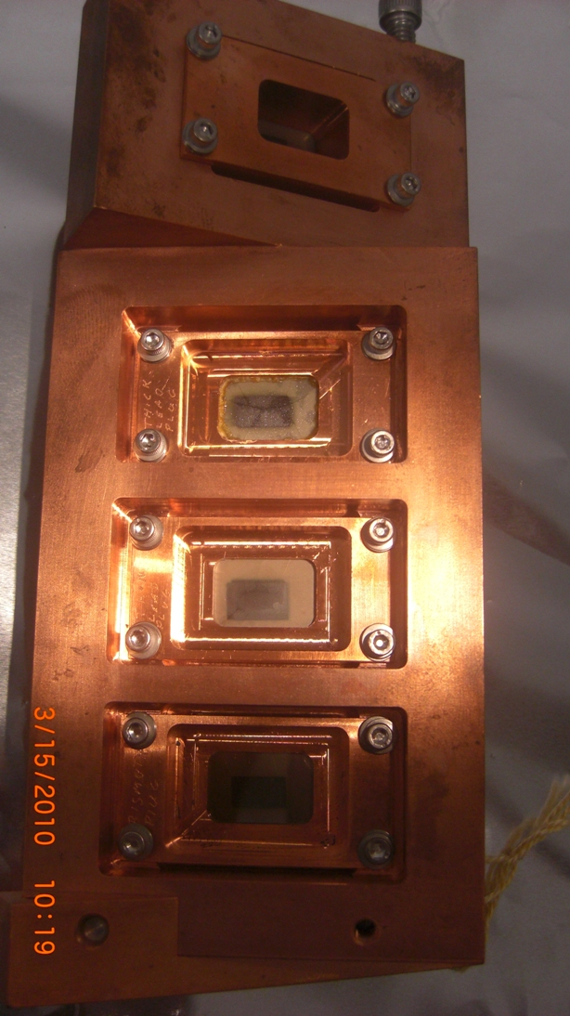
Visual Inspections of targets from run 2
(January 2008) – E06007 tgts at 30 deg.
0.5 mm, ²⁰⁸Pb
0.17mm, ²⁰⁸Pb
0.2mm ²⁰⁹Bi
A better design than for run 1.

Slide 14
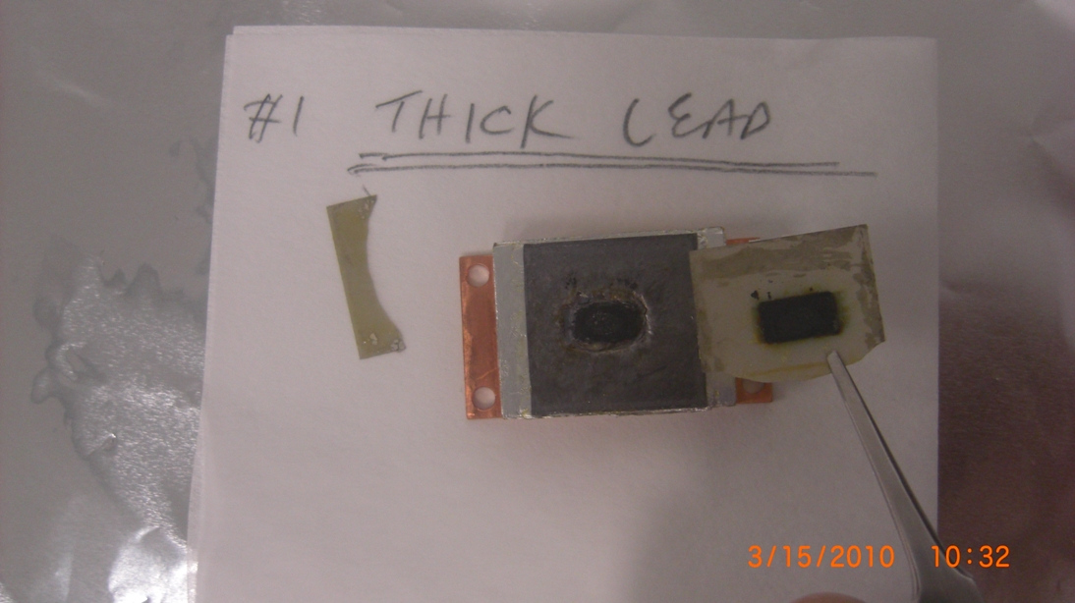
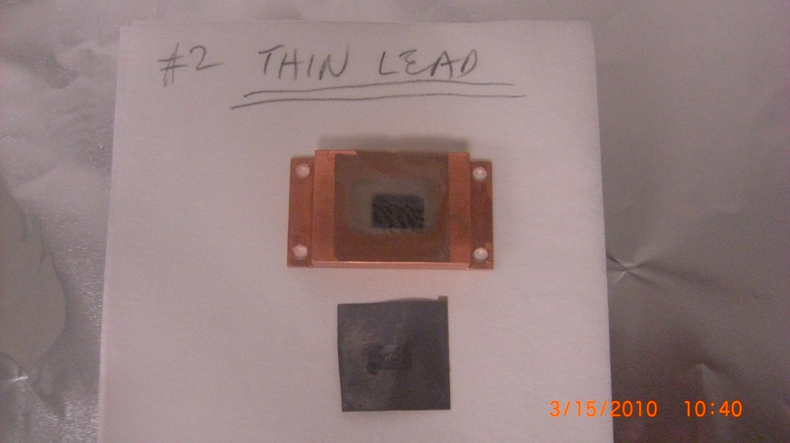
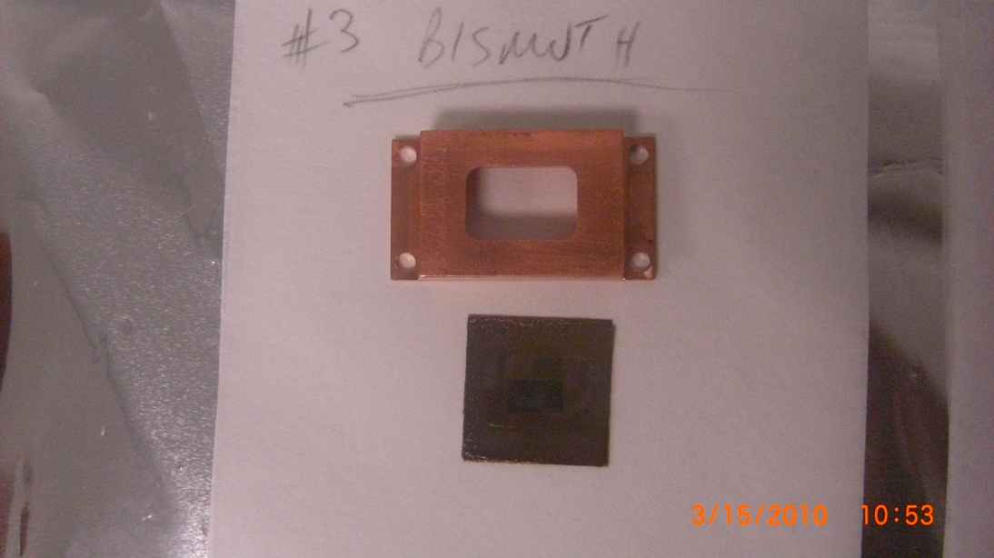
Migration of lead – target gave bad e_{miss} spectrum.
Thin lead and bismuth targets look to be in good shape. Analysis is continuing.

Slide 15
Conferences/meetings:
- XLVII International Winter Meeting on Nuclear Physics, 26-30 January Bormio
- European Nuclear Physics Conference 2009, Bochum 16-20 March 2009:
3rd Joint Meeting of the APS Division of Nuclear Physics and the Physical Society of Japan, Octber 13-17. Hawaii Japan.
Publications:
Most of the work done.
To address completely the target thickness issue.

Slide 16

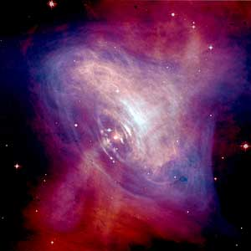
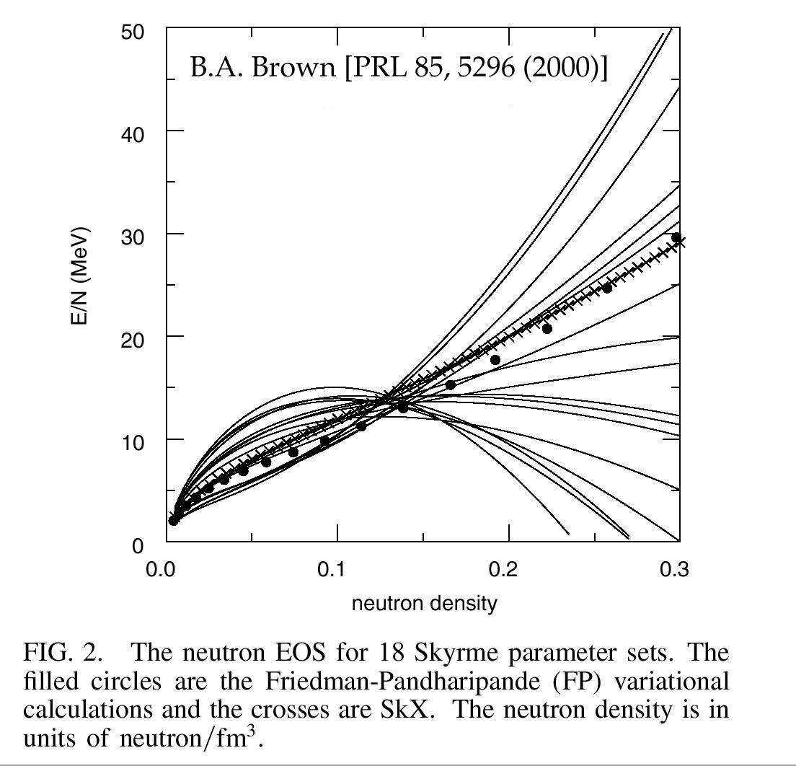
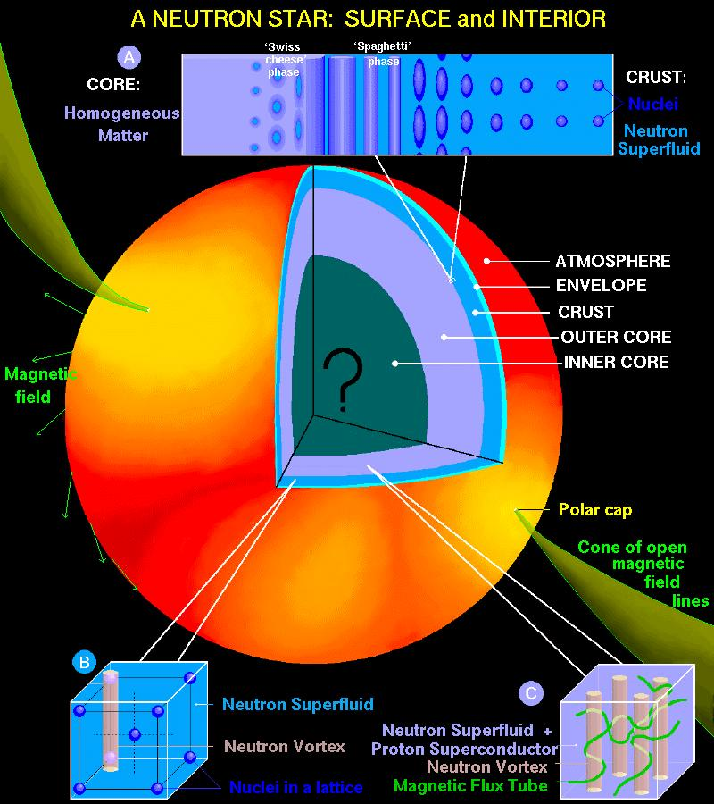
Lead (²⁰⁸Pb) Radius Experiment : PREX
Elastic Scattering Parity-Violating Asymmetry
E = 1 GeV,
Z⁰ : Clean Probe Couples Mainly to Neutrons
( T.W. Donnelly, J. Dubach, I Sick )
F_{N} (Q²)
Many applications:
Nuclear Physics
Neutron Stars
Atomic Parity Violation
Heavy Ion Collisions
Fundamental Nuclear Physics
Combine with astophysics observations
Is dense Neutron-rich matter exotic ?
( Dany Page )
PREX : precise measurement of the density -dependence of the symmetry energy.

Slide 17
PREX Timeline (2010)
Proposal : 130 Coulombs
Mar 11-24
Sched. Commis.
O-ring repair
Apr 14 – 23 Pb Production: → PC systematic !
Target Accident
17 Coul.
Mar 1-5
Source Setup
Mar 19 – Apr 6
Actual Commissioning
Systematic Studies
¹²C, pulsed beam
(Angle calibration, adjust HRS tune, Compton, dithering, focal plane detectors)
Hall A Meeting
41 C total
Apr 29 – May 11 Pb Production (good)
May 14 – 20 Pb Production
June 3 - Now Pb Production
Magnet problems
Magnet problems
End June 20
Apr 29
Vacuum Repair
May 11 - 14
Vacuum Repair
May 20 – June 3
Replace all O-rings
Leak checks
~ 65 C total
17 C bad ?
48 C good ?

Slide 18
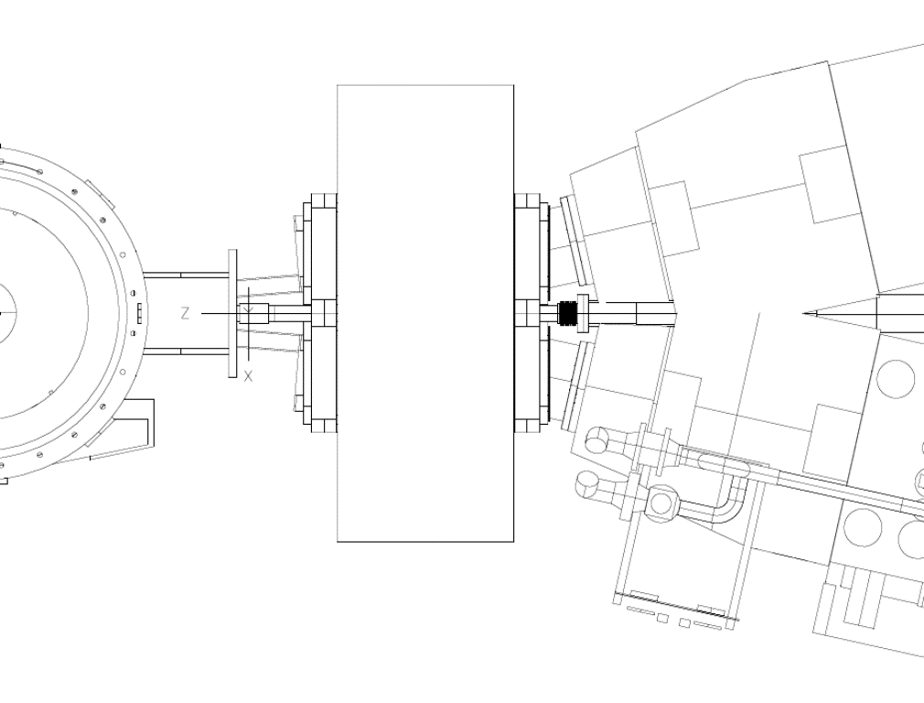
PREX Region After Target
Top view
HRS-L
Q1
Septum Magnet
target
HRS-R
Q1
O-Rings (which failed)
Collimators

Slide 19
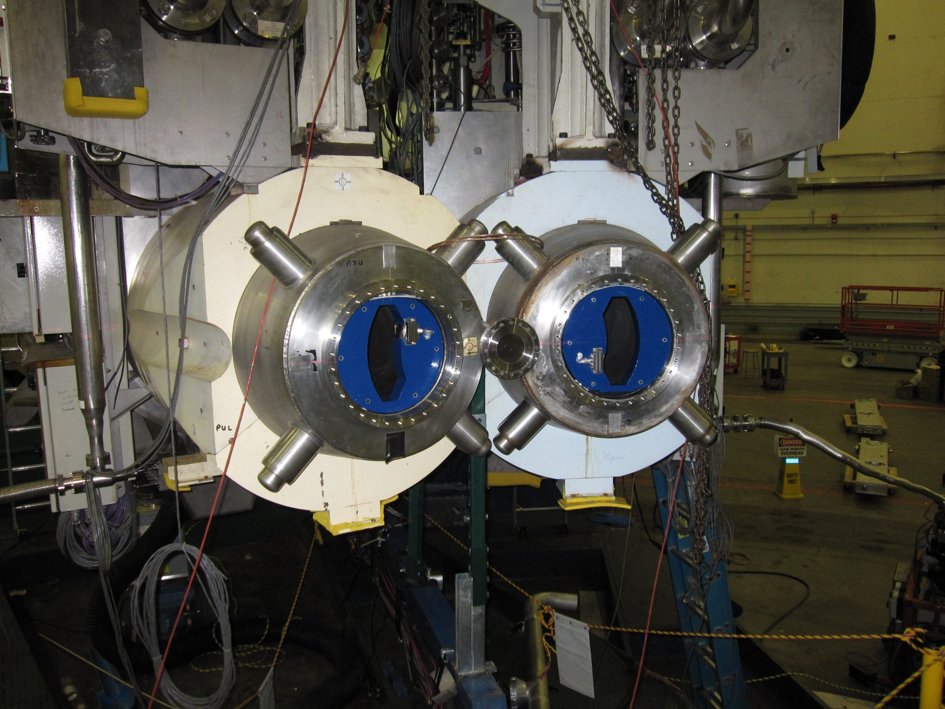
Collimators inside Q1
Symmetry in all dimensions to 1 mm

Slide 20
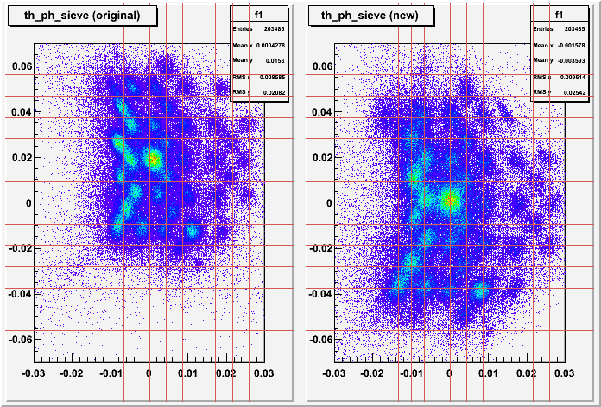
Optics of HRS + New Septum
Nilanga Liyanage, Seamus Riordan, Kiadtisak Saenboonruang,

Slide 21
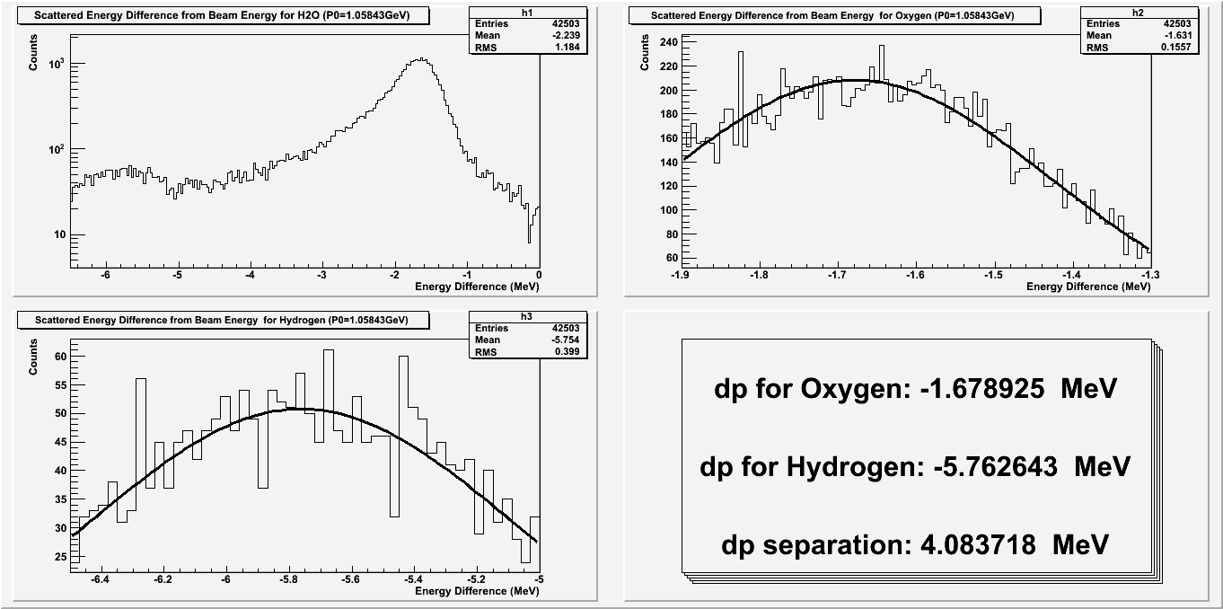
Water Cell : Measure
(agrees with survey)
Nilanga Liyanage, Seamus Riordan, Kiadtisak Saenboonruang,
¹⁶O
Hydrogen

Slide 22
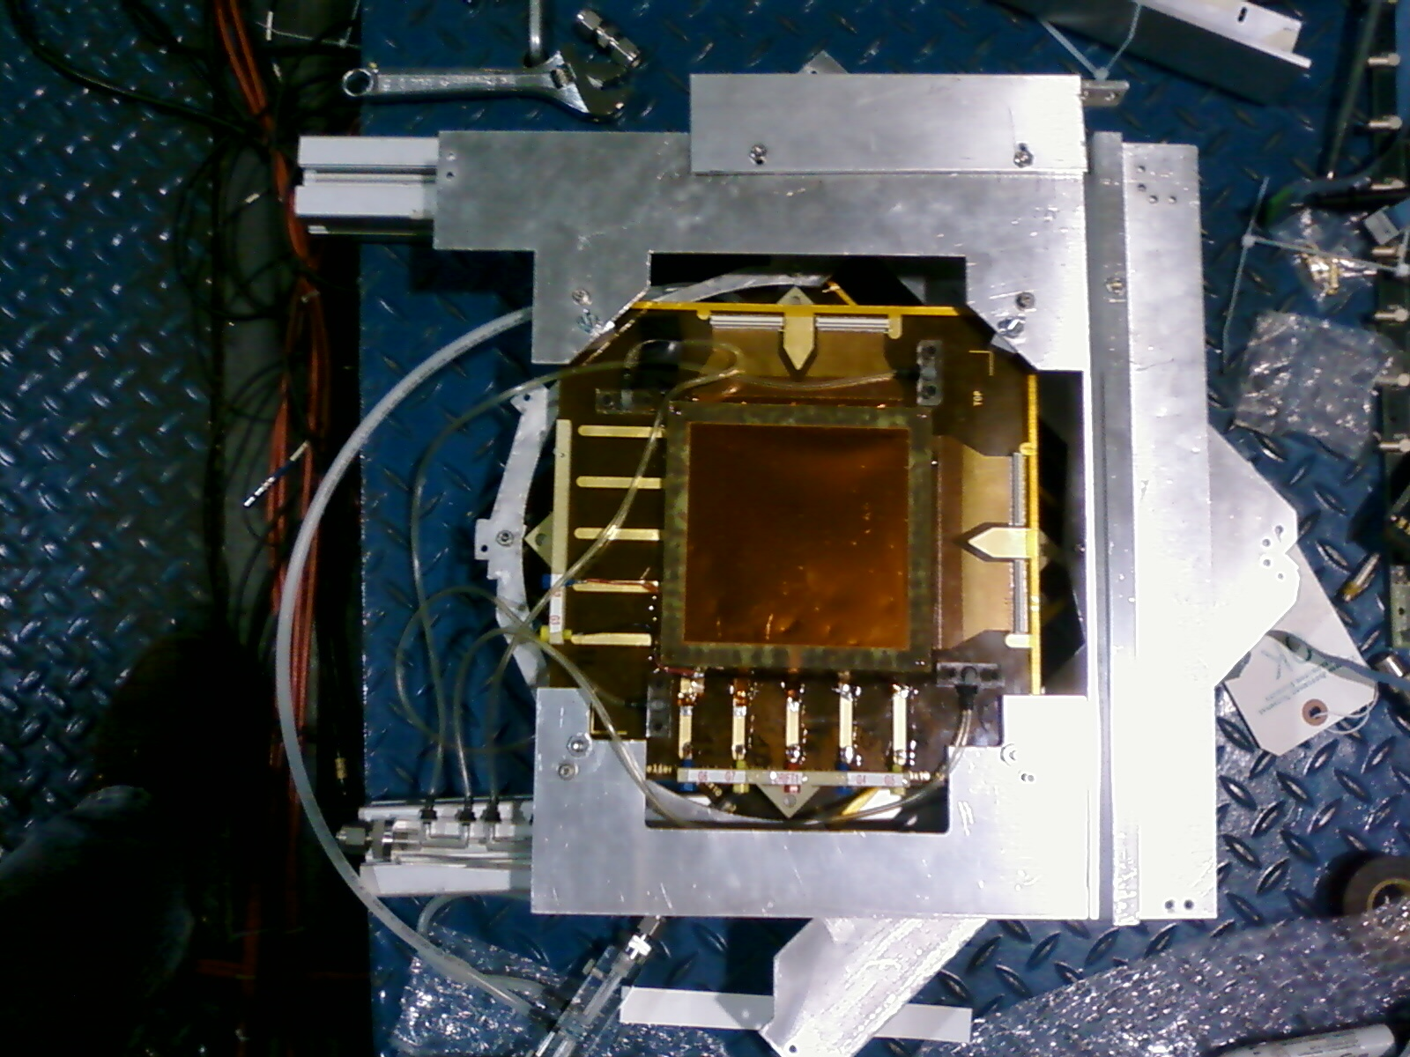
ISS GEM
Notes:
ISS GEM

Slide 23
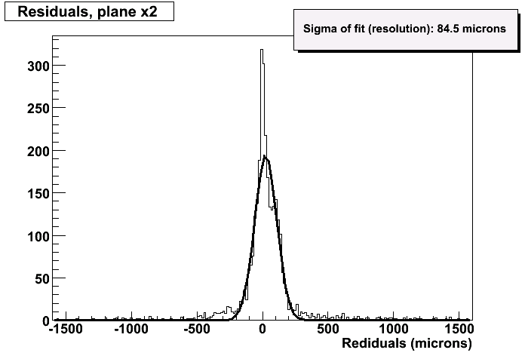
New GEM Detectors
High-rate tracking (issue for Q² )
4 Chambers on L-HRS are working.
Nilanga Liyanage, Seamus Riordan,
Kiadtisak Saenboonruang, Alexandre Camsonne,
Ole Hansen, Guido Urciuoli, Evaristo Cisbani
Plot from Megan Friend

Slide 24
During the experiment:
- Source Studies to optimize laser optics to minimize helicity-correlated systematics.
Cavity Monitors: Resolution ~1 mm
HRS Tune Found
Synchin Raster to Reduce Noise due to Target Non-uniformity
A Pockel Cell Related Systematic Error found in the first week: An instability in Pockel Cell “bleeds” into the itegration gate. It depended on helicity.

Slide 25
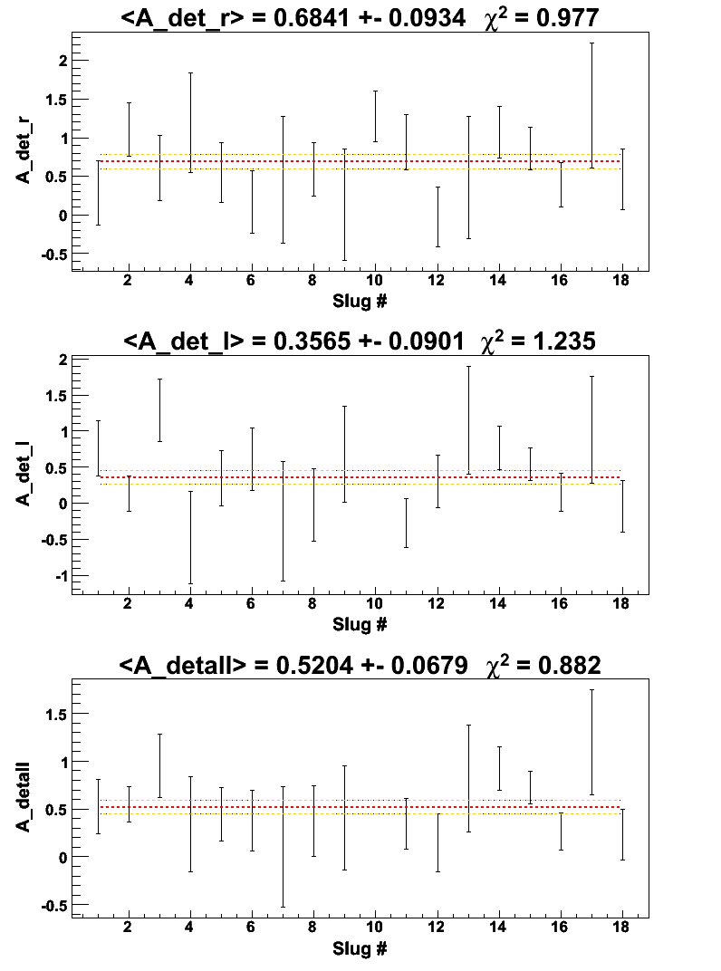
Online (blinded) Asymmetries
Left HRS
Expectation 0.51 ppm
Right HRS
excluding, for now, the first 17C of data (PC systematic)
Corrected for Sign Flips due to IHWP and Wien
Combined Statistics

Slide 26
PREx
Projected Errors
(roughly)
Projected / Actual
Proposal
6 to 8 %
Statistical
3 %
Polarimetry
1 to 2 %
1.5 %
< Q² >
1 %
0.5 %
Other Systematics
0.5 % ?
0.5 %
Total Error
3.2 to 3.7 %
6.3 to 8.2 %
2.1 to 2.7 %
Error in R_{N}
1.1 to 1.3 %

Slide 27
Conferences/ Meetings
The Lead Radius Experiment and Neutron Rich Matter in Astrophysics and in the Laboratory, Trento, August 3-7 2009
Nuclear reactions on Nucleons and Nuclei, Messina, October 5-9 2009.

Slide 28
Hypernuclei (ISS-Roma1-Bari).
- Studio dello spettro di energia mancante ottenuto con Targhetta di Berillio
- Tentativo di aggiungere i dati dalle finestre di Berillio di entrata ed uscita della Targhetta ad acqua utilizzata per lo studio della produzione di ipernuclei da nuclei di Ossigeno.
- Studio delle correzioni radiative ancora da effettuare.

Slide 29
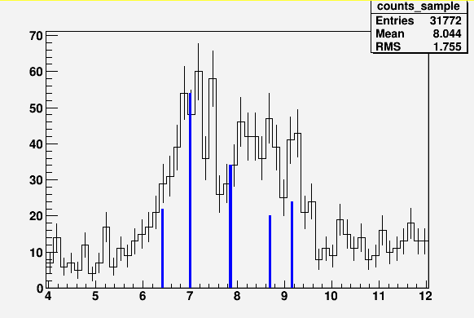
Predicted Levels

Slide 30
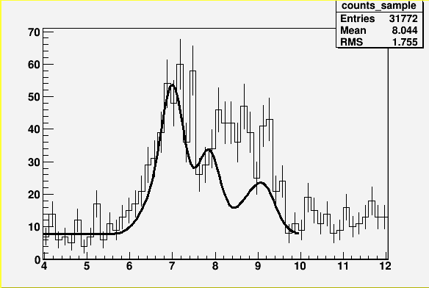
Expected Spectrum at 650 keV FWHM

Slide 31
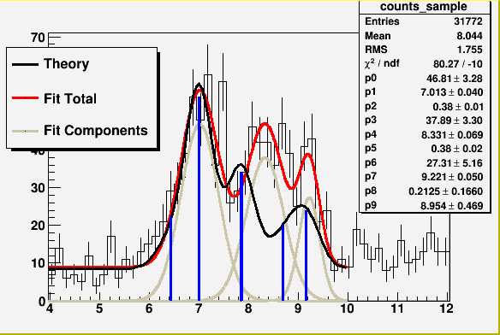
The fit does not match the expectations.
Χ² / ndf = 1.43 but the width of first two peaks is 900 keV FWHM while the width of the 3-rd peaks = 500 keV → other levels?

Slide 32
Publications:
Done:
A chi**2 test used for particle identification with the Hall A RICH detector at Jlab
(NIM A)
            To do
Beryllium data
Algorithm on optic (data base) optimization
Septum magnet

Slide 33
Monte Carlo Simulations (SBS)

Slide 34
Proposed new
Silicon plane Detector

Slide 35

STUDY OF THE (e,e’p)
QUASIELASTIC REACTION
IN COMPLEX NUCLEI:
THEORY AND EXPERIMENT
Grupo de Física Nuclear
Departamento de Física Atómica, Molecular y Nuclear
Universidad Complutense de Madrid
Joaquín López Herraiz
Thesis supervisor
Dr. José Manuel Udías Moinelo
14-May-2010

Slide 36
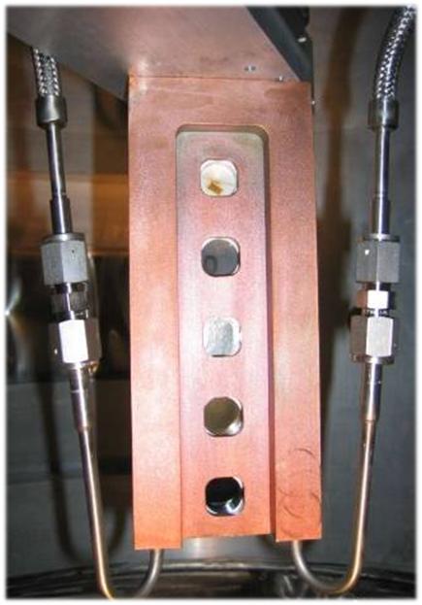
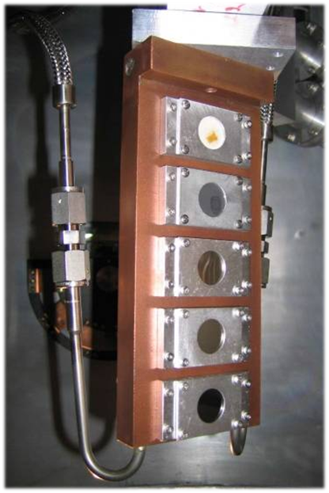
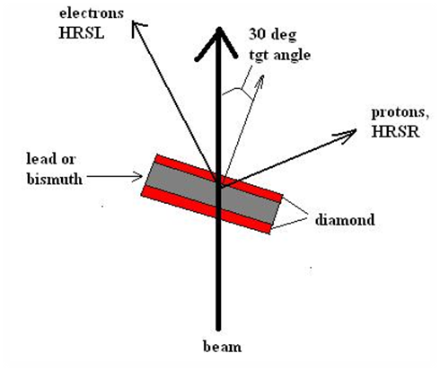
Experimental Setup:
2. – Targets: C+Pb+C
1 ) QUASIELASTIC (e,e’p) REACTION
2 ) SIMULATION
4 ) DATA ANALISIS
5 ) RESULTS
6 ) SUMMARY AND CONCLUSIONS
Target ladder
BeO
C
Pb
Pb
Bi
BeO
C
Pb
Pb
Bi
Diamond | 0.0465 g/cm²
Lead | 0.194 g/cm²
Diamond | 0.0395 g/cm²
Diamond/Lead/Diamond
cryogenic target
(for high beam current)
0.2 mm Lead Foil
0.15 mm Diamond Foils
Beam entrance
Beam exit
36

Slide 37
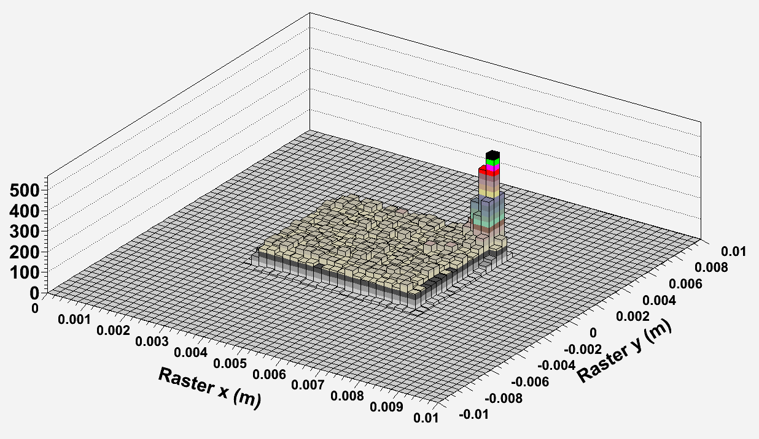
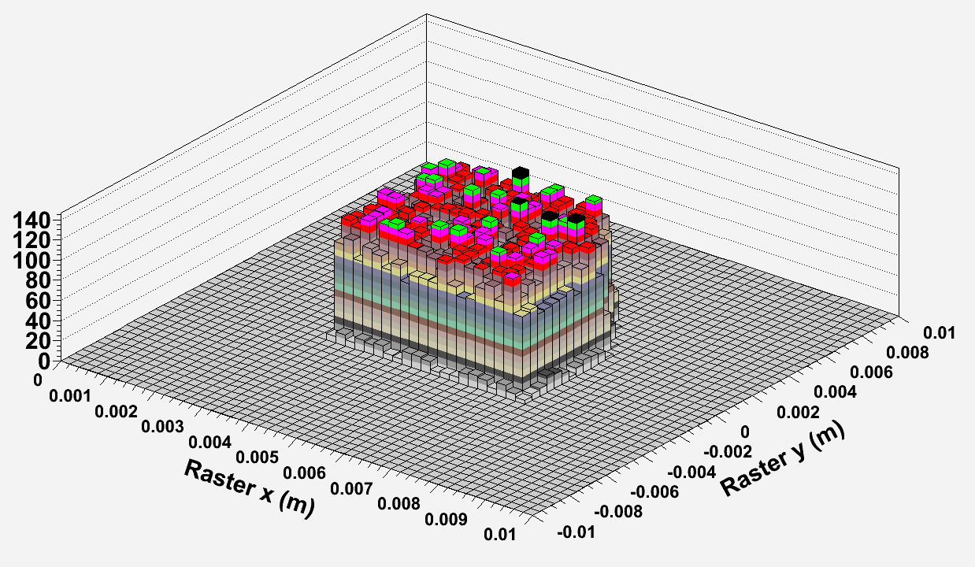
Efficiency corrections
1 ) QUASIELASTIC (e,e’p) REACTION
2 ) SIMULATIONS
3 ) DESCRIPTION OF THE EXPERIMENTS
4 ) DATA ANALISIS
5 ) RESULTS
6 ) SUMMARY AND CONCLUSIONS
Raster position cut – Required in ²⁰⁸Pb to remove those events that hit the frame.
37

Slide 38
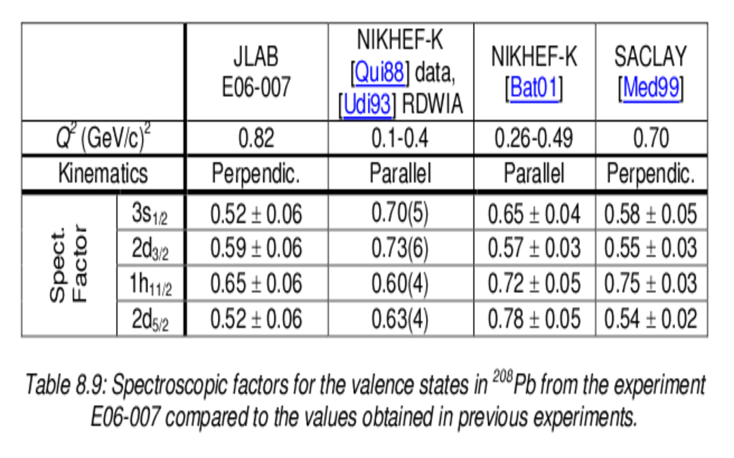
From PhD thesis of Joaquin Lopez Herraiz

Slide 39

Some Target Issues – A tough neighborhood for experimenters!

Slide 40
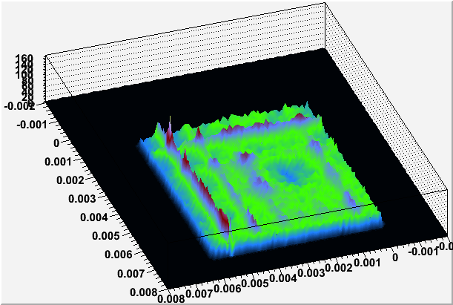
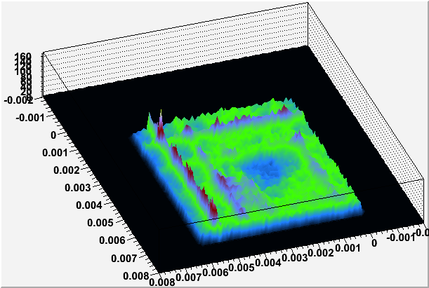
R1209, Pb/Q = 255.6
R1210, Pb/Q = 247.4

Slide 41
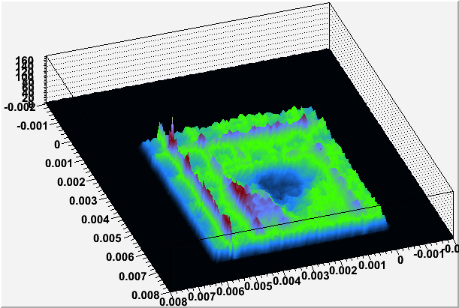
R1211, Pb/Q = 244.1

Slide 42
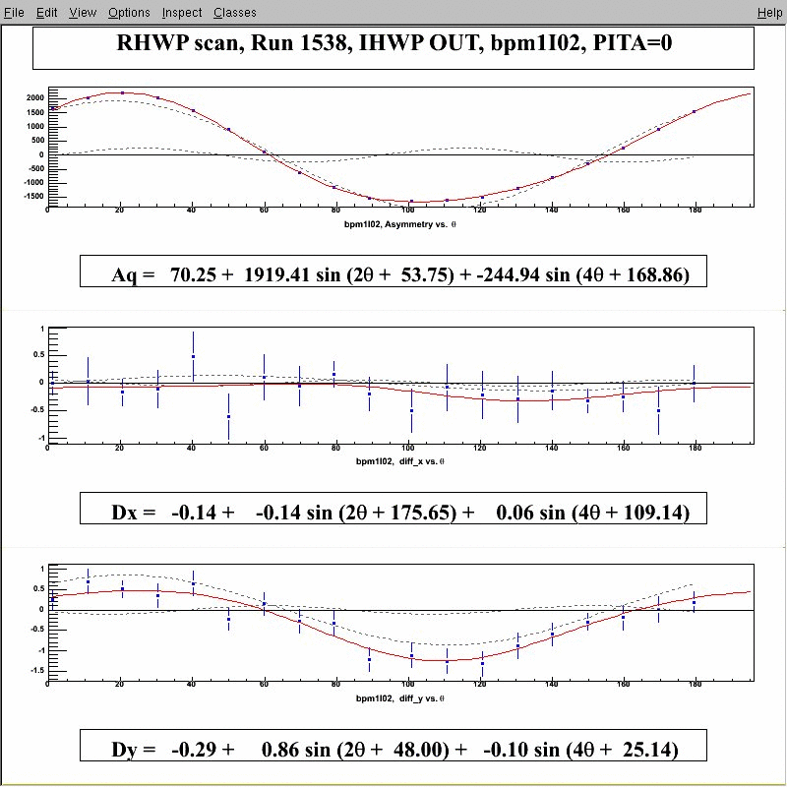
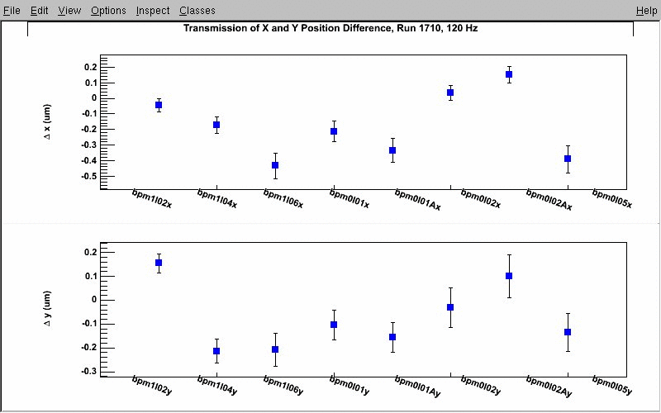
Source Studies
~ 2000 ppm
Charge Asymmetry
Kent Paschke, Gordon Cates, Mark Dalton, Rupesh Silwal
Optimizing laser optics to minimize helicity-correlated systematics.
~ 0.5 um
Hel. Correl. Diff (X)
Transmission of Helicity-Correlated Position DIffs
Hel. Correl. Diff (X)
Hel. Correl. Diff (Y)
Delta X (um)
~ 0.5 um
BPMs in Injector Region
Hel. Correl. Diff (Y)
Delta Y (um)

Slide 43
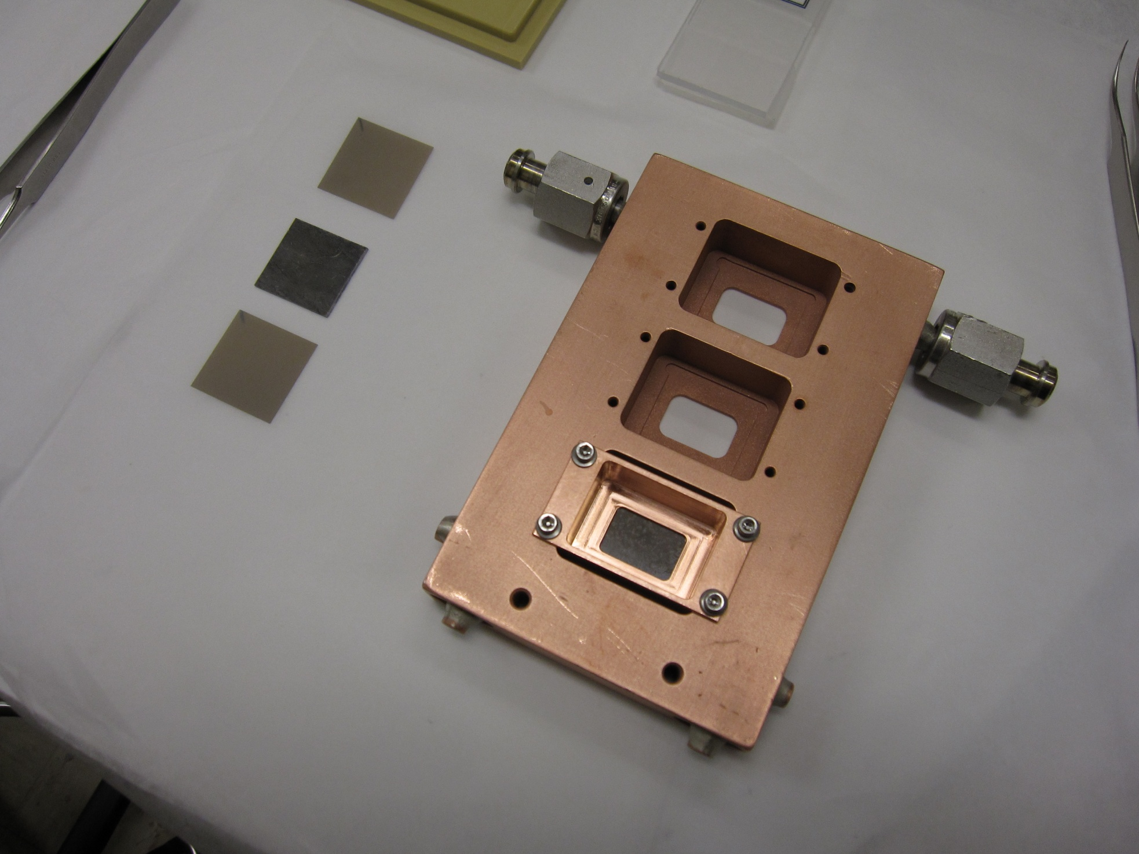
Lead / Diamond Target
Diamond
LEAD
Three bays
Lead (0.5 mm) sandwiched by diamond (0.15 mm)
Liquid He cooling (30 Watts)

Slide 44
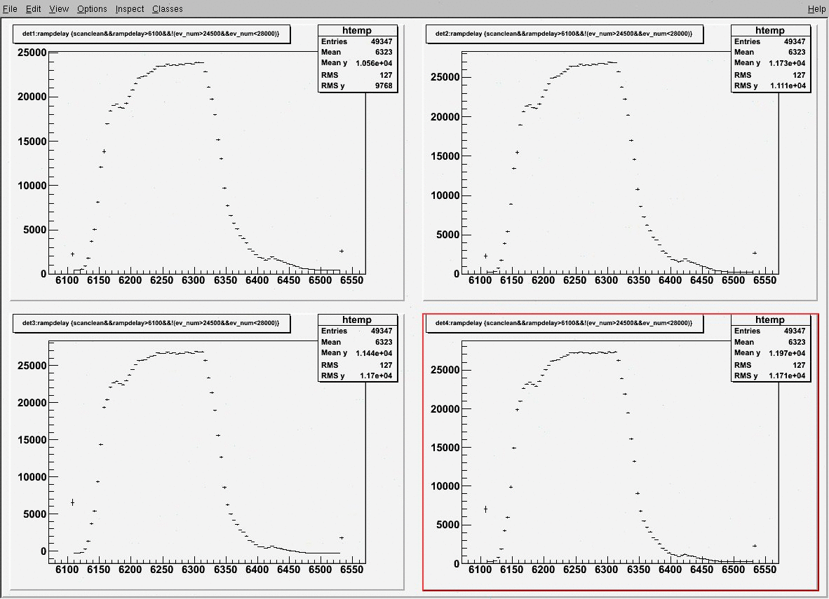
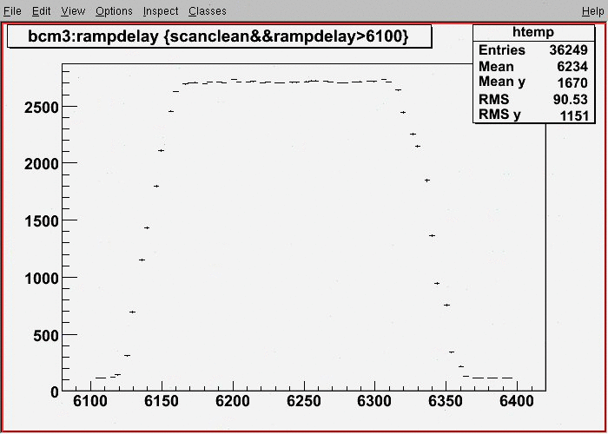
Pockel Cell Related Systematic Error
wait
integrate
wait
An instability in Pockel Cell “bleeds” into the itegration gate. It depends on helicity.
Beam Current
Detector (1 of 4)
Response to pulsed beam
time
time
Want small time constants, and same for detectors and bcm

Slide 45
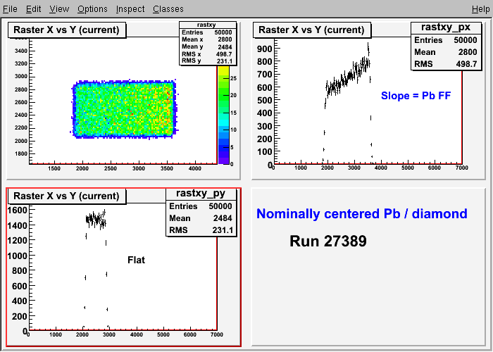
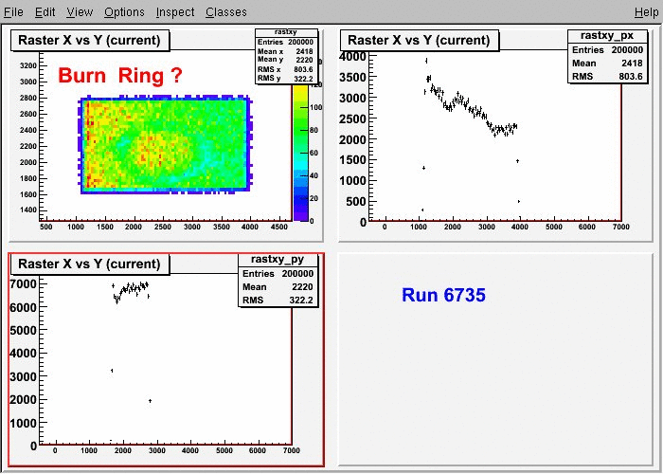
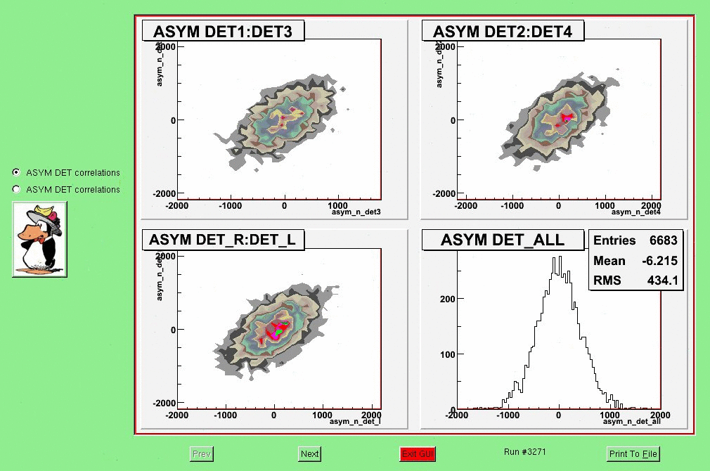
Synching Raster
To Reduce Noise due to Target Non-uniformity
Gordon Cates, Krishna Kumar, Bill Gunning
Flat
Initial Running
This eliminated the ….
Non-stat Noise !
NOT Flat
After 1 Week

Slide 46
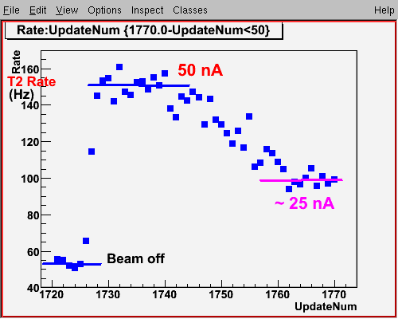
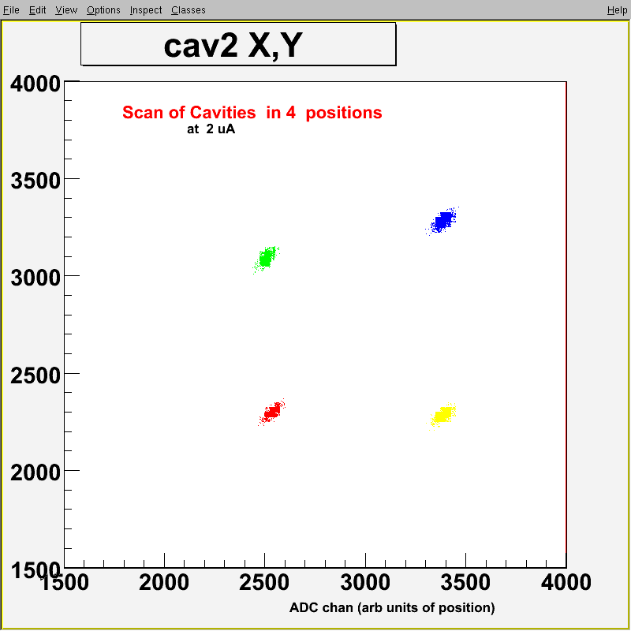
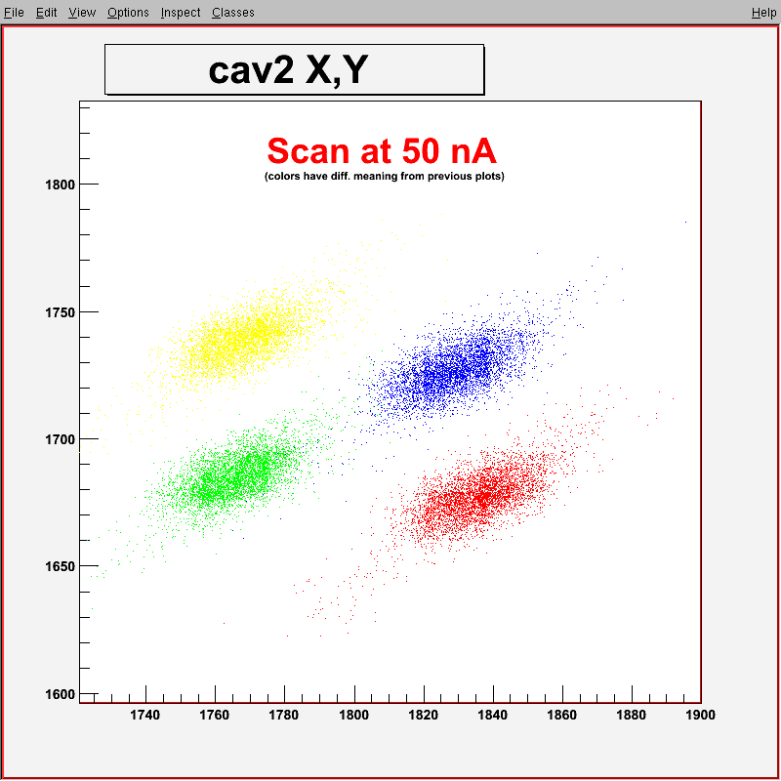
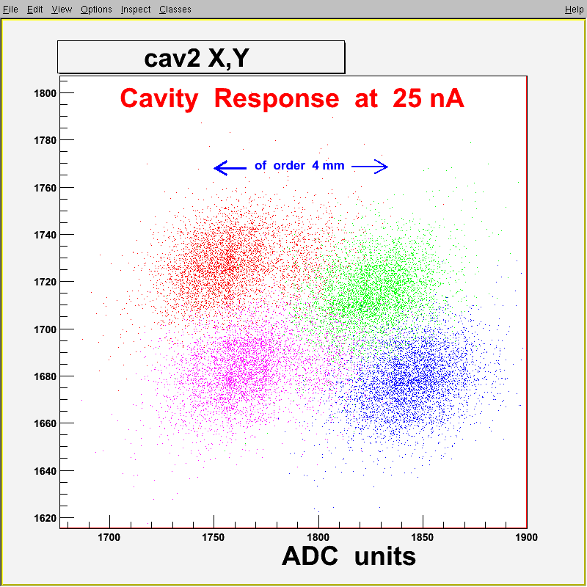
Cavity Monitors
How to judge low currents: scintillator
John Musson, Zafar Ahmed
At 2 uA
Magnets used to calibrate
Time axis
4 mm
Resolution ~1 mm
at 25 to 50 nA

Slide 47



Finding HRS Tune
Acceptance defined by collimator
Efficient overlap with detectors
John LeRose, Seamus Riordan, Dustin McNulty, et.al.

Slide 48
Other Issues
Establishing few - ppb systematic errors.
Measurements of A_{T}
Double Wien Filter for Spin Flips
New Beam Modulation System
Requires off-line analysis
Small ! (but not public yet)
Useful for Qweak

