Slide 1
Advanced time-of-flight diagnostics for real-time characterization of ions accelerated by high energy lasers
PhD candidate: Martina Salvadori
Supervisors: Mauro Migliorati, Patrizio Antici, Fabrizio Consoli
Agenzia nazionale per le nuove tecnologie,
L’energia e lo sviluppo economico sostenibile

Slide 2
Overview
Introducing laser-driven ion acceleration
context and motivation
Advanced Time-Of-Flight (TOF) diagnostic system
Methodology
From the acquired data to the spectrum reconstruction
Data Analysis
Application to different experimetal Scenarios
Results and Discussion
29/04/2021
2

Slide 3
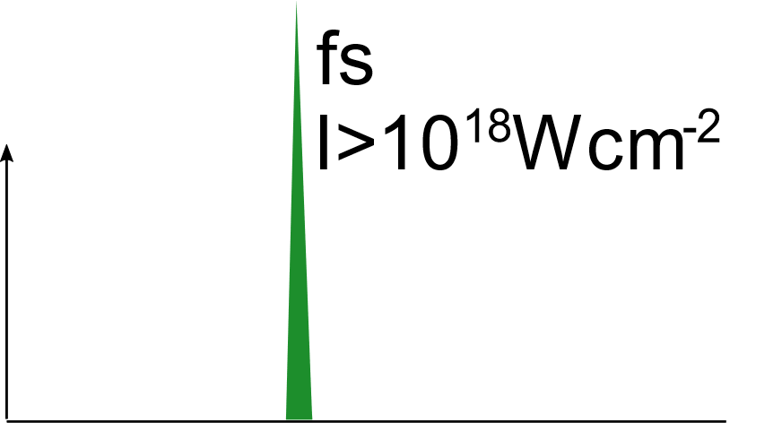
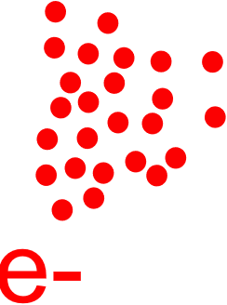
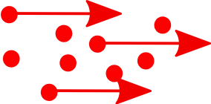
Introducing Laser driven ion acceleration
, ps
Ions⁺
Ions⁺
Suprathermal electrons
1. Plasma generation
2. Laser energy absorption by plasma electrons
Collisional processes (I < 10¹⁵ W cm⁻²)
Collisionless processes (resonance absorption, vacuum heating, J$×$B heating)
2.1. electrons transport through the dense target
A. Macchi et al., Rev. Mod. Phys. 85 (2013) 751, H. Daido et al., Reports Prog. Phys. 75 (2012) 056401 and references there in
29/04/2021
3

Slide 4
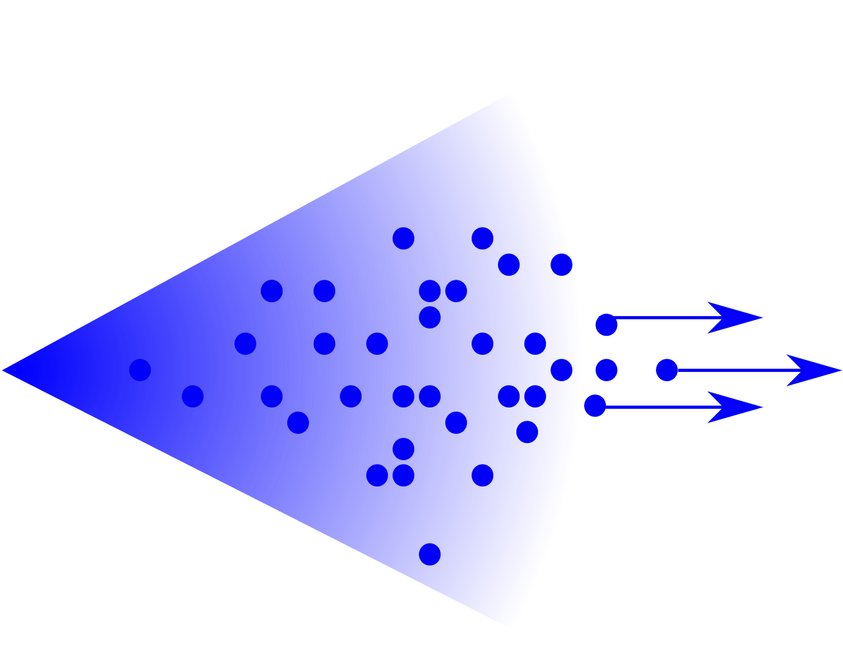
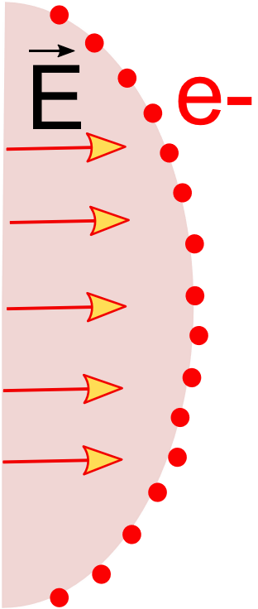
Introducing Laser driven ion acceleration: TNSA
3. The escaping electrons will give rise to an electrostatic potential derived by the charge-separation between themselves and the positively charged target.
4. The oncoming electrons are thus going to be confined under Coulombic forces to a Sheath field, directed as the Target Normal, that extends for a distance $λ_{D}$ and reaches an intensity of the order of TV/m.
+
5. The intensity of this electric field in high enough to ionise the atoms present at the rear surface of the target.
$$λ_{D}≃1 μm$$
$$E∼TV/m$$
6. These ions, which are subjected to an intense electric field, will be then accelerated to the order of MeV energies. Protons, having the highest charge to mass ratio, are in the most favorable condition for Acceleration
A. Macchi et al., Rev. Mod. Phys. 85 (2013) 751, H. Daido et al., Reports Prog. Phys. 75 (2012) 056401 and references there in
29/04/2021
4

Slide 5
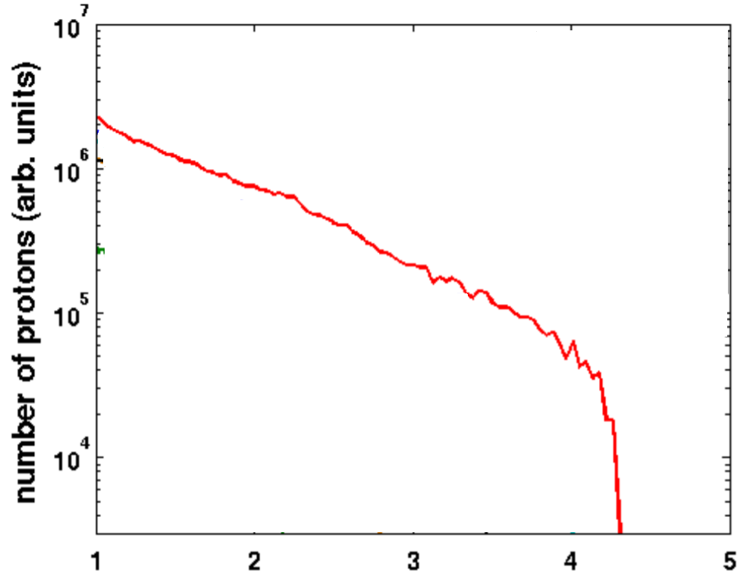
Introducing Laser driven ion acceleration:
ions bunch characteristics
Proton energy up to a few tens of MeV
Short proton bunch duration at the source (fs-ps)
Charge of a few nC
Conical beam of tens of degrees ($≃$ 20°)
The spectrum can be approximated with a Maxwellian
+
detector
$$λ_{D}≃1 μm$$
$$E∼TV/m$$
Highest energies
Lowest flux
What requirements does it have to satisfy?
A. Macchi et al., Rev. Mod. Phys. 85 (2013) 751, H. Daido et al., Reports Prog. Phys. 75 (2012) 056401 and references there in
29/04/2021
5

Slide 6
Diagnostic system requirements
The ideal diagnostic system should have:
High sensitivity
High energy resolution
and should allow to retrieve:
Spectrum of accelerated ions
Angular distribution of accelerated ions
but it also has to provide:
Electro Magnetic Pulses (EMPs) robustness
Real-time detection and characterization of ions
Layered Imaging systems (RCF, Imaging plates…)
Solid state nuclear track detectors
Thomson spectrometers
Electrostatic-magnetostatic spectrometers
Time Of Flight technique
M. Salvadori et al. Scientific Reports 11, 3071 (2021)
29/04/2021
6

Slide 7
Diagnostic system requirements
The ideal diagnostic system should have:
High sensitivity
High energy resolution
and should allow to retrieve:
Spectrum of accelerated ions
Angular distribution of accelerated ions
but it also has to provide:
Electro Magnetic Pulses (EMPs) robustness
Real-time detection and characterization of ions
Layered Imaging systems (RCF, Imaging plates…)
Solid state nuclear track detectors
Thomson spectrometers
Electrostatic-magnetostatic spectrometers
Time Of Flight technique
M. Salvadori et al. Scientific Reports 11, 3071 (2021)
29/04/2021
7

Slide 8
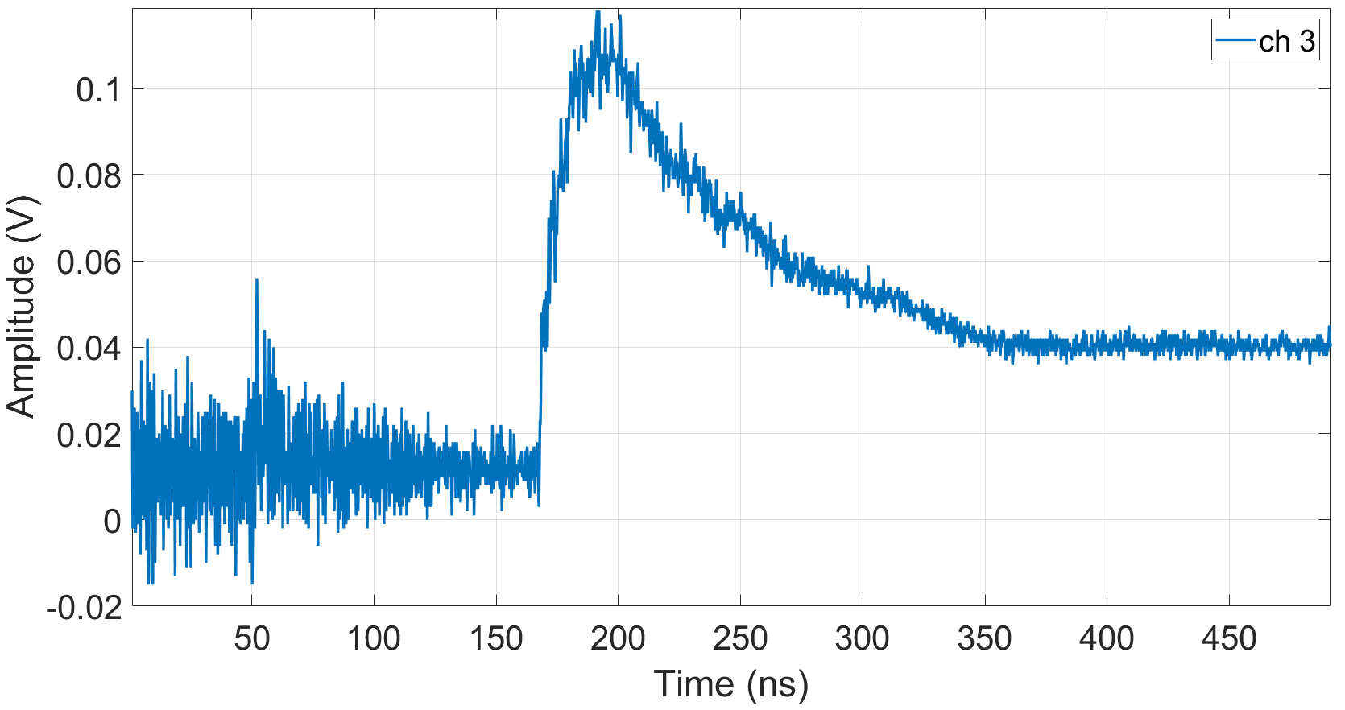
Time Of Flight Technique
Typical signal from Time Of Flight
Time Of Flight measurements are a powerful and effective method to obtain timely spectra of accelerated particles.
X-rays peak
(photopeak)
Ion signal
TOF technique relies on the measurement of the time needed by a particle to travel for a known distance
Photons, c
Ion, v₁
Ion, v₂ < v₁
EMP noise
time
X-rays peak: signal generated by the incoming X-rays produced by the laser-matter interaction.
TOF signals have an intrinsic high dynamic range.
EMP pollution hinders the employment of TOF in high energies facilities
TNSA: temporal window with pure proton contribution
It is necessary to develop a technique able to appreciate the full dynamic range
It is necessary to optimize the system to work in these environments
$∆t_{i}= t_{pM}\left(\sqrt{\frac{A_{i }}{Z_{i}}}−1\right)$ $≥{ t}_{pM}\left(\sqrt{2}−1\right)$
Or in terms of proton energy: $∆E_{p}≥ E_{pM}/2$
29/04/2021
8

Slide 9
Towards the spectrum reconstruction
Signal Acquisition
Energy
estimation
Number
estimation
29/04/2021
9

Slide 10
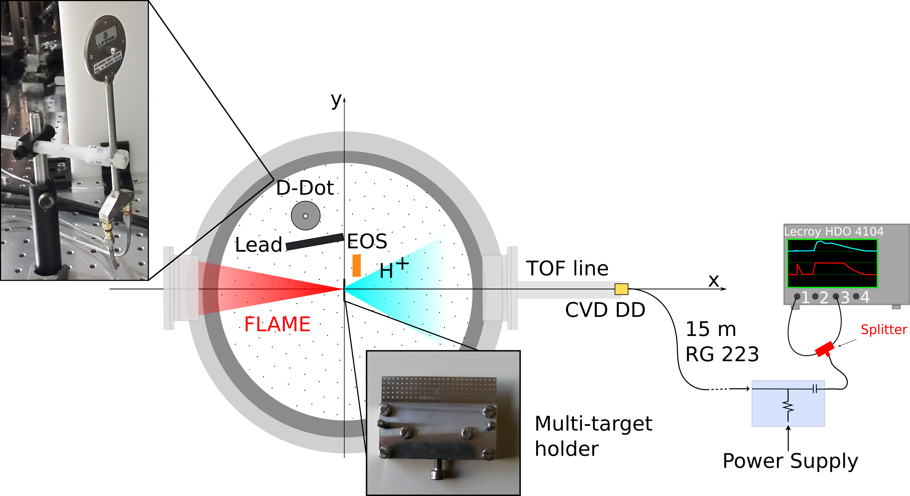
Detrimental effect of EMPs on TOF signals: an example
FLAME
E = 2.5 J
$I= 1.7×{10}^{19}$ W ${cm}^{−2}$
τ = 25 fs
Target : 10 µm Al
Coupling with the acquisition system
Coupling with the detection system
Broadband EMP spectra
Associated electric field at 30 cm: 25 kV/m
M. Salvadori et al., Journal of Instrumentation 15, C10002 (2020)
F. Consoli et al., Scientific Reports 9, 8551 (2019)
29/04/2021
10

Slide 11
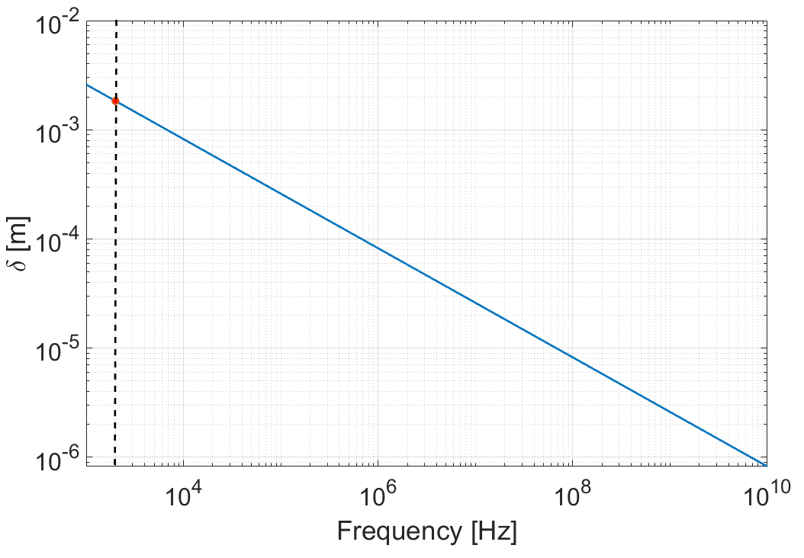
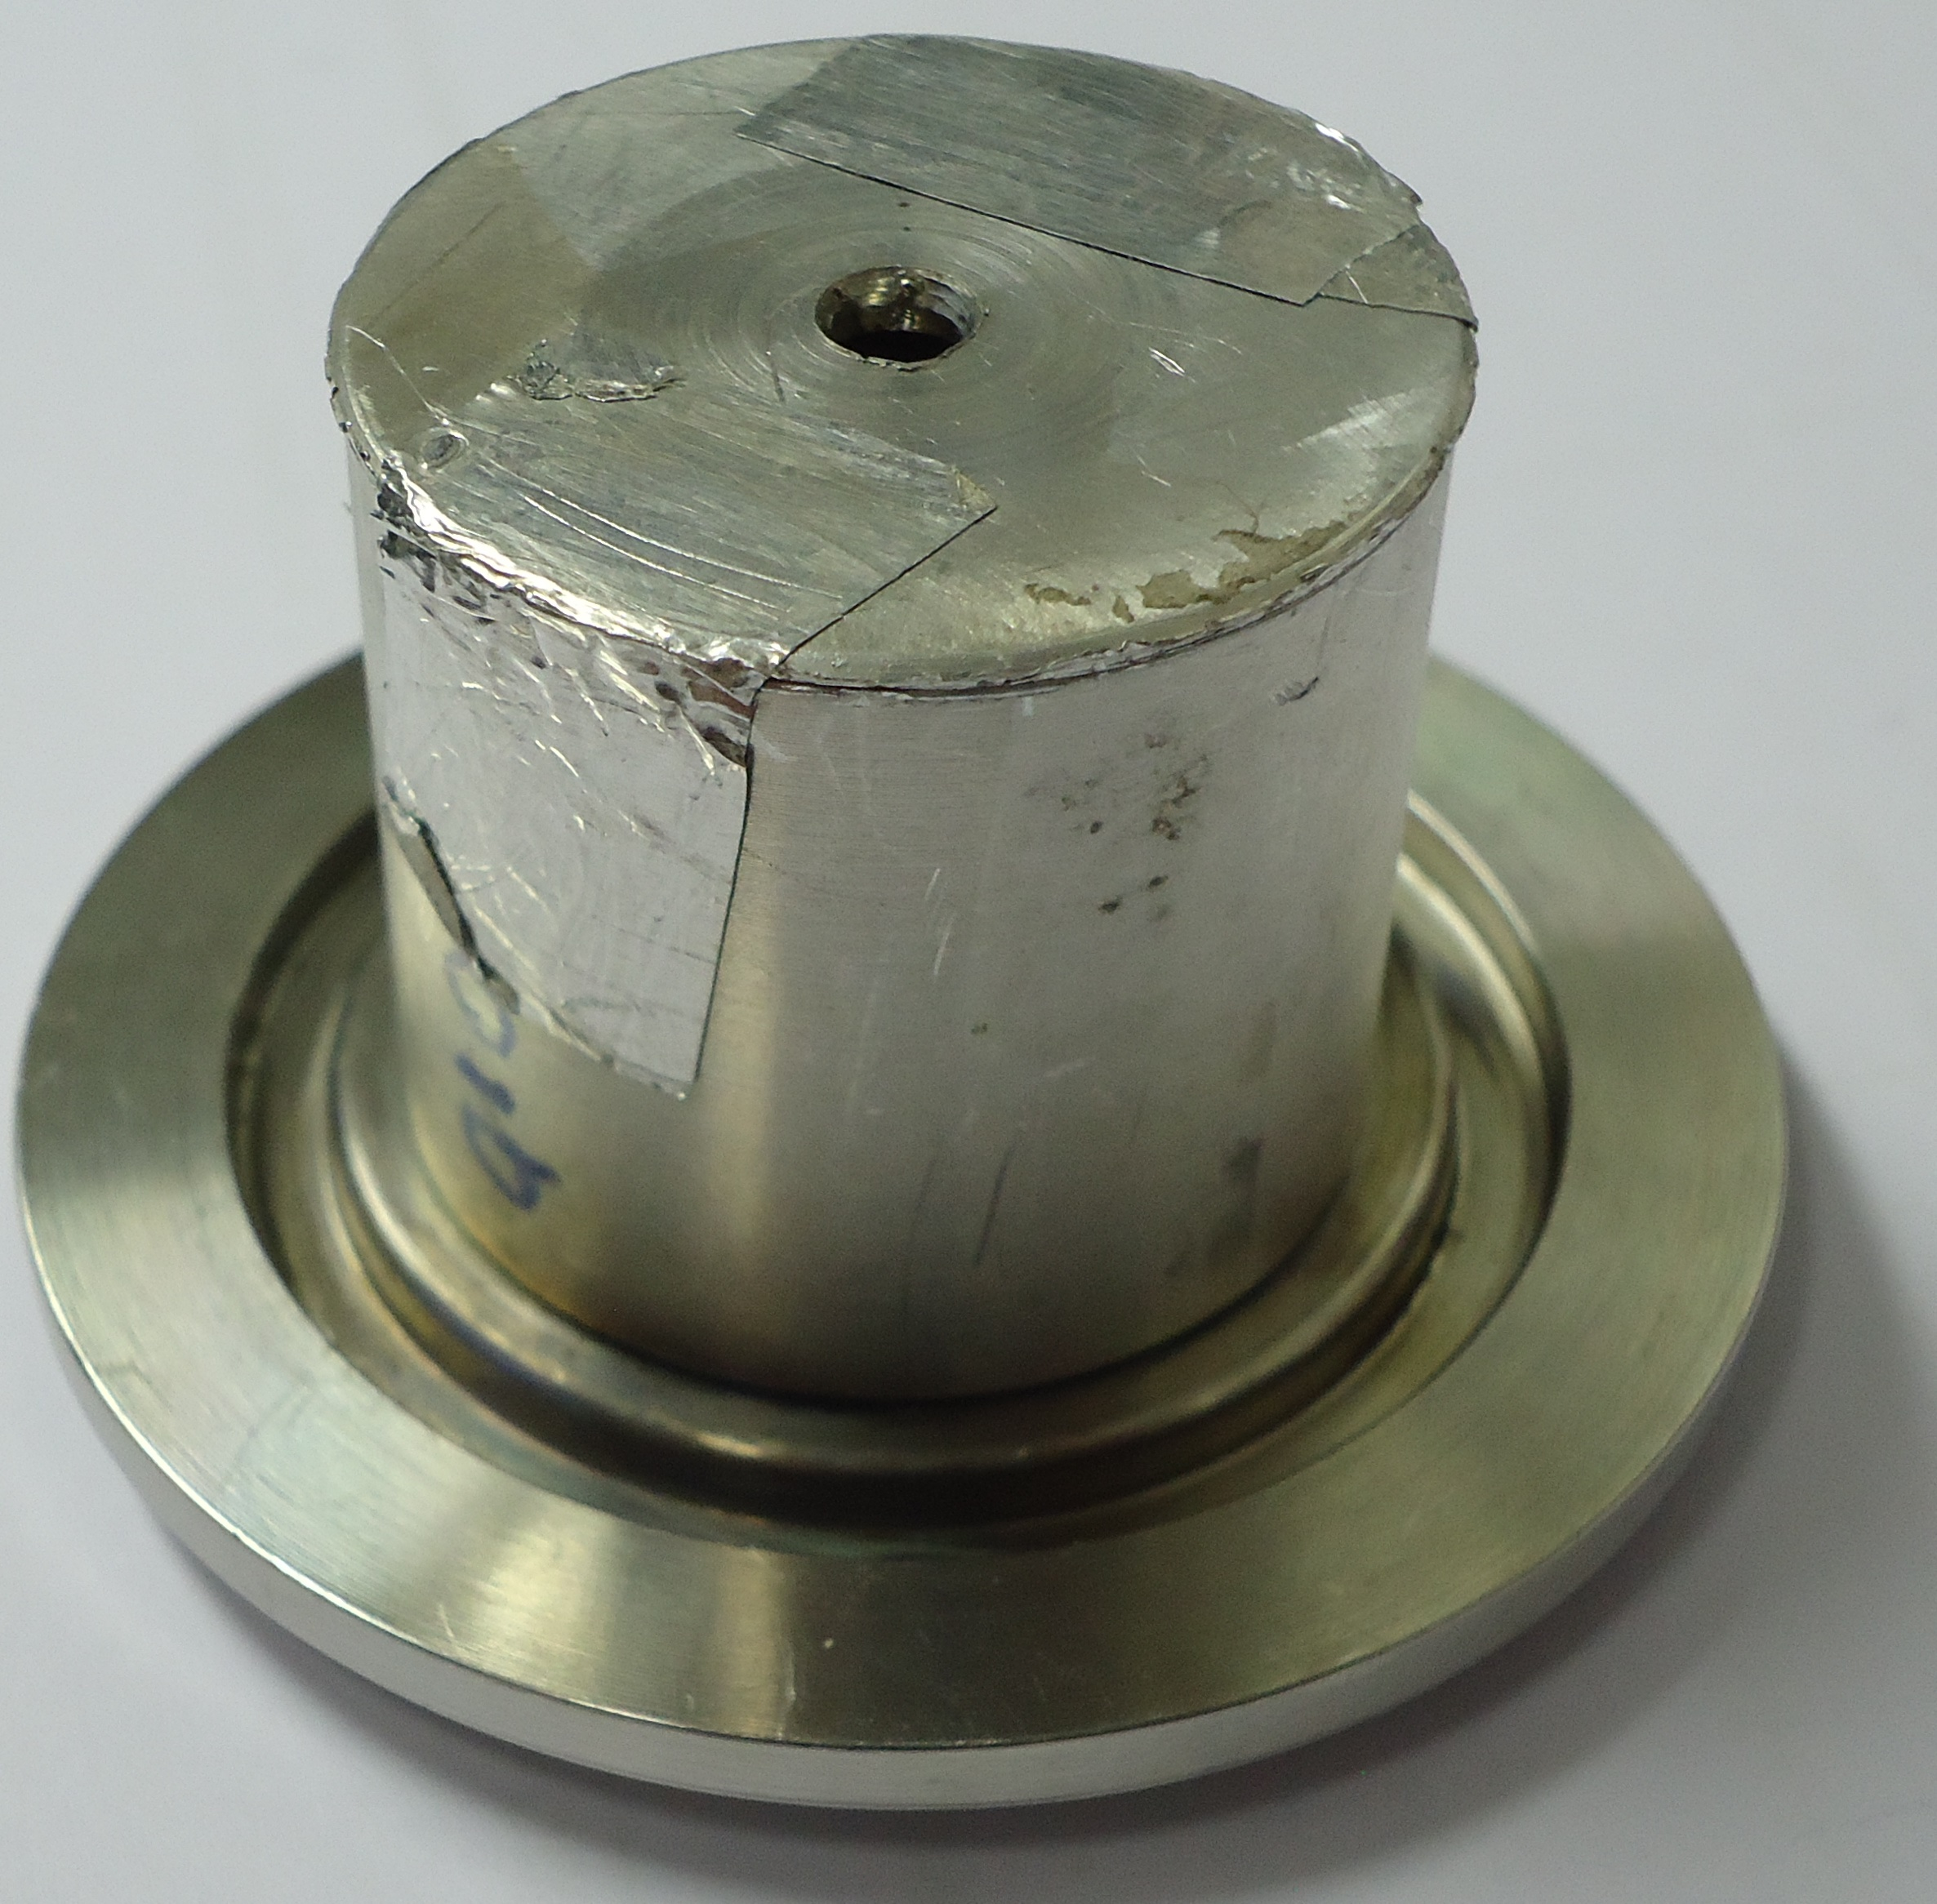
Avoiding EMP coupling with the detection system (1)
Skin depth for aluminum
Developing a proper shielding
Compact metallic enclosure: exploting skin effect
$δ$= 2 mm
$$δ=\sqrt{\frac{ρ}{πfμ_{r}μ_{0}}}$$
$$E\left(z\right)∝E_{0}e^{−\frac{z}{δ}}$$
$ρ$ resistivity; $μ_{r}$permeability
The 2 mm Al enclosure attenuate EM waves with frequencies down to 2 KHz
≈ 2 kHz
M. Salvadori et al. Scientific Reports 11, 3071 (2021)
29/04/2021
11

Slide 12
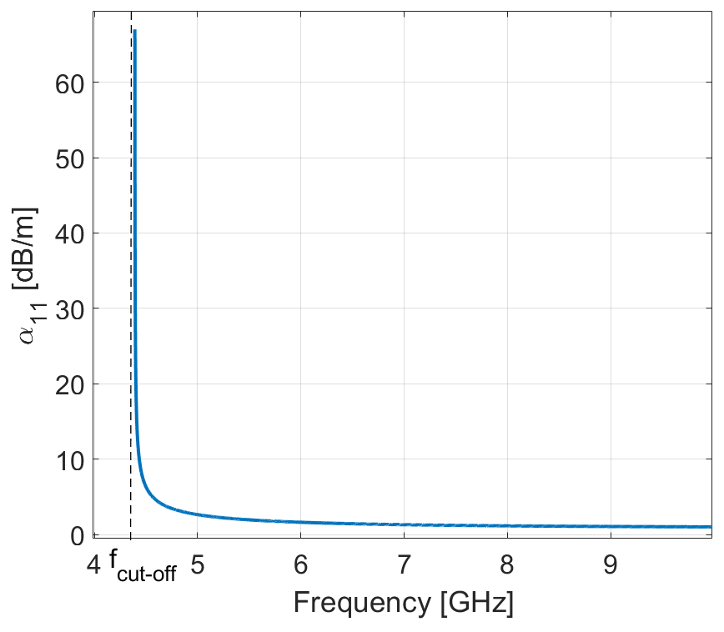
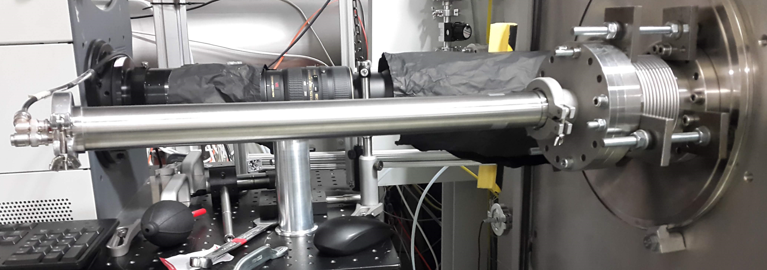
Avoiding EMP coupling with the detection system (2)
Exploiting the attenuation provided by waveguides
1. Cutoff frequency
40 mm Aluminum pipe
2. Attenuation of the propagating EM waves:
$$E\left(z\right)∝E_{0}e^{−α_{m,n}z}$$
Skin depth
Material conductivity
Geometrical parameters
M. Salvadori et al. Scientific Reports 11, 3071 (2021)
29/04/2021
12

Slide 13
Avoiding EMP coupling with the acquisition system
Scattering parameter S₂₁ Transmission coefficient
Long double shielded coaxial cables
Provide high frequency attenuation,
Introduce a temporal delay between the TOF signal and the EMP contribution,
Allow to place the scope far from the experimental chamber.
ù
Scope with minimal bandwidth to reduce coupling with high frequency electromagnetic pulses.
M. Salvadori et al. Scientific Reports 11, 3071 (2021)
29/04/2021
13

Slide 14
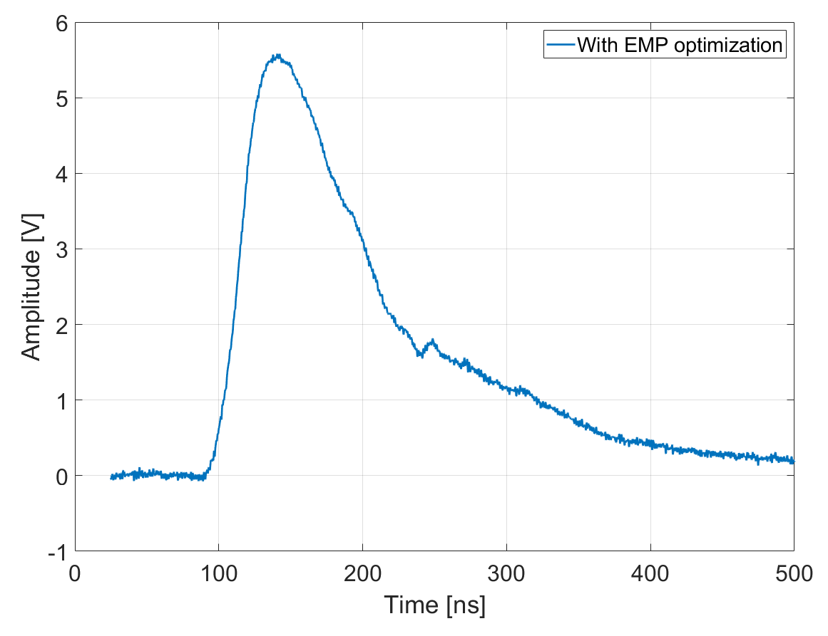
Effectiveness of avoiding EMP coupling
Raw signal: no numerical filtering technique is used!
Where is the photopeak?
Need an higher dynamic range
29/04/2021
M. Salvadori et al., Journal of Instrumentation 15, C10002 (2020)
14

Slide 15
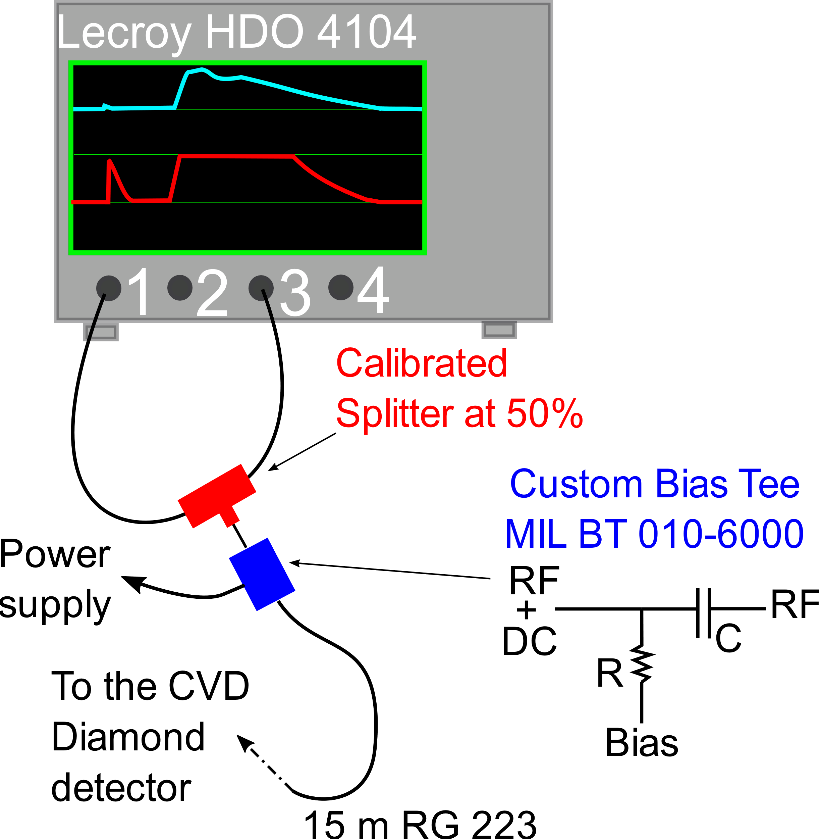
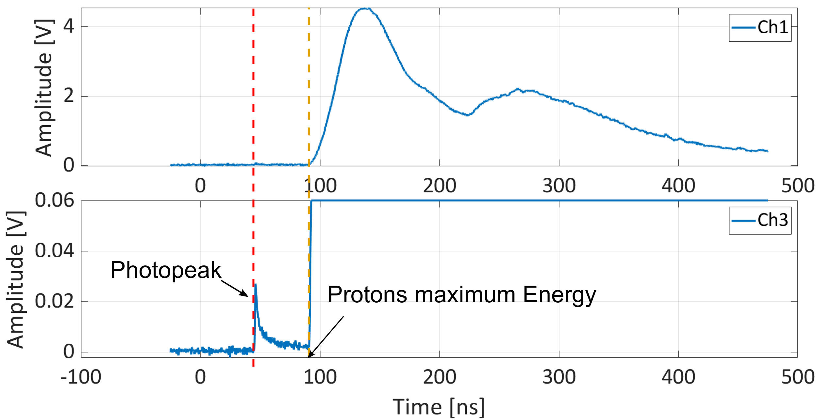
High dynamic range acquisition
M. Salvadori et al. Scientific Reports 11, 3071 (2021)
29/04/2021
15

Slide 16
Towards the spectrum reconstruction
Energy
estimation
Signal Acquisition
Number
estimation
29/04/2021
16

Slide 17
Energy Estimation
The temporal position T₀ of the photopeak provides a reliable signature of the laser-matter interaction instant
$$t_{bang}=T_{0}−\frac{d}{c}$$
Ion energies are computed evaluating the delay between the signal detection time and $t_{bang}$
$v=\frac{d}{t_{i}−t_{bang}}$
T₀
$$E_{i}=\left(γ_{i}−1\right)m_{i}c^{2}$$
It holds assuming that
one type of ion, of known mass,
is detected
M. Salvadori et al. Scientific Reports 11, 3071 (2021)
29/04/2021
17

Slide 18
Towards the spectrum reconstruction
Energy
estimation
Signal Acquisition
Number
estimation
29/04/2021
18

Slide 19
Estimation of the particle number
De-embedding procedure of the signal to retrieve its amplitude at source
Characterization of the detector used for TOF measurements
Particle number estimation from signal amplitude
M. Salvadori et al. Scientific Reports 11, 3071 (2021)
29/04/2021
19

Slide 20
1. De-Embedding Procedure
WHAT WE NEED
WHAT WE HAVE
$𝓢_{𝓓}\left(t\right)=𝓕^{−1}\left[\frac{𝓕\left(V\left(t\right)\right)}{S_{21}\left(f\right)}\right]$
$ℱ$ = Fourier Transform, $𝒮_{𝒟}\left(t\right)$ De-embedded signal
M. Salvadori et al. Scientific Reports 11, 3071 (2021)
17/02/2021
20

Slide 21
2. Diamond detectors characterization
Ionizing radiation
Wide bandgap (5.5 eV)
High charge carrier mobility
High breakdown field
1. Production of free electron-hole pairs ($ε_{g}$ = 13.1 eV). $Q_{i,g}$ ${=N}_{i}\frac{E_{i}q_{e}}{ε_{g}}$
Not sensible to visible and IR light High radiation hardness
Fast time response
Low leakage current
C. Verona et al. , J. Appl. Phys. 118 (2015) 184503,
R. Sussmann CVD diamond for electronic devices and sensors, Wiley and Sons (2009)
29/04/2021
21

Slide 22
2. Diamond detectors characterization
Ionizing radiation
Wide bandgap (5.5 eV)
High charge carrier mobility
High breakdown field
Carriers drift velocity
mobility, Electric field
E
(> 1 MV/m)
$$∝$$
1. Production of free electron-hole pairs ($ε_{g}$ = 13.1 eV). $Q_{i,g}$ ${=N}_{i}\frac{E_{i}q_{e}}{ε_{g}}$
Not sensible to visible and IR light High radiation hardness
Fast time response
Low leakage current
2. Charge collection at the electrodes thanks to the applied electric field
$$Q_{i,c}= N_{i}\frac{E_{i}q_{e}}{ε_{g}CCE(E_{i})}$$
3. Signal Generation according to the collected charge
Charge Collection Efficiency
Two main characterizing parameters: TIME RESPONSE and CHARGE COLLECTION EFFICIENCY
C. Verona et al. , J. Appl. Phys. 118 (2015) 184503,
R. Sussmann CVD diamond for electronic devices and sensors, Wiley and Sons (2009)
29/04/2021
22

Slide 23
2. CVD-DD characterization
50 µm thickness = Protons up to 3 MeV are completely stopped inside their bulk
29/04/2021
23

Slide 24
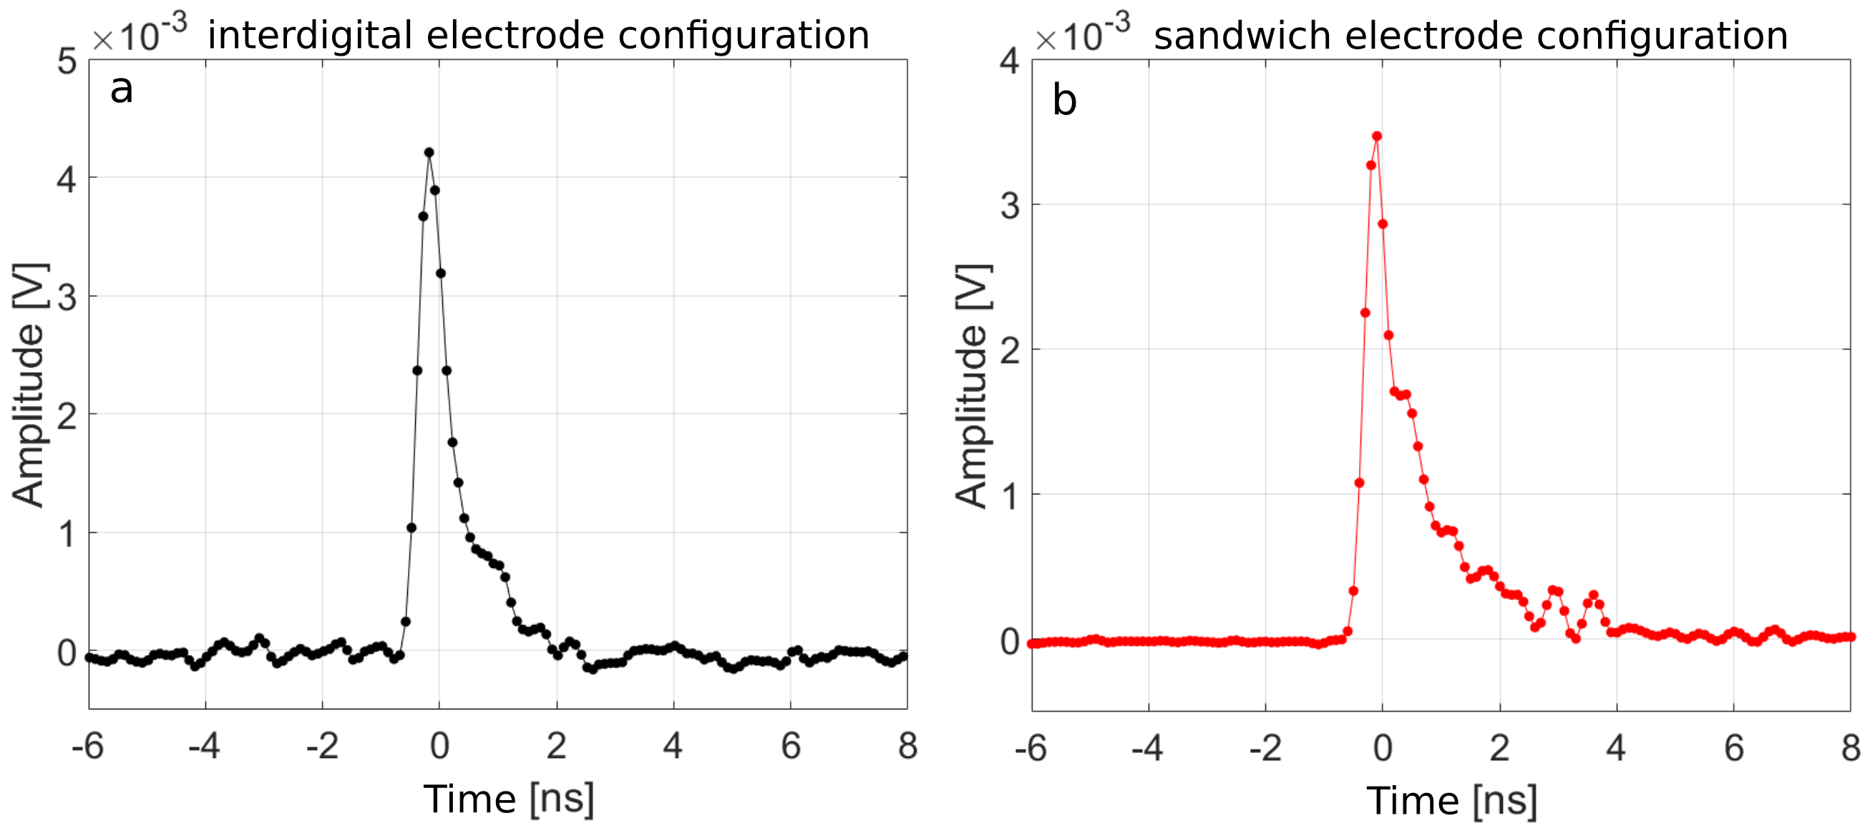
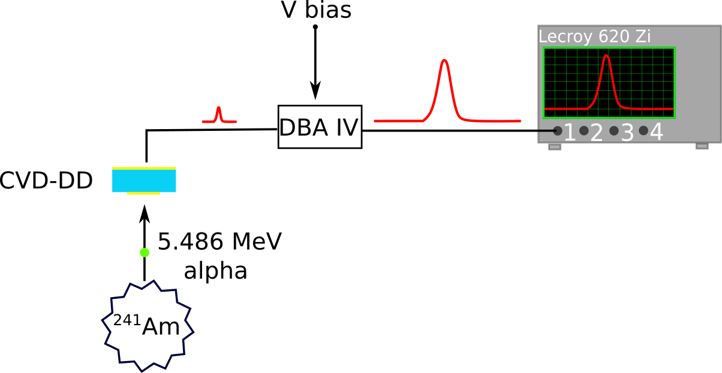
2. CVD-DD characterization : Time Response
FWHM = 520 ps
FWHM = 460 ps
29/04/2021
24

Slide 25
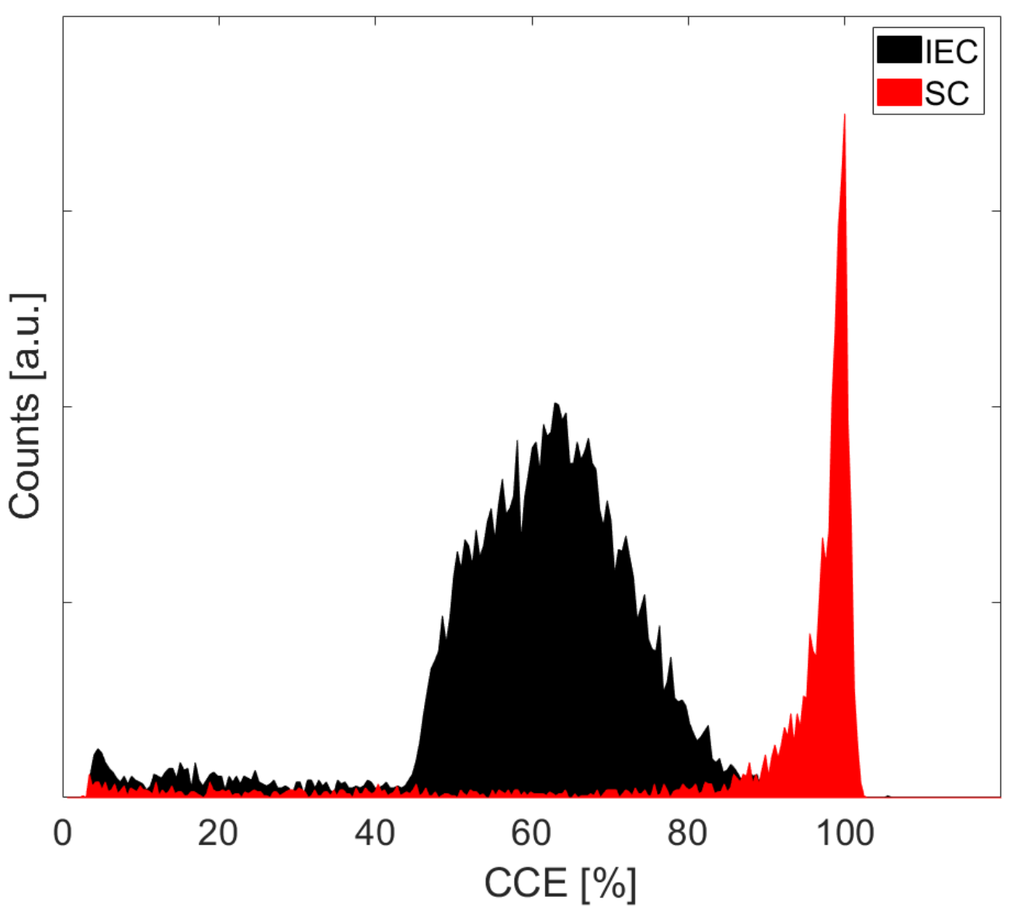
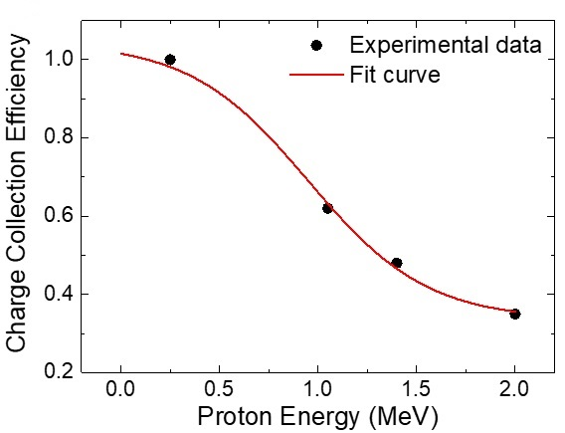
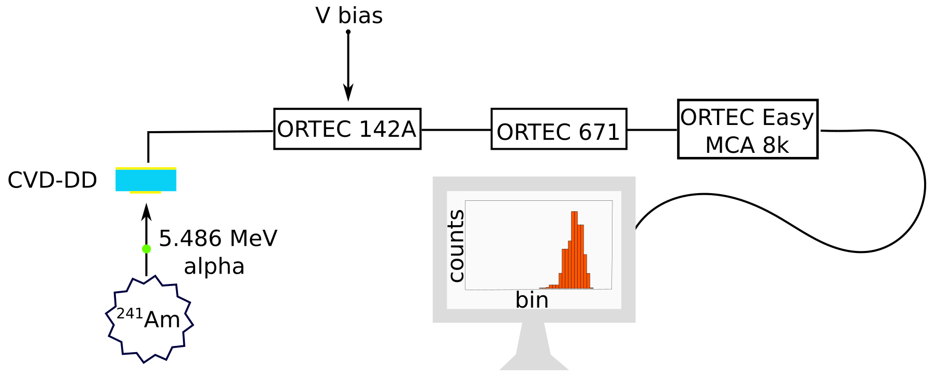
2. CVD-DD characterization : CCE
$Q_{α}= \frac{{E_{α}q}_{e}}{ε_{g}}$ = $\frac{{5.486×{10}^{6}q}_{e}}{13.1}$ ≈ $6.75×{10}^{−14}C=100 \%$
Effect of a thickness-dependent electric field on CCE
29/04/2021
25

Slide 26
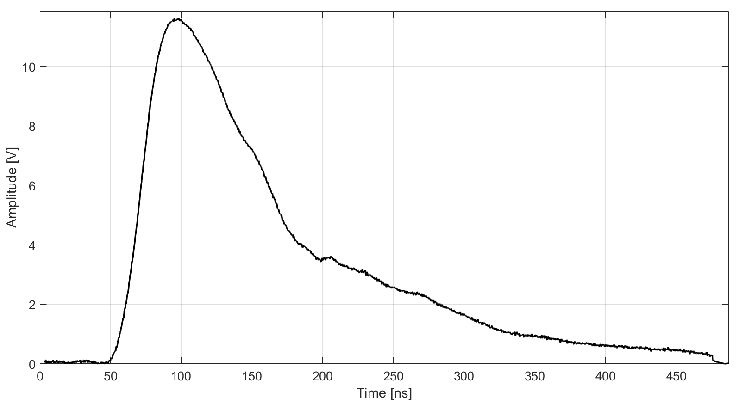
3. Particle number estimation
Numerical integration of the signal to retrieve the collected charge $Q_{i}$
Time step = temporal response of the diagnostic system
t_{i}
8
Time step
$Q_{i}=\frac{1}{R}\int_{t^{i}}^{t^{f}}{𝒮_{𝒟}\left(V\left(t\right)\right)dt}$
$N_{i}= \frac{Q_{i}ε_{g}}{CCE\left(E_{i}\right)E_{i}q_{e}}$
t_{i}
t_{f}
t
$$E_{i}^{f}$$
$$\overline{E_{I}}$$
$$E_{i}^{i}$$
E
M. Salvadori et al. Scientific Reports 11, 3071 (2021)
29/04/2021
26

Slide 27
The final spectrum
Pure proton Contribution
Application of suitable filters
helps to down extend
the region of pure proton contribution
M. Salvadori et al. Scientific Reports 11, 3071 (2021)
29/04/2021
27

Slide 28
Towards the spectrum reconstruction
Energy
estimation
Number
estimation
Signal Acquisition
Experimental Results
29/04/2021
28

Slide 29
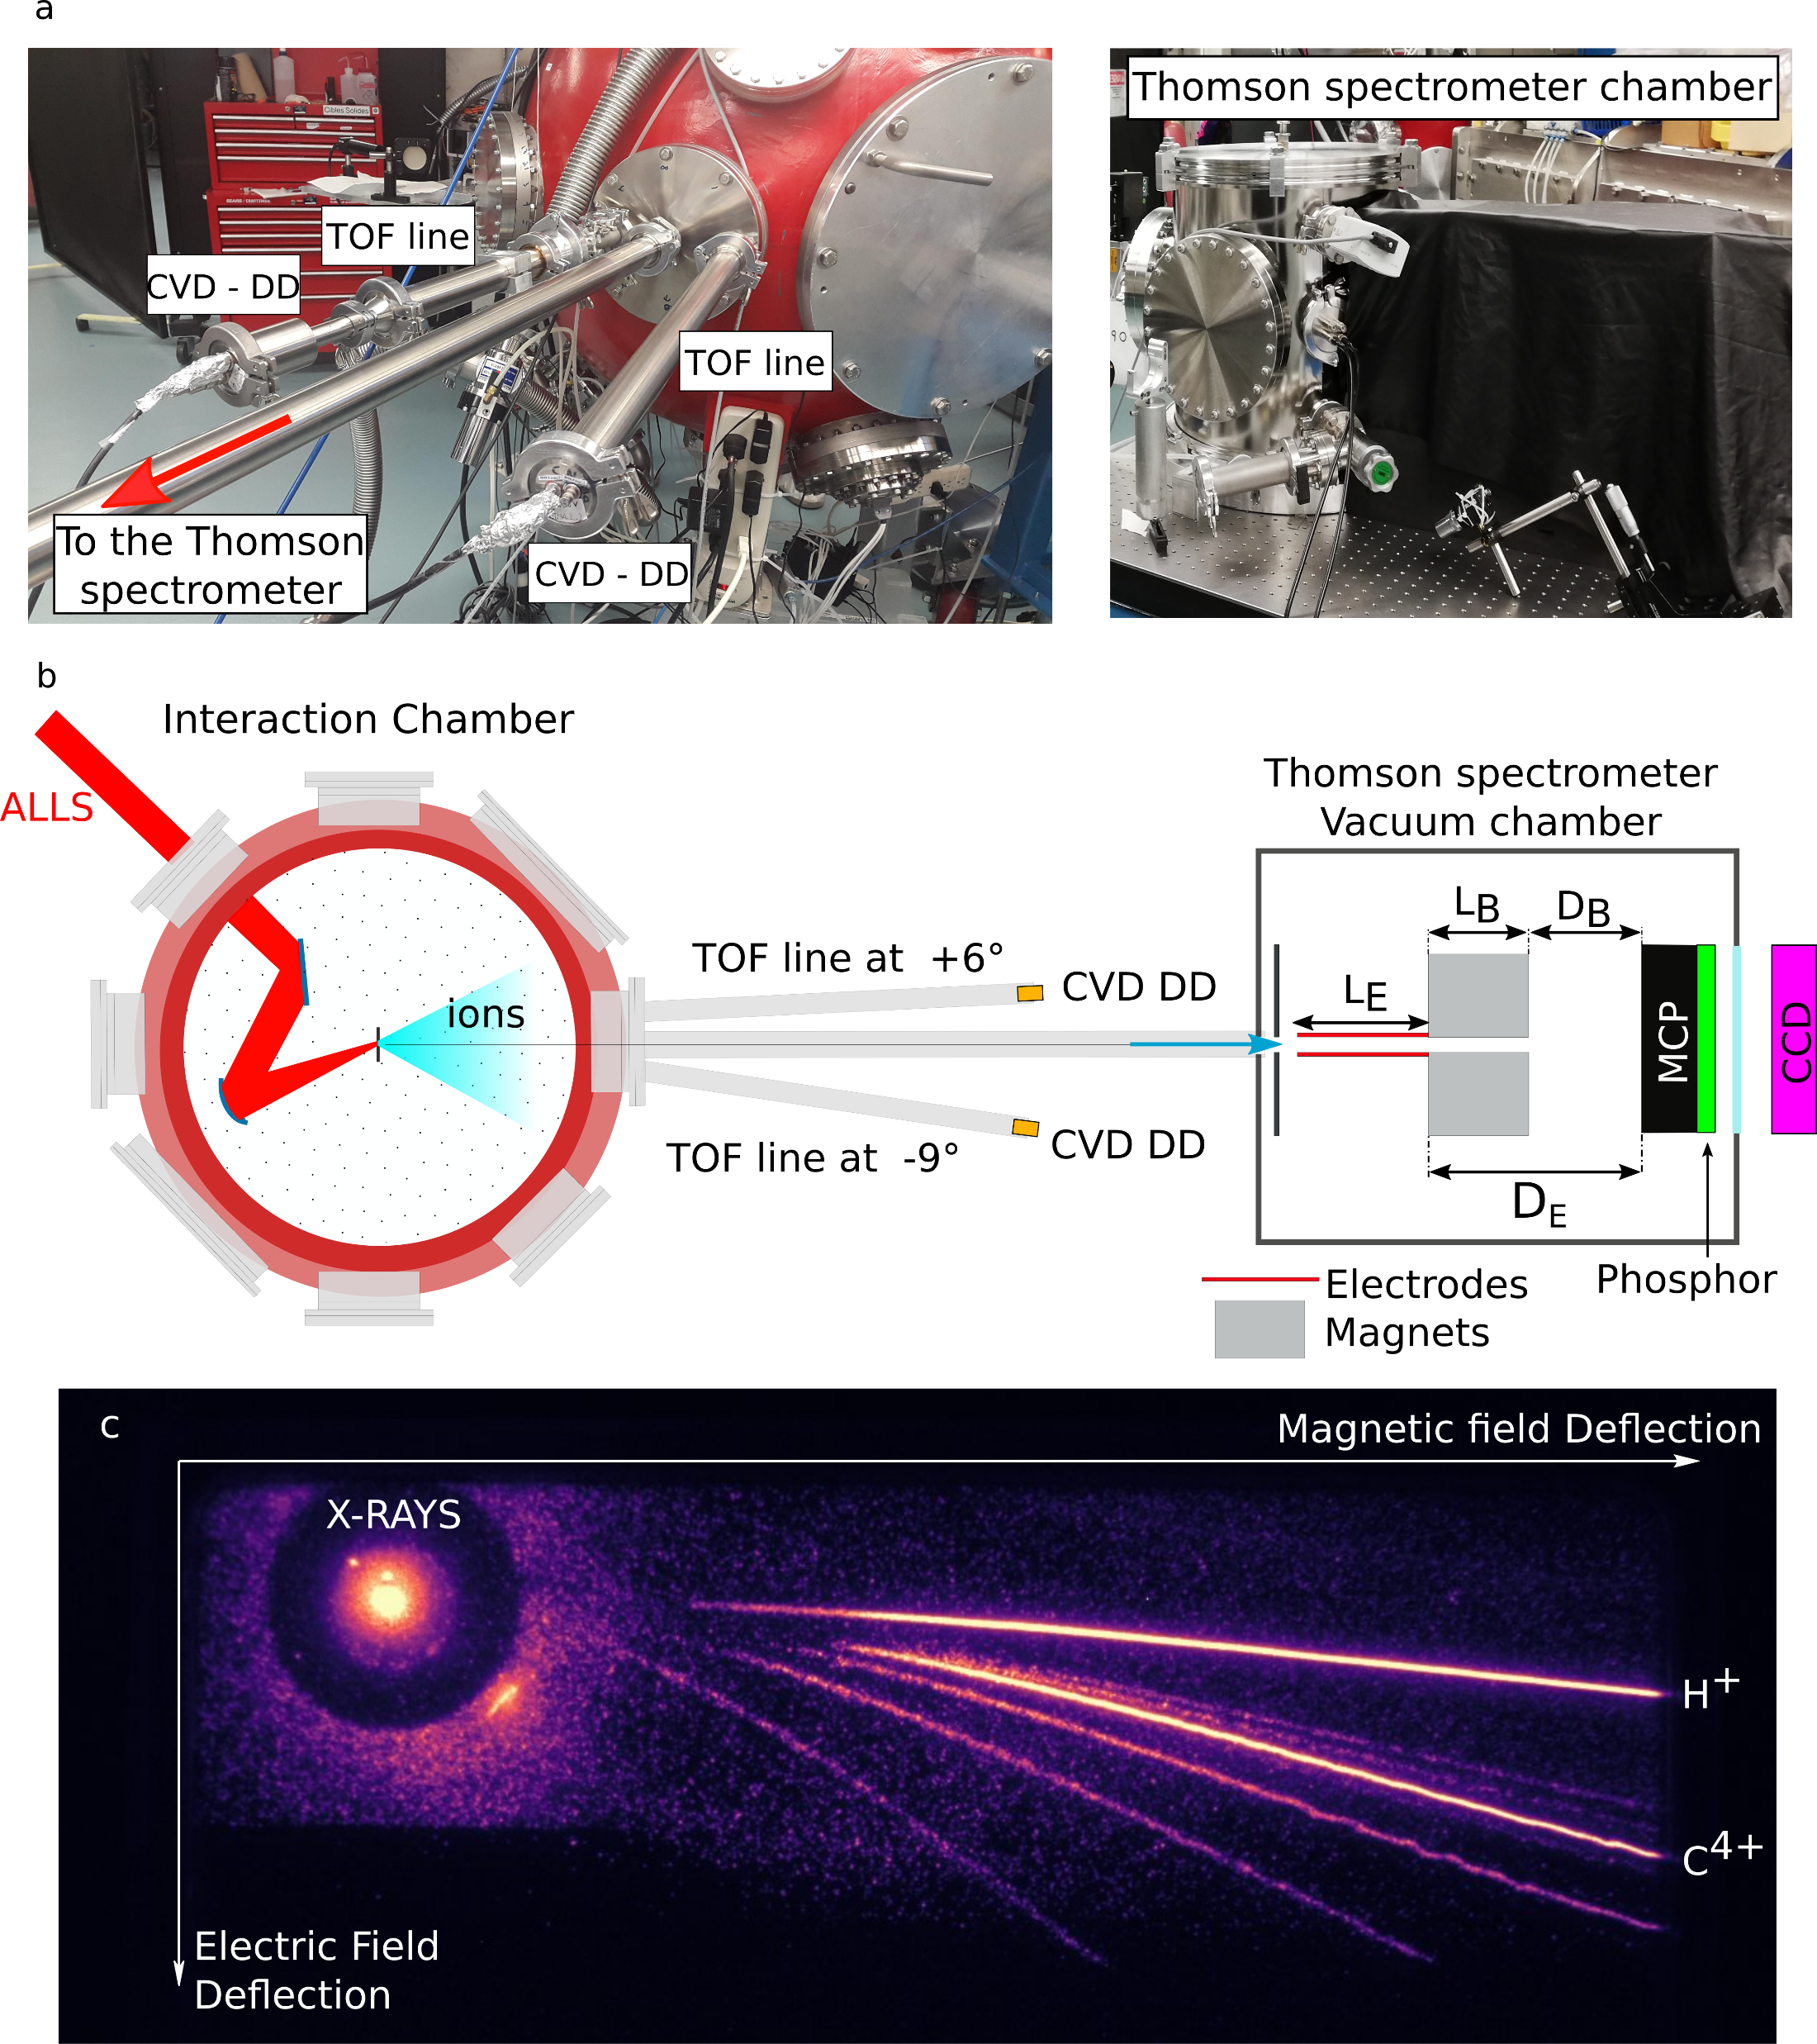
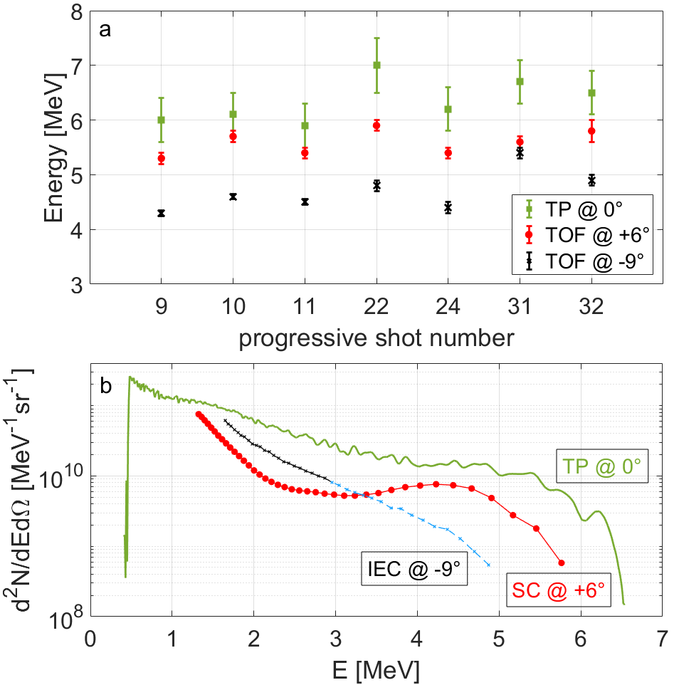
Experimental results : ALLS facility
ALLS
E = 2 J
$I=1.3×{10}^{20}$ W ${cm}^{−2}$
ʎ = 800 nm
τ = 20 fs
Target : 5 µm Copper
S. Vallières, M. Salvadori et al. Review of Scientific Instruments 91, 103303 (2020)
29/04/2021
29

Slide 30
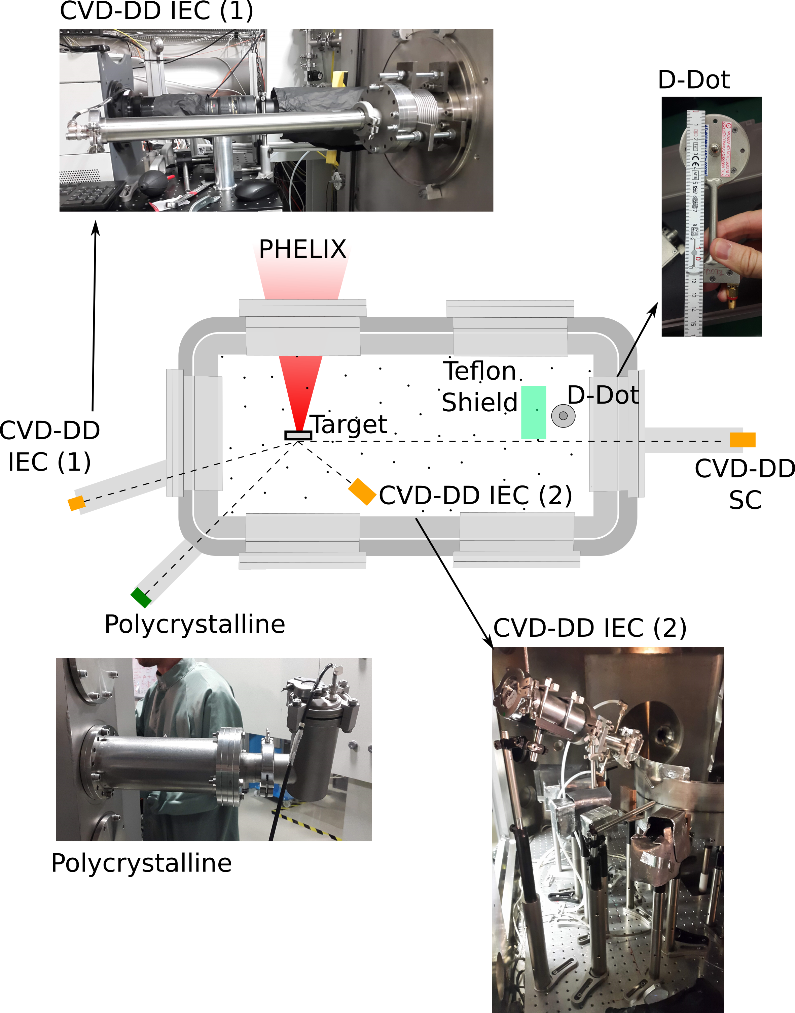
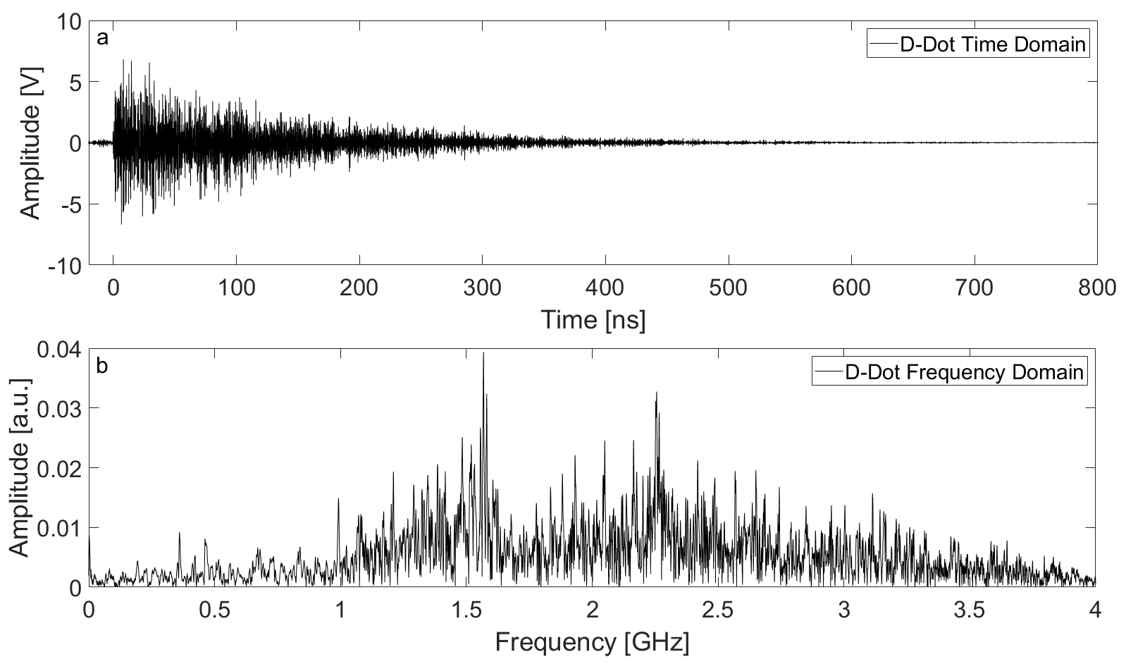
Experimental results : PHELIX facility
10 µm Al filter
PHELIX
E = 88 J
$I=2.5×{10}^{19}$ W ${cm}^{−2}$
τ = 750 fs
Target: 10 µm Titanium
20 µm Al filter
10 µm Al filter
15 × 15 mm² area
Associated estimated electric field at 30 cm: 250 kV/m
FWHM = 3.4 ns
CCE ≈ 30 %
29/04/2021
30

Slide 31
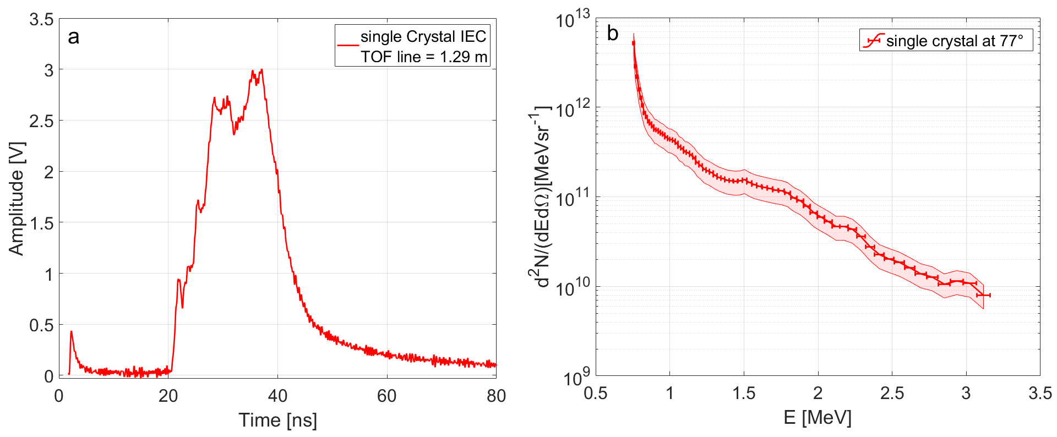
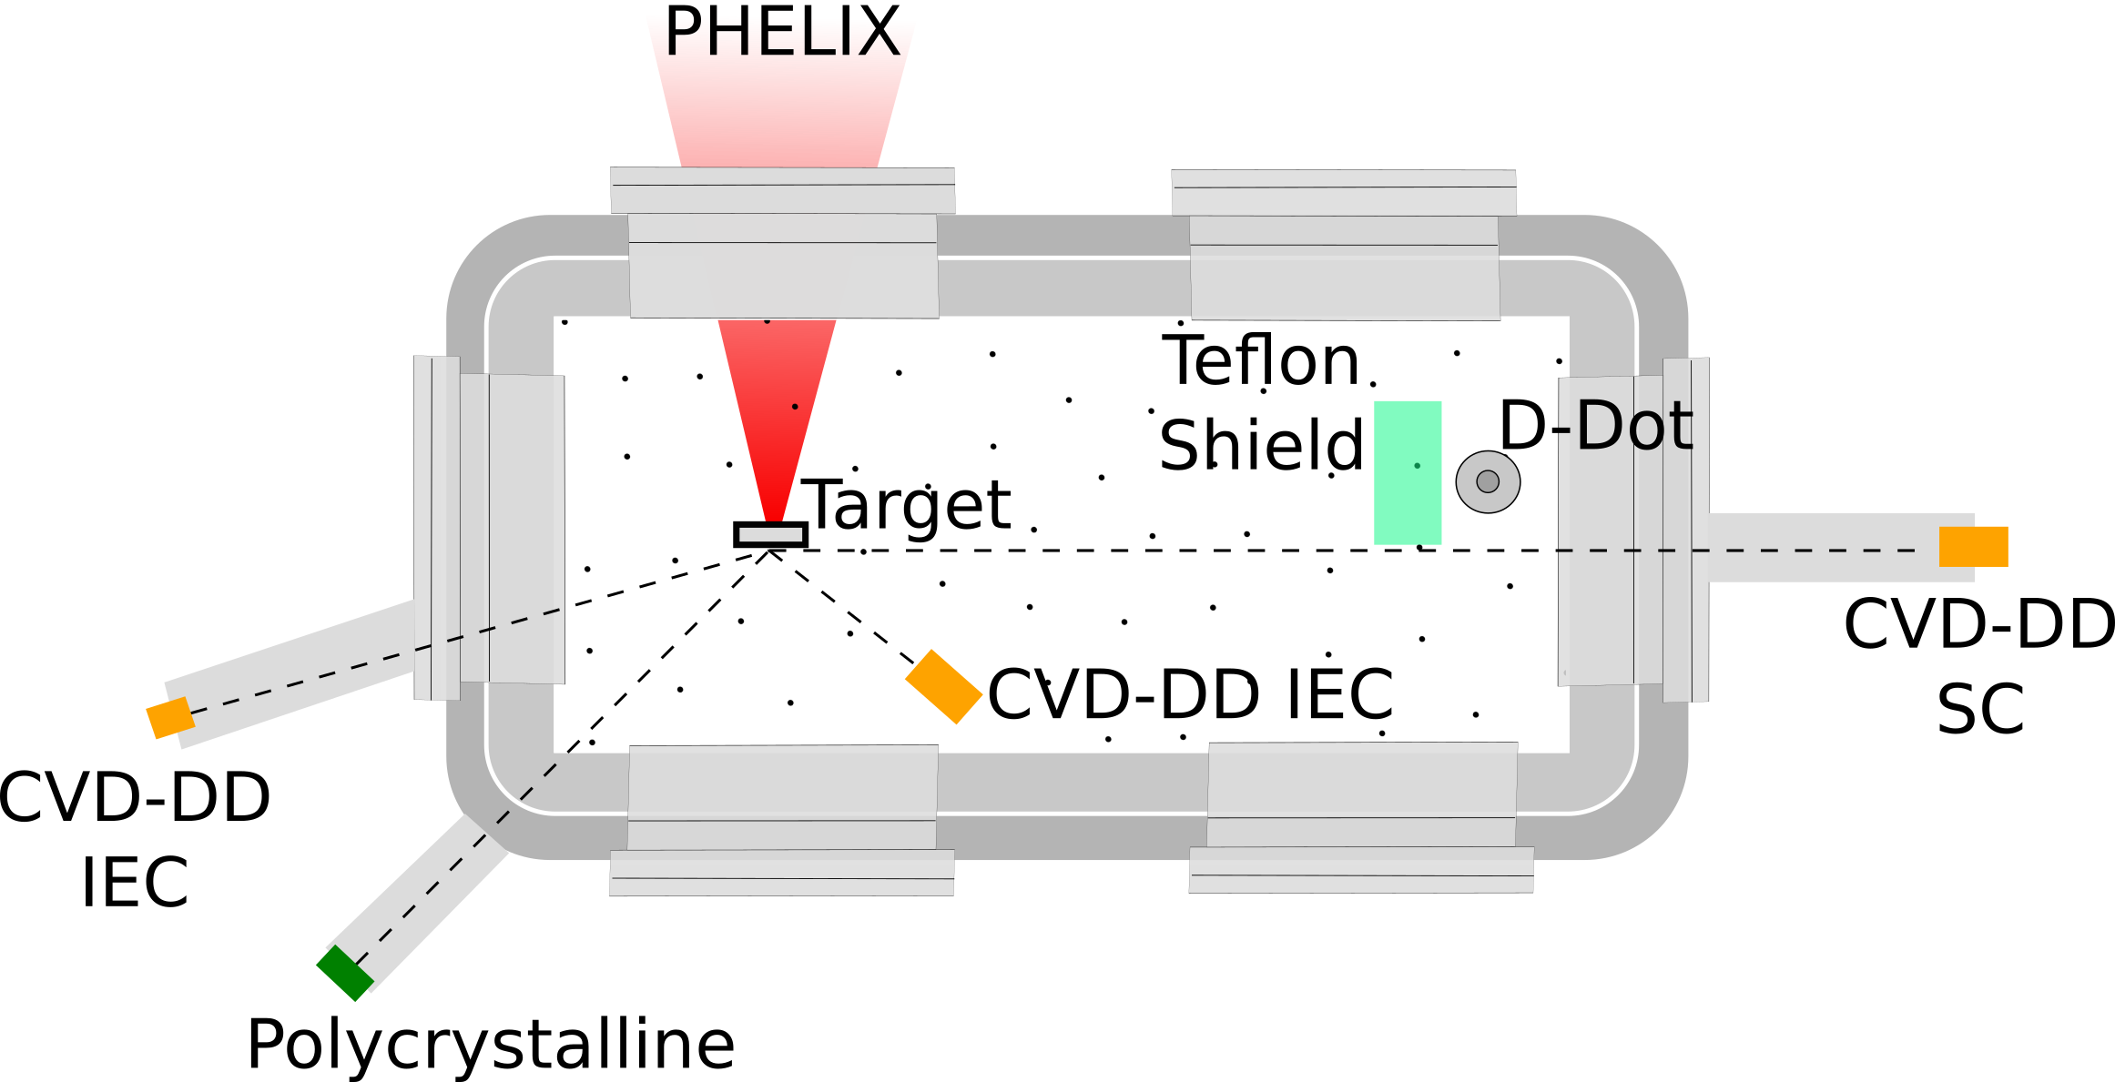
GSI experimental campaign
29/04/2021
31

Slide 32
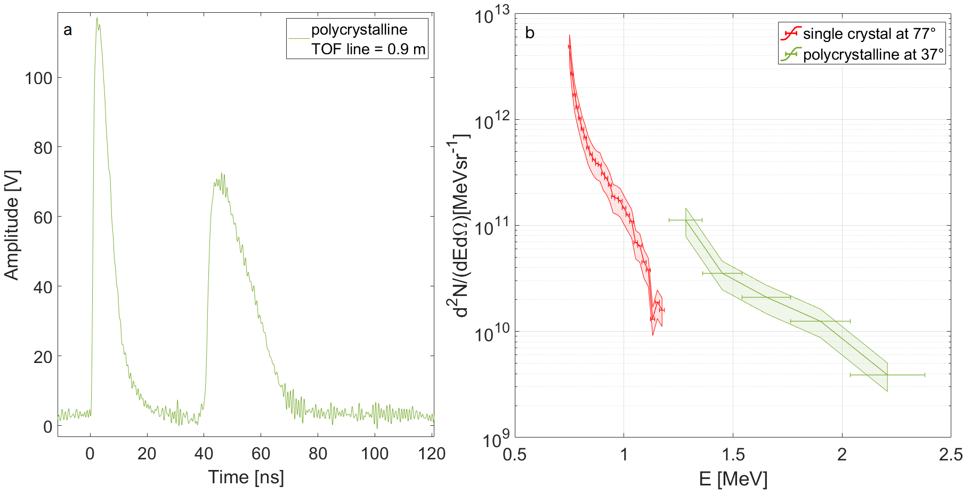
Experimental Validation: GSI experimental campaign
29/04/2021
32

Slide 33
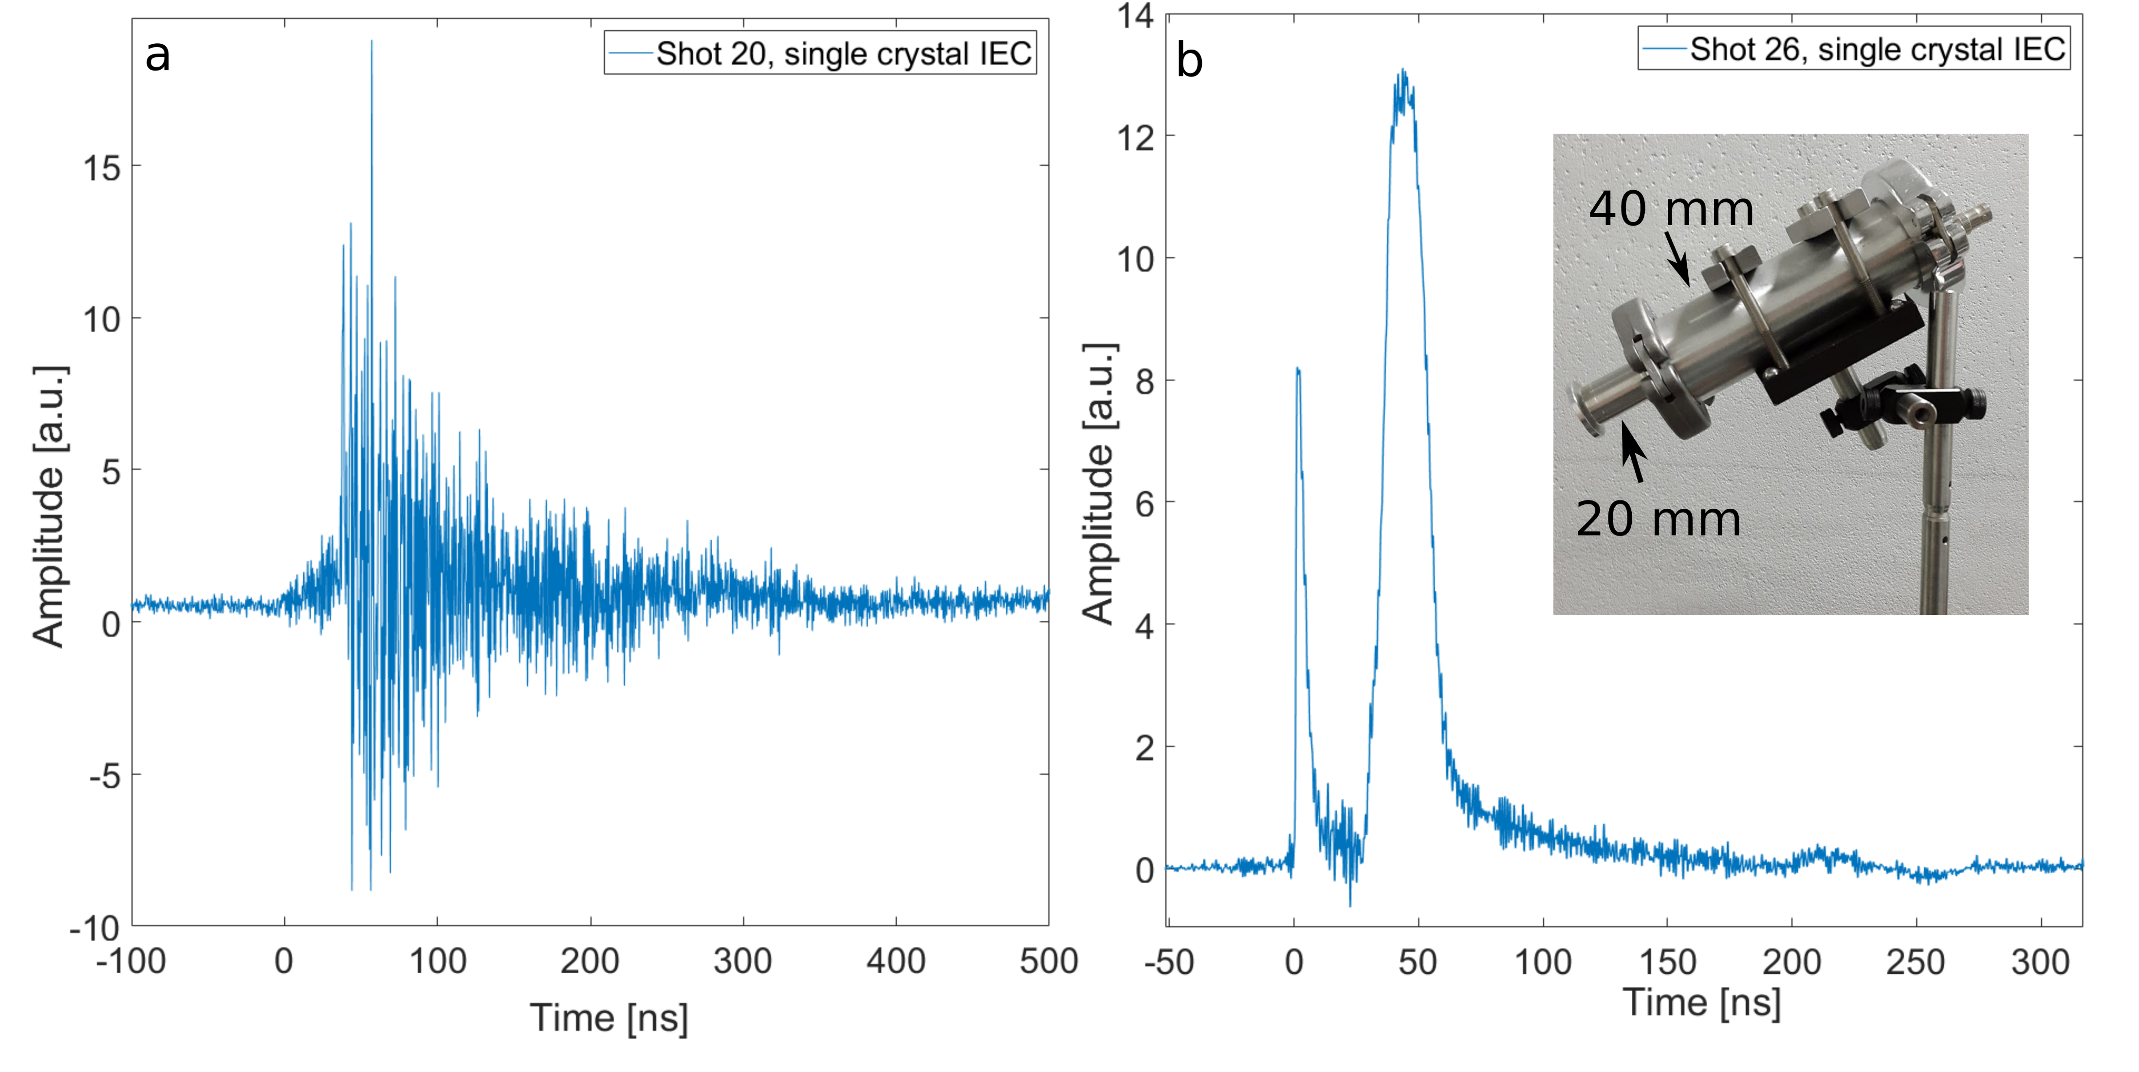
GSI experimental campaign
Detector inside the experimental chamber 60 cm from target
29/04/2021
33

Slide 34
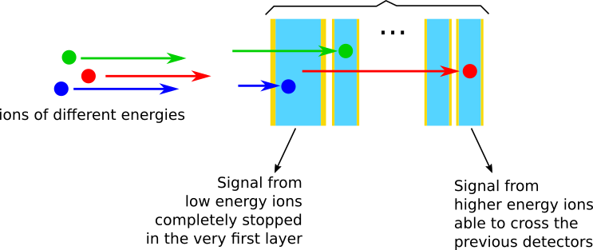
Conclusion and Perspectives: a novel detector design
Now ongoing:
Development of an effective procedure to acquire signals with high signal to noise ratio even in highly EMP polluted environments
A layered diamond structure enables:
High sensitivity for a wide range of ion energies
High energy resolution
High radiation hardness
Characterization of diamond detectors exploiting α particles produced by the radioactive decay of Americium
n
Spectra reconstruction algorithm
Successful employment of the advanced TOF technique in various experimental campaigns exploiting different laser systems (ABC, ECLIPSE, FLAME, LLC, ALLS, PHELIX)
Calibration of diamond detectors through the exposition to proton beams of different fluxes and energies
M. Salvadori et al. Scientific Reports 11, 3071 (2021)
17/02/2021
34

Slide 35
Publications
M. Salvadori, P.L. Andreoli, M. Cipriani, F. Consoli, G. Cristofari, R. De Angelis, G. di Giorgio, D. Giulietti, F. Ingenito, S. Y. Gus’kov, A. A Rupasov, “Laser Irradiated Foam Targets: Absorption and Radiative Properties“, EPJ Web of Conferences 167 (2018)
M. Salvadori, P.L. Andreoli, S. Bollanti, F. Bombarda, M. Cipriani, F. Consoli, G. Cristofari, R. De Angelis, G. Di Giorgio, F. Flora, D. Giulietti, L. Mezi, M. Migliorati, M.A. Alkhimova, S. Pikuz, T. Pikuz, and R. Kodama. “A laser-produced plasma X-ray source for contact microscopy” Journal of Instrumentation 14, C03007 (2019)
M. Salvadori, F. Consoli, C. Verona, M. Cipriani, P. L. Andreoli, G. Cristofari, R. De Angelis, G. Di Giorgio, D. Giulietti, M.P. Anania, F. Bisesto, G. Costa, M. Ferrario, M. Galletti, R. Pompili, A. Zigler, P. Antici, M. Migliorati “Assessment of sensitivity improvement for Time-Of-Flight schemes in experiments with high intensity lasers” Journal of Instrumentation 15, C10002 (2020)
M. Salvadori, F. Consoli, M. Cipriani, M. P. Anania, P. L. Andreoli, P. Antici, F. Bisesto, G. Costa, G. Cristofari, R. De Angelis, G. Di Giorgio, M. Ferrario, M. Galletti, D. Giulietti, M. Migliorati, R. Pompili, C. Verona and A. Zigler, “Accurate spectra for high energy ions by advanced time-of-flight diamond-detector schemes in experiment with high energy and intensity lasers” Scientific Reports 11, 3071 (2021)
S. Vallières, M. Salvadori, P. Puyuelo-Valdes, S. Payeur, S. Formaux, F. Consoli, C. Verona, E. d’Humières, M. Chicoine, S. Roorda, F. Schiettekatte, P. Antici. “Thomson Parabola and Time-of-Flight Detector Cross-Calibration Methodology on the ALLS 100 TW Laser-Driven Ion Acceleration Beamline” review of Scientific Instruments 91, 103303 (2020)
S. Vallières, M. Salvadori , A. Permogorov, G. Cantono, K. Svendsen, Z. Chen, S. Sun, F. Consoli, E. D’Humières, C.-G. Wahlstrom, P. Antici. “Enhanced laser-driven proton acceleration using nanowire targets” Scientific Reports 11, 2226 (2021)
C. Verona, M. Marinelli, S. Palomba, G. Verona-Rinati, M. Salvadori, F. Consoli, M. Cipriani, P. Antici, M. Migliorati, F. Bisesto, R. Pompili. “Comparison of single crystal diamond TOF detectors in planar and transverse configuration” Journal of Instrumentation 15, C09066 (2020)
Publications
S. Vallières, C. Bienvenue, P. Puyuelo-Valdes, M. Salvadori, E. d’Humières and P. Antici. “Low-Energy Proton Calibration and Energy-Dependence Linearization of EBT-XD Radiochromic Films” Review of Scientific Instruments 90 (8) (2019)
S. Vallières, P. Puyuelo-Valdes, M. Salvadori, C. Bienvenue, S. Payeur, E. d’Humières, P. Antici. “The laser-driven ion acceleration beamline on the ALLS 200 TW for testing nanowire targets” Proc. SPIE 11037, Laser Acceleration of Electrons, Protons, and Ions V, 1103703 (2019)
F. Bisesto, M. Galletti, M.P. Anania, M. Ferrario, R. Pompili, M. Botton, A. Zigler, F. Consoli, M. Salvadori, P. Andreoli and C. Verona. “Single-shot and time-resolved detection from high-intensity laser-solid matter interaction at SPARC_LAB” High Power Laser Science and Engineering 7 (2019)
F. Bisesto, M. Galletti, M. P. Anania, G. Costa, M. Ferrario, R. Pompili, A. Poye, F. Consoli, M. Salvadori, M. Cipriani, C. Verona, A. Zigler. “Ultrafast electron and proton bunches correlation in laser-solid matter experiments” Optics Letters 45, 5575 (2020)
F. Bisesto, M. Galletti, M. P. Anania, G. Costa, M. Ferrario, R. Pompili, A. Zigler, F. Consoli, M. Cipriani, M. Salvadori, C. Verona. “Simultaneous observation of ultrafast electron and proton beams in TNSA” High Power Laser Science and Engineering 8, E23 (2020)
G. Di Giorgio, F. Consoli, R. De Angelis, P. Andreoli, M. Cipriani, G. Cristofari, A. Bonasera, M. Salvadori, J. Sura. “Development of advanced Thomson spectrometers for nuclear fusion experiments initiated by laser” Journal of Instrumentation 15, C10013 (2020)
F. Consoli, P. L. Andreoli, M. Cipriani, G. Cristofari, R. De Angelis, G. Di Giorgio, L. Duvillaret, J. Krasa, D. Neely, M. Salvadori, M. Scisciò, R. A. Smith, V. T. Tikhonchuk. “Sources and space-time distribution of the electromagnetic pulses in experiments on inertial confinement fusion and laser-plasma acceleration” Phylosophical Transaction of the Royal Society A Mathematical Physical and Engineering Sciences 379, 20200022 (2021)
F. Consoli, R. De Angelis, P. L. Andreoli, A. Bonasera, M. Cipriani, G. Cristofari, G. Di Giorgio, D. Giulietti, M. Salvadori. “Diagnostic Methodologies of laser-initiated 11B(p,a)2a fusion reactions” Frontiers in Physics 8, 561492 (2020)
17/02/2021
35

Slide 36
Oral presentations
“Laser Irradiated Foam Targets: Absorption and Radiative Properties“ Plasma Physics by Laser and Application, Messina July 2017
“Advanced methods for the quantitative detection of Laser-Plasma accelerated MeV protons” Plasma Physics by Laser and Applications, Pisa October 2019
“Effective diagnostics of ions accelerated in laser-matter experiments with intense EMPs” EMP satellite workshop, Prague, Czech Republic. March 2021 (held online)
“Time-of-Flight methodologies with large-area diamond detectors for ion characterization in laser-driven experiments” 4th international symposium on High Power Laser Science and Engineering, Suzhou, April 2021 (off-site contribution)
Poster presentations & Awards
4/10/2018 “Characterization of a X-Ray source for contact-microscopy applications obtained from laser-produced plasma” 5th International Conference Frontier in Diagnostics Technologies, Frascati, Italy. Winner of the Best Poster Award.
8/5/2019 “Determination of accurate spectra for laser-accelerated MeV ions by CVD diamond-detector setups optimized for experiments subject to intense EMPs” 3rd European Conference on Plasma Diagnostics, Lisbon, Portugal. Winner of the Student Poster Award.
23-24 /3/2021 “Advanced Time-Of-Flight methodologies for real time characterization of multi-MeV ions accelerated by high energy lasers” 16th Direct Drive and Fast Ignition workshop, Prague, Czech Republic.
Summer schools
January 2018, Archamps: Attendance at JUAS “The science of particle accelerators”
June 2018, Kudowa: Attendance at Kudowa summer school “Toward Fusion Energy”
September 2018, CLPU Salamanca: Attendance at LaPlaSS “Diagnostic Techniques for Laser-Plasma Experiments”
17/02/2021
36

Slide 37
Thank you for your attention
Any Questions?

Slide 38
Back Up slides

Slide 39
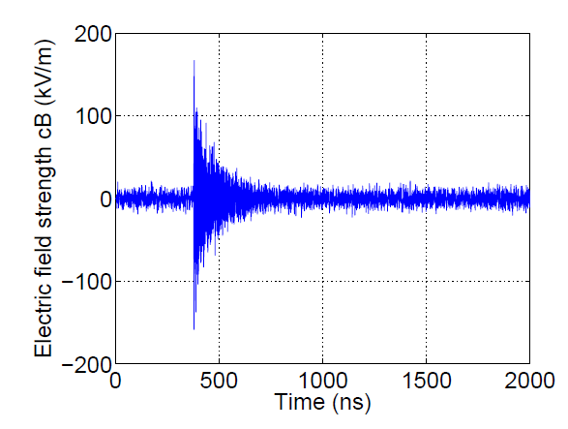
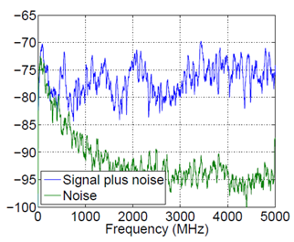
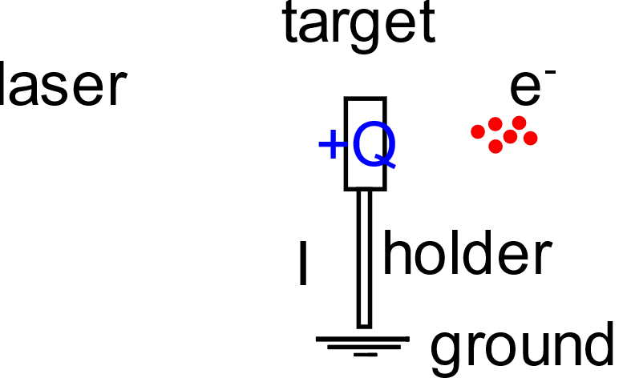
The EMPs
Temporal extension: hundreds of ns
Intensity: hundreds of kV/m
ESD [a.u.]
Broadband frequency range
Spectrum defined by the geometry of the target holder
Intensity related to the amount of generated charge
Electromagnetic Pulses (EMPs) can be destructive for any electronic device
C. G. Brown et al., Journal pf Physics conference series 244 (2010) 032001

Slide 40
Detrimental effect of EMPs on TOF signals: an example
FLAME
E = 2.5 J
$I= 1.7×{10}^{19}$ W ${cm}^{−2}$
17/02/2021
40

Slide 41
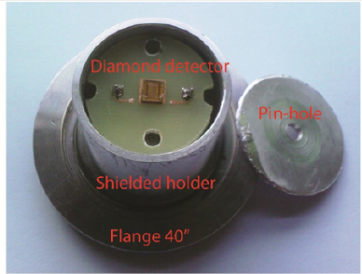
Single crystal CVD diamond detector
The Amplitude of the generated signal will be proportional to the amount of charges generated inside the detector, which in turn is related to the impinging particle Energy:
$$Q_{i,g}= N_{i}\frac{E_{i}q_{e}}{ε_{g}}$$
$${ N}_{i}= \frac{ε_{g}Q_{i,g}}{E_{i}q_{e}}$$
According to the detector characteristics, only a certain amount of the produced charge is going to be effectively collected, this effect is taken into account with the charge collection efficiency CCE. The number of ions generating the signal can be written as:
$$N_{i}= \frac{Q_{i}ε_{g}}{CCE\left(E_{i}\right)E_{i}q_{e}}$$
Wide bandgap (5.5 eV)
High charge carrier mobility
High breakdown field
Diamond detector
Pin-hole
Not sensible to visible and IR light High radiation hardness
Fast time response
Low leakage current
Shielded holder
Flange 40
Charged particles passing through the detector deposit their energy into the material creating free electron-hole pairs
($ε_{g}$ = 13.1 eV).
Voltage applied to the electrodes of the detector allows for charges collection. The Voltage Amplitude is chosen such to have an electric field E > 1 MV/m in order to operate in electron holes pairs velocity saturation regime.
C. Verona et al. , J. Appl. Phys. 118 (2015) 184503
29/04/2021
41

Slide 42
Spectra reconstruction
Example:
FWHM = 0.8 ns
2.31 ± 0.04 MeV
Roughly 2%
FWHM = 3.2 ns
2.7 ± 0.2 MeV
Roughly 7%
0,8 ns
$dN_{i}=\frac{dQ_{i}}{Q_{α}}\frac{E_{α}}{\overline{E_{I}}}$
$dQ_{i}=\frac{1}{R}\int_{t^{i}}^{t^{f}}{𝒮_{𝒟}\left(V\left(t\right)\right)dt}$
Error on Energy
$$\frac{ΔE_{i}}{E_{i}}=\frac{m_{i}c^{2}}{E_{i}}\left(\frac{cΔt}{d}\right){\left[{\left(\frac{E_{i}}{mc^{2}}+1\right)}^{2}−1\right]}^{3/2}$$
$E_{i}=\left(γ−1\right)m_{i}c^{2}$.
Error on Number
$\frac{ΔdN_{i}}{dN_{i}}=\frac{N_{i}\left(E_{i}^{f}\right)−N_{i}\left(E_{i}^{s}\right)}{N_{i}}$
Few %
$γ$ = Relativistic parameter
$m_{i}$ = Ion rest mass = error on time
$\overline{E_{I}}$ = $\frac{1}{2} (E_{i}^{f}−$ $E_{i}^{i}$)
$Δt$ = error on time measurement
$d$ = TOF line length
16/10/2019

Slide 43
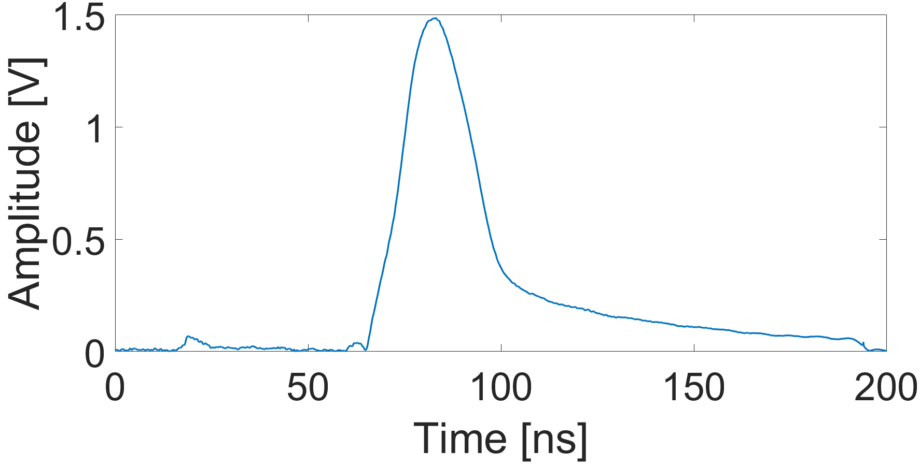
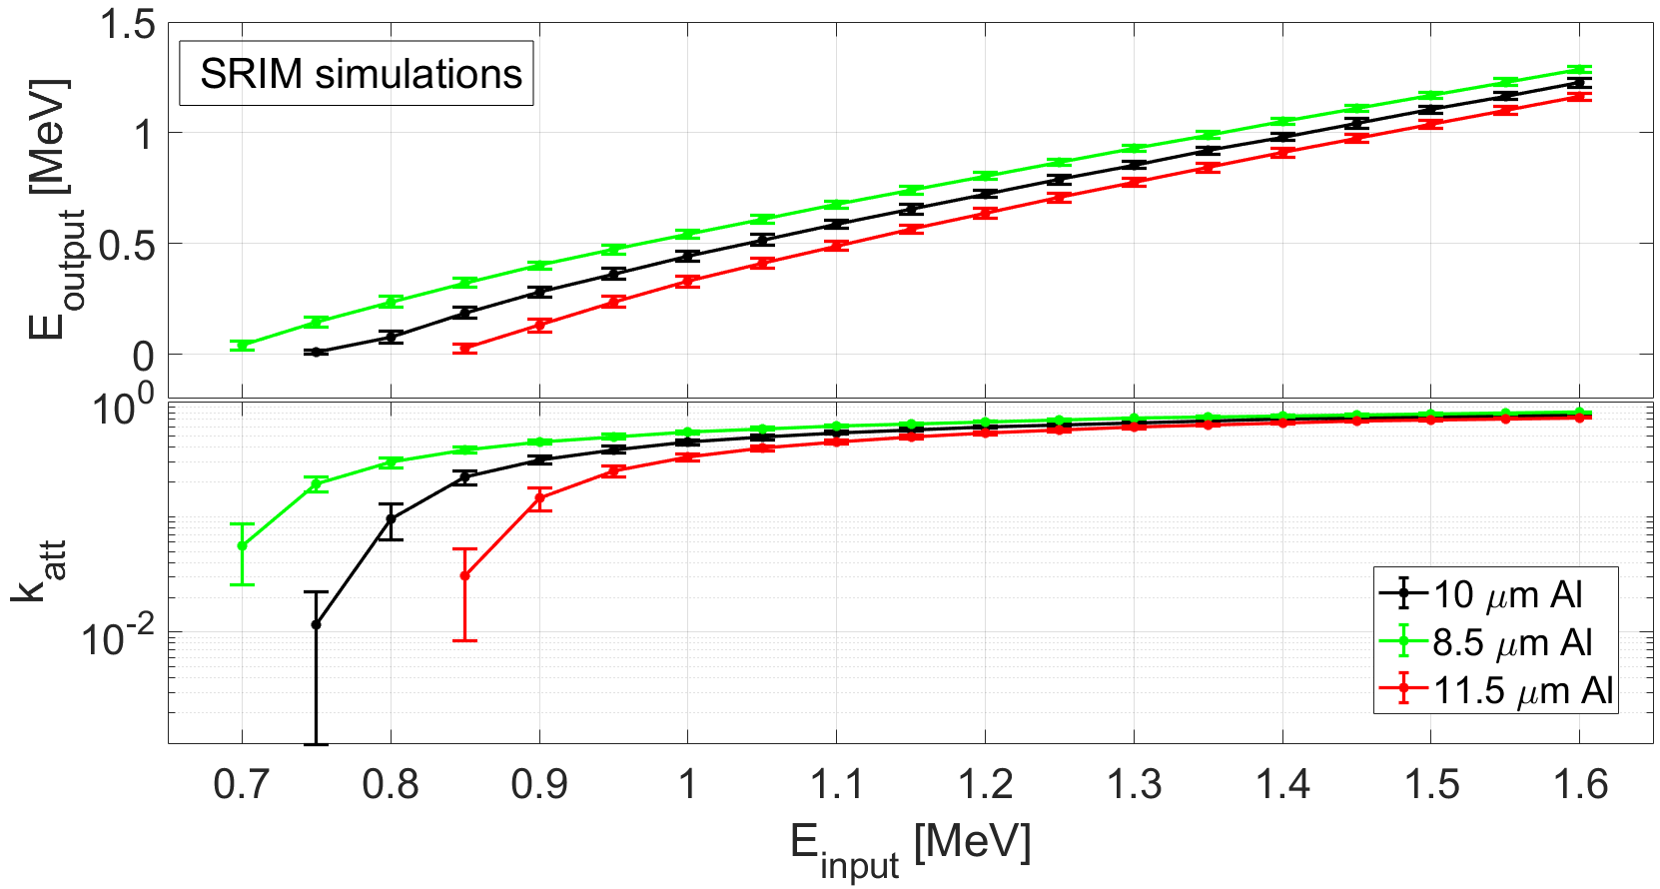
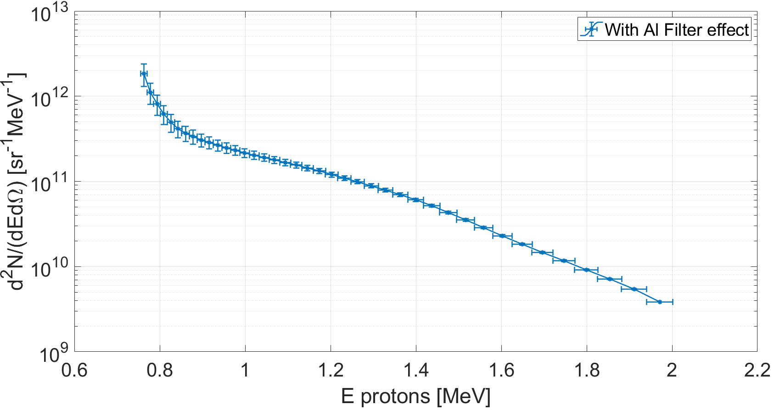
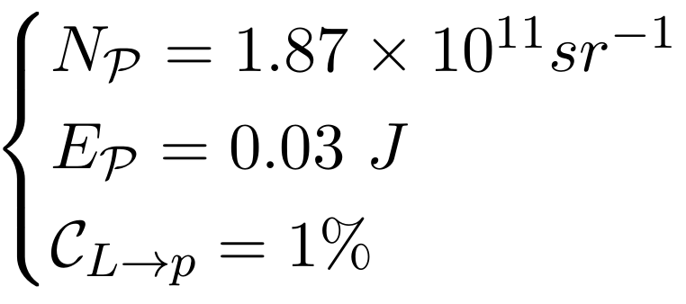
Spectra reconstruction
Al filter cut
Al filter cut
According to the performed SRIM simulations, (10±1.5) µm aluminium filter stops protons up to 750 keV and heavier ions.
SHOT #5
E_{L} on Target = 2.65 J
16/10/2019

Slide 44
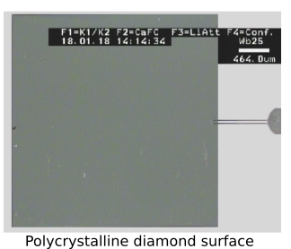
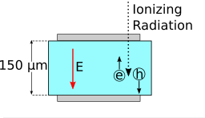
Polycristalline diamond detector
Type: IIa-Electronic grade
15 mm
Polycristyalline structure:
Allow to have large area detectors
CCE lower than single crystal structures
Lower temporal response than single crystal structures
Wide active surface:
Enhanced sensitivity
More susceptible to direct EMP coupling
15 mm
150 µm thicnkess:
Suitable for protons up to 6 MeV
For higher energies a correction factor must be introduced
C. Verona et al. , J. Appl. Phys. 118 (2015) 184503

Slide 45
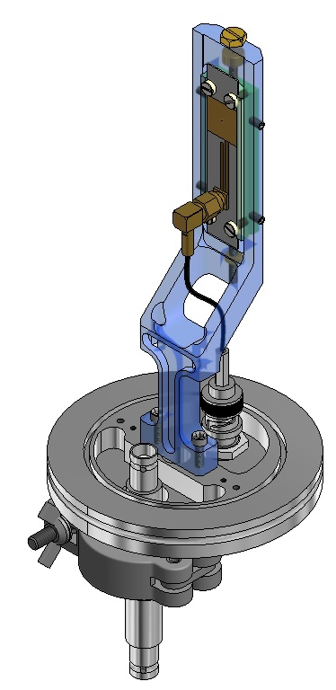
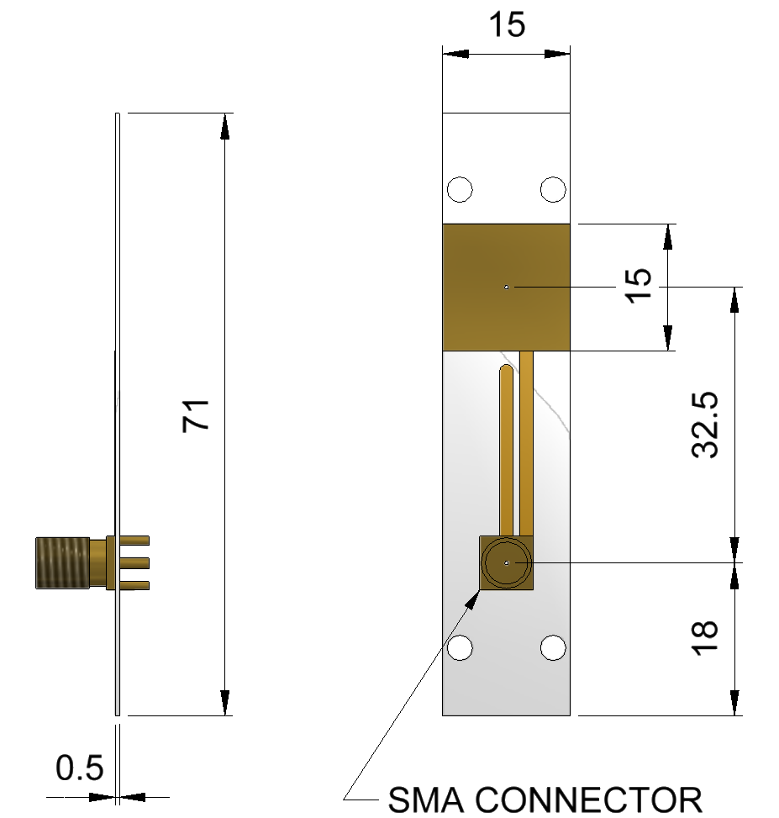
Polycristalline diamond detector
15 mm
15 mm
C. Verona et al. , J. Appl. Phys. 118 (2015) 184503

Slide 46
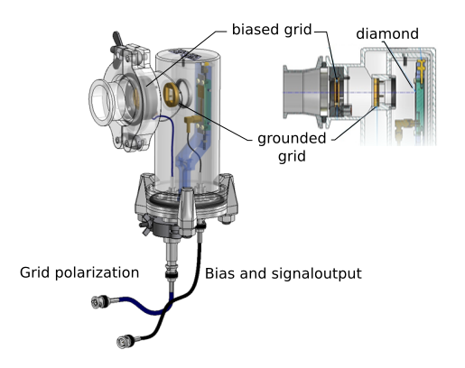
Polycristalline diamond detector
Mounting of the detector
1. Stainless steel case for proper EMP shielding
2. Electrical connection optimized to cope with EMPs
3. Possibility to place a filter to cut heavier ion contribution
4. Biased grid to deflect electrons
C. Verona et al. , J. Appl. Phys. 118 (2015) 184503

Slide 47
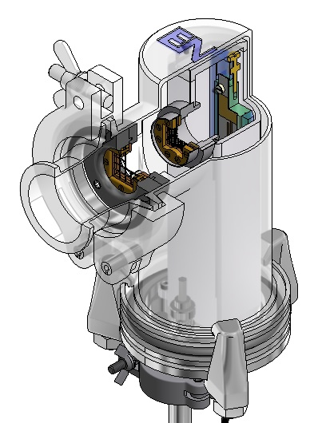
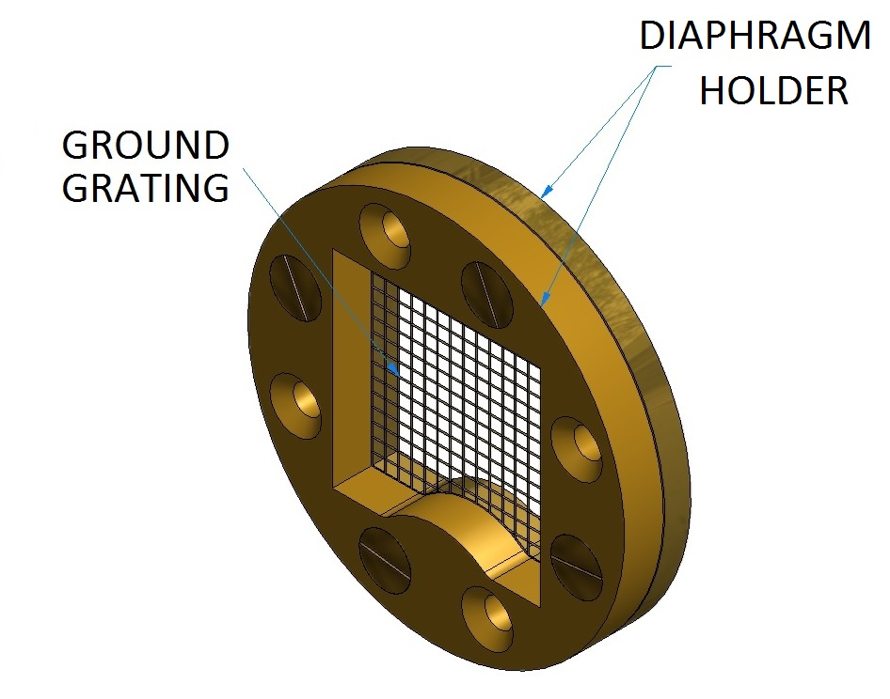
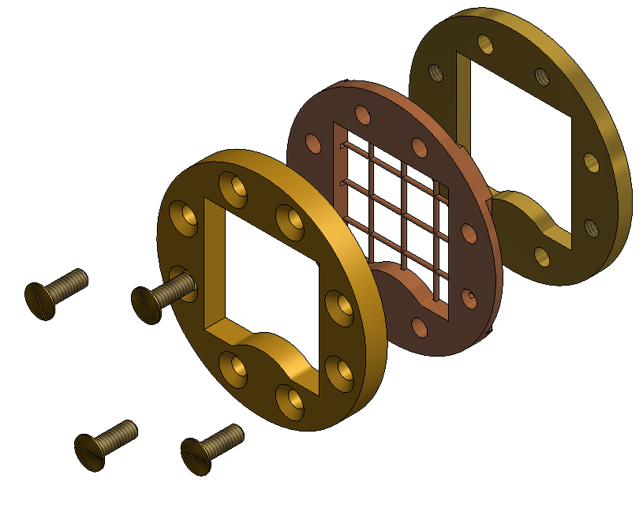
Polycristalline diamond detector
Two grids separated by 40 mm
The first can be biased the second grounded
They provide a static electric field separating the electric component from the ionic one
4. Biased grid to deflect electrons
C. Verona et al. , J. Appl. Phys. 118 (2015) 184503

Slide 48
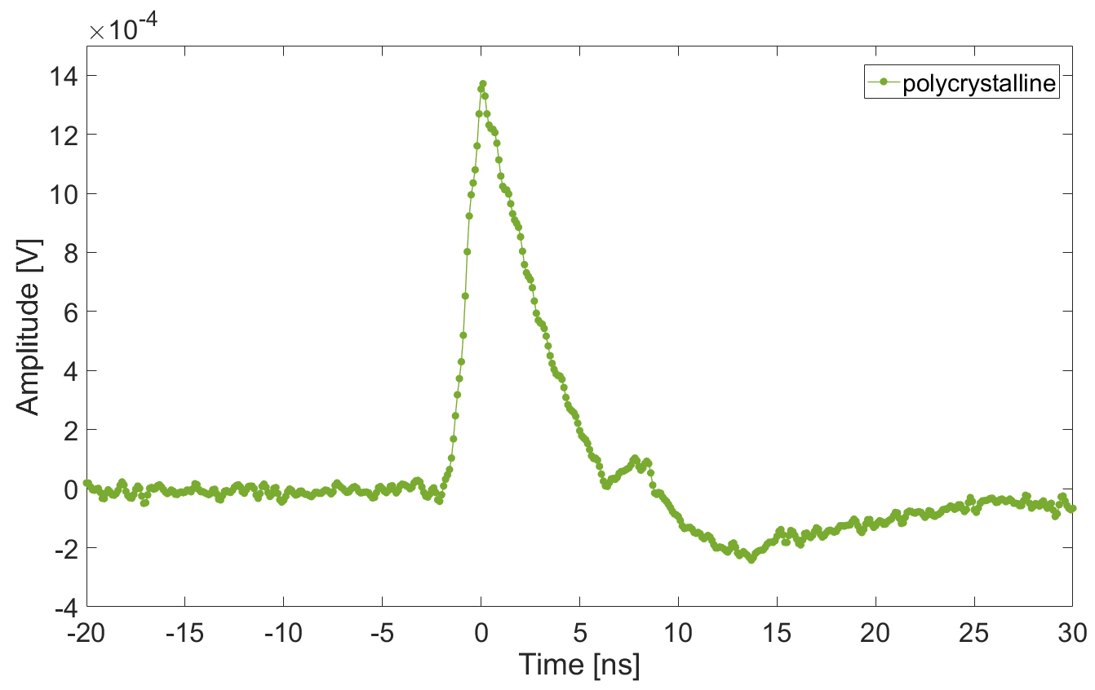
Polycristalline diamond detector: charaterization
FWHM = 3.4 ns
CCE ≈ 30 %
$$Q_{α,g}= N_{i}\frac{E_{i}q_{e}}{ε_{g}}$$
$=\frac{{5.486×{10}^{6}q}_{e}}{13.1}$ $≃$ $6.75×{10}^{−14}C$
$$Q_{α,c}= N_{i}\frac{E_{i}q_{e}}{ε_{g}CCE(E_{i})}$$
$$C$$
$≃2.06×{10}^{−14}$

Slide 49
