Slide 1



Transport and manipulation of laser driven proton beams for diagnostics and applications
PhD candidate: Antonia Morabito
Supervisors: Prof. Mauro Migliorati (Sapienza Uni.), Prof. Sargis Ter- Avetisyan (Szeged Uni.)
Scientific evaluators: Prof. Luca Volpe (CLPU), Prof. Subhendu Kahaly (ELI-ALPS)
29 April 2021

Slide 2
Outline
Laser driven proton acceleration (LDPA)
  Target Normal Sheath acceleration mechanism (TNSA)
Ion acceleration by few cycle laser pulses (exp.campaign)→ The first laser driven proton beams observation at ELI-ALPS research center
Theoretical study of a novel design spectrometer for LDPA diagnostics
Design and optimization of a laser Particle inducted X-ray emission (PIXE) beamline for material science application
Conclusions and future works
1

Slide 3
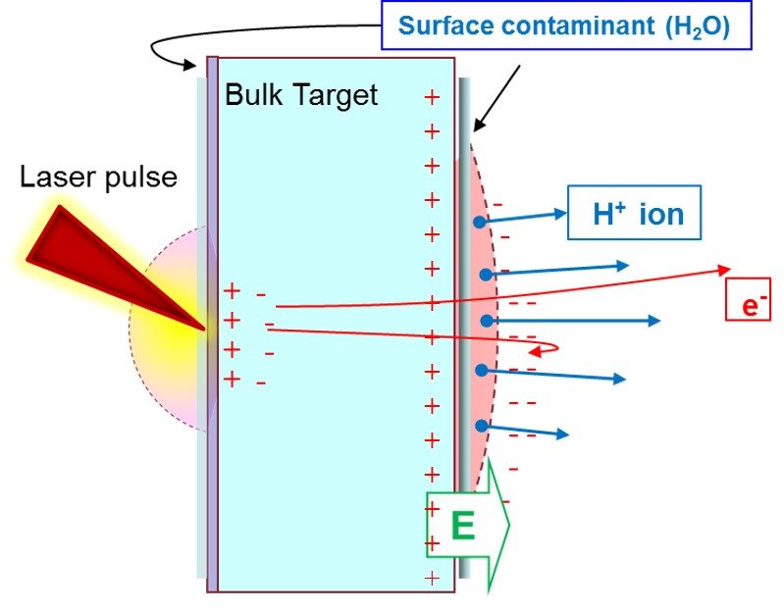
Laser driven proton acceleration
Target Normal Sheath acceleration(TNSA)
High intensity laser pulse interacts with a solid target
Laser Intensity on target
  Typically > 10¹⁸ W/cm²
Laser energy
  Few milliJoules to hundreds of Joules
Pulse duration
  ps → fs
Target thickness
  nm → µm
Experimental evidence
Low energy Ion acceleration (LEIA) campaign
Energetic “hot” electrons expelled from the target
Charge separation field created on the rear surface (up to TV/m)
Macchi, A, arXiv preprint arXiv:1712.06443 (2017).
Borghesi, M., Nuclear Instruments and Methods in Physics Research Section A: Accelerators, Spectrometers, Detectors and Associated Equipment 740 (2014): 6-9.
Daido, H. et al., Reports on progress in physics 75.5 (2012): 056401 and references therein.
2

Slide 4
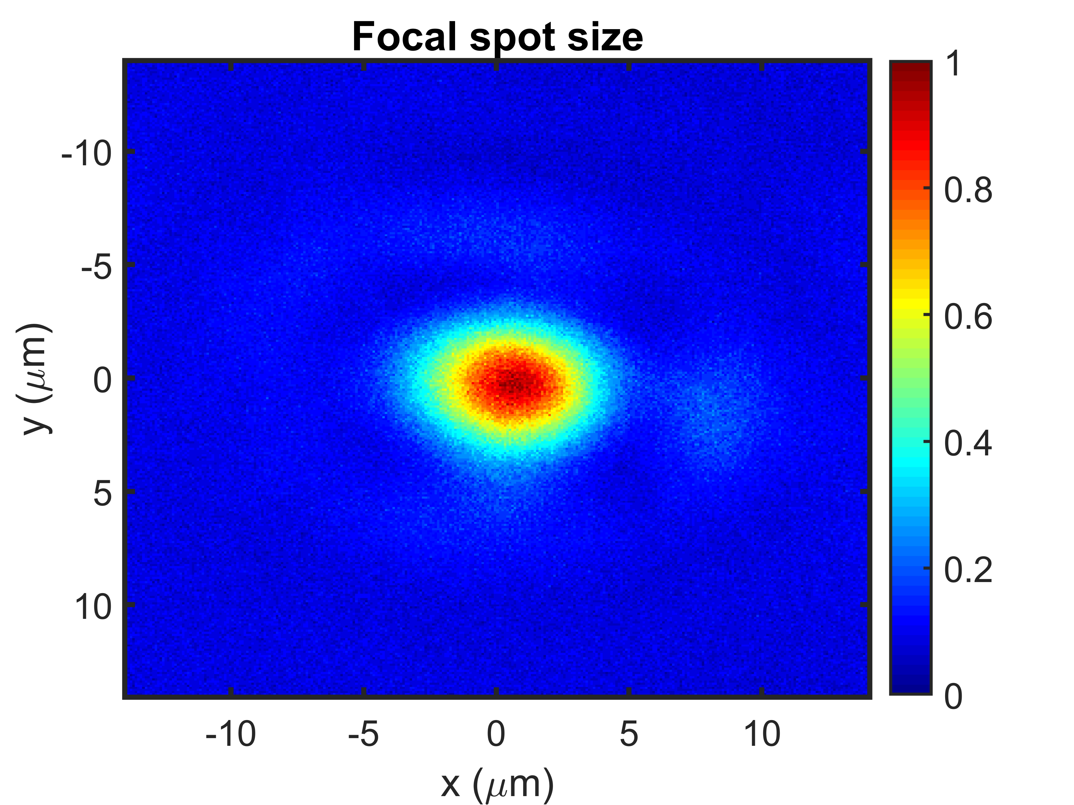
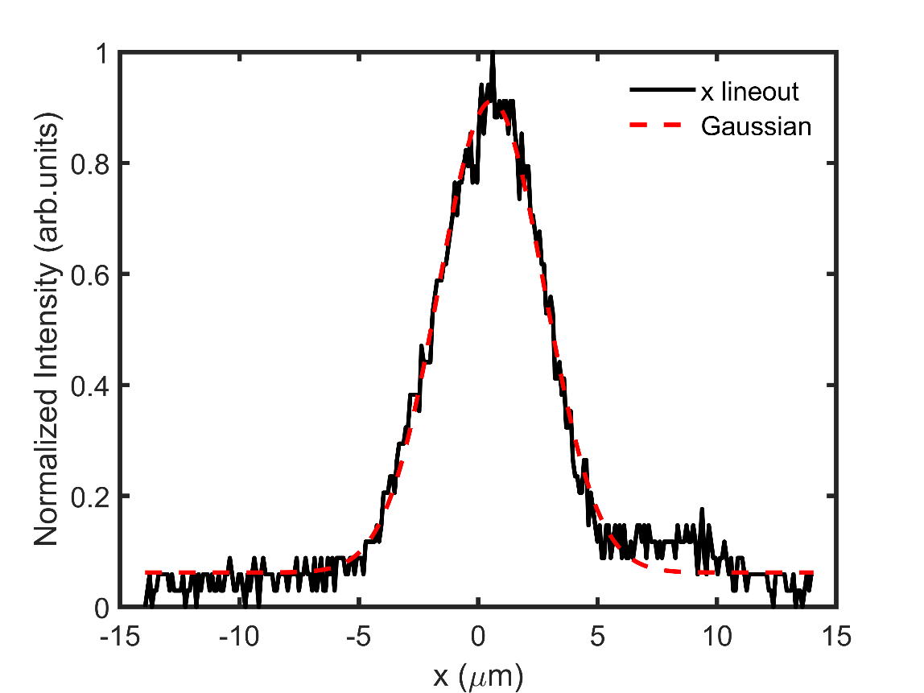
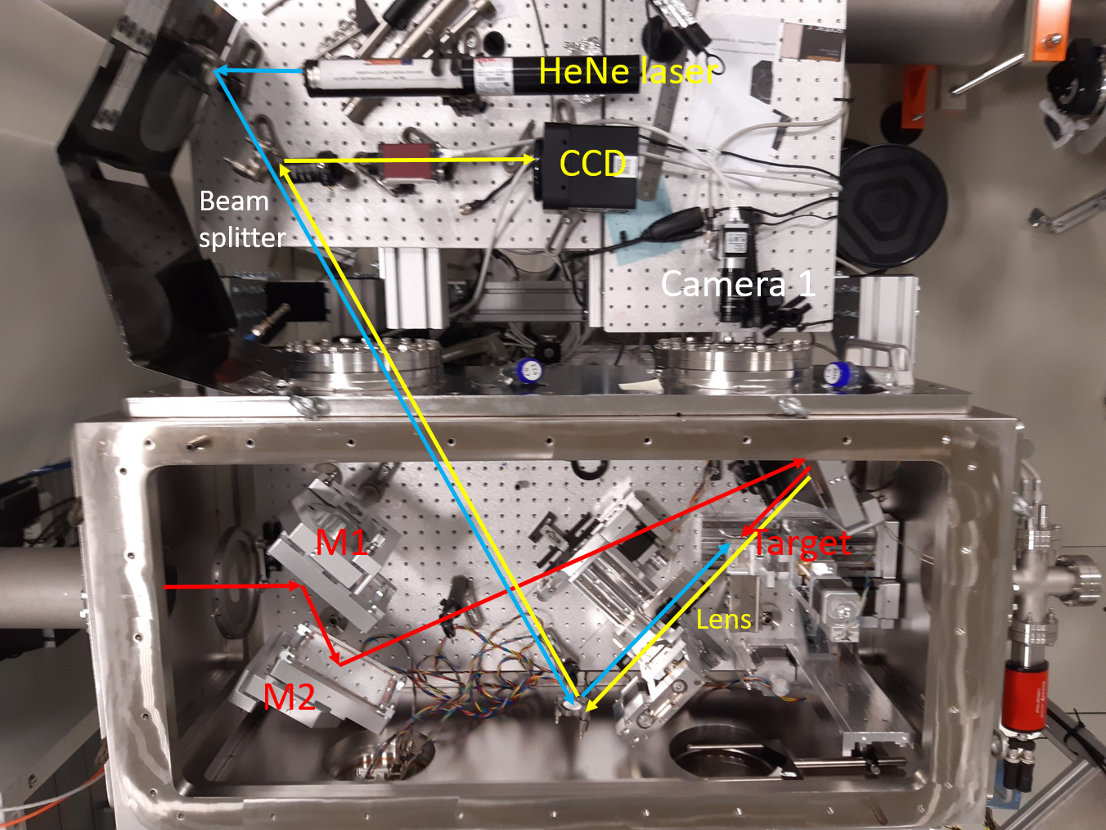
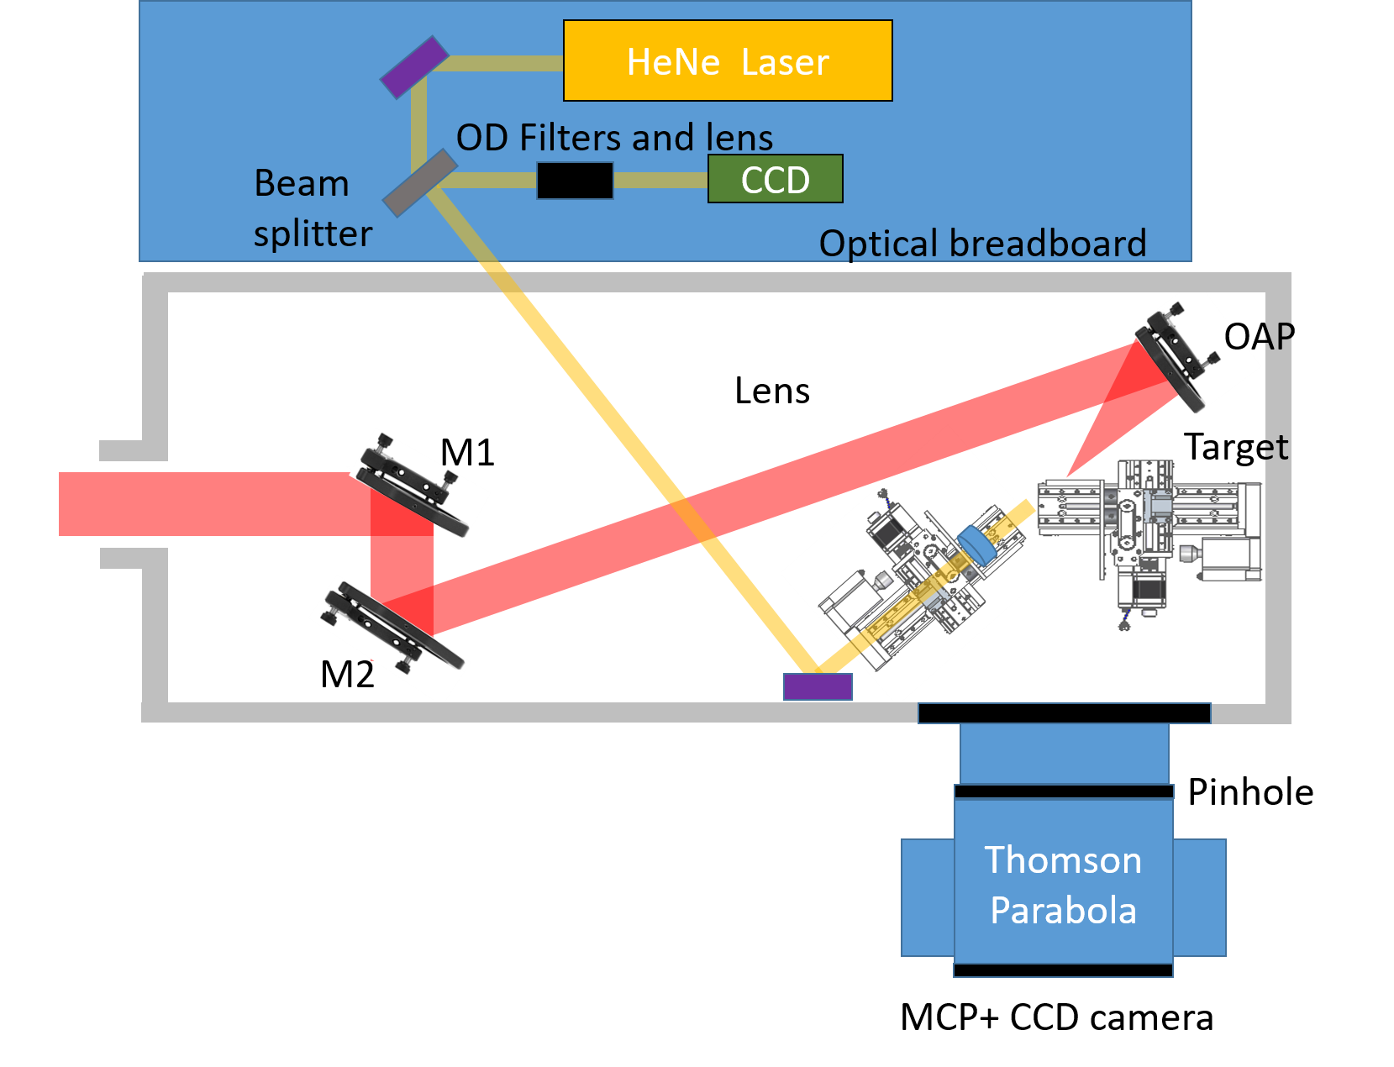
Ion acceleration with few cycle laser pulses
Sylos Experimental Alignment(SEA) laser
Interaction chamber @ (SEA) ELI-ALPS (Hungary)
Jan-March 2020
Focal spot measurement
f/2.5
Sylos Experiment Alignment laser @ELI-ALPS research center
Intensity ~ 10¹⁹ W/cm²
Laser energy ~ 36 mJ
Pulse duration ~ 11 fs
Central Wavelength ~ 820 nm
Repetition rate: single shot up to 10 Hz
Focal spot diameter (FWHM) ~ 5.1 µm
3

Slide 5
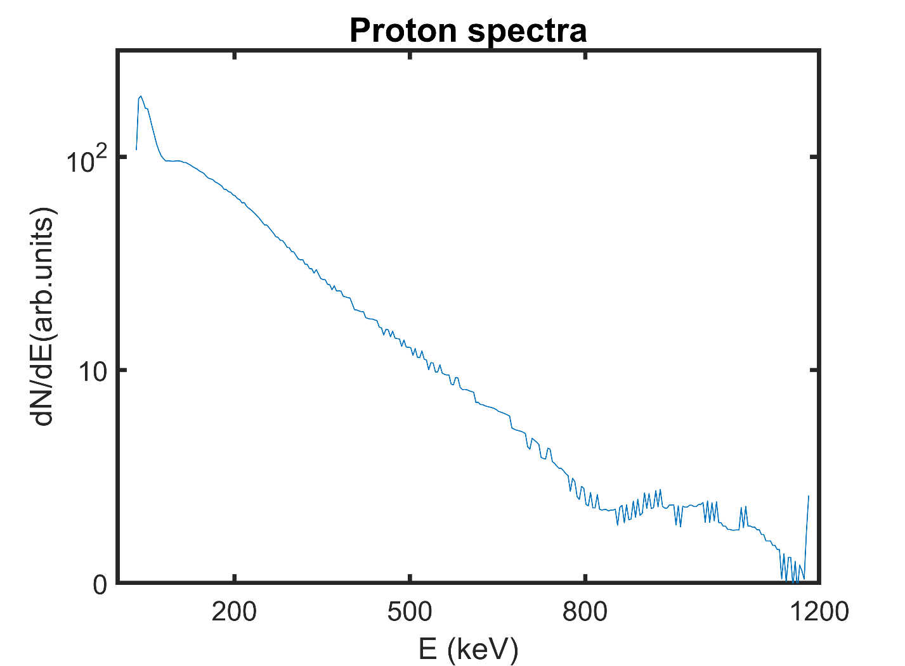
Ion acceleration by few cycle laser pulses
LEIA exp.campaign - diagnostics
Detection system
Data analysis is still a work in progress
260 mm
50 mm
88 mm
Pinhole
Ф = 200 µm
Magnets: 0.266 T
CCD camera
Electric plate: 2.61 KV/ cm
Slotted CR-39
Microchannel plate (MCP)+ phosphor screen
̴10⁻⁶ mbar
SEA laser @ELI-ALPS research center
Intensity ~ 10¹⁹ W/cm²
Laser energy ~ 36 mJ
Focal spot diameter (FWHM) ~ 5 µm
Pulse duration ~ 11 fs
Central Wavelength ~ 820 nm
Repetition rate: single shot up to 10 Hz
Proton energies of few hundreds of keV
Short pulse duration (~ps at the source)
Multispecies ( Proton, Carbon ions , etc..)
15-20⁰ divergence half angle
Broad energy spectra
4

Slide 6
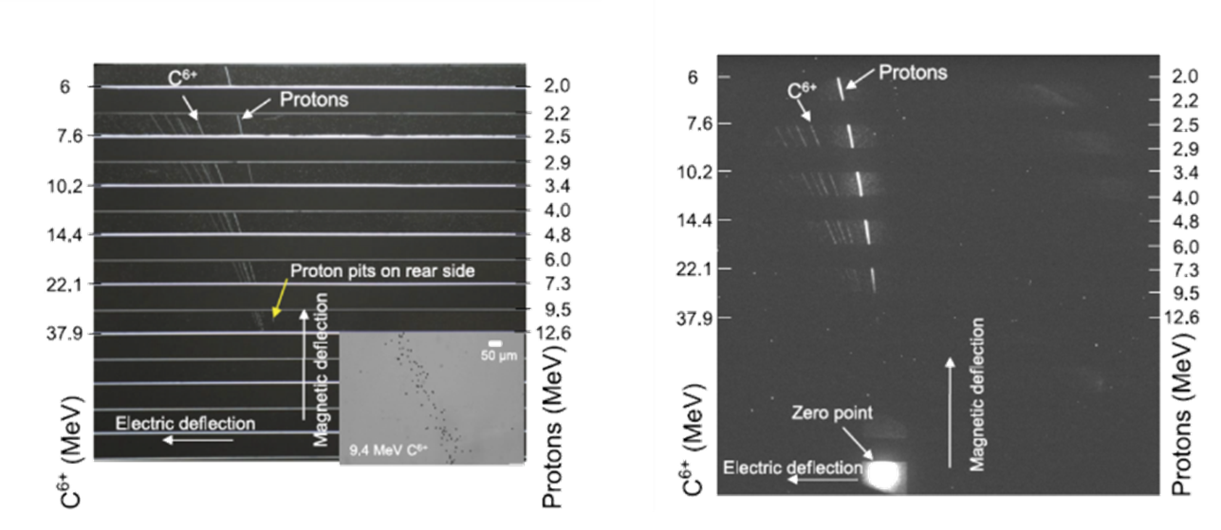
Typical design of
Thomson parabola spectrometer
Thomson parabola (TP) :
B: 0.9 T;
E: 22 kV/cm;
CR-39: thickness: 1mm
A theoretical model allows to predict the MCP response:
5–58 MeV carbon ions
2–17.3 MeV protons
CR-39
MCP
Laser parameters:
Intensity ~ 10²⁰ W/cm²
Laser energy ~ 14 J
Pulse duration ~ 30 fs
Jeong, Tae Won, et al., Review of Scientific Instruments, 87(8), 083301.
McIlvenny, A., et al. , Journal of Instrumentation 14.04 (2019): C04002.
5

Slide 7
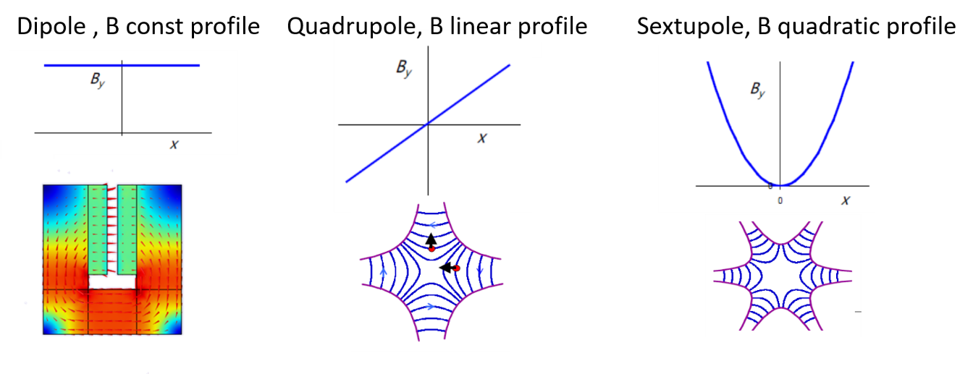
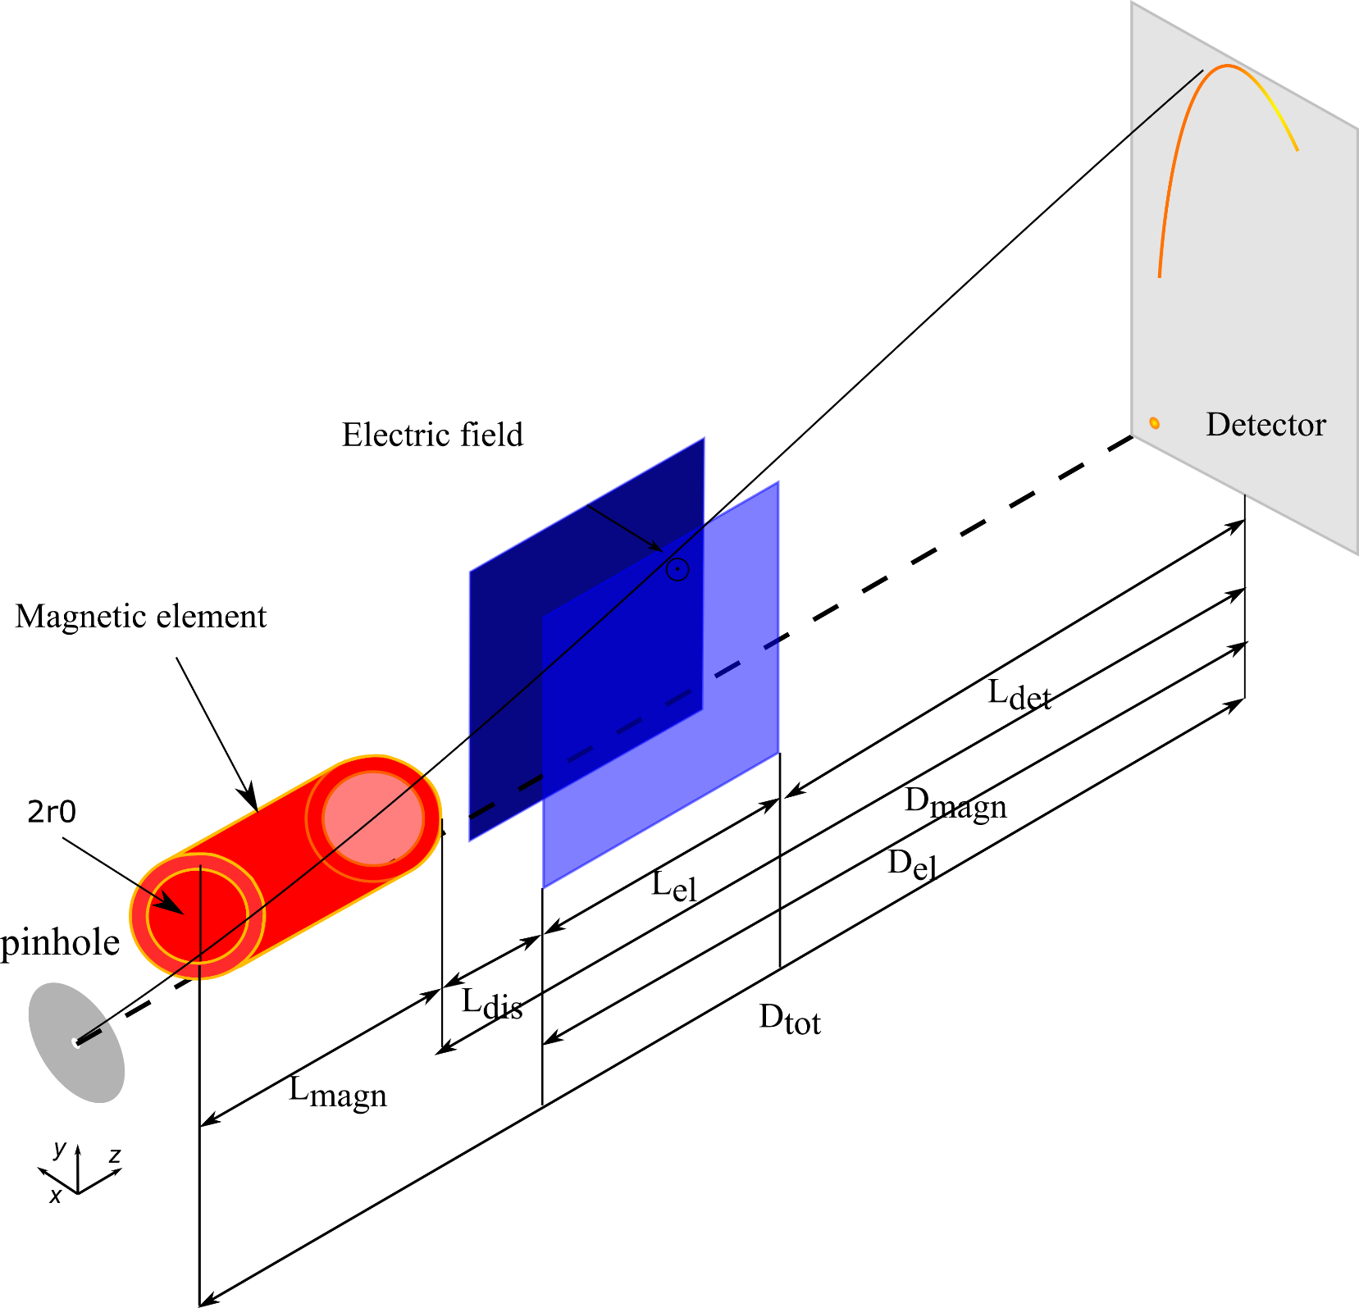
Novel design: magnetic dispersion
Replacement of the magnetic field of the dipole with different magnetic field profiles (e.g. quad.)
→ Enhance the proton energy dynamic range (towards low energies)
Initial conditions:
Vertical shift (y= r₀)
Two different proton point sources energy range
Detector with a dimension of 8 cm
El field
El-field
bore radius (r₀)
6

Slide 8
Model System
Model system solves the equation:
Point source of protons and/or carbon ions (typical LDPA diagnostic setup→ low divergence beam)
1 D approximation for magnetic field profile (e.g quad and multipole magnetic elements)
Neglect the relativistic effects (100MeV << 1GeV)→ proton energy up to 700 MeV
No particle-particle interaction →No space charge effects
Tool: Matlab (second order Runge-Kutta)
7

Slide 9
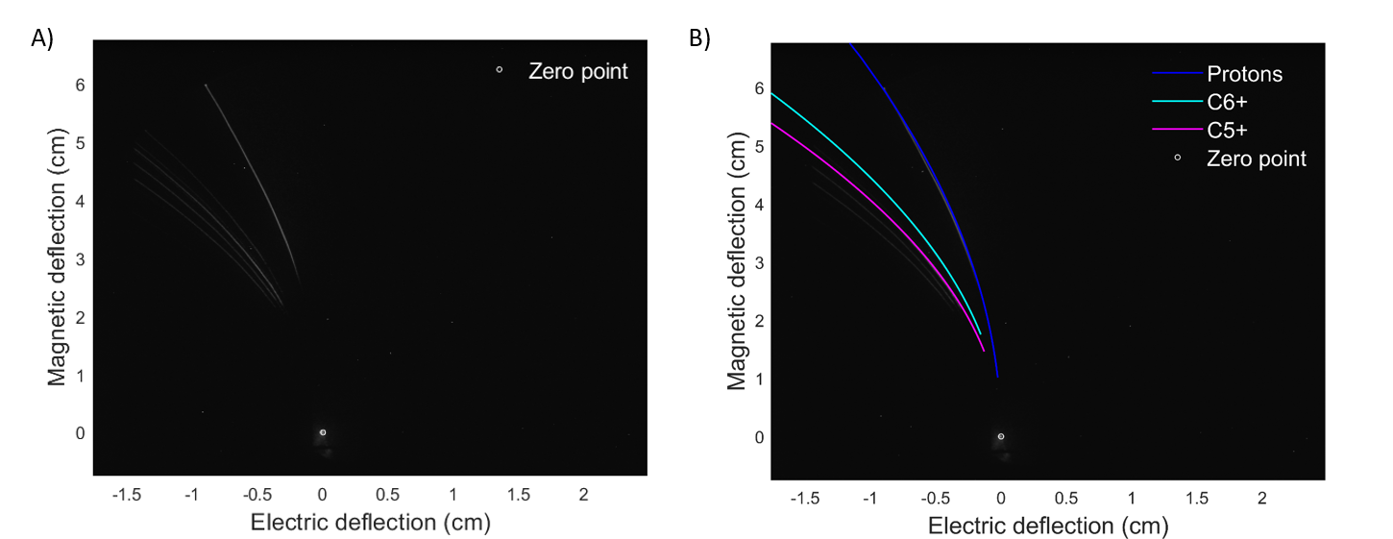
Validation of the model
Simulation data
Experimental data
L_{tot}
Geometry :
B= 0.9T; L_{magn}= 5 cm
E= 22 kV/cm; L_{el}= 10 cm
L_{det}= 18.4 cm
L_{tot} ≈ 50 cm
8

Slide 10
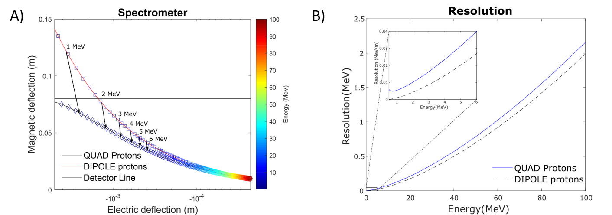
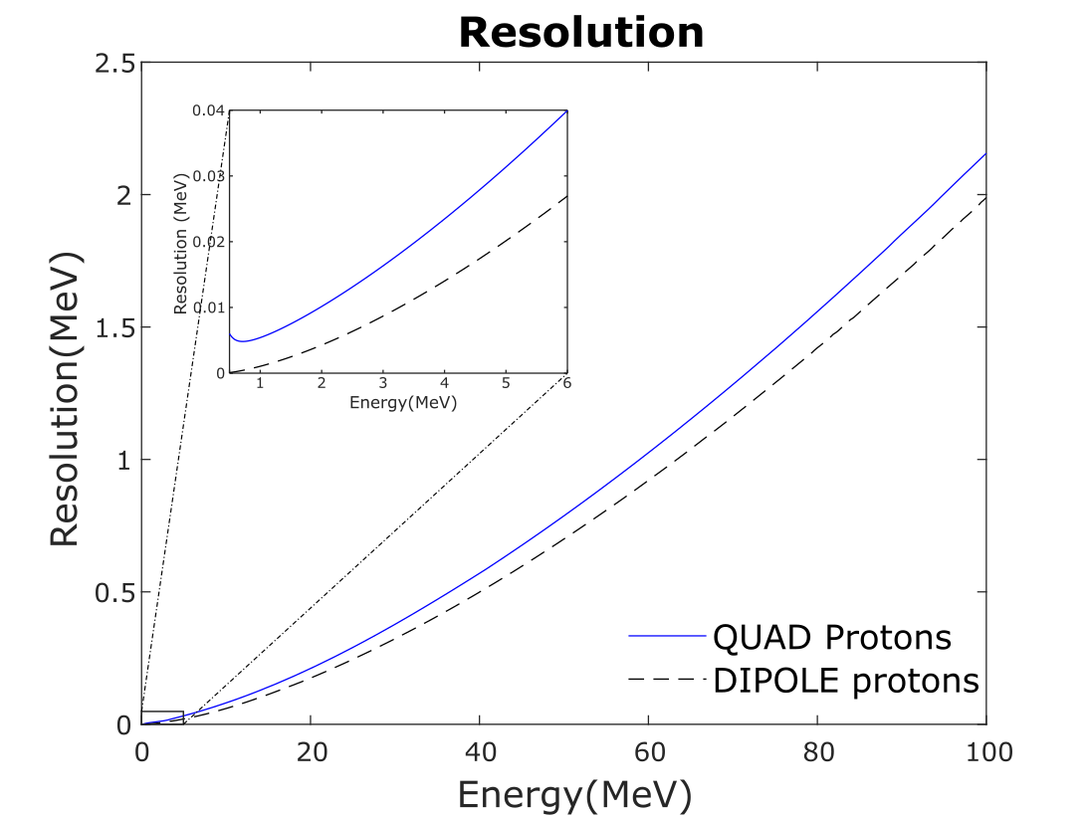
Novel design
quad profile - low proton energy range
Element | B₀ / G | L_{magn} | El | L_{el} | Ldet
Dipole | 0.9 T | 10 cm | 12 kV/m | 5cm | 11 cm
Quadrupole | 45 T/m | 10 cm, r₀=2.2 cm | 12 kV/m | 5cm | 11cm
9

Slide 11
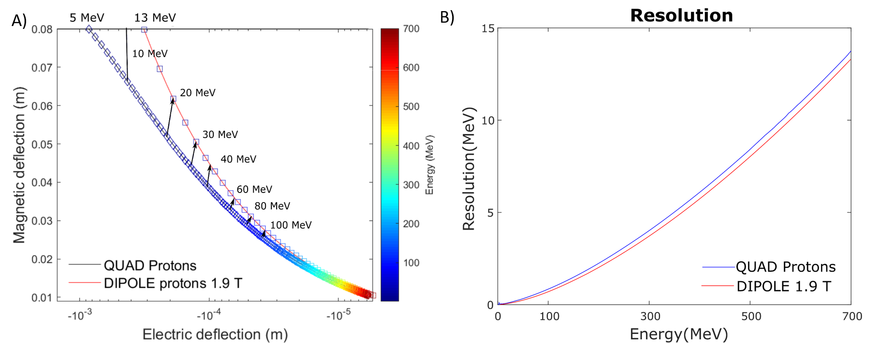
Novel design
quad profile - high proton energy range
Element | B₀ / G | L_{magn} | El | L_{el} | Ldet
Dipole | 1.9 T | 10 cm | 12 kV/m | 5cm | 11 cm
Quadrupole | 100 T/m | 10 cm r₀=1.9 cm | 12 kV/m | 5cm | 11cm
10

Slide 12
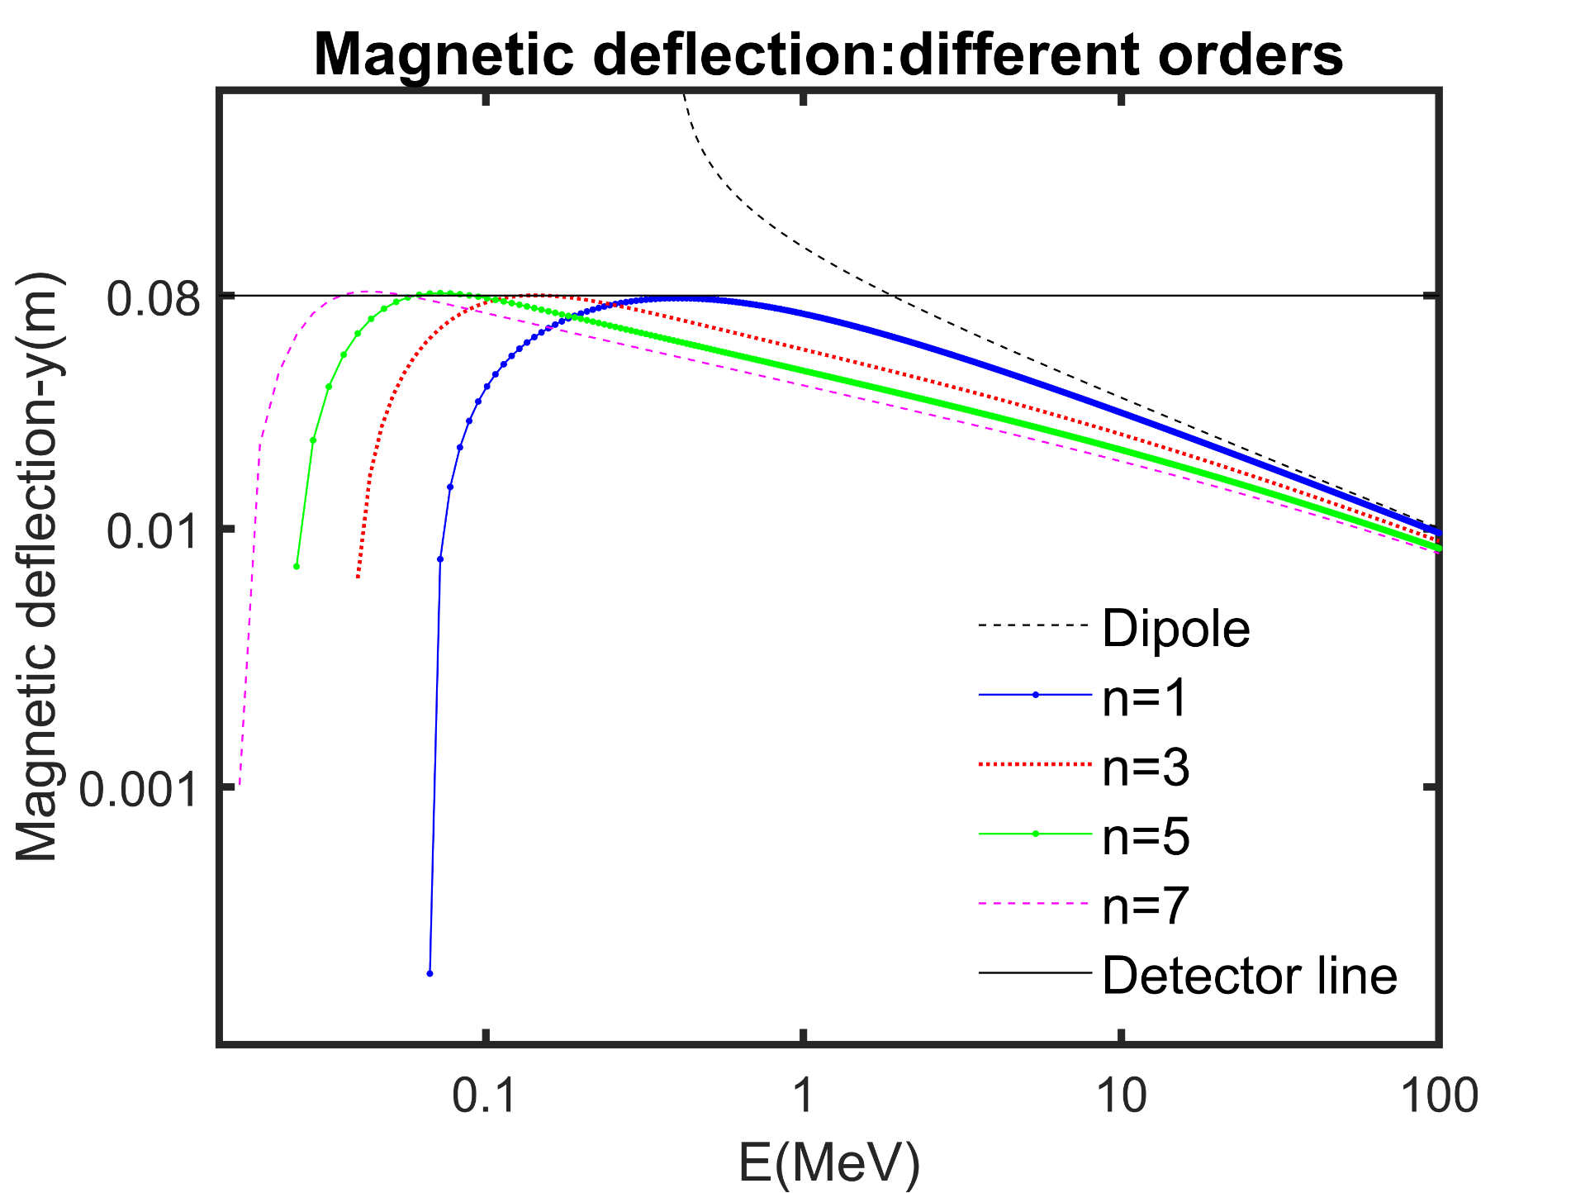
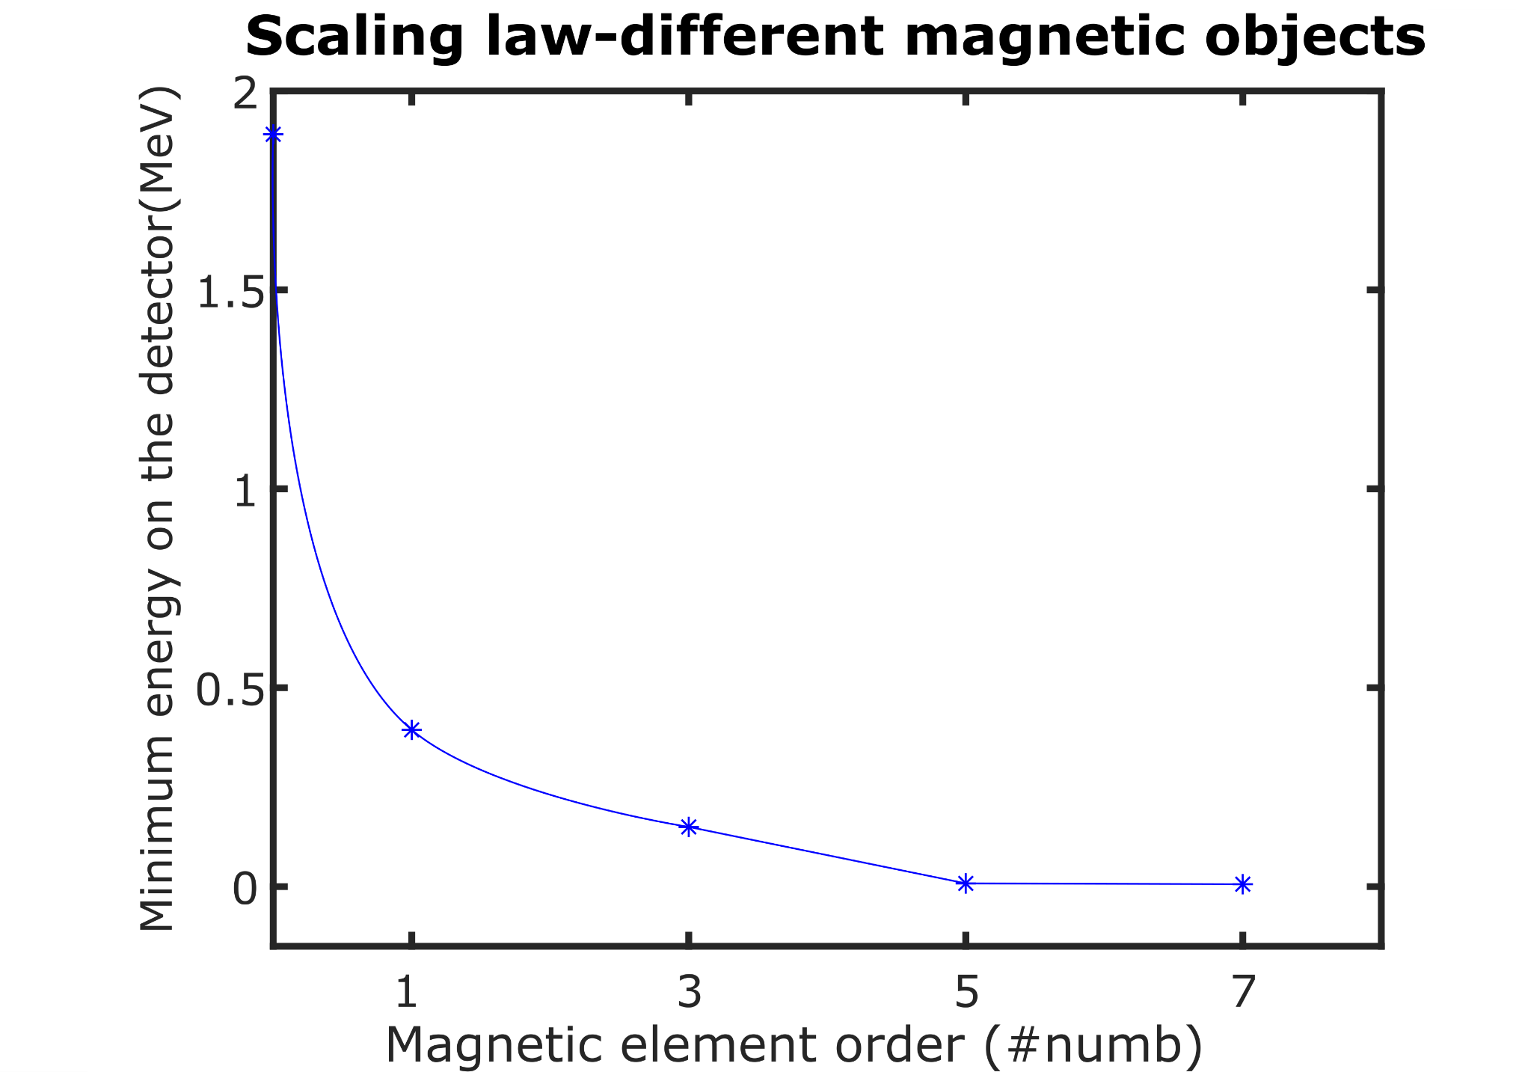
Magnetic dispersion
scaling law of different orders
Replacement of the dipole with different magnetic field profiles → increase of minimum detectable energy on the detector
E_{prot}: few keV up 100 MeV; B₀=0.9 T, L _{det}= 5 cm; B_{x}= -G_{n}*y^{n}
11

Slide 13
Novel design
The proposed designs allow :
• the enhancement of detectable energy dynamic range for low proton energies in a compact distance
• to easily scale and increase the energy dynamic range both in the low energy proton scenario and in the high energy one.
High energy protons → Quadrupole parameters: 100 T/m, r₀: 1.9 cm, length: 10 cm
Low-energy protons →A lower gradient of G: 45 T/m is possible.
Higher-order magnetic profiles → the saturation at the decapole element
Morabito A. et al, Theoretical study of a new spectrometer design for laser driven ion acceleration diagnostic (manuscript under prep.)
Gain in information for low energy proton → applications, such as the laser-Particle Induced X-ray emission (PIXE)
12

Slide 14
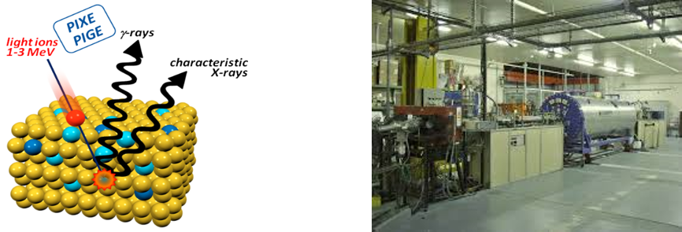
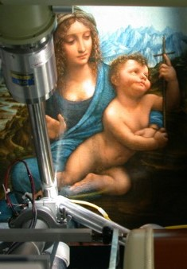
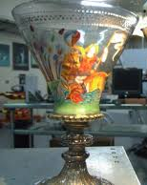
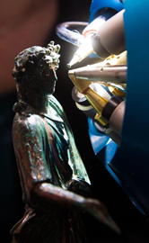
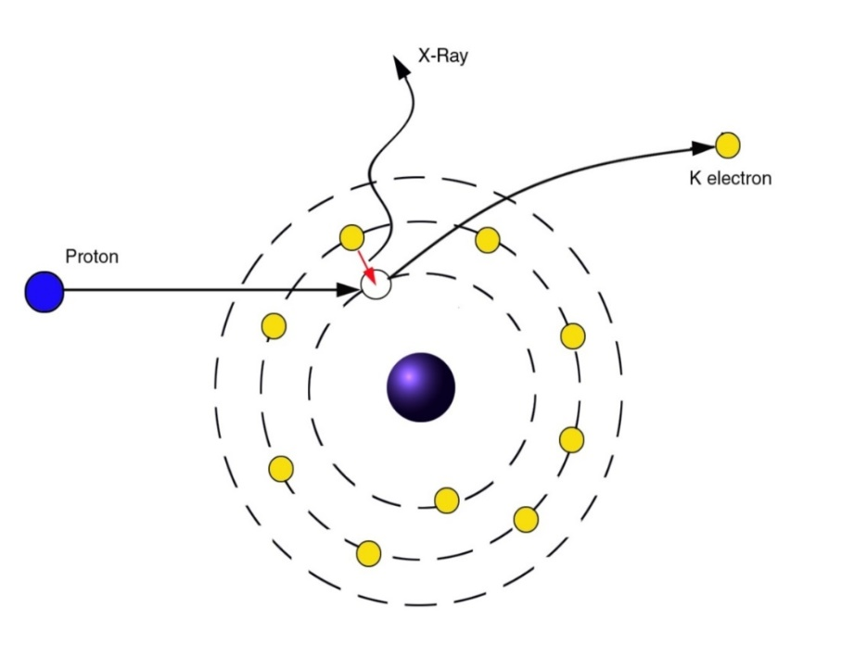
Particle Induced X-ray emission (PIXE) in cultural heritage (CH)
Innovative physical and chemical technique for Cultural Heritage for both diagnostic and conservations.
Proton beams (1-3 MeV) hit the target
Core electronic excitation
X-ray produced from subsequent electron hole or vacancy rearrangement
Produced radiation measured by an energy-dispersive detection system
  a characteristic fingerprint of each chemical element present in bulk sample.
Advantage over XRF:
Detection of low Z elements
Higher spatial precision
Detection of elements up to 20 ppb
13

Slide 15
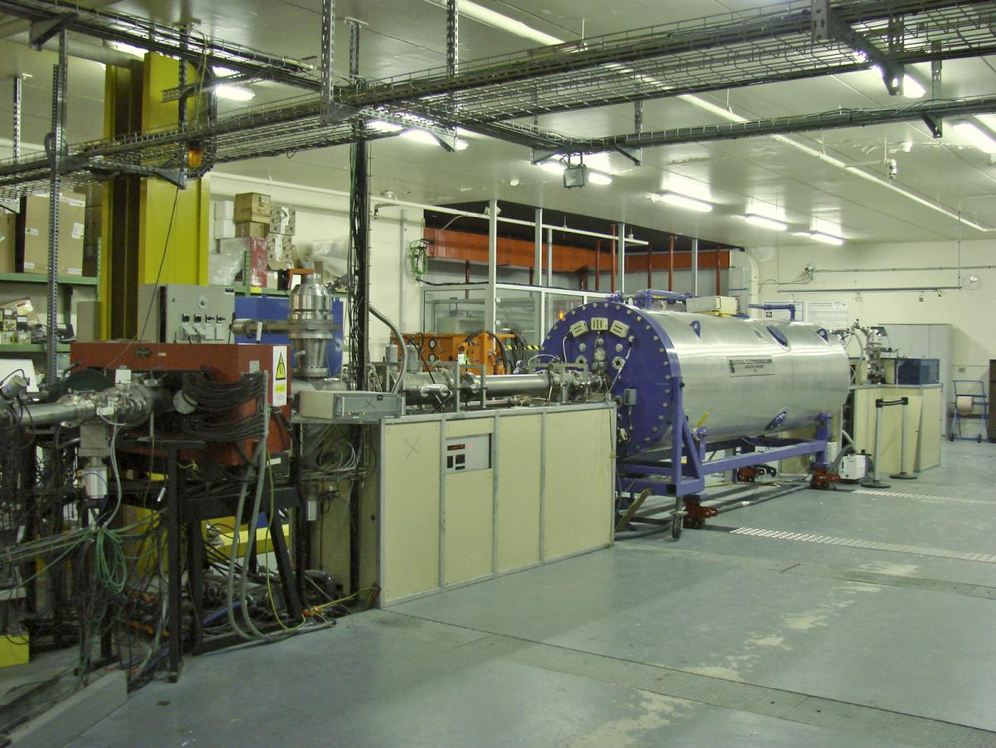
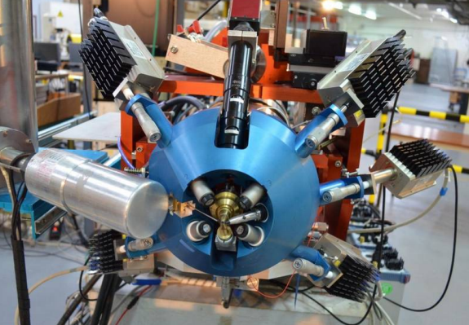
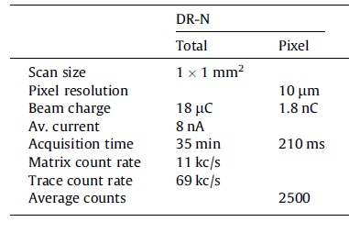
PIXE : Conventional accelerators
‘’Accélérateur Grand Louvre d'analyse élémentaire’’(AGLAE, Paris, France)-
CENBG (Bordeaux , France) - INFN LABEC – Florence (Italy)
Drawbacks
Limited energy tunability (1-3 MeV)
Penetration depth 20 µm below the surface → decoration or corrosive patina
Highly localised analysis→Stepwise measurement: beam sizes of the order of µm²
Long analysis time →each point 100-9000 s measuring time → potential damage
Pichon, L. et al., " Nuclear Instruments and Methods in Physics Research Section B: Beam Interactions with Materials and Atoms 363 (2015): 48-54.
14

Slide 16
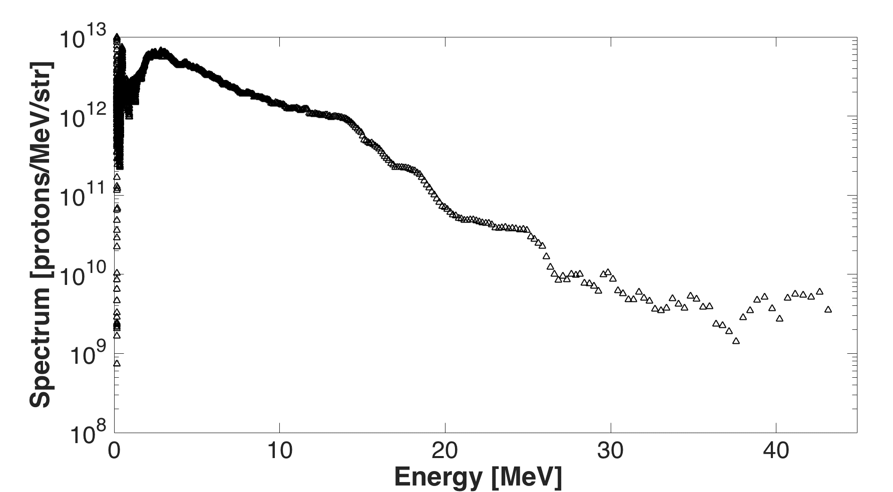
PIXE : Conventional accelerators vs LDPA
LDPA : typical TNSA spectrum @ JLF-TITAN
Advantages of PIXE with laser-driven proton beams:
layer-by-layer analysis by energy tuning
larger analyzed surface due to larger beam spot size
higher signal-to-noise ratio allows shorter measuring times
higher charge for each shot
Intensity ~ 10²⁰ W/cm²
Laser energy ~ up to 220 J
Focal spot diameter (FWHM) ~ 9 µm
Pulse duration ~ 700 fs
Central Wavelength ~ 1.056 µm
Repetition rate << 1 Hz
Barberio, M. et al. Scientific reports 7.1 (2017): 1-8.
15

Slide 17
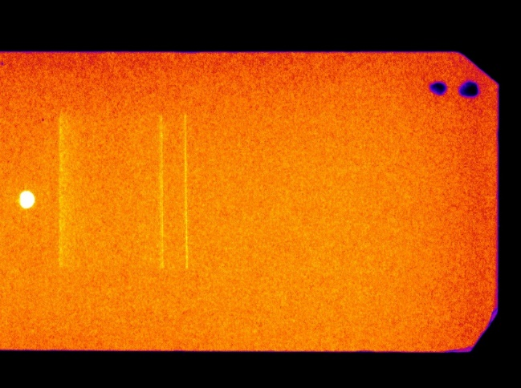
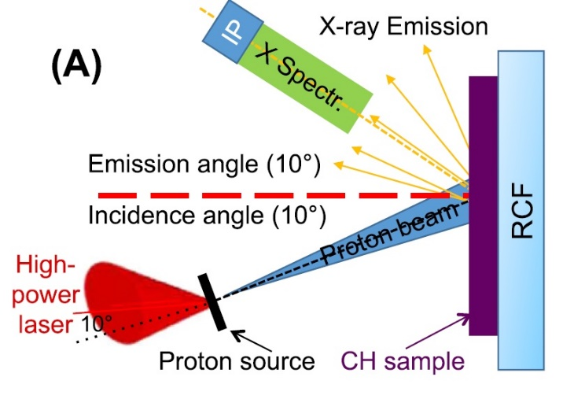
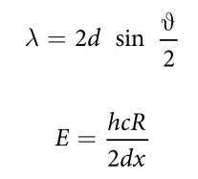
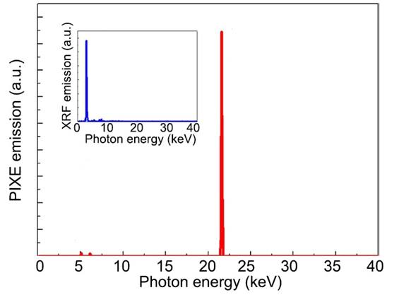
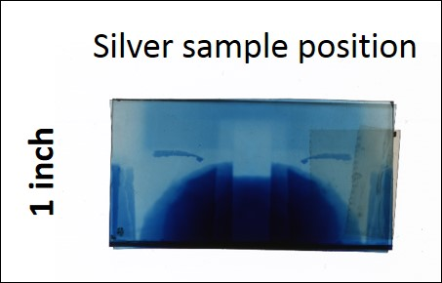
LDPA as diagnostic for CH heritage
IP image with one shot!
Bragg’s law
Energy range
X-ray spectr.
20 - 100 KeV
6 cm
Ag sample
Silver sample position
Ag kα (22 KeV)
Ag Lα
2.54 cm
Proton beam center
Spectrometer alignment
Ti Kβ
Cr Kβ
The one shot PIXE data are in agreement with conventional
XRF data on the same sample
Barberio, M. et al. Scientific reports 7.1 (2017): 1-8.
16

Slide 18
PIXE : Conventional accelerators vs LDPA
Proof of principle experiment of ‘’laser-driven PIXE’’
Complete chemical analysis of the silver sample in ‘’one single’’ laser-driven PIXE
Barberio, M. et al. Scientific reports 7.1 (2017): 1-8.
Mirani, F., et al. " Science advances 7.3 (2021): eabc8660.
Barberio M. and . Antici P.," Scientific reports 9.1 (2019): 1-9.
Protons are accelerated within a cone of tens of degrees
Initial energy spread for the layer by layer PIXE analysis.
LDPA hybrid transport beamline for material science applications
17

Slide 19
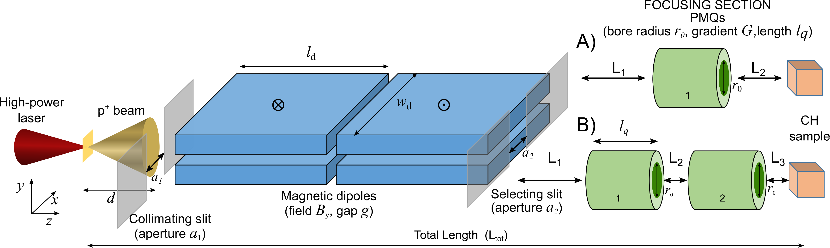
Laser PIXE beamline : energy selector (ES) + quadrupole/s (QUAD)
The proposed hybrid beamline is composed :
An energy selector (L_{d}: 10 cm, w_{d}:10 cm, B_{y}: 0.92 T) coupled with one or two QUADs
Three different scenarios (vacuum chamber) :
1) ES + QUAD ( 50 cm – compact distance)
2) ES + QUAD ( 90 cm – extended distance)
3) ES + 2 QUAD (90 cm)
Scisciò, M., et al. " Scientific reports 8.1 (2018): 1-11.
Morabito A. et al., Laser and Particle Beams, 1-10 (2019).
18

Slide 20
Particle tracking simulations
TSTEP and TRACE3D simulations :
Optimization of the Energy Selector (ES) performance
‘’Tuning’’ of the proton beam in the low range (1, 3, 5 MeV) needed for PIXE (‘’layer by layer analysis’’)
Obtain a quasi-monoenergetic beam →final energy spread(≤10%)
Study the coupling of the Energy Selector (ES) + quadrupole/s (QUAD)
Test the advantage to focus/shape the final spot sizes according to the artifact size analyzed.
Verify the feasibility of the quadrupole’s addition→ varying its position between the energy selector (ES) and the sample.
L. M. Young. TSTEP.LANL Report LA-UR-96-1835, 1996; K. R. Crandall and Rusthoi. TRACE3D LANL Report, LA-UR-97-886(1997), 1997. url:https://laacg.lanl.gov/laacg/services/traceman.pdf.
19

Slide 21
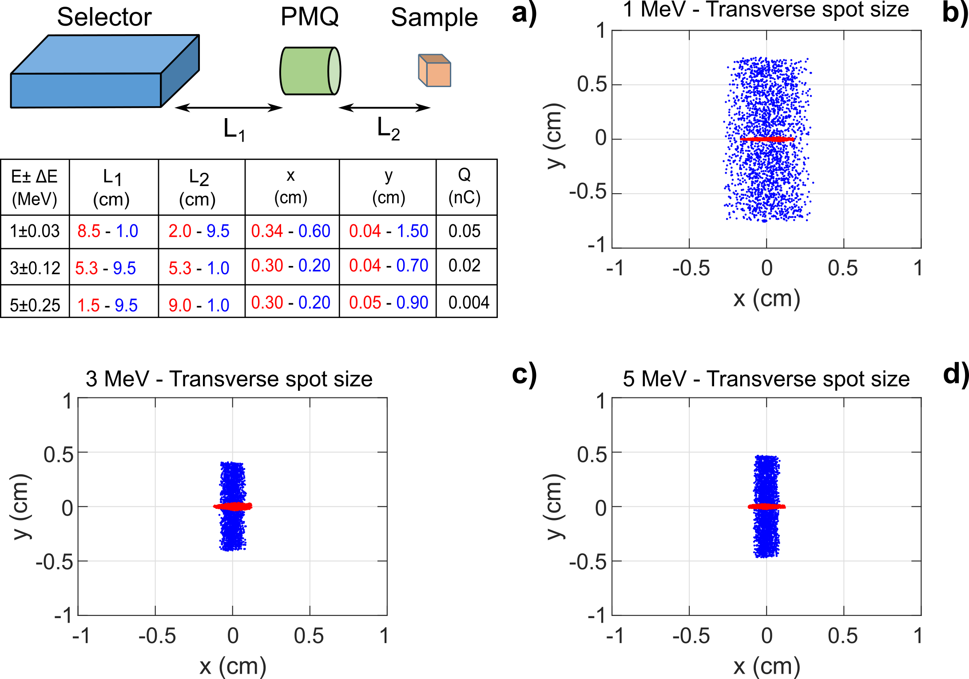
Laser PIXE beamline : energy selector (ES) + quadrupole (QUAD)-compact version
Energy tunability within the low energy PIXE range (1, 3, 5 MeV) with a final energy spread ΔE≤10%
Charge evaluation possible starting from a typical TNSA spectra
Minimum transverse spot size between few mm up to 1 cm scale with the same QUAD
20

Slide 22
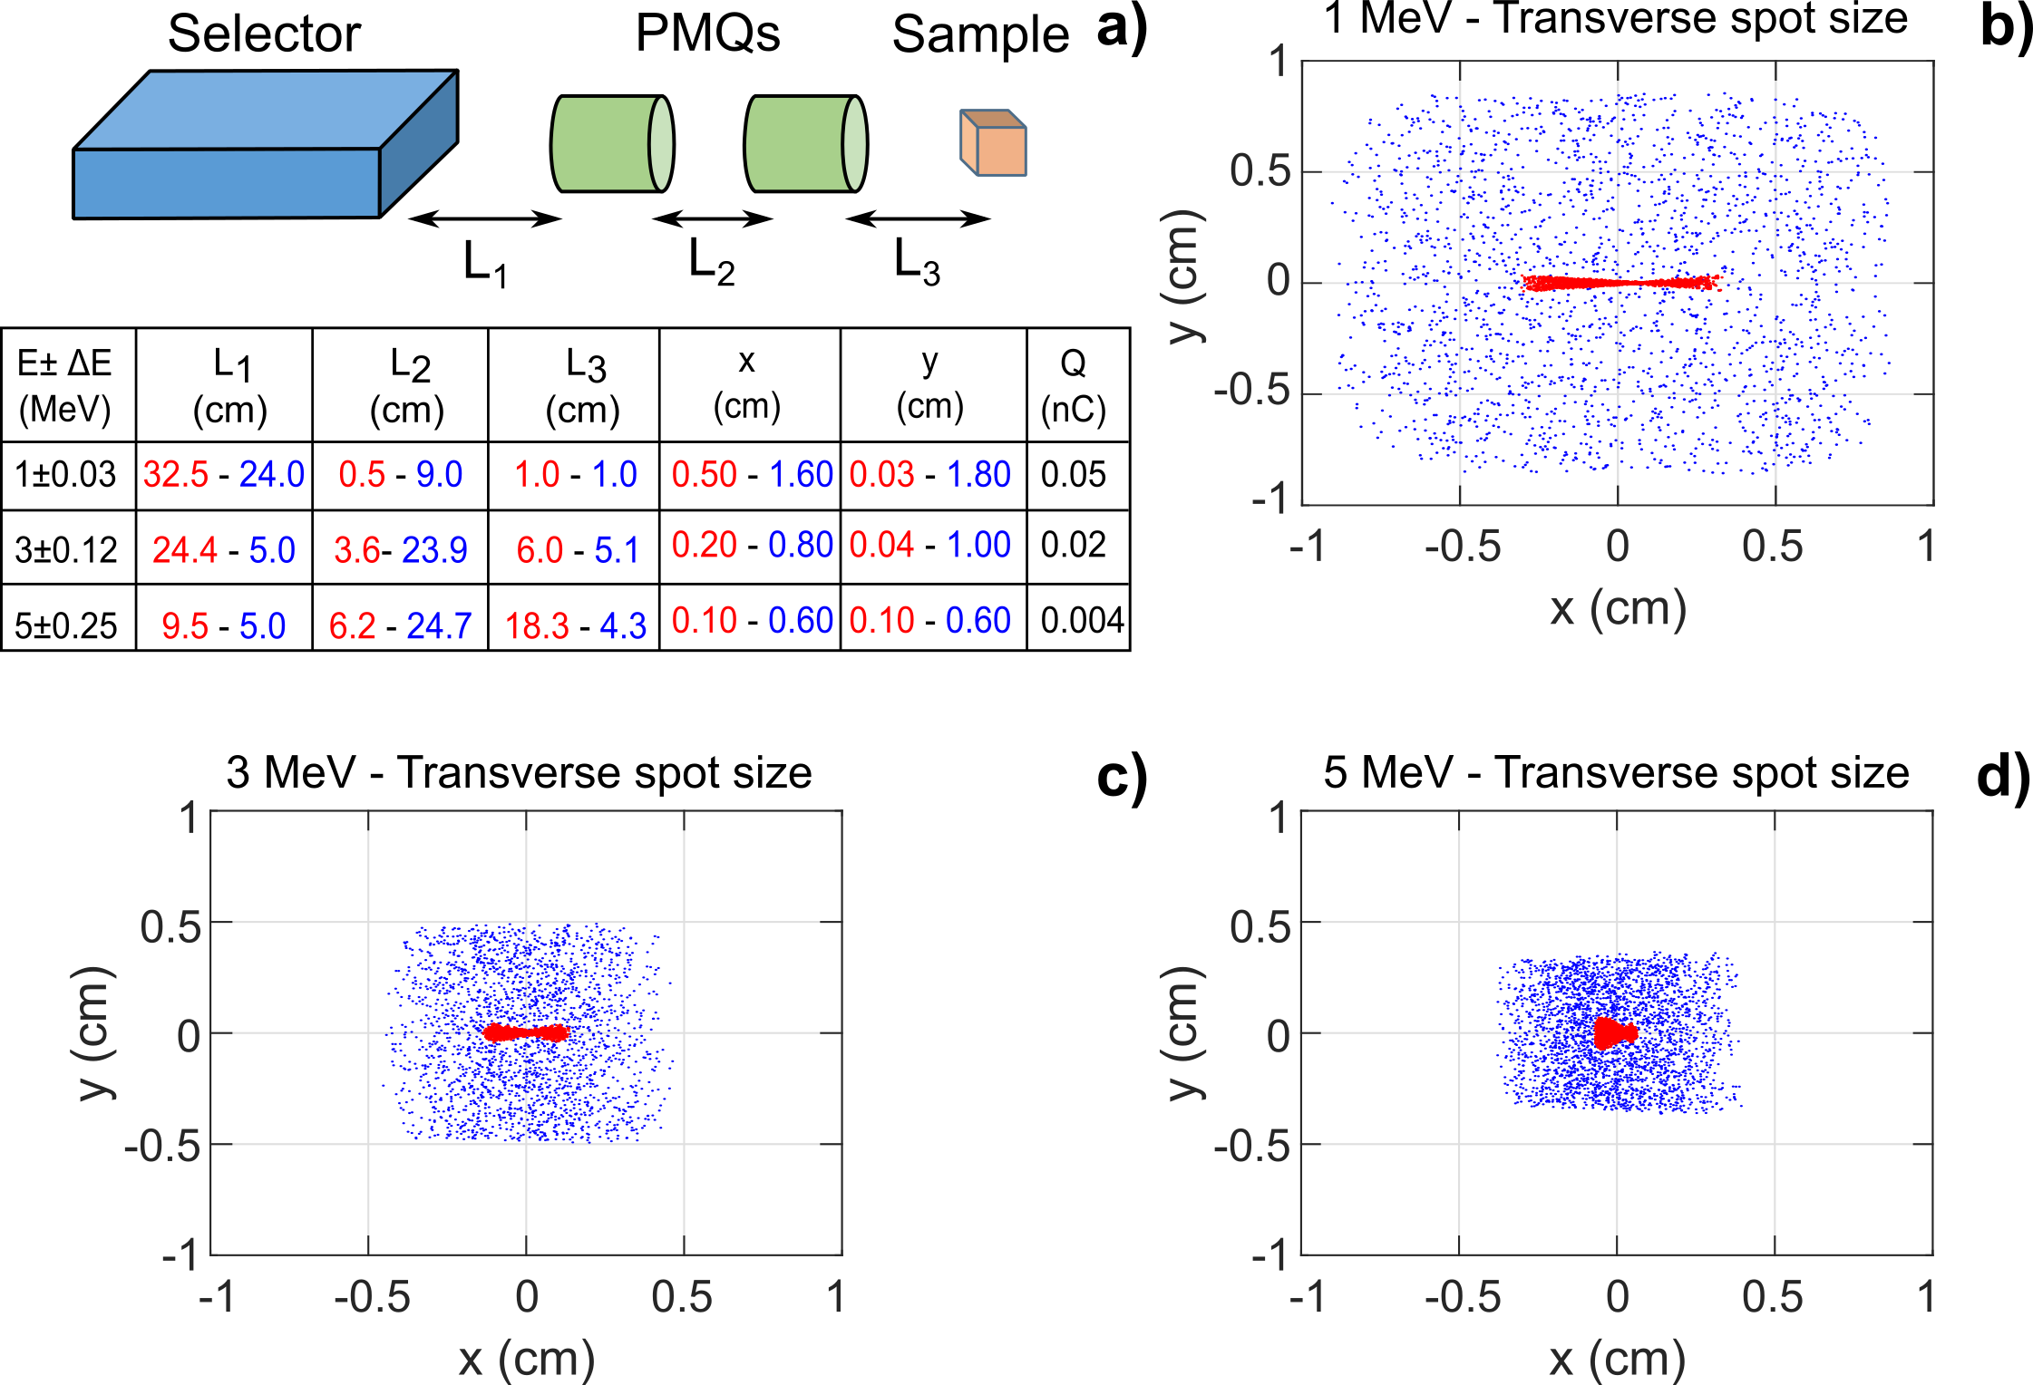
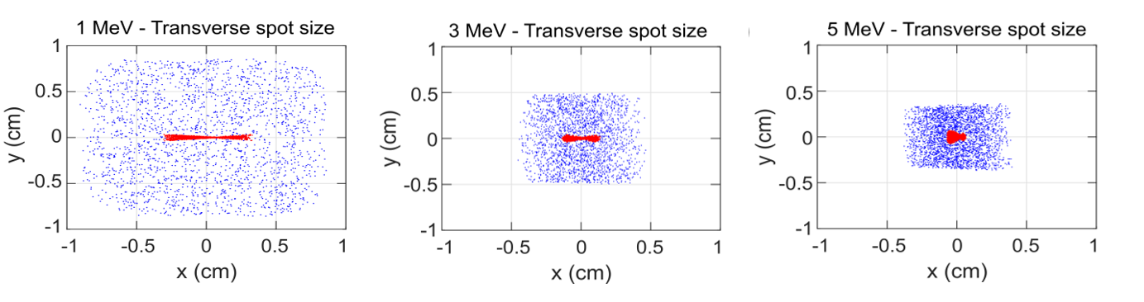
Laser PIXE beamline : energy selector (ES) + 2 quadrupole (QUAD)
Total length: less than 1 m (90 cm)
Addition of 2 quadrupoles → more symmetric final transverse spot sizes (2 cm)
No alteration of final energy spread and charge observed
Intermediate spot sizes available by quad’s position displacement→high precise PIXE analysis
21

Slide 23
Laser-PIXE beamline for
material science applications
The proposed hybrid beamlines provide :
Compactness → less than 1 m beamline.
Tunability in energy and reduce the initial energy spread at the source to ≤10% (potential ‘’layer by layer’’ PIXE)
Tunability in final transverse spot sizes according to studied artifact by addition of a quadruple/s
→ few mm up to cm scale
Quadrupole parameters: 100 T/m, bore radius: 1 cm, length: 4.5 cm (compact version).
A lower gradient (G: 60T/m) is possible for an extended distance and the case of ES + 2 QUADs
Coupling with a 1-10 Hz high intense laser system allows potentially to shorten the time of analysis compared to classical PIXE
Morabito A. et al., Laser and Particle Beams, 1-10 (2019).
22

Slide 24
Conclusions and perspectives
Conclusions
Theoretical results regarding a new spectrometer design for laser driven ion acceleration diagnostic, (Morabito A. et al. ,manuscript under prep.)
Numerical results regarding the design and optimization of a laser Particle inducted X-ray emission (PIXE) beamline for material science application (Morabito A. et al., Laser and Particle Beams, 1-10 (2019).
Work in progress and perspectives
Quotation, purchase and test of the spectrometer design pieces
Next beam time for spectrometer implementation ( Fall 2021)
Participation as internal ELI member for LEIA campaign (April-May 2021)
23

Slide 25
Publications
S. N. Chen, M. Gauthier, M. Bazalova-Carter, S. Bolanos, S. Glenzer, R. Riquier, G. Revet, P. Antici, A. Morabito, A. Propp, M.Starodubtsev and J. Fuchs, Absolute dosimetric characterization of Gafchromic EBT3 and HDv2 films using commercial flat-bed scanners and evaluation of the scanner response function variability, Review of Scientific Instruments 87, 073301 (2016)-doi: 10.1063/1.4954921;
S. Vallières, A. Morabito, S. Veltri, M. Scisciò, M. Barberio, P Antici, Laser-driven proton acceleration with nanostructured targets, SPIE Optics & Optoelectronics, 1024009-6 (2017)-doi: 10.1117/12.2265913;
M. Barberio, M. Scisciò, S. Vallières, S. Veltri, A. Morabito, P. Antici, Laser-Generated Proton Beams for High-Precision Ultra-Fast Crystal Synthesis, Sci. Rep (2017)-doi: 10.1038/s41598-017-12782-w;
A. Morabito, M. Scisciò, Veltri S., M. Barberio, M. Migliorati, P.Antici, Design and optimization of a laser-PIXE beamline for material science applications, Laser and particle beams-1–10 (2019)-doi:10.1017/S0263034619000600;
A. Morabito, K.Nelissen, M. Migliorati, S. Ter-Avetisyan, Theoretical study of a new spectrometer design for laser driven ion acceleration diagnostic (manuscript under prep.) (2021).
24

Slide 26
Oral presentation and poster presentations
A. Morabito, “Transport and manipulation of laser driven proton beams for application and diagnostics”, oral presentation, University of Szeged, Hungary, Oct 2019
A. Morabito et. al., “Novel spectrometer design for laser driven ion acceleration diagnostic ”, oral presentation, ELI-ALPS Science Day hosted by ELI-ALPS, Szeged, Hungary, Oct 2019;
A. Morabito et. al., “Novel spectrometer design for laser driven ion acceleration diagnostic” ,poster presentation, European Advanced Ac-celerator Conference 2019, Elba, Italy, Sept 2019;
A. Morabito et. al., “Design and optimization of a laser-PIXE beam-line for material science applications”, poster presentation, ATTO2019 hosted by University of Szeged Congress Centre, Szeged, Hungary, Jul 2019;
A. Morabito et. al., “Optimization of a dedicated laser driven proton hybrid beamline for cultural heritage applications”, oral presentation, ELI-ALPS Science Day hosted by ELI-ALPS, Szeged, Hungary, Mar2019;
A. Morabito et. al., “ Design and optimization of a dedicated laser driven proton hybrid beamline for cultural heritage applications”, oral presentation, European Conference on Laser Interaction with Matter2018, Rethymno, Greece, Oct 2018;
A. Morabito et. al., “Dedicated laser driven proton hybrid beamline for cultural heritage applications”, poster presentation, Laser Plasma Summer School Diagnostics techniques for laser-plasma experiments@HRR hosted by CLPU, Salamanca, Spain, Sept 2018;
A. Morabito et. al., “Laser Accelerated Proton Beams as Diagnostics for Cultural Heritage”, oral presentation ELI-ALPS Science Day hosted by ELI-ALPS, Szeged, Hungary, Mar 2018;
A. Morabito et. al., “Absolute dosimetric characterization of Gaf.EBT3 and HDv2 films using commercial flat-bed scanners and evaluation of the scanner response function variability”, poster presentation, The International Science@Free Electron Lasers FELs Conference2016,Trieste, Italy, Sept 2016;
A. Morabito et. al., “Laser-Driven Proton Beam Ablation for Micro-Crystals Synthesis”, poster presentation, NIF and JLF User GroupMeeting 2016, Livermore (California), 31 Jan 2016 - 3 Feb 2016.
25

Slide 27
Thank you for your attention!

Slide 28
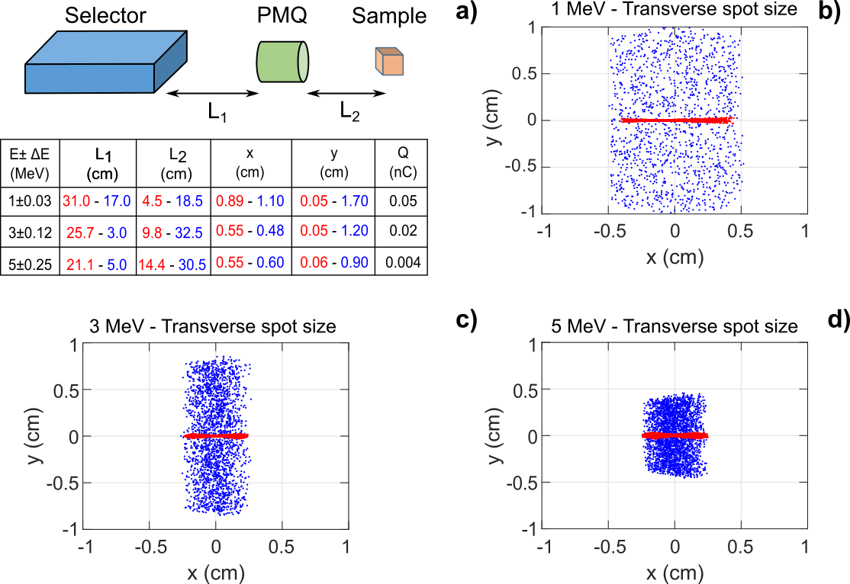
Laser PIXE beamline : Energy selector (ES) + quadrupole (QUAD)-extendend version
No alteration of final energy spread and charge
Minimum transverse spotsize between few mm up to 1 cm scale
28
Morabito A. et al., Laser and Particle Beams, 1-10 (2019).

Slide 29
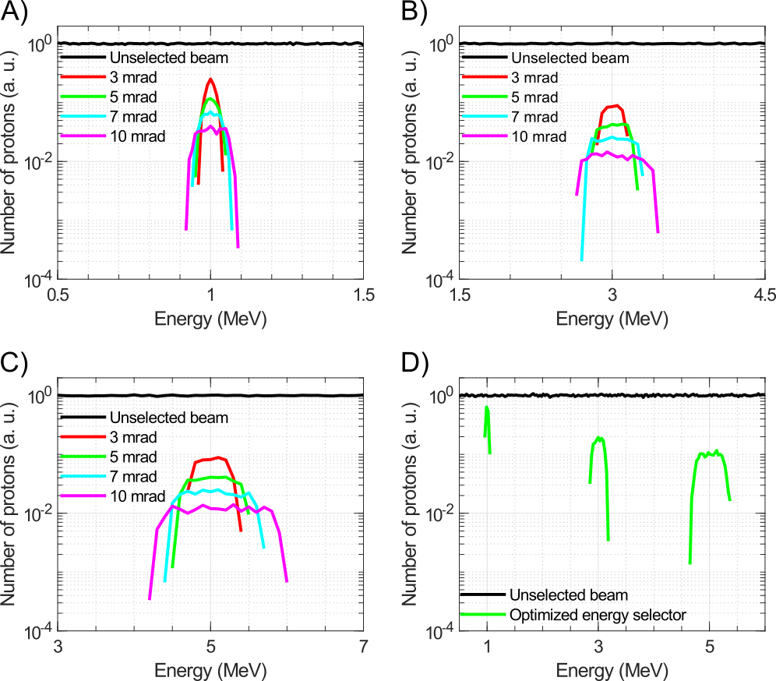
Particle simulation codes
Input : Initial uniform proton distribution
Study of initial divergence
29
Morabito A. et al., Laser and Particle Beams, 1-10 (2019).

Slide 30
Novel design starting from existing combinations
A theoretical model was develop in order to predict the MCP response at even high proton energies

