Slide 1
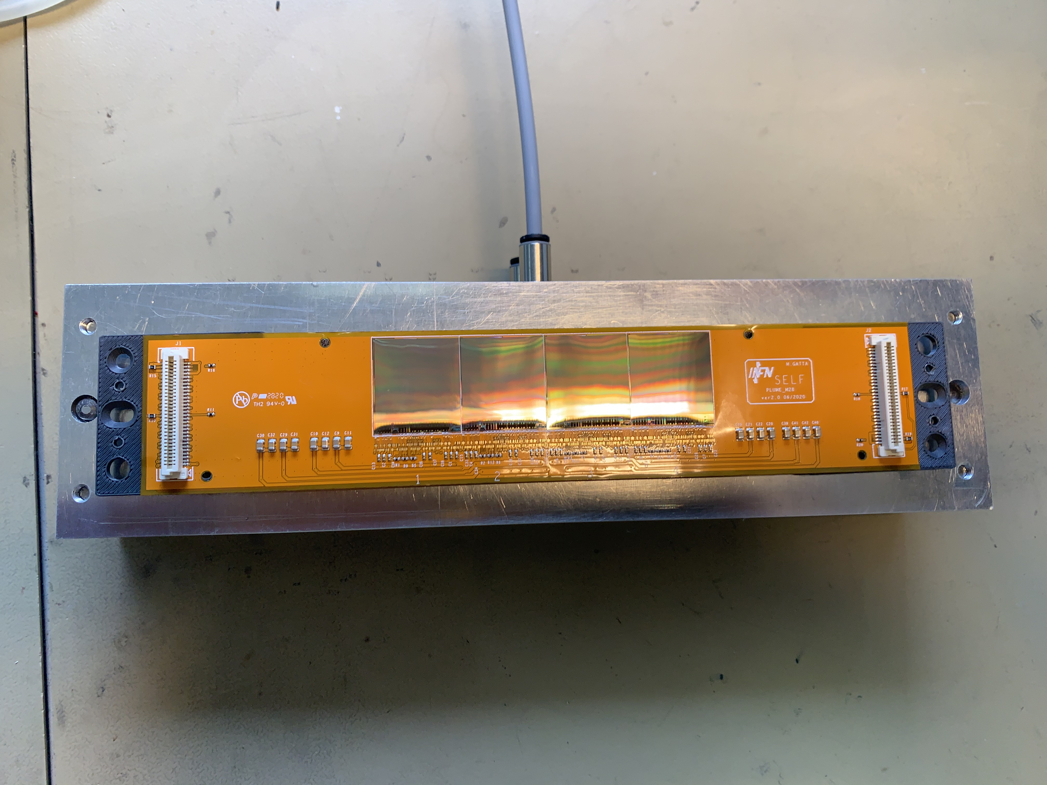
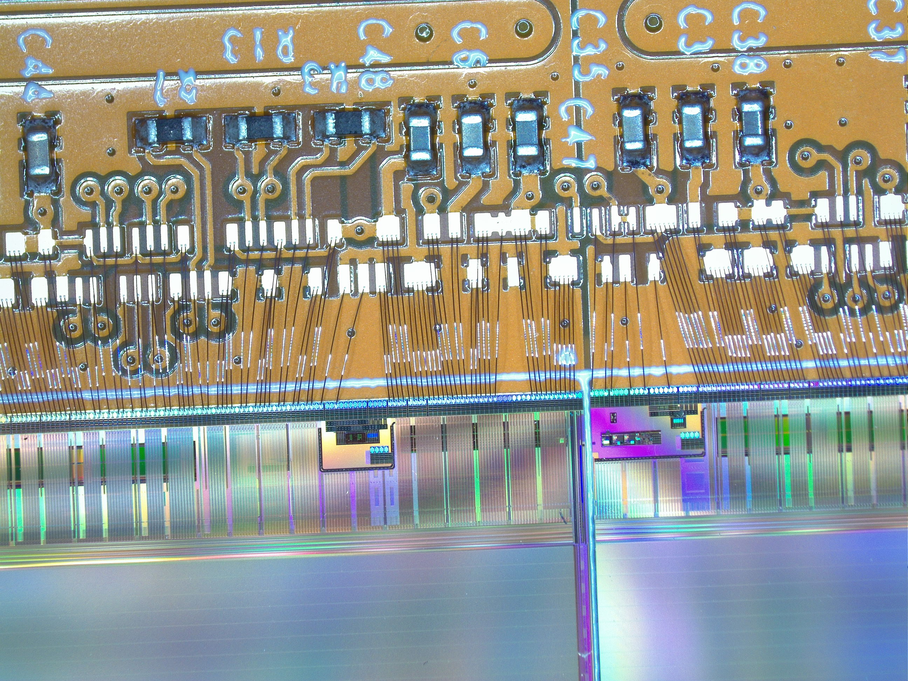
FOOT
What is allready done?
Dummy stave

Slide 3
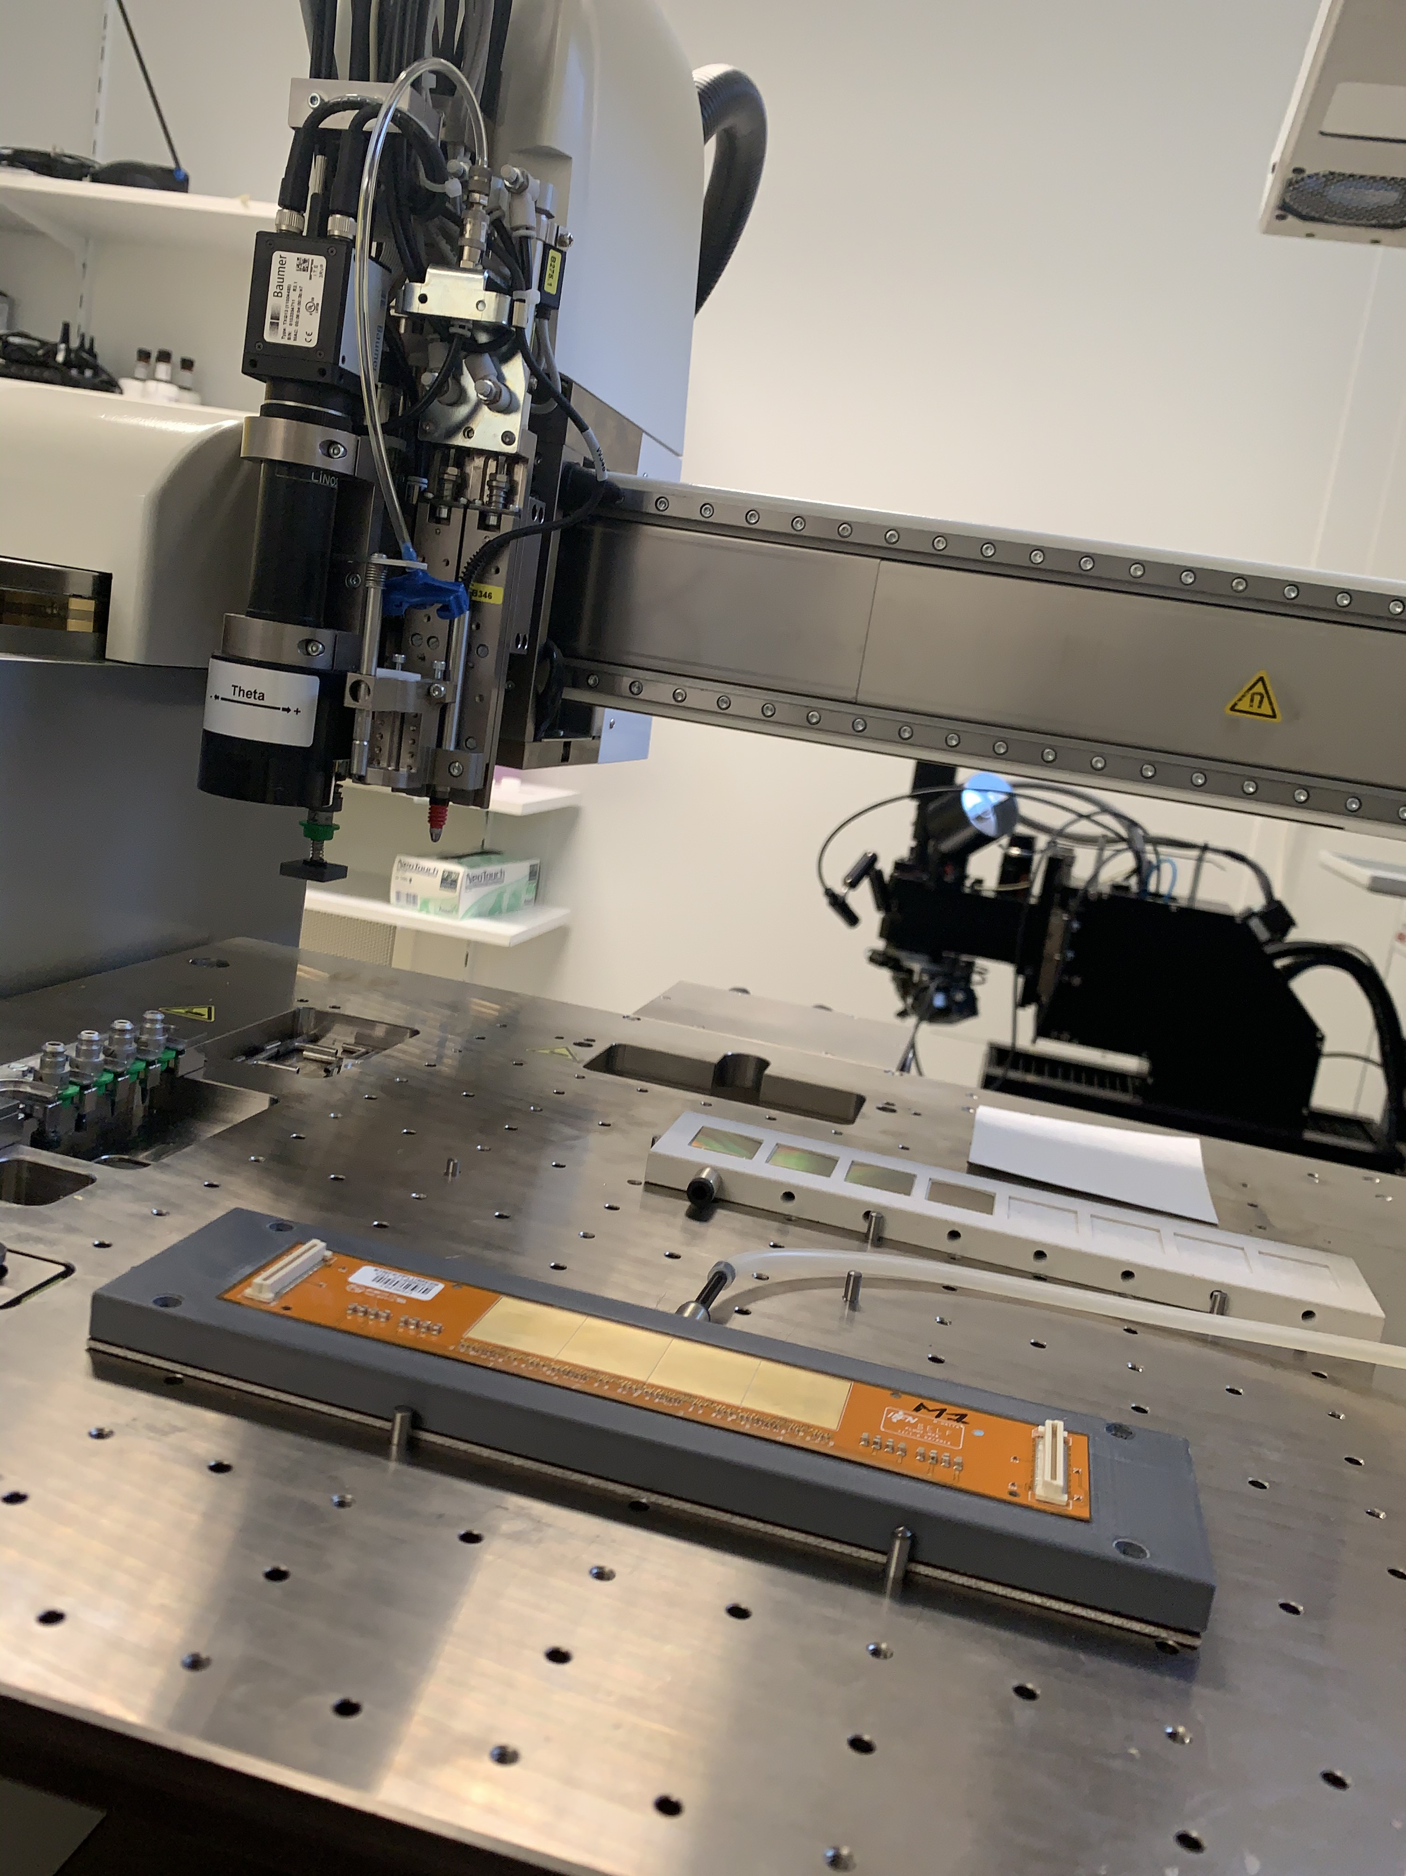
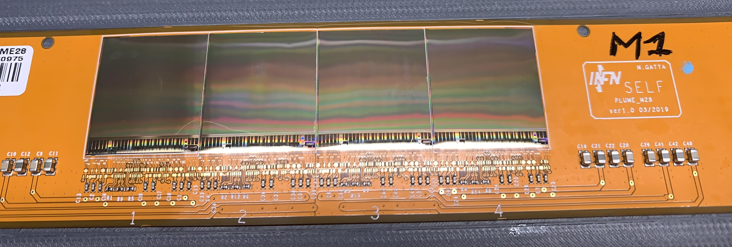
Functional module (hope it is)

Slide 4
Next steps:
Send the functional module to Eleuterio for test system evaluation (wait for shipping box)
Fabrication of the set of jigs (outsourcing or LNF). Decision took on Tuesday (tomorrow).
Reception of test system and jigs.
Once this is done, let’s continue to produce…

