Slide 1
N_TOF Italia ”What’s NEXT?”

Slide 2
Veniamo al nostro ranking annuale
Ni
W
Mo
Ba

Slide 3
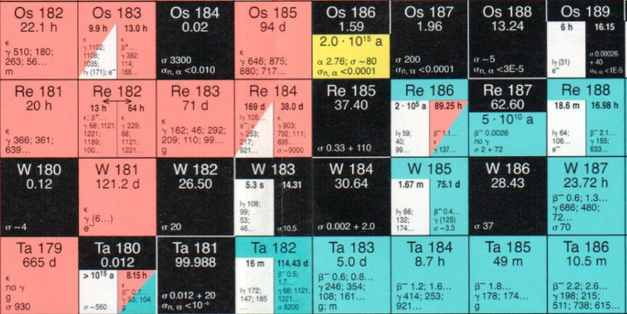
Tungsten isotopes

Slide 4
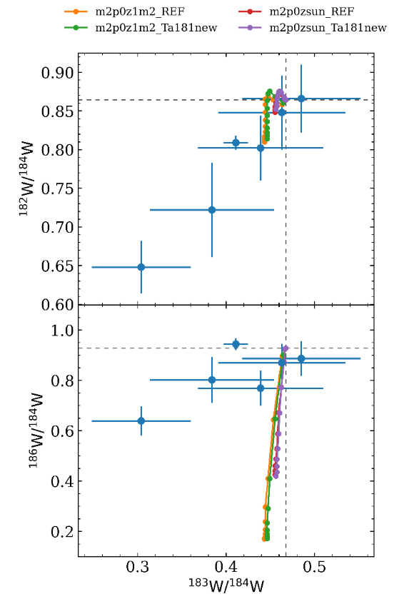
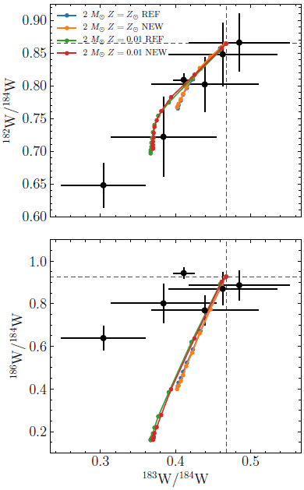
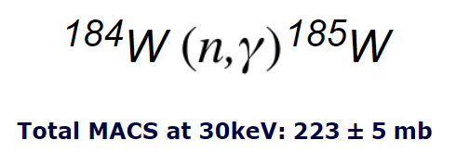
Tungsten isotopes
Kadonis v0p3
Kadonis v1p0

Slide 5
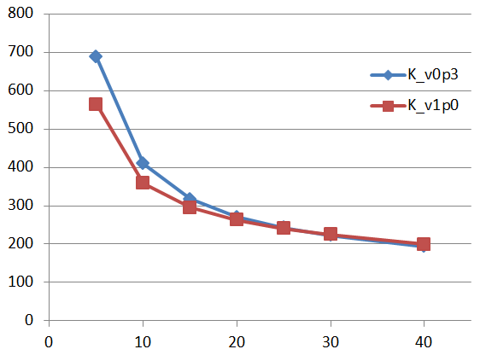
Tungsten isotopes

Slide 6
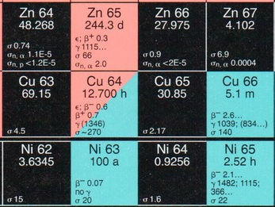
Nickel isotopes

Slide 7
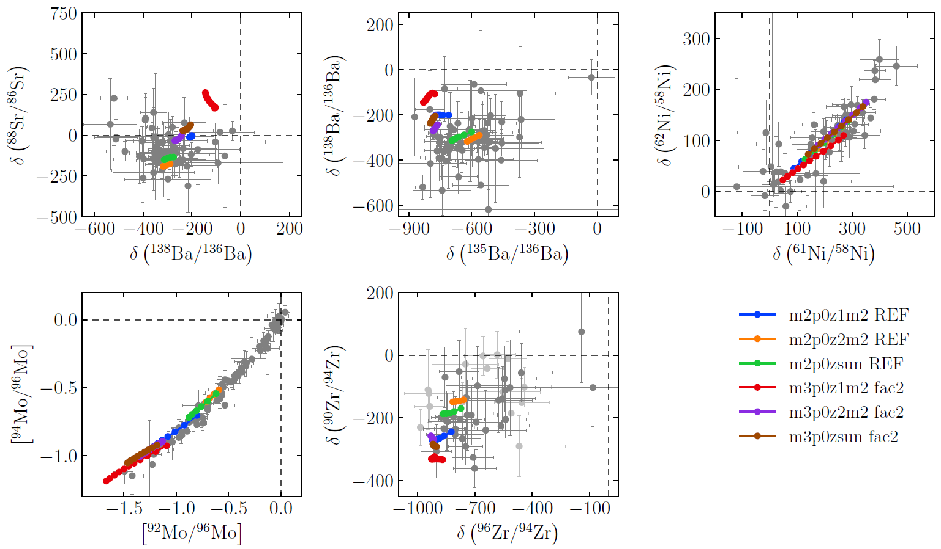
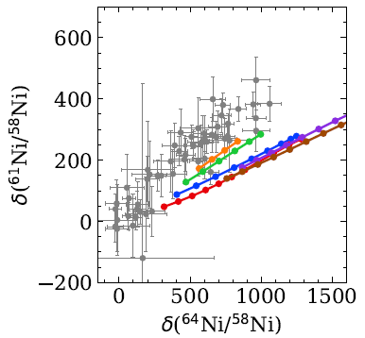
Nickel isotopes

Slide 8
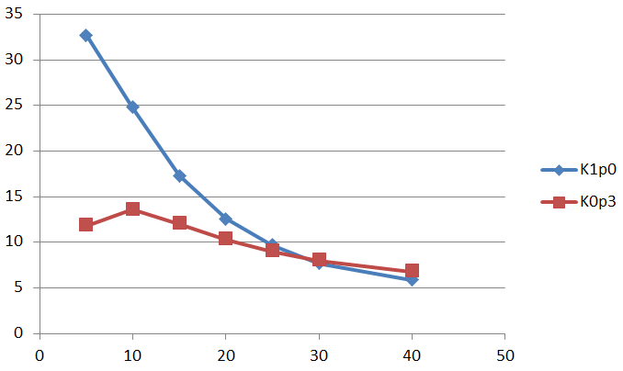
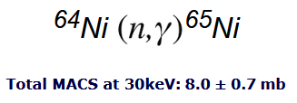
Nickel isotopes
Kadonis v0p3
Kadonis v1p0

Slide 9
Z
Barium isotopes
Ba
134
135
136
137
138
83 m
Cs
133
2.06 y
2.3 My
13.2 d
Xe
128
129
130
131
132
5.2 d
134
9.1 h
136
3.8 m
I
127
25 m
15.7
My
12.4 h
Te
126
109 d
128
70 m
130
25 m
10 h
r-process
A

Slide 10
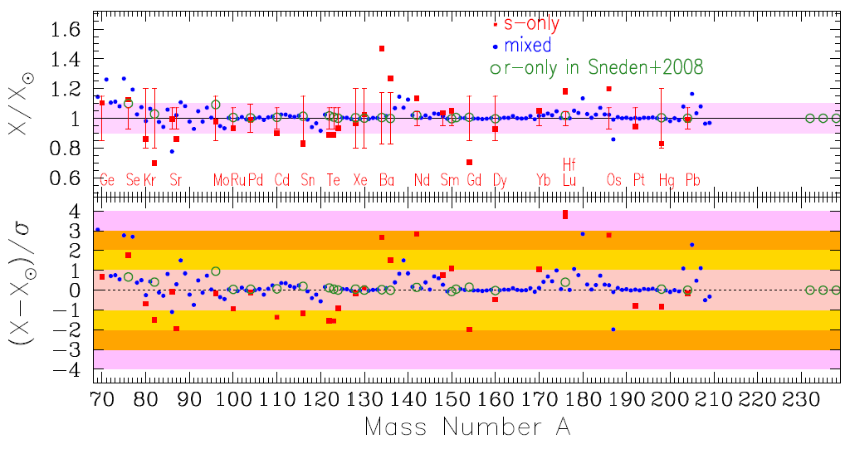
Z
Barium isotopes
Ba
¹³⁴⁻¹³⁶Ba(n,γ) s-only
134
135
136
137
138
83 m
Cs
133
2.06 y
2.3 My
13.2 d
Xe
128
129
130
131
132
5.2 d
134
9.1 h
136
3.8 m
I
127
25 m
15.7
My
12.4 h
Te
126
109 d
128
70 m
130
25 m
Prantzos+ 2020, MNRAS
10 h
r-process
A

