Slide 1
Facing the n-n scattering length measurement @ n_TOF
Agatino Musumarra
UNICT and INFN-CT

Slide 2
Fundamental Nuclear Physics towards a new
experimental and theoretical approach
n_TOF Cristian Massimi and Nikolas Patronis
http://cds.cern.ch/record/2730967/files/INTC-I-220.pdf
The experiment is based on the detection of the
three outgoing particles in kinematic coincidence,
leading to a full threebody kinematic reconstruction
In 2006 the n-TOF Collaboration already submitted a proposal (INTC-P-204) for a measurement of the neutron-neutron scattering length.
The original proposal had a deep review:
-Very challenging:
Theoretical model: three-body → two-body n-n(n-p)
Experimental technique: detection efficiency and
n-momentum reconstruction
-But high-gain: first wide energy range n-n scattering-length
measurement (10-100 MeV) after five decades of efforts

Slide 3
Work in progress (LoI and experimental set-up)
Preliminary active target scintillator and sensors already acquired:
Experimental task: LoI
setup and test of the first
n-TOF Active target
Information on γ-flash response and related determination of the highest neutron energy that can be reached
background characterization rate induced by the neutron beam in
the active target and detectors (very high rate)
2) Experimental task: final proposal
new detection technique for n-momentum reconstruction
with high efficiency
several application fields
«Blended» PRIN 2020
Bologna & Catania
«RIPTIDE»
C. Massimi(UNIBO)
M. Villa (UNIBO) PI
R. Spighi (INFN-BO)
F. Romano(INFN-CT)
M.G. Pellegriti(INFN-CT)
A.Musumarra(UNICT)
F. Leone(UNICT)
Spin-Off
Joining HEP + NP skills
RecoIl-Proton Track
Imaging DEtector
Monthly meeting (mini-workshop)
in progress from November 2020
Two congress contributions already submitted in 2021
C. Massimi (22nd International Workshop on Radiation Imaging Detectors) Ghent June-July
A. Musumarra (The 12th International Conference on Position Sensitive Detectors ) Birmingham September

Slide 4
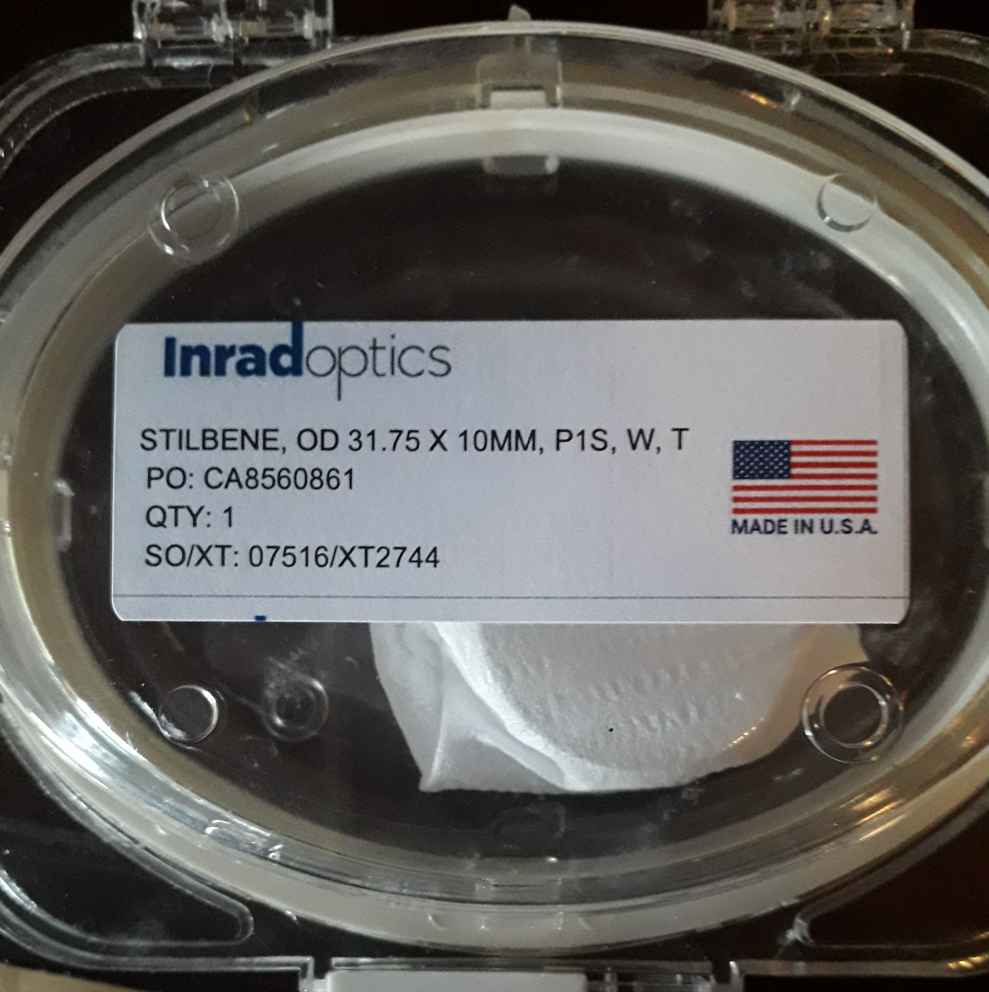
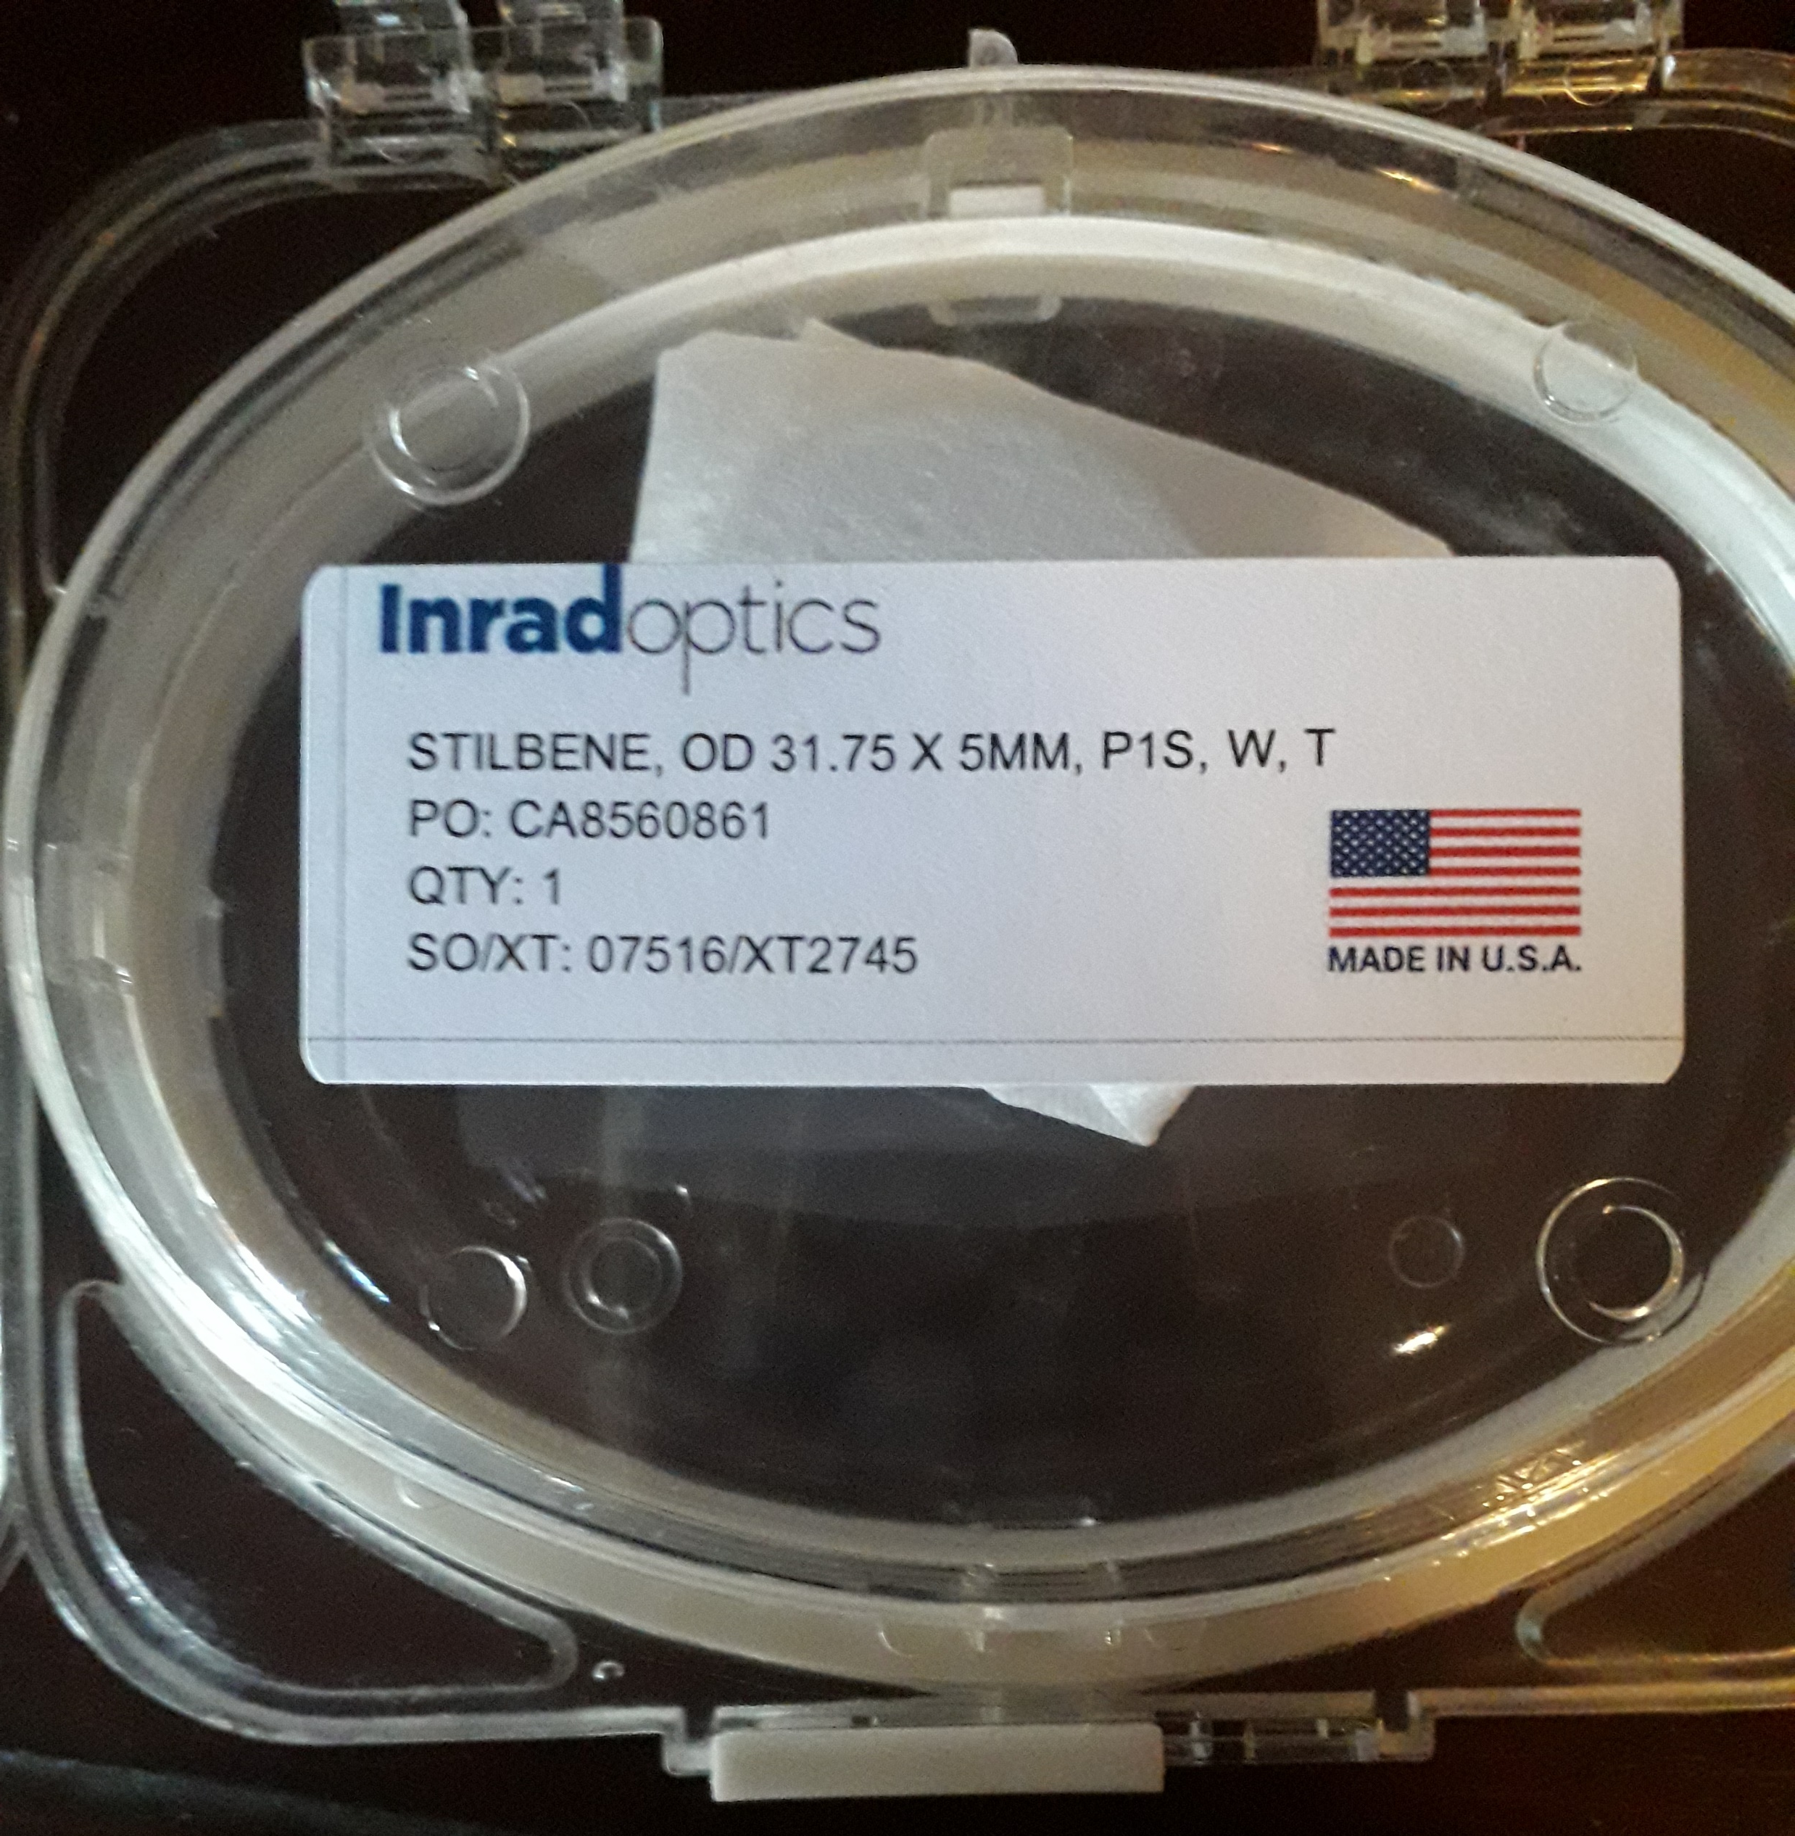
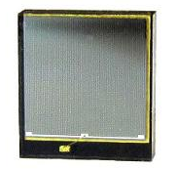
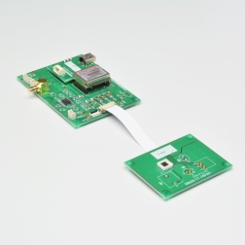
Experimental task: LoI
setup and test of the first
n-TOF Active target (n-n & n-p)
Cristian and Nikolas (Riccardo Mucciola - GEANT4 simulations)
Agatino and Maria Grazia (Experimental setup)
First test planned
at NCSR Demokritos
Preliminary
deuterated scintillator:
Stilbene (380 nm Pulse Shape disc.)
Disk: 32mm diameter, 5 & 10 mm thick
Scintillators
INRADoptics
(Nikolas)
NE-232 liquid scintillator
BC-436 plastic scintillator
Used at TUNL
Loading ?
AdvanSid
ASD-NUV4S-P (4x4) and
Standard RC + fast pre-amp
Hamamatsu
C12332-01 evaluation kit
and 2xS13360-6050CS (6x6)
SiPM readout
(two options)
Peltier Cooling ?
Radiation hardness ?
Fast (scintillator and readout)
Improved light collection (multi point)
PS capabilities by light sharing (primary vertex)
Reduced amount of in-beam material
γ-n discrimination
n-point SiPM readout
(4x4 and 6x6 mm²)
Better coating
Wrapping (direct-diffuse)
PS vs light collection

Slide 5
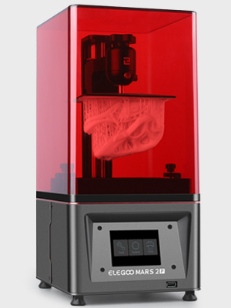
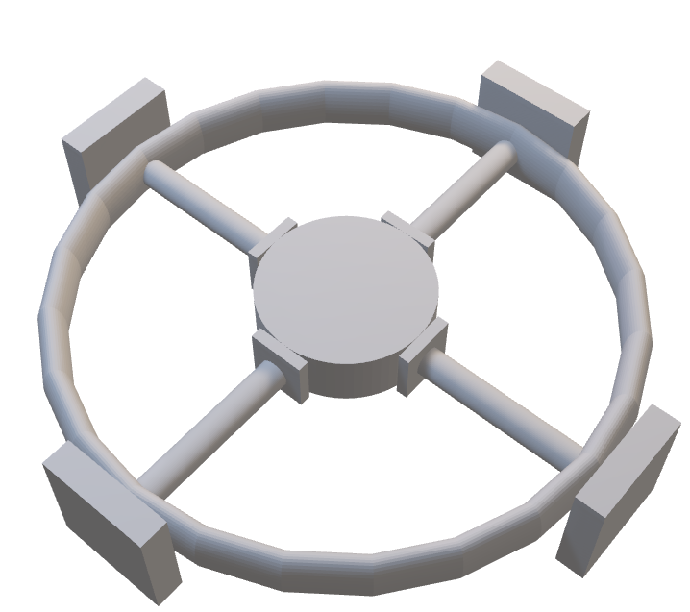
Setup and engineering
(preliminary):
UNICT-DIEEI
3D MSLA printing for fast prototyping
Masked StereoLithogrAphy
cheap and reliable technology
Tested and working (3D-objects in-vacuum 2ˑ10⁻⁵ mbar)
50 μm tolerance (x-y)
Real-time machining (FAST)
Mechanical structure
impossible or hard-to-design
by ‘standard’ approach
No workshop required
COVID free
Easy to
replace
Scintil.
SiPM
Front-end
and HV
Symmetry allows rescaling
(number of sensors and diameters)
The final design (if necessary) can be implemented in any material (Aluminum)

Slide 6
Signal readout:
Fast ADC 1-10 GHz (BW) 10-100 GS (full signal shape acquisition) → Time Series
e.g. Acqiris 12-bit, from 500 MS/s to 4 GS/s,DC up to 2 GHz bandwidth
New data analysis approach
the technique has been developed and applied in Complex System PhD by UNICT
«Matrix Rotation Analysis» → Principal Component Analysis (PCA I.T. Jolliffe - Springer)
A step beyond: - heterogeneous data set (mixing very different kind of classes)
- unsupervised analysis (no a-priori data correlation has to be known)
Coupled to standard Pattern Recognition: e.g. Neural-Network analysis

Slide 7
Outlook (to be COVID verified):
Active Target: 1) First test at NCSR Demokritos (June-July)
2) Parasitic n-beam n_TOF@CERN (commissioning)
n-n experimental setup: «RIPTIDE» in progress
Preliminary test of the technique
at Demokritos in June-July
Very serious INFN situation: due to the COVID, INFN-CT Director has blocked INFN
participation to experiments performed abroad (also involving INFN-CT spokesperson).
We expect actions by n_TOF national and international experiment spokespersons

