Slide 1
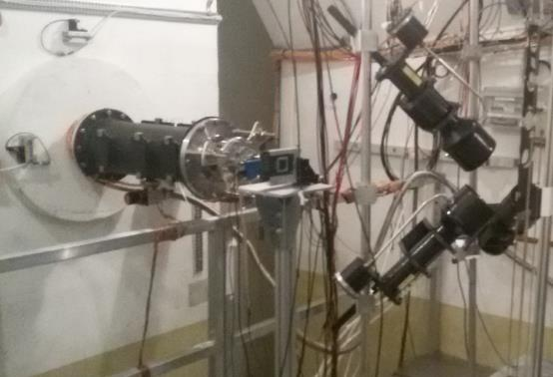
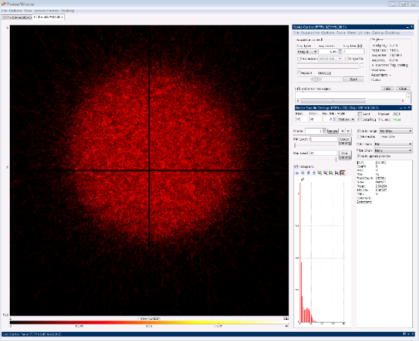
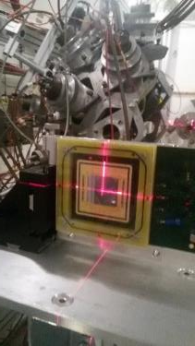
Timepix Neutron Beam Monitor at nTOF
nTOF EAR1
Beam image
In 2018 a beam monitor based on 2 Quad Timepixes has been installed in nTOF EAR1
It has been used for the beam alignment and could be used for flux measurements in 2021-2022
LNF proposed in 2019 to realize a second alignment system in EAR2 (financial requests for 2020)
2 silicon quad are in wire bonding phase here at CERN

Slide 2
Tests on MBGEM neutron detector

Slide 3
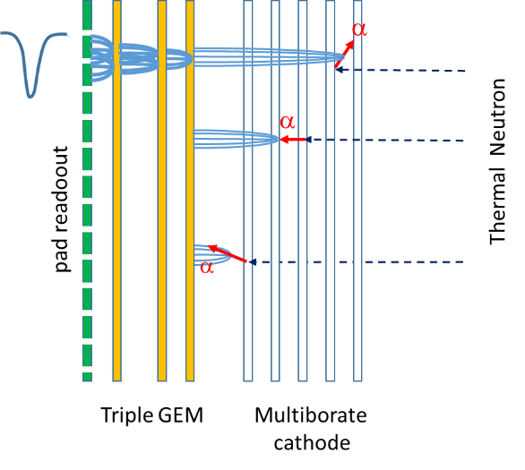
Borated GEM: MultiBorated head-on converter
The borated GEM was proposed for the first time by Cascade project
but problems on boron deposition stability
and GEM reliability.
In three years several attempts have been made in collaboration with Milano Bicocca, CERN and ESS Liopking
and now a new etching and Boron deposition procedure has been defined
We have assembled two detectors for the first characterization.
Good prospective for high efficiency thermal neutron imaging for nTOF.

Slide 4
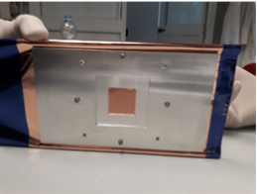
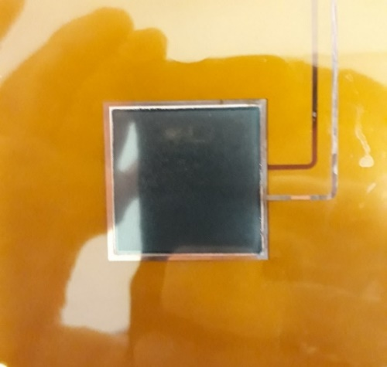
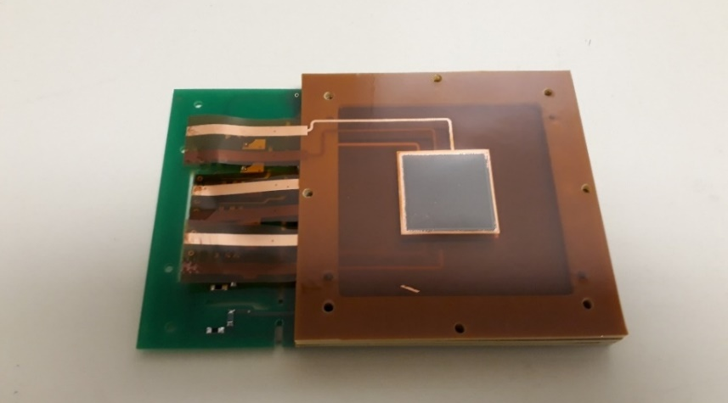
Borated GEM for high efficiency thermal neutrons detector
The GEMPix detector allows to develop and optimize a new thermal neutron detector based on GEM technology.
A collaboration between CERN ESS INFN has recently develop a new procedure to realize borated GEM.
A detector efficiency 7 times the single foil has be reached on a uniform big surface (3x3 cm²)
with high time (10 ns) and spatial resolution (50 μm) with Timepix electronics.
F.Murtas, G.Claps, R.De Oliveira, C.Lai, G.Croci, A.Muraro

Slide 5
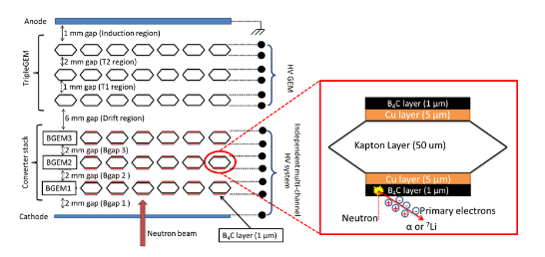
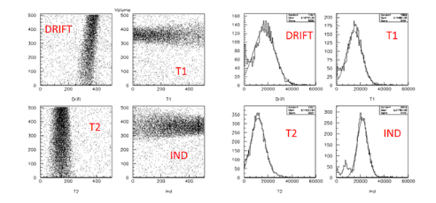
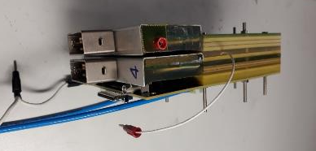
MBGEMPix detector
Active area 3x3 cm²
Characterization with ⁵⁵Fe source with the aim to uniform the Q_{ion} produced by alfas in the different conversion layer
⁵⁵Fe
2D images of X ray “beam” through
1 mm hole and spectra

Slide 6
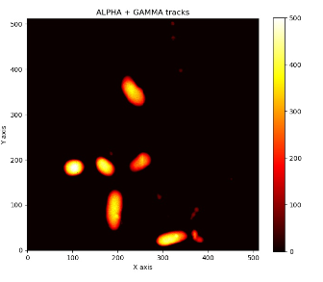
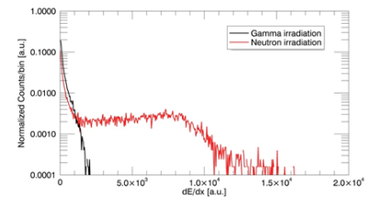
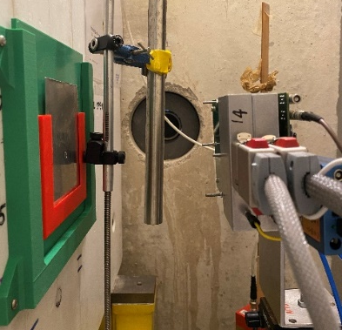
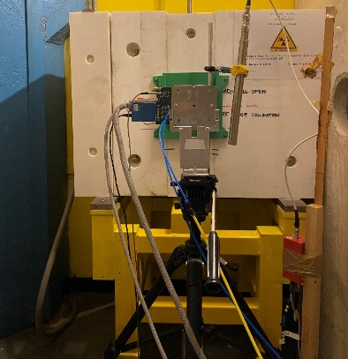
MBGEMPix detector
³He Tube
neutrons
Neutron gamma discrimination
gammas
Relative efficiency switching ON the BGEM foils
Linearity up to 1.2 MHz/cm²
with the reactor at 250 kW.
Measurements at LENA

Slide 7
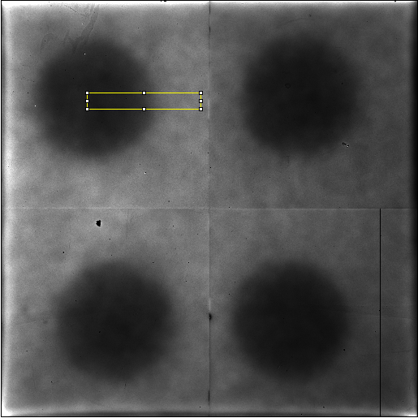
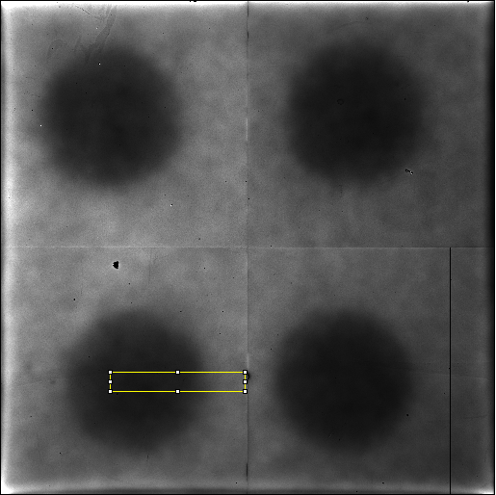
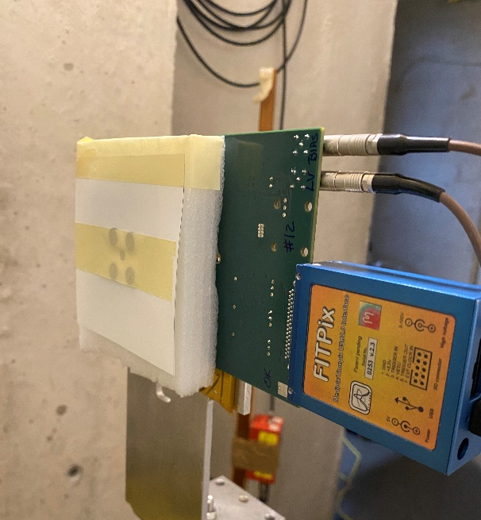
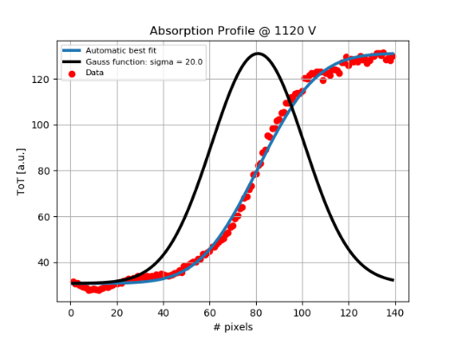
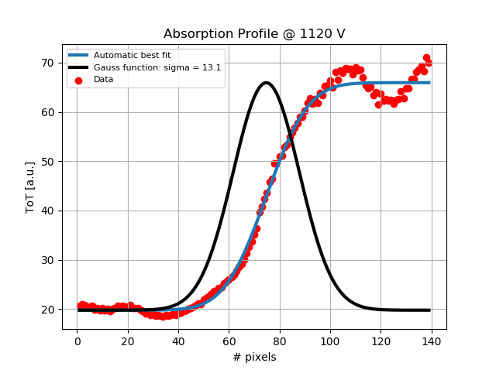
MBGEM Spatial Resolution
140 pixels
20 pixels
Sigma: 20.0 pixels
Sigma: 13.1 pixels
4 Cd disks:
diameter 8 mm, width 1 mm.
Edge sigma <1mm
(1 pixel 55x55 um)

Slide 8
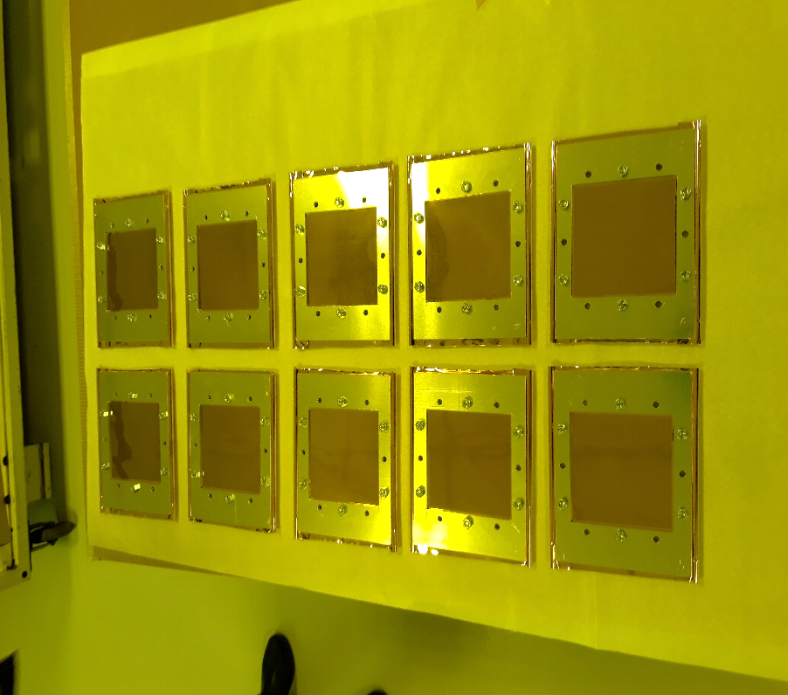
Production of 10 Borated GEM foils 10x10 cm²
10 GEM foils (10x10 cm²) have been borated
in Sweden on February 15th
They are at CERN ready after the etching
(Rui’s Laboratory)
Two detectors we’ll be built in Frascati
before September.
The electronic readout is ready :
- 256 pads 6x6 mm²
8 Gemini32 boards and FPGA board (designed by Corradi Tagnani)
Paid by nTOF-LNF and MIB

Slide 9
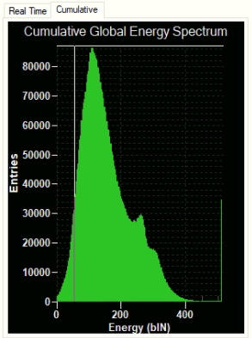
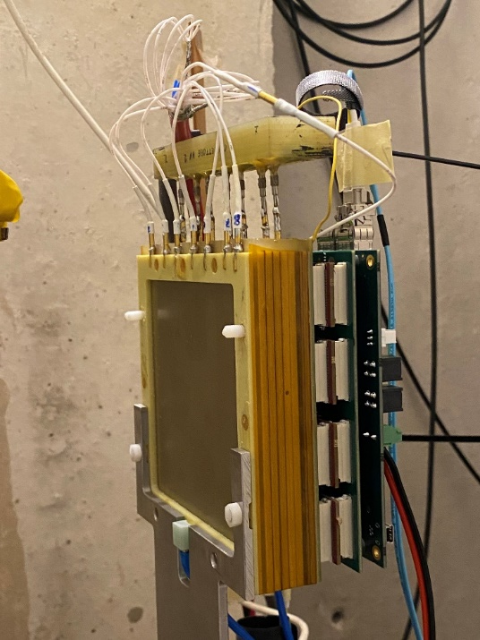
Preliminary results on 10x10cm² MBGEM
2D beam image
Spectrum with GEMINI chip
Measurements at LENA

