Slide 1



News from CERN
Alberto Mengoni
Meeting della Collaborazione nazionale n_TOF
26 marzo 2021

Slide 2
n_TOF Phase-2021
n_TOF target III & facility upgrades
target installation started (target lowered into the pit for a test of positioning)
beam starts: W29 (19 July 2021)
beam ends: W45 (14 November 2021) and resumes W5 (31 January, TBC) in 2022
INTC meeting coming up on 23-24 June
LOI on HPGe “in beam” test
LOI on the X17 setup test

Slide 3
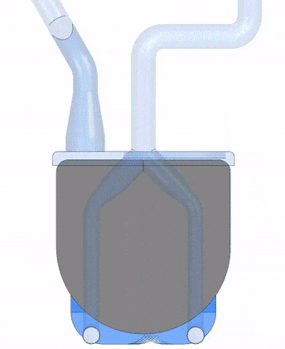
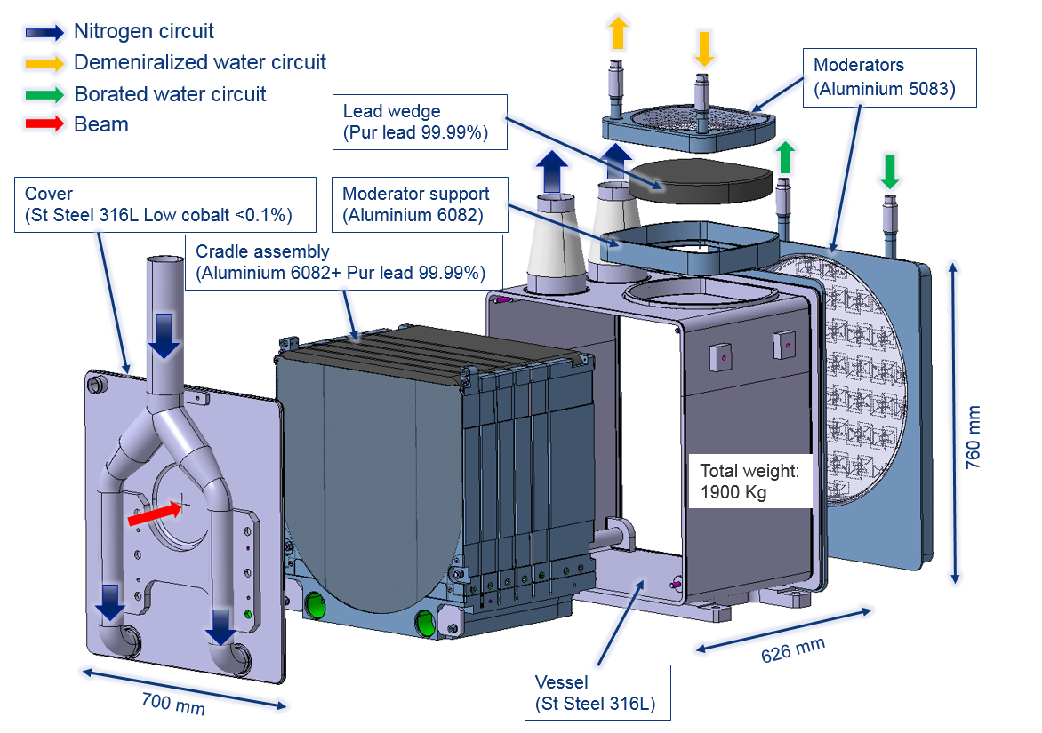
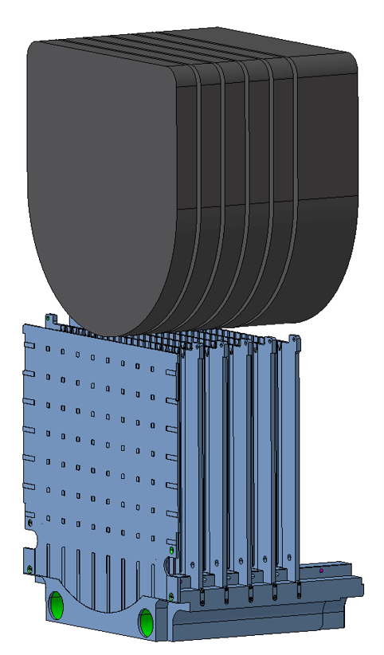
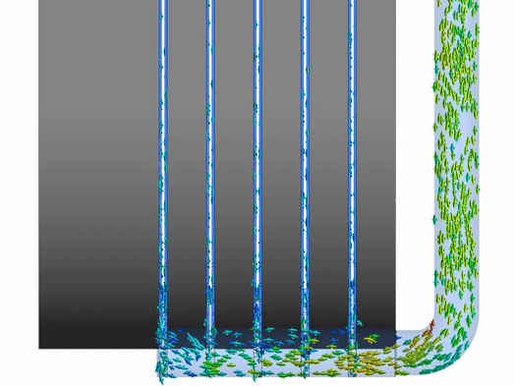
n_TOF Target III
50 mm
150 mm
Al-6082-T6 supporting structure
(anti-creep and N₂ cooling channels)
Target design report: EDMS 2154581

Slide 4
n_TOF Target III
After 5 years and 5 project reviews, the n_TOF Target #3 is ready to be installed in the area where it will stay at least until LS4.
The project is on track; commissioning with beam will start in July 2021.
Cold tests on final target assembly successful:
  Pressure test: 2.5 barg (moderators) and 0.715 barg (N₂ vessel)
  Operating water circuits and N₂ circuit tested up to 1000 m³/h
  All 6 thermocouples properly working with online recording and monitoring on NXCALS/TIMBER
  Pressure drop at the target experimentally validated (∼10 kPa max. at 1000 m³/h)
  Target deformations experimentally validated by DIC (max. displacement: 0.55 mm)
  Target vibrational behavior validated by accelerometers

Slide 5
n_TOF Phase-2021
Main activities going on at CERN
full fledged FLUKA simulations (Massimo B)
test of the new SiMON chamber (Oliver A & Massimo B)
test/setup L6D6 detectors (Javier P & two PhD students)
DAQ commissioning (DAQ team with Massimo B)

Slide 6
For your reference, by Javier Praena

Slide 7
n_TOF Phase-2021
useful links:
Index of documents for the Commissioning (Phase-2021)
Local Team @ CERN
n_TOF twiki

Slide 8
Slides di Massimo B

Slide 9


Update on the Fluka simulations for the new target performances and for the NEAR Station
n_TOF Collaboration Board Meeting, March 2021

Slide 10

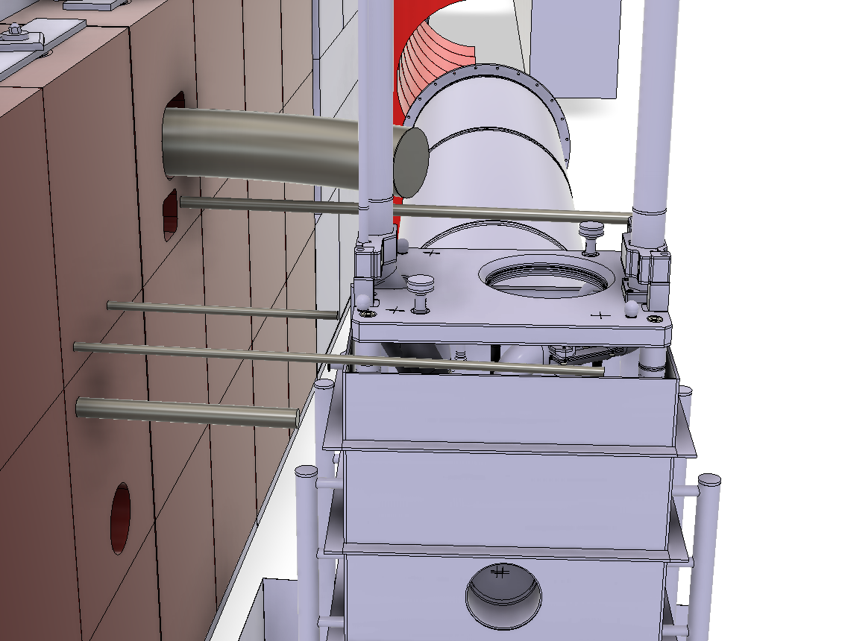
Simulations for R2M
Rabbit 1
RP
Rabbit 2
Endoscopes
Rabbit 3
Collimator
M. Barbagallo, Report on fluka simulations, n_TOF Collaboration Board Meeting, March 2021

Slide 11
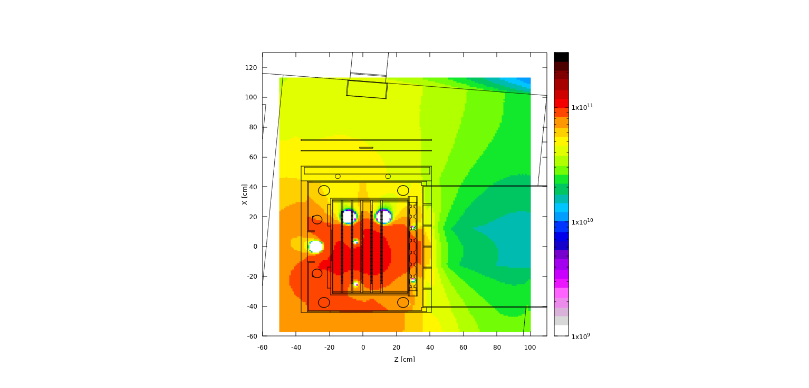
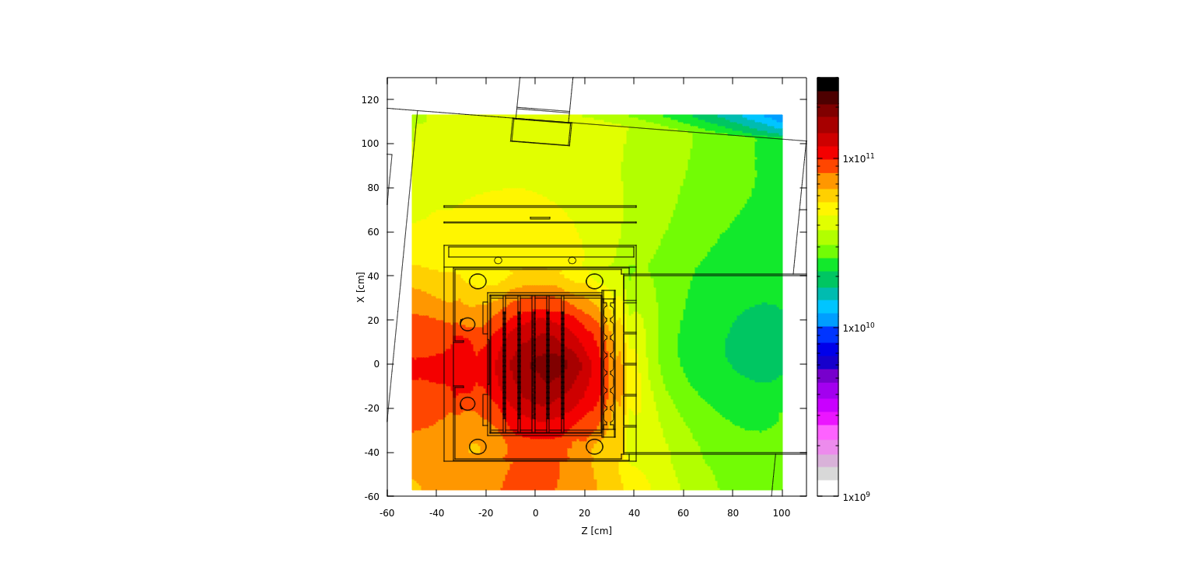
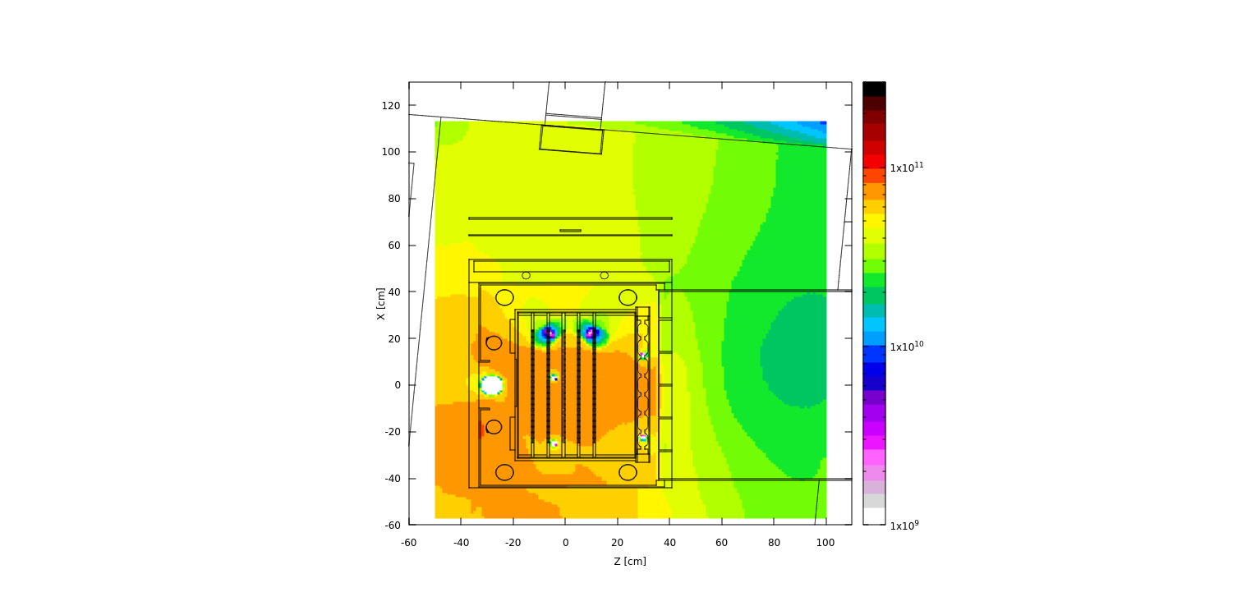
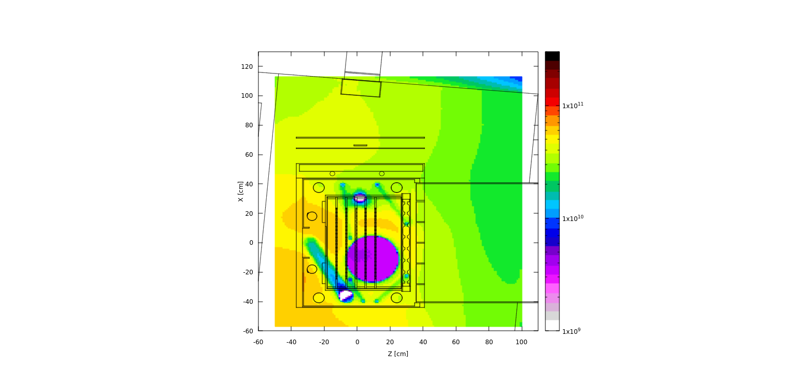
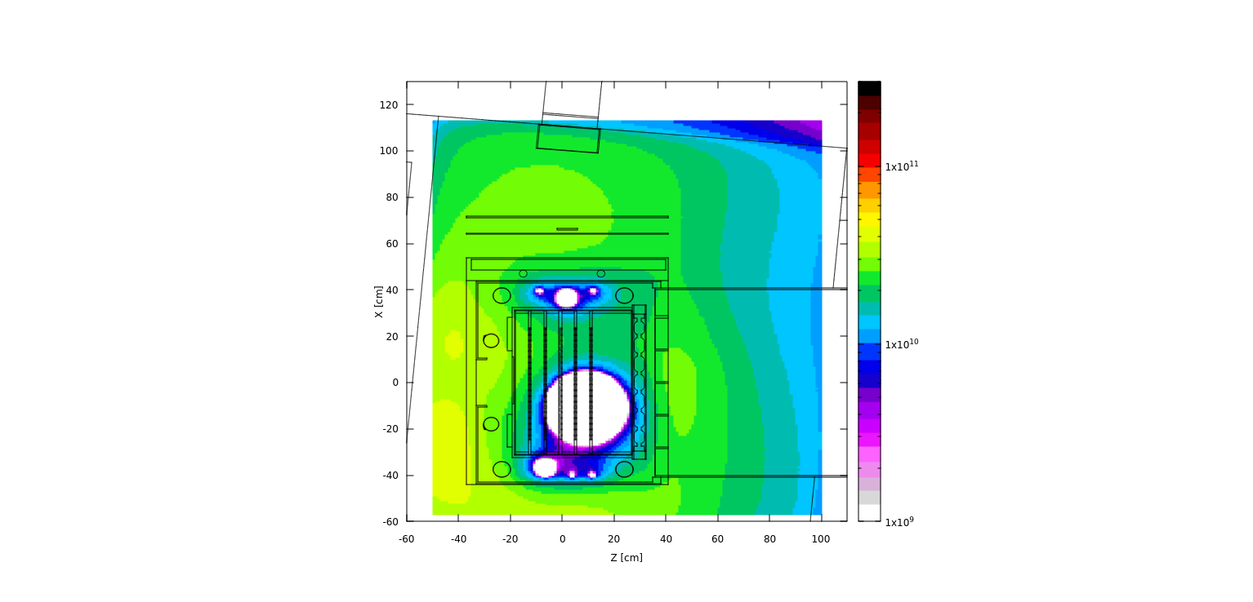
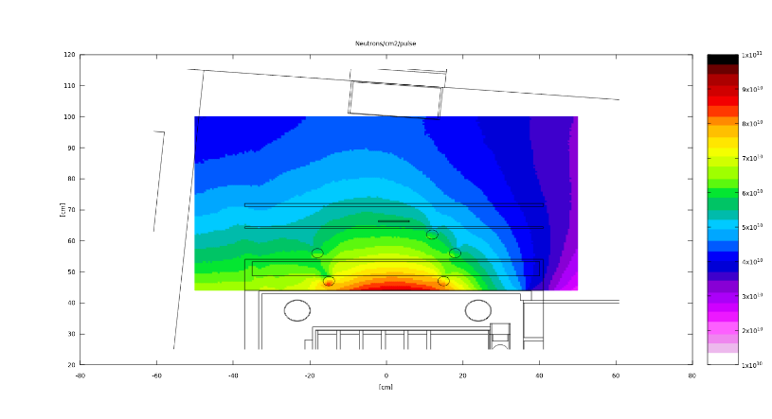
Neutrons distribution (n/cm2/pulse)
Shelf top
Shelf bottom
Rabbit 3
Rabbit 2
Rabbit 1
‘’Old’’ reduced calculations
Same order of magnitude at different heights
Upstream side of the target area slightly higher neutron density
M. Barbagallo, NEAR Simulation, January 2021

Slide 12
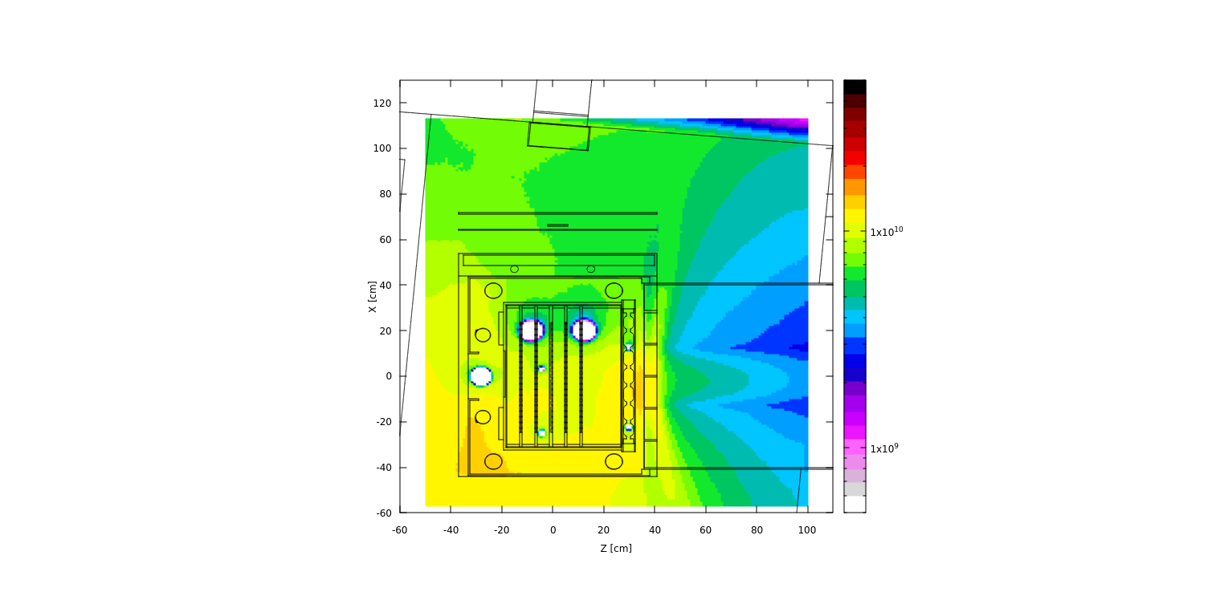
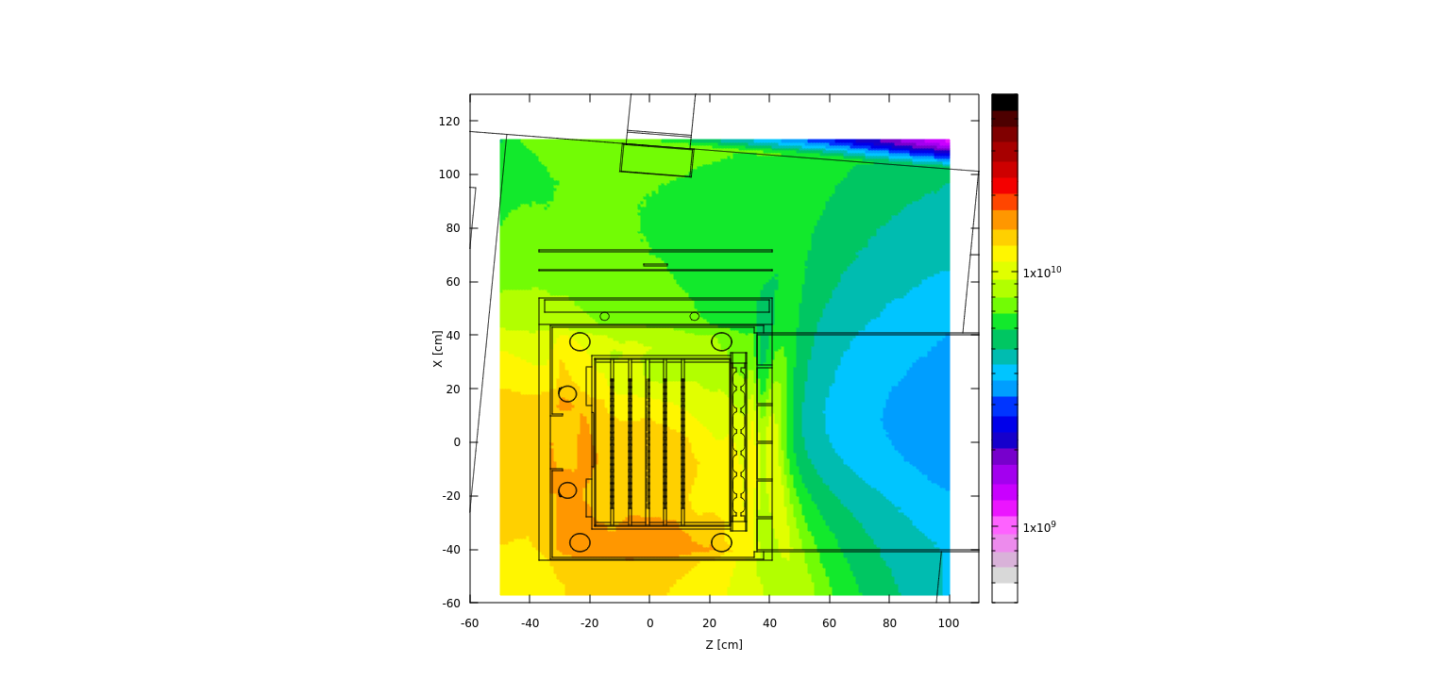
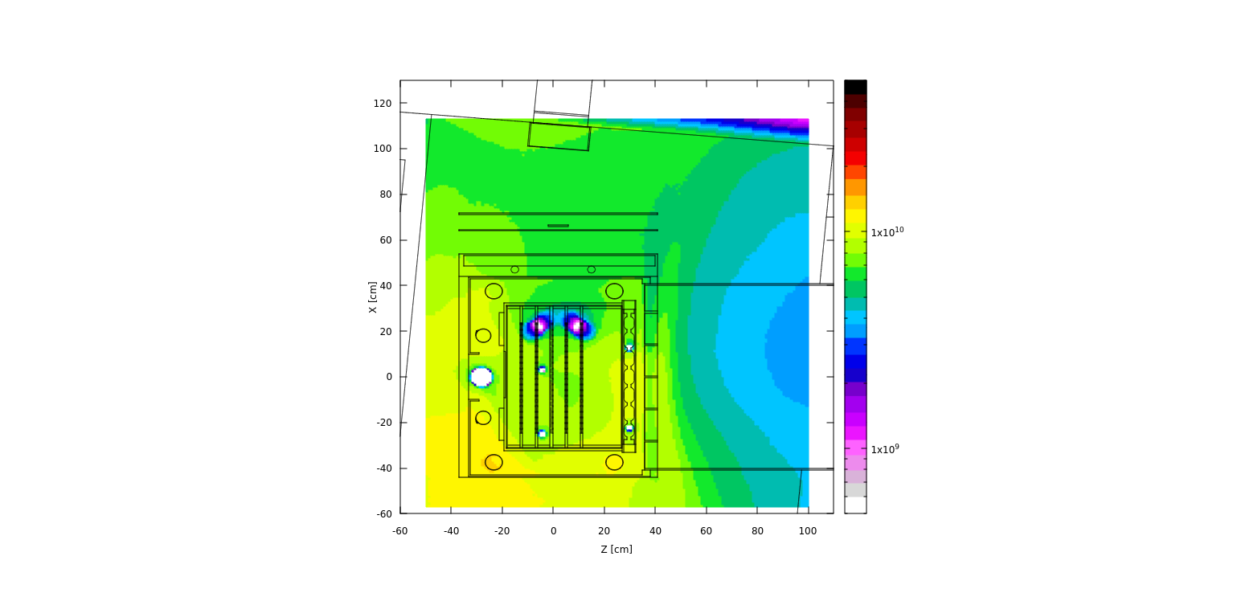
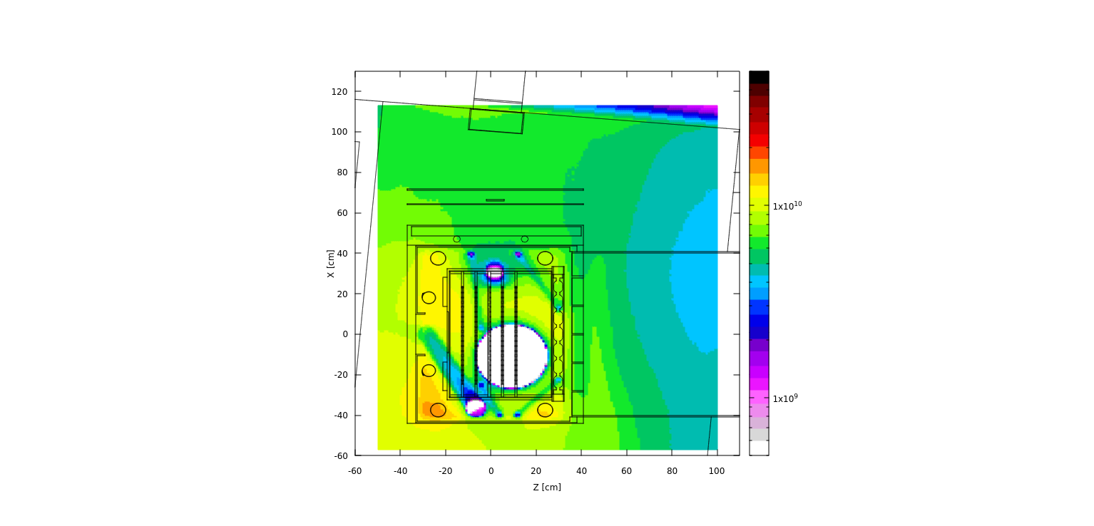
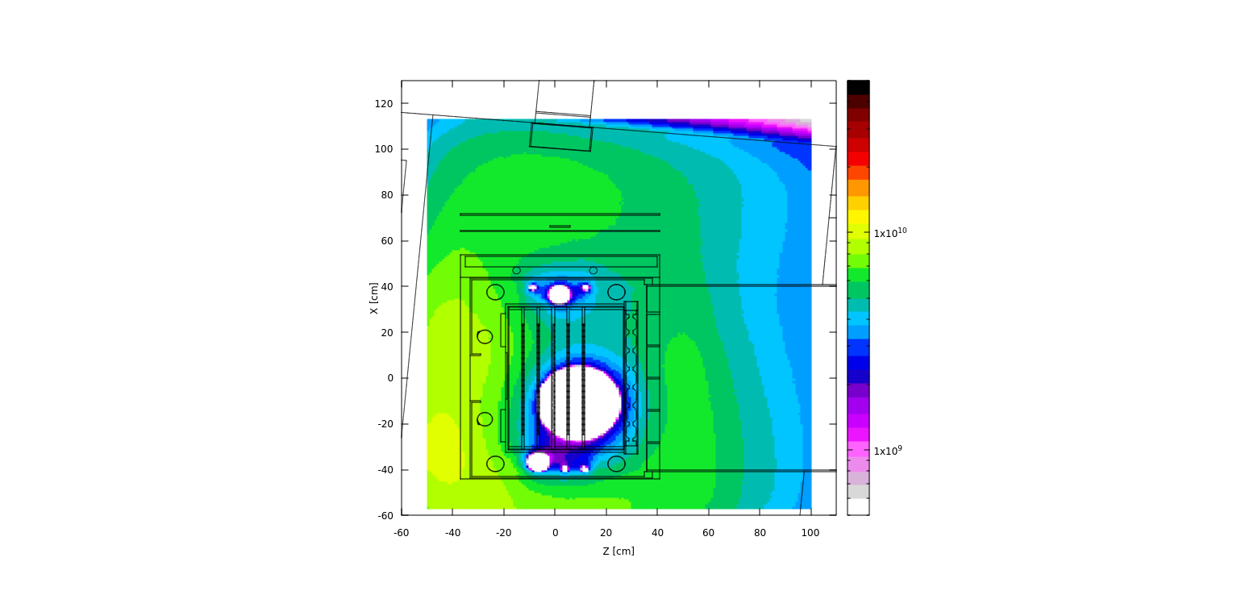
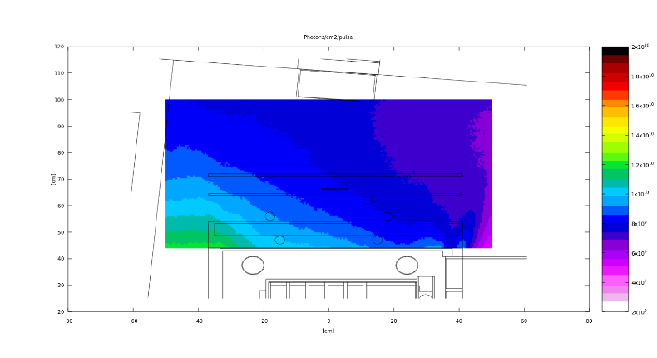
Gammas distribution (γ/cm2/pulse)
Shelf top
Shelf bottom
Rabbit 3
Rabbit 2
Rabbit 1
‘’Old’’ reduced calculations
Same order of magnitude at different heights
Upstream side of the target area slightly higher gamma density (in particular on the right side wrt to p beam positive direction)
M. Barbagallo, NEAR Simulation, January 2021

Slide 13
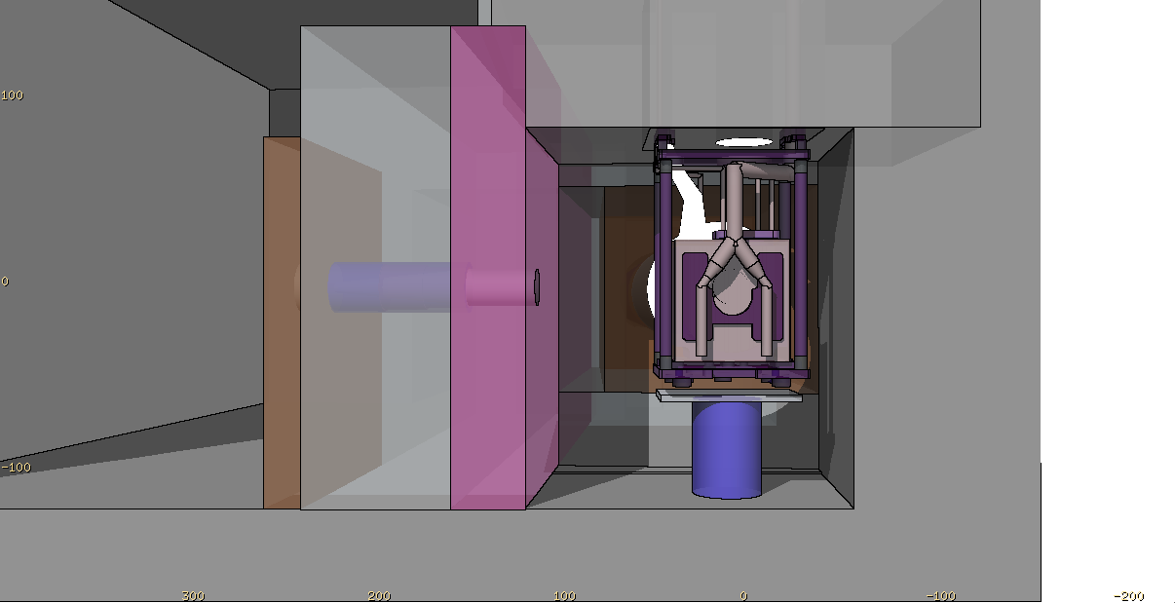
Summary of simulation status for NEAR
Updated facility Fluka model (includes shelves for R2M samples and NEAR moderator (if any), holes for rabbit)
Quantities scored: Dose (total and EM), spatial distributions of n, γ, p, e, μ, π, k, HEH
neutrons
Available upon request
M. Barbagallo, Report on fluka simulations, n_TOF Collaboration Board Meeting, March 2021

Slide 14
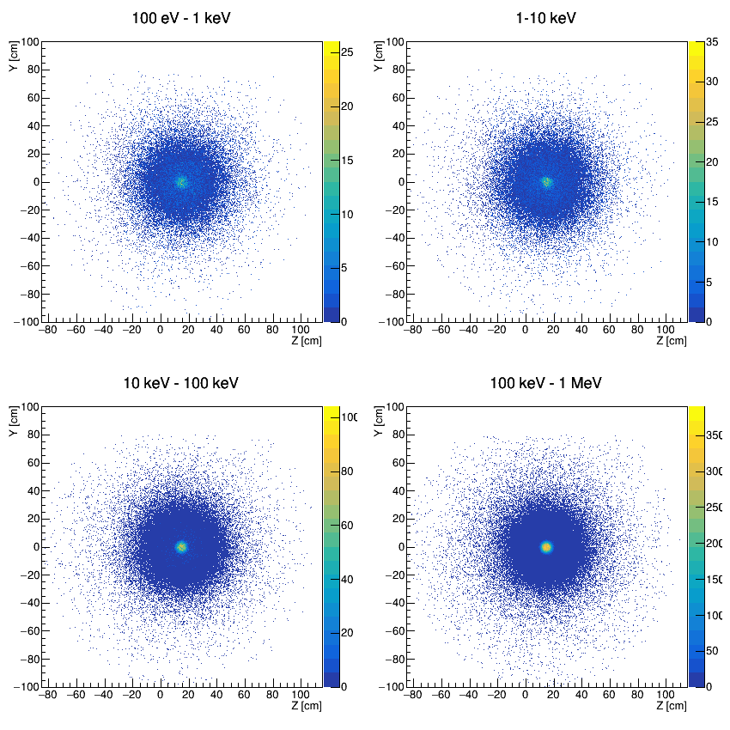
Beam profile at scoring plane
M. Barbagallo, Report on fluka simulations, n_TOF Collaboration Board Meeting, March 2021

Slide 15
Beam profile at scoring plane
M. Barbagallo, Report on fluka simulations, n_TOF Collaboration Board Meeting, March 2021

Slide 16
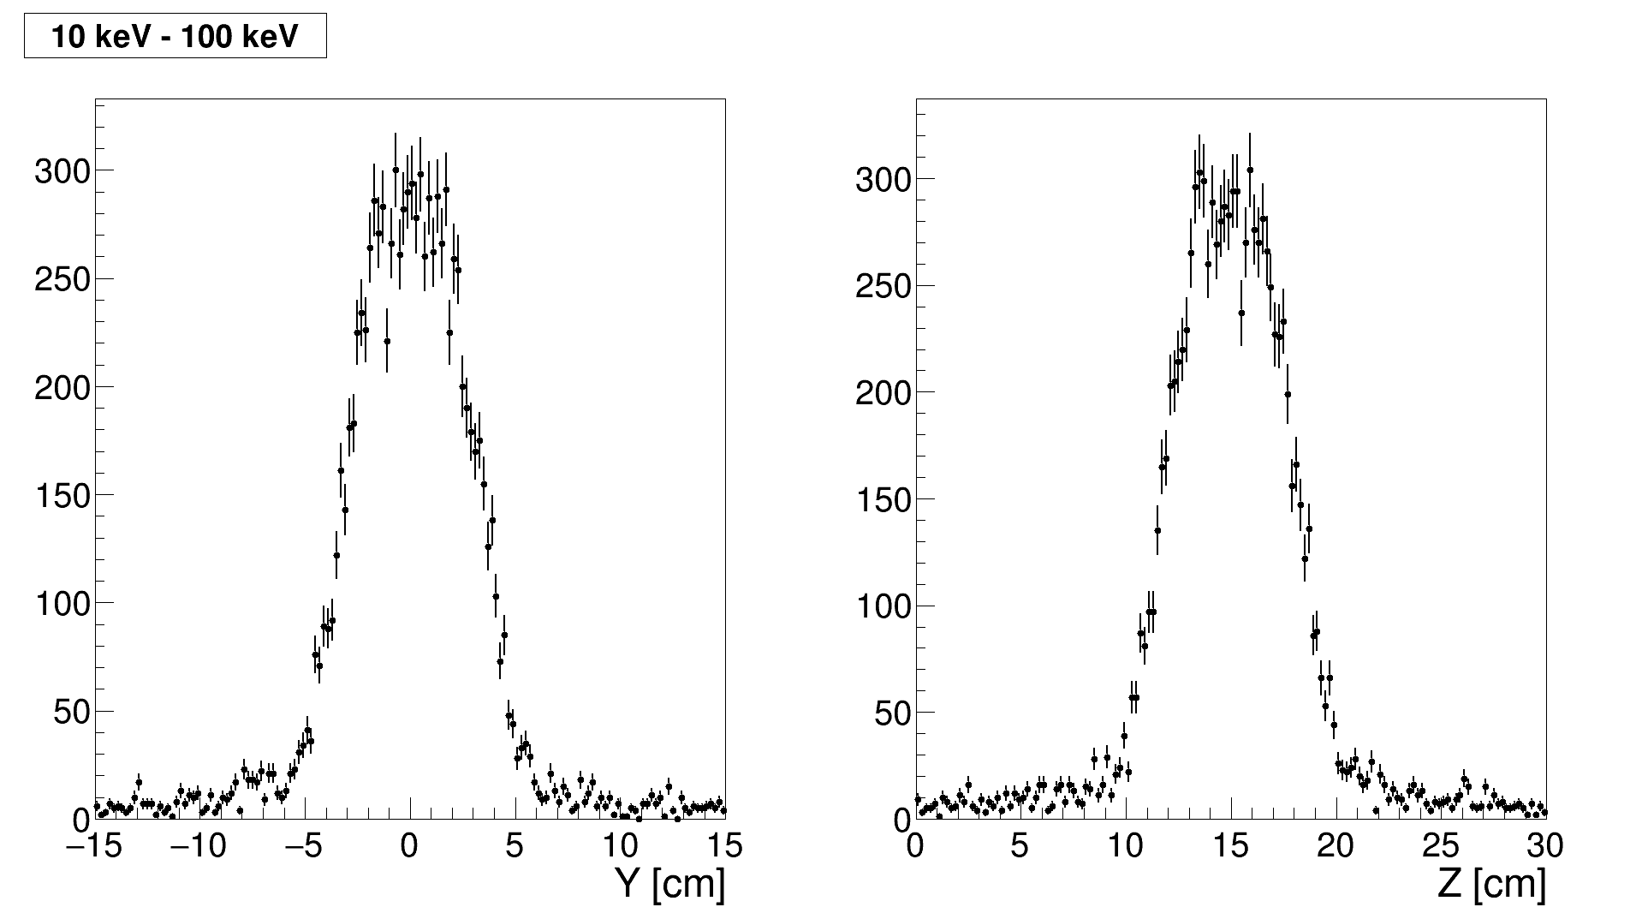
μ profile projection
M. Barbagallo, March 2021

