Slide 1
Monitoring of Hadrontherapy treatments through secondary fragments detection
17th March 2021
Irene Egidi

Slide 2
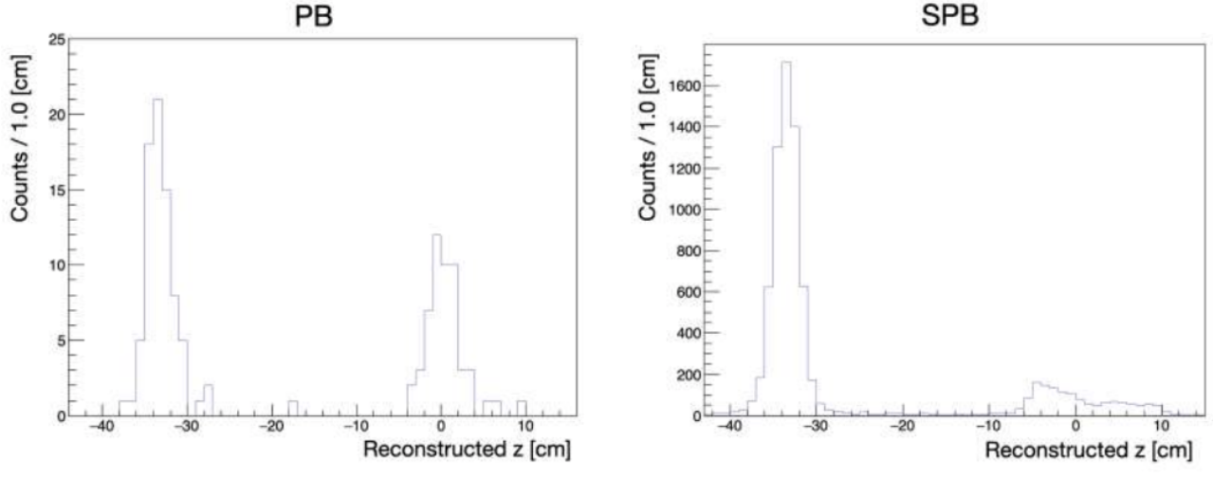
Previous work: One-dimensional analysis
METHOD:
Projection onto z-axis of the emission maps considering SPB to minimize statistical fluctuations.
~ x75 stat
Goal: find discrepancies among fractions of a carbon treatment
Comparison among one-dimensional spectrum of different fractions $\left(χ2\right)$. The first fraction is considered as reference information$:$
No peak for low p-value: no significant morphological changes,
Peak for low p-value: morphological changes observed.

Slide 3
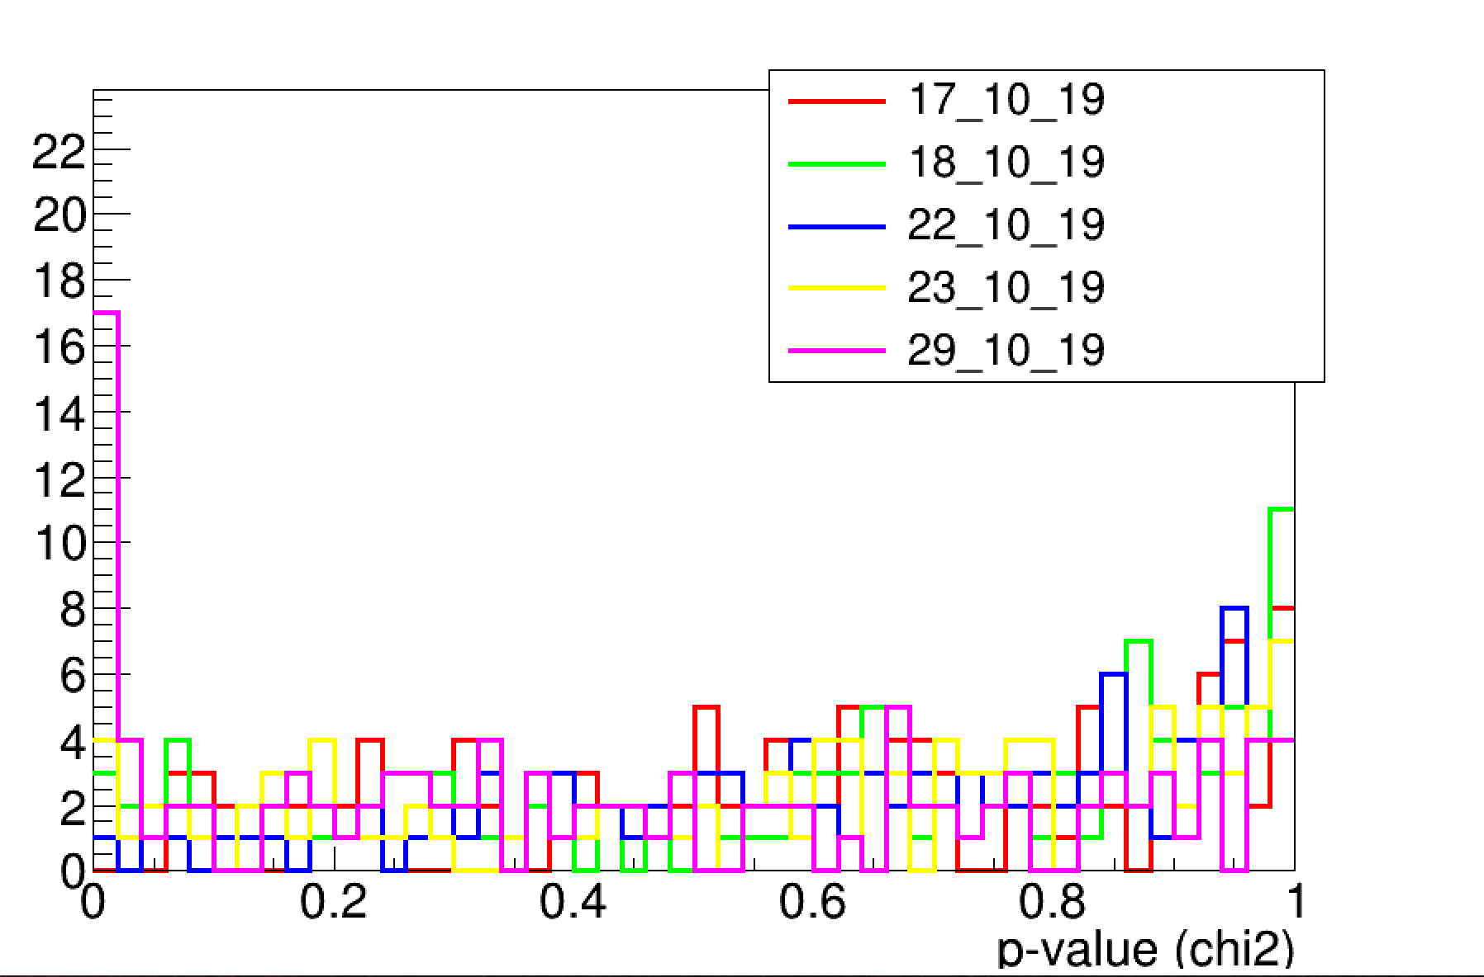
One dimensional analysis results: PZ4
Morphological variations are observed in the second CT.
The $χ2$ test shows a low p-value peak in the comparison between the first and the last fraction.
There treatment was not replanned

Slide 4
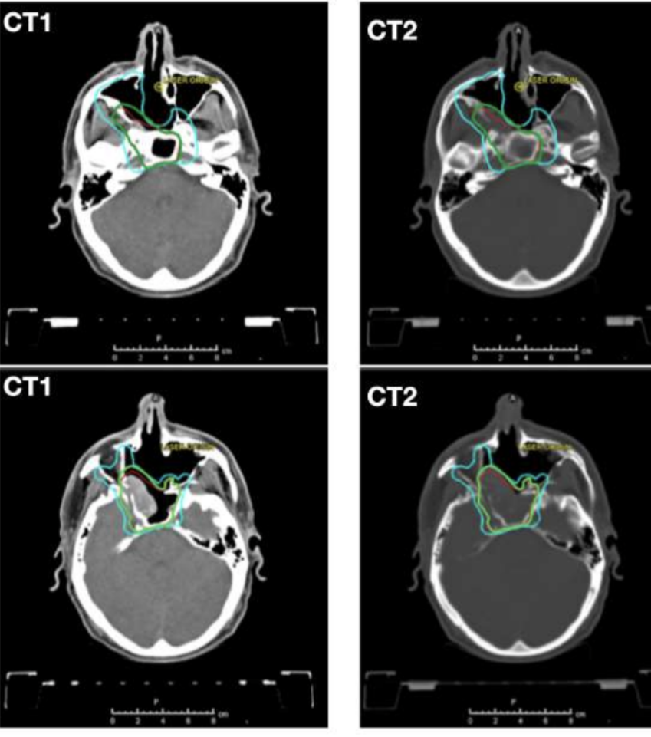
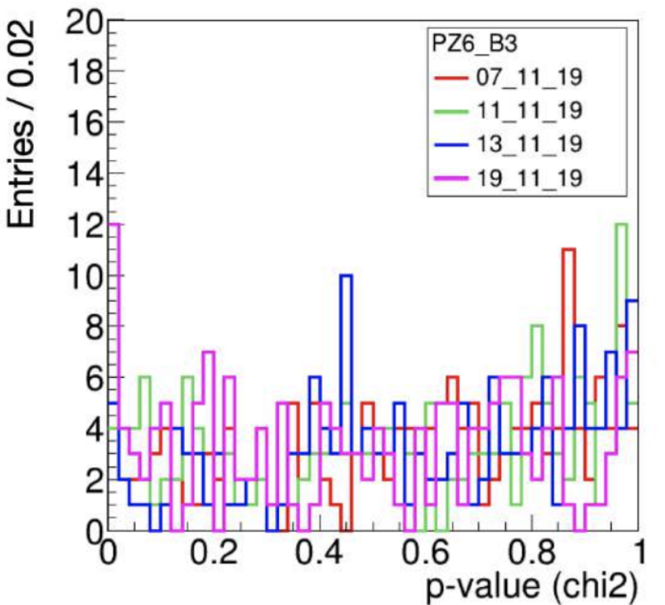
One dimensional analysis results: PZ6
Consistent morphological changes are observed.
We expected a higher low p-value peak in the $χ2$ test.
The treatment was replanned

Slide 5
MY WORK: 3D analysis
The idea is to compare the 3D emission maps to have more information about the location of the morphological changes
METHODS
Hellinger distance (an analogue of Euclidean distance) Jansen Shannon divergence (DJS) | Metrics used to find similarity between two probability distributions. The output is a numeric value between 0 and 1: 0: indicates that the two distributions are compatible; 1: the two distributions are nowhere similar.
Gamma-index | Parameter that measures the degree of agreement between two dose distributions: one is the reference information, while the other one is under test.
GOAL:
a higher sensitivity to morphological variations and the localization of morphological differences

Slide 6
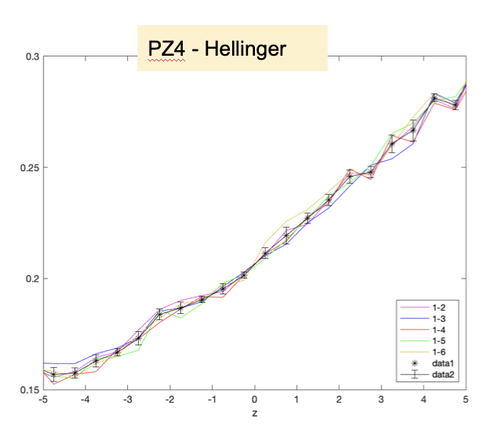
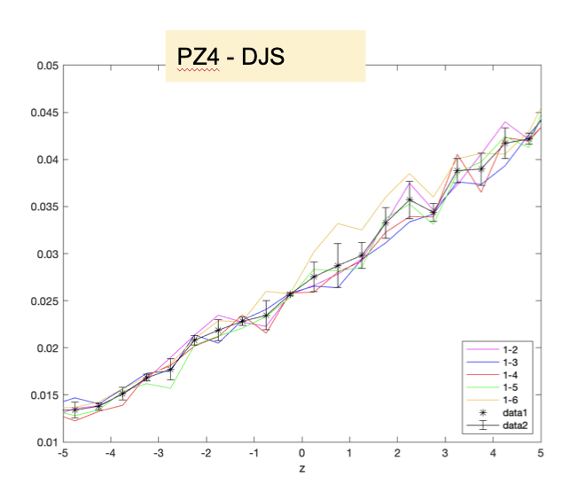
Hellinger and djs test
The tests were done considering slices onto z axis and applying the metrics to each slice: the following graphs shows the metrics trends for all the comparison considering the first one as reference information.
We focused on PZ4, the unidimensional analysis showed a discrepancy between the first and the last fraction of the treatment: we expected the metrics to be sensitive to this difference.
The yellow line show the comparison between the 1st and the last fraction of the treatment: we notice that these metrics don’t seem to be enough sensitive.

Slide 7
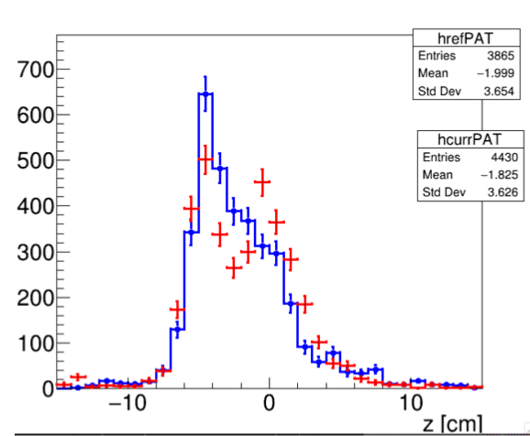
Hellinger and djs test
We tried to evaluate the metrics behaviour considering only a discrepant SPB: in this case, we expected the metrics to be more sensitive. The following results show the metrics behaviour considering only SPB. 485.
Results of the one-dimensional analysis for SPB 485.
We expected to see a difference in the comparison 1-6.
Preliminary conclusion
These metrics are used to measure the similarity between probability distributions, so they are applied to normalized distributions. They are not sensitive to the shapes of the distributions and this could be the reason the discrepancies are not underlined.
NEXT STEP: apply a not normalized form of these metrics.

Slide 8
Gamma index
INTRODUCTION
The gamma index is a parameter that measures the degree of agreement between two dose distributions: one is the reference information, while the other has to be evaluated. In general, the gamma function is an Euclidean distance including both space and dose dimensions where both axis are normalized considering a dose and a distance tolerance:
Where r_{e} is a point of the evaluation map, r_{r} considers all the point the reference map, De and Dr are the evaluated and the reference doses. Δd and ΔD are the two tolerances (referred as DD and DTA in the following). The gamma index 𝛾 is the minimum of this function.

Slide 9
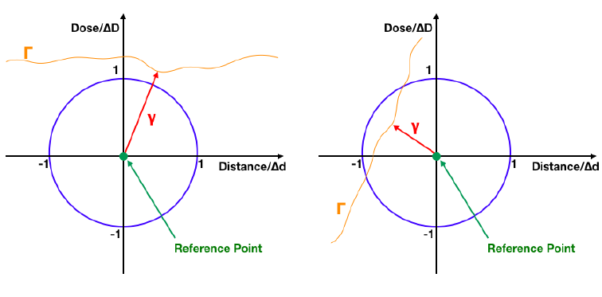
Gamma index
Considering the normalization of the axis, when we evaluate the distance between two distributions, the test will be passed if the index (the minimum distance) is less or equal to 1.
The image shows to examples of the test, where the orange line is the map of evaluation: the evaluated map of the left example has not passed the text, in fact the distance vector is higher than the radius, while the right one has passed it because the point of minimum distance is included in the circumference.
Our goal is to use the gamma index among emission maps, in order to identify discrepancies among different fractions correlated to morphological changes.

Slide 10
Gamma index – code
The code requires in input the reference and the evaluation map, and three parameters:
DD -> Density distance [mm]
DTA -> Distance to Agreement [%]
DHT -> DensityThreshold [%] cut all those values which are specific percentage of the maximum density value.
It can be run in two different ways: gammaMode or passRateMode. In the first case we obtain a map with the distribution of the gamma index, in the second one we have a map that shows the voxels that have passed the test.
The tests have been done considering different value of the three parameters to evaluate their influence.
3D emission maps
The 3D maps are done considering the points of emission as a sphere with a certain radius to minimize the statistical fluctuations.

Slide 11
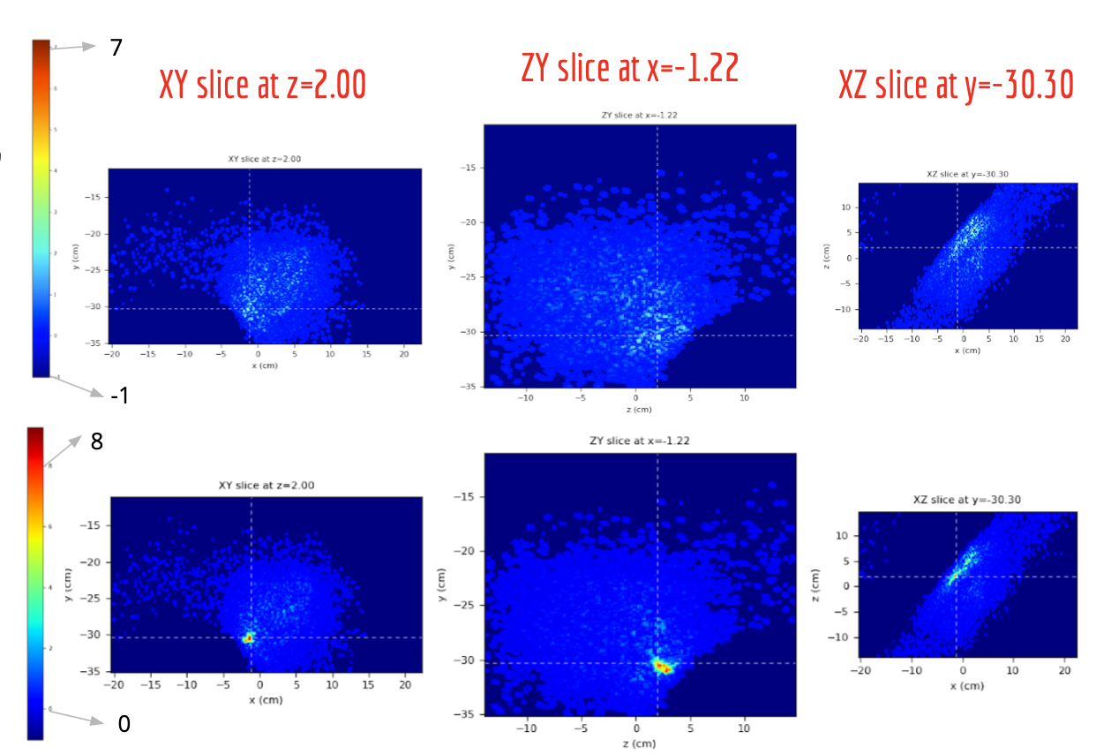
Gamma index – Preliminary results (PZ4)
Results of the comparison between the 1st and the 2nd fraction
DD=2, DTA=3, DHT=0.
RADIUS = 0.2
The two images show the comparison between the first and the second fraction of the treatment (upper), and the first and the last fraction of PZ4 (bottom). The first ones are obtained using the gammaMode, while the second ones using the passRateMode (the green voxels are the ones that didn’t pass the test).
We notice a hotspot of the gamma index value in the gamma index distribution, that results in an accumulation of failed voxels.
Results of the comparison between the 1st and the last fraction

Slide 12
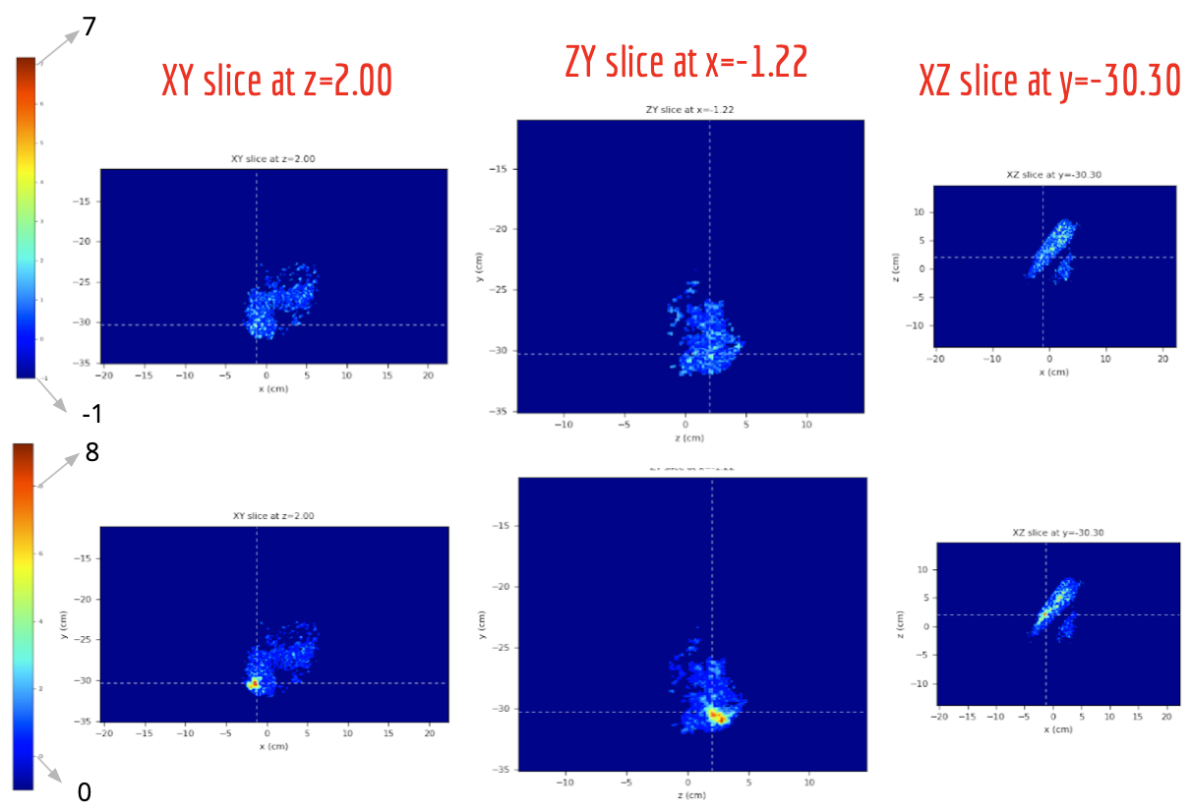
Gamma index – Preliminary results (PZ4)
Results of the comparison between the 1st and the 2nd fraction
DD=2, DTA=3, DHT=5
RADIUS = 0.2
In this case all the voxels whose values are lower that the 5% of the maximum are not considered for the analysis.
The threshold cut help, as expected, removing low density voxels from the test.
Results of the comparison between the 1st and the last fraction

Slide 13
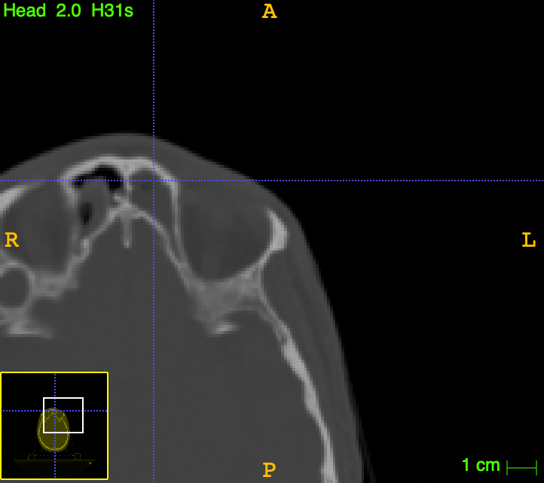
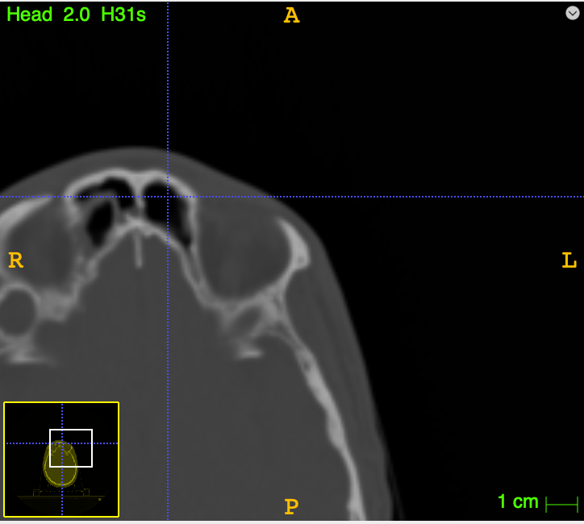
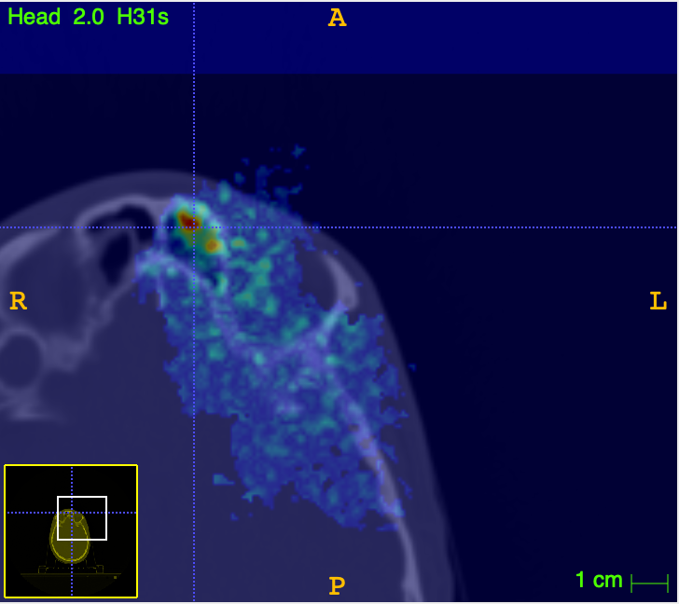
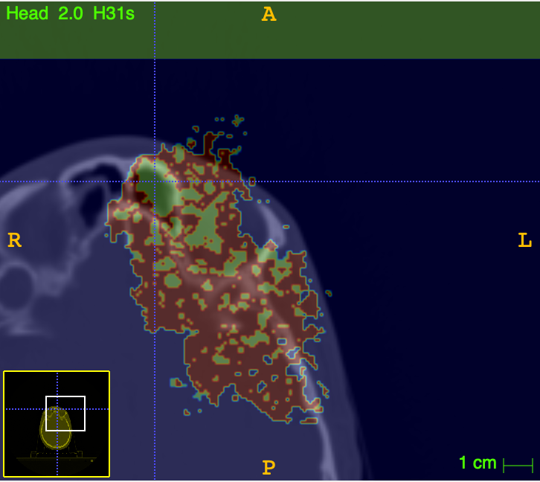
Gamma index on ct – pz4
CT1
CT2
We overlaid the results of the gamma index analysis on the CTs of PZ4 to evaluate if the voxels that didn’t pass the test are correlated to a morphological variation.
-gammaMode
-passRateMode

Slide 14
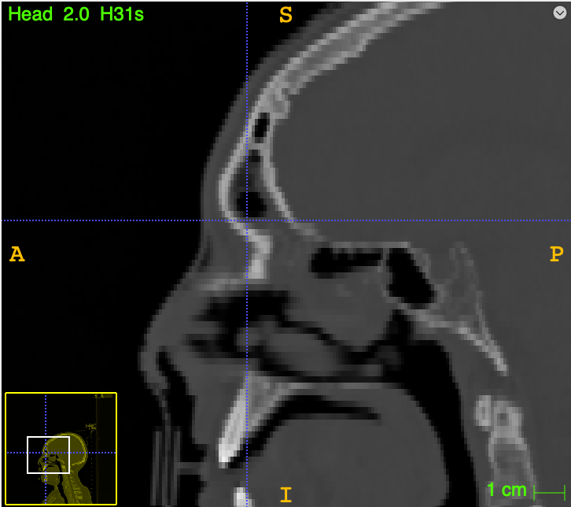
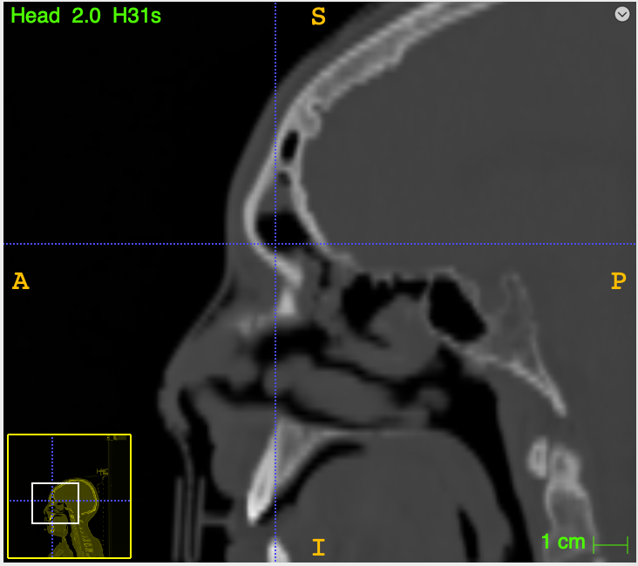
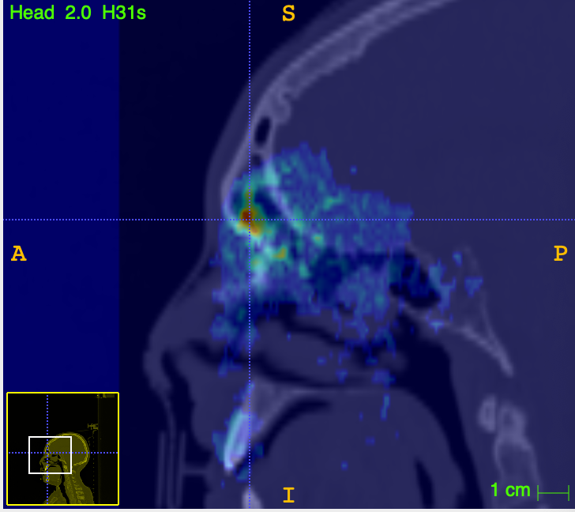
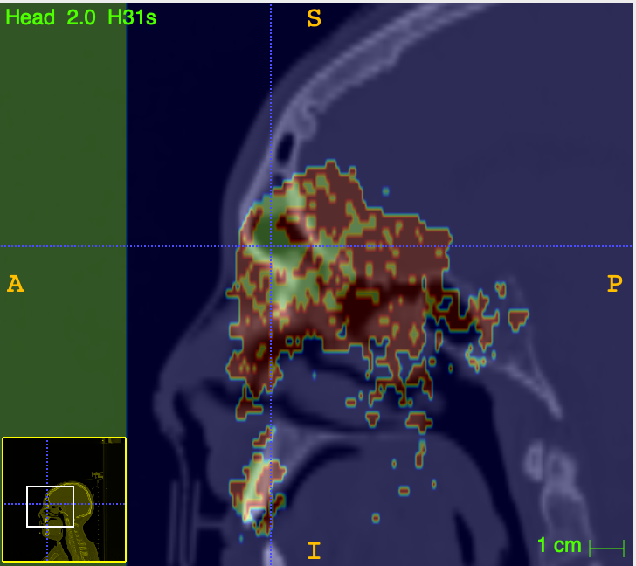
Gamma index on ct – pz4
CT2
CT1
We overlaid the results of the gamma index analysis on the CTs of PZ4 to evaluate if the voxels that didn’t pass the test are correlated to a morphological variation.
-gammaMode
-passRateMode

Slide 15
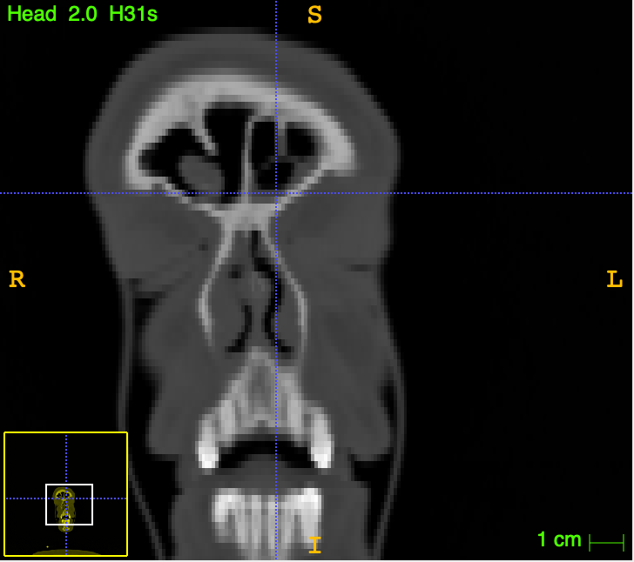
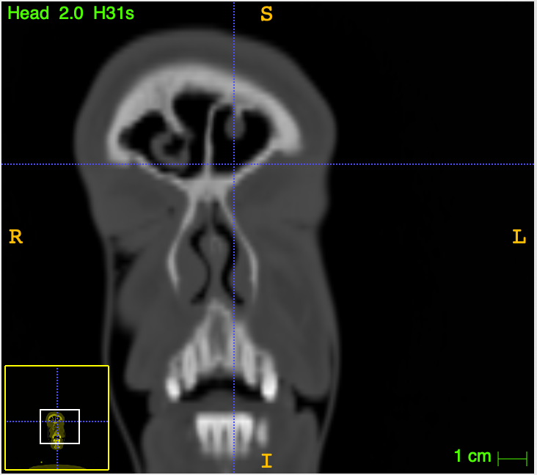
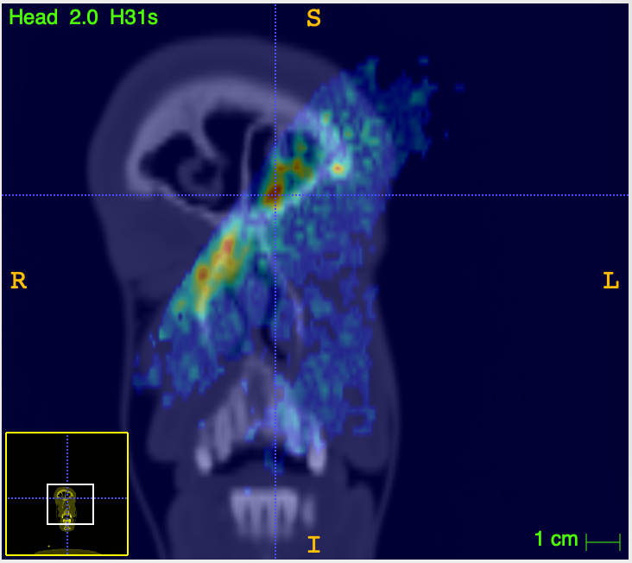
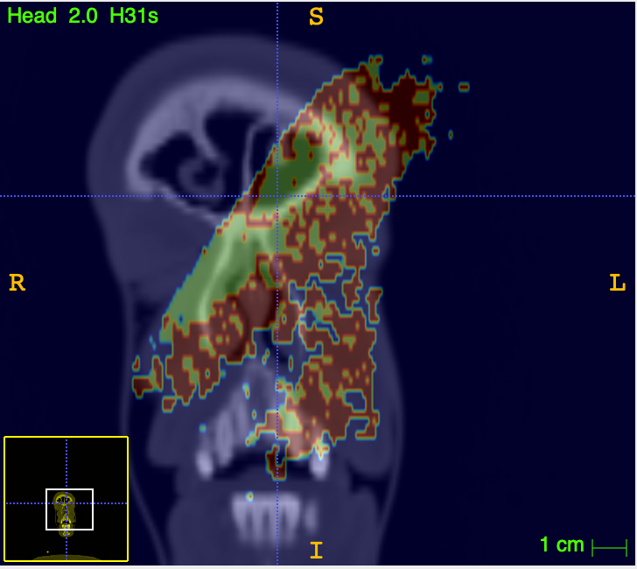
Gamma index on ct – pz4
CT1
CT2
We overlaid the results of the gamma index analysis on the CTs of PZ4 to evaluate if the voxels that didn’t pass the test are correlated to a morphological variation.
RED CIRCLE: we notice a more extended area of failed voxels along the beam direction, after crossing the morphological change. The observed distribution seems to be sensible to the range variation induced by the higher density region crossed by the beam.
-gammaMode
-passRateMode

Slide 16
Gamma index – Preliminary results (PZ4)
Results of the comparison between the 1st and the 2nd fraction
2.5
0.5
-1
DD=5, DTA=3, DHT=5
RADIUS = 0.5
In this case we have chosen a bigger radius of the sphere to build the 3D maps and a bigger value of the parameter Dose Distance.
We notice:
a better localization of the voxels that haven’t passed the test.
Results of the comparison between the 1st and the last fraction
7
3
-1

Slide 17
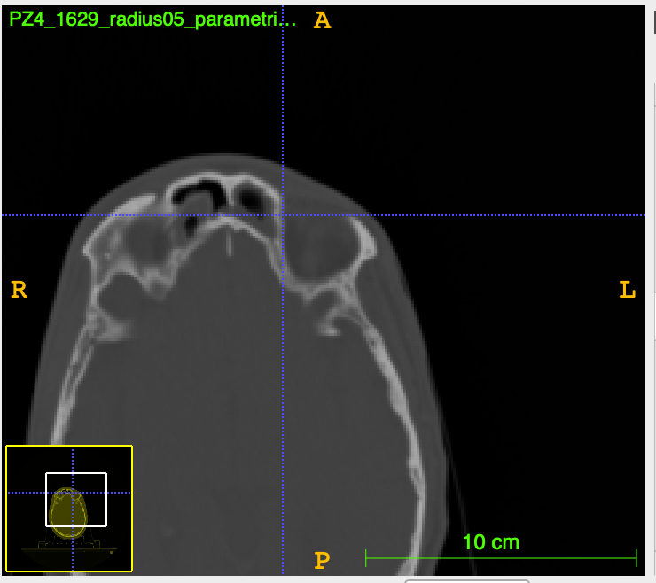
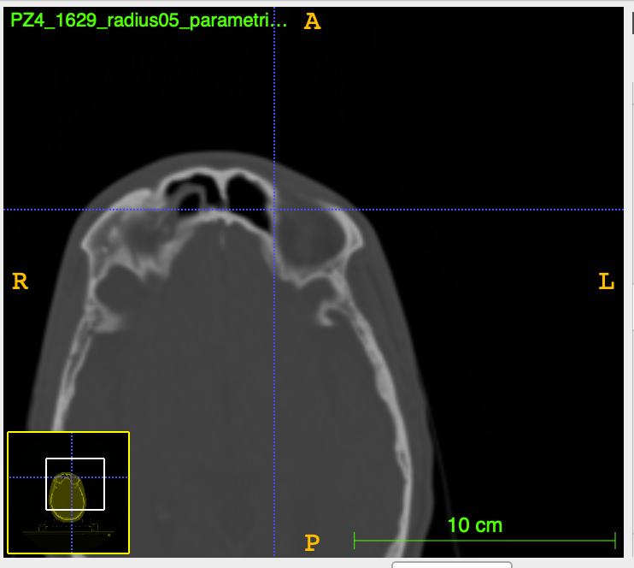
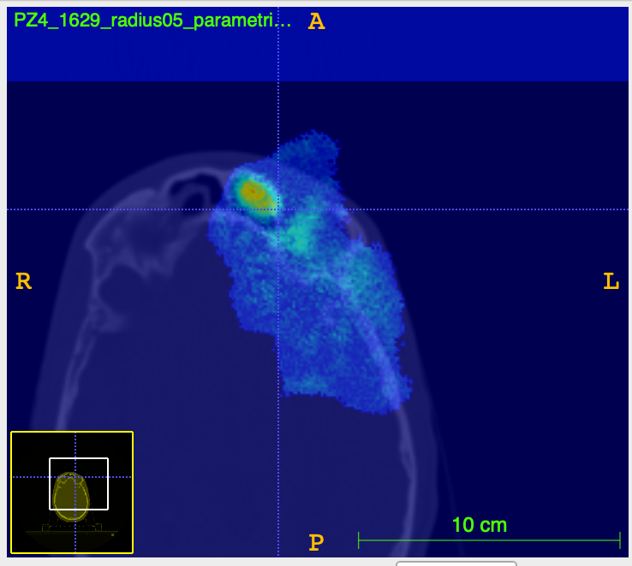
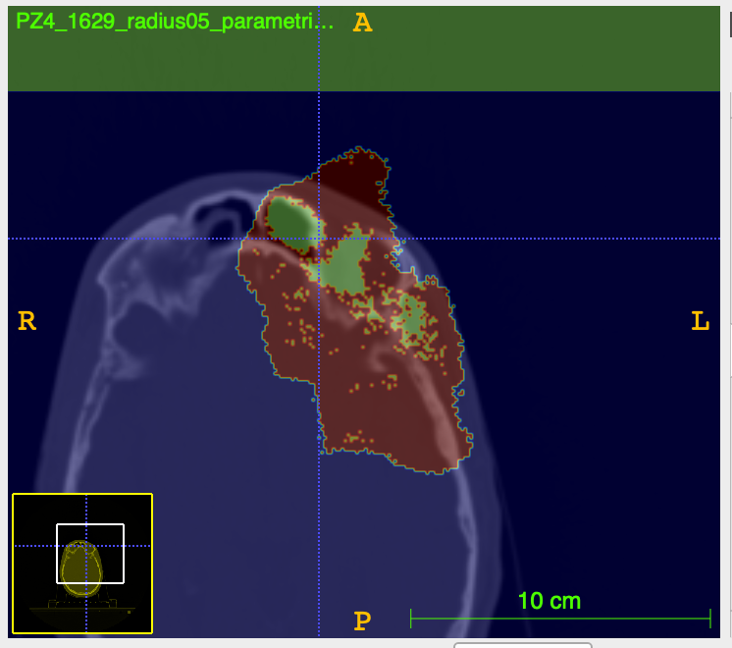
Gamma index on ct – pz4
CT1
CT2
DD=5, DTA=3, DHT=5
RADIUS = 0.5
We notice a better evaluation of the localization of the morphological changes.
-gammaMode
-passRateMode

Slide 18
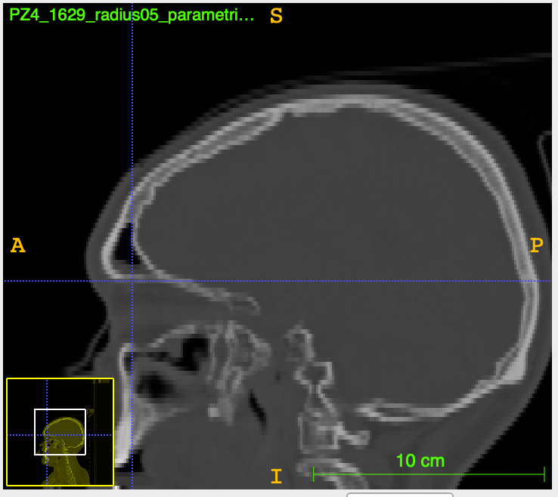
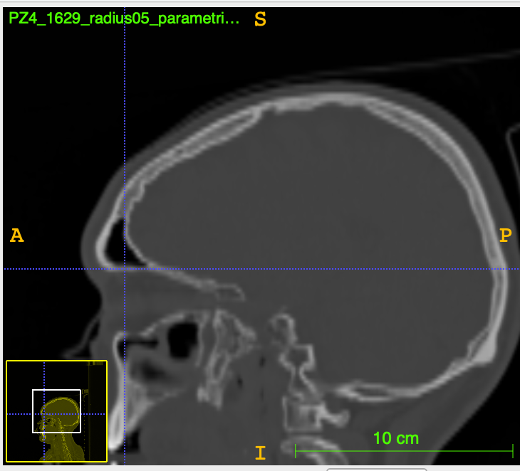
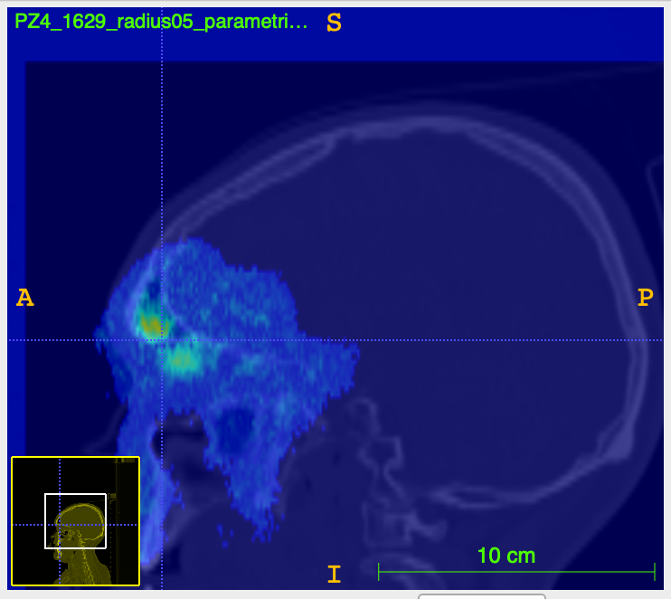
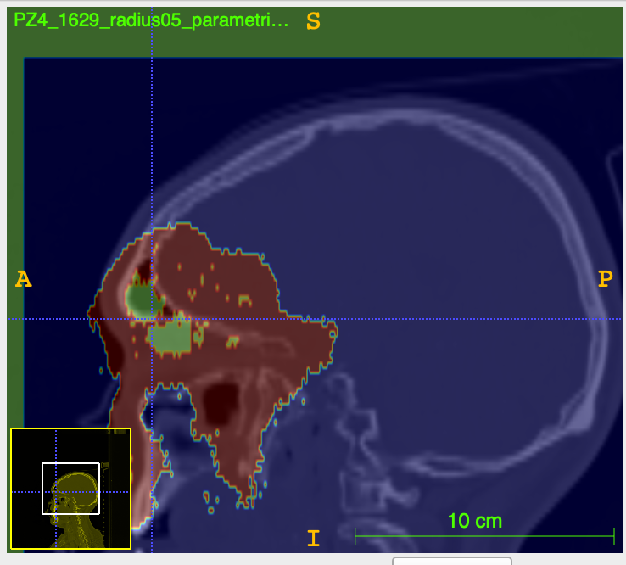
Gamma index on ct
CT2
CT1
DD=5, DTA=3, DHT=5
RADIUS = 0.5
We notice a better evaluation of the localization of the morphological changes.
-gammaMode
-passRateMode

Slide 19
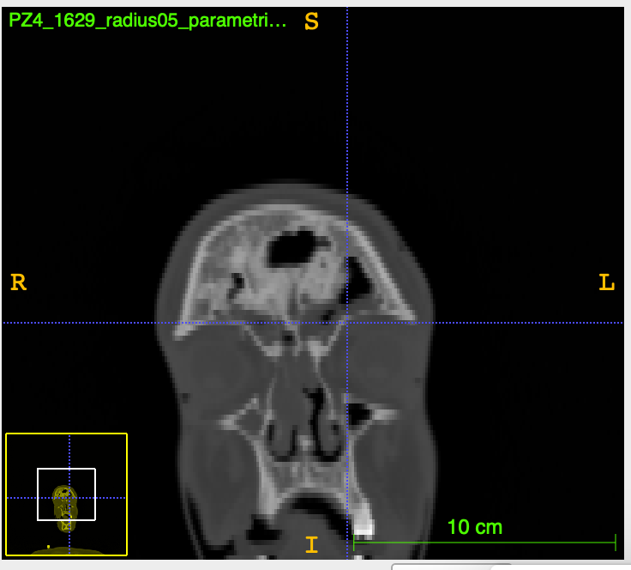
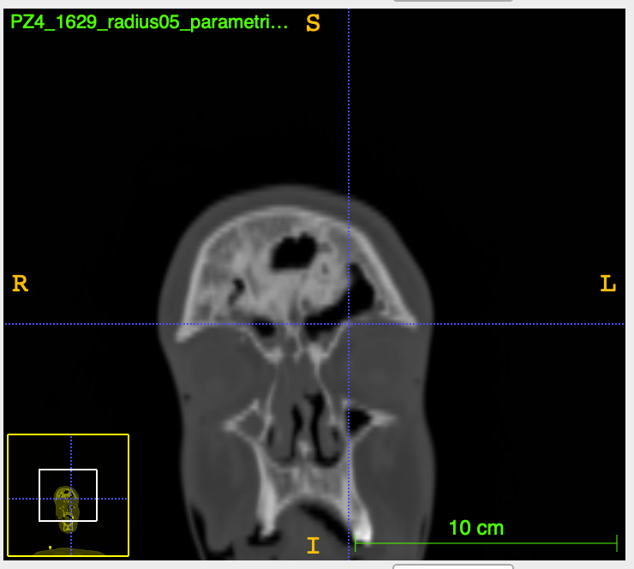
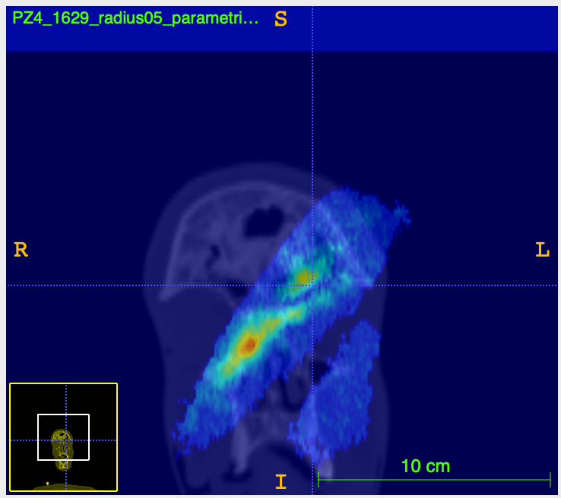
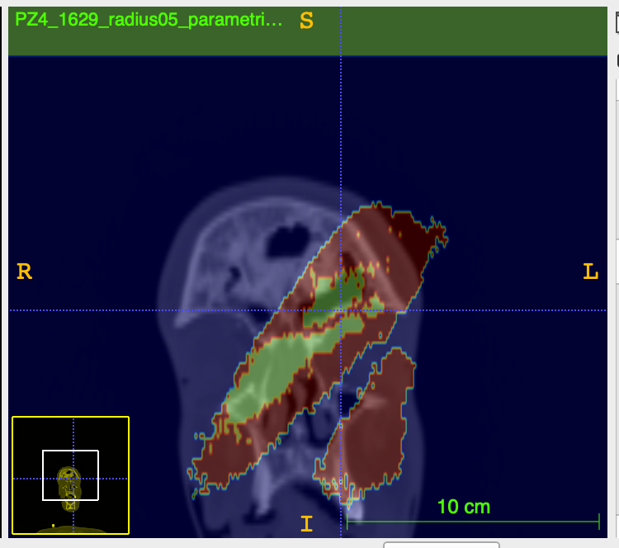
Gamma index on ct
CT1
CT2
DD=5, DTA=3, DHT=5
RADIUS = 0.5
We notice a better evaluation of the localization of the morphological changes.
-gammaMode
-passRateMode

Slide 20
One dimensional analysis results: PZ10
CT1
CT2
CT1
CT2
From one-dimensional analysis we notice peaks for the comparison between the following comparisons:
11th and 18th December;
11th and 19th December;
11th and 23rd December.
We expected to obtain the same hierarchy with the gamma index method.

Slide 21
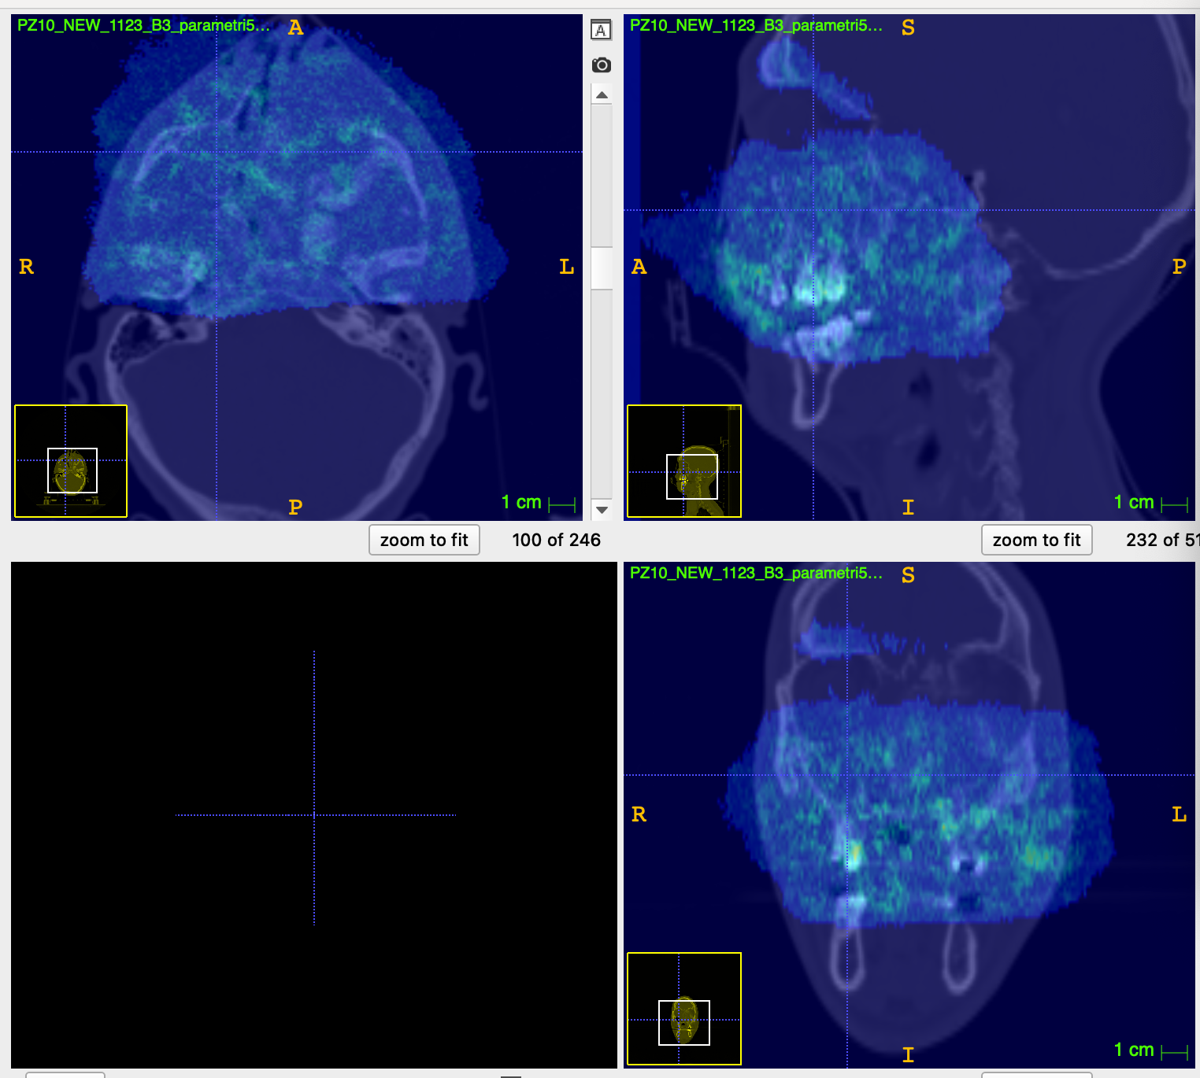
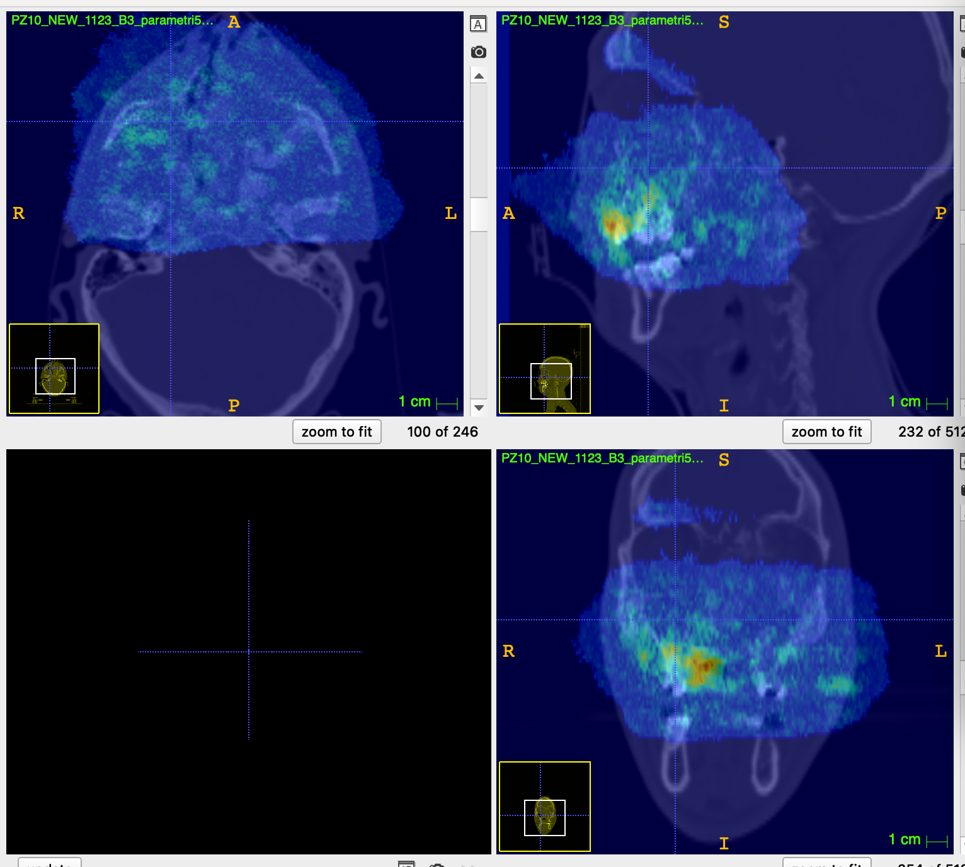
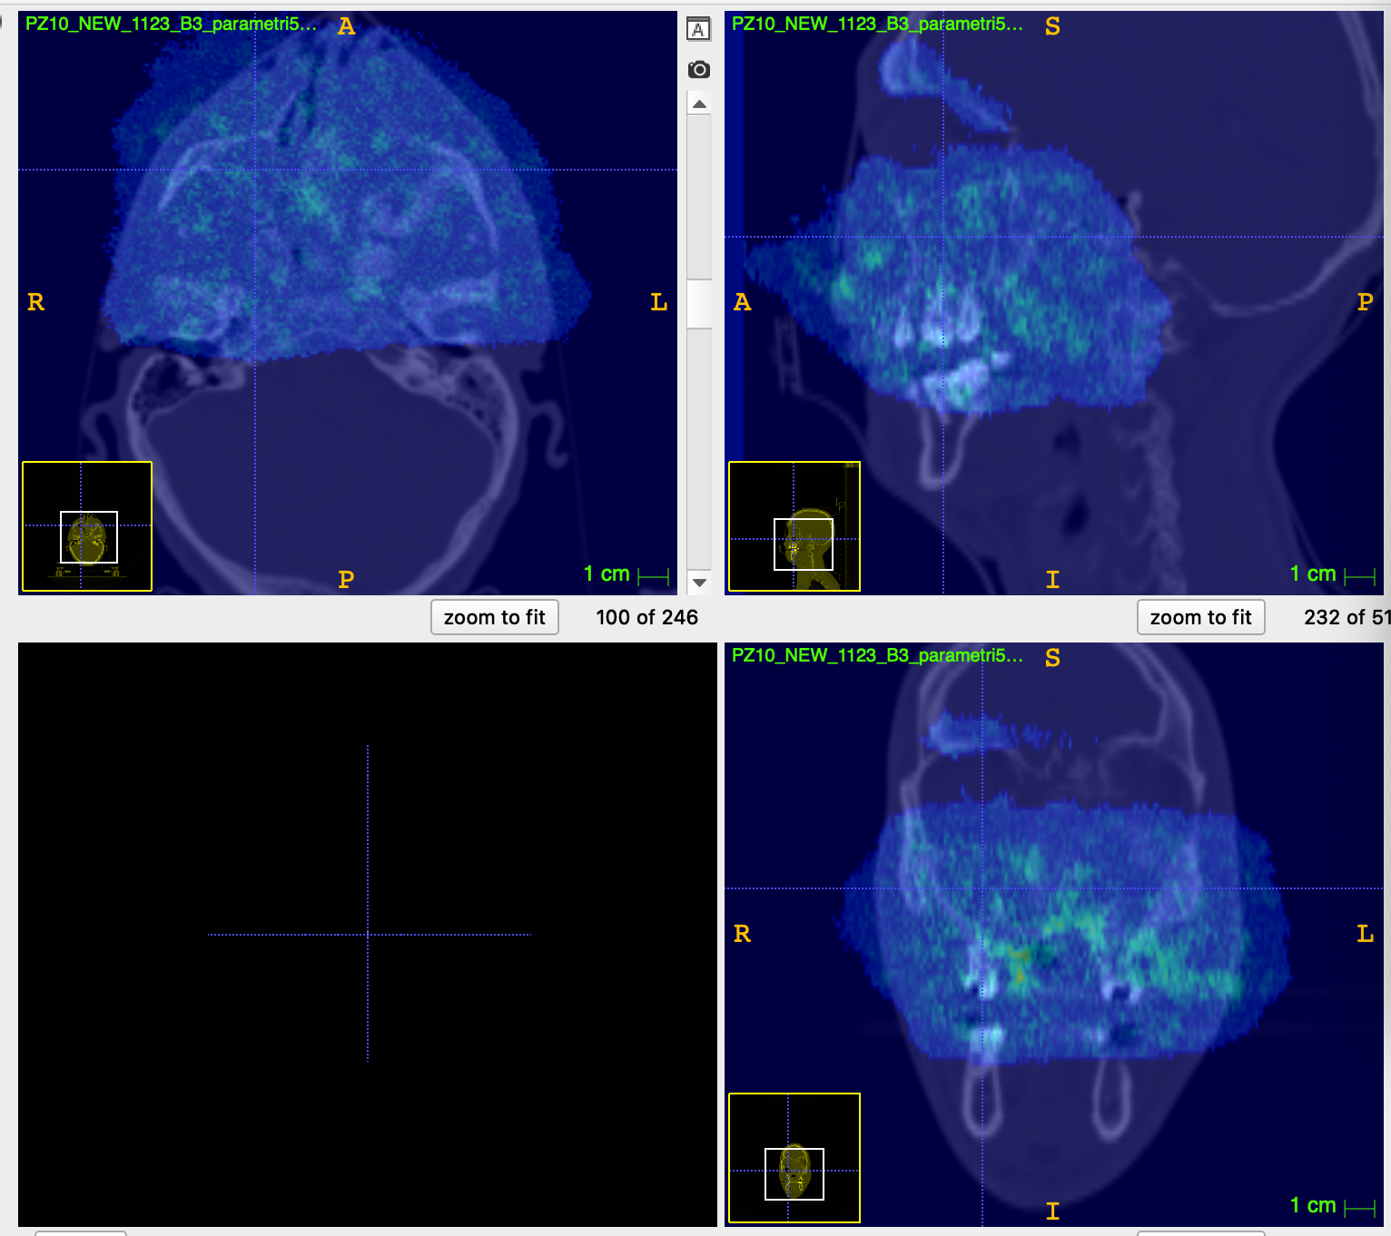
Gamma index results – pz10
Gamma index – comparison between 11th and 18th December
Gamma index – comparison between 11th and 19th December
Gamma index – comparison between 11th and 23rd December

Slide 22
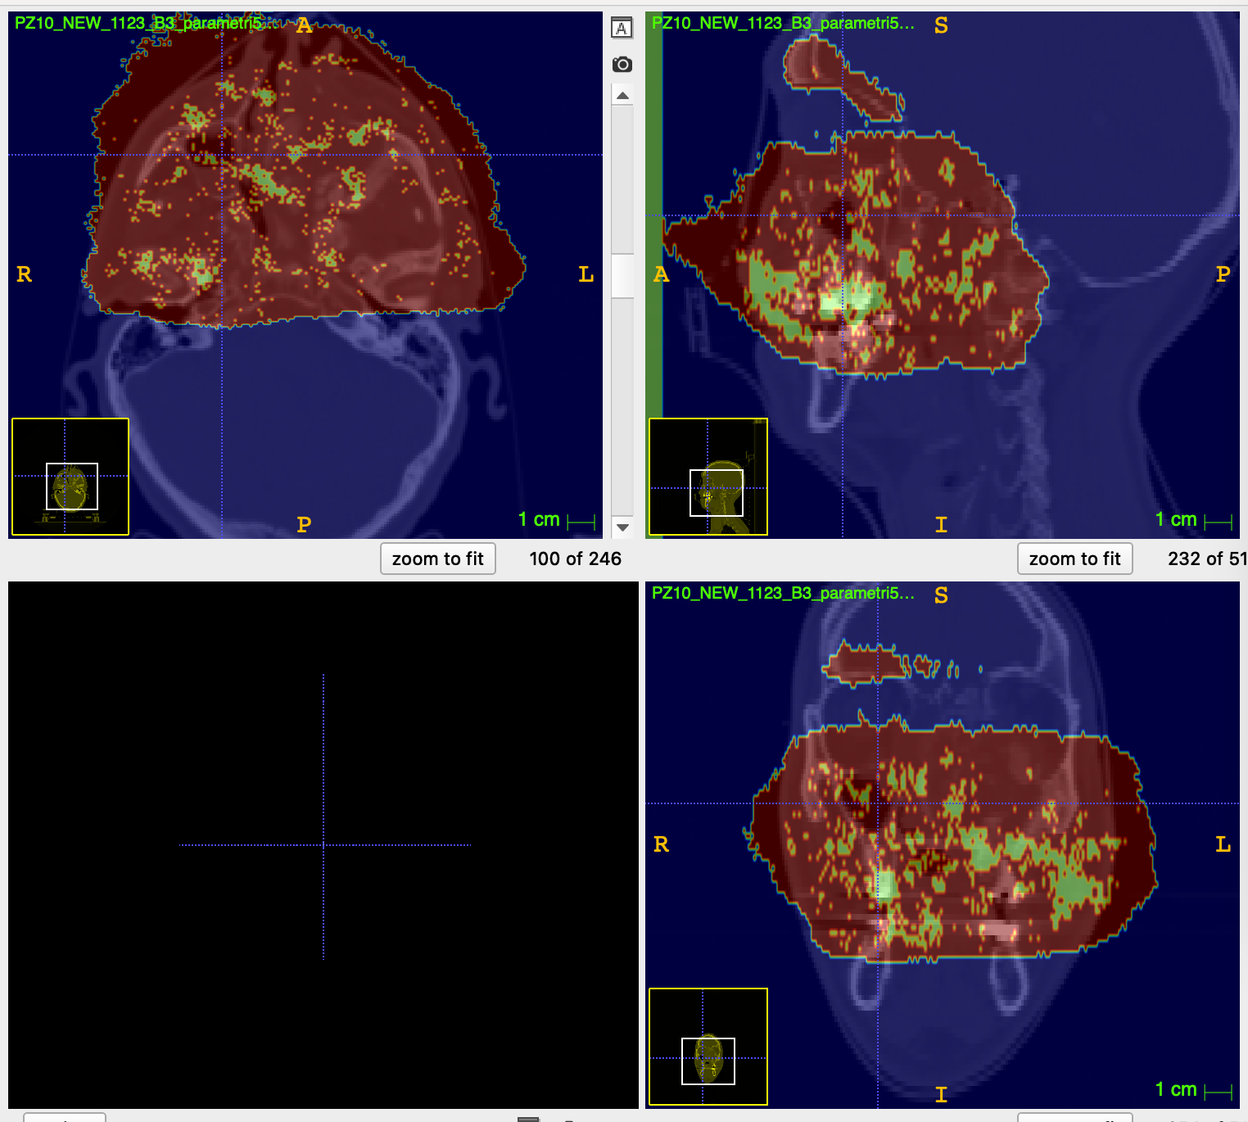
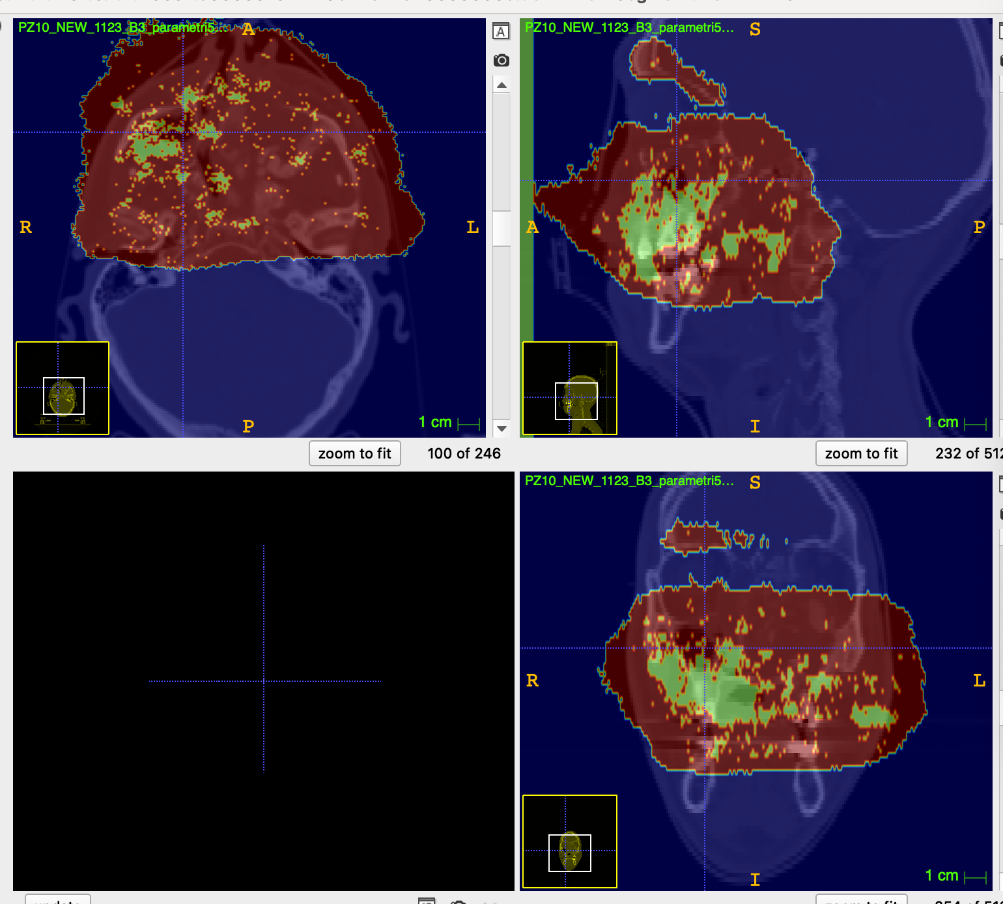
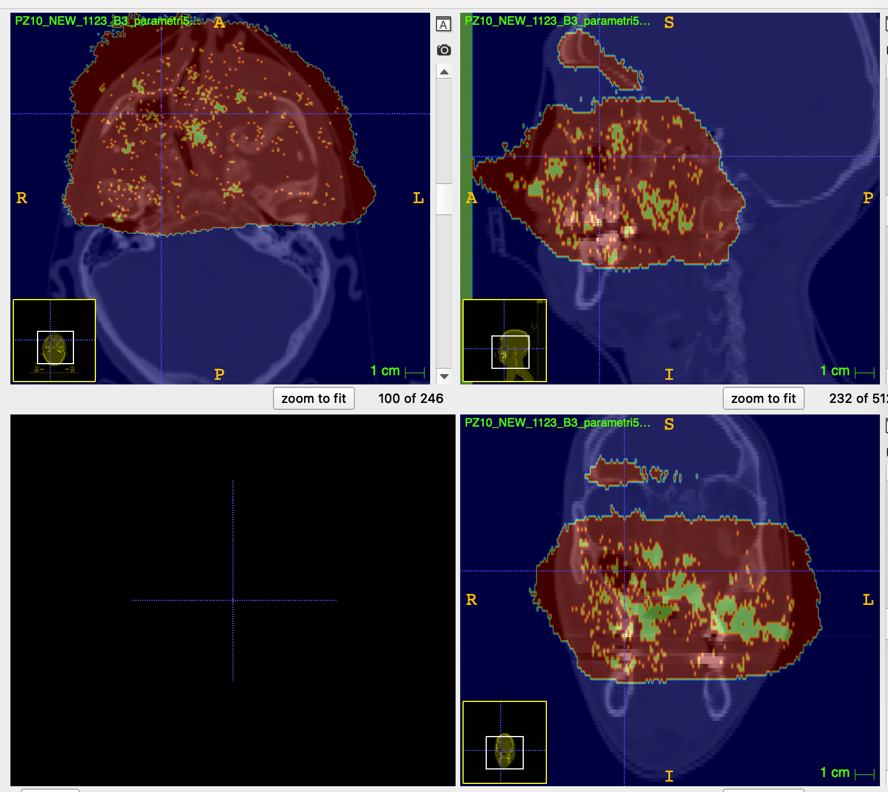
Gamma index Preliminary results – pz10
Gamma index – comparison between 11th and 18th December
Gamma index – comparison between 11th and 19th December
Gamma index – comparison between 11th and 23rd December

Slide 23
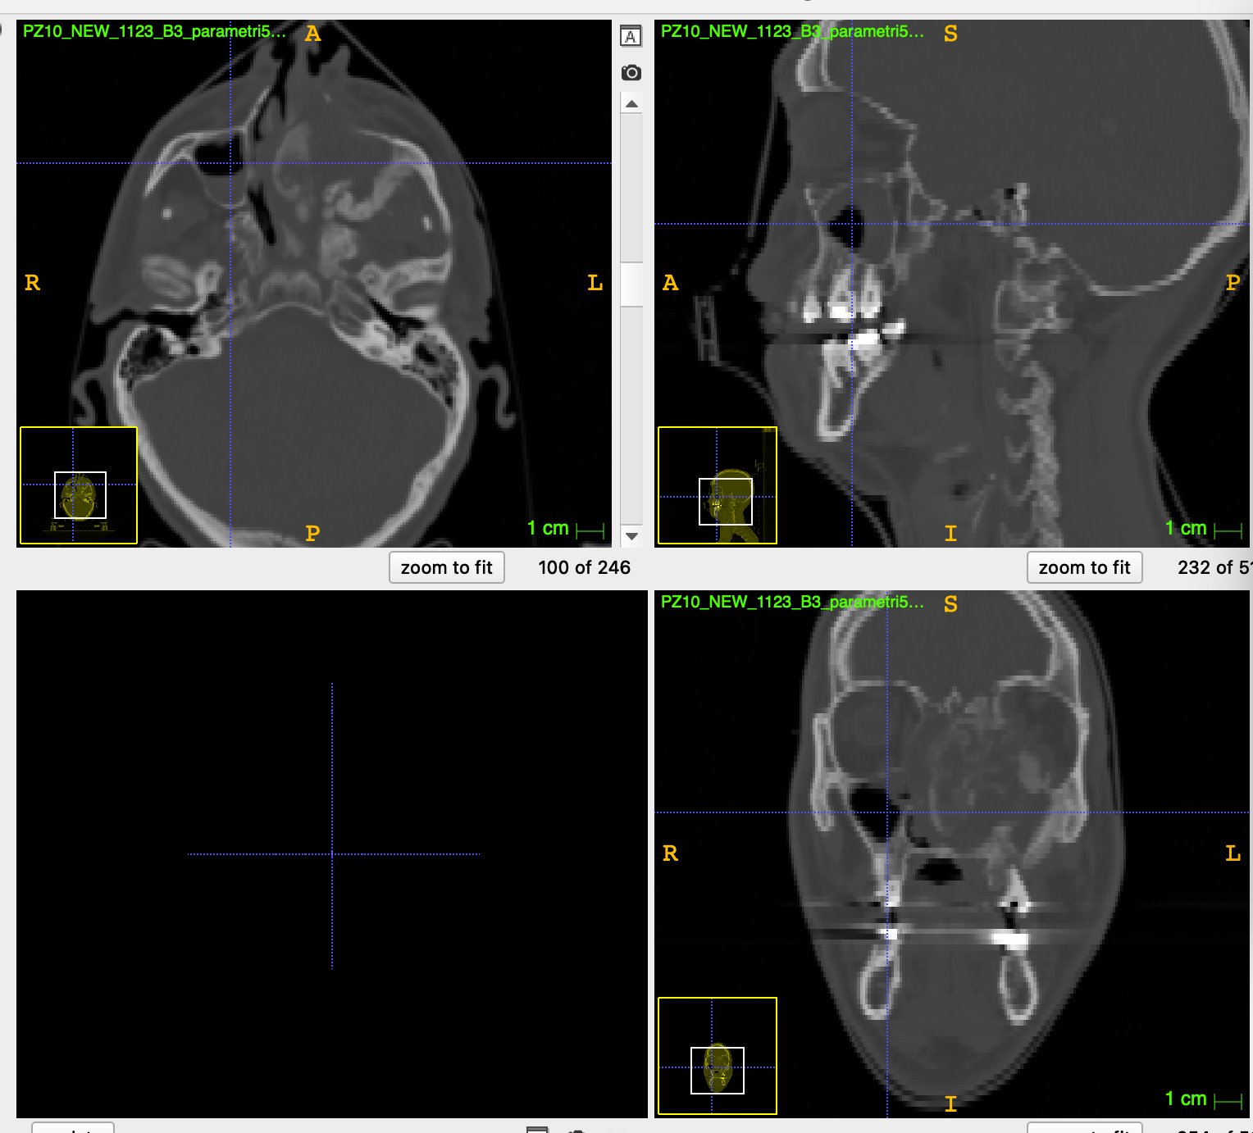
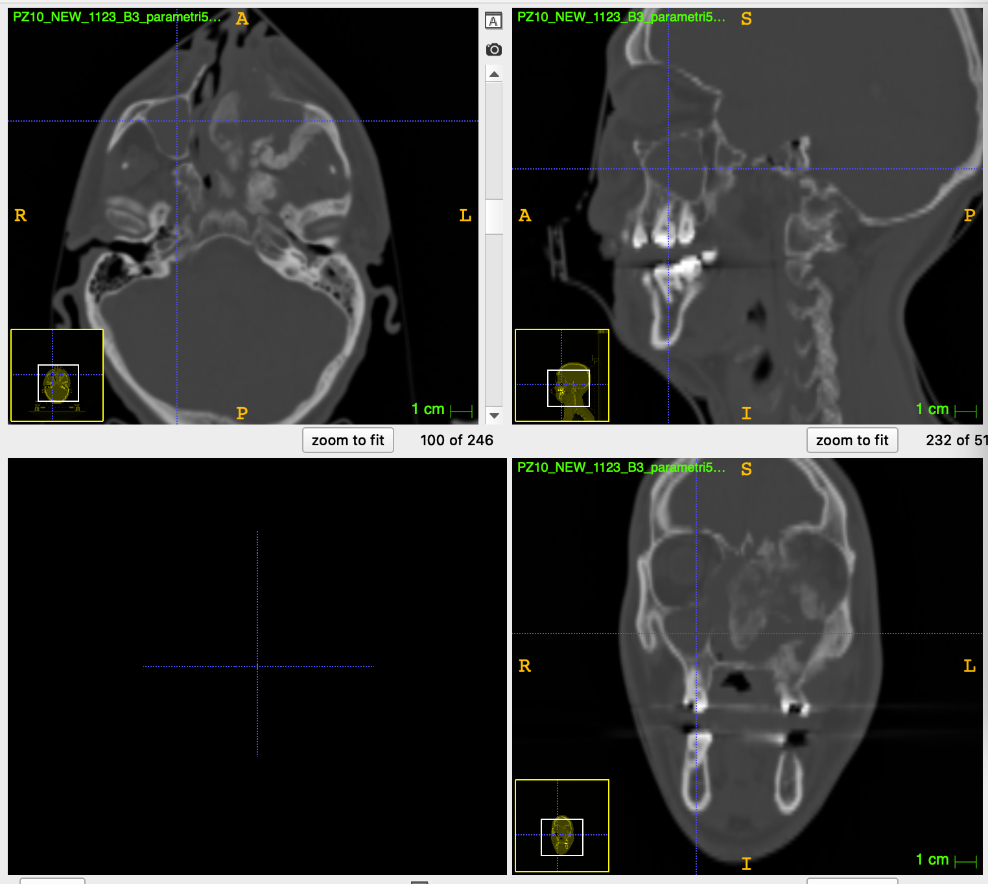
Gamma index pz10 – open points
We don’t see a strong relation between the voxels who haven’t passed the test and the morphological changes observed.

Slide 24
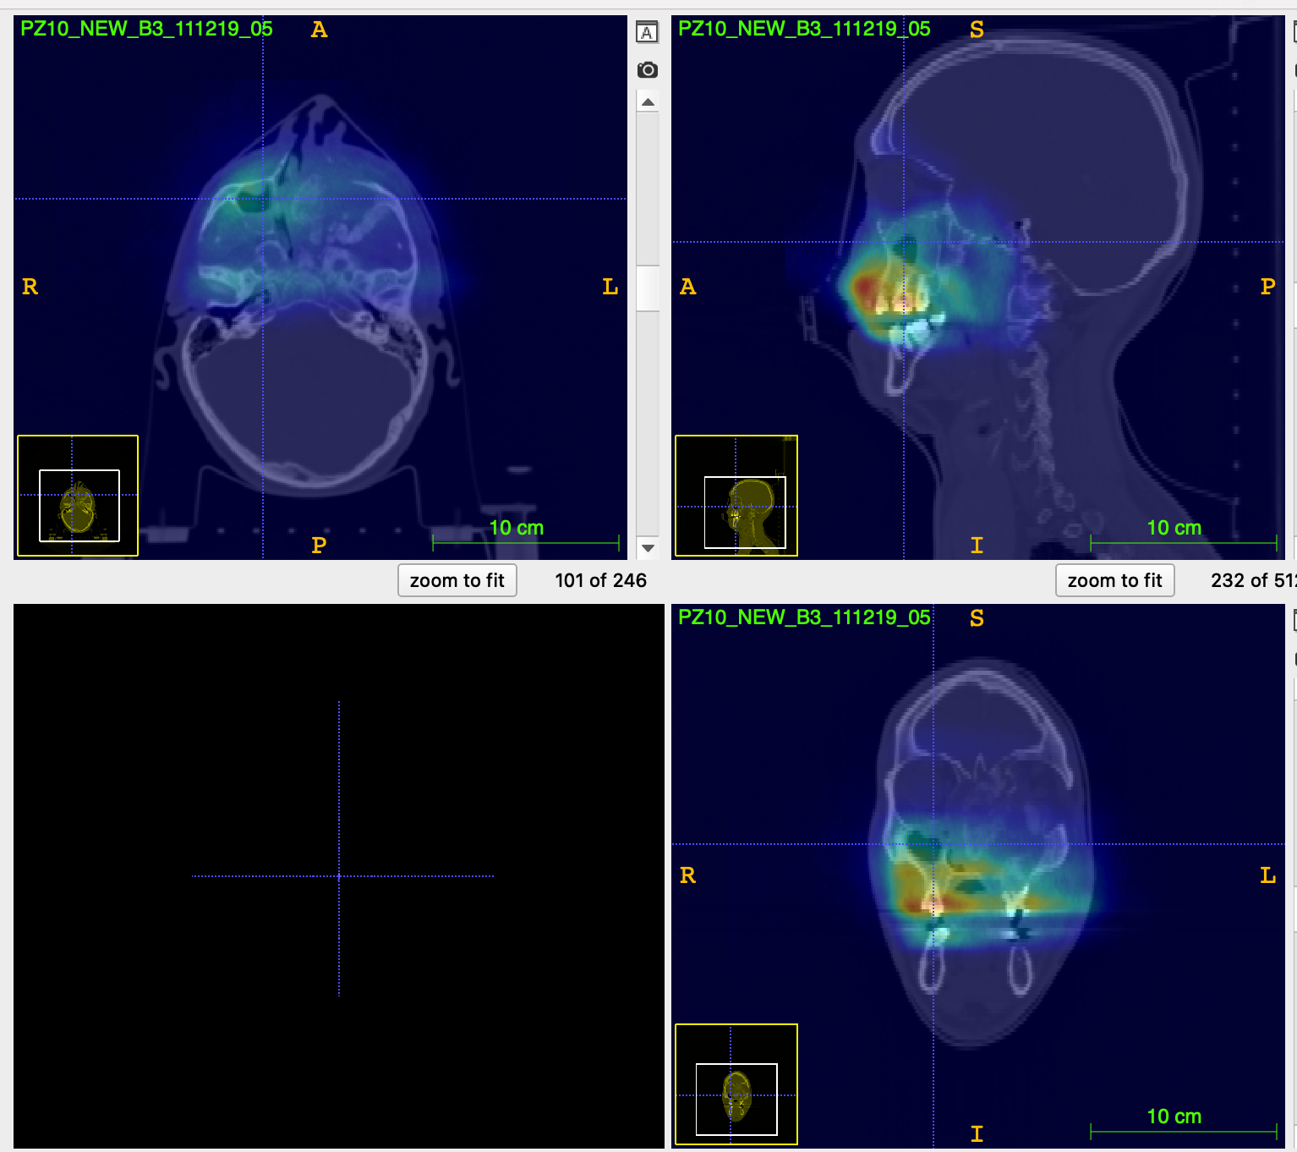
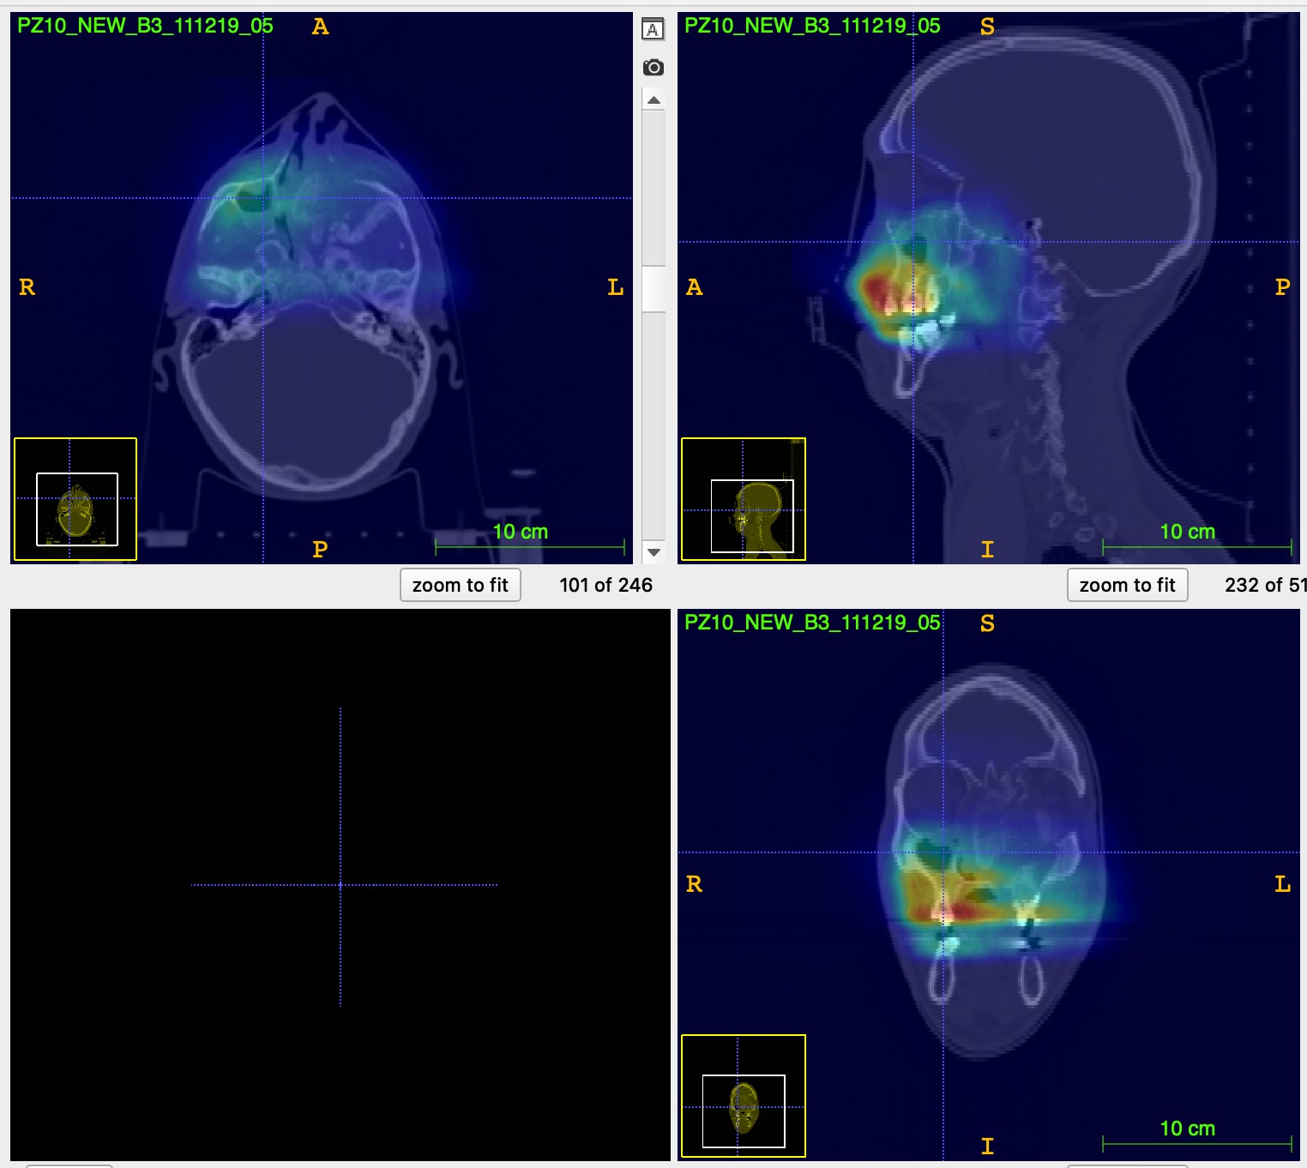
Gamma index pz10 – open points
The following images show the emission maps.
Looking at the emission maps we notice that the emission level of the interested point is lower: one of the reason why the gamma index doesn’t seem to underline the morphological variations could be that we are less sensitive in that area.

Slide 25
Gamma index pz10 – open points
We noticed that the two CTs are quite different, so we want to understand if there is some geometrical problem that could have influenced the behaviour of the gamma index method.
The video shows the transition from the 1st and the 2nd CT and the difference observed.

Slide 26
Preliminary conclusions and Next steps
We started from the 1D analysis used to publish the SciRep article and tried to implement a full 3D analysis to be applied to all the patients, aiming to gain some sensitivity in the analysis of PZ6 and PZ10.
The initial attempt to check the metrics related to the shape of the distribution seems to have a lower sensitivity wrt the projected 1D distribution analysed using the $χ2$test.
The gamma index shows promising results allowing a 3D identification of the morphological change in PZ4.
Further studies are ongoing to understand the sensitivity of the technique vs the different algorithm parameters and the results for PZ6 and PZ10

Slide 29
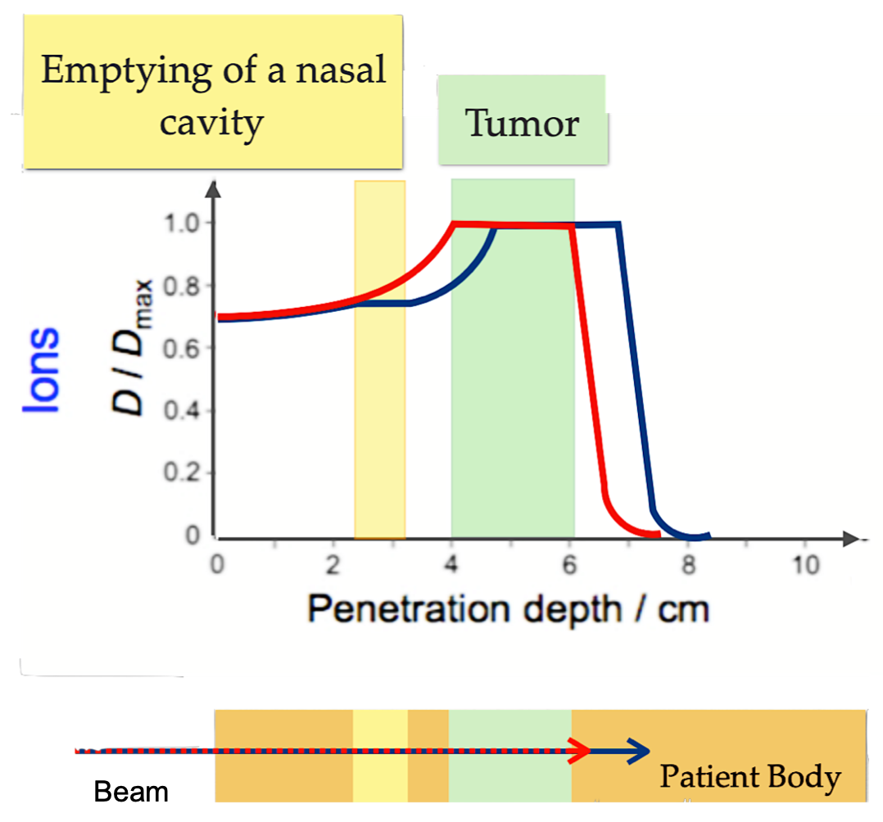
Impact of morphological changes in particles therapy
Inter-fractional morphological changes during the treatment could cause range modification and tumor under-dosage.
THE DELIVERED DOSE MONITORING IS A CRUCIAL ISSUE IN PARTICLE THERAPY
Current clinical routine:
1st CT: treatment planning, SAFETY RANGE to prevent the tumor under-dosage.
2nd CT: method based on clinical experience.

Slide 30
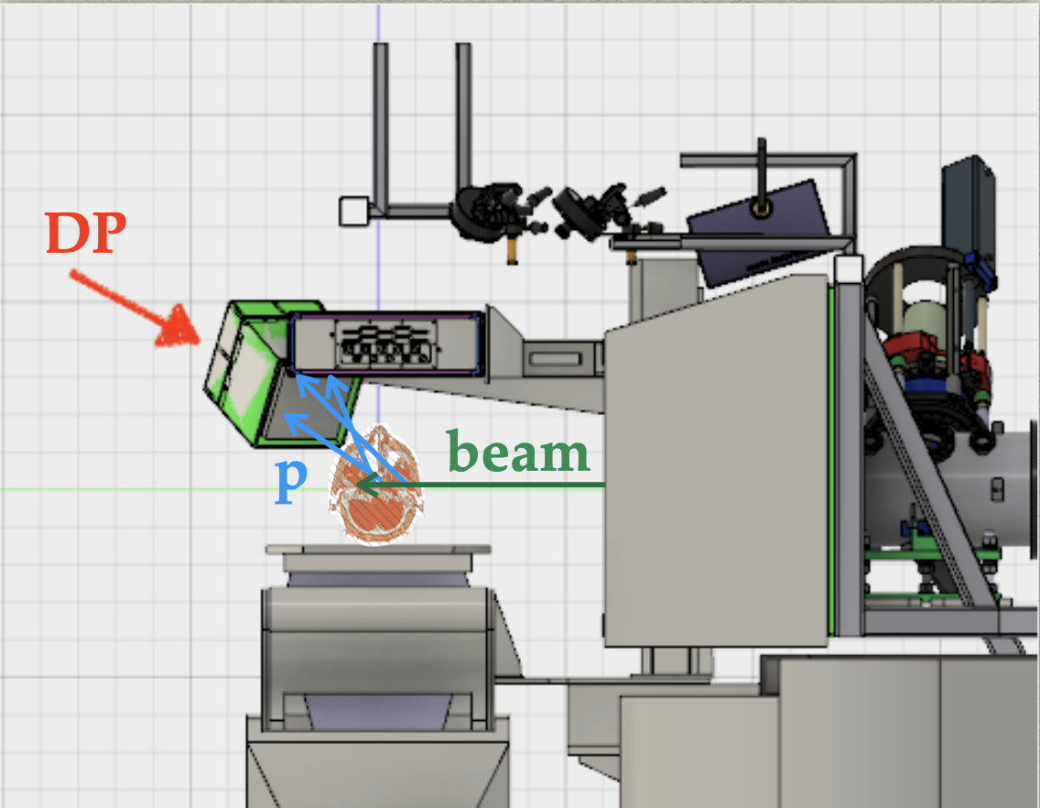
INTER-FRACTIONAL MONITORING WITH DOSE PROFILER
GOAL: spotting of morphological changes comparing the fragments emission maps of different fractions. In fact, the production of secondary fragments is correlated to the density of the crossed materials.
DOSE PROFILER: charged particles tracker. Localization of the emission points in the patient.

Slide 31
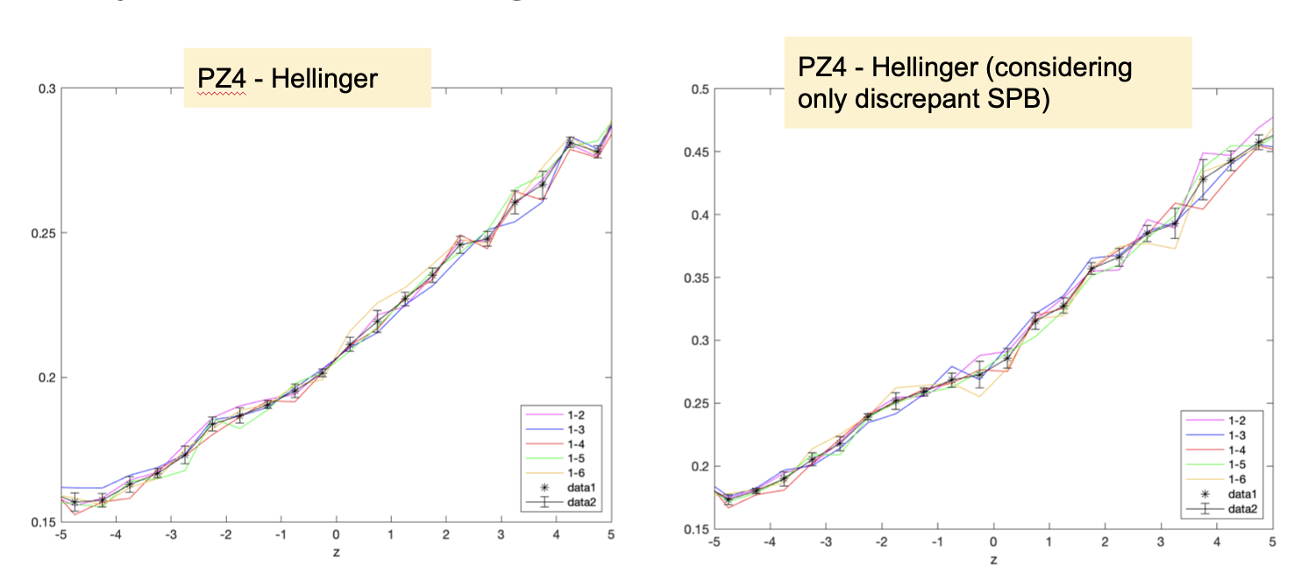
Hellinger and djs test
We tried to evaluate the metrics behaviour considering only the discrepant SPB: in this case, we expected the metrics to be more sensitive.
We don’t see significant differences.

