Slide 1
HERD weight, where are we?
March 11th 2021
G. Ambrosi

Slide 2
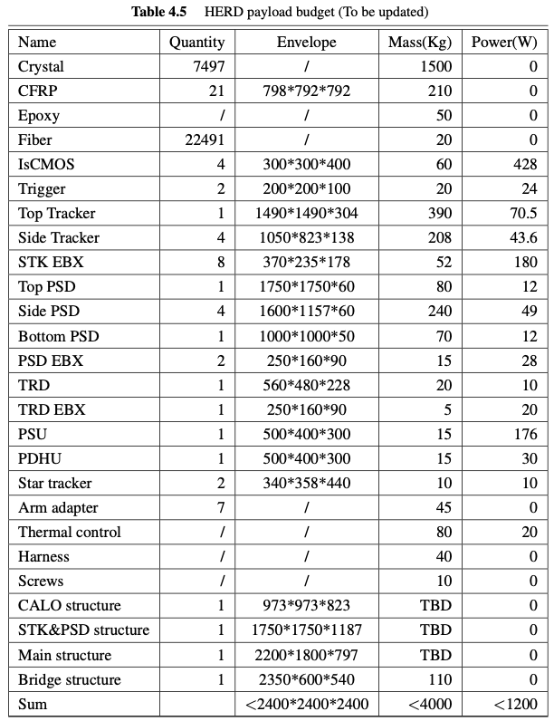
HERD proposal, 2018

Slide 3
SCD weight (configuration currently in HerdSoftware, weight based on DAMPE design)
ladders: 90 kg
top planes: 150 kg
side planes: 192 kg
mechanical support to the planes: ???
readout electronics: ???
total: 430 kg + xx kg

Slide 4
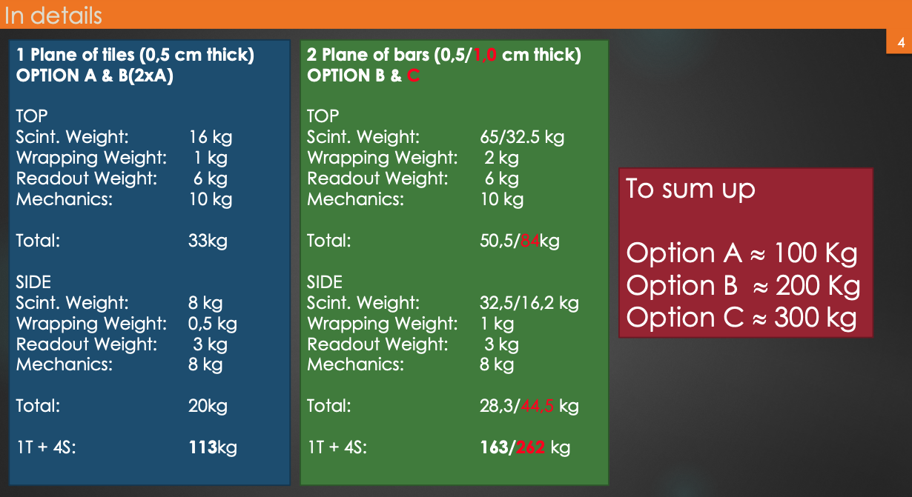
PSD

